Slide 1
Quantization of 10d massless superparticle
Lado Razmadze
Supervisor: Prof. George Jorjadze
Free University of Tbilisi
8 th Georgian – German School and Workshop in Basic Science
Tbilisi – 23.08.2018

Slide 2
Motivation
Strings and Superstrings in AdS space
Quantizing relativistically invariant theories in curved spacetime involve solving nonlinear Klein-Gordon equations
Algebraic approach using Faddeev-Jackiw method is favorable.

Slide 3
Quantizing gauge theories

Slide 4
Quantizing gauge theories
Covariant quantization first quantizes the gauge theory and then reduces the space of states by the condition $\hat{O}\left|\left.Ψ_{phys}\right\rangle \right.=0$ where $\hat{O}$ corresponds to classical constraints.
Hamiltonian reduction is done via gauge fixing or by choosing a complete set of gauge invariant variables.

Slide 5
Quantizing gauge theories
Using Darboux’s theorem we can always change to canonical variables
$$p_{μ}dx^{μ}=dF\left(p,x\right)−Q^{k}dP^{k}$$
Q and P are canonical coordinates of our reduced phase space

Slide 6
Quantizing gauge theories
We can then rewrite our conserved quantities in terms of $Q^{k}$ and $P^{k}$
Define canonical Poisson brackets as $\left\{P^{k},Q^{k}\right\}=1$
Use this to define canonical commutator relations
After this we define Inner product so that the operators defined by the conserved quantities are self-adjoint

Slide 7
Brink-Schwartz action
Consider superspace with coordinates $\left(x^{μ},θ_{i}\right)$ where $x^{μ}∈M^{10}$ and $θ_{i}$ are fermionic coordinates given by 32-component Majorana-Weyl spinors.
$θ_{i}$ are Grassmann numbers

Slide 8
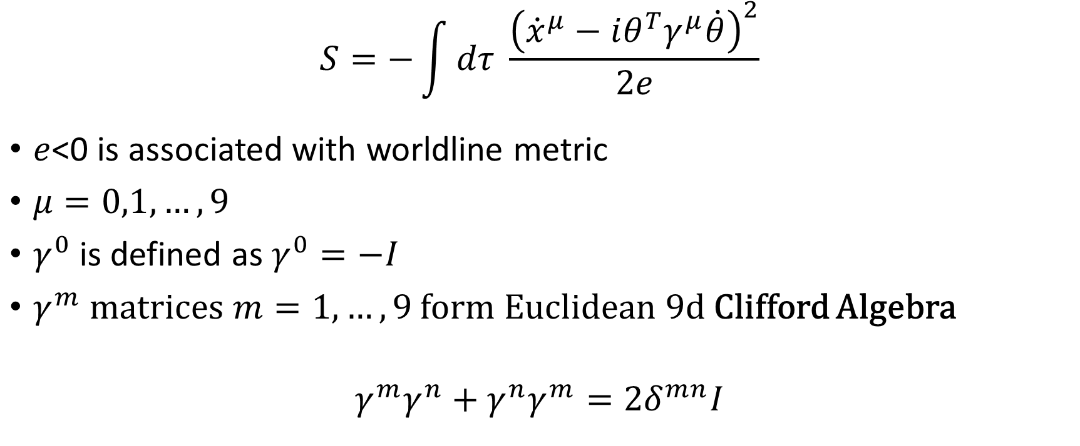
Brink-Schwartz action
$$S=−\int{dτ \frac{{\left({\dot{x}}^{μ}−iθ^{T}γ^{μ}\dot{θ}\right)}^{2}}{2e}}$$
$e$<0 is associated with worldline metric
$μ=0,1,…,9$
$γ^{0}$is defined as $γ^{0}=−I$
$γ^{m}$ matrices $m=1,…,9$ form Euclidean 9d Clifford Algebra
$$γ^{m}γ^{n}+γ^{n}γ^{m}={2δ}^{mn}I$$

Slide 9
Super-Algebra
Our action is invariant under the transformations of the form
$$x^{μ}→x^{μ}+a^{μ}, θ→θ$$
$$x^{μ}→x^{μ}+\frac{i}{2}ε^{T}γ^{μ}θ, θ→θ+\frac{ε}{2}$$
$$x^{μ}→x^{μ}+ω^{μν}x_{ν}, θ→θ+\frac{1}{2}ω_{mn}γ^{mn}θ+\frac{1}{2}ω_{0n}γ^{n}θ$$
$$γ^{μν}≡\frac{1}{4}\left[γ^{μ},γ^{ν}\right], m,n=1,2,…,9$$

Slide 10

Super-Algebra
Introducing the momentum variables
$$p_{μ}=−\frac{{\dot{x}}_{μ}−iθ^{T}γ_{μ}\dot{θ}}{e}$$
Corresponding charges are
$$P_{μ}=p_{μ}$$
$$Q_{a}=ip_{μ}γ_{ab}^{μ}θ_{b}$$
$$J_{mn}=p_{m}x_{n}−p_{n}x_{m}−{Q_{a}γ}_{ab}^{mn}θ_{b}$$
$$J^{0n}=Ex^{n}−p^{n}x^{0}−\frac{1}{2}{Q_{a}γ}_{ab}^{n}θ_{b}$$

Slide 11
Super-Algebra
Introducing first order formalism
$$S=\int{dτ p_{μ}\left({\dot{x}}^{μ}−iθ^{T}γ^{μ}\dot{θ}\right)+\frac{e}{2}p^{2} }$$
$e$ plays a role of Lagrange multiplier and its variation $p^{2}=0$ and defines energy of the particle $E=−p_{0}$

Slide 12

Super-Algebra
$$Q_{a}=\sqrt{E}e_{a}^{α}\left(p\right)s_{α}, α=1,2,…,8$$
$e_{a}^{α}\left(p\right)$ are orthonormal solutions of
$$p^{n}γ_{ab}^{n}e_{b}^{α}=Ee_{a}^{α}$$
Factor of $\sqrt{E}$ is added for convenience

Slide 13

Generator construction
We take the presymplectic form
$$θ=p_{μ}\left(dx^{μ}−iθ^{T}γ^{μ}dθ\right)$$
We choose $p^{n},J^{0n},Q_{a},x^{0},θ_{a}$as our variables
$$x^{n}=\frac{J^{0n}+p^{n}x^{0}+\frac{1}{2}Q_{a}γ_{ab}^{n}θ_{b}}{E}$$
$$θ=p_{n}d\left(\frac{J^{0n}}{E}\right)−\frac{i}{2E}Q_{a}dQ_{a}$$

Slide 14

Generator construction
Using the solutions of $Q_{a}$
$$θ=p_{n}dq^{n}+\frac{i}{2}s_{α}ds_{α}$$
$$q^{n}=\frac{J^{0n}}{E}−\frac{i}{2}R_{n}^{αβ}s_{α}s_{β}, R_{n}^{αβ}=e_{a}^{α}\frac{∂e_{a}^{β}}{∂p^{n}}$$
We neglected $d\left(p_{n}R_{n}^{αβ}s_{α}s_{β}\right)$

Slide 15
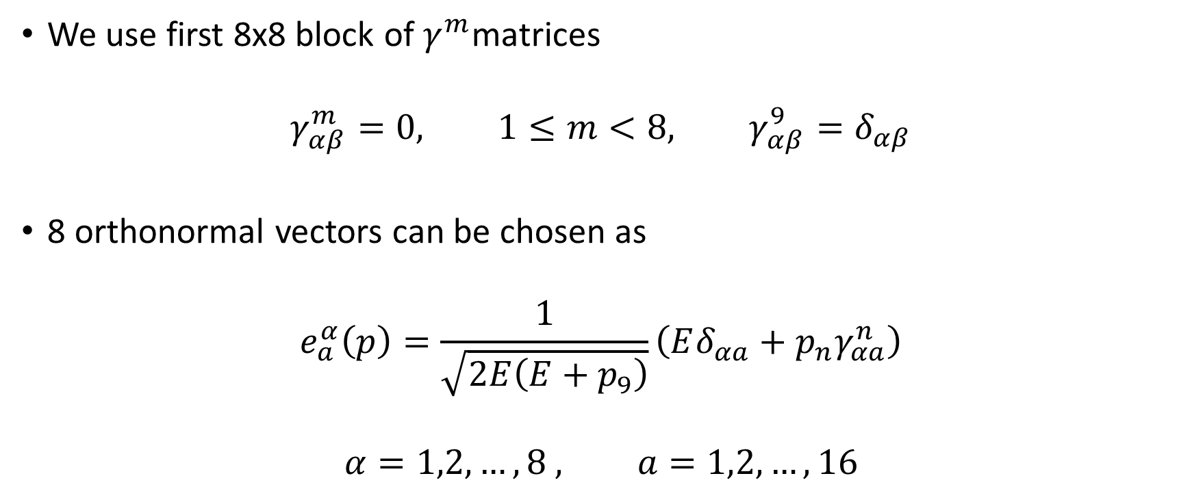
Generator construction
We use first 8x8 block of $γ^{m}$matrices
$$γ_{αβ}^{m}=0, 1≤m<8, γ_{αβ}^{9}=δ_{αβ}$$
8 orthonormal vectors can be chosen as
$$e_{a}^{α}\left(p\right)=\frac{1}{\sqrt{2E\left(E+p_{9}\right)}}\left(Eδ_{αa}+p_{n}γ_{αa}^{n}\right)$$
$$α=1,2,…,8 , a=1,2,…,16$$

Slide 16
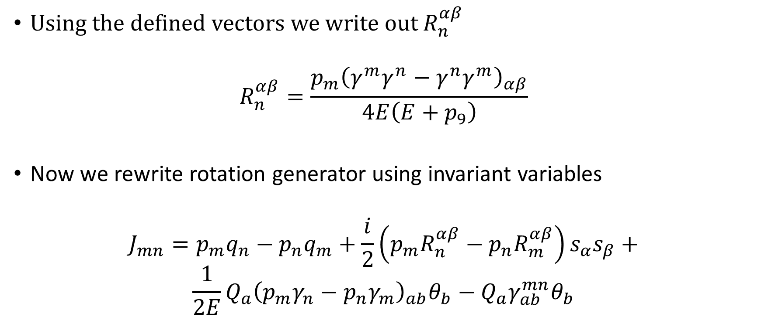
Generator construction
Using the defined vectors we write out $R_{n}^{αβ}$
$$R_{n}^{αβ}=\frac{p_{m}{\left(γ^{m}γ^{n}−γ^{n}γ^{m}\right)}_{αβ}}{4E\left(E+p_{9}\right)}$$
Now we rewrite rotation generator using invariant variables
$$J_{mn}=p_{m}q_{n}−p_{n}q_{m}+\frac{i}{2}\left(p_{m}R_{n}^{αβ}−p_{n}R_{m}^{αβ}\right)s_{α}s_{β}+$$
$$\frac{1}{2E}Q_{a}{\left(p_{m}γ_{n}−p_{n}γ_{m}\right)}_{ab}θ_{b}−Q_{a}γ_{ab}^{mn}θ_{b}$$

Slide 17
Thank you!
Thanks to VW-Stiftung for the opportunity of continuing my studies in Bonn
I intend to continue working on superstings in AdS

