Slide 1
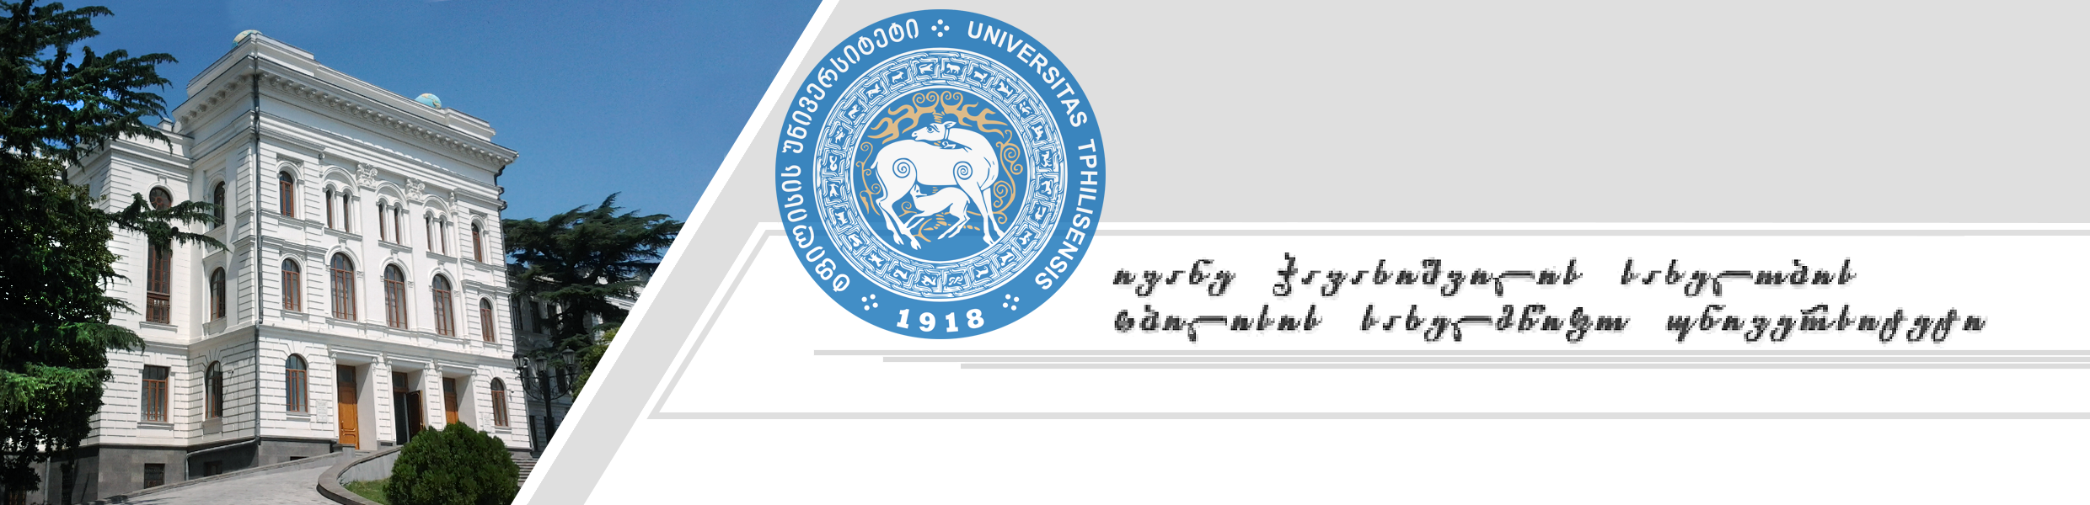
Ivane Javakhishvili Tbilisi State University
Faculty of Exact and Natural Sciences
Geometric application of non-compact $G_{2}$ group
Presenter: Alexandre Gurchumelia
Master's supervisor: Merab Gogberashvili

Slide 2
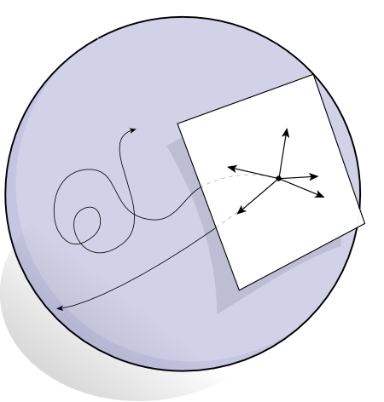




Lie algebras in physics
Conservation Laws
Symmetries
Groups
Lie Algebras
Noether's theorem
$$q\left(α\right)$$
$$e$$
$$X∈𝔤$$
$$\exp\left(αX\right)∈G$$

Slide 3

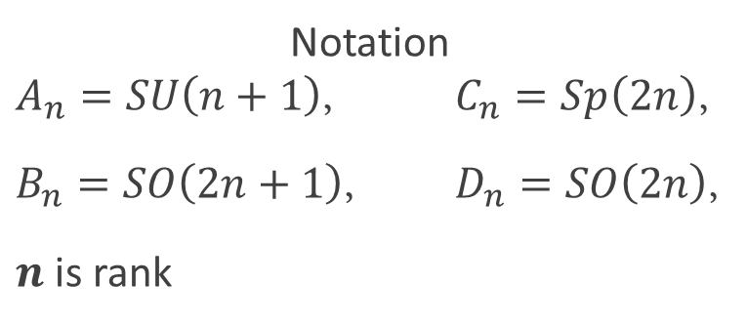








Classification of Lie algebras (with Dynkin diagrams)
Infinite families
Exceptional cases
$$A_{n}$$
$$G_{2}$$
$$B_{n}$$
$$F_{4}$$
$$C_{n}$$
$$D_{n}$$
$$E_{6}$$
Notation
$A_{n}=SU\left(n+1\right)$, $C_{n}=Sp\left(2n\right)$,
$B_{n}=SO\left(2n+1\right)$, $D_{n}=SO\left(2n\right)$,
$n$ is rank
$$E_{7}$$
$$E_{8}$$

Slide 4
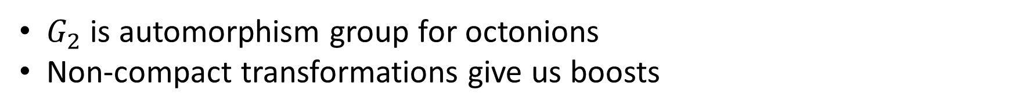
Something wrong with Poincare groups?
Planck length isn’t supposed to Lorentz contract
No division algebra in 3+1 D to describe transformations
Why non-compact $G_{2}$?
$G_{2}$ is automorphism group for octonions
Non-compact transformations give us boosts

Slide 5
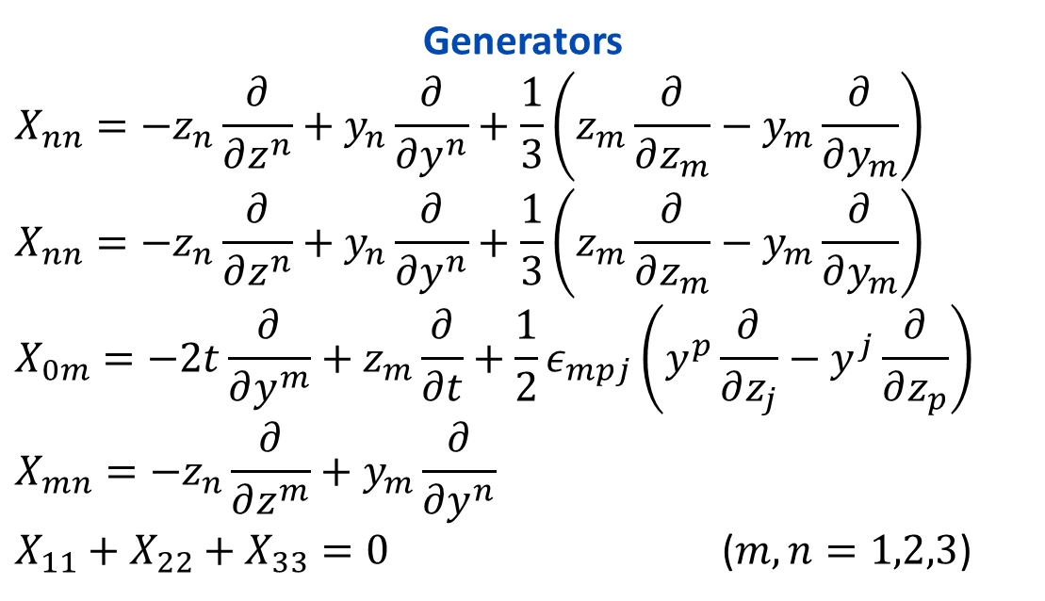
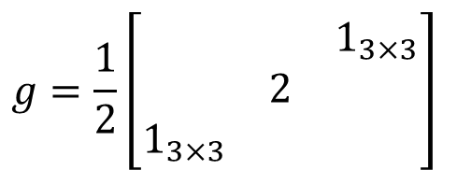


Non-compact $G_{2}$ group ($G_{2}^{NC}$)
Generators
$$X_{nn}=−z_{n}\frac{∂}{∂z^{n}}+y_{n}\frac{∂}{∂y^{n}}+\frac{1}{3}\left(z_{m}\frac{∂}{∂z_{m}}−y_{m}\frac{∂}{∂y_{m}}\right)$$
$$X_{nn}=−z_{n}\frac{∂}{∂z^{n}}+y_{n}\frac{∂}{∂y^{n}}+\frac{1}{3}\left(z_{m}\frac{∂}{∂z_{m}}−y_{m}\frac{∂}{∂y_{m}}\right)$$
$$X_{0m}=−2t\frac{∂}{∂y^{m}}+z_{m}\frac{∂}{∂t}+\frac{1}{2}ε_{mpj}\left(y^{p}\frac{∂}{∂z_{j}}−y^{j}\frac{∂}{∂z_{p}}\right)$$
$$X_{mn}=−z_{n}\frac{∂}{∂z^{m}}+y_{m}\frac{∂}{∂y^{n}}$$
$X_{11}+X_{22}+X_{33}=0$ ($m,n=1,2,3$)
Space: $p^{T}=\left[y_{n},t,z_{n}\right]$
Metric:
$$g=\frac{1}{2}\left[\begin{matrix} & & 1_{3×3} \\ & 2 & \\ 1_{3×3} & & \end{matrix}\right]$$
Quadratic form: $p^{T}gp=t^{2}+y_{n}z^{n}$

Slide 6

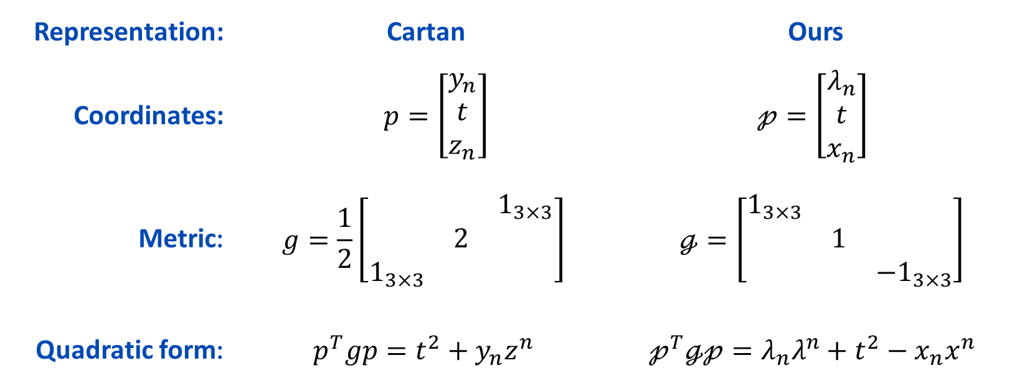
7-dimensional equivalent representation
Minkowski-like metric
Representation: | Cartan | Ours
Coordinates: | $p=\left[\begin{matrix}y_{n} \\ t \\ z_{n}\end{matrix}\right]$ | $$𝓅=\left[\begin{matrix}λ_{n} \\ t \\ x_{n}\end{matrix}\right]$$
Metric: | $$g=\frac{1}{2}\left[\begin{matrix} & & 1_{3×3} \\ & 2 & \\ 1_{3×3} & & \end{matrix}\right]$$ | $ℊ=\left[\begin{matrix}1_{3×3} & & \\ & 1 & \\ & & −1_{3×3}\end{matrix}\right]$
Quadratic form: | $$p^{T}gp=t^{2}+y_{n}z^{n}$$ | $$𝓅^{T}ℊ𝓅=λ_{n}λ^{n}+t^{2}−x_{n}x^{n}$$
$$y_{n}=λ_{n}+x_{n}$$
$$z_{n}=λ_{n}−x_{n}$$

Slide 7
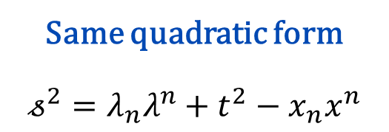

Same quadratic form
$$𝓈^{2}=λ_{n}λ^{n}+t^{2}−x_{n}x^{n}$$
Change of basis
Generators
$$T_{n}=𝒳_{0n}−𝒳_{n0} =−2\left(x_{n}\frac{∂}{∂t}+t\frac{∂}{∂x^{n} }\right)−\frac{1}{2}ε_{nqi}\left[\left(λ^{q}\frac{∂}{∂x_{i} }−λ^{i}\frac{∂}{∂x_{q} }\right)−\left(x^{q}\frac{∂}{∂λ_{i}}−x^{i}\frac{∂}{∂λ_{q}}\right)\right]$$
$$F_{n}=−\left(𝒳_{0k}+𝒳_{k0}\right)=−2\left(λ_{n}\frac{∂}{∂t}−t\frac{∂}{∂λ^{n}}\right)−\frac{1}{2}ε_{nqi}\left[\left(λ^{q}\frac{∂}{∂λ_{i}}−λ^{i}\frac{∂}{∂λ_{q}}\right)−\left(x^{q}\frac{∂}{∂x_{i} }−x^{i}\frac{∂}{∂x_{q} }\right)\right]$$
$$G_{k}=\left|ε_{kmn}\right|𝒳^{mn} =\frac{1}{2}\left|ε_{knm}\right|\left[\left(x_{n}\frac{∂}{∂λ^{m}}+x_{m}\frac{∂}{∂λ^{n}}\right)+\left(λ_{n}\frac{∂}{∂x^{m} }+λ_{m}\frac{∂}{∂x^{n} }\right)\right]$$
$$R_{k}=ε_{kmn}𝒳^{mn} =\frac{1}{2}ε_{knm}\left[\left(λ_{n}\frac{∂}{∂λ^{m}}−λ_{m}\frac{∂}{∂λ^{n}}\right)+\left(x_{n}\frac{∂}{∂x^{m} }−x_{m}\frac{∂}{∂x^{n} }\right)\right]$$
$$Φ_{n}=𝒳_{kk} =x_{n}\frac{∂}{∂λ^{n}}+λ_{n}\frac{∂}{∂x^{n}}−\frac{1}{3}\left(x_{m}\frac{∂}{∂λ_{m}}+λ_{m}\frac{∂}{∂x_{m}}\right)$$

Slide 8
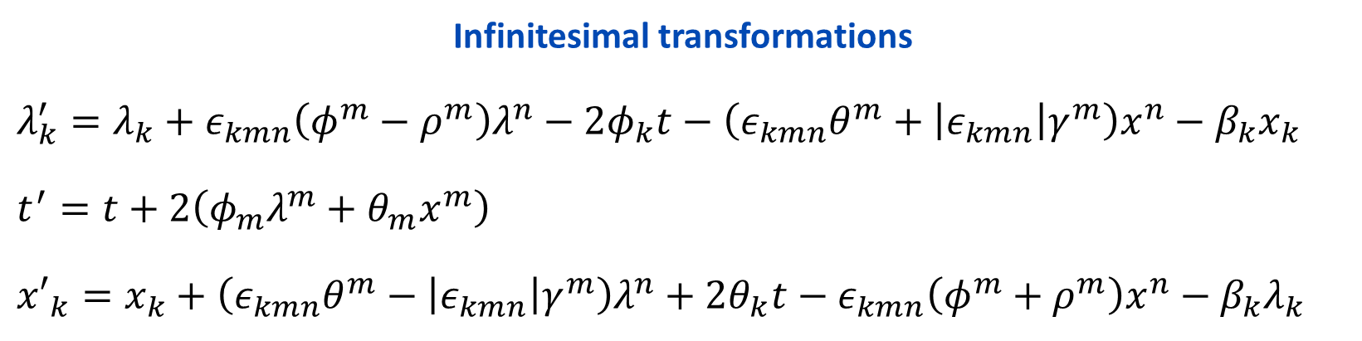
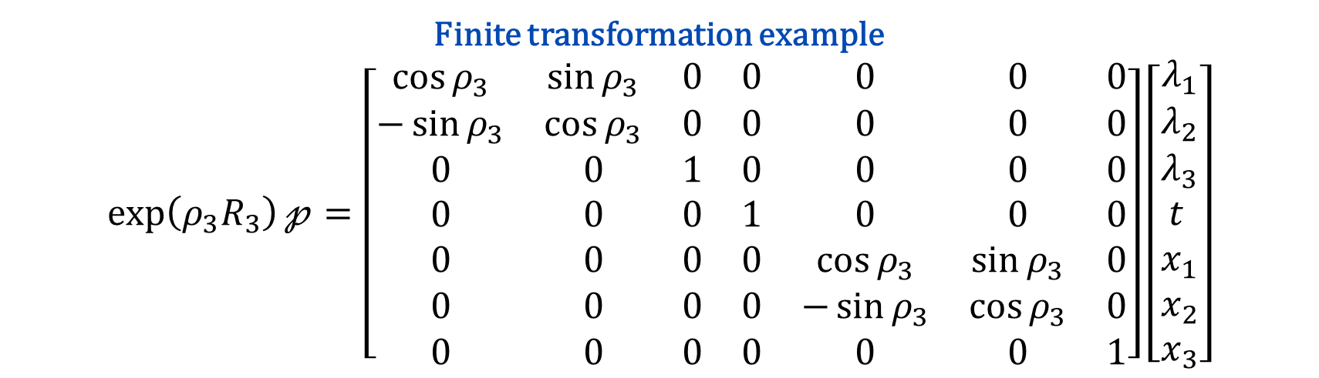
$G_{2}^{NC}$ group transformations in the new basis
Infinitesimal transformations
$$λ_{k}^{′}=λ_{k}+ε_{kmn}\left(φ^{m}−ρ^{m}\right)λ^{n}−2φ_{k}t−\left(ε_{kmn}θ^{m}+\left|ε_{kmn}\right|γ^{m}\right)x^{n}−β_{k}x_{k}$$
$$t^{′}=t+2\left(φ_{m}λ^{m}+θ_{m}x^{m}\right)$$
$${x′}_{k}=x_{k}+\left(ε_{kmn}θ^{m}−\left|ε_{kmn}\right|γ^{m}\right)λ^{n}+2θ_{k}t−ε_{kmn}\left(φ^{m}+ρ^{m}\right)x^{n}−β_{k}λ_{k}$$
Finite transformation example
$$\exp\left(ρ_{3}R_{3}\right)𝓅=\left[\begin{matrix}\cos{ρ_{3}} & \sin{ρ_{3}} & 0 & 0 & 0 & 0 & 0 \\ −\sin{ρ_{3}} & \cos{ρ_{3}} & 0 & 0 & 0 & 0 & 0 \\ 0 & 0 & 1 & 0 & 0 & 0 & 0 \\ 0 & 0 & 0 & 1 & 0 & 0 & 0 \\ 0 & 0 & 0 & 0 & \cos{ρ_{3}} & \sin{ρ_{3}} & 0 \\ 0 & 0 & 0 & 0 & −\sin{ρ_{3}} & \cos{ρ_{3}} & 0 \\ 0 & 0 & 0 & 0 & 0 & 0 & 1\end{matrix}\right]\left[\begin{matrix}λ_{1} \\ λ_{2} \\ λ_{3} \\ t_{ } \\ x_{1} \\ x_{2} \\ x_{3}\end{matrix}\right]$$

Slide 9
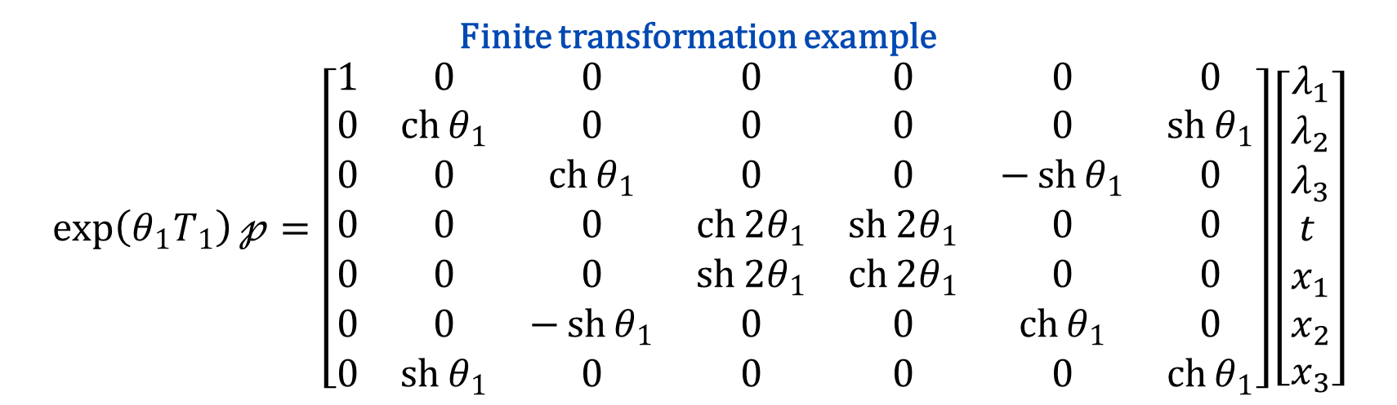
$G_{2}^{NC}$ group transformations in the new basis
Infinitesimal transformations
$$λ_{k}^{′}=λ_{k}+ε_{kmn}\left(φ^{m}−ρ^{m}\right)λ^{n}−2φ_{k}t−\left(ε_{kmn}θ^{m}+\left|ε_{kmn}\right|γ^{m}\right)x^{n}−β_{k}x_{k}$$
$$t^{′}=t+2\left(φ_{m}λ^{m}+θ_{m}x^{m}\right)$$
$${x′}_{k}=x_{k}+\left(ε_{kmn}θ^{m}−\left|ε_{kmn}\right|γ^{m}\right)λ^{n}+2θ_{k}t−ε_{kmn}\left(φ^{m}+ρ^{m}\right)x^{n}−β_{k}λ_{k}$$
Finite transformation example
$$\exp\left(θ_{1}T_{1}\right)𝓅=\left[\begin{matrix}1 & 0 & 0 & 0 & 0 & 0 & 0 \\ 0 & \operatorname{ch}{θ_{1}} & 0 & 0 & 0 & 0 & \operatorname{sh}{θ_{1}} \\ 0 & 0 & \operatorname{ch}{θ_{1}} & 0 & 0 & −\operatorname{sh}{θ_{1}} & 0 \\ 0 & 0 & 0 & \operatorname{ch}{2θ_{1}} & \operatorname{sh}{2θ_{1}} & 0 & 0 \\ 0 & 0 & 0 & \operatorname{sh}{2θ_{1}} & \operatorname{ch}{2θ_{1}} & 0 & 0 \\ 0 & 0 & −\operatorname{sh}{θ_{1}} & 0 & 0 & \operatorname{ch}{θ_{1}} & 0 \\ 0 & \operatorname{sh}{θ_{1}} & 0 & 0 & 0 & 0 & \operatorname{ch}{θ_{1}}\end{matrix}\right]\left[\begin{matrix}λ_{1} \\ λ_{2} \\ λ_{3} \\ t_{ } \\ x_{1} \\ x_{2} \\ x_{3}\end{matrix}\right]$$

Slide 10
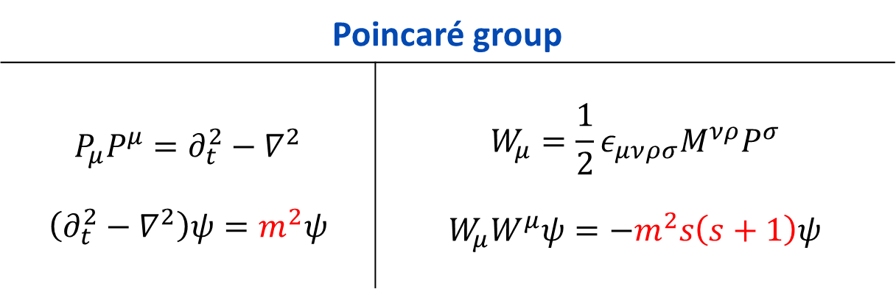
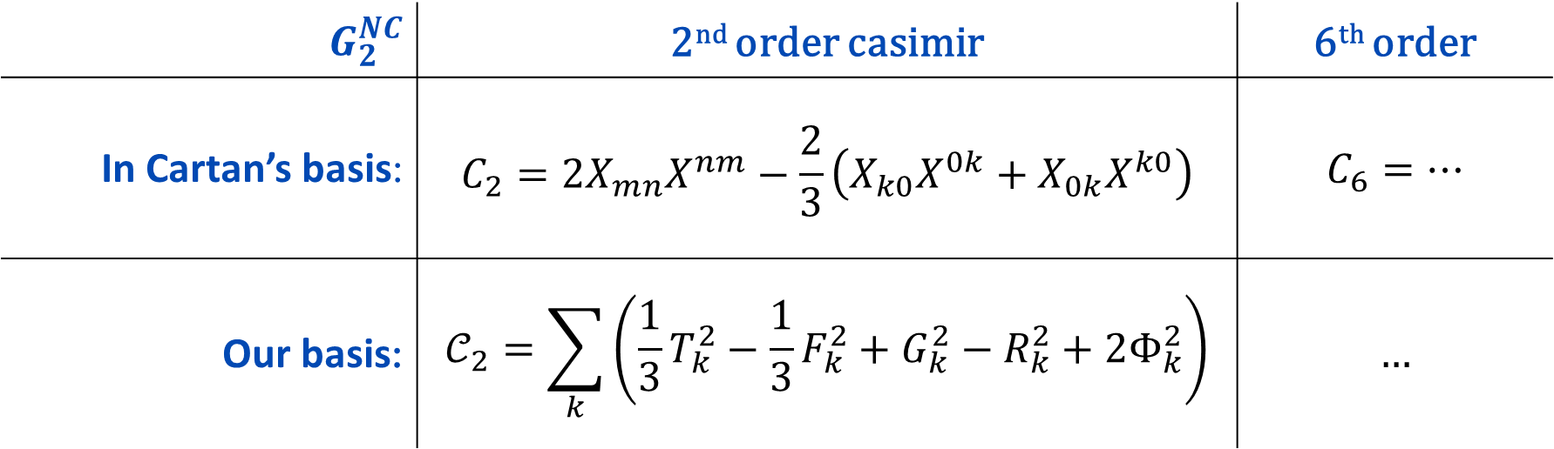
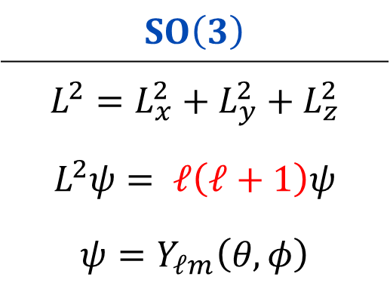
Casimir Operators
$$SO\left(3\right)$$
$$L^{2}=L_{x}^{2}+L_{y}^{2}+L_{z}^{2}$$ $$L^{2}ψ=\begin{matrix} \end{matrix}ℓ\left(ℓ+1\right)ψ$$ $$ψ=Y_{ℓm}\left(θ,φ\right)$$
Poincaré group
$$P_{μ}P^{μ}=∂_{t}^{2}−∇^{2}$$ $$\left(∂_{t}^{2}−∇^{2}\right)ψ=m^{2}ψ$$ | $$W_{μ}=\frac{1}{2}ε_{μνρσ}M^{νρ}P^{σ}$$ $$W_{μ}W^{μ}ψ=−m^{2}s\left(s+1\right)ψ$$
$$G_{2}^{NC}$$ | 2nd order casimir | 6th order
In Cartan’s basis: | $$C_{2}=2X_{mn}X^{nm}−\frac{2}{3}\left(X_{k0}X^{0k}+X_{0k}X^{k0}\right)$$ | $$C_{6}=…$$
Our basis: | $$𝒞_{2}=\sum_{k}{\left(\frac{1}{3}T_{k}^{2}−\frac{1}{3}F_{k}^{2}+G_{k}^{2}−R_{k}^{2}+2Φ_{k}^{2}\right)}$$ | $$…$$

Slide 11
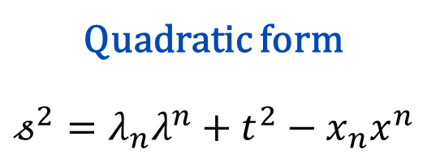


2nd order Casimir of $𝔤_{2}$ algebra
Neglecting change in $λ$
$${dλ}_{k}=0$$
Quadratic form
$$𝓈^{2}=λ_{n}λ^{n}+t^{2}−x_{n}x^{n}$$
$$𝒞_{2}=6t\frac{∂}{∂t}−\left(𝓈^{2}−t^{2}\right)\frac{∂^{2}}{∂t^{2}}$$
$$+\sum_{k}{\left\{\left(𝓈^{2}+x_{k}^{2}\right)\frac{∂^{2}}{∂x_{k}^{2}}−\left(𝓈^{2}−λ_{k}^{2}\right)\frac{∂^{2}}{∂λ_{k}^{2}}+6\left(λ_{k}\frac{∂}{∂λ_{k}}+x_{k}\frac{∂}{∂x_{k}}\right)+2t\left(x_{k}\frac{∂}{∂x_{k}}+λ_{k}\frac{∂}{∂λ_{k}}\right)\frac{∂}{∂t}+\sum_{m}{\sum_{n}{\left[\left(1+δ_{mn}\right)λ_{m}x_{n}\frac{∂^{2}}{∂λ_{m}∂x_{n}}+\left|ε_{kmn}\right|\left(x_{m}x_{n}\frac{∂^{2}}{∂x_{m}∂x_{n}}+λ_{m}λ_{n}\frac{∂^{2}}{∂λ_{m}∂λ_{n}}\right)\right]}}\right\}}$$

Slide 12
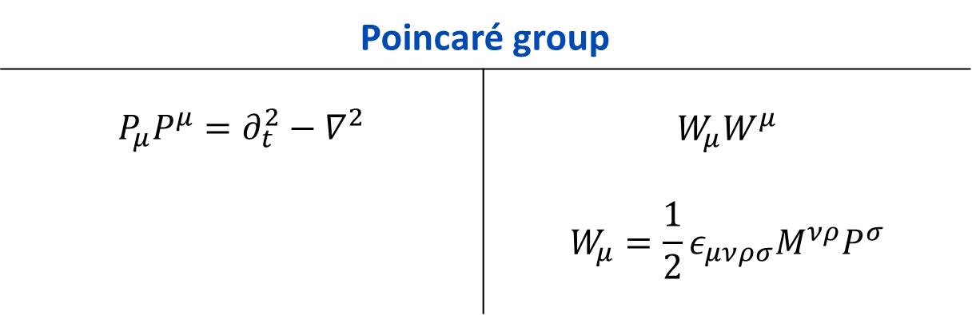
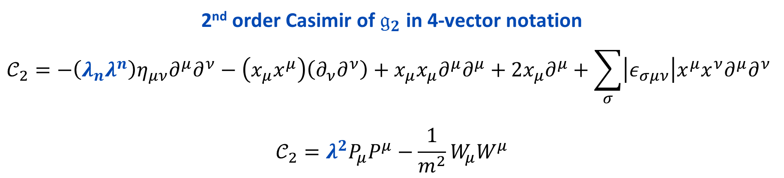
Comparing Casimir operators
2nd order Casimir of $𝔤_{2}$ in 4-vector notation
$$𝒞_{2}=−\left(λ_{n}λ^{n}\right)η_{μν}∂^{μ}∂^{ν}−\left(x_{μ}x^{μ}\right)\left(∂_{ν}∂^{ν}\right)+x_{μ}x_{μ}∂^{μ}∂^{μ}+2x_{μ}∂^{μ}+\sum_{σ}{\left|ε_{σμν}\right|x^{μ}x^{ν}∂^{μ}∂^{ν}}$$
$$𝒞_{2}=λ^{2}P_{μ}P^{μ}−\frac{1}{m^{2}}W_{μ}W^{μ}$$
Poincaré group
$$P_{μ}P^{μ}=∂_{t}^{2}−∇^{2}$$ | $$W_{μ}W^{μ}$$ $$W_{μ}=\frac{1}{2}ε_{μνρσ}M^{νρ}P^{σ}$$

Slide 13
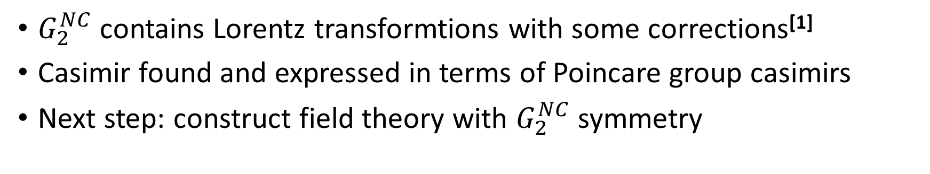
Summary & further research
Thank you!
$G_{2}^{NC}$ contains Lorentz transformtions with some corrections^{[1]}
Casimir found and expressed in terms of Poincare group casimirs
Next step: construct field theory with $G_{2}^{NC}$ symmetry
Reference
[1] Gogberashvili M, Sakhelashvili O, (2015). Geometrical Applications of Split Octonions; Hindawi Publishing Corporation: Adv. Math. Phys. p.196708; doi: 10.1155/2015/196708

