Slide 1
Contamination Gradient For Air Pollutants In space
SMART|ATMO_SIM LAB
Master of Chemistry Nana Khundadze
Supervisor: Assistant Professor Giorgi Jibuti
Chair of Physical and Analytical Chemistry
Tbilisi State University

Slide 2
Dirty cars = Dirty air
Notes:
Dirty cars = Dirty air

Slide 3
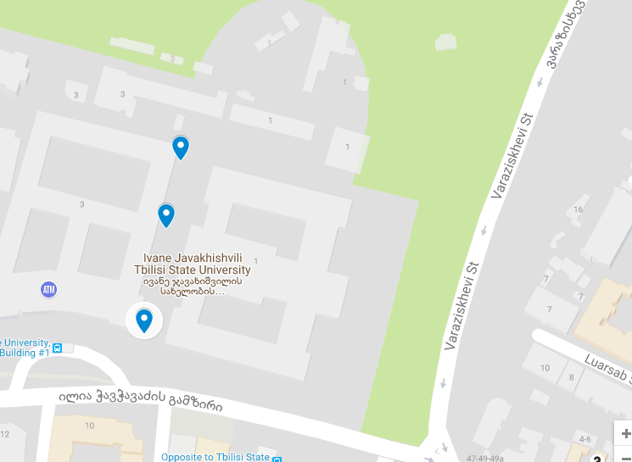
TSU 2nd campus back doors
TSU between 1st&2nd campus
TSU 1st campus door

Slide 5
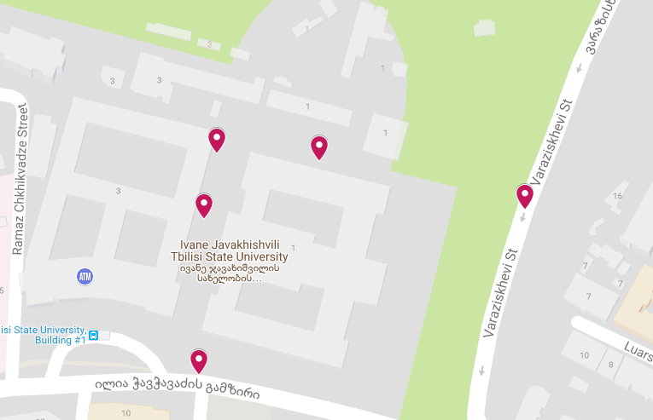
2nd campus back door
1st campus garden
between 1st & 2nd building
Varazis khevi
chavchavadze ave

Slide 6
PPBV
PPBV
PPMV
PPMV

Slide 7
Deviation from the permissible norm
83.70046
38.5565
98.37088
Notes:
Deviation from the permissible norm

Slide 8
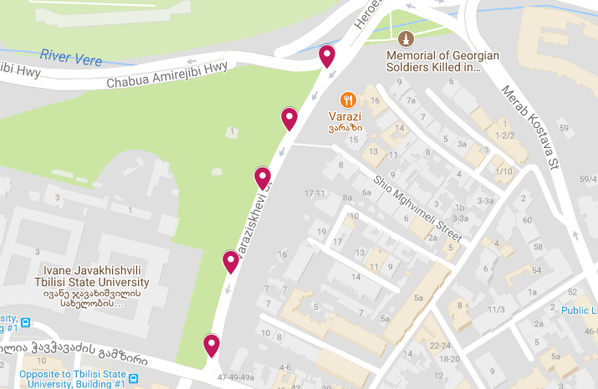
Varazis Khevi (22)
Varazis Khevi (5)
Varazis Khevi (G50)
Varazis Khevi (4)
Varazis Khevi (2

Slide 9
100 %
PPBV
PPBV
PPMV
PPMV
PPMV
Notes:
372.1914894 349.674234

Slide 10
Deviation from the permissible norm
1.274059
1.838812
4.855279

Slide 11
chavchavadze 2 (coffeesta)
the end of Varazis khevi
the crossroad of Chavchavadze and Varazis Khevi
Melikishvili
51 public school
Varazis Khevi, near stears
New road,under the bridge
Pilarmonia, park Vere
Chachava clinic
near Vere Palace

Slide 12
PPBV
PPBV
PPBV

Slide 13
PPMV
PPMV
PPMV
PPMV
PPMV
Notes:
PPMV

Slide 14
PPBV
PPBV
CO
the end of Varazis khevi
the crossroad of Chavchavadze and Varazis Khevi
PPMV
Notes:
5 wertili 51 sajaro skola 3 4 NO2 acharbebs limits da 5shi limitze dabalia. CO-shemtxvevashi gadaacharba 2ma wertilma

Slide 15
On-Line
3 LAB
21 LAB
W7 chavchavadze ave.
22 near back door
5 between stadium and good food
4 between good food and varazi
7 varazis khevi
G50
W8 new road
24 parking xeoba

Slide 16
4.3
6.7
21
40
92
269
PPBV
PPBV
PPBV
PPMV
PPMV
PPMV
Notes:
Mosashorebelia ciprebi PPMV

Slide 17
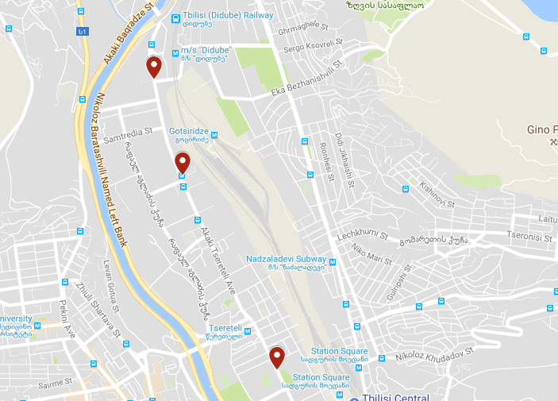
wereteli

Slide 18
PPBV
PPMV
PPMV

Slide 19
PPBV
PPMV
PPBV
PPMV
109.2914 PPMV
55.96669 PPMV
69.49821 PPMV

Slide 20
PPMV
PPMV

Slide 22
Marjanishvili
Danish House
McDonalds Marijanishvili
Saarbrucken Square

Slide 23
PPBV
PPBV
PPBV
PPMV

Slide 24
Notes:
გადახრებზე მსჯელობა

Slide 25
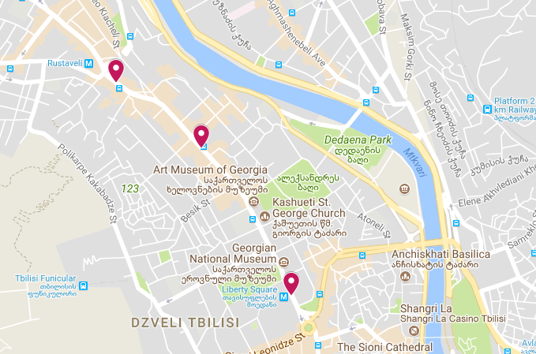
Metro Station "Rustaveli"
Opera House
Metro Station "Liberty square"

Slide 26
PPBV
PPMV
PPMV
PPBV
PPBV
Notes:
Ch4is grafiki

Slide 28
Statistics for pollutants in space
Notes:
statistics

Slide 29
PPBV
PPBV
Notes:
Contamination by NO in space

Slide 30
PPBV
PPBV
Notes:
NO2

Slide 31
PPMV
PPMV
Notes:
PPMV

Slide 32
PPMV
PPMV
Notes:
CO

Slide 33
PPMV
PPMV

Slide 34
0.175479
75.43026
38.60259
34.23448

