Slide 1
Vehicle type, quantity and velocity calculation from video
Giorgi Svanadze David Jokhadze
Supervisors: Ramaz Botchorishvili
Tinatin Davitashvili
24/08/2018

Slide 2
Aims and objectives
Our aim was to create software which allows us to determine moving vehicle
Type
Velocity
Quantity
during the observation from the camera, which will be set beside the road, at the fixed place.

Slide 3
Possible techniques
Optical Flow
Background Subtraction

Slide 4
Optical Flow
Optical flow refers to the visible motion of an object(apparent flow of pixels) in an image. It is the result of 3d motion being projected on a 2-dimensioinal image plane.
Wikipedia.org/wiki/Optical_flow

Slide 5
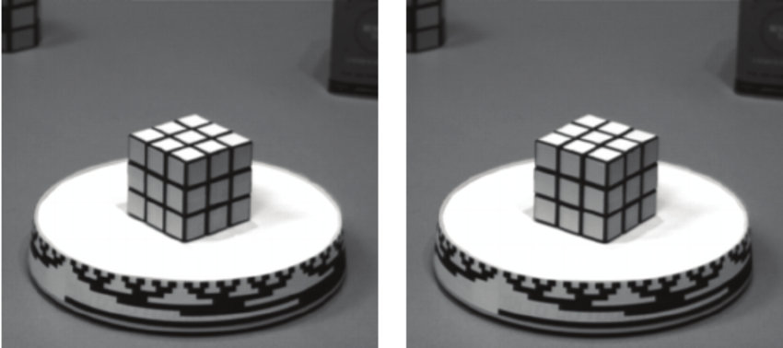
Optical Flow
Moving Rubik’s Cube
Initial frame
Second frame
Vector field
Barron, J.L. et. al., Performance of Optical Flow Techniques, IJCV, 12:1, 43-77, 1994

Slide 6
Formulation
I(x,y,t)=I(x+Δx, y+Δy,t+Δt)
I(x+Δx, y+Δy,t+Δt)= I(x,y,t) + $\frac{∂I}{∂x}$Δx + $\frac{∂I}{∂y}$Δy + $\frac{∂I}{∂t}$ Δt + O(${Δx}^{2},{Δy}^{2},{Δt}^{2},…$)
$\frac{∂I}{∂x}$V_{x} + $\frac{∂I}{∂y}$V_{y} + $\frac{∂I}{∂t}$= 0
$$∇I^{T}×\vec{V}=−I_{t}$$

Slide 7
Aperture problem
https://wolfe4e.sinauer.com/wa08.02.html
picture C
picture A
picture B
Although the object is moving in different directions on the pictures A,B,C, the visual image through the aperture remains the same

Slide 8
The computation of optical flow
Differential (Lucas-Kanade, Horn-Schunk)
Correlation based
Feature based (1-dimensional,2-dimensional)
Hierarchical (Anandan)

Slide 9
Lucas-Kanade method
$$I_{x}\left(q_{1}\right)V_{x}+I_{y}\left(q_{1}\right)V_{y}=−I_{t}\left(q_{1}\right) \\ I_{x}\left(q_{2}\right)V_{x}+I_{y}\left(q_{2}\right)V_{y}=−I_{t}\left(q_{2}\right) \\ . \\ .$$
. $$I_{x}\left(q_{n}\right)V_{x}+I_{y}\left(q_{n}\right)V_{y}=−I_{t}\left(q_{n}\right)$$
$$Av=b$$
$$B=\left[\begin{aligned}−I_{t}\left(q_{1}\right) \\ −I_{t}\left(q_{2}\right) \\ ⋮ \\ −I_{t}\left(q_{n}\right)\end{aligned}\right]$$
$$A=\left[\begin{aligned}I_{x}\left(q_{1}\right) I_{y}\left(q_{1}\right) \\ \begin{aligned}⋮ \\ I_{x}\left(q_{n}\right) { I}_{y}\left(q_{n}\right)\end{aligned}\end{aligned}\right]$$
$$v=\left[\begin{aligned}V_{x} \\ \\ V_{y}\end{aligned}\right]$$
$$A^{T}Av=A^{T}b$$
$$v={(A^{T}A)}^{−1}A^{T}b$$
$$\left[\begin{aligned}V_{x} \\ \\ V_{y}\end{aligned}\right]={\left[\begin{aligned}\sum_{i}{{I_{x}\left(q_{i}\right)}^{2}} \sum_{i}{I_{x}\left(q_{i}\right)}I_{y}\left(q_{i}\right) \\ \\ \sum_{i}{I_{y}\left(q_{i}\right)}I_{x}\left(q_{i}\right) \sum_{i}{{I_{y}\left(q_{i}\right)}^{2}} \end{aligned}\right]}^{−1}\left[\begin{aligned}−\sum_{i}{I_{x}\left(q_{i}\right)}I_{t}\left(q_{i}\right) \\ \\ −\sum_{i}{I_{y}\left(q_{i}\right)}I_{t}\left(q_{i}\right) \end{aligned}\right]$$

Slide 10
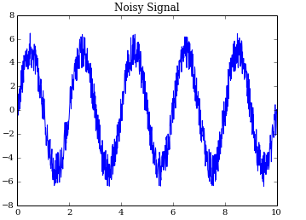
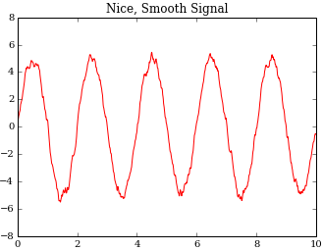
Image filtering
Linear filter (Gaussian,Mean)
Non-linear filter (Median)
Noisy signal F
smooth signal H
F * G → H
Using G filter
https://joseph-long.com/writing/AstroPy-boxcar/

Slide 11
Examples of filtering

Slide 12
Gaussian Filter
2-dimensional Gaussian filter
Filter radius depends on the standard deviation
https://en.wikipedia.org/wiki/Gaussian_blur

Slide 13
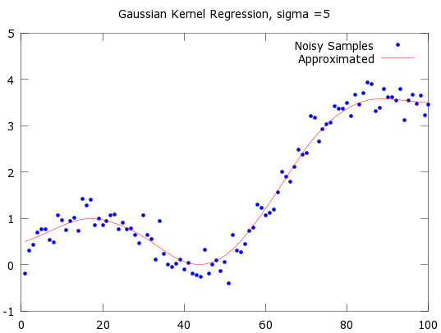
Gaussian Filter

Slide 14
Kernel Matrix
For simplicity and to reduce the computational cost we use the discrete version of Gaussian
fractional matrix
integer matrix

Slide 15
Convolution

Slide 16
Derivative
Classical derivative of a function formulates as
But we can’t use this in our case, because pixels are discrete and thus we need discrete approximation of the derivative.

Slide 17
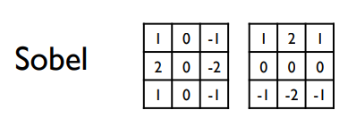
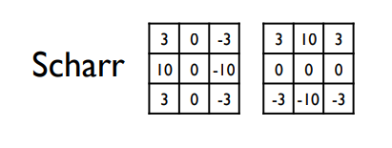
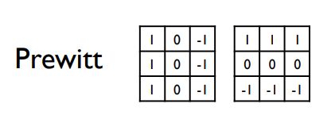
Common discrete ‘derivative’ filters
To achieve the goal, we just have to convolve the image with any of these matrices the same way we did with the filter.

Slide 18
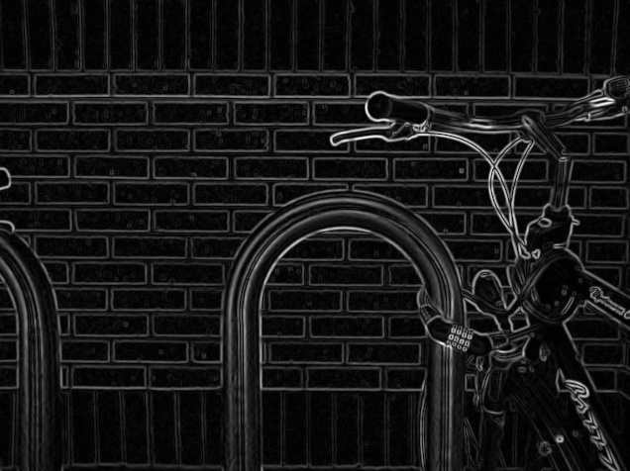
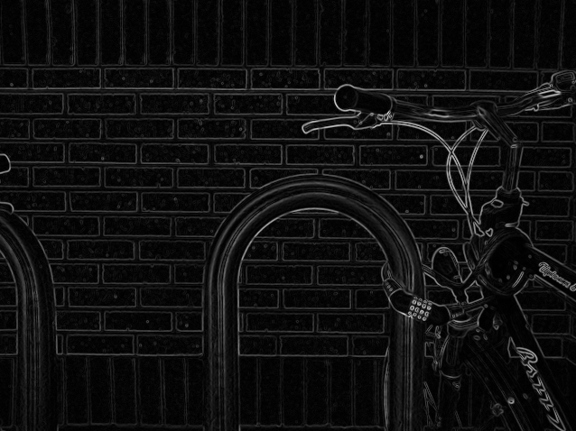
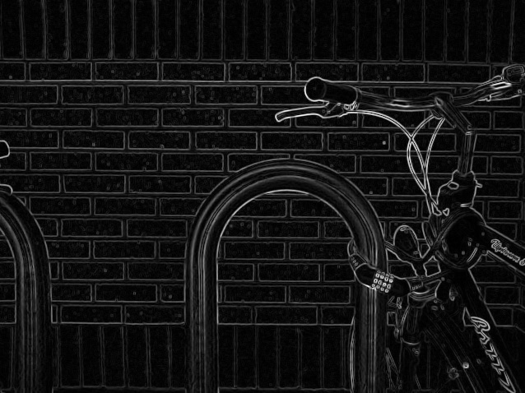
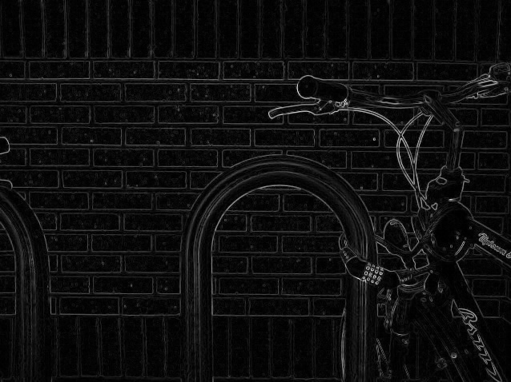
Differences of derivative filters

Slide 19
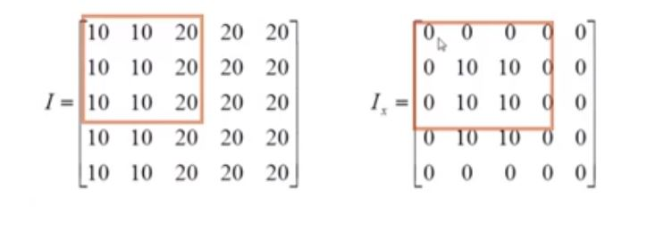
Prewitt Operator

Slide 20
Discrete Derivative

Slide 21
Software tools
Python
OpenCV library

Slide 22
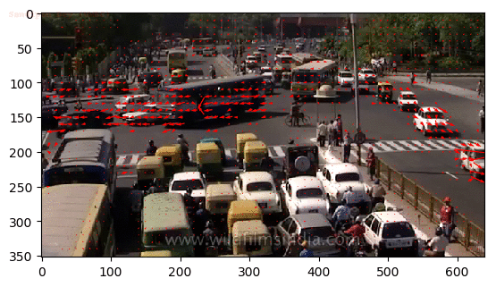
Outcome
These samples are in slow motion, so that the vectors are relatively small. Red lines represent the produced optical flow.
input
output

Slide 23
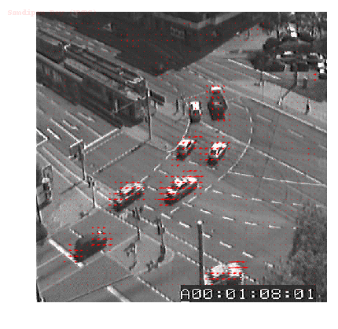
Outcome
input
output

Slide 24
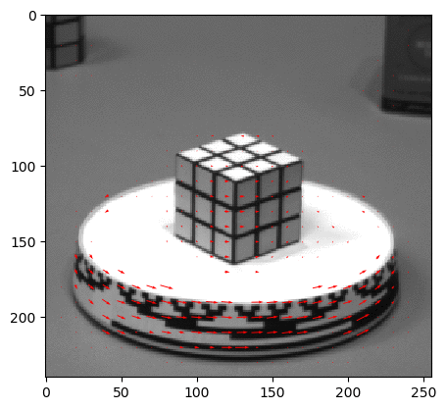
Outcome
input
output

Slide 25
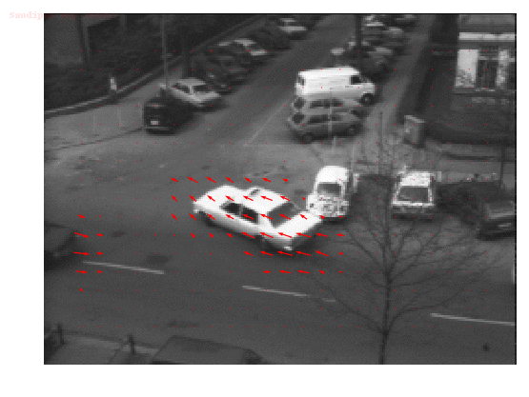
Outcome
input
output

Slide 26
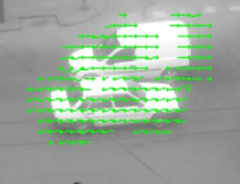
Grouping pixels
When the two vehicles are very close and moving in different directions, the optical flow gets mixed up. So, we will need to group up some pixels in order to distinguish two different optical flows.

Slide 27
Determination of the type by calculating its approximate area
The numbers represent the areas of the vehicles
We calculate the approximate areas of the vehicles and group them by the types. Certain type has its corresponding range of areas and the range varies with the distance from the observing camera to the vehicle

Slide 28
References
Techniques to calculate Optical Flow - Optical flow : Techniques and Applications, Peter O’Donovan, University of Saskatchewan
Lucas-Kanade method - International Journal of Computer Applications (0975-8887) Volume 61-No.10, January 2013
Pyramidal implementation of the affine lucas kanade feature tracker description of the algorithm. Jean-Yves Bouguet, 5, 2001.
Gaussian Blur - Machine Vision, Chapter 4 – Ramesh Jain, Rangachar Kasturi, Brian G Schunck, Published by McGraw-Hill 1995
"Object Enhancement and Extraction" in "Picture processing and Psychopictorics“. J.M.S. Prewitt , Academic Press, 1970
openCV library - https://docs.opencv.org/2.4/index.html

Slide 29
Thank you for your attention!

