Slide 1
Coupled Horn-Schunck and Lukas-Kanade for image processing
Tamaz Sepiashvili, Mari Jananashvili
Supervisors: Ramaz Botchorishvili, Tinatin Davitashvili
Ivane Javakhishvili Tbilisi State University
24/08/2018

Slide 2
Outline
Optical Flow
Mathematic interpretation and methods
coupled algorithm

Slide 3
What is Optical Flow ?
The pattern of apparent motion of objects, surfaces, and edges in a visual scene caused by the relative motion between an observer and a scene
https://docs.opencv.org/3.4/d7/d8b/tutorial_py_lucas_kanade.html

Slide 4
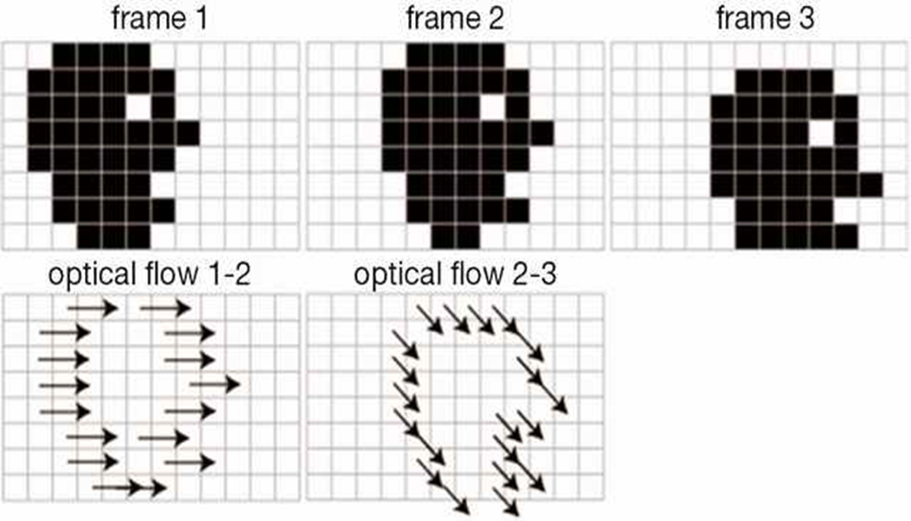
Examples
http://tcr.amegroups.com/article/view/3200/html

Slide 5
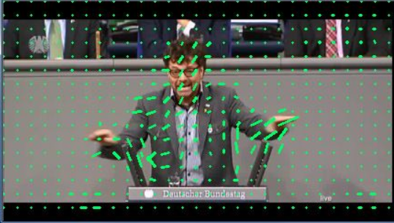
Examples
https://www.codeproject.com/Articles/1192205/Capturing-motion-from-video-using-the-Emgu-CV-libr

Slide 6
Uses of Optical Flow
Practical Uses
Object tracking
Video compression
Structure from motion
Segmentation
Combining overlapping images
Robot navigation , etc.

Slide 7
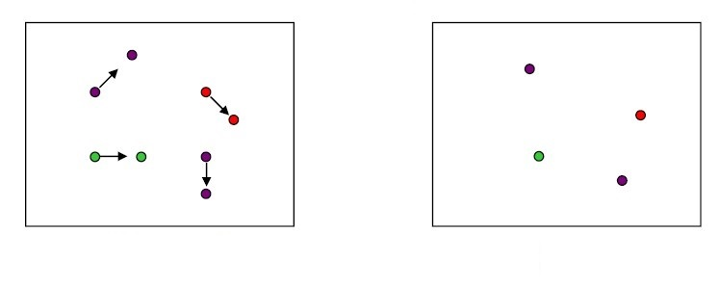
Problem Statement: Optical Flow
https://courses.cs.washington.edu/courses/cse455/16wi/notes/14_Optical_Flow.pdf
How to estimate pixel motion from image J to image I?
Find pixel correspondences
Given a pixel in J, look for nearby pixels of the same color in I
Main assumptions
A point in J looks “the same” in image I
Points do not move far

Slide 8
Optical Flow Equation
www.cs.cmu.edu/afs/cs/academic/class/15385-s06/lectures/ppts/lec-16.ppt
Displacement:
Optical Flow:
Assumptions:
Brightness remains same in both images:
Small motion: (Taylor series expansion of right-hand side)

Slide 9
Optical Flow Equation
Divide by and take the limit
Constraint Equation:
must lie on a blue line.
compute partial derivatives.
cannot be found uniquely.

Slide 10
Finding Gradients
y
t
j+1
k+1
j
k
x
i
i+1
http://image.diku.dk/imagecanon/material/HornSchunckOptical_Flow.pdf

Slide 11
Finding Gradients

Slide 12
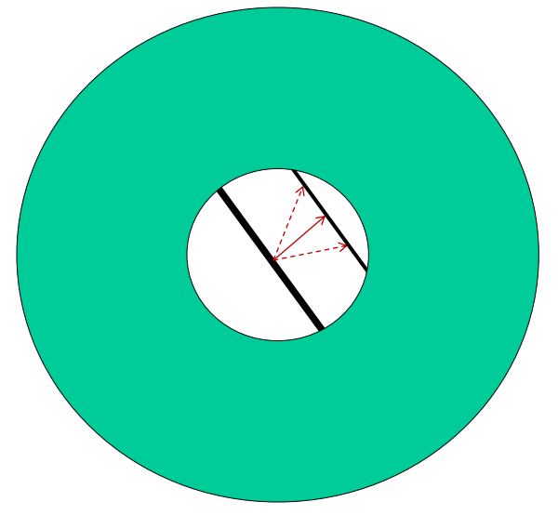
Aperture Problem
Points around have the same intensity.
Impossible to determine which point from match point
http://www.sci.utah.edu/~gerig/CS6320-S2013/Materials/CS6320-CV-S2012-OpticalFlow-I.pdf

Slide 13
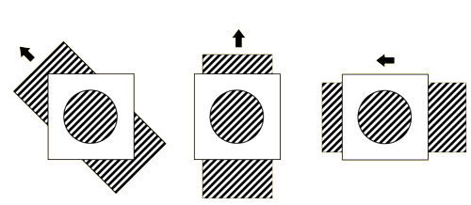
Aperture Problem
https://wolfe4e.sinauer.com/wa08.02.html

Slide 14
Algorithms for Computing Optical Flow
Horn-Schunck(Global Method)
Lucas-Kanade(Local Method)
Phase correlation
Block-based method
Buxton-Buxton method
Black-Jepson method, etc.

Slide 15
Computing Optical Flow: Horn-Schunck method
Error in Optical Flow Constraint:
Smoothness Constraint:
Usually motion field varies smoothly in the image:
Find (u,v) at each image point that minimizes:
Weighting Factor

Slide 16
Horn-Schunck method
Consider image pixel
Departure from Smoothness Constraint:
Error in Optical Flow constraint equation:
We need to minimize:

Slide 17
Horn-Schunck method
Differentiating by and setting to zero:
are averages of around pixel
Finally:

Slide 18
Lucas-Kanade method
The local image flow vector is constant and satisfy
Pixels inside the window
partial derivatives of the image , evaluated at the point at the current time.
The Optical Flow Field/Caltech, Oct. 2004/Lihi Zelnik-Manor

Slide 19
Lucas-Kanade method
Minimize
The method of least squares

Slide 20
Lucas-Kanade method

Slide 21
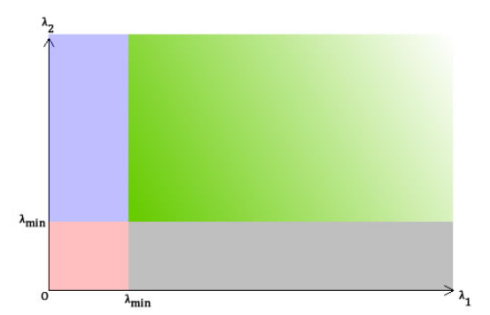
The Shi-Tomasi Corner Detector
The score is calculated like this:
and are eignevalues
Green: λ₁ and λ₂ are greater than a certain value.
-For pixels "accepted" as corners.
Blue and gray : λ₁ or λ₂ is less than required minimum.
-Equivalent to the "edge" areas.
Red region: λ₁ and λ₂ are less than the required minimum.
-This region is for "flat" areas.
http://aishack.in/tutorials/shitomasi-corner-detector/

Slide 22
OpenCV Library
Three libraries in one:
“CV” – Computer Vision Algorithms
“CXCORE” – Linear Algebra
Raw matrix support, etc.
“HIGHGUI” – Media/Window Handling
It’s created and maintained by Intel

Slide 23
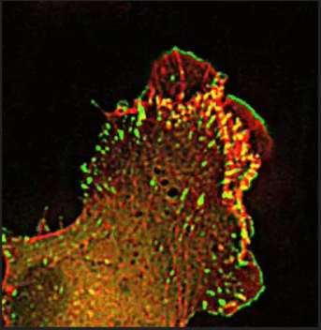
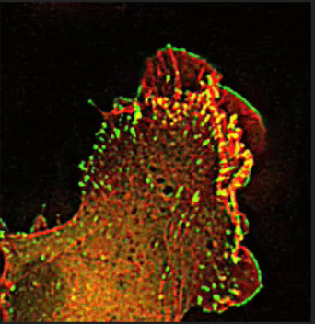
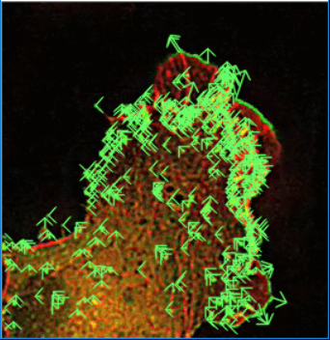
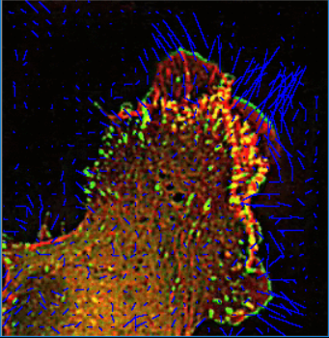
Estimations
Original Photos
1st Frame
2nd Frame
Simple Lucas-Kanade
Horn-Schunck

Slide 24
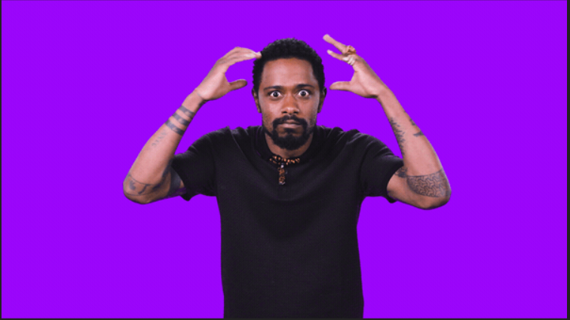
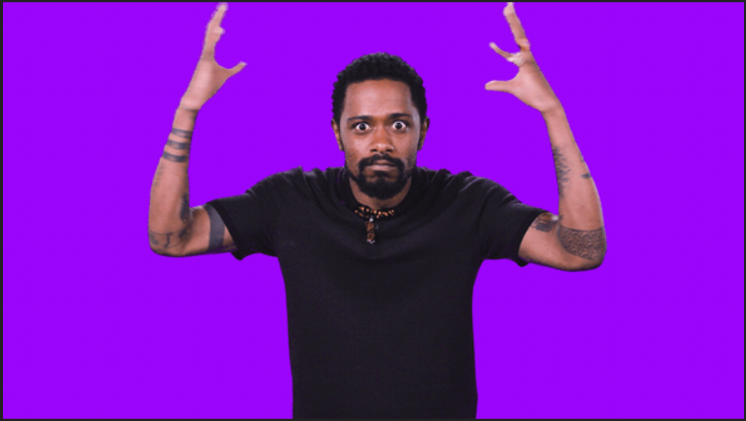
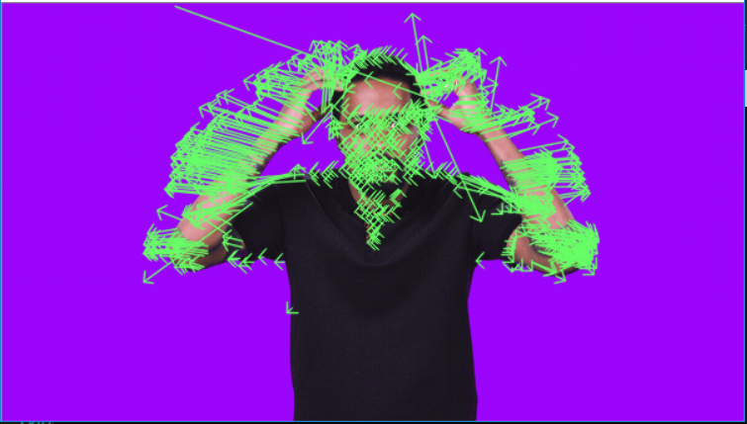
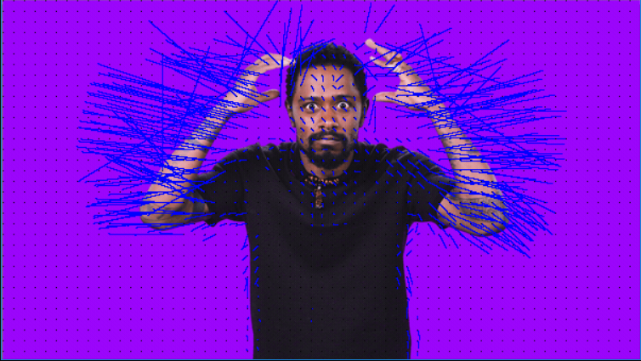
Estimations
Original Photos
1st Frame
2nd Frame
Simple Lucas-Kanade
Horn-Schunck

Slide 25
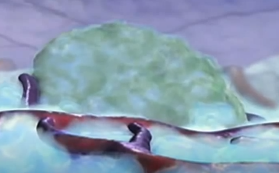
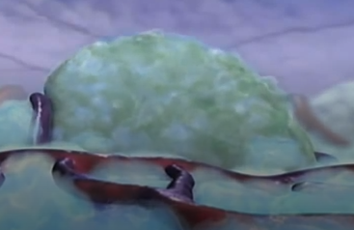
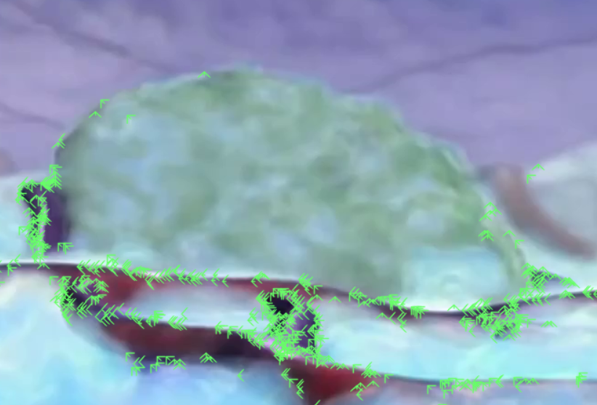
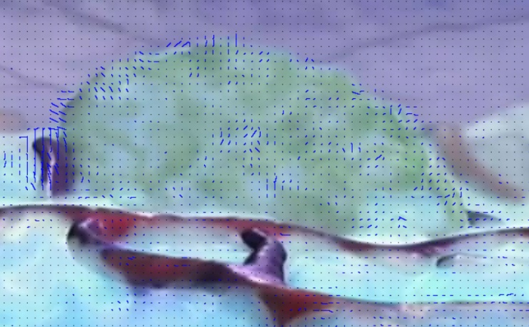
Estimations
Original Photos
1st Frame
2nd Frame
Simple Lucas-Kanade
Horn-Schunck

Slide 26
The main idea of combining
Combination of both local and global methods for the following requirements:
• Need dense flow estimate
• Robust to noise

Slide 27
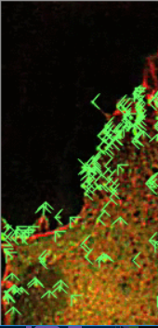
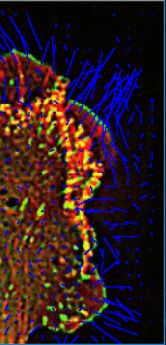
The result of combination
Calculations are much more reliable
Unlike horn-Schunck method, Lukas-Kanade algorithm is not detecting those edges, which are not growing

Slide 28
Thank you!

