Slide 1

Tbilisi State University Extremely Low Frequency Radiation Research Net (ELFTSU Net): The First Measurements at Station Locations
Department of Electrical and Electronics Engineering
The Faculty of Exact and Natural Sciences
Ivane Javakhishvili Tbilisi State University
Tbilisi, Georgia
Pavle Tsotskolauri
Supervisor: Assistant Professor Lev Gheonjian

Slide 2
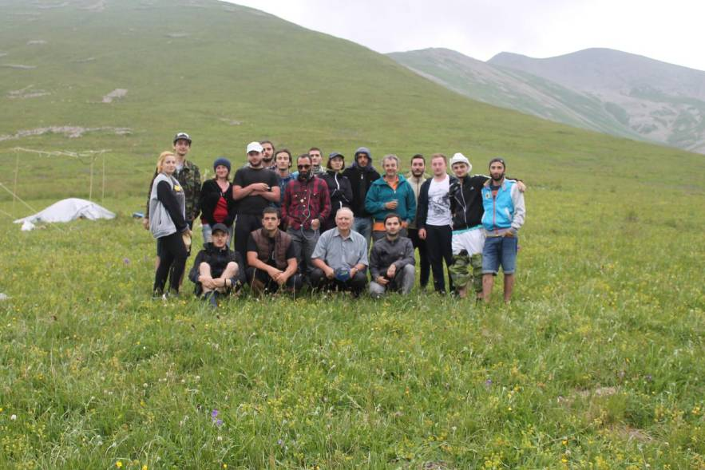
Our Team
L. Gheonjian, G. Kapanadze, L. Bebiava, R. Kereselidze, A. Rikadze, D. Samkharadze, P. Tsotskolauri, I. Buzaladze, T. Digmelishvili, G. Dolidze, S. Evajyan, S. Gachechiladze, L. Giorgobiani, I. Kuprashvili, G. Lomidze, M. Oragvelidze, S. Rakviashvili, A. Tkhinvaleli, I. Ubiria
with professor David Pomerenke, Didi Abuli hillside, July 2017

Slide 3
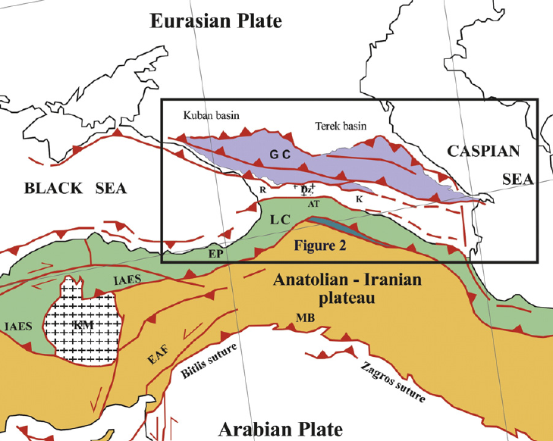
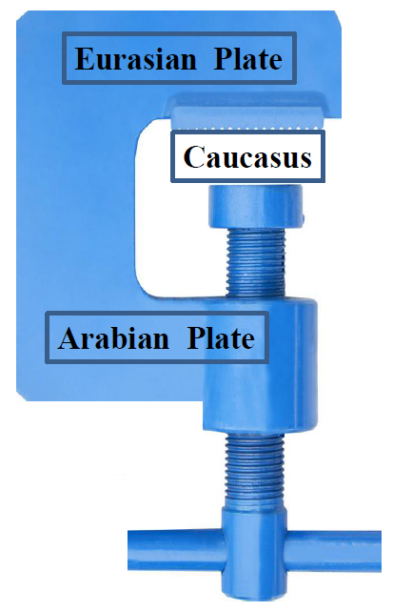
Our Concept: Monitoring of geotectonic compression process by ELF radiation

Slide 4

Our Concept: Regional seismic process – self-organizing criticality of regional tectonic elements
Tectonic Fault
Tectonic Element
Geotectonic Compression

Slide 5
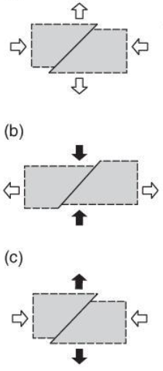
Our Concept: Each fault is an indicator of the state of junction of an element of self-organizing criticality
Tectonic Fault
Tectonic Element
- ELF Radiation
Notes:
Here we have several types of fault activations

Slide 6
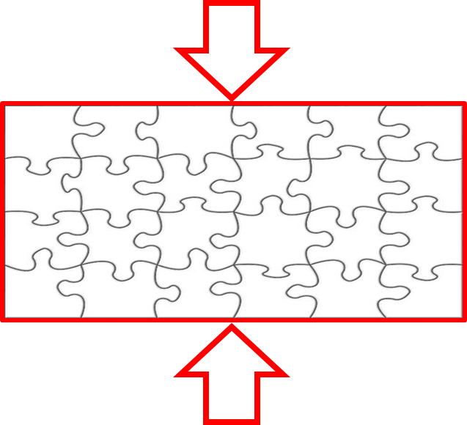

Our Concept: The process of strong earthquake preparing is the junction and growth process of tectonic elements and the increase of compression in remaining faults

Slide 7
Self-organized criticality and main fault formation process
System of faults
Main fault

Slide 8
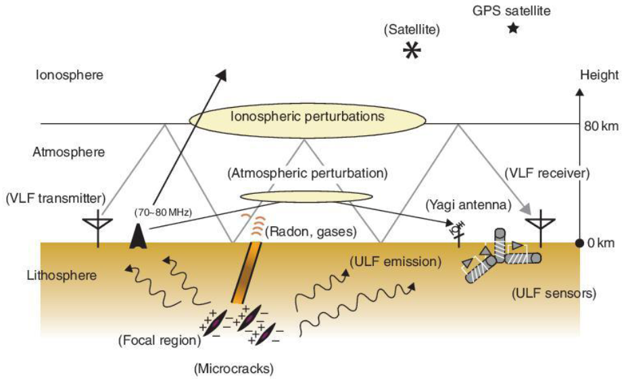
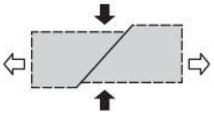
ELF Radiation
Concept of “Earthquake prediction with radio techniques”
M.Hayakawa, Wiley, 2015.
Notes:
This is a concept of Hayakawa of Earthquake prediction with radio techniques

Slide 9
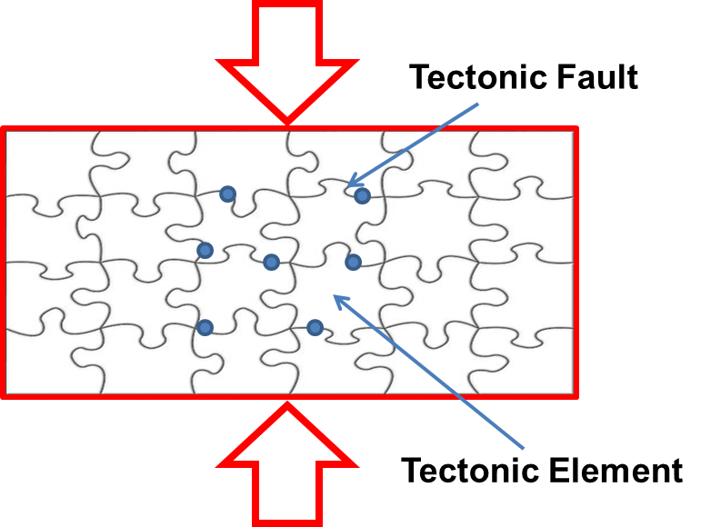
Our Concept: Monitoring of geotectonic compression and main fault formation process by ELF radiation stations
System of ELF Receivers
300-3000Hz

Slide 10
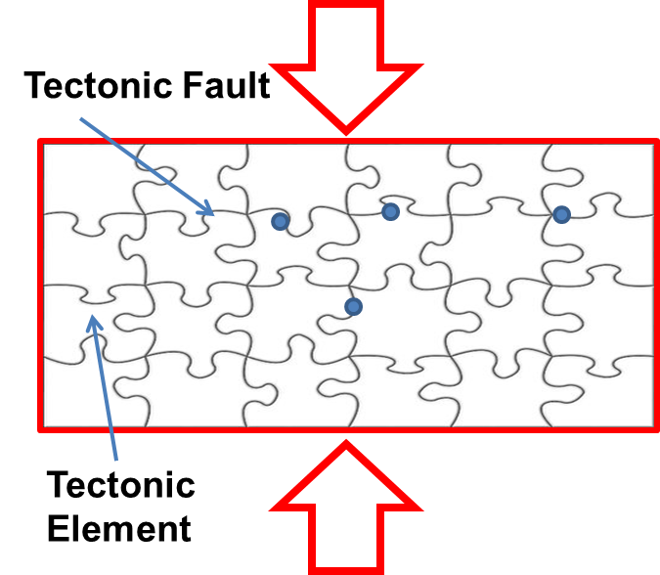
First Step:
System of 4 ELF 300-3000Hz Receivers
Abastumani
Tbilisi
Akhaldaba
60 km triangle
Akhalkalaki

Slide 11
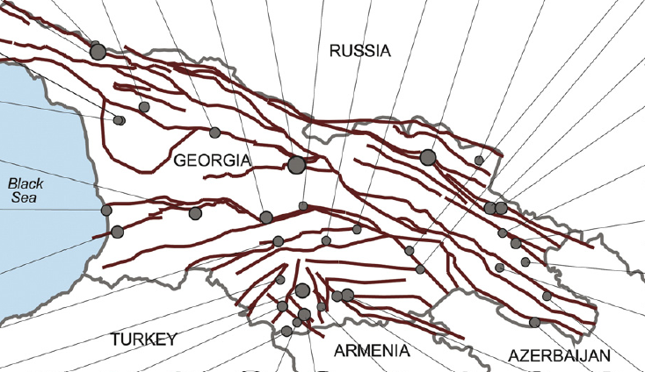
Fault System of Georgia
1963
2013
2005
2011
1982
1991
1968
1977
1968
1992
1973
2002
1968
1979
1985
1979
2013
2011
1968
1988
1981
1959
1982
1989
1969
2006
1986
1986
1969
1991
2007
1990
1982
2008
1978
1982

Slide 12
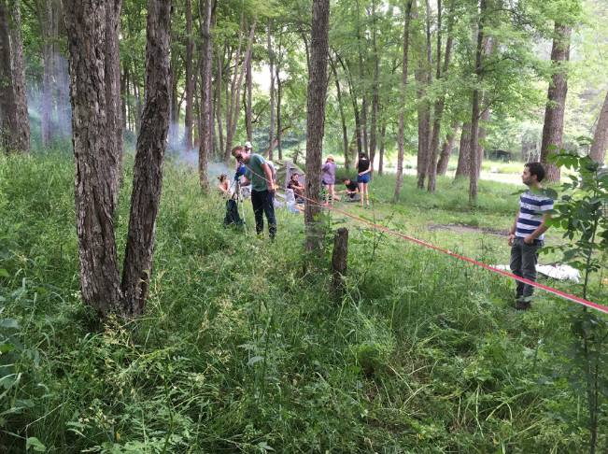
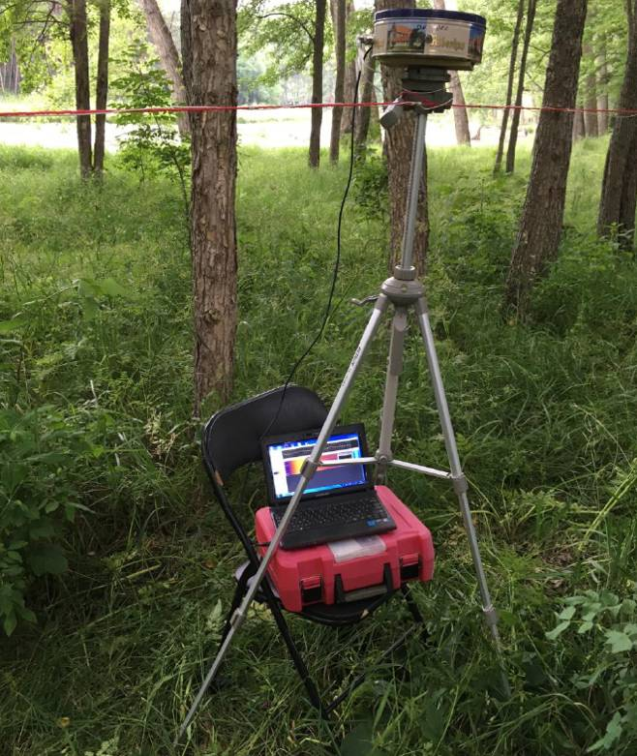
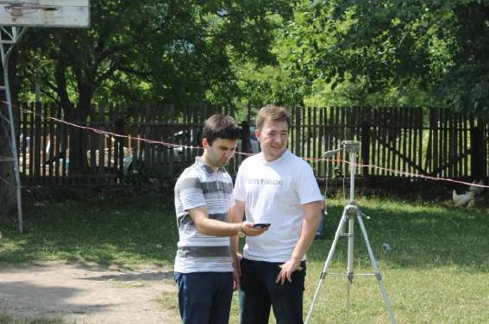
Our Instrument
Notes:
Elementary electric dipole, circuit, filter, receiver device.

Slide 13
Our Instrument:
Block Diagram
Dipole Antenna
Instrumentation amplifier
300-3000 Hz filter
FM transmitter
PC
FM receiver

Slide 14
Measurements
Akhaldaba
Notes:
Calm Situation, ideal for calibration.

Slide 15
Measurements Akhalkalaki
Notes:
This is The data of Preparation of thunderstorm, hail and then we have series of how it discharges and returning of normal state like Akhaldaba.

Slide 16
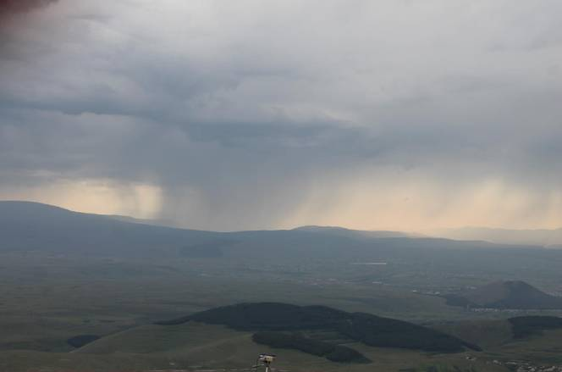
Measurements Akhalkalaki, Mt. Abuli
Notes:
Thunderstorm measurements

Slide 17
Measurements Abastumani, Mt. Kanobili
Notes:
Abastumani is calm like akhaldaba.

Slide 18
Conclusion: Comparison of measurements
Notes:
All this places are ideal for ELFTSU Net.

Slide 19
ELF excitation of Abastumani fault
Usual calm background level
Discharge
Unique ideal
calm
Electrical relaxator
charge
About 8h time interval

Slide 20

Acknowledgment
The authors would like to acknowledge financial and organizational support of The Ivane Javakhishvili Tbilisi State University and Department of Electrical and Electronics Engineering of University.
Many thanks to EMCoS for financial support.

Slide 21
Thank you for attention

