Slide 1
Optimization of Shape Parameters for Radial Basis Functions
Salome Kakhaia, Mariam Razmadze
Supervisors - Ramaz Botchorishvili
Tinatin Davitashvili
Department of Mathematics
Tbilisi State University
August 24, 2018

Slide 2
Aim:
Define method for shape parameter Identification
Improve accuracy of radial basis function Interpolation
Applications for SmartLab measurements

Slide 3
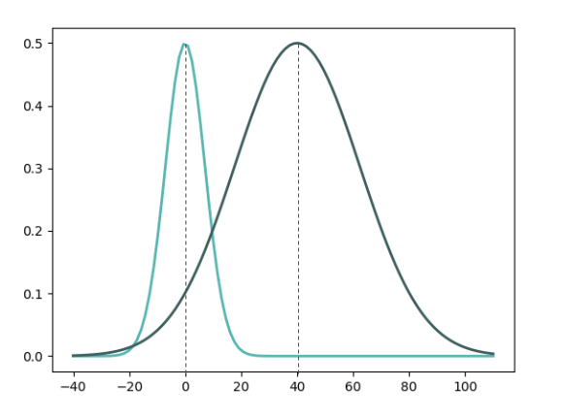
RBF - Radial Basis Function
$φ=φ(r)$
$r=\left\|x−x_{i}\right\|$ - Euclidian distance
$x_{i}$ - centers
Gaussian RBF - $φ=e^{−ε^{2}r^{2}}$
$ε_{i}$ - shape parameters
RBF Interpolant, given by a linear combination :
$$φ\left(x\right)=\sum_{i=1}^{N}{λ_{i}}φ\left(\left\|x−x_{i}\right\|,ε_{i} \right)$$
Figure 1.
$ε^{2}$=0.01
$ε^{2}$=0.001

Slide 4
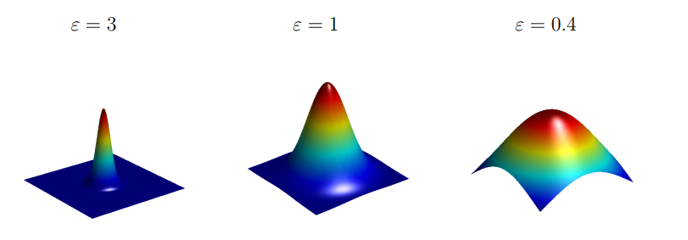
Importance of the Shape Parameter
Figure 1
Figure 1 :
Choosing Basis Functions and Shape Parameters for Radial Basis Function Methods
Michael Mongillo October 25, 2011

Slide 5
Optimization of Parameters 1D
Individual Shape parameter for each basis
Problem and Data orientated
Best approximation rate in mid points between nodes
More accurate Interpolation process

Slide 6
Optimization of Parameters 1D
$E\left(x\right)=f\left(x\right)−φ\left(x\right) :$Error function
$f\left(x\right)$- exact
$φ\left(x\right)$ - gaussian RBF
RBF Centers : $x_{0}$, $x_{1}$, $x_{2}$
Taylor series expansion around $x_{1/2}$ in terms of $∆x/2$:
$E\left(x_{1/2}\right)= −\frac{∆x^{2}}{8} \left(E^{′′}\left(x_{1/2}\right)\right)+O\left(∆x^{4}\right)$*
.
.
assumed : $ε_{i}^{2}−ε_{1}^{2}=O(∆x)$
.
$E\left(x_{1/2}\right)=−\frac{∆x^{2}}{8}(u"(x_{1/2})+2ε_{1}^{2}u+O(∆x))+ O(∆x^{4}) ∗∗{ ε}_{1}^{2}=−\frac{u"(x_{1/2})}{2u(x_{1/2})}$for$O(∆x^{3})$
$$x_{0}$$
$$x_{1}$$
$$x_{2}$$
$$x_{1/2}$$
$$x_{3/2}$$
$$∆x$$
$$∆x$$

Slide 7
Optimized Shape Parameters 1D
$ε_{1}^{2}=−\frac{u"(x_{1/2})}{2u(x_{1/2})}$
$${ ε}_{3}^{2}−ε_{i}^{2}=O(∆x)$$
${ ε}_{2}^{2}=−\frac{u"(x_{3/2})}{2u(x_{3/2})}$
$$E\left(x_{1/2}\right) \sim E\left(x_{3/2}\right)\sim O(∆x^{3})$$
${ ε}_{3}^{2}= \frac{\left(ε_{1}^{2}\text{+} ε_{2}^{2}\right)}{2}$

Slide 8
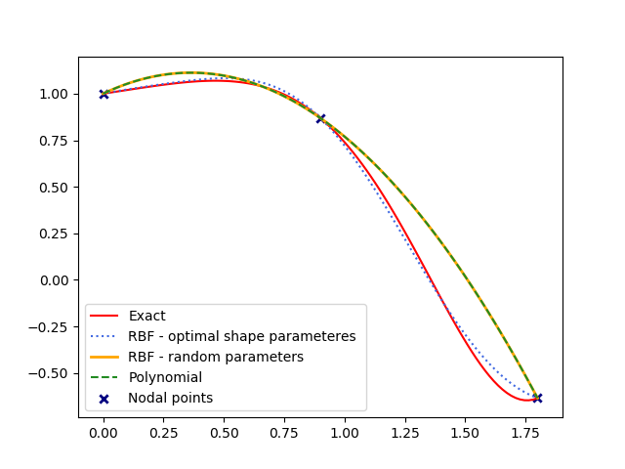
Function Approximation 1D
$$f\left(x\right)=\cos\left(x^{2}\right)+\frac{x}{5}$$
Mean Squared Error :
RBF (optimized parameters) - 0.0004
Polynomial - 0.0128
RBF (random parameters) - 0.0128

Slide 9
SmartLab Measurements

Slide 10
SmartLab Measurements
No2
April 13, 2018
$$3$$
$$6$$
$$7$$
$$8$$
Real measured value in node (7) - 57.92
Predicted by RBF Interpolation - 57.23
Predicted by Polynomial - 61.22

Slide 11
SmartLab Measurements
CO
April 13, 2018
$$3$$
$$6$$
$$7$$
$$8$$
Real measured value in node (7) - 0.78
Predicted by RBF Interpolation - 0.89
Predicted by Polynomial - 0.91

Slide 12
SmartLab Measurements
Elements Mean squared Error | CO | NO2 | CH4
Real value | 0.78 | 57.92 | 2.43
RBF (optimized parameters) | 0.89 | 57.23 | 2.19
Polynomial | 0.91 | 61.22 | 2.17
RBF (random parameter $ε^{2}=$0.0001) | 0.91 | 61.25 | 2.17

Slide 13
Optimization of Parameter 2D
$${(x}_{3},y_{3})$$
$E\left(x,y\right)=f\left(x,y\right)−φ\left(x,y\right)$
Taylor series expansion around $\left(x_{0},y_{0}\right)$
$E \left(x_{0},y_{0}\right)=−({E\left(x_{0},y_{0}\right)}_{xx}∙{\frac{∆x}{4}}^{2}$+${E\left(x_{0},y_{0}\right)}_{yy}∙{\frac{∆y}{4}}^{2})+O({∆x}^{4})+O({∆y}^{4})$
$E =−\frac{1}{4}(f_{xx}∙{∆x}^{2}$+$f_{yy}∙{∆y}^{2}+2ε^{2}f∙( {∆x}^{2}+ {∆y}^{2}))+O({∆x}^{4})+O({∆y}^{4})$+
$$O\left({∆x}^{2}∙{∆y}^{2}\right)$$
Optimization condition :
$(f_{xx}∙{∆x}^{2}$+$f_{yy}∙{∆y}^{2}+2ε^{2}f∙( {∆x}^{2}+ {∆y}^{2}))=0$
$$∆y/2$$
$${(x}_{2},y_{2})$$
$${(x}_{1},y_{1})$$
$$∆x/2$$
$${(x}_{0},y_{0})$$
$${(x}_{4},y_{4})$$

Slide 14
Optimization of Parameter 2D
$${(x}_{3},y_{3})$$
${ ε}^{2}= −\frac{f_{xx}∙{∆x}^{2}\text{+}f_{yy}∙{∆y}^{2}}{2f∙( {∆x}^{2}+ {∆y}^{2})}$
For higher accuracy: add a new data location
Add a zero degree polynomial term to RBF interpolant
$$φ\left(x\right)=\sum_{i=1}^{4}{λ_{i}}φ\left(\left\|x−x_{i}\right\|,ε_{i}\right)+λ_{5 }$$
$${(x}_{0},y_{0})$$
$${(x}_{0},y_{0})$$
$$∆y/2$$
$${(x}_{2},y_{2})$$
$${(x}_{1},y_{1})$$
$$∆x/2$$
$${(x}_{0},y_{0})$$
$${(x}_{4},y_{4})$$

Slide 15
Optimised Shape Parameter 2D
Obtained :
$E\left(x_{0},y_{0}\right)$= $O({∆x}^{4})+O({∆y}^{4})$ - error in $\left(x_{0},y_{0}\right) given by RBF with optimised shape parameters$
While:
$E\left(x_{0},y_{0}\right)$= $O({∆x}^{2})+O({∆y}^{2})$ - error in $\left(x_{0},y_{0}\right)$given by Polynomial Interpolation.
Achieved high order of convergence around the location $\left(x_{0},y_{0}\right)$
$$− \frac{{ 2( f(x}_{1},y_{1})+{{f(x}_{3},y_{3})+{f(x}_{2},y_{2})+f(x}_{4},y_{4})−4{f(x}_{0},y_{0})\text{) } }{{(∆x}^{2}+{∆y}^{2})∙{f(x}_{0},y_{0})}$$
$$ε^{2}$$

Slide 16
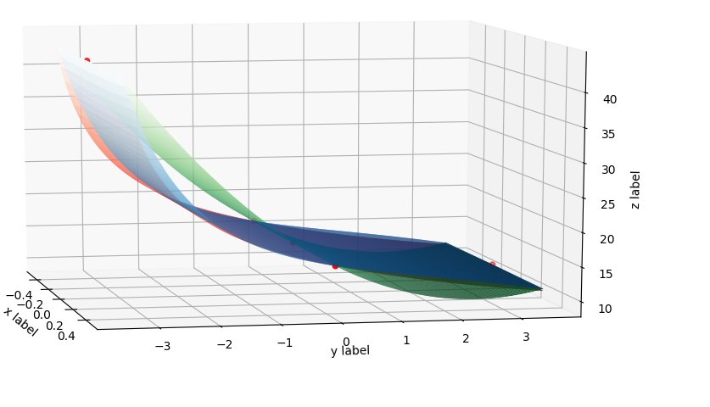
$$f\left(x,y\right)=\frac{1}{(2+{(xy)}^{2})}+\frac{30}{\sqrt{y+4}}$$
Function Approximation 2D
Optimized Shape Parameter = -0.06
Mean Squared error over the area :
RBF - 0.286
Polynomial - 7.697
Exact
RBF
Polynomial

Slide 17
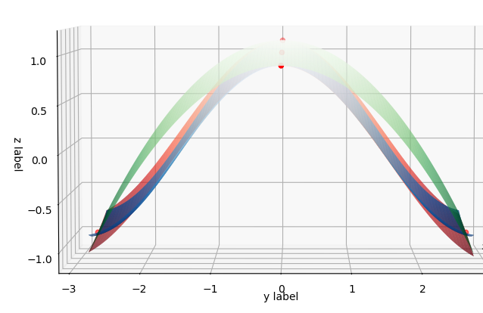
$$f\left(x,y\right)= \frac{x}{\sin\left(xy\right)−5}+cos(y)$$
Function Approximation 2D
Optimized Shape Parameter = 0.246
Mean Squared Error over the area :
RBF - 0.002
Polynomial - 0.033
Exact
RBF
Polynomial

Slide 18
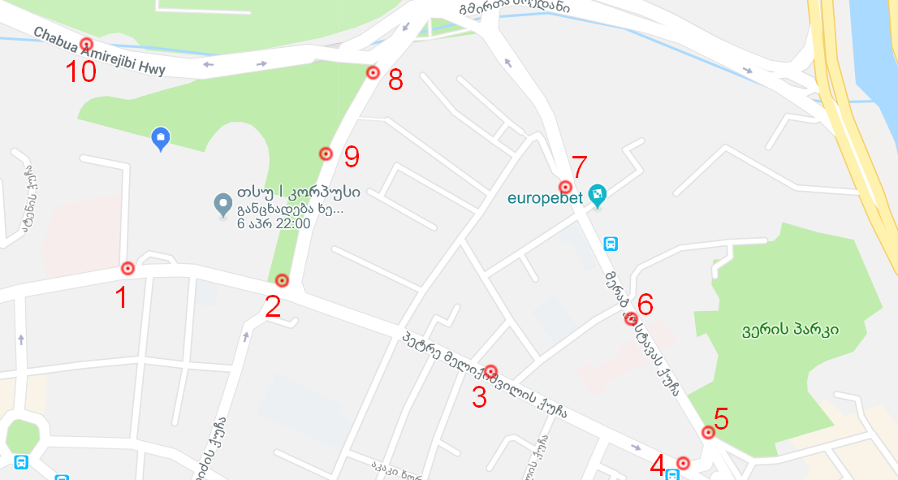
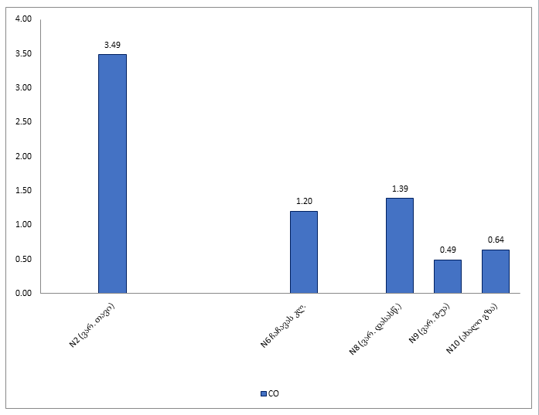
SmartLab Measurements 2D
CO
April 4, 2018

Slide 19
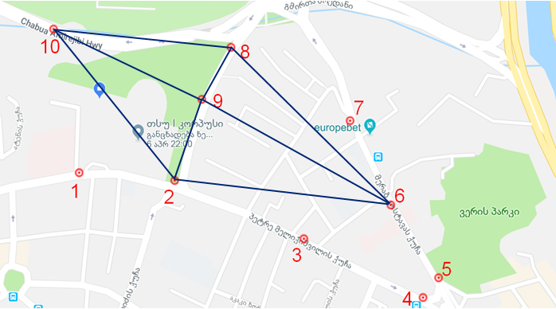
SmartLab Measurements 2D
$$10$$
$$2$$
$$9$$
$$8$$
$$6$$
Assumption :
surface is flat and extra factors do not influence the results

Slide 20
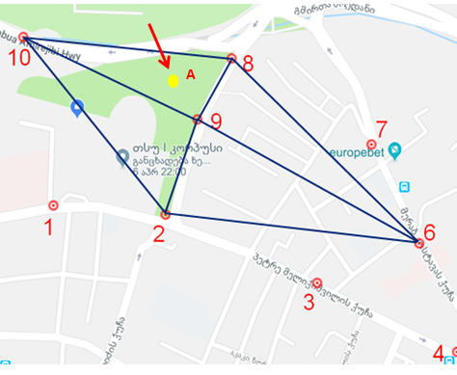
Results in unmeasured locations
CO - April 4th, 19:20
Prediction of CO value in A location:
RBF Interpolation – 0.472
Polynomial Interpolation – 2.222
Polynomial
Rbf
A

Slide 21
Multiple Variable Shape Parameters
What if we add more parameters?
While, Gaussian RBF has 1 shape parameter
Multiple variable shape parameters provide adaptive basis
Adaptive basis can achieve higher order of accuracy based on optimizing parameters.

Slide 22
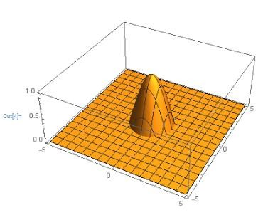
RBF transformation Multiple variable shape parameters
Transformation :
Circle $: f\left(φ\right)=R$ new shape : $r=f\left(φ\right)∙g\left(φ\right)$
$g\left(φ\right)$ has multiple shape parameters

Slide 23
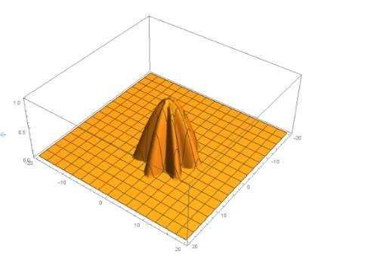
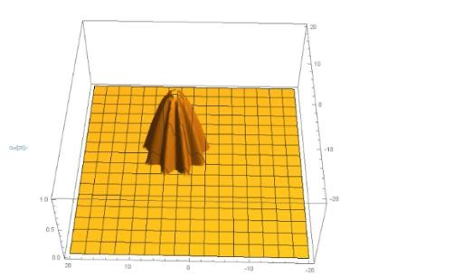
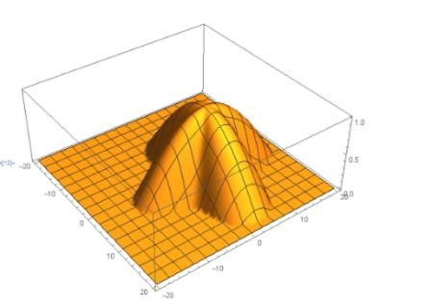
RBF transformation Multiple variable shape parameters results:

Slide 24
References
A RBF-WENO finite volume method for hyperbolic conservation laws with the monotone polynomial interpolation method
Jingyang Guo, Jae-Hun Jung
Radial basis function ENO and WENO finite difference methods based on the optimization of shape parameters
Jingyang Guo, Jae-Hun Jung
Inventing the Circle
Johan Gielis
Geniaal bvba , 2003.

Slide 25
Thank you !

