Slide 1
Possibilities to use Sustainable suspension of silver nanoparticles in medicine
Davit katsadze University of GeoMedi Faculty of Medicine IV course Head of the topic nino chichiveishvili

Slide 2
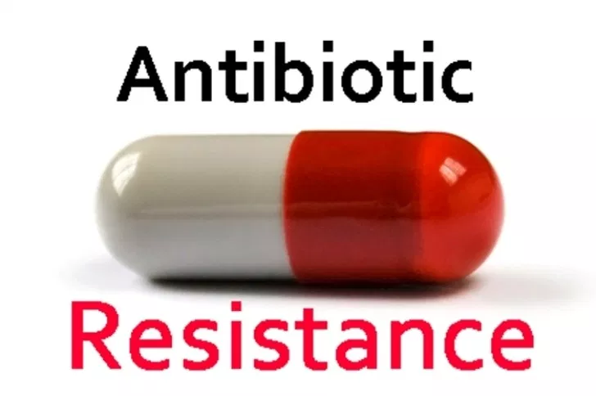
Resistance One of the main problems of medicine

Slide 3
In South Asia, about 300,000 newborns die each year from staphylococcus aureus, bacteria Escherichia coli, Enterobacter , Acinetobacter and Pseudomonas caused by neonatal sepsis, which are not susceptible to antibiotic therapy, due to increased resistance to microbial drugs, because of this 58,000 children die only in the Republic of India

Slide 4
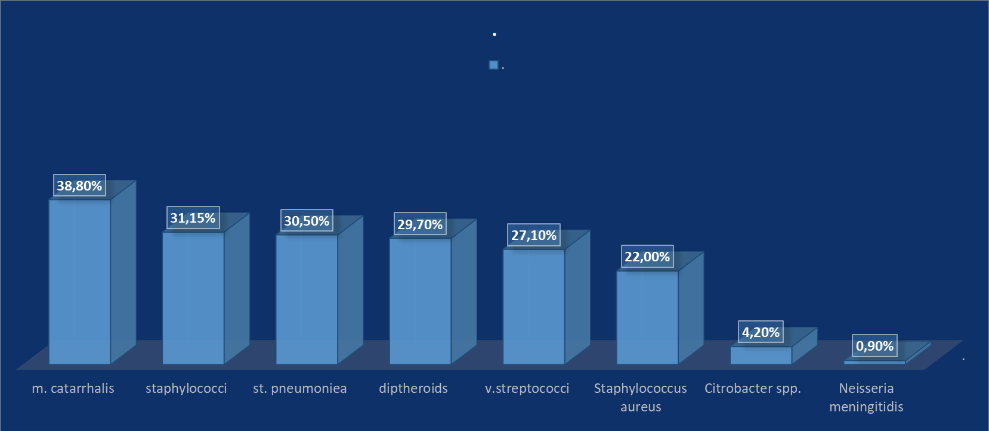
Antibiotic therapy of infections, Which are Attached with Various Infected Viruses, remains a problem. The results of studies conducted among children infected with HIV in the southern part of the Sahara

Slide 5
show antibioticogramma after bacterial colonization

Slide 6
Studies in Uganda show that 4231 women in the period of residence (50% cesarean section), their average age is 25 years, 5% is fever or hypothermia 48% identified at least one laboratory diagnostic infection.
A study in the South Ethiopian hospital conducted on resistance to antibiotics showed that resistance to bacteria, such as for example:staphylococci , Staphylococcus aureus, Enterococci species, Enterococcus faecalis, Enterococcus faecium , Acinetobacter species , Escherichia coli, Pseudomonas aeruginosa From 7.5 to 87.5%, all varied in isolation.

Slide 7
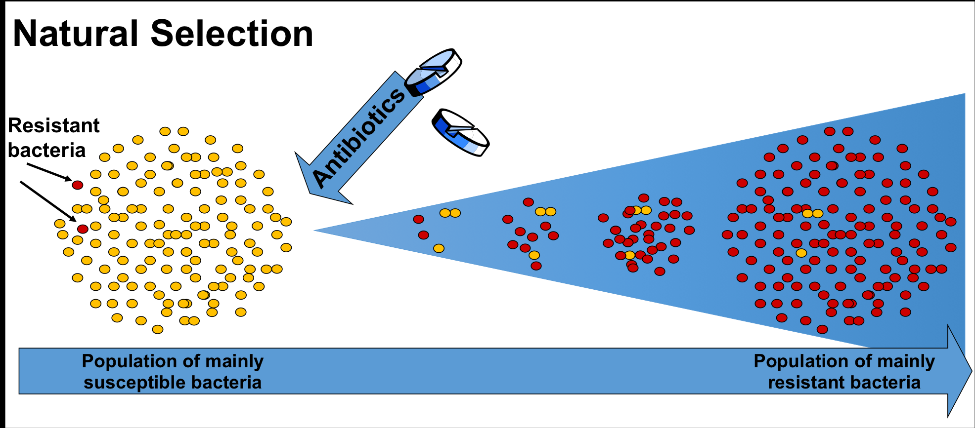
Resistance causes
Self-treatment of patients
Invalid choice of antibiotics
Invalid combination therapy of antibiotics
bacteriaL Mutational skills

Slide 8
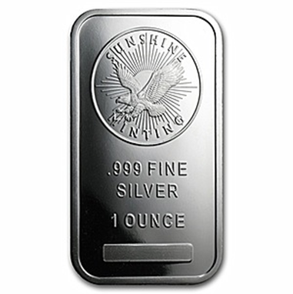
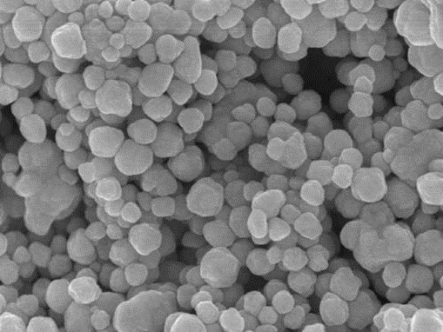
solution
Silver antibacterial properties have been known since time immemorial, but it also differs in toxicity. The development of modern science and medicine has gave us opportunity to obtain silver nanoparticles

Slide 9
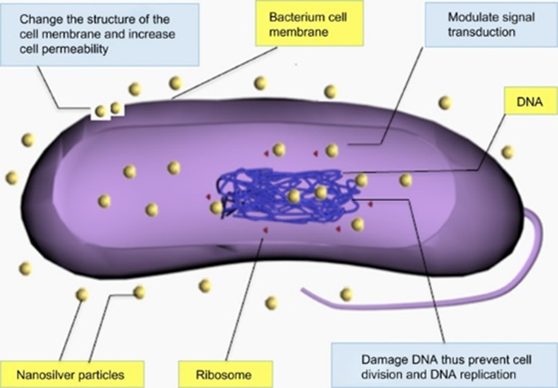
Mechanism of action
In particular, what causes silver nanoparticles Bactericidal effect is unknown Some researchers believe that the antibacterial properties of silver nanoparticles depend on their nanometer size

Slide 10
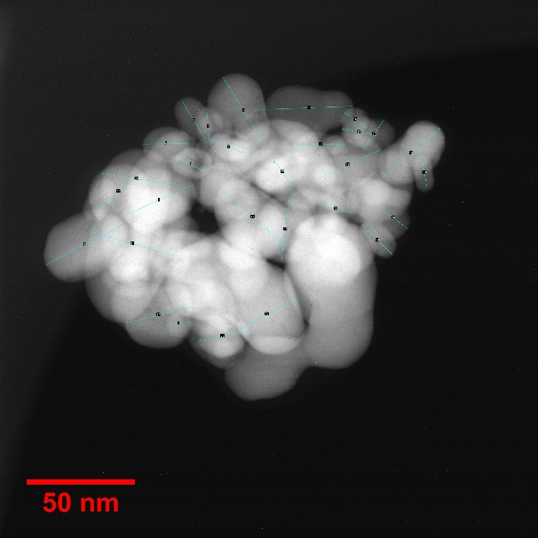
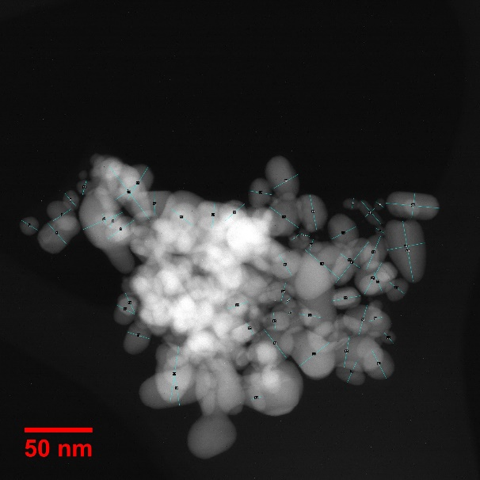
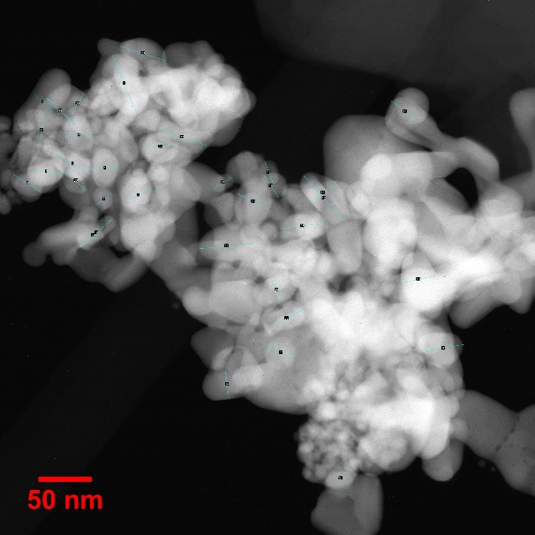
Because silver is highly toxic. Therefore, the purpose of our studies was to find out how much it can be used in medicine As a substitute for antibiotics, therefore, the first task of the study is detecting its toxicity, in particular LD50 And the action in the living body. For this, we prepared a stable suspension of silver nanoparticles measuring 50 nm and investigated its LD50,By entering Both oral and intraperitoneal on laboratory animals, in particular rats.

Slide 11
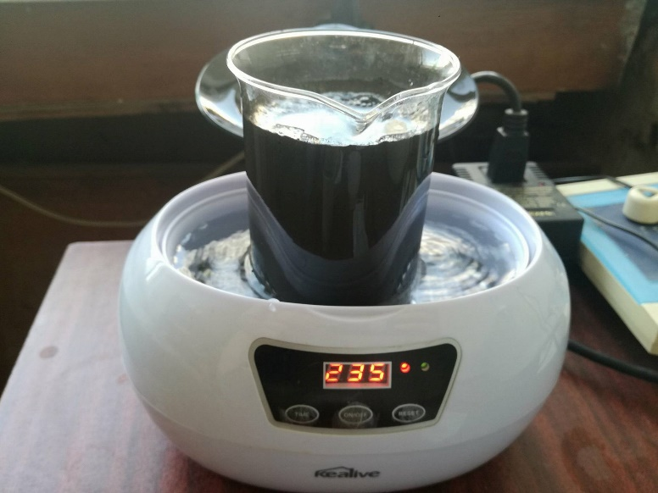
Methods of dissolution of silver nanoparticles
For the inspection, silver powder with a silver content of 99.9% was prepared. 1 gr was dissolved in 100 ml. In a solution for injection, 5 minutes was centrifuged and we obtained a suspension, Which was placed on a low-frequency ultrasonic (35 W) bathroom for 3 minutes. Then we switched to a more powerful ultrasonic 200 W (8 min). After that, we brought Nano silver in the suspension and silver didn't precipitated

Slide 12
For the experiment, the rats were divided in two groups (5 rats 200-300 g in each group) And for different doses, We injected the drug i.p and p.o (0.5 ml/100 g, up to 5 ml/100 g)
Number of rats | THE DOSE PER 100 GRAMS | Mortality within 24 hours | Mortality within 168 hours | General condition | Nutrition and water | Diuresis and defecation
5 | 0,5 ml. | --- | --- | good | norm | norm
5 | 2 ml. | --- | --- | good | norm | norm
5 | 5 ml. | --- | --- | good | norm | norm

Slide 13
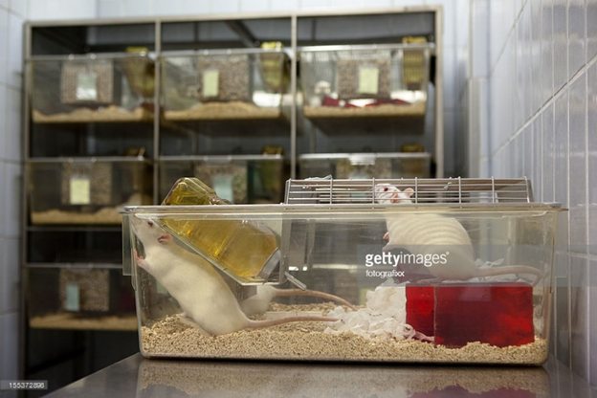
Results and goals
The general condition of the animal (movement, nutrition, fluid intake,defecation) after the experiment did not change and within 24 hours and a week. Accordingly, some of our experiments showed that 50 nm do not have a lethal dose (LD50) with a stable suspension of silver nanoparticles.
We continue to investigate and evaluate the effect of silver nanoparticles on tissues and it's antibacterial effect on living organism.

Slide 14
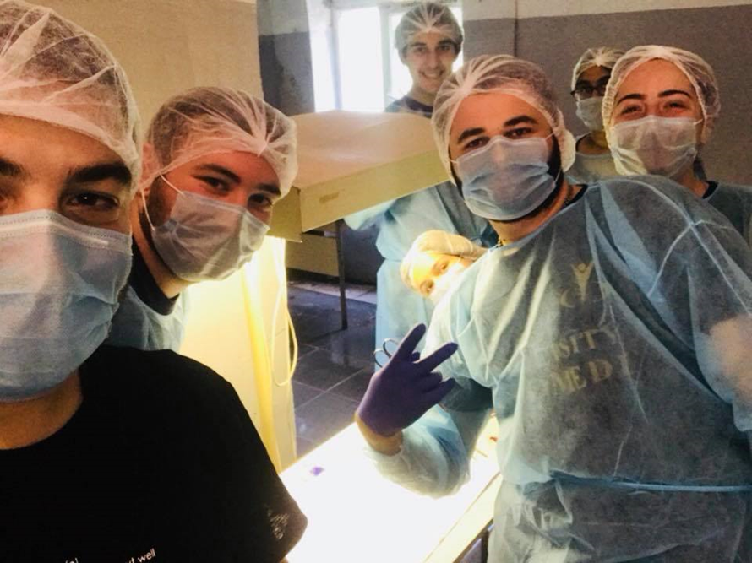
Thanks for your attention

