Slide 1
Quality Control and Quality Assurance in Radiotherapy
Maia Topeshashvili
Medical Physicist
Radiotherapy Department
Academician F. Todua Medical Center-
Research Institute of Clinical Medicine

Slide 2
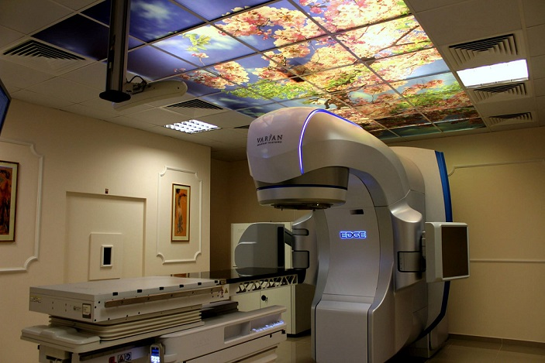
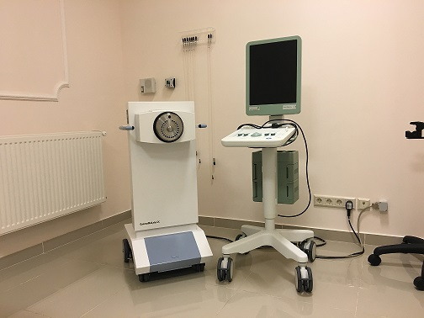
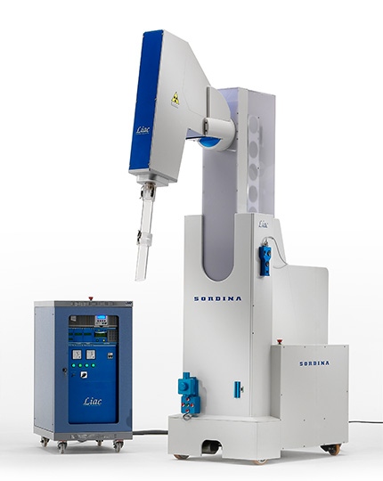
Uses of Radiotherapy
External Beam Radiotherapy
Brachytherapy
Intra-operative Radiotherapy

Slide 3
Radiation Therapy Process
The concept of a Quality System in Radiotherapy is broader than a restricted definition of technical maintenance and quality control of equipment and treatment delivery.
It encompasses a comprehensive approach to all activities in the radiotherapy department:
Starting from the moment a patient enters the department until the moment he leaves it.
And it should also continue into the follow-up period.

Slide 4
Sources of Errors in Radiotherapy
The uncertainty in the dose delivered is due to errors that may occur at different steps in the radiotherapy process, are as follows:
Determination of patient anatomy (errors in obtaining outline, patient positioning, defining organs at risk, estimating tissue inhomogeneities, etc.);
Definition of target volume(s) (shapes and location, failure to take into account movements of organs or tissues due to circulation and respiration and/or of the whole patient, etc.);
Treatment planning (errors in beam data, beam models, computer software and hardware, etc.);
Treatment delivery (errors in machine calibration, patient set-up, improper machine settings, etc.);
Patient data (identification, diagnosis, treatment prescription, records of previous treatment given, portals of entry, etc.).

Slide 5
Need for Quality Assurance in Radiotherapy
For reduction of uncertainties and errors (in dosimetry, treatment planning, equipment performance, treatment delivery, etc.).
For inter-comparison of results both among radiotherapy centres within a country and internationally by ensuring More uniform and accurate dosimetry and treatment delivery
For reduction of the likelihood of accidents and errors occurring as well as increase of the probability that they will be recognized and rectified sooner
For full and safe exploitation of improved technology and more complex treatments in modern radiotherapy.

Slide 6
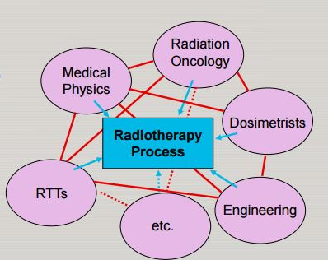
Multidisciplinarity in Radiotherapy Team
Responsibilities are shared between the different disciplines and must be clearly defined.
Each group has an important part in the output of the entire process of quality assuarance, and their overall roles, as well as their specific quality assurance roles, are interdependent, requiring close cooperation.

Slide 7
GENERAL STRUCTURE OF A QUALITY ASSURANCE
Commitment to Quality Assurance (QA) needs a sound familiarity with some main relevant terms such as:
QUALITY ASSURANCE
QUALITY SYSTEM
QA IN RADIOTHERAPY
QUALITY STANDARDS
QUALITY CONTROL

Slide 8
QUALITY ASSURANCE
Quality Assurance is all those planned and systematic actions necessary to provide adequate confidence that a product or service will satisfy the given requirements for quality.
QA aims to prevent defects with a focus on the process used to make the product. It is a proactive quality process.
As such QA is wide ranging, covering
Procedures;
Activities;
Actions;
Groups of staff.
Management of a QA program is also called QUALITY SYSTEM MANAGEMENT.

Slide 9
QUALITY CONTROL
Quality Control is the regulatory process through which the actual quality performance is measured, compared with existing standards, and the actions necessary to keep or regain conformance with the standards.
QC aims to identify (and correct) defects in the finished product. Quality control, therefore, is a reactive process.
Quality control is a part of quality system management.
It is concerned with operational techniques and activities used:
To check that quality requirements are met.

Slide 10
QUALITY STANDARDS
Quality standards is the set of accepted criteria against which the quality of the activity in question can be assessed.
In other words:
WITHOUT QUALITY STANDARDS, QUALITY CANNOT BE ASSESSED.

Slide 11
QUALITY SYSTEM
Quality System is a system consisting of:
Organizational structure.
Responsibilities.
Procedures.
Processes.
Resources.
QUALITY MANAGEMENT SYTEM
Required to implement a quality assurance program.
QUALITY ASSURANCE
QUALITY CONTROL

Slide 12
QUALITY ASSURANCE IN RT
Quality Assurance in Radiotherapy is all procedures that ensure consistency of the medical prescription, and safe fulfillment of that radiotherapy related prescription.
Examples of prescriptions:
Dose to the tumor (to the target volume).
Minimal dose to normal tissue.
Adequate patient monitoring aimed at determining the optimum end result of the treatment.
Minimal exposure of personnel.

Slide 13
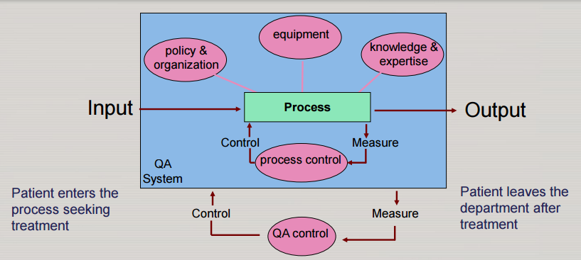
COMPREHENSIVE QA PROGRAMME
Outcome can be considered to be of good quality when the handling of the quality system well organizes the five aspects shown in the illustration above.

Slide 14
COMPREHENSIVE QA PROGRAM
Comprehensive quality system in radiotherapy is a management system that:
POLICY AND ORGANIZATION
Should be supported by the department management in order to work effectively.
Must have a clear definition of its scope and of all the quality standards to be met.
Must be regularly reviewed as to operation and improvement. To this end a quality assurance committee is required, which should represent all the different disciplines within radiation oncology.
Must be consistent in standards for different areas of the program.

Slide 15
COMPREHENSIVE QA PROGRAM
Comprehensive quality system in radiotherapy is a management system that:
EQUIPMENT
Requires availability of adequate test equipment.

Slide 16
COMPREHENSIVE QA PROGRAM
Comprehensive quality system in radiotherapy is a management system that:
KNOWLEDGE AND EXPERTISE
Requires that each staff member must have qualifications (education, training and experience) appropriate to his or her role and responsibility.
Requires that each staff member must have access to appropriate opportunities for continuing education and development.

Slide 17
COMPREHENSIVE QA PROGRAM
Comprehensive quality system in radiotherapy is a management system that:
PROCESS CONTROL
Requires the development of a formal written quality assurance program that details the quality assurance policies and procedures, quality control tests, frequencies, tolerances, action criteria, required records and personnel.
Must be consistent in standards for different areas of the program
Must incorporate compliance with all the requirements of national legislation, accreditation, etc

Slide 18
COMPREHENSIVE QA PROGRAM
Comprehensive quality system in radiotherapy is a management system that:
QA CONTROL
Requires control of the system itself, including:
Responsibility for quality assurance and the quality system: quality management representatives.
Document control.
Procedures to ensure that the quality system is followed.
Reporting all non-conforming parts and taking corrective action.
Recording all quality activities.
Establishing regular review and audits of both the implementation of the quality system (quality system audit) and its effectiveness (quality audit).

Slide 19
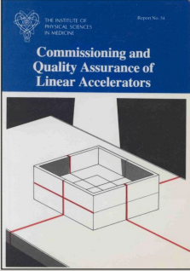
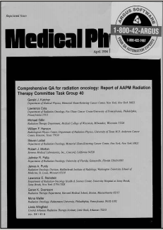
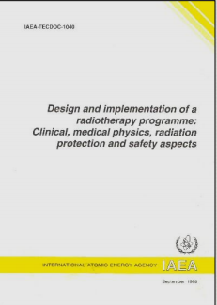
QA PROGRAMME FOR EQUIPMENT
Appropriate material: Many documents are available from international organizations:

Slide 20
QA PROGRAMME FOR EQUIPMENT
General structure of a quality assurance program for equipment
1) Initial specification, accep-tance testing and commissioning
For Clinical use, including calibration, where applicable
2) Quality control tests
Before the equipment is put into clinical use, quality control tests should be established and a formal QC program initiated
3) Additional Quality Control tests
After any significant repair, intervention or adjustment or when there is any indication of a change in performance
4) Planned preventive maintenan-ce program
In accordance with the manufacturer’s recommendations

Slide 21
COMPREHENSIVE QA PROGRAM
Equipment quality control program should specify the following:
Parameters to be tested and the tests to be performed
Specific equipment to be used for that.
Geometry of the tests.
Frequency of the tests (daily/weekly, monthly annual)
Staff group or individual performing the tests, as well as the individual supervising and responsible for the standards of the tests and for actions that may be necessary if problems are identified.

Slide 22
COMPREHENSIVE QA PROGRAM
Factors , affecting frequency and scope of the tests:
Type of treatment delivered on the machine
3DCRT/ IMRT/VMAT/SRS/SBRT/TBI/TSI
Manufacturer of the machine
Scope of tests:
General QA tests for Radiotherapy Machine performance verification
Tests for CT Scanners/CT Simulators
Tests for TPS calculation precision verification
Tests for imaging devices (kV, MV, CBCT) when the treatment is performed with image guidance
Patient specific QA tests investigating individual plan performance on the machine

Slide 23
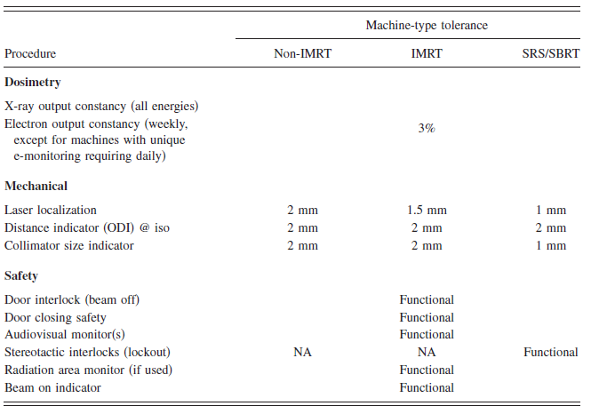
COMPREHENSIVE QA PROGRAM
List of test procedures, performed on daily/weekly basis:

Slide 24
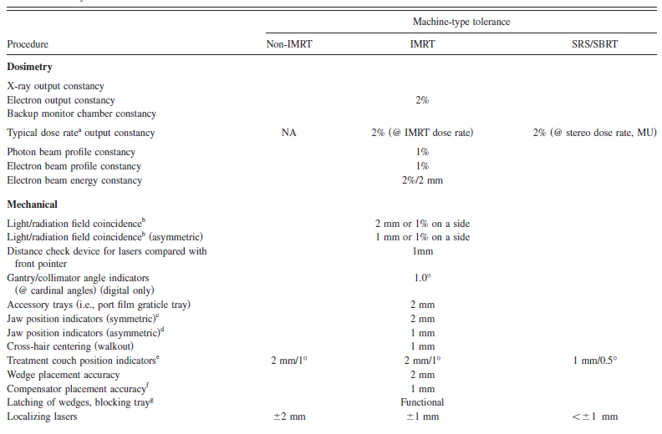
COMPREHENSIVE QA PROGRAM
List of test procedures, performed on monthly basis:

Slide 25
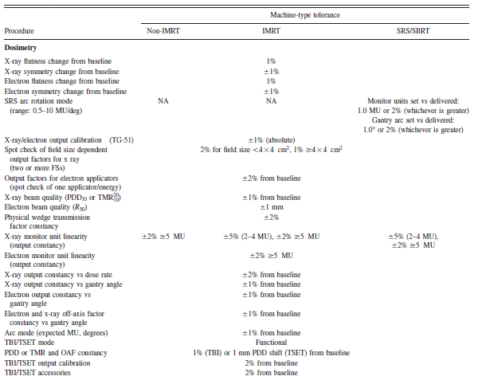
COMPREHENSIVE QA PROGRAM
List of test procedures, performed on annual basis:

Slide 26
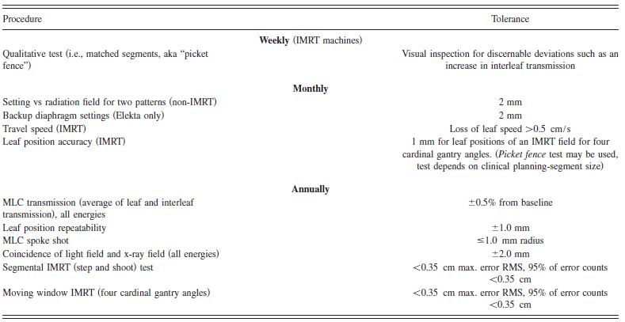
COMPREHENSIVE QA PROGRAM
List of test procedures for Multileaf collimation with differentiation of IMRT vs non-IMRT machines.

Slide 27
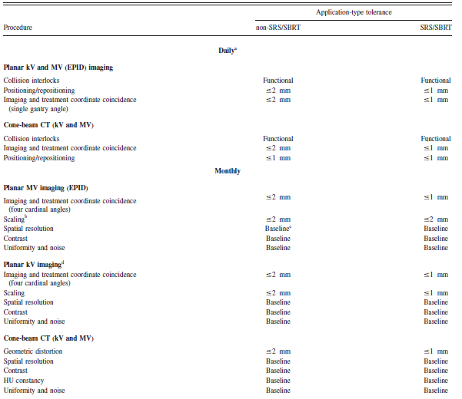
COMPREHENSIVE QA PROGRAMc
List of test procedures for Imaging Devices used for Image guidance on treatment delivery process

Slide 28
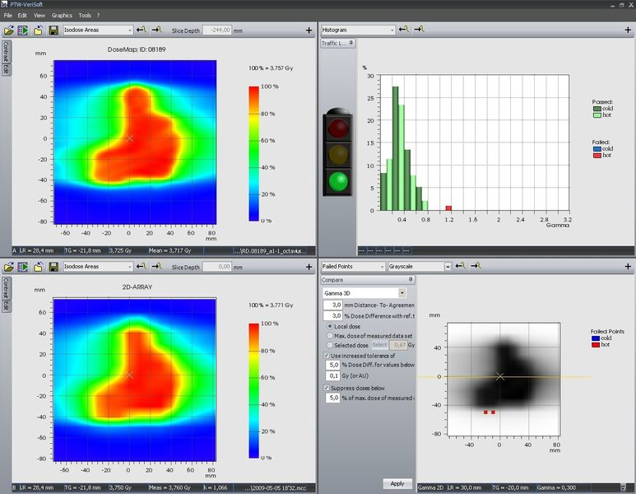
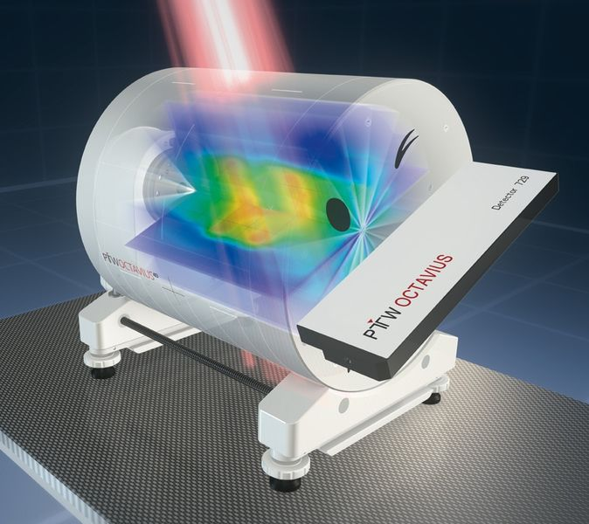
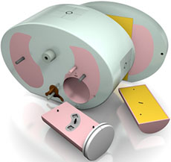
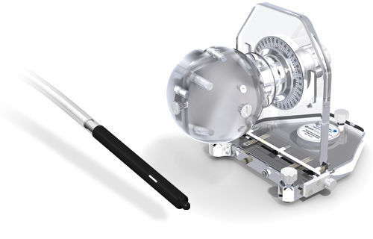
PATIENT SPECIFIC QA
IMRT, VMAT, SRS/SBRT techniques are more risky than 3DCRT
Measurement Based QA refers to the machine QA specific to each patient treatment plan (generaly phantom based)
Independent MU/dose verification to include beam-patient geometry

Slide 29
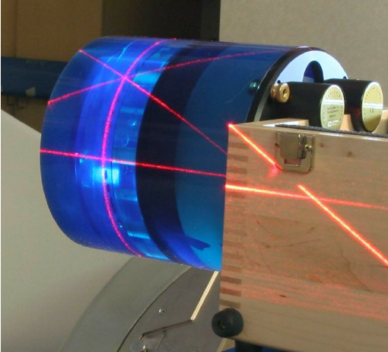
CT SCANNERS AND CT SIMULATORS
CT data is used for:
Indication and/or data acquisition of the patient’s anatomy
To provide tissue density information which is essential for accurate dose prediction.
Therefore, it is essential that the geometry and the CT densities are accurate. CT test tools are available for this purpose.

Slide 30
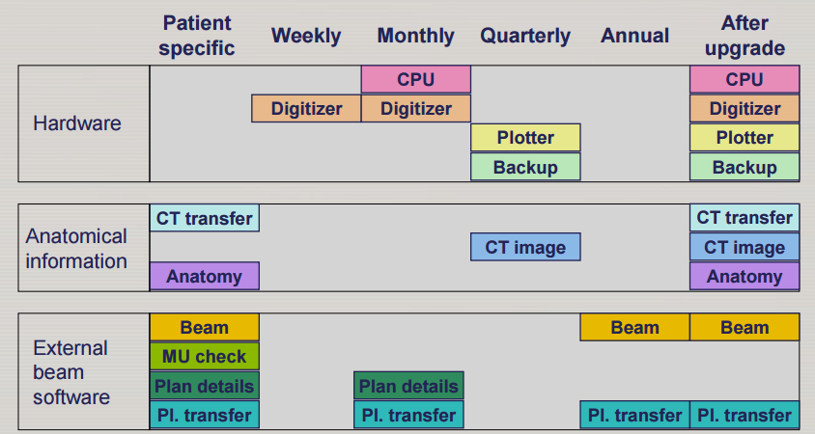
TREATMENT PLANNING SYSTEMS
Example of a periodic quality assurance program (TRS 430)

Slide 31
TEST EQUIPMENT
Test equipment in radiotherapy concerns all the required additional equipment such as:
Measurement of radiation doses.
Measurement of electrical machine signals.
Mechanical measurement of machine devices.
Test and measuring equipment which should be considered for a quality control program
Local standard and field ionization chambers and electrometer.
Thermometer.
Barometer.
Phantoms.
Automated beam scanning systems.
Other dosimetry systems: e.g., systems for relative dosimetry, in-vivo dosimetry and for radiation protection measurements.

Slide 32
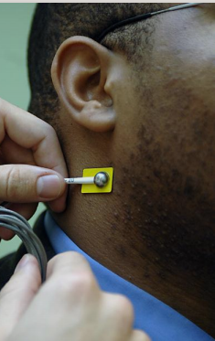
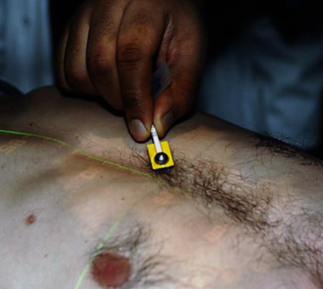
IN-VIVO DOSE MEASUREMENTS
In-vivo dose measurements can be divided into:
Intracavitary dose measurements (frequently used).
Entrance dose measurements (less frequently used).
Exit dose measurements (still under investigation).

Slide 33
IN-VIVO DOSE MEASUREMENTS
Examples and aims of typical application of in-vivo dosimetry:
To check the MU calculation independently from the program used for routine dose calculations.
To trace any error related to the set-up of the patient, human errors in the data transfer during the consecutive steps of the treatment preparation, unstable accelerator performance and inaccuracies in dose calculation, e.g., of the treatment planning system.
To determine the intracavitary dose in readily accessible body cavities, such as the oral cavity, oesophagus, vagina, bladder, and rectum.
To assess the dose to organs at risk (e.g., eye lens, gonads and lungs during TBI) or situations where the dose is difficult to predict (e.g., nonstandard SSD or using bolus).

Slide 34
TESTS ON REMOTE AFTERLOADING DEVICES
Source positioning in the applicator
The accuracy and the reproducibility of source positioning with respect to the applicator
The frequency of checking will depend on the frequency of use of the device but should not be less Than every month.
Safety position of the sources
When in the "off“ position, the sources should be inside the shielded part of the device (the safe) and the radiation hazard should be within the limits required by the local legislation. The correct positioning of the sources in the safe should be checked periodically and at least twice a year.
Timers.
Intend of the test is to record the time during which the active sources are positioned within the applicator and to ensure that the duration of the treatment is as prescribed. The test should be checked periodically and at least every month.

Slide 35
EVALUATION OF RESULTS OF QA/QC PROCEDURE
Equipment quality control program specifies the following:
Expected results.
Tolerance and action levels.
Actions required when the tolerance levels are exceeded.
Actions required must be based on a systematic analysis of the uncertainties involved and on well defined tolerance and action levels.

Slide 36
UNCERTAINTIES, TOLERANCES AND
ACTION LEVELS
If a measurement result is within the tolerance level, no action is required.
If the measurement falls between tolerance and action levels, this may be considered as currently acceptable. Inspection and repair can be performed later, for example after patient irradiations. If repeated measurements remain consistently between tolerance and action levels, adjustment is required.
If the measurement result exceeds the action level, immediate action is necessary and the equipment must not be clinically used until the problem is corrected.

