Slide 1
Can diffusion kurtosis imaging provide evidence for gradients in maturation of the brain white matter?
My experience in Juelich as a Ph.D.
Tamar khechiashvili
Supervision: Priv.-Doz. Dr. F Grinberg, Prof. Dr. K kotetishvili, Prof. Dr. N. J. Shah.
GTU, FZJ
t.khechiashvili@fz-juelich.de
24/08/2018

Slide 2
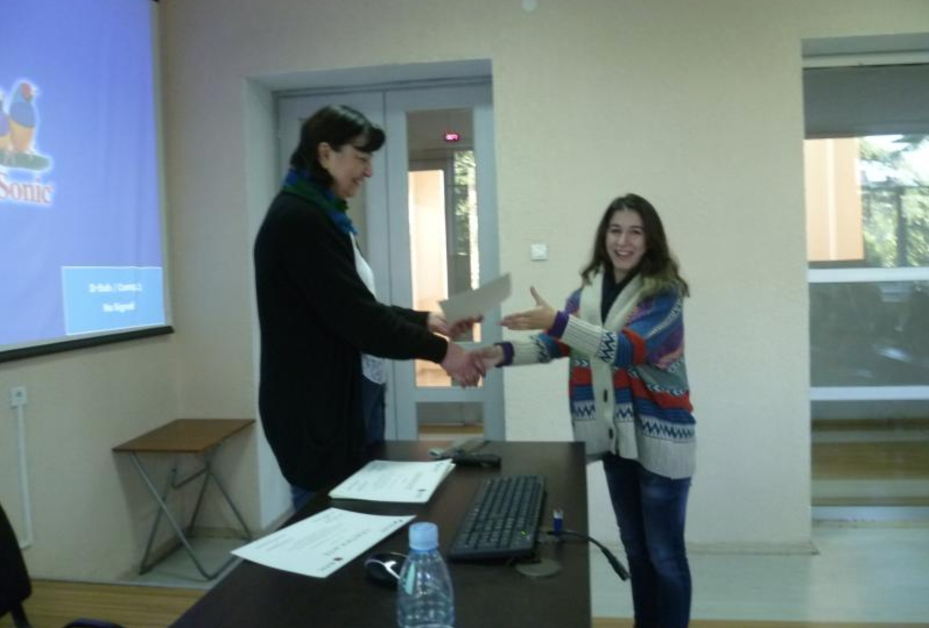
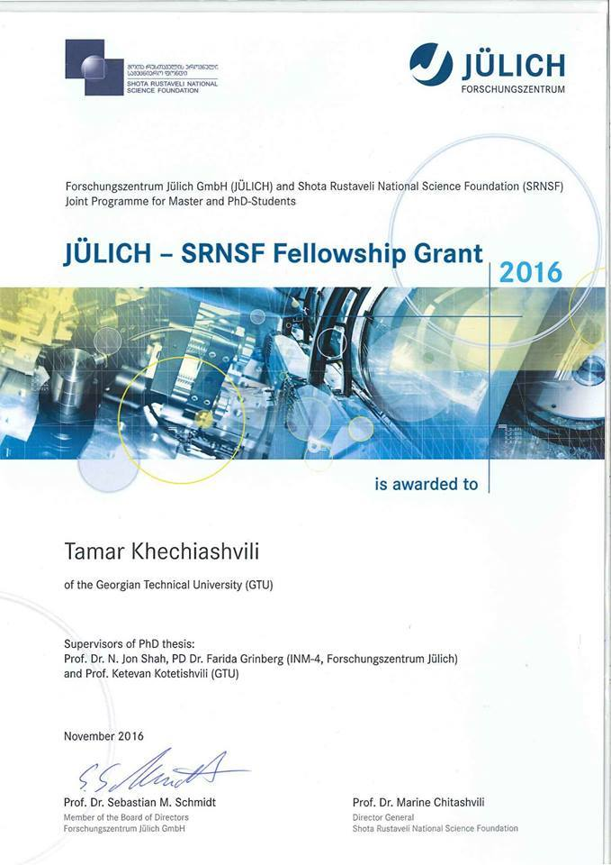
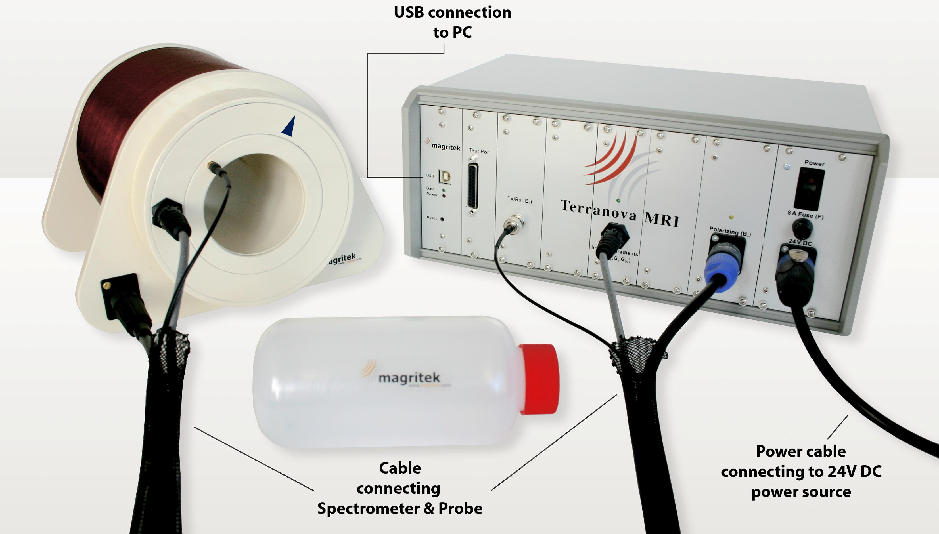
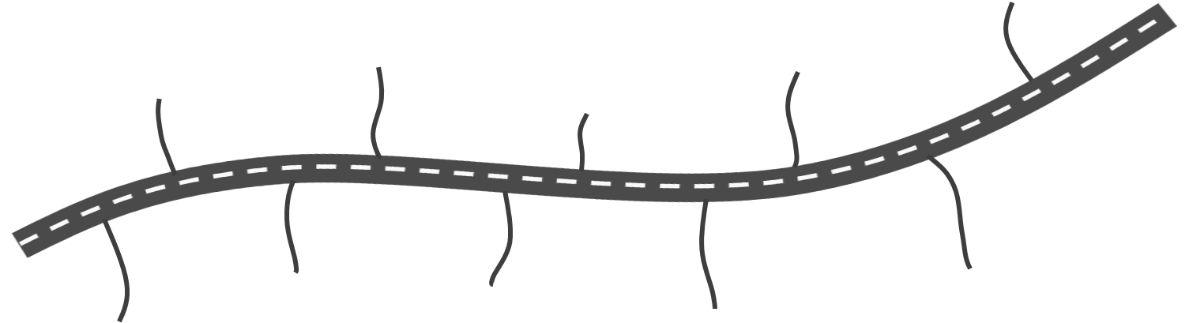
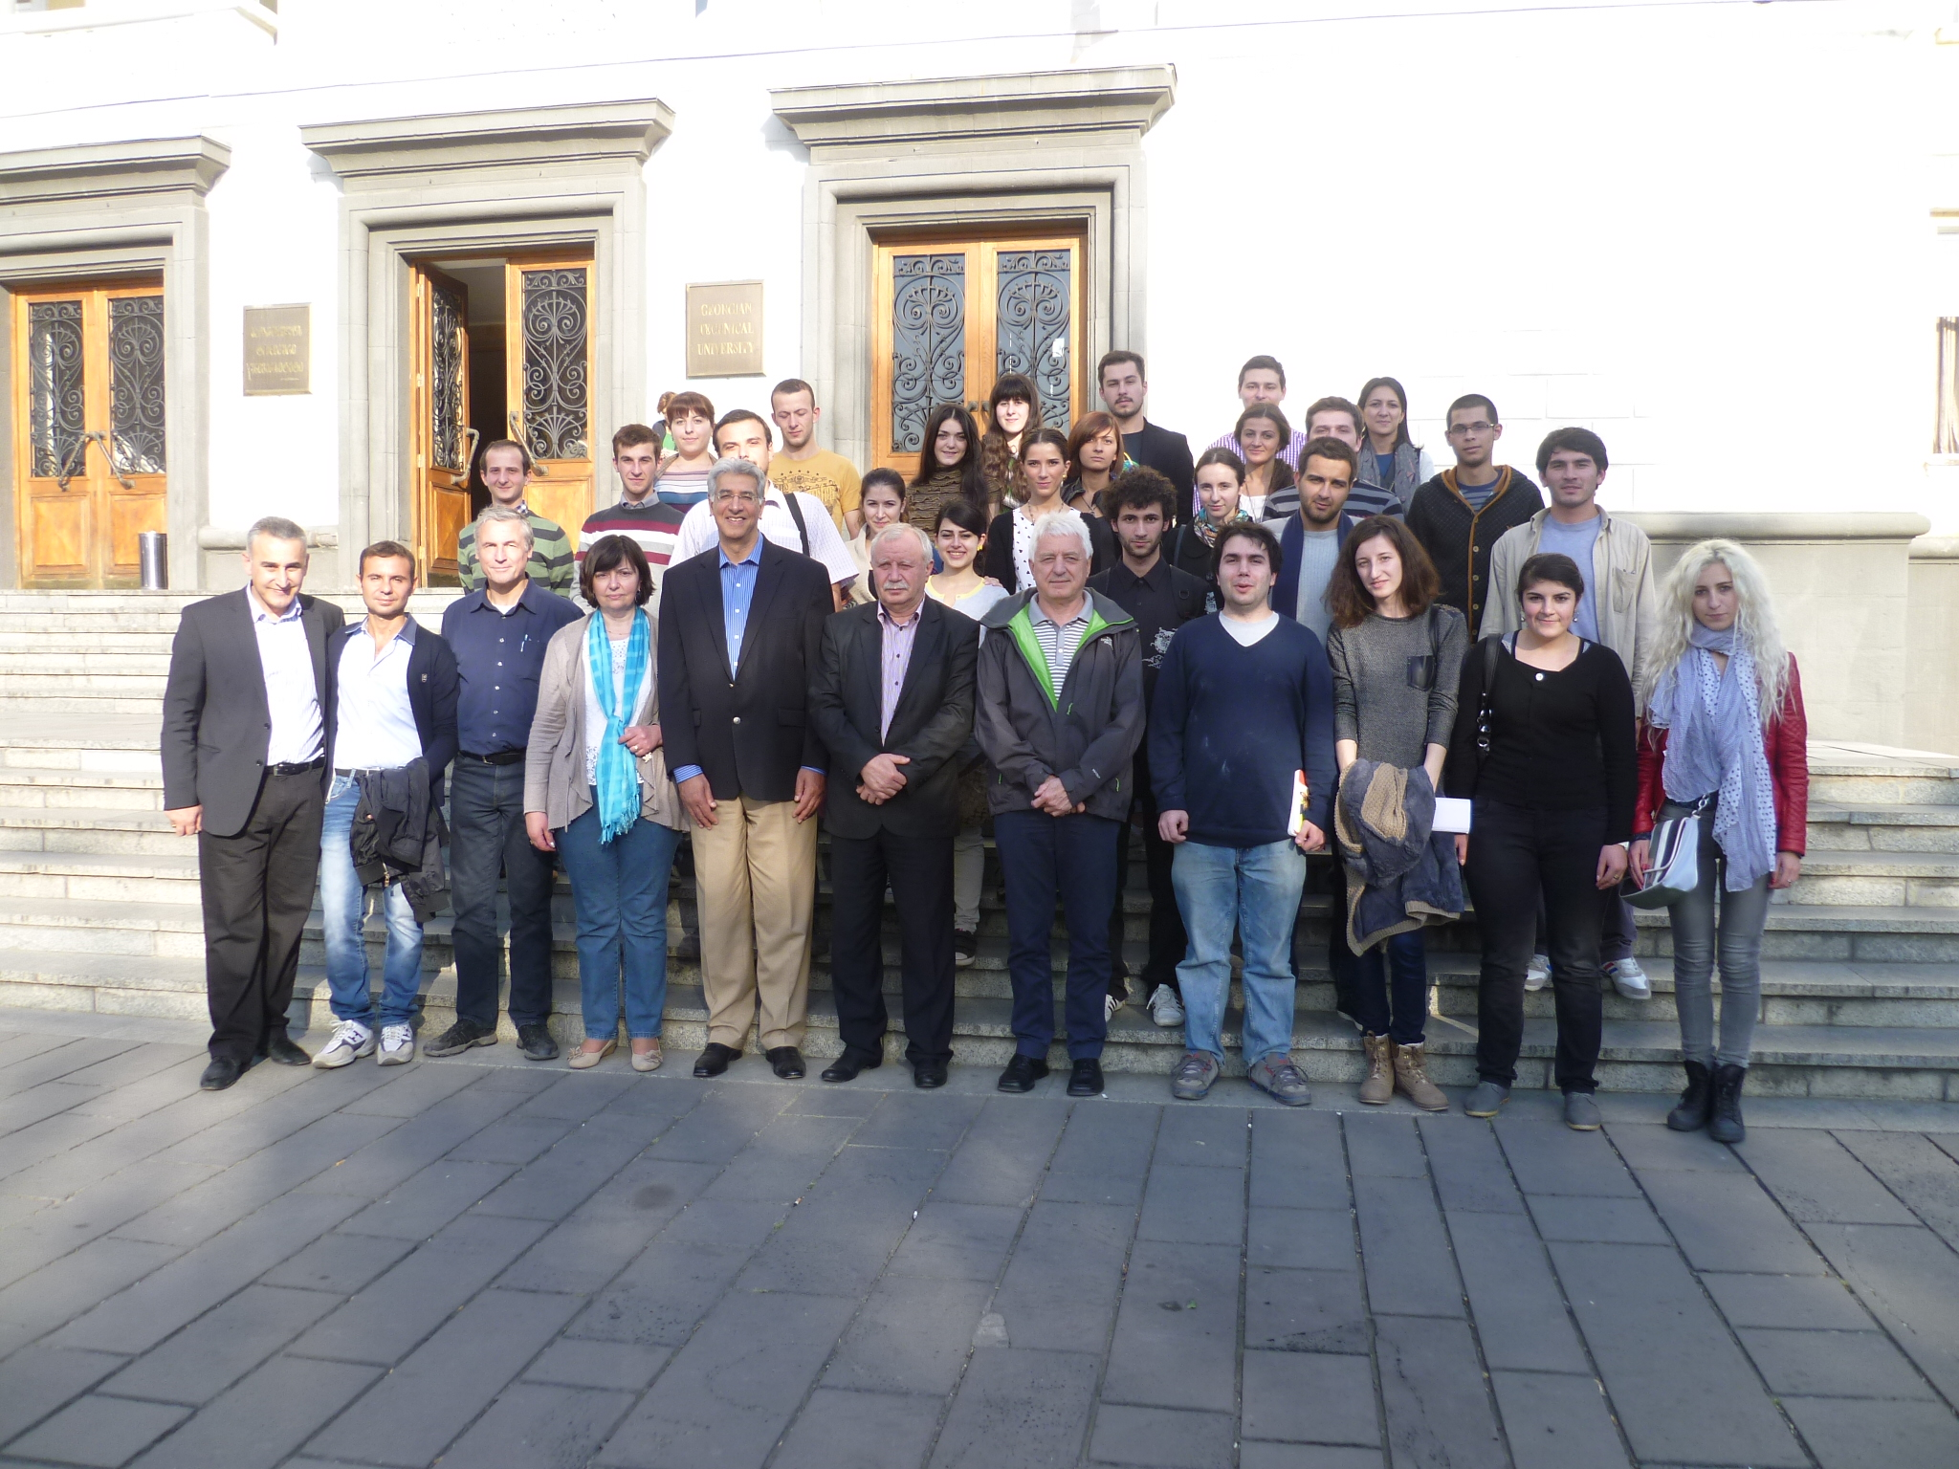
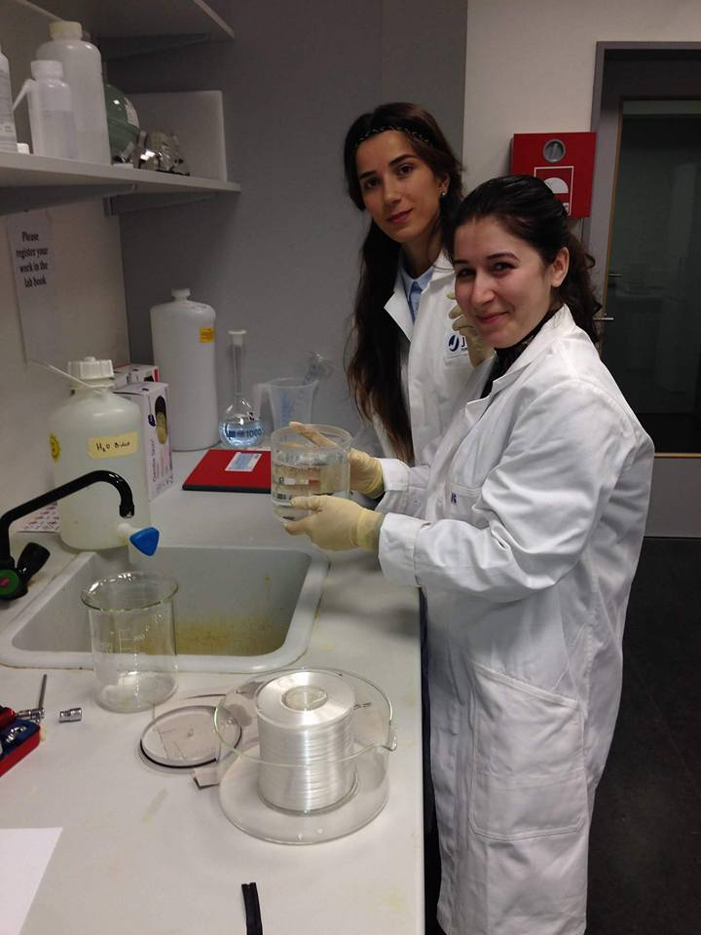
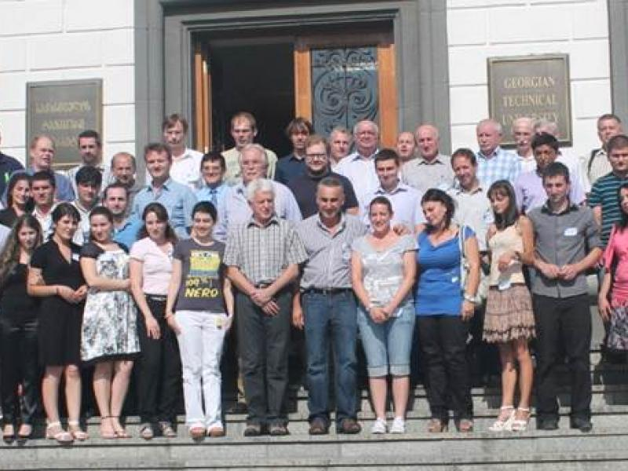
Participation in GGSB
How did I get involved ...
Oct 2017
Tbilisi
Ph.D. as a student and Grant from Rustaveli found
Dec 2013
Jülich
(Internship-INM)
Oct 2015
Tbilisi
(Autumn Lectures-2)
July 2013
Jülich
(Internship-INM)
Aug 20ic14
Jüllich
(Internship-INM)
Apr 2016
Jülich
(Internship-INM)
Oct 2013
Tbilisi
(Autumn Lectures-1)
July 2014
Tbilisi
(6th GGSWBS)
Aug 2012
Tbilisi
(5th GGSWBS)
Sep 2014
Tbilisi
(Master student at GTU)
M.S.

Slide 3




During the my internships:
Get more experience diffusion MRI medical applications
Finding direction in medical applications for master and Ph.D. work
Master work (experimental part) (INM-4)
Master defense (GTU, 2016)
Ph.D. study … on going

Slide 4
Outlook
Introduction
    Motivation and goals
    Background of the study
Methods
Results
Discussion

Slide 5
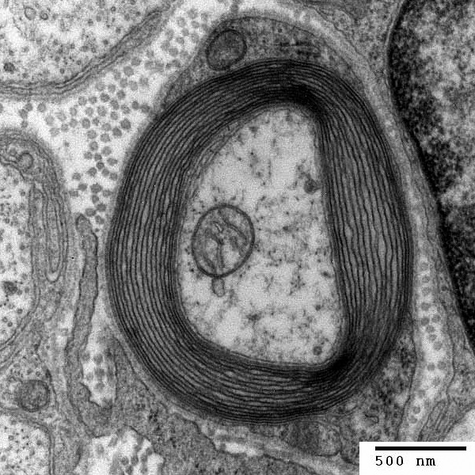
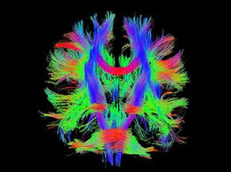
Introduction
Diffusion MRI is a unique modality of brain MRI
We can non-invasively examine
Tissue microstructure
Global white matter organization
Brain function connectivity
Cellular level
Whole brain
Whole brain
24th August

Slide 6

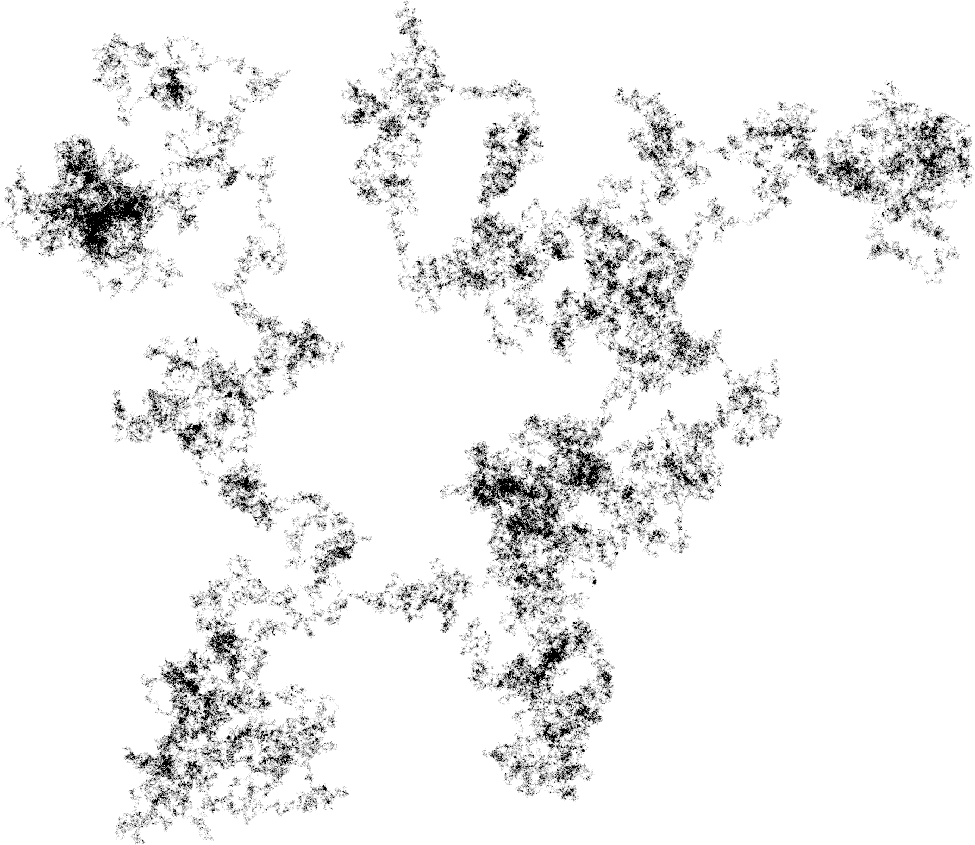
What is diffusion ?
Introduction
DIFFUSION is the process during which molecules of a solution from regions of higher concentration migrate into regions of lower concentration.
Diffusion is also known as Brownian motion
has been in clinical
use for more than 25 years. Originally
focused on stroke imaging, the modality
has evolved rapidly, gaining numerous clinical
applications in neuroradiology and beyond.
Notes:
Diffusion has been for clinical use more than 25 years. Originally focused on stroke imaging the modality has involved rapidly gaining numerous clinical applications in neuroradiology

Slide 7
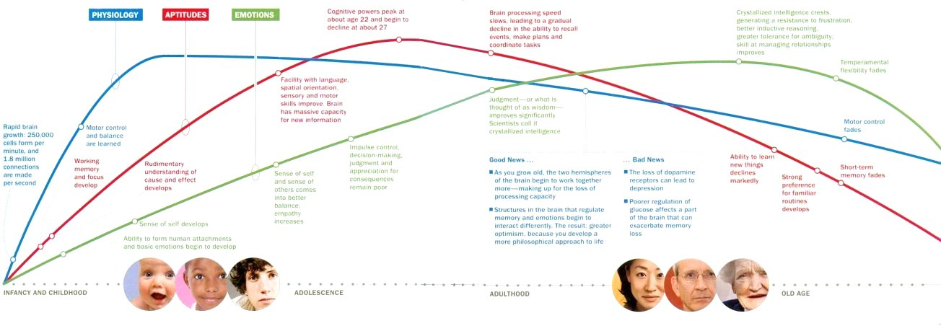
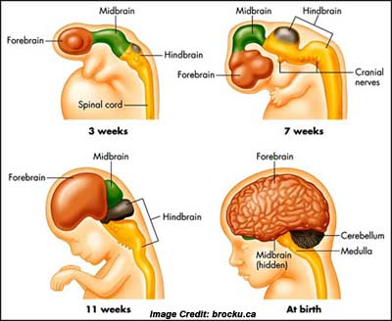
Brain Development and Ageing (Courtesy to Dr. F Grinberg )
Introduction
u – shaped trajectories of DTI parameters
Heterochronous maturation of various fibers
Notes:
and let me start with inrtoduction where is presented brain development during aging wich has so called U shaped trajectory forDTI parameters and heterochronous maturation of brain of various fibers

Slide 8
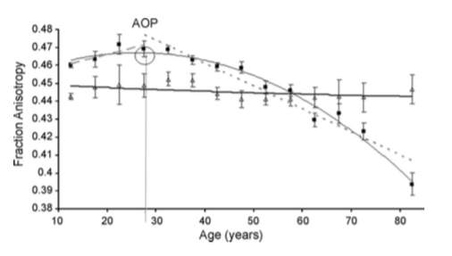
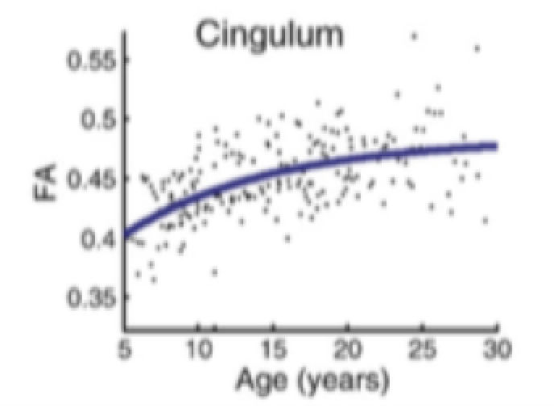
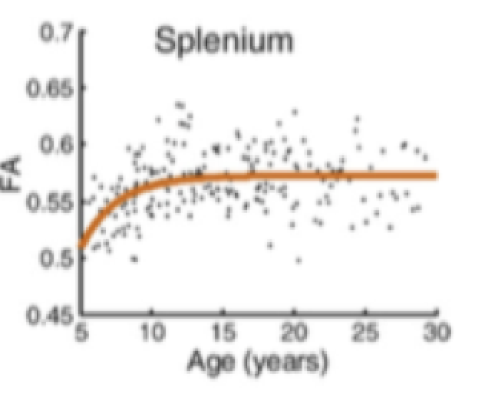
Introduction
DTI parameters: - (Inverted) U-shaped life-span trajectories, - Heterochronous maturation of various fibers
DDDTI paratemters
FA values for Corona Radildata ( ) and ^{Cortical-Spinal tract (△)}
C. Lebel et al., NeuroImage (2008)
^{202 subjects} ^{aged 5-30 years; 10 fibers;} hierarchical pattern of maturation in which areas with frontal-temporal connections develop more slowly than others.
P. Kochunov et al., Neurobiology of Aging, ^{2010.}
831 subjects aged 11-90 years;
9 fibres;
Age of peak: 23.1–39.4 years
Rate of decline correlates with rates of maturation
Notes:
so on this slide we have presented examples for u shaped trajectorys and fast developing and slow developing fibers. as we can observe here Functional anizotropy declines with age domane. And we have here various WM fibers cingulum and splenium of corpus calosum.so we have two different examples for cingulum FA development gous slowly and it is incresing by time but for splenium we have fir rupid increase and than it stays on the plato

Slide 9
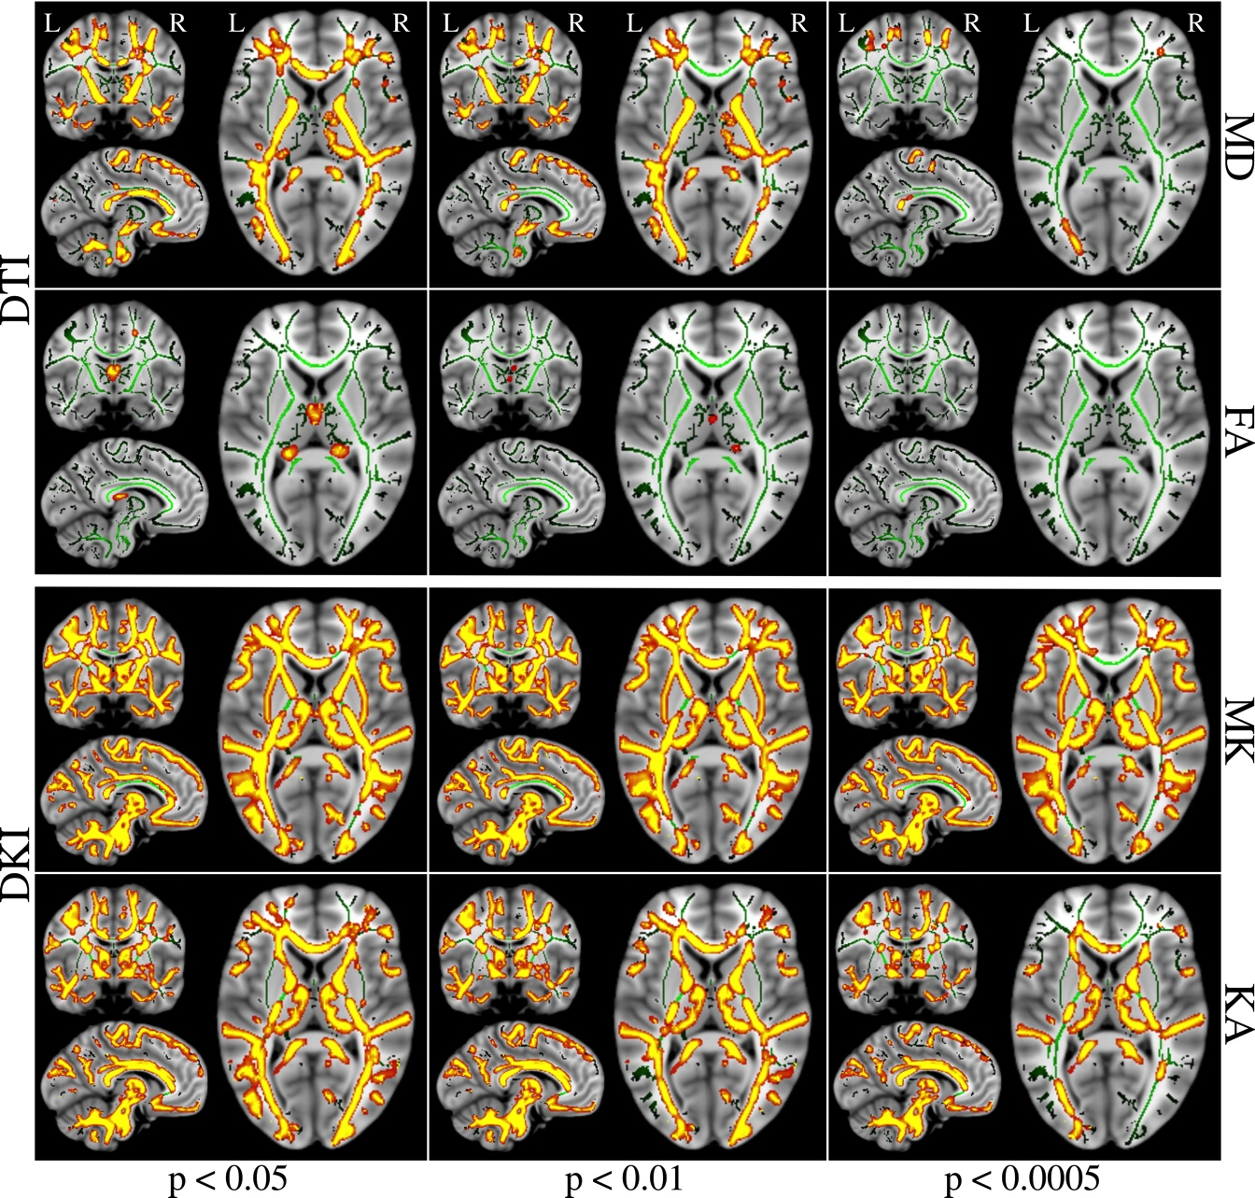
TBSS analysis: children & adults and shows that DKI parameters are more sensitive to microstructural changes than DTI
Previous study
MD higher in children than in adults
FA – only some voxel clusters (not reliable)
MK, AK (RK, KA) higher in adults than in children
Farida Grinberg et al,.. Neuroimage “diffusion kurtosis metrics as biomarkers of microstructural development: A comparative study of a group children and a group of adults“ 2017
Notes:
This slide is about comparison between children and adults here is presented TBSS analysis for two groups were shown that DKI parameters are more sensitive to microstructural changes than DTI parameters. DT metrics were larger in children than in adults and there were no regions were dti parameters were larger in adults than in children. FA revealed only a very few distributed cluster like regions in chich the between group differences were observed. All contraststhe between goup diffenrence were observen in all KT metrics nearly in the whole brain, with exaption of few regions. Only all parameters were significantly largerin children than in adults in all regions and there were no significanty larger in adults than in children. TBSS analysis showd that between group differences in DKI metrics are more wide spread in comparison to DTI metrics

Slide 10
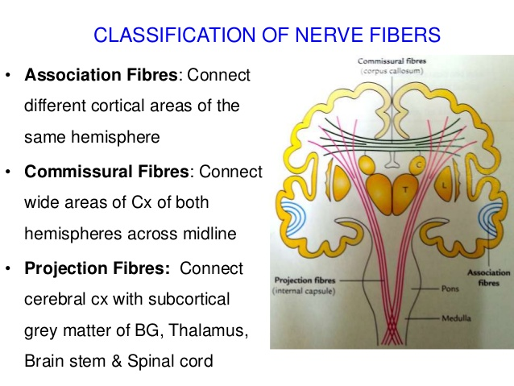
Notes:
Just to enplane the fibers very briefly

Slide 11
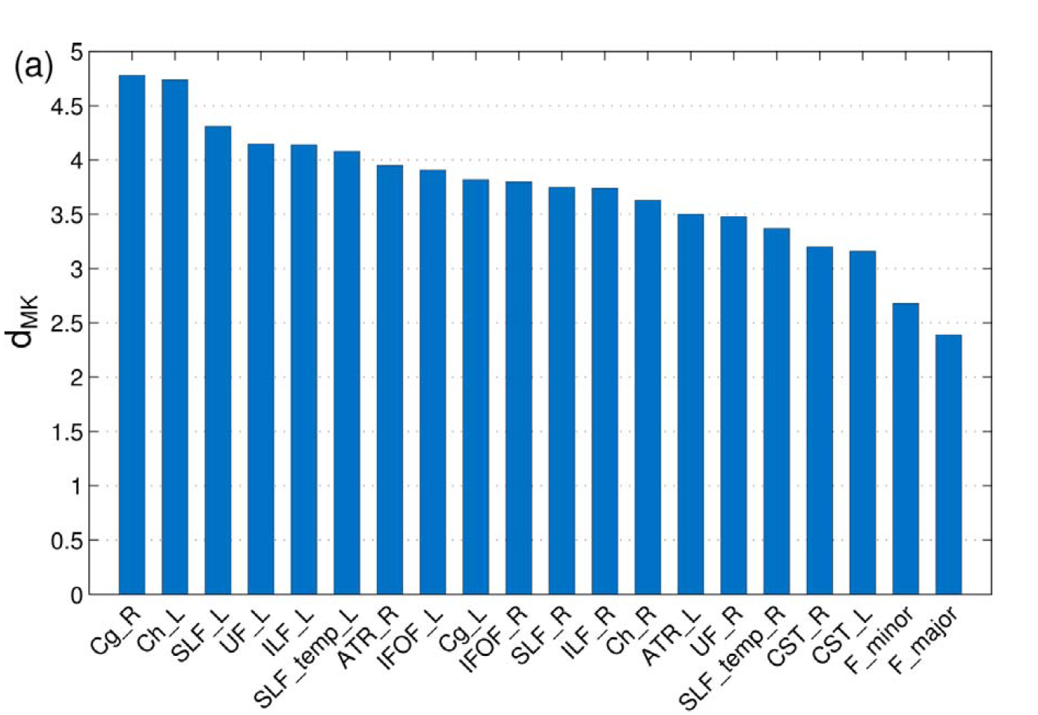
Previous study
Sensitivity of MK parameter, maturation for different fiber types
Cohen’s d of MK: large values indicate protracted maturation, small values – early maturation
Cohen's d = (M2 - M1) ⁄ SDpooled
- d_MK is very sensitive to microstructural changes beyond pre-adolescence
- d_MK indicates more protracted maturation of association compared to projection and commissural fibers
Farida Grinberg et al,.. Neuroimage “diffusion kurtosis metrics as biomarkers of microstructural development: A comparative study of a group children and a group of adults“ 2017
Notes:
here we have also previous study which is also children and adults comparison. On this slide is presented cohens ‘d of MK higher value of D MK were interpreted as reflecting lower maturation levels of the individul fibers. Based on d MK difference betwen the age of preadolecene and adulthood where large in assosiation fibers that projection and coissural fibers. So cohens d of mk were larger between group difference in KT metrics. The lowes value of MK were observe in the comissural fibers F major F minor this finding sujested a sigher sensitivity of DKI metrics as biomarkers of microstructural development and regional heterogenety beyond preadulesense.

Slide 12
Motivation
How WM maturation microstructural connectivity changes along major WM tracts, and how they can be described along major spatial gradients in the brain, i.e. posterior-to-anterior, medial-to-lateral and inferior-to superior.
Importantly eight specific WM tracts shoed non-linear developmental patterns for one or several diffusion metrics. In addition, the results suggested that WM developments follows major gradients in the brain .
Notes:
Here come motivation and goals for our study so we have two main sentanses which was motivation for a us there is the isea theory that WM maturation microstuctural conectivity changes along the major WM tracts and they could be followed by major gradients in the brain. And the suty based on this idea was carread out for DTI parameteers and as we already know from previous stydies DKI metrics are more sensitive on microstructura changes for us was intereting to so some similar study with DKI metrics couse we could find the prove an evidance of that theory.

Slide 13
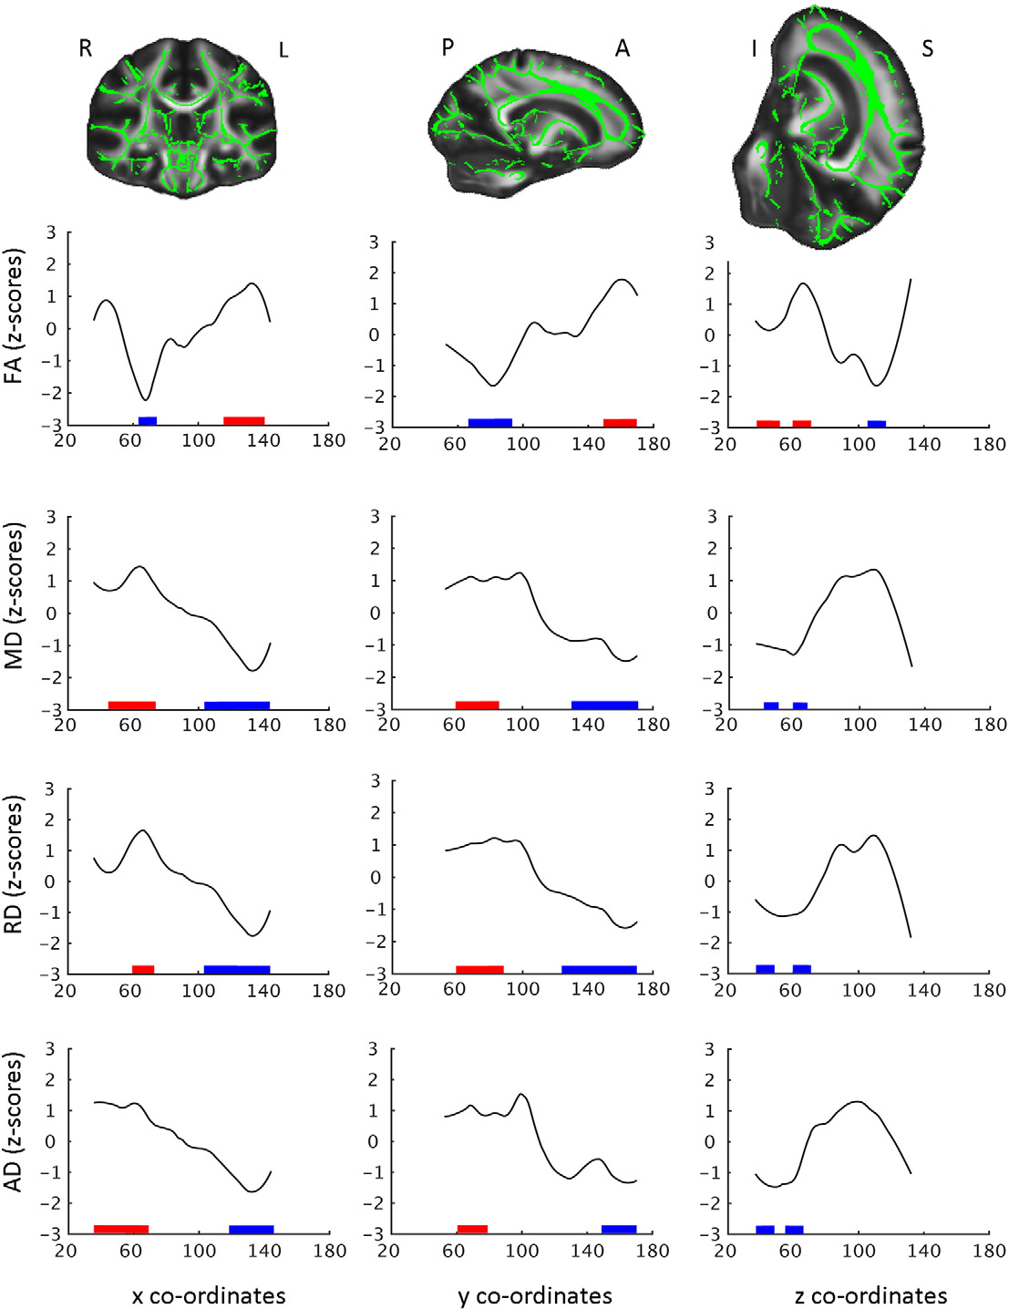
Motivation
Previous studies
This is about an attempt to confirm such gradients using DTI parameters, results may be provide some evidence but not clear ones
Stine K. krogsrud at el.. “Changes in white matter microstructure in the developing brain –A longitudinal diffusion tensor imaging study of children from 4to11 years of age” 2015
Notes:
Here is presented previous study in which were scanned 159 partisipants in 1.5 t scanner with age range 4-11 in differente time points with time interval 584 days. And we see slice bu slice profiles of change for MD RD, FA, AD parameters, XYZ coordinates in MNI space. The FA skeleton Green displayed on the FMRIB FA tamplate in MNI space ilustrate principal gradients. R -L ,P -A ,I -S . Red sinifies greater positive changes and blue greater negative changes. The inferion tu superior gradient displaye a u shaped trajectory pattern for FA and inversed u shaped paternes for MD and RD and AD ilustrating greator changesin spesifi superior inferior regions. So there were foun singificant diffrenecein global FA and Decreases in Globa MD RD over time in 4-11 years old within the age range the where found more changes in anteriorthan posterion regions for all parameters. That can sujest that development of WM microstructure may follow major gradients in the brain in adition to individual WM tracts.

Slide 14
Goal
goal: given high sensitivity of DKI parameters to microstructural changes in brain development to examine if DKI parameters can provide evidences for major gradients in microstructural development of the brain?

Slide 15
Method
  Quantifies the non-Gaussian behavior of water diffusion in tissue.
  provides more comprehensive characterization of microstructural changes in comparison to DTI.
  detects changes in various white and gray matter structures.

Slide 16
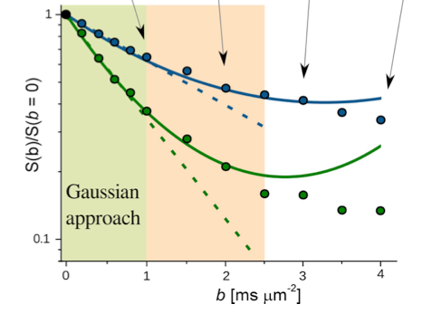
Diffusion Kurtosis Imaging(DKI)
accounts for non-Gaussianity due to diffusional barriers in tissue
kurtosis
Monoexponential
Non-exponential
extension of DTI, requires more acquisition time
provides a new biomarker: (mean) diffusional kurtosis, MK
richer information on complexity of microstructure
Applications (stroke, neurodegenerative pathologies)
JH Jensen et al., MRM, 2005

Slide 17


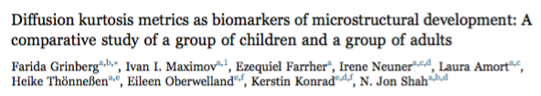
Imaging
  DKI data collected on whole-body 3T Siemens MAGNETOM Tim-Trio scanner
  Subjects: two groups of healthy volunteers , 20 school children (range,9 – 12years,mean age 10.3) and 21 adults (range,38 – 64 years mean age 54.3)

Slide 18
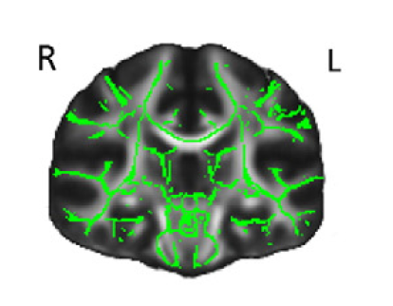
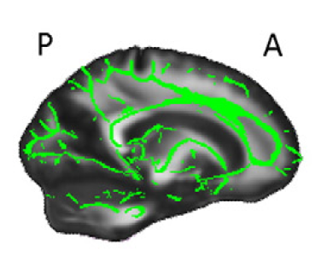
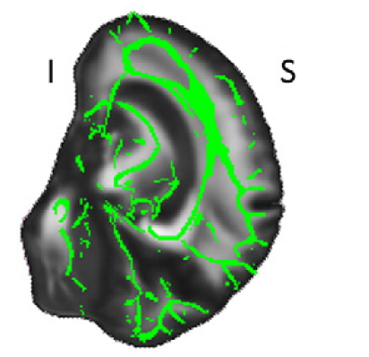

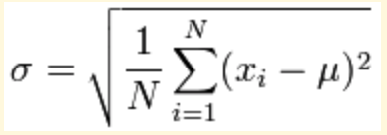
Pipeline for producing profiles
Averaged maps for group of Adults and a group of Children
21 subject 1 map 20 subjects 1 map
WM Skeleton mask from TBSS study
Calculate difference in percentage
Calculate Cohen's-d (Cohen’s-d= FA children- FA adults / σ)
Two sampled t-test
One samples t-test
T-test between two sides left and right side
(%diff = adults – children/children *100)
pooled std
std
, Pooled std
Subtracted data around mean = 0
All data analyses was done by matlab scripts

Slide 19
Results: whole brain histograms
histograms where DTI parameters are overlapped and DKI parameters are shifted

Slide 20
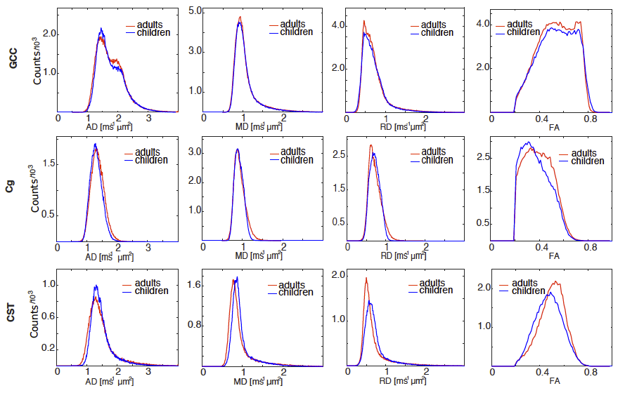
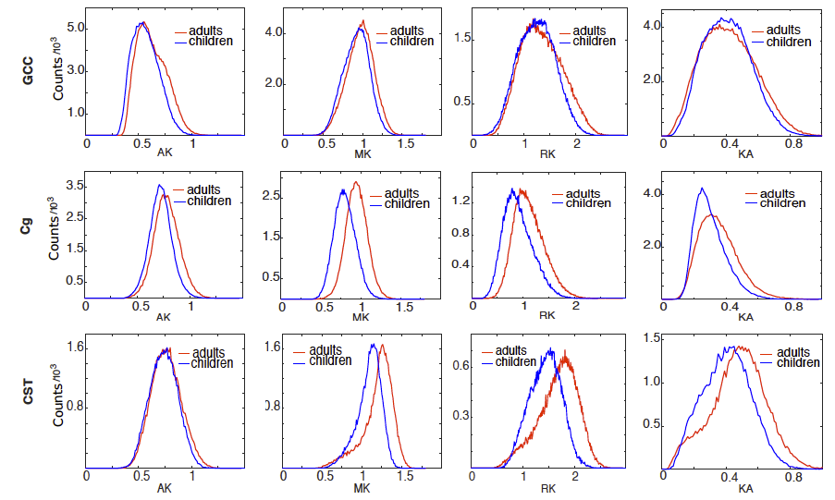
Results: ROI analyses histograms
JHU- ICBM atlas based fiber histograms where also DTI parameters are overlapped and DKI parameters are shifted
DTI
DKI

Slide 21
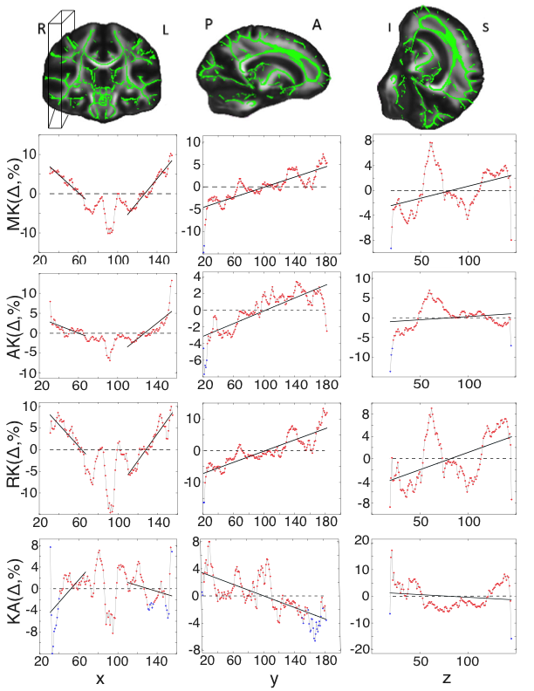
Results: profiles with all DKI parameters
Children and adults slice by slice averaged profiles for WM skeleton with x, y and z direction. Red and blue points correspond, respectively, to significant and non-significant changes between the group of children and group of adults
Gradients in the brain, Which are presented with all DKI parameters
Gradients in the brain, Which are presented with all DKI parameters
Gradients in the brain, Which are presented with all DKI parameters
Notes:
X y and z direction x labels diference in precentage on y label voxsel numbers

Slide 22
Results: profiles with MD and MK parameters
Between-group differences of the MD and mean MK along C-P, P-A and I-S directions.

Slide 23
Results: table with student t-test
Table with two sampled t-test between L&R sides and one sample t-test for separate L&R sides
d≤0.05 diff. H=1 , d≥0.05 not diff H=0
Marked values shows difference between left and wright sides of profiles
 | TWO SAMPLED T-TEST SIDES |  |  |  |  |  | ONE SAMPLE T-TEST SIDES L |  |  |  |  |  | ONE SAMPLE T-TEST SIDES R
X-DIRECTION |  | Y-DIRECTION |  | Z-DIRECTION |  | X-DIRECTION |  | Y-DIRETION |  | Z-DIRECTION |  | X-DIRECTION |  | Y-DIRECTION |  | Z-DIRECTION
H | P | H | P | H | P | H | P | H | P | H | P | H | P | H | P | H | P
0 | 0.4573 | 1 | 0.0164 | 1 | 0.0127 | 0 | 0.6205 | 0 | 0,2066 | 1 | 0.0039 | 0 | 0.5756 | 0 | 0.1896 | 1 | 0.0012
0 | 0.8635 | 1 | 1.3569e-42 | 1 | 8.6987e-12 | 0 | 0.9102 | 1 | 3.4916e-06 | 1 | 1.7983e-15 | 0 | 0.8948 | 1 | 1.4188e-18 | 1 | 2.7105e-05
0 | 0.8056 | 1 | 3.0101e-40 | 1 | 3.3905e-13 | 0 | 0.8751 | 1 | 2.0562e-05 | 1 | 4.7868e-09 | 0 | 0.8440 | 1 | 1.9662e-16 | 1 | 1.0567e-05
0 | 0.5919 | 1 | 5.0297e-40 | 1 | 4.4951e-9 | 0 | 0.7182 | 1 | 7.4465e-07 | 1 | 1.0217e-18 | 0 | 0.6902 | 1 | 5.4735e-17 | 1 | 9.8410e-05
0 | 0.7149 | 1 | 1.4681e-10 | 1 | 4.0554e-6 | 0 | 0.8147 | 1 | 3.5599e-10 | 0 | 0.5584 | 0 | 0.7719 | 1 | 2.8067e-08 | 0 | 0.4725
0 | 0.1324 | 1 | 3.6734e-37 | 1 | 0.0021 | 0 | 0.2313 | 1 | 3.4669e-11 | 0 | 0.8738 | 0 | 0.3351 | 1 | 2.5819e-25 | 0 | 0.6260
0 | 0.4856 | 1 | 5.2478e-19 | 1 | 9.4918e-4 | 0 | 0.6265 | 1 | 5.1225e-10 | 0 | 0.4119 | 0 | 0.6188 | 1 | 1.3347e-13 | 0 | 0.2175
0 | 0.6762 | 1 | 1.1051e-17 | 1 | 1.3359e-4 | 0 | 0.7848 | 1 | 1.4267e-14 | 0 | 0.0699 | 0 | 0.7470 | 1 | 1.4920e_10 | 0 | 0.0590
FA
MD
RD
AD
KA
AK
MK
RK

Slide 24
Results: R-square values with the constant, linear and quadratic functions

Slide 25
Discussion
Both DTI and DKI methods provided patterns generally consistent with the above hypothesis. In particular, we observed symmetric patterns of between-group differences from the center to peripheral regions and ascending or descending patterns in P-A, I-S directions. DKI was shown to provide more sensitive biomarkers than DTI

Slide 26
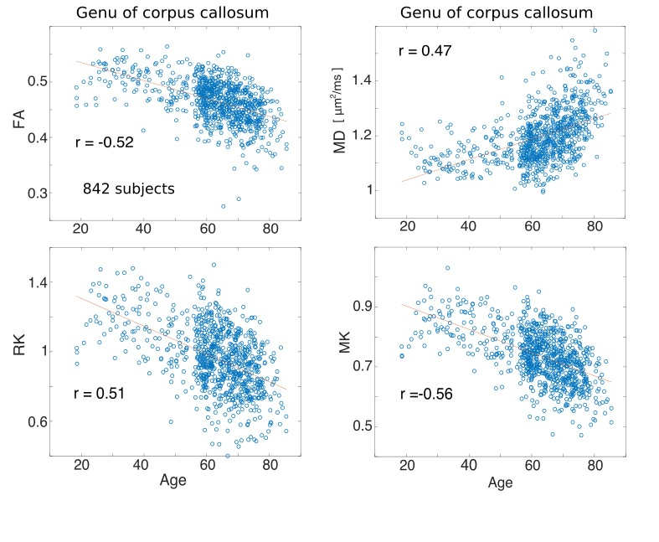
Current work: Aging 1000 Brains Study
This study demonstrates statistically significant positive and negative changes between diffusion tensor, diffusion kurtosis parameters, and age for some WM microstructures, which was done by statistical Pearson correlation
on going…

Slide 27
Acknowledgements
Dr. Farida Grinberg
Dr. Ezequiel Farrher
Ms. Karina Ruzaeva
Ms. Nino Kobalia
Prof. K. kotetishvili
Prof. N.J Shah

Slide 28

Thank you for you attention

