Slide 1






Ivane Javakhishvili Tbilisi State University
School of Exact and Natural Sciences
Current projects at AtmoSim_lab
PhD student: Ketevan Kharaishvili
Supervisors:
Full Professor Bezhan Chankvetadze
Assistant-professor Giorgi Jibuti
8TH GEORGIAN – GERMAN SCHOOL AND WORKSHOP IN BASIC SCIENCE
August 20–25
Tbilisi,2018

Slide 2
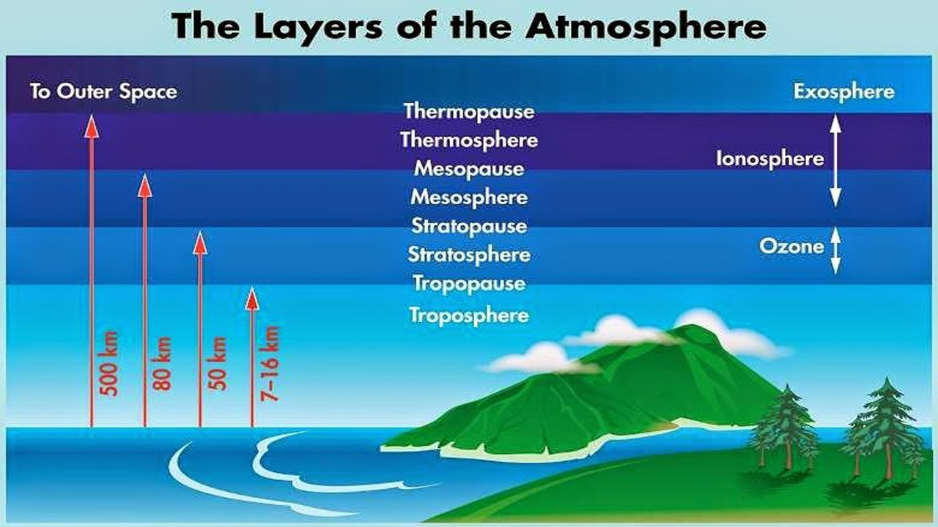
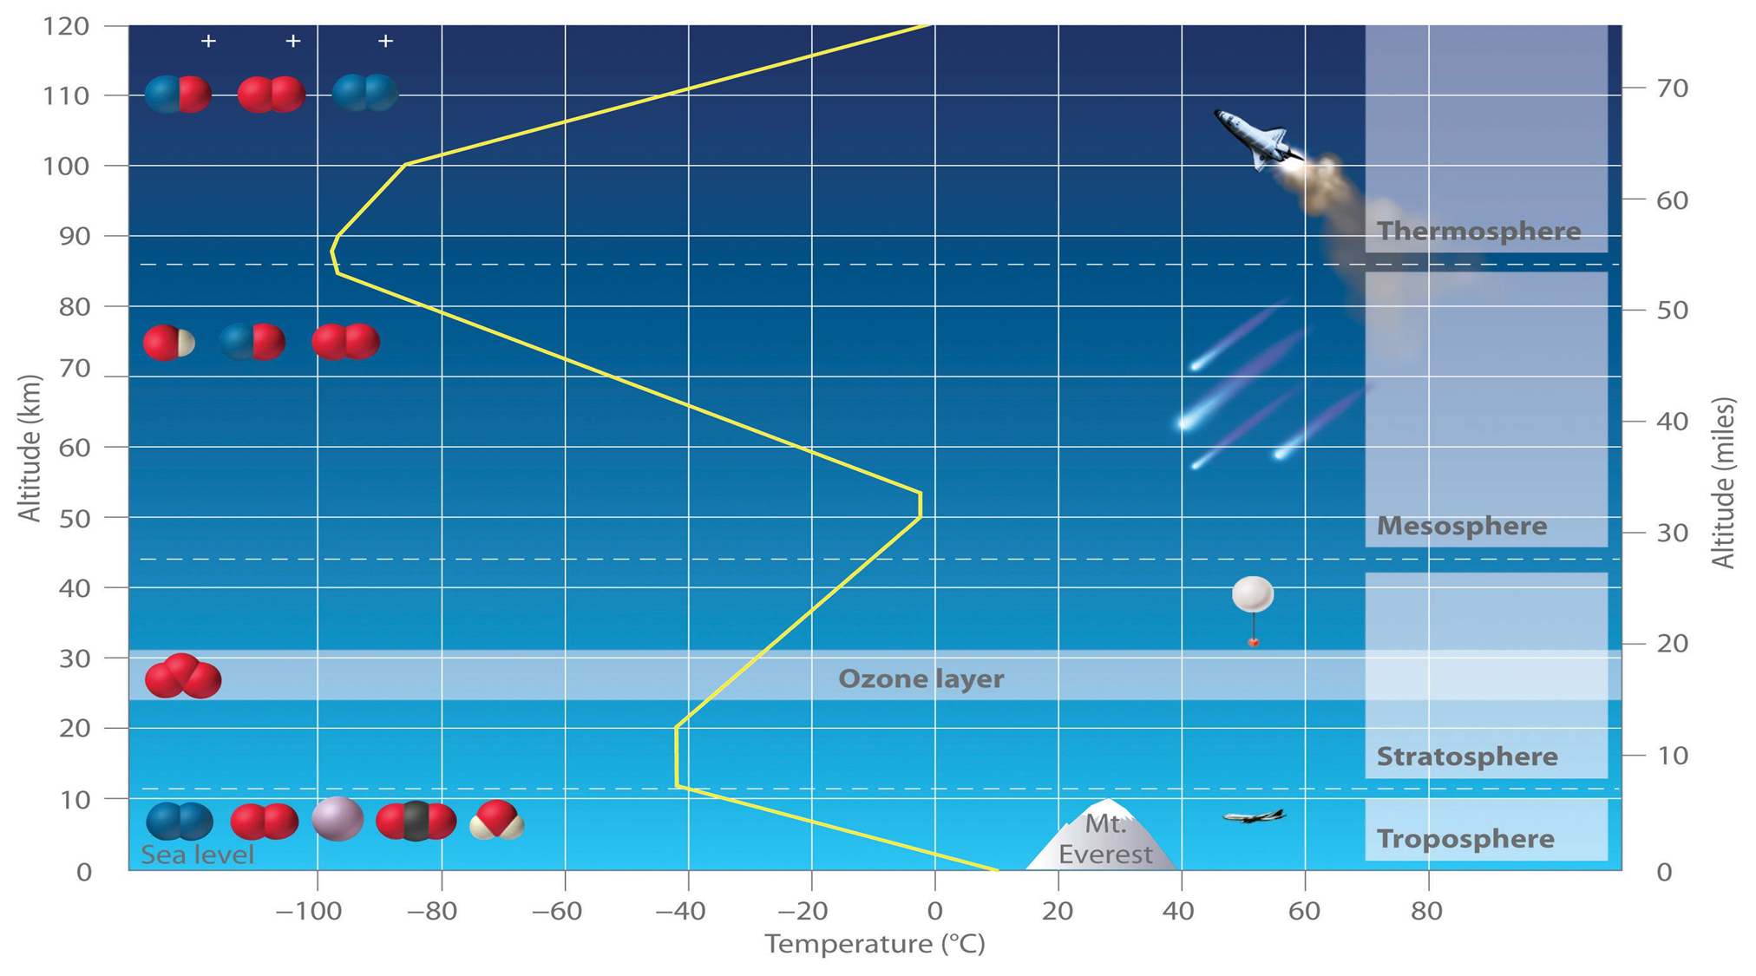

Slide 3
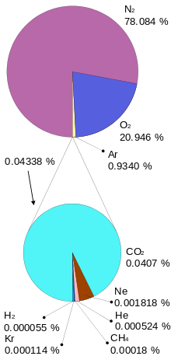
Gas Phase Composition of the Atmosphere
Amount
 | Basic components | Trace gases
Permanent gases | Nitrogen( N2); Oxygen (O2); Argon (Ar) | Other Noble gases
Volatile gases | Carbon dioxide (CO2) | Other long lifetime gases
Highly volatile gases | Water vapor | Other short lifetime gases
Atmospheric Lifetime
Classification of atmospheric gases

Slide 4
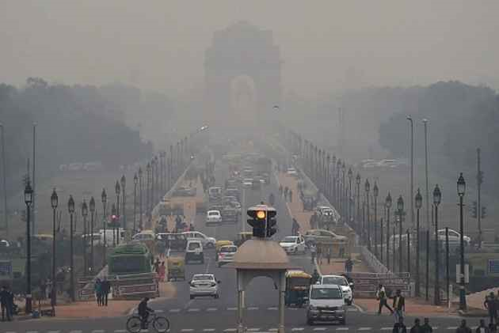
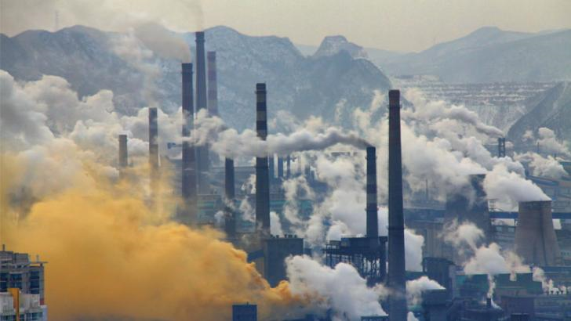
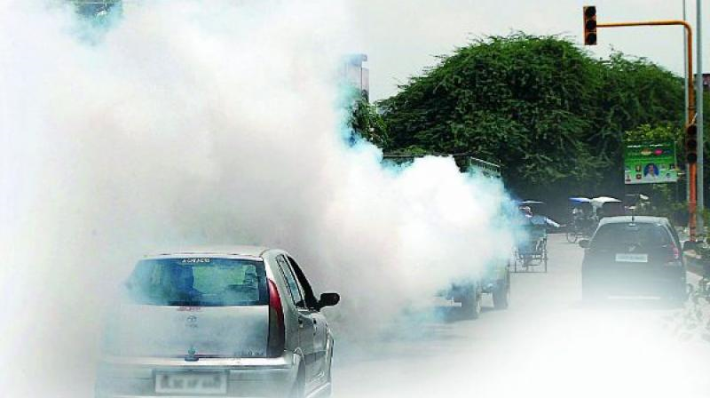
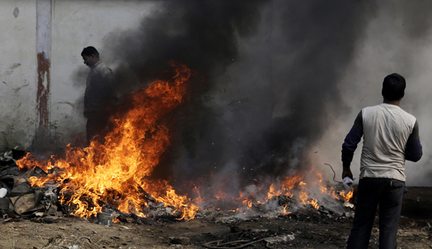
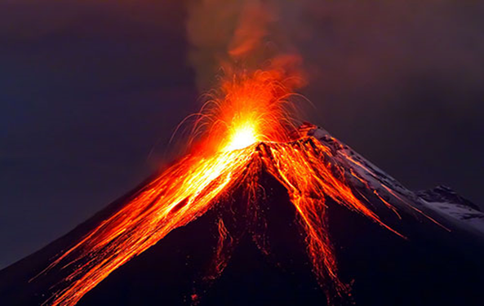
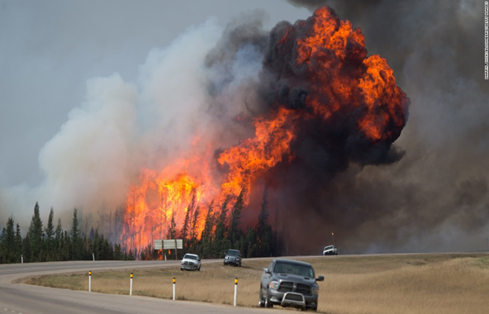
Pollution sources:
Transportation
Energy Production
Biomass Burning
Volcanoes Eruption
Forest Fire

Slide 5
Measurements at SMART|AtmoSim_LAB
The laboratory equipment that we used;
Some of the gas measurement and monitoring in Tbilisi;
The methods of atmospheric measurement which we used in laboratory;

Slide 6
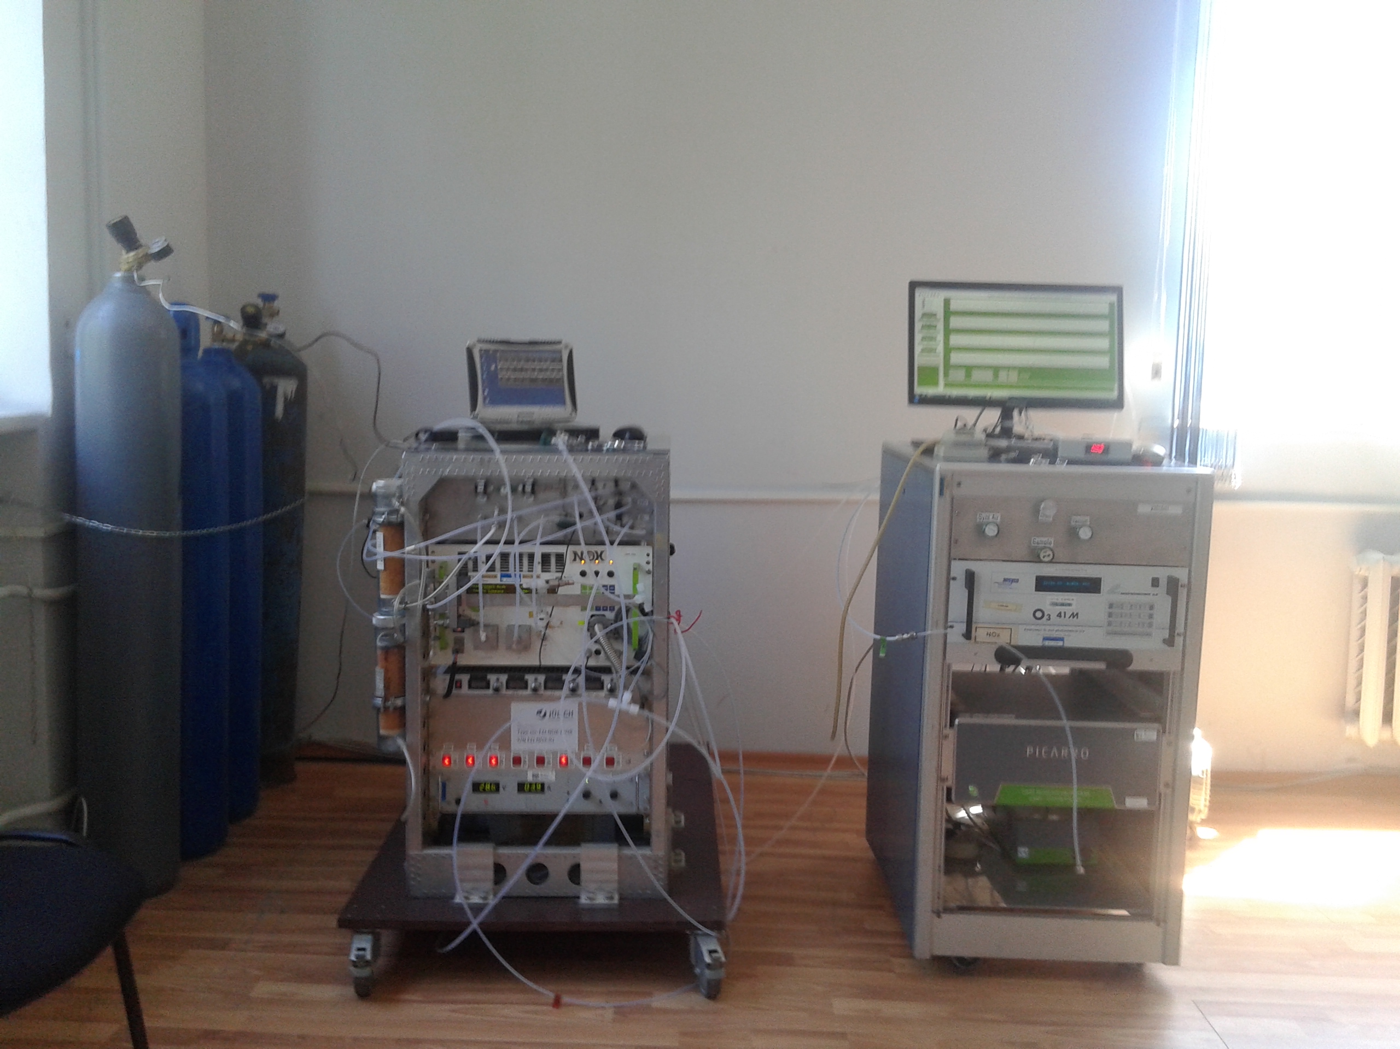
Ozone monitor
NOx
(NO + NO2)
Picarro CRDS CO2;CO; CH4; H2O;

Slide 7

Definition:
NOx=NO(nitrogen monoxide)+NO2(nitrogen dioxide)
NOx has different chemistry at day time and at night time
-Day: photolysis and thermal reactions
-Night: thermal reactions only

Slide 8
Nitrogen compounds (NO,NO2) via chemiluminescence with O3
The 𝑵𝑶 + 𝑶₃ reaction
NO+ O3 → 𝑵𝑶2 + 𝑶2
𝑵𝑶 + 𝑶3 → 𝑵𝑶2 + 𝑶2
𝑵𝑶 + 𝑶3 → 𝑵𝑶2*+ 𝑶2
𝑵𝑶2* → 𝑵𝑶2 + 𝒉𝝂
𝑵𝑶2*+ 𝑴 → 𝑵𝑶2 + 𝑴
NO2 is converted to NO
𝒉𝝂
𝟐𝑵𝑶𝟐→𝟐𝑵𝑶+𝑶𝟐

Slide 9
NOx analyzer
Blue Light Converter efficiency 30 %

Slide 10
CLD 780TR, Unit-CPS (Count Per Second)
Measure of NOx
NOx equipment works in the following mode:
NO-measure
Z- Zero mode, without O3 Generator
M-Measure mode, with O3 Generator
NO Calculation
[NO]= (M-Z(cps)) × Sensitivity (PPB/CPS)

Slide 11

NO2 -measure
NO2 with NO2 Converter
NO2 = NO - NO
Conv
l- Zero mode, without O3 Generator
L- with O3 Generator
NO2 Calculation
[𝑳 − 𝒍 − (𝑴 − 𝒁 )
𝑵𝑶]𝟐 =
Sensitivity × Efficiency

Slide 13
Ozone monitor
NOx
(NO + NO2)
Picarro CRDS CO2;CO; CH4; H2O;

Slide 14
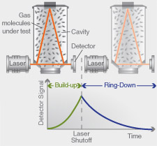
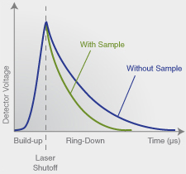
Cavity Ringdown Spectrometer

Slide 17
Determination of ozone with ultraviolet photometry
Ozone is measured by absorbance of corresponding wavelength of UV light by air sample inside gas cuvete

Slide 18
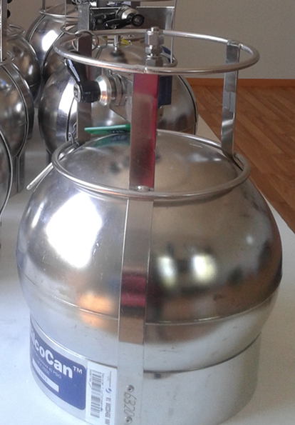
Measurements with cylinders
Preparing cylinders for sampling
Sampling
Analysis

Slide 19
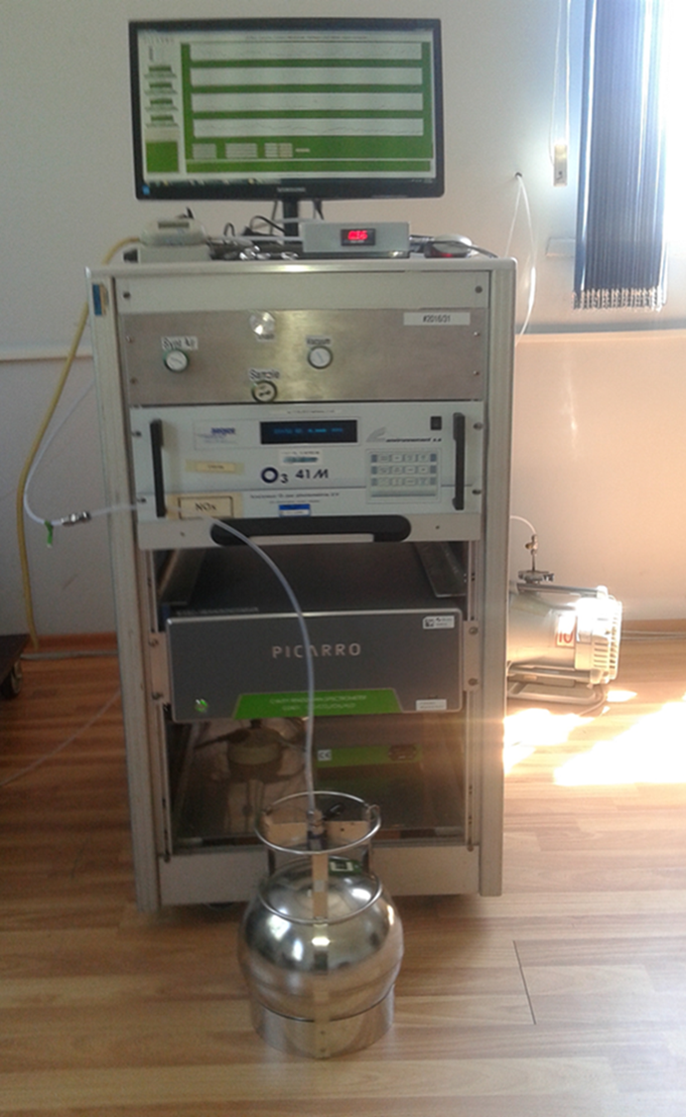
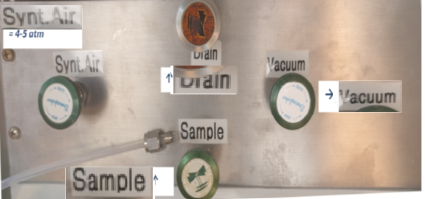
Cylinders washing and Drain system

Slide 20
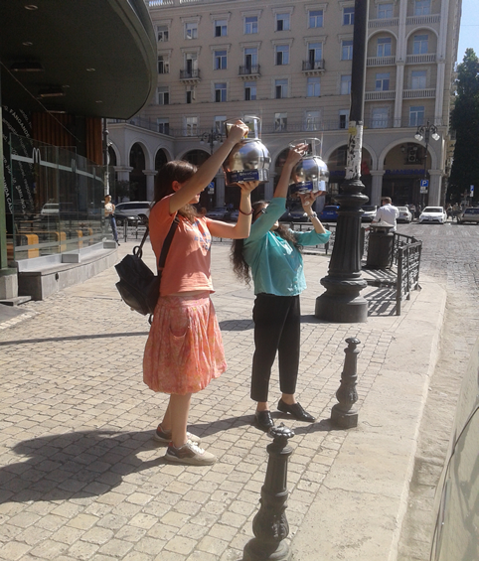
Atmospheric measurements in Tbilisi
Sampling
Last three months:
Tsereteli
Marjanishvili
Rustaveli

Slide 21
Write data and process results
Analysis
By washing and drain system prior to analysis we dilute the samples up to 3 atmospheric pressure with the use of Argon and start analysis.
As we have already mentioned that picarro gives us ready results which we use directly

Slide 22
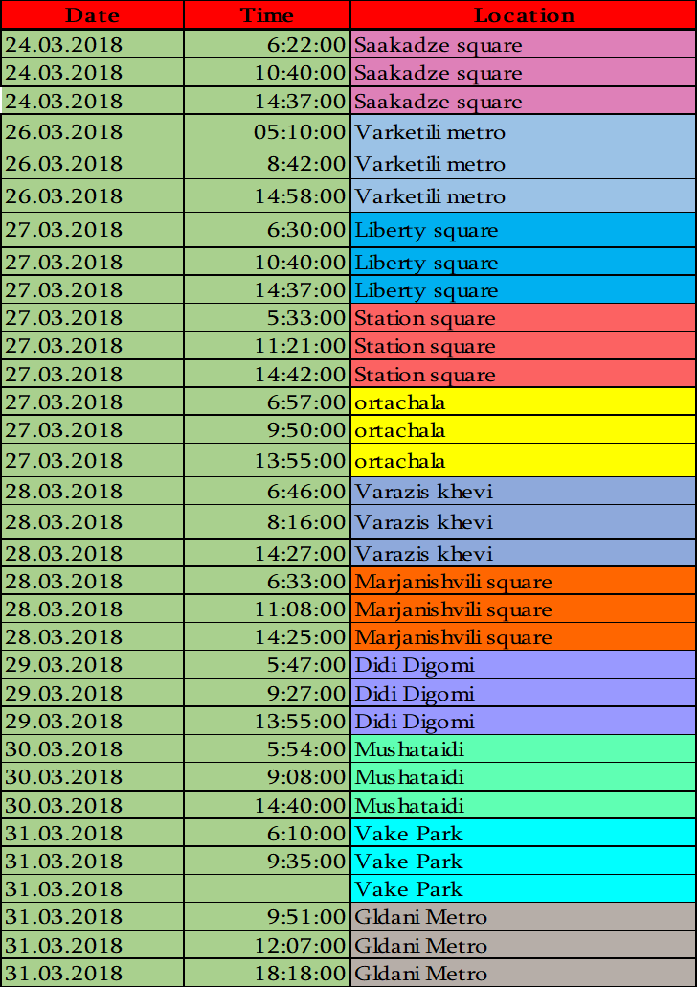
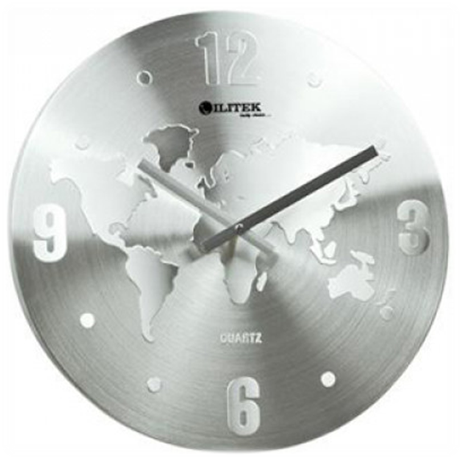
Contamination gradients for air pollutants in time
Rush hour in the morning
Not during rush hour in the afternoon
Rush hour in the evening

Slide 23
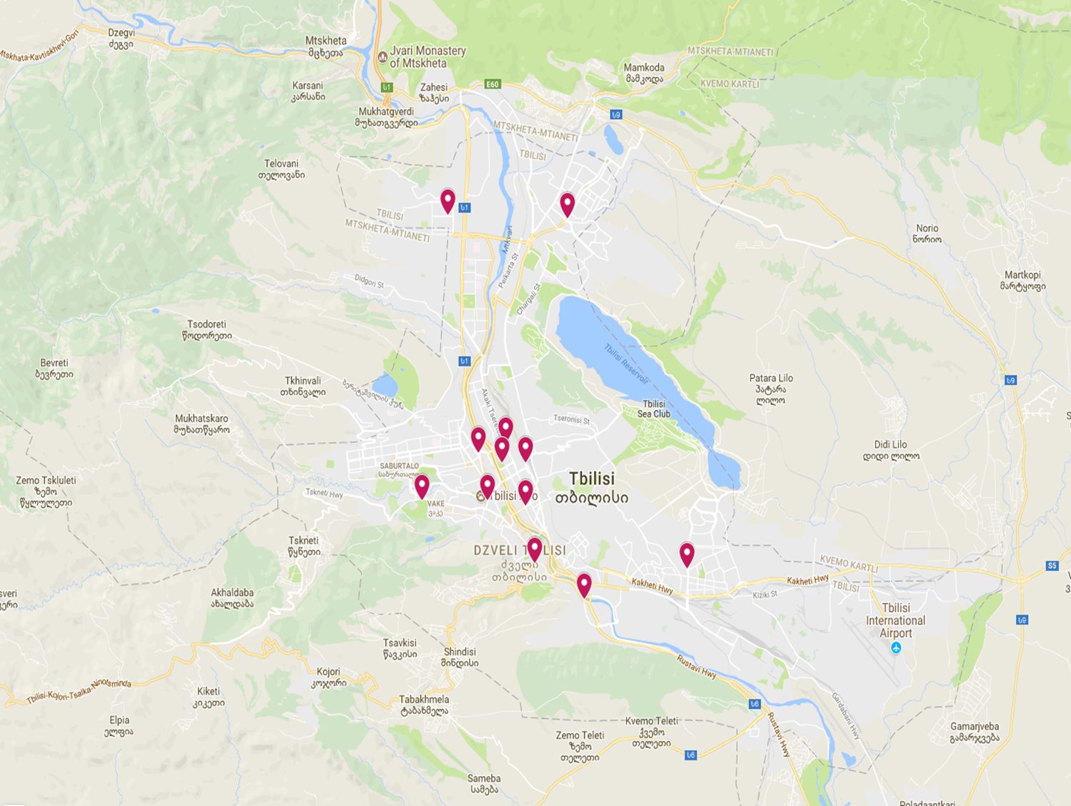
Contamination gradients for air pollutants in space
To exclude the inaccuracy we perform sampling in a room and compare it to online
We were distributed with 10 cylinders ( 2 of them stay in room) on a TSU nearby location and sampling with online.

Slide 24

Thank you for your attention!

