Slide 1
Diurnal and annual cycle of Nitrogen Oxides
ROBERT WEGENER

Slide 2
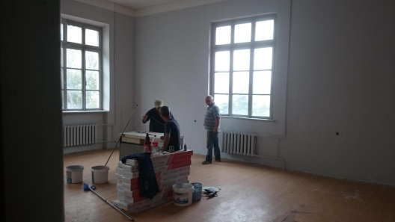
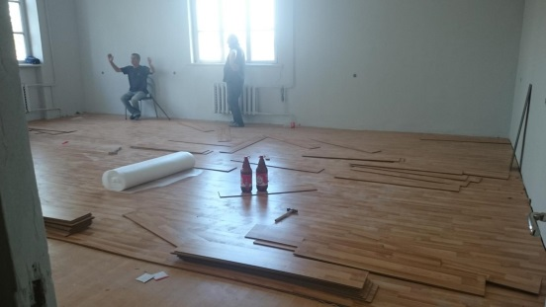
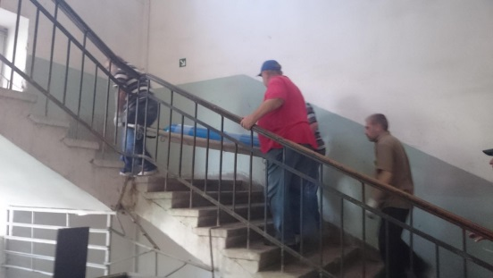
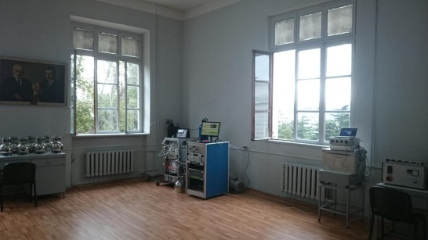
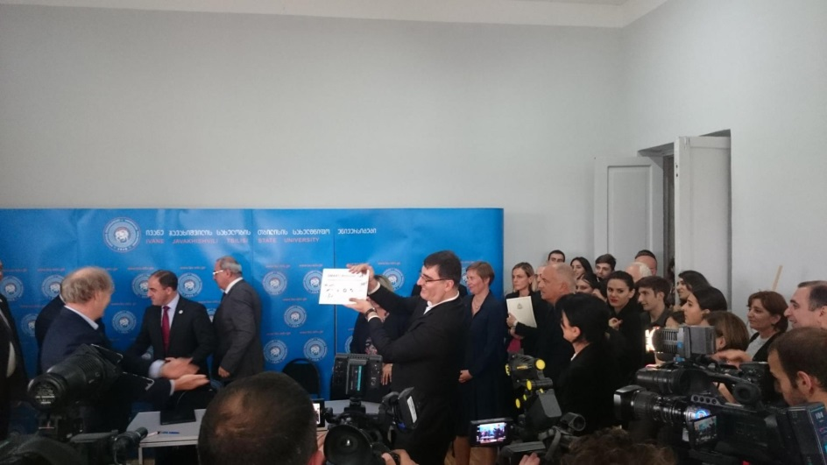
Diurnal and annual cycle of Nitrogen Oxides
SmartLab Opening 27/09/2017

Slide 3
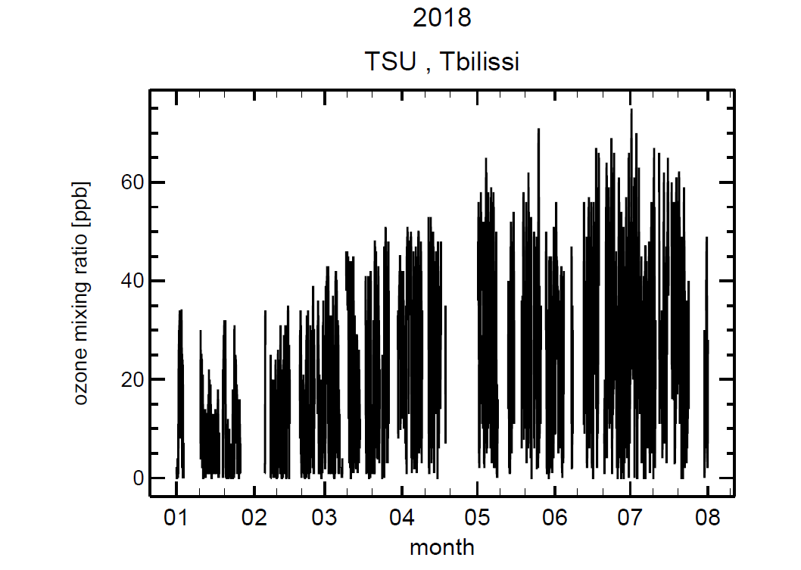
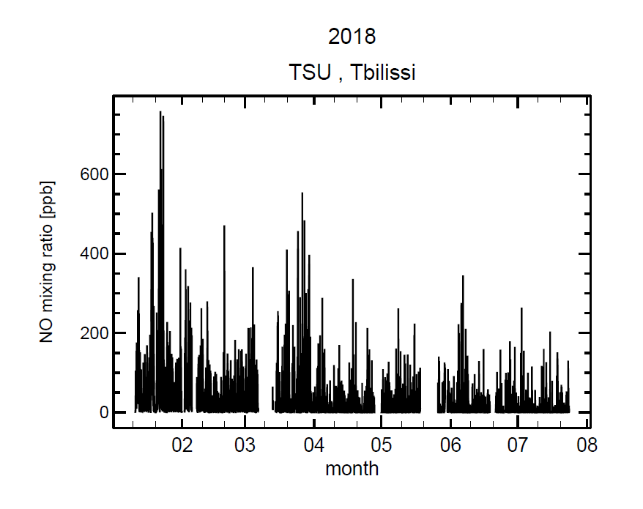
Diurnal and annual cycle of Nitrogen Oxides
SmartLab Opening 27/09/2017
11 Month of continuous data of CO₂, CO, CH₄, NO, NO₂ and ozone

Slide 4
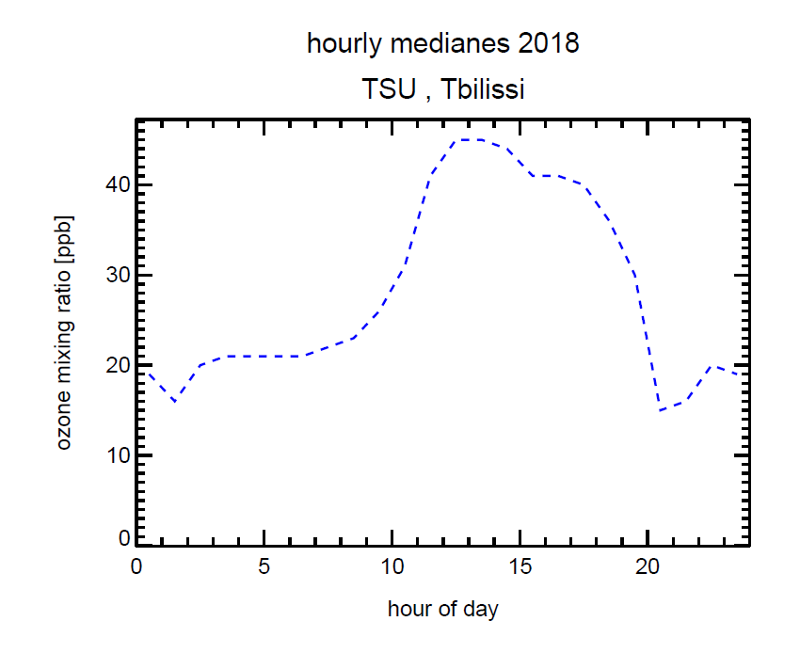
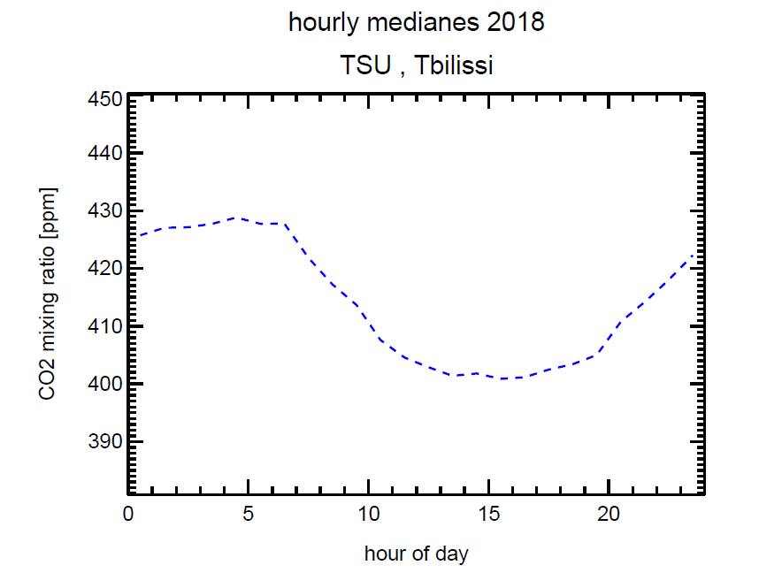
Diurnal and annual cycle of Nitrogen Oxides
Diurnal cycles of ozone / CO₂ in June

Slide 5
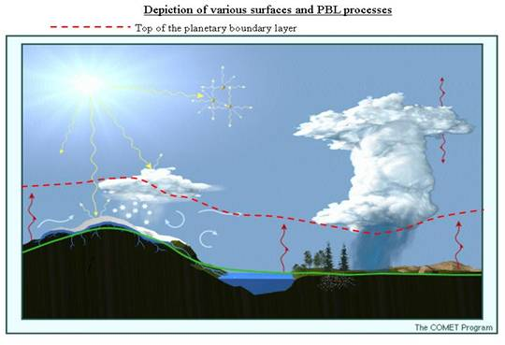
Diurnal and annual cycle of Nitrogen Oxides
The Planetary Boundary Layer (PBL)
part of the
atmosphere that is strongly influenced directly by the presence of the surface
of the earth
Day time boundary layer is usually very turbulent, due to ground-level heating
Thickness varies between 100 and 3000m in time
Strong diurnal variations
From: Stull, 1988

Slide 6
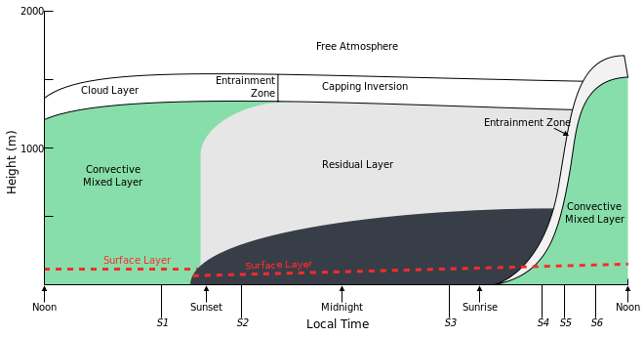
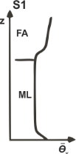
Diurnal and annual cycle of Nitrogen Oxides
Diurnal evolvement of the boundary layer in high pressure regions
Mixed Layer
Virtual potential temperature
Virtual temperature is the temperature that dry air must
have to equal the density of moist air at the same pressure
From: Stull, 1988
Notes:
sun heats the surface during daytime
surface is cooling during the night due to thermal radiation
5-10°C temperature difference day/night at the surface
air temperature above the surface follows slowly
temperature above 400m shows almost no variation
surface temperature is the driver for vertical mixing even with moderate wind
At and shortly after sunrise, surface heating causes turbulent eddies to develop,
producing a mixed layer whose depth grows to a maximum depth in late morning.
In this mixed layer, potential temperature and water vapor mixing ratio are nearly
uniform.

Slide 7
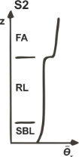
Diurnal and annual cycle of Nitrogen Oxides
Diurnal evolvement of the boundary layer in high pressure regions
Stable Boundary Layer formed
From: Stull, 1988
Notes:
At the sunset, the deep surface cooling creates a stable (nocturnal) boundary
layer, above which is a residual layer, basically the leftover part of the daytime
mixed layer

Slide 8
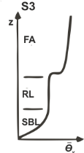
Diurnal and annual cycle of Nitrogen Oxides
Diurnal evolvement of the boundary layer in high pressure regions
Residual Layer (detached from ground)
From: Stull, 1988

Slide 9
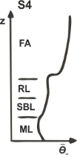
Diurnal and annual cycle of Nitrogen Oxides
Diurnal evolvement of the boundary layer in high pressure regions
Mixed Layer fomed again
From: Stull, 1988

Slide 10
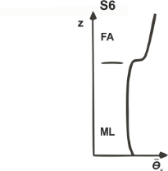
Diurnal and annual cycle of Nitrogen Oxides
Diurnal evolvement of the boundary layer in high pressure regions
Mixed Layer
developped
From: Stull, 1988

Slide 11
Diurnal and annual cycle of Nitrogen Oxides
Diurnal evolvement of the boundary layer in high pressure regions
m
2000
800
400
50
sunrise
sunset
Residual
Layer RL
Planetary
Boundary
Layer PBL
Residual
Layer RL
Nocturnal Boundary
Layer NBL
NBL
00:00 6:00 12:00 18:00 24:00

Slide 12
Diurnal and annual cycle of Nitrogen Oxides
Concentration of pollutants emitted from the ground (local sources, e.g. NOx,CO₂)
m
2000
800
400
50
sunrise
sunset
00:00 6:00 12:00 18:00 24:00

Slide 13
Diurnal and annual cycle of Nitrogen Oxides
Concentration of pollutants emitted from the ground (local sources, e.g. NOx)
lifting of the mixing layer
Mixing layer is fully developed
Nocturnal boundary
layer is developing
Nox, CO, CO2, CH4
concentrations are
highest in the early
morning

Slide 14
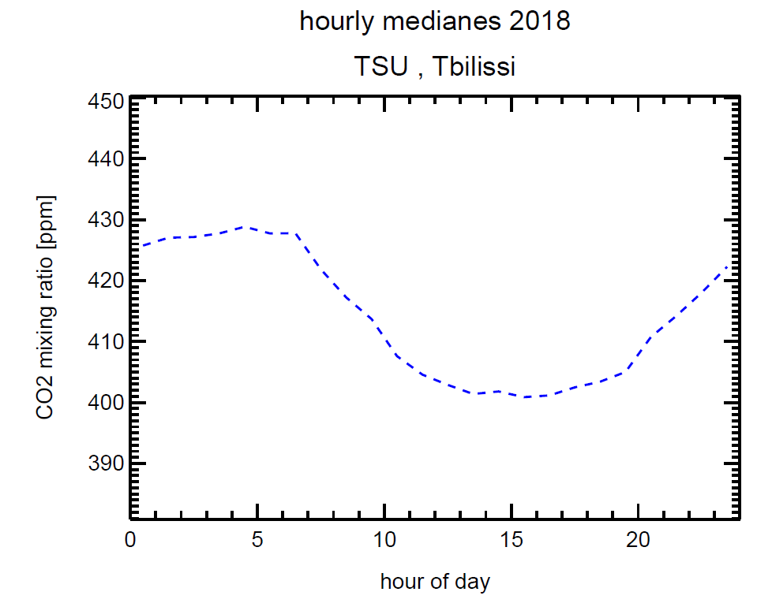
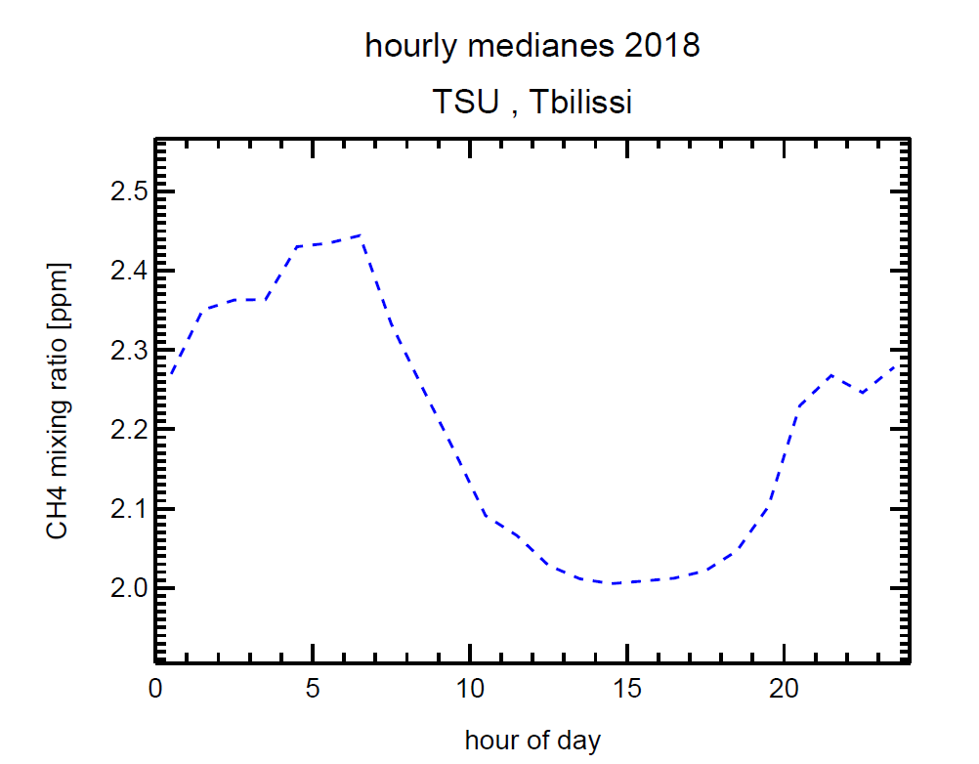
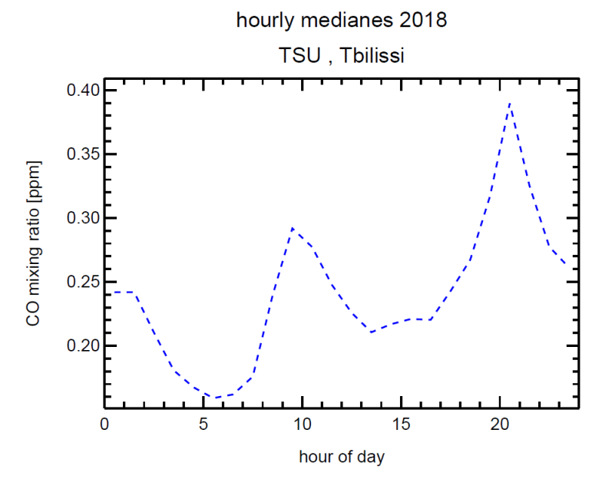
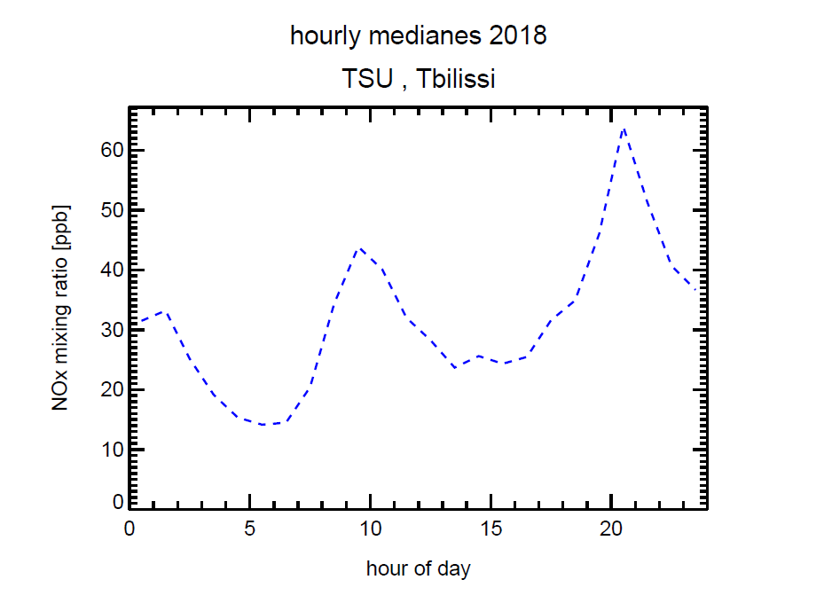
Diurnal and annual cycle of Nitrogen Oxides
Concentration of pollutants emitted from the ground (local sources)
sunrise
sunset
Notes:
Sunrise 5:30
Sunset 20:30

Slide 15
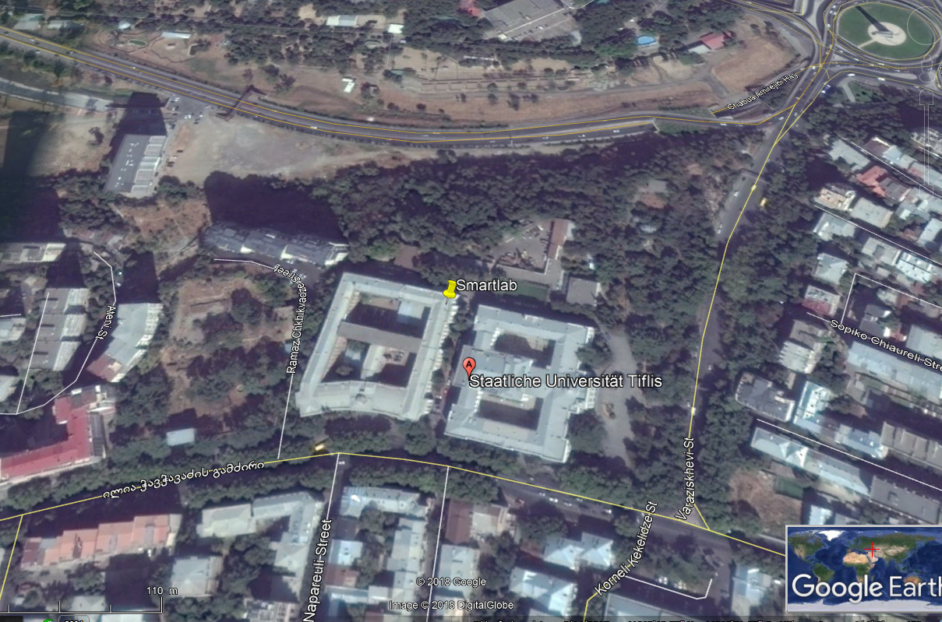
Diurnal and annual cycle of Nitrogen Oxides
Concentration of pollutants emitted from the ground (local sources, e.g. NOx)
Position of the SmartLab

Slide 16
Diurnal and annual cycle of Nitrogen Oxides
Concentration of pollutants emitted from the ground (local sources)
sunrise
sunset
Notes:
Sunrise 5:30
Sunset 20:30

Slide 17
Diurnal and annual cycle of Nitrogen Oxides
Concentration of pollutants with no local sources, e.g. Ozone
m
2000
800
400
50
sunrise
sunset
00:00 6:00 12:00 18:00 24:00

Slide 18
Diurnal and annual cycle of Nitrogen Oxides
Concentration of pollutants with no local sources, e.g. Ozone
Can it be measured ?
m
2000
800
400
50
sunrise
sunset
00:00 6:00 12:00 18:00 24:00

Slide 19
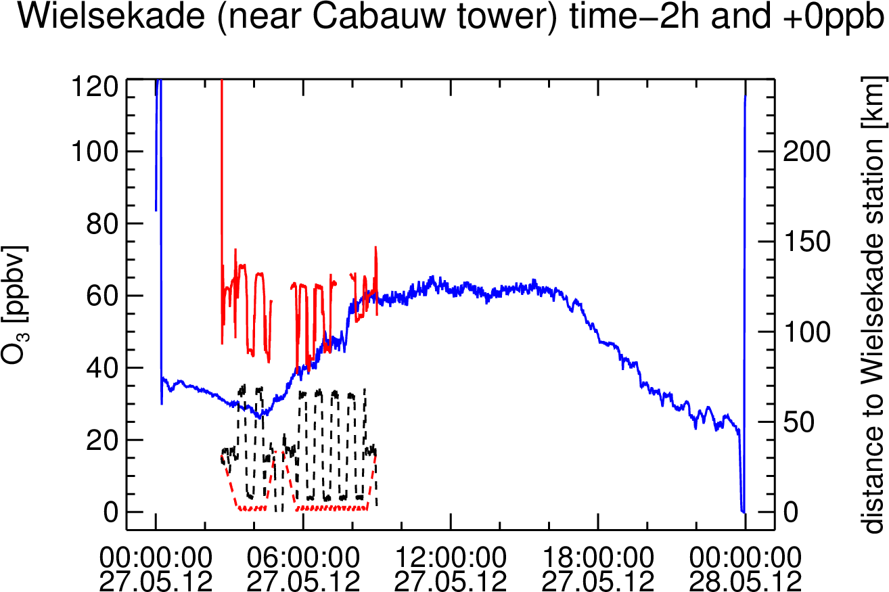
Diurnal and annual cycle of Nitrogen Oxides
Concentration of pollutants with no local sources, e.g. Ozone
m
2000
800
400
50
sunrise
sunset
00:00 6:00 12:00 18:00 24:00

Slide 20
Diurnal and annual cycle of Nitrogen Oxides
Concentration of pollutants with no local sources, e.g. Ozone
lifting of the mixing layer
Mixing layer is fully developed
Nocturnal boundary
layer is developing
Ozone
Concentrations is
highest during the day

Slide 21
Diurnal and annual cycle of Nitrogen Oxides
Concentration of pollutants with no local sources, e.g. Ozone
lifting of the mixing layer
Mixing layer is fully developed
Nocturnal boundary
layer is developing
photochemical
production
of ozone

Slide 22
Diurnal and annual cycle of Nitrogen Oxides
Median Ozone data June 2018
sunrise
sunset

Slide 23
Diurnal and annual cycle of Nitrogen Oxides
The ratio of NO to NO₂ is governed by the photostationary state (PSS)
NO₂ + hν →NO + O ; J(NO₂)
O + O₂ + M → O₃ + M ; very fast
NO + O₃ → NO₂ + O₂ ; k_{(NO+O3)}

Slide 24
Diurnal and annual cycle of Nitrogen Oxides
The ratio of NO to NO₂ is governed by the photostationary state (PSS)
NO₂ + hν →NO + O ; J(NO₂)
O + O₂ + M → O₃ + M ; very fast
NO + O₃ → NO₂ + O₂ ; k_{(NO+O3)}

Slide 25
Diurnal and annual cycle of Nitrogen Oxides
The ratio of NO to NO₂ is governed by the photostationary state (PSS)
NO₂ + hν →NO + O ; J(NO₂)
O + O₂ + M → O₃ + M ; very fast
NO + O₃ → NO₂ + O₂ ; k_{(NO+O3)}

Slide 26
Diurnal and annual cycle of Nitrogen Oxides
The ratio of NO to NO₂ is governed by the photostationary state (PSS)
NO₂ + hν →NO + O ; J(NO₂)
O + O₂ + M → O₃ + M ; very fast
NO + O₃ → NO₂ + O₂ ; k_{(NO+O3)}

Slide 27
Diurnal and annual cycle of Nitrogen Oxides
The ratio of NO to NO₂ is governed by the photostationary state (PSS)
NO₂ + hν →NO + O ; J(NO₂)
O + O₂ + M → O₃ + M ; very fast
NO + O₃ → NO₂ + O₂ ; k_{(NO+O3)}

Slide 28
Diurnal and annual cycle of Nitrogen Oxides
The ratio of NO to NO₂ is governed by the photostationary state (PSS)
caused by the early onset of JNO2 and the shifted lifting of the mixing layer
NO₂ + hν →NO + O ; J(NO₂)
O + O₂ + M → O₃ + M ; very fast
NO + O₃ → NO₂ + O₂ ; k_{(NO+O3)}
Zero at night

Slide 29
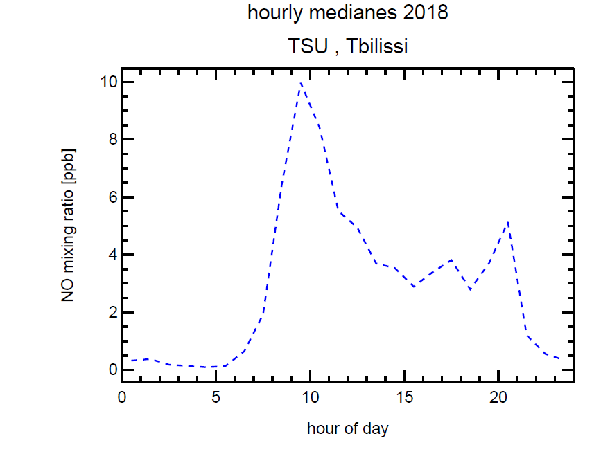
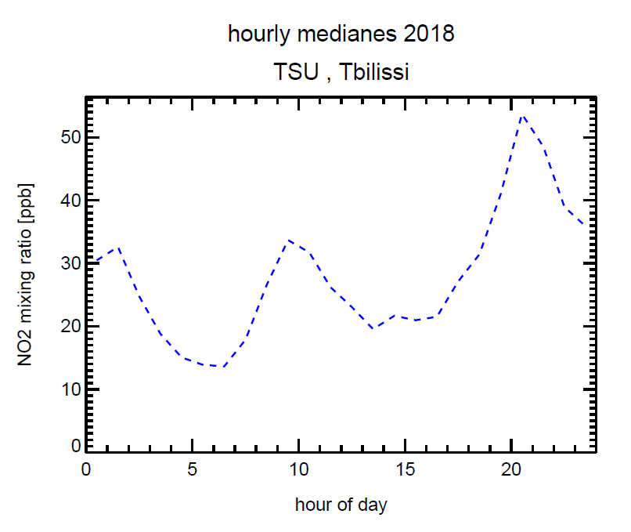
Diurnal and annual cycle of Nitrogen Oxides
The ratio of NO to NO₂ is governed by the photostationary state (PSS)
Hourly medians for June
sunrise
sunset

Slide 30
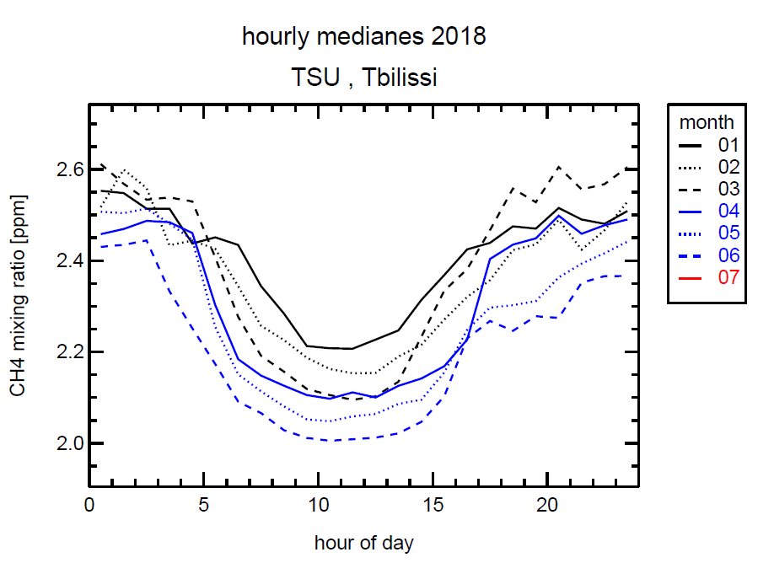
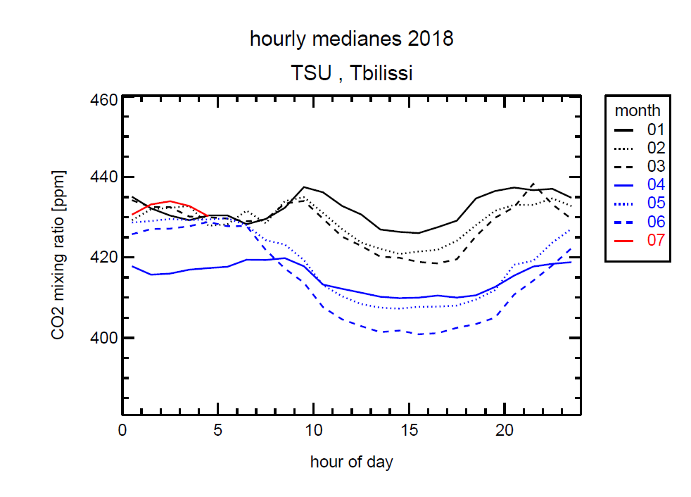
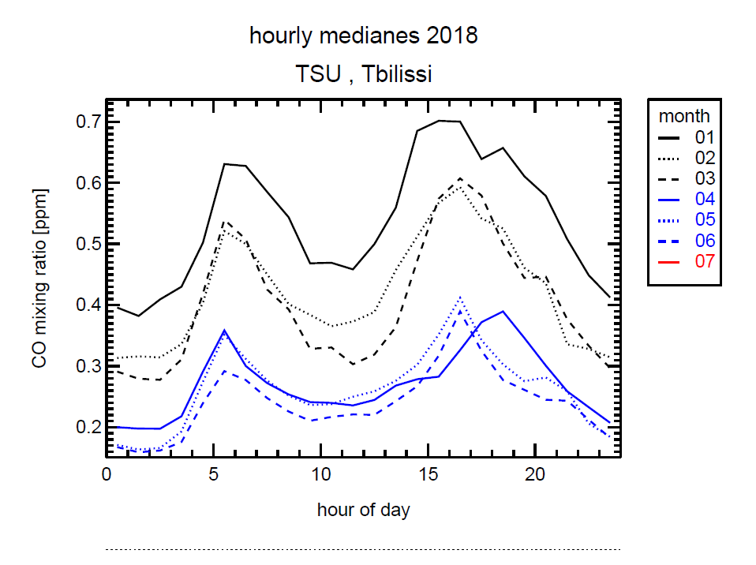
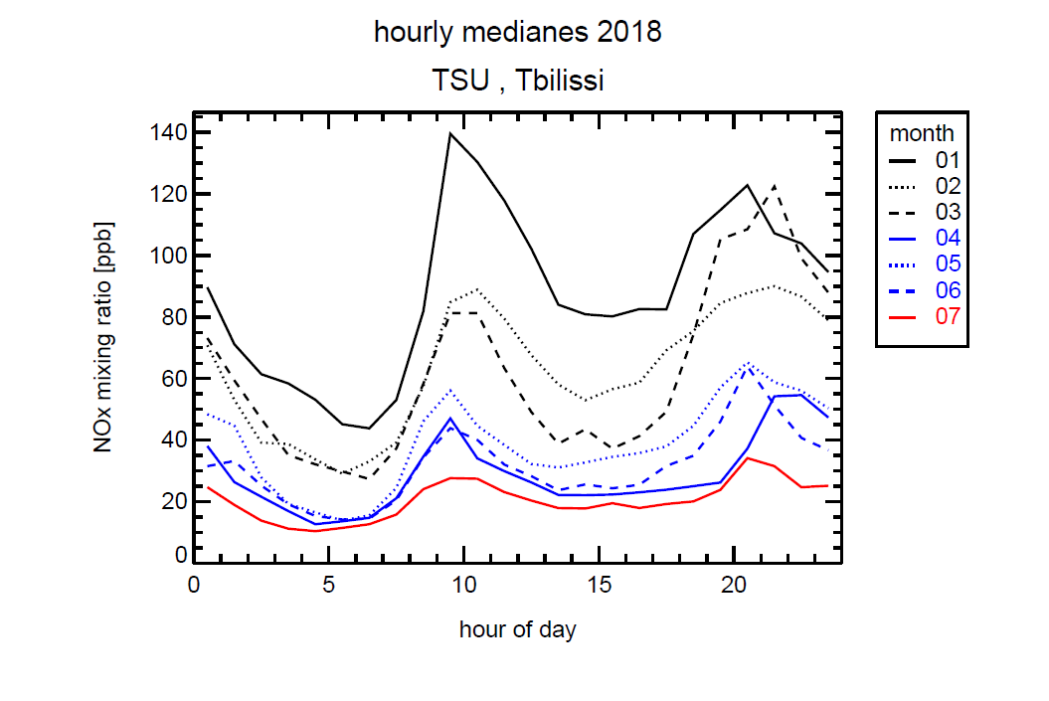
Diurnal and annual cycle of Nitrogen Oxides
Annual cycles of compounds with local sources

Slide 31
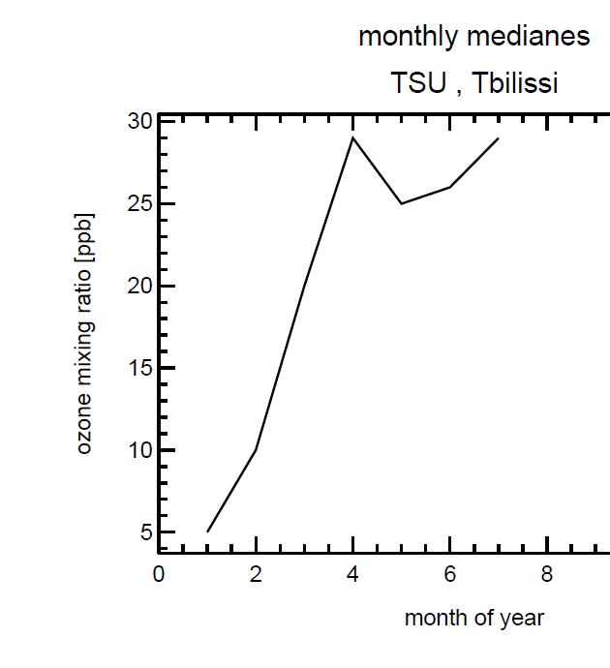
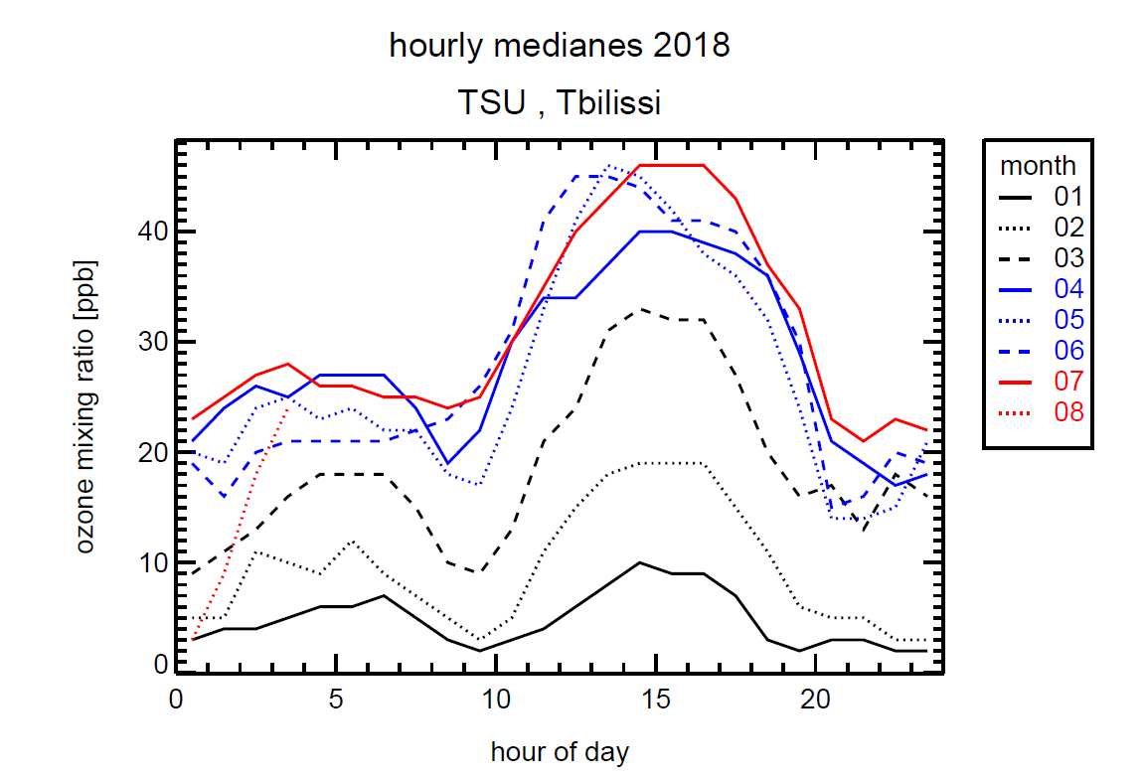
Diurnal and annual cycle of Nitrogen Oxides
Annual cycle of nitrogen oxides

Slide 32
Diurnal and annual cycle of Nitrogen Oxides
Annual cycle of nitrogen oxides
Zero at night

Slide 33
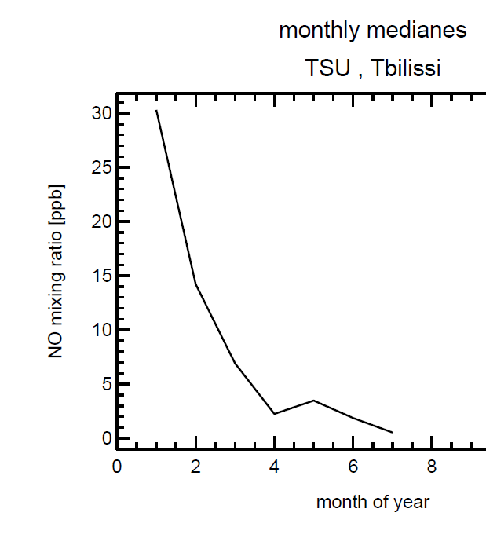
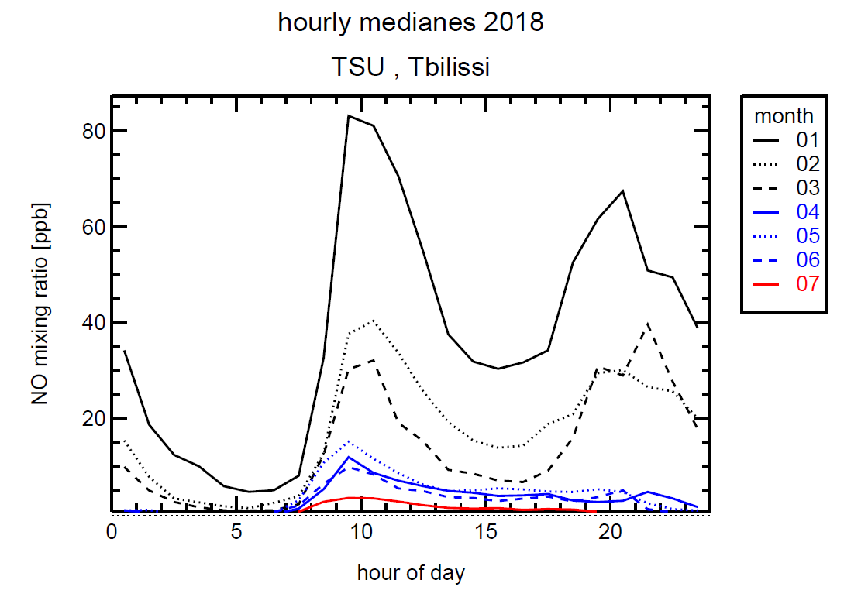
Diurnal and annual cycle of Nitrogen Oxides
Annual cycle of nitrogen oxides

Slide 34
Diurnal and annual cycle of Nitrogen Oxides
Annual cycle of nitrogen oxides
Second peak due to traffic
Larger than zero at night

Slide 35
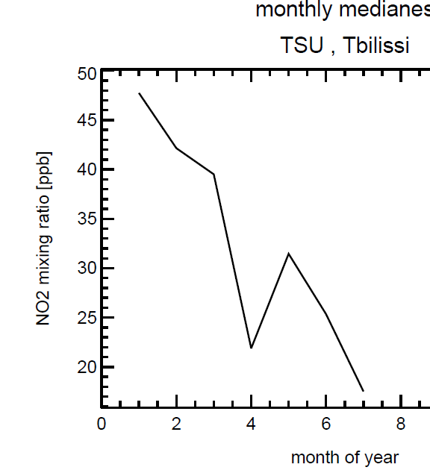
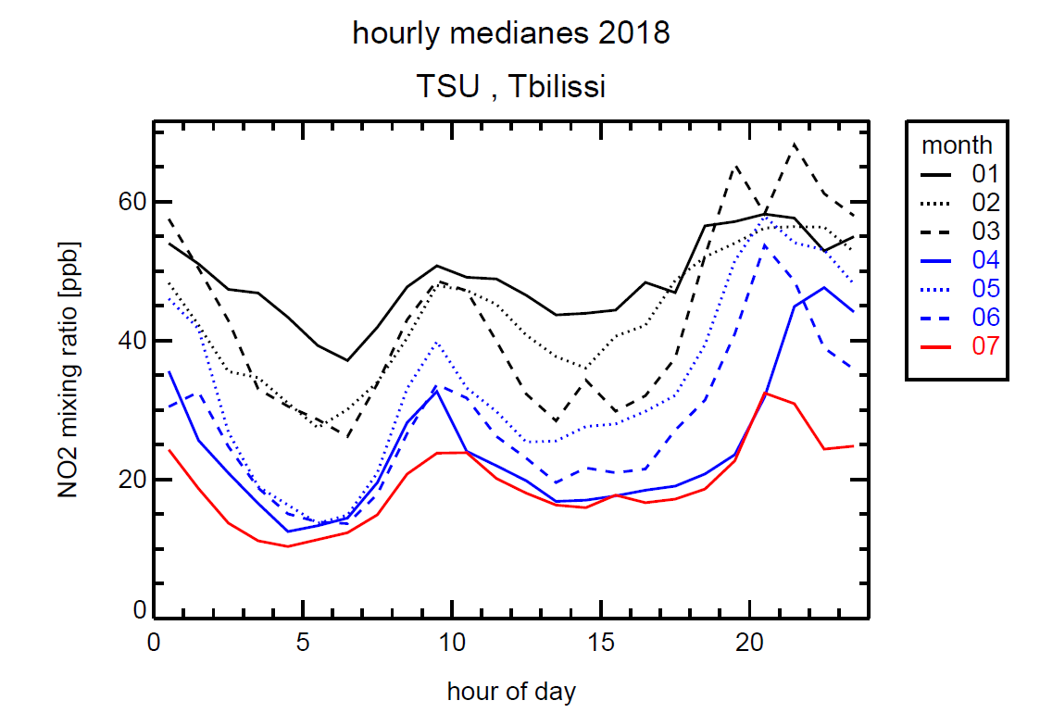
Diurnal and annual cycle of Nitrogen Oxides
Annual cycle of nitrogen oxides

Slide 36
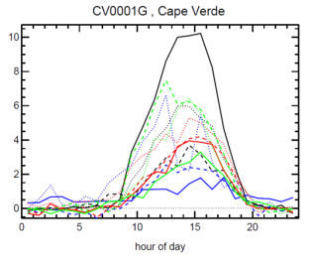
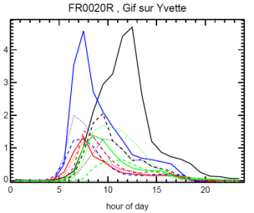
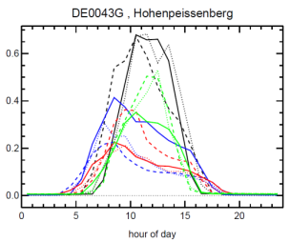
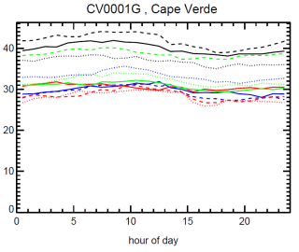
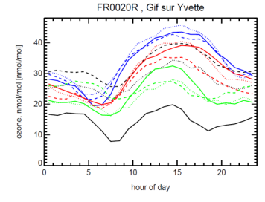
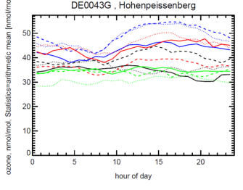
Diurnal and annual cycle of Nitrogen Oxides
Summary
High NO2 and NO values in winter
High ozone values in summer
Data affected from highly-trafficked
Street nearby.
How is the situation at other sites ?
See talks on Friday morning

Slide 37
Diurnal and annual cycle of Nitrogen Oxides
Summary
High NO2 and NO values in winter
High ozone values in summer
Data affected from highly-trafficked
Street nearby.
How is the situation at other sites ?
See talks on Friday morning
Thank you,
გმადლობთ

Slide 38
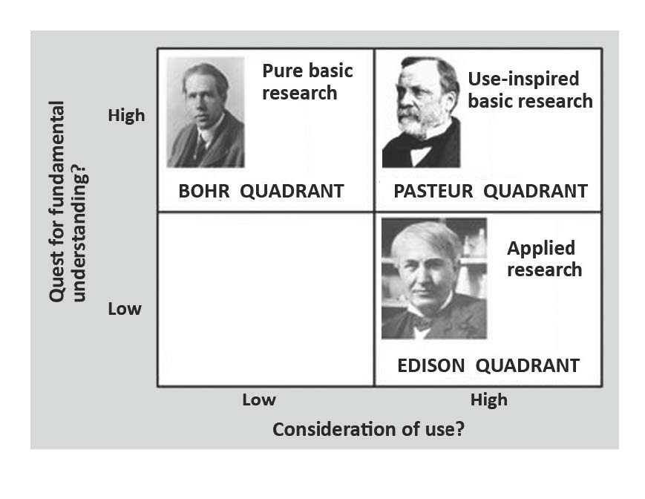
Diurnal and annual cycle of Nitrogen Oxides
Summary
High NO2 and NO values in winter
High ozone values in summer
Data affected from highly-trafficked
Street nearby.
How is the situation at other sites ?
See talks on Friday morning

Slide 39
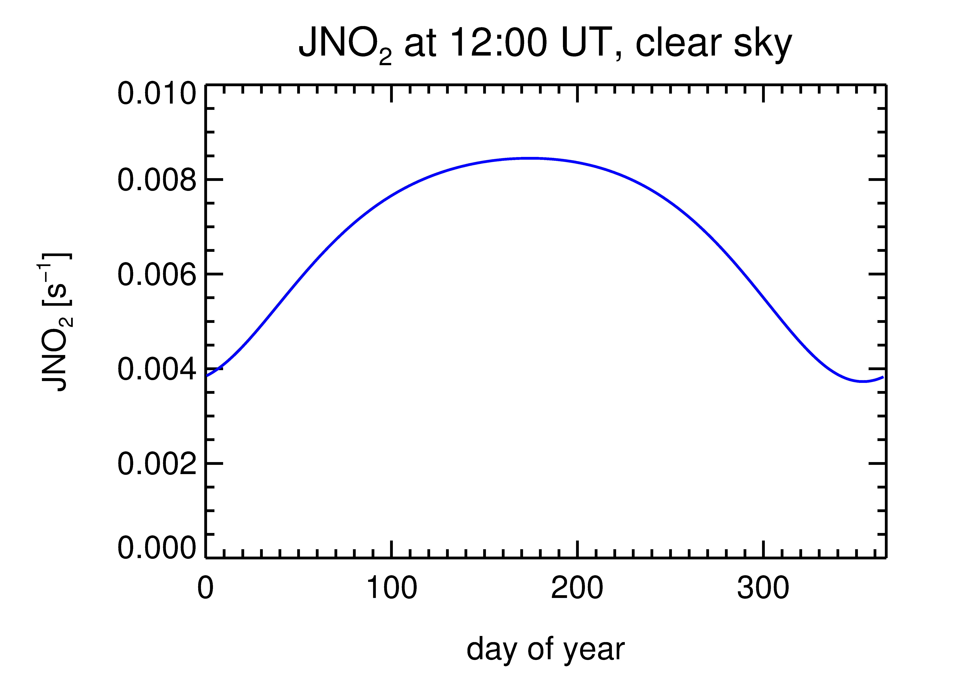
Diurnal and annual cycle of Nitrogen Oxides
Annual cycle of nitrogen oxides
NO₂ + hν →NO + O ; J(NO₂)
O + O₂ + M → O₃ + M ; very fast
NO + O₃ → NO₂ + O₂ ; k_{(NO+O3)}

Slide 40
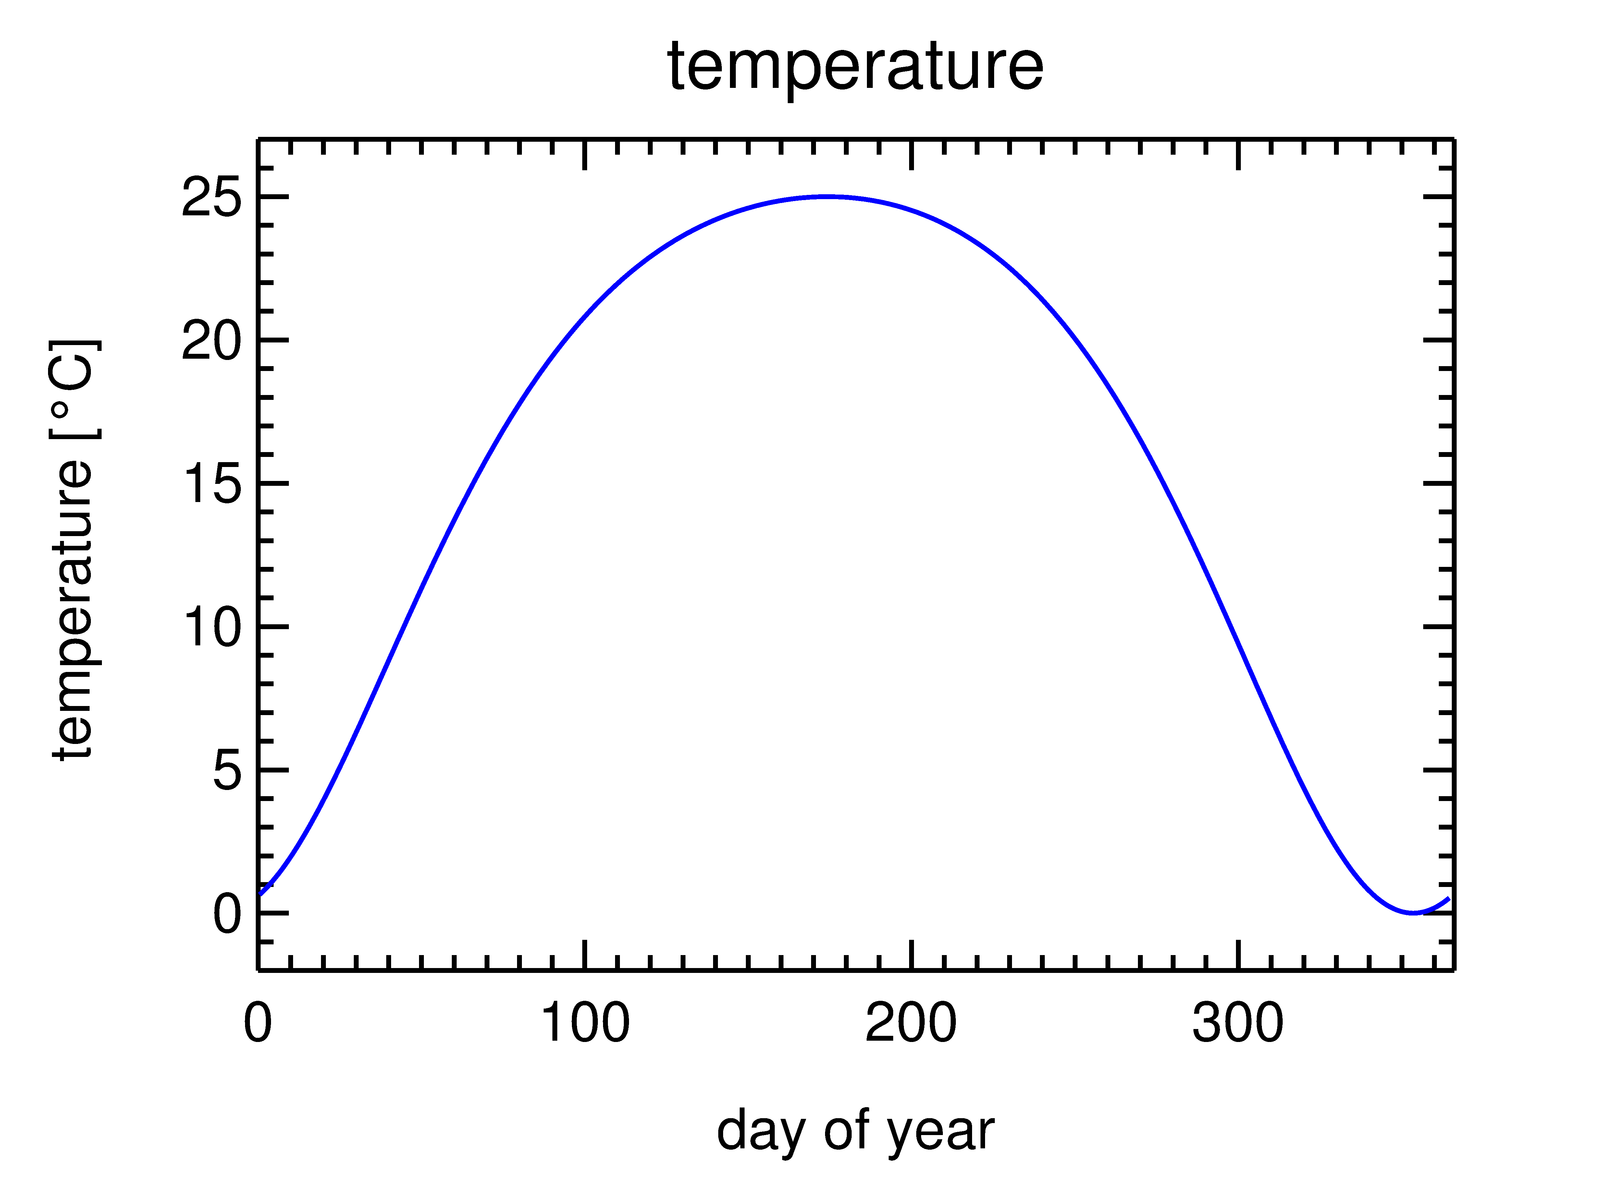
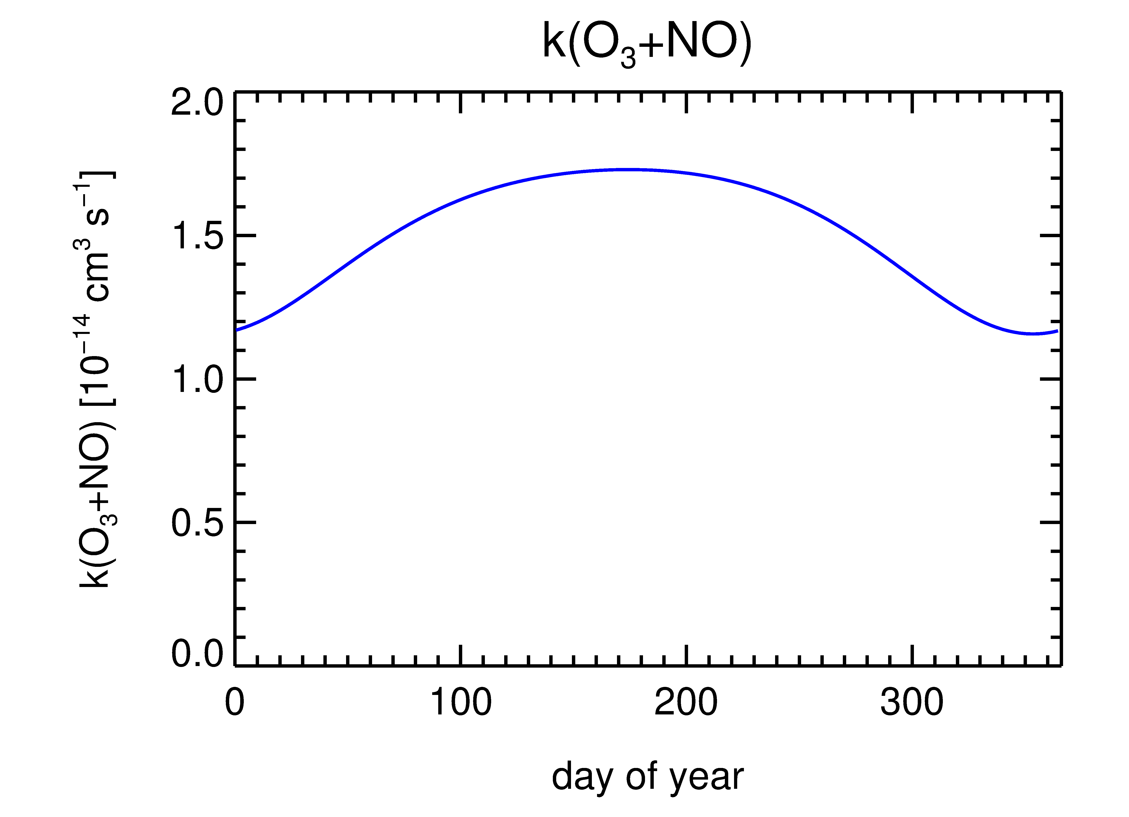
Diurnal and annual cycle of Nitrogen Oxides
Annual cycle of nitrogen oxides
NO₂ + hν →NO + O ; J(NO₂)
O + O₂ + M → O₃ + M ; very fast
NO + O₃ → NO₂ + O₂ ; k_{(NO+O3)}

Slide 41
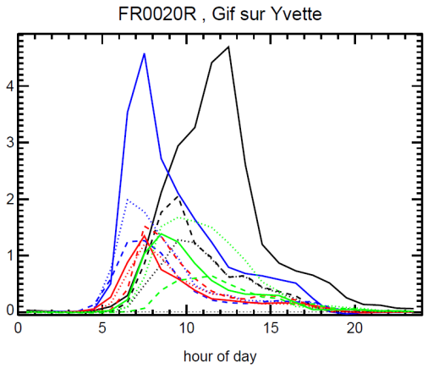
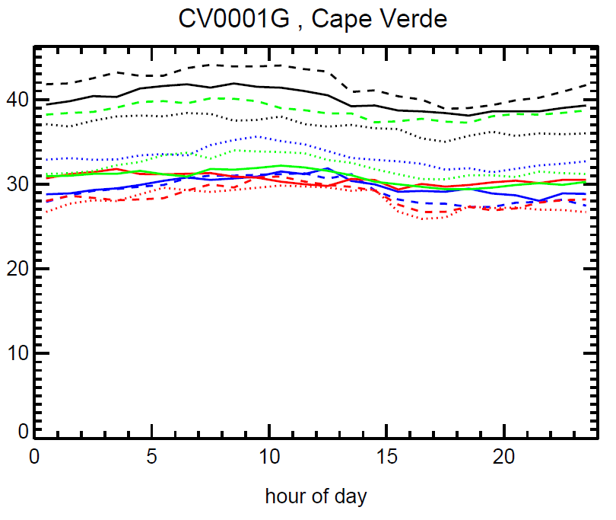
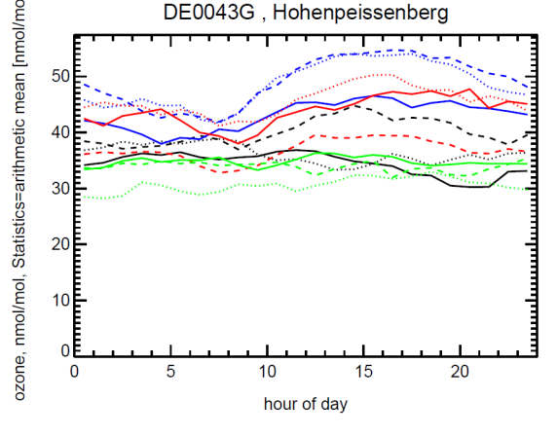
Diurnal and annual cycle of Nitrogen Oxides

Slide 42
Diurnal and annual cycle of Nitrogen Oxides
Concentration of pollutants with no local sources, e.g. Ozone
sunrise
sunset
ppb
60
40
20
0
RL at 800m
Ozone
NBL
surface observation
00:00 6:00 12:00 18:00 24:00

Slide 43
Diurnal and annual cycle of Nitrogen Oxides
Summary
High NO2 and NO values in winter
High ozone values in Summer
Data affected from highly trafficked
Street nearby
How is the situation at other sites ?
See talks on Friday morning

Slide 44
Diurnal and annual cycle of Nitrogen Oxides
Summary
High NO2 and NO values in winter
High ozone values in Summer
Data affected from highly trafficked
Street nearby
How is the situation at other sites ?
See talks on Friday morning

Slide 45
Diurnal and annual cycle of Nitrogen Oxides
Summary
High NO2 and NO values in winter
High ozone values in Summer
Data affected from highly trafficked
Street nearby
How is the situation at other sites ?
See talks on Friday morning

Slide 46
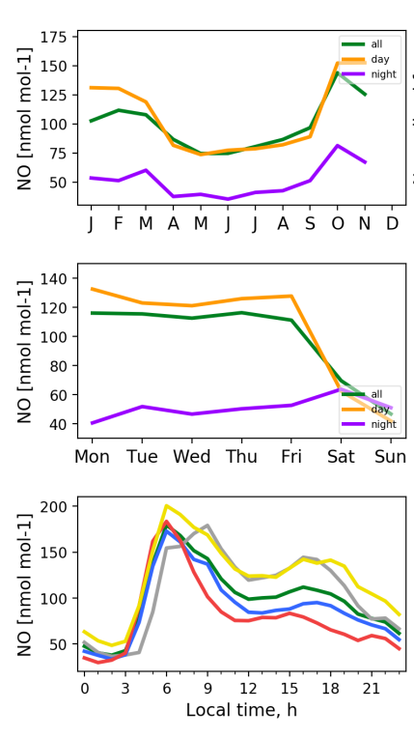
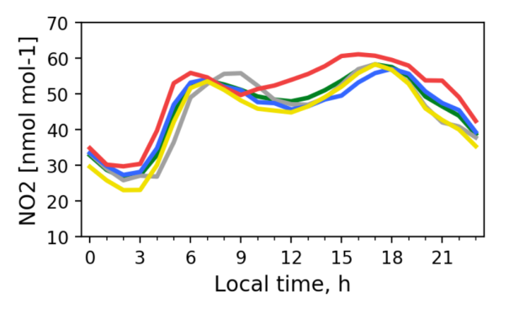
Diurnal and annual cycle of Nitrogen Oxides
Nitrogen oxides at highly trafficked streets
Weekend effect.
NO > zero, also at night.
Source: Join database
https://join.fz-juelich.de

Slide 47
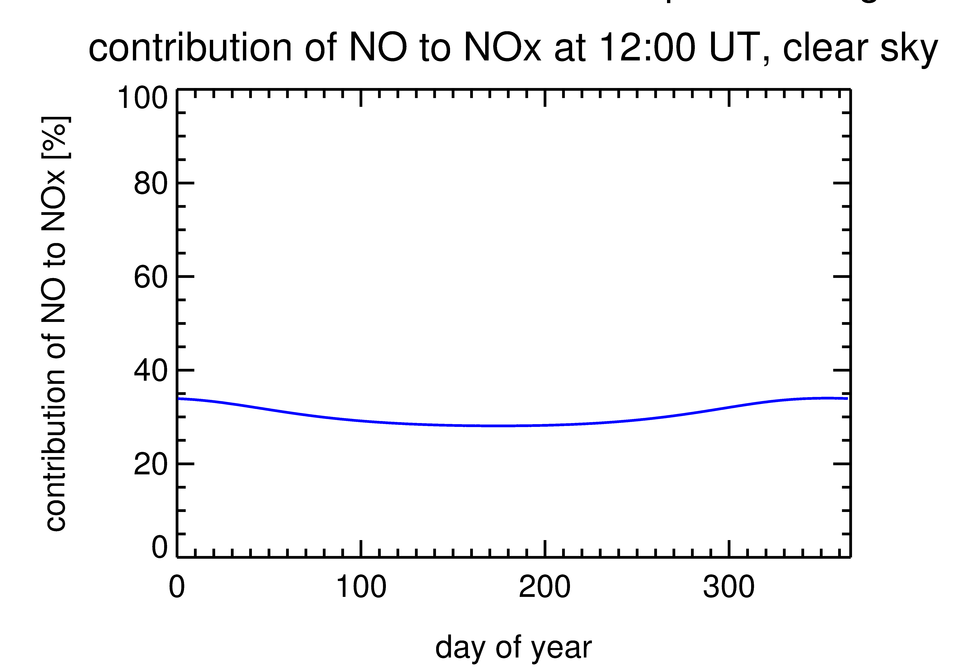
Diurnal and annual cycle of Nitrogen Oxides
Annual cycle of nitrogen oxides
NO₂ + hν →NO + O ; J(NO₂)
O + O₂ + M → O₃ + M ; very fast
NO + O₃ → NO₂ + O₂ ; k_{(NO+O3)}

Slide 48
Diurnal and annual cycle of Nitrogen Oxides
Annual cycle of CO, CH4, CO2
sunrise
sunset

Slide 49
Diurnal and annual cycle of Nitrogen Oxides
Annual cycle of nitrogen oxides
NO₂ + hν →NO + O ; J(NO₂)
O + O₂ + M → O₃ + M ; very fast
NO + O₃ → NO₂ + O₂ ; k_{(NO+O3)}

Slide 50
Diurnal and annual cycle of Nitrogen Oxides
Annual cycle of nitrogen oxides
NO₂ + hν →NO + O ; J(NO₂)
O + O₂ + M → O₃ + M ; very fast
NO + O₃ → NO₂ + O₂ ; k_{(NO+O3)}

Slide 51
Diurnal and annual cycle of Nitrogen Oxides
Diurnal evolvement of the boundary layer in high pressure regions
m
2000
800
400
50
sunrise
sunset
00:00 6:00 12:00 18:00 24:00

Slide 52
Diurnal and annual cycle of Nitrogen Oxides
The ratio of NO to NO₂ is governed by the photostationary state (PSS)
caused by the early onset of JNO2 and the shifted lifting of the mixing layer
NO₂ + hν →NO + O ; J(NO₂)
O + O₂ + M → O₃ + M ; very fast
NO + O₃ → NO₂ + O₂ ; k_{(NO+O3)}

Slide 53
Diurnal and annual cycle of Nitrogen Oxides
Nitrogen oxides at highly trafficked streets

Slide 54
Diurnal and annual cycle of Nitrogen Oxides
Temporal evalution of the planetary boundary Layer

Slide 55
Messungen TP6 für die DRITTE IOP-STUTTGART (07.02.18 – 23.02.18)
Mobile Messungen Messrouten:
Feuerbach
Krummbachtal
Neckartor
Heslacher Tunnel

Slide 56
Messungen TP6 für die DRITTE IOP-STUTTGART (07.02.18 – 23.02.18)
Mobile Messungen Messrouten Neckartor
Neckartor
Route um das Neckartor

Slide 57
Messungen TP6 für die DRITTE IOP-STUTTGART (07.02.18 – 23.02.18)
Mobile Messungen MOBILAB:
Datum | Name
23.02.2018 | Stuttgart -> FZJ
22.02.2018 | Neckartorrunde / Heslachtunnel (3x), Kaltenbachtal, Krummbachtal, Sonnenberg
21.02.2018 | Neckartorrunde / Heslachtunnel (3x), Kaltenbachtal, Krummbachtal, Sonnenberg
20.02.2018 | FZJ -> Stuttgart
15.02.2018 | Rückfahrt Stuttgart FZJ
14.02.2018 | Neckartorrunde / Heslachtunnel (4x), Kaltenbachtal
13.02.2018 | Neckartorrunde / Heslachtunnel (4x), Kaltenbachtal
12.02.2018 | Uni Vaihingen Feuerbachrunde
11.02.2018 | Uni Vaihingen, Feuerbachrunde, Krummbachtal
10.02.2018 | Neckartorrunde / Heslachtunnel (3x) , Uni Vaihingen
09.02.2018 | Neckartorrunde / Heslachtunnel (4x) , Krummbachtal
08.02.2018 | Neckartorrunde / Heslachtunnel (5x)
07.02.2018 | Hinfahrt
Übersicht Messfahrten

Slide 58
Messungen TP6 für die DRITTE IOP-STUTTGART (07.02.18 – 23.02.18)
NO2 um das Neckartor (13.02.2018)
NO2 [ppb]
06:00
09:00
12:00
15:00
18:00
Ausgeprägter NO₂
Tagesgang.
Starke Unterschiede
westlich und östlich
der B14.

Slide 59
Messungen TP6 für die DRITTE IOP-STUTTGART (07.02.18 – 23.02.18)
NO2 / N2O um das Neckartor (13.02.2018)
N₂O [ppb]
NO₂ [ppb]
09:00
12:00
15:00
18:00
N₂O ist wie NO₂ entlang der B14 erhöht, zeigt z.T. aber andere Features

Slide 60
Messungen TP6 für die DRITTE IOP-STUTTGART (07.02.18 – 23.02.18)
NO2 / N2O um das Neckartor (13.02.2018)
Das Verhältnis von
N2O zu NOx-Emissionen
unterschiedet sich.
From: HAUSBERGER, Stefan: N2O aus mobilen Quellen. In: ACCC-Workshop „N2O und das Kyoto-Ziel“,
Universität für Bodenkultur, Wien. 1999, S. 1–14. URL: http://www.accc.gv.at/pdf/no-hausberger.pdf

Slide 61
VieRTE IOP StuTTGART
Mobile Messungen zusammen mit DLR:
WIND
WIND
Messungen im Luv / Lee der Stadt
Messungen im Luv / Lee der Stadt

