Slide 1
Power Supply Development for JEDI Polarimeter Modules
Otari Javakhishvili
(AUG / SMART|EDM_Lab TSU )
23.08.2018

Slide 2
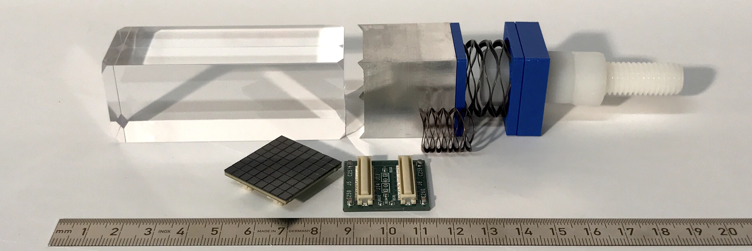
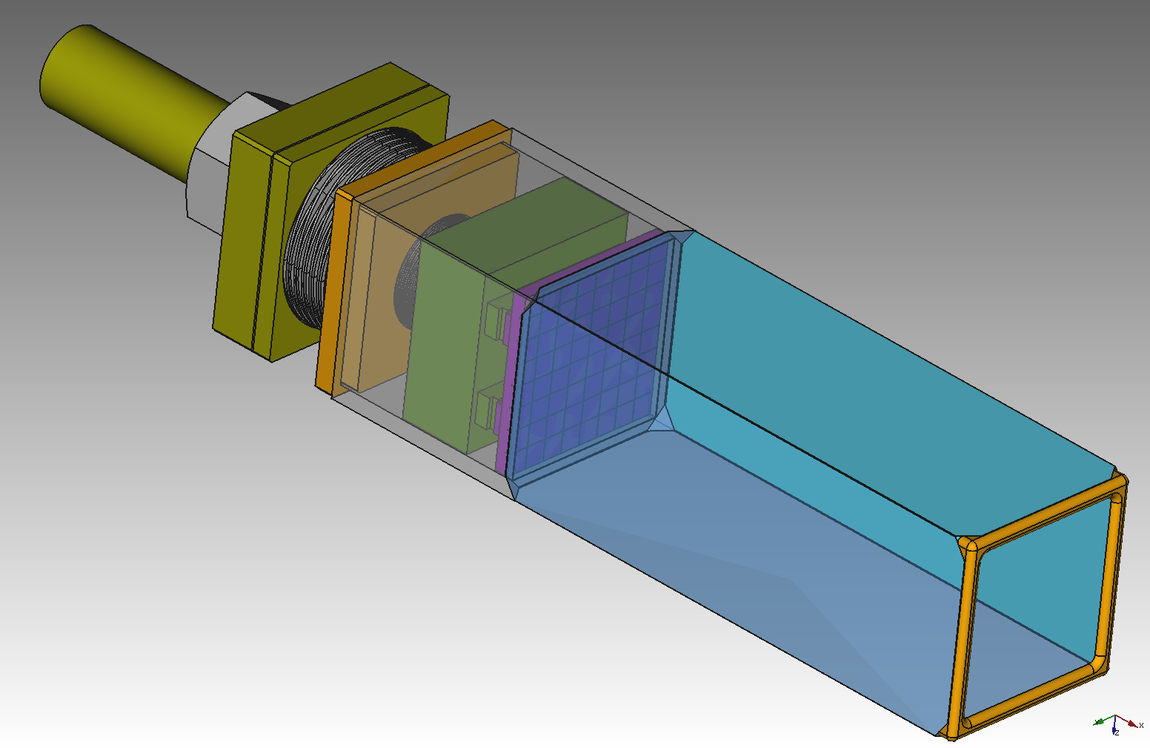
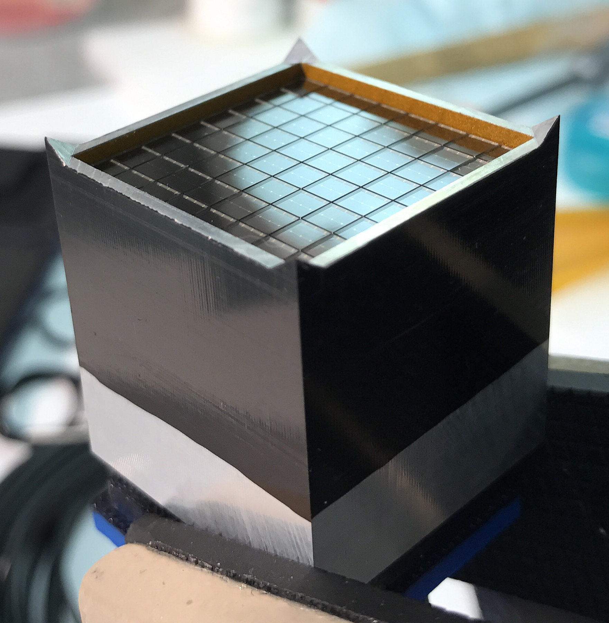
Detector module structure
Aluminum holder and wave springs for tension
LYSO Cristal 3X3X8 cm
SiPM (SensL J-series, 20µm pixel) Module and connector
23/08/2018
Otari Javakhishvili
2

Slide 3
SiPM Lab Test
Signal Generator
Power Supply
25v ~ 32v
Dark box
SiPM
Oscilloscope
(Fixed Signal)
LED Flasher
23/08/2018
Otari Javakhishvili
3

Slide 4
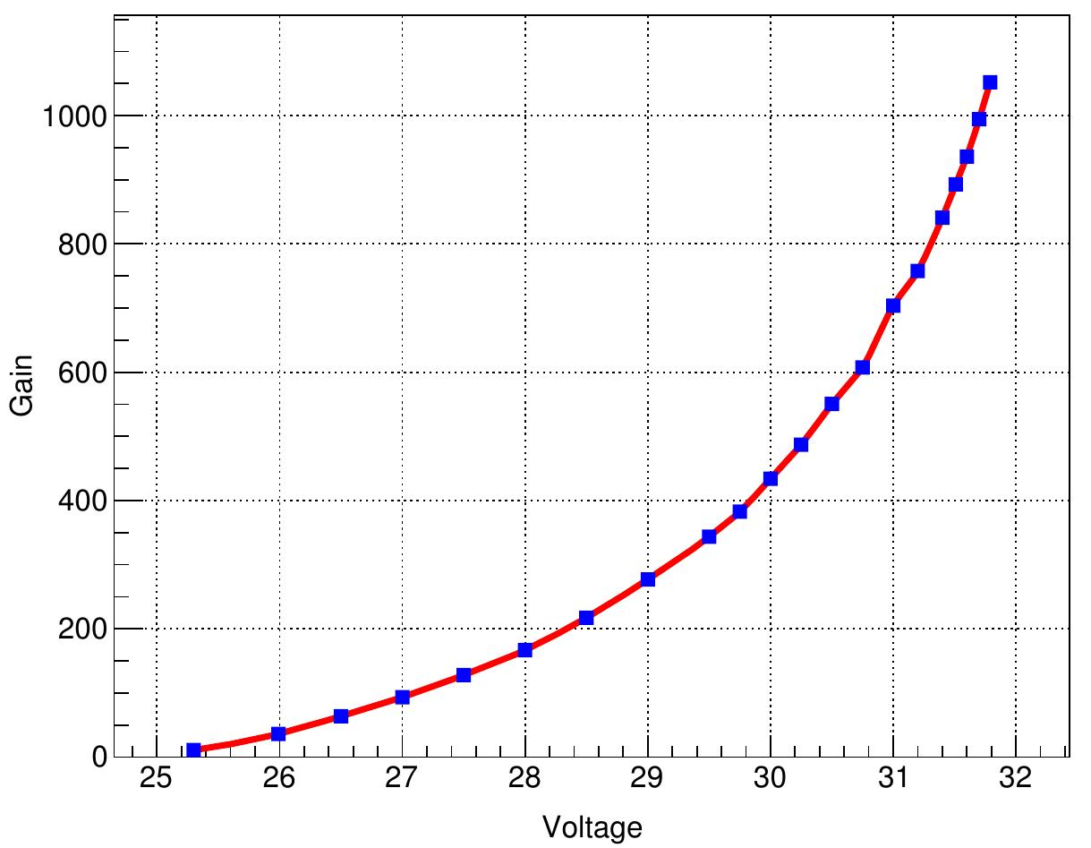
SiPM Gain vs Voltage
1mV variation ~ 0.02…0.05 % in gain
[a.u.]
Gain variation is directly related to energy resolution
Voltage [V]
LYSO energy resolution ~ 1%
Max. accepted ∆V ~ 10mV
23/08/2018
Otari Javakhishvili
4

Slide 5
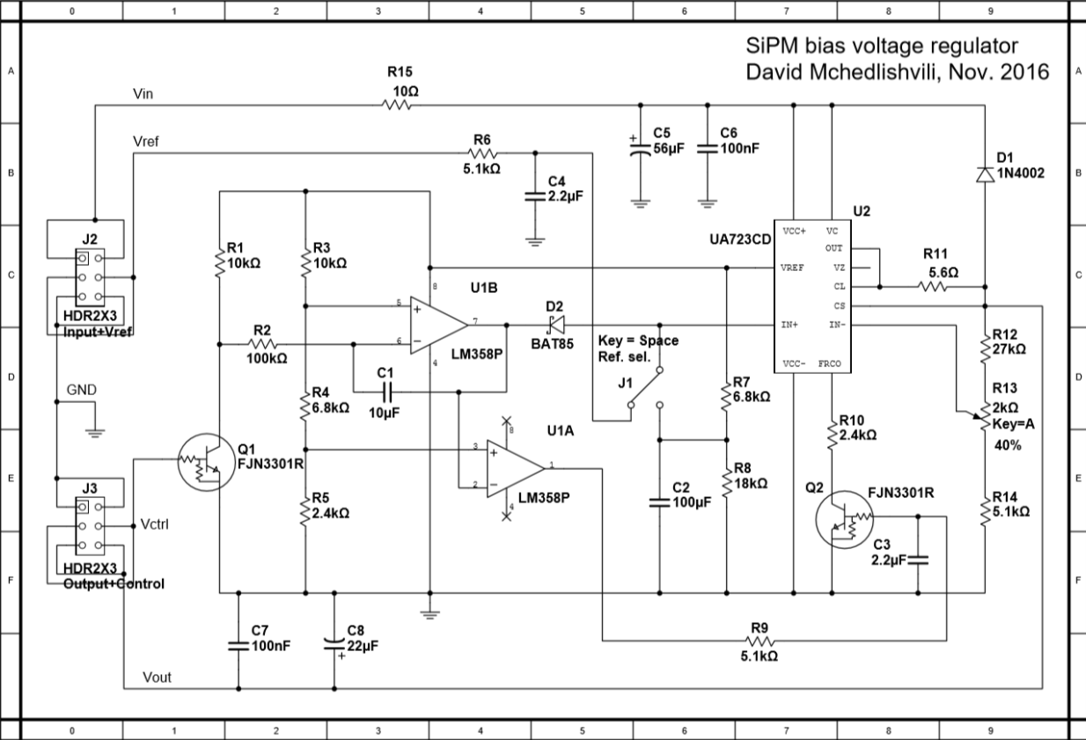
Development of a new voltage source
Basic requirements:
Modular design
High output stability (temperature, long/short term, low noise)
Remote on/off capability (currently organized using Raspberry Pi)
Voltage adjustment (currently only manual)
Linear voltage regulator part
Ramp generator and on/off part
23/08/2018
Otari Javakhishvili
5

Slide 6
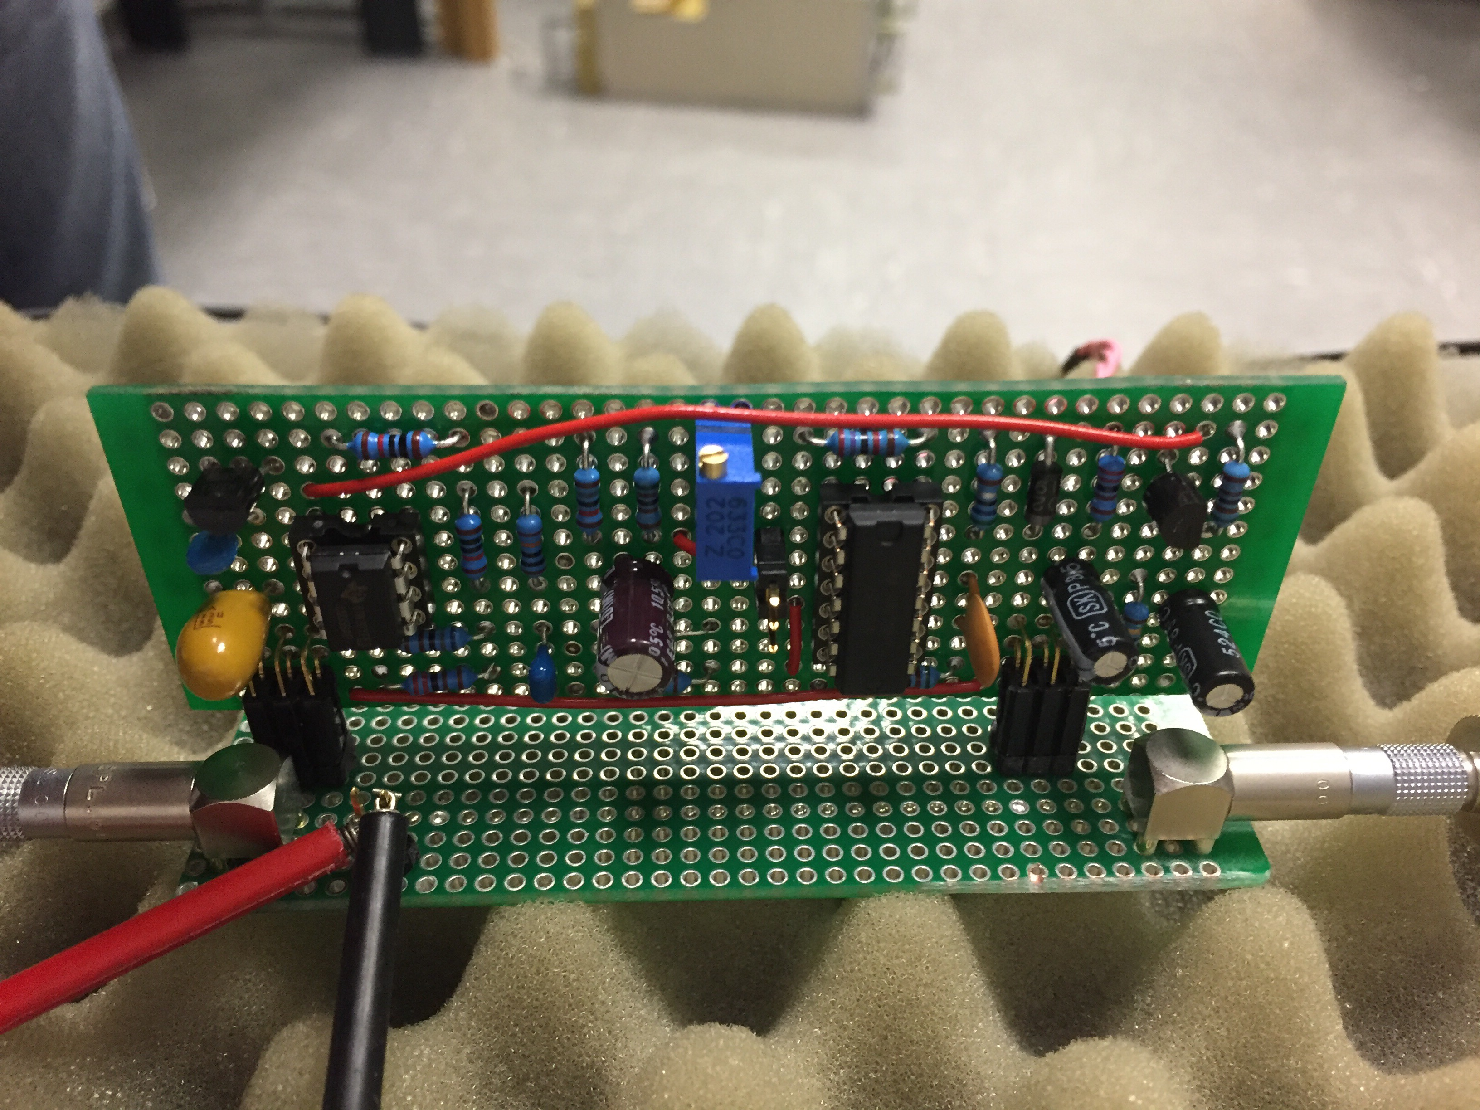
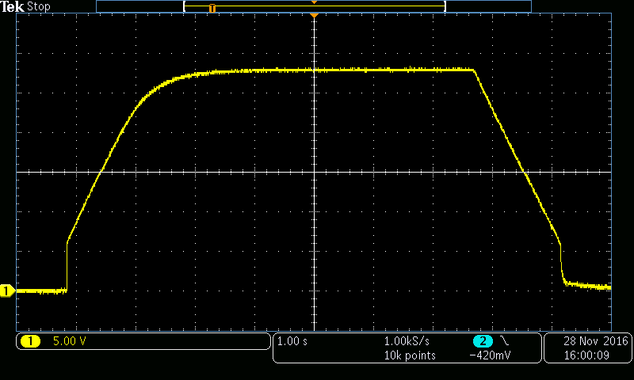
First tests
First prototype board on a test bench (using internal voltage reference)
Output on/off curve with voltage ramp
23/08/2018
Otari Javakhishvili
6

Slide 7
Power Supply Testing
The Idea:
Employ real SiPM signal from the data
Simulate SiPM loads in lab condition (no COSY beam)
Measure voltage drop at SiPM input
What was made :
Signal shape was extracted from real data
Special software was developed to generate same signal using RedPitaya
Fast current sink was designed and developed to mimic the SiPM
Same RedPitaya was used for readout
23/08/2018
Otari Javakhishvili
7

Slide 8
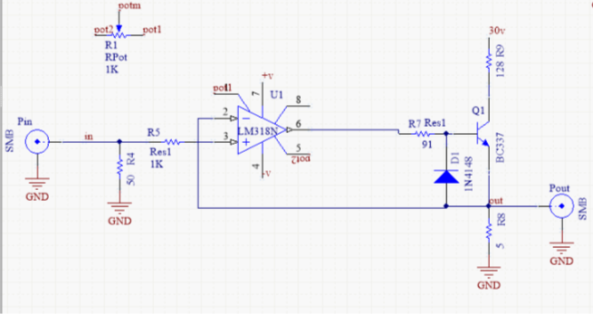
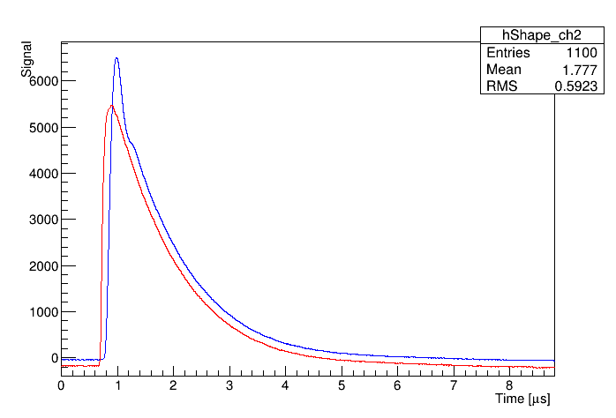
Fast current sink – First prototype
First prototype without filters
Original signal (red)
Fast current sink signal (green)
23/08/2018
Otari Javakhishvili
8

Slide 9
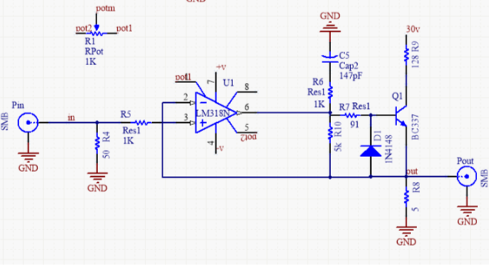
Fast current sink – Second prototype
Original signal (red)
Fast current sink signal with “snubber” filter(green)
23/08/2018
Otari Javakhishvili
9

Slide 10
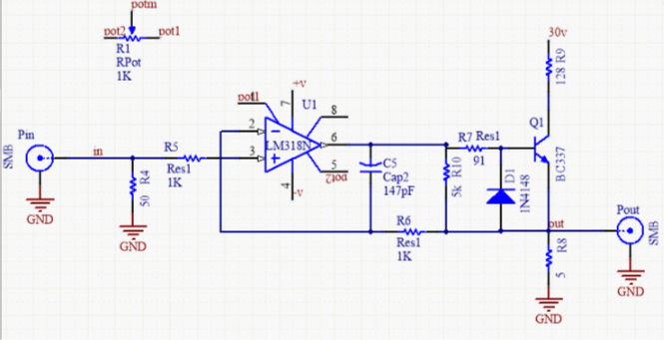
Fast current sink – Final prototype
Original signal (red)
Fast current sink signal with improved feedback and filters (green)
23/08/2018
Otari Javakhishvili
10

Slide 11
Testing Environment
RedPitaya
Signal from
generator
Signal from converter
Fast current sink
37 V
23/08/2018
Otari Javakhishvili
11

Slide 12
Power supply testing
SiPM board designed at Ferrara university, Italy
On SiPM board there is 4x2uF capacitors (red) and inductance (blue)
RedPitaya
Signal from
generator
Voltage drop
measurement
Vin 37
Fast current sink
30V
100
8uF
Power Supply
Long cable
SiPM board
23/08/2018
Otari Javakhishvili
12

Slide 13
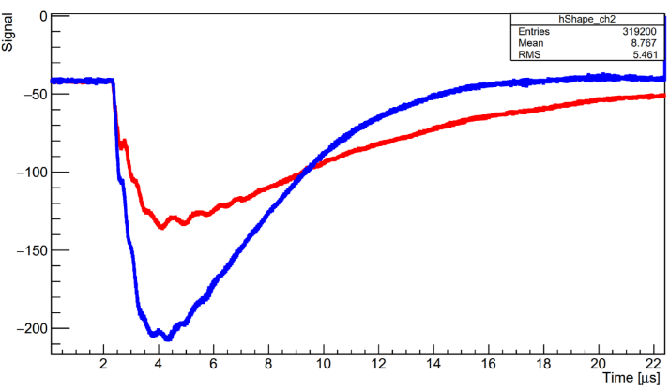
SiPM Board Test
One of the first measurement of voltage drop on SiPM board
Blue ≈ 21 mV – voltage drop at first prototype of SiPM board with 8µF capacitors
Red ≈ 12 mV – voltage drop on improved board with 40µF capacitors
On vertical scale 100 ≈ 12.2 mV
23/08/2018
Otari Javakhishvili
13

Slide 14
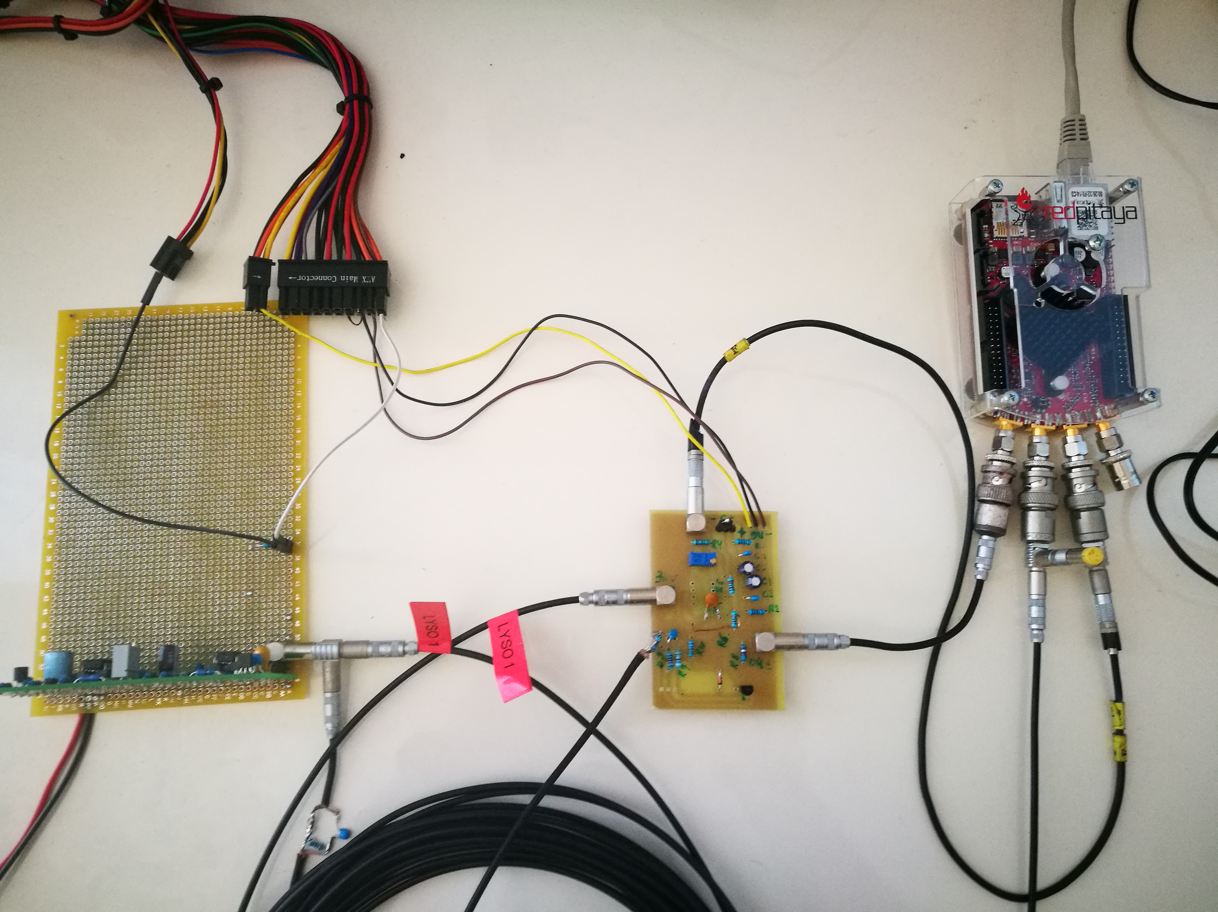
Testing Environment
PC power supply
Fast current sink
POWER SUPPLY
Red Pitaya
23/08/2018
Otari Javakhishvili
14

Slide 15
Voltage monitoring
controller
Multimeter
MUX0
MUX1
MUX2
MUX3
MUX4
MUX5
MUX6
MUX7
MUX8

Slide 16
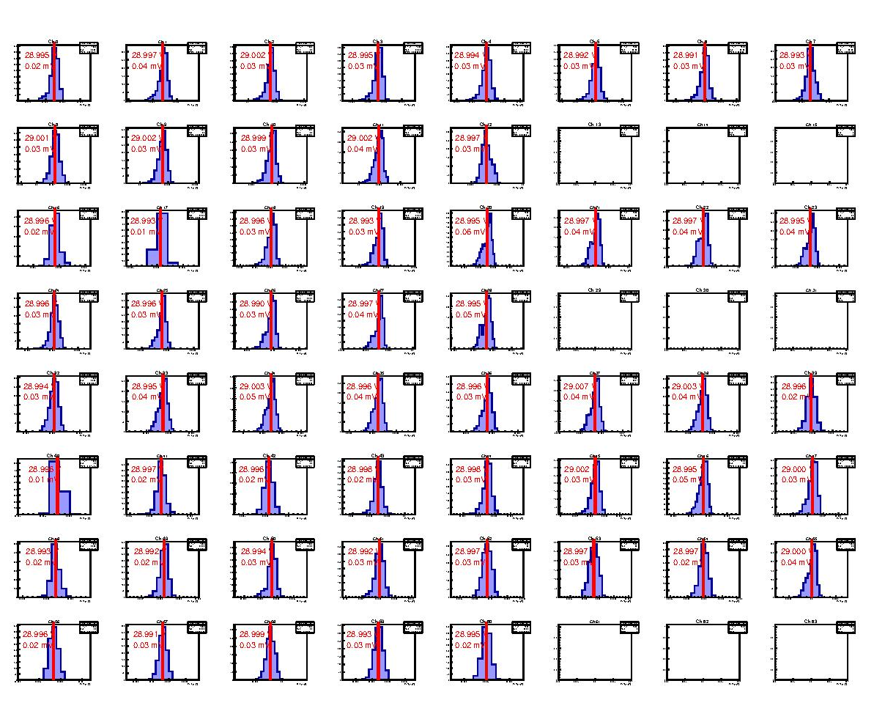
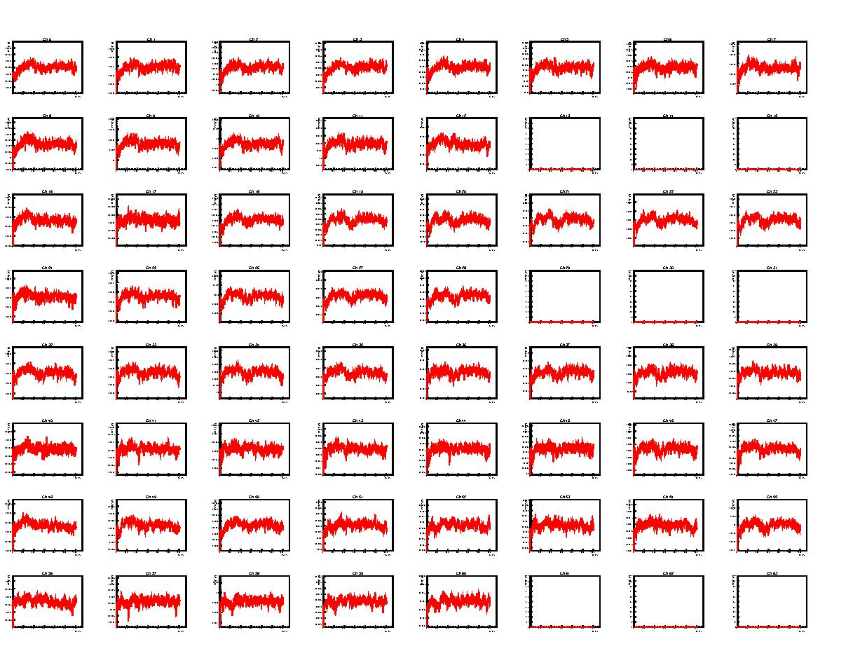

Slide 17
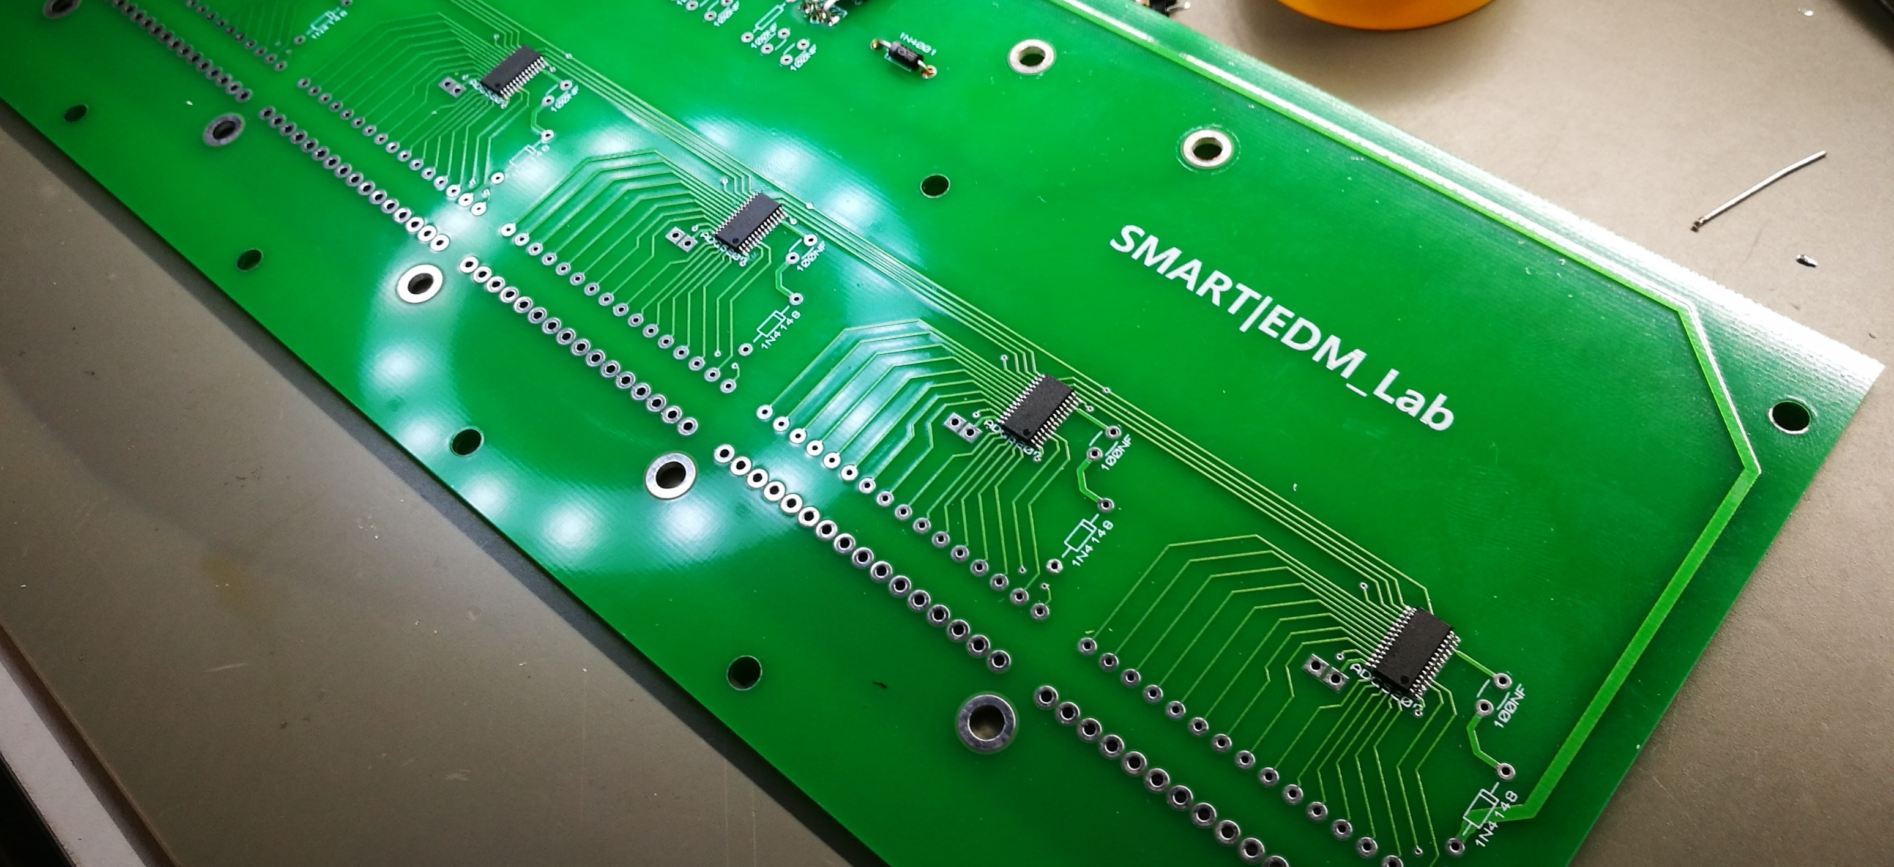
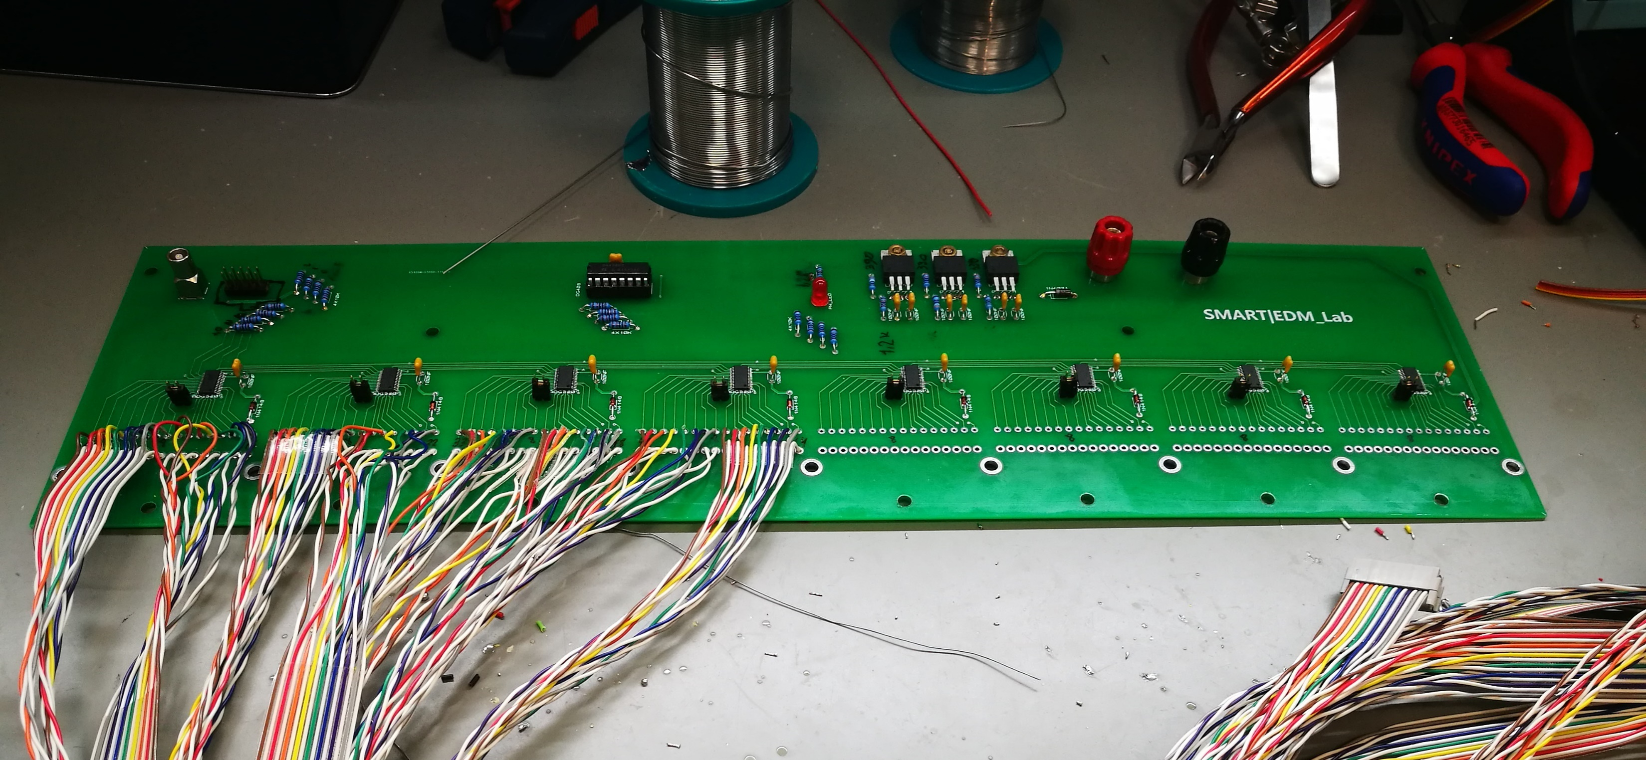
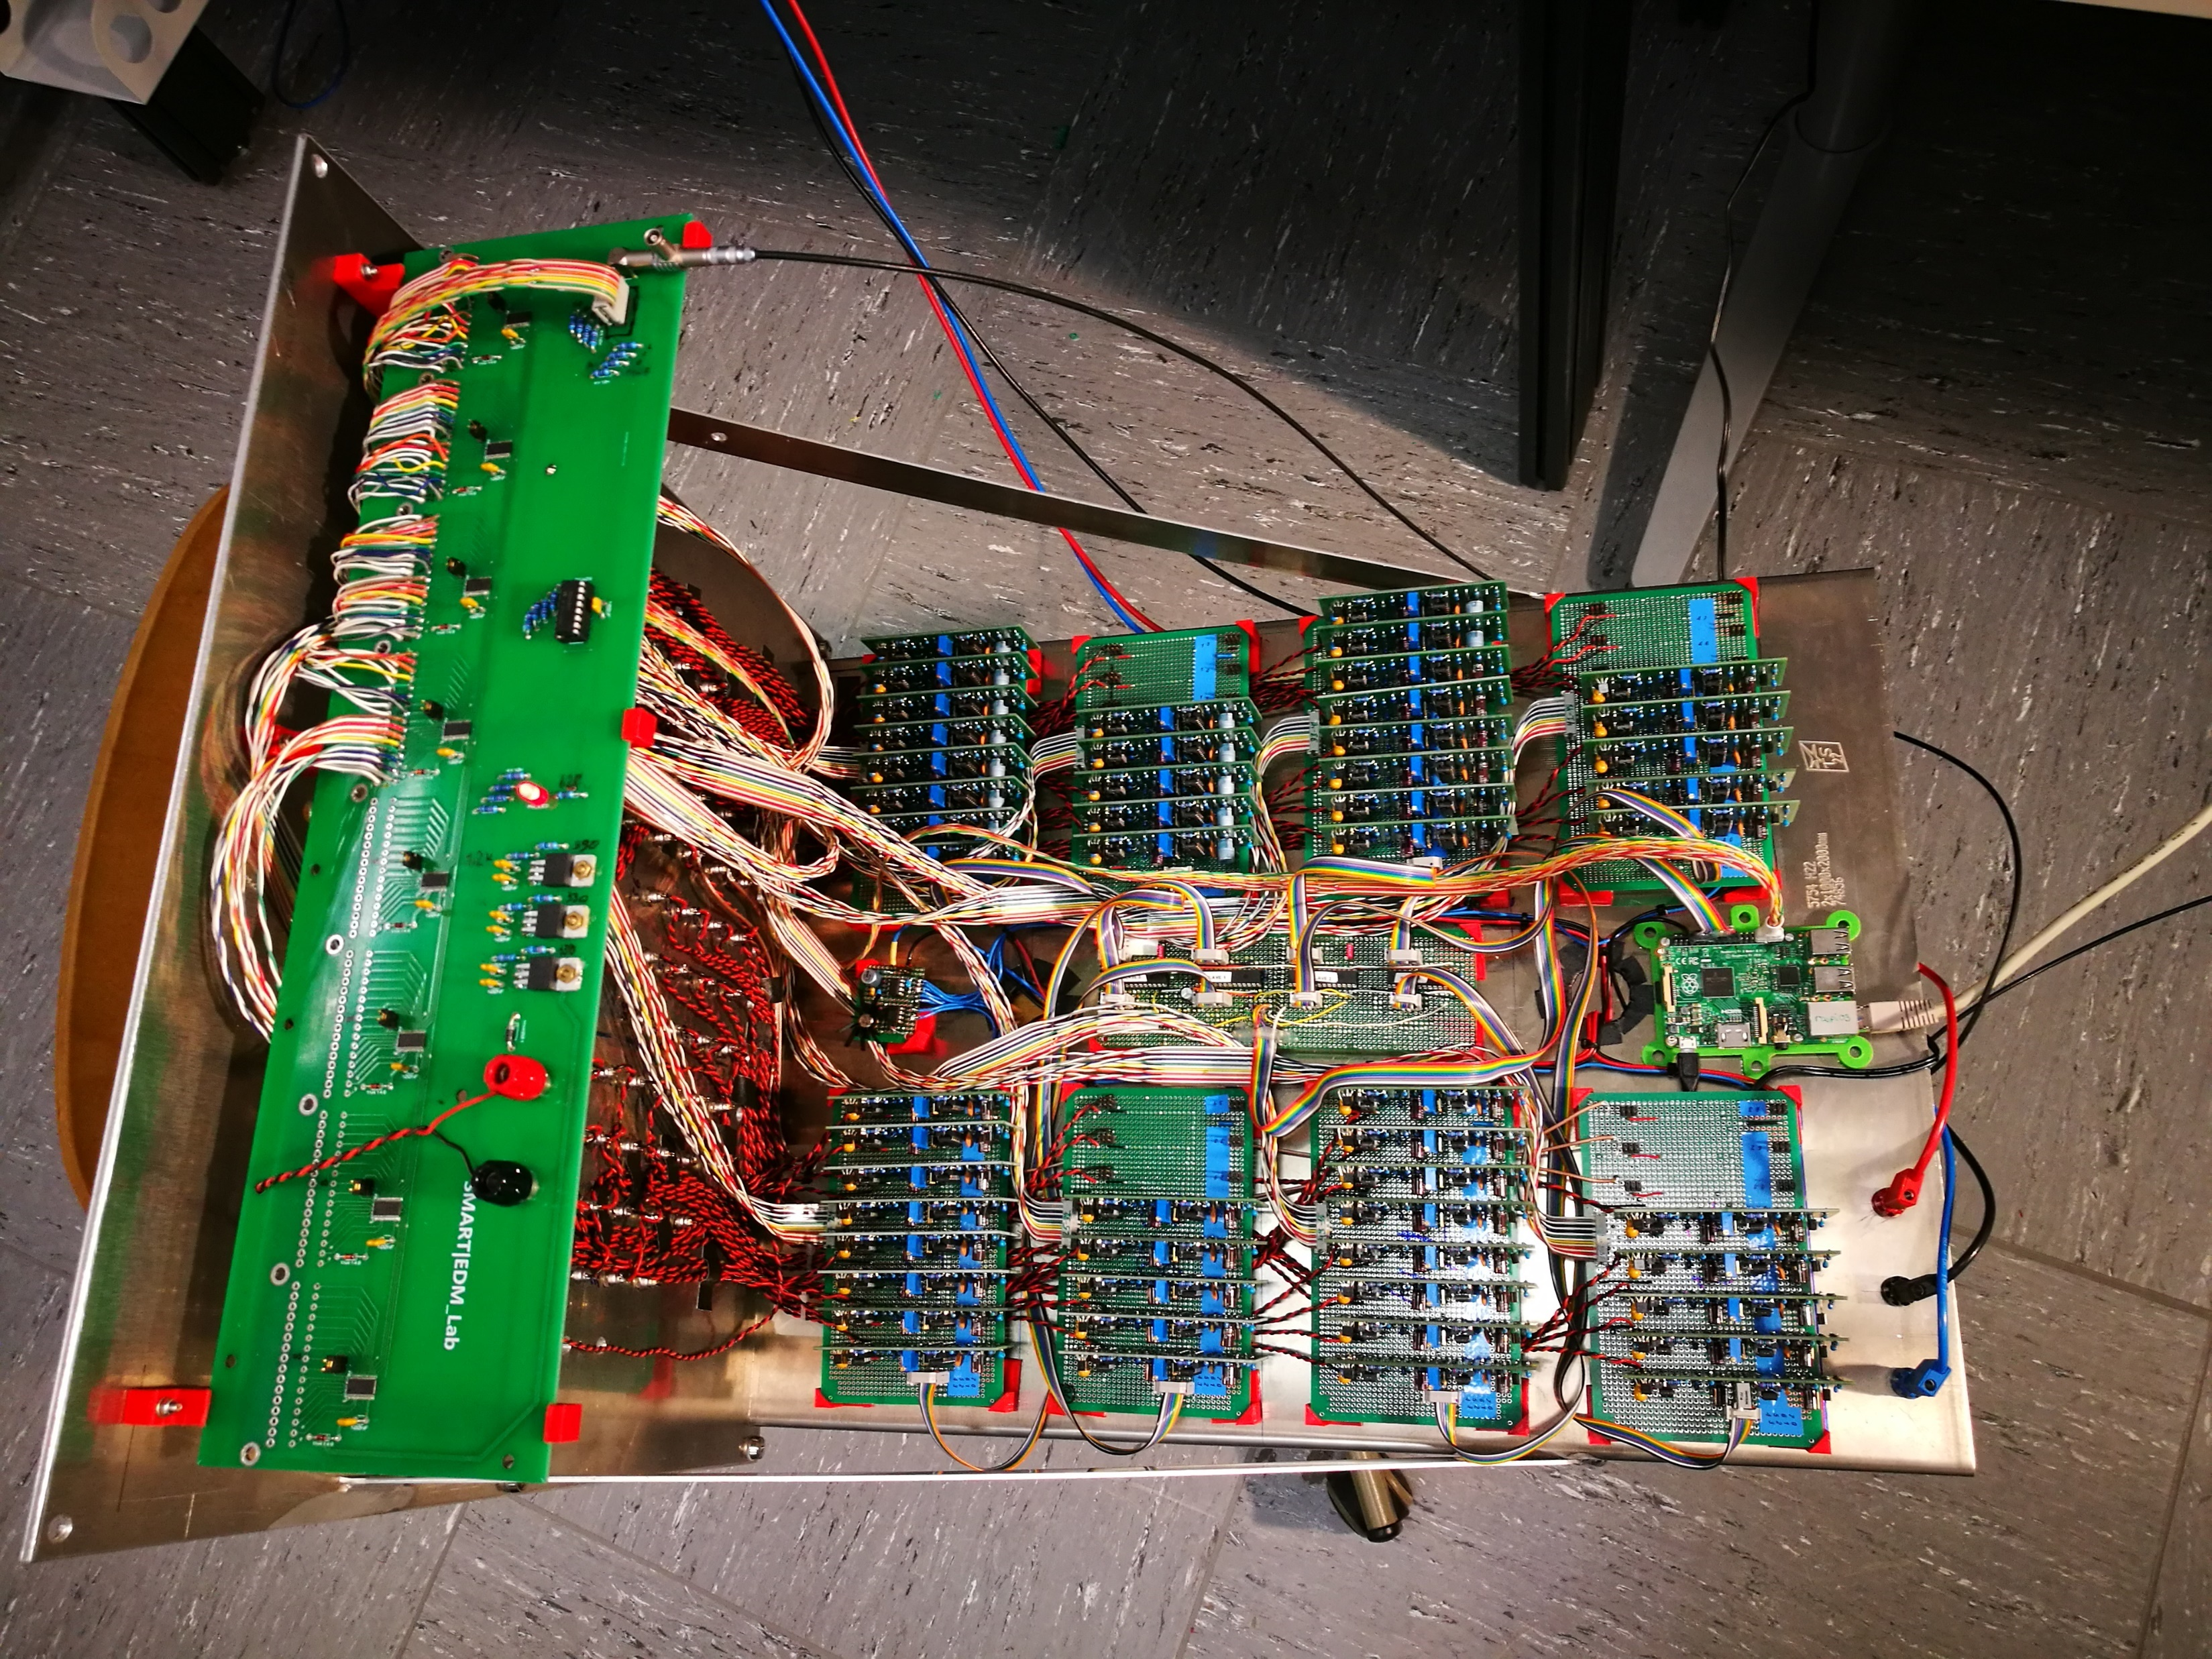
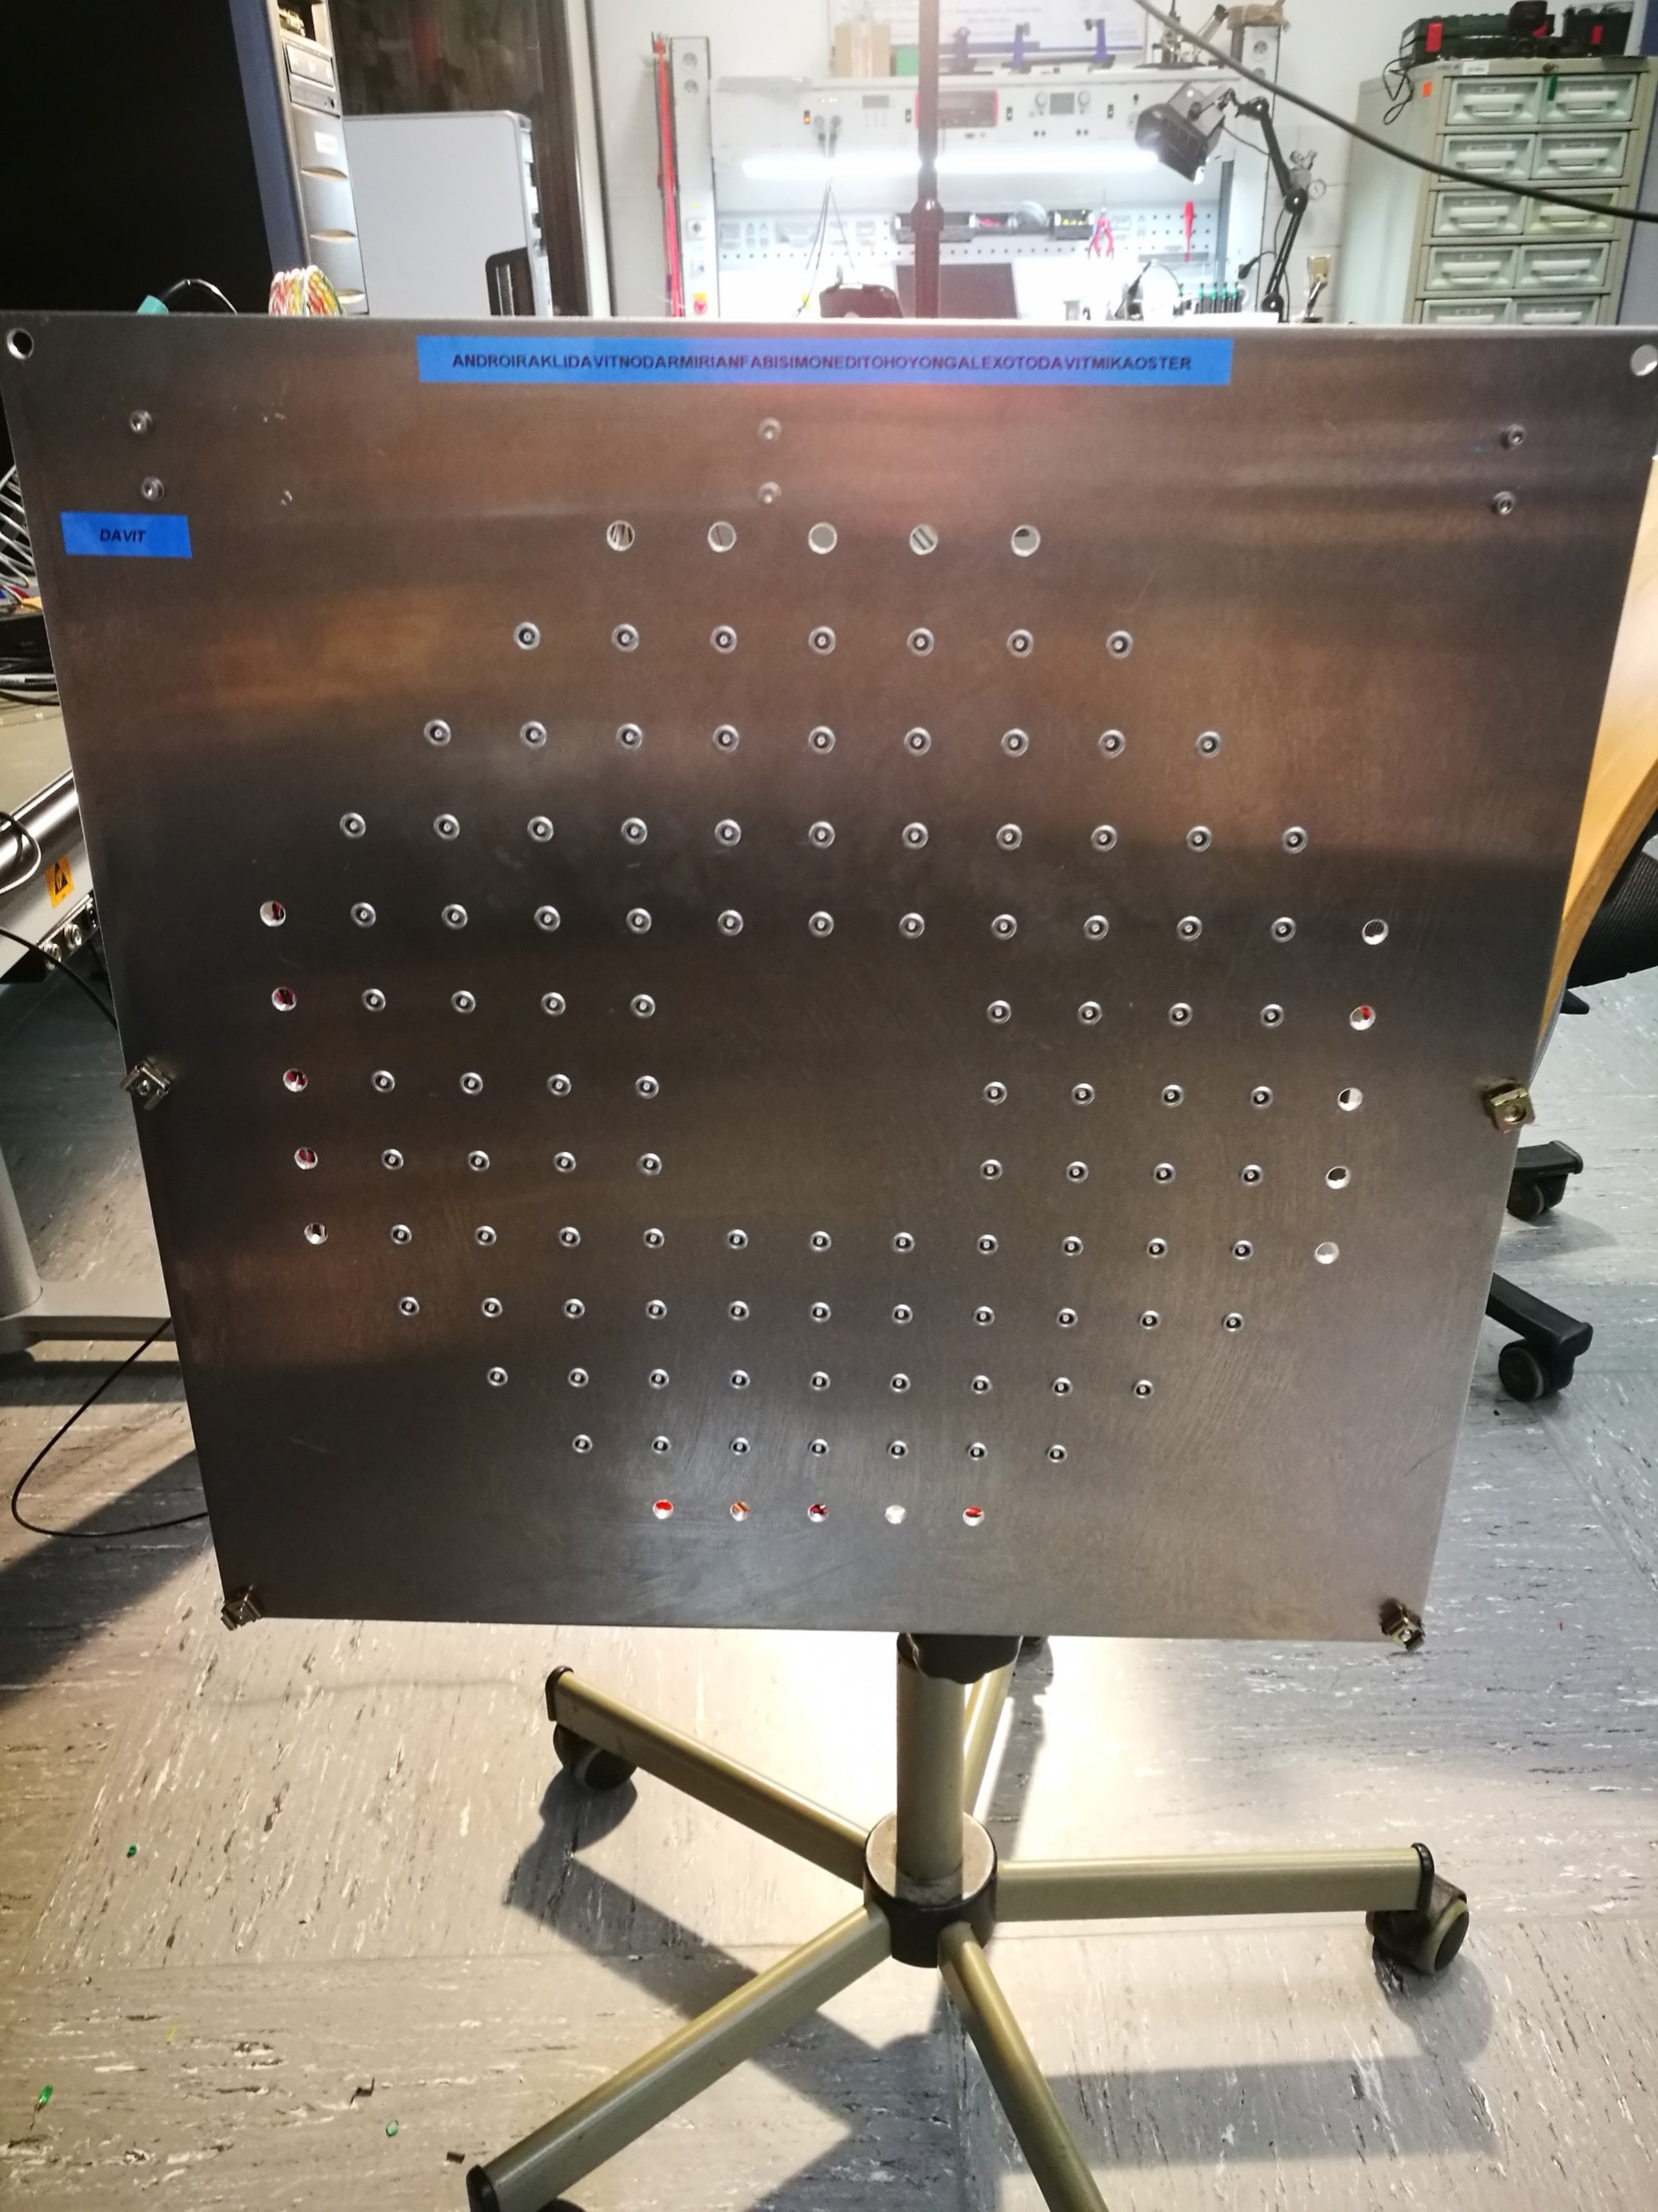
Voltage monitoring

Slide 18
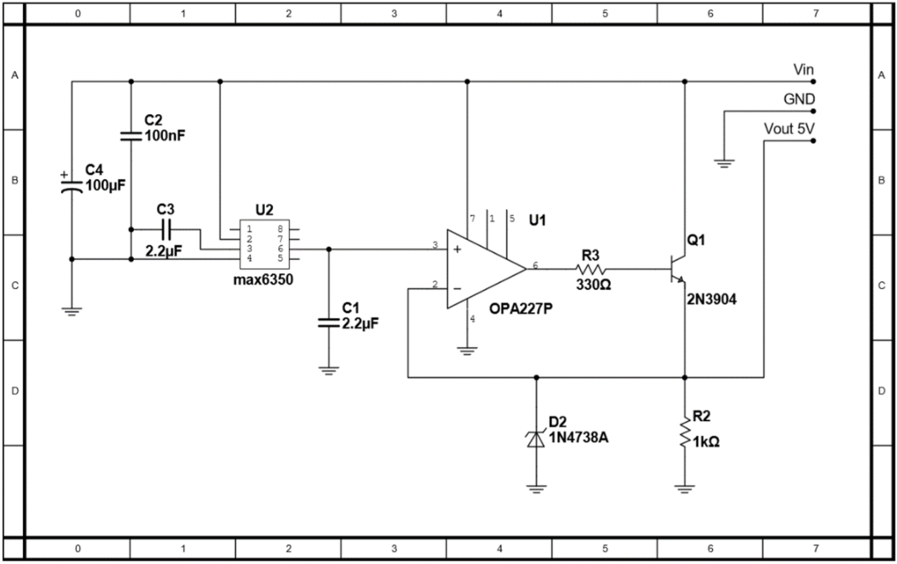
Reference voltage
Ic max6350
output temperature coefficient 0.5 ppm/C˚
Output noise 3 µVp-p
long term stability 30 ppm/1000hr

Slide 19
Primary power supply
30-37V adjustable output voltage for detector modules and voltage monitoring system
12V for reference voltage source power
3.3V for port expander
5V for Raspberry Pi

Slide 20
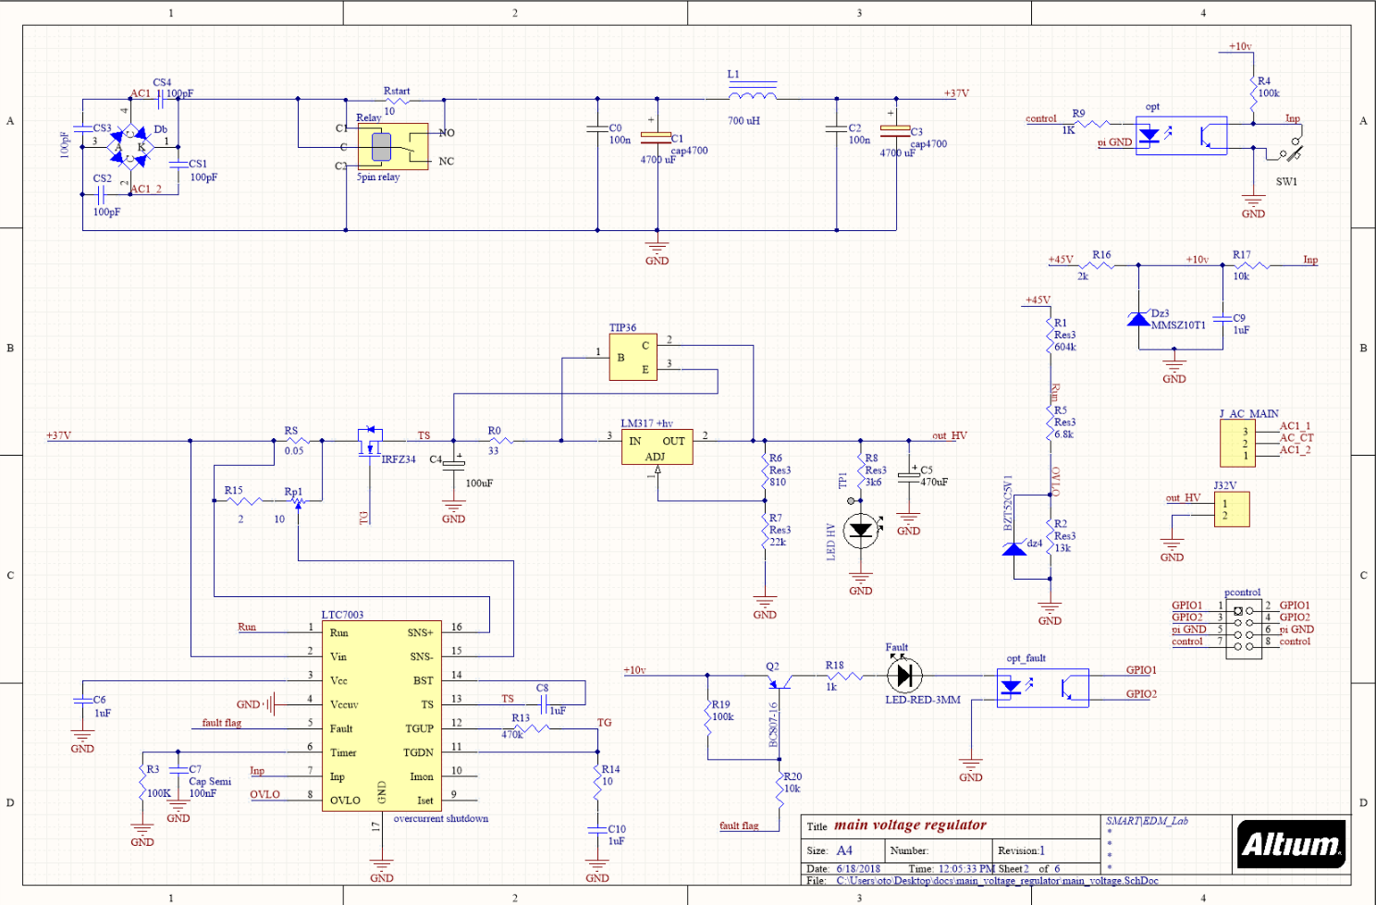
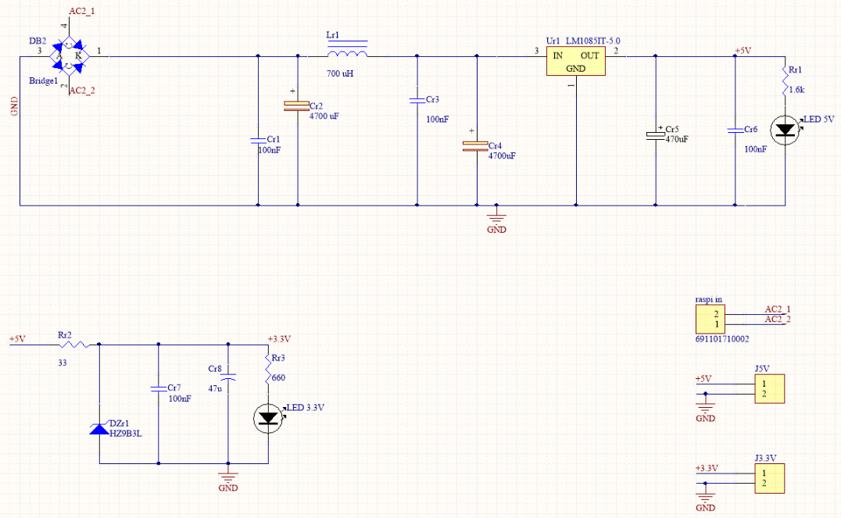
Primary power supply
Raspberry Pi power
Port expander power
Power for detector modules
Reference power

Slide 21
Power supply working chart
Voltmeter
Voltage monitoring system
Power supply modules
Reference voltage source
Raspberry Pi
Port expander
Network

Slide 22
Power supply modules
Power monitoring system
Raspberry Pi
Port expander

Slide 23
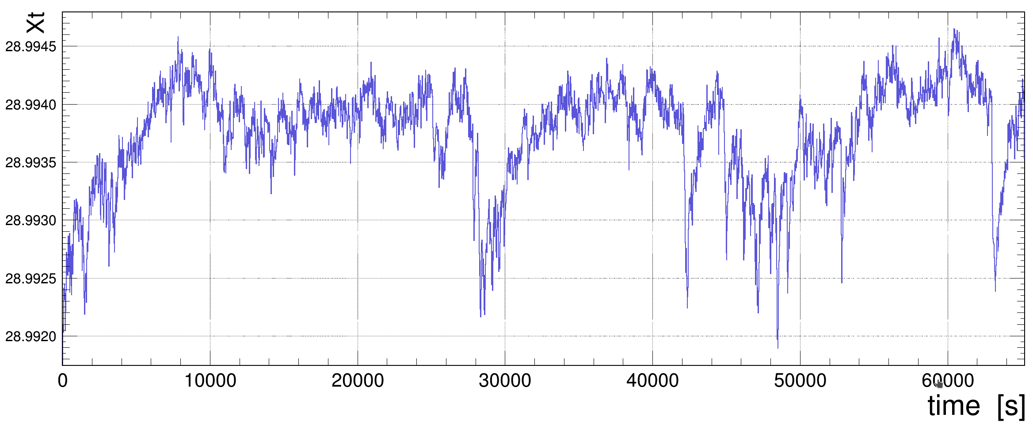
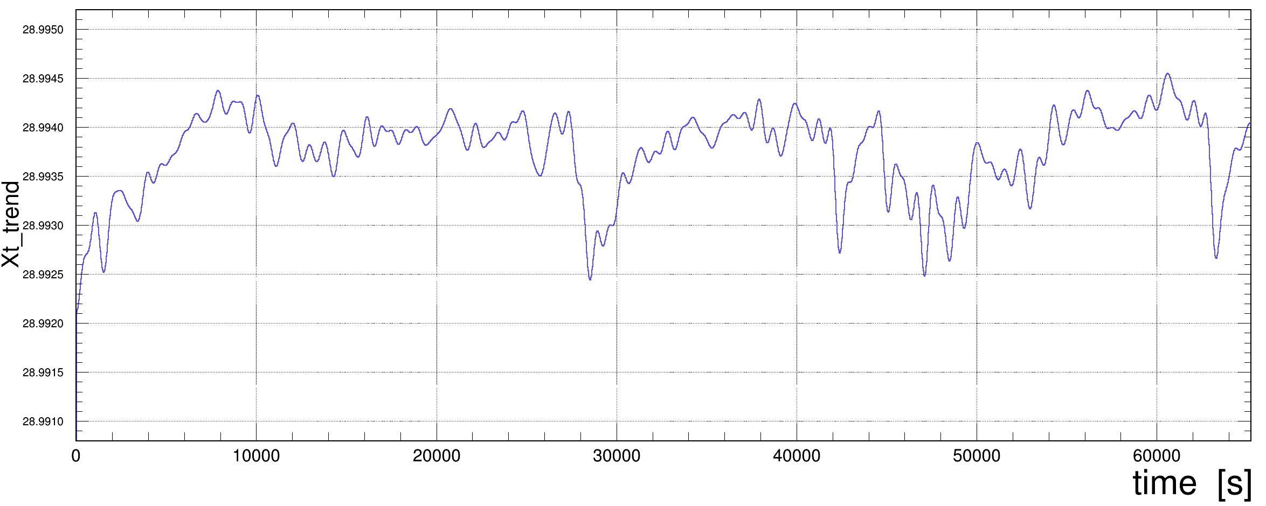
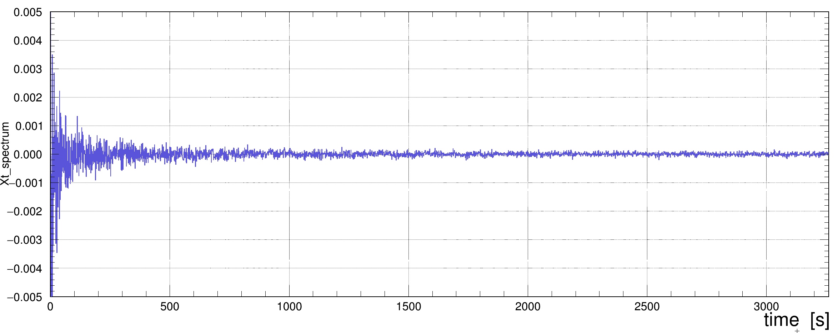
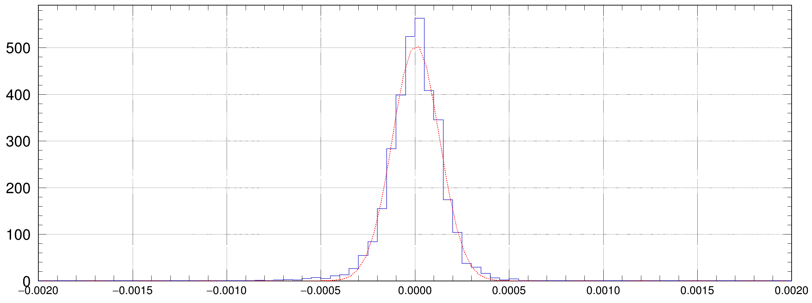
Determining noise level
σ = 0.13 mV

Slide 24
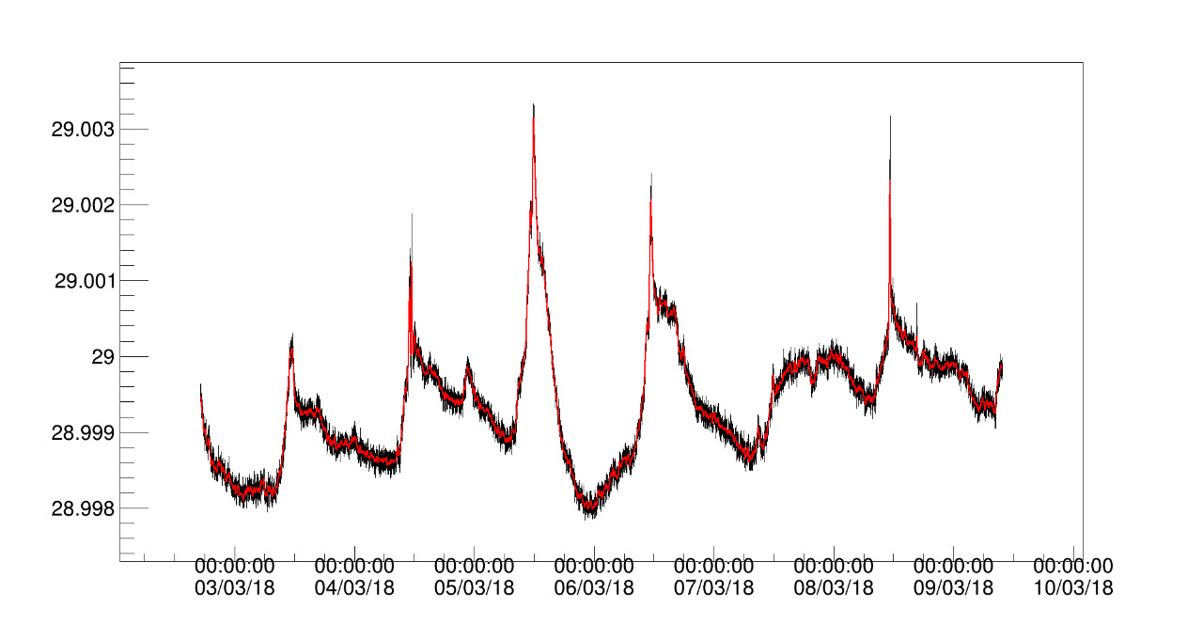
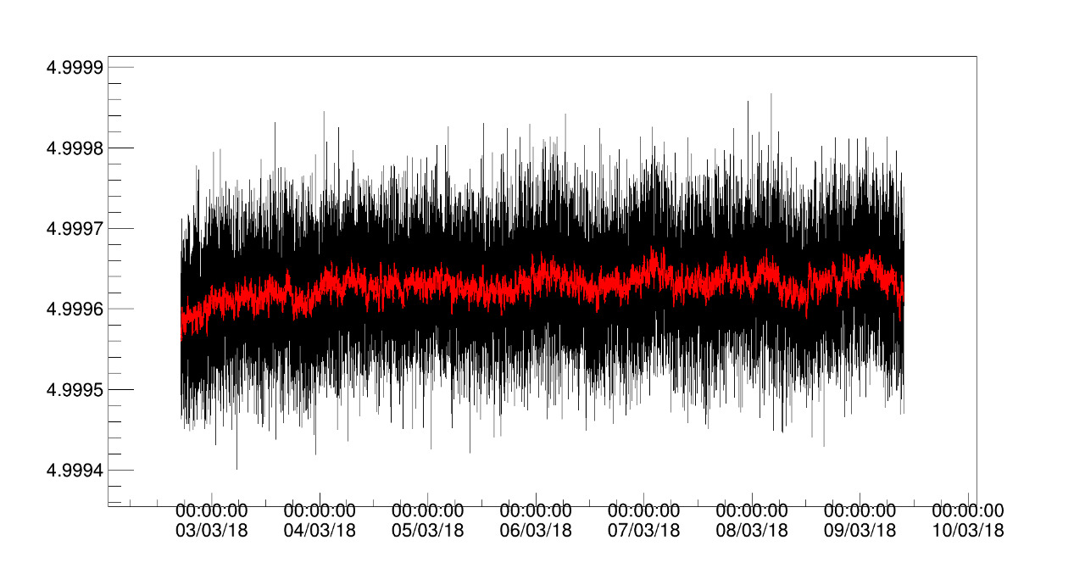
Determining the cause of voltage drops
Voltage monitoring data. 6 days
Reference voltage source

Slide 25
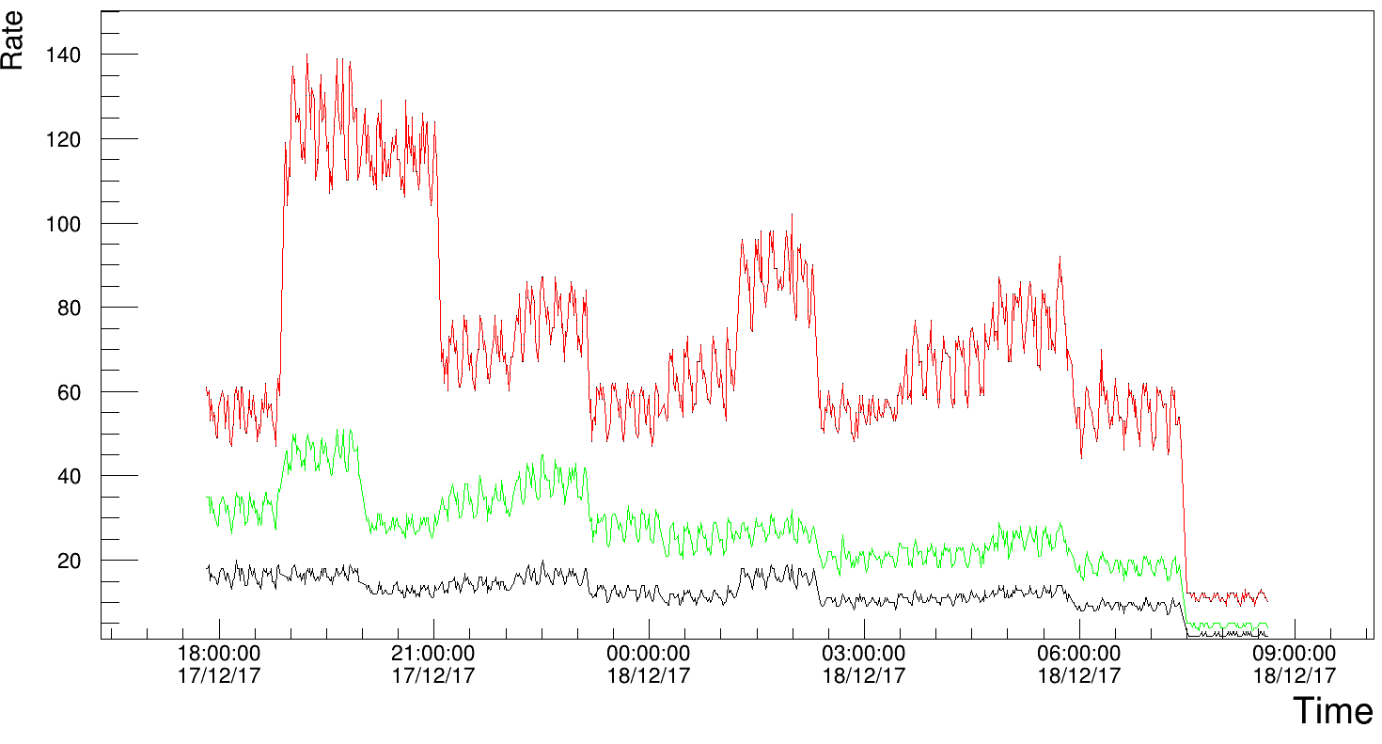
Voltage drop VS detector count rate
Detector count rates for different channels
Current flowing in detector in pics will be 0.075mA, this is very small amount of current and it can not cause such big voltage drops

Slide 26
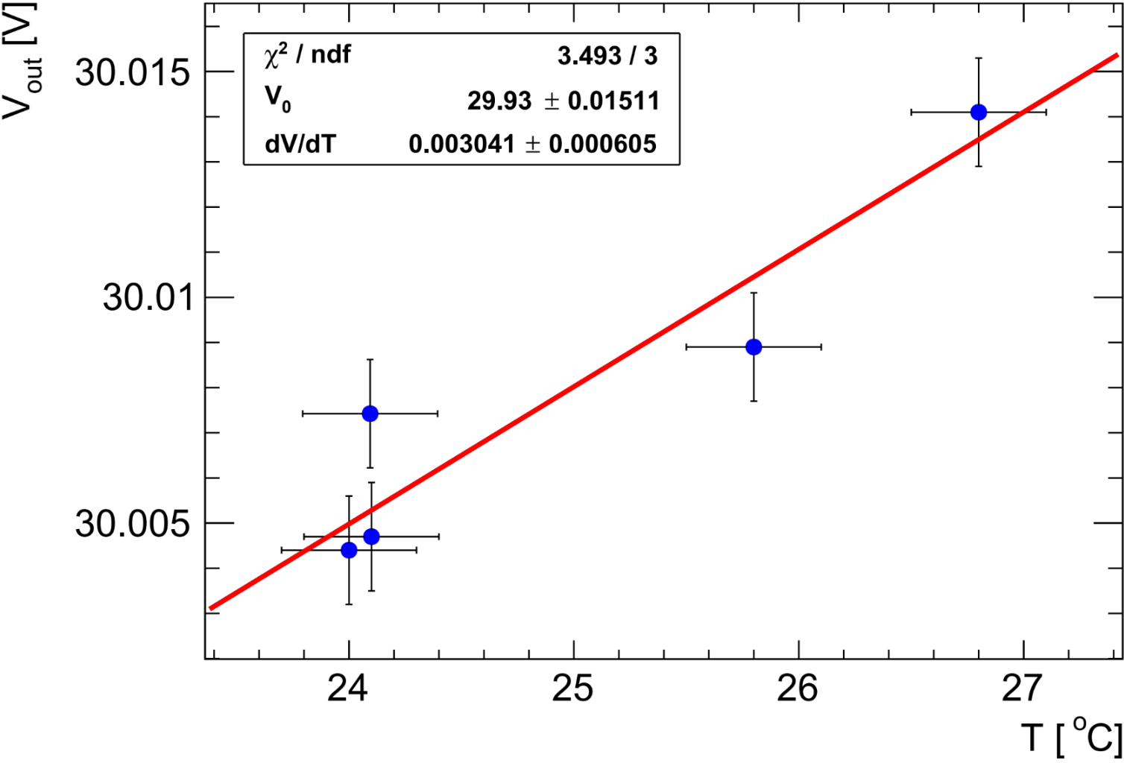
Voltage drop VS temperature
System overall temperature coefficient is ≈ 3mV in 1C˚
Reference voltage source temperature coefficient is so small that we can not measure it with our equipment

Slide 27
Summary & Outlook
First version of modular voltage supply for SiPMs was created and successfully tested
Dedicated test bench was developed for SiPM power system testing in lab condition
Multi channel power monitoring system was created and successfully used in experiment
Primary power supply has been developed with several output voltages and protection functions
Assemble primary power supply and make some tests and measurements
Add remote voltage adjustment for power supply modules.
Add current and temperature sensing
Add voltage compensation function on temperature changes
30/09/2017
Otari Javakhishvili
27

