Slide 1
Axion Research: Plans at COSY
Giorgi Kvantrishvili

Slide 2
Axion Origins
The Strong CP Problem
$\left|d_{n}^{θ}\right|=θ_{QCD}∙{10}^{−16}e∙cm$ – $\text{QCD} \text{theory} \text{prediction}$
$d_{n}=2.9∙{10}^{−26}e∙cm$ – Experimental Result
$\left|θ_{QCD}\right|<{10}^{−10}$ – Strict Upper Limit

Slide 3
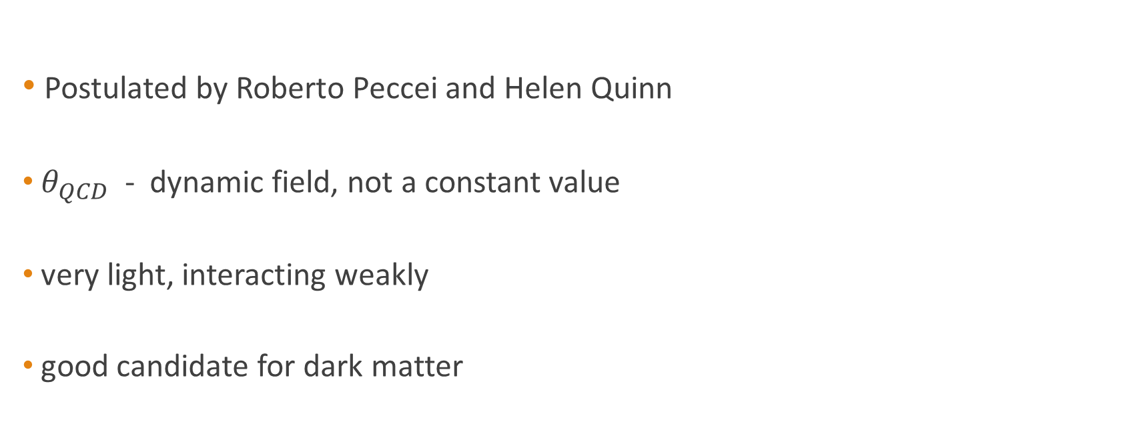
Axion Origins
Postulated by Roberto Peccei and Helen Quinn
$θ_{QCD}$ - dynamic field, not a constant value
very light, interacting weakly
good candidate for dark matter

Slide 4
Axion Research Experiments
Microwave Cavity
ADMX and ADMX-HF
Detection with NMR: CASPEr
Notes:
- axion-photon coupling in a strong magnetic field where axions may be converted into radio-frequency photons
ADMX at Center for Experimental Nuclear Physics and Astrophysics (CENPA) at the University of Washington; ADMX-HF at Yale
Nuclear magnetic resonance

Slide 5

COSY
Located at Jülich Forschungszentrum
Cooler synchrotron and storage ring
Up to ${5∙10}^{10}$ protons in a beam
600 MeV/c – 3.3 GeV/c momentum range
currently involved in the EDM search
Notes:
Medium-Energy pysics

Slide 6

Scientific Motivation and Context
          Axion-gluon coupling >> oscillating EDM of the nucleon
$\left|d_{n}^{θ}\right|=1.2∙{10}^{−16}\frac{a\left(t\right)}{f_{a}}e∙cm=1.2∙{10}^{−16}\frac{a_{0}cos\left(m_{a}t+φ_{a}\right)}{f_{a}}e∙cm$
  $a$ – axion/dark matter field
  $m_{a}$ – axion mass
  $f_{a}$ – axion decay constant
  $φ_{a}$ – unknown local phase

Slide 7
Experiment Proposal at COSY
A search for the oscillating EDM
Accumulation of the vertical component of polarization
Sensitivities similar to EDM search
Notes:
1. Using resonance between precession of a deuteron and axion frequency
2. In the presence of resonance
3. Resonant nature of signal - systematic errors easier to handle

Slide 8
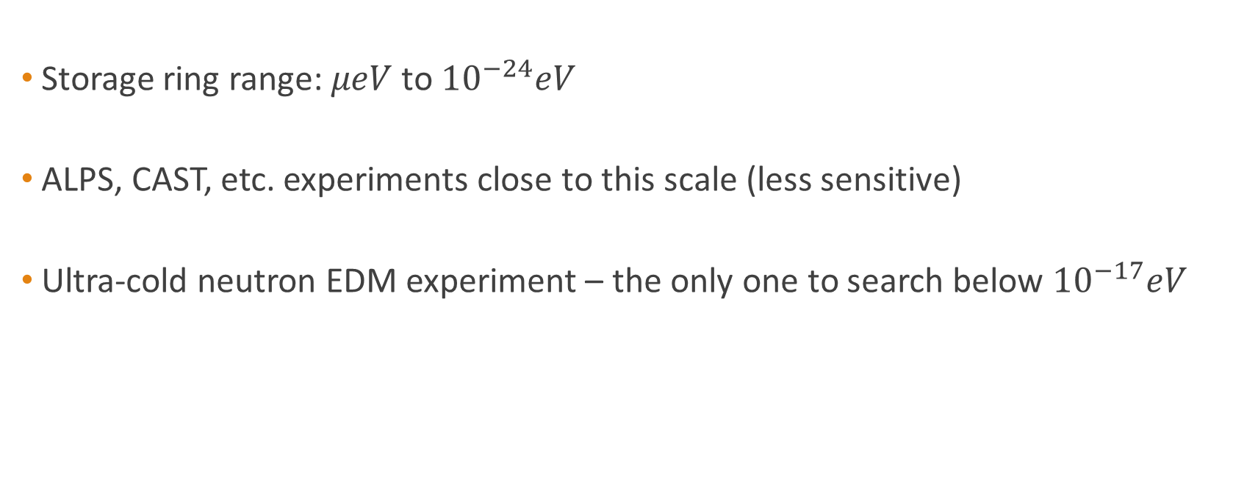
Experiment Proposal at COSY: Advantages
Storage ring range: $μeV$ to ${10}^{−24}eV$
ALPS, CAST, etc. experiments close to this scale (less sensitive)
Ultra-cold neutron EDM experiment – the only one to search below ${10}^{−17}eV$
Notes:
Most Axion experiments above micro-eV

Slide 9
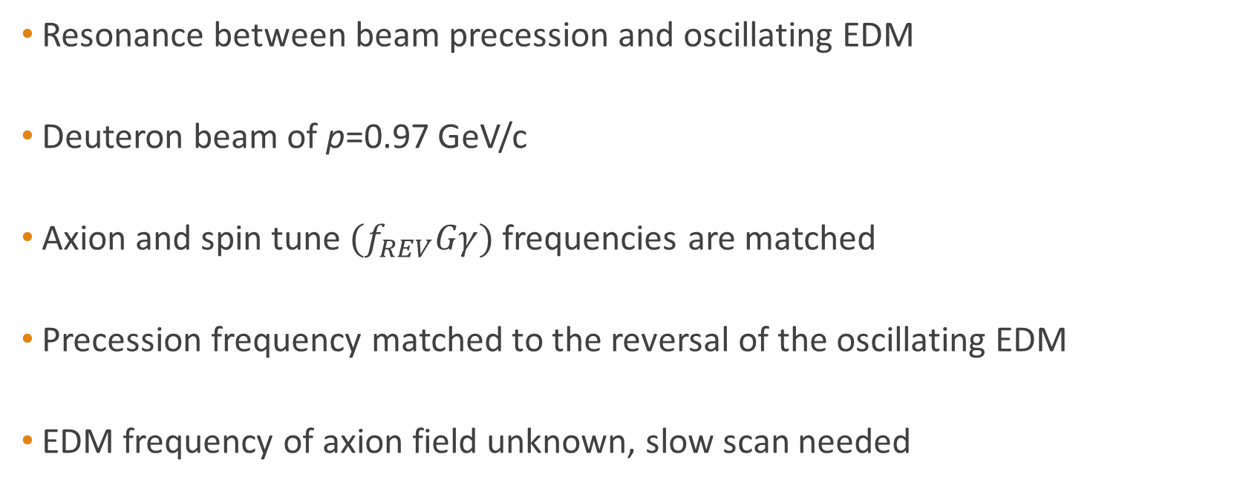
Technical Considerations
Resonance between beam precession and oscillating EDM
Deuteron beam of p=0.97 GeV/c
Axion and spin tune ${(f}_{REV}Gγ)$ frequencies are matched
Precession frequency matched to the reversal of the oscillating EDM
EDM frequency of axion field unknown, slow scan needed
Notes:
1. in-plane polarization precession of the beam and the frequency of an oscillating EDM component
2. with a long in-plane polarization lifetime
3. Vertical component accumulation in beam polarization
4. Static EDM – frozen spin

Slide 10
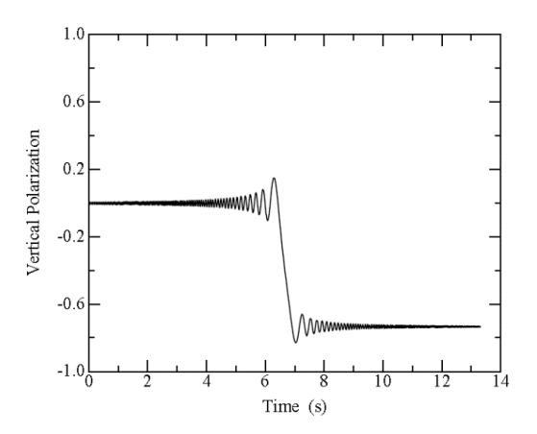
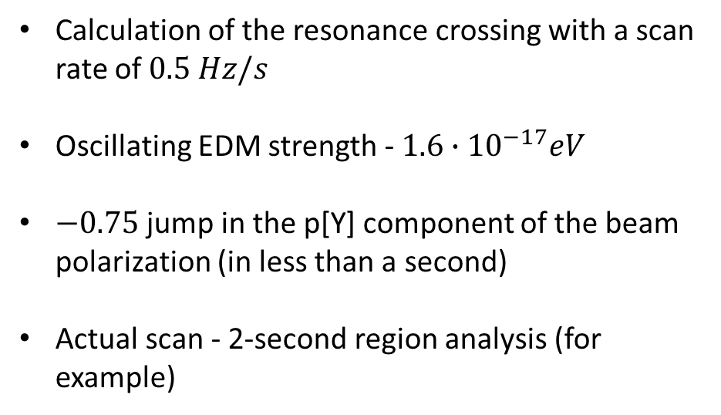
Technical Considerations
Calculation of the resonance crossing with a scan rate of $0.5 Hz/s$
Oscillating EDM strength - ${1.6∙10}^{−17}eV$
$−0.75$ jump in the p[Y] component of the beam
polarization (in less than a second)
Actual scan - 2-second region analysis (for example)

Slide 11
Axion field property assumptions
Coherent over sufficiently large region of space
  Particles see the same field
  Beam properties = single particle properties
  Spatial coherence must extend to all parts of the COSY ring
Coherent in time
  Fixed field oscillation phase
  Dependence on axion field speed
Difference between spin tune and EDM oscillations favors accumulation

Slide 12
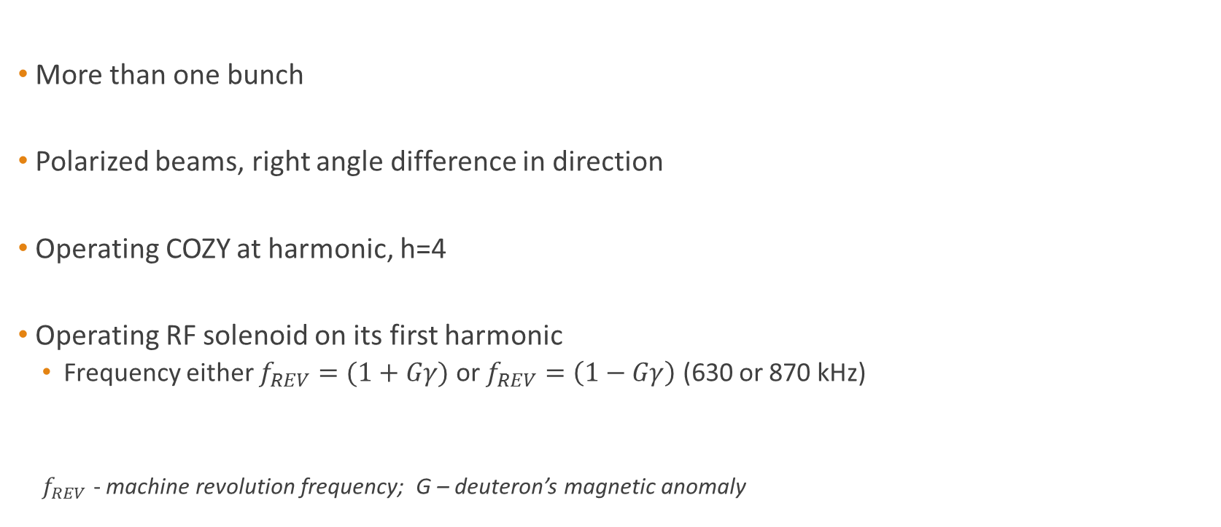
Technical Considerations: Managing the unknown phase of the axion field
More than one bunch
Polarized beams, right angle difference in direction
Operating COZY at harmonic, h=4
Operating RF solenoid on its first harmonic
  Frequency either $f_{REV}=(1+Gγ)$ or $f_{REV}=\left(1−Gγ\right)$ (630 or 870 kHz)
  $f_{REV}$ - machine revolution frequency; G – deuteron’s magnetic anomaly
Notes:
Radiofrequency Solenoid

Slide 13
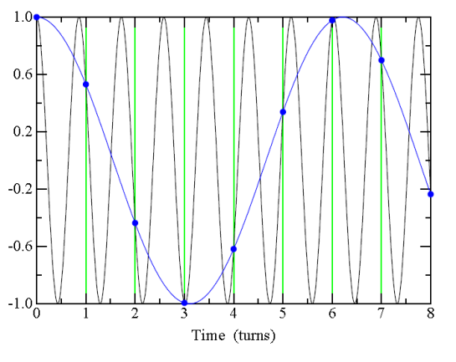
Technical Considerations: Managing the unknown phase of the axion field
Oscillations of the RF solenoid (870 kHz)
Spin tune frequency, 120 kHz oscillation
Each Turn
Blue dots indicate moments when the beam
passes through the solenoid

Slide 14
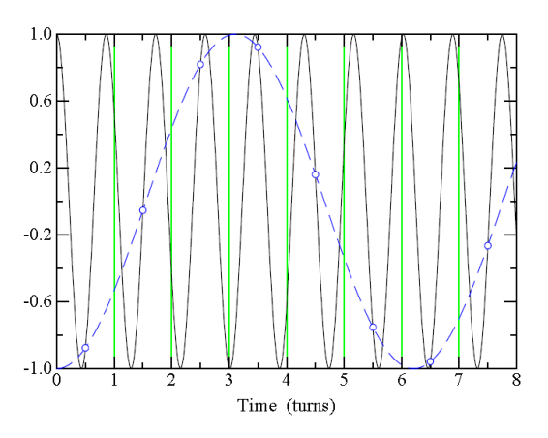
Technical Considerations: Managing the unknown phase of the axion field
Oscillations of the RF solenoid (870 kHz)
Spin tune frequency, 120 kHz oscillation
Each Turn
Blue circles indicate moments when the beam
passes through the solenoid halfway through a turn

Slide 15
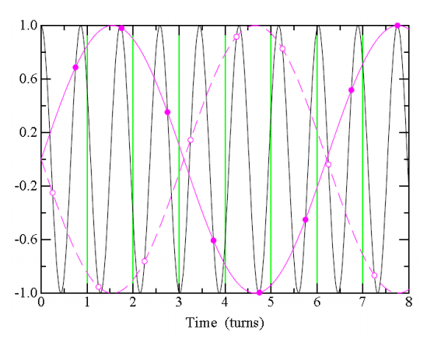
Technical Considerations: Managing the unknown phase of the axion field
Oscillations of the RF solenoid (870 kHz)
Spin tune frequency, 120 kHz oscillation
Each Turn
Purple circles and dots respectively indicate moments when
the beam passes through the solenoid at ¼ and ¾ of a turn

Slide 16
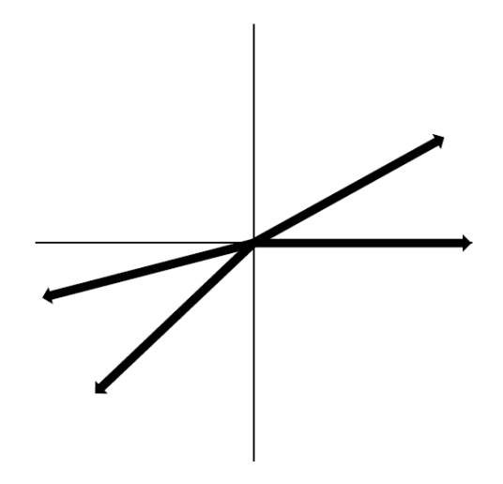
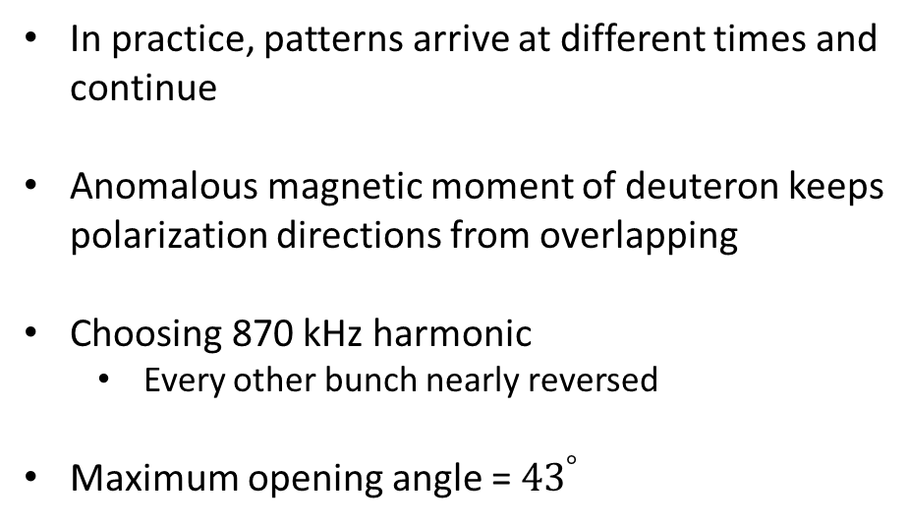
Technical Considerations: Managing the unknown phase of the axion field
In practice, patterns arrive at different times and
continue
Anomalous magnetic moment of deuteron keeps
polarization directions from overlapping
Choosing 870 kHz harmonic
  Every other bunch nearly reversed
Maximum opening angle = ${43}^{°}$

Slide 17
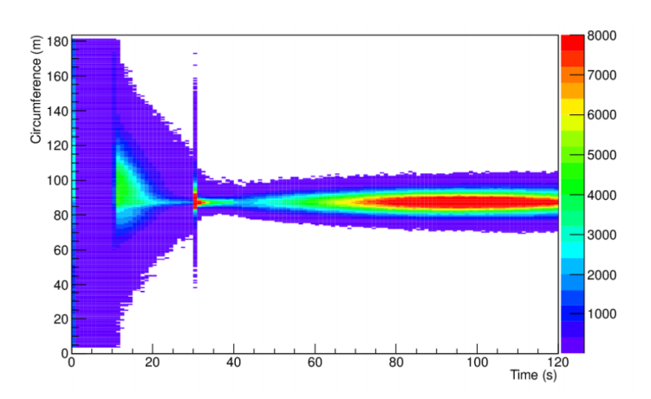
Technical Considerations: Managing the unknown phase of the axion field
2-D plot of ring circumference vs time
Channels with less than 5 events/bin
have been suppressed.
A graph of particle flux at the EDDA polarimeter
as a function of time in the store and position
around the ring circumference.

Slide 18
Technical Considerations: Managing the unknown phase of the axion field
Injection
Initial cooling
Moving to the polarimeter target
Beam Preparation
Data acquisition

Slide 19
Further Comments
COSY machine parameters
Polarization jump – repeat scans
Machine Resonances

Slide 20

Thank You For Your Attention

