Slide 1

Climate change
Current Knowledge
21. 8. 2018 I Prof. Dr. Astrid Kiendler-Scharr

Slide 2
Outline
Goal: Answer the following questions
What is the greenhouse effect?
What do we know about the temporal evolution of important greenhouse gases?
What are the consequences of increasing greenhouse gas concentrations in the atmosphere?
Are there uncertainties?

Slide 3
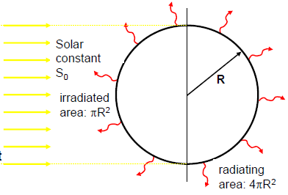
The greenhouse effect
Natural occurring greenhouse effect due to presence of atmosphere
Radiative balance: 1st approximation no atmosphere
SW radiation input from sun:
P_{in} = πR²S₀ (1-A)
S₀ = 1368 W/m² = solar constant
A ~ 0.3 = Albedo of Earth
1-A = short wave absorptivity of Earth
R_{e} = 6740km
IR emission from Earth:
P_{out} = 4πR² ε σ_{SB} T_{B}⁴
ε ~ 0.9…1, IR emissivity of Earth
σ_{SB}=5.67.10⁻⁸ Wm⁻²K⁻⁴, Stefan Boltzmann constant

Slide 4
The greenhouse effect
Natural occurring greenhouse effect due to presence of atmosphere
Radiative balance: 1st approximation no atmosphere
In thermal equilibrium
P_{in} = P_{out} T_{B} =(S₀*(1-A)/4εσ)^{1/4}
T_{B} ~ 255 K (-18°C)
But observed average T_{B}~ 288K
There is a natural greenhouse effect of +33K
This comes from IR active gases that emit radiation back to Earth
Changes in concentration of IR emitting/absorbing gases change the surface and atmospheric temperature

Slide 5
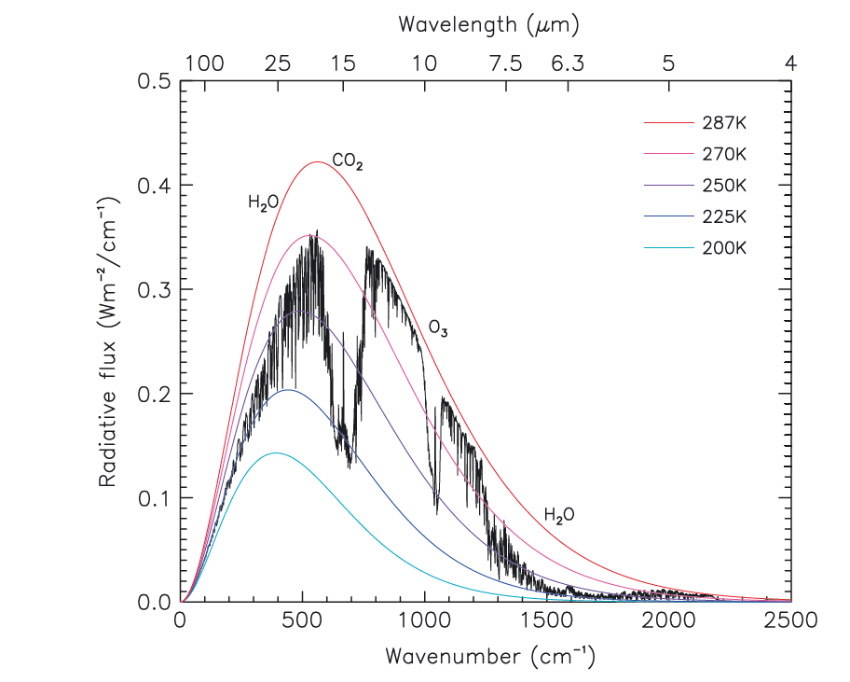
Reduced outgoing radiative flux
Impact of IR absorbing gases
Zhong and Haigh, The greenhouse effect and carbon dioxide, in Weather, vol68, No4, 2013

Slide 6
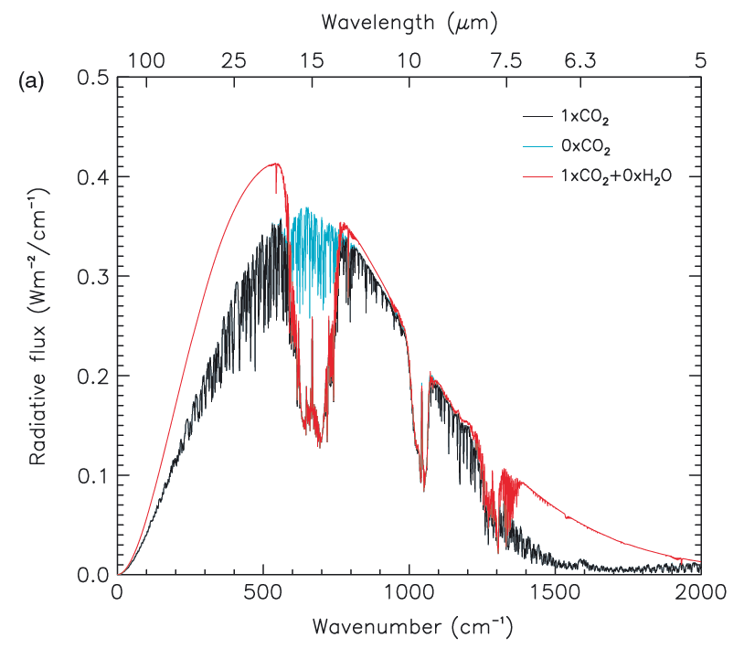
Reduced outgoing radiative flux
Impact of IR absorbing gases
Zhong and Haigh, The greenhouse effect and carbon dioxide, in Weather, vol68, No4, 2013

Slide 7
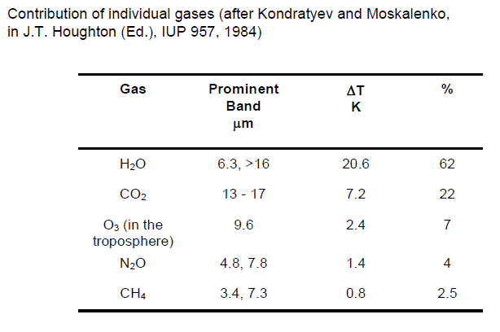
Natural greenhouse effect

Slide 8
Changing concentration of CO₂
Pre-industrial and industrial era

Slide 9
Changing concentration of CO₂
How can we verify CO₂ sources and sinks?
C-isotopes as powerful tool
  Utilizes either ¹³C or ¹⁴C signatures

Slide 10
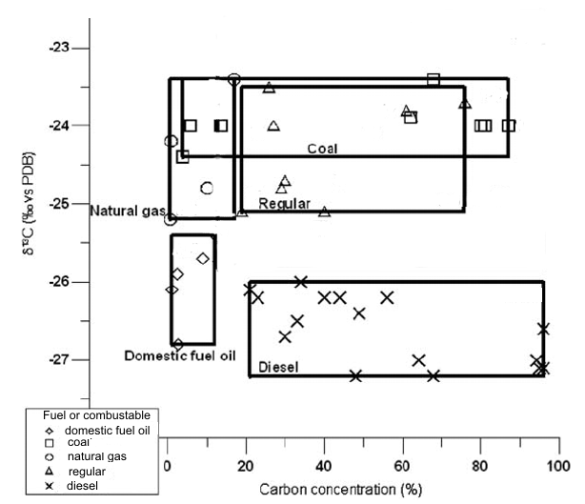
¹³c content in CO₂ sources
How can we verify CO₂ sources and sinks?
Fossil fuels:
No ¹⁴C due to age
Low ¹³C
Addition of CO₂ to the atmosphere from fossil fuel combustion should decrease δ¹³C and ¹⁴C content of atmospheric CO₂

Slide 11
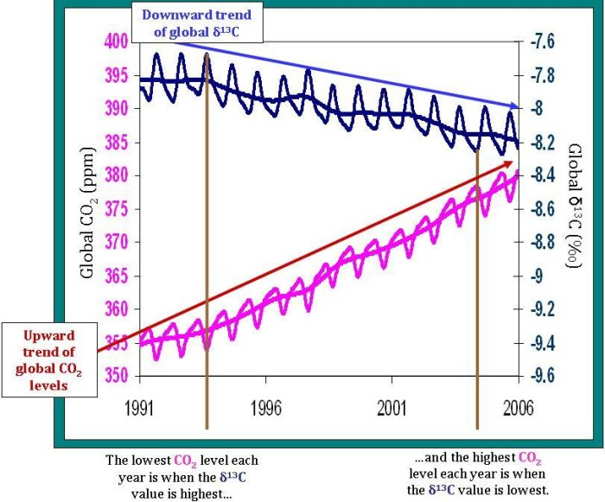
¹³c content in CO₂ sources
How can we verify CO₂ sources and sinks?

Slide 12
Changing concentration of CO₂
How can we verify CO₂ sources and sinks?
Are CO₂ and O₂ trends consistent?
What do we expect if increased CO₂ originates from combustion of fossil fuels?
Carbon monoxide | CO + ½ O₂ | CO₂
Methane | CH₄ + 2 O₂ | CO₂ +2 H₂O
Ethen | C₂H₄ +3 O₂ | 2 CO₂ + 2 H₂O
Ethane | C₂H₆ + 3 ½ O₂ | 2 CO₂ + 3 H₂O
Propane | C₃H₈ + 5 O₂ | 3 CO₂ + 4 H₂O
N-Butane | C₄H₁₀ + 6½ O₂ | 4 CO₂ + 5 H₂O
Hydrogen | H₂ + ½ O₂ | H₂O

Slide 13
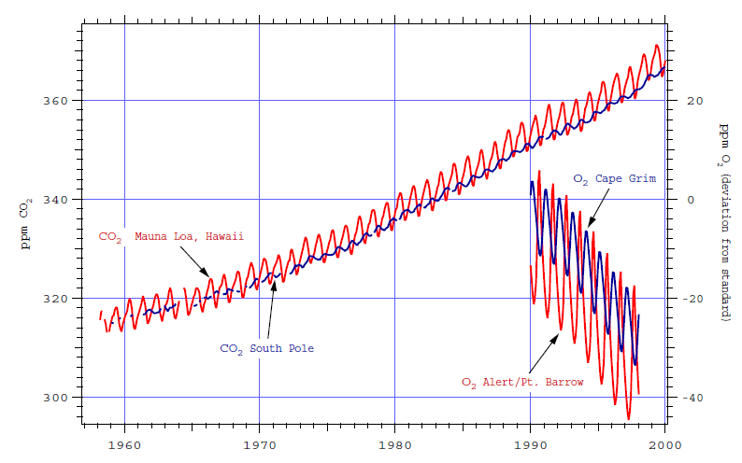
Changes of CO₂ and O₂

Slide 14
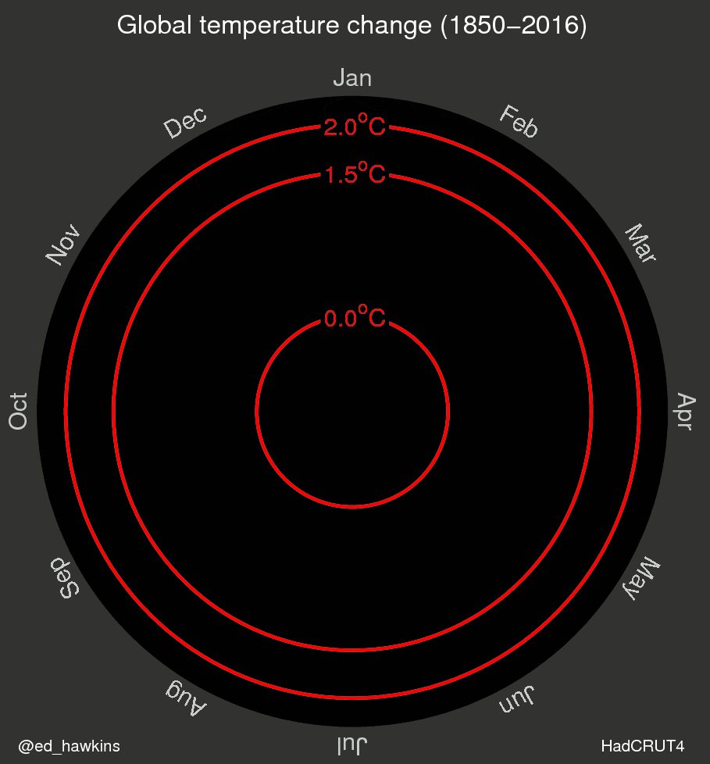
Changing Temperature
Pre-industrial and industrial era

Slide 15
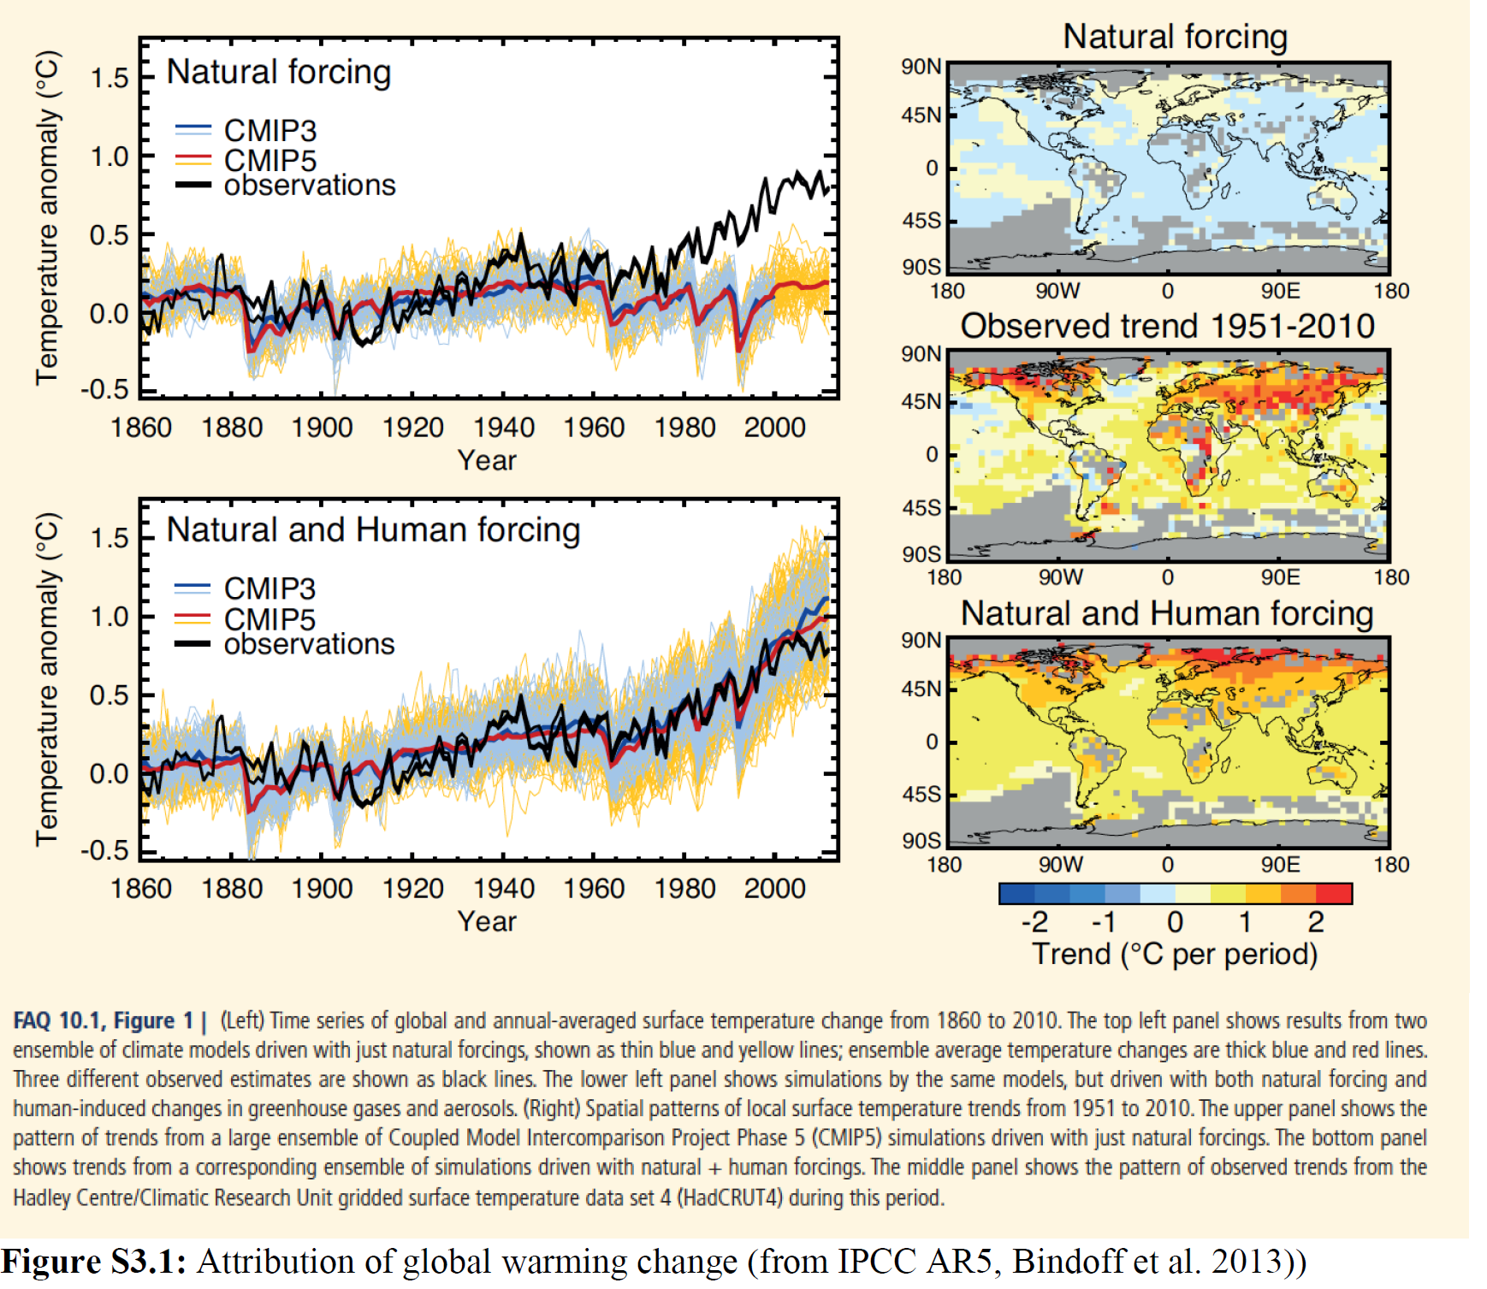
Changing Temperature
Models accounting for natural forcing only cannot reproduce observations

Slide 16
Changing Temperature
Models accounting for natural AND HUMAN forcing reproduce observations
Figure S3.1; IPPC Assessment Report AR5

Slide 17
Current Status
CO₂ levels reached 408 ppm in June 2018
The year 2017 was +0.9°C warmer relative to the average of the years 1951-1980
Seventeen of the 18 warmest years in the 136-year record have occurred since 2001, with the exception of 1998.
The year 2016 ranks as the warmest on record
(NOAA)

Slide 18
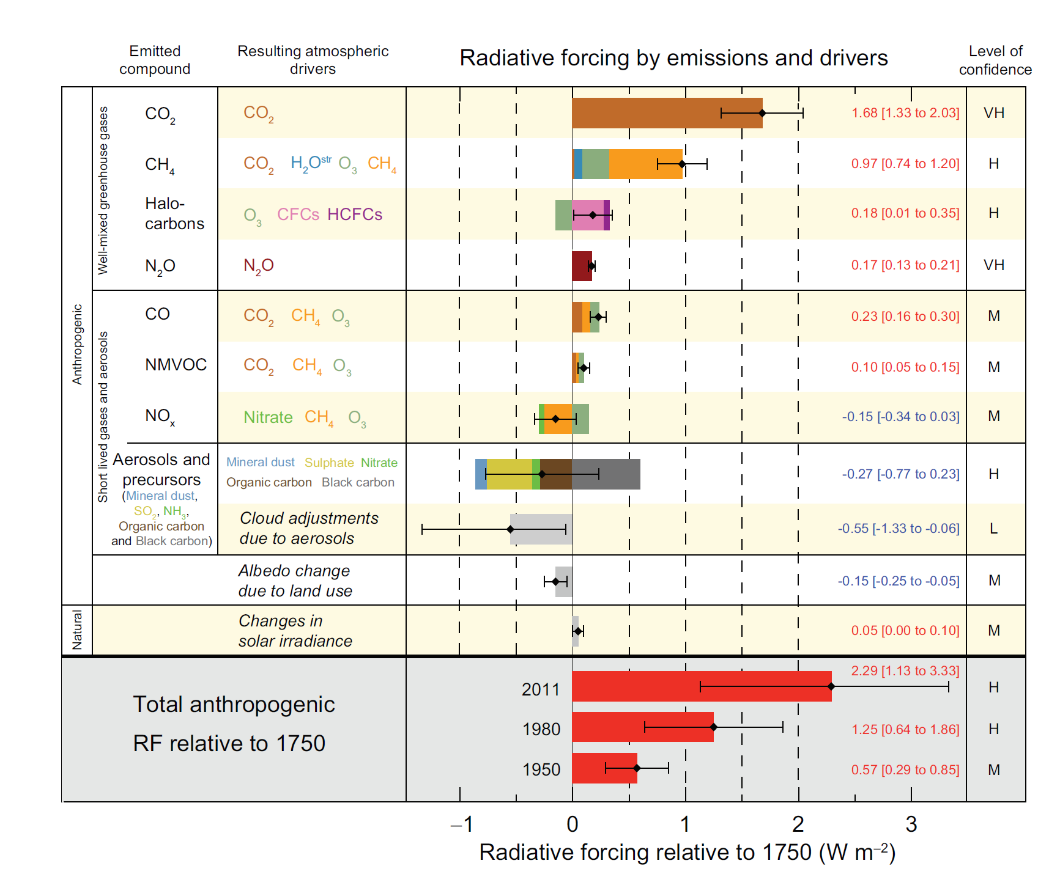
Where do Uncertainties come from?
Relative to pre-industrial conditions

Slide 19
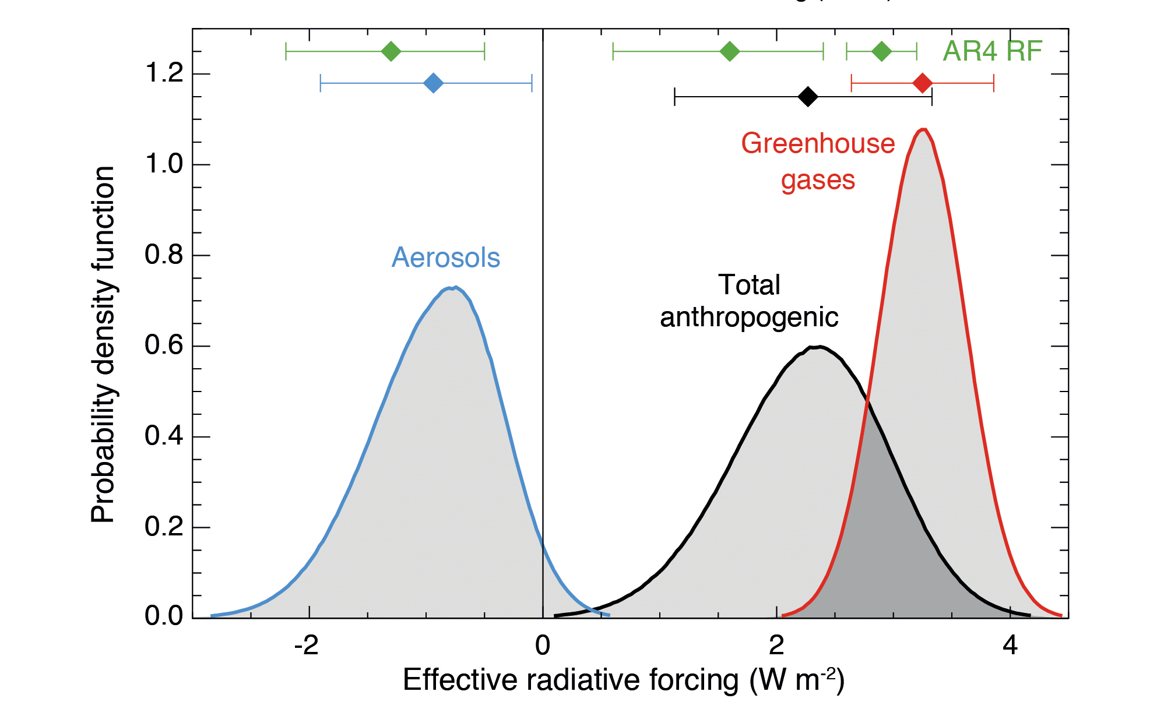
Aerosol effects in climate
Aerosols major cause of uncertainty in climate sensitivity
IPCC, 2013
Notes:
Knowing the temperature response related to unit GHG emission is a prerequisite for desiging policies for meeting COP21 targets. This is still highly uncertain and the forcing caused by aerosol particles is a major reason for the uncertainty. The probability distribution for GHGs is relatively narrow as compared with the aerosols. This propagates to the uncertainty in the total anthropogenic effect.

Slide 20
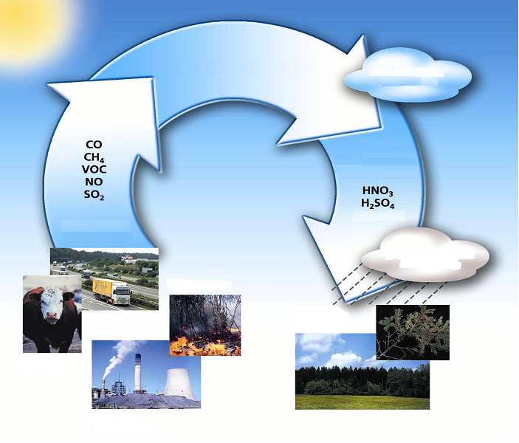
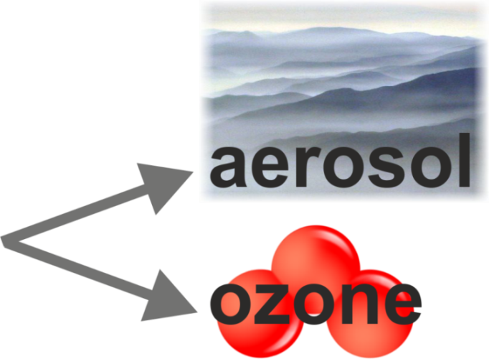


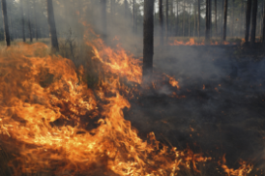


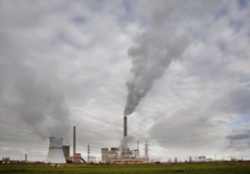

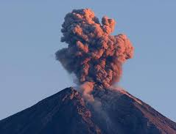
Radiative forcing
Impact of atmospheric chemistry
Atmospheric
Oxidation
PM
CO₂
H₂O
...
Emissions
Removal
Traffic
Agriculture
Energy production and use
Natural sources

Slide 21
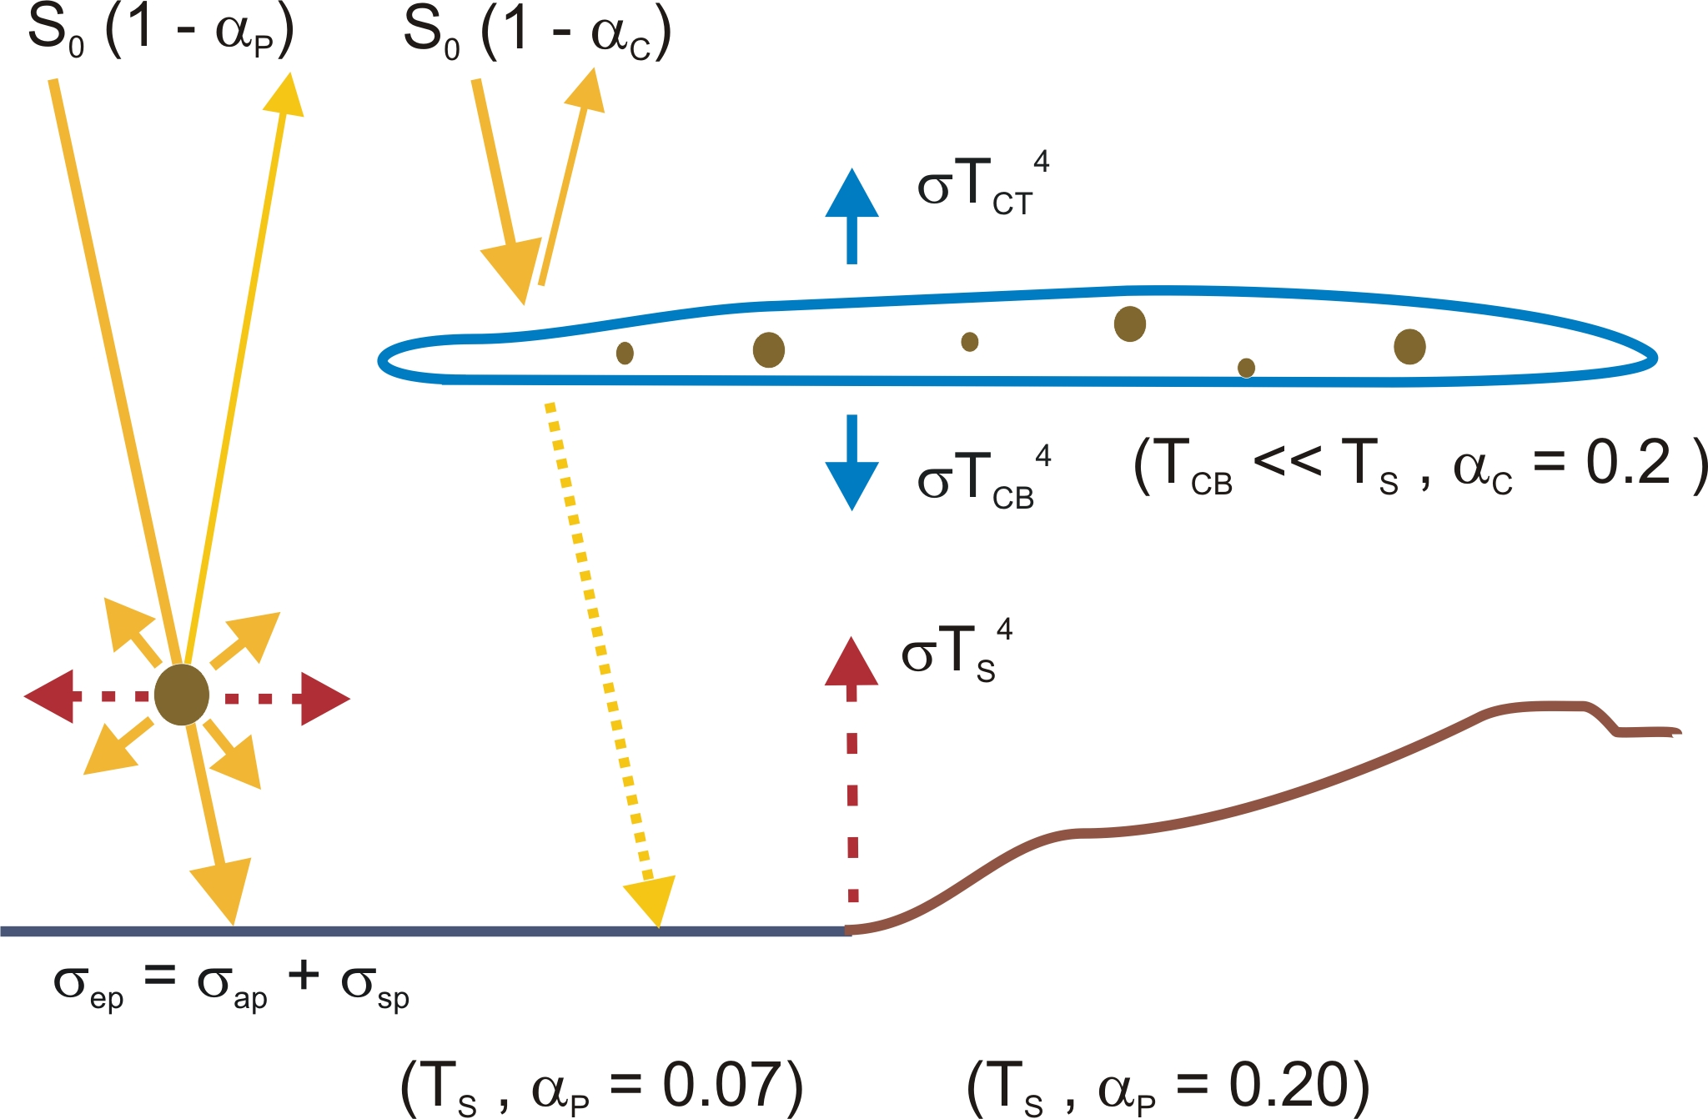

Radiative forcing
Impact of aerosol
Direct effect
Direct aerosol effects on climate result from the interaction with solar radiation:
radiation scattered back into space
⇒ increased net flux at TOA reduced surface radiation overall cooling effect.
(ii) radiation absorbed in the atmosphere
⇒ reduced net flux at TOA reduced surface radiation overall heating effect impact on atmospheric temperature profile and stability.

Slide 22
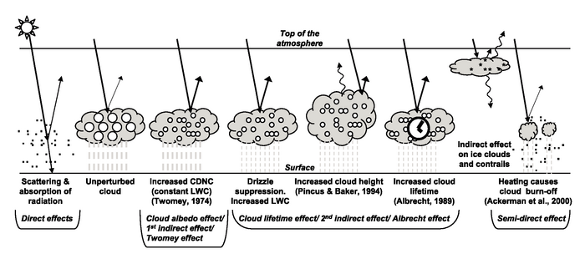
Radiative forcing
Impact of aerosol
Indirect aerosol effects on climate result from the formation of clouds → overall cooling effect

Slide 23
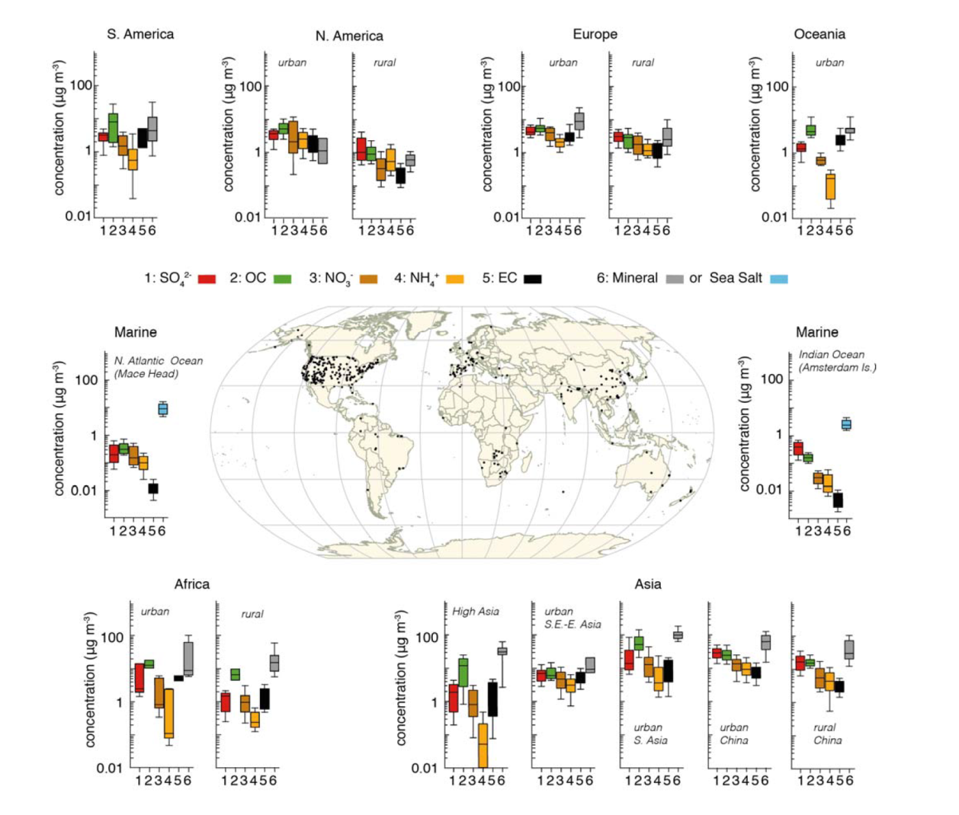
Aerosol in the atmosphere
Majority of aerosol compounds formed through atmospheric chemistry
IPCC 2013

Slide 24

Aerosol in the atmosphere
Majority of aerosol compounds formed through atmospheric chemistry
Africa N. America Europe China
Sulphate
Organics
Nitrate
Ammonium
Elemental Carbon
Mineral Dust
IPCC 2013

Slide 25
Can Aerosols compensate warming?
Most GHG are long lived in the atmosphere → uniform global distribution
Aerosol life time 1-2 weeks → concentration high near sources
GHG forcing operates day and night
Aerosol forcing operates only during daytime
Full compensation not possible but aerosols have masked the full effect of GHG warming
Reductions in aerosols due to air pollution control will reduce the aerosol cooling effect

Slide 26
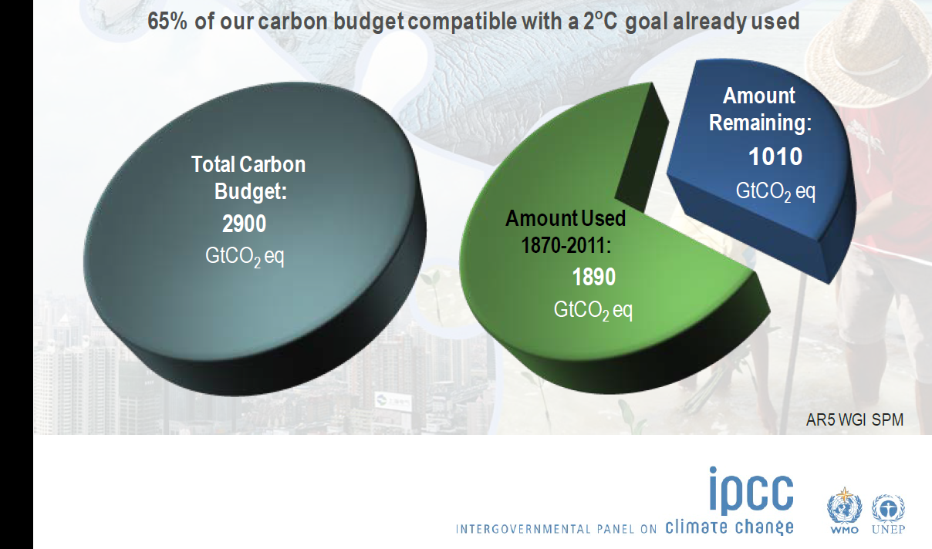
Summary

