Slide 1
¹⁸F-labeled peptides for the diagnosis of Alzheimers‘s Disease
21.08.2018 I Swen Humpert

Slide 2
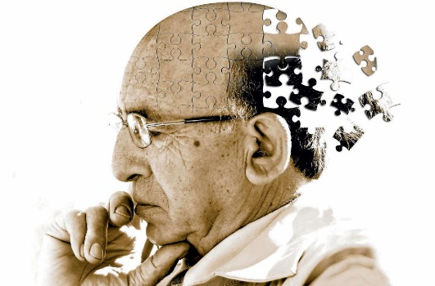
Alzheimer‘s Disease
Alzheimer’s disease (AD) is the
most common form of dementia
1.2 M patients in Germany –
24 M worldwide
Rapidly increasing prevalence
2030: 44 M
2050: 70 M
Currently no curative treatment

Slide 3
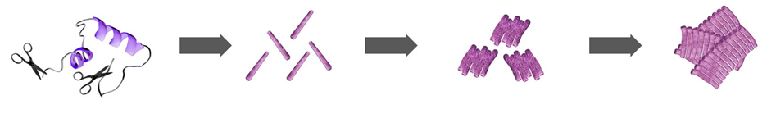
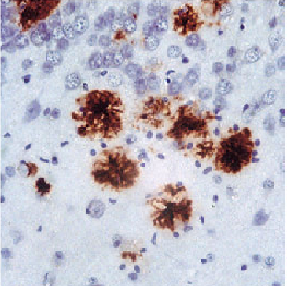
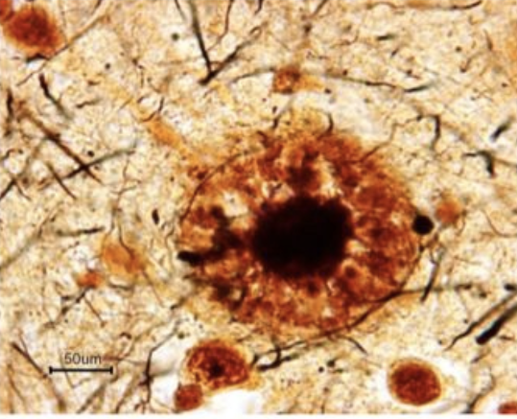
Amyloid cascade hypothesis
Enzymatic
cleavage
Amyloid-β
Monomers
(Aβ)
Amyloid-β
oligomers
Amyloid-β
fibrils
Classic: Stepwise formation of amyloid beta deposits (plaques)
ultimately leads to cell death and dysfunction
Recently: Soluble Aβ oligomers considered major neurotoxic
Pathologic changes long before symptoms appear
Neuronal damage is irreversible
Early stage diagnosis is important

Slide 4
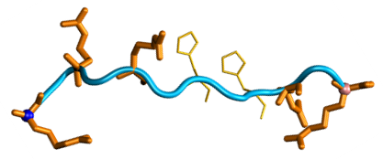
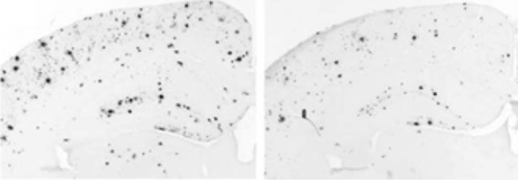
Peptide-based therapy approach
Leading structure D3:
H-rprtrlhthrnr-NH₂
Fully d-enanatiomeric peptides with high binding affinity to Aβ
Therapeutic effect
  In-vitro: - Soluble oligomers converted to non-toxic aggregates
  In-vivo: - Improved cognition in AD mouse model
    - Reduced plaque load
Control
Treated with D3

Slide 5
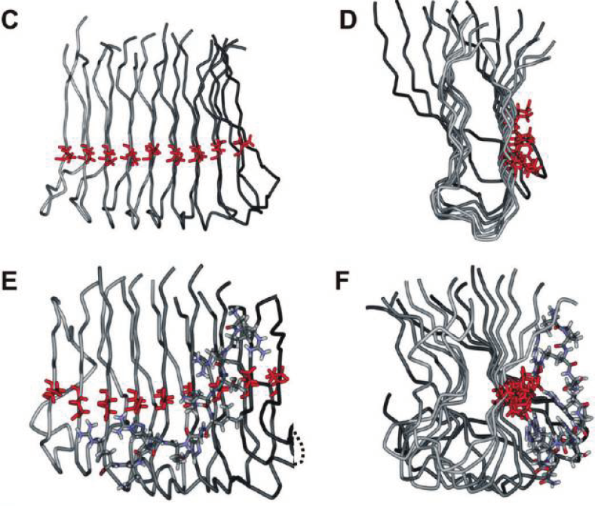
Molecular mode of action
Electrostatic driven interaction
between D3 (charge +6) and negatively charged glutamic acid
Conformational change into insoluble nontoxic Aβ aggregates
Toxic form removed from equilibrium by precipitation

Slide 6

Radiotracer Principle
Biological target
“Lock“
Vehicle
“Key”
Linker
Reporting Unit
-Proteins
-Receptors
-Transporter
-Enzymes
-Metabolism
-Peptides
-Sugars
-Amino acids
-Nukleotides
-Antibodies
-Radiolabelled building block
-Radiometal chelate
-Radionuclide directly to
attached to vehicle

Slide 7
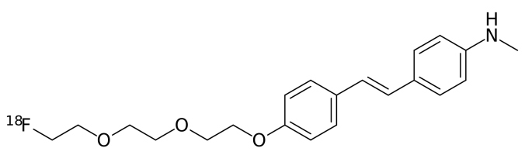
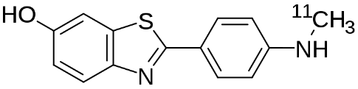
Amyloid Radiotracer
Thioflavin T derivatives
Stilbene derivatives
[11C]PIB
Pittsburg compound B
[18F]FBB
Florbetaben (NeuraCeqTM)
Current amyloid tracer:
  Unfavourable visualization of insoluble Amyloid
  Unspecific white matter binding
Radiolabelled D3 offers:
  Highly specific monomer- and oligomer addressing radiotracer
  Elucidation of tracer biodistribution by PET imaging

Slide 8
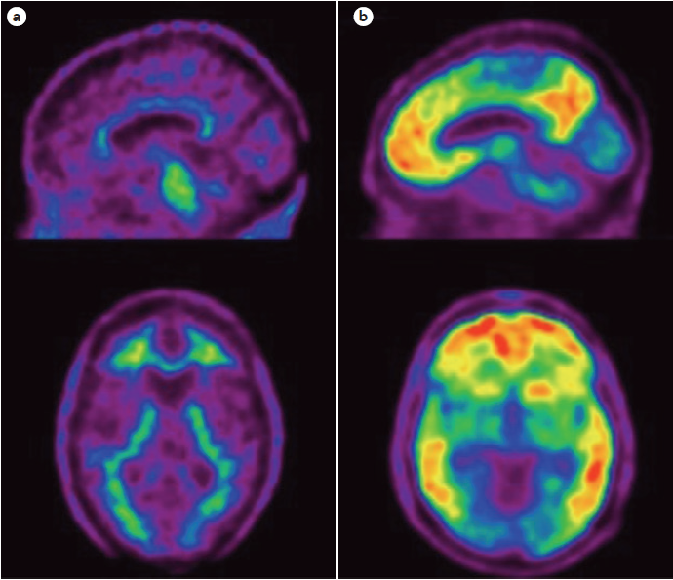
Diagnosis of AD
Classical diagnosis based on dysfunction
or histopathology (post mortem)
Positron emission tomography (PET) allows for quantification of amyloid non-invasive in vivo
Early stage prognosis:
  a) Cognitive stable for >4.5 years
  b) Dementia within 3 years
¹⁸F-NAV4694 PET of two patients with mild
cognitive impairment

Slide 9
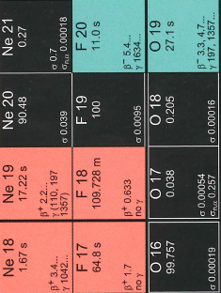
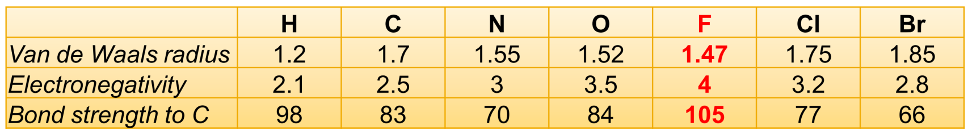
Working Horse: Fluorine-18
97% β⁺, E_{max} = 0.635 MeV
- low positron-energy;
suitable for PET with high resolution
• T_{1/2} = 109.7 min
- half-life suitable for extended syntheses
and PET protocols
• C-F bond
- covalent and stable; monovalent chemistry
- organic analog-compounds

Slide 10
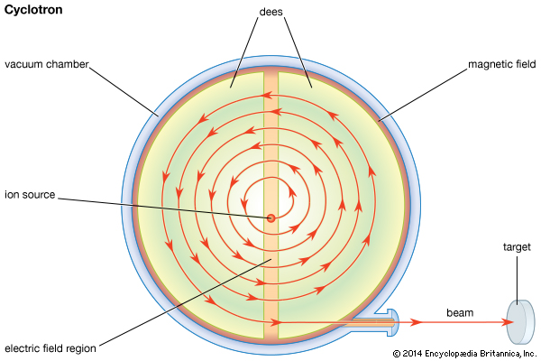

Working Horse: Fluorine-18
≠
n
¹⁸O
p
¹⁸F
On-demand production at Cyclotron (charged particle accelerator)
1-2 h bombardment of [¹⁸O]H₂O
[¹⁸F]fluoride delivered as aqueous solution

Slide 11
Radiofluorination
S_{N}Ar or S_{N}2

Slide 12
Fluorination via Prosthetic Groups
Indirect radiolabeling
Synthesis of radiolabeled prosthetic group and coupling with peptide are separated steps
Sensitive peptides not affected by harsh labeling conditions

Slide 13
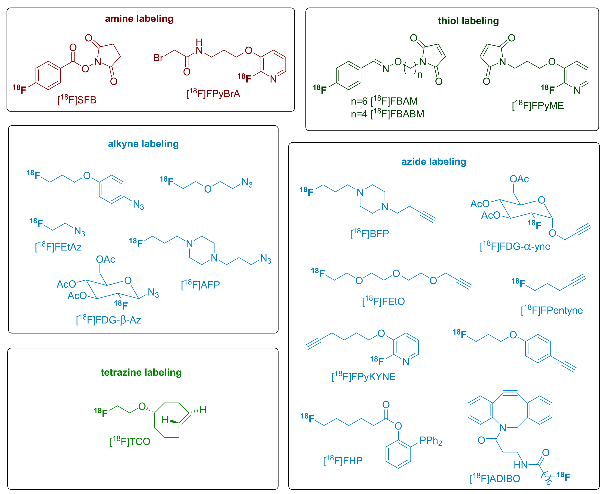
Examples of Prosthetic groups
Incompatible with D3
Complex synthesis low yields

Slide 14
New Method: Fluorovinyliodonium salts
Nucleophilic addition of ¹⁸F⁻
60 % RCY
10 min
Solvent: DMSO/Water – no drying steps needed
38 – 88 % RCY
10 min, r.t.
Fast and operationally simple access to ¹⁸F-labeled building block
Fast coupling to vehicle molecules under mild reaction conditions
Protocol successfully applied to several biomolecules as model compounds

Slide 15
Peptide labeling
Necessary adaptions for peptide labeling:
  Identification of suitable linkers
  Application of low peptide concentration
  Tolerance of guanidine groups (arginine)
→Transfer of the labelling protocol to a model-dipeptide
    Proof-of-principle
    Optimisation of critical reaction parameters
- solvent, catalyst, concentrations etc…
Coupling of [¹⁸F]FHexI⁺ with H-Arg-Pra-OBn gives > 60 % RCY

Slide 16
Labeling of “RD2“
Application on improved D3-derivative RD2 (rational design – 2)
Tracer is currently evaluated:
  Comparison of transgenic AD mouse model with wildtype (control) by PET-CT and ex-vivo autoradiography

Slide 17
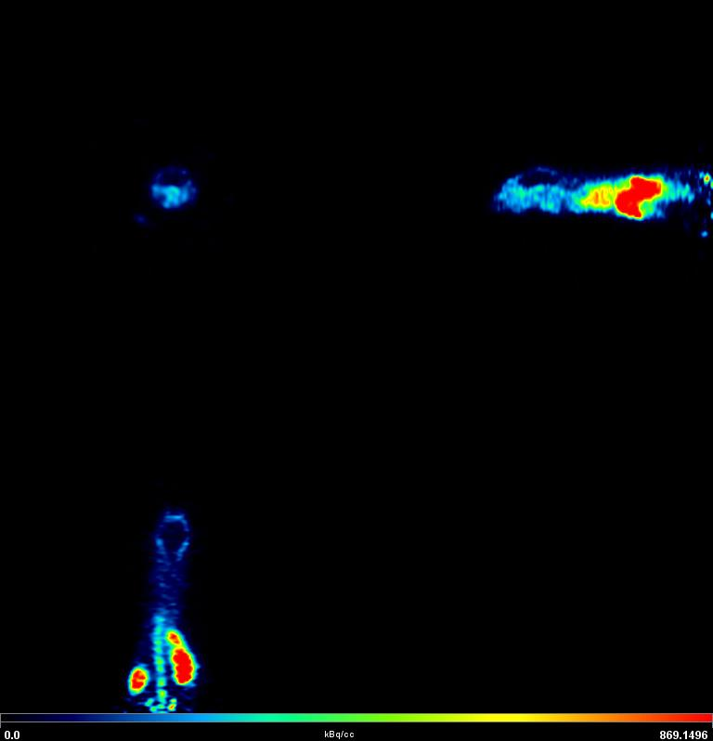
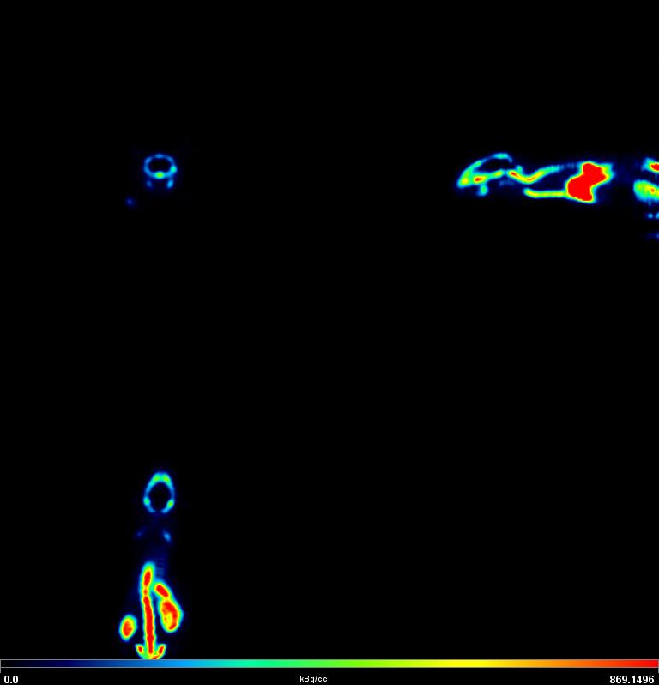
Preliminary In-vivo results
4-5 min p.i.
110-120 min p.i.
Rapid tracer accumulation in kidney
Increasing uptake of radioactivity into bone undesired defluorination
Early brain uptake might be useful for assessment
Further evaluation of the results needed

Slide 18
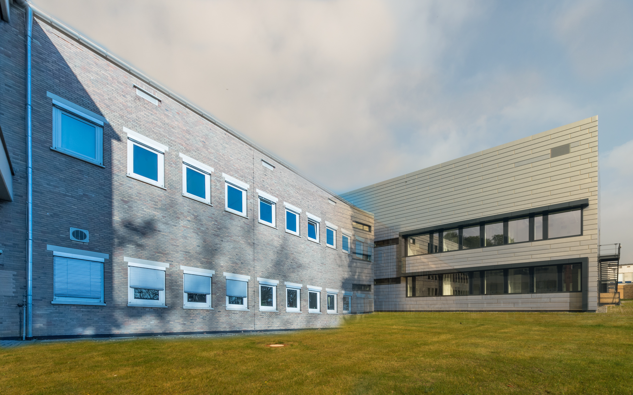
Thank You

