Slide 1
Mikheil Kelenjeridze
(PhD student at GTU, INM-4 FZJ)
Development of an MRI Antenna Array for MR-PET imaging
Supervisors:
Prof. Dr. Ketevan Kotetishvili (GTU)
Dr.-Ing. Joerg Felder (INM-4 FZJ)
21.08.2018, Tbilisi

Slide 2
Outline
MRI basics
Magnetic field
Spin precession
Electromagnetic spectrum
Motivation
Conventional coil
Parallel transmission
SAR
Head coils
Problems & Solutions
Notes:
Outline is following:
I’ll start with basics of MRI technique, which consists Magnetic field, how to pick up spin precession, then comes motivation, discuss several coils, introduce SAR and other problems and solutions

Slide 3
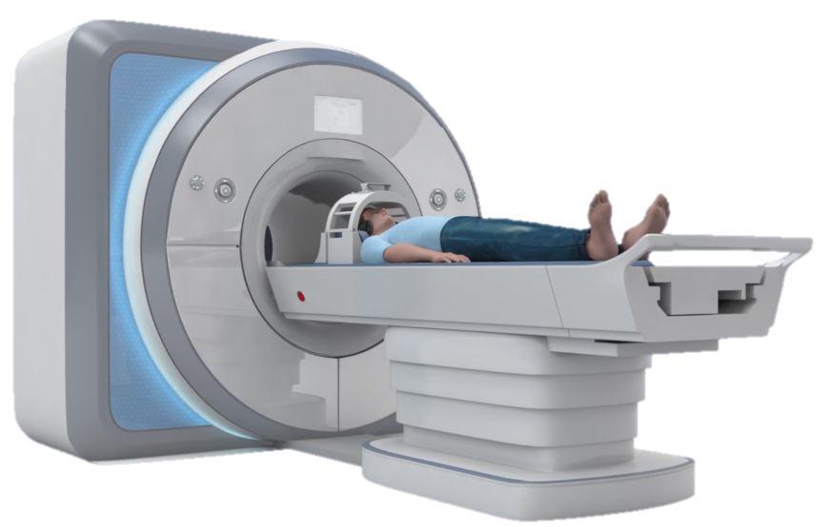
MRI scanner
Main magnet
Head coil
Patient
Patient table
Notes:
Here you see the normal MRI scanner, which you’ll meet at hospitals or research centers. In this big cabinet main magnet is located, actually there is not ordinary magnet which you already seen, but there is a big coil made out of superconductor, which is put in to the helium to cool down at approximately -270 degree Celsius.
Here is also located a head coil, which is for transmitting and receiving the signal. MRI magnet itself has another bigger coil for signals, but to catch more signal, it is located around the head.
Well, this is my work at FZJ to improve such kind of coils, and I’ll explain bit later why is it necessary to develop this part of the MRI.
And the bonus information at the and of this slide, MRT is not only this shown at the image, but there is also another room for voltage generators, cables and etc. and another room where the computer is located and can control the examination.

Slide 4
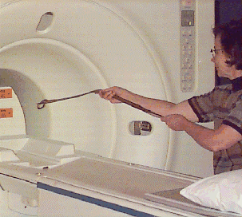
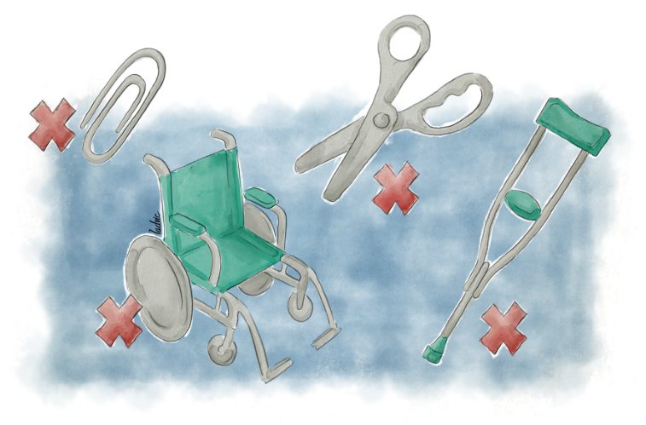
Magnetic field
Ferromagnetic parts are not allowed
Notes:
How strong is Magnetic field at MRT? For the hospitals it is 1.5, 3, 5 tesla. It is 100 000 larger than earths magnetic field. well, it is kind of informative information, but for better understanding we can see the images.
As you see on the images, this magnet has a very big impact at ferromagnetic parts =And this is why there are very strong restrictions for entering in to the scanner room and about patient implants also.
Ferromagnetic – Having a high susceptibility to magnetization - Examples: iron, nickel, cobalt, bullets

Slide 5
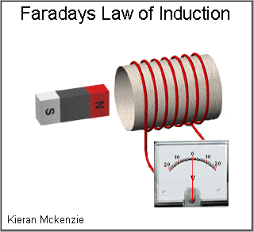
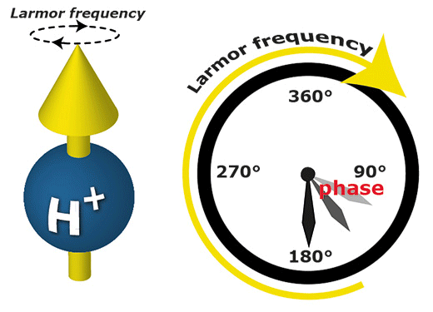
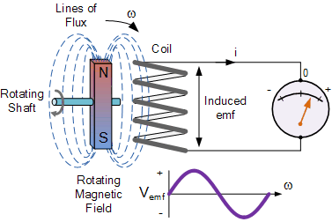
Spin precession
Larmor equation
Frequency calculation
Wavelength calculation
$$f=\frac{ω}{2π}$$
$$λ$$
$$B_{0}$$
$$=\frac{c}{f}$$
$$ω=γ$$
electronics.stackexchange.com
Notes:
Why do we need such strong magnets? Because we want to interact with very small particles, Hydrogen protons, and especially we want to align them in one direction.

Slide 6
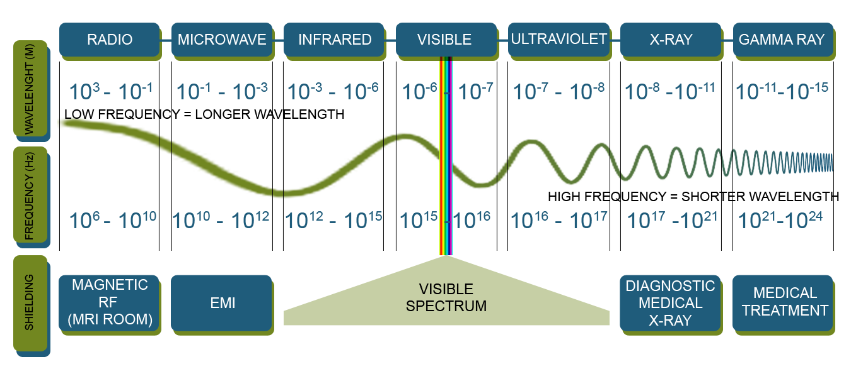
Electromagnetic spectrum

Slide 7
Ultra high field magnets
mri-q.com

Slide 8
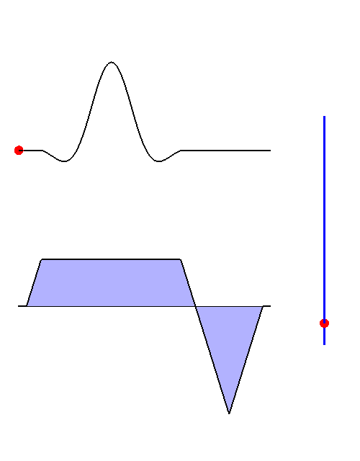
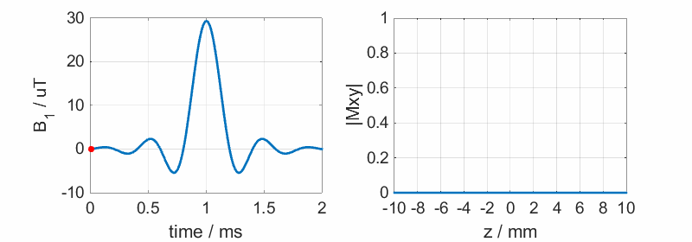
Conventional coil

Slide 9
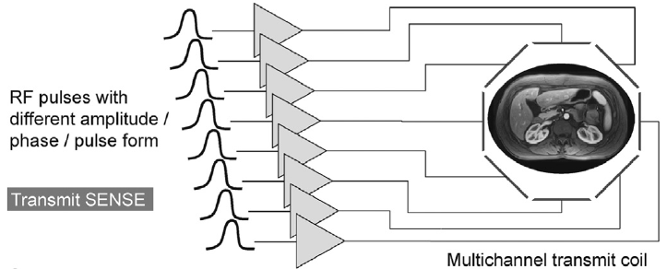
Solution: Parallel transmission
Additional degrees of freedom
Change amplitudes, phases, waveforms individually

Slide 10
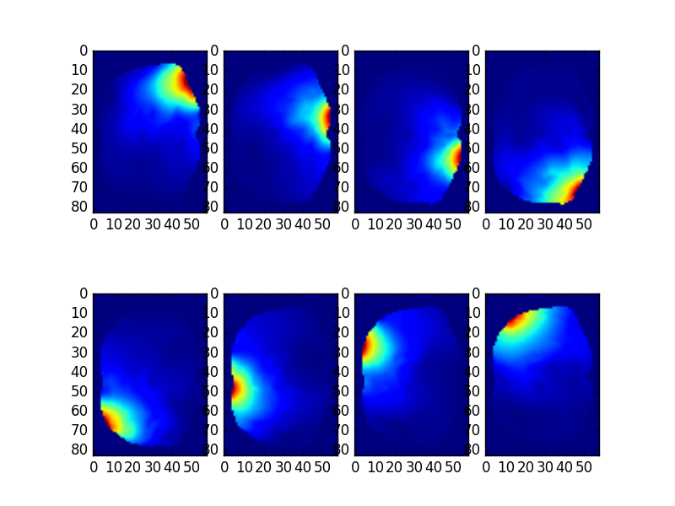
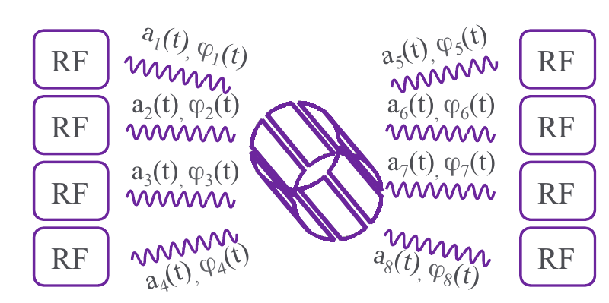
Solution: Parallel transmission

Slide 11
Pulse design
https://slideplayer.com/slide/7640523/

Slide 12
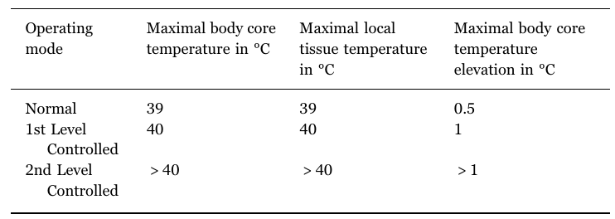
Challenge: Specific Absorption Rate
IEC 601-2-33 Guideline for SAR - 2 W/kg - 4 W/kg

Slide 13
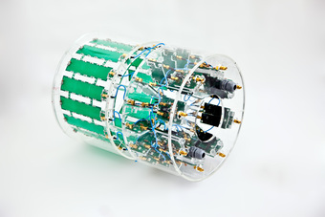
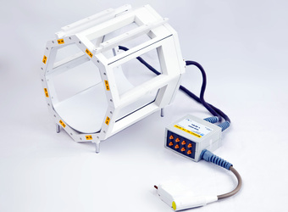
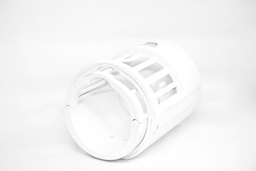
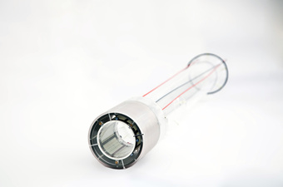
Head coils
16-Channel Transmit Array
Modified 8-Channel pTX Coil
Sodium Coil Array
Body Coil for Small Animals
http://www.fz-juelich.de/inm/inm-4/EN/Forschung/MR-Physik/TeamHardware/Spulen/_node.html
Notes:
16-Channel Transmit Array This is a prototype coil developed in collaboration with the NRI in Incheon, South Korea, that can be used for parallel transmission and reception. It is driven by eight independent power amplifiers, each transmit channel is then fed to two coils. In receive mode, 16 completely independent receive loops are available.
Sodium Coil Array This coil array, intended for imaging sodium nuclei at 9.4T, consists of a transmit birdcage and an eight channel receive array. Both coils can be split for easy patient positioning and are based on the design of a 3T MR-PET coil array from Siemens.
Modified 8-Channel pTX Coil This single channel transmit, 8-channel receive coil fabricated by Rapid Biomedical has been modified for parallel transmission systems. It now allows the use of eight independent transmitters as well as eight receivers.
Body Coil for Small Animals Designed as a classical birdcage, this coil is installed in the 9.4T animal scanner. It operates in conjunction with any receive only coil array in the same manner as the coil setup in modern clinical MRI systems.

Slide 14
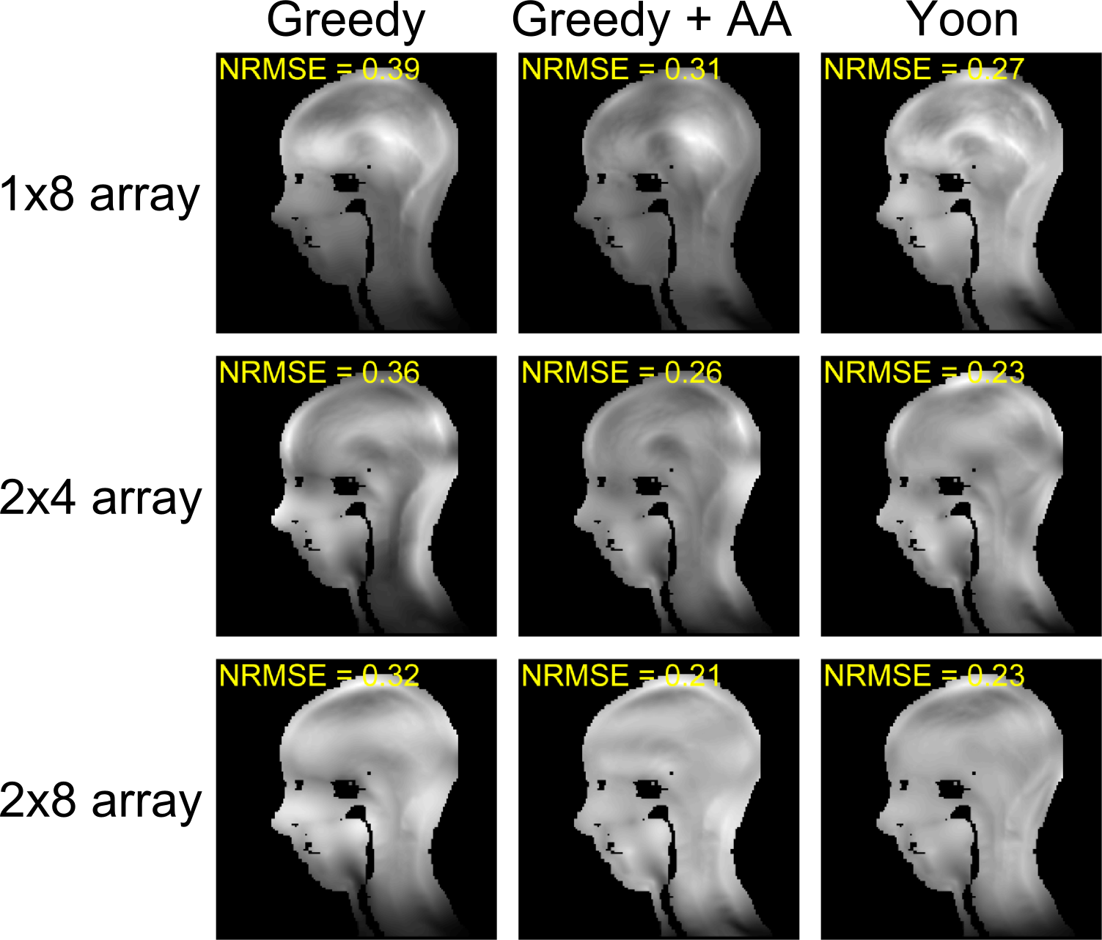
Problems & Solutions
FZJ, INM-4

Slide 15
Ultra High Field increases SNR
Developing Parallel transmission is essential for developing MRI
Thank you for your attention

