Slide 1
Giorgi Jibuti
Ivane Javakhishvili Tbilisi State University
Faculty of Exact and Natural Sciences,
Head of the SMART|AtmoSim_LAB
Project overview: smart platform sensors and drones
8TH GEORGIAN – GERMAN SCHOOL AND WORKSHOP IN BASIC SCIENCE (GGSWBS‘ 18)
SCIENCE AT MULTIDISCIPLINARY
SMART | LABS IN GEORGIA
August 22, 2018
Tbilisi; Georgia
04.06.2018, Jülich

Slide 2
SMART|AtmoSim_Lab overview
Past Future
June 2015
Jülich
(Internship 1 student)
Jan 2016
Jülich
test phase for first joint project
May 2016
Jülich
(Internship 2 students)
29.09.2017
Opening of
AtmoSim_LAB
Nov 2015
Definition of first joint project
Feb 2016
Selection of
George Jibuti Smart Lab
chairperson
GGSWBS‘ 18
Sept 2016 Tbilisi
First Summer School “Atmosphere”
Page 2
Notes:
I want to thank everyone involved,
Rector of TSU
Vice-rector of TSU
Directors of IEK
Robert, Franz,
Mentors Ramaz and Bezan,
Andro Kacharava

Slide 3
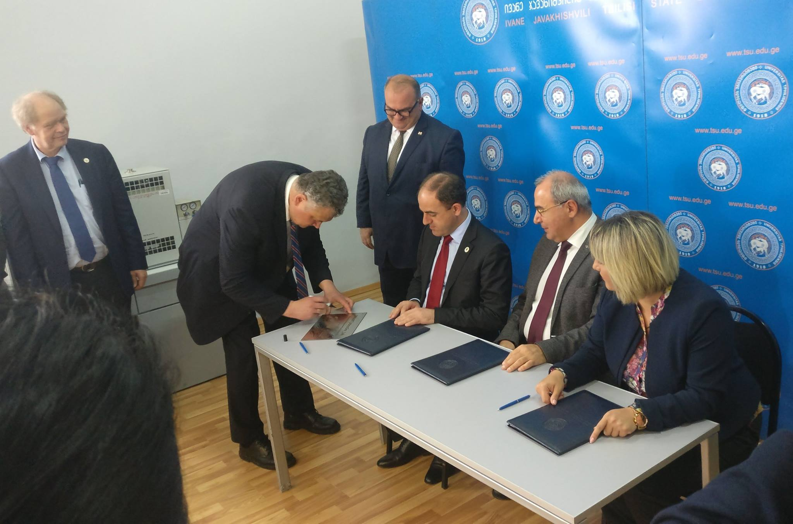
SMART|AtmoSim_Lab inauguration
Page 3

Slide 4
SMART|AtmoSim_Lab on-going projects
Current Instrumentation and measurements
NO and NO₂ measurement (ECO PHYSICS model: CLD 780 TR)
Ozone measurement (Environnement S.A. model: O₃ 41 M)
CO, CO₂, CH₄, H₂O analyzer (PICARRO CRDS model G2401)
PM (aerosol) monitor (Grimm Aerosol Technik model: 1.129 OPC)
Page 4
Notes:
Continuous measurements (online and offline) are running from January 2018
Each month we select new region of the city to measure regularly
Reports are sent to Tbilisi City hall: Monthly graphs, offline analysis results, average values

Slide 5
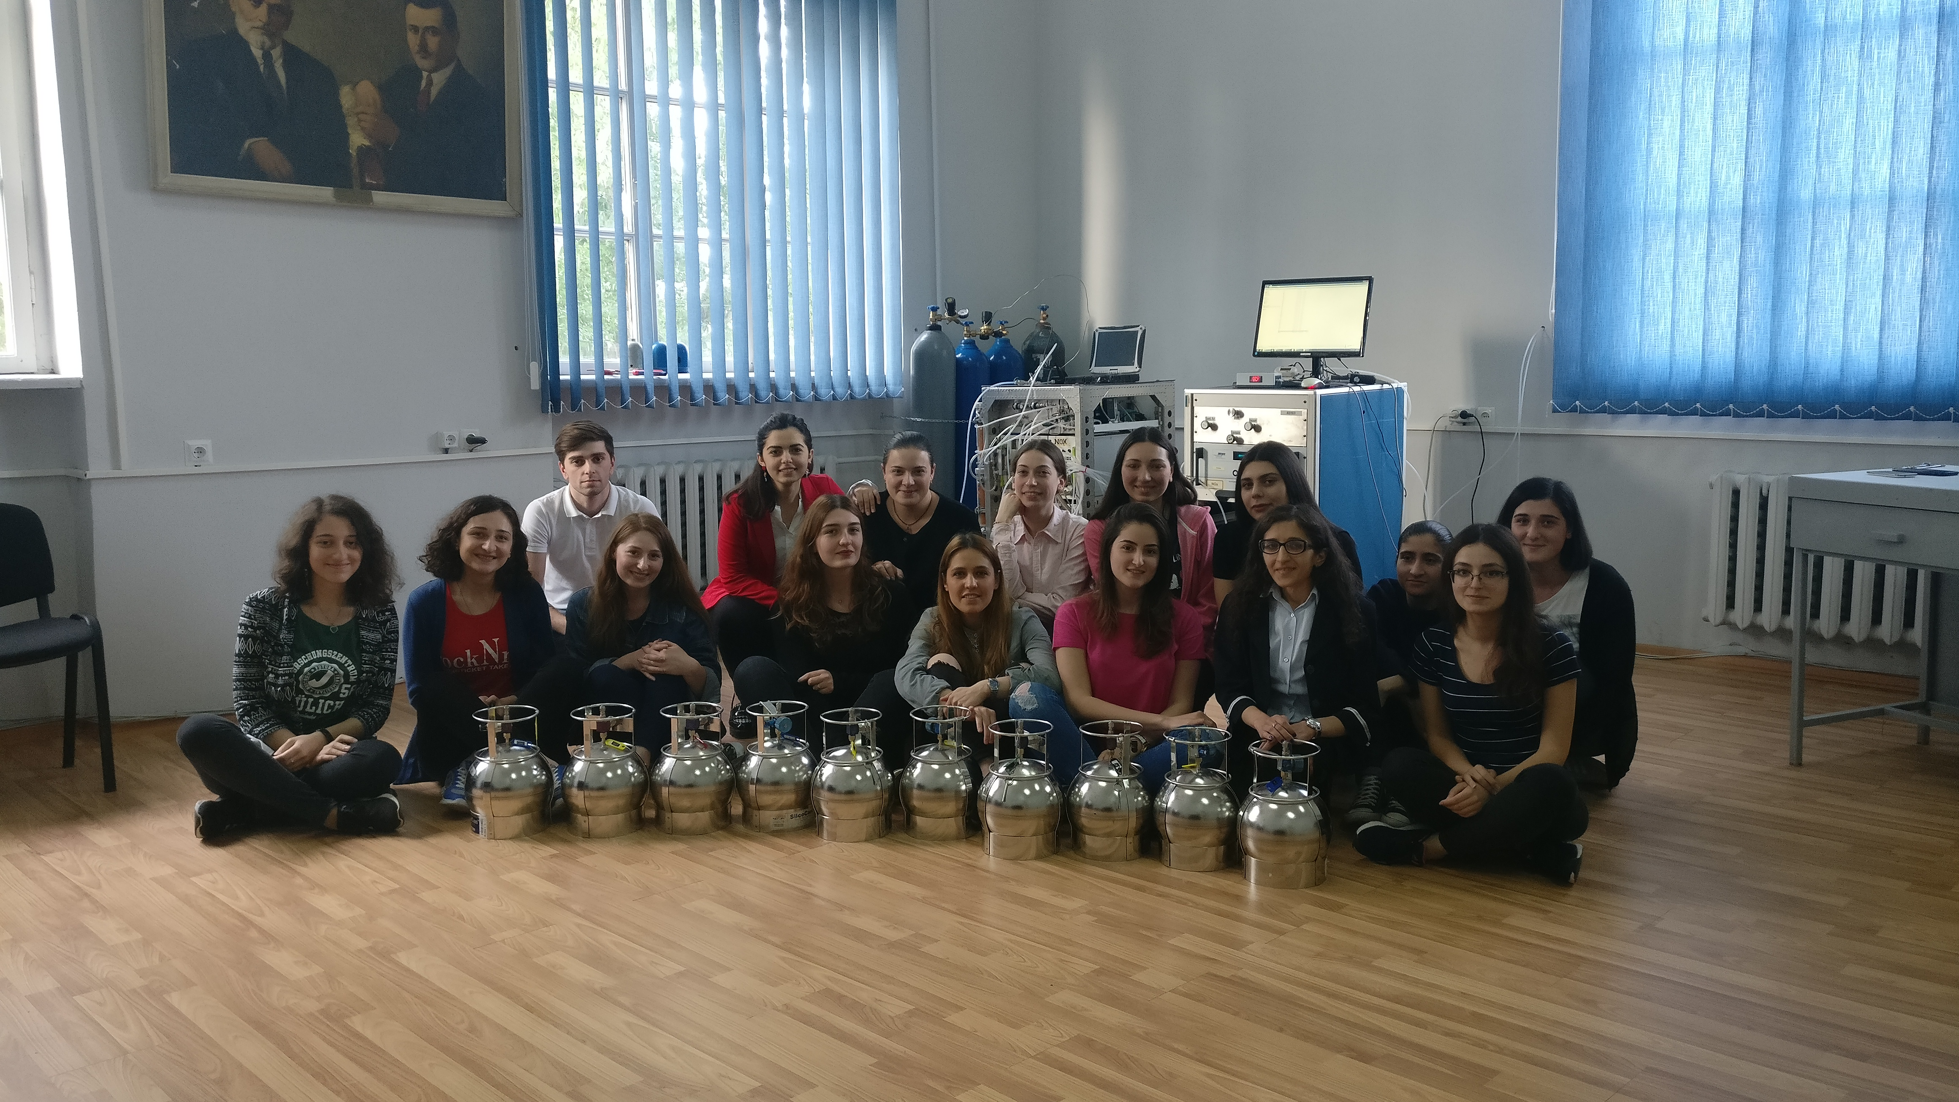
Involved young researchers
2 PhD students,
4 MS students,
4 BS students
2 BS diploma:
Ana Chokheli – NOx concentration in Tbilisi
Nino Kirtadze – CO and CO₂ concentrations in Tbilisi
Page 5

Slide 6
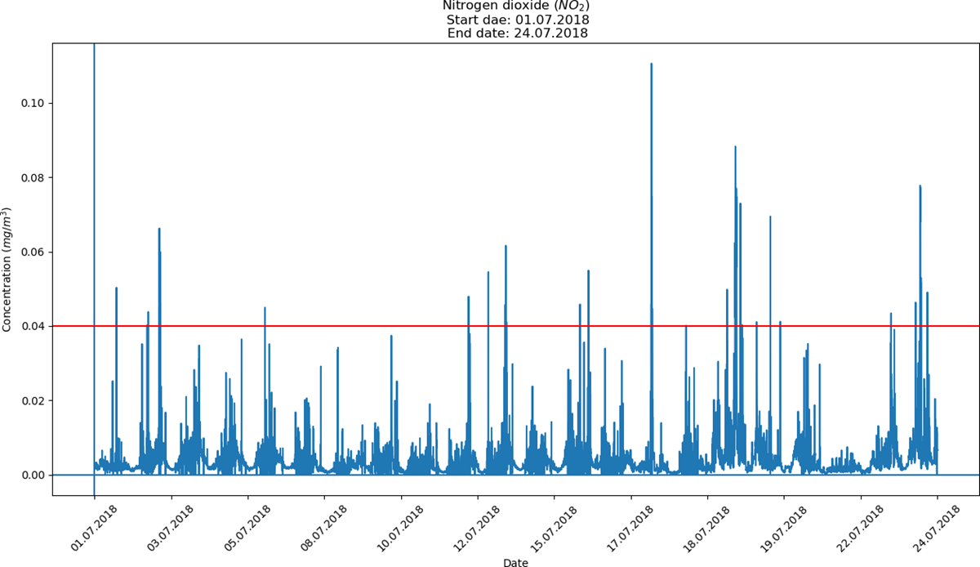
On-line analysis and evaluation of atmospheric contamination
Page 6

Slide 7
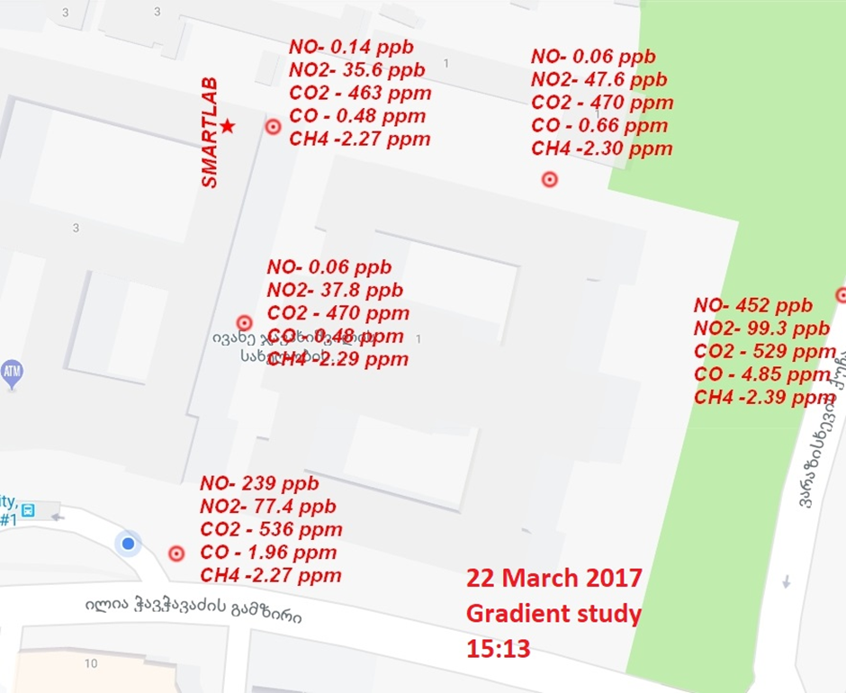
Offline sampling via canisters
Routine sampling in average 3 times per week in selected street, at least 3 points, 2 canister at the point
Several time and space gradient measurements
Routine validation and canister check
Weekly internal summaries
Quarter summaries are submitted to Tbilisi City Hall
Page 7
Notes:
Continuous measurements (online and offline) are running from January 2018
Each month we select new region of the city to measure regularly
Reports are sent to Tbilisi City hall: Monthly graphs, offline analysis results, average values

Slide 8
Drone based platforms to supplement stationary laboratories
Stationary laboratories
Less logistical issues
Research grade instruments, very low LOD & LOQ
High specificity
Very good time resolution- continuous measurements
Low spatial resolution
Offline sampling has low time resolution
Not all species could be measured offline
High cost of instruments
Drone based platforms
Time and special resolution can be adjusted based on needs
Relatively low cost drones and sensors
Highly flexible
In-situ measurements (close to the source)
Page 8
Notes:
Challenges of atmospheric contaminant research: Low concentration, highly variable based on chemistry or metrology
Fast, sensitive instruments with high specificity
Drone measurement complements and fills stationary measurement data and gives more insights
Stationary laboratories could be used for validating sensor data
Mathematical model and machine learning can be used to improve cheap sensor data quality

Slide 9
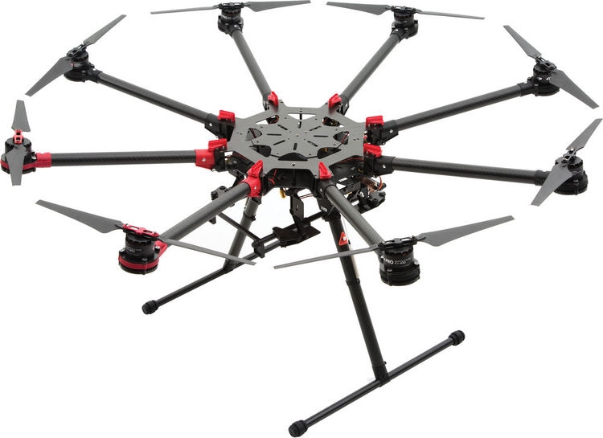
Requirements to the drones
Sufficient payload capability
Ease of use
Good maneuverability (vertical flight, freezing on point, etc.)
No special permits to fly given drone
DJI SPREADING WINGS S1000+
Octocopter,
5 kg payload – 15 minutes of hover time
Page 9
Notes:
Drone types, military, wing drones, gliders, copters
Drones are improving rapidly, mostly used in video production

Slide 10
Challenges of Atmospheric analysis and sensor requirements
Trace gases, as name suggests are present at low concentration, usually ppbv level or lower (CO, CO₂, water vapor are noticeable exemptions)
Concentration of this compounds are often highly variable - high reactivity and meteorological conditions are usually deciding factors
Trace gases undergo very complex chemical transformations (The Master Chemical Mechanism contains data of degradation of 143 VOC’s, up to 6000 chemical reactions and 14000 intermediary species)
Interferences from other/similar species
According mentioned above, sensors should be sufficiently sensitive, selective and fast, preferably relatively cheap.
In addition power requirements and mass should be low, as well as dimensions
Page 10
Notes:
Some sacrifices should be made

Slide 11
Sensors Types
Optical sensors (UV, VIS, IR sensors)
Electrochemical sensors
Gas-semiconductor sensors
MEMS sensors (pressure and flow)
Capacitive/Resistive sensors (Humidity, temperature)
Photodiodes (sunlight sensors)
Light scattering sensors (for PM)
Page 11
Notes:
MEMS ვილაპარაკო!

Slide 12
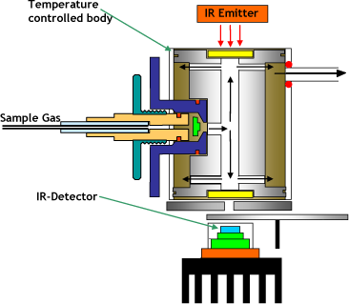
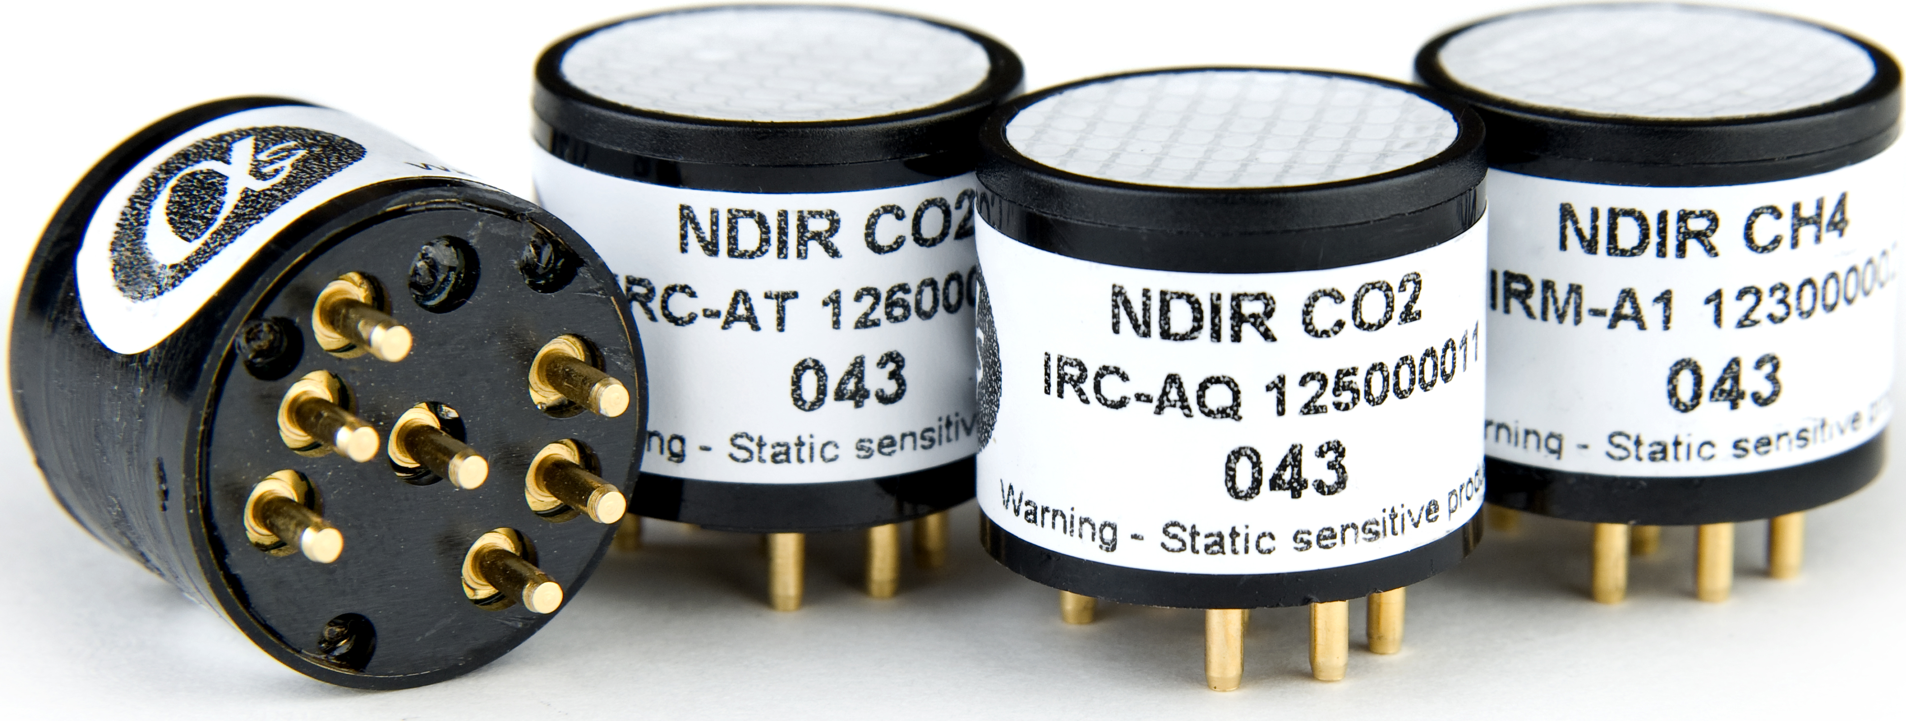
Optical sensors (NDIR sensors)
(CO; CH₄)
Pyroelectric and thermopile detection
Page 12
Notes:
20 mm diameter

Slide 13
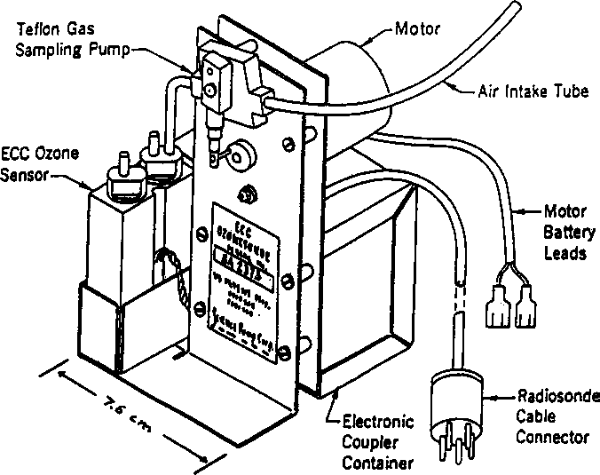
Electrochemical sensors
(Brewer-Mast cell)
$$2KI+O_{3}+H_{2}O→I_{2}+O_{2}+2KOH$$
E-cell with Pt cathode and Ag anode
$$Cathode: I_{2}+2e^{−}→2I^{−}$$
$$Anode: 2Ag→2{Ag}^{+}+2e^{−}$$
Page 13
Notes:
1 molecule of Ozone yields 2 e-
High sensitivity, selectivity, low dynamic range

Slide 14
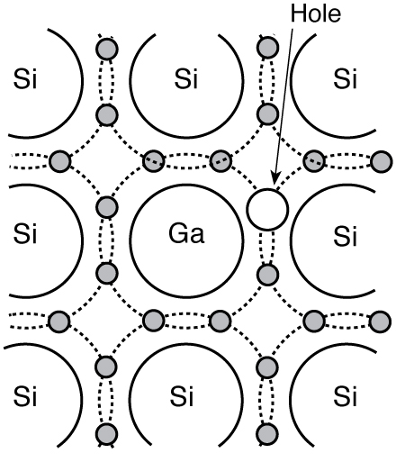
Metal oxide Semiconductor sensors
The sensing principle relies on the interaction between the porous gas sensitive layer and the target gas: the adsorption of the gas causes a change in the electrical resistance of the porous layer.
Discrimination between different gases is optimized through a combination of fine-tuning manufacturing processes, selecting the sensor operating parameters and including embedded filters.
4 electrode design (working, counter, reference, auxiliary) ensures sensitivity and reliability.
P-type semiconductor
Page 14

Slide 15
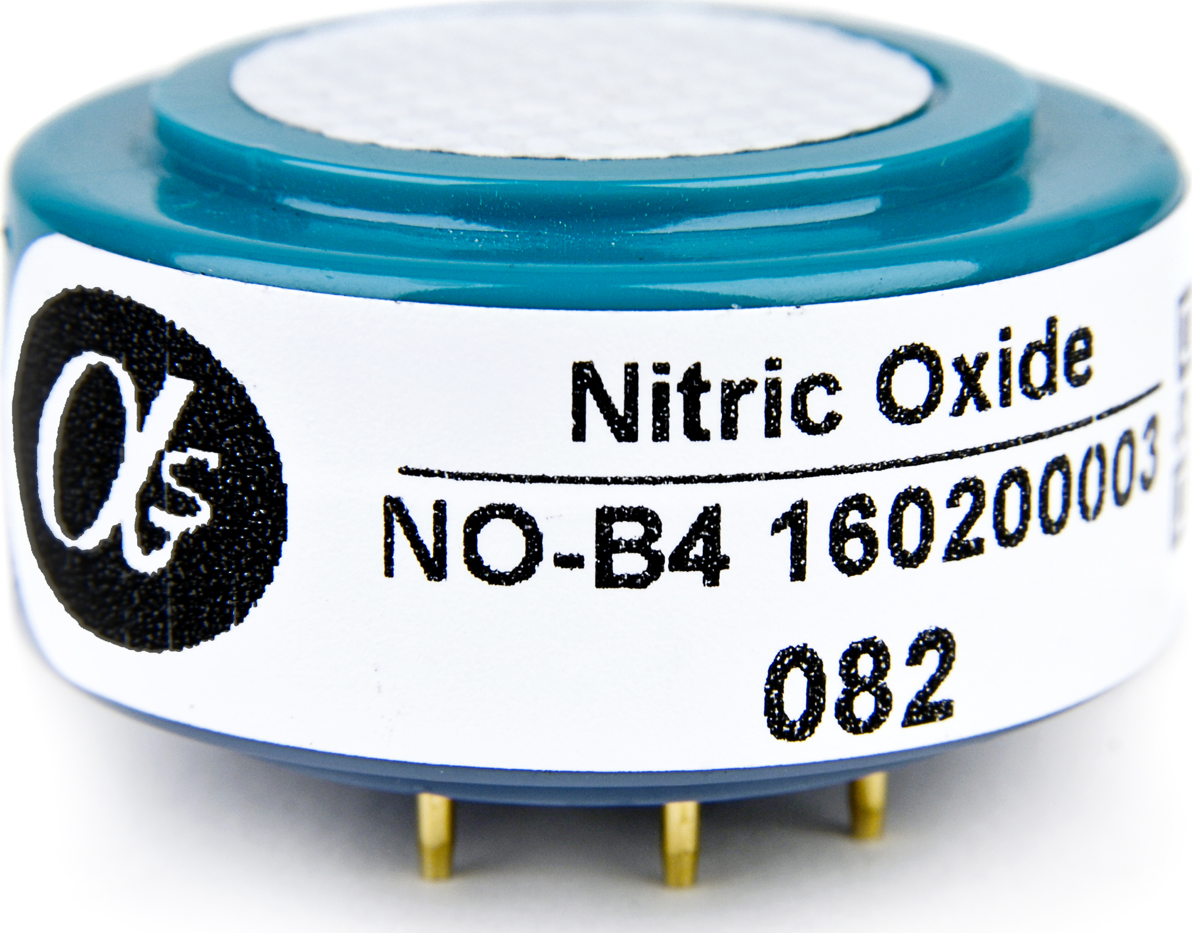
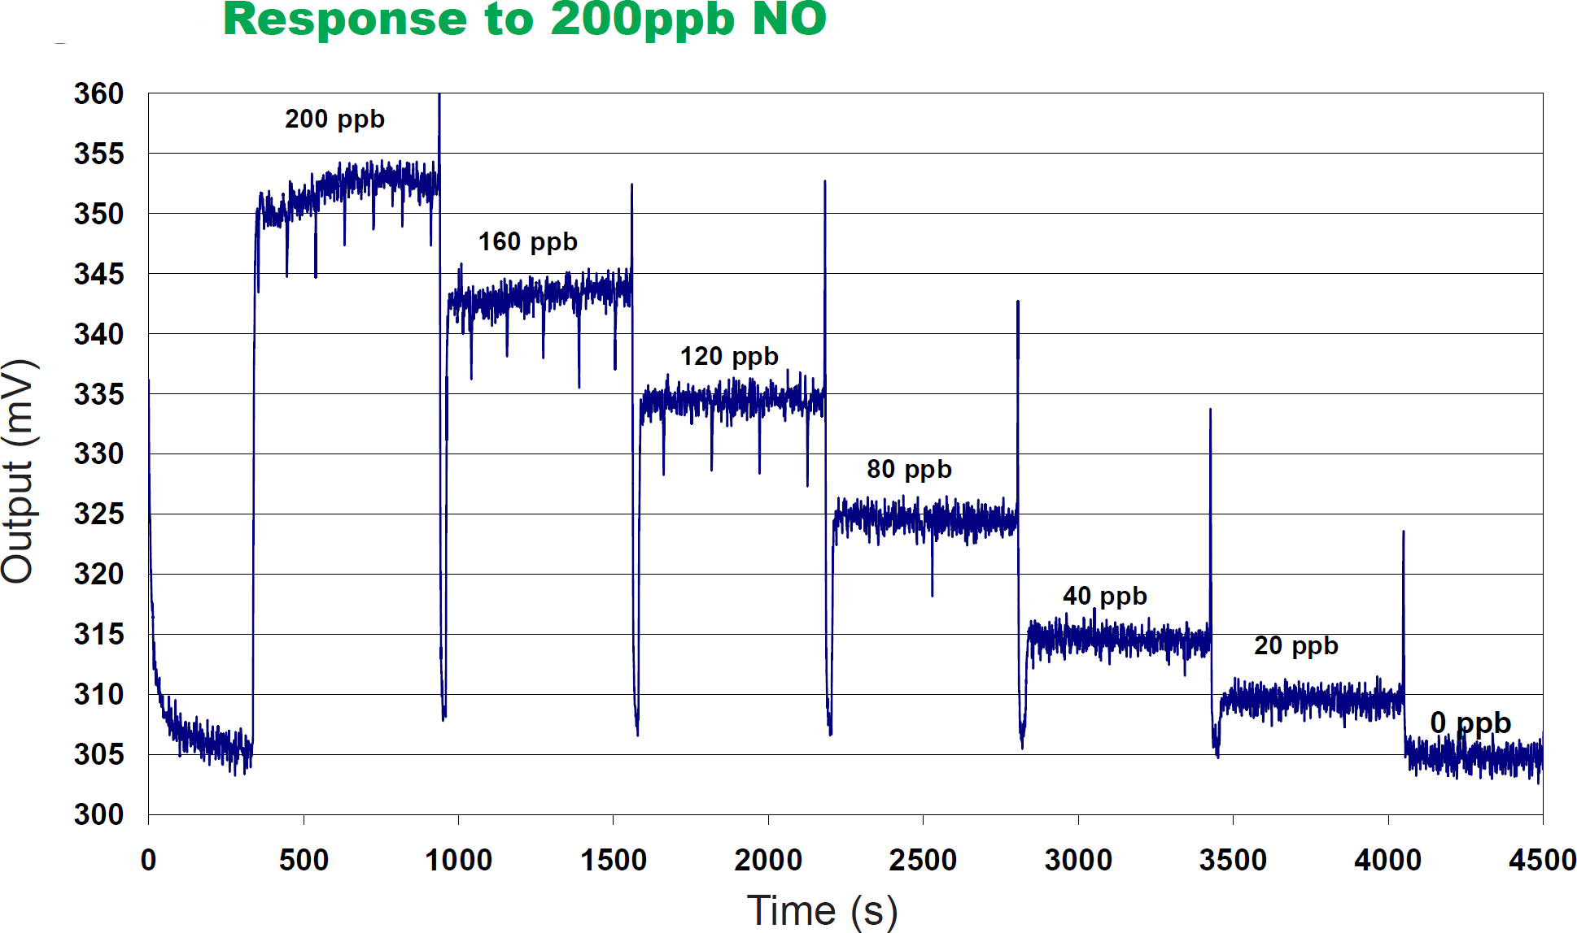
NO-A4 Nitric Oxide Sensor
Page 15

Slide 16
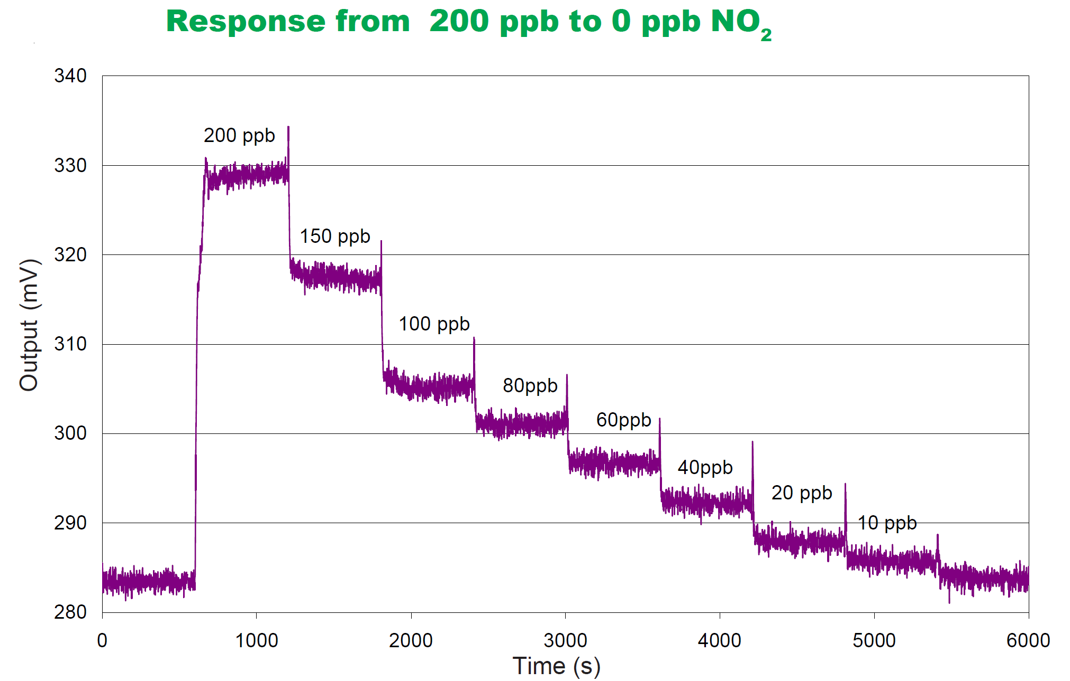
Page 16

Slide 17
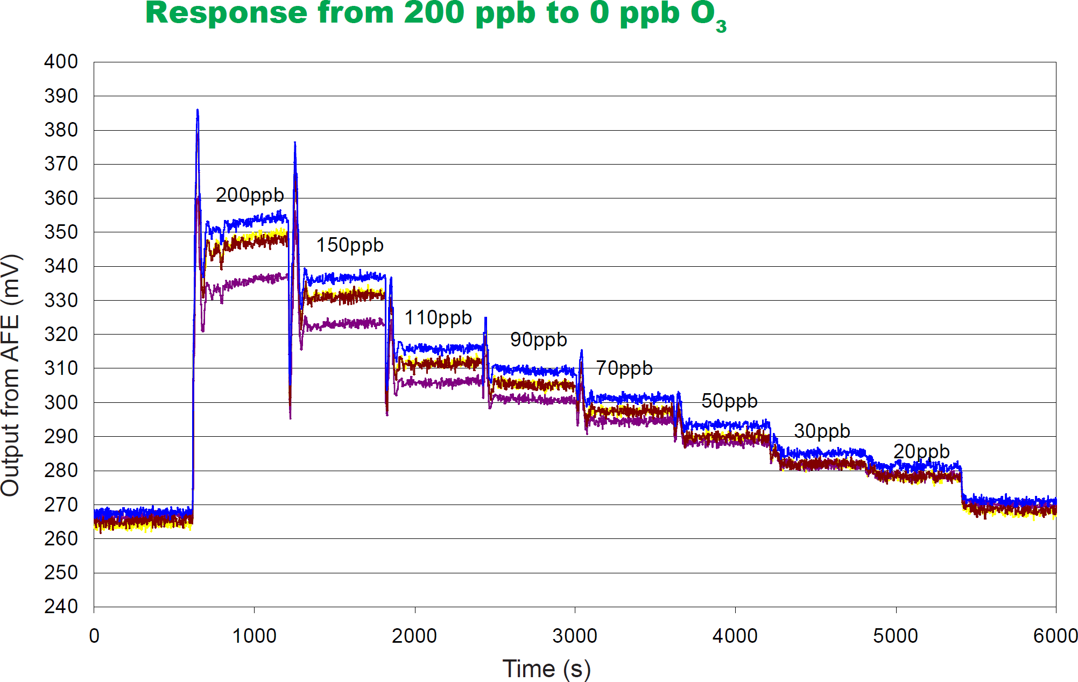
Page 17

Slide 18
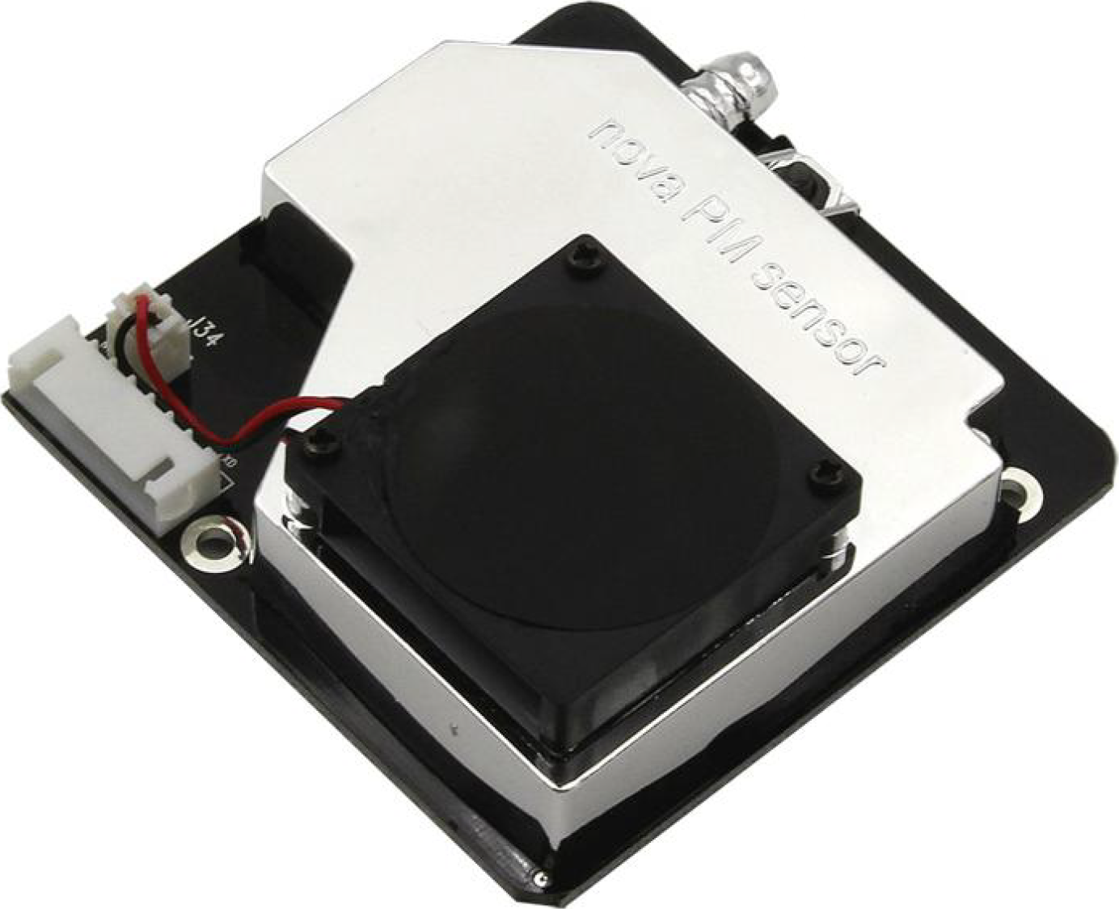
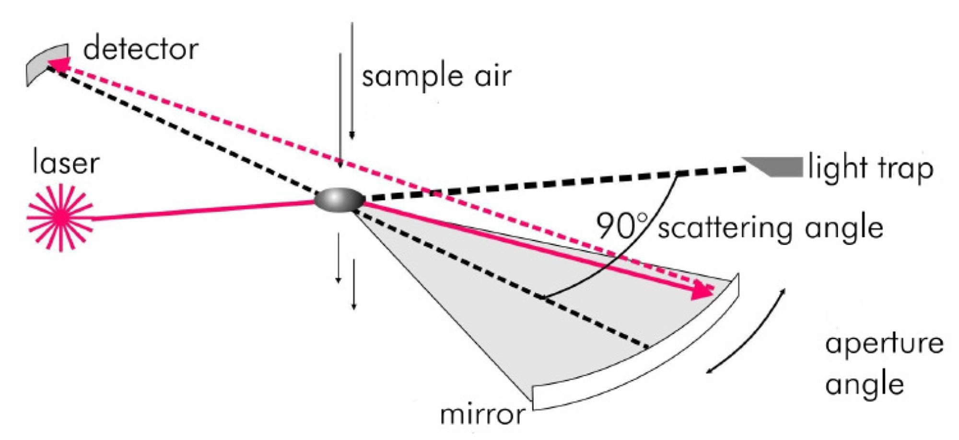
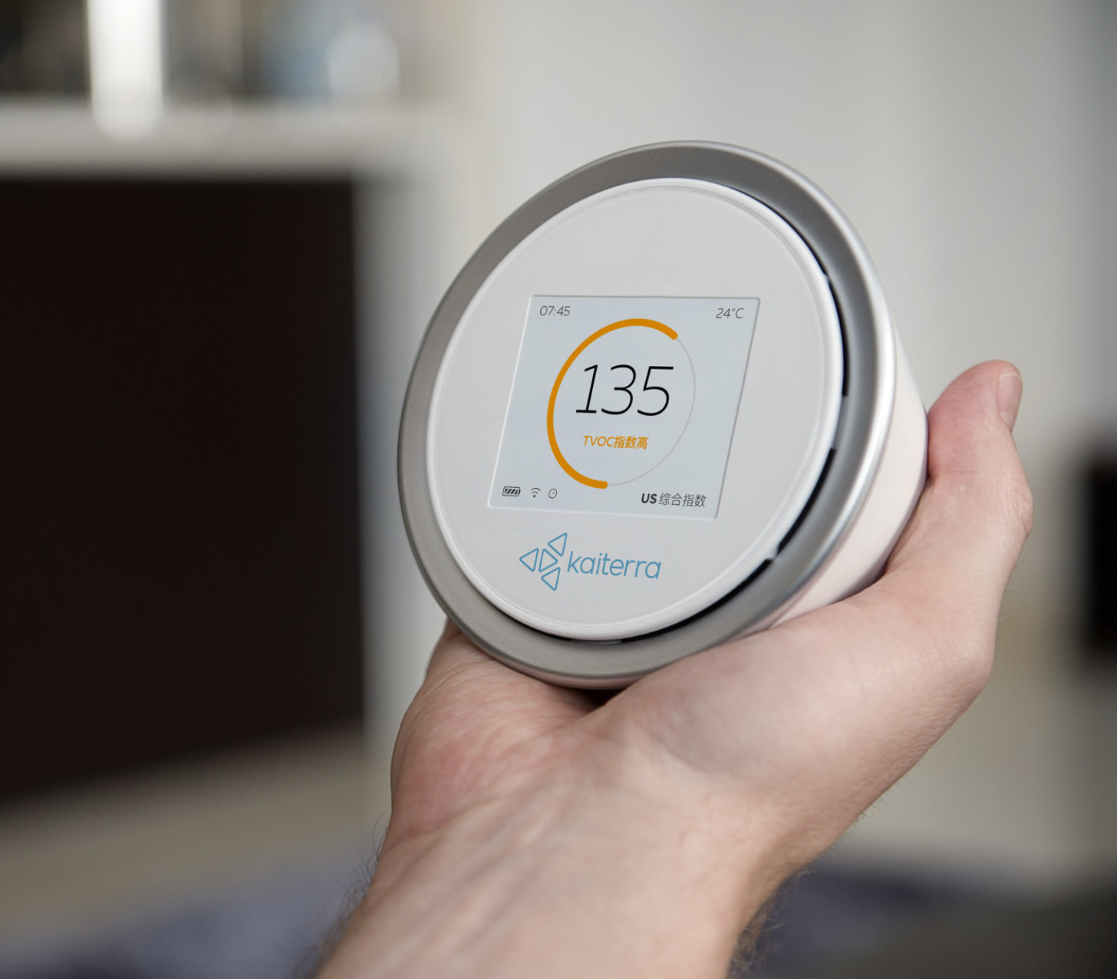
Light scattering sensors for PM
Page 18
Notes:
May scattering

Slide 19
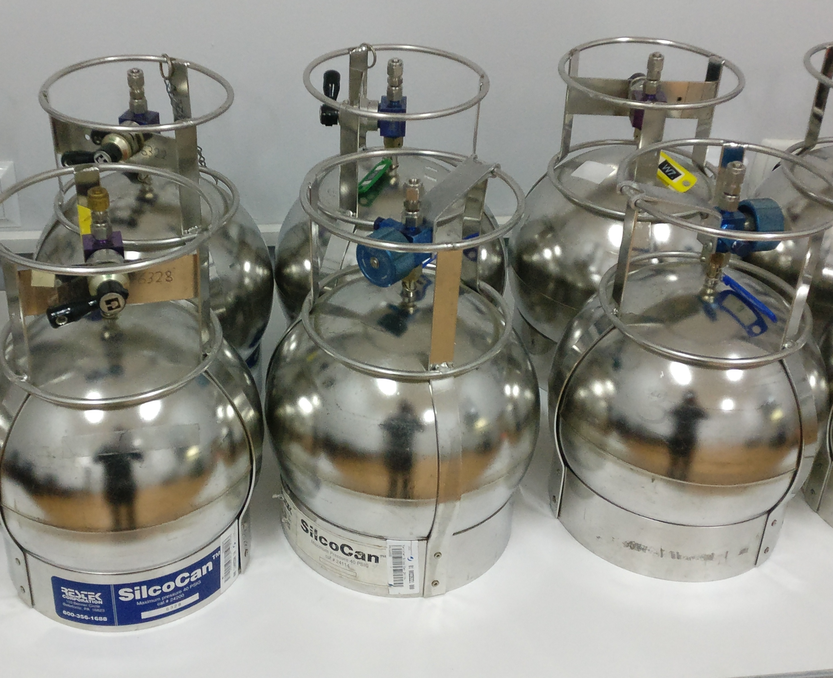
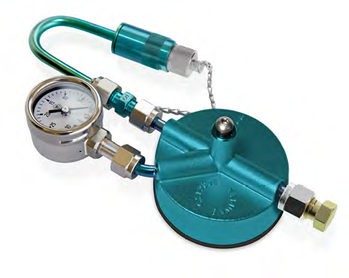
Cylinder sampling using drones
Page 19

Slide 20
Thank you for your attention

