Slide 1
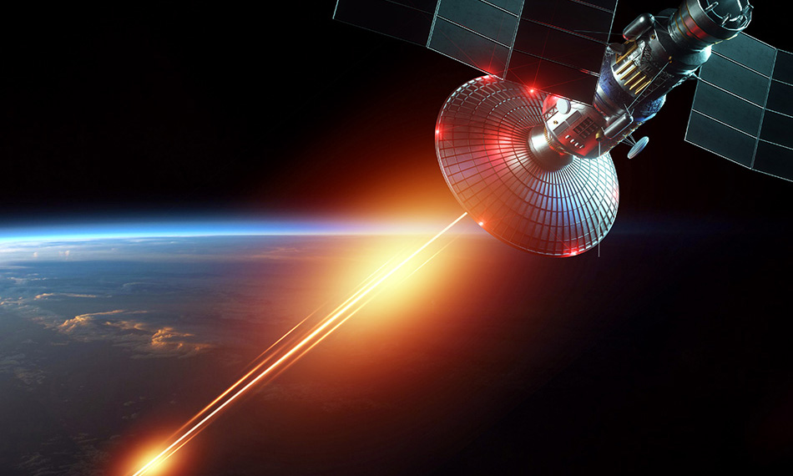
Laser Communication
3rd year student of Electrical and Computer Engineering department of Agricultural Univercity of Georgia: Vazha Purtseladze

Slide 2
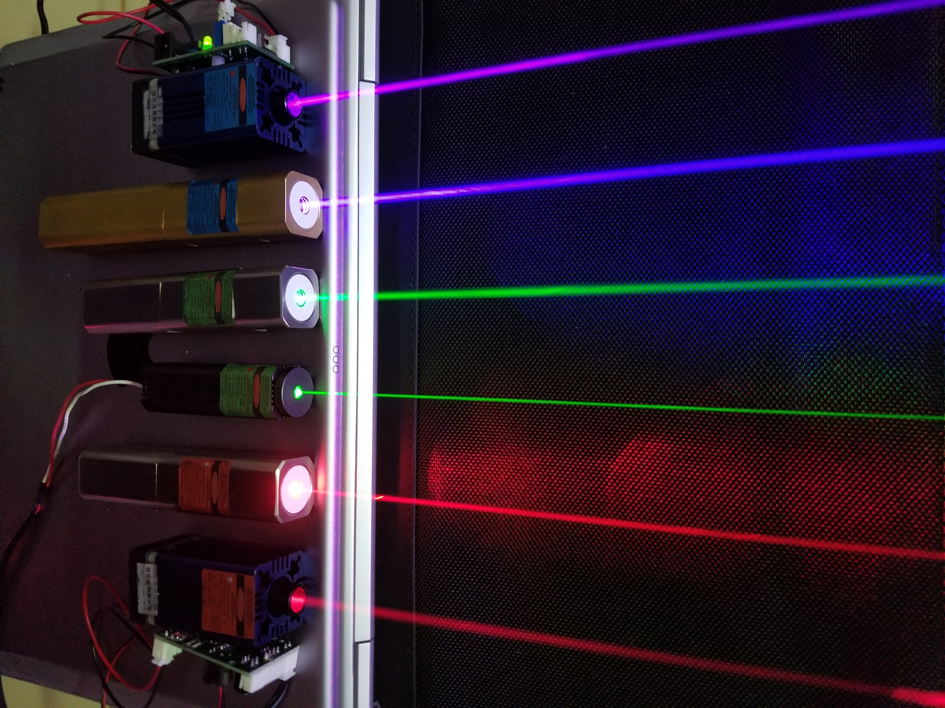
Contents
Introduction
The First Laser
How it Works
Laser Communication
Laser Communication in Space
Challenges
My Project
Future Plans

Slide 3
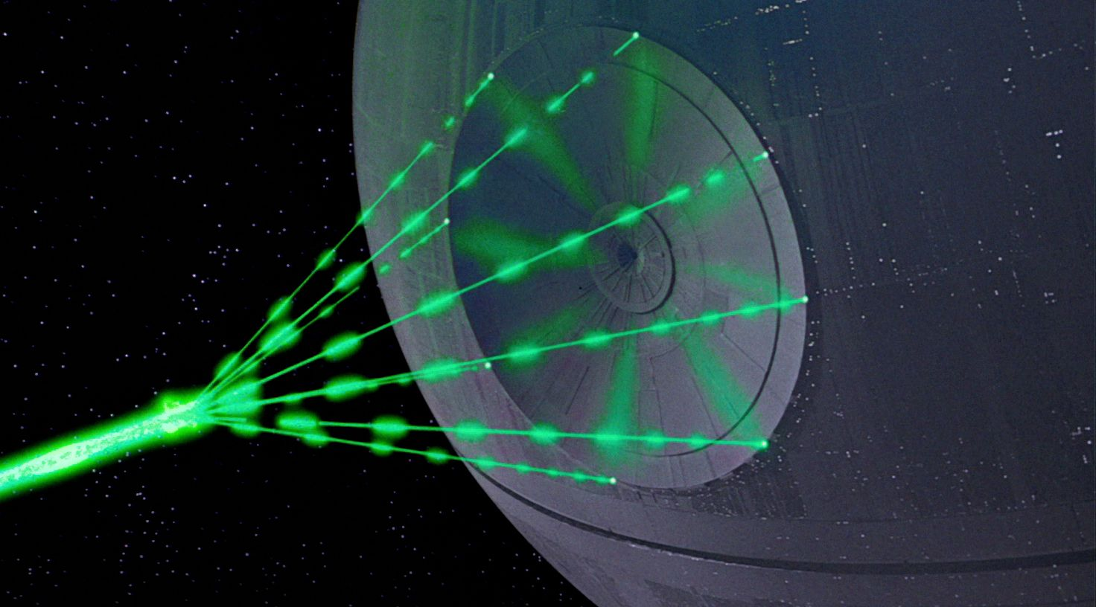
The First Thing
That Comes to
Our Mind
The Laser technology is not a product of science fiction
Star Wars: A New Hope
1977

Slide 4
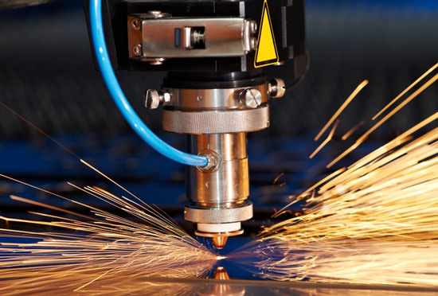
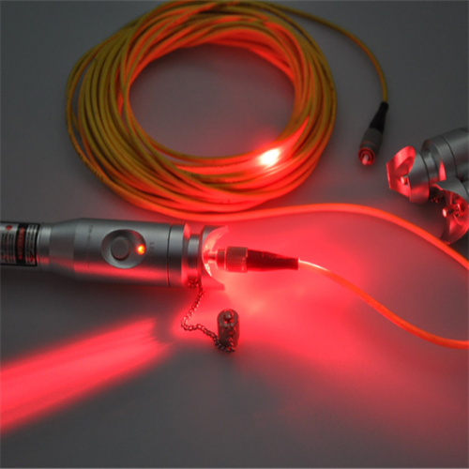
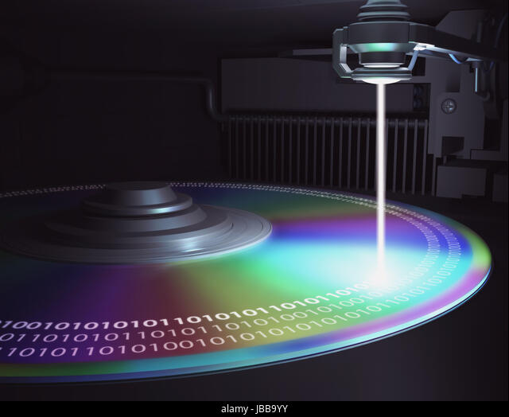
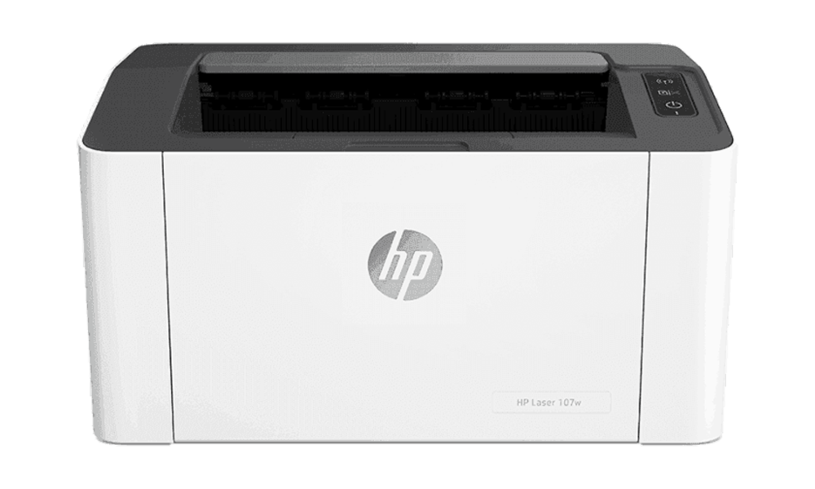
Lasers Around Us
Welding
Barcode scanners
Fiber optics
CD&DVD
Printers

Slide 5
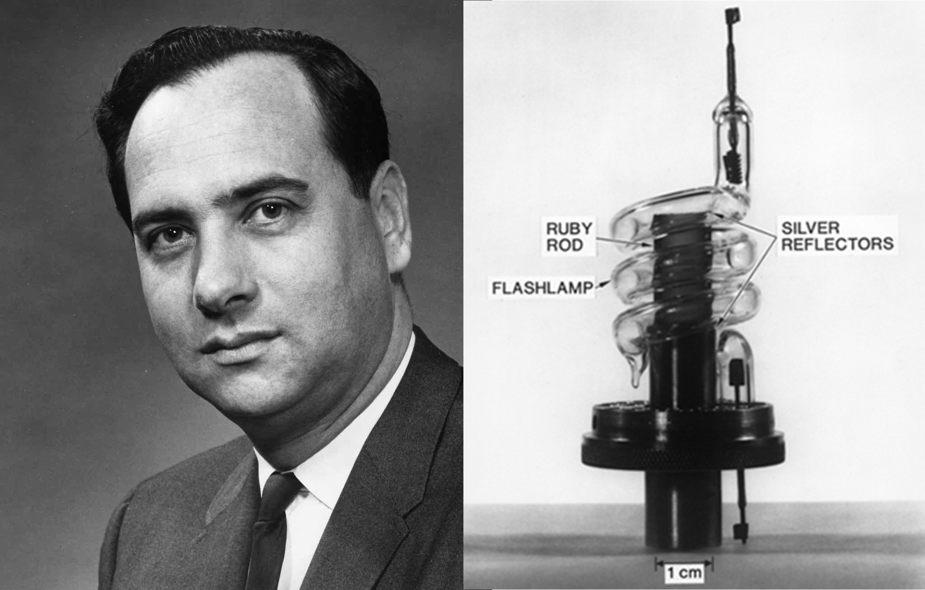
The
First Laser
Theodore Maiman made the first laser operate on 16 May 1960 at the Hughes Research Laboratory in California, by shining a high-power flash lamp on a ruby rod with silver-coated surfaces.

Slide 6
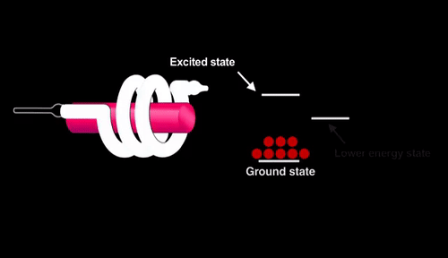
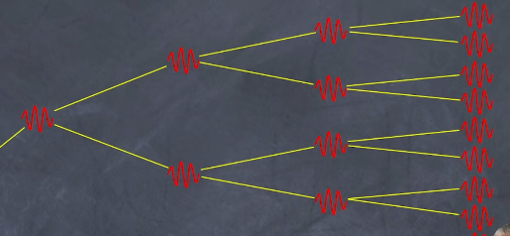
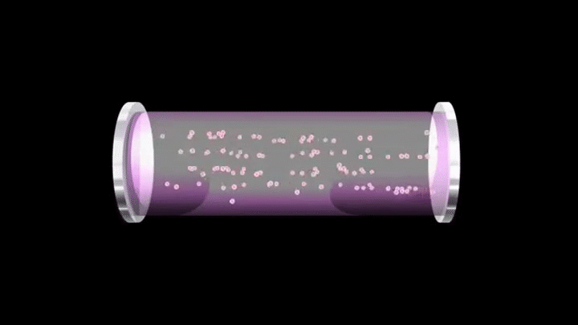
Working Principle
Light
Amplification
Stimulated
Emission
Radiation
Monochromatic
Coherent
Highly Intense

Slide 7
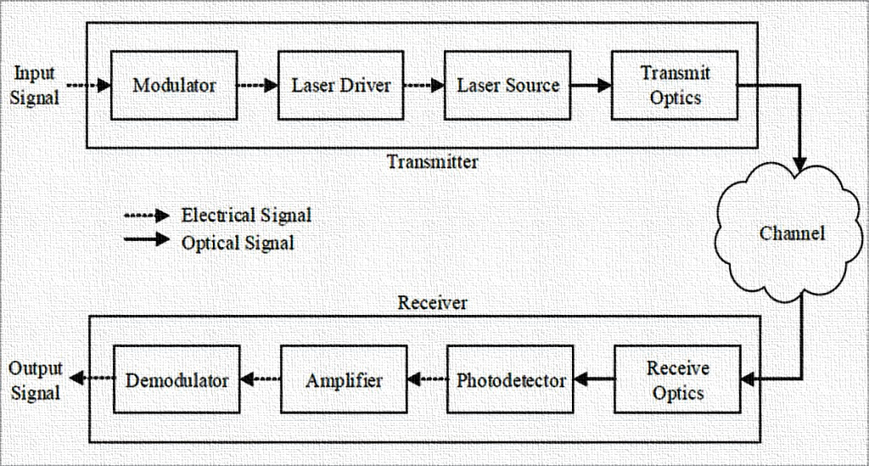
Laser
Communication
Using laser beams to transmit information
Apart from fiber optics, The beam is transmitted trough free space
Point to point communication over vast distances. Even between planets.
Increased bantwith (More data in less time. Up to 100 Gbit/s)
Transmittion rate 10 to 100 times faster than radio
Eliminating broadcast rights and need for cables
Easily deployable, inexpensive, low power, small
Free from radio interferences

Slide 8
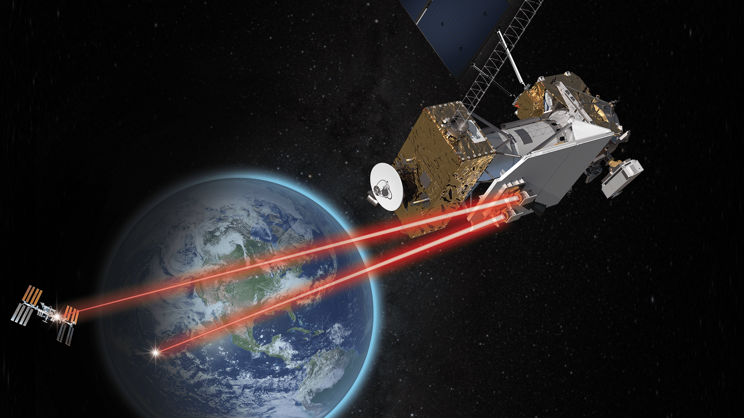
Laser Communication in space
Communication relies on a transmitter and a receiver. An Encoded message is modulated by electromagnetic waves.
The receiver collects electromagnetic waves from spaces
And demodulates them back to initial message
Optical communication uses infrared waves to send data
NASA’s Laser Communication Relay Demonstration (LCRD) Satellite

Slide 9
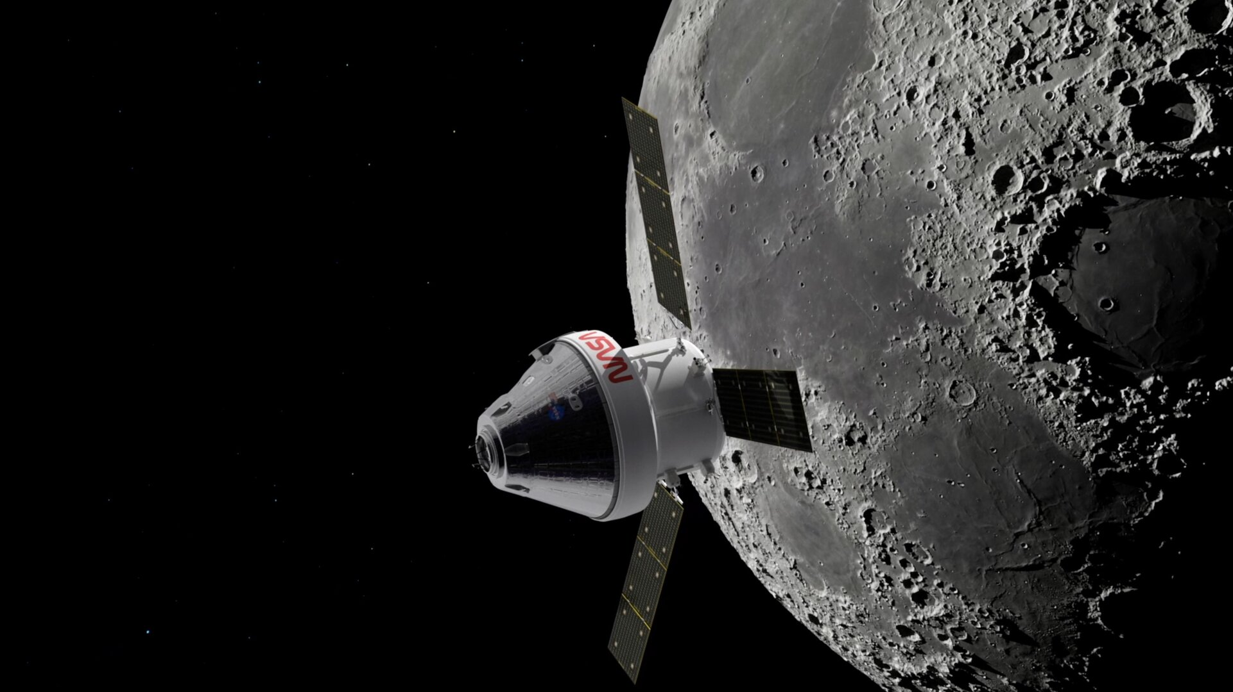
NASA Orion Artemis II Moon Mission
Laser communications will empower Earthlings to enjoy high-definition images and video when astronauts return to the lunar region for the first time in almost 50 years.
With laser systems onboard, O2O will enable live, 4K ultra-high-definition video from the Moon, as well as enhanced science data transmission and more.

Slide 10
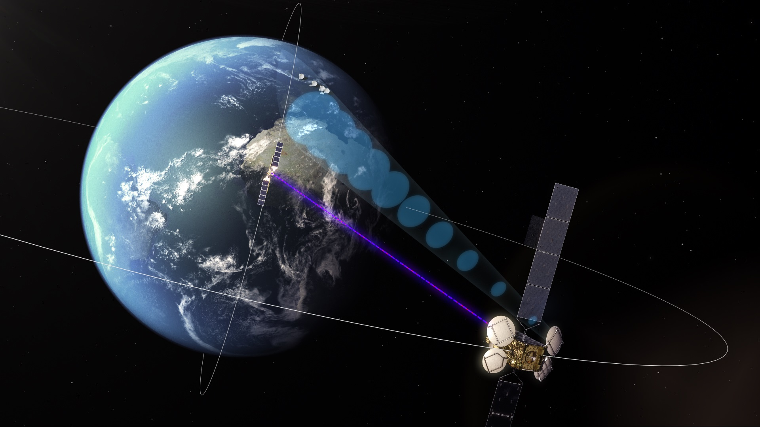
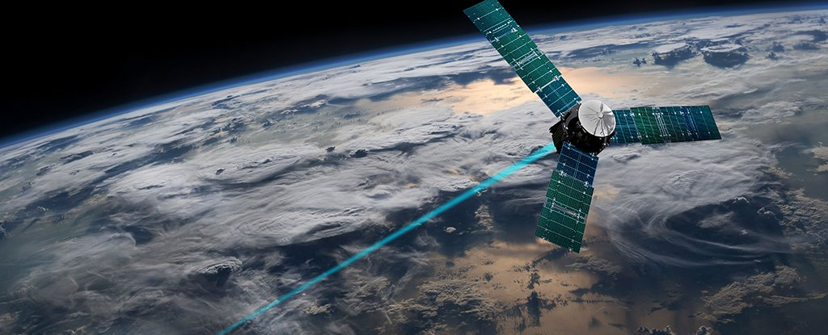
Challenges
European Data Relay System (EDRS)
Air influence on laser signals attenuation is big
Atmospheric obsorbtion
Can be blocked by Physical Obstacles
Dispersion
Transmittance rate in an extreme weather conditions is low

Slide 11
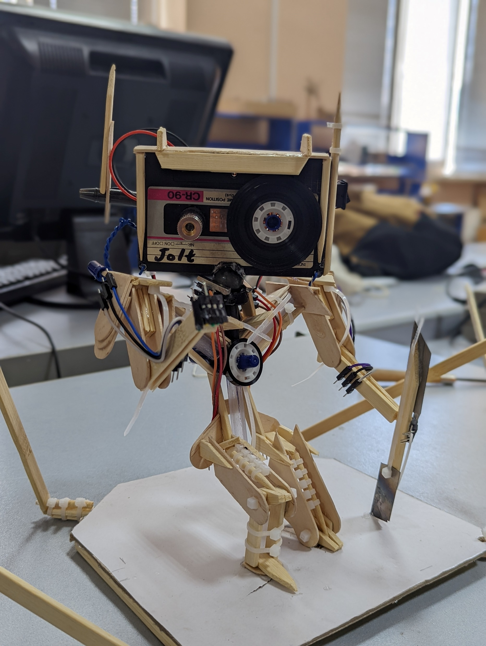
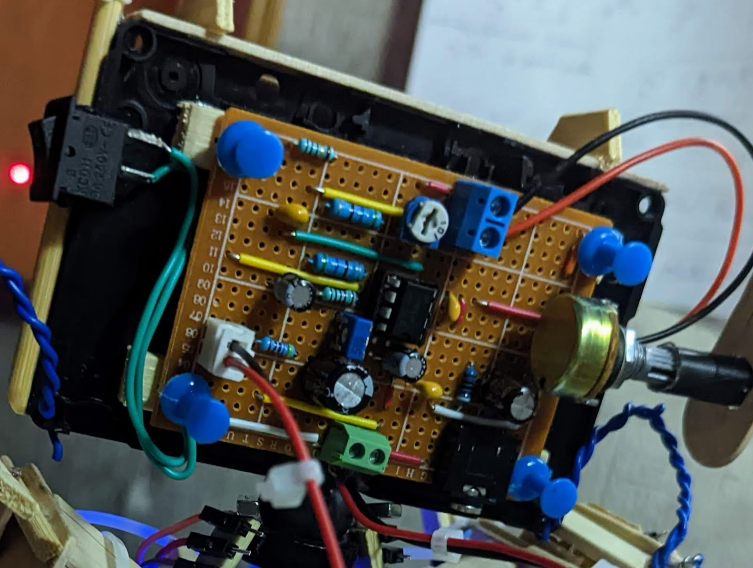
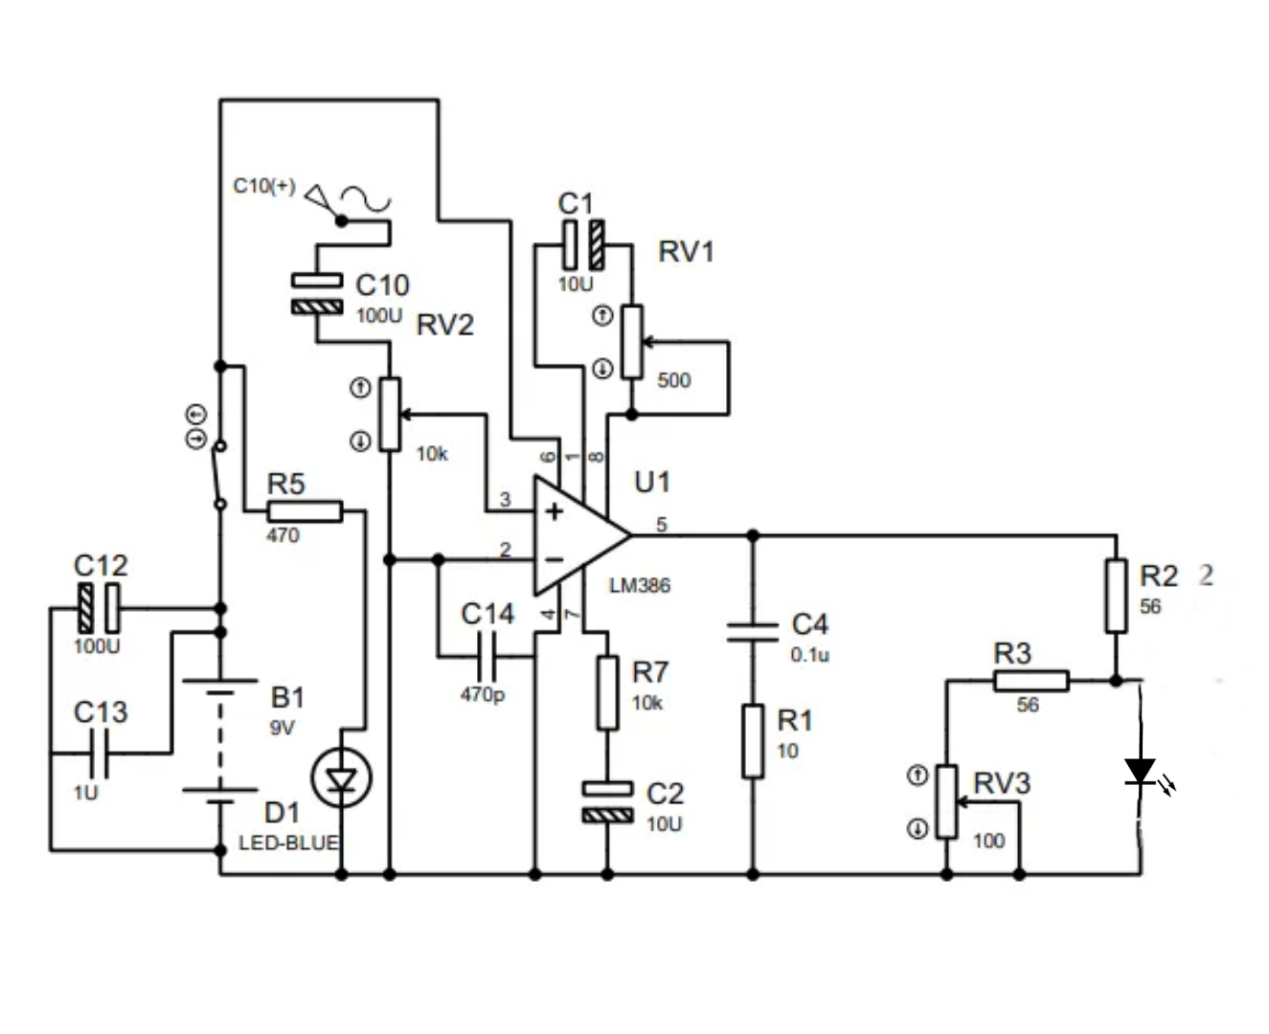
Audio Signal Transmitter and Receiver using Laser as a Medium
Transmitter
LM386 Operational Amplifier
Audio Signal Input
Red laser with the wavelength of 650nm
Laser Diode

Slide 12
Audio Signal Input
LM386 Operational Amplifier
Adjustable magnetic Stance for Direction Control
Laser Diode

Slide 13
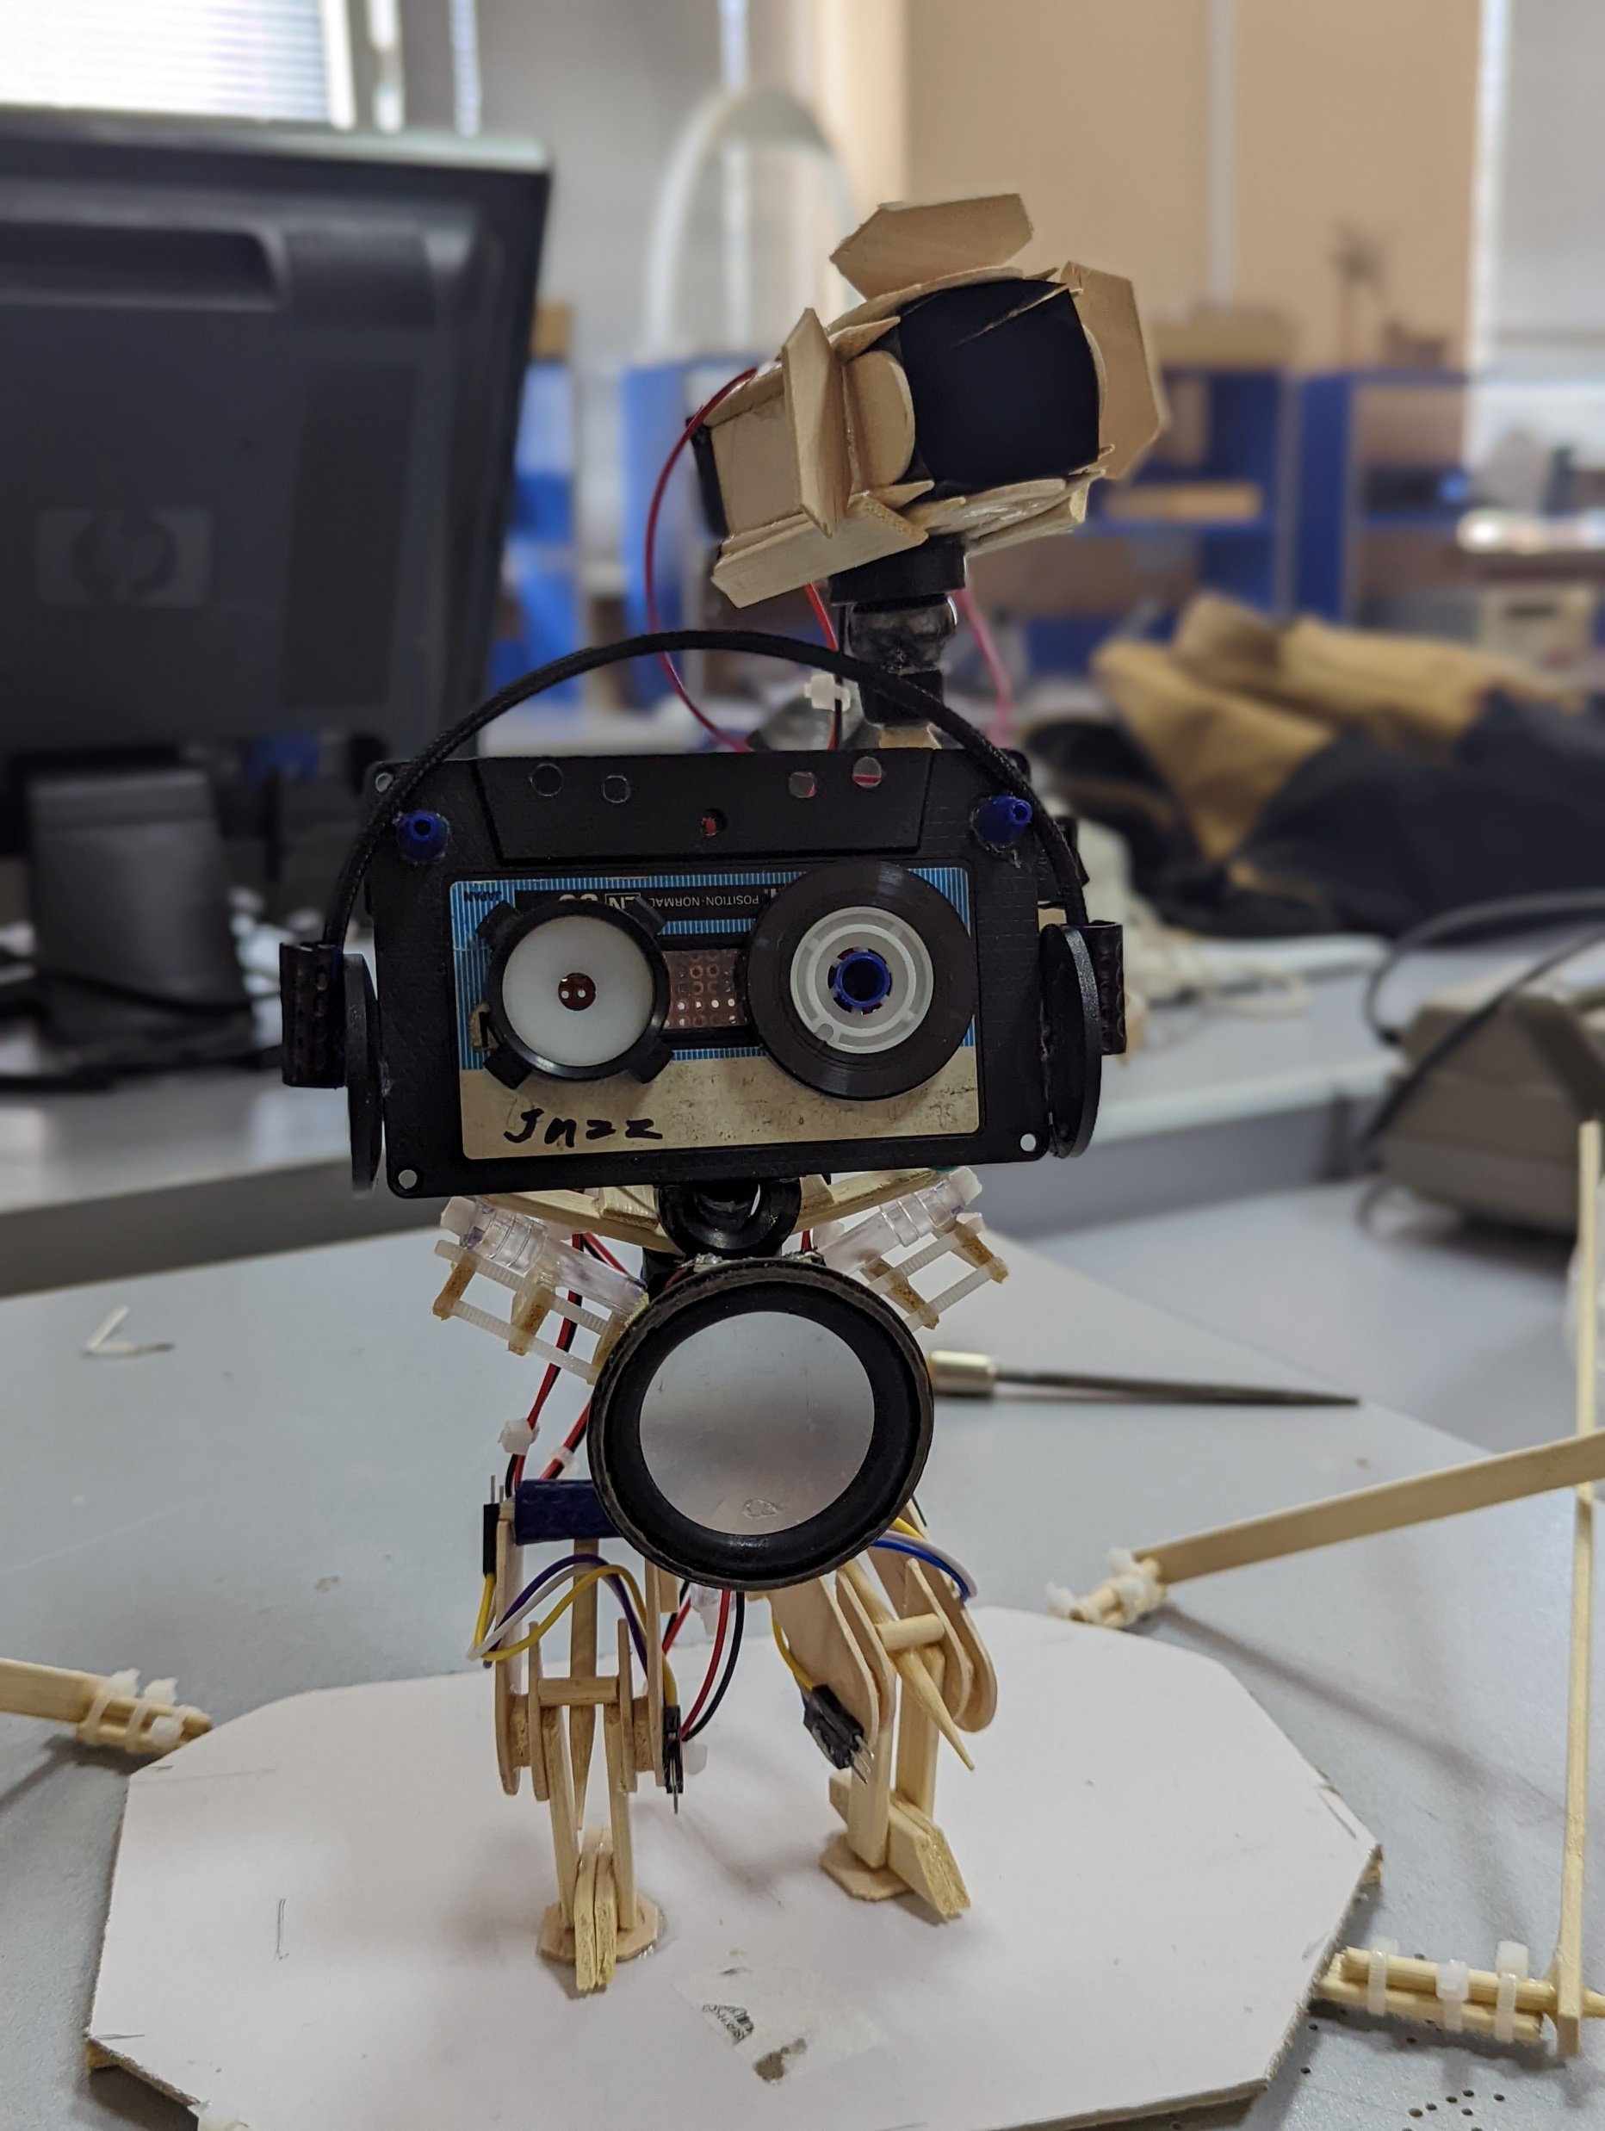
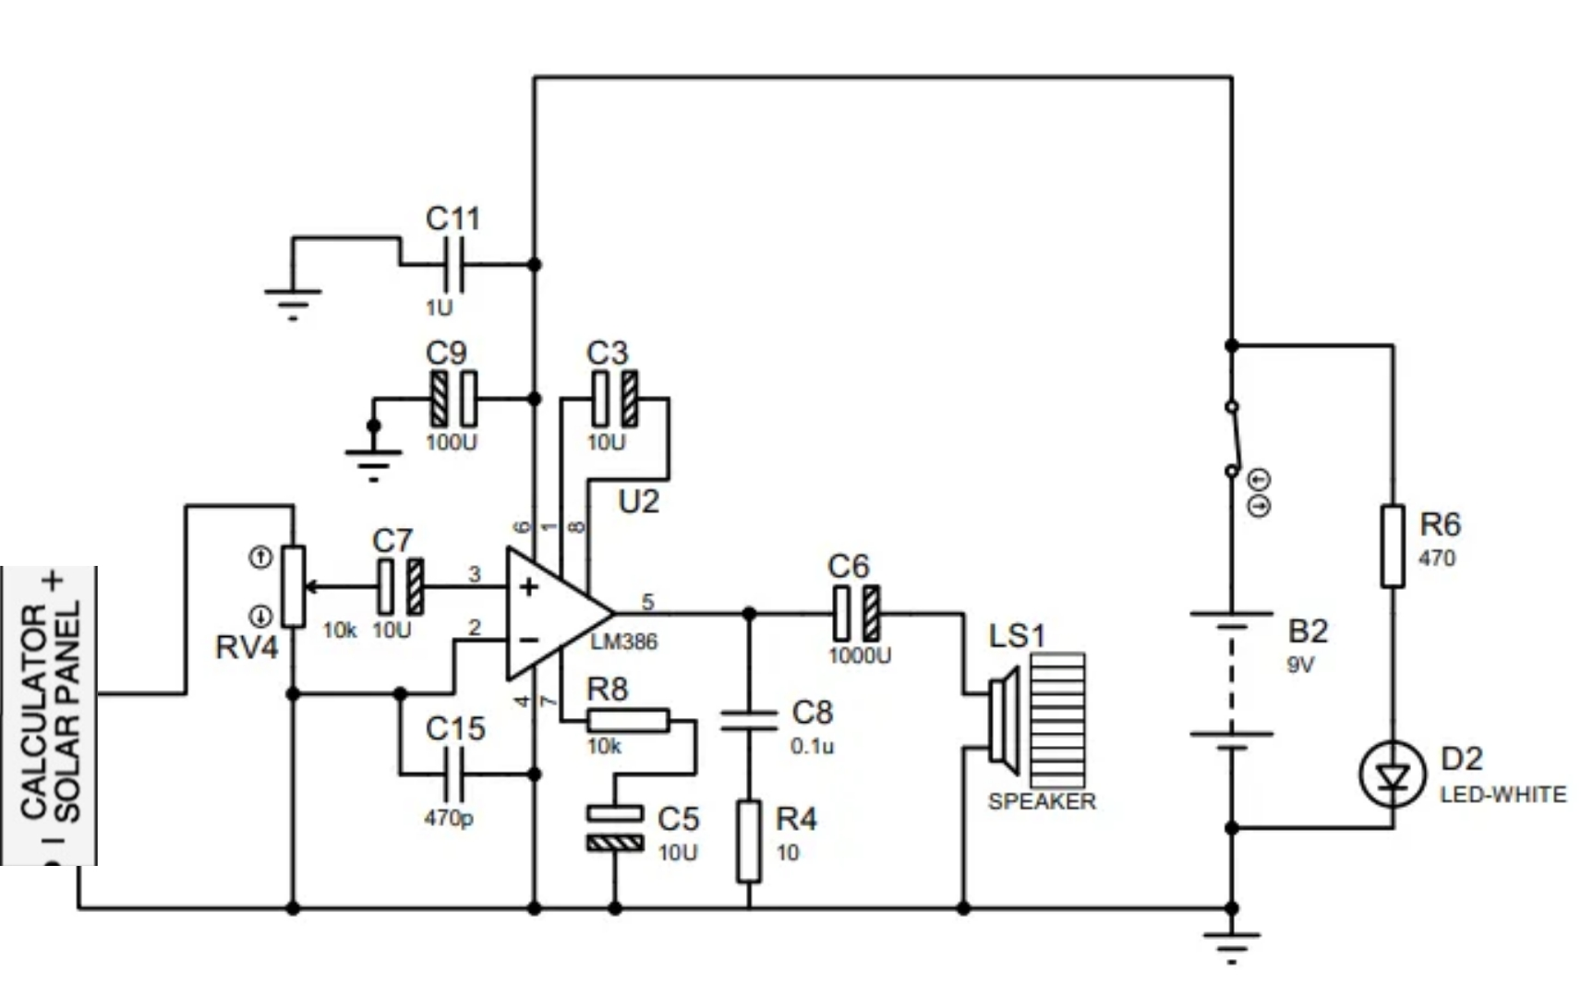
A solar panel enclosed with shading coverage for
avoiding day light interference
Receiver
The solar panel as sensitive lement
Audio Output
LM386 Operational Amplifier
Loudspeacker

Slide 14
Adjustable Magnetic Stance for Catching Laser Beam.
The solar panel as sensitive lement
LM386 Operational Amplifier
Audio Output
A Tube for Blocking Day Light Using Shade Coating from inside

Slide 15
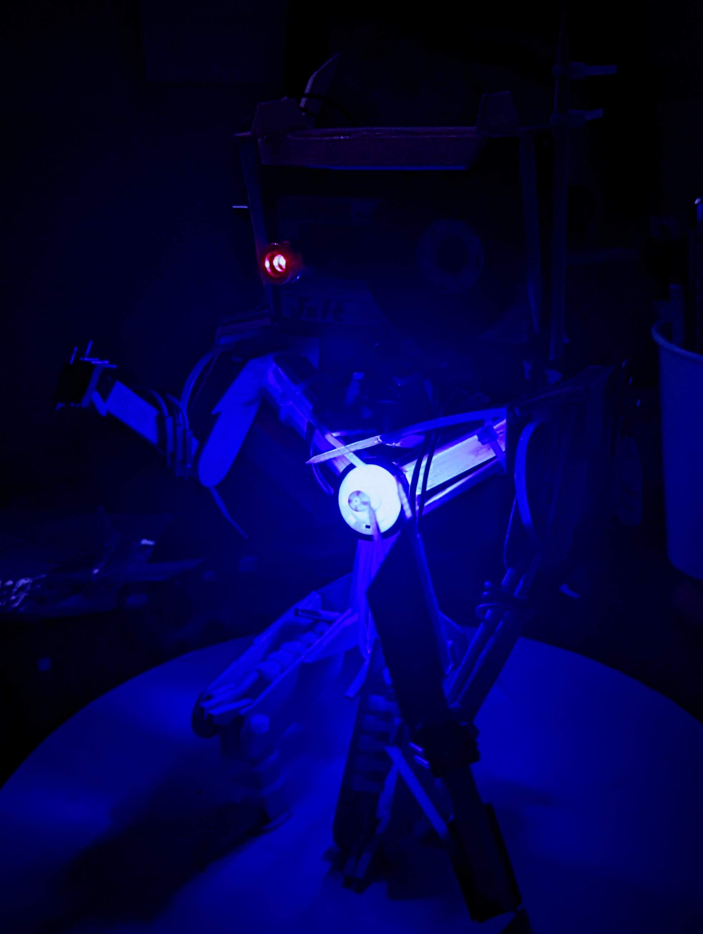
Future Plans
Solving interference issues
Experimenting on different kinds of lasers
Adding direction controlling system
Using modulation techniques
Sending digital data
Developing veriety of more compact designs

Slide 16
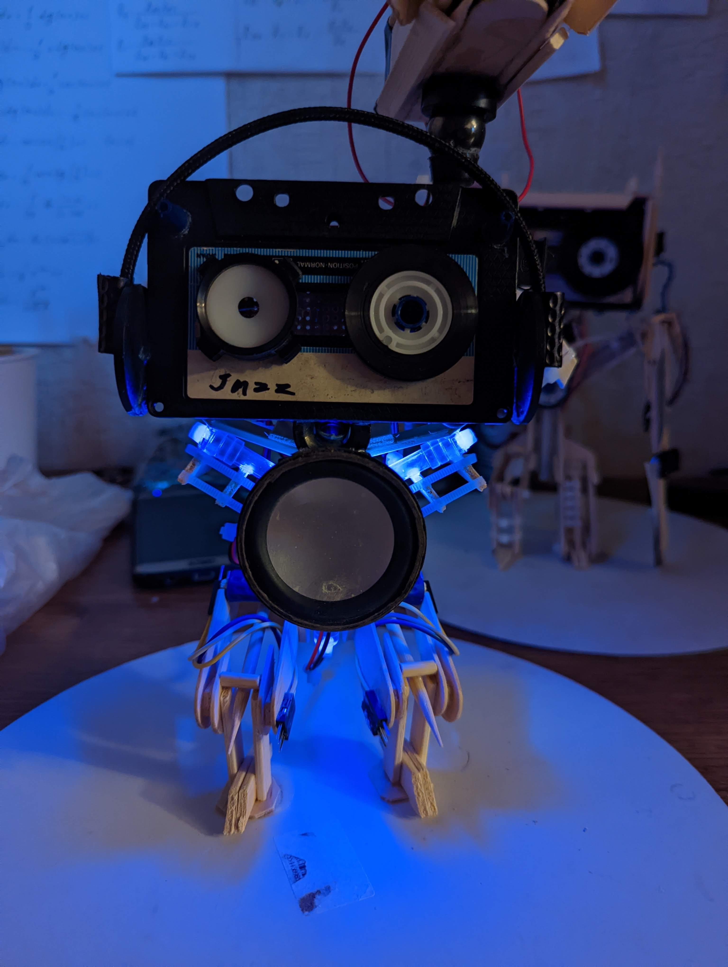
Thank You For Attention

