Slide 1
Experience as a Medical Physicist at the National Center of Surgery.
Dr. Tamar khechiashvili
J.S.C. “K. Eristavi National Centre of Surgery”
Tamar.Khechiashvili@aversi.ge
12/16 – September 2022
Notes:
opening story about how I came to the clinic, good and bad stories happens in our life so that starts in 2020 when I decide to end of my research carrier and go to the clinical practice without any guidance , but good think happened when I just went throw Mr. Lasha and ask for a guidance, today I am going to talk about a big idea with reducing Don’t underestimate me, that’s my mother’s job. The human brain starts working the moment you are born and never stops until you stand up to speak in public.

Slide 2
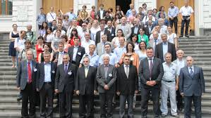
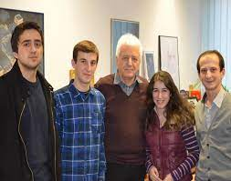
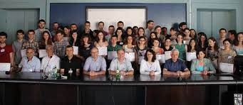
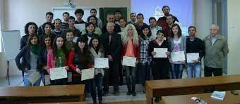
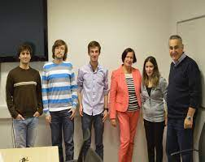
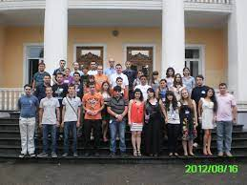
Story from the beginning…
Destination
2020
2017
2016
2014
2013
2013
Notes:
Well original story begins ending of the 20 century when I was born, ups I make it sound like I am too old whatever I am sorry but this is the truth. Well here is the path way through out the years

Slide 3
Outlook
Introduction
Motivation and goals
Methods
Results
Discussion
New experience !

Slide 4
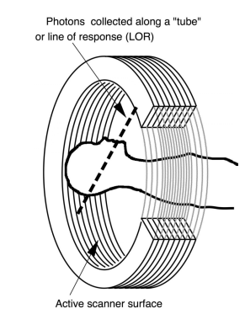
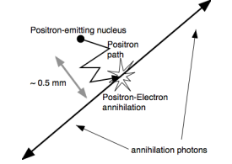
Introduction
Why PET is useful ?
Fig. 1. General principle of PET imaging: decay of radionuclide, positron (β+ ) emission, multiple scatter in tissue, annihilation with electron, and production of two back-to-back 511 KeV annihilation photons.
Notes:
Positron emission tomography (PET) offers a number of unique advantages compared to other imaging modalities. PET measures the two annihilation photons that are produced back-to-back after positron emission from a radionuclide tagged tracer molecule, which is chosen to mark a specific function in the body on a biochemistry level (Fig. 1). Hence PET provides molecular imaging of biological function instead of anatomy

Slide 5
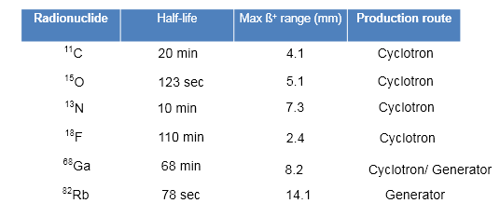
Introduction
Nuclear medicine is a medical specialty involving the application of radioactive substances in the diagnosis and treatment of disease.
Table 1: The most common radionuclides for PET
Notes:
In addition to radiation issue, short half-lives of these positron emitters (78 sec~110 min) definitely result in unavoidable limitations on manufacturing (including production and following quality control (QC) analyses) and clinical use of PET radiopharmaceuticals.

Slide 6
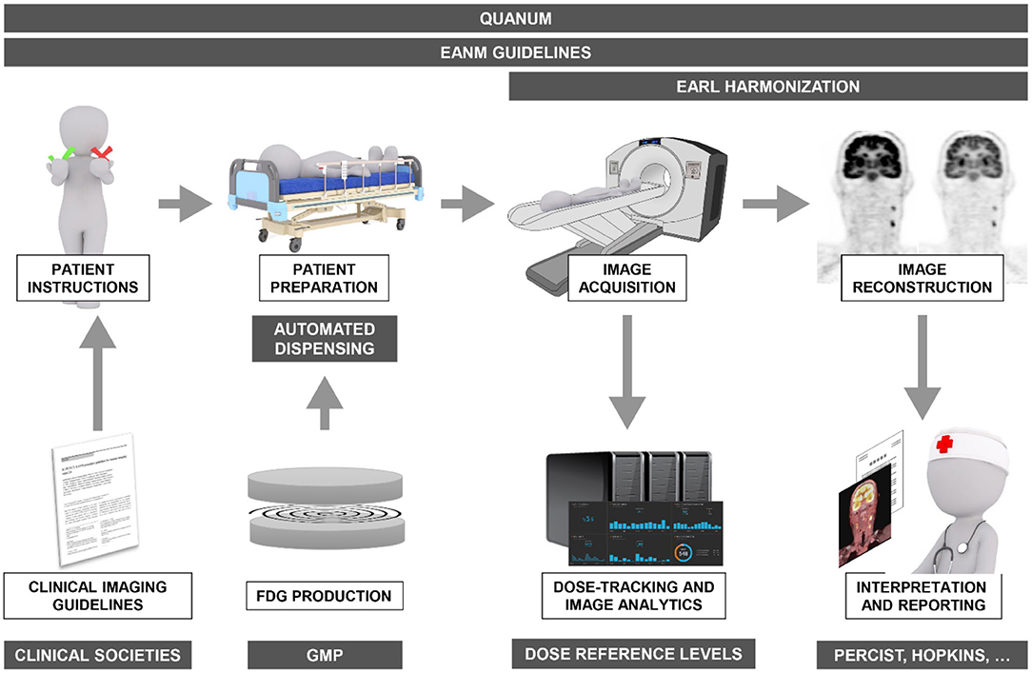
Introduction
FDG Procedure and Validity.
Fig. 2. International guideline of FDG PET/CT scanning
Notes:
Instruction of patients is very important for us we have prepared special forms to guide a patient throw procedure fasting radiation safety.

Slide 7
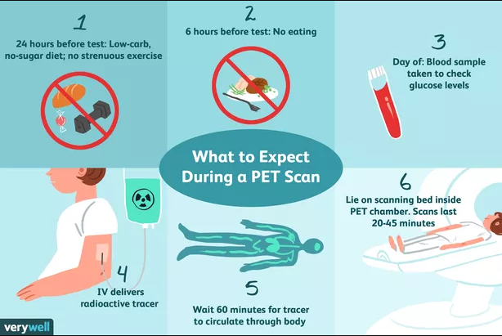
Introduction
FDG Procedure and Validity.
10-15
Fig. 3. Standard procedure for patients preparing for PET/CT scan
Notes:
For the domestic colleagues, The effects of fasting, varying blood sugar levels, conditions of glucose intolerance, and diabetes mellitus on Fludeoxyglucose F 18 distribution in humans have not been ascertained. Diabetic patients may need stabilization of blood glucose levels on the day before and on the day of the Fludeoxyglucose F 18 Injection study.

Slide 8
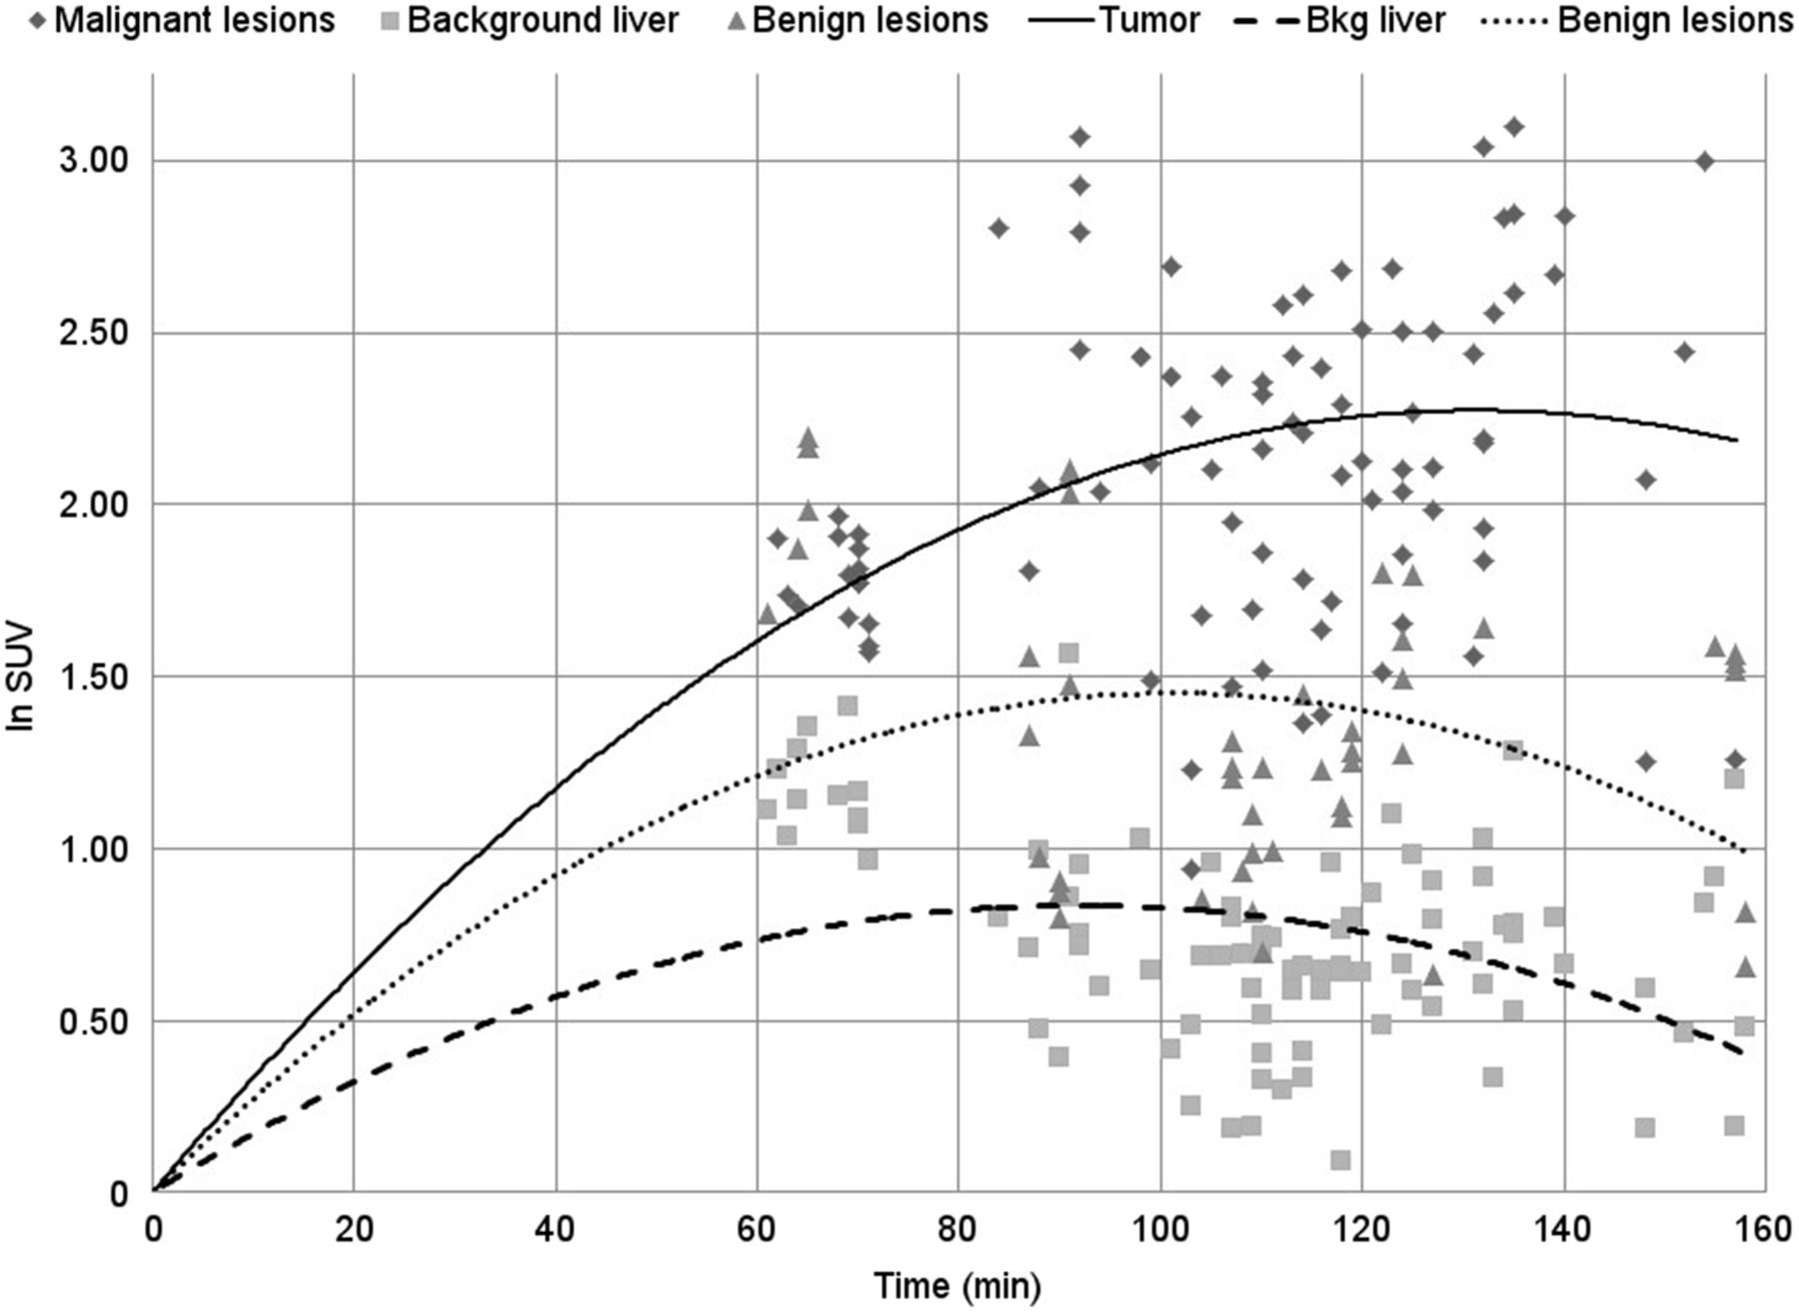
Introduction
FDG Procedure and Validity.
Take home message! FDG (F-18) – half life is 109.6 (2 hour) min, not expiration time.
Fludeoxyglucose F 18 Injection should be used within 12 hours of the end of synthesis.
Notes:
This slide will be addressed mostly to our domestic colleagues because I don't know why but, recently I am hearing a myth, that radiopharmaceuticals which we use for PET is expiring after 2 hours after opening it. Well I want to assure you expired dosage of FDG injection is an , Fludeoxyglucose F 18 and related compounds are cleared from non-cardiac tissues within 3 to 24 hours after administration. Clearance from the cardiac tissue may require more than 96 hours,

Slide 9
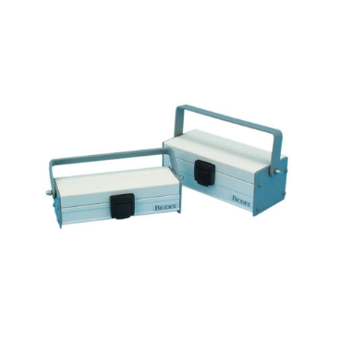
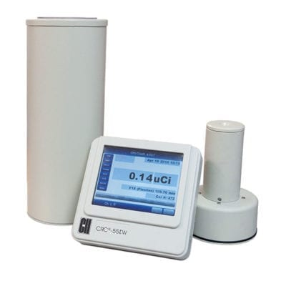
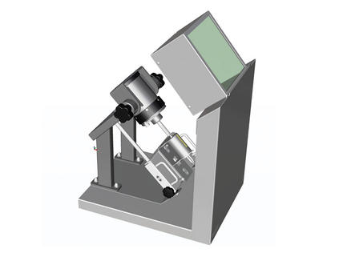
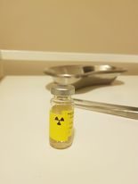
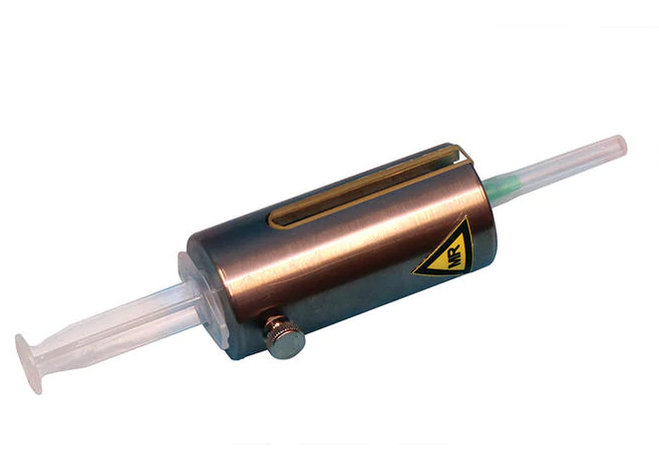
Introduction
Equipment for procedure.
Fig. 4. 1) Well counter, 2)L block ,3) Syringe container, 4) Shielded cover, 5) Box for transportation 6) FDG vial

Slide 10
Safety hazards:
As a PET scan uses radioactive material, there is a risk of radiation exposure.
Well trained staff and strict order following leads us to a safe procedure…
Following simple guidelines for reducing contact time and increasing distance would suffice to minimize the radiation exposure to staff.
use of dose limits for workers and general public and “As Low As Reasonably Achievable” (ALARA) principle to keep doses well below the dose limits.
1) Time, 2) Distance, 3) Shielding
Notes:
as

Slide 11
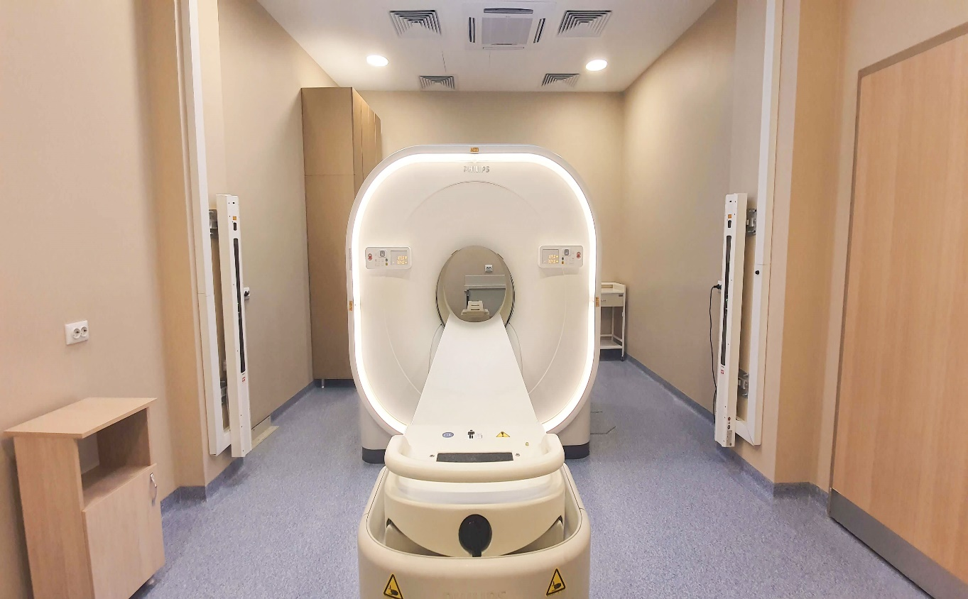
Motivation and goals
5m-5cm-5mCi;
Patient's condition;
Technology possibility;
Patient's comfort;
New pattern of work;
Fig. 5. Vereos Digital PET/CT PHILIPS
Notes:
As motivation there was few triggers to try what we reale can do with this monster machine.

Slide 12
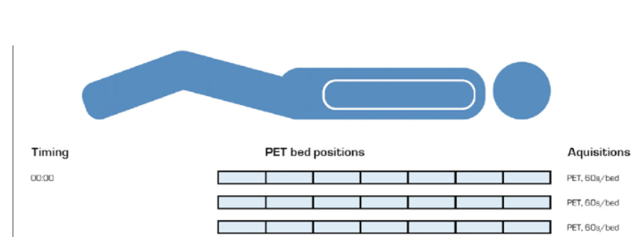
Work protocol:
Fig. 6. PET/CT scan time per/bed positioning
Current protocol: 3 it/5 subsets,
Body protocol: 60 sec per/bed,
whole body 60 sec per/bed and 20 sec legs per/bed.

Slide 13
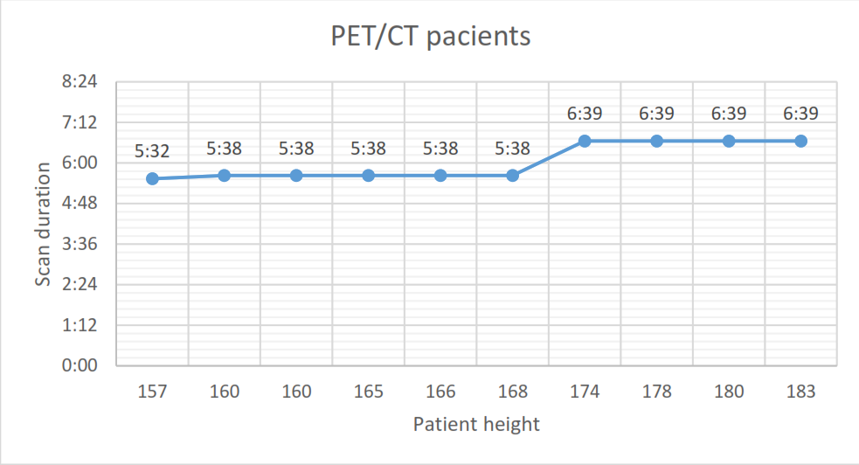
Results:
Fig. 7. Correlation between patient height and scan duration. Approximation

Slide 14
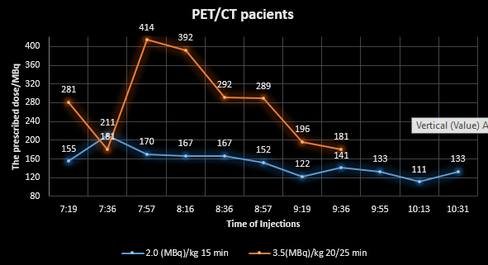
Results:
Fig. 8. Plots of real data between injections and injected activity. Figure describes two different protocols, that was developed by PET/CT group. Reduced radiopharmaceutical doses and time per bed position.

Slide 15
Results:
Fig. 9. Plots of real time data between prescribed doses and patients weight. Figure describes two different protocols, results how it increases patient number.

Slide 16
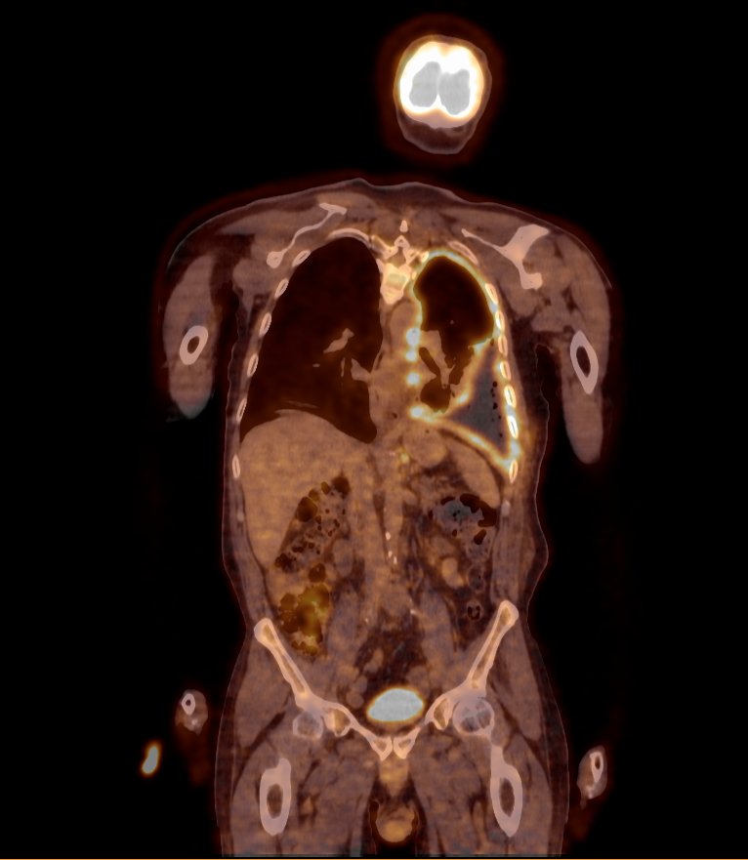
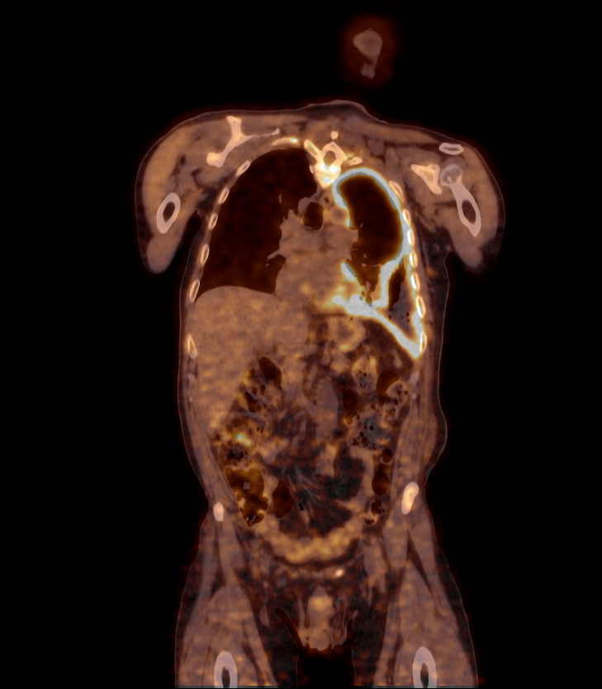
Results:
Fig. 10. Total body PET/CT 59 y, M 1.73m, 81kg (left 9:53 scan time- right 11:36 repeat scan time), prescribed dose 7.7mCi, injection time 8:47.

Slide 17
Results:
Fig. 11. Animation of patient with multiple bone metastasis. Patient physical data: 97kg, prescribed activity 197MBq (5.2mCi)

Slide 18
Discussion
Analog is approximate. Digital is specific. Therein lies the fundamental difference between digital PET and its analog cousin.
Alternatively, the digital PET/CT might maintain image quality achieved over a substantially reduced scan time, as low as one-third or less of the typical 10 to 15 minutes. Or, physicians — exercising their knowledge and expertise to practice medicine — might choose a third option: to maintain image quality and scan time but reduce the dose of radiopharmaceutical injected into the patient.
Current work: … ?- per/kg if …
Notes:
If lettuce farmers used similar technologies, their digital detectors would count the leaves of lettuce. Analog detectors would count the heads. When applied to clinical medicine, exactness translates into options.

Slide 19
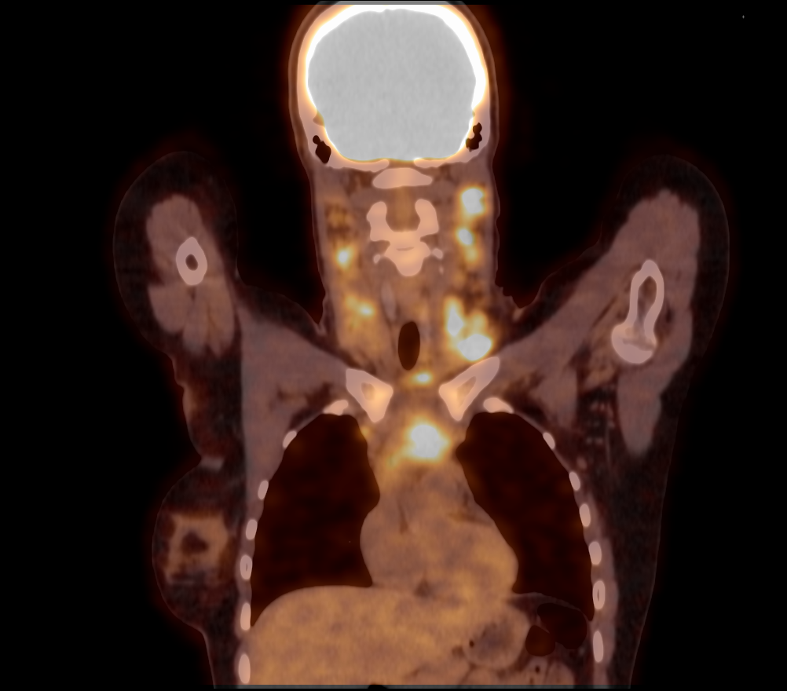
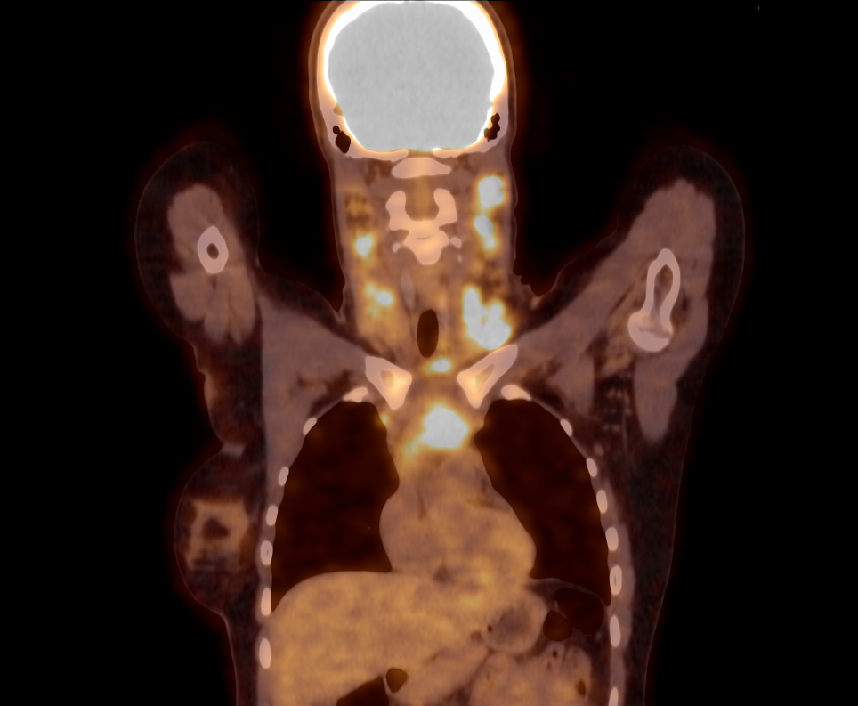
Another possibilities: experts opinions?!
Fig. 12. Reconstructions: 25 y, F, 1.64 cm, 66kg, left real image right reconstructed with different injection dose.
Notes:
Real possibility and my personal opinion on this slide is that we can reconstruct the real data we see what we would get with different parameters. Body protocol.

Slide 20
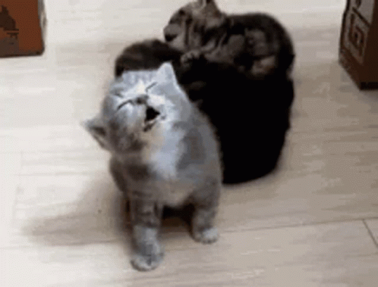
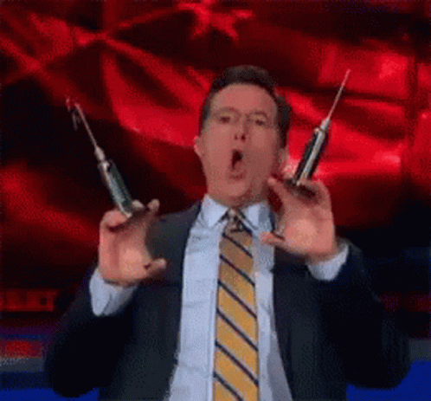
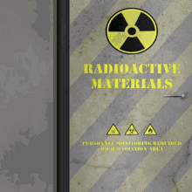
Funny story: Different vision ☺
Notes:
This slide is interpretation of me with my colleagues eyes at 6 AM.

Slide 21
Take home message: What I have learned!
True story behind the successes…

Slide 22
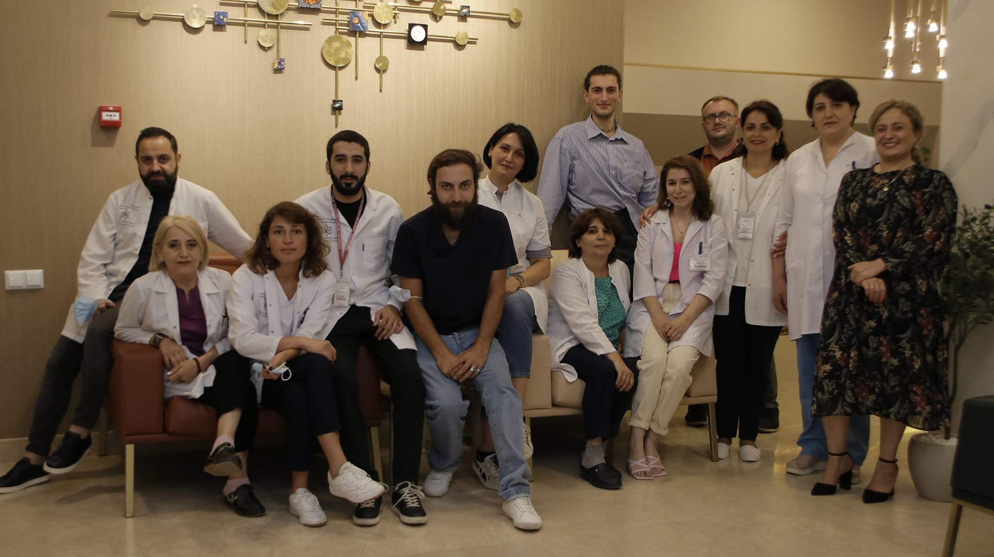
Acknowledgements
Dr. Kacharava Andro
Prof. N.J Shah
Dr. Farida Grinberg
Dr. Ezequiel Farrher
Cindy Lennertz
PET/CT group

Slide 23
Thank you for your attention

