Slide 1
Development of biochemical bases for rapid method of Staphylococcus aureus detection in food
Tamar Khatisashvili
Master’s student in Food Technology, Agricultural University of Georgia
Supervisor: Prof. K. Didebulidze
September 15th, 2022

Slide 2
Presentation outline:
Foodborne diseases as a global challenge in public health
Staphylococcal food poisoning
Staphylococcus aureus pathogenicity
S. aureus contamination detection methods
Developing bases for novel method
Method concept
Method development and future perspectives

Slide 3
Foodborne diseases (FBD)
Foodborne diseases are usually infectious or toxic in nature and caused by bacteria, viruses, parasites or chemical substances entering the body through contaminated food.
An estimated 600 million – almost 1 in 10 people in the world – fall ill after eating contaminated food and 420 000 die every year, resulting in the loss of 33 million healthy life years (DALYs- the loss of the equivalent of one year of full health). Children under 5 years of age carry 40% of the foodborne disease burden, with 125 000 deaths every year.
110 billion US $ is lost each year in productivity and medical expenses resulting from unsafe food in low- and middle-income countries.
Foodborne diseases impede socioeconomic development by straining health care systems and harming national economies, tourism and trade.

Slide 5
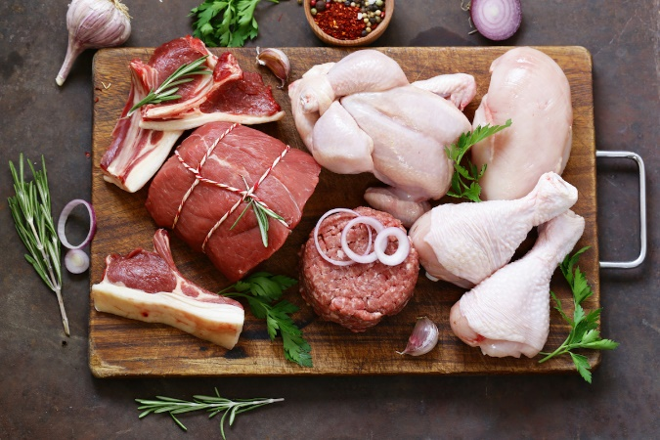
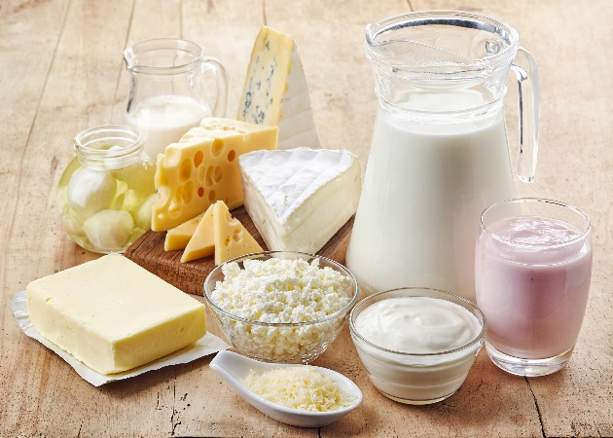
Staphylococcal food poisoning (SFP)
S. aureus is listed in top 5 microorganisms causing FBD worldwide.
SFP is characterized by a sudden start of nausea, vomiting, and stomach cramps. Most people also have diarrhea.
SFP cases are frequently underreported because of misdiagnosis, improper sample collection and laboratory examination lack of seeking medical attention by the affected persons complicating the laboratory confirmation (Death rate <0.01%).
Food vulnerable to S. aureus contamination include meat, poultry, milk and dairy products, custard, salads and salad dressings.

Slide 6
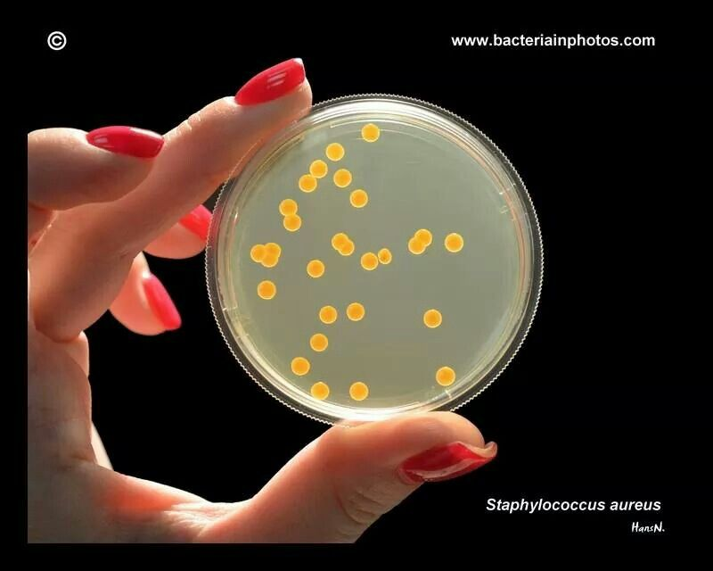
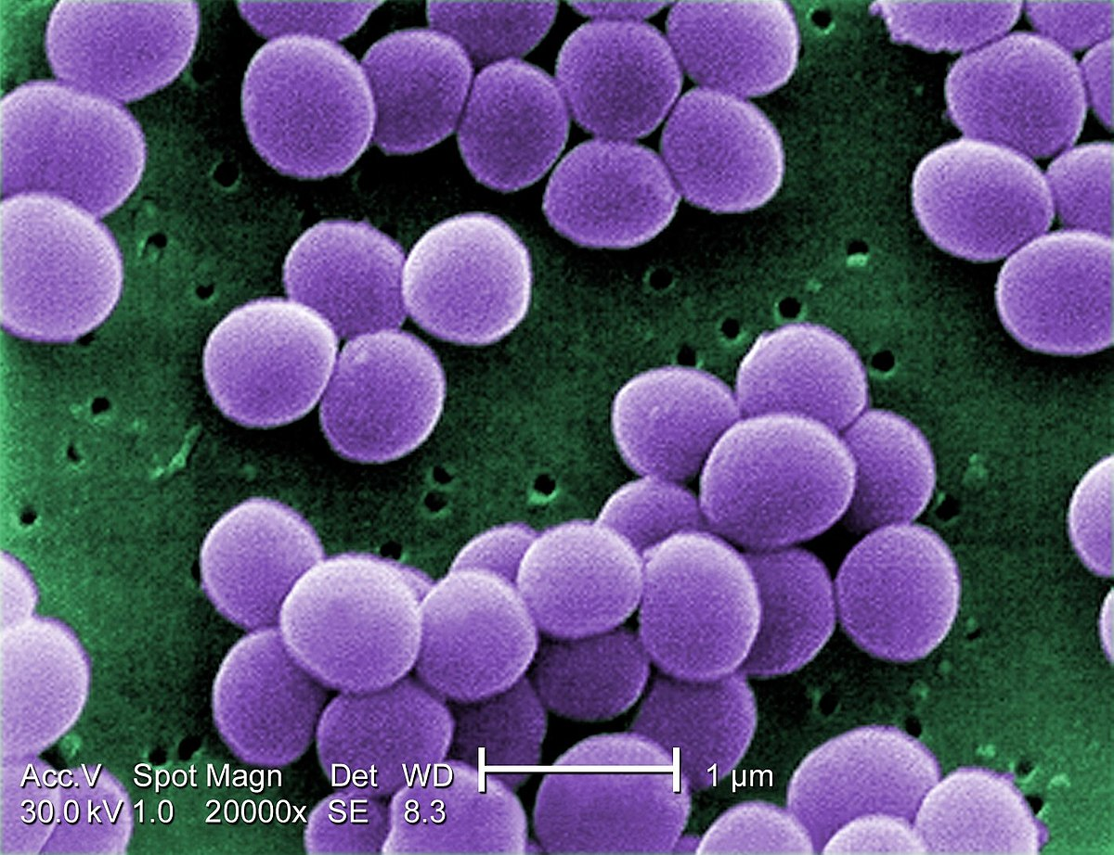
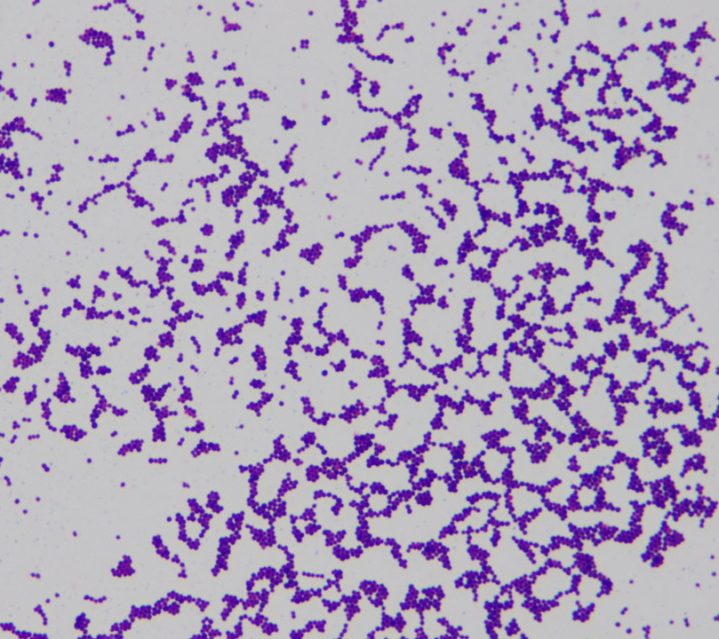
Introduction
Gram-positive spherically shaped bacterium, facultative anaerobe, forms golden colonies on nutrient agar (NA).
An usual member of the microbiota of the body, frequently found in the upper respiratory tract and on the skin ($\sim 30\%$ of people).
Temperature range: 8-43$℃$
pH range: 7-7.5
Resistant to 5-10% NaCl

Slide 7
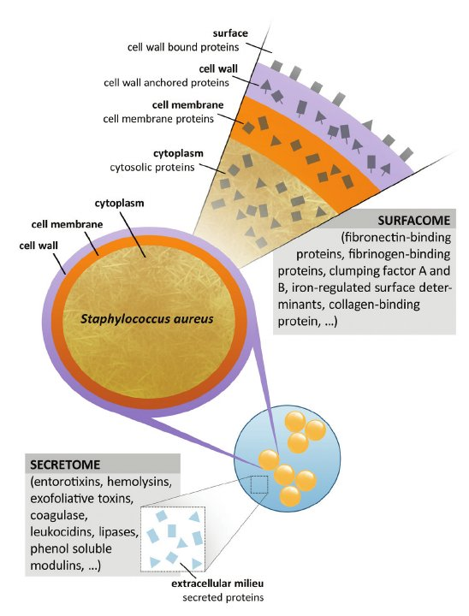
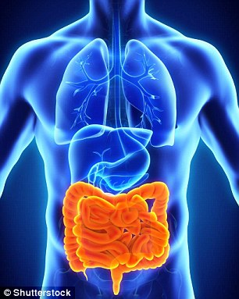
S. aureus virulence factors
Enterotoxins are heat stable!
They target the intestine,
causing cell death and dehydration

Slide 8
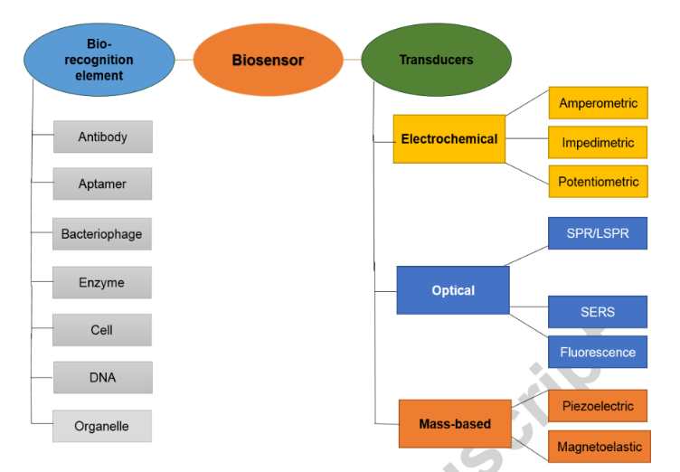
Methods for S. aureus contamination detection in food
Biochemical methods
Immunological methods
Molecular biology methods
Biosensor Technology
Chromogenic medium
Biochemical Tests
Catalase test
Urease test
API Staph identification system
Indole test
Baird-Parker agar
Baird-Parker agar + rabbit plasma
Blood agar
Mannitol salt agar
ELISA
Immuno-labelling
Immune agar diffusion
Immunofluorescence assay
PCR
RT-PCR
LAMP
Gene chip detection
Nucleic acid probe technique

Slide 9
Standard method – ISO 6888:1999/2021
Sampling
Inoculation on Baird-parker agar
Incubation (24-48 h)
Colony selection and results interpretation
Incubation (24 h)
Confirmation Test (24 h)

Slide 10
Baird-Parker (BP) Agar
Baird Parker Agar contains casein peptone, beef extract and yeast extract as sources of nitrogen, carbon, sulfur, vitamins and trace elements.
Sodium pyruvate: Stimulates the growth of S. aureus without destroying the selectivity of the medium.
The egg yolk: Not only enrichment, Staphylococci which contain lecithinase break down egg yolk (lipolysis) and create clear areas (halo) around colonies.
The tellurite additive: All of S. aureus known strains are able to reduce tellurite to telluride, insoluble black substance.
Glycine and lithium chloride: Have an inhibitory action against organisms other than S. aureus.

Slide 11
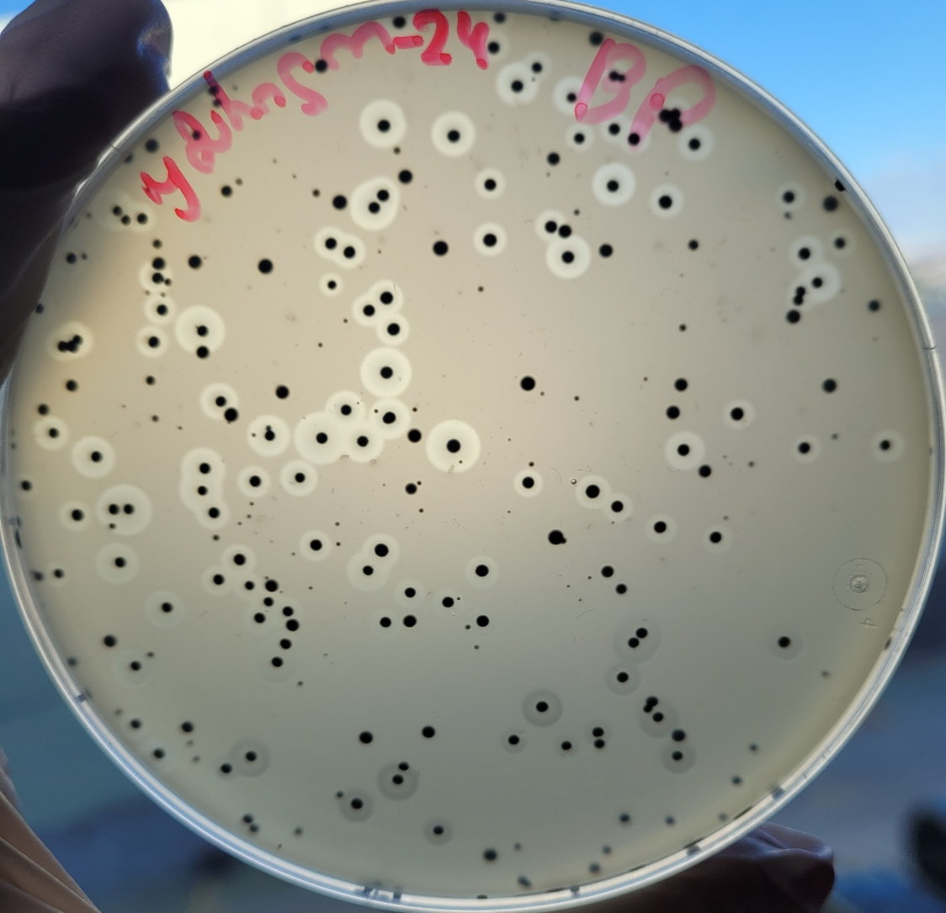
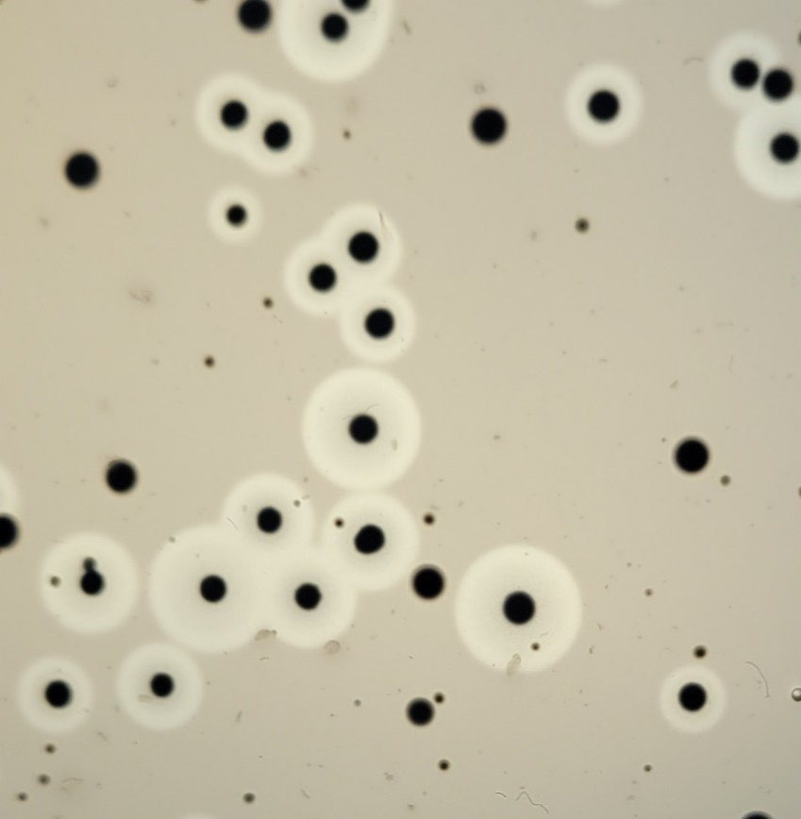
Baird-Parker (BP) Agar
Staphylococcus spp. but not aureus
Staphylococcus Aureus

Slide 12
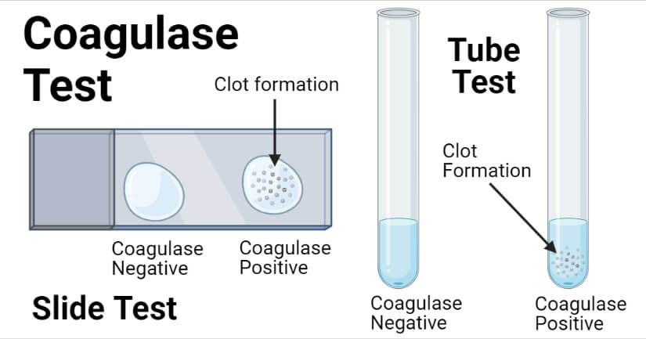
Confirmation Test

Slide 13
Disadvantages of existing methods
High cost
Trained laboratory personnel
Procedures are rather complicated with equipment and clean environment required
False positive result without rigorous experiment environments
Standard method is inexpensive and sensitive, but complicated operation and time consumption (3-7 days)
There is no “field” method you can use on-site
Objective of the study was to develop biochemical bases for rapid, inexpensive and simple novel method (simplified standard method)

Slide 14
Step 1: Microflora Evaluation
Freshly made cheese was selected as model of food vulnerable to contamination.
Microflora of cheese samples from 40 different business operators were studied with standard method (ISO 6888).
Key results:
$\sim 30\%$were contaminated with S. aureus!
Cheese microflora is mainly occupied by enterobacteria (E. coli mostly).

Slide 15
Step 2: Enterobacteria inhibitor selection
E. coli can give false-negative result due to antagonistic effect.
Tellurite ion is gram-negative bacteria inhibitor, but in case of cheese it’s not quite enough.
Sodium azide (respiration inhibitor) was used in different concentrations and then tested on Endo agar. Unfortunately it didn’t work either.
KOH 3% solution was used (Adaptation of method of gram strain detection on slide by KOH solution) which did work.
3% solution in required with cheese samples, 1% solution is enough for pure cultures.
To be sure that bacteria won’t die in abnormal pH for them HCl in equimolar concentration was used to optimize pH of the final solution.

Slide 16
Step 3: method simplification
Incubation steps were discarded.
Egg yolk tellurite and coagulase tube test were combined.
Quantities and dilution ratios of each component were optimized with numerous experiments.
It was made sure of that plasma coagulation and tellurite reduction doesn’t interfere with each other.
These changes significantly shortened time of the procedure.
Sampling
Enterobacteria
Inhibition
Confirmation Test (24 h)
pH optimization

Slide 17
Novel method concept
Sampling
Inoculation on Baird-parker agar
Incubation (24-48 h)
Colony selection and interpretation
Incubation (24 h)
Confirmation Test (24 h)
Sampling
Enterobacteria
Inhibition
Confirmation Test (24 h)
pH optimization

Slide 18
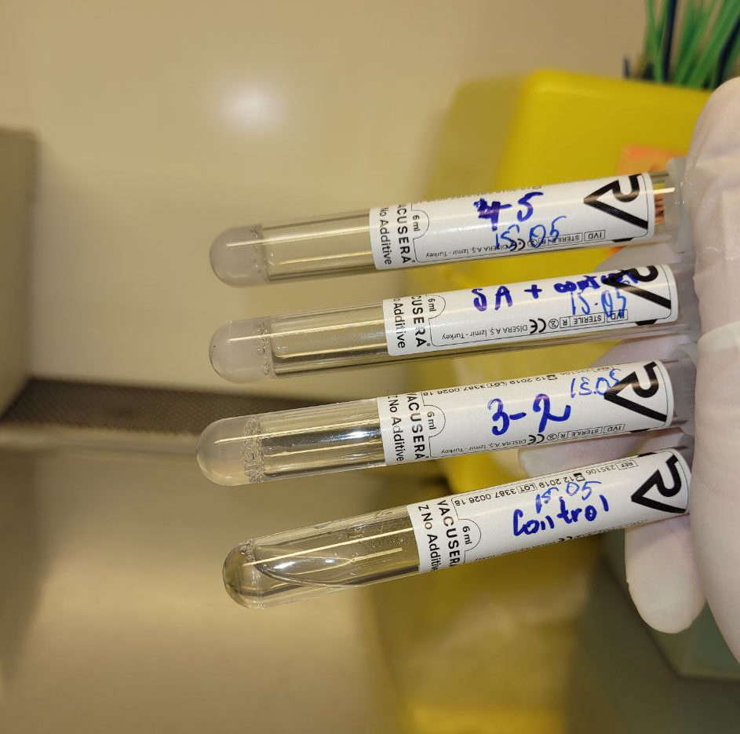
Step 4: Model Experiments
Pure cultures (and culture mixtures) were studied with parallel methods.
Cheese samples were intentionally contaminated with s. aureus strains and then studied with parallel methods.
In all 40 cases the results were the same with standard and novel methods.
Method sensitivity was studied on isolated cultures and it is $\sim$110 CFU/g (Food safety guidelines allow concentration of 10-100 CFU/g in cheese)
Clot formation and dark grey particle formation on the surface or somewhere in the clot.

Slide 19
Disadvantages of new approach
Can’t show lecithinase activity.
Can’t be used as enumeration method without using baird-parker agar.
Still needs optimization and validation.

Slide 20
Further development and future plans
Try to incorporate lecithinase activity detection in the method.
Other biochemical tests (rapid and inexpensive – for example: catalase) can be combined with this method.
With regulation of KOH concentration method can be more precise.
Method has potential of detecting even 1 CFU in the sampling solution if enough time is given (not time-consuming though).
Method has potential of detecting toxins independently if centrifuge is added at that point to get supernatant with all the toxins possibly in it (not on-site method though).
Method will be validated by another master’s student in the future.
Method can be used in different fields other than food quality control.

Slide 21
THANK YOU FOR YOUR ATTENTION!

