Slide 1
PARTICULATE MATTER MEASUREMENT IN HIGH TRAFFIC AREAS
SABA JORBENADZE
Mail: saba.jorbenadze324@ens.tsu.edu.ge
Department of Chemistry, Faculty of Exact and Natural Sciences, IV. Javakhishvili Tbilisi State University, I. Chavchavadze Ave. 3, 0179 Tbilisi
Supervisors:
Dr. Giorgi Jibuti
Prof. Bezhan Chankvetadze
Co-Authors : Lika Kirtadze, Ani Rurua, Mariam Shanidze, Nino Jajanidze
1

Slide 2
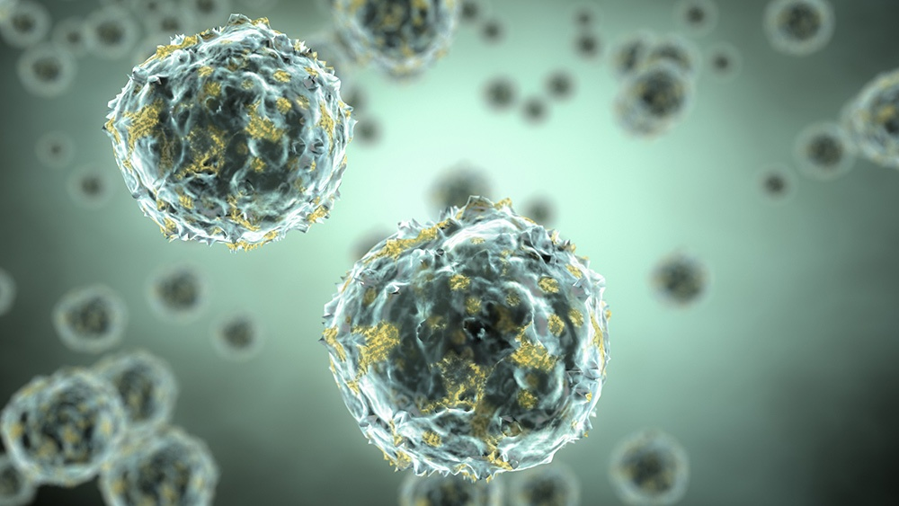
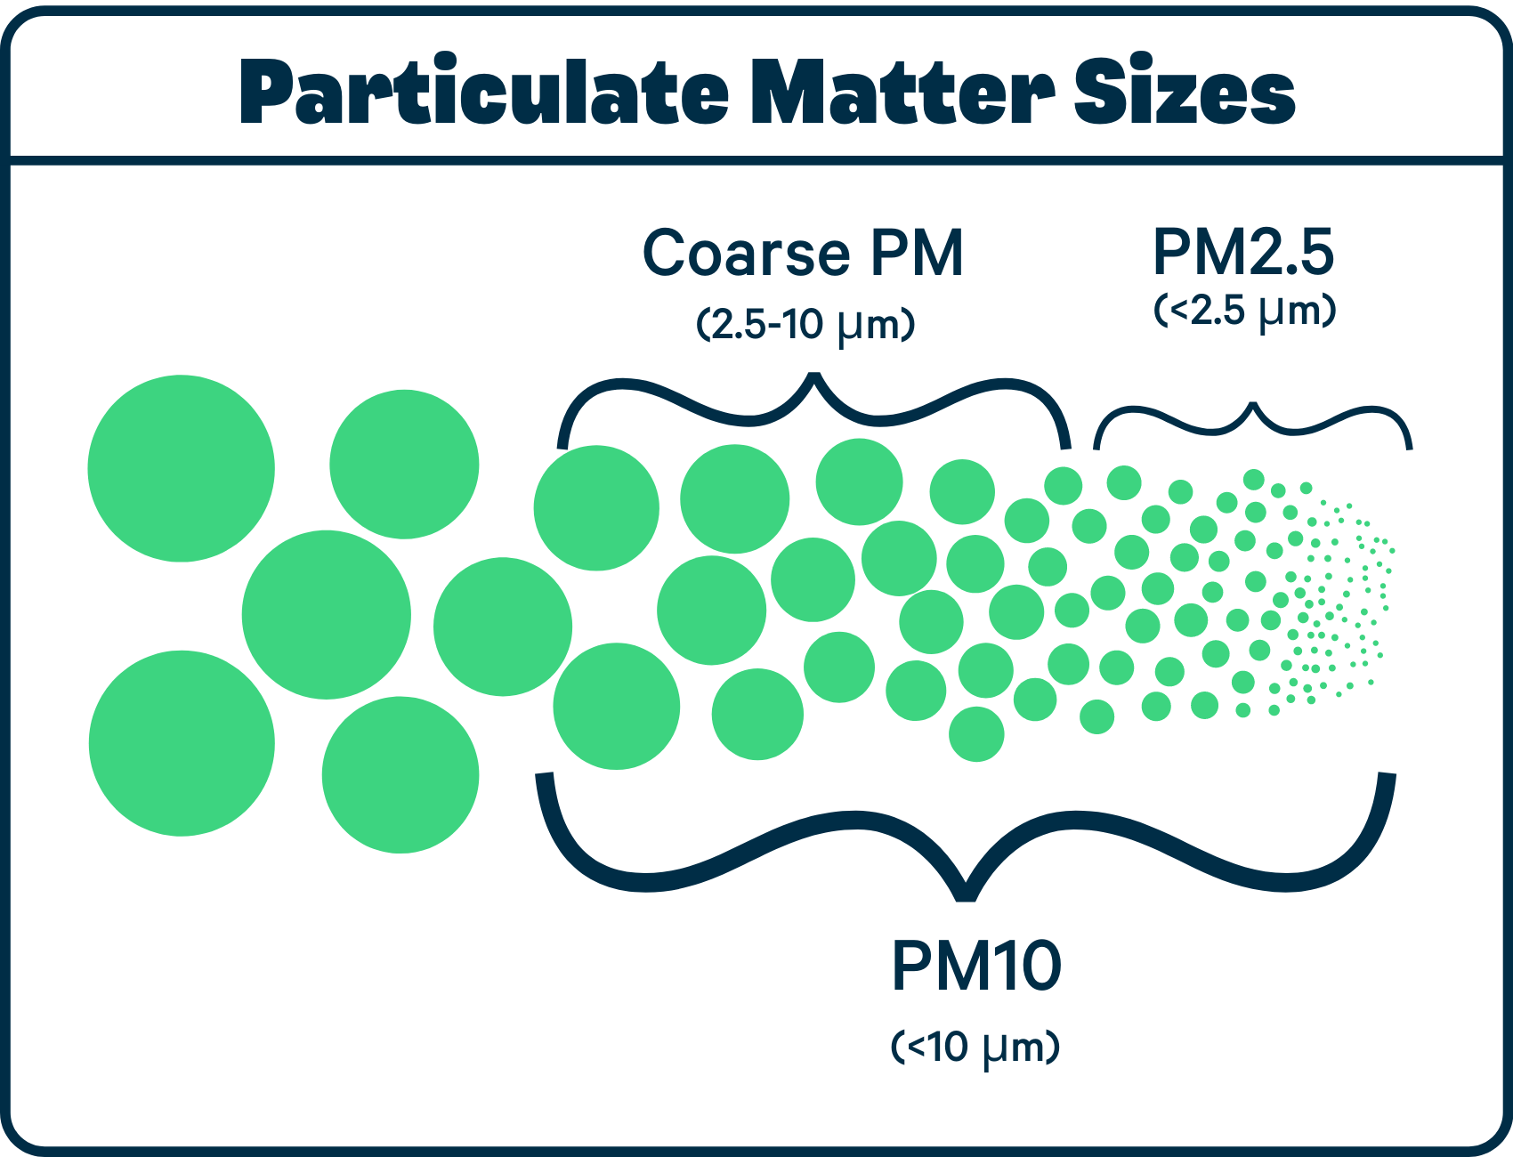
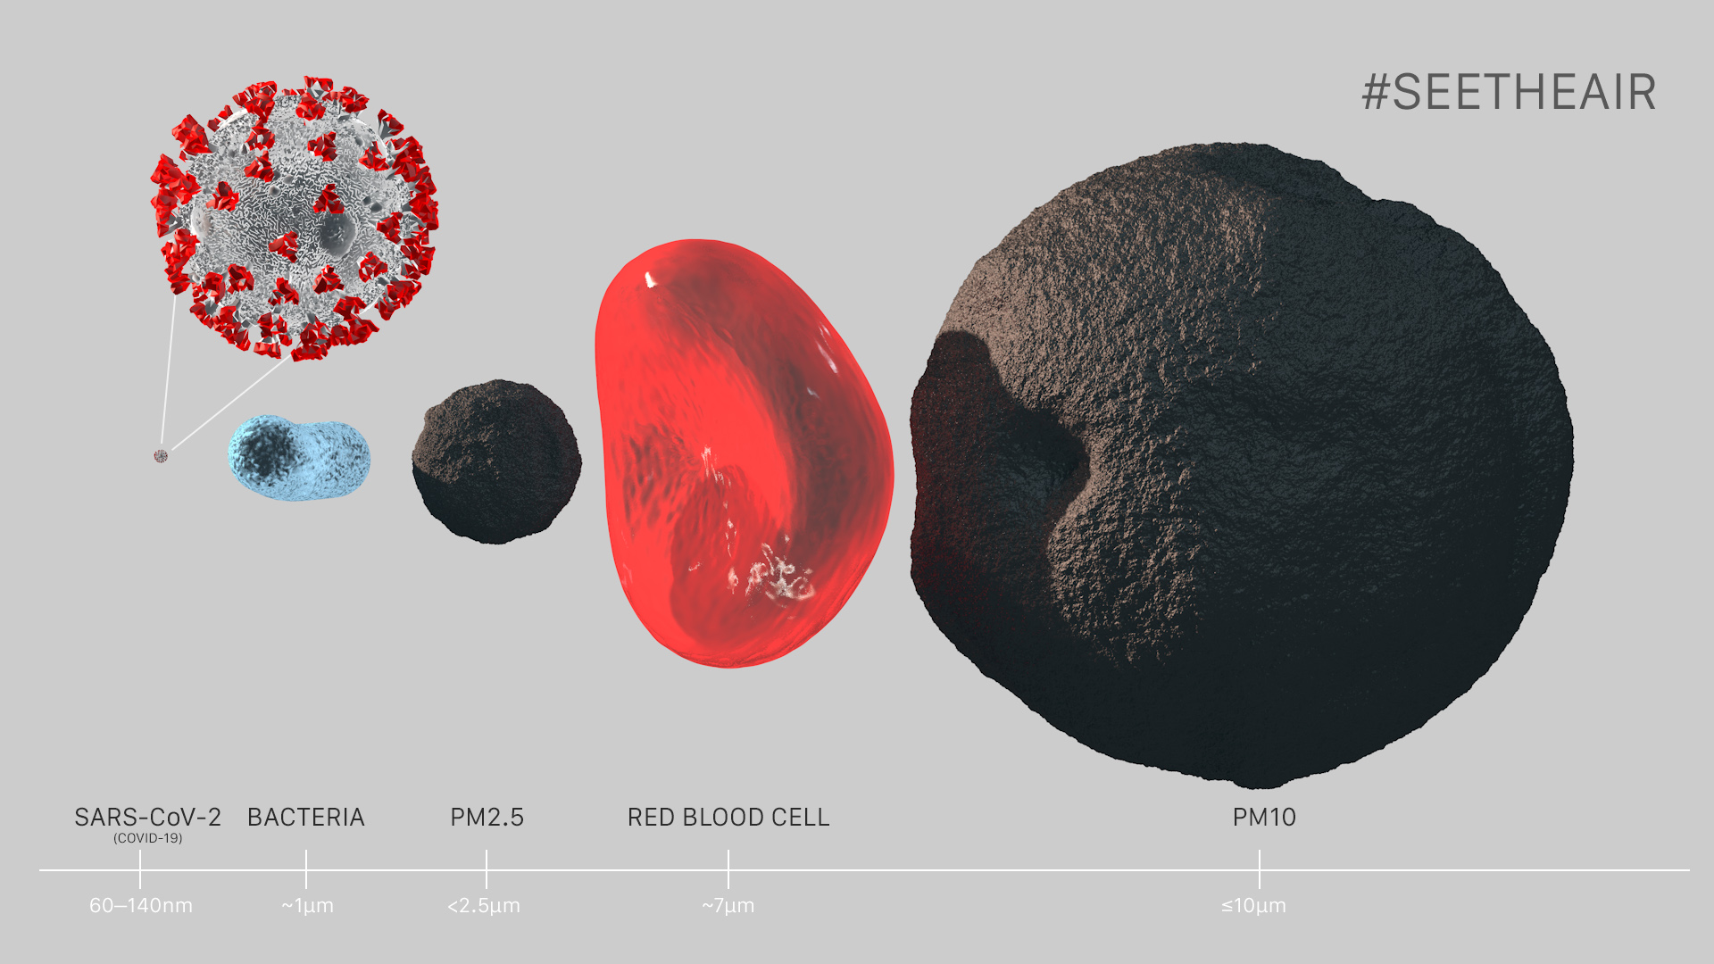
PARTICULATE MATTER MEASUREMENT IN HIGH TRAFFIC AREAS
• What is Particulate Matter (PM) and where does it actually come from?
2

Slide 3
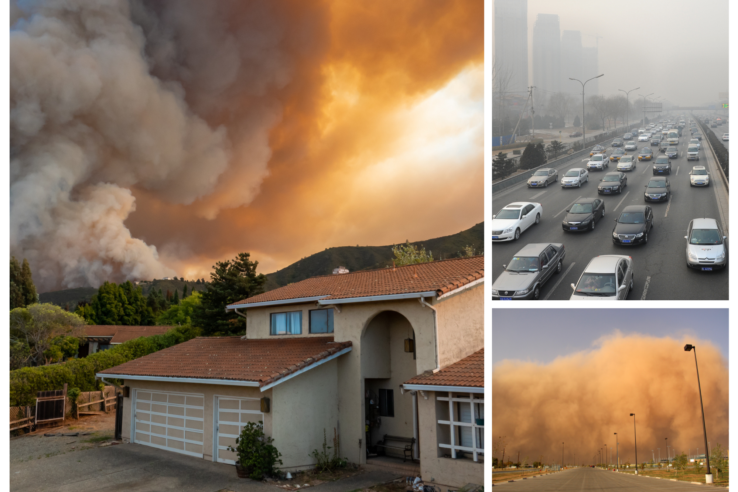
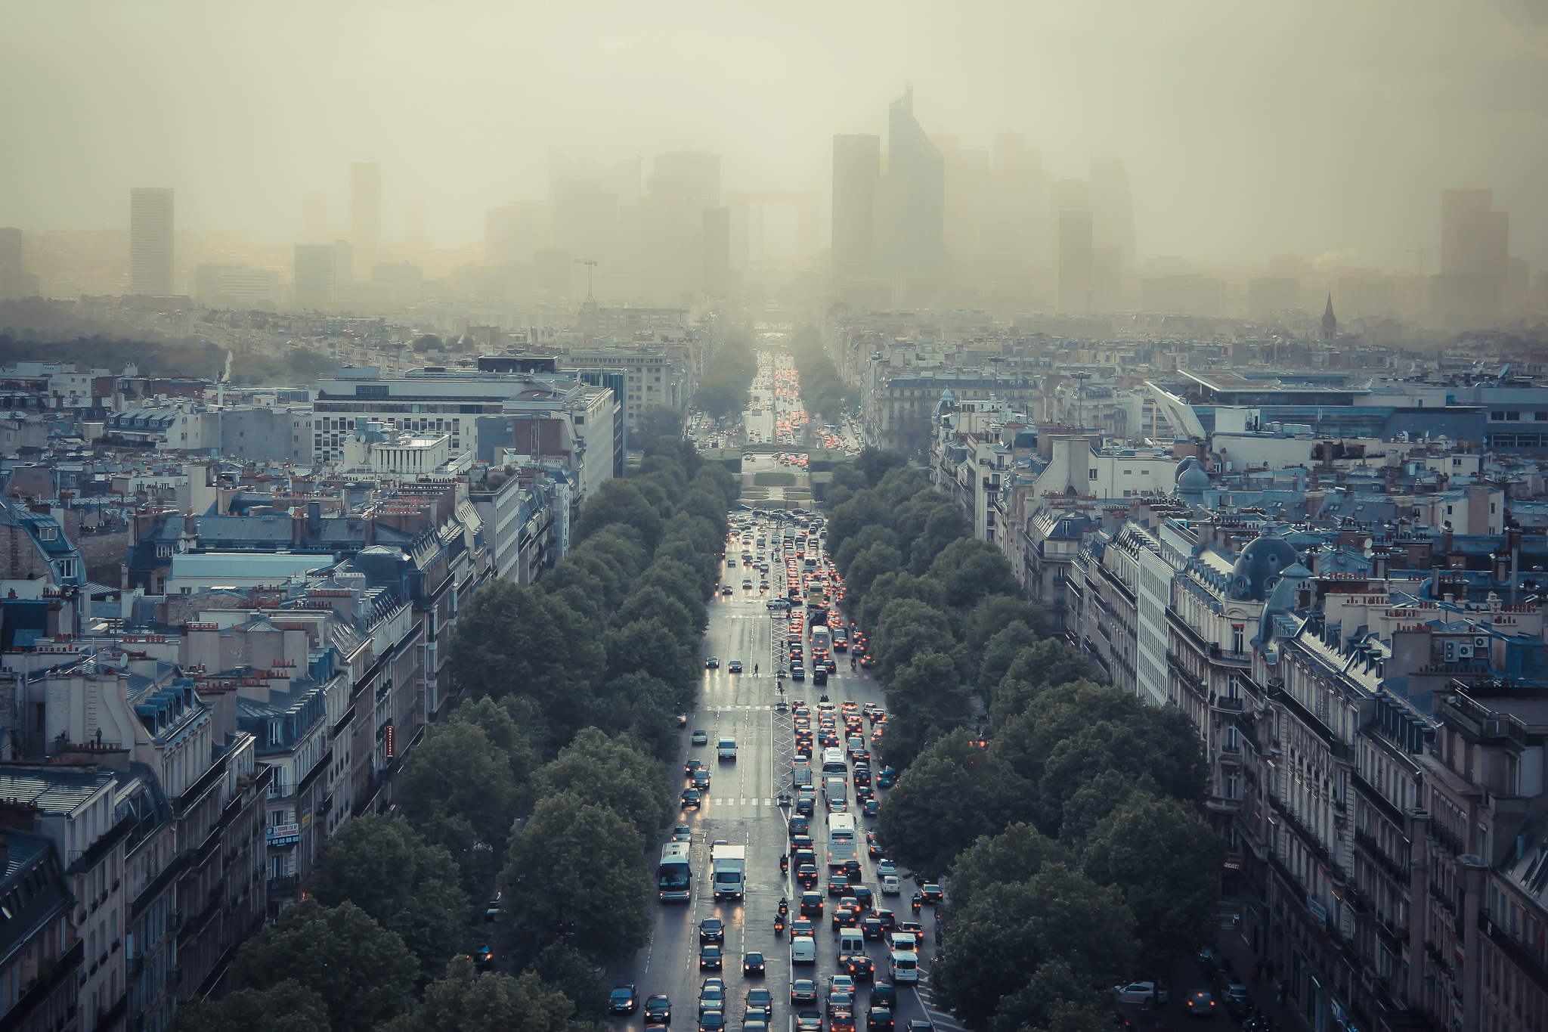
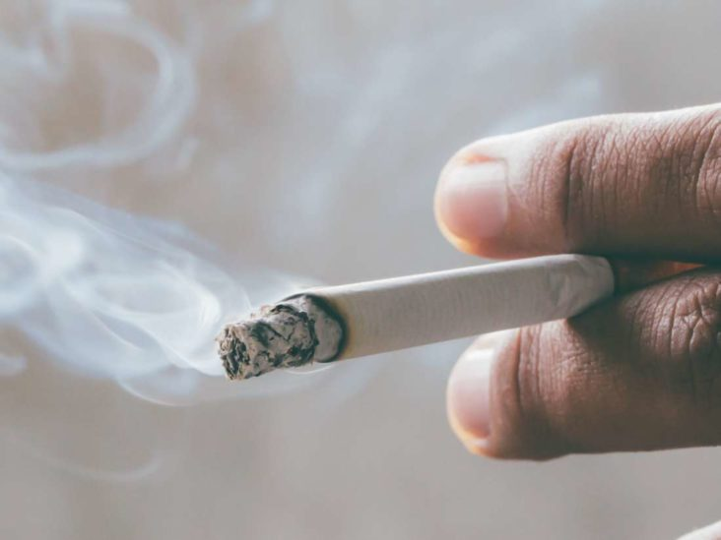
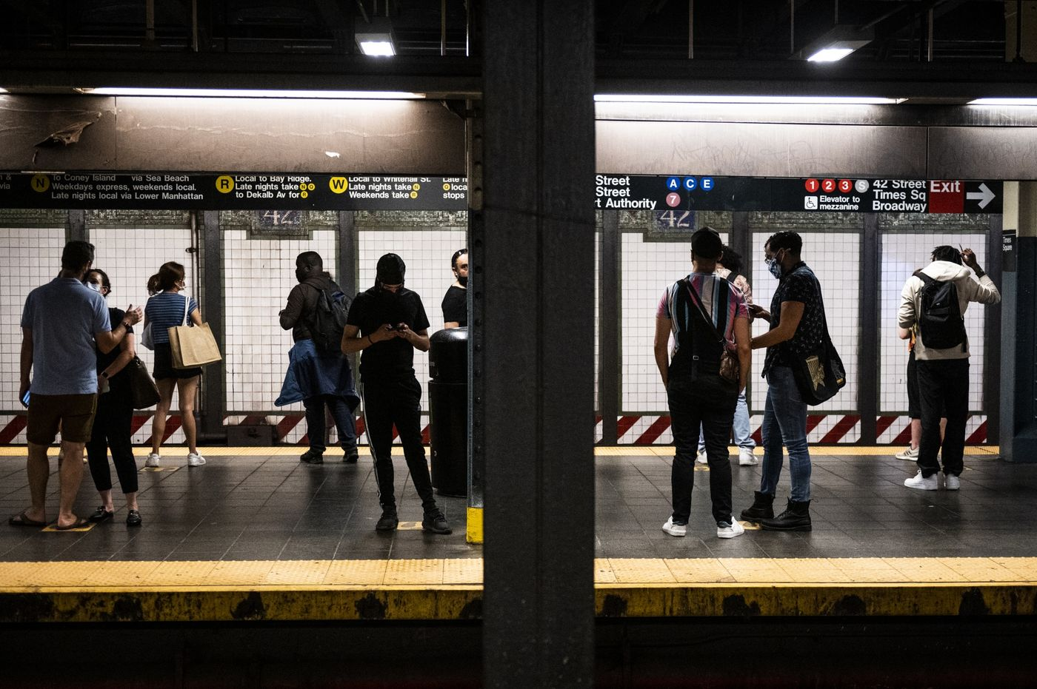
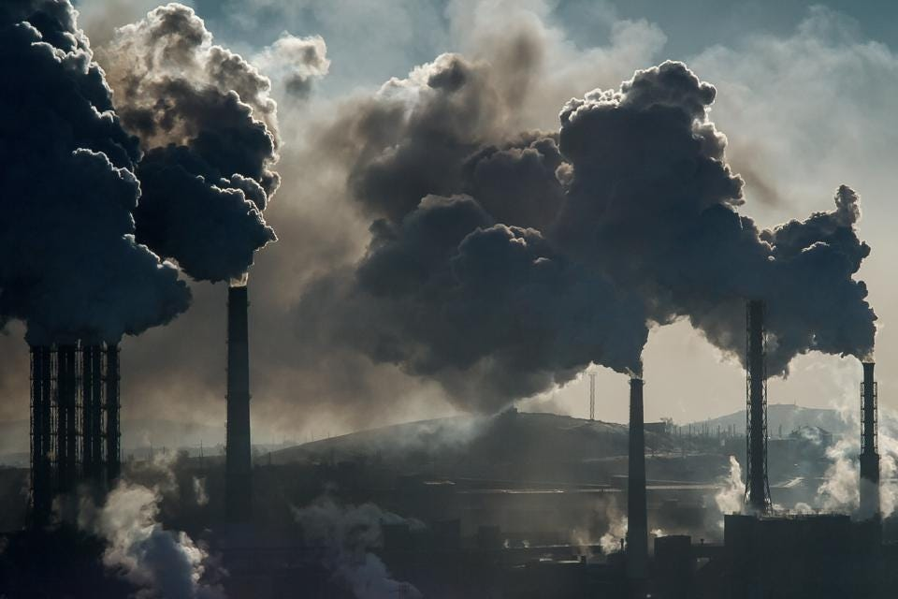
PARTICULATE MATTER MEASUREMENT IN HIGH TRAFFIC AREAS
INDOOR
OUTDOOR
3

Slide 4
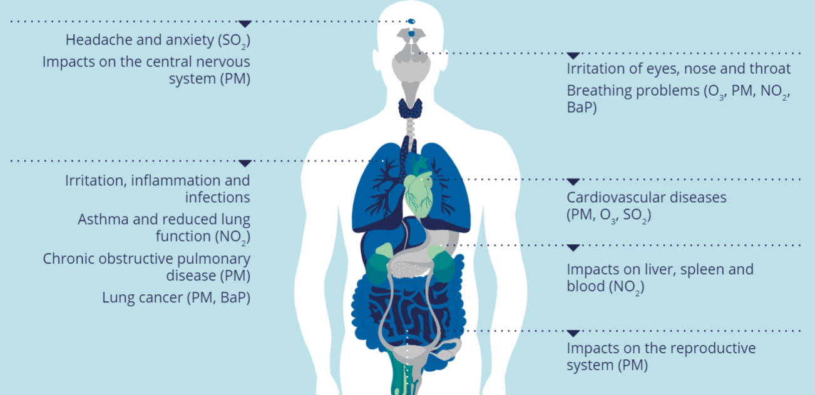
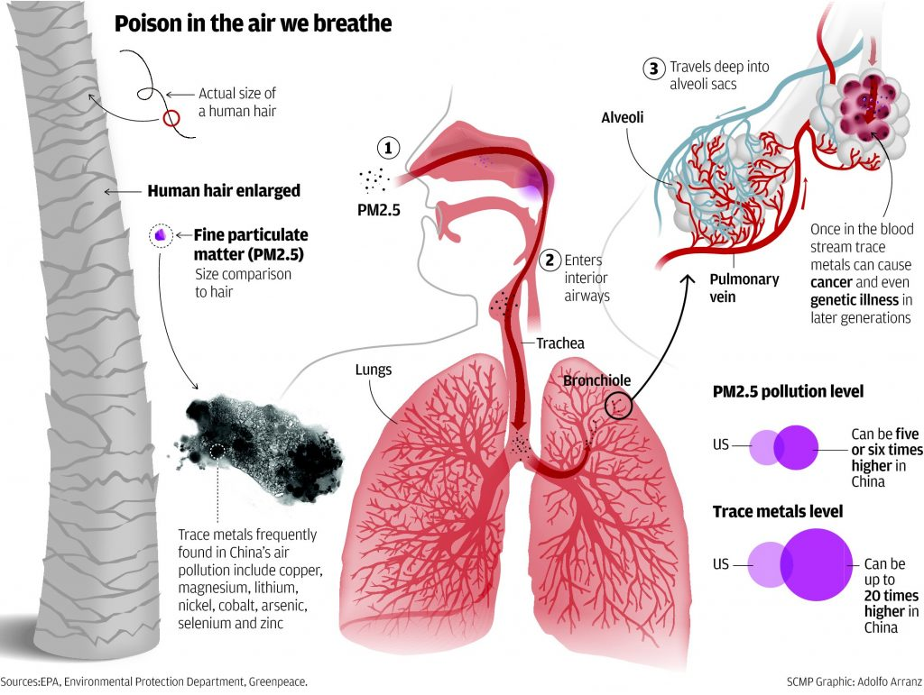
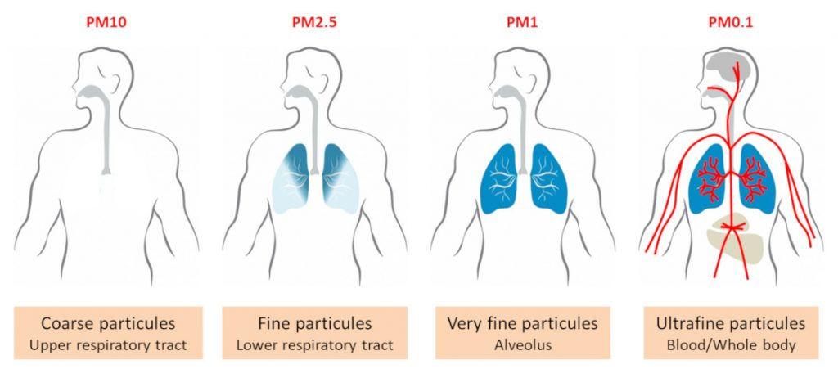
PARTICULATE MATTER MEASUREMENT IN HIGH TRAFFIC AREAS
• Why is the study of Particulate Matter so important and what problems they cause in everyday life?
4

Slide 5
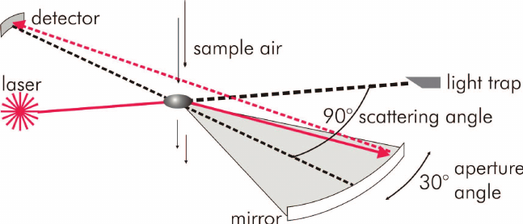
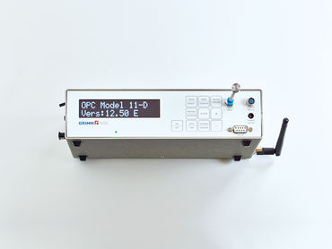
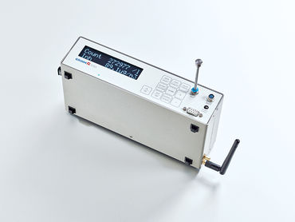
PARTICULATE MATTER MEASUREMENT IN HIGH TRAFFIC AREAS
• How can we measure Particulate Matter (PM 2.5 ; PM10.0) ?
6

Slide 7
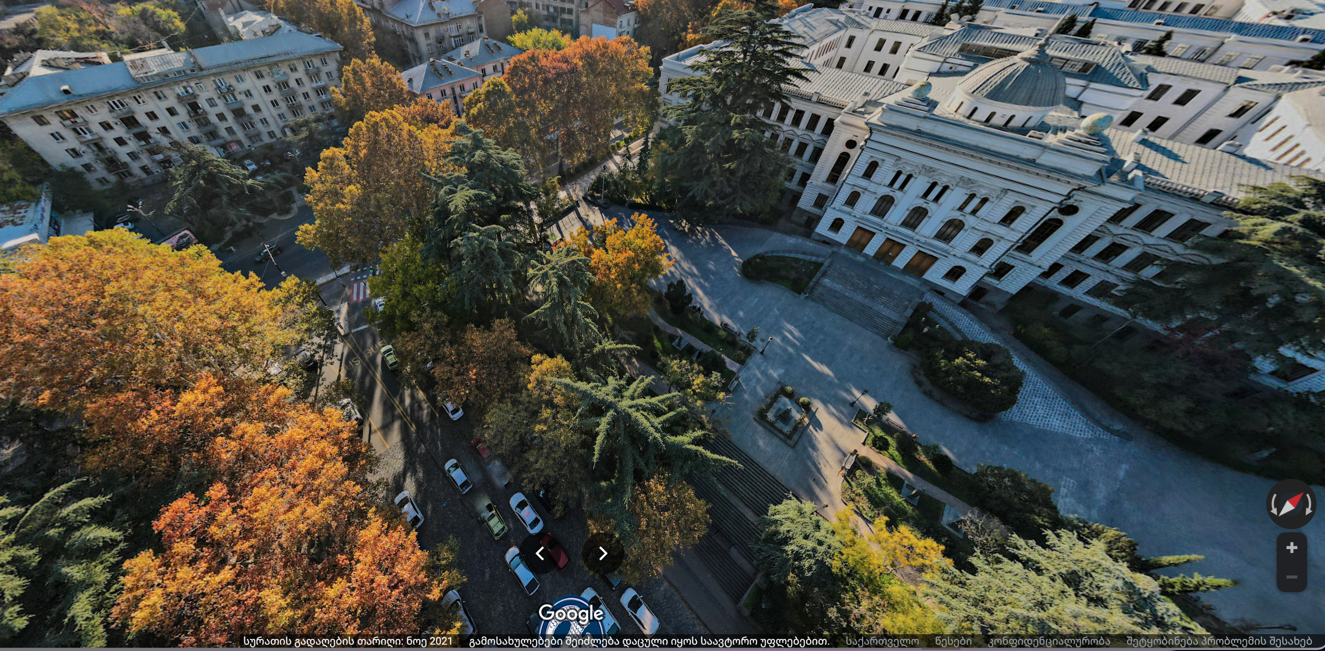
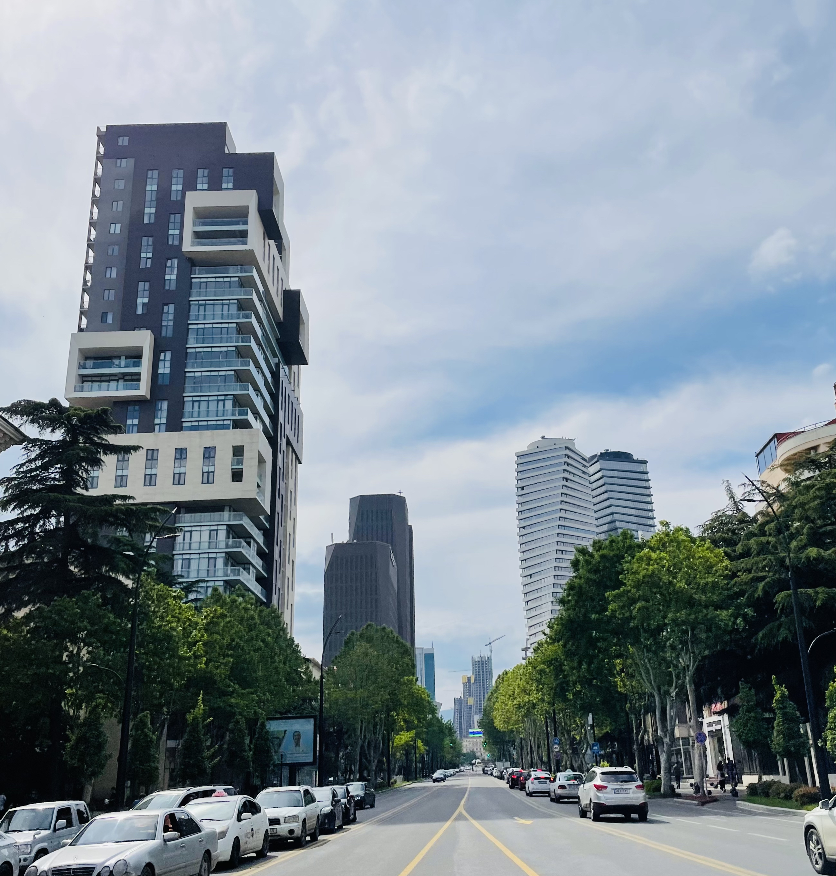
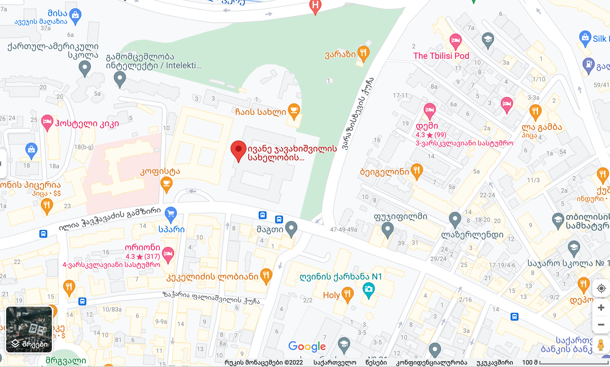
PARTICULATE MATTER MEASUREMENT IN HIGH TRAFFIC AREAS
8

Slide 8
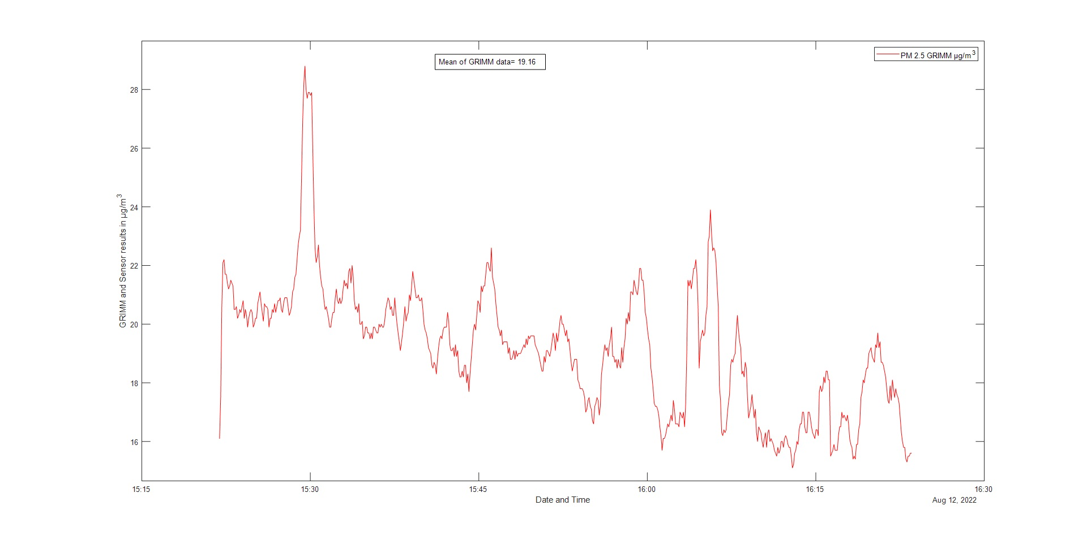
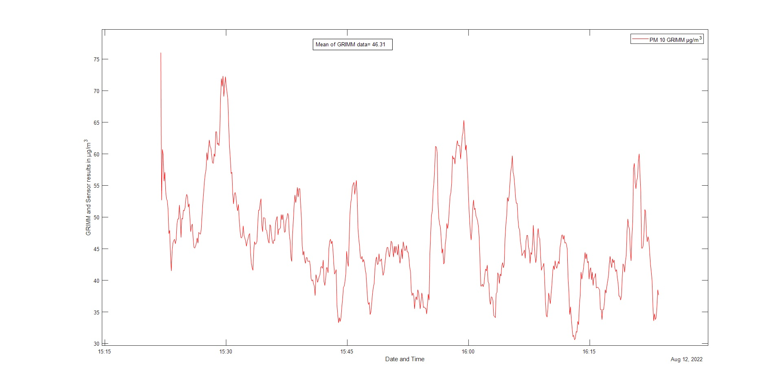
PARTICULATE MATTER MEASUREMENT IN HIGH TRAFFIC AREAS
DATA FROM 12 AUGUST
MEAN OF THE GRIMM mkg/m3
START TIME | FINISH TIME | PM 2.5 | PM10.0
15:20 | 16:25 | 19.16 | 46.31
18:00 | 19:00 | 17.60 | 45.57
Maximum permissible value of Particulate Matter
PM 2.5 | 25 ${mkg/m}^{3}$
PM 10.0 | 40 ${mkg/m}^{3}$
9

Slide 9
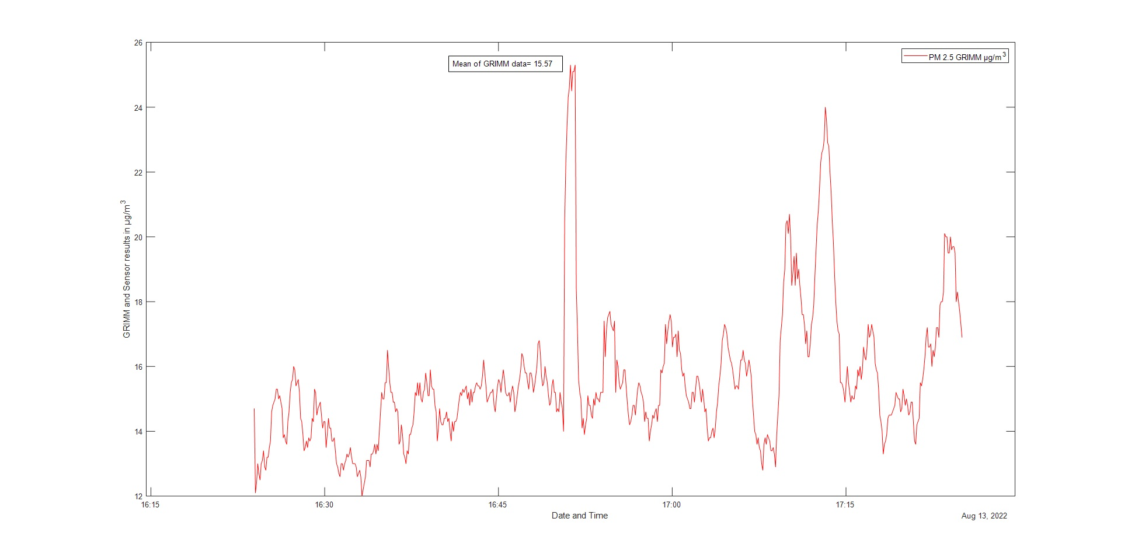
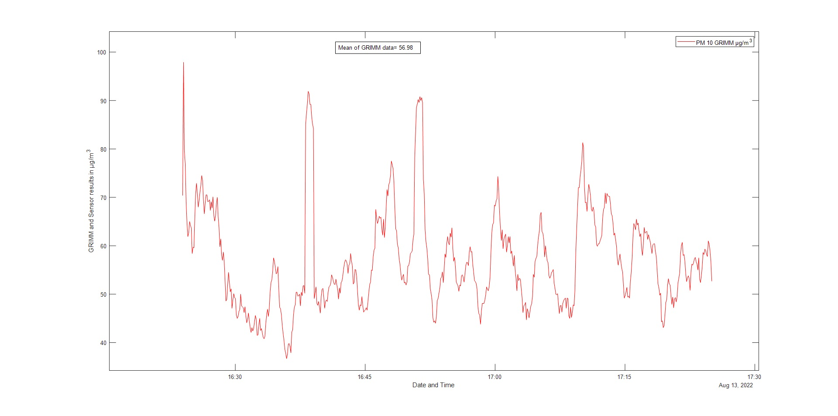
PARTICULATE MATTER MEASUREMENT IN HIGH TRAFFIC AREAS
DATA FROM 13 AUGUST
MEAN OF THE GRIMM mkg/m3
START TIME | FINISH TIME | PM 2.5 | PM 10.0
16:20 | 17:20 | 15.57 | 57.98
Maximum permissible value of Particulate Matter
PM 2.5 | 25 ${mkg/m}^{3}$
PM 10.0 | 40 ${mkg/m}^{3}$
 | UPPER LIMITS | LOW LIMITS
PM 2.5 | 17 | 12
PM 10.0 | 35 | 25
10

Slide 10
PARTICULATE MATTER MEASUREMENT IN HIGH TRAFFIC AREAS
CONCLUSIONS
• According to the data of August 12-13, it can be seen that the concentration of PM 2.5, as on August 12 and 13, is within the limit norms, while the concentration of PM 10.0 exceeds the norms established by the government of Georgia in both cases. Moreover, it is worth noting the fact that during this period of the year, most of the livings in Tbilisi are on vacation, and in the coming months, more activity and car traffic is expected in these streets, which will increase the concentration of these particles.
• Therefore, monthly monitoring of these particles worldwide is necessary. And modern instruments allow us both today and in the future to detect the dangers in order to detect them and apply our knowledge efficiently and innovatively to make our environment more sustainable and safer.
11

Slide 11
THANK YOU FOR ATTENTION!
• I would like to thank my supervisors, Dr. Giorgi Jibuti and Professor Bezhan Chankvetadze, who taught me both the practical and theoretical side of this topic.
•I want to thank also all my colleagues, whose contribution to data collection and processing is great.
12

