Slide 1
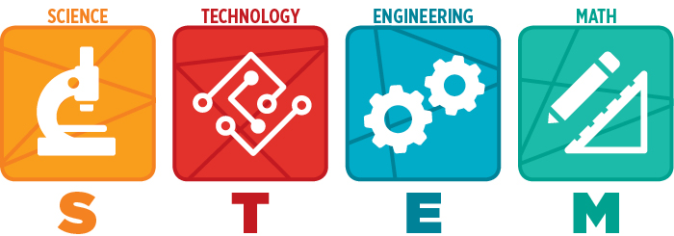
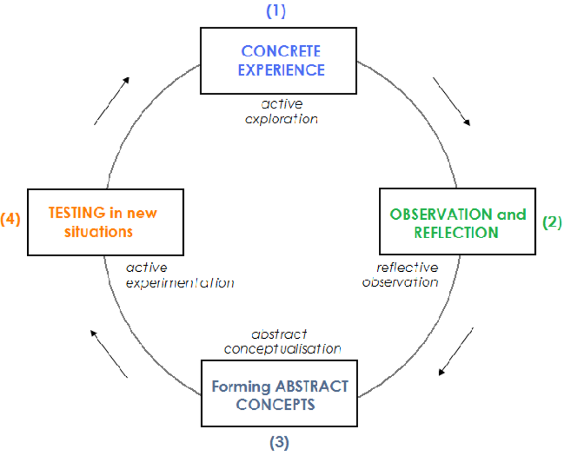
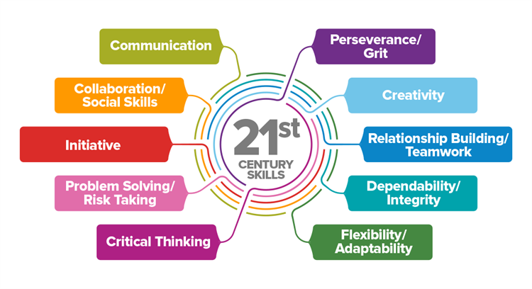
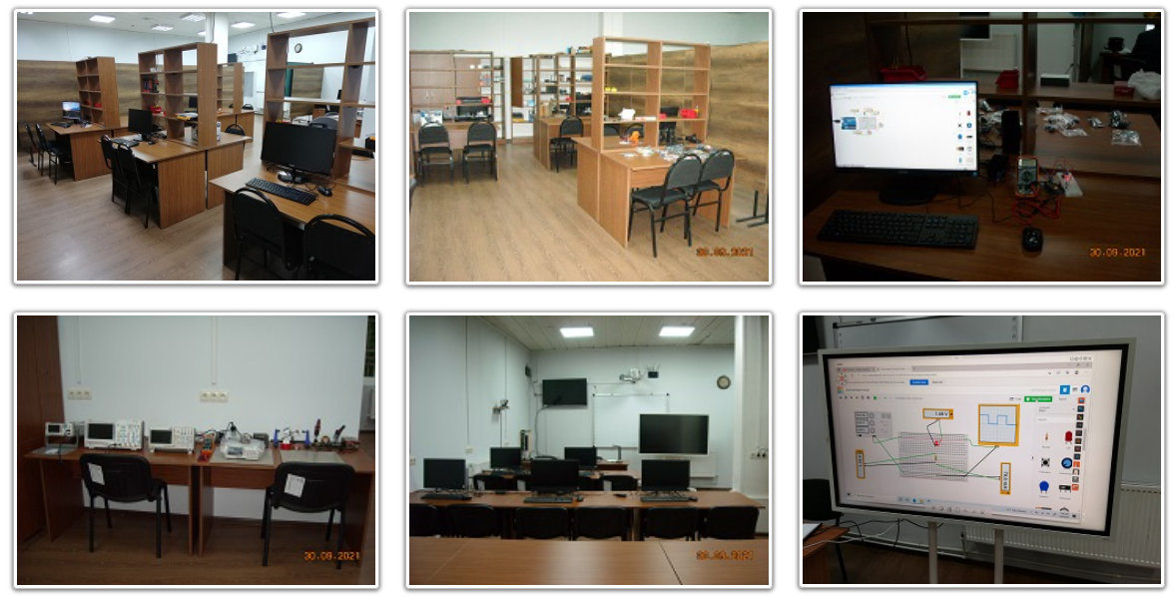
Determining the effectiveness of STEM education in Georgian schools
Medea Abramishvili, PhD, TSU
Supervisor Dr. Mirian Tabidze (HEPI TSU)
“We learn from reflecting on experience” – John Dewey
Concept
Learning by doing
STEM education has become a primary focus of many countries because it is crucial for economic advancement and for tackling complex problems of the world, such as climate change, by using multidisciplinary, interdisciplinary, or transdisciplinary approaches.
STEM is based on learning by doing approach that encourages students to follow a guided discovery while their creativity is enhanced. For this, students are faced with real-world scenarios in such a way that they get used to working in groups, solving problems, finding solutions, and verifying results.
Needs and Demands of 21st century learning skills
The proliferation of technology ubiquitous has advanced the pace of the learning process and the 21st literacy skills by subverting the traditional way of teaching-learning activities and the paper-based source of knowledge and information. The world is experiencing changing trends in education and it prioritizes determining the 21st-century learners' needs and demands to succeed and thrive in the global workplace today.
Stages in learning by doing (experiential) method
Features of traditional education
Teachers are sources of information and authority
Decision-making is centrally based and administratively delivered
Learners are passive absorbers of information and authority
Parents are outsiders and uninvolved
Program is determined by external criteria, particularly test results
Knowledge is absorbed through lectures, worksheets, and texts.
Benefits of STEM education
Fosters ingenuity and creativity
Builds resilience
Encourages experimentation
Encourages teamwork
Encourages knowledge application
Encourages tech use
Teaches problem-solving
Encourages adaption
Summary
To successfully implement STEM activities into formal education, teachers' motivation must be considered in the first place. That is why after creating the STEM projects for 10th graders the first that will be done under the framework of research will be workshops for STEM subjects teachers from the schools where research will be conducted.
For training, the resources of TSU STEM Junior University
will be used (juni.tsu.ge).
Stages of research implementation
Create STEM activities
Train teachers
Create a pre and post-survey for conducting the quantitative research
Implement STEM activities in formal lessons and take control classes
Implement survey
Compare the knowledge of students in STEM subjects and problem-solving, make a conclusion
References
Ng Han Guan, at. al (2020). “Perspectives of STEM Education from Physics
Teachers' Points of View: A Quantitative Study”
2) RABEYA BEGUM1&HUSSAIN AHMED LITON, (2018), “NEEDS AND DEMANDS OF 21st
CENTURY LEARNING SKILLS: A REFLECTIVE APPROACH”
3) Loof Haydée De, at. Al, (2021). Teachers’ motivating style and students’ motivation
and engagement in STEM: The relationship between three key educational concepts”
The author was supported by Volkswagenstiftung grant Az. 93 562

