Slide 1




Evaluation of 5-OH-7-[¹⁸F]FTrp and N-Me-6-[¹⁸F]FTrp as tracers for kynurenine and serotonin metabolic pathways
Presenter: M.D. Otari Gokhadze, TSU
Supervisor: Prof. Heike Endepols
IREMB

Slide 2
Content of Presentation
General information about Tryptophan
PET-imaging of Trp metabolism
Purpose of Experiment
Materials and Methods
Results
Discussion

Slide 3
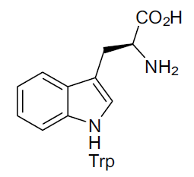
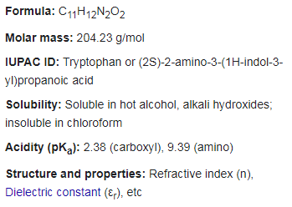
Tryptophan
Tryptophan (Trp) is an essential proteinogenic amino acid, which contains an indole ring in the side chain.
Trp is the least abundant amino acid in animal proteins,
Trp serves mainly as a precursor for various metabolic pathways (serotonin, melatonin, niacin (vitamin B3) and kynurenine).
Wikipedia, https://g.co/kgs/VQLTQB

Slide 4
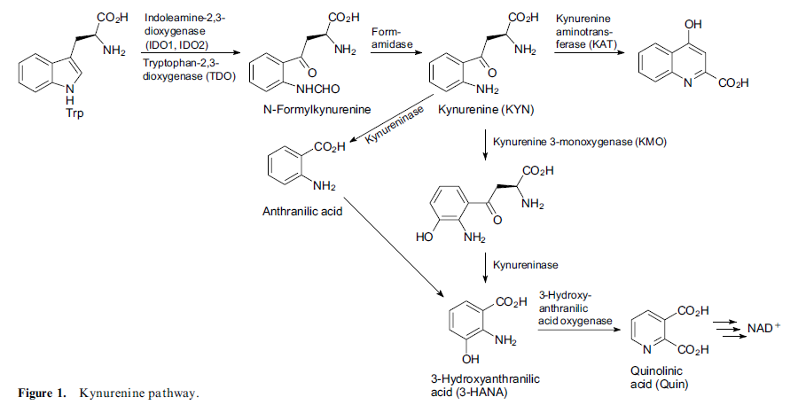
Kynurenine Pathway
NMDARA,
α7nAChRA,
free radical scavenger
If KYN↑,
anti-infl.,
3-HANA blocker.
Zlatopolskiy, Boris D, Heike Endepols, Raisa N Krasikova, and Olga S Fedorova. 2020. “C- and 18 F-Labelled Tryptophans as PET-Tracers for Imaging of Altered Tryptophan Metabolism in Age-Associated Disorders and 18 F-Labelled Tryptophans as PET-Tracers for Imaging of Altered Tryptophan Metabolism in Age-Associated Disorders.”
Notes:
The kynurenine pathway is intimately linked to the immune system. It has been speculated that it has evolved as a defense strategy against viral and bacterial infections, based on tryptophan depletion.4, 5 The initial step is the oxidative cleavage of the indole ring by tryptophan-2,3-dioxygenase
TDO plays an essential role in the homeostasis of systemic Trp metabolism 8 and oxidizes 90% of body Trp under physiologic conditions.9 IDO is induced at sites of inflammation and infection, depleting Trp from the local microenvironment.7 The kynurenine pathway metabolites regulate the immune response during pregnancy, cancer, inflammation and autoimmunity, but also with respect to commensal microorganisms, e.g. in the gastrointestinal tract. Kynurenine biosynthesis in the healthy brain is negligible

Slide 5
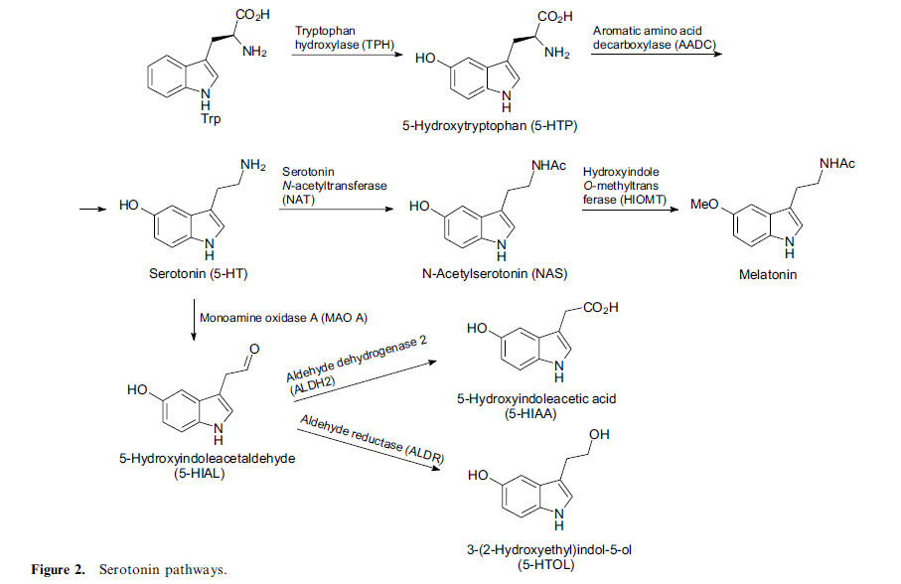
Serotonin Pathways
Zlatopolskiy, Boris D, Heike Endepols, Raisa N Krasikova, and Olga S Fedorova. 2020. “C- and 18 F-Labelled Tryptophans as PET-Tracers for Imaging of Altered Tryptophan Metabolism in Age-Associated Disorders and 18 F-Labelled Tryptophans as PET-Tracers for Imaging of Altered Tryptophan Metabolism in Age-Associated Disorders.”
Notes:
Serotonin (5-hydroxytryptamine) is a signalling molecule which influences, through regulation of sensory and motor processing, cognition and autonomous functions, all essential systems in the brain.15 The cell bodies of serotonergic neurons are localized in the brainstem raphe nuclei, and a dense network of axonal fibres covers all regions of the brain. While only 5% of body serotonin is produced in the brain, 95% is found in enterochromaffin cells in the gastrointestinal tract, where it plays a key role in sensory-motor and secretory functions and also in immune cell activation.

Slide 6
PET-imaging of Trp metabolism
Visualization of different tryptophan metabolic pathways is highly relevant for clinical diagnostics.
In neurodegenerative diseases Serotonin Pathway ↓ and Kynurenine Pathway ↑ vs in most of the brain tumors visa versa.
The plasma kynurenine to tryptophan ratio is therefore frequently used as an indirect measure to estimate IDO activity.
PET imaging can be used for the direct and repetitive measurements of serotonin and kynurenine metabolism in the same individual.
Notes:
IDO Ð indoleamine 2,3-dioxygenase

Slide 7
Purpose of Experiment
While numerous PET tracers specific for serotonin receptors and transporters have been developed, tracers for the visualization of serotonin synthesis and/or activity of the KYN pathway are still rarely found.
Aim of experiment was to reveal 5-OH-7-[¹⁸F]FTrp and N-Me-6-[¹⁸F]FTrp tracer effect on rat brain in a stroke model.
5-OH-7-[¹⁸F]FTrp
N-Me-6-[¹⁸F]FTrp

Slide 8
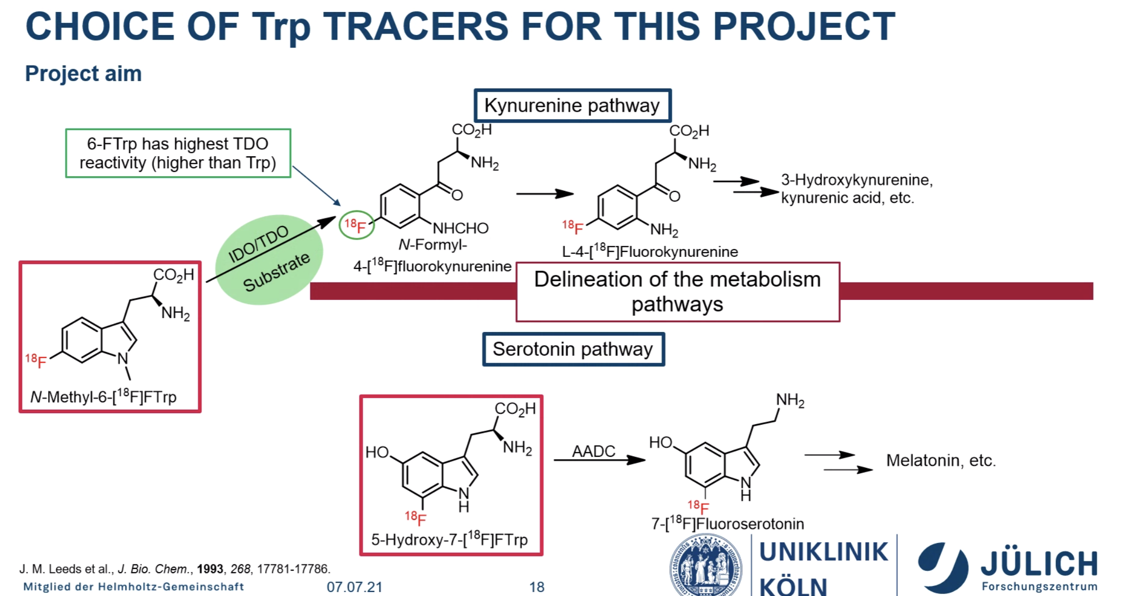
Abbildung von Niklas Kolks

Slide 9
Materials and methods
5-OH-7-[¹⁸F]FTrp
In experiment is used:
4 Rats (Sprague Dawley (745g).
300 pmol Endothelin-1 (Sigma-Aldrich E7764-50µg) in 1.5 µl NaCl injected at coordinates +1.5 mm a, 0.0 mm l, -3.3 mm v to Bregma.(21/06/21)
MRI – 22/06/2021
injection and PET scanning dates
  N-Me-6-Trp 19/07/2021
  DPA-714 21/07/2021
  5-OH-7-[¹⁸F]FTrp 20/07/2021
N-Me-6-[¹⁸F]FTrp
[¹⁸F]DPA-714

Slide 10
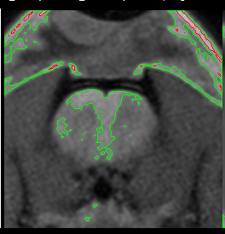
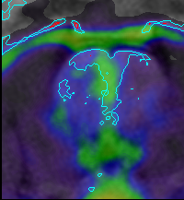
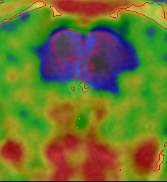
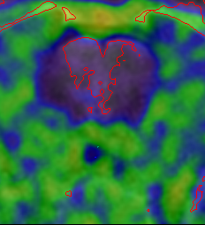
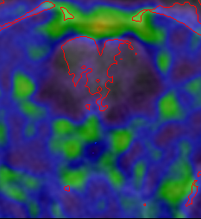
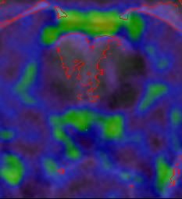
Results
C
A
B
MRI: 24 h post op
0-30 min
m.a.
[¹⁸F]DPA-714
30 days post op
0-30 min
m.a.
edema
h.s.
0-30 min
30-60 min
60-90 min
90-120 min
m.a.
b
0-30 min
m.a.
5-OH-7-[¹⁸F]FTrp
31 days post op
b
SUV_{bw}
0
90

Slide 11
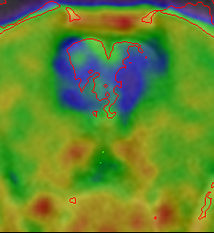
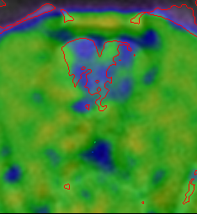
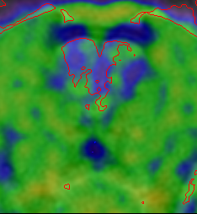
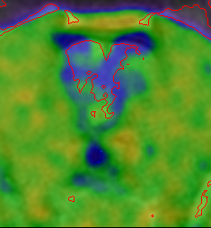
A
B
C
MRI: 24 h post op
0-30 min
m.a.
[¹⁸F]DPA-714
30 days post op
m.a.
0-30 min
edema
0-30 min
30-60 min
60-90 min
90-120 min
h.s.
m.a.
b
N-Me-6-[¹⁸F]FTrp
31 days post op
0-30 min
m.a.
b
SUV_{bw}
0
250

Slide 12
m.a.
m.a.
0-30 min
0-30 min
30-60 min
60-90 min
90-120 min
h.s.
m.a.
b
N-Me-6-[¹⁸F]FTrp
31 days post op
0-30 min
m.a.
b
SUV_{bw}
0
250

Slide 13
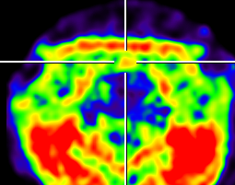
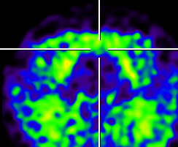
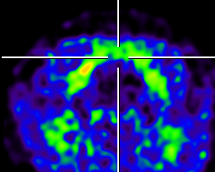
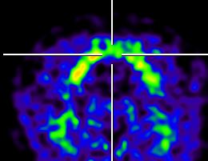
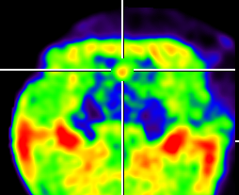
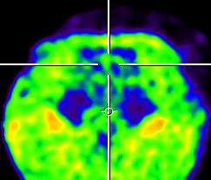
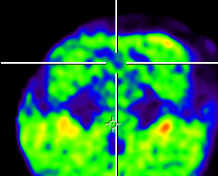
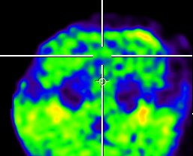
Pineal gland uptake
SUV_{bw}
0
90
0-30 min
30-60 min
60-90 min
90-120 min
5-OH-7-[¹⁸F]FTrp
31 days post op
N-Me-6-[¹⁸F]FTrp
31 days post op
SUV_{bw}
0
250

Slide 14
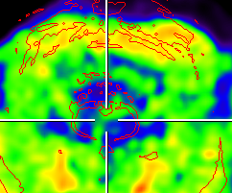
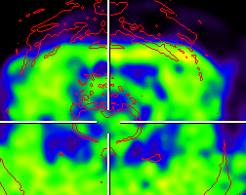
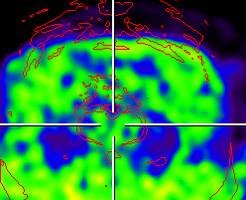
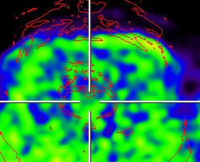
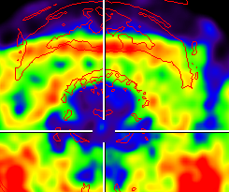
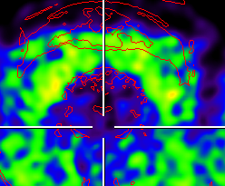
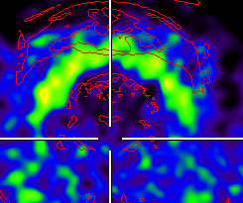
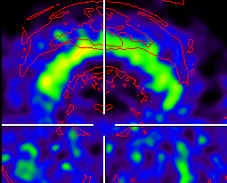
Raphe Nucleus Uptake
SUV_{bw}
0
90
0-30 min
30-60 min
60-90 min
90-120 min
5-OH-7-[¹⁸F]FTrp
31 days post op
N-Me-6-[¹⁸F]FTrp
31 days post op
SUV_{bw}
0
250

Slide 15
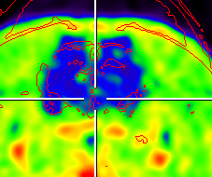
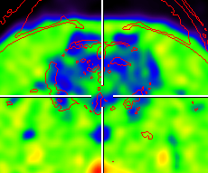
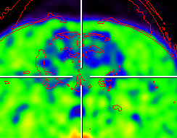
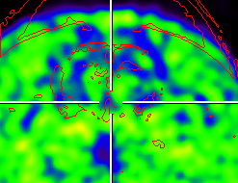
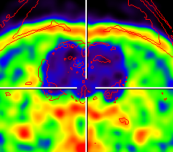
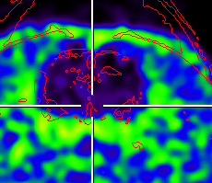
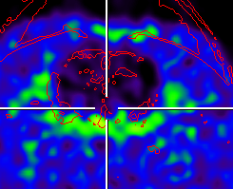
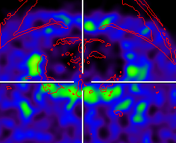
Hypothalamus uptake
7-[¹⁸F]FTrp
SUV_{bw}
0
90
0-30 min
30-60 min
60-90 min
90-120 min
5-OH-7-[¹⁸F]FTrp
31 days post op
N-Me-6-[¹⁸F]FTrp
31 days post op
SUV_{bw}
0
250

Slide 16
Discussion
Edema
[¹⁸F]DPA-714
5-OH-7-[¹⁸F]FTrp expected to go through the serotonin pathway, but it has been revealed, that tracer do not accumulate in the edema area nor in the sites of serotoninergic parts of brain.
N-Me-6-[¹⁸F]FTrp expected to go only through the kynurenine pathways, which tracer does near the edema area, but not in the lesion. Experiment also reveald, accumulation of N-Me-6-[¹⁸F]FTrp in the typical serotoninergic organelles of brain.(Pineal gland, hypothalamus, raphe nucleus)
the morphological studies of the brains by imunohistochemistry method(IBA, quinoline acid)
N-Me-6-[¹⁸F]FTrp
Brain

Slide 17
Imunochemistry IDO-1

Slide 18
Acknowledgment
Prof. Bernd Neumaier
Prof. Heike Endepols
Lukas Vieth
Dr. Niklas Kolks
Dr. Andro Katcharava

Slide 19
Literature
Zlatopolskiy, Boris D, Heike Endepols, Raisa N Krasikova, and Olga S Fedorova. 2020. “C- and 18 F-Labelled Tryptophans as PET-Tracers for Imaging of Altered Tryptophan Metabolism in Age-Associated Disorders and 18 F-Labelled Tryptophans as PET-Tracers for Imaging of Altered Tryptophan Metabolism in Age-Associated Disorders.”
Wikipedia, https://g.co/kgs/VQLTQB
Presentation von Niklas Kolks

