Slide 1

Ivane Javakhishvili Tbilisi State University
Nutsa Tsetskhladze
Faculty of Exact and Natural Sciences, Department of Chemistry
Thermodynamic study of the enantioseparation of planar chiral ferrocenes with high-performance liquid chromatography
Scientific Supervisor:
Doctor of Chemical Sciences, Professor,
Full Member of the Georgian National Academy of Sciences Bezhan Chankvetadze
Tbilisi
2021

Slide 2
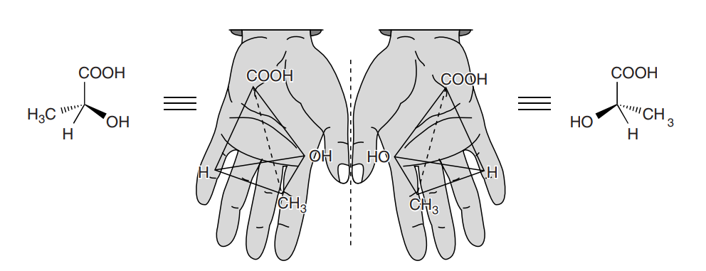
What does chirality mean?
Chiral molecule is the one that is not superimposable with its mirror image
Enantiomer- a pair of molecules that exist in two forms that are mirror images of one another but cannot be superimposed one upon the other
Racemate – a mixture that contains equal amount of two enantiomers
Notes:
Before discussing experimental part, lets explain some important terms.
What does chirality mean?
Chirality is a fundamental property of three-dimensional objects. The word “chiral” is derived from the Greek word cheir, meaning hand. The left and right hands are mirror images of each other no matter how the two are arranged. And Like our hands, chiral molecule is the one that is not superimposable with its mirror image.
And Two possible mirror image forms are called enantiomers and are exemplified by the right-handed and left-handed forms of lactic acids in this picture.
other word that we should know is racemate.
Racemate is a mixture that contains equal amounts of two enantiomers .

Slide 3
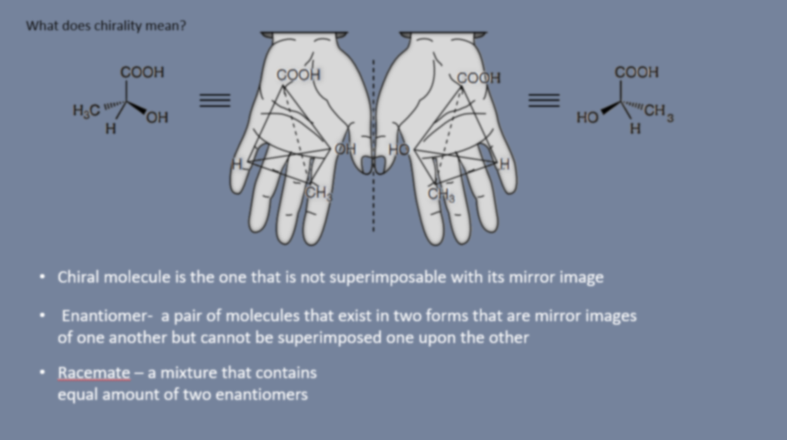
Why is it so important to separate enantiomers?
Because of the fact that In an achiral environment, enantiomers of a chiral compound exhibit identical physical and chemical properties, but they rotate the plane of polarized light in
opposite directions and react at different rates with a chiral compound or with an achiral compound in a chiral environment.
Notes:
So why is resolution of enantiomers so important?
Because of the fact that In an achiral environment, enantiomers of a chiral compound exhibit identical physical and chemical properties, but they rotate the plane of polarized light in
opposite directions and react at different rates with a chiral compound or with an achiral compound in a chiral environment.
For example enantiomers of chiral drug could have different pharmacological activities
when Both enantiomers act on the same biological target(s), but one isomer has
higher binding affinity than the other:
Both enantiomers act on the same biological target, but exert different
pharmacological activities:
or only One enantiomer has the desired effect and other one can cause unwanded side effects.
That is why enantiomer separation methods have become necessary, in order to study individual enantiomers and produce enantiomerically pure chiral compounds that will be safe for humans and the environment. Among the many methods for the separation of enantiomers, the most effective, practical and convenient is the use of a high-performance liquid chromatograph.

Slide 4
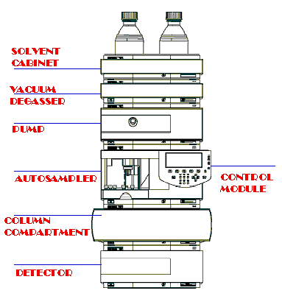
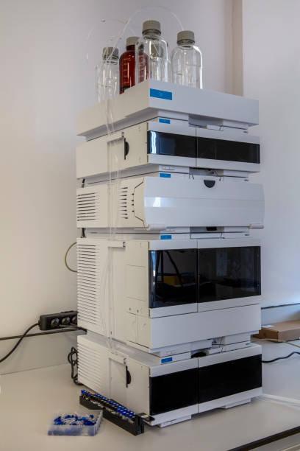
High Performance Liquid Chromatography
Notes:
Almost 90% of chiral separations are achieved with this technique. Compared to other methods, its advantages are speed, sensitivity and reapitability results.
In our study Agilent 1200 series HPLC , which consists of a pump, an automatic sample delivery system, a column compartment and an ultraviolet detector.

Slide 5
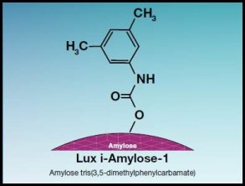
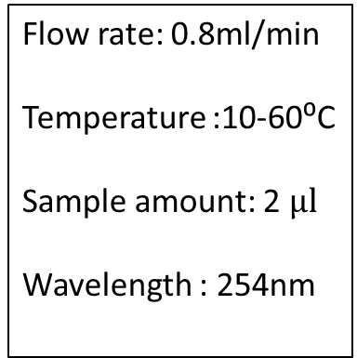
Chiral selector used in the experiment:
Mobile phase:
Experimental Conditions:
Acetonitrile (ACN)
ACN:Water 90:10
ACN:Water 80:20
ACN:Water 70:30
ACN:Water 60:40
Flow rate: 0.8ml/min
Temperature :10-60⁰C
Sample amount: 2 $μl$
Wavelength : 254nm
Notes:
For creating a chiral environment are polysaccharide-based chiral stationary phases used, mainly cellulose and amylose based products, which, along with a number of other properties, are distinguished by a unique ability of chiral resolution.
In our experiment, as a chiral selector we had immobilized amylose-1 stationary phase and as a mobile phase acetonitrile and acetonitrile with different water contents

Slide 6
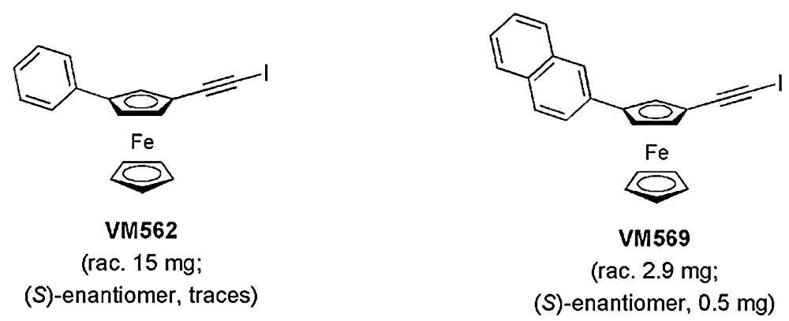
Planar chiral ferrocenes
Notes:
As we know reason for chirality other than stereogenic center can be axis or plane of asymmetry and we could also have topological chirality.
Our research compounds are Planar chiral ferrocenes, which are well-known compounds that have attracted interest for application in synthesis, catalysis, material science, and medicinal
chemistry for several decades.
In addition to the practical point of view, the separation of enantiomeric mixture has a significant theoretical load, because despite the well-developed methods of chiral separation, the mechanisms of enantiomer separation are still not fully defined.
Thus, This project describes our attempt to revisit the role of temperature in the separations of enantiomers and to determine thermodynamic parameters for this process. This can help to predict the suitable analytical conditions for the given compound in given conditions, and achieve the desired selectivity and enantiomer elution order.

Slide 7
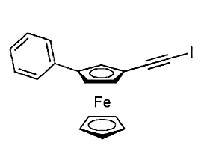
Effect of different water contents in mobile phase on retention time
ACN
tR1=7.08min
tR2=17.210min
ACN:Water-90:10
tR1=8.28min
tR2=32.16min
ACN:Water-80:20
tR1=13.57min
tR2=68.376min
ACN:Water-70:30
tR1=27.126min
tR2=142.376min
ACN:Water-60:40
tR1=52.435min
tR2=284.994min
Notes:
First, lets see how water content in mobile phase affect retention time of enantiomers. When we had pure acetonitrile retention time for first in this case for s enantiomer was 7 minutes and for second one seventeen. By adding 10 percent of water The retention time of the second enantiomer was doubled, this happened again when increased water content up 20%, then 30% and 40%. So retention time from 7 and 17 minutes changed to 52 and 285 minutes.

Slide 8


Dependence of retention an separation factor on water content in
acetonitrile on Lux Amylose-1 column.
Content of water in the mobile phase, v/v | kS | kR | α
0 | 0.8827 | 3.5893 | 4.0665
10 | 1.2035 | 7.5784 | 6.2971
20 | 2.6189 | 17.2336 | 6.5804
30 | 6.2344 | 36.9645 | 5.9291
40 | 12.9827 | 74.9984 | 5.7768
$$k_{R}$$
$$k_{s}$$
Notes:
After that we measured hot different water content in mobile phase affected retention factor and selectivity of separation. As we can see retention factor grows and interesting is that that the selectivity reaches its optimal value at ACN:Water -80:20 ratio .

Slide 9







1) MP-ACN
$t_{R1}$= 7.35min $t_{R2}$=20.12min
$t_{R1}$=7.11min $t_{R2}$= 17.92min
$t_{R1}$= 6.89min $t_{R2}$= 16.11min
$t_{R1}$= 6.52min $t_{R2}$= 13.74min
$t_{R1}$= 6.21min $t_{R2}$= 12.02min
$t_{R1}$= 5.88min $t_{R2}$= 10.34min
Notes:
On this slide, we have pure acetonitrile mobile phase but at different temperatures. Begginig with 10 celcius and increasing in every next experiment by 10 degrees. As expected, for more retained enantiomer retention time is decreasing.
Accordind to temperature gradient results we calculated thermodynamic parametres.

Slide 10
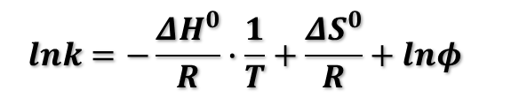

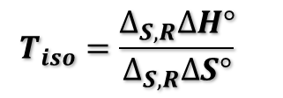
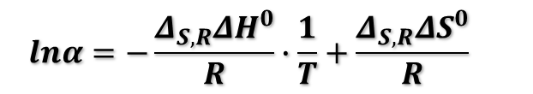
The Van't Hoff equation can be used for describing the dependence between the retention factor k and the temperature (T) of the chiral separations
$$lnk=−\frac{{ΔH}^{0}}{R}∙\frac{1}{T}+\frac{{ΔS}^{0}}{R}+lnφ$$
$$α={k_{R}}/{k_{s}}$$
And, the differences in adsorbtion enthalpy and adsorbtion entropy are conveniently obtained by plotting the natural logarithm of the separation factor a versus the reciprocal of the absolute temperature T.
$$lnα=−\frac{Δ_{S,R}{ΔH}^{0}}{R}∙\frac{1}{T}+\frac{Δ_{S,R}{ΔS}^{0}}{R}$$
Isoenantioselective temperature:
$$T_{iso}=\frac{∆_{S,R}∆H°}{∆_{S,R}∆S°}$$
Notes:
So, The Van't Hoff equation can be used for describing the dependence between the retention factor k and the temperature (T) of the chiral separations .
Lnk=…
The plot of lnk versus 1/T permits the determination of the standart molar enthalpy of adsorption DH from the slope of line, while the intercept is related to the adsorbtion entropy DS.
And, the differences in adsorbtion enthalpy ddH and adsorbtion entropy ddS are conveniently obtained by plotting the natural logarithm of the separation factor a versus the reciprocal of the absolute temperature T.
.At a certain temperature, the so called isoenantioselective temperature (Tiso), the
enthalpic and entropic terms compensate each the enantiomers are not separated.
Above the isoenantioselective temperature the elution order of
the enantiomers reverses compared to below it.
Commonly, the enantioseparations attempted at lower temperature are enthalpy-driven while at higher temperatures they are entropy-driven.
On this basis, we could evaluate if the enantioseparation was controlled by enthalpic or entropic terms and gain interesting information on the effect of adding water to the MP on both retention and selectivity.

Slide 11
mp-ACN
t,°C | to | t1 | t2 | kS | kR | α | T.K | 1/T | lnkS | lnkR | lnα
10 | 3.75 | 7.3500 | 20.1120 | 0.9600 | 4.3632 | 4.5450 | 285.1500 | 35.0693 | -0.0408 | 1.4732 | 1.5140
15 | 3.75 | 7.4190 | 19.8640 | 0.9784 | 4.2971 | 4.3919 | 290.1500 | 34.4649 | -0.0218 | 1.4579 | 1.4798
20 | 3.75 | 7.1140 | 17.9230 | 0.8971 | 3.7795 | 4.2131 | 295.1500 | 33.8811 | -0.1086 | 1.3296 | 1.4382
25 | 3.75 | 7.0600 | 17.2100 | 0.8827 | 3.5893 | 4.0665 | 300.1500 | 33.3167 | -0.1248 | 1.2780 | 1.4028
30 | 3.75 | 6.8910 | 16.1060 | 0.8376 | 3.2949 | 3.9338 | 305.1500 | 32.7708 | -0.1772 | 1.1924 | 1.3696
35 | 3.75 | 6.5850 | 14.3100 | 0.7560 | 2.8160 | 3.7249 | 310.1500 | 32.2425 | -0.2797 | 1.0353 | 1.3150
40 | 3.75 | 6.5280 | 13.7460 | 0.7408 | 2.6656 | 3.5983 | 315.1500 | 31.7309 | -0.3000 | 0.9804 | 1.2805
45 | 3.75 | 6.3690 | 12.8730 | 0.6984 | 2.4328 | 3.4834 | 320.1500 | 31.2354 | -0.3590 | 0.8890 | 1.2480
50 | 3.75 | 6.2170 | 12.0240 | 0.6579 | 2.2064 | 3.3539 | 325.1500 | 30.7550 | -0.4188 | 0.7914 | 1.2101
55 | 3.75 | 6.0710 | 11.1910 | 0.6189 | 1.9843 | 3.2059 | 330.1500 | 30.2893 | -0.4798 | 0.6852 | 1.1650
60 | 3.75 | 5.8879 | 10.3470 | 0.5701 | 1.7592 | 3.0857 | 335.1500 | 29.8374 | -0.5619 | 0.5649 | 1.1268
ΔHs (cal/mol) | ΔHR (cal/mol) | ΔSs/R+lnΦ (cal/mol) | ΔSR/R+lnΦ (cal/mol) | ΔS,RΔH (cal/mol) | ΔS,RΔS (cal/mol) | Tiso (K)
-2048.6 | -3525.09 | -3.5936 | -4.6729 | -1476.59 | -2.14478 | 688.4555

Slide 12
2) ACN:Water- 90:10

Slide 13
mp-ACN:Water-90:10
t,°C | to | t1 | t2 | kS | kR | α | T(K) | 1/T x 10⁻⁴ | lnkS | lnkR | lnα
10 | 3.75 | 8.8740 | 39.0100 | 1.3664 | 9.4027 | 6.8813 | 285.15 | 35.0693 | 0.3122 | 2.2410 | 1.9288
15 | 3.75 | 8.7320 | 37.4890 | 1.3285 | 8.9971 | 6.7722 | 290.15 | 34.4649 | 0.2841 | 2.1969 | 1.9128
20 | 3.75 | 8.5240 | 34.8580 | 1.2731 | 8.2955 | 6.5161 | 295.15 | 33.8811 | 0.2414 | 2.1157 | 1.8743
25 | 3.75 | 8.2630 | 32.1690 | 1.2035 | 7.5784 | 6.2971 | 300.15 | 33.3167 | 0.1852 | 2.0253 | 1.8401
30 | 3.75 | 7.2470 | 24.9690 | 0.9325 | 5.6584 | 6.0678 | 305.15 | 32.7708 | -0.0699 | 1.7331 | 1.8030
35 | 3.75 | 7.7380 | 26.9330 | 1.0635 | 6.1821 | 5.8132 | 310.15 | 32.2425 | 0.0615 | 1.8217 | 1.7601
40 | 3.75 | 7.4920 | 24.6290 | 0.9979 | 5.5677 | 5.5796 | 315.15 | 31.7309 | -0.0021 | 1.7170 | 1.7191
45 | 3.75 | 7.2410 | 22.4150 | 0.9309 | 4.9773 | 5.3466 | 320.15 | 31.2354 | -0.0716 | 1.6049 | 1.6765
50 | 3.75 | 6.9820 | 20.2340 | 0.8619 | 4.3957 | 5.1002 | 325.15 | 30.7550 | -0.1487 | 1.4806 | 1.6293
55 | 3.75 | 6.7340 | 18.2570 | 0.7957 | 3.8685 | 4.8616 | 330.15 | 30.2893 | -0.2285 | 1.3529 | 1.5814
60 | 3.75 | 6.4940 | 16.4320 | 0.7317 | 3.3819 | 4.6217 | 335.15 | 29.8374 | -0.3123 | 1.2184 | 1.5308
ΔHs (cal/mol) | ΔHR (cal/mol) | ΔSs/R+lnΦ (cal/mol) | ΔSR/R+lnΦ (cal/mol) | ΔS,RΔH (cal/mol) | ΔS,RΔS (cal/mol) | Tiso (K)
-2341.7165 | -3876.4310 | -3.7866 | -4.5325 | -1534.6549 | -1.4823 | 1035.3533

Slide 14
mp-ACN:Water-80:20
t,°C | to | t1 | t2 | kS | kR | α | T.K | 1/T | lnkS | lnkR | lnα
10 | 3.75 | 17.8730 | 97.6450 | 3.7661 | 25.0387 | 6.6484 | 285.1500 | 35.06926 | 1.3260 | 3.2204 | 1.8944
15 | 3.75 | 14.5270 | 78.4260 | 2.8739 | 19.9136 | 6.9292 | 290.1500 | 34.46493 | 1.0557 | 2.9914 | 1.9357
20 | 3.75 | 14.4910 | 74.5870 | 2.8643 | 18.8899 | 6.5950 | 295.1500 | 33.88108 | 1.0523 | 2.9386 | 1.8863
25 | 3.75 | 13.5710 | 68.3760 | 2.6189 | 17.2336 | 6.5804 | 300.1500 | 33.31667 | 0.9628 | 2.8469 | 1.8841
30 | 3.75 | 13.3300 | 60.9680 | 2.5547 | 15.2581 | 5.9727 | 305.1500 | 32.77077 | 0.9379 | 2.7251 | 1.7872
35 | 3.75 | 12.6180 | 55.3790 | 2.3648 | 13.7677 | 5.8219 | 310.1500 | 32.24246 | 0.8607 | 2.6223 | 1.7616
40 | 3.75 | 12.1140 | 50.6640 | 2.2304 | 12.5104 | 5.6090 | 315.1500 | 31.73092 | 0.8022 | 2.5266 | 1.7244
45 | 3.75 | 11.5290 | 45.6120 | 2.0744 | 11.1632 | 5.3814 | 320.1500 | 31.23536 | 0.7297 | 2.4126 | 1.6830
50 | 3.75 | 11.0080 | 41.2370 | 1.9355 | 9.9965 | 5.1649 | 325.1500 | 30.75504 | 0.6603 | 2.3022 | 1.6419
55 | 3.75 | 10.3420 | 36.8170 | 1.7579 | 8.8179 | 5.0162 | 330.1500 | 30.28926 | 0.5641 | 2.1768 | 1.6127
60 | 3.75 | 9.9310 | 32.9510 | 1.6483 | 7.7869 | 4.7243 | 335.1500 | 29.83739 | 0.4997 | 2.0524 | 1.5527
ΔHs (cal/mol) | ΔHR (cal/mol) | ΔSs/R+lnΦ (cal/mol) | ΔSR/R+lnΦ (cal/mol) | ΔS,RΔH (cal/mol) | ΔS,RΔS (cal/mol) | Tiso (K)
-2725.05 | -4167.95 | -3.5738 | -4.1607 | -1442.91 | -1.166288 | 1237.178

Slide 15
mp-ACN:Water-70:30
t,°C | to | t1 | t2 | kS | kR | α | T.K | 1/T | lnkS | lnkR | lnα
10 | 3.75 | 29.6220 | 176.8810 | 6.8992 | 46.1683 | 6.6918 | 285.1500 | 35.0693 | 1.9314 | 3.8323 | 1.9009
15 | 3.75 | 29.5280 | 166.5250 | 6.8741 | 43.4067 | 6.3145 | 290.1500 | 34.4649 | 1.9278 | 3.7706 | 1.8428
20 | 3.75 | 28.3690 | 155.4130 | 6.5651 | 40.4435 | 6.1604 | 295.1500 | 33.8811 | 1.8818 | 3.6999 | 1.8181
25 | 3.75 | 27.1290 | 142.3670 | 6.2344 | 36.9645 | 5.9291 | 300.1500 | 33.3167 | 1.8301 | 3.6100 | 1.7799
30 | 3.75 | 25.9530 | 130.5950 | 5.9208 | 33.8253 | 5.7130 | 305.1500 | 32.7708 | 1.7785 | 3.5212 | 1.7427
35 | 3.75 | 24.0310 | 119.5030 | 5.4083 | 30.8675 | 5.7075 | 310.1500 | 32.2425 | 1.6879 | 3.4297 | 1.7418
40 | 3.75 | 23.3170 | 106.0600 | 5.2179 | 27.2827 | 5.2287 | 315.1500 | 31.7309 | 1.6521 | 3.3063 | 1.6542
45 | 3.75 | 22.1760 | 96.8420 | 4.9136 | 24.8245 | 5.0522 | 320.1500 | 31.2354 | 1.5920 | 3.2118 | 1.6198
50 | 3.75 | 21.0330 | 87.6120 | 4.6088 | 22.3632 | 4.8523 | 325.1500 | 30.7550 | 1.5280 | 3.1074 | 1.5794
55 | 3.75 | 20.0410 | 80.5890 | 4.3443 | 20.4904 | 4.7167 | 330.1500 | 30.2893 | 1.4689 | 3.0200 | 1.5511
60 | 3.75 | 19.1380 | 74.0220 | 4.1035 | 18.7392 | 4.5667 | 335.1500 | 29.8374 | 1.4118 | 2.9306 | 1.5188
ΔHs (cal/mol) | ΔHR (cal/mol) | ΔSs/R+lnΦ (cal/mol) | ΔSR/R+lnΦ (cal/mol) | ΔS,RΔH (cal/mol) | ΔS,RΔS (cal/mol) | Tiso (K)
-2098.28 | -3548.34 | -1.7143 | -2.3687 | -1450.04 | -1.30022 | 1115.222

Slide 16
mp-ACN:Water-60:40
t,°C | to | t1 | t2 | kS | kR | α | T.K | 1/T | lnkS | lnkR | lnα
10 | 3.75 | 54.8040 | 322.3850 | 13.6144 | 84.9693 | 6.2411 | 285.1500 | 35.0693 | 2.6111 | 4.4423 | 1.8312
15 | 3.75 | 53.4680 | 308.1720 | 13.2581 | 81.1792 | 6.1230 | 290.1500 | 34.4649 | 2.5846 | 4.3967 | 1.8120
20 | 3.75 | 52.3660 | 298.1180 | 12.9643 | 78.4981 | 6.0550 | 295.1500 | 33.8811 | 2.5622 | 4.3631 | 1.8009
25 | 3.75 | 52.4350 | 284.9940 | 12.9827 | 74.9984 | 5.7768 | 300.1500 | 33.3167 | 2.5636 | 4.3175 | 1.7539
30 | 3.75 | 50.3670 | 262.4680 | 12.4312 | 68.9915 | 5.5499 | 305.1500 | 32.7708 | 2.5202 | 4.2340 | 1.7138
35 | 3.75 | 48.4310 | 245.9810 | 11.9149 | 64.5949 | 5.4213 | 310.1500 | 32.2425 | 2.4778 | 4.1681 | 1.6903
40 | 3.75 | 46.1330 | 220.8150 | 11.3021 | 57.8840 | 5.1215 | 315.1500 | 31.7309 | 2.4250 | 4.0584 | 1.6334
45 | 3.75 | 43.7330 | 200.8630 | 10.6621 | 52.5635 | 4.9299 | 320.1500 | 31.2354 | 2.3667 | 3.9620 | 1.5953
50 | 3.75 | 41.3210 | 181.9420 | 10.0189 | 47.5179 | 4.7428 | 325.1500 | 30.7550 | 2.3045 | 3.8611 | 1.5566
55 | 3.75 | 39.0710 | 164.5120 | 9.4189 | 42.8699 | 4.5515 | 330.1500 | 30.2893 | 2.2427 | 3.7582 | 1.5154
60 | 3.75 | 36.6700 | 147.8470 | 8.7787 | 38.4259 | 4.3772 | 335.1500 | 29.8374 | 2.1723 | 3.6487 | 1.4764
ΔHs (cal/mol) | ΔHR (cal/mol) | ΔSs/R+lnΦ (cal/mol) | ΔSR/R+lnΦ (cal/mol) | ΔS,RΔH (cal/mol) | ΔS,RΔS (cal/mol) | Tiso (K)
-1648.5 | -3055.52 | -0.2425 | -0.8605 | -1406.98 | -1.22789 | 1145.849

Slide 17
Table 1.
Content of water in the mobile phase, v/v | ΔHs (cal/mol) | ΔH_{R} (cal/mol) | ΔH_{R-}ΔHs (cal/mol) | Δ_{S,R}ΔH (cal/mol) | ΔSs/R+lnΦ (cal/mol) | ΔS_{R}/R+lnΦ (cal/mol) | ΔS_{R}/R- ΔSs/R | Tiso (K)
0 | -2048.6 | -3525.09 | -1476.49 | -1476.59 | -3.5936 | -4.6729 | -1.0793 | 688.4555
10 | -2341.7165 | -3876.4310 | -1534.7146 | -1534.6549 | -3.7866 | -4.5325 | -0.8354 | 1035.3533
20 | -2725.05 | -4167.95 | -1442.906 | -1442.91 | -3.5738 | -4.1607 | -0.5869 | 1237.178
30 | -2098.28 | -3548.34 | -1450.06 | -1450.04 | -1.7143 | -2.3687 | -0.6544 | 1115.222
40 | -1648.5 | -3055.52 | -1407.017 | -1406.98 | -0.2425 | -0.8605 | -0.618 | 1145.849
Content of water in the mobile phase, v/v | ΔHs (cal/mol) | ΔH_{R} (cal/mol) | ΔH_{R-}ΔHs (cal/mol) | Δ_{S,R}ΔH (cal/mol) | ΔSs/R+lnΦ (cal/mol) | ΔS_{R}/R+lnΦ (cal/mol) | ΔS_{R}/R- ΔSs/R | Tiso (K)
0 | -2048.6 | -3525.09 | -1476.49 | -1476.59 | -3.5936 | -4.6729 | -1.0793 | 688.4555
10 | -2341.7165 | -3876.4310 | -1534.7146 | -1534.6549 | -3.7866 | -4.5325 | -0.8354 | 1035.3533
20 | -2725.05 | -4167.95 | -1442.906 | -1442.91 | -3.5738 | -4.1607 | -0.5869 | 1237.178
30 | -2098.28 | -3548.34 | -1450.06 | -1450.04 | -1.7143 | -2.3687 | -0.6544 | 1115.222
40 | -1648.5 | -3055.52 | -1407.017 | -1406.98 | -0.2425 | -0.8605 | -0.618 | 1145.849
ΔHs
ΔHR

Slide 18





Effect of different water contents in mobile phase on retention time
ACN
$$t_{R2}=\text{ 14}\text{.}\text{633}\text{min} {t }_{R1}=6.753min$$
ACN:Water-90:10
$$t_{R2}=\text{ 26}\text{.}\text{500}\text{min} { t}_{R1}=7.93min$$
ACN:Water-80:20
$$t_{R2}=\text{ 62}\text{.}\text{477 }{ t}_{R1}=14.264წთ$$
ACN:Water-70:30
$$t_{R2}=\text{ 142}\text{.}\text{882}\text{min} { t}_{R1}=30.264min$$
ACN:Water-60:40
$$t_{R2}=\text{ 321}\text{.}\text{929}\text{min} t_{R1}=65.66min$$

Slide 19
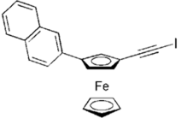
Dependence of retention factor of enantiomers and selectivity on the content of water in acetonitrile mobile phase
Content of water in the mobile phase, v/v | kS | kR | α
0 | 0.8008 | 2.9061 | 3.624
10 | 1.1304 | 6.0667 | 5.3668
20 | 2.8091 | 15.6605 | 5.575
30 | 7.0971 | 37.1019 | 5.2278
40 | 16.5109 | 84.8477 | 5.1389

Slide 20
Table 2.
Content of water in the mobile phase, v/v | ΔHs (cal/mol) | ΔH_{R} (cal/mol) | ΔH_{R-}ΔHs (cal/mol) | Δ_{S,R}ΔH (cal/mol) | ΔSs/R+lnΦ (cal/mol) | ΔS_{R}/R+lnΦ (cal/mol) | ΔS_{R}/R- ΔSs/R | Tiso (K)
0 | -2067/28 | -3595.84 | -1528.554 | -1528.49 | -3.7001 | -4.9887 | -1.2886 | 596.9036
10 | -2022.17 | -3524.1 | -1501.93 | -1501.79 | -3.2962 | -4.1506 | -0.8544 | 884.5154
20 | -2887.6 | -4152.25 | -1264.654 | -1264.71 | -3.7779 | -4.2111 | -0.4332 | 1469.137
30 | -1925.88 | -3114.94 | -1189.061 | -1188.98 | -1.2879 | -1.632 | -0.3441 | 1723.768
40 | -1351.16 | -2532.29 | -1181.132 | -1181.21 | 0.4981 | 0.1431 | -0.355 | 1674.866

Slide 21
Summary:
Increasing the water content in the mobile phase increases retention time of the enantiomers. At 20% water content selectivity factor is maximum.
In this experiment enantioseparation process was controlled by enthalpy.
The transition from enthalpic to entropic control occurs at such a high temperature that it couldn't be observed by high performance liquid chromatography analysis.
For the first substance Molar enthalpy for adsorbiton of individual enantiomers and isoenantioselective temperature were found to be optimal in the mobile phase containing 20% water.
Achieving the optimum of the chromatographic and thermodynamic parameters in ACN:water-80:20 mobile phase is very interesting and should be observed in the later stages of this research.

Slide 22
References:
¹V. Mamane, P. Peluso, E. Aubert, R. Weiss, E. Wenger, S. Cossu, P. Pale, Disubstituted Ferrocenyl Iodo- and Chal-cogenoalkynes as Chiral Halogen and Chalcogen Bond Donors, Organometallics 2020, 39, 3936–3950.
²A. Dessì, B. Sechi, R. Dallocchio, B. Chankvetadze, M. Pérez-Baeza, S. Cossu, V. Mamane, P. Pale, P. Peluso, Comparative Enantioseparation of Planar Chiral Ferrocenes on Polysaccharide-Based Chiral Stationary Phases, Chirality 2022, 34, 609–619.
³B. Chankvetadze, Recent Trends in Preparation, Investigation and Application of Polysaccharide-Based Chiral Stationary Phases for Separation of Enantiomers in High-Performance Liquid Chromatography, Trends Anal. Chem. 2020, 122, 115709.

Slide 23

Thank you for your attention !

