Slide 1
Ivane Javakhishvili Tbilisi State University
Nino Chapidze
Faculty of Exact and Natural Sciences, Department of Chemistry
Assessment Of Some Heavy Metal Content in the soils of Villages Talaveri, Udabno and The Tissues of Licorice using Microwave Plasma Atomic Emission Spectrometer
Supervisors:
Professor -Bezhan Chankvetadze
Assistant Professor-Nino Takaishvili
Tbilisi 2022

Slide 2
Heavy Metals Toxicity Mechanism
Inhibition of neurotransmitter release
binding to certain groups of enzymes and proteins(-SH) and inhibition of their activity
Heavy metals
replacement of a metallo-enzyme by another metal ion of similar size. For instance, cadmium can replace zinc in certain enzymes, leading to cadmium toxicity. .

Slide 3
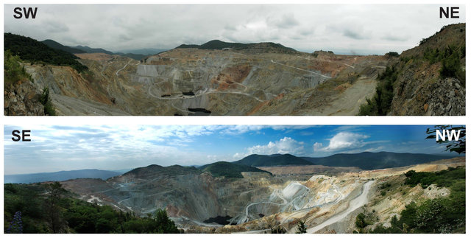
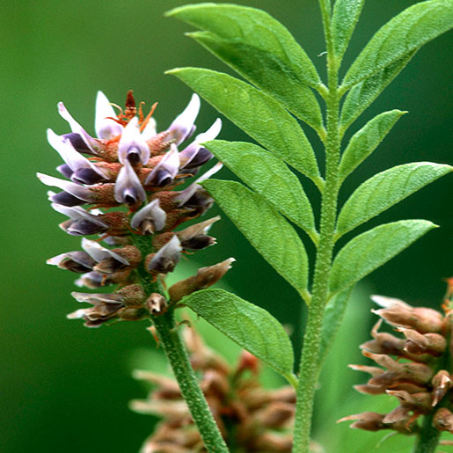
Goal of Analysis
Drawbacks Of Open-Cast Mining
Air Pollution-Heavy Dust Clouds
Destruction of Habitat
Water Consumption
Water Pollution
Soil Contamination with heavy metals
Panorama of the open pit in Bolnisi
“Madneuli”mining plant operates on the basis of copper-lead-zinc ores.

Slide 4
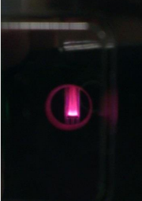
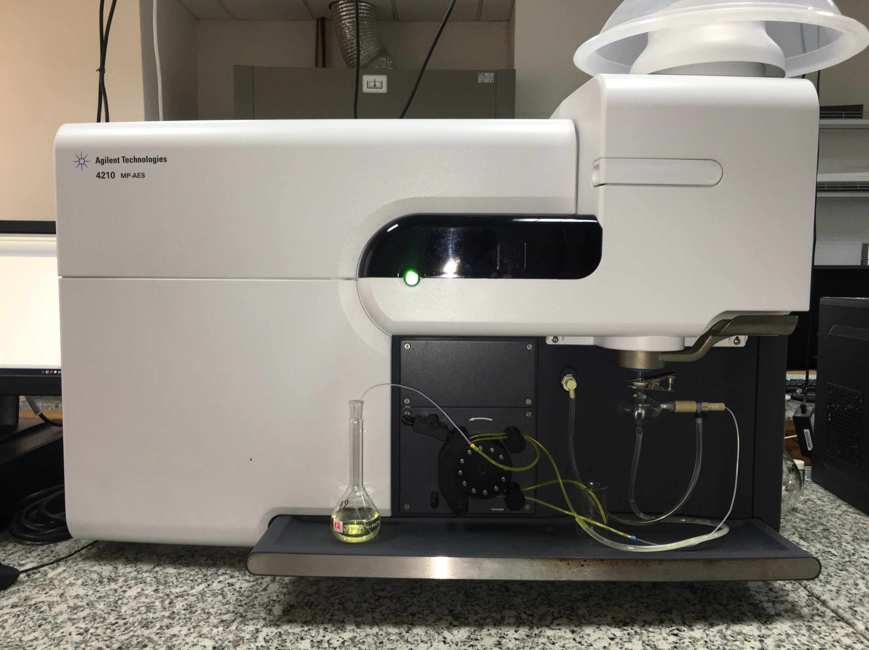
Instrumentation
Plasma viewing port
chimney
Pre-Optics window
Nitrogen Plasma
Torch
Nebulizer
4210 MP-AES
Spray chamber
Peristaltic pump
Waste for larger droplets

Slide 5
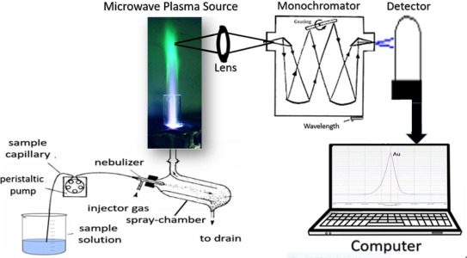
General Scheme

Slide 6
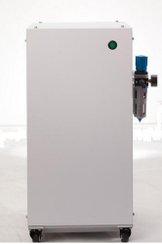
Comparison to FAAS
Agilent 4107 Nitrogen Generator
Low Maintanance
MP-AES runs on nitrogen extracted from the air
Improved Safety
Elimination of the usage of flammable gases like acetylene and propane
Improved Analytical Performance
Wider linear range and lower detection limits
Elimination of Chemical Interferences
Lower temperature and reactive atmosphere of flames are most likely to form molecular species. The presence of phosphate in the sample can alter the atomic concentration of calcium due to the formation of relatively nonvolatile complexes. Higher temperature of plasma (5000K) hinders this process
Simplified sample preparation
No need to add releasing agents like Sr or La or exctract metal from interfering material

Slide 7
Sample Preparation
Soil samples were cleaned of impurities, air dried, grinded and sieved until particles of less than 0.1mm in size were obtained.
Soil samples were further dried at 105-110°C to ensure the removal of moist.
1g of dried sample was placed in aporcelain crucible and dry ashed at 350-400°C in a muffle furnance for 1 hour to combust organic material.
The ash was wet digested with 20 ml aqua regia (3:1 mixture of HCl and HNO₃ and) and slowly evaporated to dryness on a hot plate. This procedure was repeated twice. 5 ml of concentrated HCI (diluted twice with deionized water) was added to the final residue, filtered through filter paper with pore size of 0.3μm and made up to 100 ml volume with deionized water.
Plant sample was washed with deionized water. Then its leaves, stem and roots were dissected , air dried and blended to homogenize the sample. 3 g of dried samples were taken and brought up to 50 ml volume employing the same preparation procedures.

Slide 8
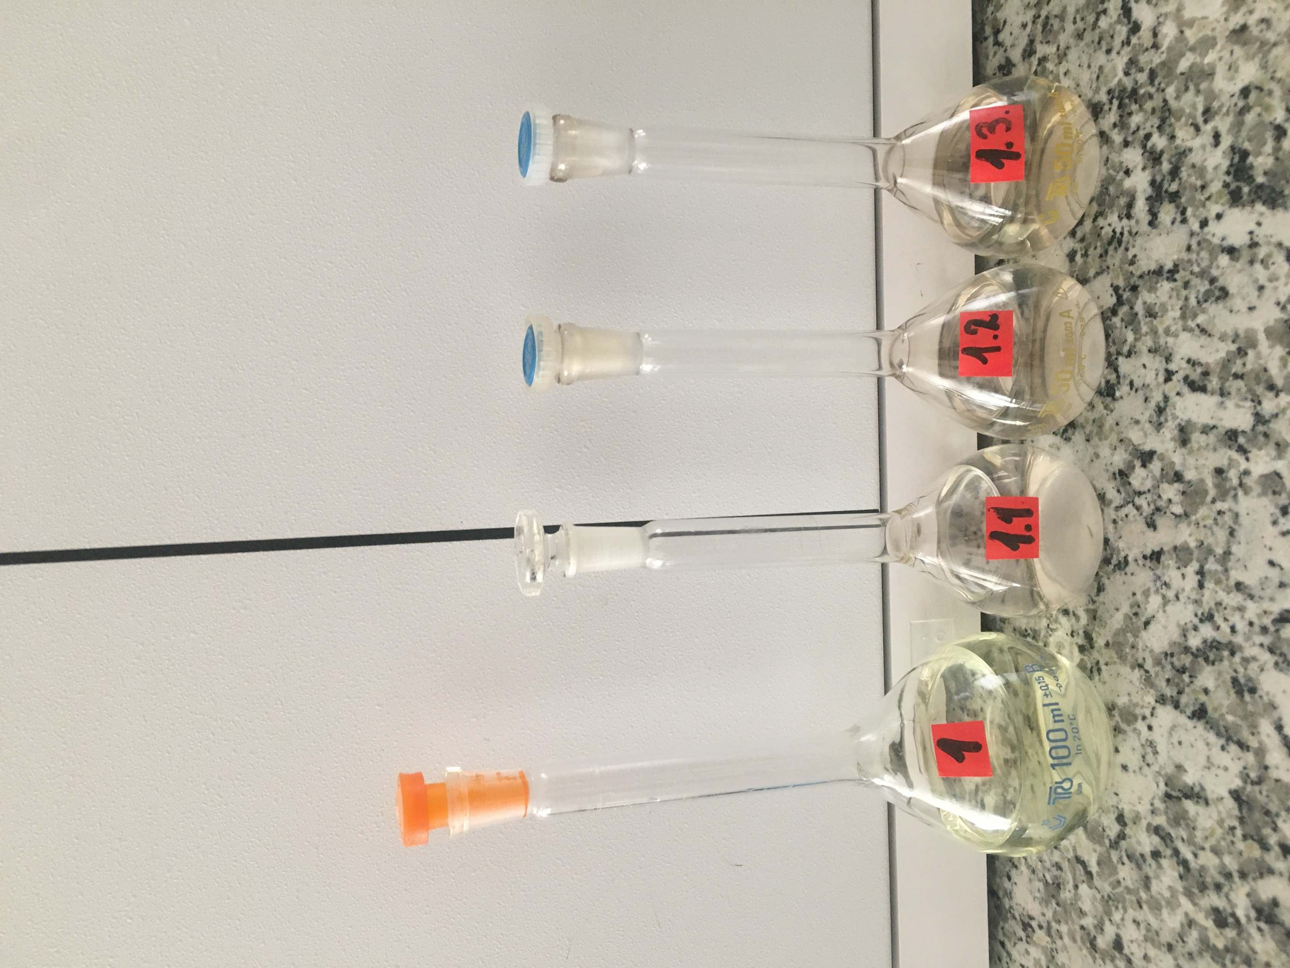
Sample Preparation
№1, 1.1, 1.2, 1.3, 1.4 Sample Solutions

Slide 9
Common Conditions
Elements | Wavelength(nm) | Detection Limit (μg/L)
Cu | 324.754 | 0.5
Zn | 213.857 | 3.1
Ni | 352.454 | 1.1
Mn | 403.076 | 0.2
Fe | 371.993 | 1.7
Cd | 228.802 | 1.4
Pb | 405.781 | 2.5
Parameter | Setting
Pump Speed (rpm) | 15
Sample Uptake Time(s) | 20
Stabilization Time(s) | 20
Number of Replicates | 3
Background Correction | FLIC
Calibration Fit | Linear

Slide 10
Sample Information
№ | 1 | 1.1 | 1.2 | 1.3 | 2 | 3 | 4 | 5
Sample | Village Udabno, Kakheti June,2022 | Licorice Roots June, 2022 | Licorice Stem June,2022 | Licorice Leaf June, 2022 | Bolnisi,Village Talaveri,0-30cm, Exp. 1 February 2022 | Bolnisi,Village Talaveri,30-60cm, Exp. 1 February 2022 | Bolnisi,Village Talaveri,0-30cm, Exp.2 February 2022 | Bolnisi,Village Talaveri,30-60cm, Exp. 2 February 2022
Standard Solution Concentrations for External Clibration
Cd (μg/ml) | Ni (μg/ml) | Zn (μg/ml) | Cu (μg/ml) | Mn (μg/ml) | Fe (μg/ml) | Pb (μg/ml)
0 | 0 | 0 | 0 | 0 | 0 | 0
0.005 | 0.005 | 0.05 | 0.2 | 0.5 | 1 | 0.01
0.01 | 0.01 | 0.1 | 0.4 | 1.0 | 2 | 0.05
0.05 | 0.05 | 0.5 | 0.8 | 2.0 | 3 | 0.1
0.1 | 0.1 | 1 | 1 | 5.0 | 5 | 1
1 | 1 | 2 | 2 | 6.0 |  | 2

Slide 11
Results and Data Analysis
Calibration Curves of Elements for Samples № 1 , 1.1, 1.2, 1.3
Zinc
Cadmium

Slide 12
Results and Data Analysis
Calibration Curves of E lements for Samples № 1 , 1.1, 1.2, 1.3
Copper
Nickel

Slide 13
Results and Data Analysis
Calibration Curves of Elements for Samples № 1 , 1.1, 1.2, 1.3
Lead
Iron

Slide 14
Results and Data Analysis
Calibration Curves of Elements for Samples № 1 , 1.1, 1.2, 1.3
Manganese

Slide 15
Results and Data Analysis
Content mg/kg
№ | Sample | Cd | Pb | Zn | Cu | Ni | Mn | Fe
1 | Udabno soil | 0.8 | 4.7 | 63.7 | 40.4 | - | 1056 | 36900
1.1 | Licorice Root | 0.05 | 7.9 | 15.25 | 19.1 | 3.65 | 14.8 | 155.5
1.2 | Licorice Stem | - | 8.0 | 6.22 | 10.4 | 0.96 | 14.1 | 48.1
1.3 | Licorice Leaf | - | 2.9 | 9.33 | 7.4 | 0.7 | 65.7 | 153.1
MPL in Soils |  | 0.5-2 | 20-30 | 100 | 55 | 85 | 1500
MPL in Medicinal Plants (WHO) |  | 0.3 | 10 | 50 | 20-150 | 1.5 | 200 | 200
MPL-Maximum Permissible Limit

Slide 16
Results and Data Analysis
Zinc (Zn)
Copper (Cu)
Root>Leaf>Stem
Root>Stem>Leaf

Slide 17
Results and Data Analysis
Nickel (Ni)
LEAD (Pb)
Root>Stem>Leaf
Stem>Root>Leaf

Slide 18
Results and Data Analysis
Iron (Fe)
Manganese (Mn)
Root>Leaf>Stem
Leaf>Root>Stem

Slide 19
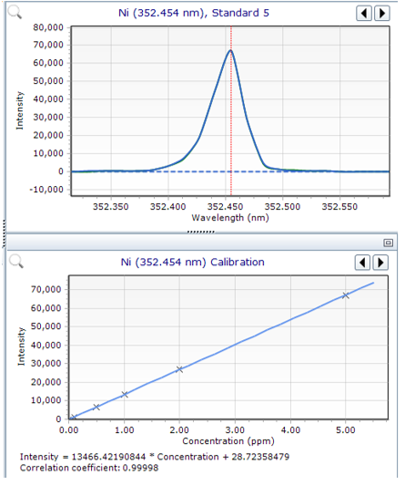
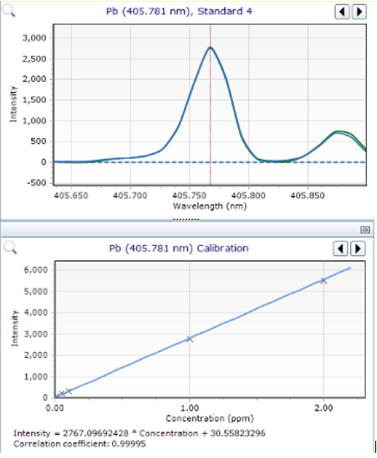
Results and Data Analysis
Calibration Curves of Elements for Samples № 7 , 8, 9, 10
Nickel
Lead

Slide 20
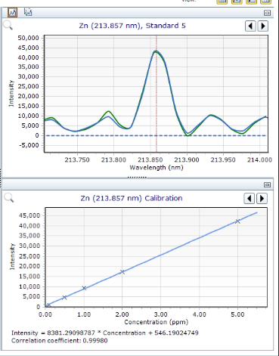
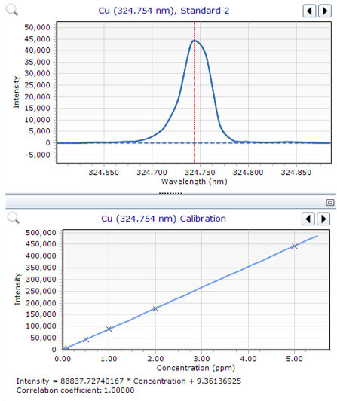
Results and Data Analysis
Calibration Curves of Elements for Samples № 7 , 8, 9, 10
Zinc
Copper

Slide 21
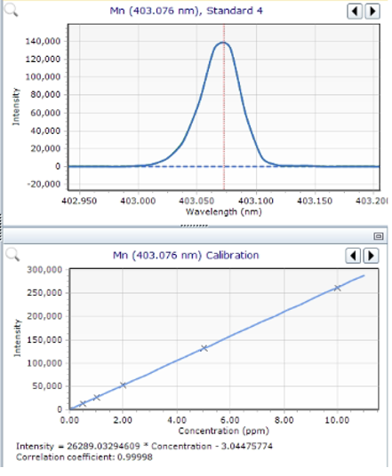
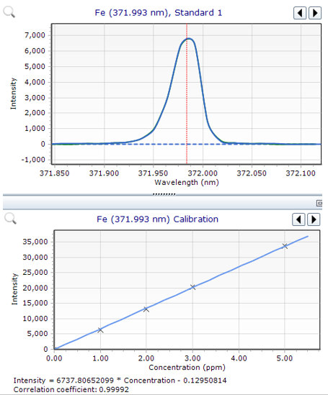
Results and Data Analysis
Calibration Curves of Elements for Samples № 7 , 8, 9, 10
Manganese
Iron

Slide 22
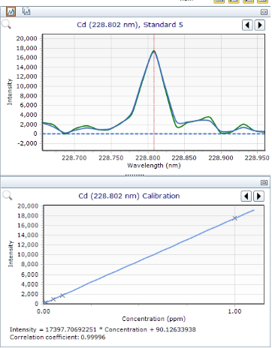
Results and Data Analysis
Calibration Curves of Elements for Samples № 7 , 8, 9, 10
Cadmium

Slide 23
Results and Data Analysis
Content mg/kg
№ | Sample | Cd | Pb | Zn | Cu | Ni | Mn | Fe
2 | Bolnisi, Village Talaveri, 0-30cm, Exp.1 | 1.8 | 6.0 | 112.0 | 84.0 | 63.0 | 900.0 | 38.30
3 | Bolnisi Village Talaveri, 30-60cm, Exp.1 | 0.98 | 4.0 | 72.0 | 41.0 | 54.0 | 770.0 | 34.90
4 | Bolnisi, Village Talaveri,0-30cm, Exp.2 | 0.6 | 3.0 | 86.0 | 59.0 | 61.0 | 900.0 | 37.00
5 | Bolnisi, Village Talaveri, 30-60cm, Exp.2 | 0.4 | 2.0 | 72.0 | 48.0 | 52.0 | 790.0 | 34.40
MPL in Soils |  | 0.5-2 | 20-30 | 100 | 55 | 85 | 1500
g/kg

Slide 24
Summary
Industrialization and human activities have increased our exposure to heavy metals and harmful substances,which inspired our analysis. From the obtained results, we can conclude that territories in close proximity to mining sites can be affected at some extent , thus further research is necessary to provide us with more detailed explanation of mechanisms of heavy metal distribution and accumulation in the biome.

Slide 25
References
G. Supatashvili, Environmental Chemistry, Tsu, 2009
Baba, H. S. and Mohammed, M. I. Determination of Some Essential Metals in Selected Medicinal Plantshttps://www.ajol.info/index.php/csj/article/view/209959/197947
WHO- guidelines for assessing quality of herbal medicines with reference to contaminants and residuehttps://apps.who.int/iris/handle/10665/43510
Donald M. West, Douglas A. Skoog, F.James Holler, Stanley R. Crouch- Fundamentals Of Analytical Chemistry, 9th edition

Slide 26
Thanks For Attention!
¯\_(ツ)_/¯

