Slide 1

Problems Of Methane Explosion And Blast Energy Suppression In Coal Mines
Nini Kvintradze
Bachelor Student,
Department of Engineering Physics, GTU

Slide 2


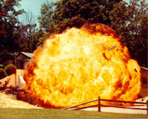
The Challenges Of Coal Producing Mines
Almost every year methane explosions happen in coal mines and have fatal outcomes
In spite of existing standards and strict regulations, such accidents are not avoided
Existing means of protection have low level of effectiveness against minimization of negative consequences

Slide 3
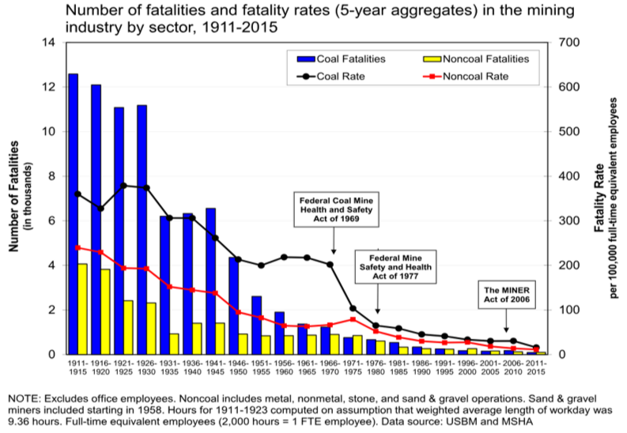
How Dangerous Can Methane Explosions Be?

Slide 4
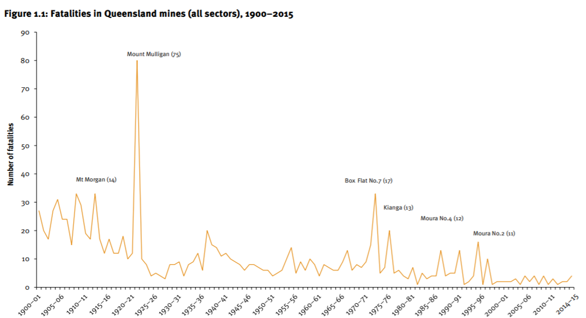

Slide 5
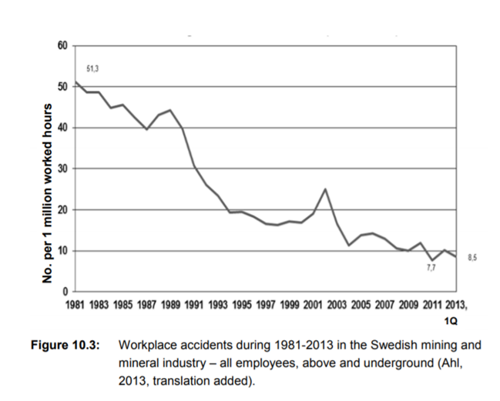

Slide 6
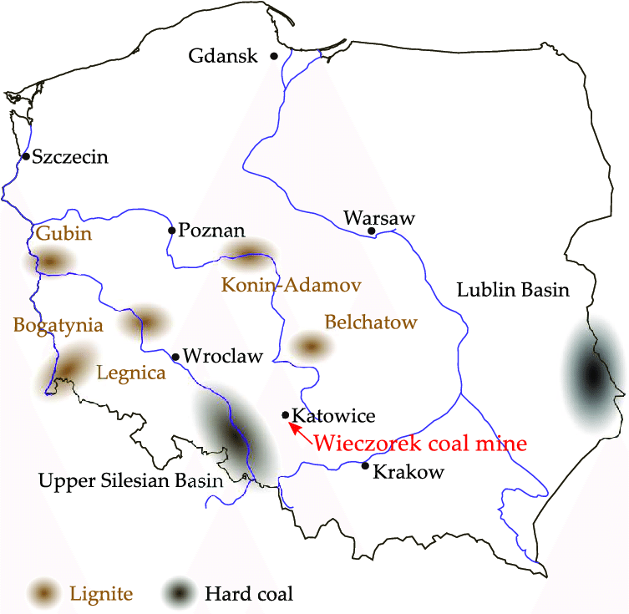
Statistics Of Fatal Outcomes
Statistics of fatal outcomes in 2022 and 2021,USA
From January 7, 2022 till September 1, 2022 – 20 fatal outcomes
From January 16, 2021 till December 13, 2021 - 37 fatal outcomes
Fatality Reports _ Mine Safety and Health Administration (MSHA).html
Statistics of fatal outcomes in Poland
2014 – 5 dead
2013- 3 dead
2022, 20-21 April-9 dead
2022, 23 April-10 dead
2021, 5 March-2 dead
Poland remains by far the largest hard coal producer in Europe.

Slide 7
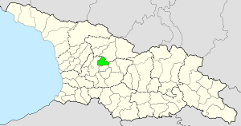

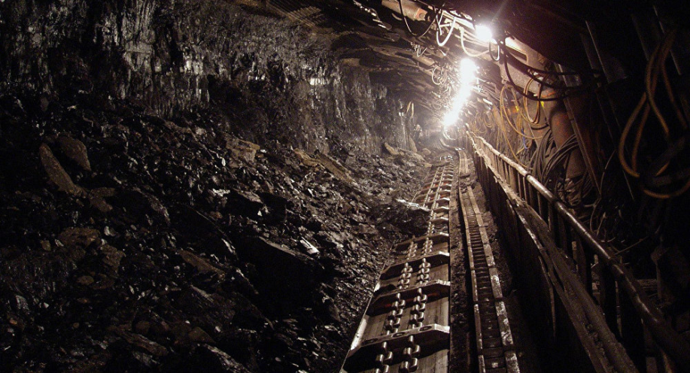
Coal Mine in Tkibuli
Exploitation since 1846
Tkibuli, Georgia: Shafts/mine-Methane Explosions- fatal outcomes
2014 - 2 Dead, 4 injured;
2015 - 1 Dead;
2016 - 1 Dead;
2018 , April 5 - 6 Dead, 3 injured;
2018, July16 - 4 Dead, 6 injured.

Slide 8
Standards And Existing Means Of Protection
Regulations
1969; USA- Federal Low for mining safety and health
1995; International Labor office - Safety and Health in Mines Convention
Other documentations in European Union improved the safety conditions in Mines
impact: rapidly reduced the fatal results and improved safety

Slide 9
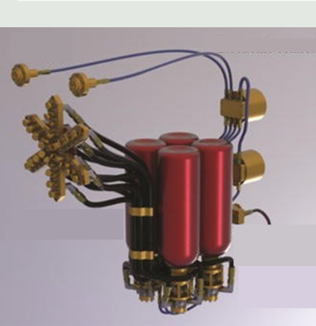
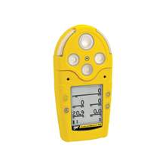
Existing protective systems which are used in coal mines
Active explosion barrier
How can methane explosion be prevented
adequate ventilation
regular monitoring of gas concentrations
the elimination of ignition sources.
Methane Detector

Slide 10
What Problems We Should Fix To Prevent Fatal Outcomes?
Problems of detection and prevention of methane explosion
Problems of fast identification of explosion
Problems of suppression of blast energy, generated by methane explosions
. It requires the complex multidisciplinary study of many units. This is possible only based on fundamental laws of physics, thermodynamics, hydrodynamics and mechanics.

Slide 11
Goals and directions of scientific research
main directions of scientific research
Elaboration of methods for fast identification of Explosions, fires and other provoking factors and quick information delivery adequate actions
Developing and Designing of protective systems and their testing
Goal
Reliable protection of people and infrastructure from explosions and fires.

Slide 12
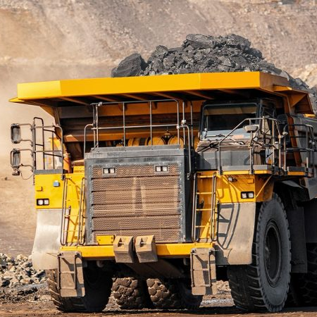
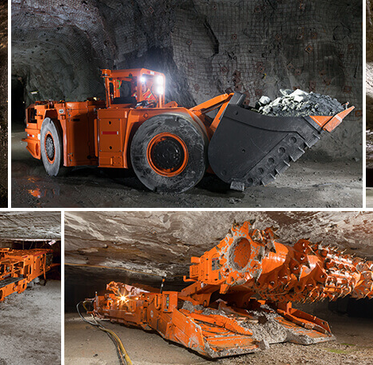
Requirements for advancing and developing protective systems
Qualified workers
human resources
significant knowledge of key subjects engineering, physics

Slide 13

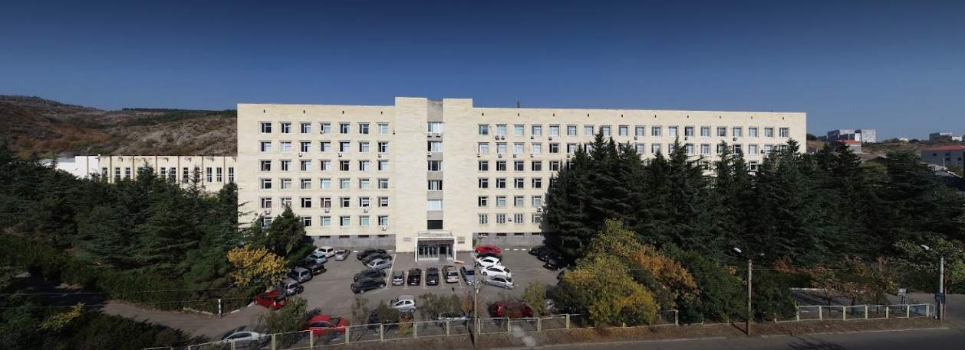
Research group
The group of scientists at G.Tsulukidze mining institute of Georgia is working on the development of modern energy suppression systems.
which will enable to reduce the negative consequences from accident explosions in underground structures. The mentioned systems are developed headed by Dr. E. Mataradze, in collaboration with US partner prof. T. Krauthammer.

Slide 14
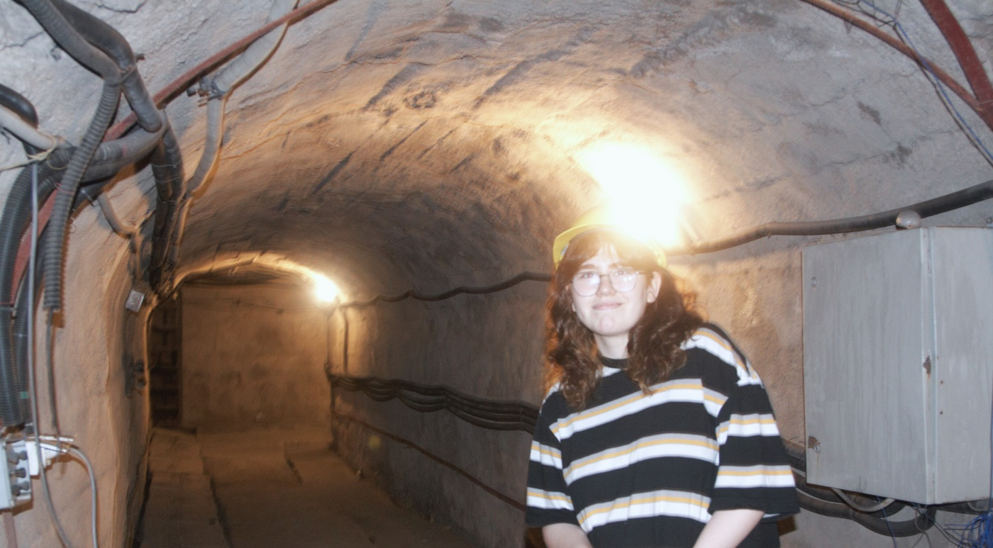
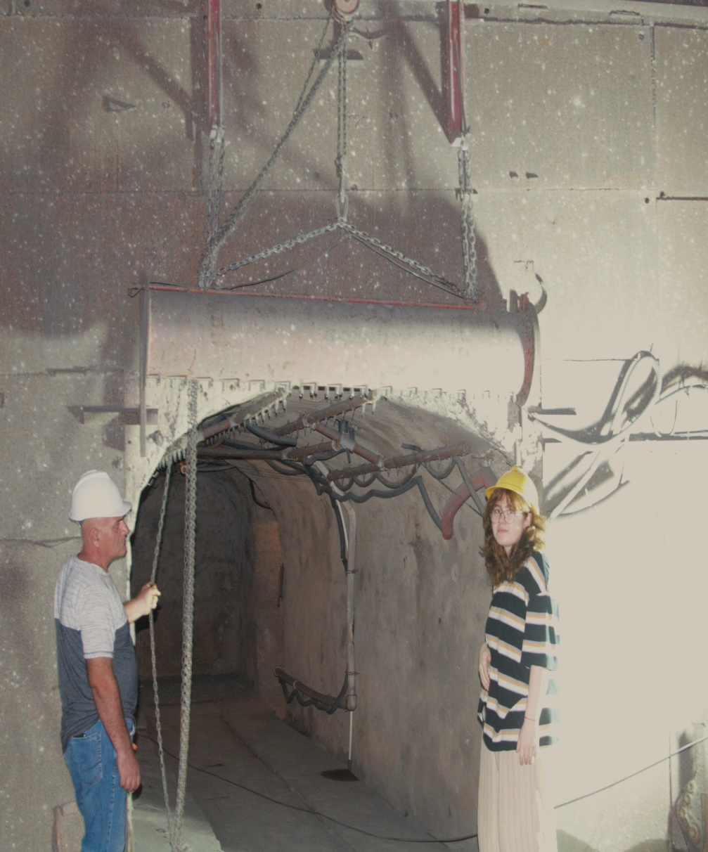
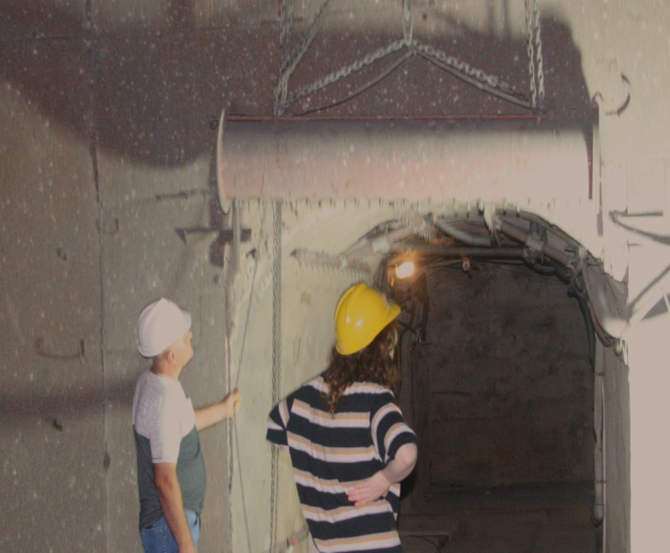
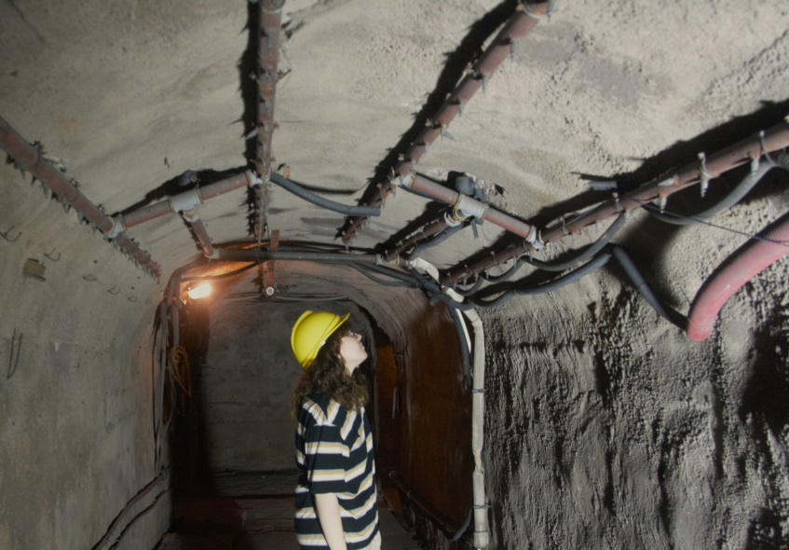

Slide 15
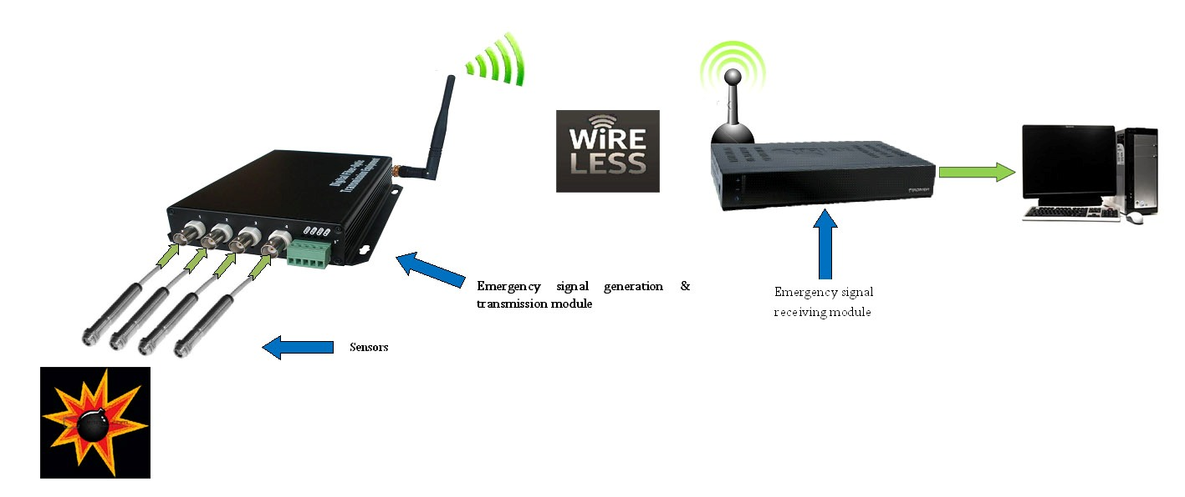
Requirements for protection systems:
Fast acting
Efficiency (Reduction of overpressures )
Reliability
General principle scheme
3
2
1
Sensors
2) detection and transmission module
3) emergency signal receiving module

Slide 16
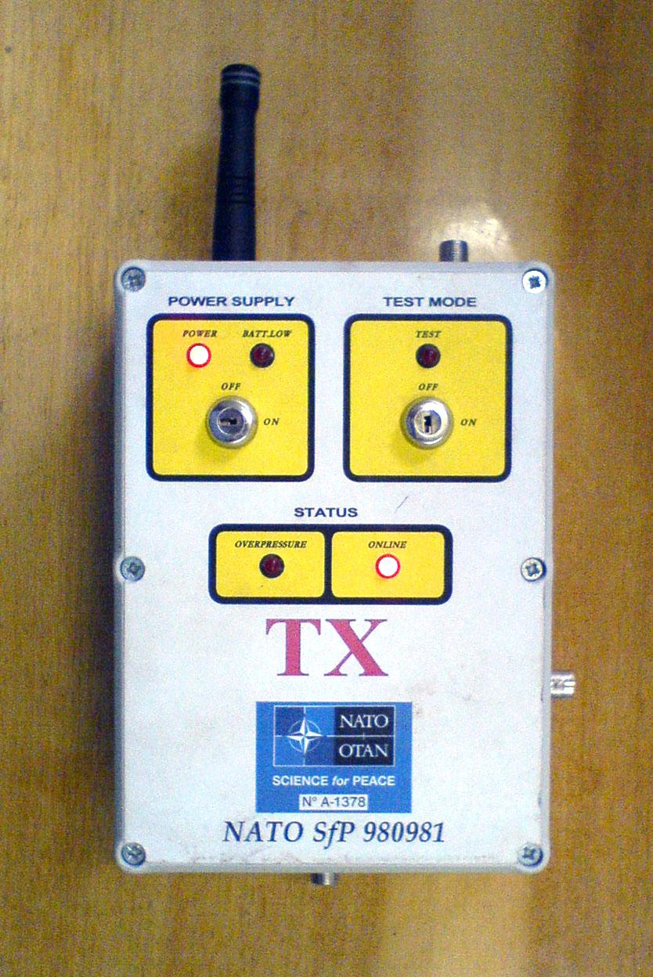
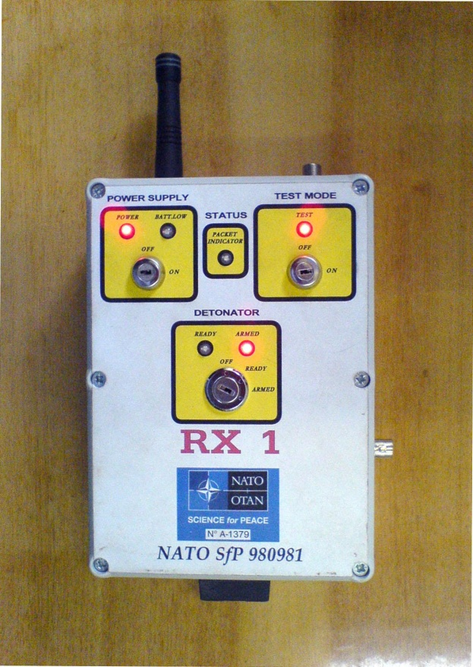
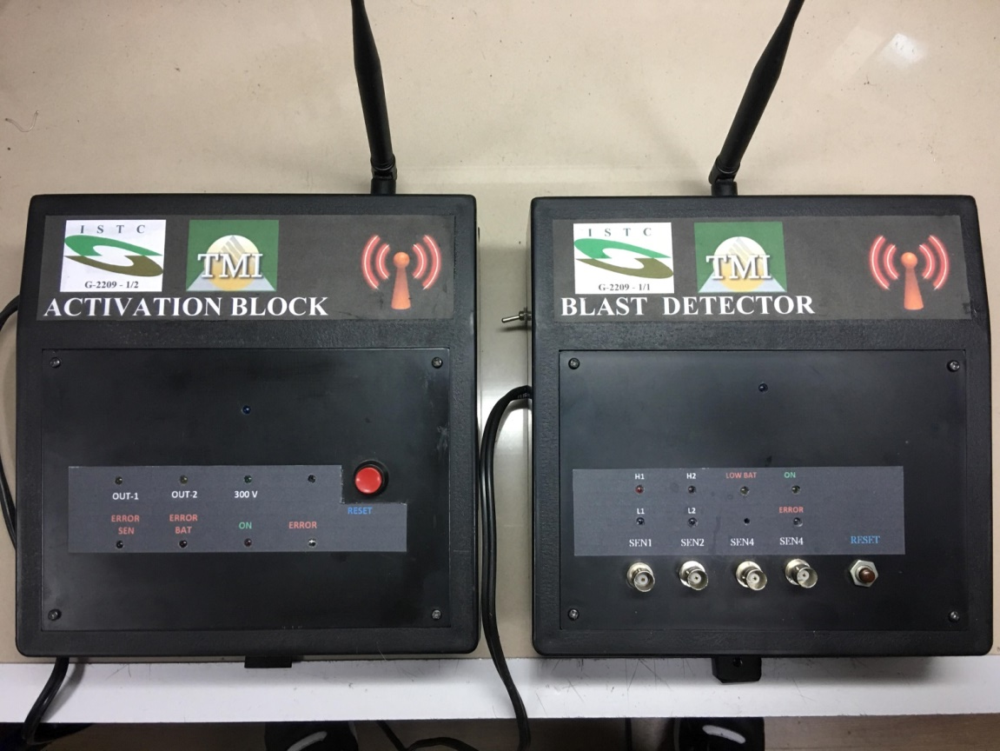
Detection/ identification module

Slide 17
Protective devices
Water Spray at high speed: 50-70 m/s

Slide 18


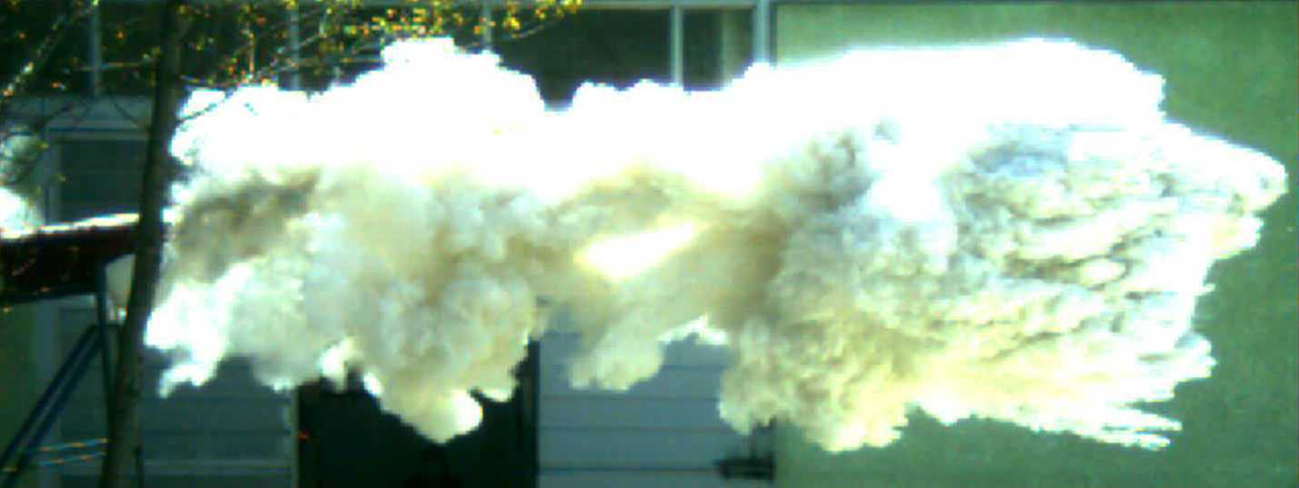
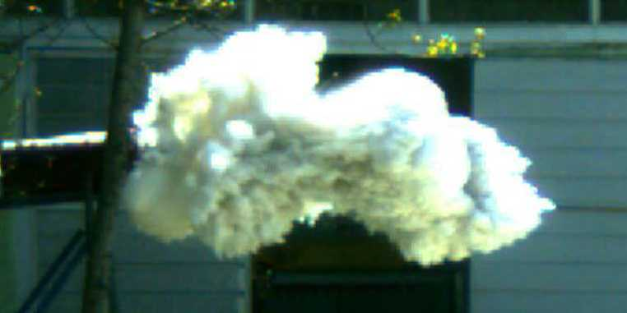
Inert Powders: 30 kg
Velocity: (30-40) m/s

Slide 19
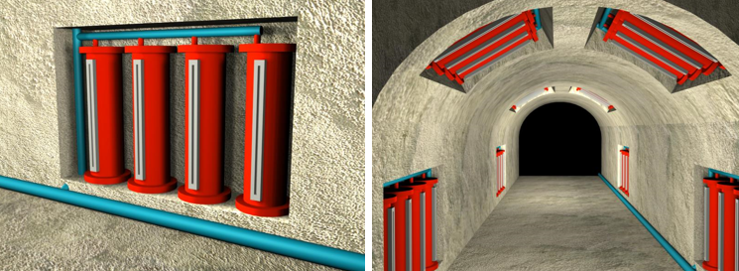
Layout plan of protective devices in Tunnels

Slide 20

Why is this important?!
Its important to improve key parameters (problem identification, explosion detection, energy suppression devices: creation, development, improvement.)
Developing devices in order to minimize injuries or fatal outcomes is vital. Advanced devices will help to keep infrastructure safe under low risk of methane explosion Above described problems are typical and artificial for Georgia as well

Slide 21
Future Plans, Interests
Interest in Physics and Engineering
Status Now : 3rd Year Bachelor Student
Possible options at the department / Degree:
“Engineering Physics”
“Medical Physics”
Future Plans: Master ----------> Ph.D
in: Medical Physics, Engineering Physics, or other Related direction.

Slide 22
THANK YOU FOR LISTENING!!!

