Slide 1
Contribution to the
SMART | EDM_Lab
POLARIMETER - SMART EDM_LAB
EMPIRE NUCLEAR MODEL CALCULATIONS - INM5 (Forschungszentrum Jülich)
Ninea Anasovi
GGSB 2022
15/09/2022

Slide 2
ABOUT ME
I am second year masters student of Electrical & Computer Engineering department of Agricultural University of Georgia
I work at SMARTLAB in Tbilisi, where I mostly do digital signal processing and data analysing
www.agruni.edu.ge

Slide 3
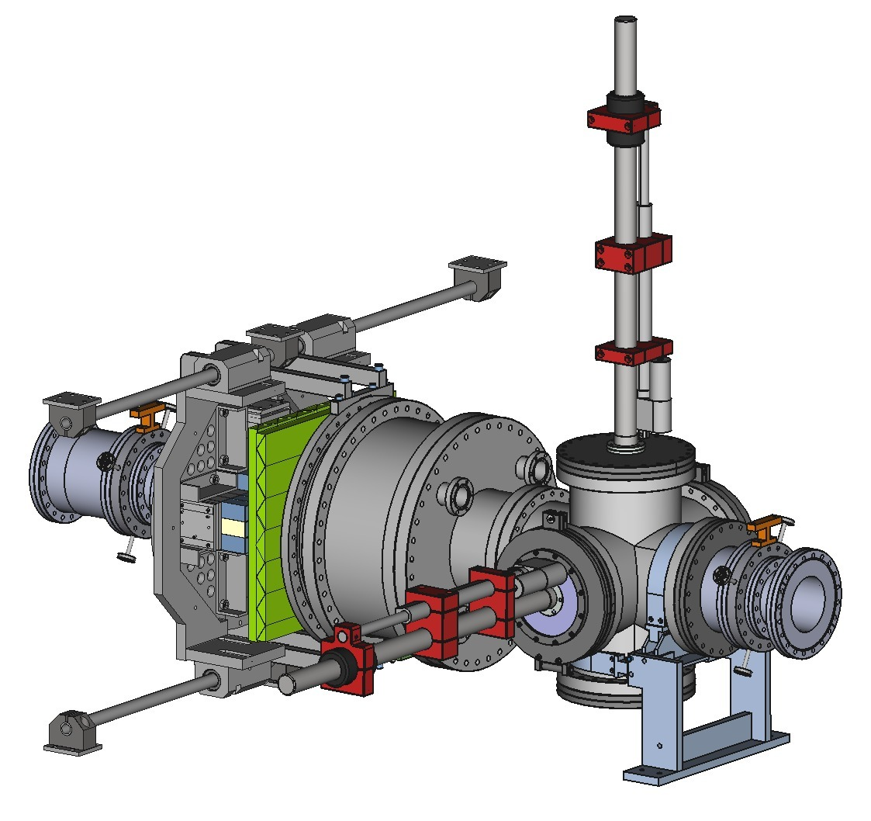
POLARIMETER
Tracking scintillators
Long scintillator bars with triangular cross section are stacked to form a flat wall
Each bar is read out independently
Read out path: SiPMs, analog amplifier and sampling ADC
Proportion between signal amplitudes of neighboring bars in the wall provides correction on particle hit coordinate
Notes:
In Smartlab I worked on a polarimeter improvement project, these polarimeters are used in COZY accelerator’s beam line. Polarimeters most important part is calorimeter that is already created and installed, We were working on tracking part of this project. This technology uses plastic scintillators as sensors. We were testing the newest design that can increase accuracy. We have a triangular-shaped scintillator that should be researched.

Slide 4
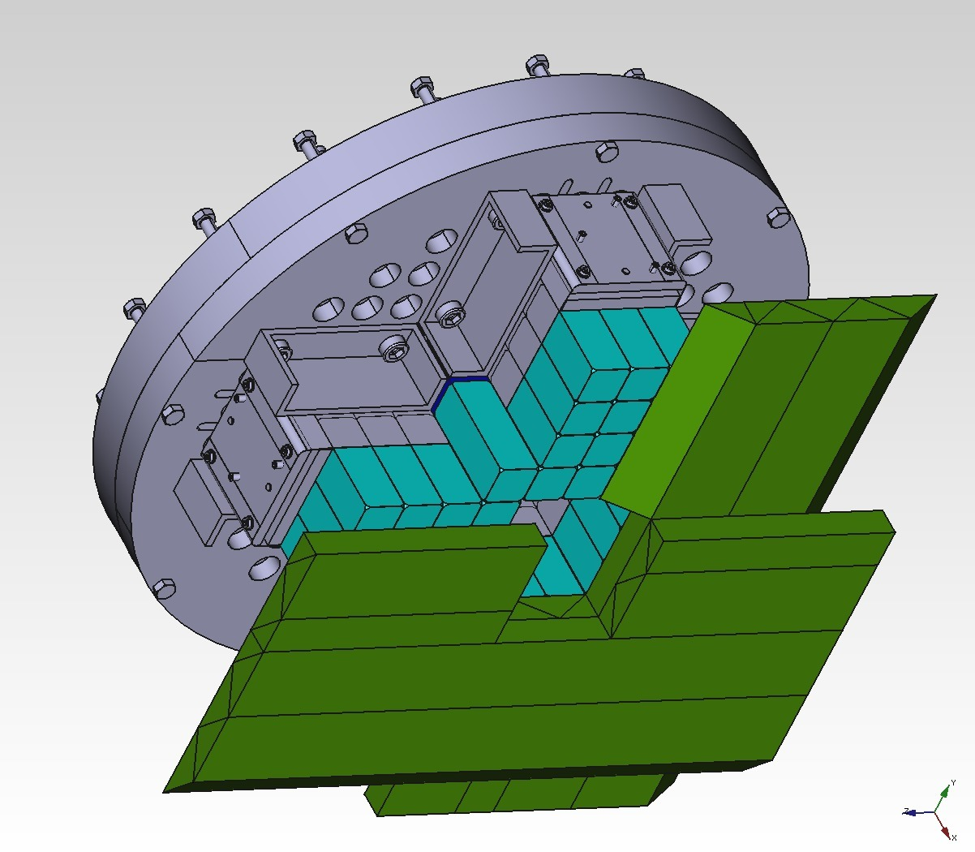
POLARIMETER
Calorimeter part
Two such walls will be employed
Vertical (X-coordinate) and horizontal (Y-coordinate)
Better tracking = better estimation of the scattering angles
Can we estimate hit coordinate along the bar using signal timings at both ends?
Notes:
Those scintillators are placed in a particular order where it creates a grid, and when the projected particle hits the grid on both ends of the scintillator there are signal amplifiers and flash ADC gets the input. Through The research, we have gathered lots of data, starting with cosmic beams, and later we have used the LED light in 3 different positions of the scintillator. The main purpose of this experiment is to digitally process the signal output to increase the precision of measurements.

Slide 5
TRACKING SCINTILLATOR TESTS
Goal: Investigate time characteristics of the triangular bar and methods to obtain precise relative times between the two sides
During the lab tests:
Both sides were read out by sampling ADCs (Redpitaya)
Cosmics used for signal characterization
LED flasher at 3 different positions used for longitudinal coordinate estimation tests
Obtained data analyzed using CFD methods (direct and modified, using MAWs)
Triangular bar
LED flasher
SiPMs + amplifier

Slide 6
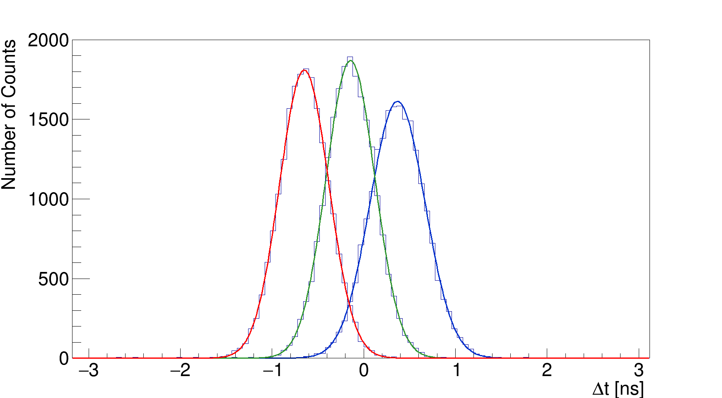
POLARIMETER
Relative time measurement at 3 positions
As a consistency check, the speed of light propagation in the plastic was estimated: 0.196 +/- 0.001 m/ns (β = 0.655)
Peak positions and their errors (not sigma parameters) are used in the calculation.
position 1
position 2
position 3
To be investigated:
Effects of amplifier boards, their noise and different gain settings on precision
Different scintillator wrapping techniques
Notes:
For now, we have some results of our experiment, but it needs further development. Based on the measurement data, the speed of light in the plastic, measured between points 1 and 3 appeared to be 0.196 +/- 0.001 m/ns (beta = 0.655)
Peak positions and their errors (not sigma parameters) are used for the calculation.
And this result is pretty good for the material that has been tested.

Slide 7
NUCLEAR DATA SIGNIFICANCE
Knowledge of nuclear data is vital for the different fields of science. They play an important role in nuclear medicine, e.g. radiotherapy and diagnostics, developing technology, nuclear safety as well as fundamental physics.
Aspects of nuclear data are as diverse as their applications, including:
reaction probabilities (cross-sections) and scattering
energies of emitted particles
formation of different fission fragments
decay processes
Data need to be evaluated to rule out false results and to assess total uncertainties
In order to address all aspects of nuclear data, different models and codes were developed to calculate nuclear reaction data.

Slide 8
EMPIRE
“EMPIRE 3.2.3 malta” is an advanced nuclear reaction modelling code
EMPIRE combines various theoretical mechanisms based on input parameters
EMPIRE calculates the extended set of observables in a single run.
It consists of FORTRAN and python codes, alongside experimental data and input parameter libraries.

Slide 9
AIM OF WORK
This project is done within the framework of the “Georgian-German science bridge” Collaboration. The work done between 06.06.2022 and 10.07.2022 was in preparation of a Master Thesis scheduled for February 2023 with the title “Charged particle induced reactions on Tc-99: nuclear model calculations and experimental measurements”.
There are only a few data on charged particle induced reactions on ⁹⁹Tc due to its rarity, and investigation of this isotope will be very interesting.
The focus of this work will be on proton induced reactions to be calculated.
In the scope of the upcoming Master Thesis, this work shall be complemented by experimental measurements at the cyclotron of the INM-5

Slide 10
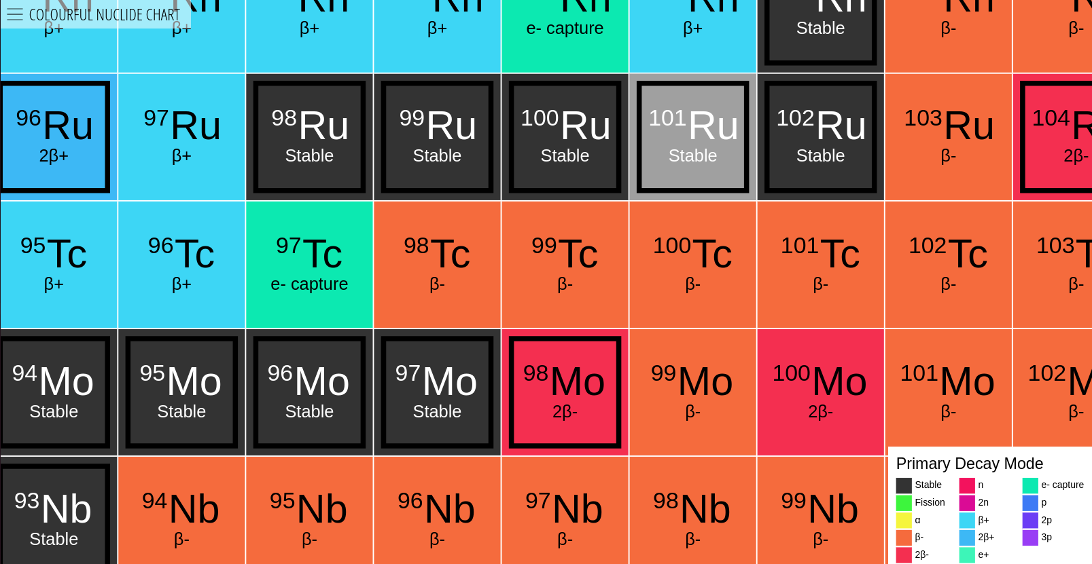

Slide 11
COMPOUND NUCLEAR REACTIONS
Product
⁹⁹Tc
p
Projectile
Target
Compound nucleus
Emitted Particle

Slide 12
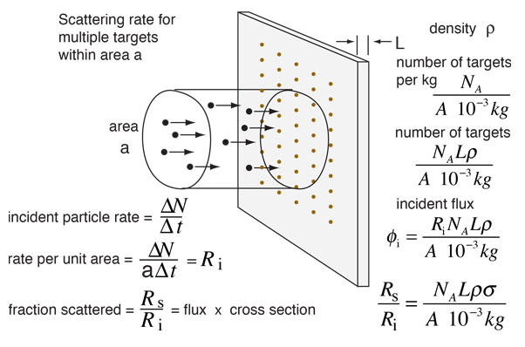
NUCLEAR REACTION CROSS SECTIONS
From experimental point of view

Slide 13
HOW EMPIRE CALCULATES REACTION CROSS-SECTIONS
k is the wave number of relative motion
i , I, J and S indicate projectile, target, compound nucleus, and channel spin
l is the orbital angular momentum of the projectile a
The function f(l, π) ensures parity conservation

Slide 14
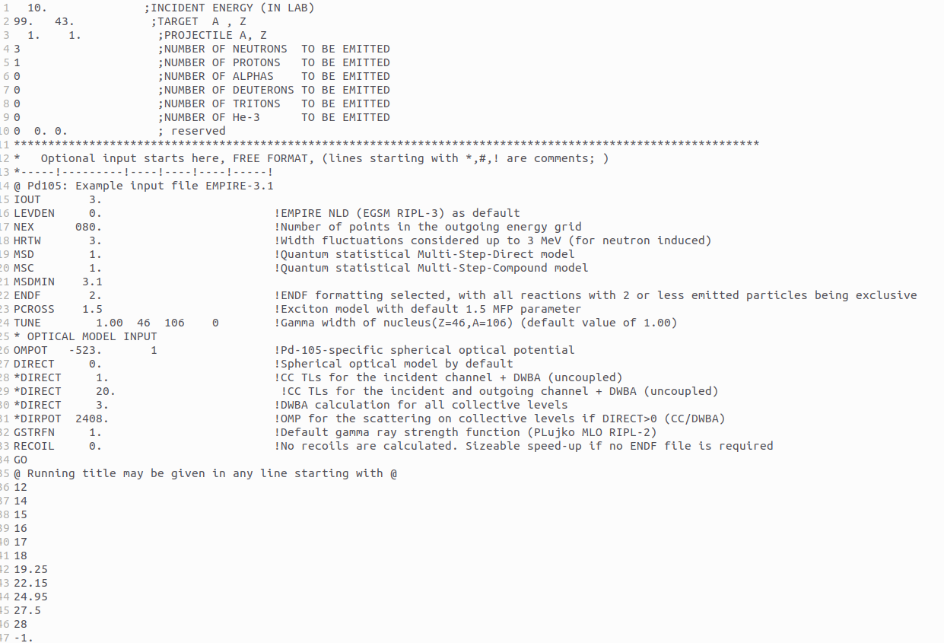
INPUT FILE

Slide 15
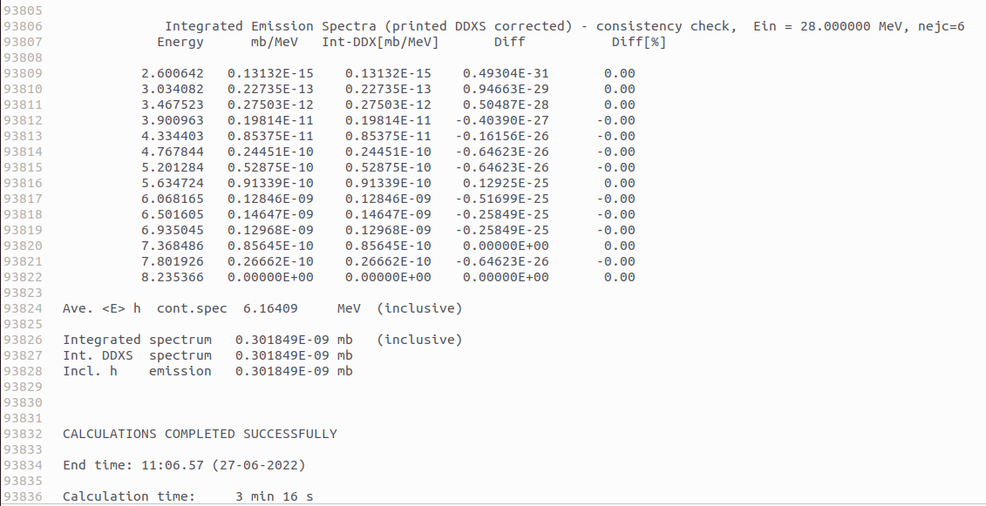
OUTPUT FILE

Slide 16
KEYWORDS IN OUTPUT FILE
Contained Data | Keyword
Input Energy | “(LAB)”
Cross Section | "reac: ("

Slide 17
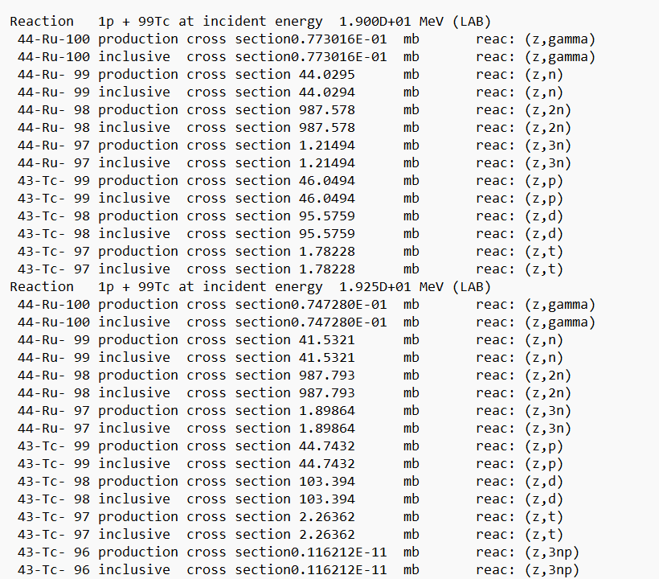
RESULT OF OUTPUT FILTERING

Slide 18
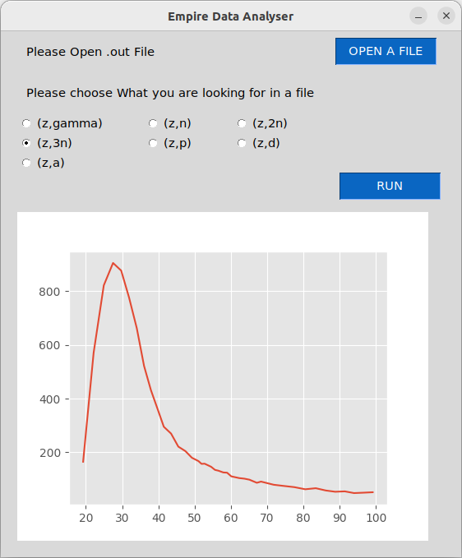
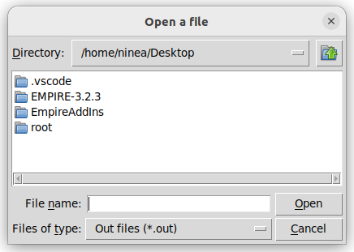
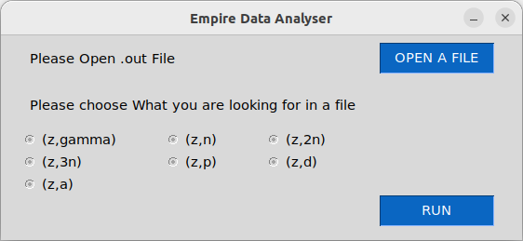
USER INTERFACE

Slide 19
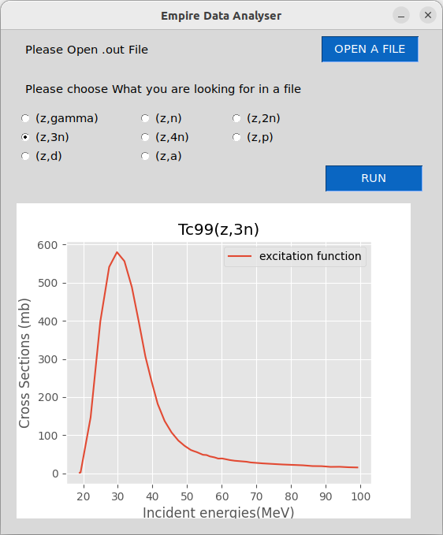
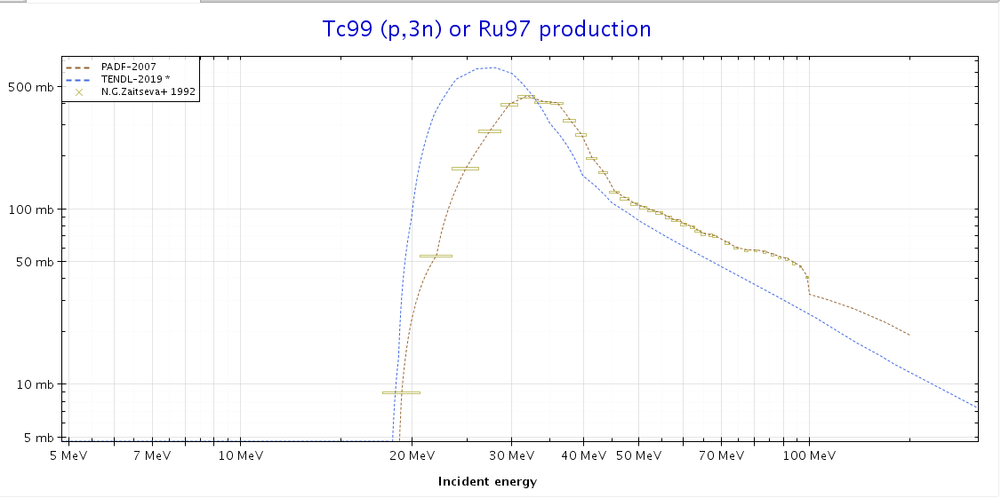
JANIS DATA VS EMPIRE SIMULATION

Slide 20
FUTURE STEPS
Measurement of experimental data at the cyclotron of INM-5.
Calculating additional reaction channels and consideration of other projectiles
Improve the interface of the EMPIRE AddIn by only choosing options that are available for the input file provided and not all possible options.

Slide 21
THANK YOU
FOR YOUR ATTENTION
Ninea Anasovi

Slide 22
BIBLIOGRAPHY
http://hyperphysics.phy-astr.gsu.edu/hbase/Nuclear/crosec.html
https://www.oecd-nea.org/jcms/pl_23149/nuclear-data-evaluation
https://www-nds.iaea.org/EMPIRE/index.html
https://www-nds.iaea.org/EMPIRE/Resources/EMPIRE.pdf
https://www.oecd-nea.org/jcms/pl_44624/janis-books

