Slide 1
DETERMINATION OF HEAVY METALS CONTENT IN THE ROOTS OF LICORICE AND VALERIANA BY MICROWAVE PLASMA ATOMIC EMISSION SPECTROMETRY
Bachelor’s student – Natia Tchanturia
Ivane Javakhishvili Tbilisi State University, The Faculty of Exact and Natural Sciences, Department of Chemistry
Supervisors: Prof. Bezhan Chankvetadze & Assistant-Professor - Nino Takaishvili
16/09/2022
1

Slide 2
HEAVY METALS THAT WE STUDIED
Cd
Pb
Zn
Cu
Ni
Mn
Fe
16/09/2022
2

Slide 3
Damages antioxidants
Heavy metals such as Cd, Pb, Zn,
Cu, Ni, Mn, Fe
Enzyme inhibition
Apoptosis (Programmed cell death)
Reactive oxygen species (ROS) Production
Alter biological pathways
Lipids
DNA
Proteins
Membrane damage by lipid peroxidation
Loss of DNA repair mechanism
Protein dysfunction
16/09/2022
3

Slide 4
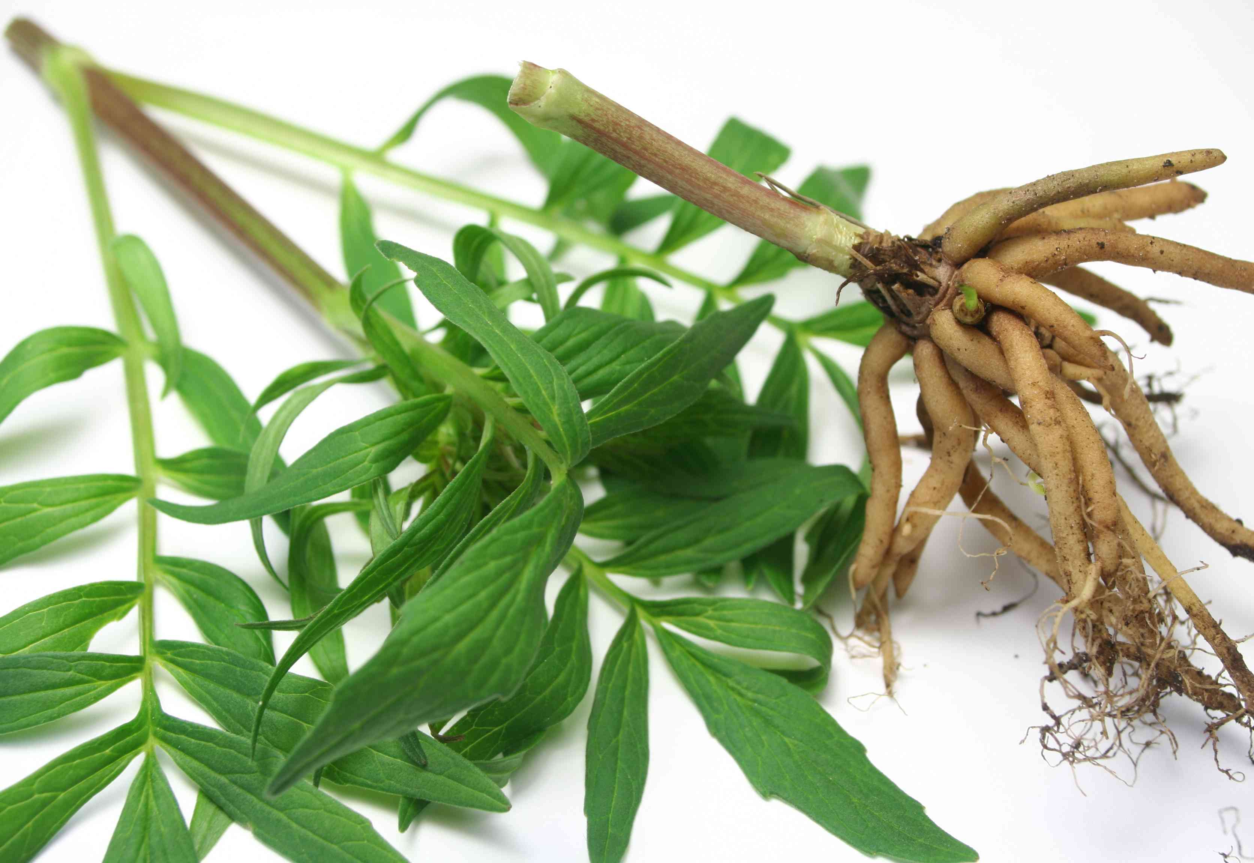
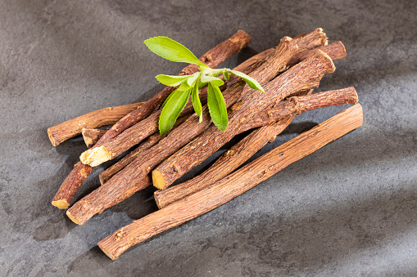
Some Medicinal Plants
Valeriana
Valeriana
Roots
Licorice
Licorice Roots
16/09/2022
4

Slide 5
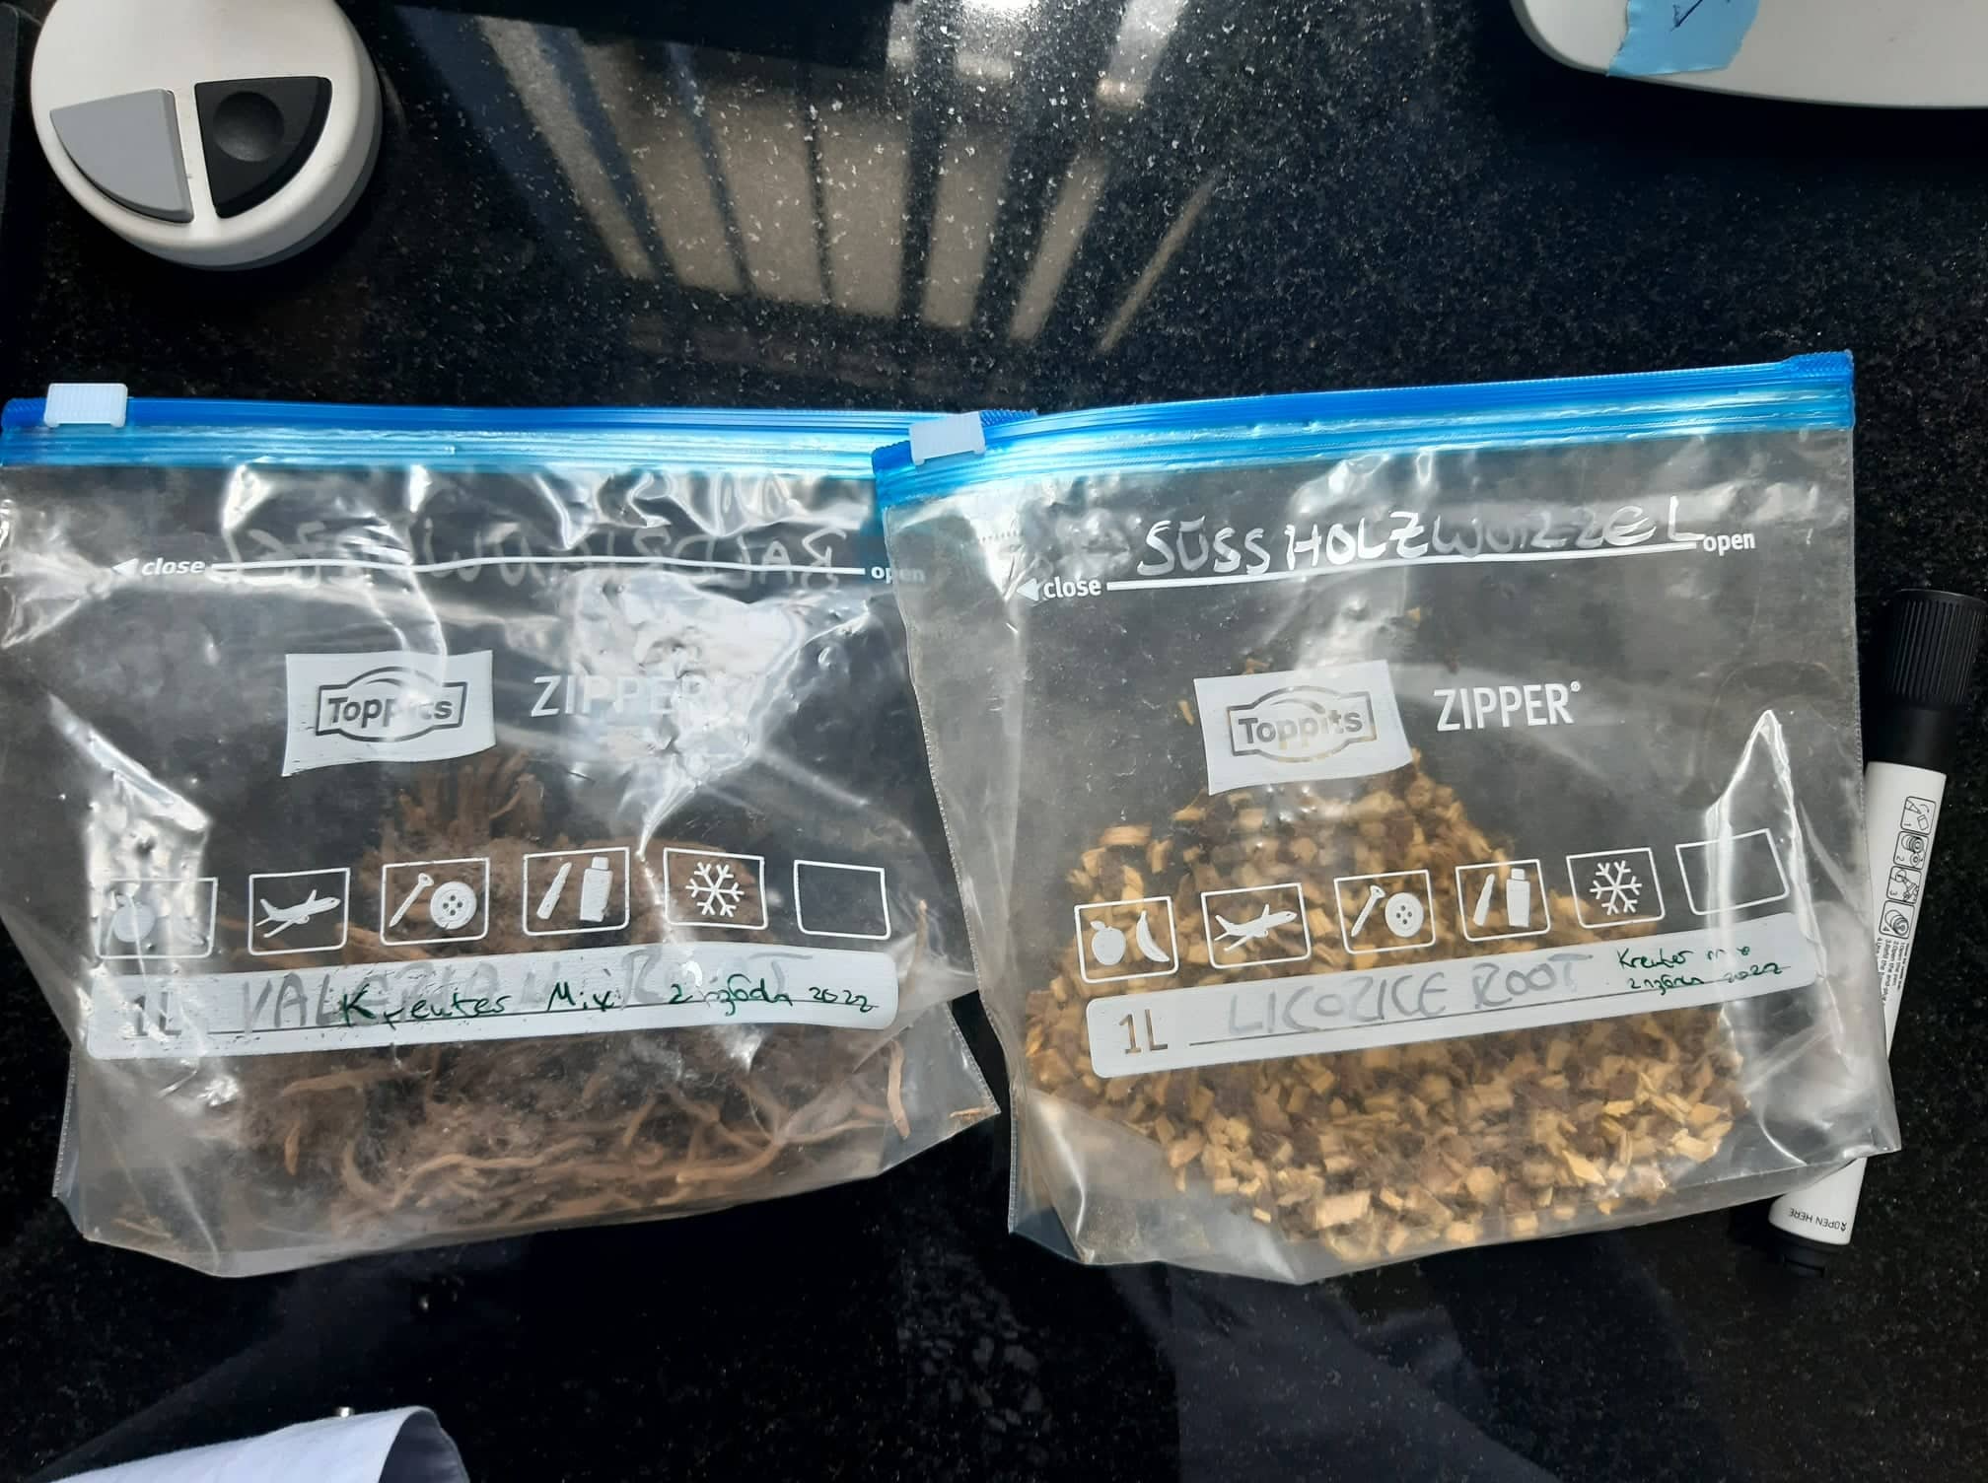
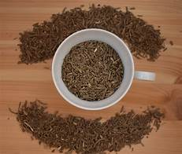
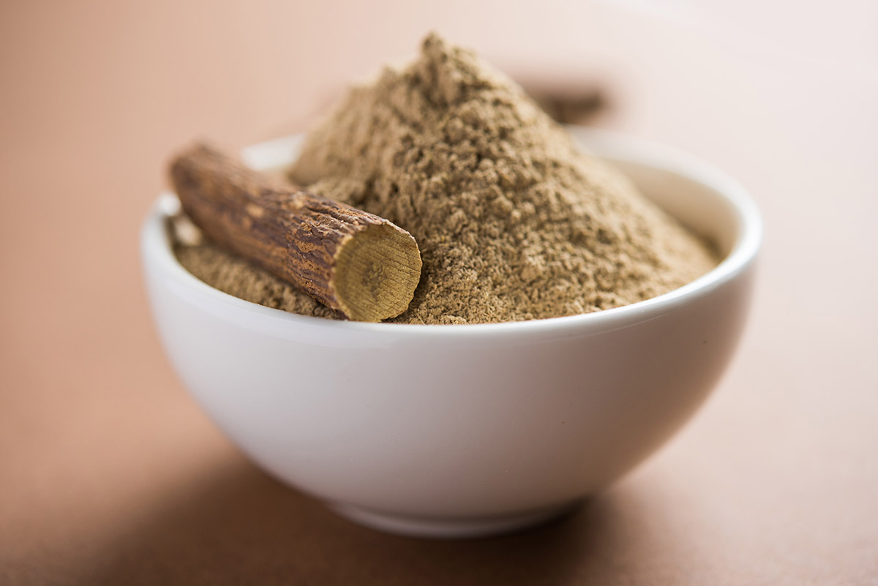
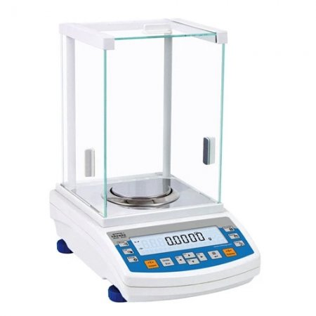
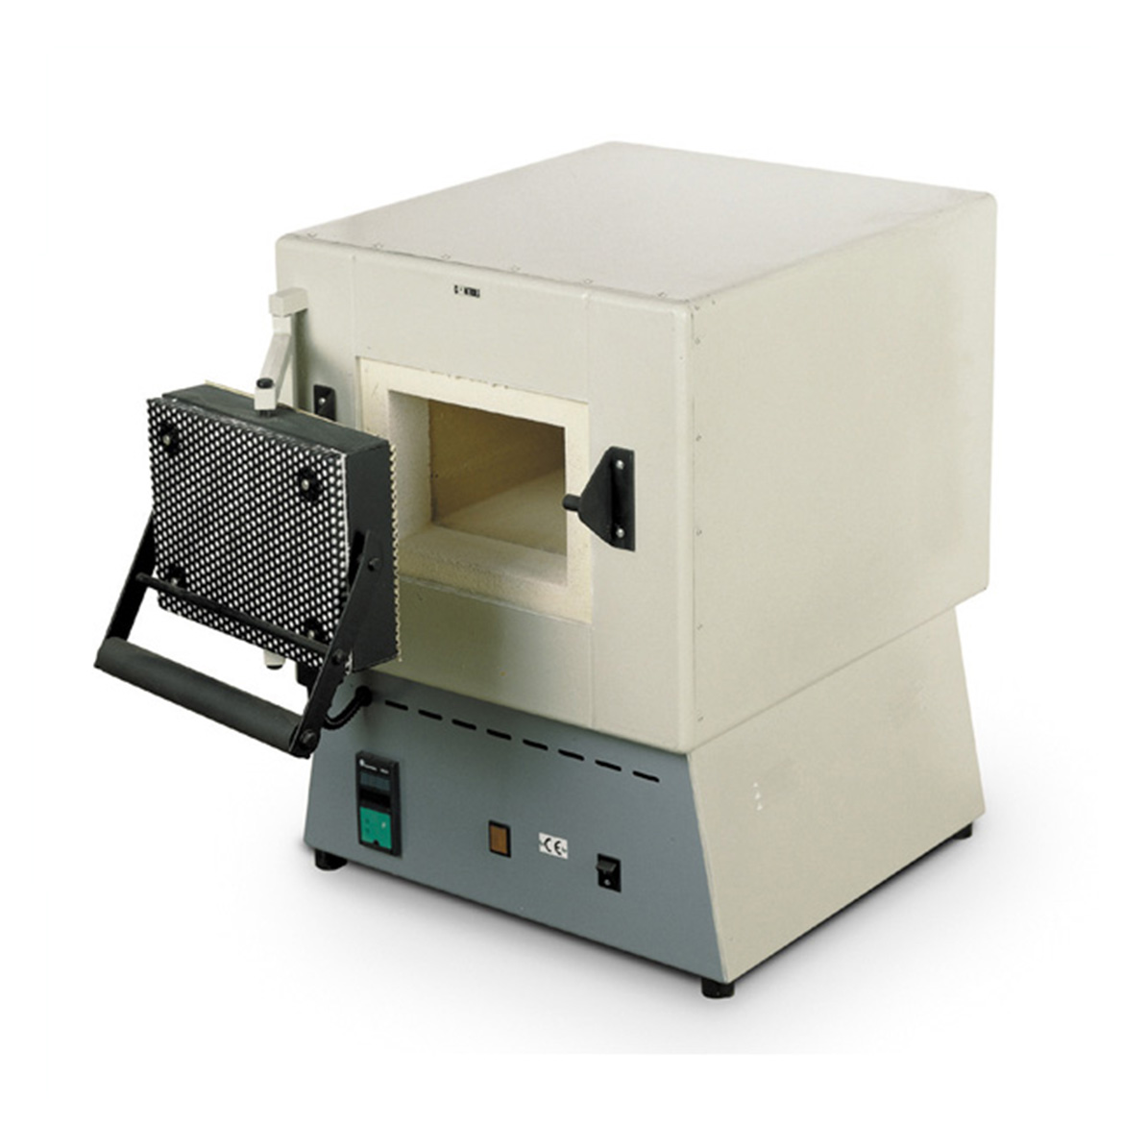
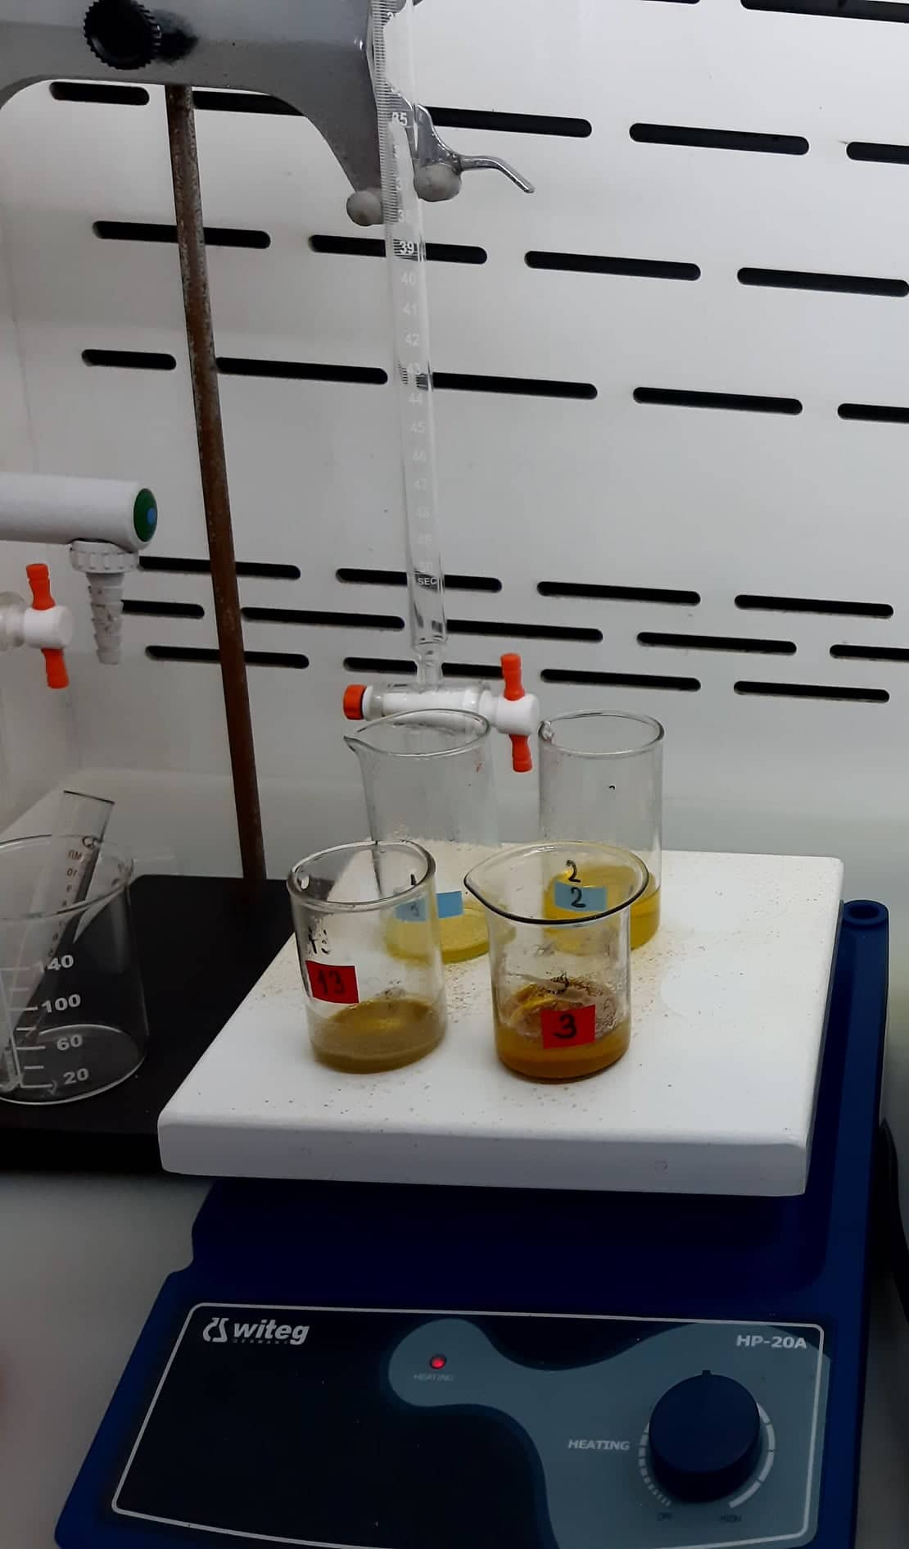
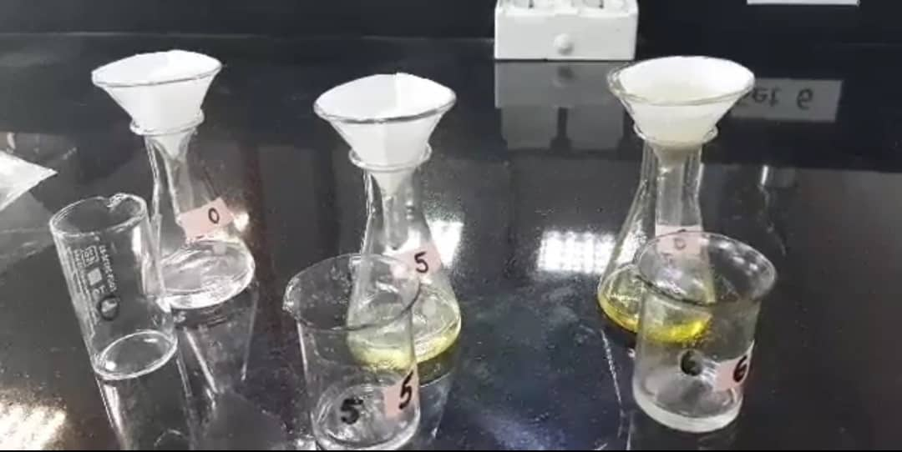
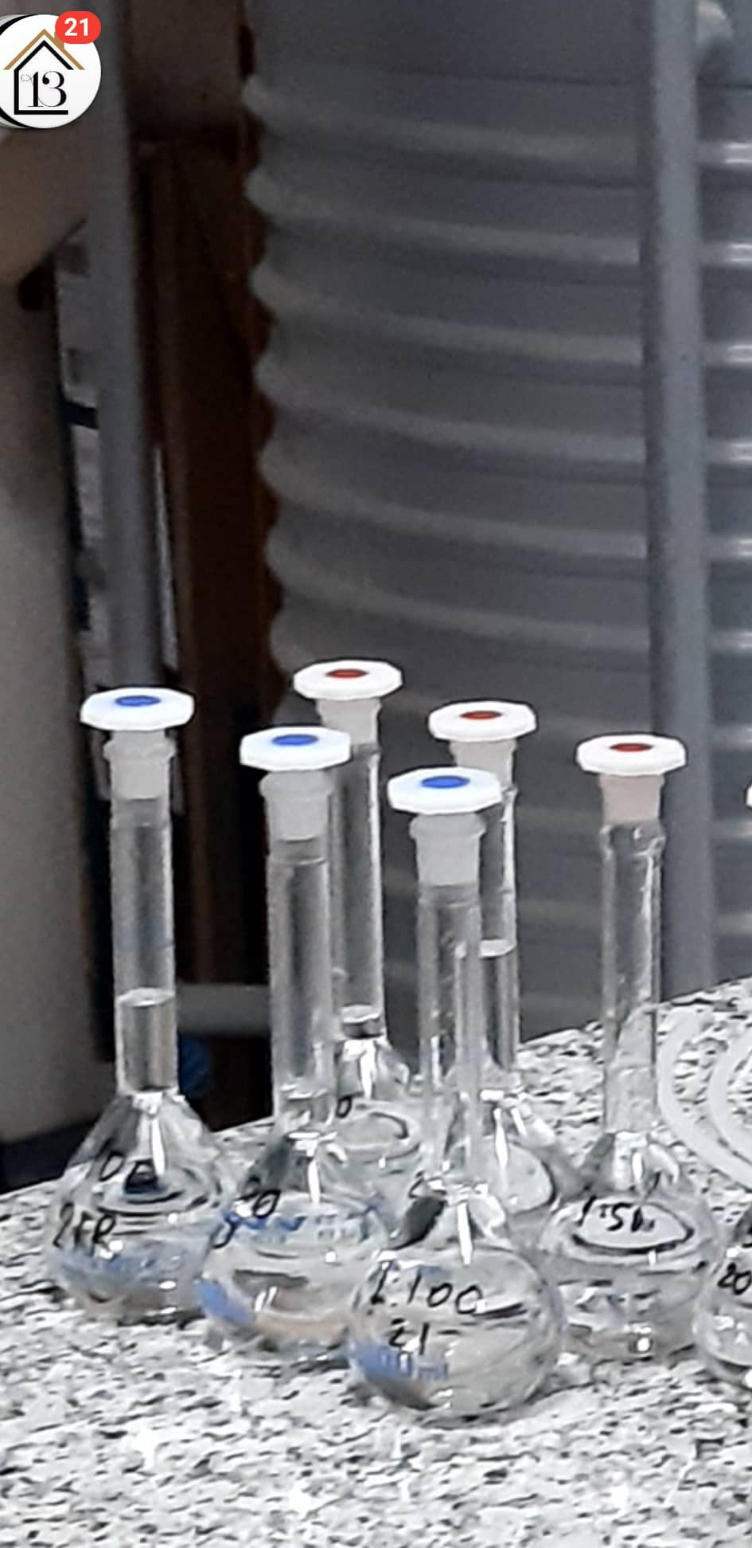
Sample preparation
The roots of Valeriana and Licorice were first ground with a pestle and mortar, then sorted according to quartering, and then sorted further to obtain the particles smaller than 0.1mm. Then they were weighed, dried, and treated with mineral acids. The filtrate was collected, transferred to a volumetric flask, and filled to the mark with DI water.
16/09/2022
5

Slide 6
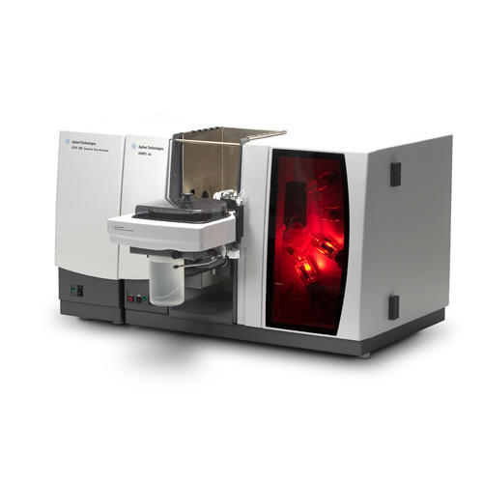
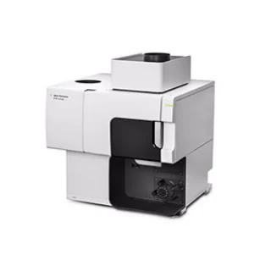
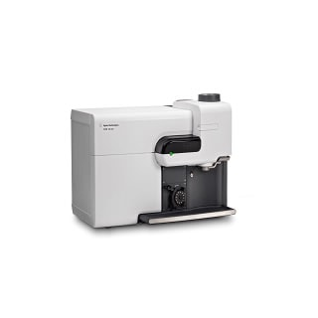
Instrumental methods used for heavy metal determination
Atomic Absorbance Spectrometry
Inductively Coupled Plasma Atomic Emission Spectrometry
Microwave Plasma Atomic Emission Spectrometry
16/09/2022
6

Slide 7
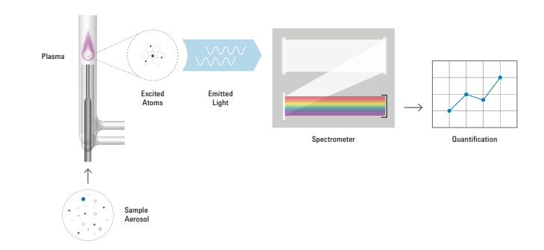
MP-AES - HOW IT WORKS
The magnetron is used to form a plasma from nitrogen gas.
Plasma excites atoms of a specific element.
Atom returns to the ground state and emits light with a wavelength that is characteristic of that element, this light then reaches a detector.
The rate of emission is directly proportional to the number of atoms in the excited state
16/09/2022
7

Slide 8
Advantages of MP-AES over AAS
Feature | MP-AES | Flame AA
Detection limits | Better | Good
Linear Dynamic Range | Better | Good
Flammable Gas | Not Required | Acetylene
Oxidizing Gas | Not Required | Nitrous oxide
Fuel gas ${CO}_{2}$ | Not Required | 1-6 tonnes p a
Light sources | Not Required | HC and D2 lamps
Drift correction | Not Required | Double beam
Overnight unattended | Yes | No
Running cost | Lowest | High
It is More than 2x faster than conventional flame AA
Superior detection limits and improved dynamic range
Cheaper to run and safer since it eliminates the usage of flammable gases
The multi-elemental analysis is possible with MP-AES, but not with AAS
16/09/2022
8

Slide 9
Preparation of sample
Making standard solutions
Experimental
procedure
Analyzing standards with Microwave Plasma Atomic Emission Spectrometer
Analyzing unknowns with Microwave Plasma Atomic Emission Spectrometer
16/09/2022
9

Slide 10
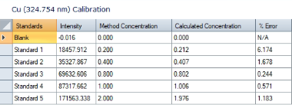
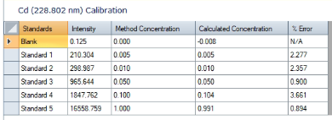
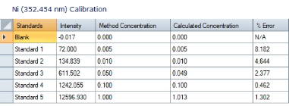
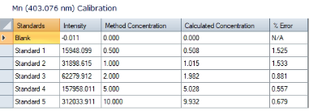
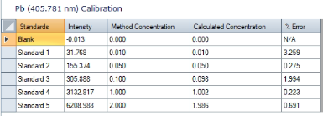
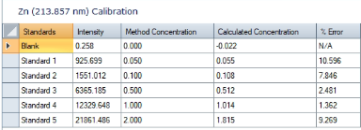
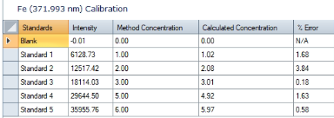
MULTISTANDARD
10

Slide 11
Parameters of the MP-AES
Replicates: 3
Pump Speed (rpm): 20 (Fast pump)
Uptake Time (s): 20
Stabilization Time (s): 20
Number of Pixels: 3
Read Time (s): 3
correlation coefficient limit - 0.9960
Nebulizer Flow:
Cu (324.754 nm) | 0.7 L/min
Zn (213.857 nm) | 0.45 L/min
Ni (352.454 nm) | 0.7 L/min
Cd (228.802 nm) | 0.5 L/min
Pb (405.781 nm) | 0.75 L/min
Mn (403.076 nm) | 0.9 L/min
Fe (371.993 nm) | 0.65 L/min
16/09/2022
11

Slide 12
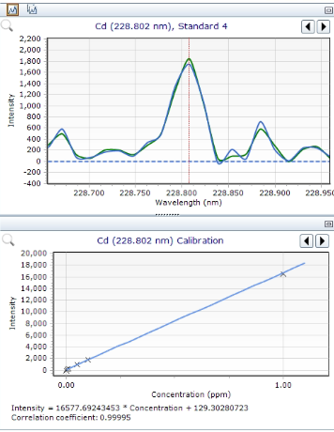
Cadmium (Cd)
16/09/2022
12

Slide 13
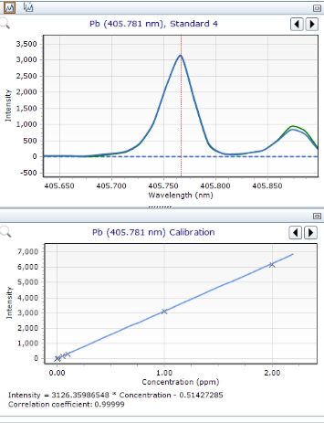
Lead (Pb)
16/09/2022
13

Slide 14
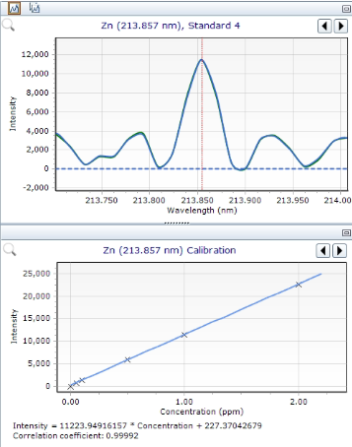
Zinc (Zn)
16/09/2022
14

Slide 15
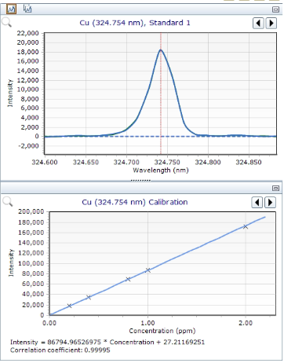
Copper (Cu)
16/09/2022
15

Slide 16
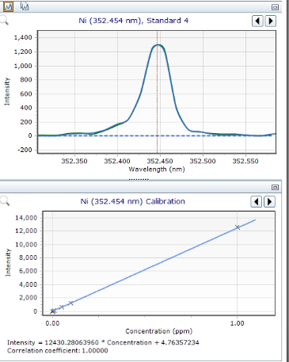
Nickel (Ni)
16/09/2022
16

Slide 17
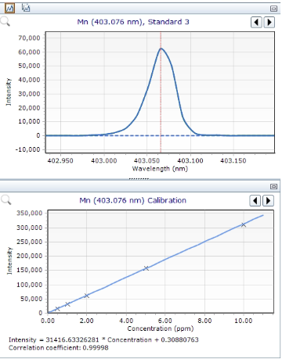
Manganese (Mn)
16/09/2022
17

Slide 18
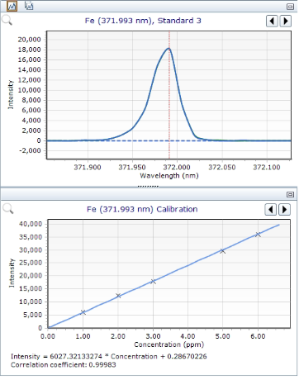
Iron (Fe)
16/09/2022
18

Slide 19
The results of the quantitative analysis of Cadmium (Maximum allowed concentration is 0.3 mg/kg According to World Health Organization)
PPM
16/09/2022
19

Slide 20
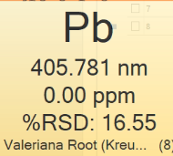
The results of the quantitative analysis of Lead(Maximum allowed concentration is 0.3 mg/kg According to World Health Organization)
PPM
16/09/2022
20

Slide 21
The results of the quantitative analysis of Zinc (Maximum allowed concentration is 50 mg/kg According to World Health Organization)
PPM
16/09/2022
21

Slide 22
The results of the quantitative analysis of Copper (Maximum allowed concentration is 150 mg/kg According to World Health Organization)
PPM
16/09/2022
22

Slide 23
The results of the quantitative analysis of Nickel (Maximum allowed concentration is 1.5 mg/kg According to World Health Organization)
PPM
16/09/2022
23

Slide 24
The results of the quantitative analysis of Manganese (Maximum allowed concentration is 200 mg/kg According to World Health Organization)
PPM
16/09/2022
24

Slide 25
The results of the quantitative analysis of Iron (Maximum allowed concentration is 200 mg/kg According to World Health Organization)
PPM
16/09/2022
25

Slide 26
Content of heavy metals in Valeriana and Licorice roots: (mg/kg)
№ | Sample | Cd | Pb | Zn | Cu | Ni | Mn | Fe
1 | Licorice Roots (Kräuter Mix), (02.06.2022) | 0.06 | 0.74 | 1.96 | 23.40 | 0.76 | 13.92 | 286.00
2 | Valeriana Roots (Kräuter Mix), (02.06.2022) | 0.16 | 0.06 | 17.42 | 7.22 | 3.76 | 172.78 | 1028.00
3 | Licorice Roots (Bolnisi, Georgia) | ⁻ | 1.18 | 14.43 | 17.88 | 0.43 | 14.33 | 390.25
4 | Licorice Roots (Kazakhstan) | ⁻ | 1.23 | 13.03 | 24.70 | 29.93 | 17.20 | 281.25
5 | Valeriana Roots (Germany) | 0.23 | 1.63 | 43.25 | 10.83 | 10.75 | 149.98 | 688.00
6 | Valeriana Roots (Georgia) | 0.47 | 4.00 | 39.70 | 41.07 | 4.50 | 185.60 | 2730.00
16/09/2022
26

Slide 27
Future Plans
Analyze Licorice and Valeriana roots from other
Locations with MP-AES
Use other analytical instruments to cross-check the
results from this study
16/09/2022
27

Slide 28
Thank You For Your Attention!

