Slide 1
Ivane Javakhishvili Tbilisi State University
The study of the peculiarities of liver’s adaptive-compensatory mechanisms at the initial stage of subdiaphragmatic vagotomy
Nino Kharaishvili;
Tornike Gogolauri; Tornike Leverashvili
Medical Faculty
Supervisor: Associated professor Irina Modebdze
Tbilisi
2022

Slide 2
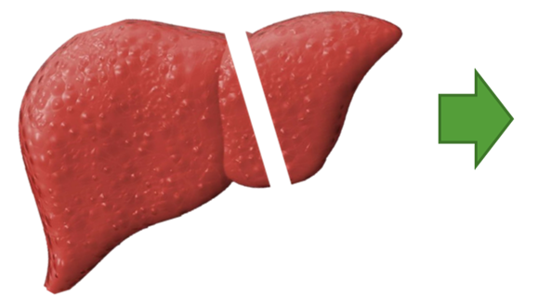
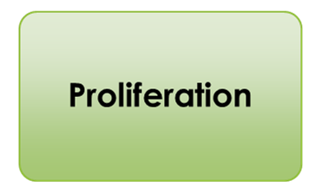
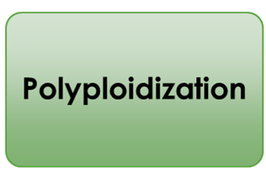
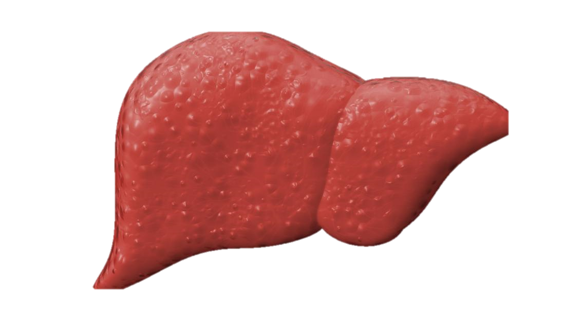
Mechanism of liver regeneration
(compensatory-adaptive growth)
50%
20%
30%
Pathology
Initial stage
genome multiplication mechanisms
increased functional load
Notes:
Regeneration occupies one of the most important places among the main vital processes of multicellular organisms. It is a constantly renewing process in the body, during which damaged organs and tissues restore their shape, size and function. The liver, as we know, has a well-expressed ability to fully recover the lost tissue mass ten days after resection. Classically, during liver regeneration in response to resection, mass recovery occurs through hepatocyte proliferation, hypertrophy, and polyploidization. But in various pathologies, without mass loss, the compensatory-adaptive growth of the liver does not always proceed with these strictly regulated sequential mechanisms of regeneration.

Slide 3
The peculiarities of liver’s adaptive-compensatory growth at the initial stage of various pathologies
Alimentary dyslipidemia
Radiative-oxidative stress
cholestasis
hormonal imbalance
(bilateral adrenalectomy)
Notes:
For example in the case of alimentary dyslipidemia, against radiative and oxidative stress, as well as under conditions of cholestasis; hormonal imbalance (bilateral adrenalechtomy). Therefore, nowadays the study of the features of liver’s compensatory-adaptive processes in the conditions of various pathologies acquired special importance, and it was interesting what processes were stimulated in the liver after subdiaphragmatic vagotomy at the initial stage.

Slide 4
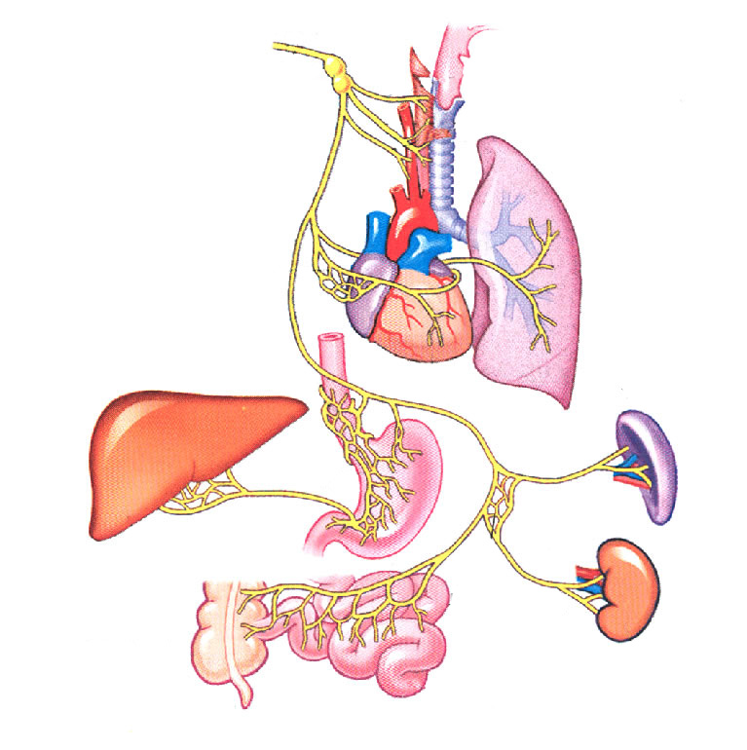
Subdiaphragmatic Vagotomy
The vagus nerve stimulates liver regeneration and its effect directly and specifically depends on vagus factors.
Subdiaphragmatic vagotomy inhibits DNA synthesis after partial hepatectomy
Subdiaphragmatic vagotomy, in addition to the reduction of regenerative processes in the liver, has other side effects on the entire abdominal organs, which in turn causes a functional load on the liver.
Vagus innervation
Notes:
The vagus nerve stimulates liver regeneration, and its effect depends on vagus factors, such as hepatocyte growth factor HGF, which stimulates the proliferative processes of the liver. Thus, after the termination of vagus innervation, regeneration processes in the liver are delayed.

Slide 5
Purpose of work
Based on all of the above, our work’s goal was to study the peculiarities of liver’s adaptive-compensatory mechanisms at the initial stage of subdiaphragmatic vagotomy.
Notes:
Based on all of the above, our work’s goal was to study the peculiarities of liver’s adaptive-compensatory mechanisms at the initial stage of subdiaphragmatic vagotomy.

Slide 6
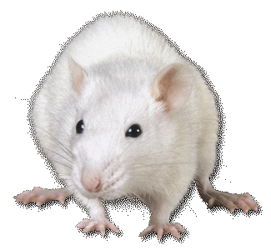
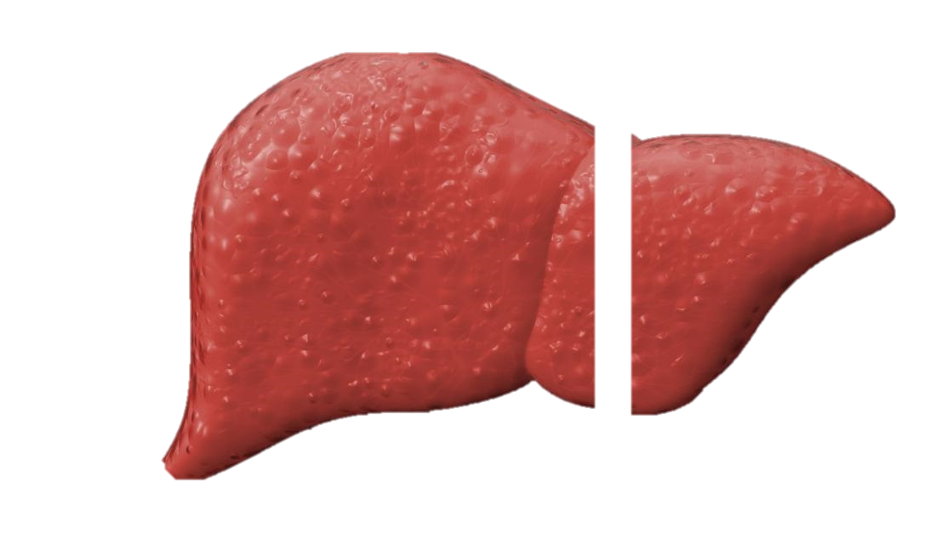
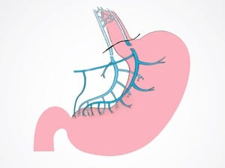
Research object, model and material
Research object: adult, white rats weighing 130-150g
70 %
Study model: subdiaphragmatic vagotomy, partial hepatectomy
Research material: liver tissue
Notes:
As a research object we used an adult, white rats. We selected subdiaphragmatic vagotomy and partial hepatectomy as research models, and the research material was liver tissue, which we obtained after decapitation of animals under ether narcosis.

Slide 7
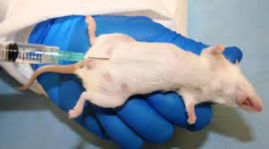
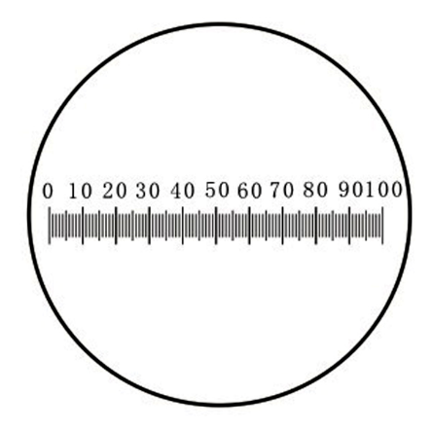
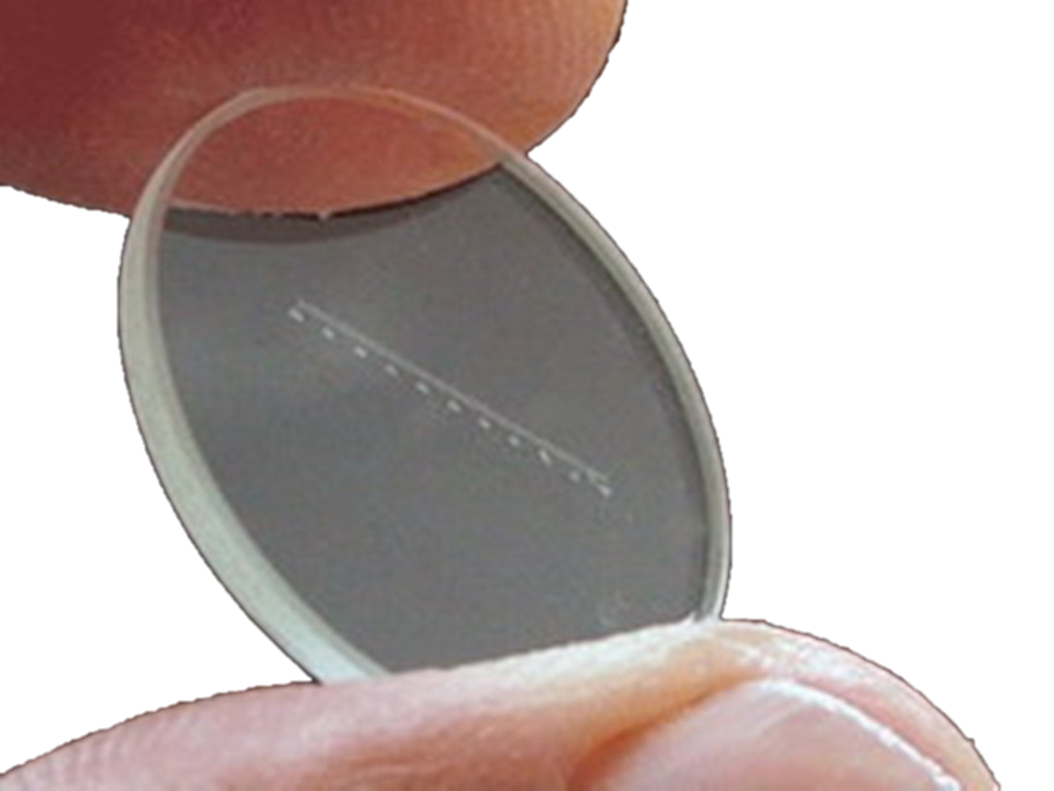
Research methods
Research material was fixed in a 4% formaldehyde solution prepared on a Na/K phosphate buffer; dehydrated in an increasing series of alcohols of different concentrations and embedded in a wax-paraffin mixture.
Colchicine mitotic index (per 100 cells, ppm ‰)
To assess ploidy, smears made from research tissues were stained with Fiolgen's reagent.
To assess tissue hyperplasia, the area of ​​cells and nuclei was measured with an ocular micrometer
Notes:
To study the liver tissue under a light microscope, we fixed the material in a 4% formaldehyde solution prepared on a Na/K phosphate buffer; dehydrated in an increasing series of alcohols of different concentrations and embedded in a wax-paraffin mixture. Sections of the research tissues were made on a rotary microtome and stained with hematoxylin-eosin.

Slide 8
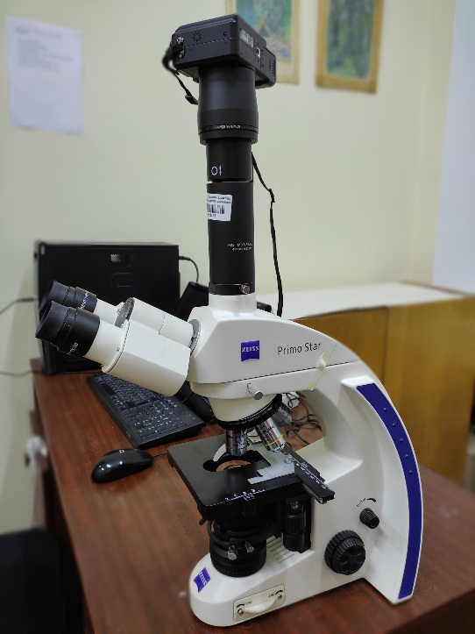
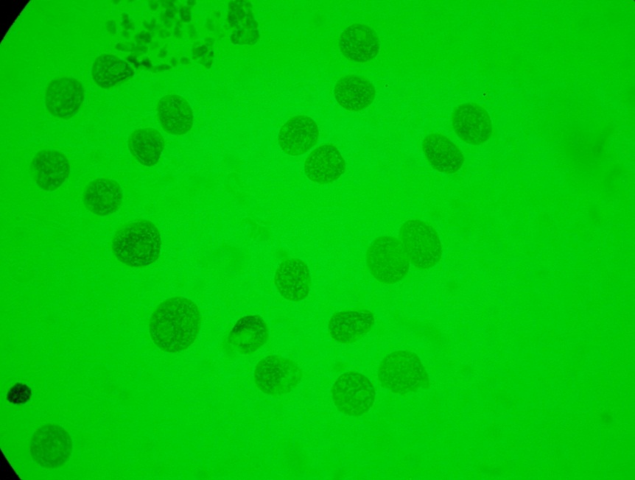
Smears stained with Schiff's reagent were photographed under a light microscope (Zeiss; 10X100).
Sections of the research tissues were made on a rotary microtome (Leica; 5-7 μm).
The amount of DNA was determined using the computer programe Image J
The reliability of the data was 95% (p<0.05).
Notes:
To determine the mitotic index, we used the colchicine mitotic index method. To assess tissue hyperplasia, the area of cells and nuclei was measured with an ocular micrometer. To assess ploidy, smears were stained with Fiolgen’s reagent and the amount of DNA was determined using the computer program Image J (method on slide 23). The reliability of the data was 95% .

Slide 9
Research results and their discussion
Task 1. Effects of subdiaphragmatic vagotomy on liver’s
Morpho-functional activity in dynamics
1. Control group, intact animals
2. I. Experimental group, subdiaphragmatic vagotomy 22 hours
3. IIE xperimental group, subdiaphragmatic vagotomy 32 hours
Notes:
Our first task was to study the features of liver’s compensatory-adaptive processes in the early stage after subdiaphragmatic vagotomy. For this, we divided animals into three groups: 1. control group (intact animals), 2. animals that underwent subdiaphragmatic vagotomy and we studied tissues at 22 hours after surgery and 3. animals that underwent subdiaphragmatic vagotomy and we studied tissues 32 hours after surgery.

Slide 10
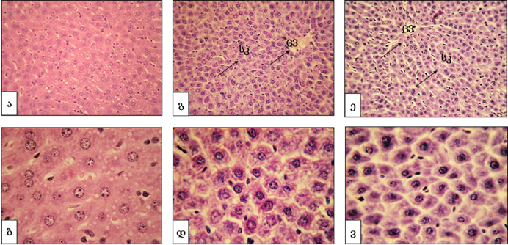
Effects of subdiaphragmatic vagotomy on adult rats’ liver’s
histoarchitectonics in dynamics.
Figure 1. a, b - control - intact animals; c, d - subdiaphragmatic vagotomy at the 22nd hour; e, f - subdiaphragmatic vagotomy at the 32nd hour; (a, c, e - 40x10; b, d, f - 100x10); SC - sinusoidal capillary; Central vein.
A
C
E
B
D
F
Notes:
Thera are no significant changes in the histoarchitectonics of liver tissue neither at 32h, nor 22h compared to the controls. There is only a slight narrowing of the sinusoidal capillaries around the central vein and a decrease in the intensity of eosin staining in the cells. There is also no significant change in the degree of destruction of liver tissue.

Slide 11
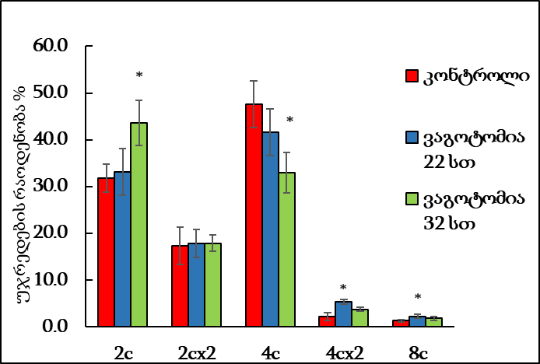
Liver’s morphometric analysis and ploidy changes
Groups | Intact | Vagotomy 22h | Vagotomy 32h
Area of ​​hepatocytes (μm)2 | 306±11 | 302±12 | 261±11*
Area of ​​hepatocyte nuclei (μm)2 | 44±3 | 49±2* | 40±3
control
Vagotomy 22h
The number of cells %
Vagotomy 32h.
Table1
Subdiaphragmatic transection of the sciatic nerve leads to the increased number of high-ploidy cells in the liver at an early stage (22 h)
Notes:
After subdiaphragmatic vagotomy, we did morphometric analysis of liver tissue from the same animals at both time points. It was revealed that at the 22nd hour after the surgery, the area of hepatocyte nuclei increases in the liver tissue of experimental animals compared to the control group. This may be related to the activation of the replication process. At the 32nd hour after the surgery, the average indicator of the hepatocytes’ nucleus’s area remains unchanged compared to controls. We simultaneously evaluated the change in the quantitative ratio of hepatocytes of different ploidy in the livers of both control and experimental groups. Studies have shown that at 22 h after subdiaphragmatic vagotomy, compared to controls, the number of cells with high DNA content and to be specific 8c and 4cx2 cells are slightly, but reliably increased. And at the 32nd hour, additional polyploidization is no longer taking place.

Slide 12
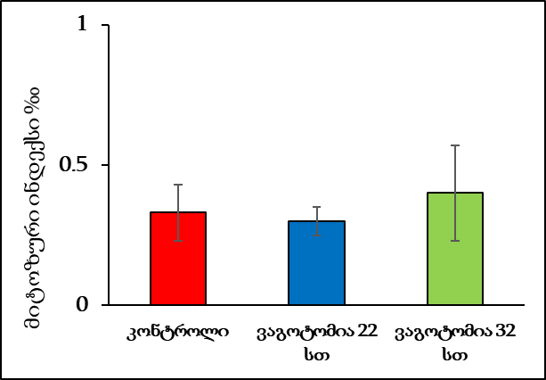
The effect of subdiaphragmatic vagotomy on the change in the proliferative activity of hepatocytes
The mitotic index does not change
How the number of 8c cells is elevated without increasing mitotic index?
Mitotic index
Without increasing the mitotic index, the increase in the number of highly ploidy 8C cells is achieved by endoreduplication mechanism.
control
Vagotomy 22h
Vagotomy 32h
Notes:
At the same time, we evaluated the changes in the proliferative activity of the liver tissue on the above-mentioned dates. It was found that the mitotic index of hepatocytes at both the 22nd and 32nd hours after surgery does not change compared to the control index, which in the intact liver of adult rats usually varies in the range of 0-1‰. The fact that the number of 8c- mononuclear octaploid cells increases in 22 hours without an increase in mitotic index allows us to assume that the multiple increase of DNA concentration in these hepatocytes is achieved by activating endoreplication mechanism. And the generation of 4cx2- binuclear octaploid cells by endomitosis.

Slide 13
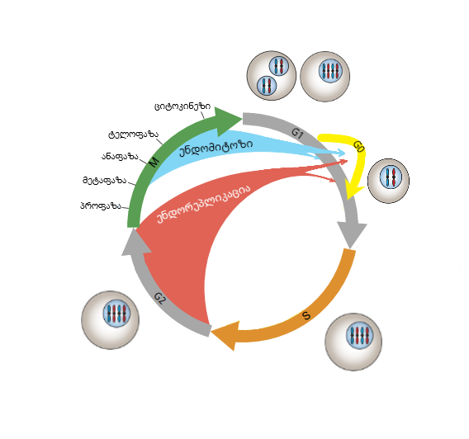
Endoreplication and Endomitosis
cytokinesis
4cx2
4c
2cx2 x 2
4c
8c
telophase
endomitosis
anaphase
metaphase
prophase
endoreplication
2c
4c
8c
4c
4c
8c
Notes:
To better understand this, let’s review the scheme of uninuclear and binuclear hyperploid cells formation. These processes proceed through the endoreplication and endomitosis. Endroeplication refers to the genome’s growth of cells without going into the proper mitosis phase, while during endomitosis, the cell will go through the interphase, enter the proper mitosis phase, karyokinesis occurs, but the cytokinesis process is delayed, which subsequently leads to the formation binucleated cells.

Slide 14
Hormonal imbalance
Bilateral adrenalectomy 4 days
Liver resection
G₂₋₀ population
The mitotic index increased at 6 h
Notes:
According to literature data, it is determined that the liver uses the endoreplication mechanism in conditions of hormonal imbalance, which is formed after bilateral adrenalectomy. The authors showed that 4 days after adrenalectomy, the mitotic index of hepatocytes reaches 40 ‰ at the 6th hour after liver resection. A significant increase in the mitotic index at 6 h after the operation was explained by the transition of cells delayed in the G2-0 phase to the proper mitosis phase.

Slide 15
Study of regenerative processes initiated in response to resection at 22 hours after subdiaphragmatic vagotomy
control group - intact rats;
I Experimental group - animals that underwent subdiaphragmatic vagotomy
II Experimental group – animals
that underwent partial hepatectomy 22 h. after
sub. vagotomy.
Notes:
To test whether the obtained 8C cells were arrested in the G2 phase, as was the case in the bilateral adrenalectomy model, we decided to perform a partial hepatectomy at 22 hours after subdiaphragmatic vagotomy and evaluate the processes in the liver 6 hours later.

Slide 16
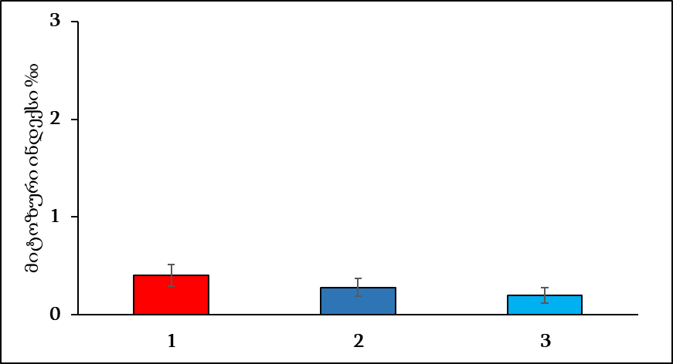
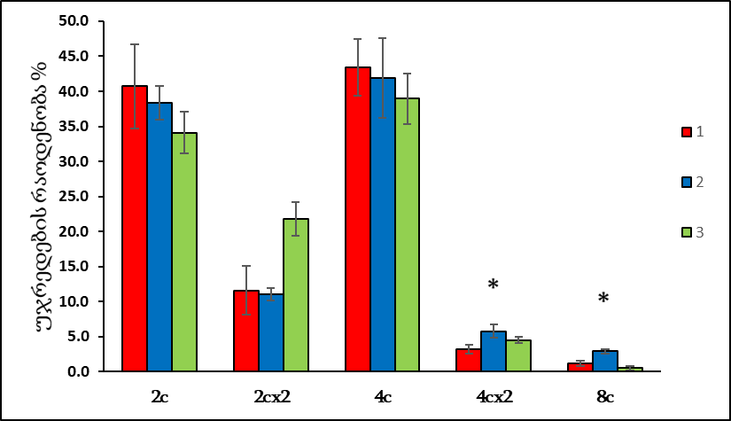
Changes in liver proliferative activity and ploidy under conditions of subdiaphragmatic vagotomy at 6 h after hepatectomy
Mitotic index
Number of cells
control - intact animals;
I test. G.- subdiaphragmatic vagotomy 22 hours;
II test. G.- subdiaphragmatic vagotomy 22 hours + hepatectomy 6 hours. (*p<0.05)
In the conditions of subdiaphragmatic vagotomy (lack of HGF), the transition of cells (generated by endoreplication) to the M phase is delayed.
Notes:
In this series of experiments, no change in the mitotic index was detected in the liver of the animals. 6 hours after liver resection, the number of highly ploidy cells does not change either. Then the question arises, why in this case the mitotic index did not increase, as it happened in the bilateral adrenalectomy model? Presumably, under the conditions of subdiaphragmatic vagotomy, the transition of the cells arrested in G2 to the M phase (caused by endoreduplication) was delayed, which may be caused by inhibition of liver’s proliferative activity. However, studies show that the vagus-specific effect only delays and does not completely inhibit liver regeneration.

Slide 17
Influence of subdiaphragmatic vagotomy on regenerative processes induced in response to liver resection (partial hepatectomy)
control group - intact rats;
I Experimental group - animals that underwent partial hepatectomy;
II Experimental group - animals that underwent simultaneous subdiaphragmatic vagotomy and partial hepatectomy.
Notes:
In order to find out whether the mentioned proliferative delay really depended on vagus factors or not, in the following series of experiments we performed simultaneous sub. Vagotomy and partial hepatectomy on animals and studied tissues at 22nd and 32nd h. after the surgeries.

Slide 18
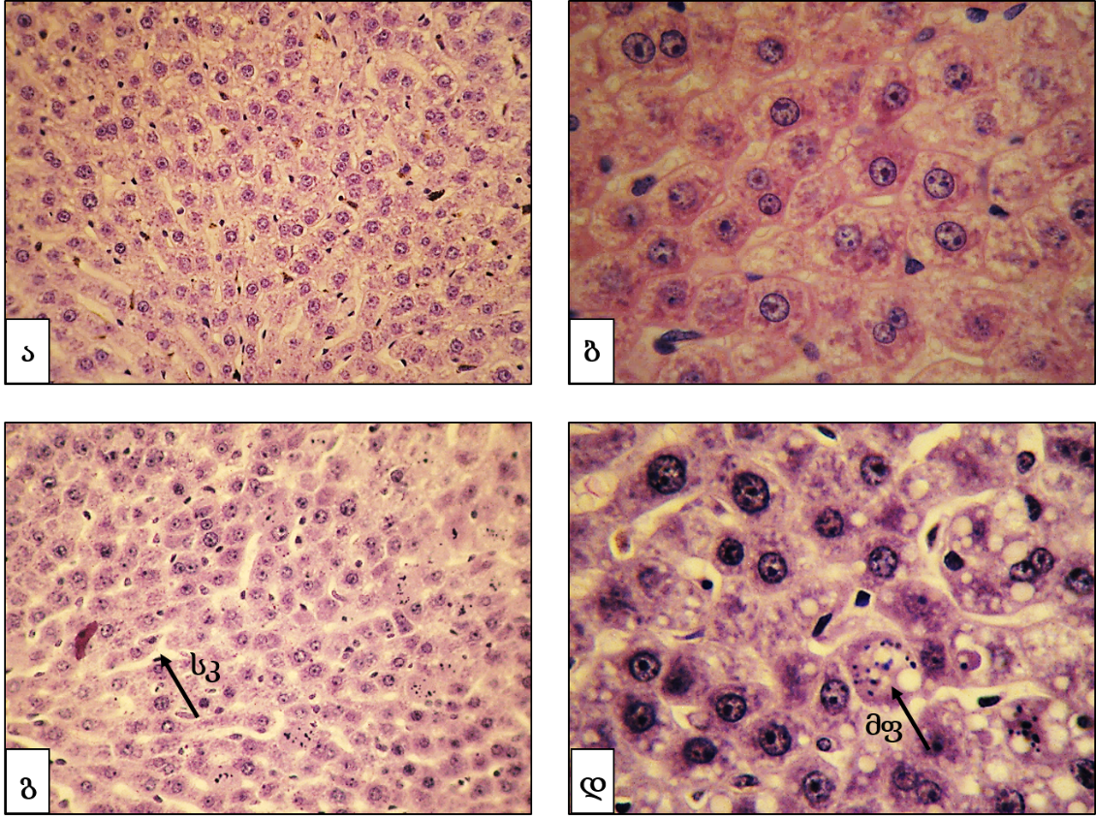
Morphological changes in the liver caused by regenerative processes in response to subdiaphragmatic vagotomy and liver resection
a, b - vagotomy+hepatectomy at 22nd hour;
c, d - vagotomy+hepatectomy 32nd hour.
(a, c - 40x10; b, d - 100x10);
SC - sinusoidal capillary;
MF - mitotic figure.
A
B
C
D
Notes:
After simultaneous hepatectomy and subdiaphragmatic vagotomy, no significant changes were observed in the histoarchitectonics of the liver. Hepatocytes maintain their typical structure at both time points. But at 32nd h. after the surgery mitotic figures are clearly visible.

Slide 19
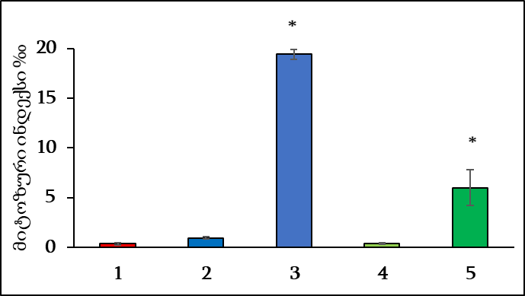
Changes in the proliferative activity of hepatocytes in the liver under the influence of subdiaphragmatic vagotomy and in response to resection
As a result of subdiaphragmatic vagotomy, proliferative processes in the liver are inhibited.
Mitotic index
1. control - intact animals;
2. Part. Hepatectomy at the 22nd hour;
3. Part. hepatectomy at the 32nd hour;
4. vagotomy+hepatectomy at 22nd hour;
5. Vagotomy+hepatectomy at the 32nd hour. (* p<0.05)
Notes:
It was shown that the rate of hepatocytes’ proliferative activity is classically increased at 32 hours after partial hepatectomy, compared to the control rate. In addition, the mitotic index is also increased in the resected liver with a parallel sudiphragmatic vagotomy, although it is much less compared to the partial hepatectomy alone. Therefore, we can say that by removing the vagus factors, the proliferative processes in the liver are actually delayed, but still not completely inhibited. as described in the literature.

Slide 20
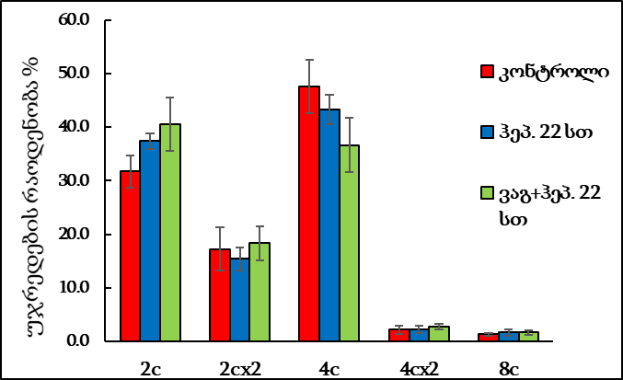
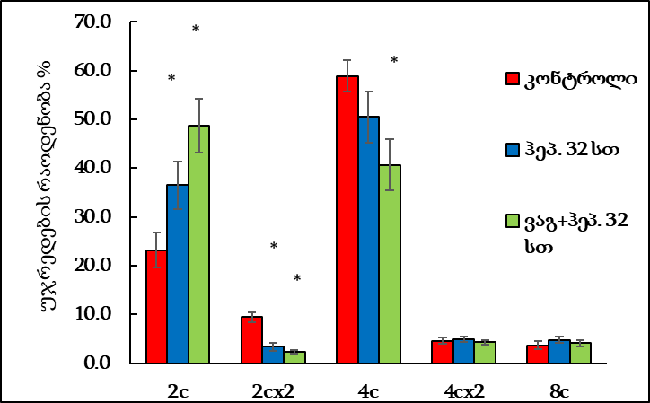
Changes in hepatocyte ploidy induced by subdiaphragmatic vagotomy and liver resection
control
control
Hep. 22h
Hep. 32h
Number of cells %
Vag.+Hep. 22h
Vag.+Hep. 32h
Subdiaphragmatic vagotomy does not lead to the increased number of polyploid cells in the resected liver at the initial stage of reparative growth
Notes:
It is interesting whether the mechanism of polyploidization is activated in the liver due to the delay in proliferation. As a result of the evaluation of the amount of DNA in the liver cells at the 22nd hour after surgery, no statistically significant change of polyploid cells was detected in the experimental groups (Fig. 9). At the 32nd hour after the operations, the mentioned changes again show the proliferative activity of the liver and not the activation of polyploidization.

Slide 21
Conclusions:
1. An increase in the number of both 4Cx2 and 8C cells at the initial stage after subdiaphragmatic vagotomy indicates that the genome fold increase in the liver is achieved by simultaneously activated two different mechanisms.
2. Simultaneous resection of the Vagus nerve and liver at the initial stage of reparative regeneration, despite the delay in proliferative activity caused by subdiaphragmatic vagotomy in the liver of adult rats, does not affect the sequence of recovery processes.
Notes:
Conclusions:
1. An increase in the number of both 4Cx2 and 8C cells at the initial stage after subdiaphragmatic vagotomy indicates that the genome fold increase in the liver is achieved by simultaneously activating two different mechanisms.
2. Simultaneous resection of the Vagus nerve and liver at the initial stage of reparative regeneration, despite the delay in proliferative activity caused by subdiaphragmatic vagotomy in the liver of adult rats, does not affect the sequence of recovery processes.

Slide 22
Thank you for your attention!

Slide 23
Method of DNA measurement
Small pieces of perfused liver are placed in first buffer (pH 8.0) for 20-30 minutes. At this time, contacts between cells is reduced.
Then tissues are transferred to second buffer (pH 7.3) for 5-10 minutes. At this time, the mass of separated cells is weighed in a liquid, this liquid is transferred to a glass and a smears are prepared. Fixation is done with methanol.
After fixation, smears are placed in 5% sulfosalicylic acid, then in a solution of LiCl and HCl...
Then staining is done with Schiff's reagent, which stains cell’s DNA.
Passing in sulphur waters, alcohols, xylol, balsam.
Finally, the nucleic acids are stained purple.
Smears are photographed under a light microscope.
DNA amount is determined with computer program image J.

