Slide 1
Ivane Javakhishvili Tbilisi State University
The adaptive mechanism of liver in response to hyperglycemic functional stress in alloxan induced diabetes
Merab Tchanturia;
Merab Sephashvili; Tornike Gogolauri;
Nini Shavadze; Temuri Chachanidze
Medical Faculty
Supervisor:
Diana Dzidziguri
Tbilisi
2022

Slide 2
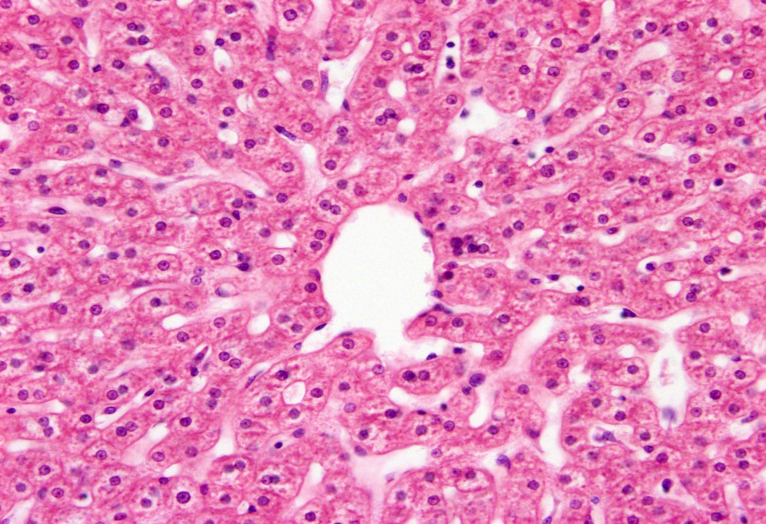
Liver regeneration (compensatory-adaptive growth)
1. Proliferation
2. Hypertrophy
3. Polyploidization
Notes:
The liver is an organ that is distinguished by a variety of metabolic processes and a unique ability to regenerate. It is established that in case of loss of liver mass, its compensatory and adaptive growth takes place through the following sequential processes: proliferation, hypertrophy and polyploidization. Genome multiple growth or polyploidization is generally considered to be an evolutionary mechanism developed in response to variable environmental factors and stress. Under the conditions of various pathologies, the liver responds to the increased functional load with quantitative changes of highly ploidy cells. That is, when the functional load on the liver increases, but the mass is not lost, the sequence of compensatory-adaptive processes changes, in particular, polyploidization begins.

Slide 3
Changes in liver regeneration in different pathologies
Diabetes experimental model
(Alloxan, streptozotocin)
Generation of
High ploid cells
Decrease of insulin concentration

Slide 4
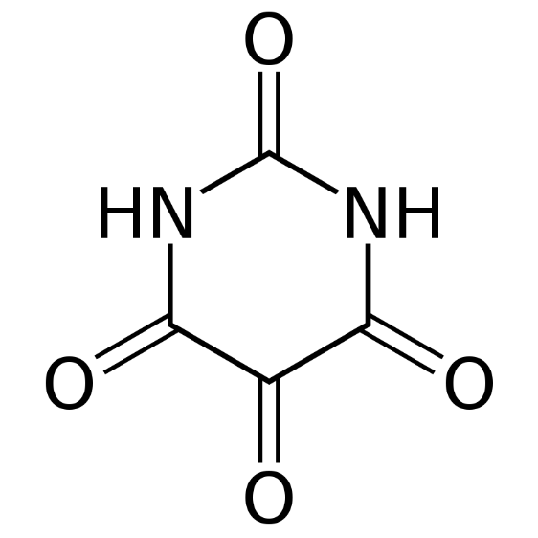
An experimental model of alloxan diabetes mellitus
Alloxan | β-D glucose
hydrophilic
Having a weak acid property
Half-life - 1.5 min.
It enters the cells with the help of GLUT2 transporter
It inhibits glucokinase and produces reactive forms of oxygen
Notes:
There are Different experimental models of diabetes , which are obtained by surgical, chemical and genetic manipulations. Chemical models of alloxan and streptozotocin-induced diabetes are mostly used to study the mechanisms of diabetes. We used the alloxan diabetes model as a diabetes model. Alloxan is a toxic analog of glucose. It is hydrophilic and cannot penetrate the lipid bilayer of the plasma membrane.

Slide 5
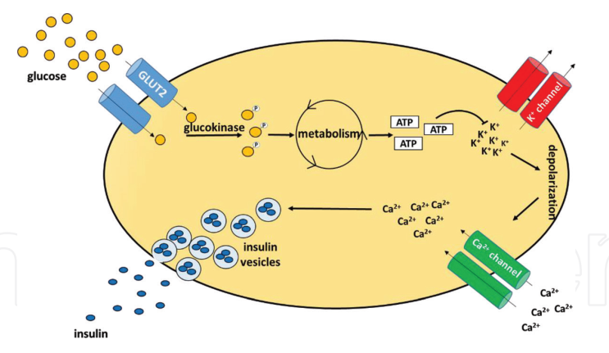
Effects of alloxan on insulin production
Notes:
Alloxan enters cells with the help of GLUT2 transporter, becouse alloxan molecule is structurally so similar to glucose. alloxan binds to the enzyme glucokinase and inhibits it, thereby inhibiting glucose-induced insulin secretion. On the other hand, alloxan is transformed into dialuric acid under the action of glutathione, which oxidizes and produces alloxan radicals and reactive oxygen radicals. Reactive forms of oxygen are oxidized to hydrogen peroxide by superoxide dismutase. The generated free radicals cause the DNA fragmentation and beta cells necrosis.

Slide 6
The aim of work
study of the adaptive mechanism of the liver in response to hyperglycemic functional stress, at the initial stage of Alloxan diabetes.

Slide 7
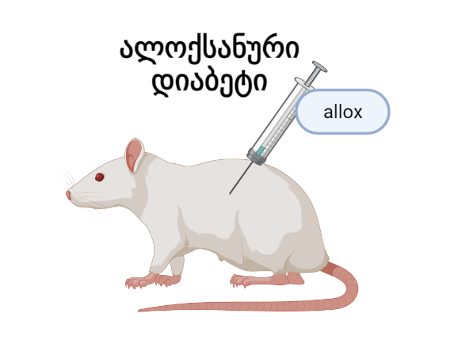
Research object and model
Adult white non-linear rats (130-150 g)
Control group - intact animals
I experimental group - Alloxan injection (180 mg/kg) was done intraperitoneally and the material was taken 24 hours after the injection.
II experimental group - Alloxan injection (180 mg/kg) was done intraperitoneally and the material was taken 48 hours after the injection.
Notes:
In order to reveal the adaptive mechanism of the liver under hyperglycemia, we took three groups of animals: 1- control intact animals, 2- animals of the first experimental group, 3 - the second experimental group. The animals of the experimental group were injected by alloxan. The animals of the first experimental group underwent partial hepatectomy at 24 h, and the animals of the second experimental group at 48 h.

Slide 8
methods
Fixation of material and preparation of slices for study in a light microscope
Determination of colchicine mitotic index
Preparation and staining of slices to determine the concentration of DNA in the nuclei of hepatocytes
Determination of DNA concentration with the help of computer program Image.J
Immunohistochemical analysis

Slide 9
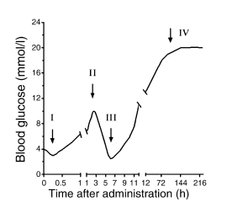
Task 1: Development of a model of alloxan diabetes
The development of stable hyperglycemia within 24 h in response to a single injection of alloxan indicates that an experimental model of diabetes has been achieved.
Notes:
The formation of diabetes is evaluated by determining the concentration of glucose. This is literary data. It is clear from the picture that three hours after the injection of alloxan, compared to the intact animals, the amount of glucose in the blood of the rats of the experimental group increased by about 4 times. The development of stable hyperglycemia within 24 h in response to a single injection of alloxan indicates that an experimental model of diabetes has been achieved.

Slide 10
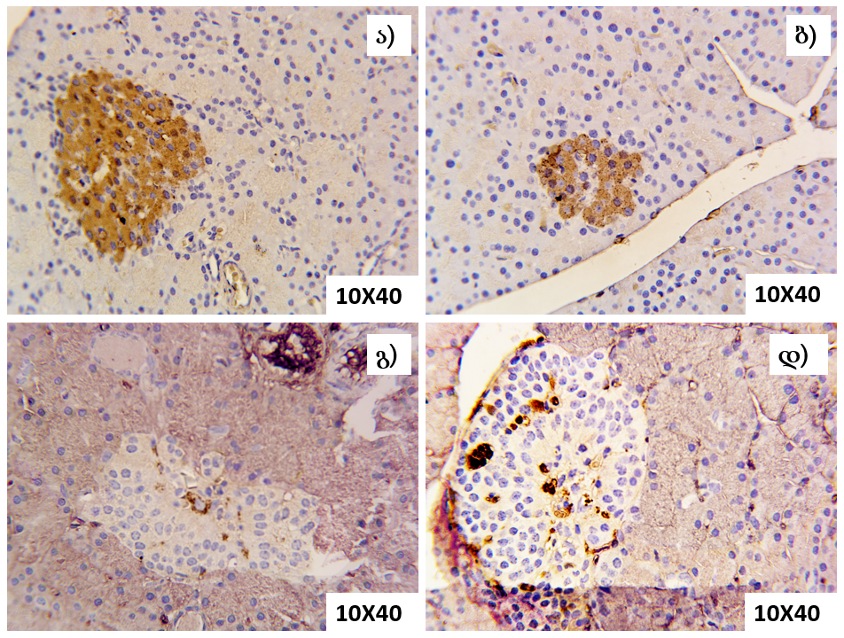
Task 2: Assessment of the activity of insulin-producing cells in the pancreas of adult rats by immunohistochemical analysis
a
b
a, b - control group - intact animals - experimental group animals (48 hours) - c, d.
c
d
At 48 hours after alloxan injection, a decrease in the intensity of pancreatic β-cell staining indicates the development of diabetes.
Notes:
To confirm alloxan-induced hyperglycemia, we performed an immunohistochemical analysis of the pancreas, where it is clearly seen that the intensity of beta cell staining in the pancreas of animals of the experimental group decreases compared to the control group. This confirms the effective action of Alloxan.

Slide 11
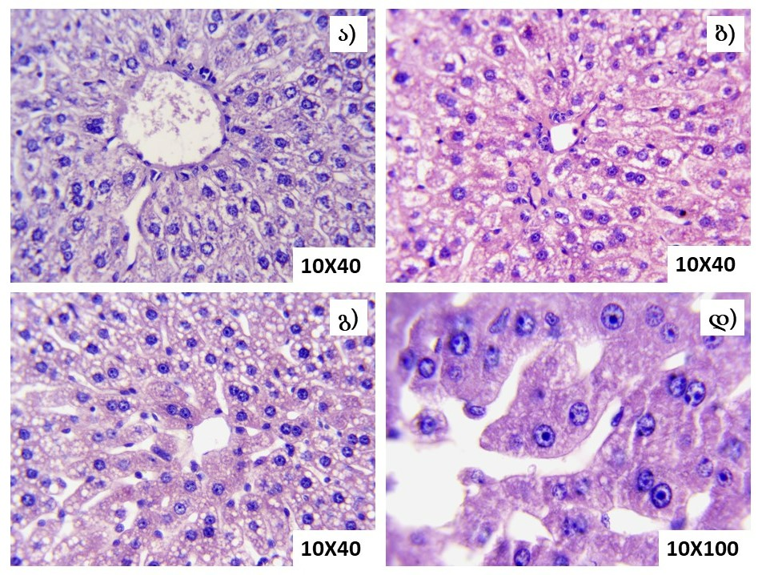
Task 3: Study of the effect of alloxan injection on the histoarchitectonics of the liver in adult rats
A - control group - intact animals;
b - I experimental group - animals 24 hours after alloxan injection;
c and d - experimental group II - animals 48 hours after alloxan injection.
At the 48th hour, in the histoarchitectonics of the liver tissue, a partial oscillation of the fibrous structures and depletion of the cytoplasm is noted.
Notes:
11. This is the histoarchitectonics of the liver. At the 48th hour, in the histoarchitectonics of the liver tissue, a partial oscillation of the fibrous structures and depletion of the cytoplasm is noted.

Slide 12
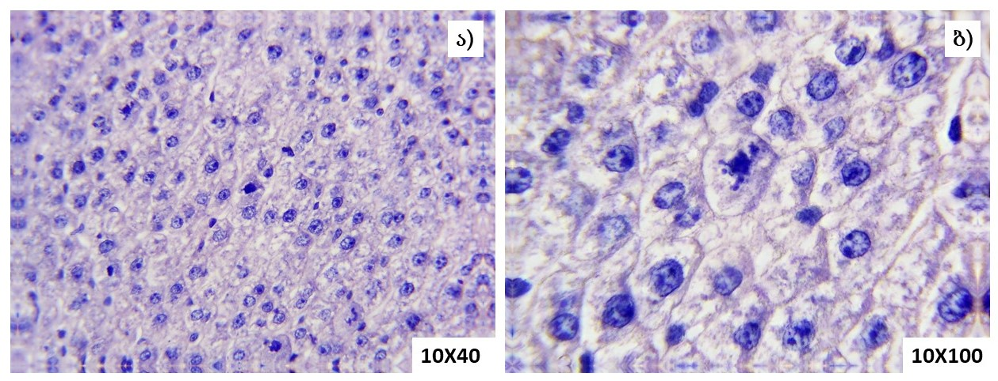
Task 4: Assessment of the proliferative activity of the liver of adult rats at the initial stage of the development of alloxan diabetes
a, b – mitotic figure in liver tissue of rats
24 h 48h
Notes:
12. A single injection of alloxan does not affect the proliferative activity of adult rat hepatocytes.

Slide 13
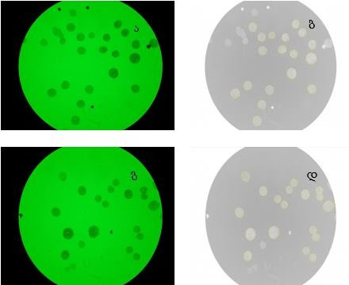
Task 5: Study of changes in the ratio of hepatocytes of different ploidy in the liver of adult rats at the initial stage of the development of alloxan diabetes
a, c - isolated hepatocytes stained with Fiolgen reaction; b, d - photo after processing in ImageJ software (10×100)
The liver responds to the functional load caused by hyperglycemia by multiplying the genome.
Notes:
After evaluating proliferative activity, we decided to see how the ratio of hepatocytes of different ploidy changed at the initial stage of disease development. At 24 hours after alloxan injection, there are no significant changes in experimental group animals compared to intact ones, and at 48 hours after injection, the number of 2C cells is significantly reduced and the number of 4C cells is increased in experimental group animals. Therefore, at the early stage of the development of alloxan diabetes, the liver responds to the increased functional load by producing high-ploidy cells. but how? I said that there was no change in proliferative activity. Then how did highly ploidy cells arise?

Slide 14
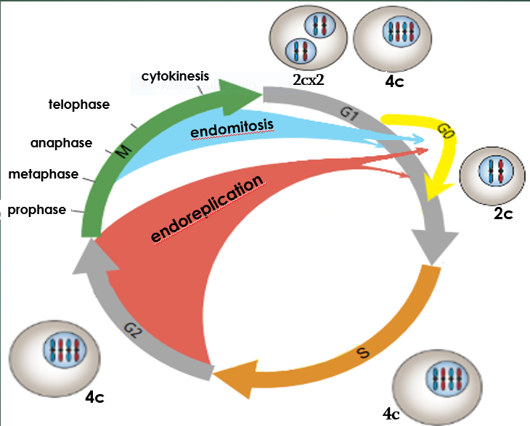
poliploidisation
G20
Notes:
The answer to this is the endoreduplication mechanism. Classically, high-ploidy cells are produced by incomplete mitosis. At this time, at the end of mitosis, cytokinesis and karyokinesis do not occur, and a uninucleate highly ploidy cell is formed. Or karyokinesis occurs and cytokinesis does not occur and a highly ploidy binucleate cell is formed. During endoreduplication, the cell cycle begins. After the G1 phase, the DNA concentration doubles from 2C to 4C through replication in the S phase, and the cell exits the cycle in the G2 phase. Such cells are called G20 population cells. The cell may then skip mitosis and start a new cycle again, resulting in a 4C to 8C octaploid cell. Since these cells are in the G20 phase, In the case of a proliferation signal, they go directly into the mitotic phase. The liver begins to proliferate when it loses mass. After the partial hepatectomy performed by us, we get mitotic figures not in 24 hours, but rather in 6 hours. This is because the cell is already in the G2 phase and does not need to go through the G1 and S phases.

Slide 15
Liver proliferative activity 6 hours after partial hepatectomy in condition of aloxan injection(48th hour).
24 h 48h 48h+6h

Slide 16
Endoredublication
G20
Notes:
The answer to this is the endoreduplication mechanism. Classically, high-ploidy cells are produced by incomplete mitosis. At this time, at the end of mitosis, cytokinesis and karyokinesis do not occur, and a uninucleate highly ploidy cell is formed. Or karyokinesis occurs and cytokinesis does not occur and a highly ploidy binucleate cell is formed. During endoreduplication, the cell cycle begins. After the G1 phase, the DNA concentration doubles from 2C to 4C through replication in the S phase, and the cell exits the cycle in the G2 phase. Such cells are called G20 population cells. The cell may then skip mitosis and start a new cycle again, resulting in a 4C to 8C octaploid cell. Since these cells are in the G20 phase, In the case of a proliferation signal, they go directly into the mitotic phase. The liver begins to proliferate when it loses mass. After the partial hepatectomy performed by us, we get mitotic figures not in 24 hours, but rather in 6 hours. This is because the cell is already in the G2 phase and does not need to go through the G1 and S phases.

Slide 17
conclusion
1. At the initial stage of the diabetes, the liver responds to the functional load caused by alloxan diabetes by activating the endoreduplication mechanism and generating a population of G2-0 cells.
2. In the conditions of hyperglycemia caused by alloxan injection, without a change in the mitotic activity of the liver, the quantitative increase of high-ploidy cells is a peculiar adaptation of the organ.

Slide 18
Thank you for attention

Slide 19
Task 6: Changes in the ratio of hepatocytes of different ploidy in the liver of an adult rat at the initial stage of regenerative growth (partial hepatectomy)
60.00
cell count %
intact
50.00
PH 18h
40.00
PH 24h
30.00
PH 36h
20.00
PH 48h
10.00
0.00
2c
2cx2
4c
4cx2
8c
In the animals of the experimental group, 24 hours after the operation compared to the intact ones, the number of 2с cells increased statistically, the percentage of 2cx2 and 4с cells decreased. which indicates that cell proliferation begins at this time.
Notes:
24 hours after partial hepatectomy, it was determined that there were no statistically significant changes in hepatocyte ploidy 18 hours after the operation in the animals of the experimental group compared to the intact group. It should be noted that the number of 2с cells increased statistically significantly, the percentage of 2cx2 and 4с cells decreased 24 hours after the operation in the animals of the experimental group. which indicates that cell proliferation begins at this time. The number of 4cx2 and 8с cells also remains unchanged (Fig. 13). In the animals of the experimental group, compared to the intact group, no statistically significant changes in the share of different ploidy cells were detected even at the later time points (36h and 48h). Based on all of the above, we can make the following conclusions:

Slide 20
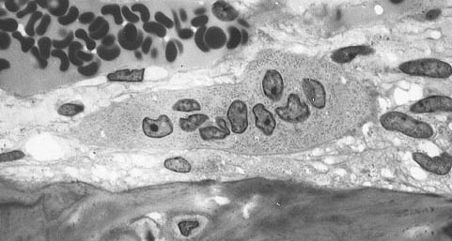
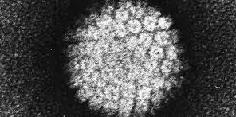
უჯრედების შერწყმა

Slide 21
არასრული მიტოზი

Slide 22
Tasks:
Development of an alloxan diabetes model
Study of changes in the histoarchitectonics of tissues using light microscopy on permanent slides made from paraffin illumination of rat liver tissue.
Assessment of changes in liver proliferative activity of adult white rats by determination of colchicine mitotic index
Studying the changes in the quantitative ratio of hepatocytes of different ploidy in the liver of adult rats at different times (24 h and 48 h) after the injection of alloxan
Study of changes in the quantitative ratio of hepatocytes of different ploidy in adult rat liver at the initial stage of regenerative growth (partial hepatectomy)
Evaluation of quantitative changes of insulin-producing cells in the pancreas of intact and experimental group animals by immunohistochemical method

Slide 24
