Slide 1
Particulate matter measurement in ambient atmosphere
Chair of Physical and Analytical Chemistry, Department of Chemistry, Tbilisi State University, Tbilisi, Georgia , SMART|AtmoSim_LAB
Student: Mariam Shanidze
mariam.shanidze601@ens.tsu.ge
Supervisor: Prof. Bezhan Chankvetadze Dr. Giorgi Jibuti
Co-authors: Ani Rurua, Lika Kirtadze, Nino
Jajanidze
September 16, 2022

Slide 2
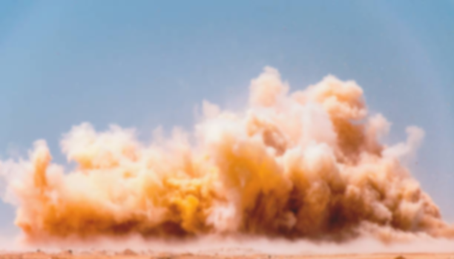
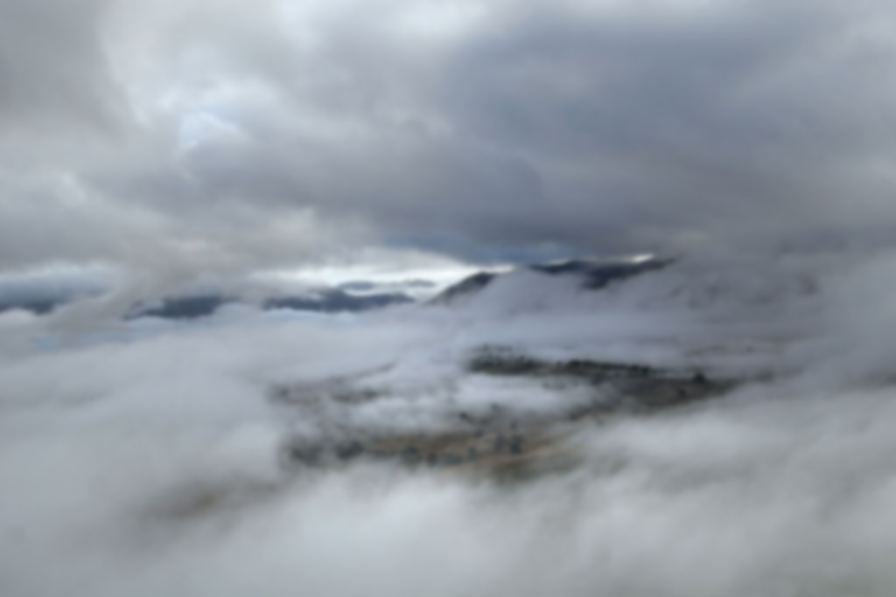
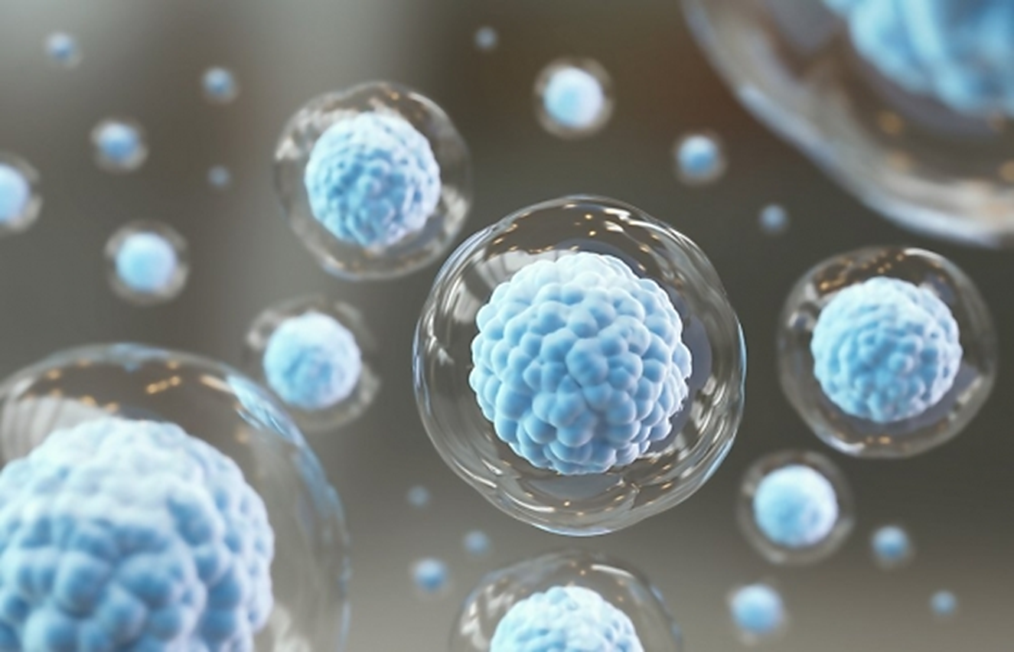
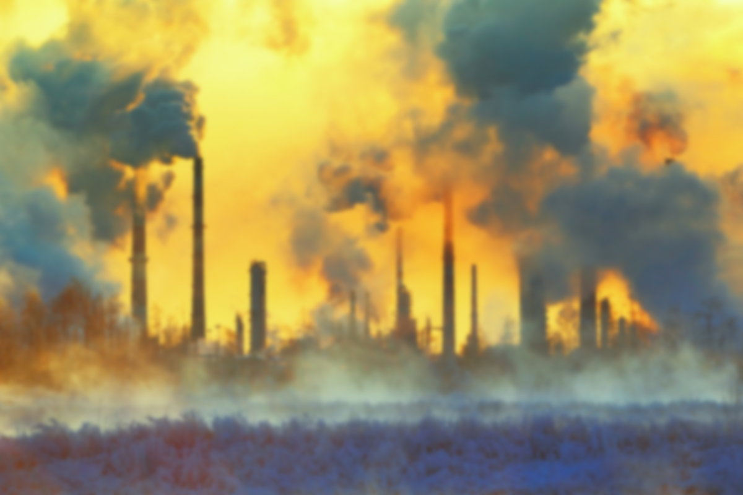
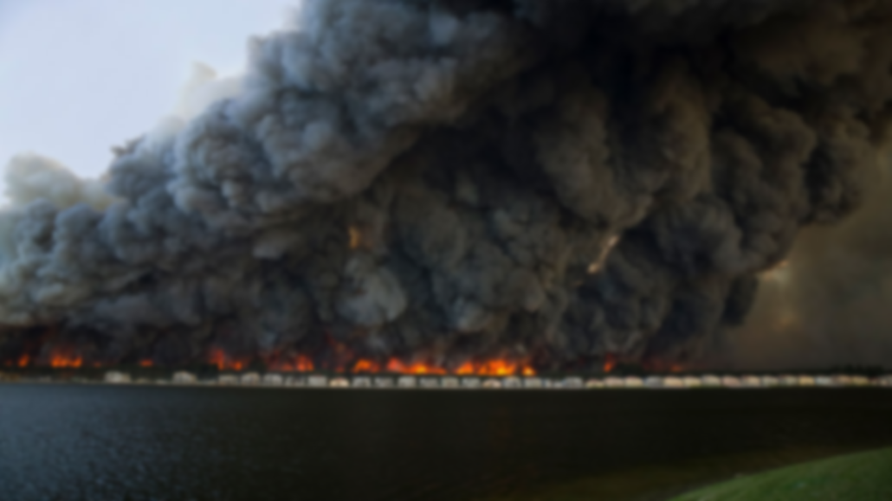

Slide 3
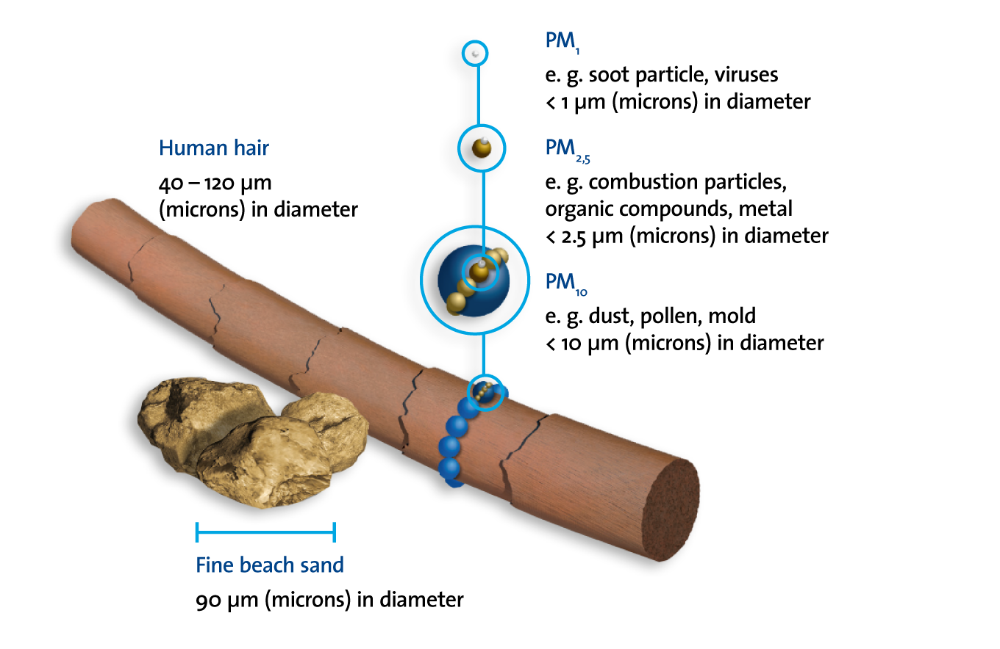
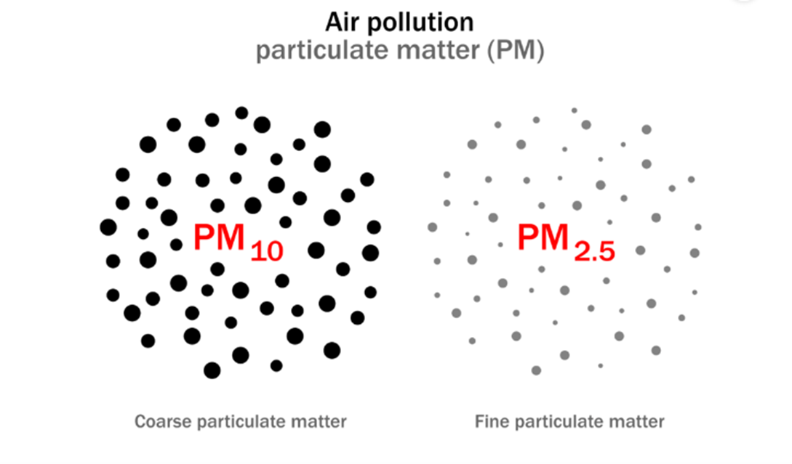
PM 2.5 and PM 10
PM10, also called coarse particulate matter, and PM2.5, otherwise referred to as fine particulate matter, are both different types of particulate matter pollution, categorized according to their size and relative impact on our health. Particulate matter that is classified as PM10, are all particles that are smaller than 1/5th of a human hair and PM2.5, are all particles that are smaller than 1/20th of a human hair.

Slide 4
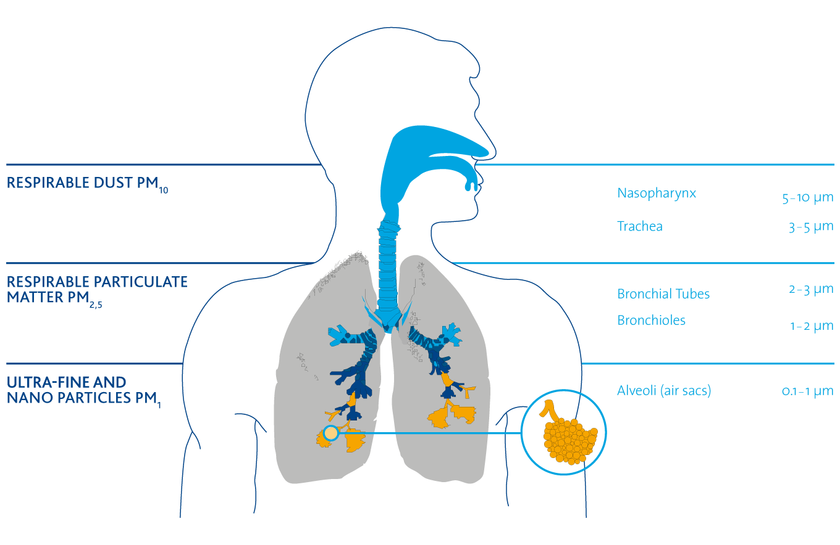
Particulate matter’s link to different diseases
The size of particles affects their potential to cause health problems:
PM10 : these particles are small enough to pass through the throat and nose and enter the lungs. Once inhaled, these particles can affect the heart and lungs and cause serious health effects.
PM2.5: these particles are so small they can get deep into the lungs and into the bloodstream. There is sufficient evidence that exposure to PM2.5 over long periods (years) can cause adverse health effects.

Slide 5
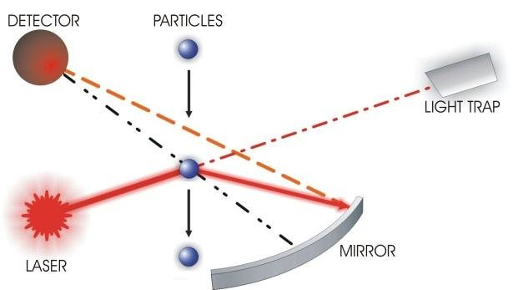
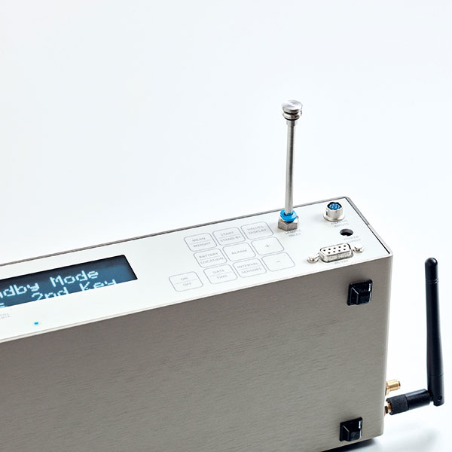
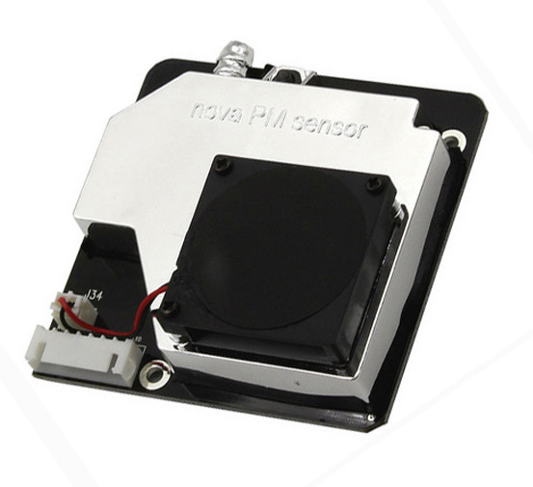
General Principles of Operation
.
Light scattering measurement of single particles comes into operation within every device of the 1.100 series consequently also at the model 1.129 at which a laser diode serves as light source. The 90° light scatter with an about 60° angle of beam spread is directed via mirror onto a receiving diode. When particles cross the laser beam they emit a light pulse. After adequate amplifying the signal of the detector is being classified.

Slide 6
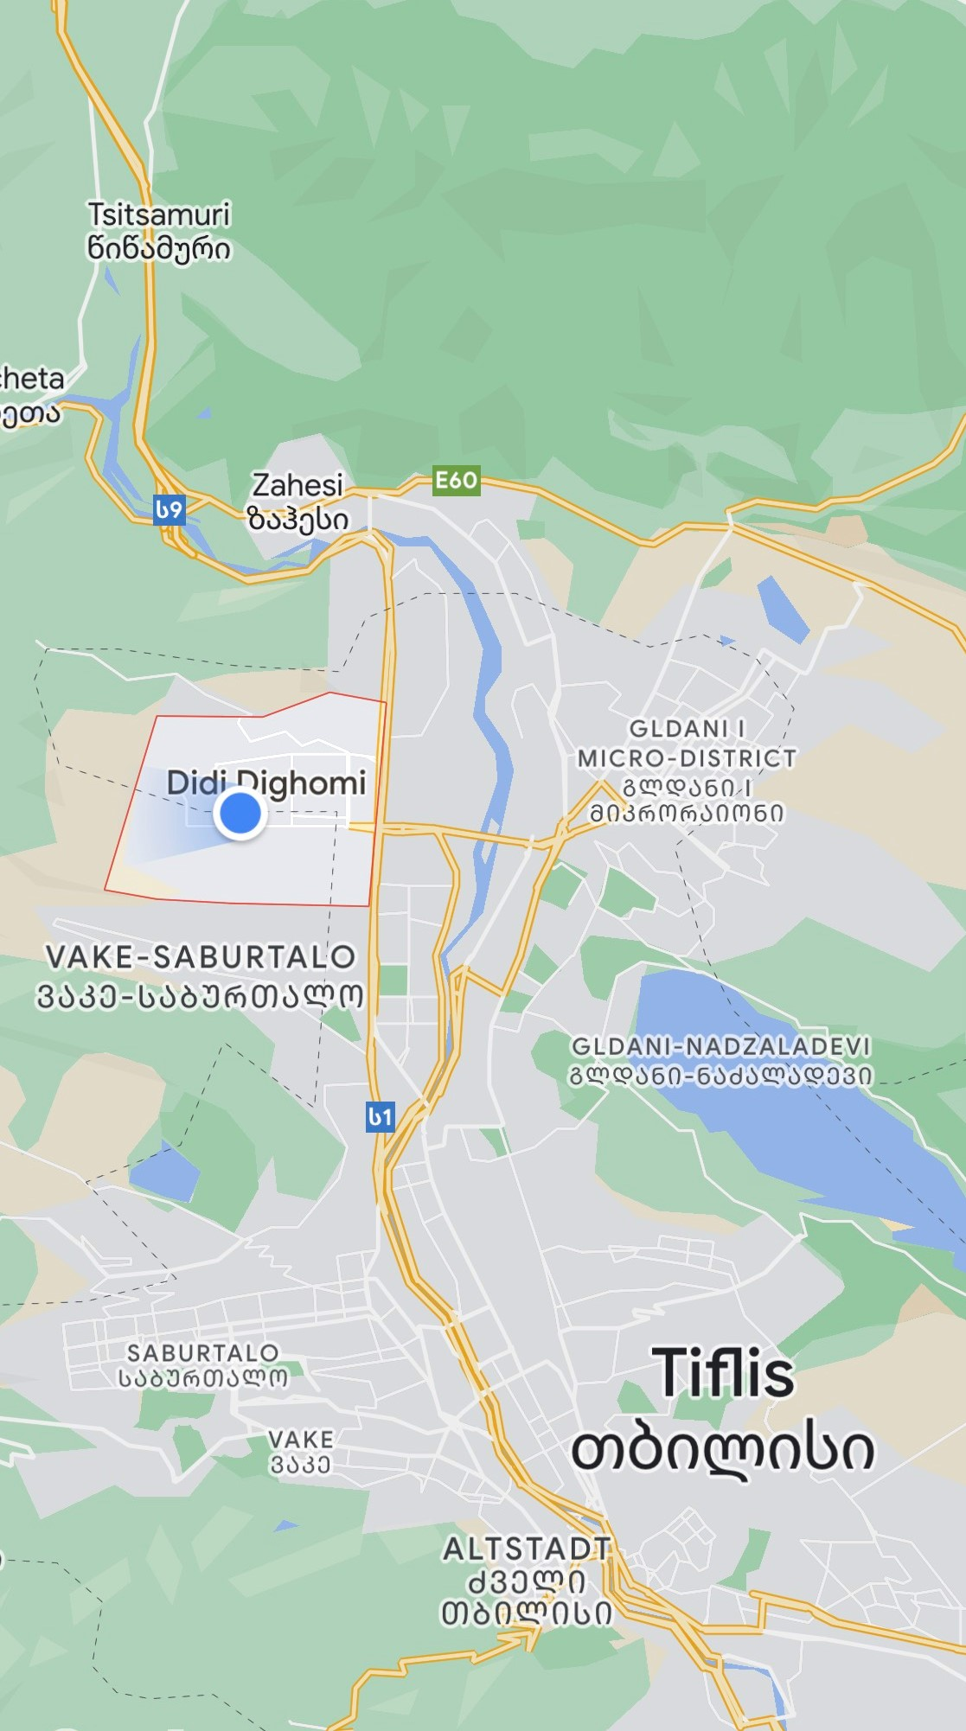
Didi Dighomi
 |  |  | Mean of Grimm in mg/m³
Date | Start time | Finish time | PM 2.5 | PM 10
20-Aug | 13:09 | 14:10 | 12.08 | 58.75
 | 19:03 | 20:05 | 21.60 | 66.41
21-Aug | 12:46 | 13:48 | 24.35 | 85.94
 | 17:49 | 18:54 | 34.39 | 127.18
23-Aug | 15:14 | 16:20 | 16.19 | 65.72
 | 17:49 | 18:55 | 8.66 | 42.72
24-Aug | 16:02 | 17:02 | 8.37 | 40.14
25-Aug | 16:22 | 17:30 | 9.01 | 40.43
 | 20:21 | 21:29 | 19.00 | 84.00
26-Aug | 12:57 | 13:57 | 11.32 | 47.78

Slide 7
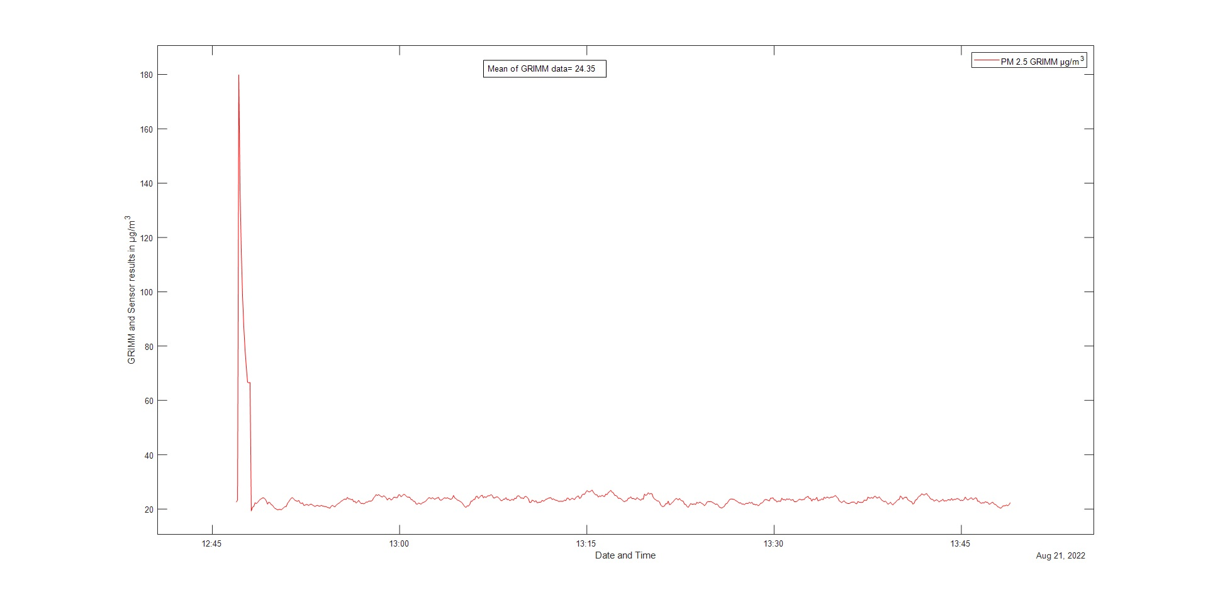
21.08.22 12:46 PM2.5

Slide 8
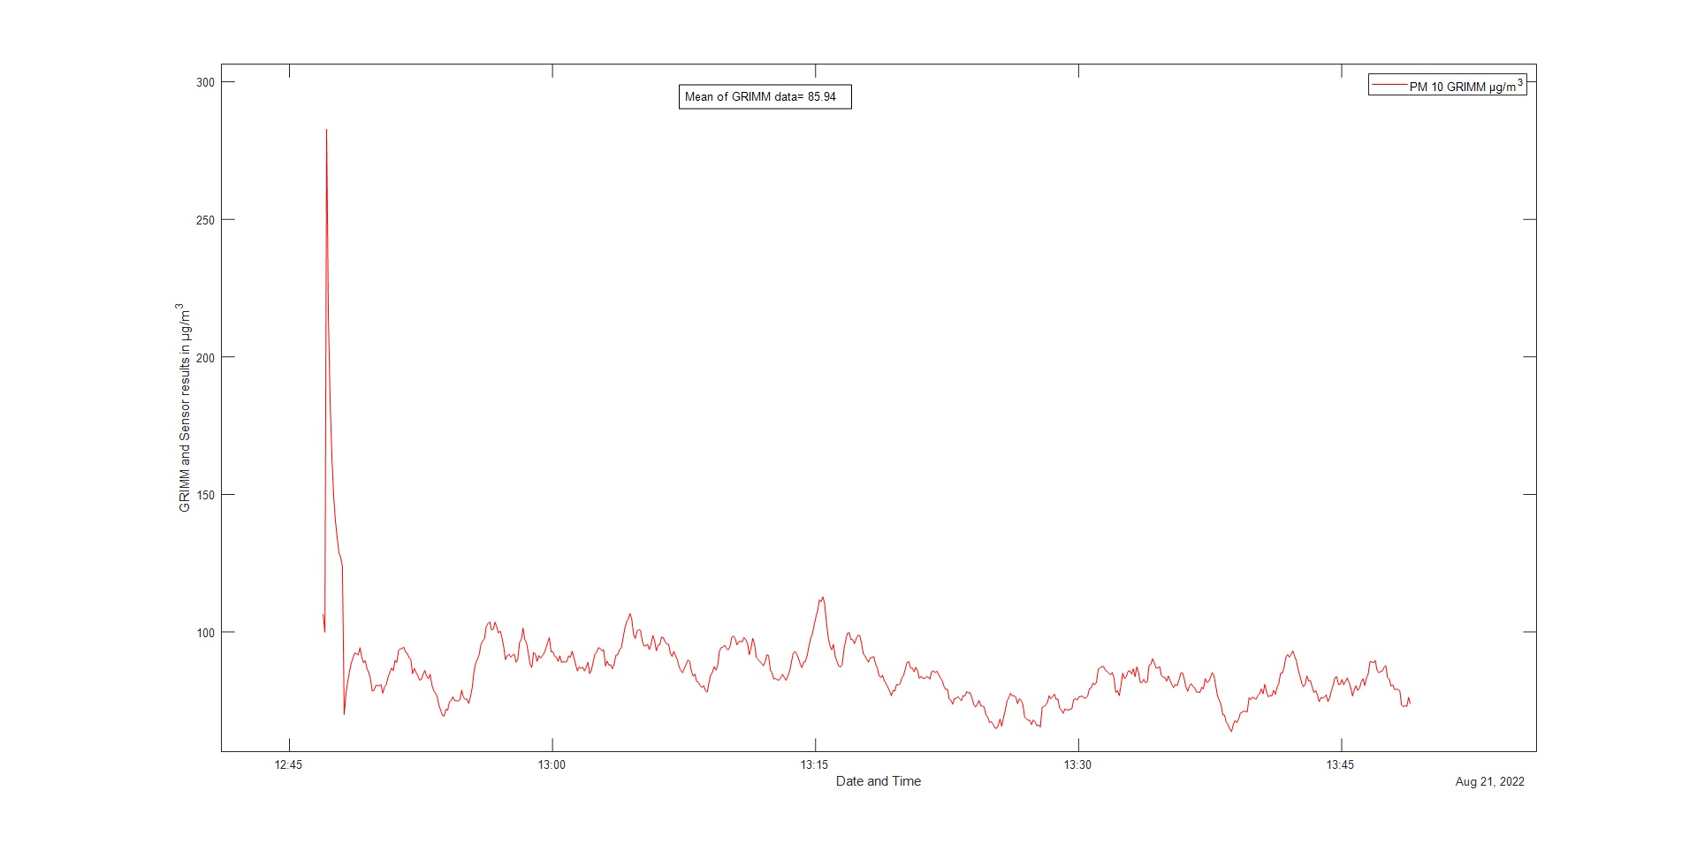
21.08.22 12:46 PM10

Slide 9
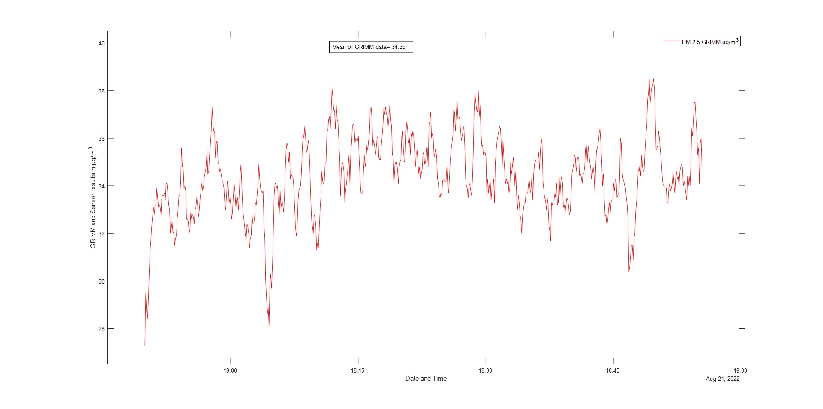
21.08.22 17:49 PM2.5

Slide 10
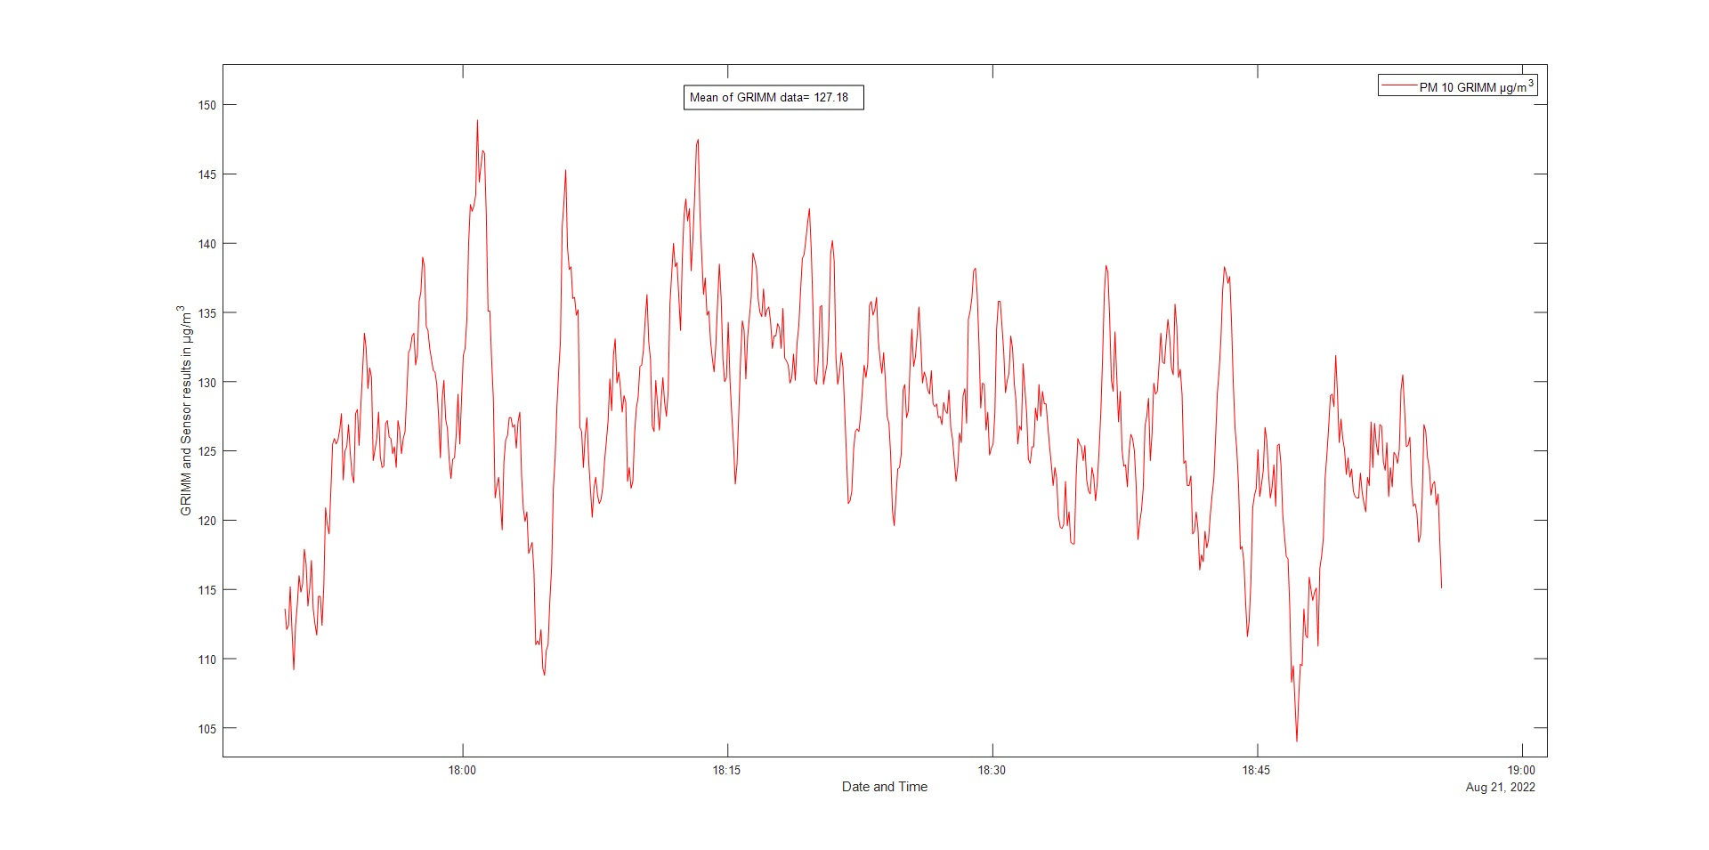
21.08.22 17:49 PM10

Slide 11
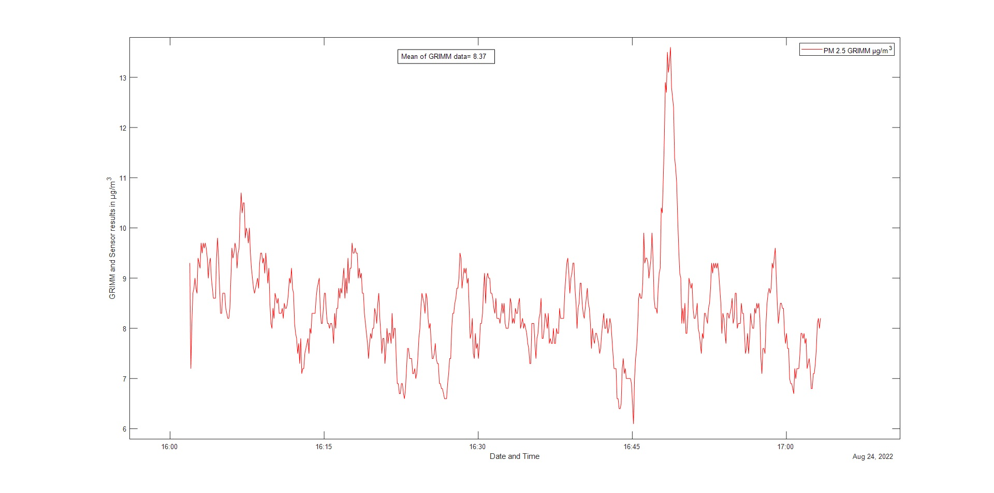
24.08.22 16:02 PM2.5

Slide 12
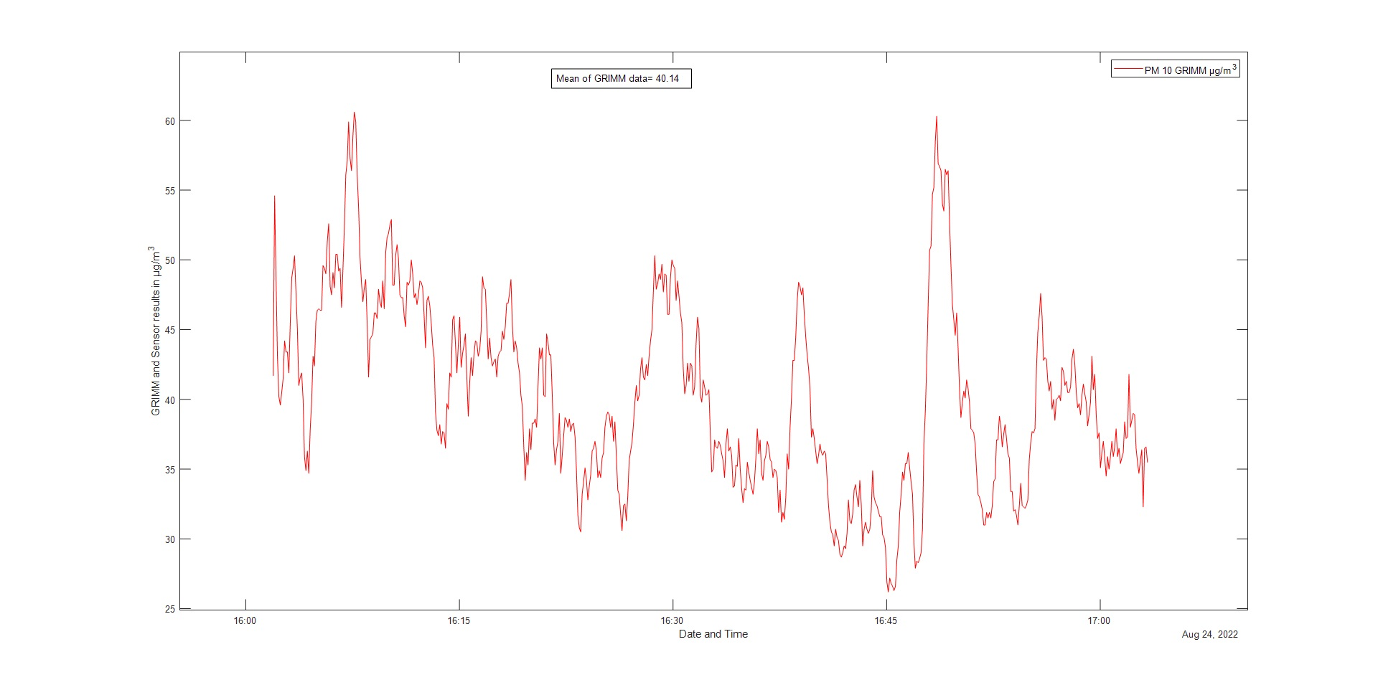
24.08.22 16:02 PM10

Slide 13
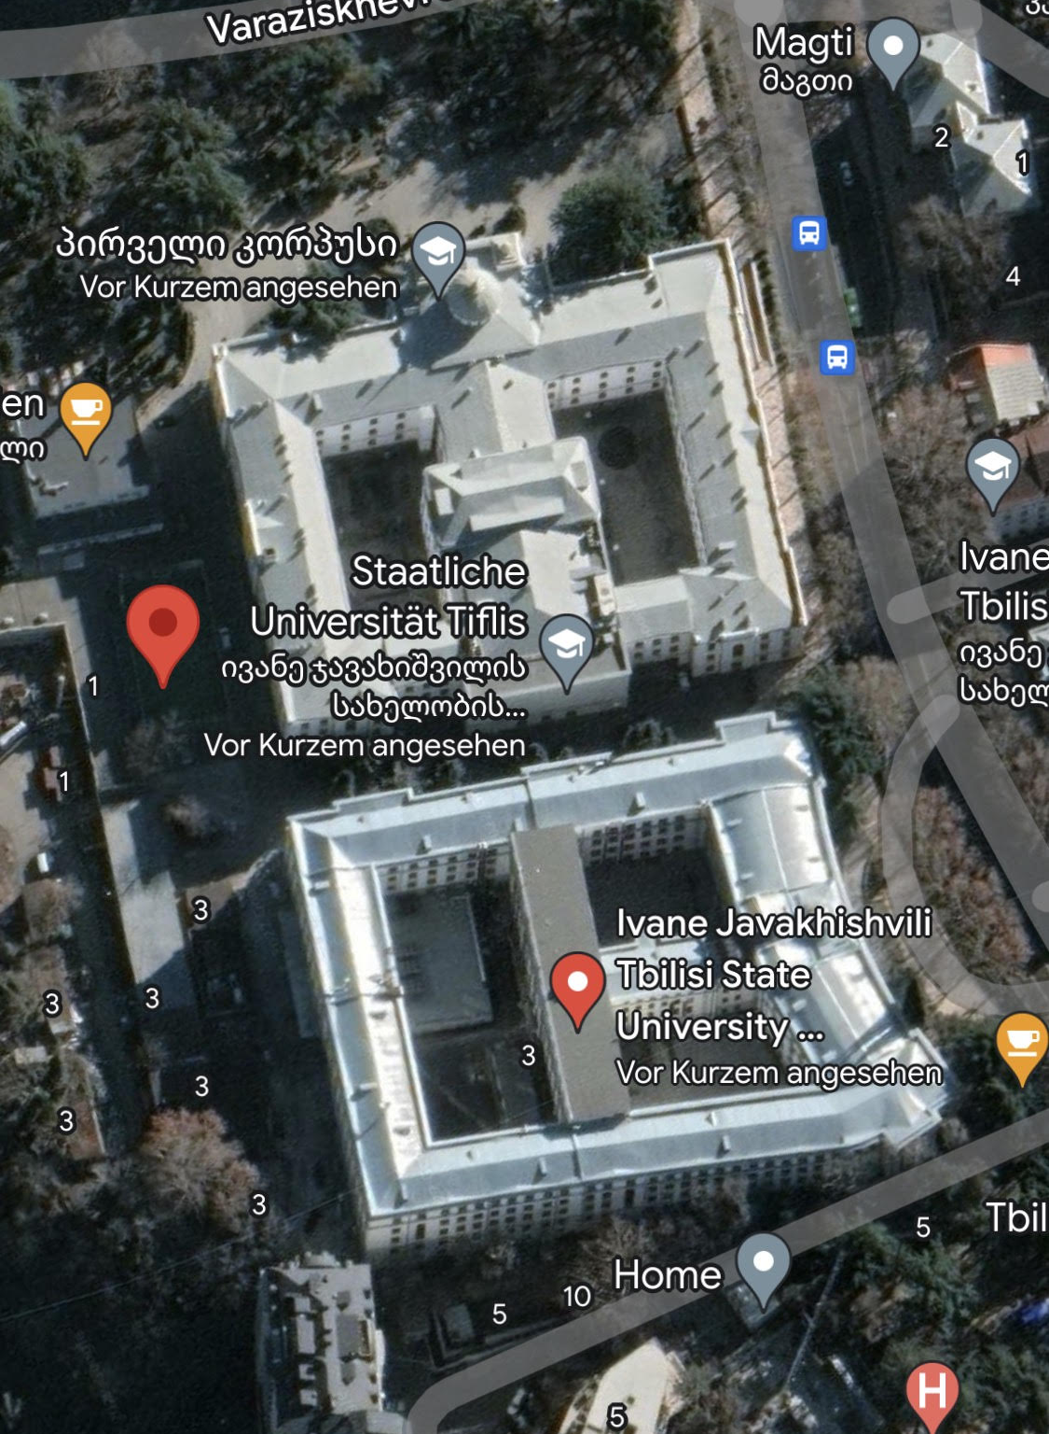
Stadium
 |  |  | Mean of Grimm in mg/m³
Date | Start time | Finish time | PM 2.5 | PM 10
15-Aug | 16:08 | 17:10 | 11.36 | 35.68
 | 18:26 | 19:24 | 10.66 | 31.23
16-Aug | 17:59 | 19:00 | 15.98 | 48.29
17-Aug | 15:54 | 16:57 | 17.32 | 65.23
18-Aug | 14:55 | 15: 57 | 23.91 | 84.50

Slide 14
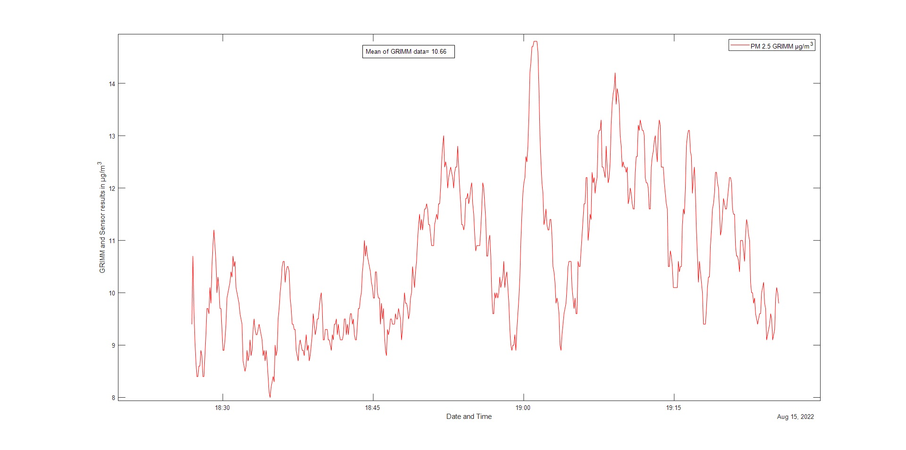
15.08.22 18:26 PM2.5

Slide 15
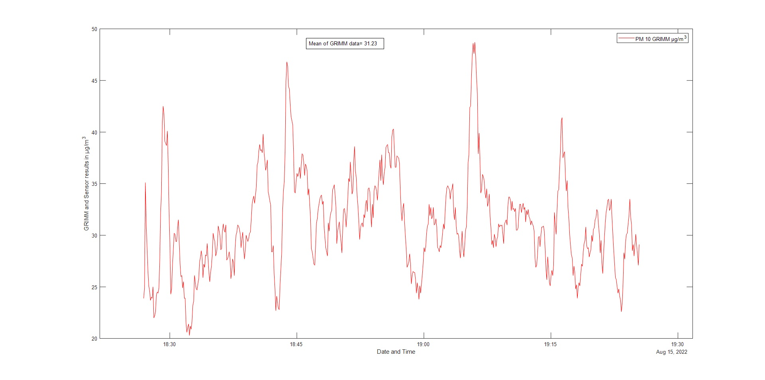
15.08.22 18:28 PM10

Slide 16
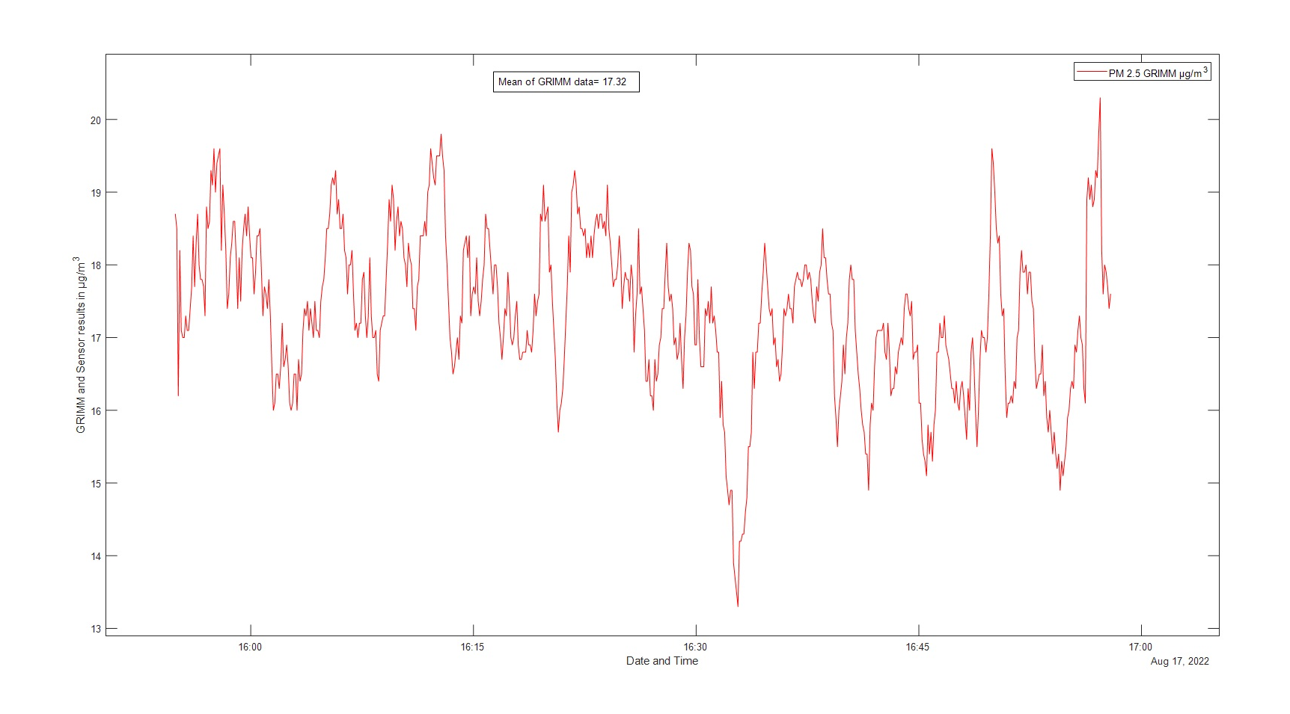
17.08.22 15:54 PM2.5

Slide 17
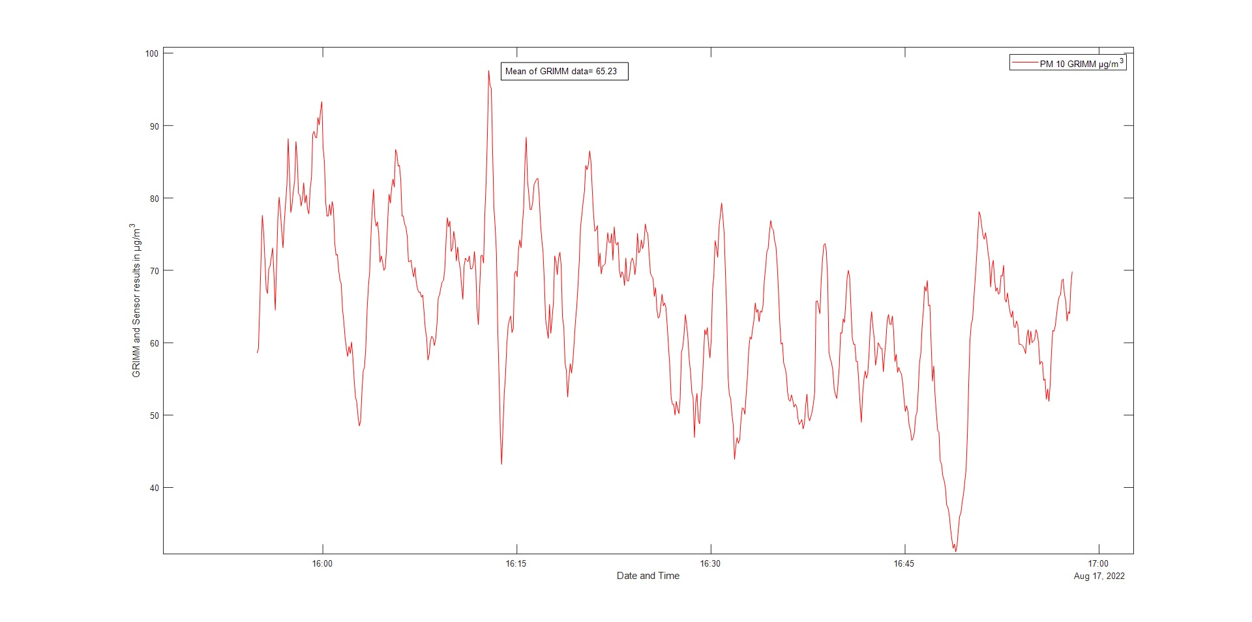
17.08.22 15:54 PM10

Slide 18
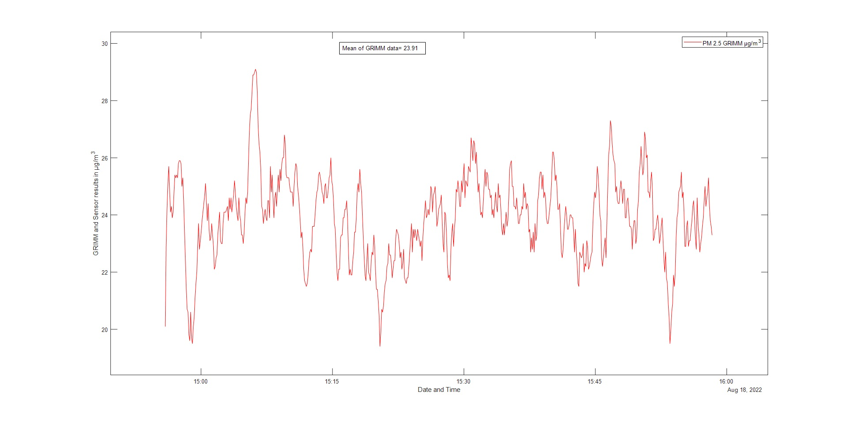
18.08.22 14:55 PM2.5

Slide 19
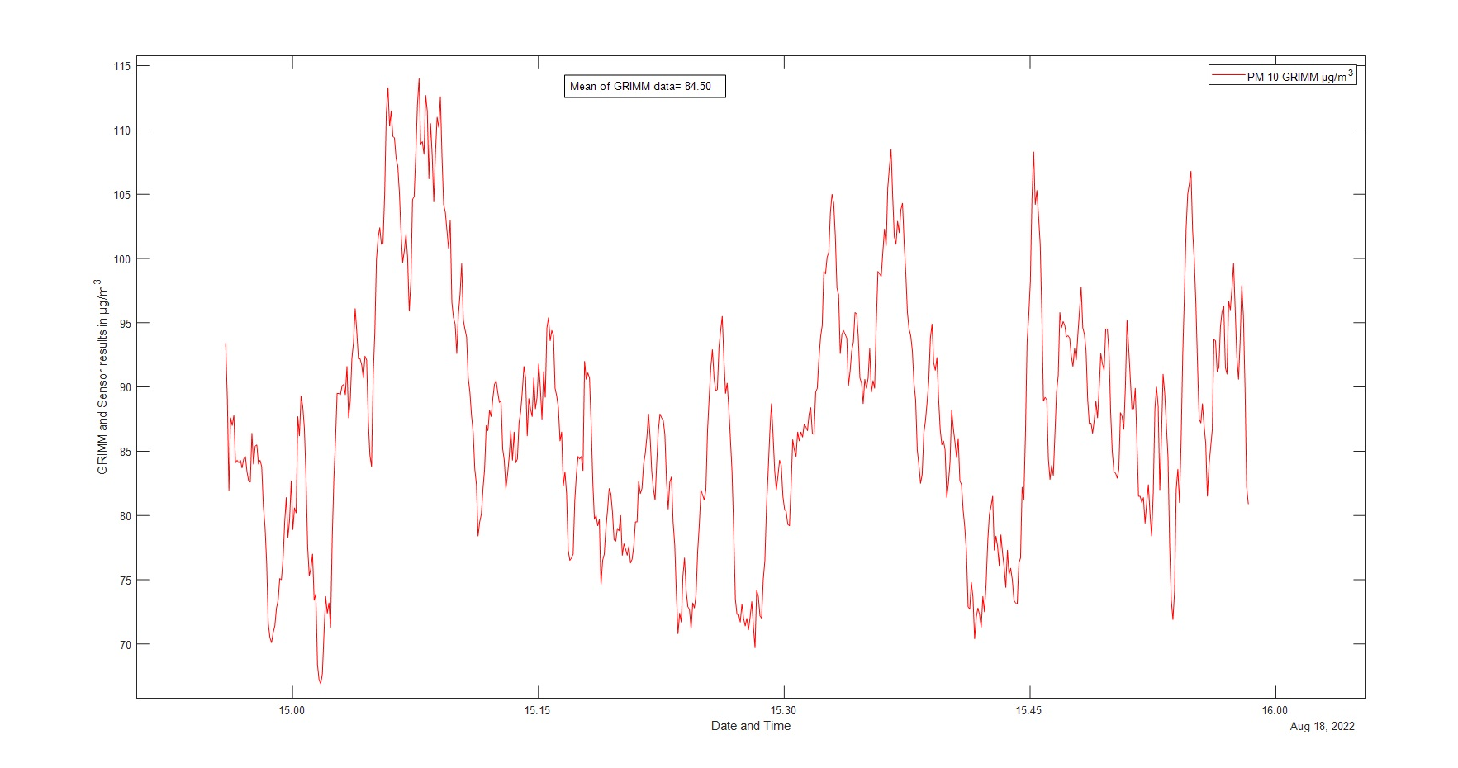
18.08.22 14:55 PM10

Slide 20
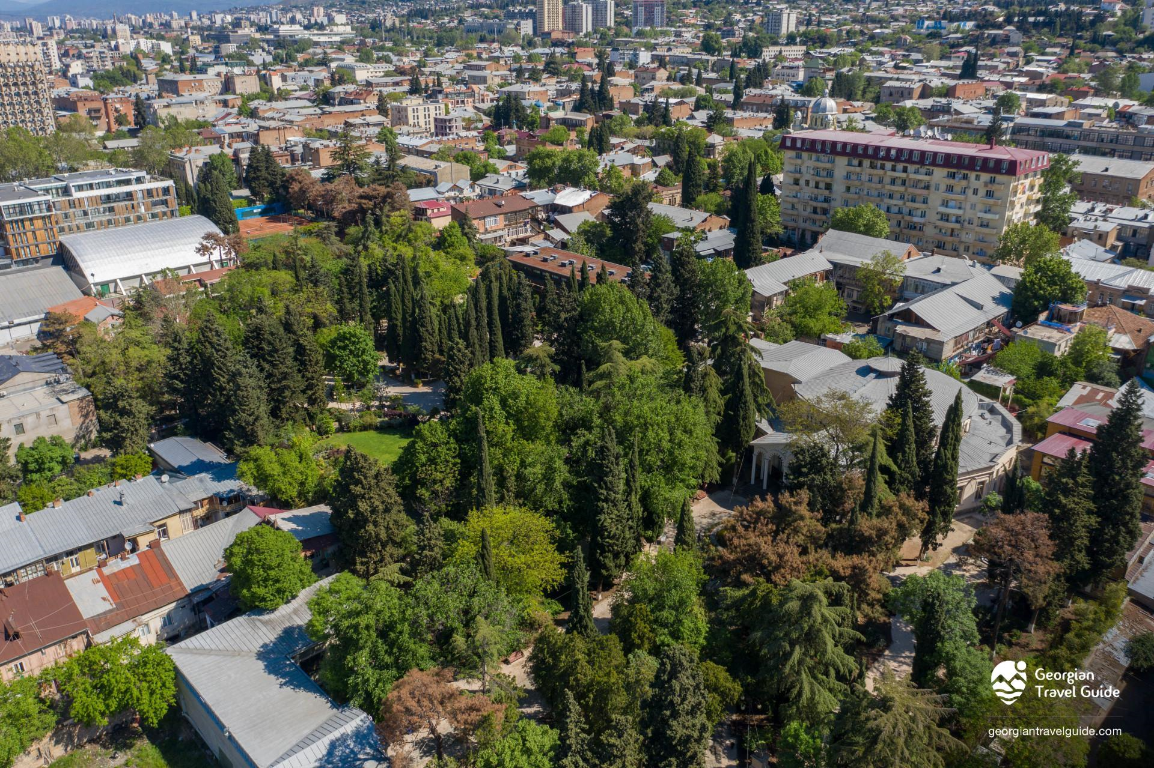
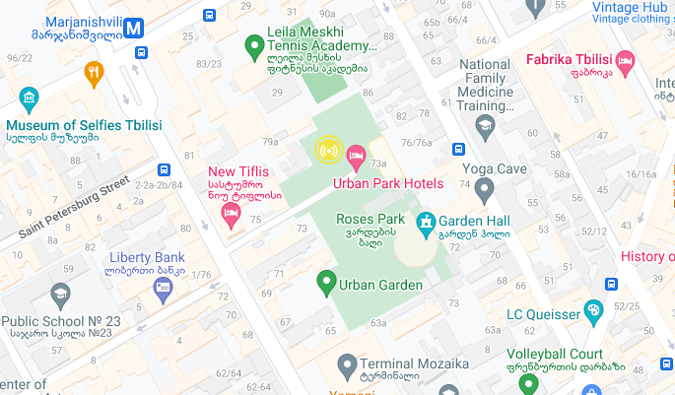
Ilia Garden
Date | Time | PM 2.5 | PM 10
15.08 | 16:08 | 15.88 | 52.95
 | 18:26 | 12.88 | 46.03
16.08 | 15:38 | 16.80 | 62.14
 | 18:00 | 14.62 | 42.99
17.08 | 15:54 | 17.90 | 79.78
 | 18:12 | 19.13 | 79.43
18.08 | 14:55 | 22.96 | 109.99
20.08 | 13:09 | 16.00 | 73.67
 | 19:03 | 16.47 | 76.84
21.08 | 12:46 | 23.74 | 109.53
 | 17:49 | 36.6 | 168.21
23.08 | 15:14 | 19.28 | 86.37
 | 17:49 | 9.86 | 44.73
24.08 | 16:02 | 10.18 | 45.66
25.08 | 16:22 | 10.34 | 48.9
 | 20:21 | 11.36 | 52.54
26.08 | 12:57 | 12.53 | 47.87

Slide 21
THANK YOU FOR YOUR ATTENTION!

