Slide 1
Innovative Methods Of Monitoring And Treatment Of Parkinson's Disease.
Bachelor student - Mariam Gulashvili
Georgian Technical University, Faculty of Informatics And Control Systems , Department of Engineering Physics. gulashvili.mariam@gtu.ge
Head of the Project- Professor D. Songhulashvili

Slide 2
The following was created within the project:
1. Smart glove for monitoring of Parkinson's one of the most frequent motor manifestation - tremor - same as limb trembling.
2. Monitoring System for not less Frequent Manifestations - bradykinesia – slowness of movement.
3. Using standing wave property to stop the deviation of the damaged brain tissue.

Slide 3
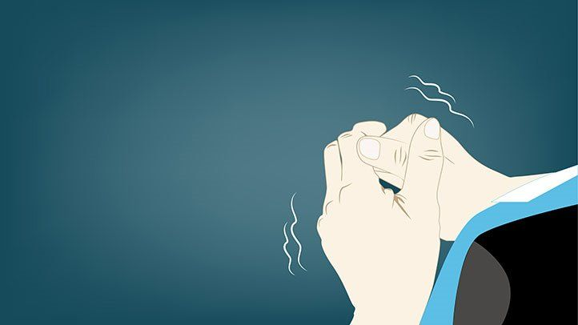
I’m introducing a 24-hour tremor monitoring system that provides accurate information to the doctor remotely and does not require constant patient visits, which is often associated with problems.

Slide 4
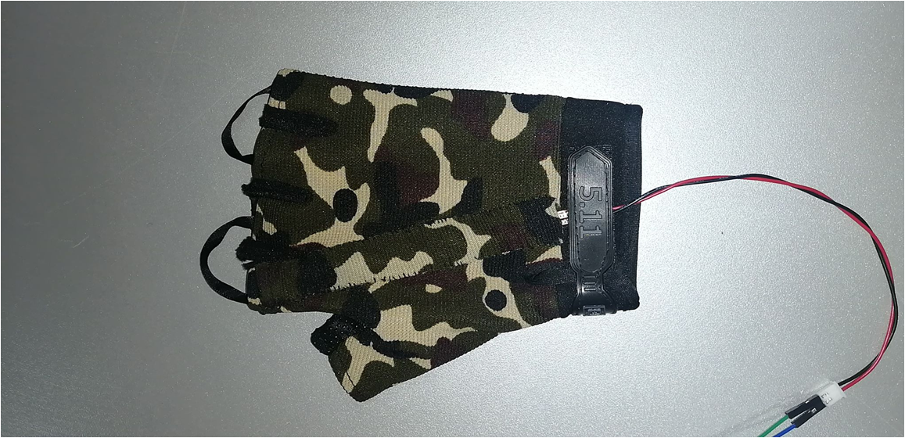
To monitor tremor (limb tremor) and measure frequency, we have created a universal "SMART glove" with a built-in tensor resistor .

Slide 5
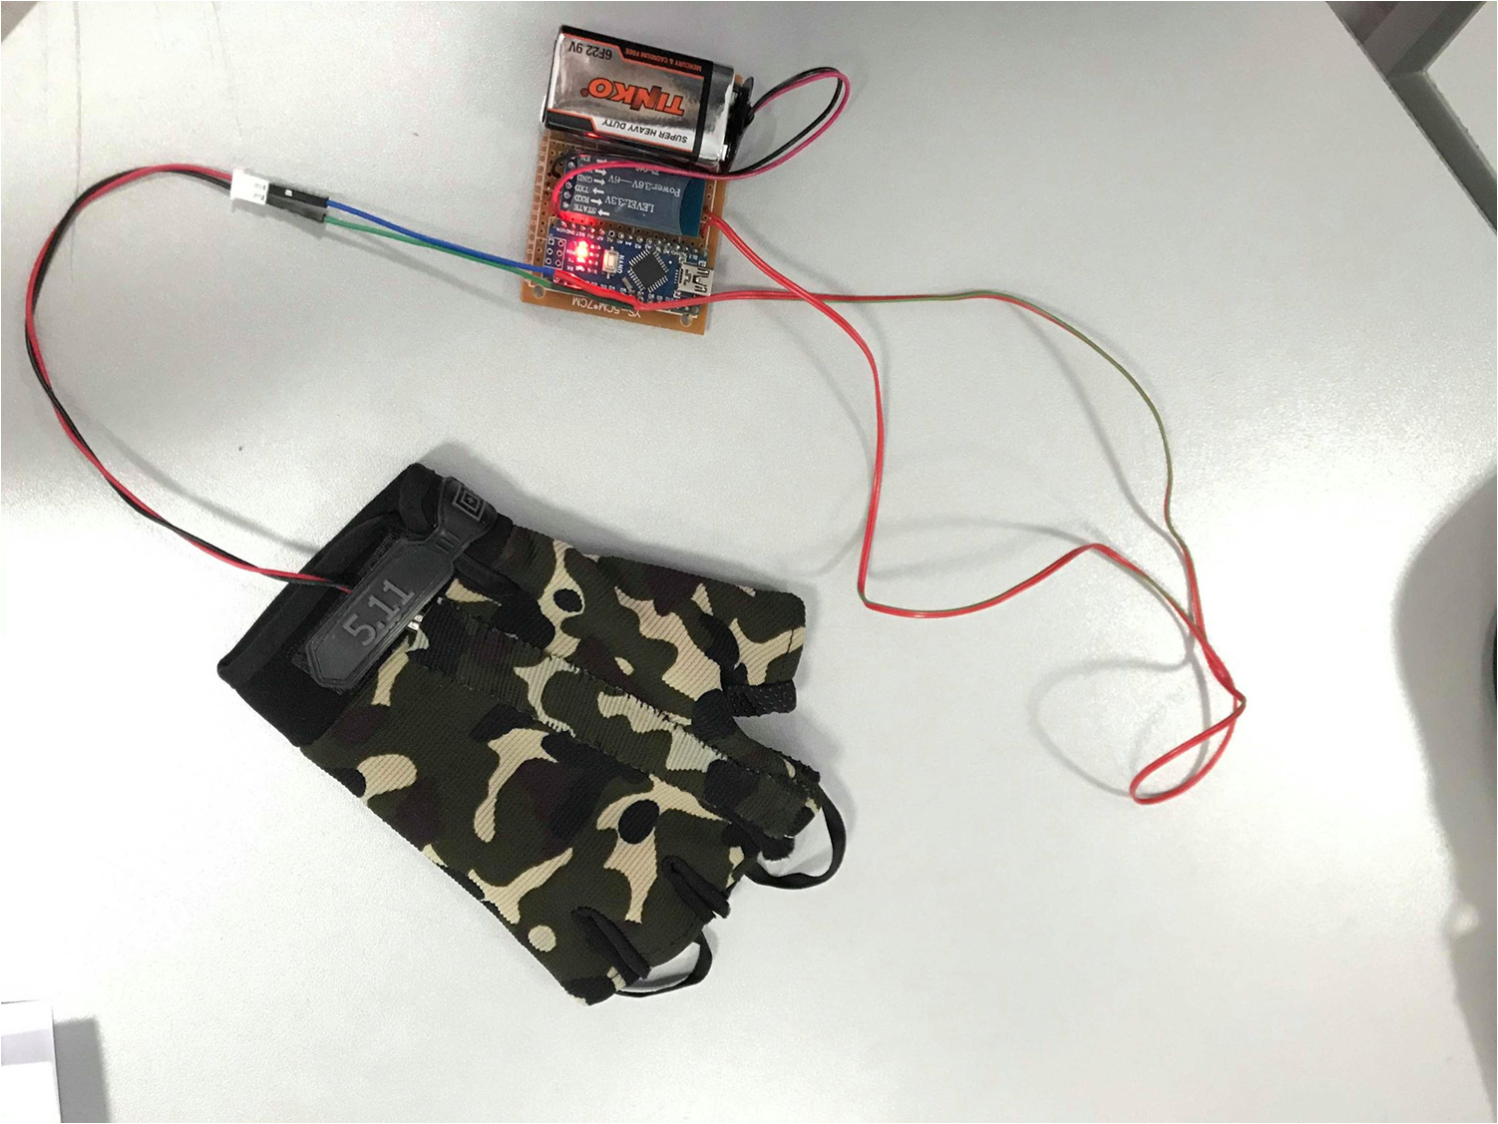

Slide 6
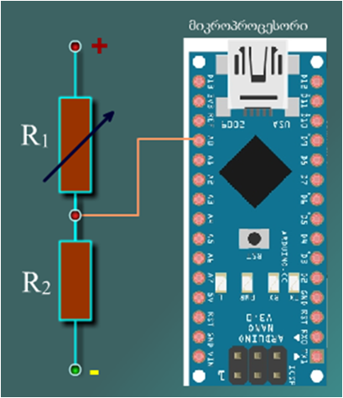
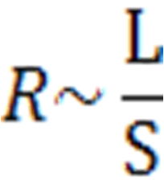
As you may know, a tensor resistor is a sensor changing resistance depending on its deformation, because during deformation the cross-sectional area of the conductor changes and the resistance changes accordingly. The latter even causes a change in the voltage across the voltage divider. Which means that the frequency and amplitude of the voltage change are directly proportional to the amplitude and frequency of the tremor. After the data is processed by the microprocessor, the monitor displays the image of tremor, frequency and amplitude.

Slide 12
Software code was written to monitor bradykinesis in Microsoft Visual Basic using the Open Source Computer Vision Library which provides filtering of contrasting images.
To detect the trajectory of motion, a sharply different colored object must be moved on a homogenous background. On this principle we have monitored the bradykinesia. A yellow-spotted black glove moves on a black background. Relative coordinates are transmitted to the imaging program compiled in ActionScript 3.0 (AS3) for remote diagnostics, then the result of the treatment is reflected, which manifests itself in trajectory linearity and reduction of limb movement time intervals.

Slide 13
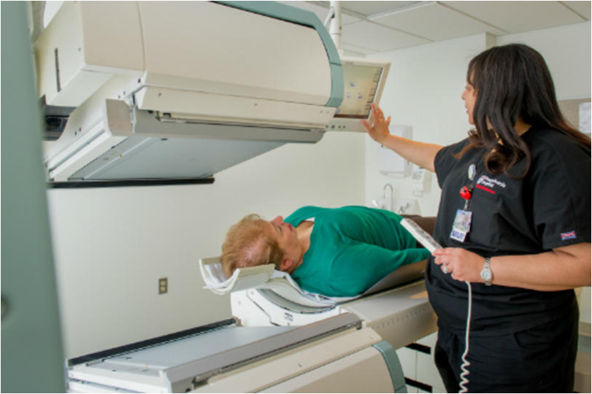
Parkinson's disease is a progressive neurodegenerative process . Multifaceted work is underway around the world to improve both medical and instrumental and surgical treatment methods. Every treatment method has its side effects. The least invasive method at this time is the focused ultrasound (with MRT control).

Slide 14
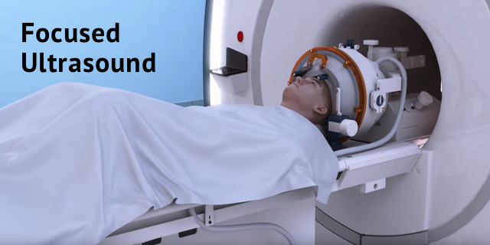

Slide 15
The main goal and innovation of the research is to use a standing wave generator to minimize the deviation process, to freeze the target area and to minimize the risk of damage other tissues!

Slide 16
The points where the oscillation amplitude is equal to 0 are called standing wave nodes.The number of nodes depends on the frequency of the wave.The acoustic pressure in the sound wave nodes is equal to 0,which means they have the ability to capture an object.

Slide 17
Finally, to summarize, we present the 24-hour monitoring systems for tremor and bradykinesia, which can be used both in direct contact with the doctor and the patient, and remotely, which is especially relevant in today's reality. And second, to the current treatment method - focused ultrasound exposure, we added a standing wave effect, which we called "ultrasound tweezer."

Slide 18
Today's reality has shown us how great challenges medicine can face and how important the development of technology in the 21st century is to save human health and lives

Slide 21
