Slide 1




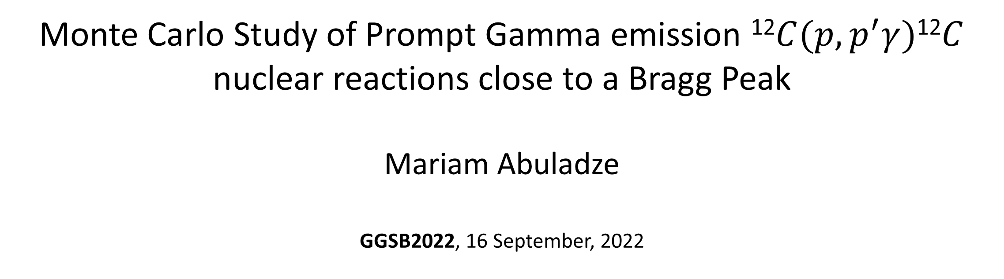
Monte Carlo Study of Prompt Gamma emission ¹²$C(p,p^{′}γ)$¹²$C$ nuclear reactions close to a Bragg Peak
Mariam Abuladze
GGSB2022, 16 September, 2022
Supervisors: Revas Shanidze
Achim Stahl

Slide 2
Outline
Description of technique of proton therapy monitoring - Prompt Gamma Imaging (PGI)
Geant4 Simulation
Results
  Experimental results
    Prompt Gamma Spectrum detected from six different Angles
    4.4 MeV and 9.64 MeV Gamma line shapes
Conclusion

Slide 3
Motivation
PGI has an advantage over PET monitoring and treatment planning
The study of properties of each peak in a PG spectra is important for PGI imaging development
  Shape and angular distribution of 4.4 MeV depends on the phase space of incoming proton beam (Experiment at (HIT), 2015)
  The intensity of 4.4 MeV peak correlates with Bragg Peak position (Experiment at (HIT), 2015)
  The study of these properties might be important for detector positioning
Hadron Therapy Center at Kutaisi international University

Slide 4
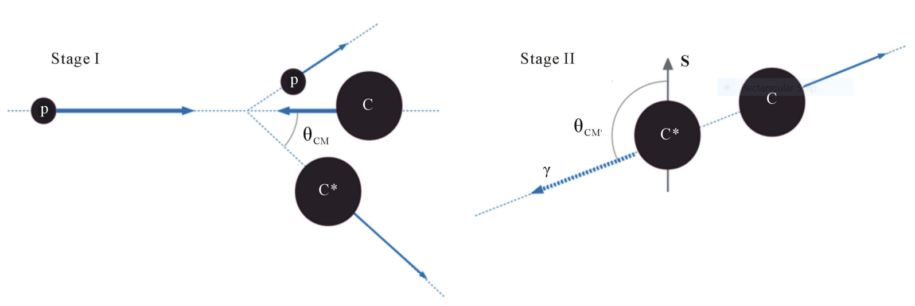
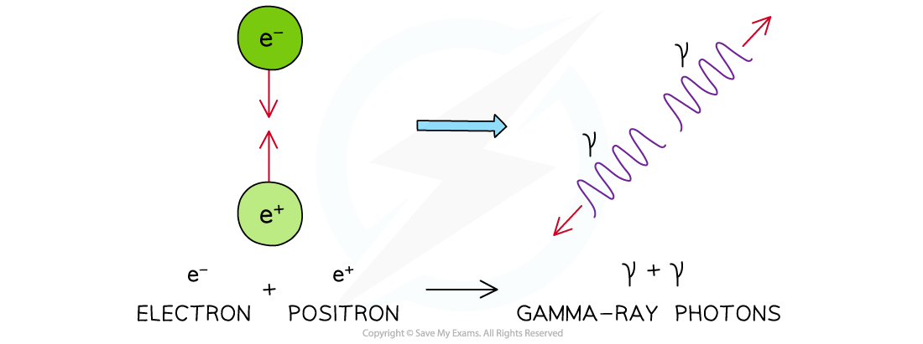
Motivation
PGI has an advantage over PET monitoring and treatment planning
Inelastic Collision and PGI emission
Inelastic Collision and PGI emission

Slide 5
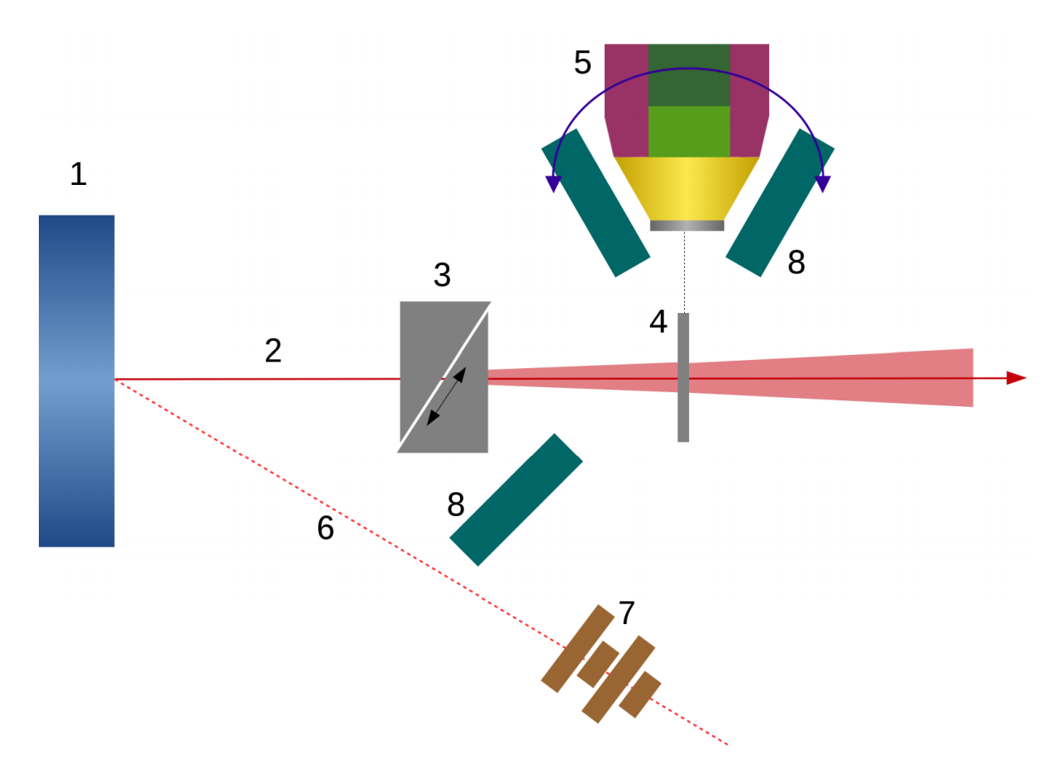
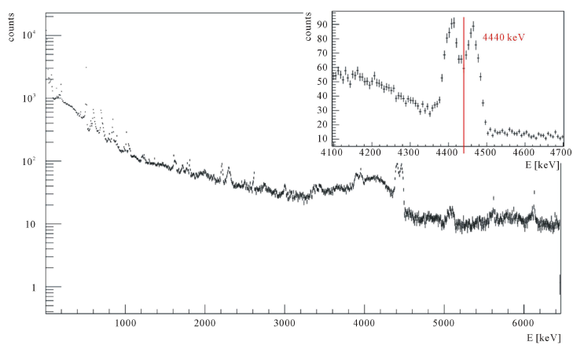
Description of Technique of proton therapy monitoring - Prompt Gamma Imaging (PGI)
gamma spectrum
Proton beam
Gamma emission
Typical gamma spectrum registered from the thin target in described experiment. Average energy of protons inside the thin target was 16.13 MeV.

Slide 6
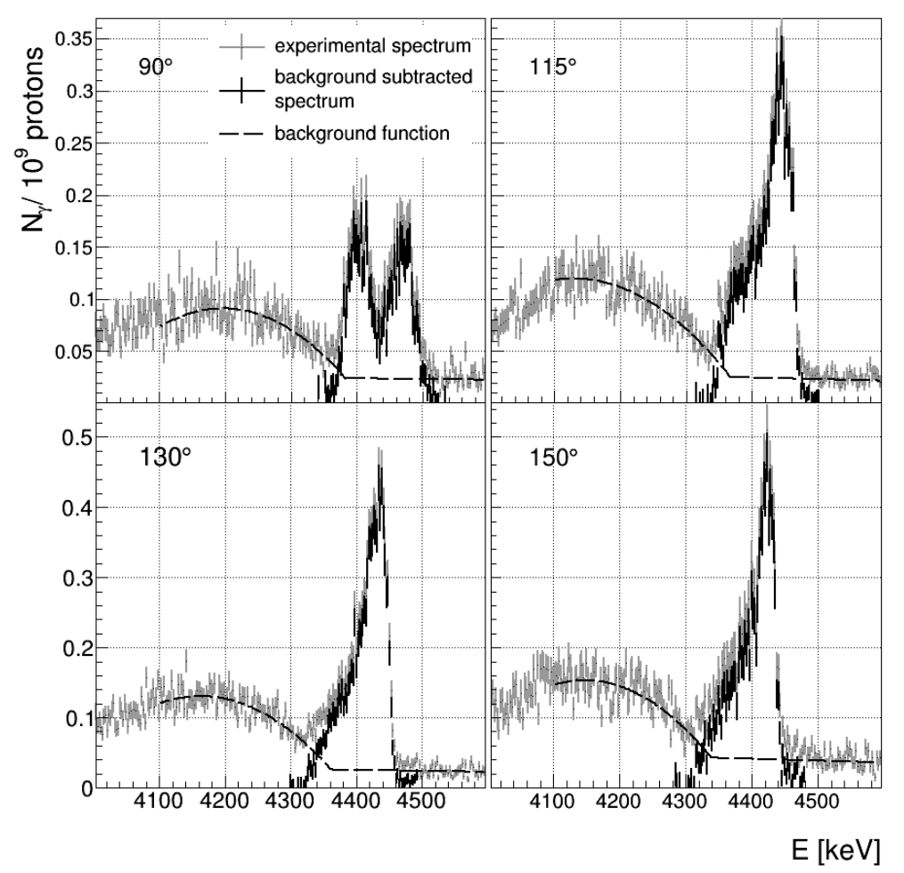
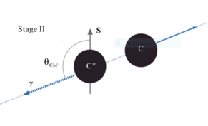
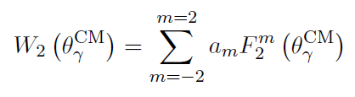
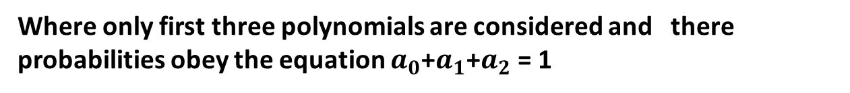
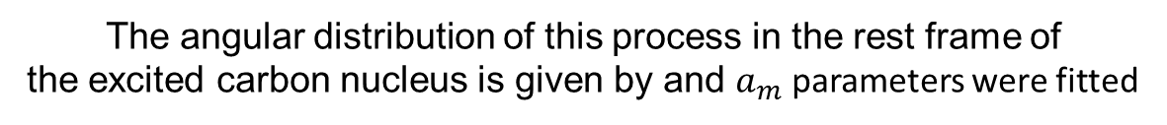
Experimental results
The angular distribution of this process in the rest frame of
the excited carbon nucleus is given by and $a_{m}$ parameters were fitted
Where only first three polynomials are considered and there probabilities obey the equation $a_{0}$+$a_{1}$+$a_{2}$ = 1
SHAPE OF THE SPECTRAL LINE AND GAMMA ANGULAR DISTRIBUTION OF THE 12C(p; p04:44)12C REACTION
Katarzyna Rusiecka

Slide 7
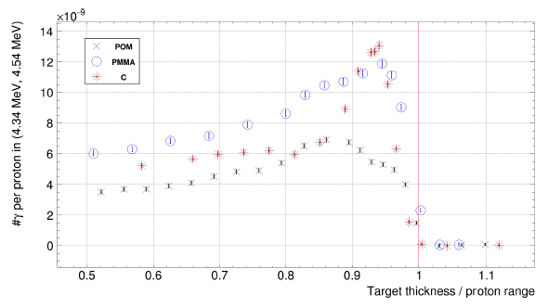
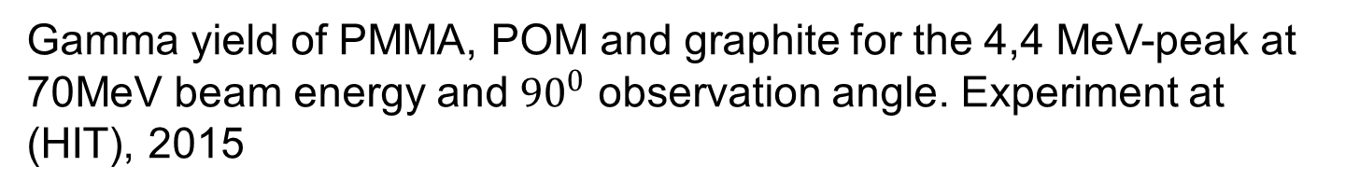
  Prompt Gamma correlation with Bragg Peak
Proton beam
Gamma emission
Gamma yield of PMMA, POM and graphite for the 4,4 MeV-peak at 70MeV beam energy and ${90}^{0}$ observation angle. Experiment at (HIT), 2015

Slide 8


Geometric model on Geant4 Simulation
Physical model: QGSP_BIC
2 mm
Graphite
35.82mm
Graphite
$${30}^{0}$$
Beam
88.97 Proton MeV
Proton Beam
17.59 MeV
Gammas
Proton Beam

Slide 9
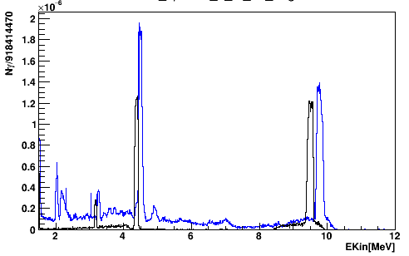
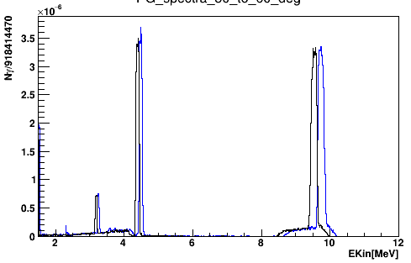
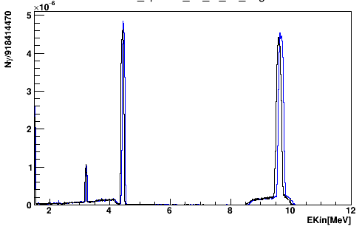







    Prompt Gamma Spectrum detected from six different Angles
Gammas on blue histograms
Carbon degrader
Thin slice
$0^{o}−{30}^{0}$
${150}^{o}−{180}^{0}$
Proton beam
$${150}^{o}$$
$${30}^{o}$$
Gammas on black histograms
$${120}^{o}$$
$${60}^{o}$$
${30}^{o}−{60}^{0}$
${120}^{o}−{150}^{0}$
${60}^{o}−{90}^{0}$
${90}^{o}−{120}^{0}$
The parameters
Beam Energy: | 88.97 MeV
Degrader Thickness | 35.82 mm
Mean energy of protons ins the slice | 17.59 MeV

Slide 10
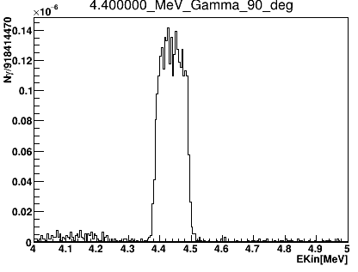
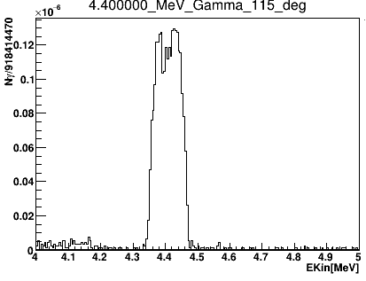
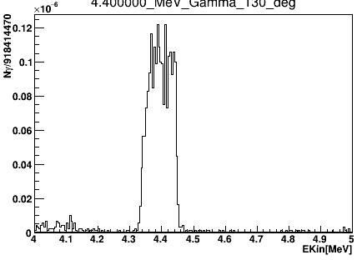
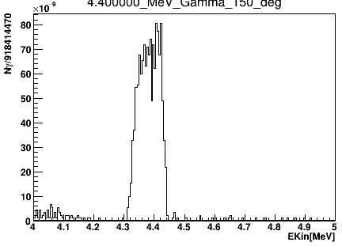








    4.4 MeV and 9.64 MeV Gamma line shapes
2 mm
Graphite
$${90}^{0}$$
$${115}^{0}$$
$${30}^{0}$$
35.82mm
Graphite
Beam
88.97 Proton MeV
Proton Beam
17.59 MeV
Gammas
Proton Beam
$${150}^{0}$$
$${130}^{0}$$
$${115}^{0}$$
$${90}^{0}$$
The parameters
Beam Energy: | 88.97 MeV
Degrader Thickness | 35.82 mm
Mean energy of protons ins the slice | 17.59 MeV
$${130}^{0}$$
$${150}^{0}$$

Slide 11
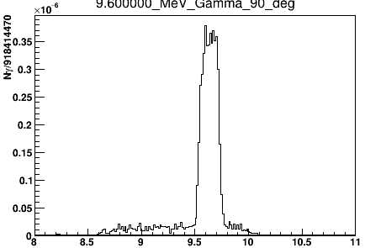
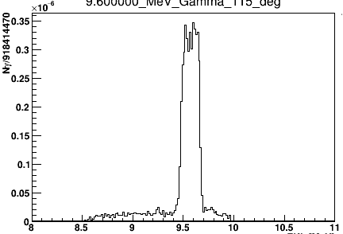
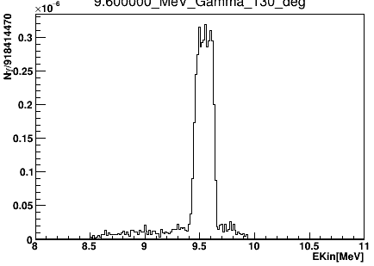
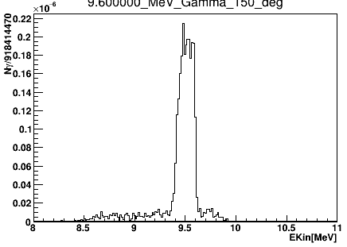




    4.4 MeV and 9.64 MeV Gamma line shapes
2 mm
Graphite
$${30}^{0}$$
$${90}^{0}$$
$${115}^{0}$$
35.82mm
Graphite
Beam
88.97 Proton MeV
Proton Beam
17.59 MeV
Gammas
Proton Beam
$${150}^{0}$$
$${130}^{0}$$
$${115}^{0}$$
$${90}^{0}$$
The parameters
Beam Energy: | 88.97 MeV
Degrader Thickness | 35.82 mm
Mean energy of protons ins the slice | 17.59 MeV
$${130}^{0}$$
$${150}^{0}$$

Slide 12
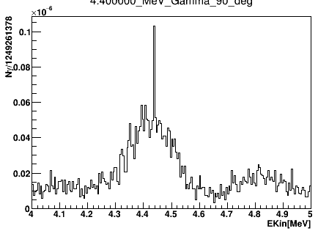
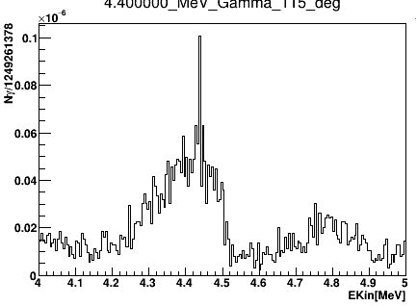
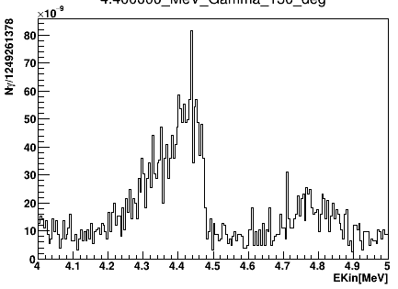
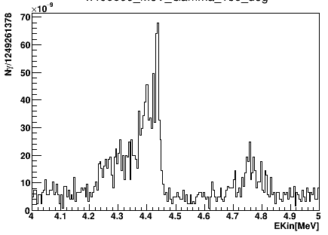




    4.4 MeV and 9.64 MeV Gamma line shapes
2 mm
Graphite
$${30}^{0}$$
35.82mm
Graphite
$${90}^{0}$$
$${115}^{0}$$
Beam
88.97 Proton MeV
Proton Beam
17.59 MeV
Gammas
Proton Beam
$${150}^{0}$$
$${130}^{0}$$
$${115}^{0}$$
$${90}^{0}$$
Sharp peaks
The parameters
Beam Energy: | 88.97 MeV
Degrader Thickness | 16.00 mm
Mean energy of protons ins the slice | 63.22 MeV
$${130}^{0}$$
$${150}^{0}$$

Slide 13
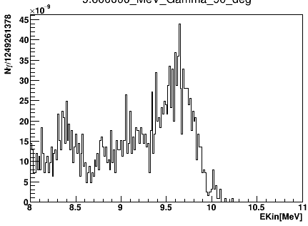
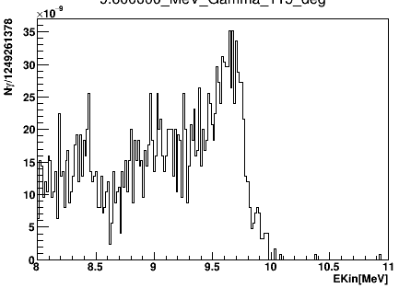
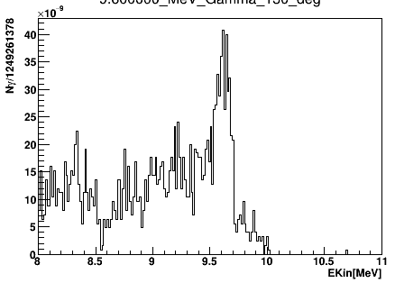
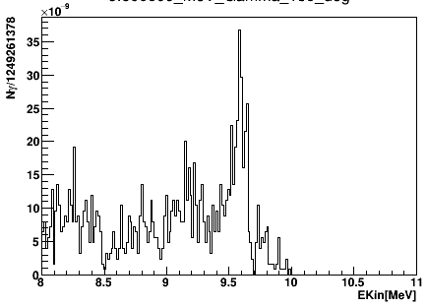
    4.4 MeV and 9.64 MeV Gamma line shapes
2 mm
Graphite
$${30}^{0}$$
35.82mm
Graphite
$${90}^{0}$$
$${115}^{0}$$
Beam
88.97 Proton MeV
Proton Beam
17.59 MeV
Gammas
Proton Beam
$${150}^{0}$$
$${130}^{0}$$
$${115}^{0}$$
$${90}^{0}$$
The parameters
Beam Energy: | 88.97 MeV
Degrader Thickness | 16.00 mm
Mean energy of protons ins the slice | 63.22 MeV
$${130}^{0}$$
$${150}^{0}$$

Slide 14
Conclusion
As non-uniformity of angular distribution of carbon de-excitement reaction products is not implemented in Geant4 software models, multiple peaks are not visible neither for 4.4 MeV nor for 9.6 MeV gamma peak.
Although, the effects of Doppler broadening are visible when impinging protons energy is relatively high (between 50 and 70 MeV), it is still underestimated as this effect is very important even in the area close to a Bragg peak too according to experimental measurement.
Additionally, the more initial kinetic energy of protons is the more important the Doppler broadening becomes which causes a sharp peak, existing due to program error, to emerge at exactly 4.43 MeV for 4.43 MeV lines detected from every angle, thus violating the conservation of energy-momentum four-vector.

Slide 15
Thanks for your Attention

Slide 16
Reference:
L. Kelleter, A. Wro´nska, Spectroscopic study of prompt-gamma emission for range verification in proton therapy, Physics Institute 3B, RWTH Aachen University, Aachen, Germany.
A. Wrońskaa , A. Anees Ahmeda, EXPERIMENTAL VERIFICATION OF KEY CROSS SECTIONS FOR PROMPT-GAMMA IMAGING IN PROTON THERAPY, The M. Smoluchowski Institute of Physics, Jagiellonian University Kraków, Poland bRWTH Aachen University, Aachen, Germany. August 21, 2017.
K. Rusiecka1, A. Wrońska, Determination of Gamma Angular Distribution from the Shape of Spectral Line for the First Excited State of Carbon Nucleus, Marian Smoluchowski Institute of Physics, Jagiellonian University, Krakόw, Poland 2 Henryk Niewodniczański Institute of Nuclear Physics PAN, Krakόw, Poland 3 RWTH Aachen University, Aachen, Germany. 11 January 2016
K. Rusiecka† , A. Wrońska, SHAPE OF THE SPECTRAL LINE AND GAMMA ANGULAR DISTRIBUTION OF THE 12C(p, p0γ4.44) 12C REACTION, Department of Nuclear Physics and Its Applications, Institute of Physics University of Silesia, Katowice, Poland. July 17, 2018

