Slide 1
Virus Spread prevention using UV light
Luka Zaalishvili
Mechanical Engineering Student at Agricultural University of Georgia 4th Year

Slide 2
Introduction
For the past 2.5 years we’ve been amidst a Global Pandemic
Covid-19 is still active and isn’t going anywhere
The only protection we have is vaccines, face masks and social distancing
We are still susceptible to new, potentially even more harmful pandemics
We need to implement new virus spread prevention methods.

Slide 3
01
02
03
The Idea
Design
The Execution

Slide 4
The Idea
01
UV light in Ventilation systems

Slide 5
Ultraviolet light

Slide 6
UV-C light kills COVID-19
Pros:
With high intensity(500 μW/cm²) it can kill the Virus in less than 10 seconds.
It works on surfaces, in liquids and in air.
Safer than chemical disinfection
Cons:
Is harmful for humans.
UV-C lamps contain mercury which is also toxic for humans.

Slide 7
Design
02
Miniature model of a room with HVAC System

Slide 8
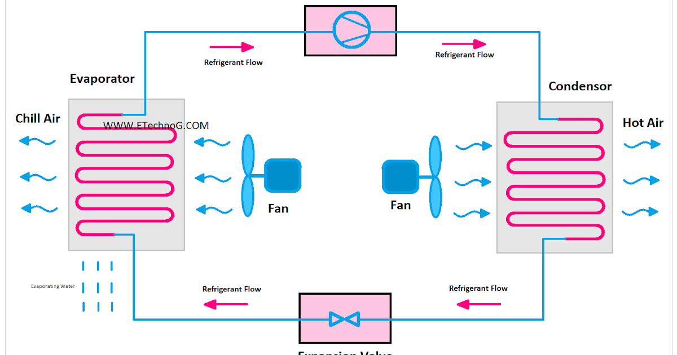
Basic work principle of Air Conditioning

Slide 9
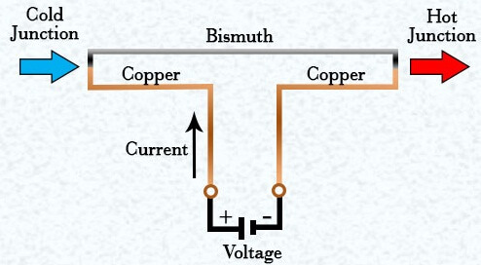
Thermo Electric cooling based on the Peltier Effect

Slide 10
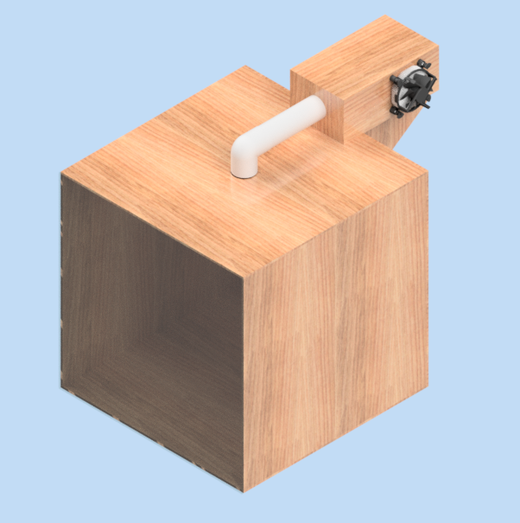
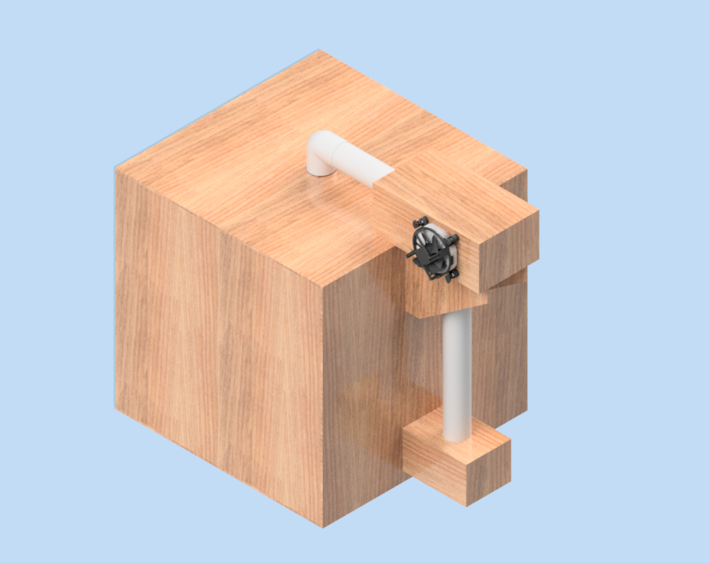
CAD model designed by me in Autodesk Inventor

Slide 11
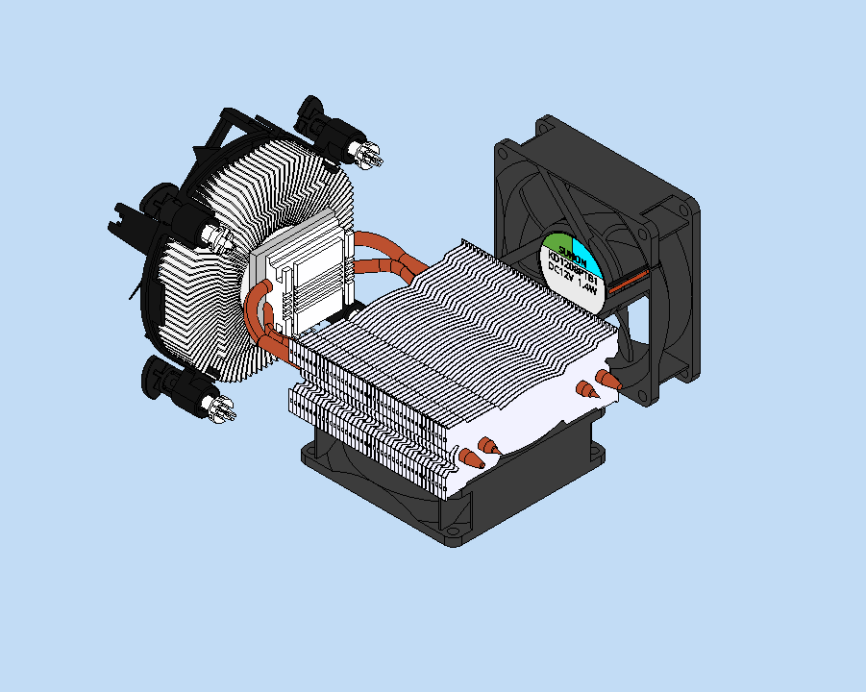
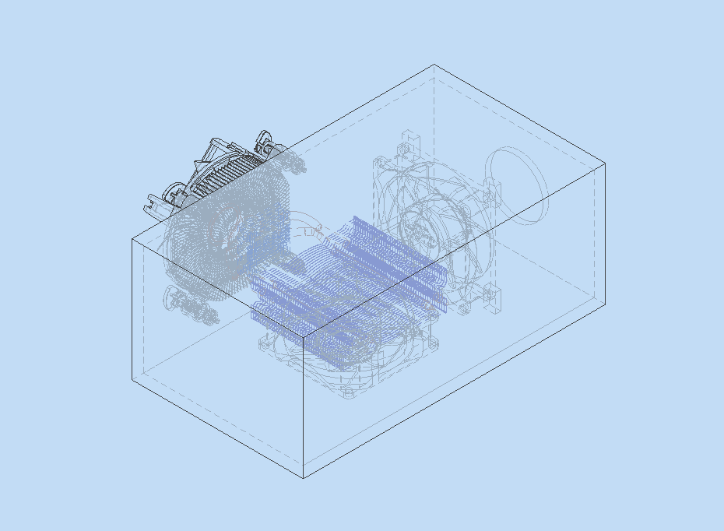
The design process

Slide 12
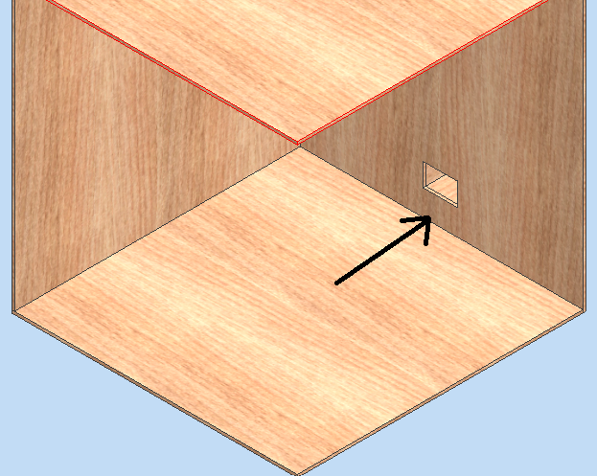
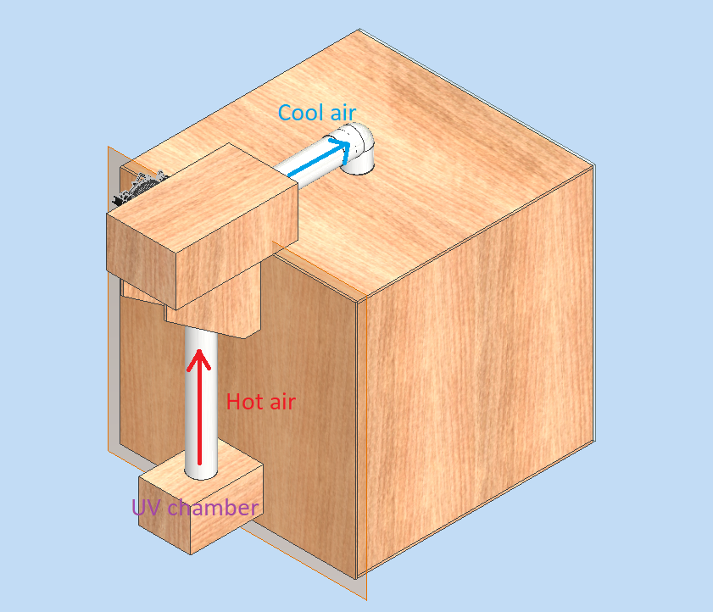
The design process

Slide 13
Execution
03

Slide 14
220v AC to 12v DC conversion

Slide 15
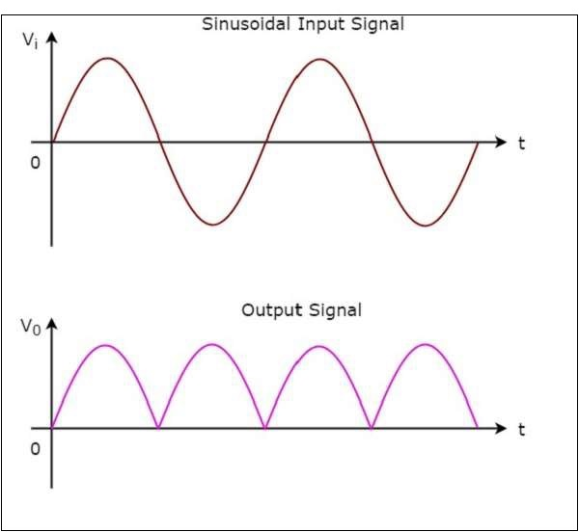
Step 1: Diode bridge

Slide 16
Step 2: Capacitor

Slide 17
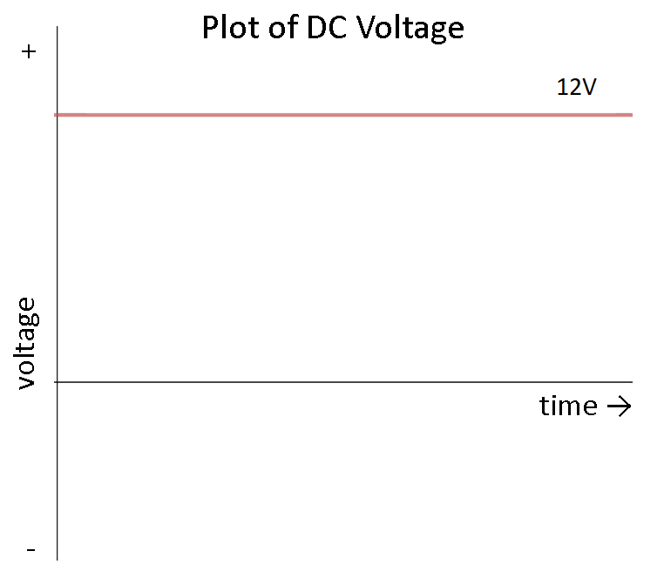
Step 3: Voltage Regulator

Slide 18
Calculations:
How much air heats up in the UV chamber
Starting Temperature of air t1=27 °C
UV light intensity = 500 μW/cm²
Heat capacity of air at 27 °C cair=718 J/kg*K
Density of air at 27 °C ρ=1.18 kg/m^3
Using this formula Q=c*m*Δt
Δt=1,5 °C

Slide 19
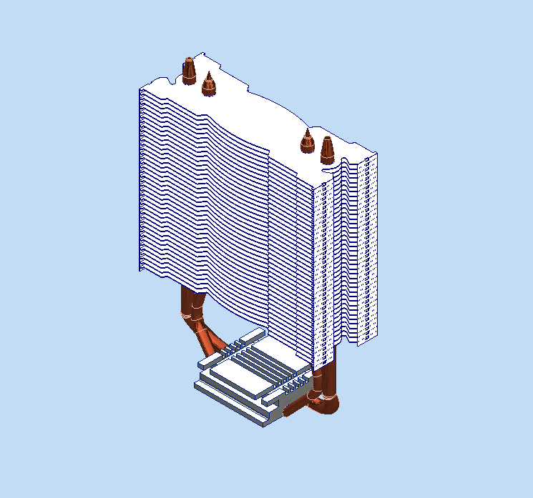
Calculations:
2. How much it cools down in Peltier Chamber:
Convection and Conduction heat transfer:
Peltier module cold side at 12v t = -17 °C
q = U A Δt
where
q = heat transfer W
U = overall heat transfer coefficient W/(m²K)
A = wall area m²
Δt = t₁ - t₂
Finding the overall heat transfer coefficient of this heat sink:
1 / U A = 1 / h_{c} A_{i} + Σ (s_{n} / k_{n} A_{n}) + 1 / h_{c} A_{o}
U = the overall heat transfer coefficient W/(m² K)
k_{n} = thermal conductivity of material W/(m K)
h_{c} = convection heat transfer coefficient W/(m² K)
s_{n} = thickness of layer

Slide 20
Output Parameters
Calculations done by code written in Matlab
Q=q*T
Where T=time=300s
Using this formula Q=c*m*Δt
Room Temperature after 5 minutes t2=18 °C

Slide 21
Conclusion
Tasks done:
Tasks in development:
Design created
Prototype built
Calculations made
Kill switch for emergencies
Temperature regulation

Slide 22
THANKS!
Do you have any questions?

