Slide 1
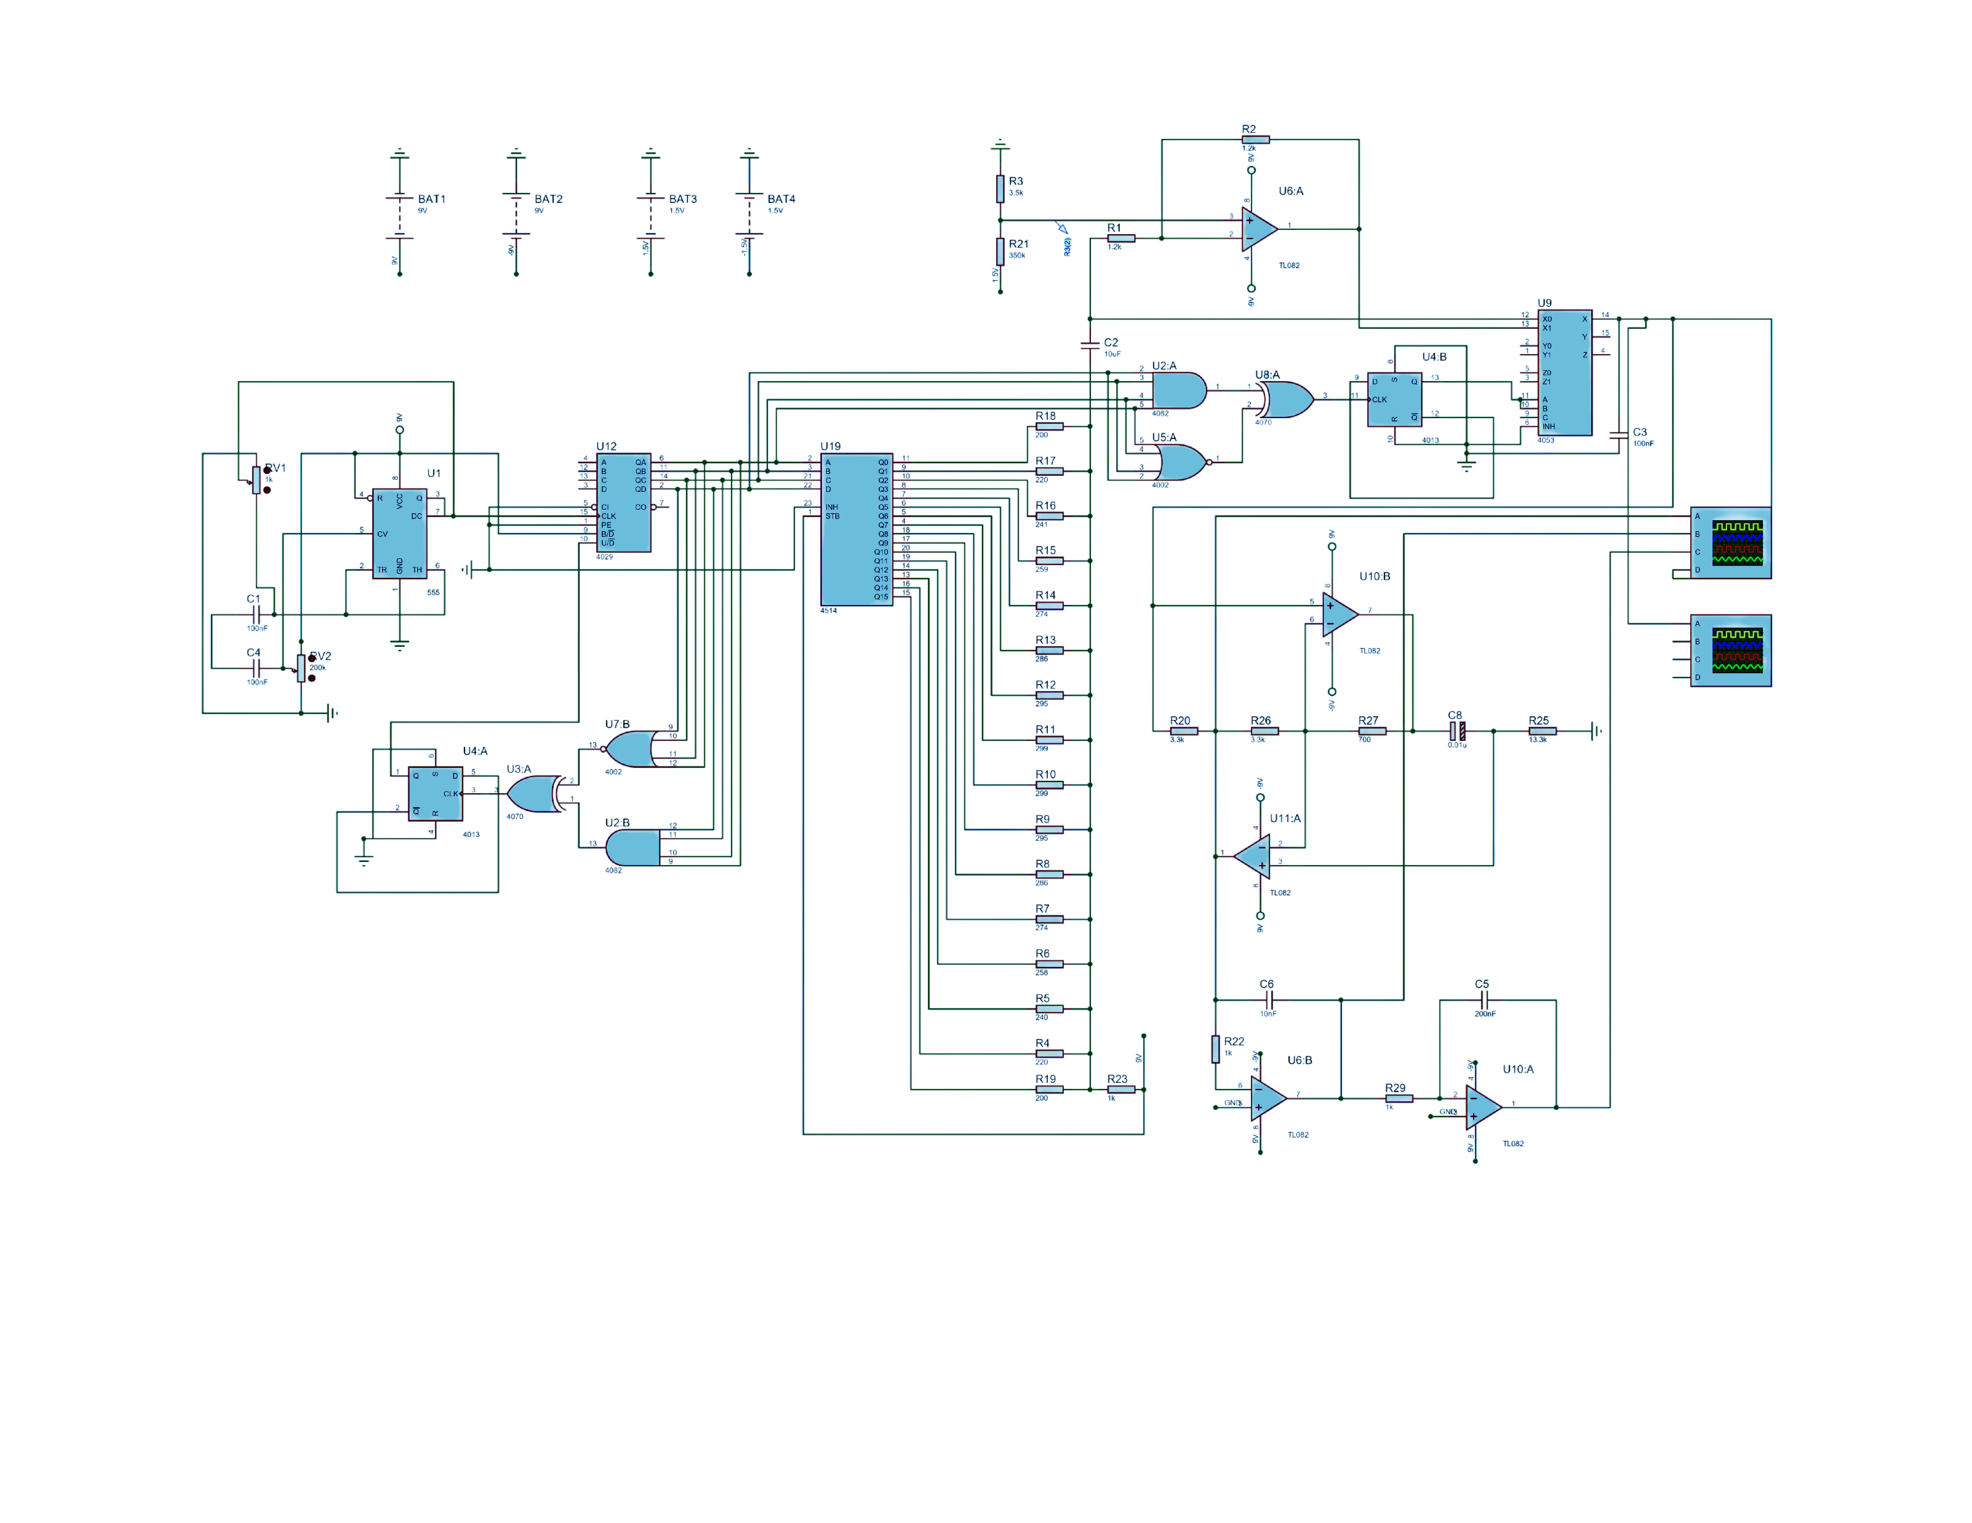
Function generator based on digital integrated circuits
4th year student of Electrical and Computer Engineering at Agricultural University of Georgia
Ketevan Lomjaria

Slide 2
Contents
What is a function generator and why do we need it?
Why are digital function generators better to make?
Sub-circuits of the project to understand how this function generator works

Slide 3
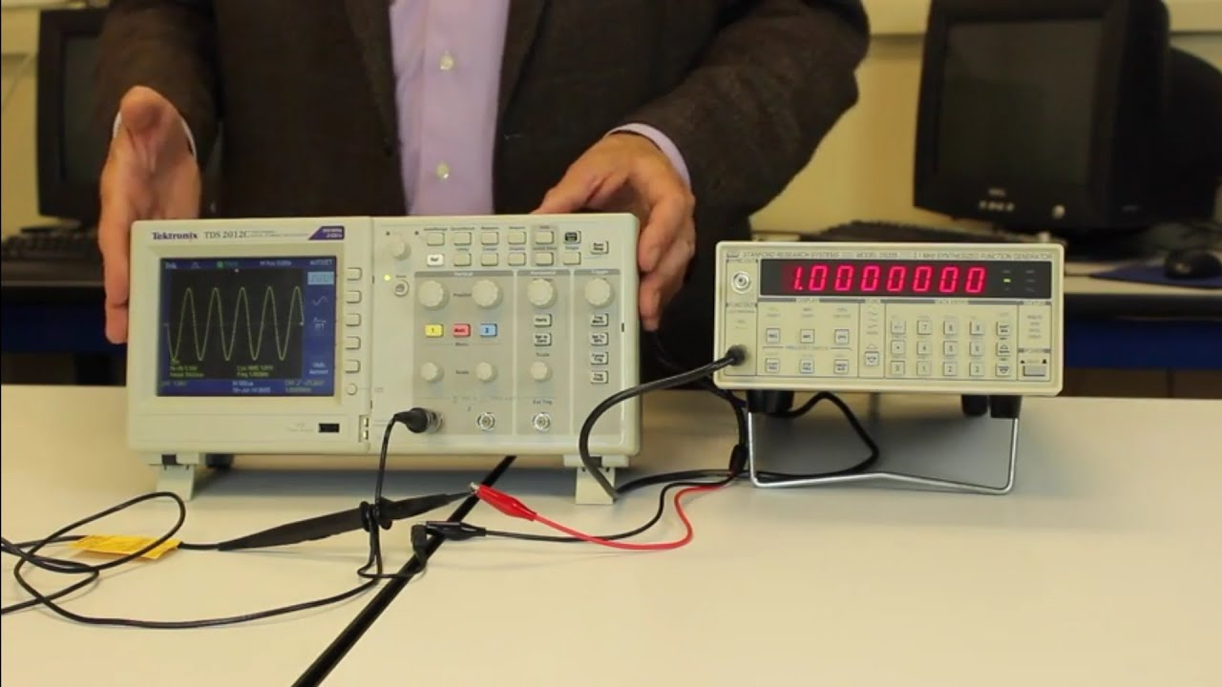
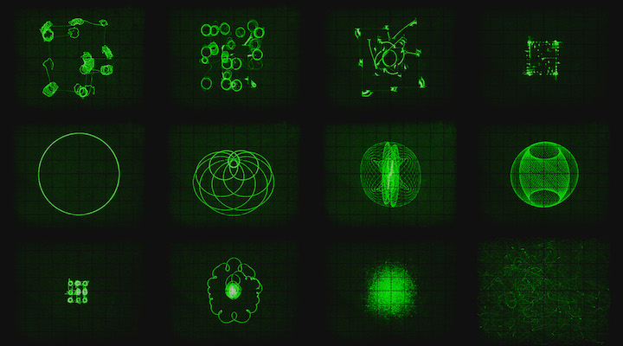
What is a function generator and why do we need it?
Generates sine, triangular and square waves
Testing electronics on frequency response
Generating waveforms with wide range of frequencies
Even for art! (Jerobeam Fenderson)
Notes:
First of all, I wanted to mention why I chose this project to begin with. As you might know, we have a lot of laboratory work as a part of our subjects. One of the devices we often use is a function generator. In our case, we use it as a source of sine, triangular, sawtooth or square waves to do some manipulations to those signals and see the outcome of the experiment. However, one can use it not only for that, but for various different things such as testing electronics on frequency responce, generating impulses for sampling and so on and so forth. One of the most charming ways to use it, in my opinion, is creating visual or audio art using mathematical manipulations. These can be done using an oscilloscope.

Slide 4
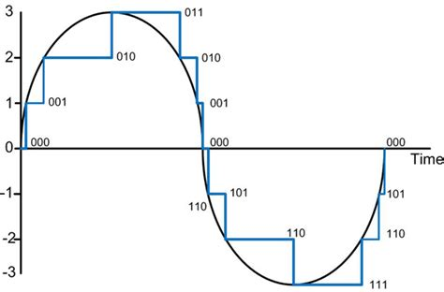
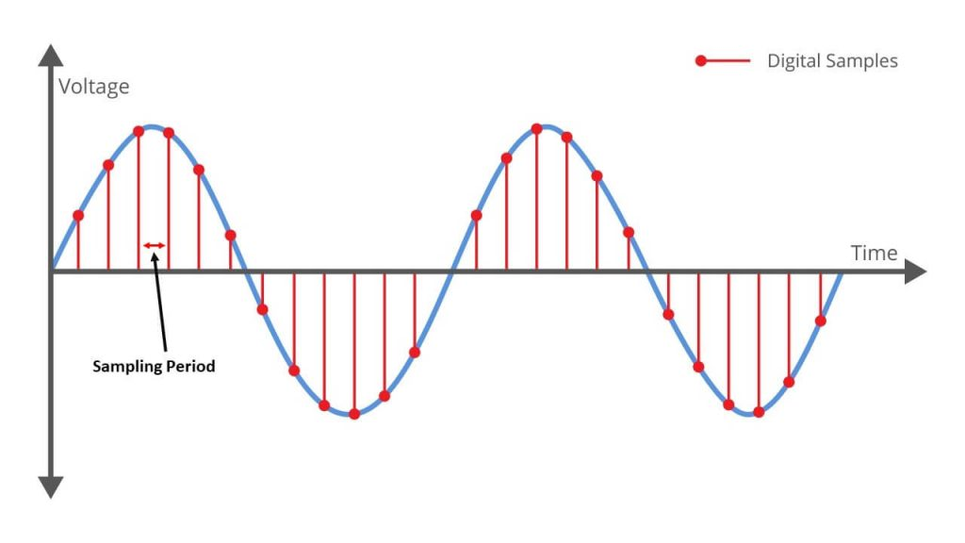
Why digital?
Digital
Pros
Not affected by outside noise
Cheap and easy to make
High accuracy can be reached by higher sampling rates
Cons
Discretized signal
Analog
Pros
Continuous and smooth signal
No discretization
Cons
Highly affected by outside noise
Very expensive or not good quality
Notes:
As said on the opening page, my function generator is based on digital integrated circuits. There are several reasons why I chose to use them, but firstly let’s talk about all the different types of function generators I could’ve built. Analog function generator is a piece of equipement which is built purely on analog electrical devices. It’s advantages include more accuracy and smooth output signal without any discretizations. However, it’s very hard to make analog devices with perfect output, because they are highly influenced by noise disturbances. If made correctly, analog devices can have much more accurate output signal.
Digital function generator provides a much more stable output signal, which means it is way harder for the outside noise to mess up proper functioning of digital integrated circuits. However, the output signal is not exactly smooth – it is descrete and does not fully represent the signal that we require. It needs to be filtered and smoothed out. with a higher sampling frequency a more accurate signal can be made.
A Sweep generator is most commonly used to test electronic devices. It’s used this way, because of it’s linearly varying frequency and stable amplitude. This way we can see the frequency response of said electronic device.
This function generator is digital because of outlined reasons and can produce 10-50k Hz sine, triangular and square waves.
SO U HAVE TO MAKE PROS AND CONS OF DIGITAL ON THIS ONE IF YOU CAN MANAGE TO DO IT

Slide 5
Generating impulses which determine frequency of the wave
Using simple 555 circuit to produce frequency of discretization
Controls frequency of waves
Created impulses are sent to presetable up/down counter (4029) – every impulse adds/subtracts one to the existing number and generates 4 bit binary output
Up/down counter
555
Notes:
firstly I made a simple circuit to produce an imulse generator. It is needed to change counting frequency. the generated impulse varies from 10k to 50k hertz. after generating that signal, it is passed to and up/down counter. when recieving impulses, this counter makes either increment or decrement, based on what the voltage is on the according pin (either high or low). the counter has a 4 bit binary output, which means it can count from 0 to 15.

Slide 6
Up/down counter configuration
10th pin of the counter represents up/down counter configuration
Inputting logical high will cause the IC to switch to up counting mode
logical low switches the IC to down counting
To produce a good quality sine wave maximum amount of discretization degree is needed
To achieve that NOR (not OR) and AND gates are used on the output of 4029, to see when 0 and 15 are generated
Up/down counter
555
NOR
Trigger
XOR
AND
Notes:
To achieve the maximum sample rate, I decided to make the counter count both up and down. if i used only up counter, it would have given us 16 samples. since i wanted to make the signal as smooth as possible, I decided, that i should get as much sample rate as possible. to achieve that, I used NOR and AND logical gates and plugged them to the output of my binary counter. NOR gate means that every input bit should be zero, in order for it to output a high voltage. AND gate means it should have 1 on every input to have 1 at the output.

Slide 7
Up/down counter configuration
0 and 15 are numbers on which the counter should to start, accordingly, up or down counting
Outputs of those elements are going through XOR, which generates 1, if only one TRUE will enter on it’s input (which always will be the case)
Output of XOR goes into a D trigger, which will generate high voltage, when 0 is reached on the counter and generate low voltage, when 15 is generated.
This provides higher degree of preciseness while generating a sine wave
1111
1
0000
0
NOR
0
1
Trigger
1
XOR
1
1111
0000
1
AND
0
Notes:
in binary 0000 = 0 and 1111 = 15. I’ve out them through XOR gate with means it will only output 1, when only one of the inputs is a 1. to explain this easier, this circuit would generate 1 when it reaches either 0 or 15. the ouput of this circuit is then passed through a trigger, which means it would output a high voltage when the counter reaches 0 and a low voltage, when counter reaches 15. The 10th pin of the binary counter represents either up or down counting option when given, accordingly, either high or low voltages. that means, that now my sampling rate is 32.

Slide 8
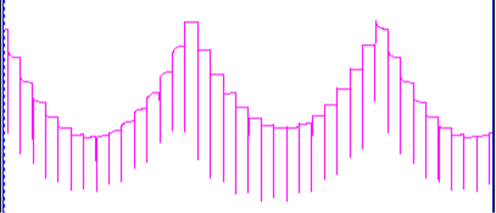
Demultiplexer and DAC
1111
Next step is to create an upper or lower half of the sine wave
Digital to analog converter, which generates the following image
lower part of the sine wave is now done
Notes:
after generating a 32 bit sampler, I passed the output of the binary counter through a decoder. The decoder recieves a 4 bit binary input and outputs a high voltage to the pin, which represents that number. on the output of the demiltiplexer I used a digital to analog convertion using precision potentiometers as voltage dividers to immitate the lower half of the sine wave.

Slide 9
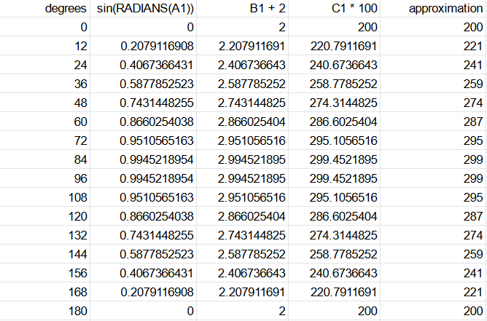
Digital to analog converter calculations
Potentiometer values are calculated to add voltage to every count, so that it looks like a sine wave
Notes:
this is how I calculated the resistance values of the precision potentiometers to simulate the lower half of a sine wave

Slide 10
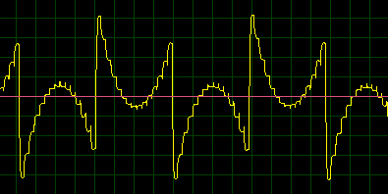
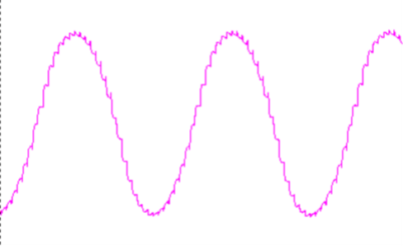
Making both halves of the sine wave
As output of DAC is now analog, it is easy to reverse is in the right moment
In the same manner as before, moments, when counter reaches numbers 0 and 15 are determined
Accordingly, trigger switches the output back and forth between lower and upper sine waves
Before sending lower or upper halves of the sine wave to multiplexer, they are run through a capacitor to filer any excessive noise that might damage the end result
Since the simulation isn’t precise, it’s impossible to align halves perfectly
Lower half
Upper half
1111
0000
1
1
0
0
1
1
1111
0000
0
1
Notes:
as you could see, the generated signal was not resembling a sine wave. in fact, to make it look like a sine wave, one of the lower parts generated, should have been flipped upside down. that could have been done with an operational amplifier in the inverting configuration. in the same fashion as before, i figured out, that when the counter is up counting the lower half of the sine wave should be shown on the output, and then the counter is down counting, the upper half should be shown. to manage the outputs i plugged the outputs of lower half of the sine wave and the upper half of the sine wave in the X channel of the multiplexer and plugger the trigger to the A pin. this way, when the counter reaches 0 or 15 (which means it will start either up or down counting), the multiplexer will output either the lower or the upper half of the sine wave. As you can see, operational amplifier’s non inverting pin is connected to a high voltage, which means that the output will be lifted up to match exactly with the lower part of the sine wave.

Slide 11
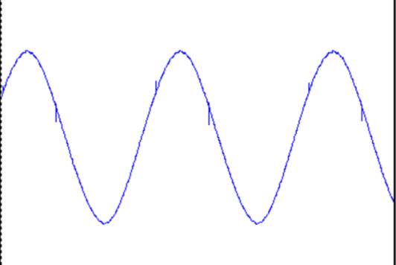
Completing the sine wave
Only one thing is left to get a perfect sine wave, filtering
To remove unnecessary high frequency harmonics, Gyrator is used as an inductor
Through observing behavior of the wave, this configuration of gyrator was satisfactory
Notes:
to finish up the sine wave, we need to smooth it out using a filter. I used a gyrator filter to create a specific induction to smooth out the sine wave.

Slide 12
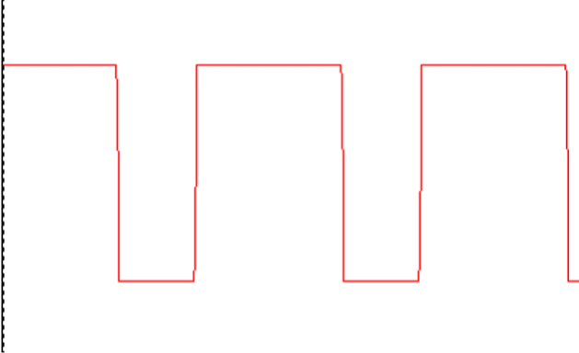
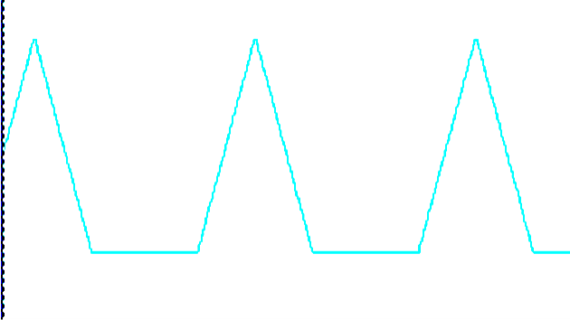
Triangle and Square impulses
Square impulses can be taken by oversaturating the existing sine wave in an operational amplifier
Triangle wave can be achieved by integrating the sine wave
Since the sine wave was not precise in simulation, duty cycle of these waves are not perfectly 50%
Notes:
And last but not least I needed to create stiangular and square waves. I created them using an integration. Integral of a sine wave is a triangular wave and an integral of triangular wave is a square wave. as you can see, these are not perfect. this is due to the analog part of the circuit, which was challenging for me to correct.

Slide 13
Conclusion and further advancements
All of the initial tasks have been accomplished
Figured out an innovative way to create signals
This project taught me a lot about digital integrated circuits
Learned how sampling worked and faced some of the difficulties it entails
Faced many issues on analog side of project
Goal to acquire more knowledge about these challenges
Found a way easier and cheaper way to make this project using microcontrollers
Notes:
I’ve faced a lot of challenges during making of this project, but I’ve grown a lot through it. It helped me to understand digital integrated circuits way better then before. with help of these circuits i was also able to understan how sampling and digital to analog converters work and what hardships I might face while making them. I’ve also faced challenges that are yet to be overcome, such as the analog part of the project. Though these are the challenges that keep me ever interested in engineering. they help me set and move towards my goals. last but not least, since making this project i’ve figured out a way easier and cheaper way to make the exact function generator using microcontrollers. I am very excited to make new projects with them.

Slide 14
Thank you for the attention

