Slide 1
Nitrogen Dioxide (NO₂) Measurement and Data Analysis Using Sensors
Presenter: Lika Kirtadze
likakirtadze99@gmail.com
Supervisor: Dr. Giorgi Jibuti
Tbilisi, September 16, 2022
Notes:
Hello Everyone, First of all I would like to introduce myself. My name is lika Kirtadze, I am graduate student from San-diego state university Georgia, my major is chemistry. Today I am going to present about determining of nitrogen dioxide in atmosphere and analysis of the collected data. This research weas conducted in 2021 as a junior student as my undergraduate research at Tbilisi State university atmosphere research laboratory atmo-sim lab. Also, I would like to highlight the role and involvement of National Environmental Agency in this research.

Slide 2
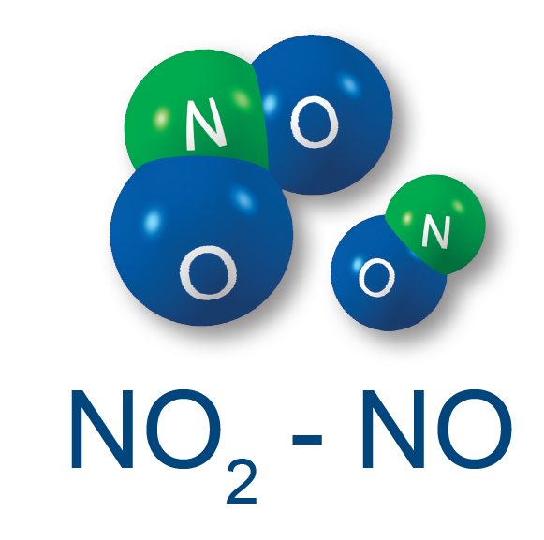
1
Natural Sources: Volcanoes, oceans, biological decay and lightning strikes.
Internal Combustion Engine (ICE) anthropogenic sources of NO₂
Notes:
The main source of nitrogen dioxide resulting from human activities is the combustion of fossil fuels (coal, gas and oil) especially fuel used in cars. Elevated levels of nitrogen dioxide can cause damage to the human respiratory tract and increase a person's vulnerability to, and the severity of, respiratory infections and asthma. Long-term exposure to high levels of nitrogen dioxide can cause chronic lung disease.

Slide 3
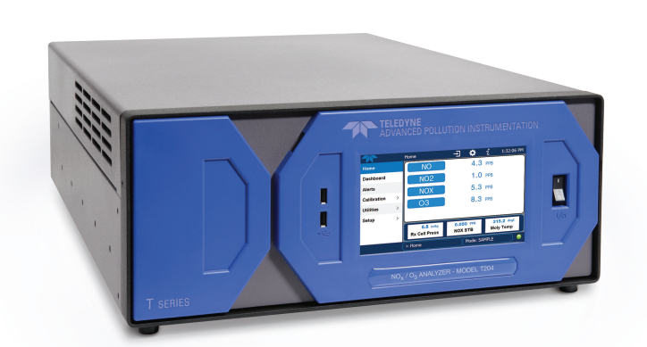
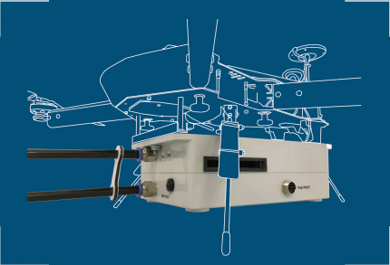
2
T204 chemiluminescence instrument USA EPA-approved NO/NO2/NOX/O3 instrument
Flying laboratory, containing electrochemical sensors measuring different sorts of pollutants, including NO2
Notes:
In this presentation you will see the NO2 measurement results by using of two different instruments. First is chemiluminescence instrument and second is electrochemical sensor.

Slide 4
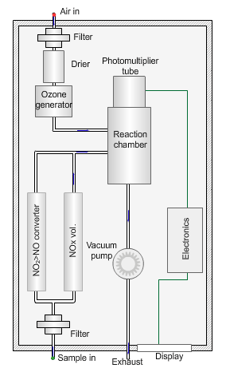
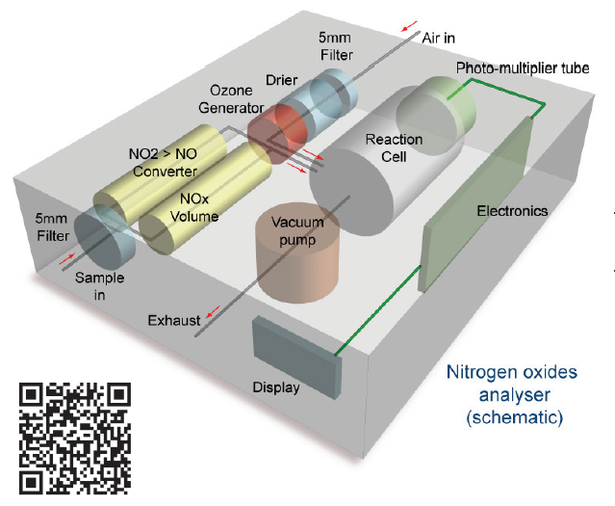
Functioning Scheme of Teledyne NO2 Analyzer
3
Notes:
Now I want to briefly describe working principle of both type of techniques.
Reactions that involve light as a rection product is called chemiluminescence reaction. Every electron that is on the high energetic level, tends to have low energy and became stable. While electron goes from high energy level to low energy level energy is released in terms of light. This principle is used in this instrument as it measures Nitrogen dioxide. When nitrogen monoxide reacts with ozone exited state nitrogen dioxide is formed. While high energylevel nitrogen dioxide is transformed in stable molecule, energy is released as a light.

Slide 5
General Schematics of Electrochemical Sensor
4

Slide 6
5
SOWA Electrochemical Sensor Installed on National Environmental Agency’s Station

Slide 7
Analysis of Collected Data
6
Data has been divided in two parts Day time data and Night-time data
Day-time data 07:00:00 am - 10:00:00 pm
Night-time data 10:00:00 pm – 07:00:00 am

Slide 8
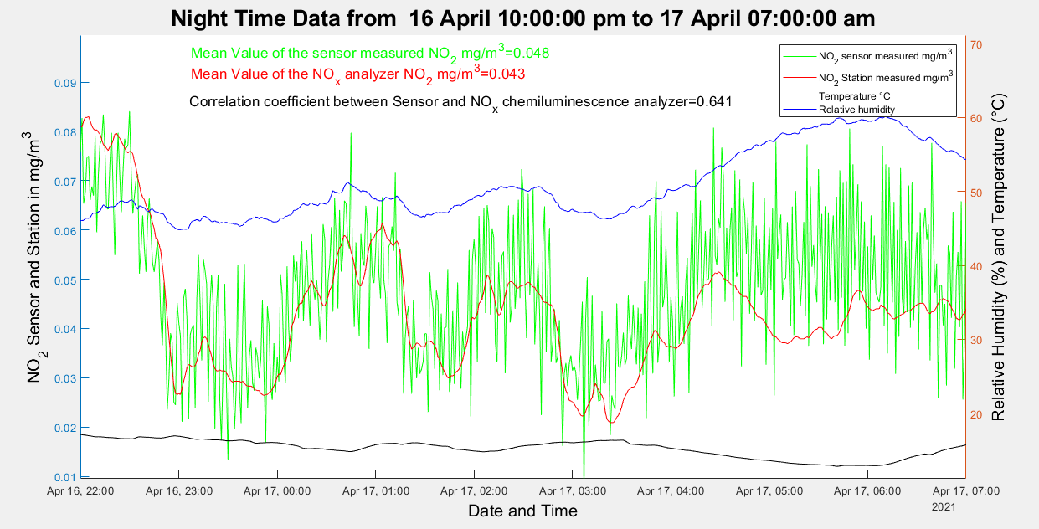
7

Slide 9
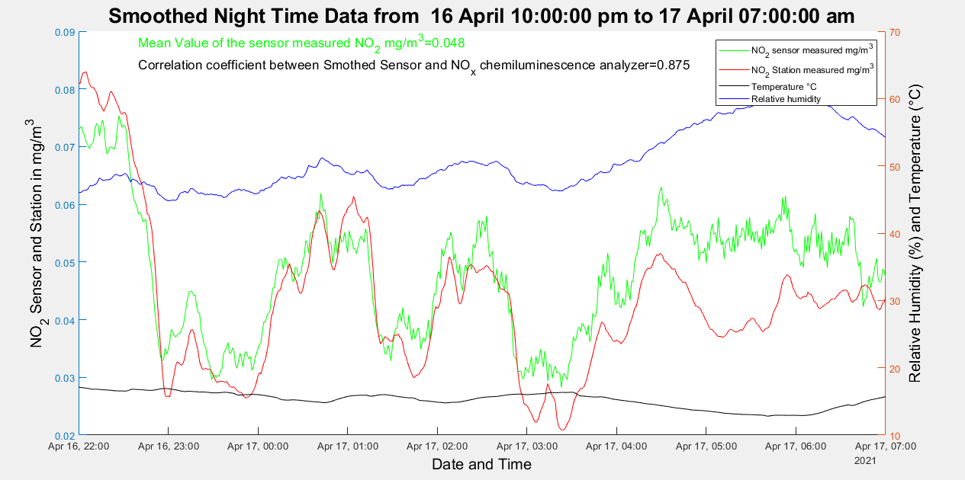
8

Slide 10
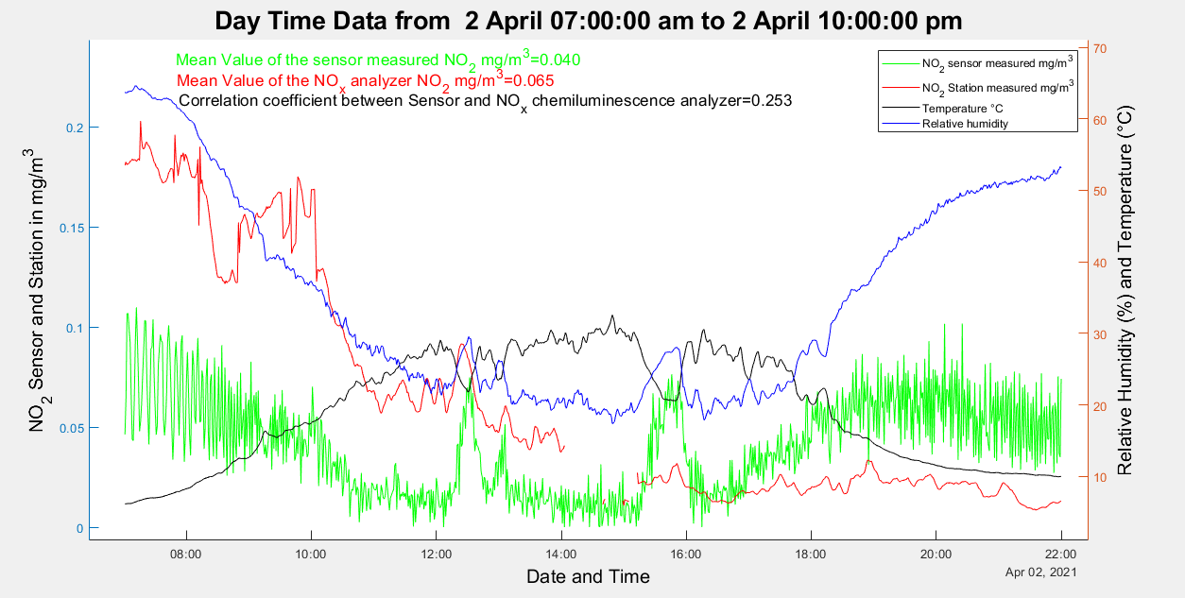
9

Slide 11
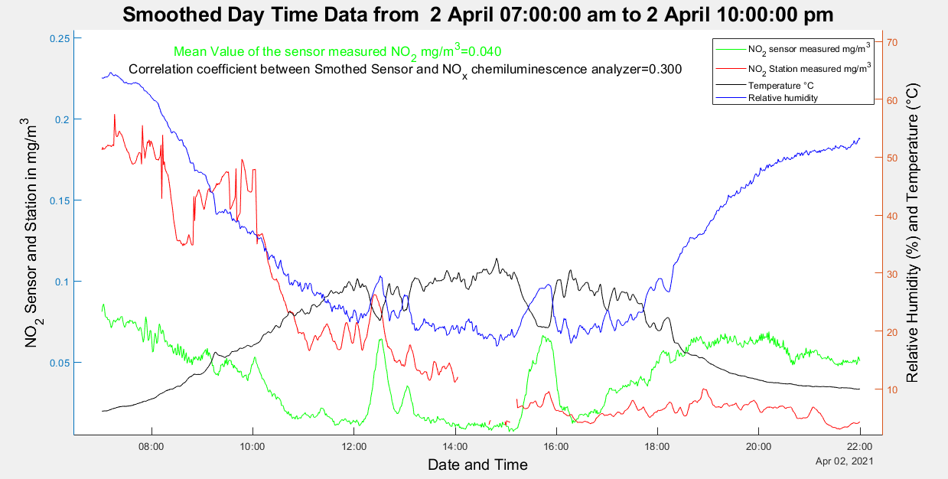
10

Slide 12
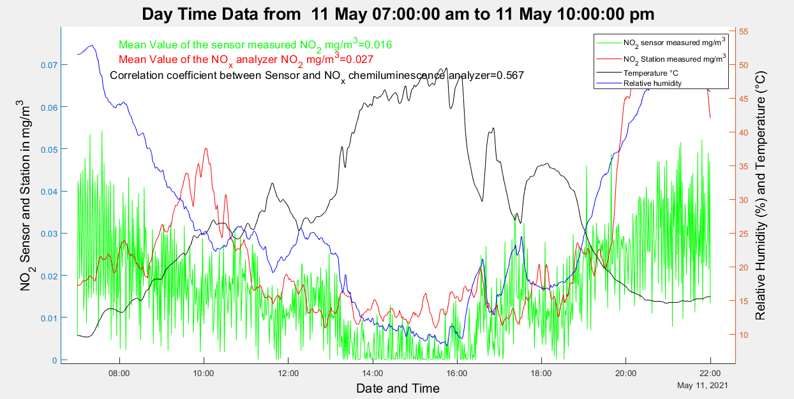
11

Slide 13
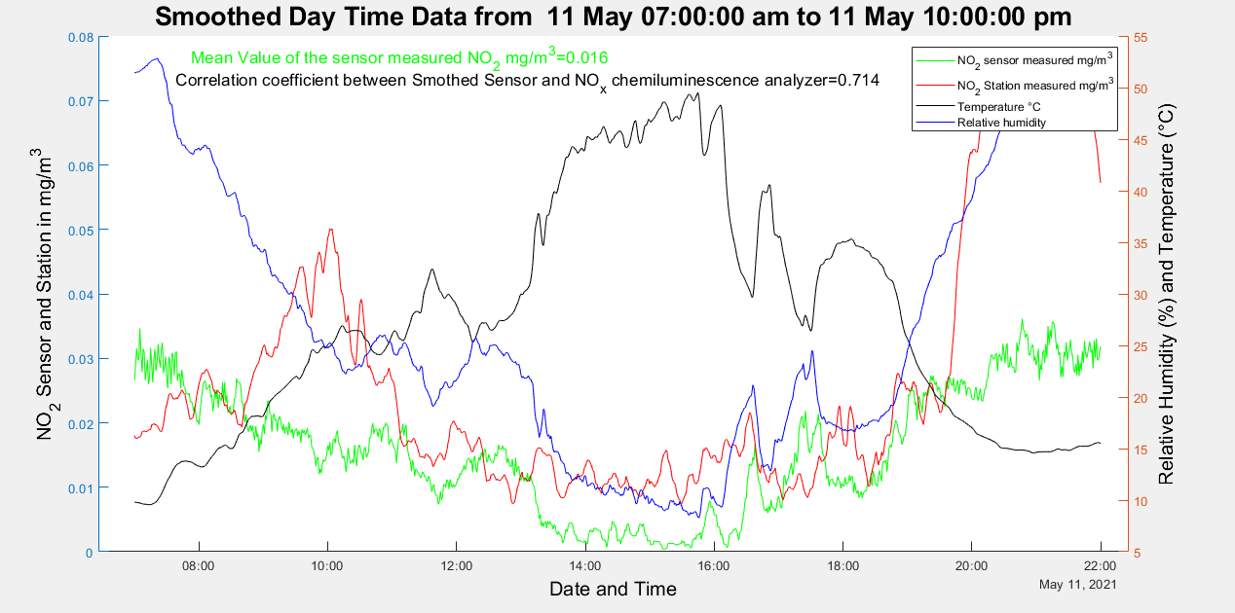
12

Slide 14
03/04/2021 27/05/2021 NO2 mg/m³
NO2 Sensor mean = 0.027 mg/m³
NO2 Station mean = 0.029 mg/m³
Correlation Coefficient = 0.3
13
Date and Time

Slide 15
03/04/2021 27/05/2021 NO2 mg/m³
Correlation Coefficient = 0.448
Mean Value of Sensor Measured Data= 0.027 mg/m³
14

Slide 16
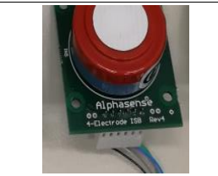
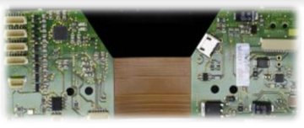
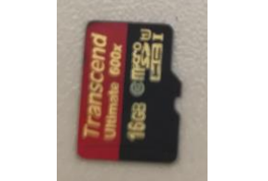
Julich Sensors
15
NO₂ Sensor
Measuring Board
Micro-SD CARD

Slide 17
Conclusion
16
Cost-Effective Sensors Might be Used as an Effective Measuring Techniques

Slide 18
Thank You For Attention!!
17

