Slide 1

Elevated concentrations of ethanol in the tunnel and city center of Stuttgart
Ethanol
© Stuttgart-Marketing GmbH / Werner Dieterich
L. karadurmus, d. klemp, R. Wegener, R. dubus, A.Wahner
15.09.2022

Slide 2



TSU
Tbilisi State University
Prof. Andreas Wahner
Prof. Astrid Kiendler-Scharr
Prof. Bezhan Chankvetadze
Dr. Dieter Klemp
Dr. Robert Wegener
Dr. Franz Rohrer
Dr. Giorgi Jibuti
Rene Dubus

Slide 3
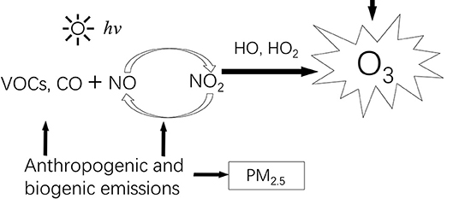
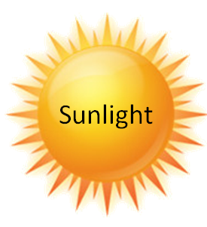
Motivation
To investigate the composition of volatile organic compounds (VOCs) in the city air of Stuttgart.
To identify causes of these emissions.

Slide 4
Efficiency of ozone production
P(O₃) aus KW-Abbau
P(O₃) aus CO-Abbau P(O₃) aus Ethanol-Abbau
OH + C₂H₅OH → HO₂ + CH₃CHO
➔ 2 O₃ pro OH-Angriff
➔ 1 O₃ pro Molekül CO
➔ 1 O₃ pro OH-Angriff

Slide 5
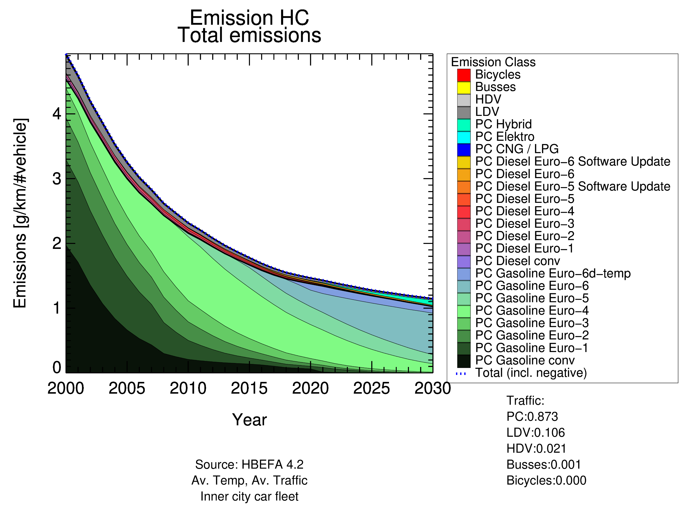
introduction

Slide 6
Literature overview
Literature | Location | Study is based on: | Origins of Ethanol
Dunmore et al. 2016 | UK, London | Measurements | Exhaust and evaporative emissions.
Willey et al. 2019 | USA, NC, Wilmington | Measurements | Production and use of biofuels.
Lewis et al. 2020 | York, UK | Emission Inventory | Solvent use
Gkatzelis et al. 2021 | New York, USA | Measurements | Volatile chemical products (VCPs)

Slide 7
Experimental approaches
Collection of air samples at different locations in Stuttgart.
Determination of VOC composition and concentration in Stuttgart air samples, using a GC-MS system.
Collection of exhaust emission samples.
Determination of VOC composition and concentration in exhaust gas samples, using a GC-MS system.
Assessment of source contributions by means of CMB analysis.

Slide 8

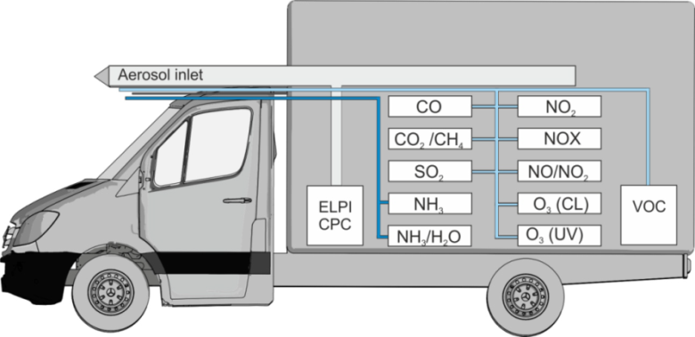
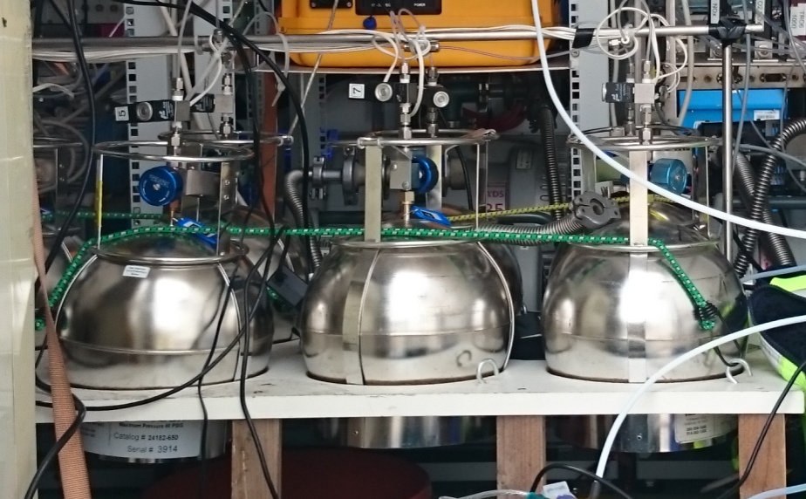
Sample collection and analysis systems
Samples were collected in previously evacuated stainless-steel canisters (SILCO-Steel).
More than 100 samples collected in several measurement campaigns.
Online measurement of CO₂, using Cavity ringdown spectroscopy (CRDS).
Detection limit 2 ppm / 0.1 s

Slide 9
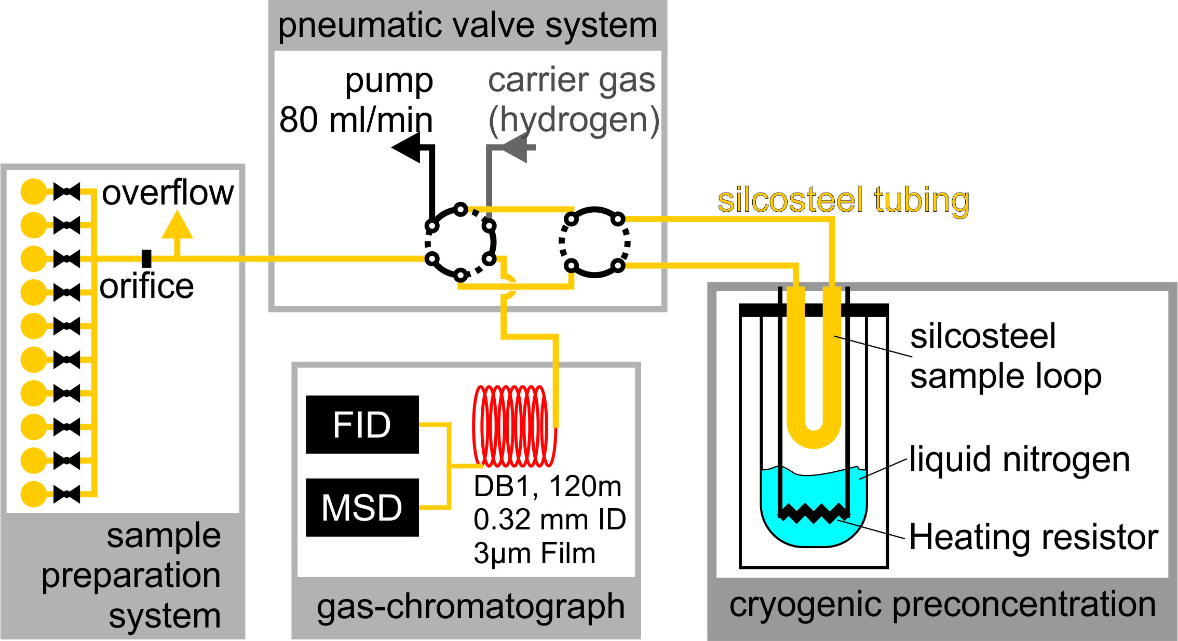
VOC analysis system
Analysis of the collected VOC samples carried in local laboratory using GC-MS system.
Analysis for about 200 individual substances.
Detection limit: 2 - 6 ppt for C2 – C12-VOC

Slide 10
Chemical Mass Balance (CMB) model
Purpose
To apportion measured pollutant concentrations (or exposures or doses) to their sources, and to assess the proportional contribution of each source.
Math
The CMB receptor model consists of a solution to linear equations that express each receptor chemical concentration as a linear sum of products of source profile abundances and source contributions.
Assumptions
Composition of the source emissions are constant over the period of ambient and source sampling.
Chemical species do not react with each other (i.e. they add linearly).
Math
Notes:
The fundamental principle of receptor modeling is based on the assumption that mass is conserved.

Slide 11
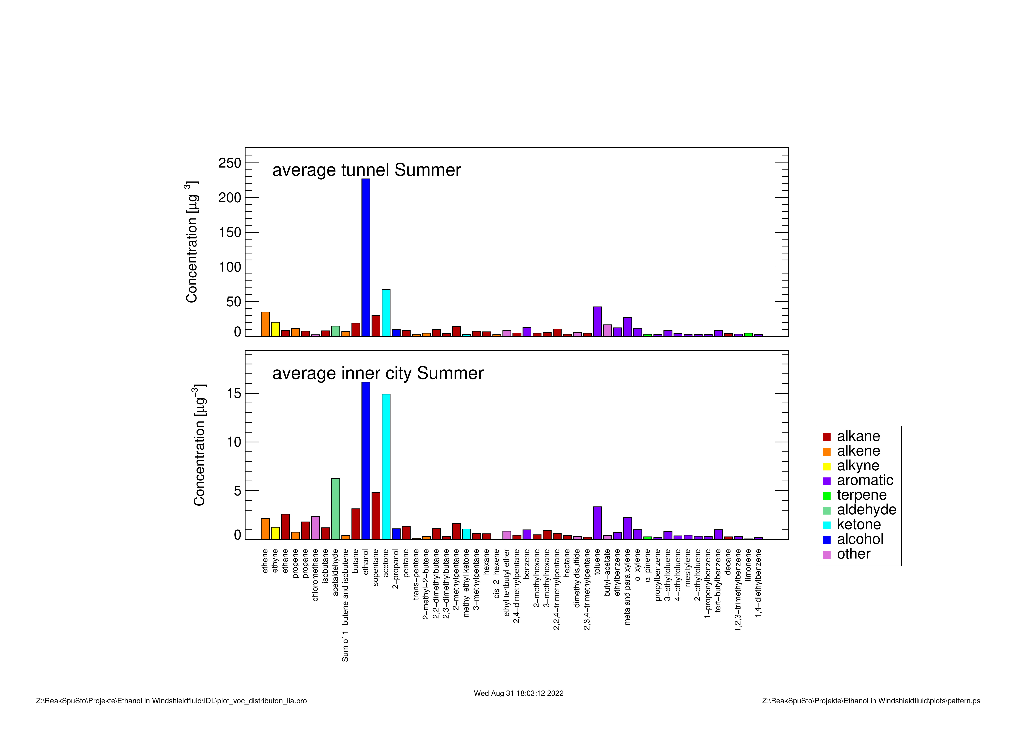
VOC patterns (summer)
μg/m³
μg/m³

Slide 12
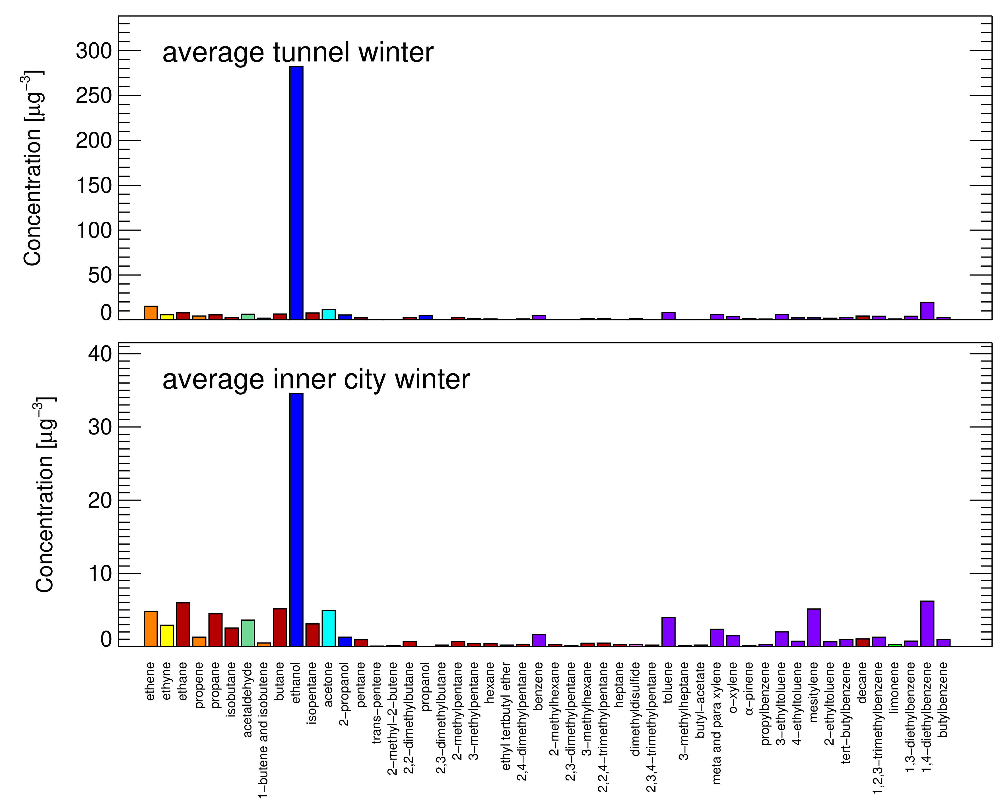
VOC patterns (winter)
μg/m³
μg/m³

Slide 13
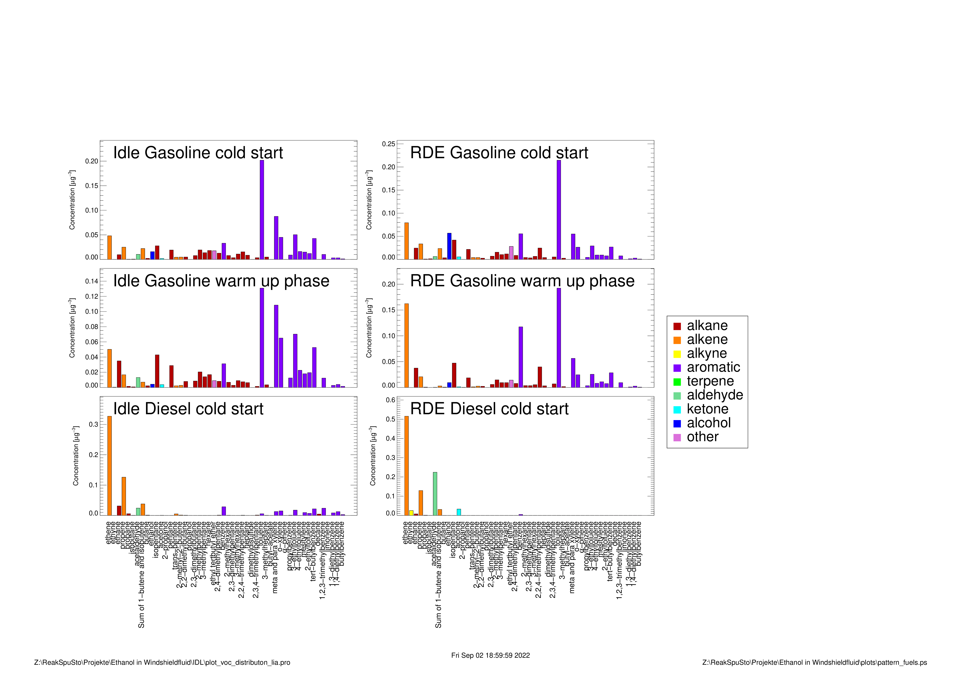
Vehicle exhaust emission profiles
Relative mass fractions
Relative mass fractions

Slide 14
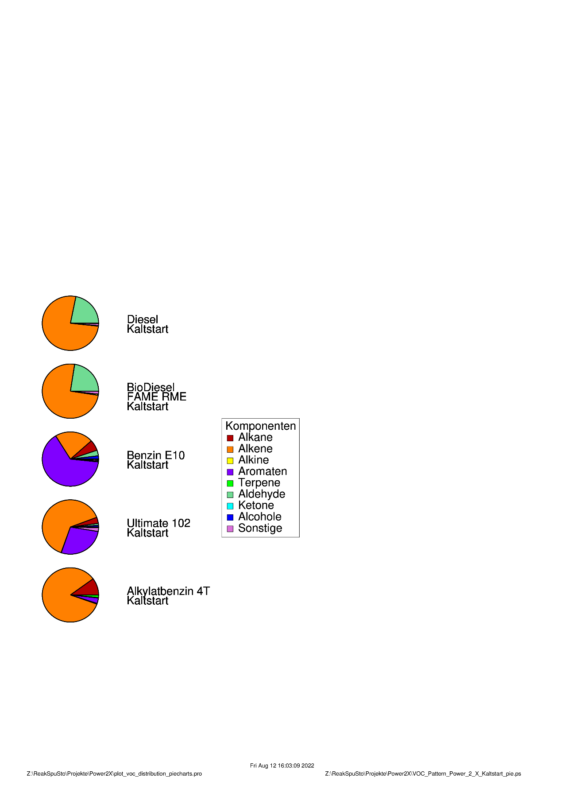
reactivity distributions of selected fuels
Cold start

Slide 15
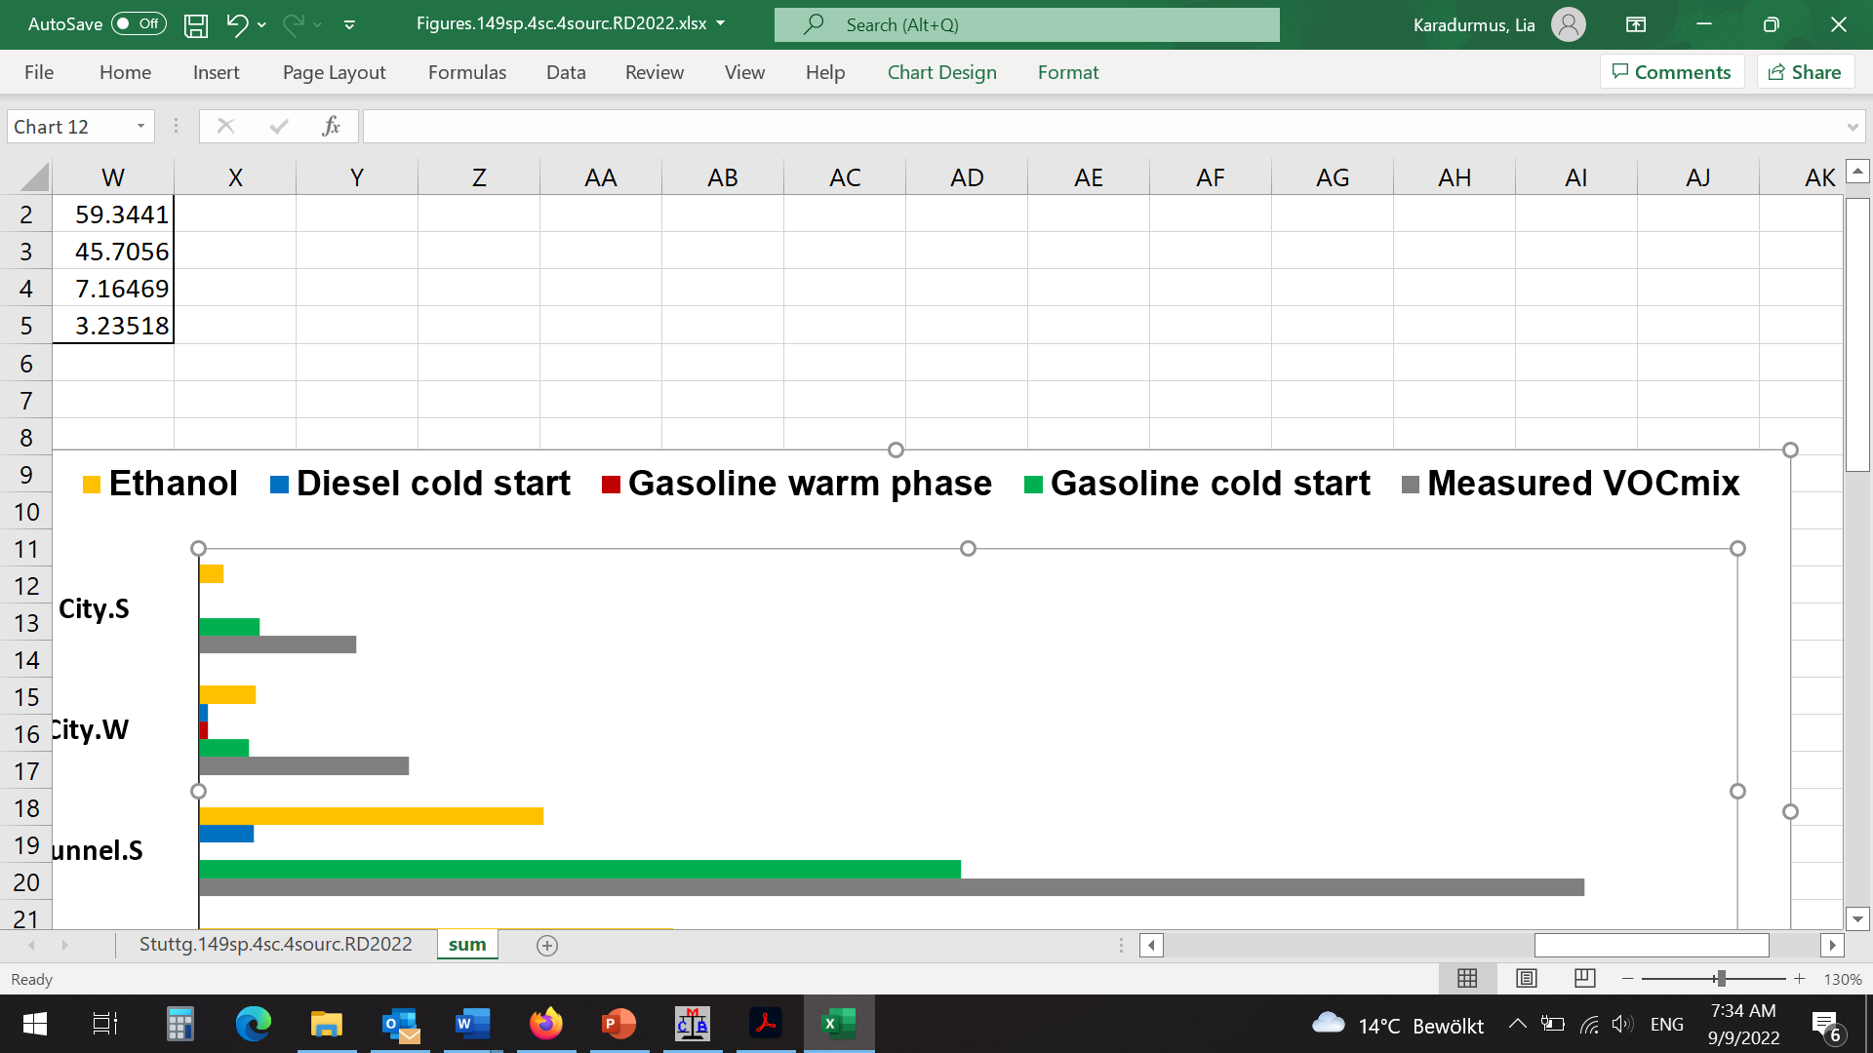
Model results
30%
IDLE
City (S)
51%
Tunnel (S)
μg/m³
Real Driving
37%
City (S)
64%
Tunnel (S)
μg/m³

Slide 16
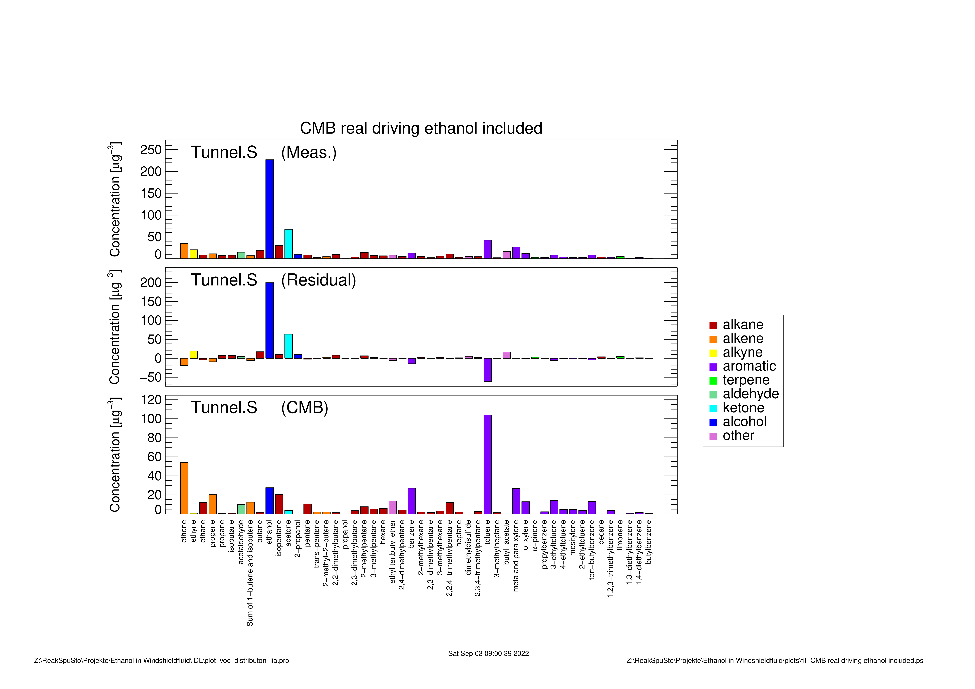
Measured vs calculated masses
μg/m³
μg/m³
Only 12.2 % of measured ethanol emissions are explained by the CMB model

Slide 17
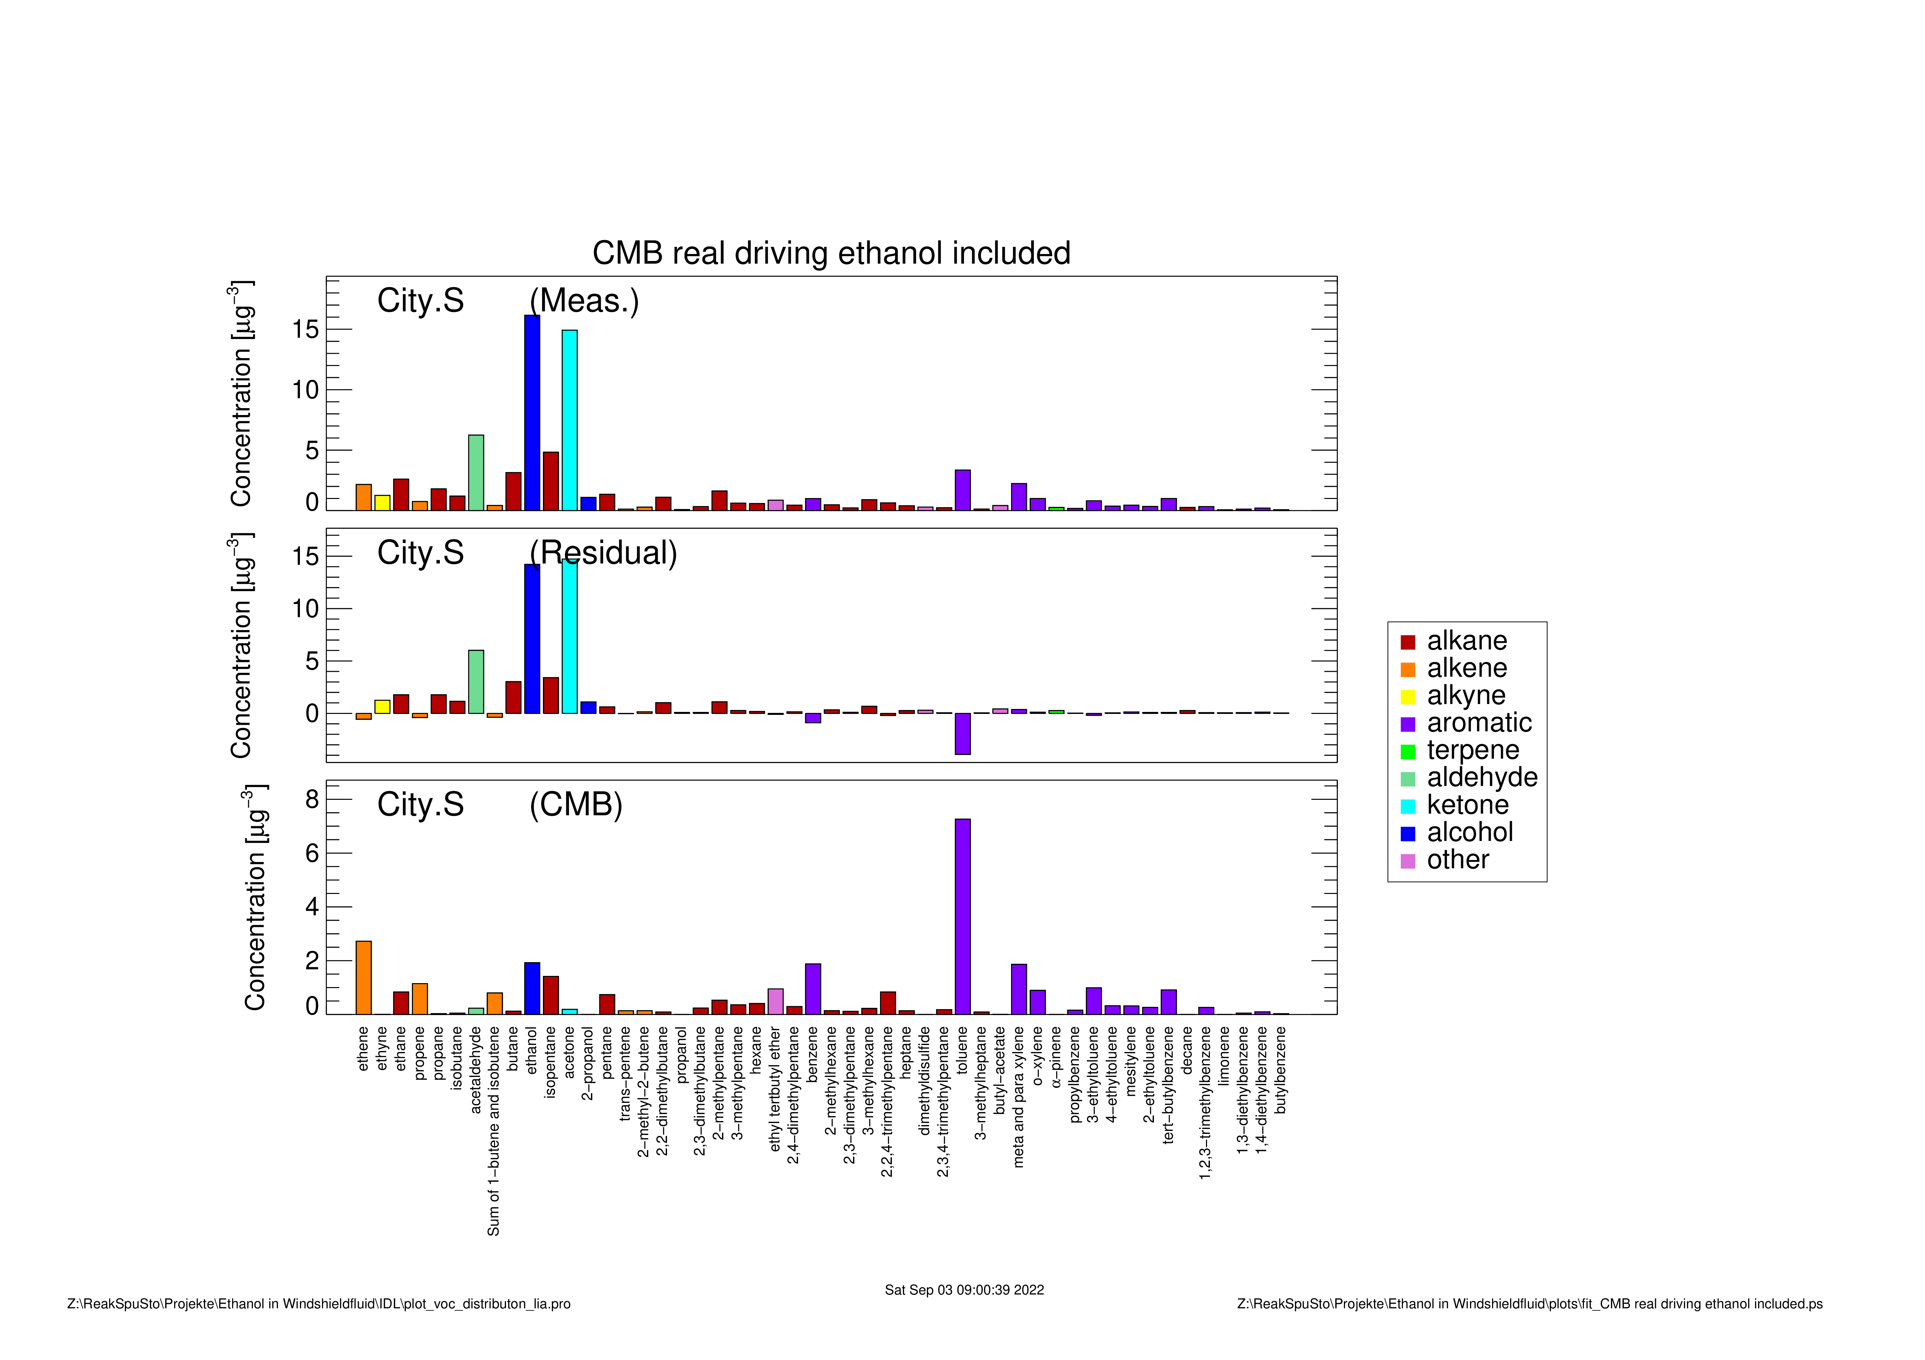
Measured vs calculated masses
μg/m³
μg/m³
Only 11.8 % of measured ethanol emissions are explained by the CMB model

Slide 18
Model Results
After adding artificial source of ethanol
54 %
Real Driving
City (S)
84 %
Tunnel (S)
μg/m³

Slide 19
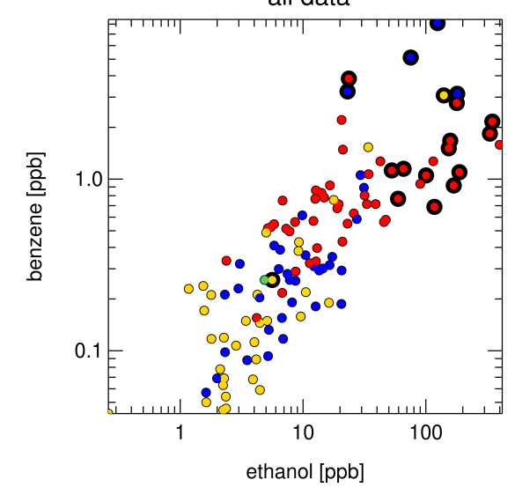
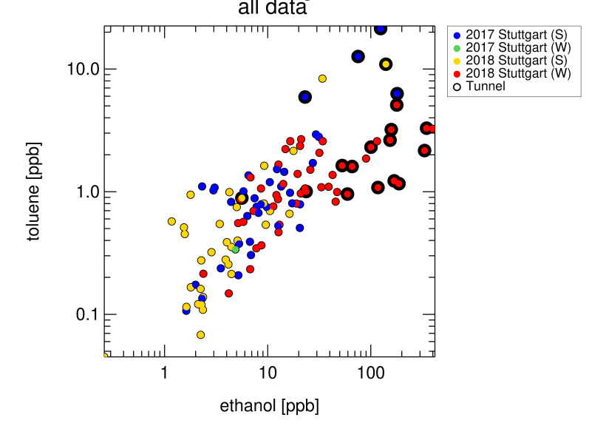
Where ethanol emissions come from?
Ethanol correlates with traffic density

Slide 20
Where ethanol emissions come from?
Ethanol emissions come from traffic but not from exhaust
Evaporative emissions
Use of Windshield washer fluids

Slide 21
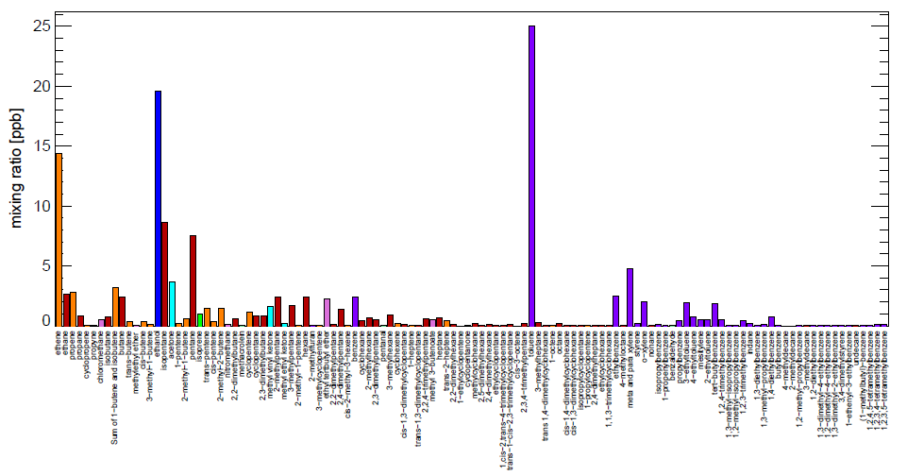
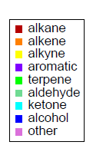
Evaporative emissions
Parking station VOC patterns
Ethanol
Notes:
Ethanol mixing ratio 10 – 60 ppb

Slide 22
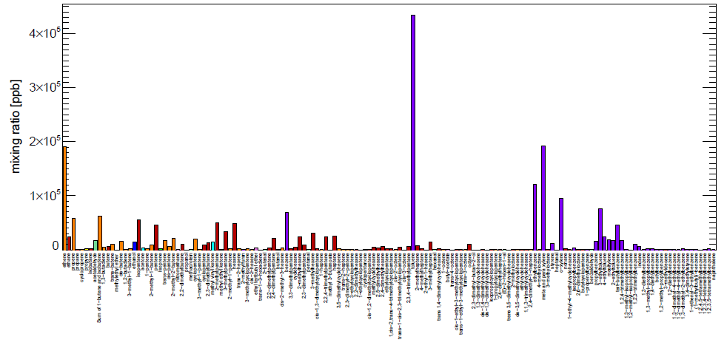
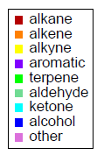
Does evaporation play a role?
Cold start gasoline emission profiles
Ethanol
Even cold-start gasoline emission profiles can only explain 12% of the measured ethanol.

Slide 23

Ethanol in windshield washer fluids
EU Legislation.
Official Journal of the European Union L 99 19.04.2018
“ Methanol Shall not be placed on the market to the general public after 9 May 2018 in windshield washing or defrosting fluids, in a concentration equal to or greater than 0,6 % by weight.^{“ [1]}
^{[1]} Official Journal of the European Union, L 99, 19 April 2018 [EUR-Lex - 32018R0589 - EN - EUR-Lex]
https://eur-lex.europa.eu/legal-content/EN/TXT/PDF/?uri=OJ:L:2018:099:FULL&from=EN
Notes:
https://eur-lex.europa.eu/legal-content/EN/TXT/PDF/?uri=OJ:L:2018:102:FULL&from=EN

Slide 24
Ratio has shifted

Slide 25
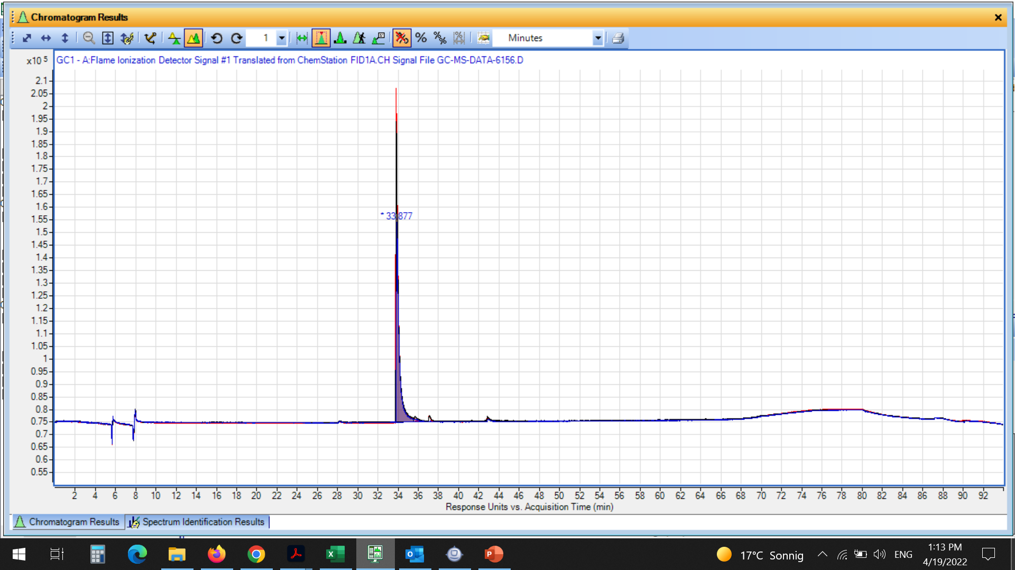
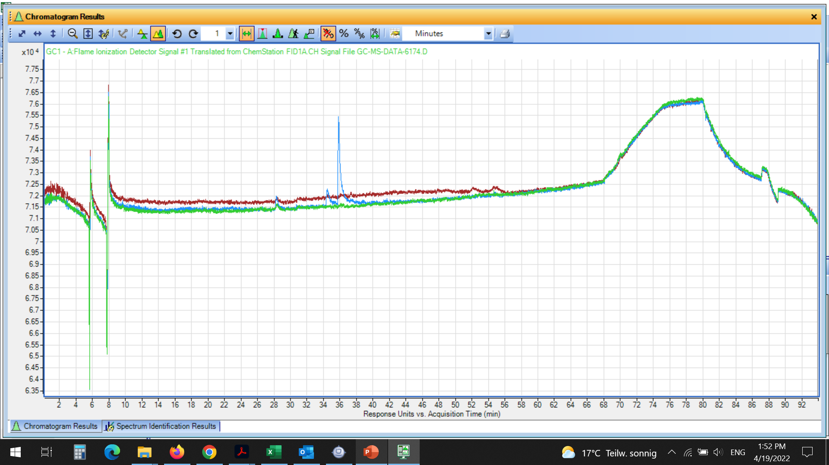
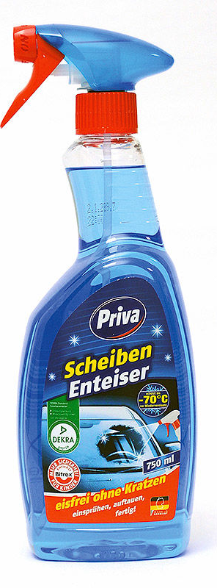
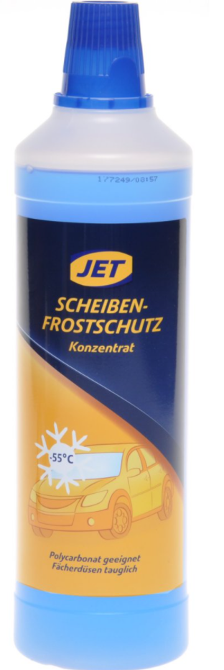
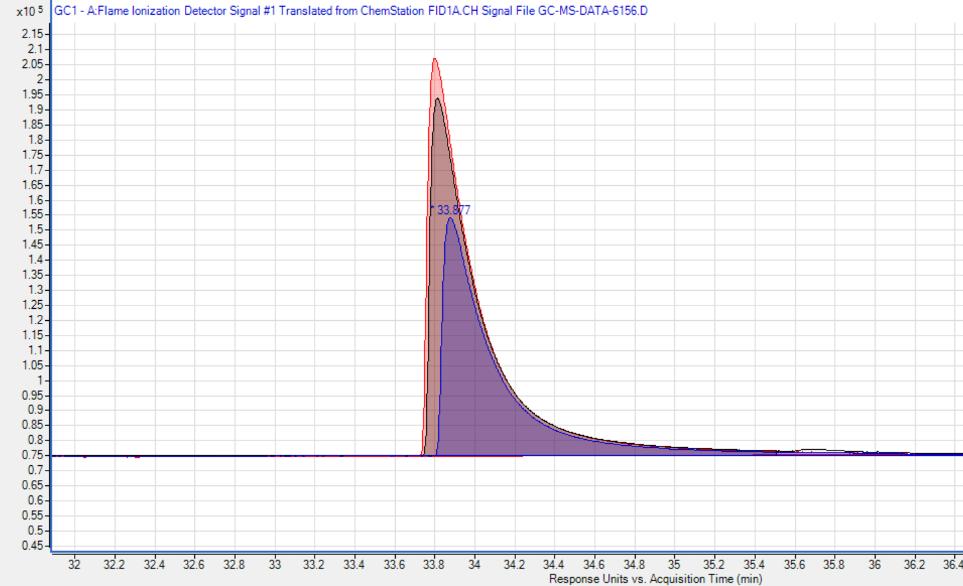
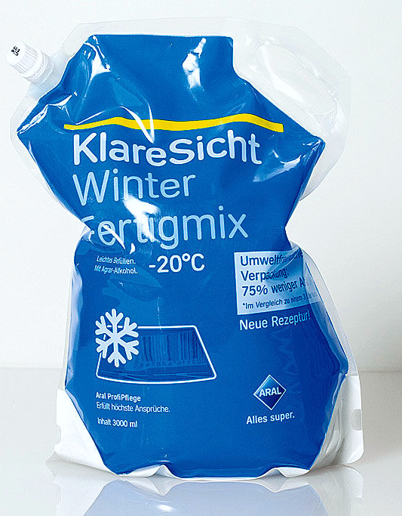
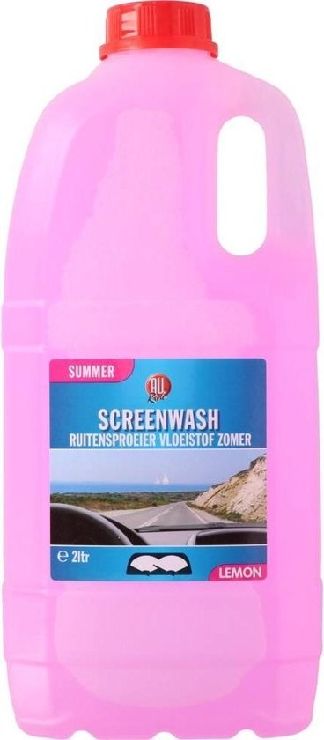
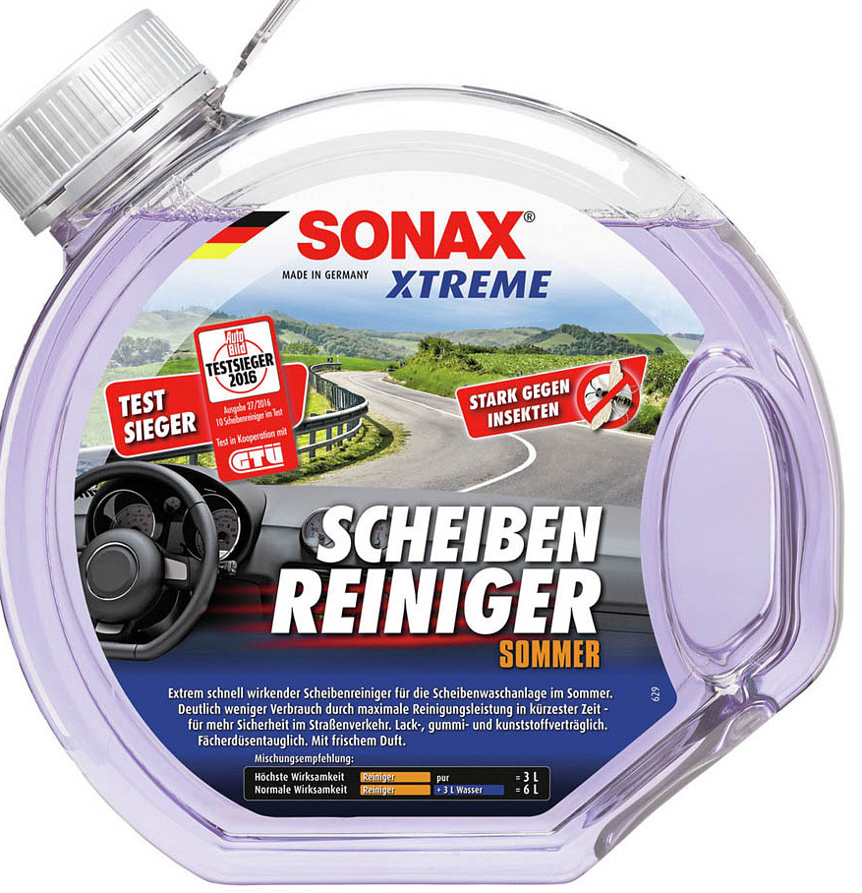
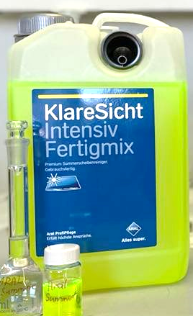
Ethanol content in windscreen washer fluid:
Ethanol
Winter formulations
Summer formulations

Slide 26
Ethanol content in windscreen washer fluid:
Ethanol
Windshield washer fluid | Ethanol content [v/v %]
“JET” concentrate -55°C | 45.8 %
“PRIVA” ready mix -60°C | 41.1 %
“ARAL” ready mix -20°C | 26.8 %
Winter formulations contain ETHANOL.
Summer formulations don’t contain ETHANOL
38 %

Slide 27
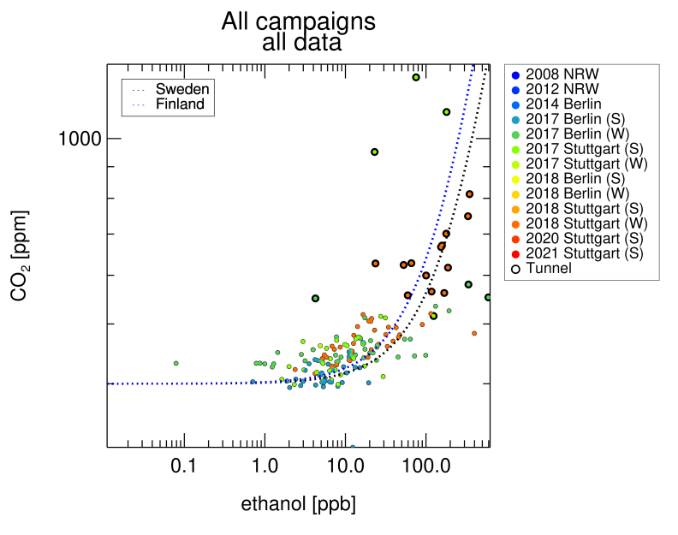
Ethanol / co2 ratio
Notes:
EtOH / CO₂ Correlation plot: 1.00E-04 Sweden: 6.20E-04 Finland: 4.20E-04
longer cold seasons seems to be reason of higher ratio

Slide 28
Ethanol denaturation
 | Ethanol / 2-propanol | Ethanol / MEK
EU Legislation | 3% | 3%
German Legislation | 1% | 1%
“JET” | 1.25% | 0.82%
“Priva” | 1.26% | 0.69%
Ethanol
Methyl Ethyl Ketone
2-propanol

Slide 29
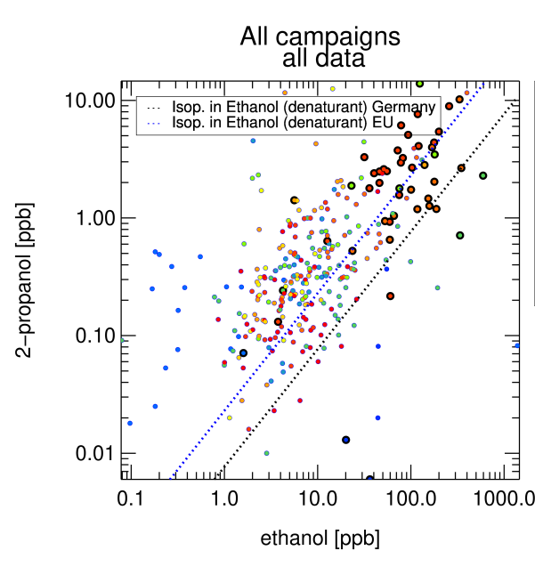
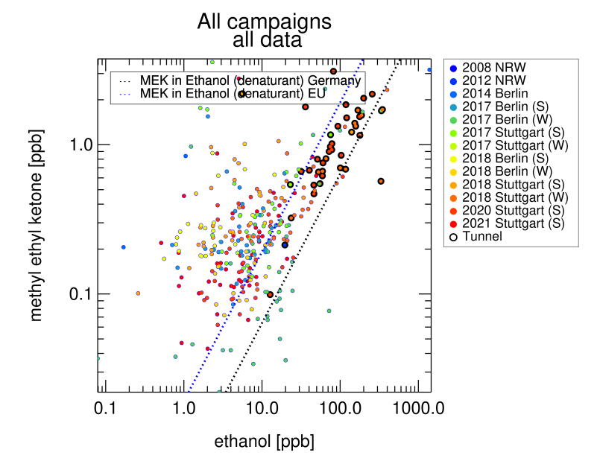
Ethanol denaturation
 | Ethanol / 2-propanol | Ethanol / MEK
EU Legislation | 3% | 3%
German Legislation | 1% | 1%
“JET” | 1.25% | 0.82%
“Priva” | 1.26% | 0.69%

Slide 30
Conclusions
Windshield washer fluid can contribute significantly to ethanol emissions in urban areas.
Gasoline cold start dominates the various sources of exhaust emissions for most of the VOCs found on the streets.

Slide 31
Acknowledgements
GGSB
FZJ (IEK-8)
TSU
BMBF
Valentin Polinowski (FZJ, IEK-8)
Yen-Sen Lu (FZJ, IEK-8)
Wen-Fei Huang (FZJ, IEK-8)
Philip Carlsson (FZJ, IEK-8)
Carl Burket (FZJ, IEK-8)
Anna Noveli (FZJ, IEK-8)
Thank you !

Slide 32
Ethanol / CO₂ ratio
Cars using Windshield fluid | 1 %
Number of cars per day | 50 000
Windshield fluid per injection | 10 mL
Share of Ethanol | 38 %
Total amount of ethanol released / day | 1900 mL
Average CO2 emission (from HBEFA) | 200 g / km / Vehicle
Total CO₂ emitted per day | 23000000 g
MW CO₂ | 44 g/mol
Total mols emitted | 522727.27 mol
Gas Volume CO₂ | 12754.55 m³
Share CO2 | 2.2 %
Ethanol / CO2 | 6.23E-05
Ethanol / CO2 (from the correlation plot) | 1.00E-04
Density | 0.789 g/mol
MW Ethanol | 46 g/mol
Mole Ethanol | 32.59 mol
Gas Volume | 0.795 m³
Tunnel Volume | 5.72E+05 m³
Mixing ratio Ethanol | 1.39 ppm

Slide 33
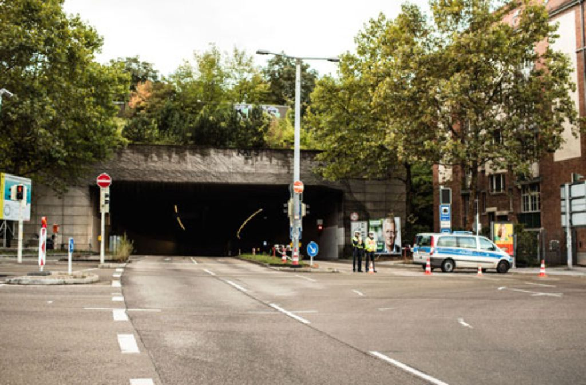
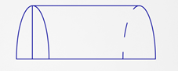

Mixing ratios of ethanol
Dimensions of Heslacher Tunnel | Traffic frequency
L: 2300m H: 8.9m W: 10.4m | 50 000 vehicles / day
$$V=\frac{1}{2}\text{π}r^{2}h$$
V_{tunnel} = 5.72E+05 m³
1% of vehicles use windshield washer fluid while driving in the Heslacher Tunnel.
10 mL windshield washer fluid per vehicle.
500 x 10 mL = 5000 mL / day of windshield washer fluid.
38 % EtOH = 1895 mL EtOH
= 1.39 ppm Ethanol
( Assuming that there is no air ventilation / air exchange in the tunnel )
Heslacher Tunnel. Stuttgart. Germany.
The Heslacher Tunnel is a 2.3 km long two-lane road tunnel in the south of Stuttgart . As part of the federal highway 14 , it is part of the connection from the city center to the Stuttgart motorway junction.

Slide 34
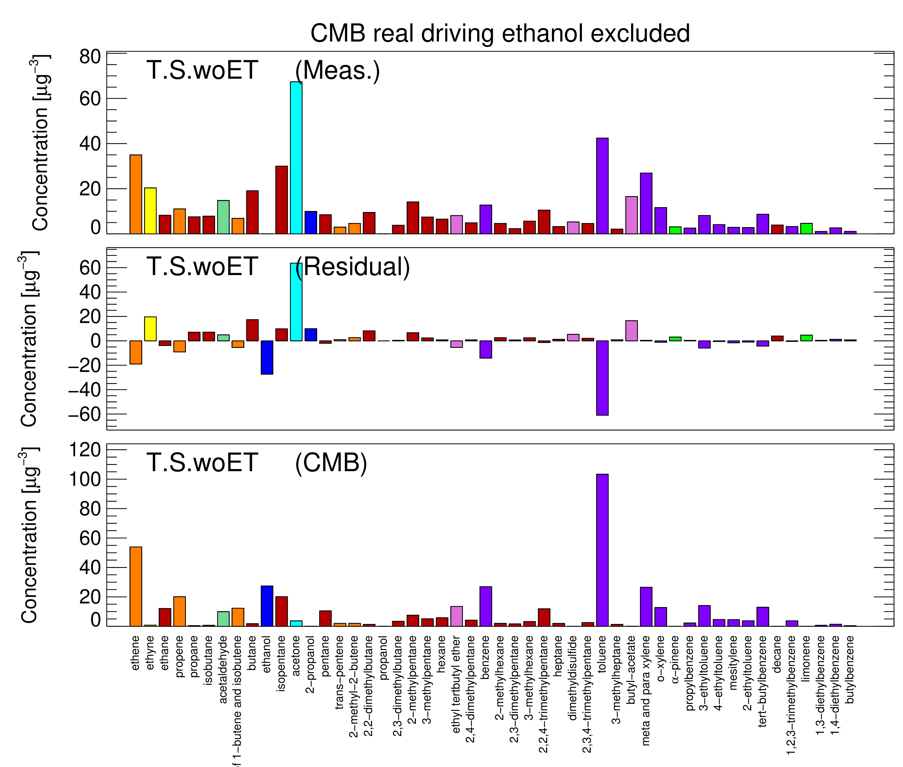
Measured vs calculated masses

Slide 35
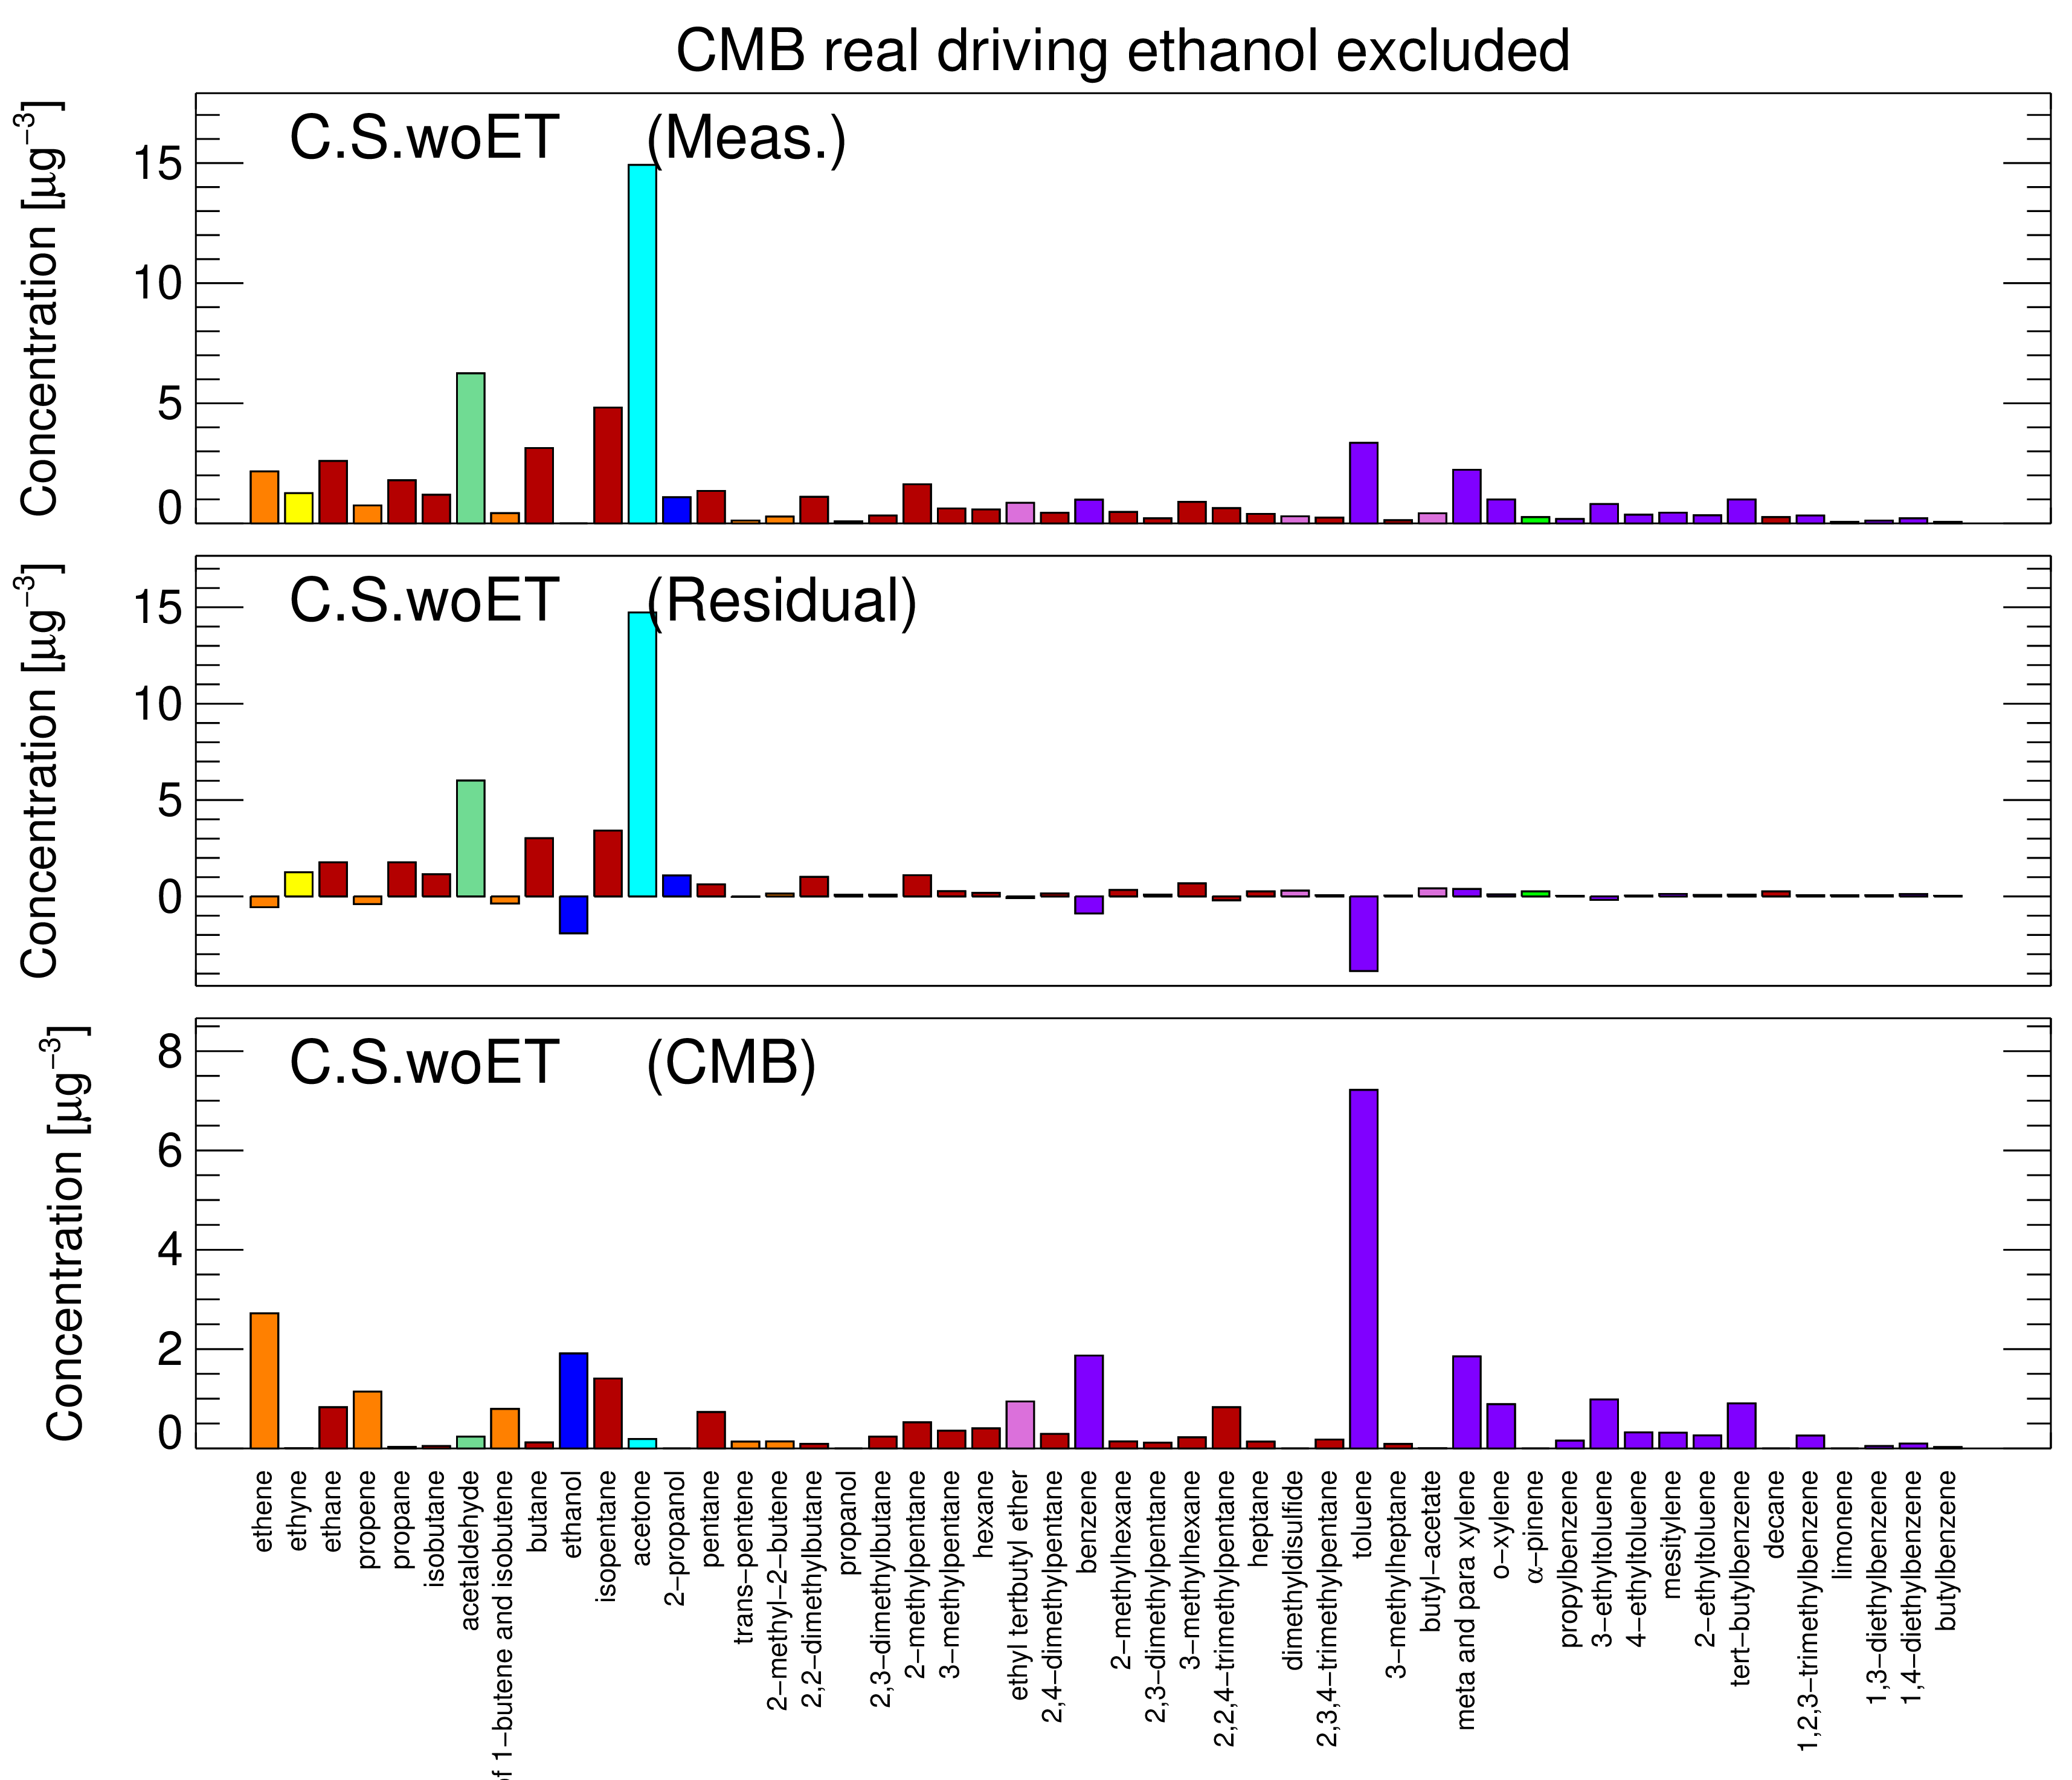
Measured vs calculated masses

Slide 36
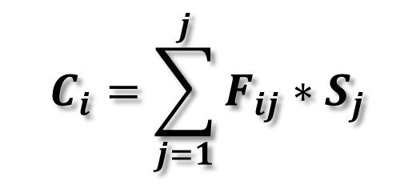
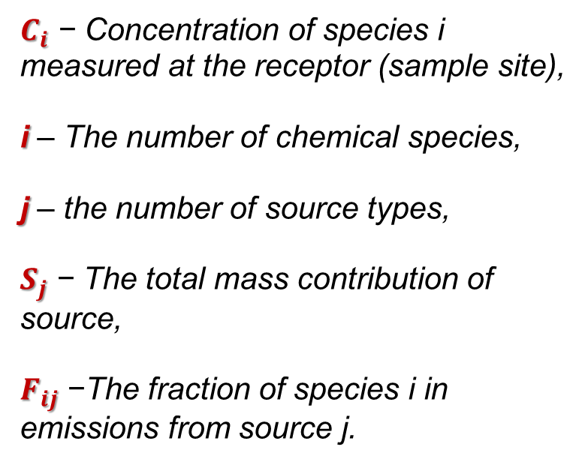
Governing Equation
  The CMB receptor model consists of a solution to linear equations that express each receptor chemical concentration as a linear sum of products of source profile abundances and source contributions.
$C_{i}$ − Concentration of species i measured at the receptor (sample site),
i – The number of chemical species,
j – the number of source types,
$S_{j}$ − The total mass contribution of source,
$F_{ij}$ −The fraction of species i in emissions from source j.
measured
$$C_{i}=\sum_{j=1}^{j}{F_{ij}∗S_{j}}$$
calculated
Notes:
Ci and Fij are measured quantities
Sj is calculated as the result of solving the multiple linear equations. Sj obtained by this method never solve the equations exactly but are the values which come closest to doing so.
Also, model compares if both sides of the equation is equal or not.

Slide 37
CMB model limitations
CMB analysis focuses on the origins of ambient pollutant (VOC) concentrations rather than the fate of their end products.
Chemically similar sources may result in analytical problems (collinearity).
The method does not directly identify the presence of unknown and unspecified sources, so a considerable proportion of the measured pollutant load may be unexplained;

Slide 38
CMB model Assumptions:
Composition of the source emissions are constant over the period of ambient and source sampling.
Chemical species do not react with each other (i.e. they add linearly).
All sources with a potential for significantly contributing to the receptor have been identified and have had their emissions characterized.
The source profiles are linearly independent of each other.
Measurement uncertainties are random, uncorrelated and normally distributed.

Slide 39
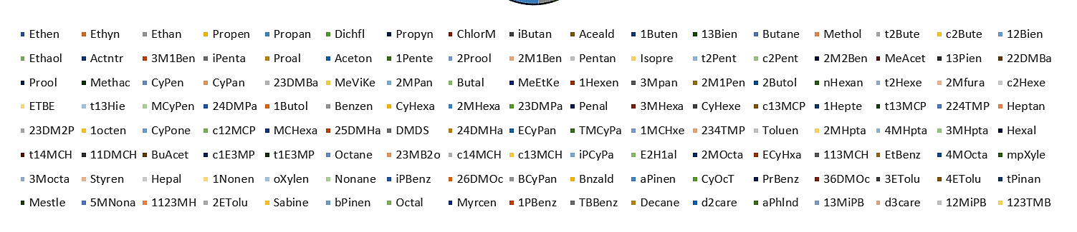
VOC patterns
(averaged mass concentrations)
Ethanol
Ethanol
Ethanol
Ethanol

Slide 40
Model results
IDLE
Real Driving

Slide 41
Model Results
After adding artificial source of ethanol
City (S)
54 %
84 %
Tunnel (S)
μg/m³

Slide 42
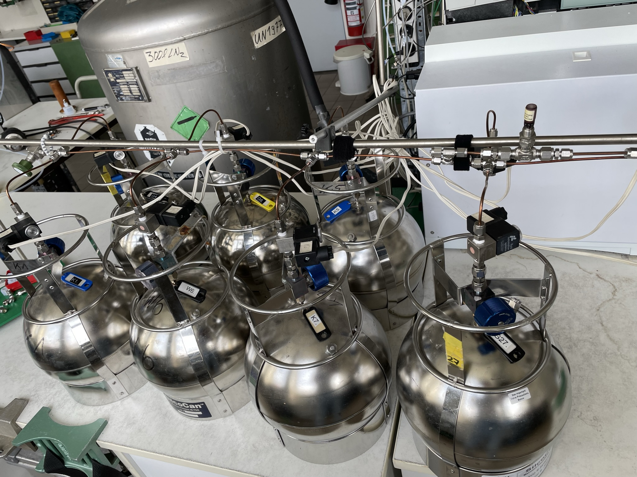
Data set
Stuttgart
2017 - 2018
Tunnel, Inner city
Sampling in canisters
GC-MS analysis
Source apportionment

Slide 43


Source apportionment
Source Apportionment (SA) is the practice of deriving information about pollution sources and the amount they contribute to ambient air pollution levels.
Receptor
Notes:
Source apportionment (SA) is the technique which relates a source emission (an activity sector or an area) to the ambient air concentration of a pollutant.
This task can be accomplished using three main approaches: Emission inventories, source-oriented models and receptor-oriented models

Slide 44
introduction
Averaged annual VOC emissions for different source categories replotted from a publication of the German Federal Environmental Agency (UBA).

Slide 45
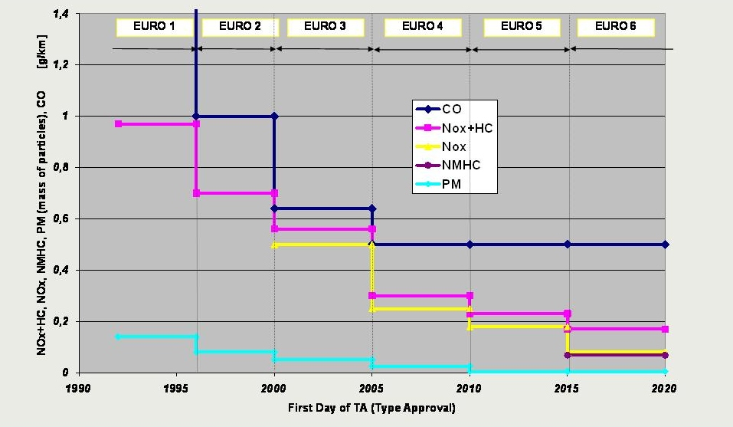
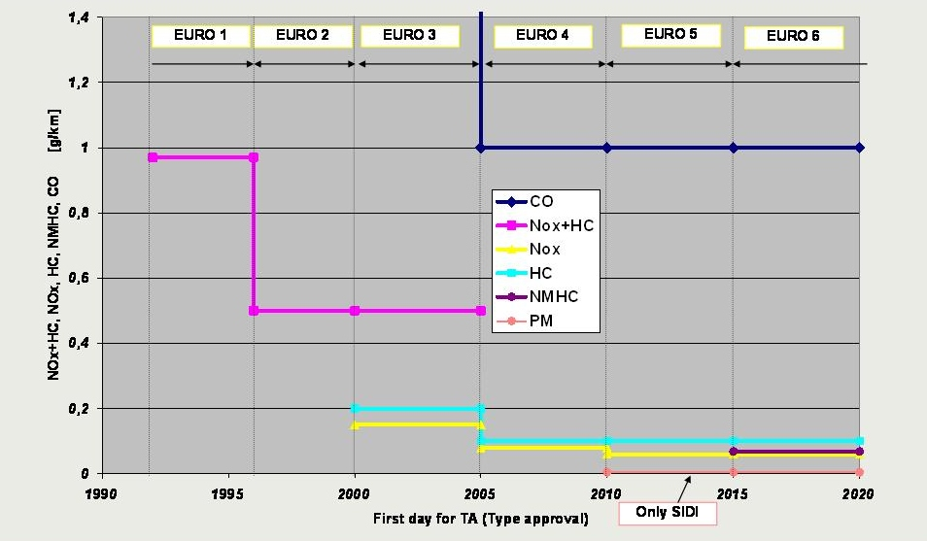
European emission standards
Diesel
Gasoline
Notes:
Great efforts have been made to reduce vehicle emissions.
The picture shows the development of pollutant limitation within the European Union from the beginning until 2020, Euro 6 for diesel and gasoline engine limitation.

Slide 46
Voc patterns
Summer

Slide 47
VOC patterns
Winter

Slide 48
VOC patterns
EtOH 95 %
EtOHl 94 %
EtOH 91 %
EtOH 96 %
Ethanol is most abundant VOC in urban air.
Ethanol concentrations dominates during both seasons, however in winter they are even higher.

Slide 49
VOC patterns
Ethanol 95 %
Ethanol 91 %

Slide 50
VOC patterns
Ethanol 94 %
Ethanol 96 %

