Slide 1
Vertical Axis Wind Turbine

Slide 2
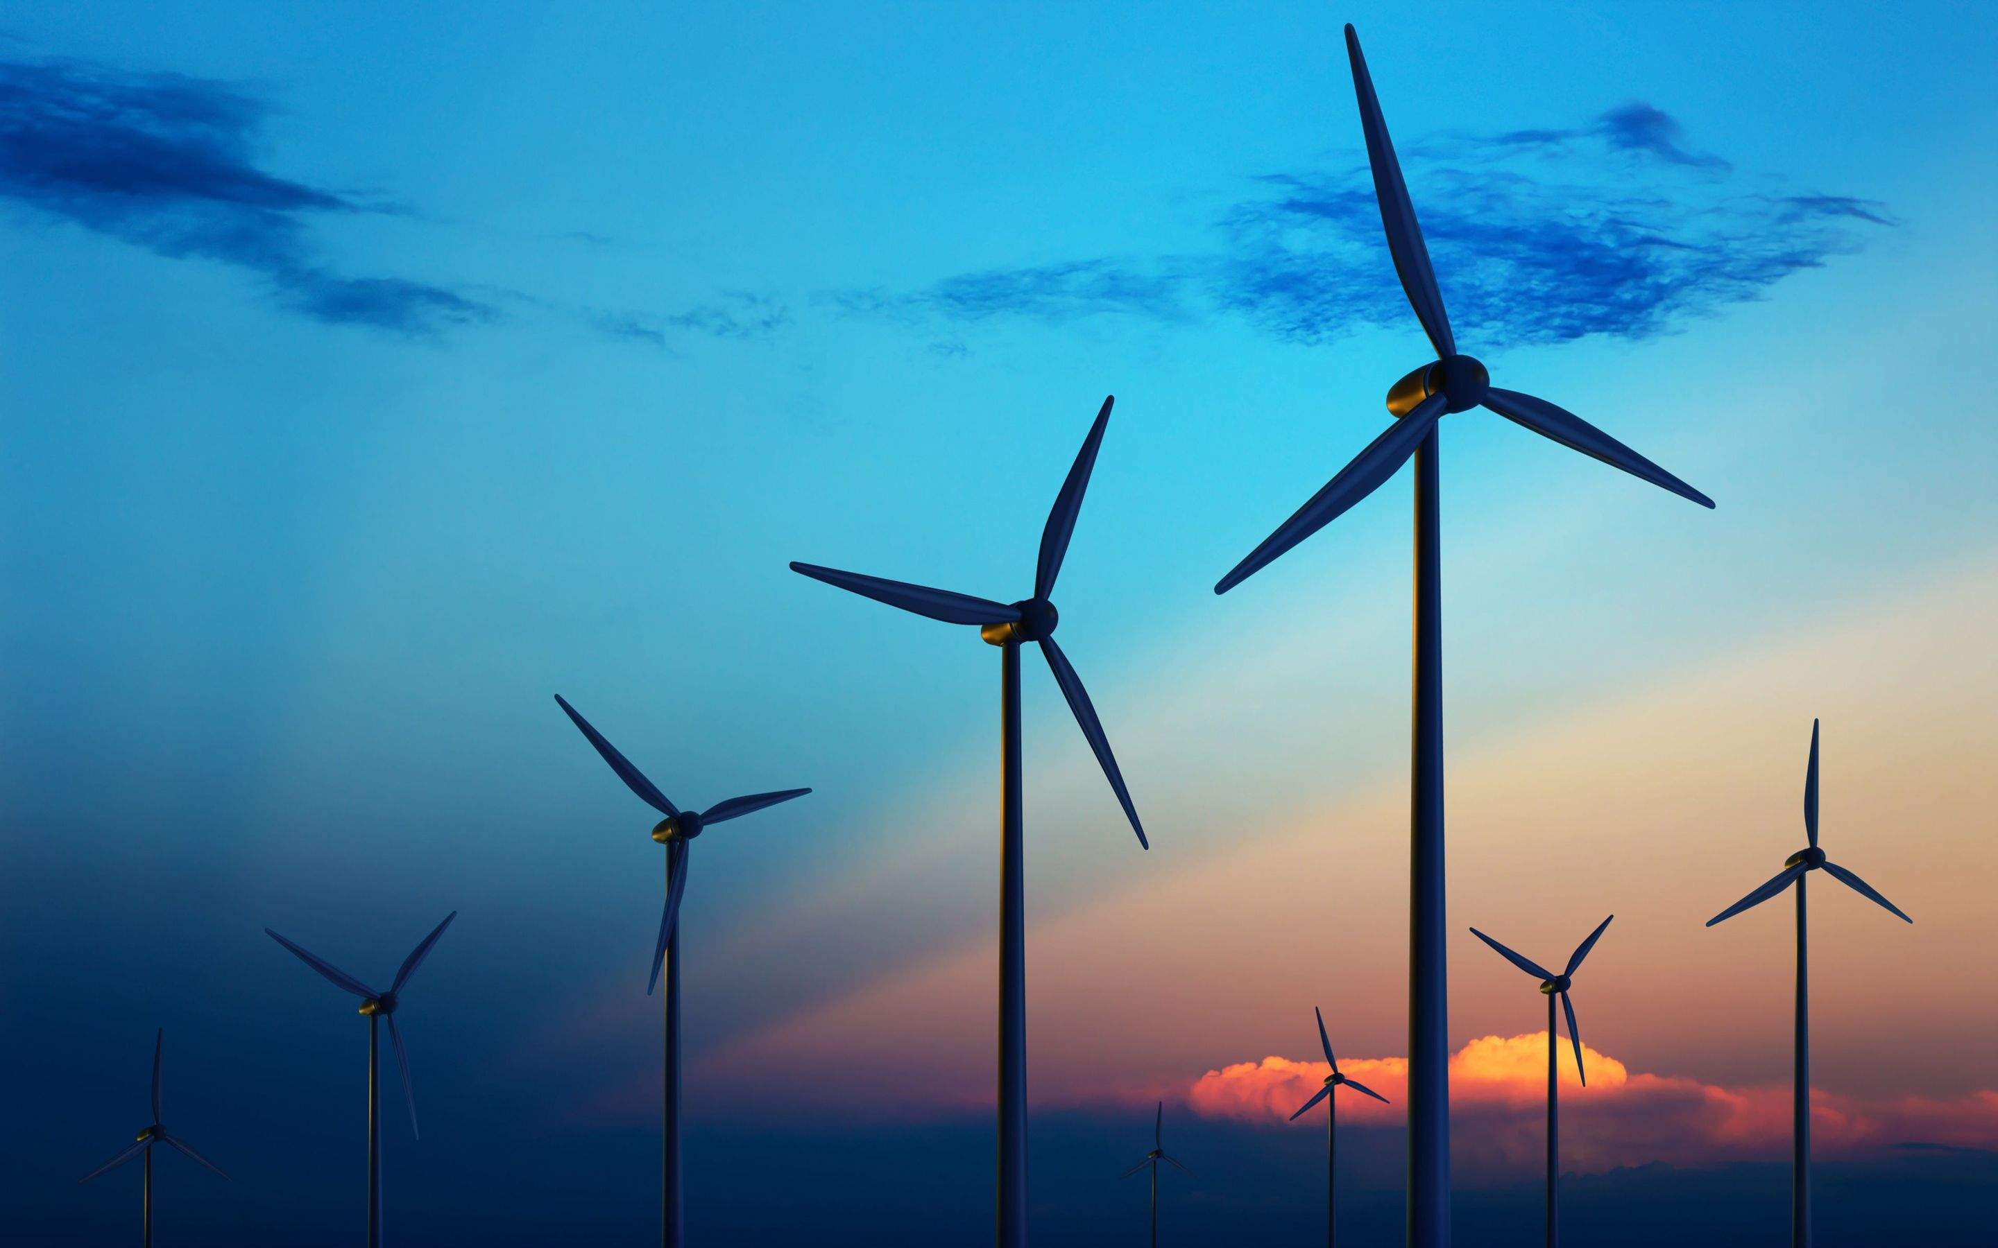
Project By Lasha Lomsadze
Mechanical Engineering – 3RD year

Slide 3
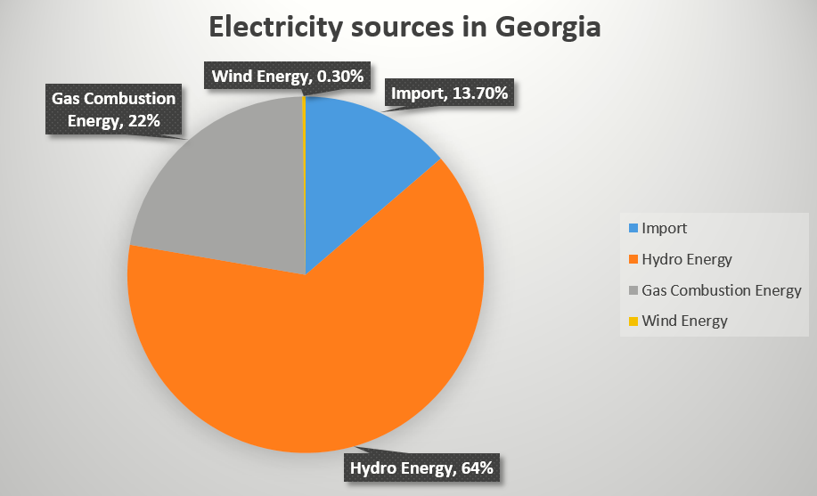
Electricity sources in Georgia

Slide 4
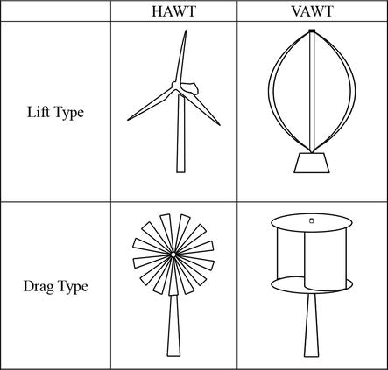
Types of Wind Turbines
Lift Type Wind Turbines
Pros: Cons:
High rotation speed
More power output
Noise issues
Requires more space
More complex to manufacture
Drag Type Wind Turbines
Pros: Cons:
More torque output
More compact
Cheaper to manufacture
Less power output

Slide 5
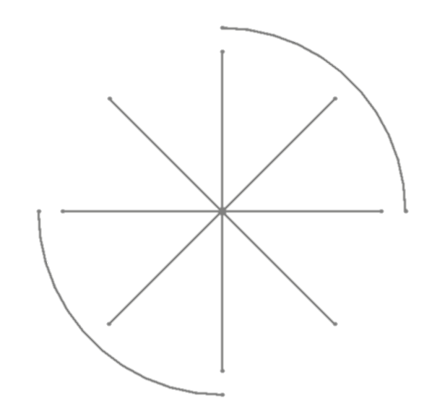
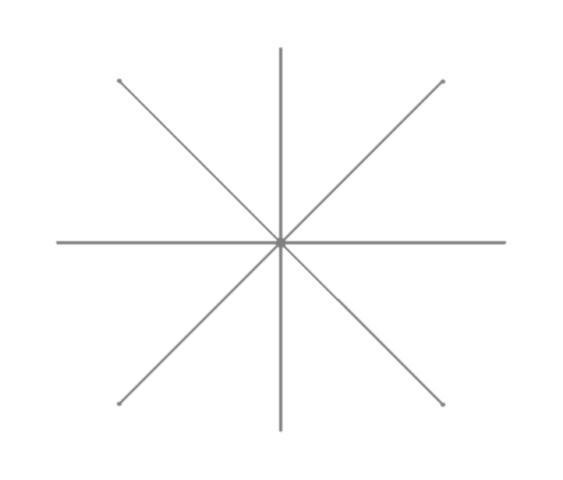
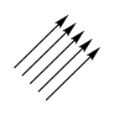
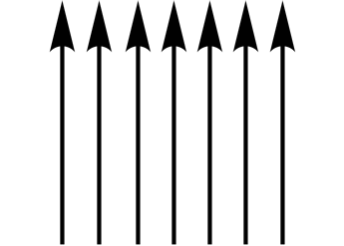
Coming Up With Design
Force Distribution
Force Distribution
Making it Work
$$\sum_{m}{=F∗l−F∗l=0}$$
$$\sum_{m}{=F∗l>0}$$
Redirecting the Air Flow
Air Flow
Air Flow

Slide 6
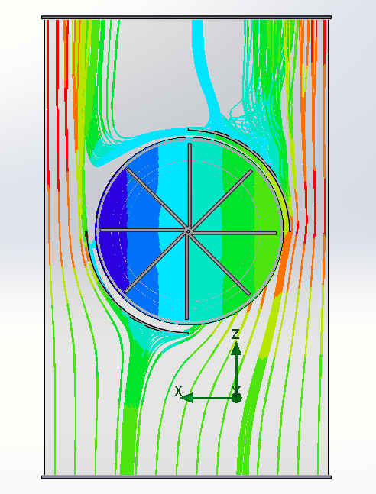
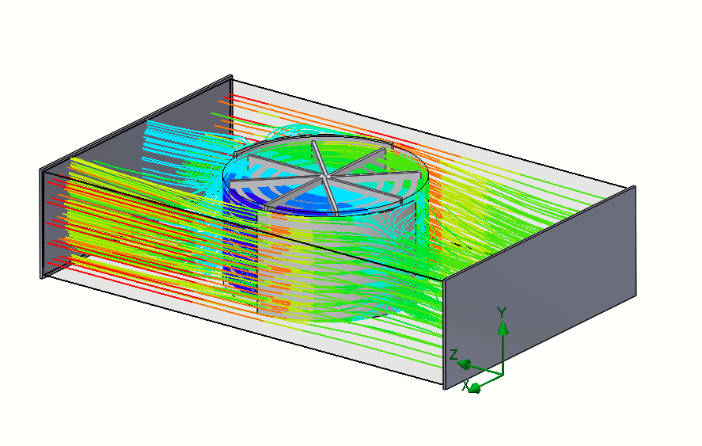
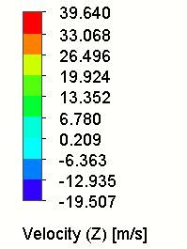
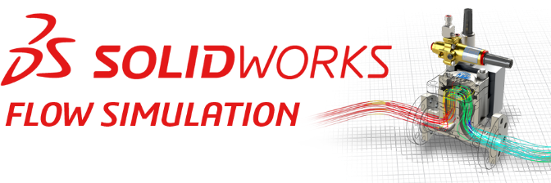
Software Visualisation

Slide 7
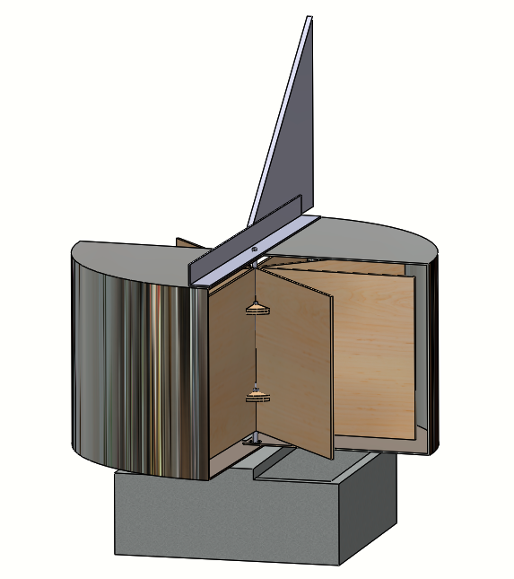
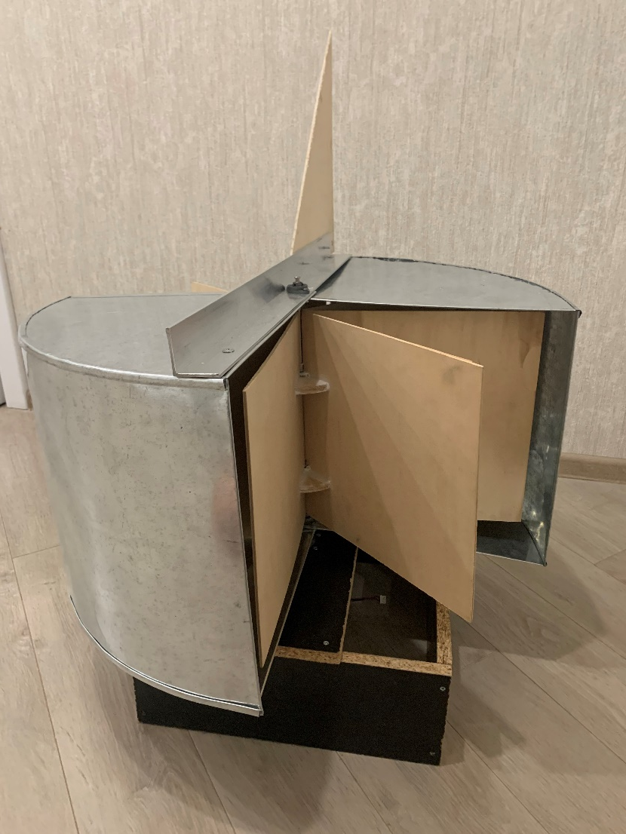
CAD Model Real Model

Slide 8
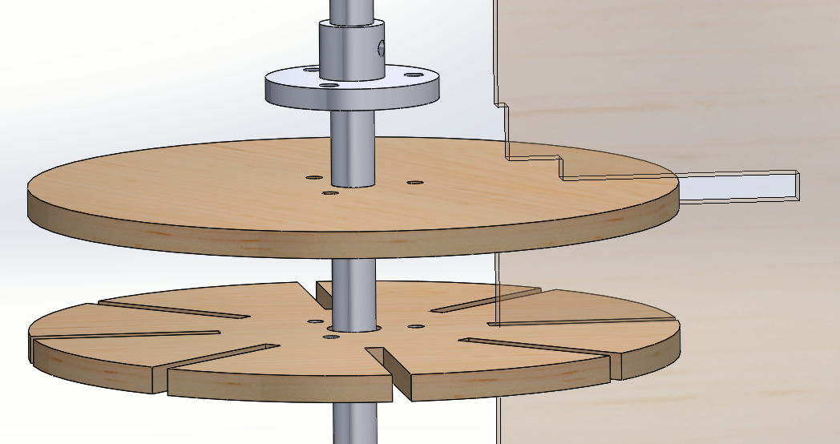
Attaching wings to the shaft
Fixed connection between hub and shaft
First disc prevents movement of the wing on the vertical axis
Fixed connection between hub and hub discs
Second disc prevents rotation of the wing around vertical axis

Slide 9
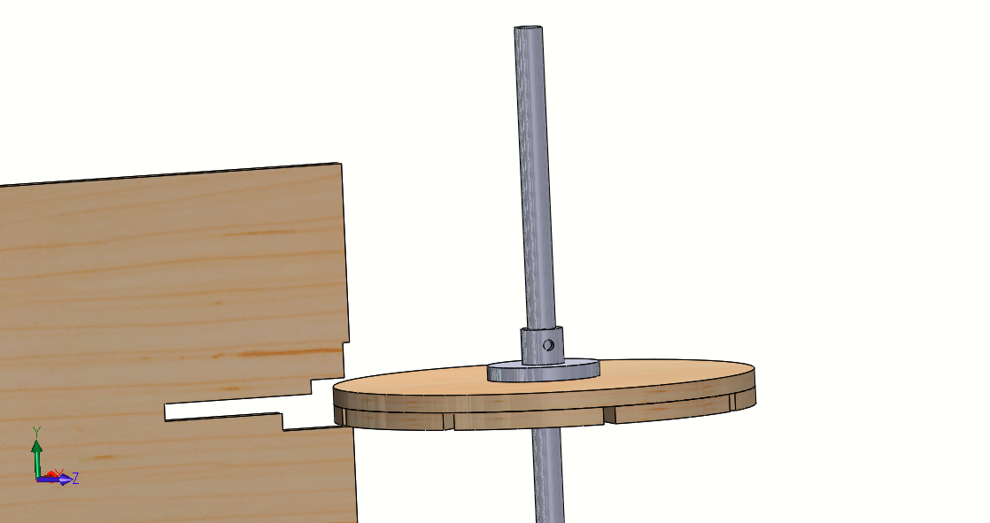
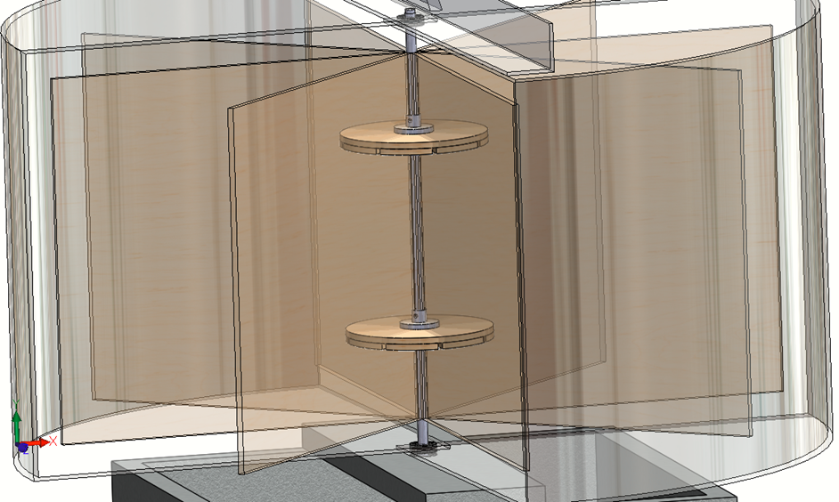
Attaching wings to the shaft

Slide 10
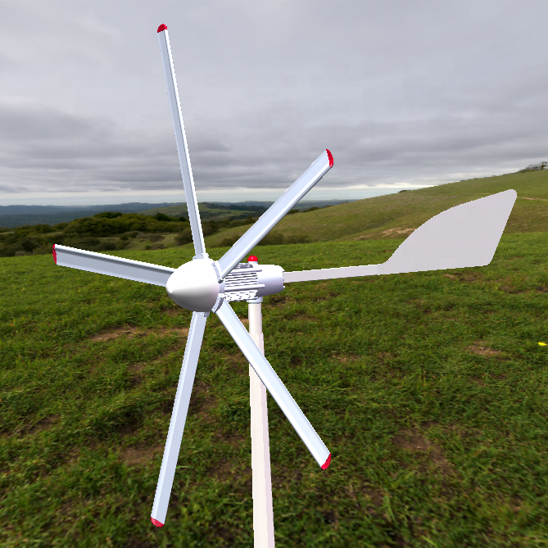
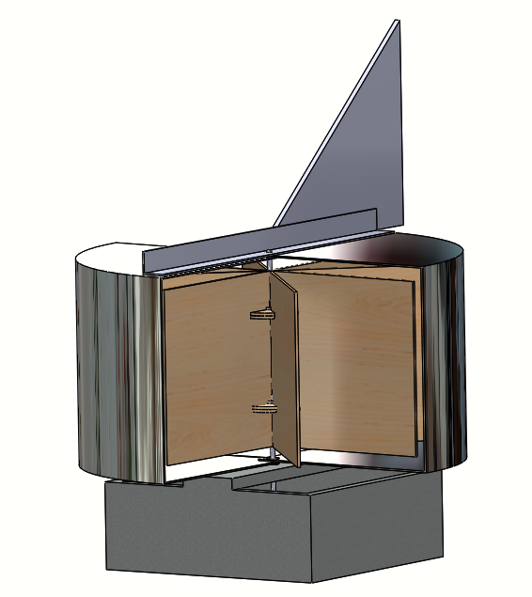
Calculating Yaw Mechanism: Explanation
$$F=C_{y}ρ\frac{v^{2}}{2}A$$

Slide 11
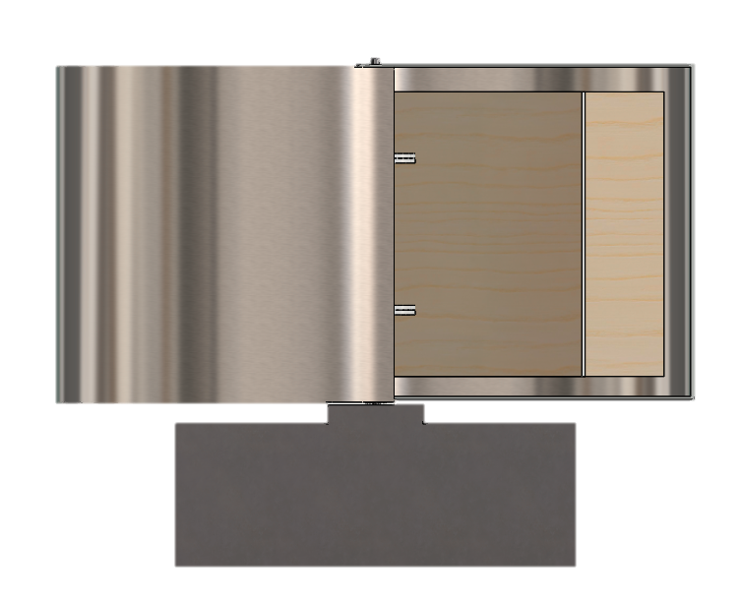
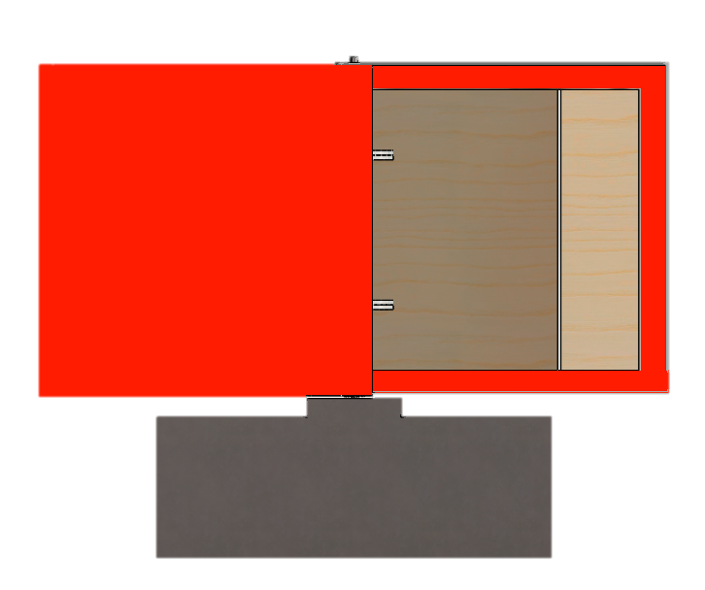
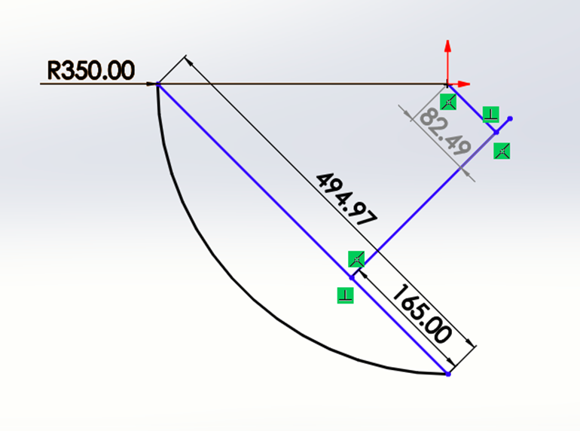
Calculating Yaw Mechanism: The Swept Area
Front View Facing the wind
Swept Area on the shell casing
Top View with Dimensions
$$x=0.083m$$
$$h$$
$$h_{1}$$
$$F$$
$$l$$
Air Flow
Swept area calculation:
$$\left[r=0.35m h=0.35m l=0.28m h_{1}=0.3m\right]$$
$$A=\frac{1}{2}πrh+\left(\frac{1}{2}πrh−\frac{1}{2}πlh_{1}\right)=πrh−\frac{1}{2}πlh_{1}=0.25m^{2}$$

Slide 12
Calculating Yaw Mechanism: The Calculation part 1
$$F={\frac{1}{2}C}_{y}ρv^{2}A=\frac{1}{2}∗0.3∗ρv^{2}0.25=0.0375ρv^{2}$$
Lift coefficient $C_{y}$=0.3
Distance between force and shaft $x=0.083m$
$$\sum_{moment}{=}F∗x=0.0375ρv^{2}∗0.083=0.003ρv^{2}$$

Slide 13
Calculating Yaw Mechanism: The Calculation part 2
$$l=0.4 meters$$
$$h=?$$
$$F=\frac{1}{2}C_{y}ρv^{2}A=\frac{1}{2}∗0.8∗0.4∗hρv^{2}$$
$$\sum_{moment}{=}F∗\frac{l}{3}=0.021hρv^{2}=0.003ρv^{2}$$
$$h=\frac{0.003}{0.021}=0.142m$$

Slide 14
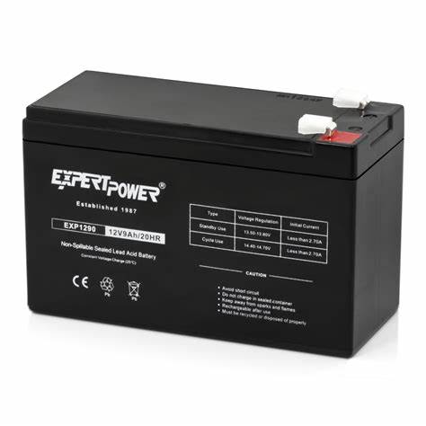
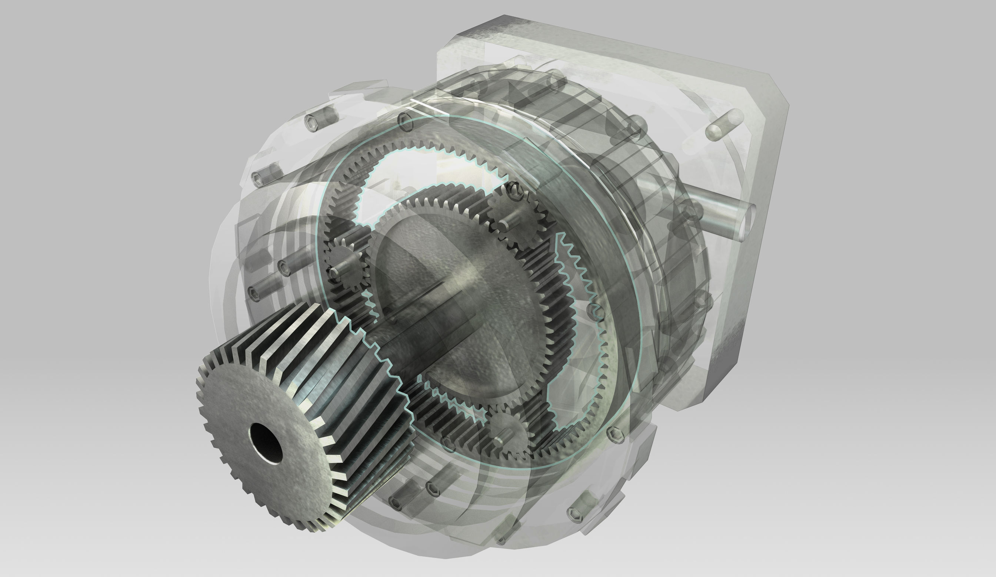
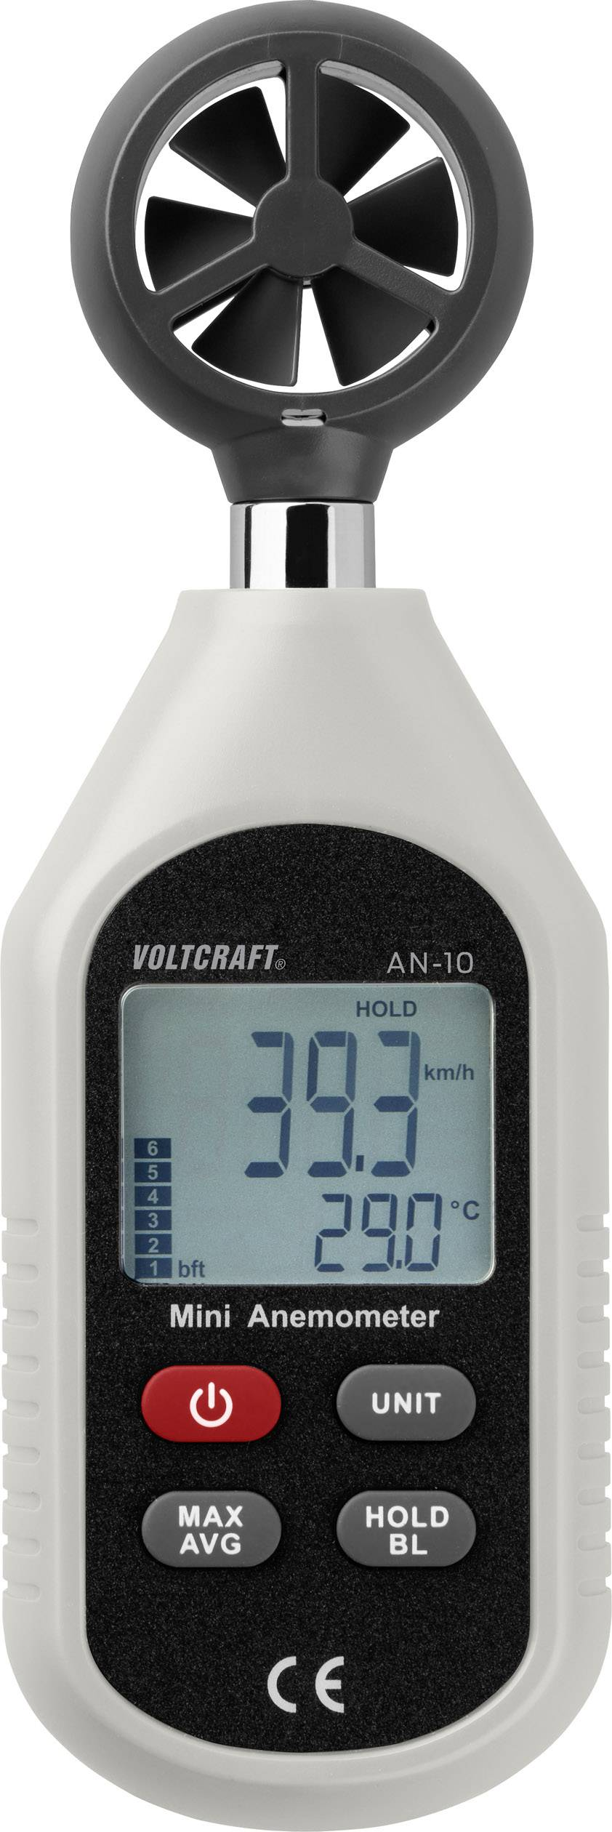
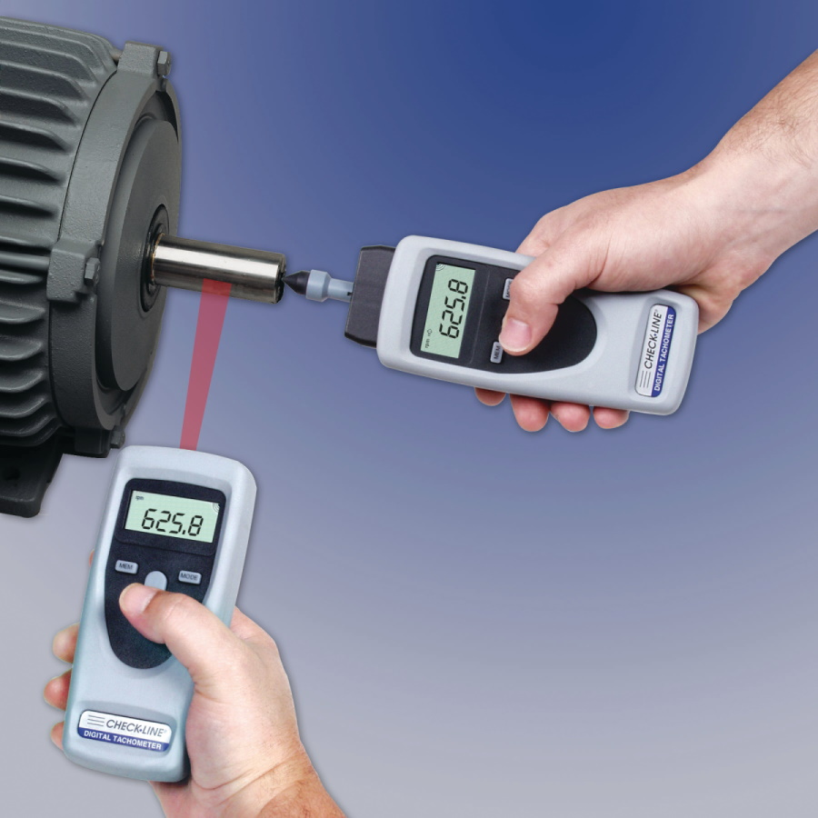
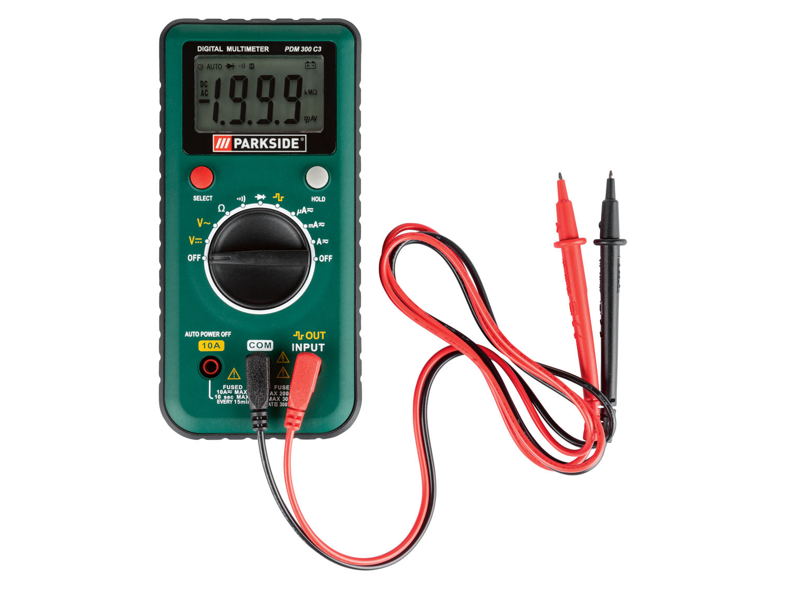
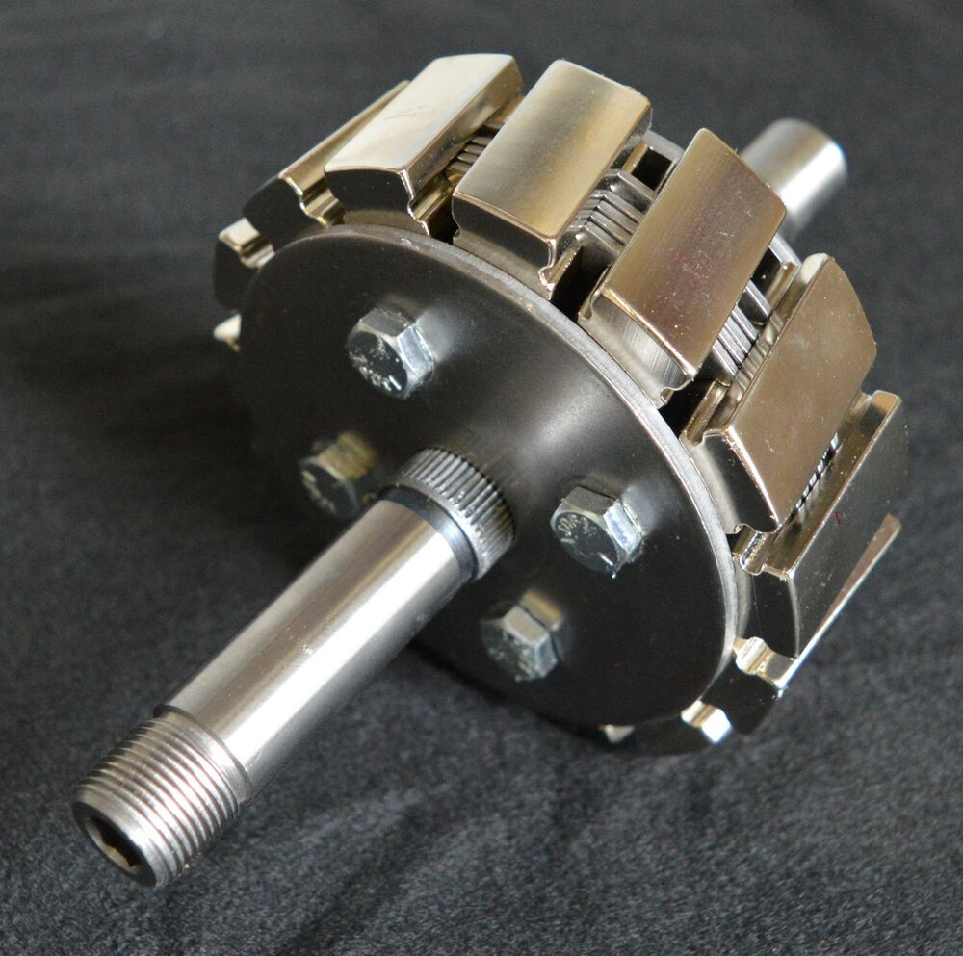
Project analysis
What is Done:
Wind turbine mechanism that works properly and can adapt to changing wind direction
Project needs:
Gearbox to increase RPM
Permanent magnet
Generator with rectifier bridge
to create DC electricity
Battery to store electricity
Testing in real conditions with measuring tools

Slide 15
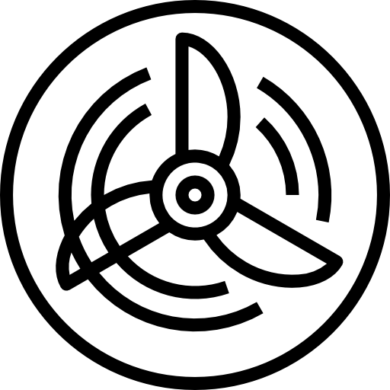
Thank Y u F r Attenti n

