Slide 1
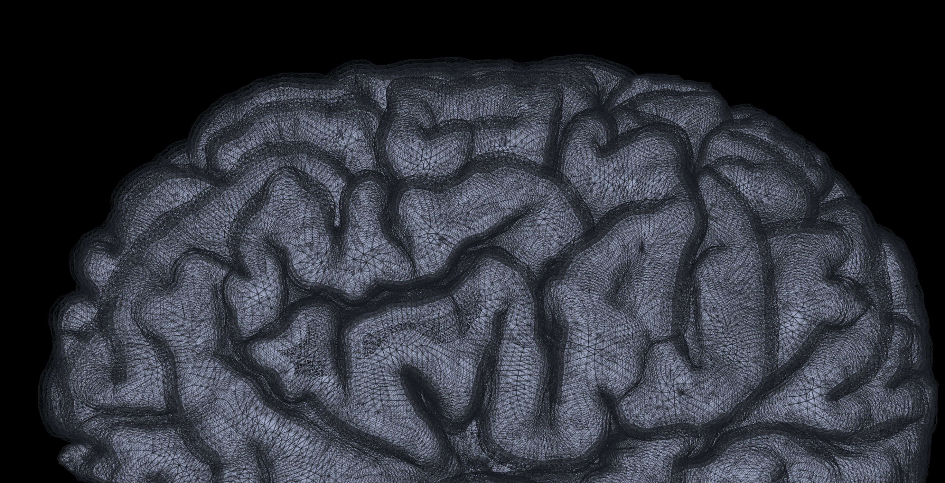
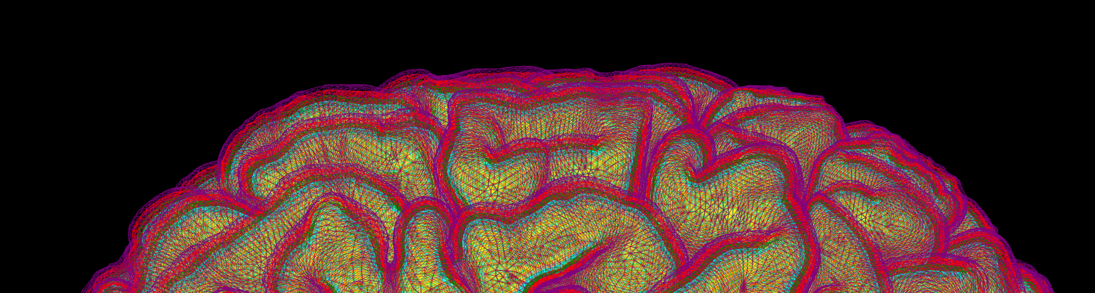
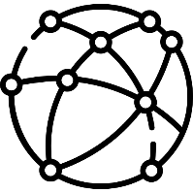

Structural-Functional-Metabolic Imaging: a Joint FZJ-Siemens Project Proposal
CSF
I
depth
II/III
IV
V
WM
VI
01 September 2022 I N. Jon Shah

Slide 2
Concept
Dysfunction
Investigation
E-infrastructure
Genetic defect
DNA sample: genomics
Protein malformation
Blood sample: proteomics
Unique Dataset for Precision Medicine
available to clinics, the community and to industry
Metabolic consequences
UHF MR-PET Imaging:
Multimodal fingerprints
Functional changes
Structural changes

Slide 3



Layer-specific fmri of the human brain using EPIK
CSF
I
II/III
depth
IV
V
WM
VI
23 May 2022 I p. pais roldán, S.-D. Yun, N. Palomero, N. J. Shah

Slide 4

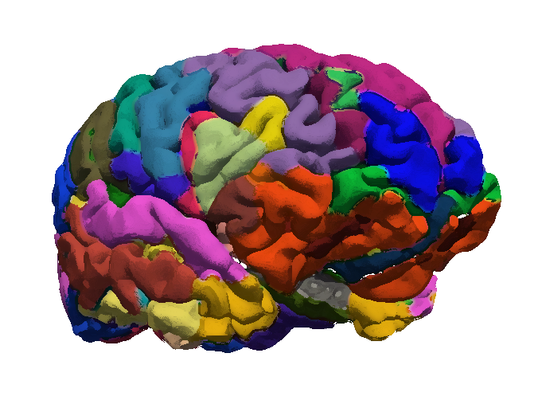
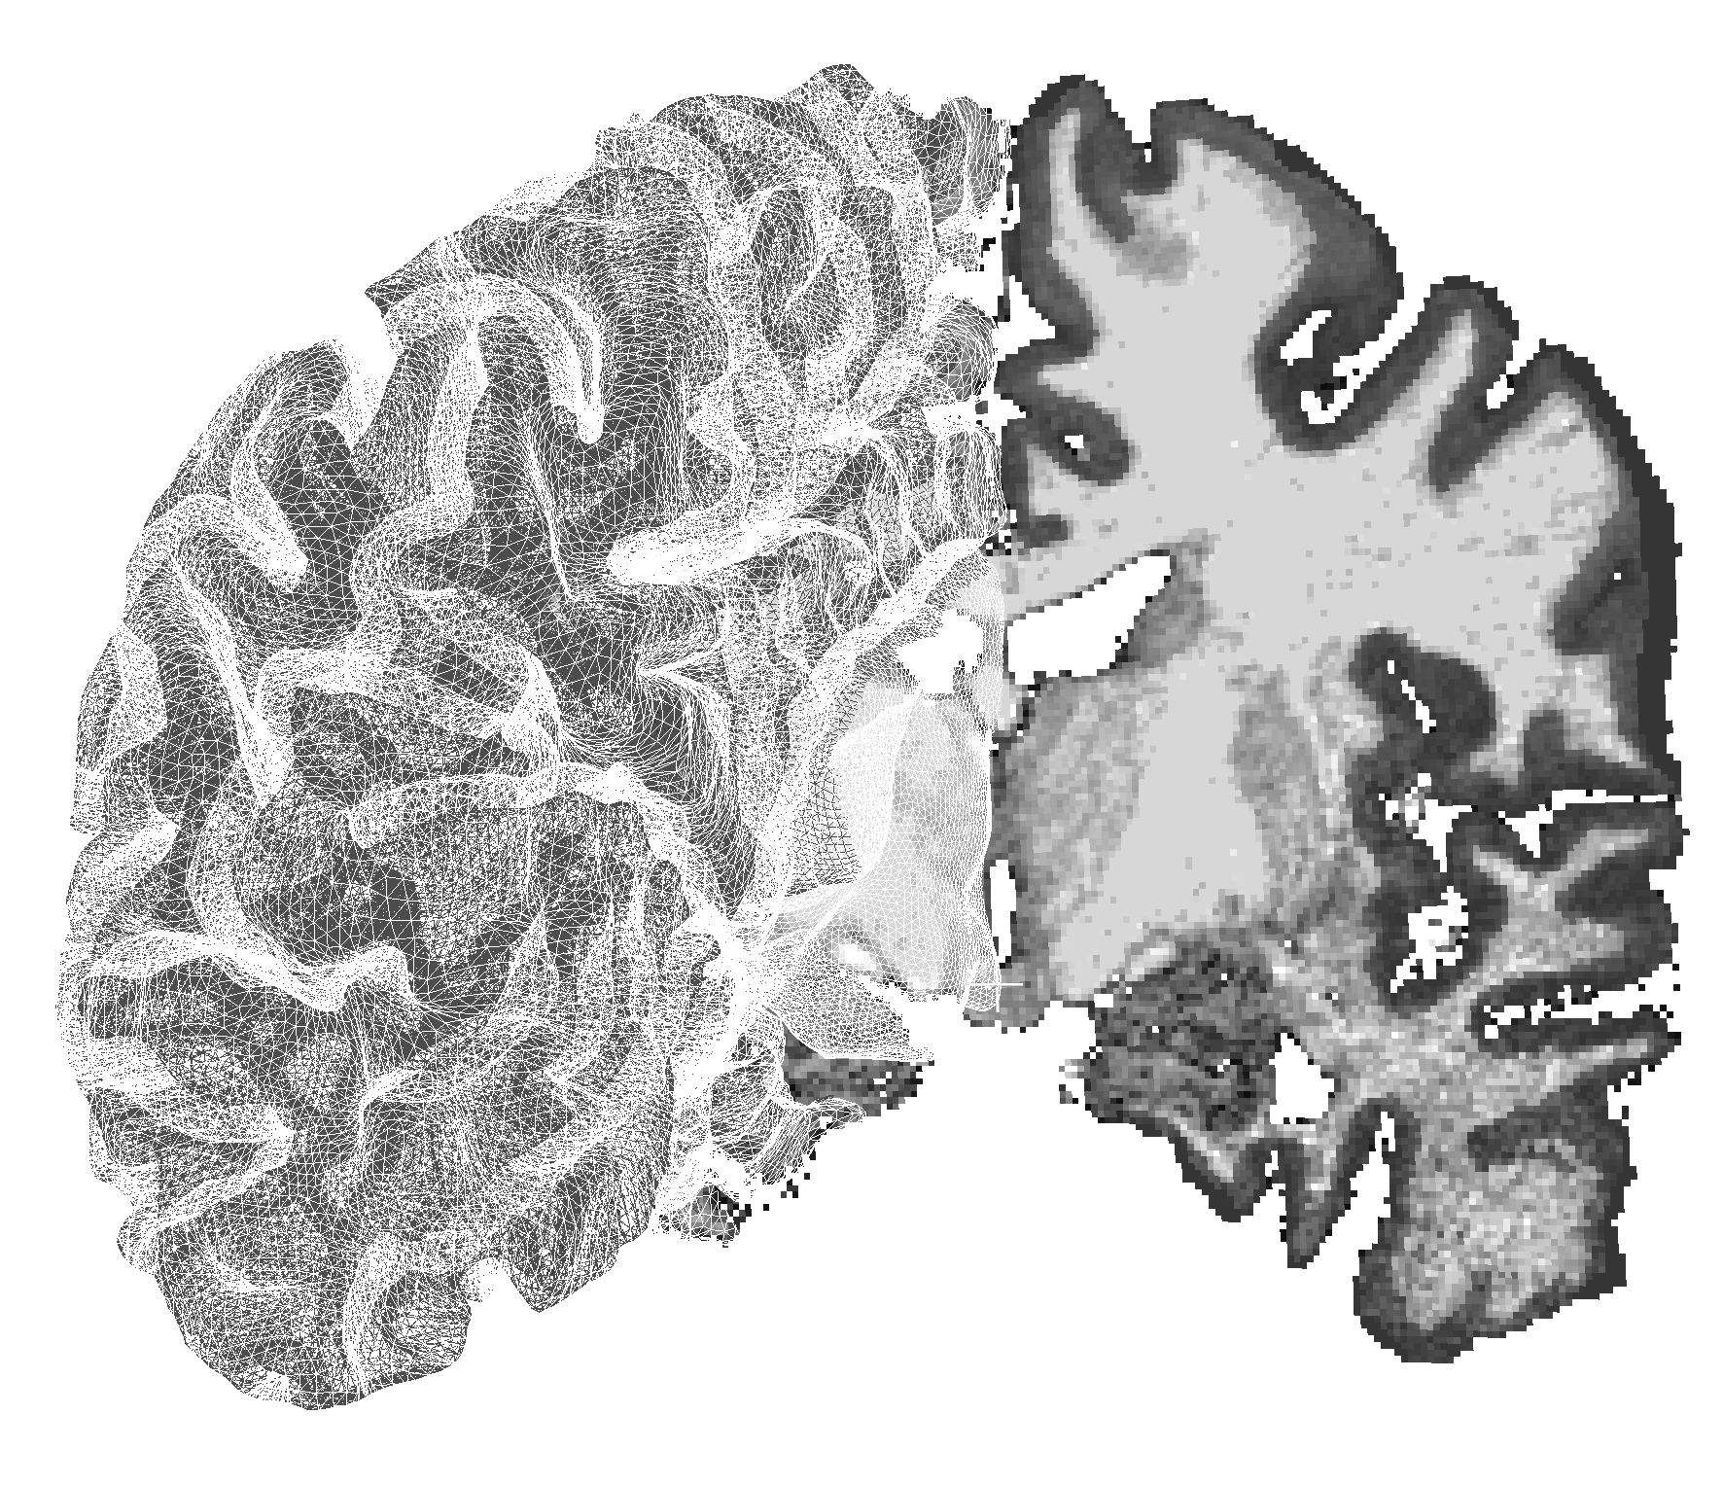
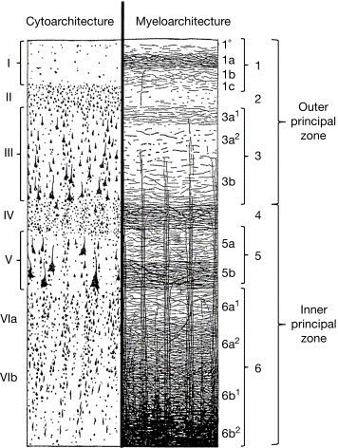
High-resolution fMRI
Studying this cortical dimension (depth) provides additional information in functional studies (“laminar fMRI” or “depth-dependent fMRI”).
Why does it matter?
I
II
.
III
.
IV
.
V
VIa
VIb
The cerebral cortex is heterogeneous
State of the art:
Measure fMRI signal from almost every voxel in the brain
Average the signal of voxels within each ROI
Report ROI-to-ROI connectivity
K Zilles, 2015
Notes:
We believe that studying this dimension could provide important information about how brain areas communicate with each other, and in general about how the brain works.
Importantly, the field is usually called “laminar fMRI”, because we attempt at studying the cortical laminae, but as you can imagine, we don’t really have the resolution to distinguish the actual layers, so we usually divide the cortical depth into a number of territories, e.g. 3, 4 or 6

Slide 5
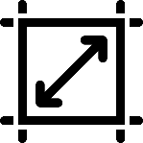
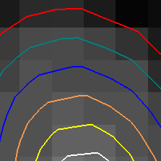
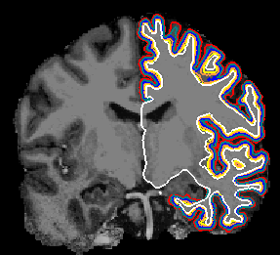
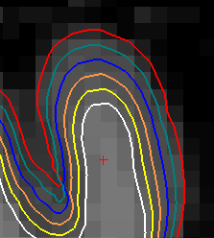
High-resolution whole-brain fMRI
3T: state-of-the-art
7T: state-of-the-art
Voxel size comparison (EPIK/others)
~ 1 mm
~ 3 mm
~ 0.6 mm
7T: EPIK

Slide 6
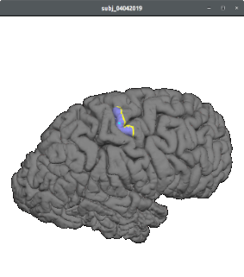
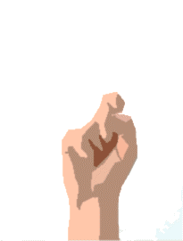


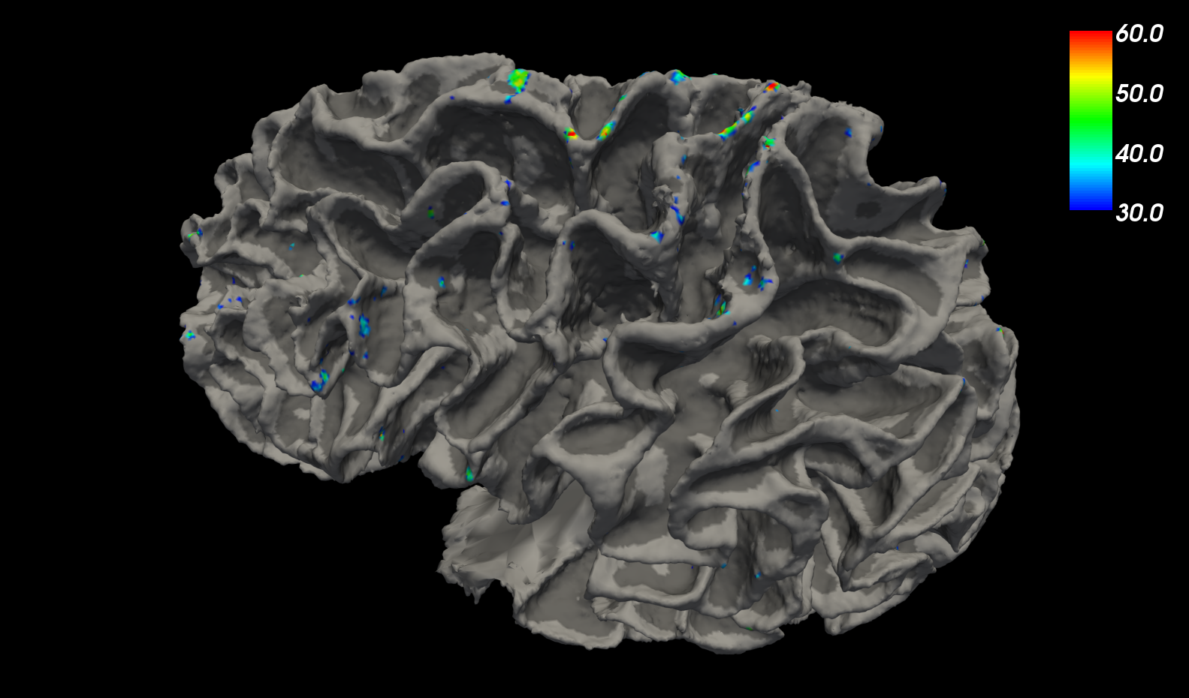
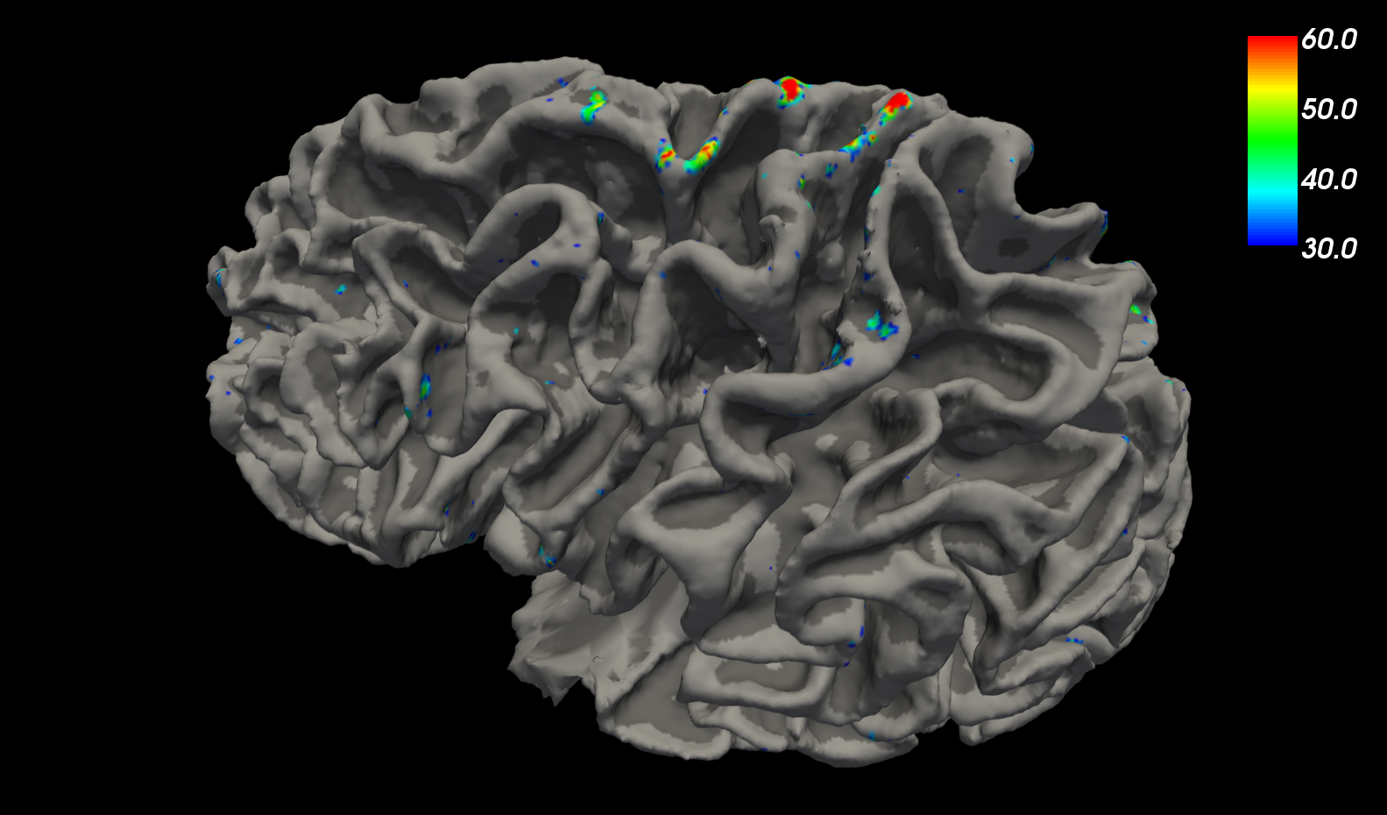
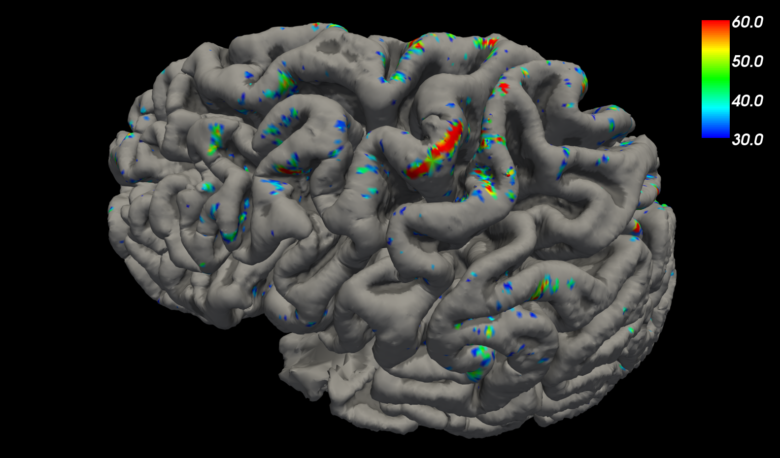
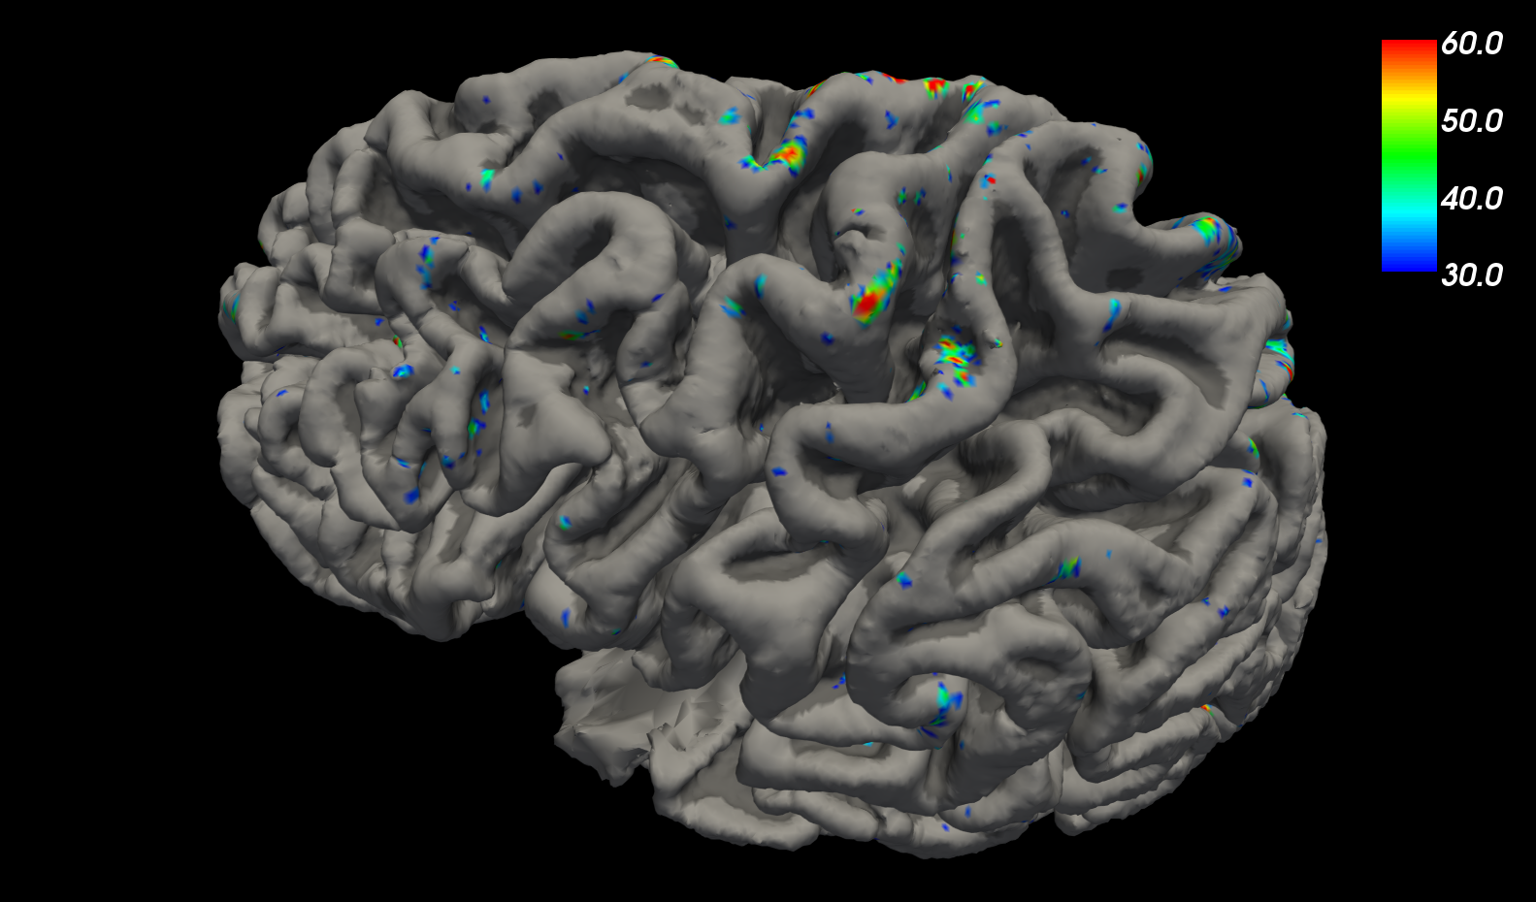
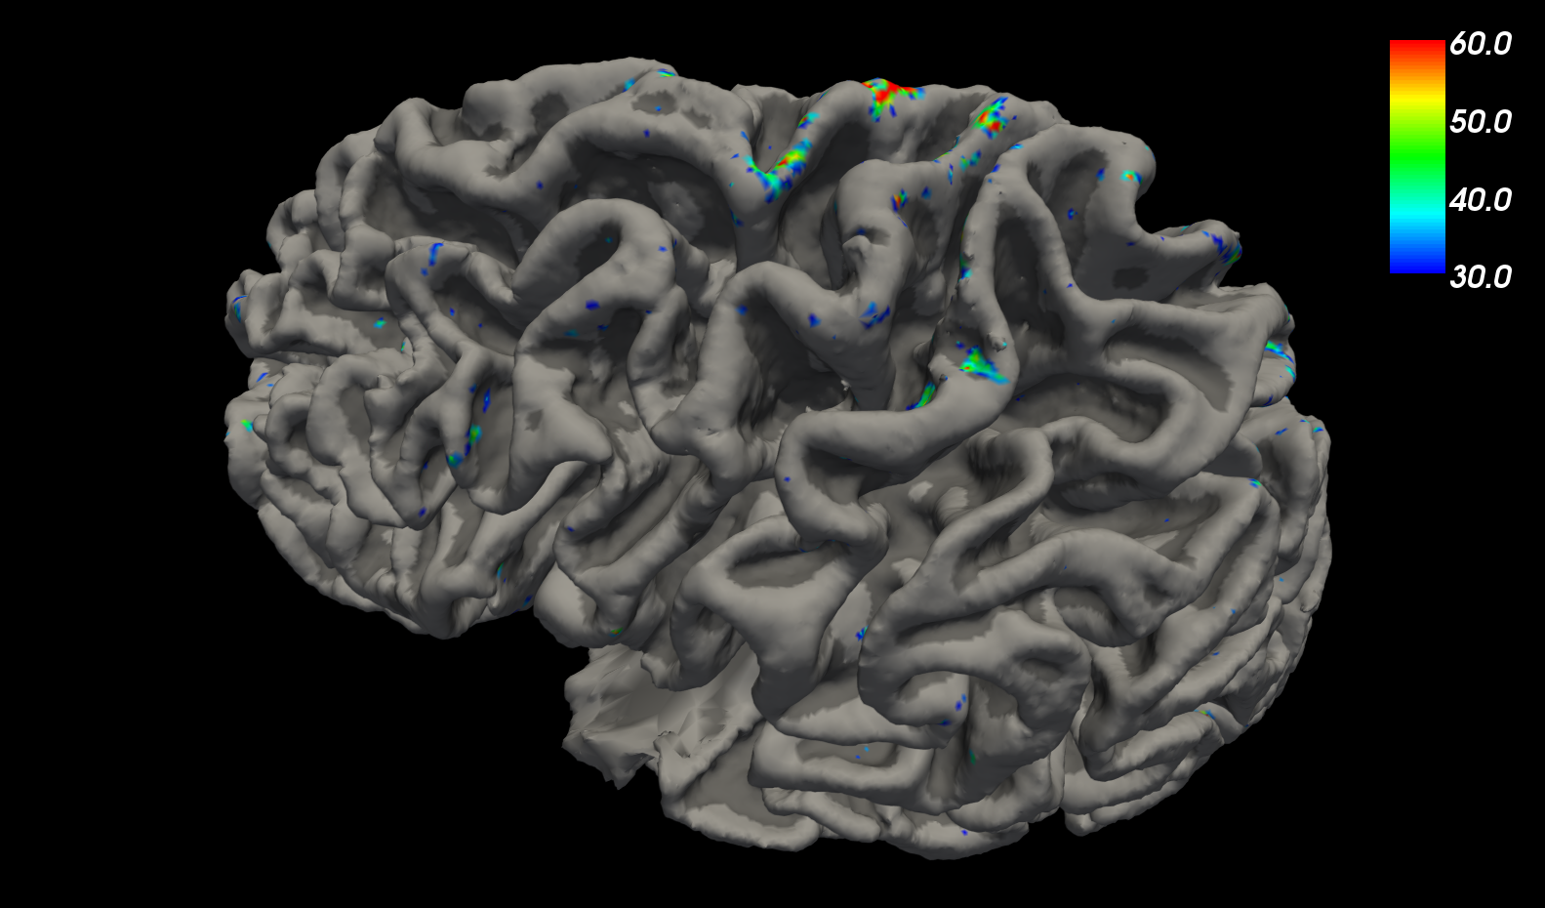
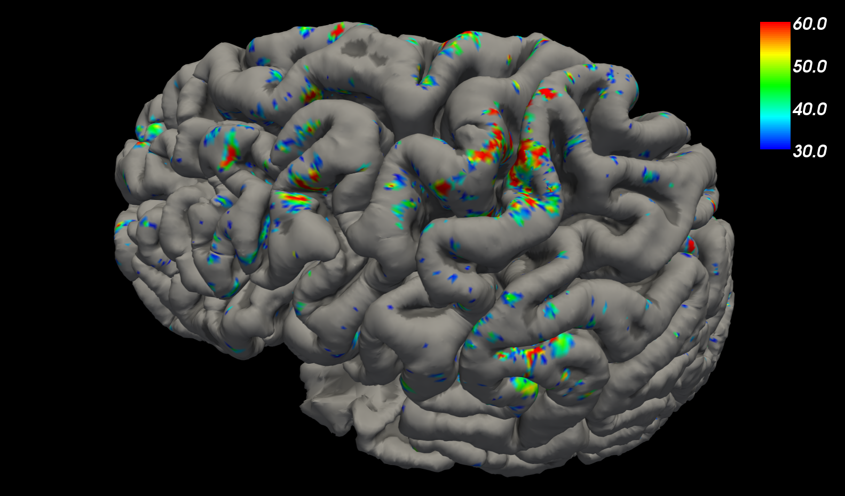
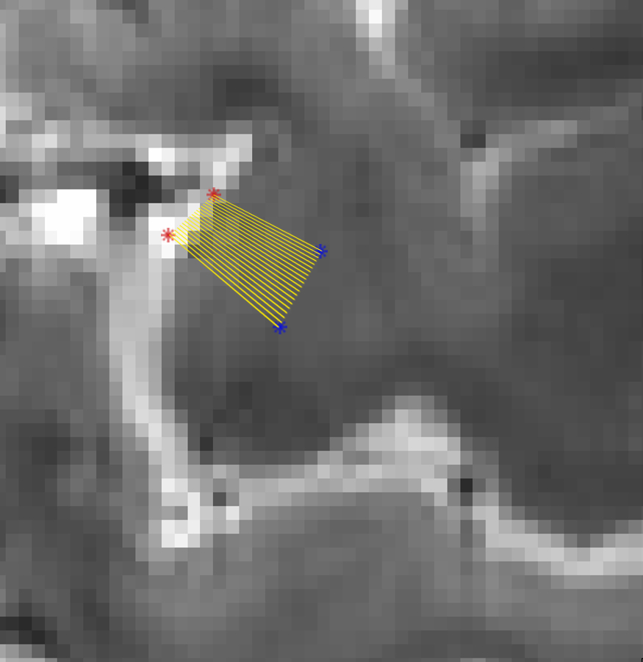
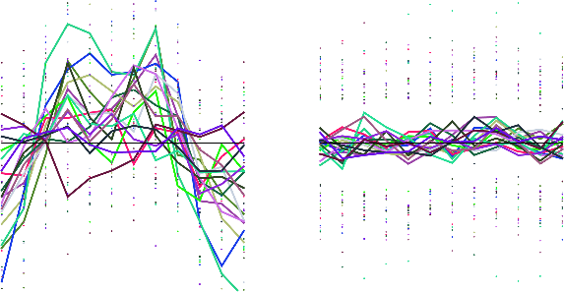
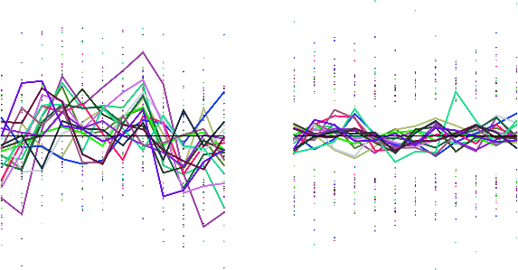
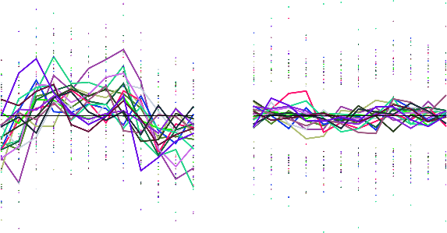
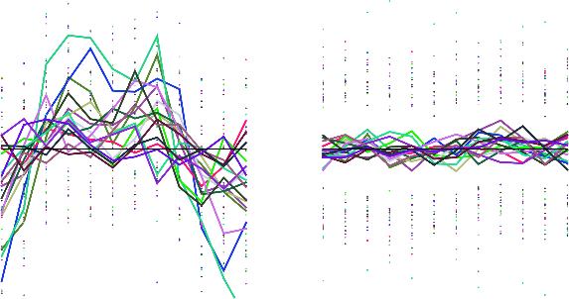
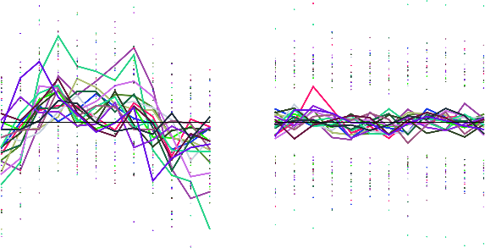
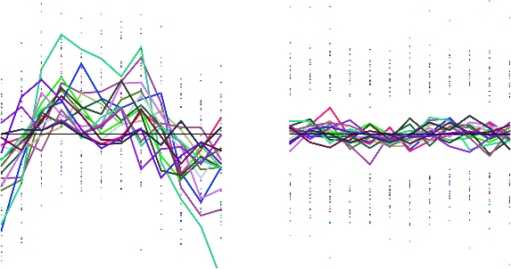
Depth-dependent fMRI
PreCG
21s movement
21s rest
x12
Evoked laminar activity
Line profile sampling
Surface GLM
β
P
Po
re
CG
0.8
CG
BOLD signal change
-0.8

Slide 7
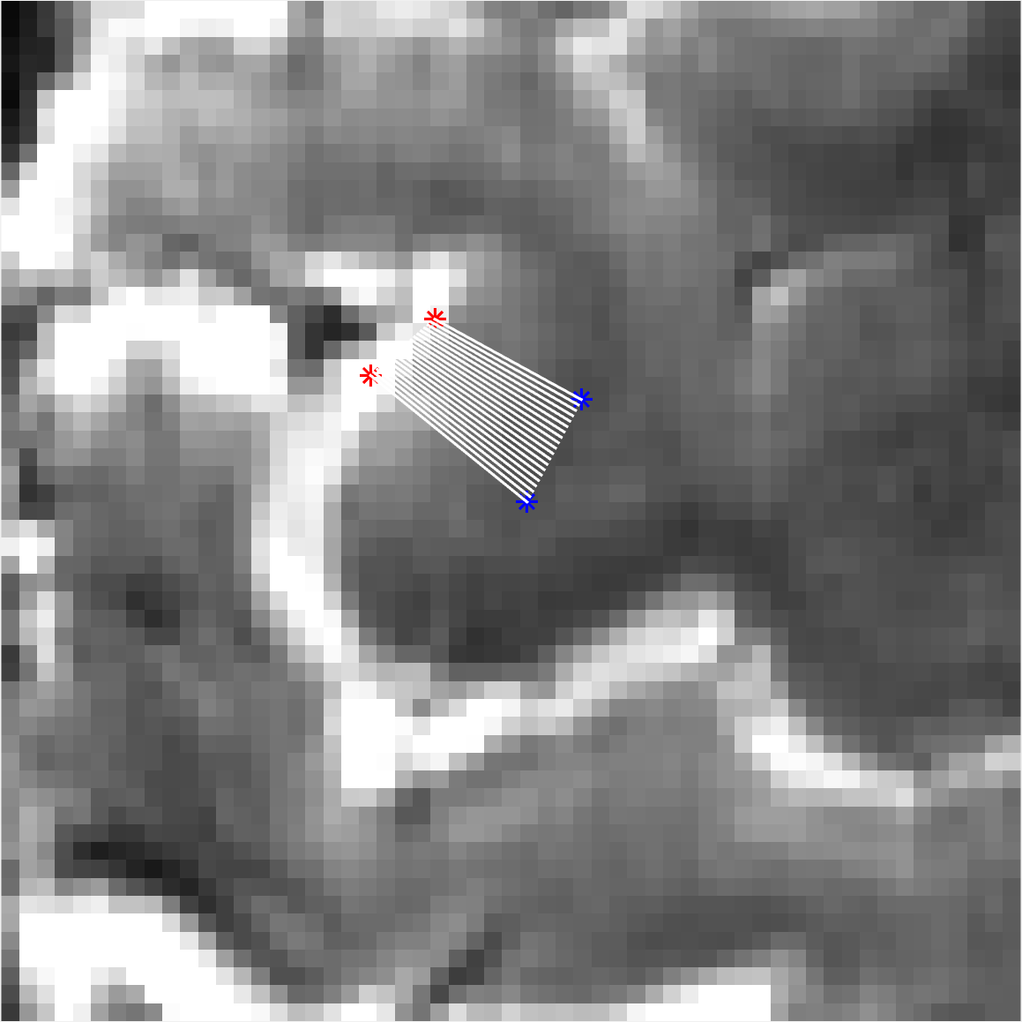
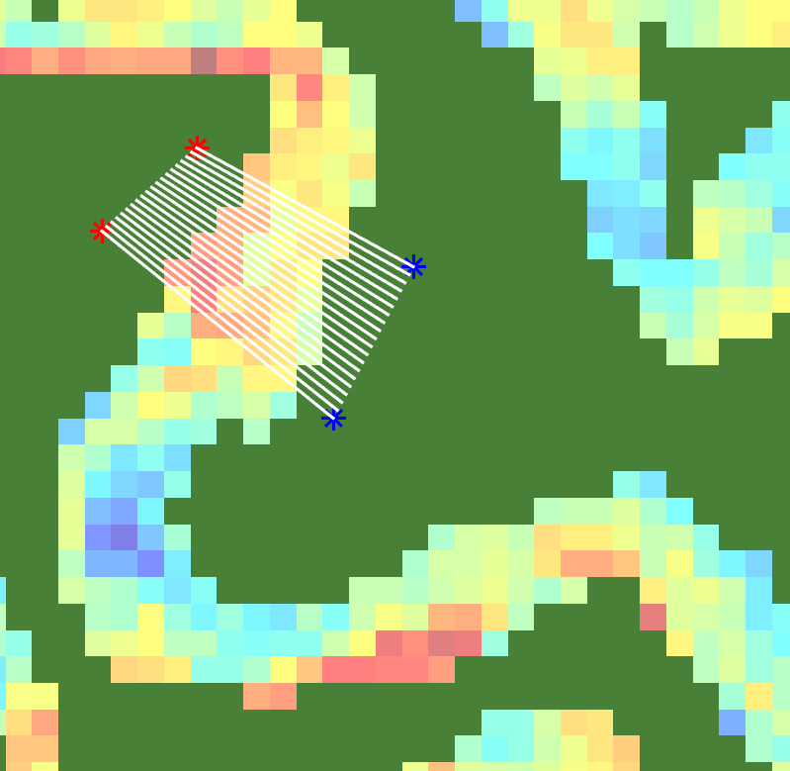
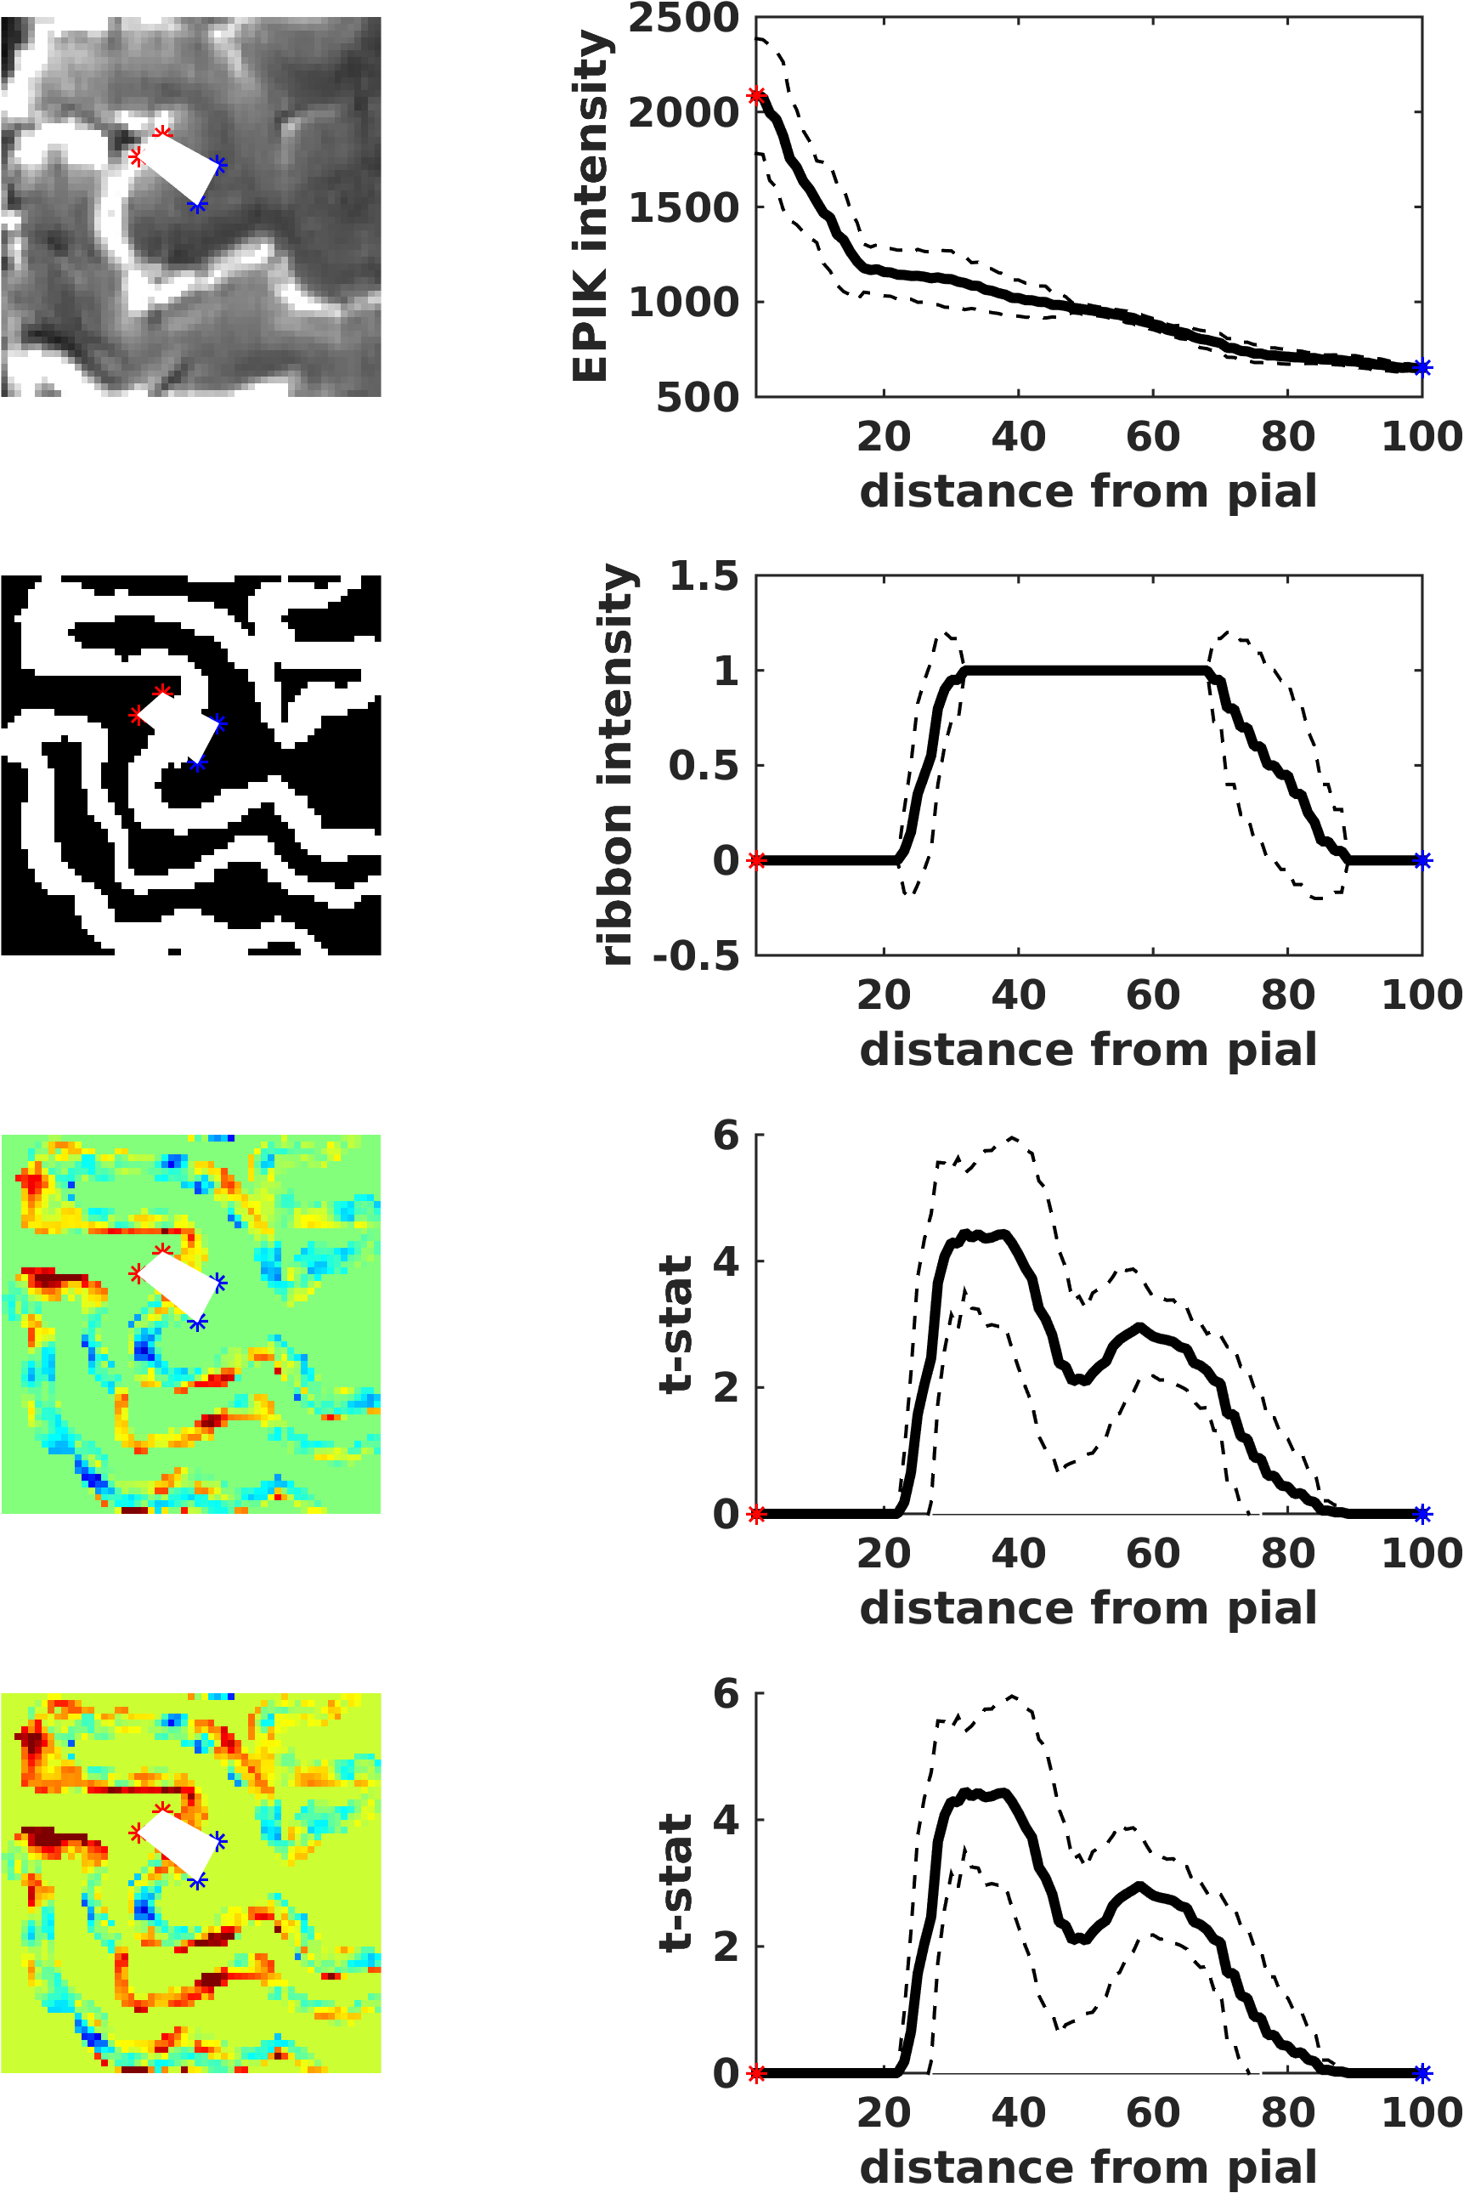
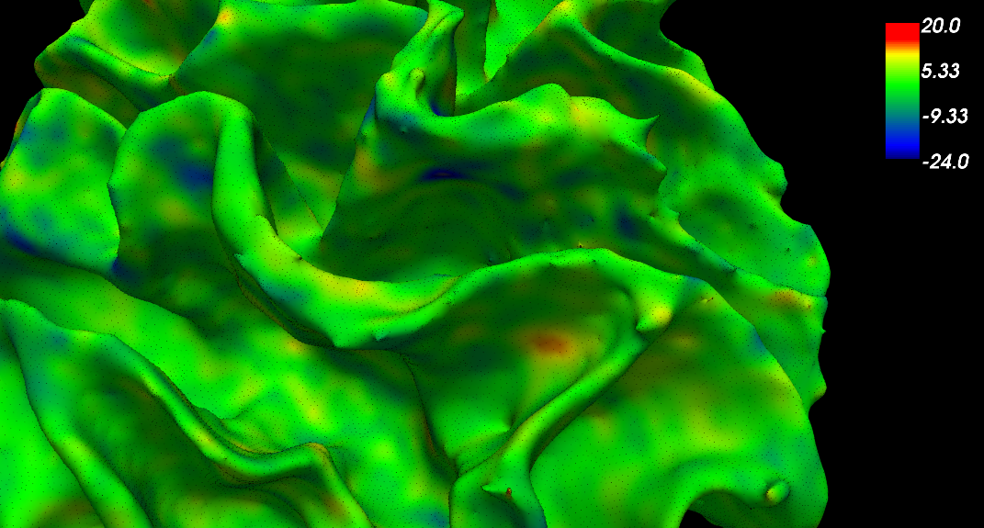
Depth-dependent fMRI
PreCG
21s movement
21s rest
x12
Evoked laminar activity
Line profile sampling
Surface GLM
β
β map
+8
6
4
2
0
CSF
WM
β
-8
P
P
β
r e
Po
re
CG
0.8
CG
CG
*
*
0 20 40 60 80 100
BOLD signal change
Sampling points
-0.8

Slide 8
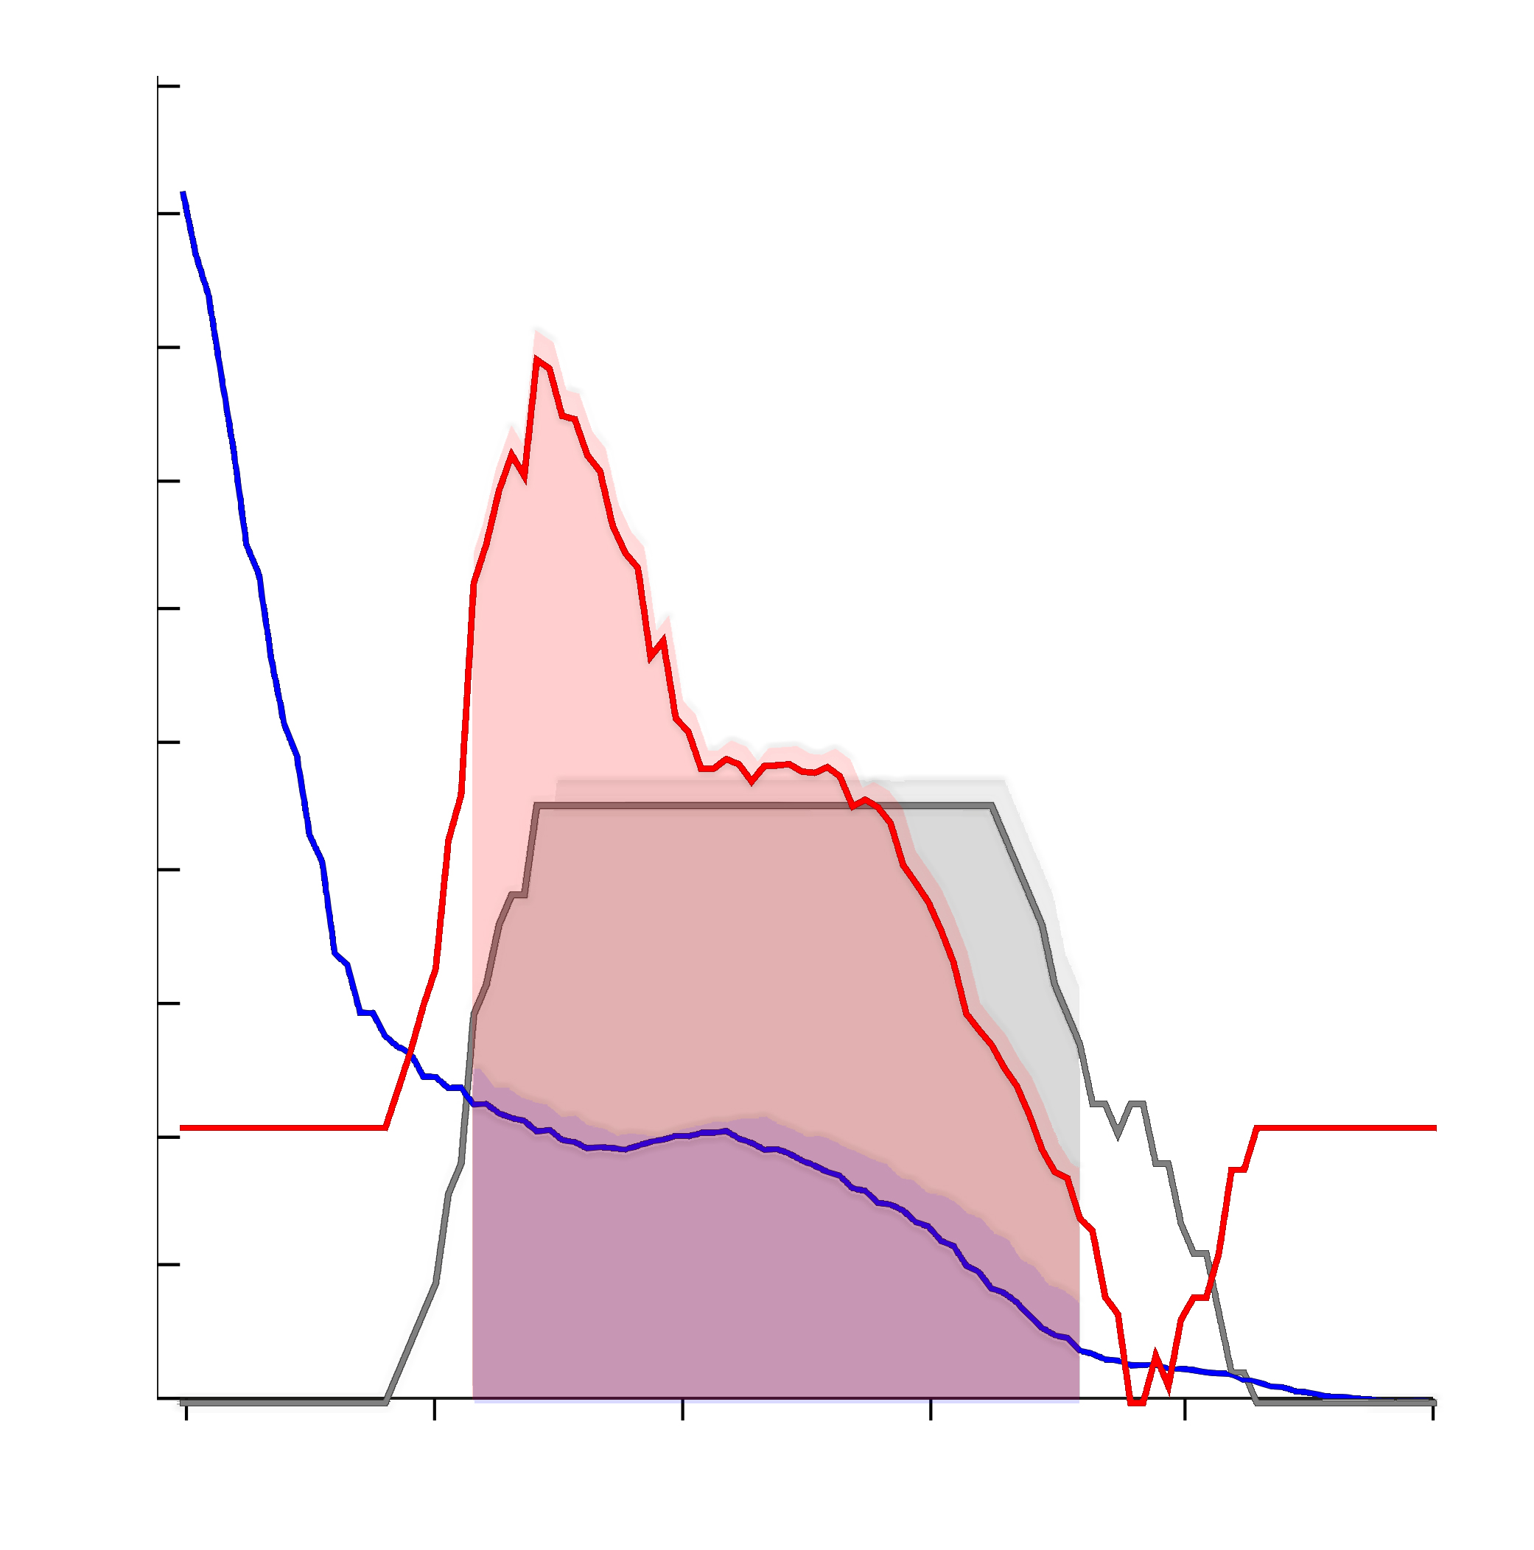
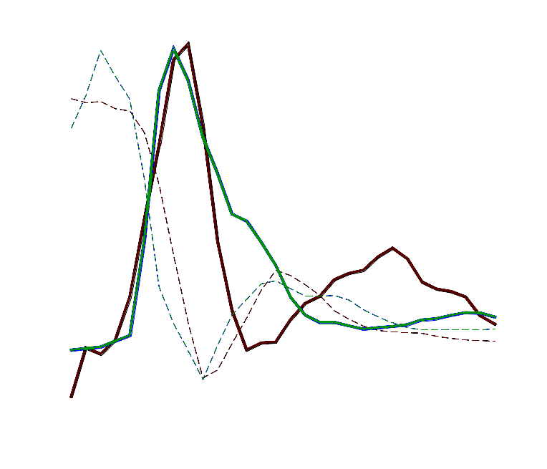


Depth-dependent fMRI
Evoked laminar activity
2.5
2
1.5
1
0.5
0
-0.5
-1
Motor
21s movement
21s rest
x12
Motor+Sensory
ß
21s movement + touch
21s rest
x12
CSF
WM
0 20 40 60 80 100
The line activation profile in the
pre-central gyrus is different when
a volunteer performs finger motion with or without touch
Sampling points
Intensity of the corresponding mean EPIK image
Notes:
, one in the superficial layers, probably related to afferents from the motor thalamus, and another one in intermediate/deep layers, presumably related to cortical motor efferents.
Finger movement resulted in activation of:
- the superficial: proprioception and cortico-cortical input (e.g. premotor cortex) + Vein BIAS
- deeper layers: possibly indicating signaling from premotor and supplementary motor cortices, also coinciding with cortical motor efferents towards pontomedullary or thalamic nuclei [11, 79].
Sensory processing triggered by the touch between two fingers:
- intermediate layers, possibly reflecting the modulation of the motor cortex by sensory cortical areas and afferents from the sensory thalamus [11, 79, 80].
The activation observed near the cortical surface may reflect, at least to a certain extent, a contribution from the venous network

Slide 9
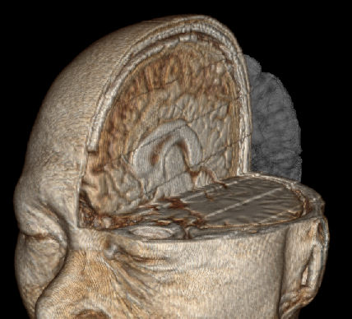
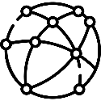
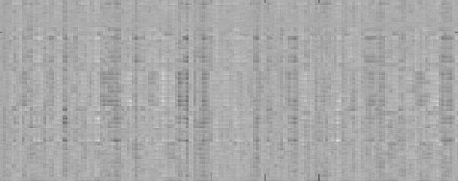

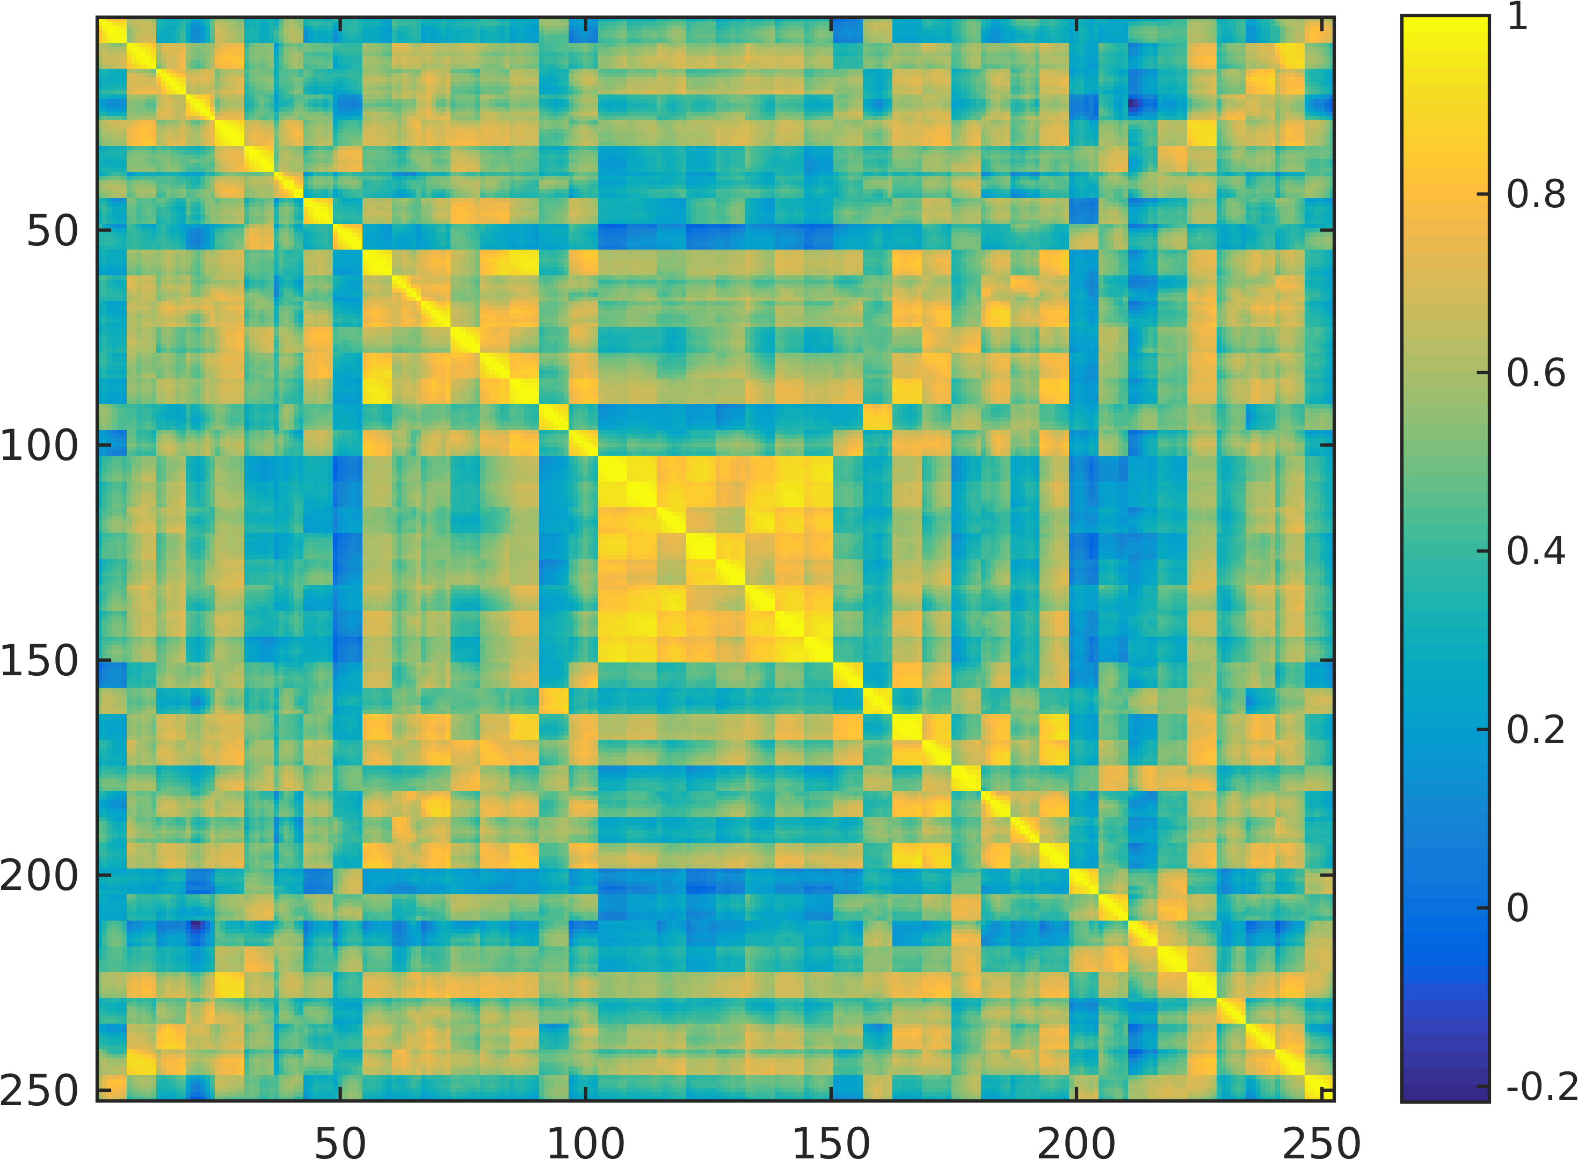
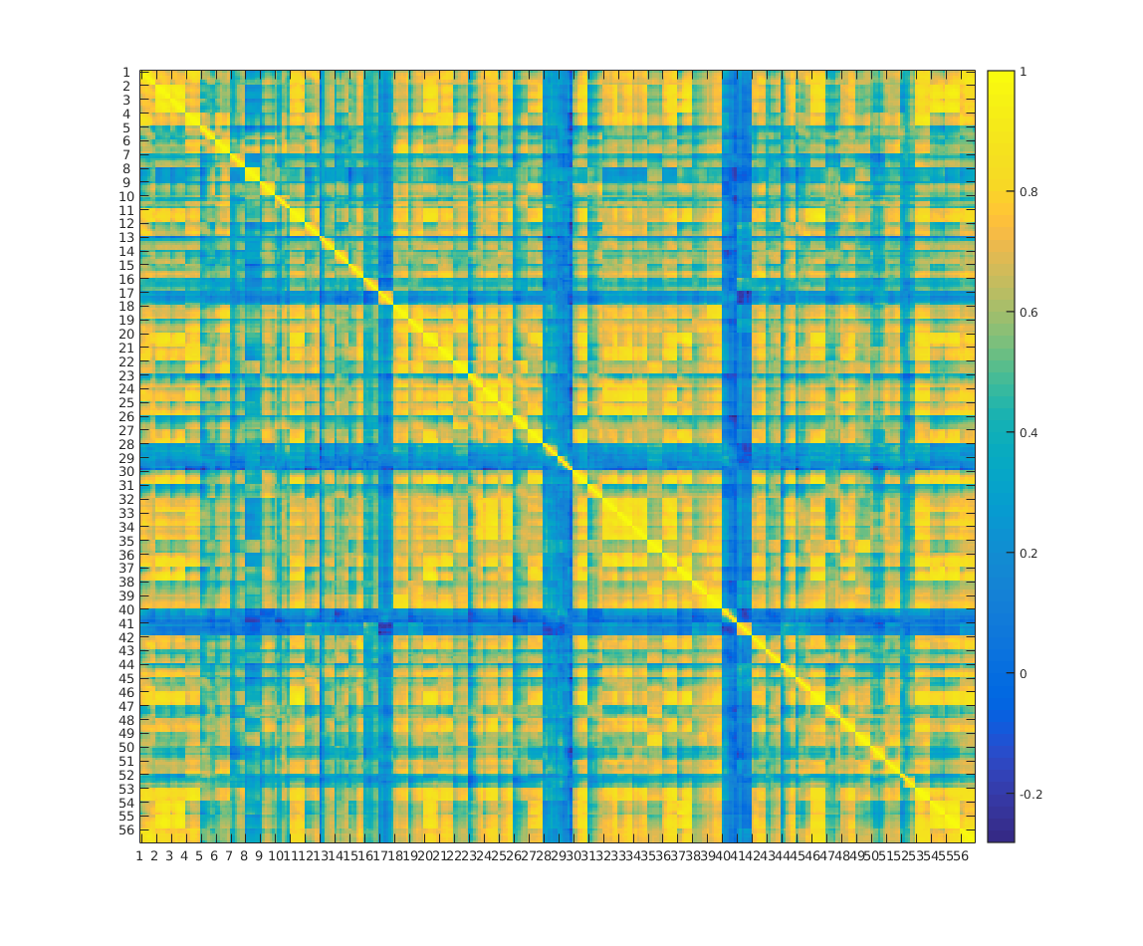
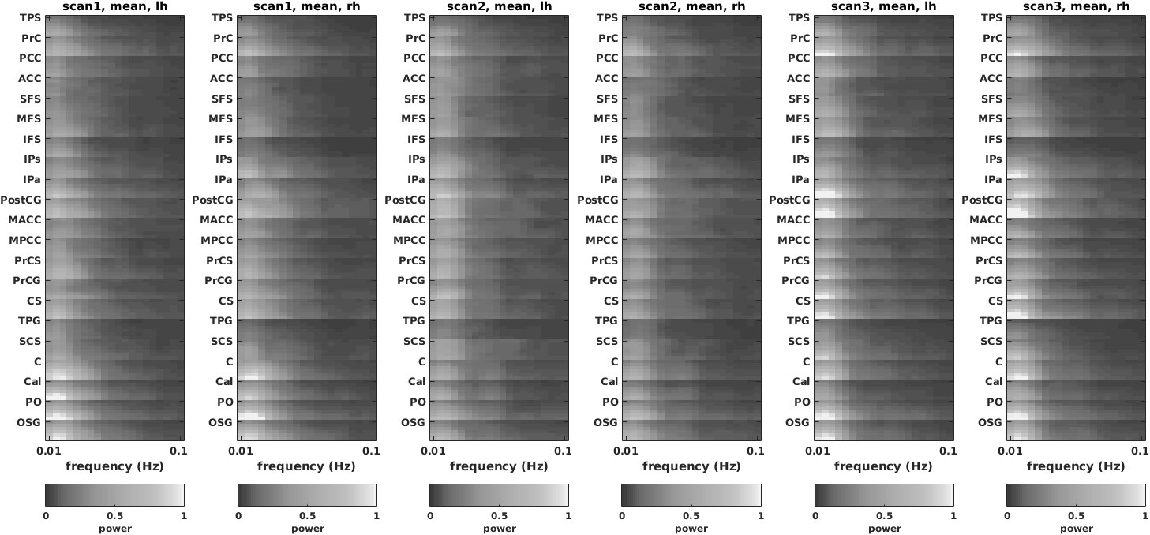
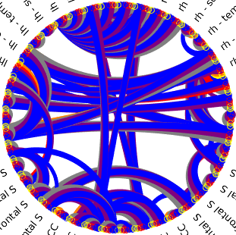
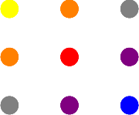
Depth-dependent fMRI
Laminar Functional Connectivity
1
100
200
Functional connectivity matrix
Functional connectivity graph
with ROI and depth specificity
layers
# Time courses
1
L R
Signal change
1 20 40 60 80 100 120 140 160 170
correlation
SOG
SOG
POS
POS
Time (TRs)
CAL
CAL
CUN
CUN
SubCG
SubCG
STG
STG
CS
CS
layers ROI 8
-0.2
PreCG
PreCG
PreCS
PreCS
ROIs x layers x 2 hemispheres
MPCG
MPCG
layers
ROI 10
MACG
L R
Correlation analysis
thresholding
MACG
PoCG
PoCG
ANG
ANG
SMG
SMG
IFG
IFG
MFG
MFG
SFG
SFG
Super
ACG
ACG
PCG
PCG
STS
STS
PCUN
PCUN
1 50 100 150 200 250
Deep
Left hemisphere
Left hemisphere
Super
Deep
deep
deep
deep
mid
deep
sup
mid
mid
mid
sup
sup
sup
Notes:
Another important measure that we took is functional connectivity.
So we computed the correlation between each pair of timecourse and obtained a high-dimension connectivity matrix, where we can see how each layer of each ROI connects to every other layers of every other ROI.
In this way, we can create connectivity graphs where we show ROIs but also give information, color-coded, about the cortical depths involved in the connections.

Slide 10
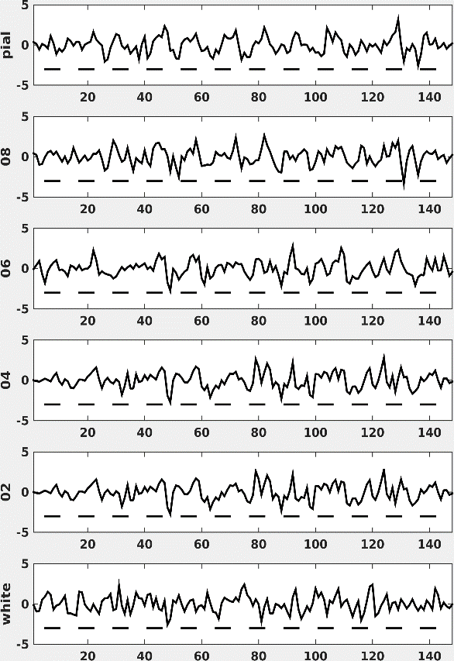
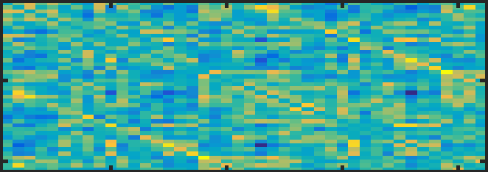
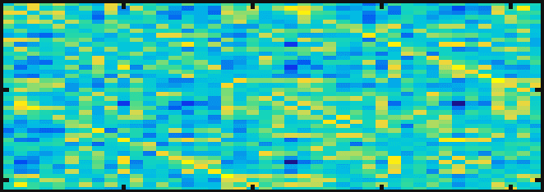
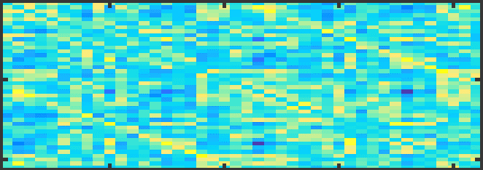
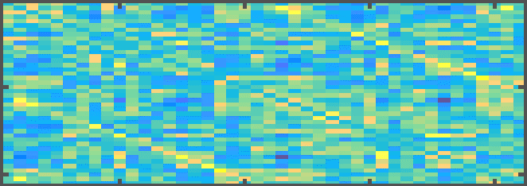
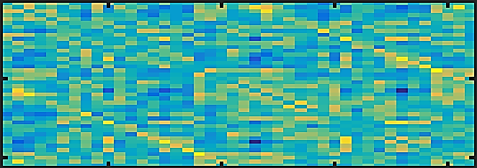
CSF
CSF
depth
Dynamic Laminar Functional Connectivity
WM
WM
Concept of (static) functional connectivity
Concept of dynamic functional connectivity
1 corr. value
1 corr. value per time step
All voxels fed into analysis produce one connectivity matrix
All voxels fed into analysis
produce multiple connectivity matrices
Notes:
I’d also like to briefly show you the results of a dynamic analysis of the connectivity.
Just a quick introduction, when we talk about functional connectivity we usually take the correlation values between pairs of timecourses considering the whole scan.
If we have the hypothesis that the connectivity may vary during a scan, then we can split our timecourses in windows, and compute one connectivity matrix per period of time.

Slide 11
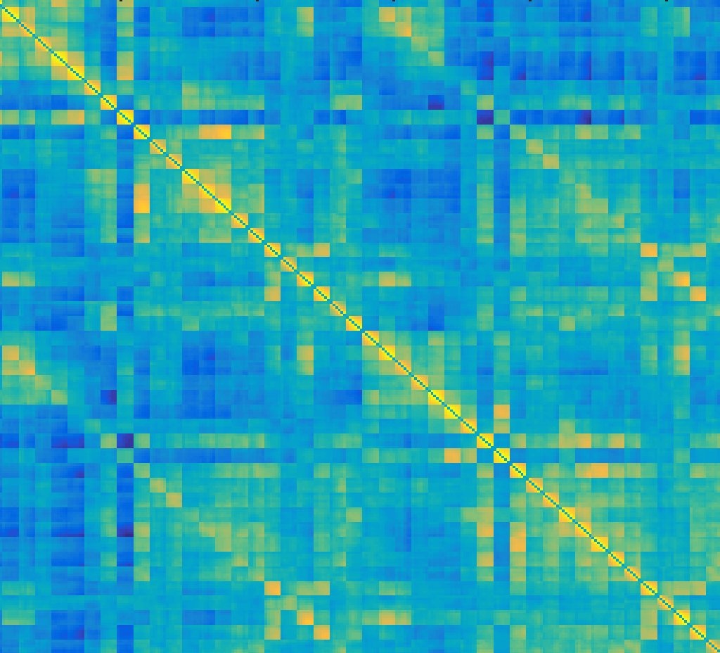
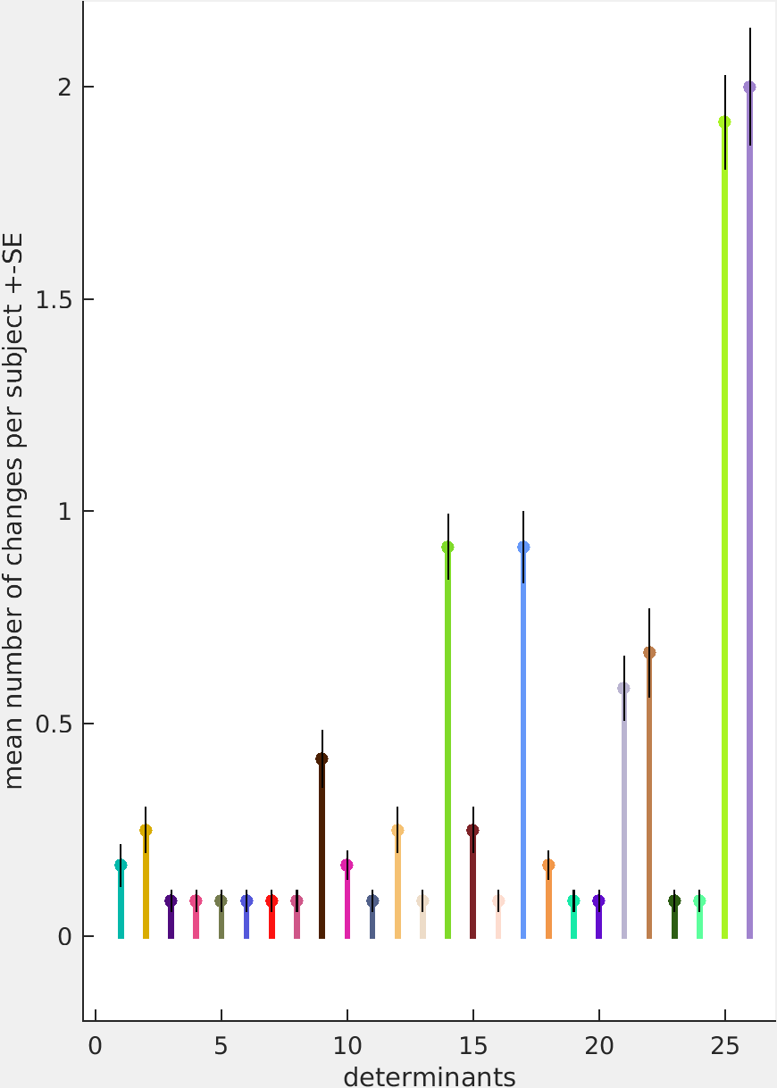
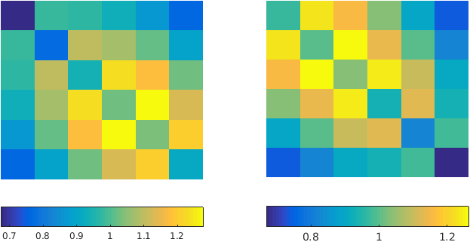
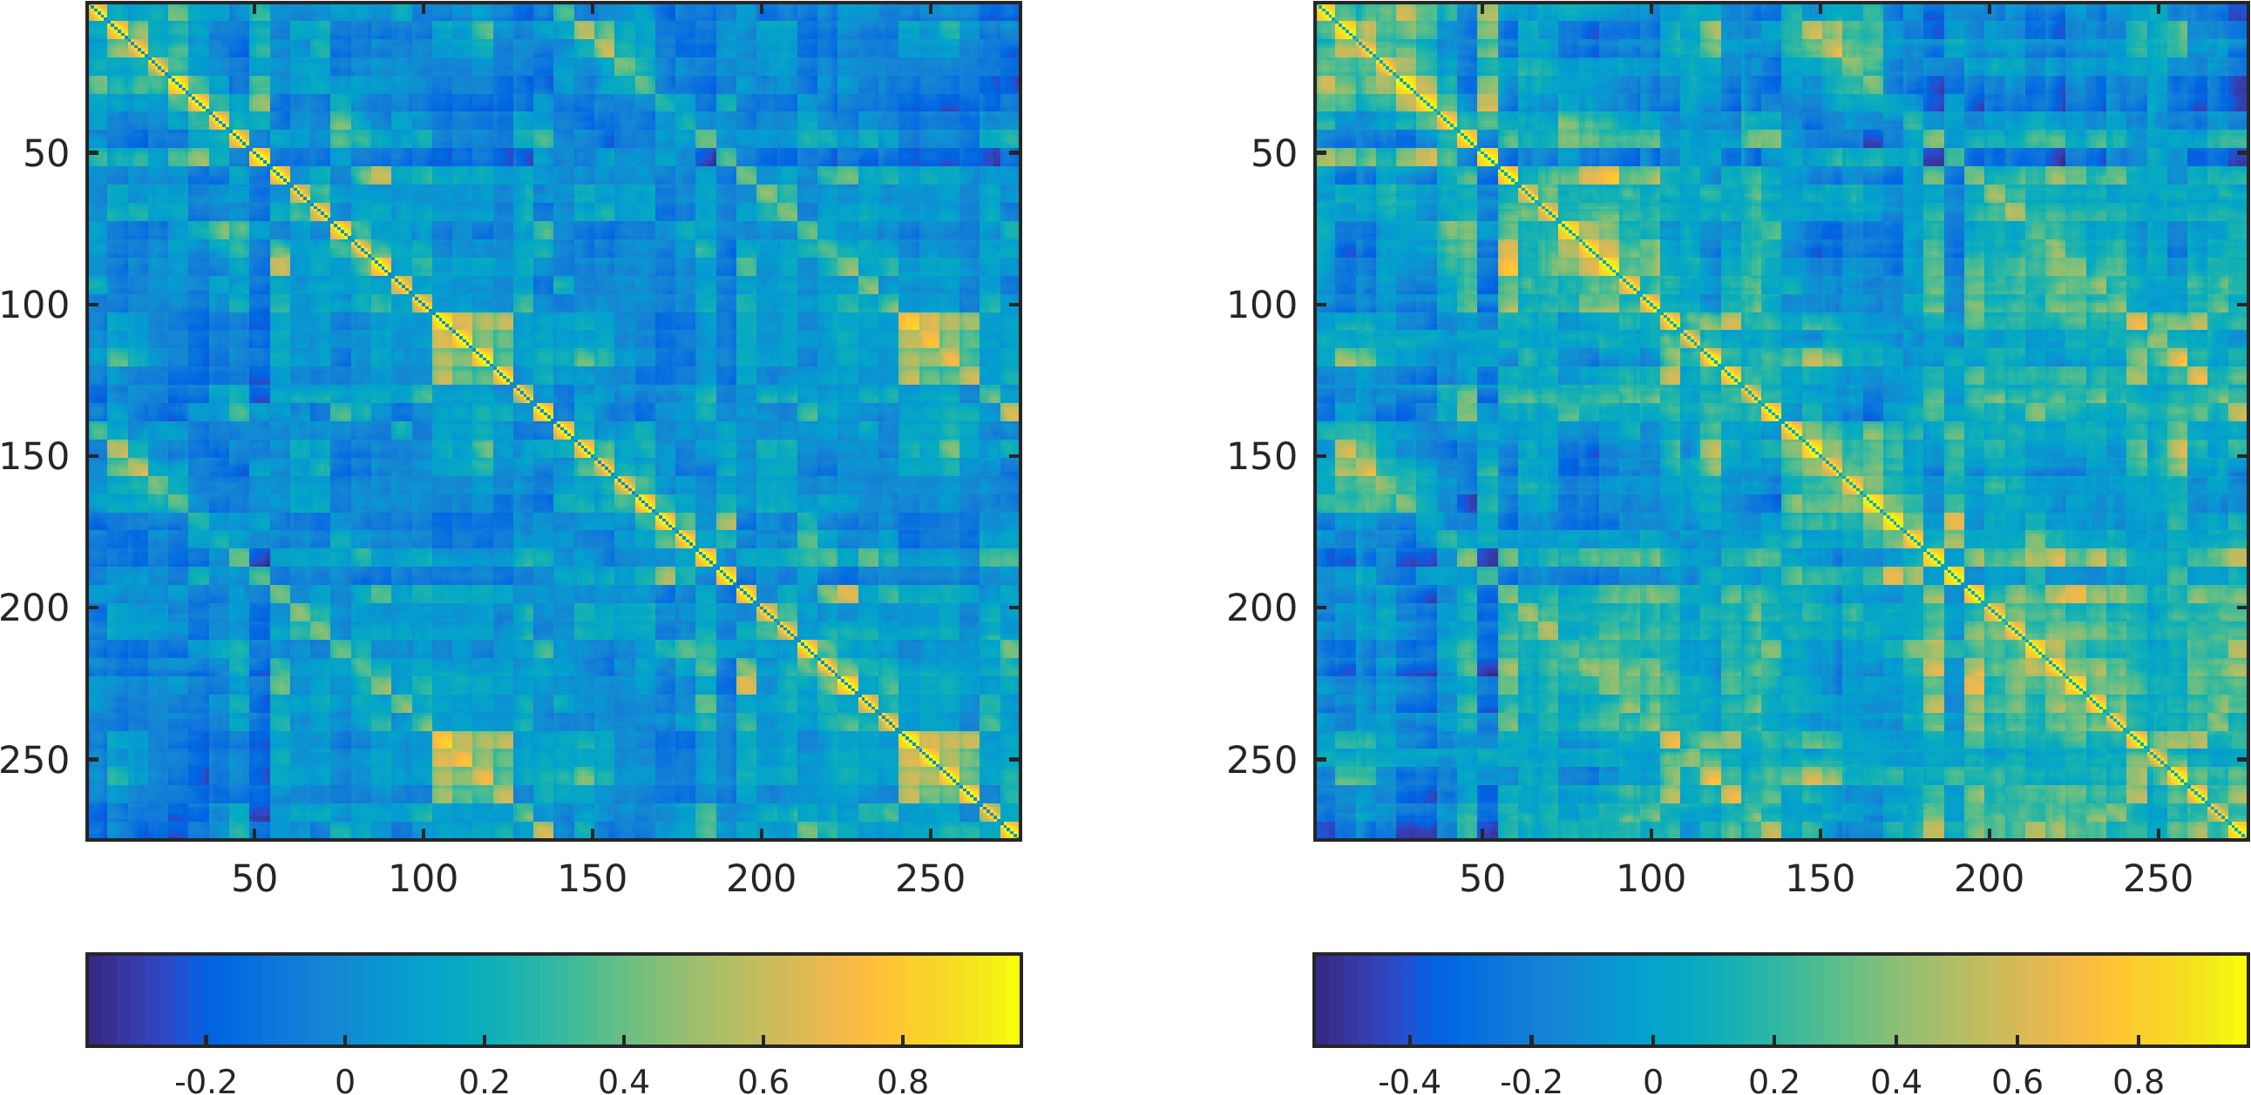
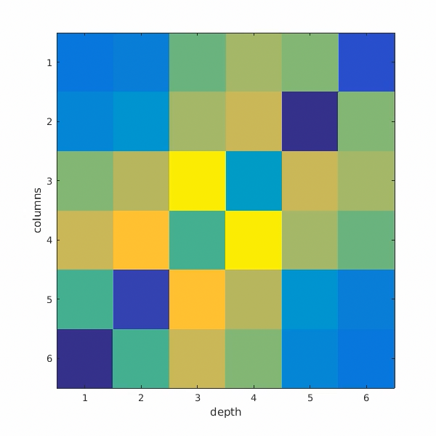
CSF
CSF
Dynamic Laminar Functional Connectivity
depth
Laminar connectivity
is more dynamic than
ROI-to-ROI connectivity
WM
WM
Hypothesis: The connectivity between cortical layers
changes along time
3. K-means to cluster into states
State prevalence
*
1. Sliding window connectivity analysis
4
3
2
1
0
Cortical-depth
connectivity states
~ scan time
Sup.
Deep
Dynamicity (n# state changes)
Correlation coef.
outer
inner
The high dynamicity of laminar connections suggests that these may serve as a marker of
brain state changes.
outer
Cortical
depth
6 layers
Layers
ROIs
46 ROIs, 6 depths
2. Average across ROIs (focus on layers only)
6 layers
inner
6 x 6
4. Compute number
of state changes during the scan time
Matrix with ROI and
cortical-depth specificity
layer-to-layer dynamic functional connectivity during a
resting-state scan
276 x 276
Notes:
So we did that in our high-resolution matrix, and then we averaged…

Slide 12


Laminar Dynamic connectivity in Major Depression (EPIK)
Differences in cortical-state prevalence
After treatment, patients who recover
or worsen show a significantly different laminar connectivity preference.
Patients who worsen are significantly different from healthy controls, but patients who recover are not.
The evolution of depression
may be related to changes in the connectivity along the cortical depth.
Mostly super
Prevalence of laminar state 1 vs 2
Mostly deep
Healthy controls | Depression -t1 R / W | Depression -t2 R / W
~ 4 w
Pais-Rodain et al. In preparation

Slide 13
Summary
High-resolution fMRI allows us to investigate cortical-depth dynamics.
  reproduced the laminar patterns observed in M1 reported in the literature.
  Provided insights into depth-dependent connectivity during resting state (e.g. DMN mostly connects at superficial layers) and identified potential brain-state dependent metrics.
The connectivity along the cortical depth is highly variable.
A depth-dependent dynamic connectivity analysis can differentiate
between patients with depression who respond or not to treatment.
The evolution of the BDI score (before/after treatment) is particularly
correlated with the evolution of the laminar connectivity state in certain
ROIs, e.g. left (pre)cuneus.

Slide 14

A Novel and Rapid MRI Method for Quantification of the Oxygen Extraction Fraction at 3T
Fabian Küppers, Seong-Dae Yun and N. Jon Shah
Notes:
In the following minutes I want to introduce you to a novel MRI sequence that offers you a rapid quantification of the oxygen extraction fraction

Slide 15




Imaging Brain Function and Metabolism
Brain function Brain metabolism
MR methods exist
often very slow (15-30 min)
Need for rapid imaging techniques to investigate brain metabolism
Notes:
One of the most conceptual questions in neuroscience is how our brain functions? And its already well known that the main driver of the brain function is its metabolism.
This makes imaging techniques of the brain metabolism highly interesting but also very difficult as the complex nature and small temporal as well as spatial scale gives a lot of challenges.
Many MR methods have already found their way into scanning protocols which are capable to image certain metabolic information, but they are often very slow and require scan times of 15 to 30 minutes.
From here the need for rapid imaging techniques to investigate the brain metabolism emerges.

Slide 16

Rapid Multi-Contrast Imaging
Rapid Imaging
Time is money
Ø cost/hour: 400-600€ (depending on staff/infrastructure) in the UK [Hollingsworth 2015]
Ø scan duration: 20-60min => 1-2 patients per hour (depending on protocol/handling)
Fast multi-contrast sequences:
- reduced acquisition time
- maintaining high parameter output
cost efficiency
Acquisition time crucial for patient comfort
motion corruption
≈ number of methods (sequences)
each contrast = one sequence multiple contrasts in one sequence
Notes:
Beyond this motivation, there is a general interest in rapid imaging methods – but why?
The answer is simple: time is money. A study from 2015 revealed that the average costs per hour of MRI examinations were between 400-600 Euro depending on the staff and infrastructure costs while the average scan duration was between 20 and 60 minutes, leading to a capacity of only one or two patients per hour. Thus, the acquisition time characterizes the cost efficiency, the patient comfort and sensitivity to motion corruption.
Another concept of MR is directly coupled with the desire to speed up acquisitions: measure multiple-contrasts
The TA depends on the number of used methods or often called sequences in the MR protocol.
An MRI sequence is a particular setting of MR pulses and gradients to form a specific image appearance. The obtained image contrast in general describes a single tissue parameter. Thus, in most measurements, each contrast requires a single sequence, while modern research trends to acquire multiple contrasts in a single sequence, such that the different parameters can be disentangled by suitable postprocessing routines.
All in all, the underlying idea is to use fast multi-contrast sequences to reduce the measurement time by maintaining a high parameter output.

Slide 17


Oxygen Extraction Fraction is the key
“Oxygen Extraction Fraction (OEF)
is the ratio of blood oxygen that a tissue takes
from the blood flow to maintain function”
Sheng Xie (2014)
Oxygen supply: critical parameter for brain health and metabolism
e.g.: Insight into prediction and therapy of stroke occurrence
unknown time point of occurrence in ~20% of stroke patients
drug-based therapy only permitted within first 4.5 hours
Stroke [Fan 2019]
Notes:
The key of our research is the Oxygen Extraction Fraction.
OEF reflects the ratio of oxygen that a tissue extracts from the incoming blood flow to maintain its own function.
The oxygen supply is a valuable biomarker for brain health and has a fundamental role in the investigation of its metabolism. Many exciting application fields are already known, for example by giving insights into the prediction and therapy of stroke
A short example why OEF is of such high value: about 20% of all stroke patients have an unknown time point of occurrence. As drug-based therapy is only permitted withing the first 4.5 hours, a reliable determination of the stroke age is essential but so far not possible by image morphology.

Slide 18












Oxygen Extraction Fraction - Quantification
Current gold-standard: ¹⁵O-PET MR methods desired
$$OEF \sim R2′$$
Transversal Relaxation Time T₂
effective
Transversal Relaxation Time T₂*
$$R_{2}^{′}=\frac{1}{T_{2}′}= \frac{1}{T_{2}^{∗}} − \frac{1}{T_{2}}$$
$$M_{0}e^{−TE{\left(n\right)}/{T_{2}}}$$
$$M_{0}e^{−TE{\left(n\right)}/{T_{2}}\text{∗}}$$
*
Gradient Echo
contrast
Spin Echo
contrast
*
MR quantities: relaxation times
T₂ w
T₂ map
T₂* w
T₂* map
Qualitative weighted Images
Quantitative Parameter Mapping
GE
GE
GESE
GESE
SE
GESE
GESE
GESE
GESE
SE
Notes:
Current gold-standard for OEF quantification are O15-PET measurements. The use of radioactive tracers, its usage as a gas and the short half-life require special equipment which is not applicable everywhere – that makes MR methods desirable which can be used at various scanners. Our approach is based on a theory which relates OEF to the MR quantity R2’. This parameter is itself defined by two MR parameters, the relaxation times T2 and T2*, which are manifested in the gradient echo and spin echo contrast, respectively.
To give you a better impression on the different meanings of an MRI image, you can see a simplified signal decay in the two figures here. The signal of a certain tissue volume decays with time and can be described by a monoexponential decay. In case that a single image is now acquired at a specific time during this decay, so-called qualitative weighted images are produced where the contrast is generated by the absolut signal magnitude. Thus, such images always depend on the measurement and will differ in their absolute values between different scanners and subjects and so on. On the other hand, if several images along the signal decay curve are measured, we are able to extract the exponential characteristic, leading to a quantitative parameter map with well-defined values for each tissue.
Our proposed sequence now acquires ten images. The image series here shows the same slice but the contrast changes dramatically along the images and enables the simultaneouse computation of T2 and T2* values, finally enabling access to OEF.

Slide 19

Combined GE and SE acquisitions ...
10-echo GE-SE EPIK sequence:
Increased Resolution (128×128 matrix size → 1.9×1.9 mm²)
More images (10)
Including a second SE
Reduced Sampling Times (SE₁ = 57 ms & SE₂ = 114 ms)
Previously used methods:
Limited by low resolution (96×96 matrix size)
Limit number of acquired images (5-7)
Limited number of acquired SE (one)
Long TE for late images ( SE ~ 80-120 ms)
2.5×2.5 mm²
1.9×1.9 mm²
GE-SE EPIK 20 slices in 57 seconds
Reference Methods ~ 15-20 minutes
×20
Notes:
The combined acquisition of GE and SE data offers the simultaneous quantification of T2 and T2*. While previous sequences were limited by low resolution and small number of acquired echoes, we have implemented a 10-echo GE-SE EPIK sequence that offers an improved resolution, 10 echoes with a second SE in below 114ms and an TA of 57s for 20 slices.

Slide 20


Validation of relaxometry quantification
GE-SE EPIK:
comparable accuracy
&
×20 speed up
T₂ / T₂* comparison to reference methods
Reference objects
In vivo study cohort
T₂*
T₂
GE-SE EPIK
Reference
Spectroscopy
T₂*
T₂
T₂*
T₂
Notes:
To validate that the quantified T2 and T2* values from our approach are correct, we compared them with reference method on 2 reference objects and 5 healthy in vivo subjects. The left figure shows you the mean values for T2 and T2* from our sequence in blue, reference imaging methods in red and further spectroscopy values in green. Such spectroscopy measurements offer very precise reference values of a chosen small voxel. The same comparison is shown in the right for the in vivo study cohort, underlying a great agreement between all methodologies.
This should show you that GE-SE EPIK offers a comparable accuracy for the parameter quantification with the benefit of a 20 fold speed up.

Slide 21


A sensitivity study: OEF during breath-holds
0.27 ± 0.14
Significant difference
- 0.53 ± 0.10
Breathe
Hold
Breathe
Hold
Breathe
Hold
Breathe Hold
Breathe Hold
Breathe Hold
Notes:
Finally, I tortured some of my collegues to hold their breath repeatedly for one minute. This sanity check was done to study the sensitivity of our approach for measurements of the Oxygen extraction fraction. This figure shows you the OEF time envelope over 6 blocks of alternating breathing and breath-holding, where the expected biological effects during breath-holds is underlined by a decrease in the oxygen extraction fraction. To further quantify the difference between both states we performed a linear regression to the data of each task block and extract the OEF slope. The mean slopes for the 6 blocks from a total of three experiments is presented here, revealing a significant difference between OEF during normal breathing and breath-holding.

Slide 22





Take-Home Message
The 10-echo GE-SE EPIK sequence offers rapid quantification of the oxygen extraction fraction
Voxel-by-voxel
Temporal resolution of 1.1s
20 Slices in 57 s
Time
20x
Baseline OEF values in agreement with literature from PET and MR
Proof-of-concept study: Sensitivity in breath-hold experiments
EPIK Patents by N.J. Shah and K. Zilles
DE 199 62 845 C2
US6781372B2

Slide 23
Other nuclei for MR metabolic imaging
²³Na
  Single-quantum and triple-quantum imaging
  Current bottleneck – CE-certified, close-fitting RF coil
³¹P
  Current bottleneck – CE-certified RF coil
²H
  Double-tuned coil in the process of approval
Hybrid FDG - ²H-glucose (together with either OEF or ³¹P)
Page 23
Notes:
Placing the antennas in close proximity results in increased coupling between the elements. This, in turn, leads to less distinct field distributions which cause reduced SNR in the receive case or elevated power requirements in the transmit case. Tolerable levels of coupling allowed us to implement a J-pole array with 6 elements which we were able to extend to 8 elements using a filter network to decouple neighboring antennas. However, arranging more elements around the circumference of the head usually leads to an increase B1 homogeneity as well as reduced transmit power requirements. The aims of the proposed transfer campaign project are thus: larger coverage, greater B1 homogeneity through increased number of channels and reduced power requirements.

Slide 24

Other nuclei for MR metabolic imaging (²³Na)
UTE data fitting:
Cartesian data fitting:
Page 24
Notes:
Placing the antennas in close proximity results in increased coupling between the elements. This, in turn, leads to less distinct field distributions which cause reduced SNR in the receive case or elevated power requirements in the transmit case. Tolerable levels of coupling allowed us to implement a J-pole array with 6 elements which we were able to extend to 8 elements using a filter network to decouple neighboring antennas. However, arranging more elements around the circumference of the head usually leads to an increase B1 homogeneity as well as reduced transmit power requirements. The aims of the proposed transfer campaign project are thus: larger coverage, greater B1 homogeneity through increased number of channels and reduced power requirements.

Slide 25
7T BrainPET Insert
Christoph Lerche and Debora Niekämper + FZJ, RWTH, Monash Teams
Thanks to Siemens for providing the crystals!

Slide 26







PET Scanners – State of the art
Clinical standard
Spatial resolution:
  centre ≈ 4 mm
  edge ≈ 6 mm
Axial field-of-view 15-25 cm
Sensitivity ≈ 2%
BrainPET
Spatial resolution:
  centre ≈ 2.5 - 3 mm
  edge ≈ 5 mm
Axial field-of-view 19.2 cm
Sensitivity ≈ 7%
Combined with 3T MRI
≈20cm
Siemens MAGNETOM Trio MRI and the BrainPET insert in Jülich
PET-CT Siemens Biograph Vision

Slide 27





7T BrainPET Insert
Improved sensitivity (>12%)
Extended imaging region axial field-of-view ≈ 25cm
Improved spatial resolution (1.5–2 mm)
Improvement of time resolution (by >90%)
Combined with 7T MRI
BrainPET 7T gantry with mounting / transport cart Status August 2022
40 mm³
5 mm³

Slide 28



Gantry
Connectors for alarm ball and head phones
Mounting allowing rotation
Check of the integration of modules and assembly
Bar for precise axial and transversal positioning of the insert

Slide 29

Modules (RWTH Aachen)
Hose for liquid cooling
Feed trough for optical links and air flushing
Mounting and transport box
Carbon fibre housing

Slide 30
Modules (RWTH Aachen)
RF Seal
Cooling liquid distribution
PET Module electronics

Slide 31



Original J-pole antenna array
Choi et al., IEEE Trans. Med. Imaging, 2022
Choi , Hong, Felder, Shah, German patent filed in 2020
Page 31
Notes:
Multi-channel benefits and decoupling problem …

Slide 32
Thank you for your attention
Questions?
CSF
I
depth
II/III
IV
V
WM
VI

Slide 33
Proposal
Based on the success of the 9.4T MR-PET approach
  EUR10 million from Siemens
  EUR10 million from BMBF
  Building and manpower from FZJ
For the new project
  50% financing from BMBF
  50% financing from Siemens
  PET Insert from FZJ
  Manpower and building (7T MR-PET) from FZJ
Page 33
Notes:
Placing the antennas in close proximity results in increased coupling between the elements. This, in turn, leads to less distinct field distributions which cause reduced SNR in the receive case or elevated power requirements in the transmit case. Tolerable levels of coupling allowed us to implement a J-pole array with 6 elements which we were able to extend to 8 elements using a filter network to decouple neighboring antennas. However, arranging more elements around the circumference of the head usually leads to an increase B1 homogeneity as well as reduced transmit power requirements. The aims of the proposed transfer campaign project are thus: larger coverage, greater B1 homogeneity through increased number of channels and reduced power requirements.

