Slide 1
Georgian-german science bridge
Three Pillars
Joint
Research
Educational
Training
Knowledge
Transfer

Slide 2
GGSB SMArt|labs (I)
SMART|Labs implemented into GGSB as a returners
program (knowledge transfer):
Well-quipped and maintained modern laboratories – funded
by Georgian government (via SRNSFG); FZJ support (equip.)
Affiliated to a Georgian university connected w/ FZJ institute
Dediated to common project in fundamental/applied sciences
Small expert team (3-5) headed by an outstanding young
Georgian scientist

Slide 3
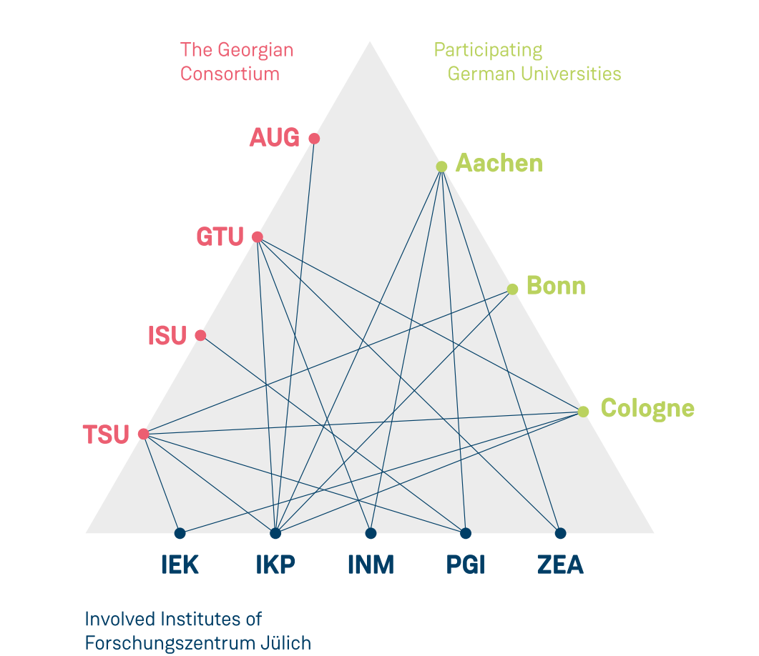
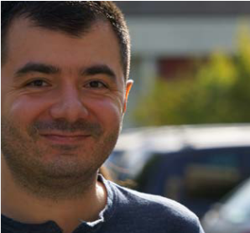
Ggsb SMART|Labs (II)
SMART|EDM_Lab
2017
2016
SMART|AtmoSim_Lab
2 existing SMART|Labs: diverse topics – but fruitful cooperation (electronics)
Both should be continued (based on external reviews; w/ possible new focus)

