Slide 1
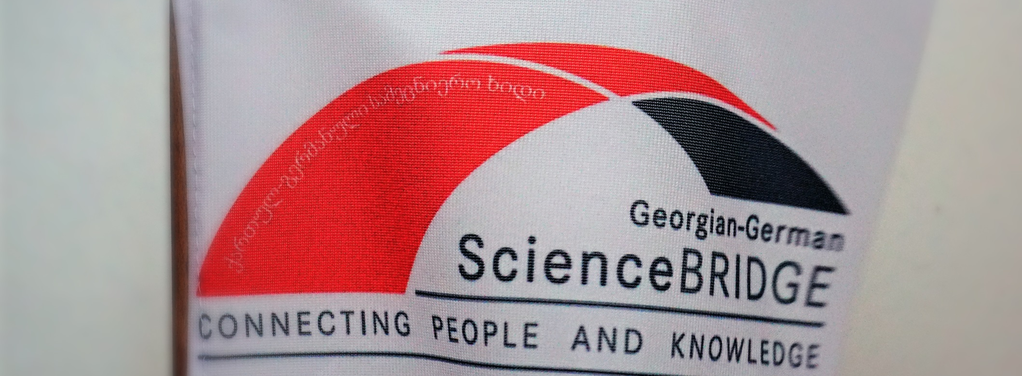
GGSB2022
Conclusions, outlook (And discussion)
hans ströher, Andro kacharava | Sept. 16, 2022

Slide 2
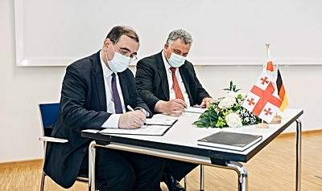
GGSB2022 – preparations
GSI/FAIR: April 2022
HZDR: May 2022

Slide 3
GGSB2022 – science program
KIU – focus on GGSB-PLUS (Health …)
Talks on past and future of GGSB
Lectures on „Grand Challenges“
HTC at KIU; possible GGSB contributions
Public Lecture „Hadron Therapy“
First discussion on new/future SMART|Labs

Slide 4
GGSB2022 – part I (KIU)
GSI/FAIR: April 2022
Sept. 13, 2022

Slide 5
GGSB2022 – science program
KIU – focus on GGSB-PLUS (Health …)
Talks on past and future of GGSB
Lectures on „Grand Challenges“
HTC at KIU; possible GGSB contributions
Public Lecture „Hadron Therapy“
First discussion on new/future SMART|Labs
TSU – focus on SMART|Labs
Work at existing SMART|Labs (EDM, AtmoSim)
Presentations on plans/ideas for future SMART|Labs
Student presentations (parallel sessions)

Slide 6
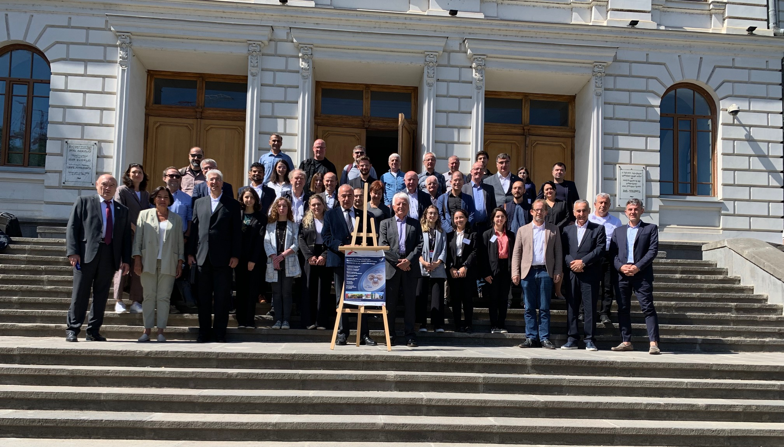
GGSB2022 – part II (TSU)
GSI/FAIR: April 2022
Sept. 15, 2022

Slide 7
GGSB2022 – Challenges
Financial support in Germany
BMBF puts application in waiting loop
Existing SMART|Labs
1st 5-year term of SMART|EDM_Lab ended in 2021
(re-focus: e.g. take the „offer“ of GSI/FAIR (Ch. Schmidt))
1st 5-year term of SMART|AtmoSim_Lab ends in 2022
→ Both must be continued!
Future SMART|Labs
Many ideas - (best) strategy?

Slide 8
GGSB2022 – outlook
Exchange program(s)
Opportunities:
FZJ (individual internships, QUALI-Startup (2023))
GSI/FAIR (Get_INvolved Program)
HZDR
Next GGSB workshop (GGSB 2024)
20 years anniversary → will try to make it a „big event“

Slide 9
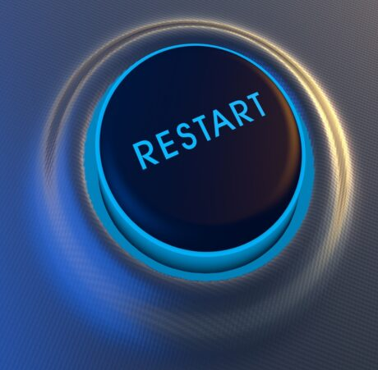
GGSB2022 – Summary
We have had a good GGSB
and look forward to an exciting future!

Slide 10
GGSB2022 – semi-final word
? Any questions?
! Are there comments?

Slide 11
… and we wish all
a safe trip home;
see of you next time!

