Slide 1
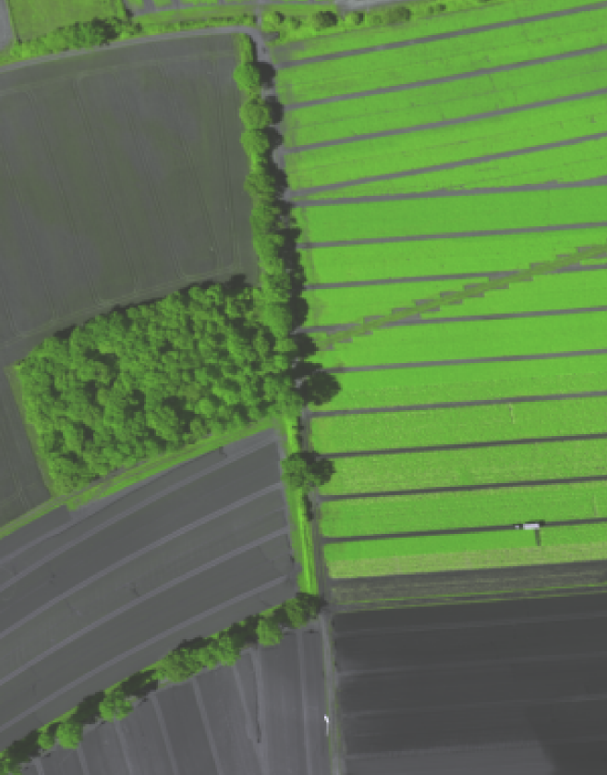
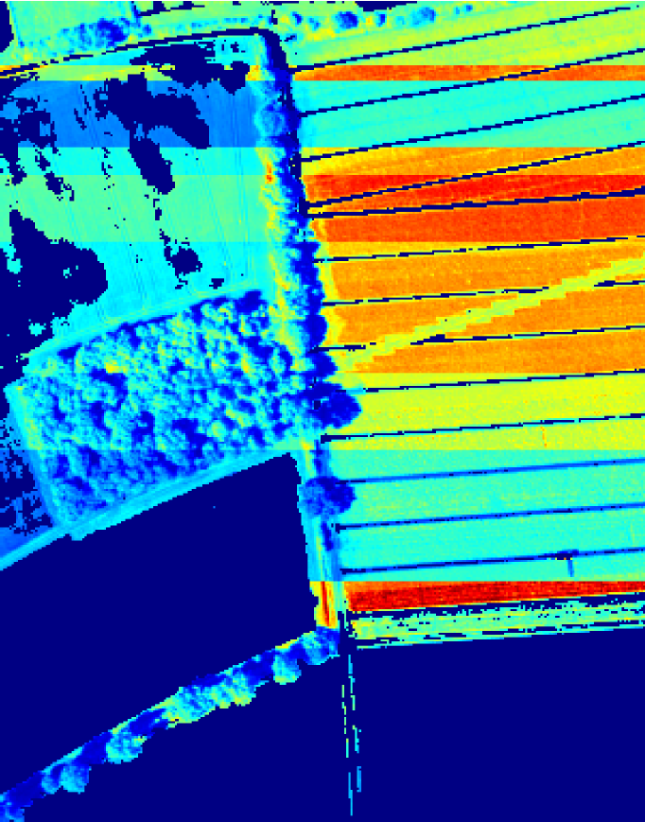
Machine Learning for Scientific Applications
Hanno Scharr, IAS-8, Forschungszentrum Jülich

Slide 2
Machine learning (ML)
Understand and build methods that 'learn'
Learning
leverage data to improve performance on some set of tasks
closely related to computational statistics
ML algorithms build a model based on sample data, known as training data, in order to make predictions or decisions without being explicitly programmed to do so.
Applications
Computer vision, image processing, speech recognition, natural language processing
Tasks, where it is unfeasible to develop conventional algorithms for

Slide 3
Machine Learning (ML)
Forward problems
Inverse problems
Artificial Intelligence
Model driven
Machine learning: data driven
PDE-based methods
Estimation, optimization
Supervised learning
semi-super-vised learning
Weakly super-vised learning
Self-super-vised learning
Unsupervised learning
Computer Vision, Image Processing, Signal Processing
Machine Learning for Scientific Applications
Deep Learning: ML using artificial neural networks with more than 7 layers

Slide 4
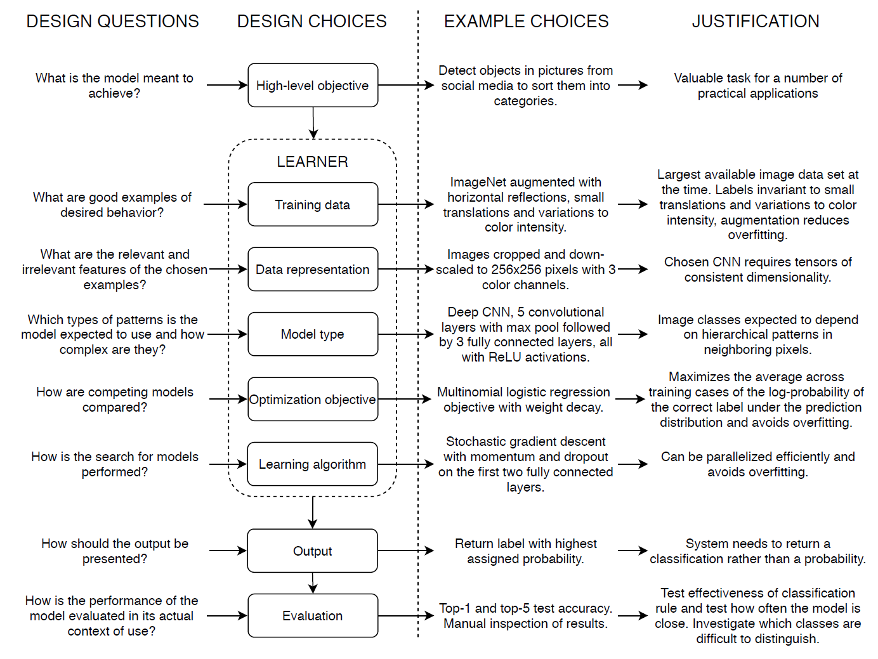
Designing ML-based Solutions
Aagaard Enni and Assent 2021, https://arxiv.org/abs/2105.00687

Slide 5
Self-Supervised Learning for Sun-Induced Fluorescence Retrieval from hyperspectral imaging data
Remote Sensing Example

Slide 6
Remote Sensing of Sun-Induced Fluorescence (SIF)
Relevant for bio-economy and climate change research
Images courtesy of Uwe Rascher

Slide 7
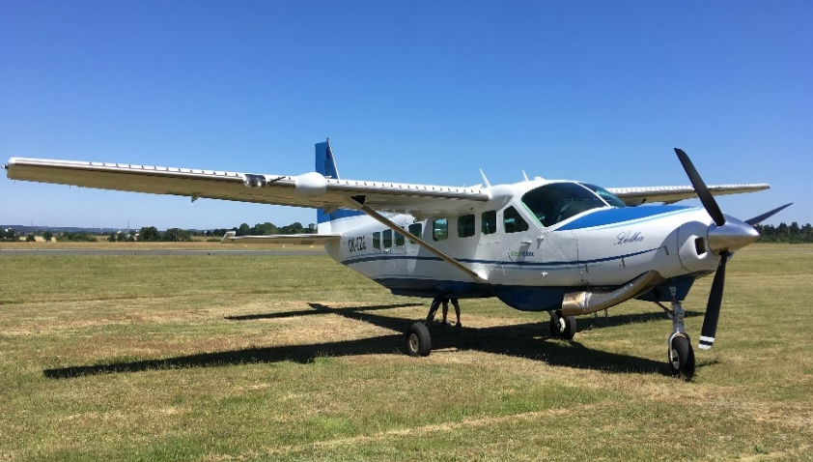
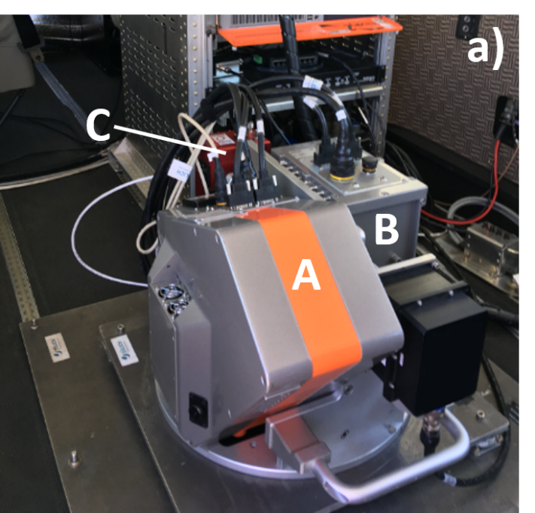
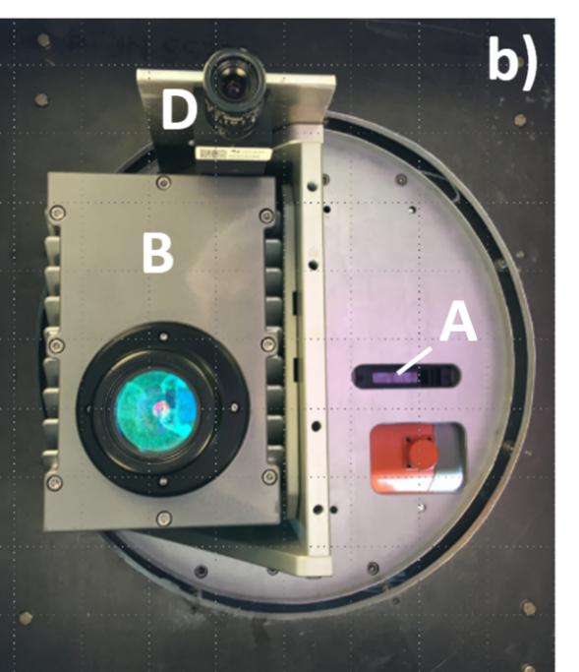
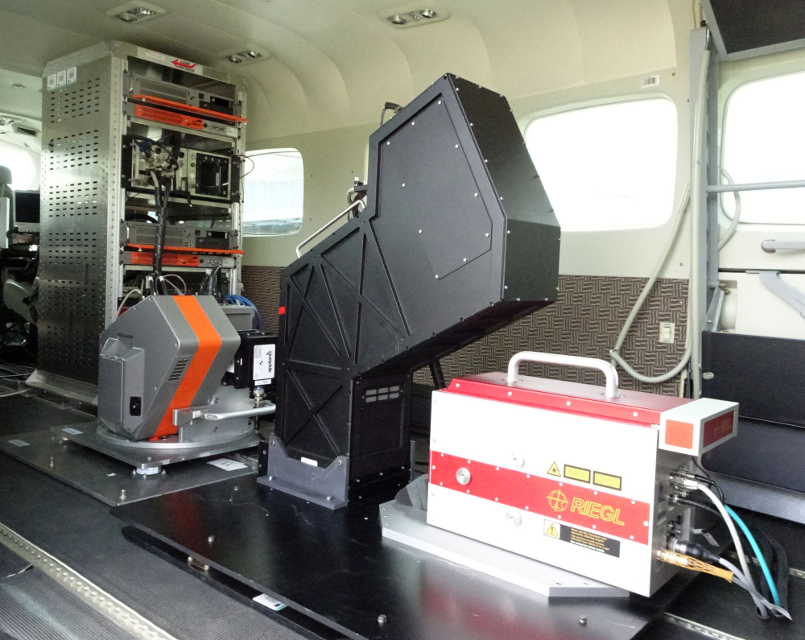
HyPlant airborne hyperspectral imaging sensor
HyPlant 3
DUAL module (380 – 2500 nm)
FLUO module (670 – 780 nm) 0.25 nm FWHM, 0.11 nm SSI, SNR >210
Images courtesy of Uwe Rascher

Slide 8
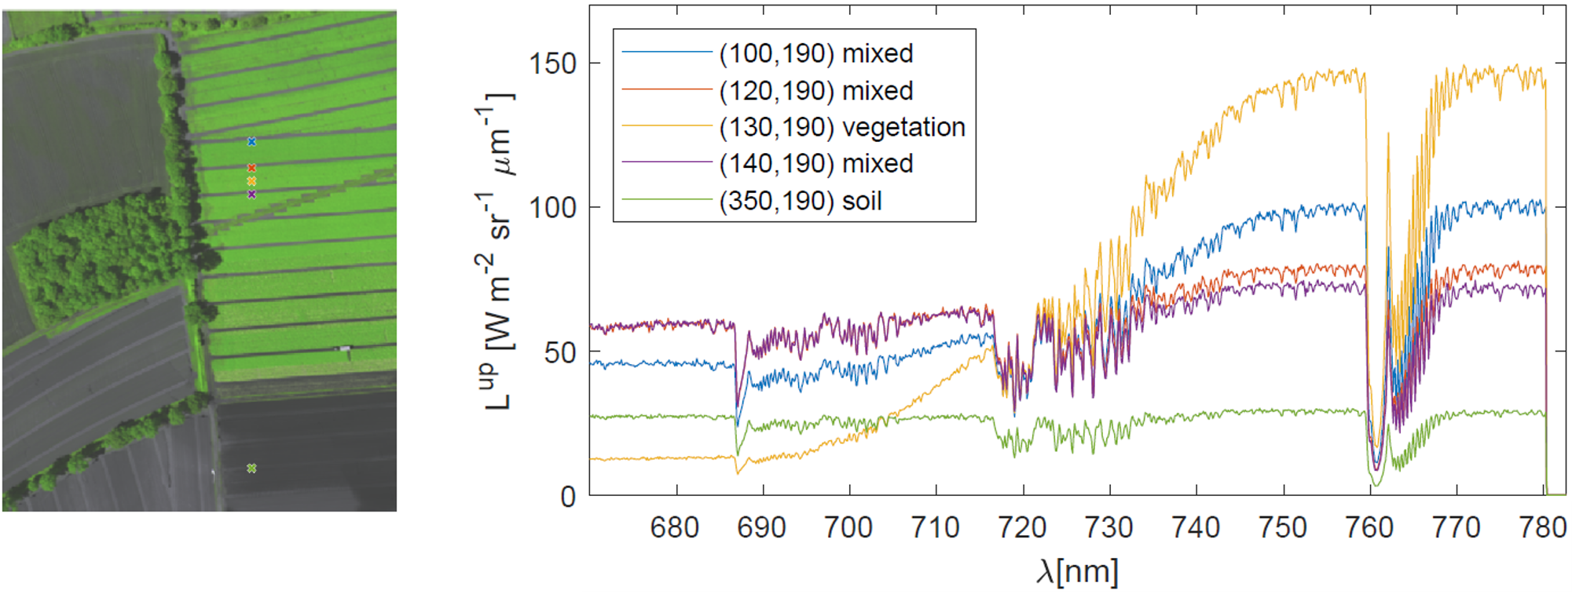
Spatio-spectral Images from HyPlant
Line sensor operated in push broom fashion
x
Flight direction, time t

Slide 9
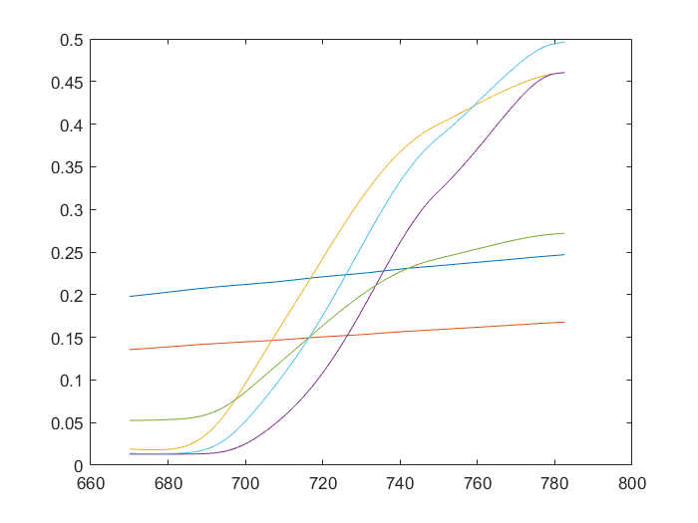
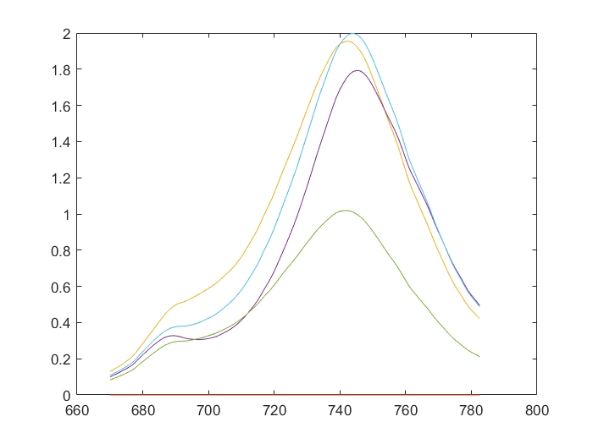
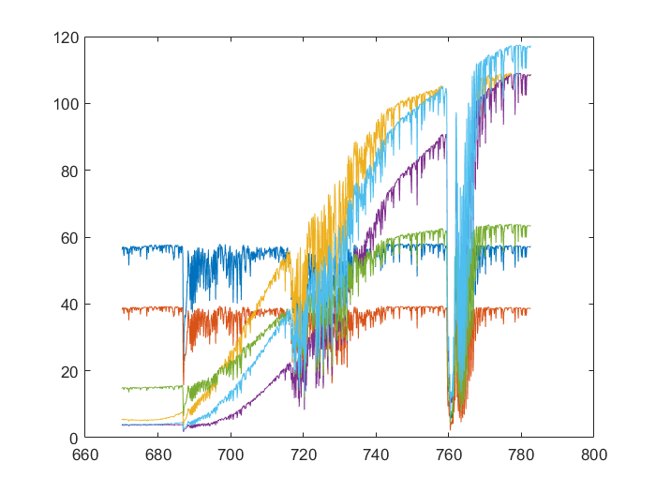
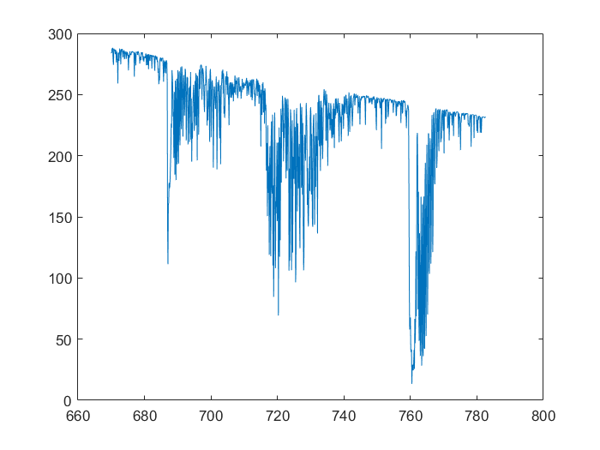
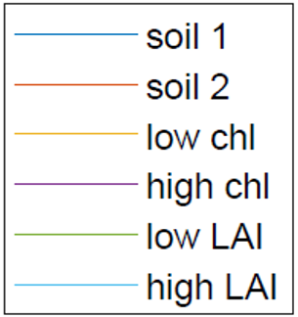
Sun Induced Fluorescence
Reflectance R
Fluorescence F
Image formation
Incoming light L_{up} goes through optics and is detected by digital sensor
I(λ,x,t) = φ (λ,x) *L_{up} (λ,x,t) + n
L_{up} (λ,x,t) = R(λ,x,t) L_{down} (λ,x,t) + F(λ,x,t)
Measured intensity I
PSF φ of sensor optics
Photon ‚shot‘ noise n
Reflectance R
Fluorescence F
L_{up}
L_{down}
I
Atmosphere
L_{down}
L_{up}
Scharr et al. (2021), Remote Sensing

Slide 10
Deep Learning for Sun-Induced Fluorescence Retrieval
High-level objective
Work in progress
LEARNER
Training data
No ground truth labels available for SIF
Data representation
Model type
Optimization objective
Learning algorithm
Output
Evaluation

Slide 11
Deep Learning for Sun-Induced Fluorescence Retrieval
High-level objective
Work in progress
LEARNER
Training data
No ground truth labels available for SIF
Self-supervised learning approach
Decompose signal I via neural network
Compose simulated signal I_{sim}
Minimize difference |I - I_{sim}|
Data representation
Model type
Optimization objective
Learning algorithm
Output
Evaluation

Slide 12
Deep Learning for Sun-Induced Fluorescence Retrieval
High-level objective
Work in progress
LEARNER
Decompose signal I
Compose simulated signal I_{sim}
Minimize difference |I - I_{sim}|
Training data
Data representation
Model type
I(λ,x,t)
I_{sim}(λ,x,t)
R(λ,x,t)
Optimization objective
e_{in}
Learning algorithm
F(λ,x,t)
sim(F,R,a)
Output
e_{atm}(λ,x,t)
a = Σ_{x,t} w(x,t) e_{atm}(λ,x,t)
Evaluation
w(x,t)

Slide 13
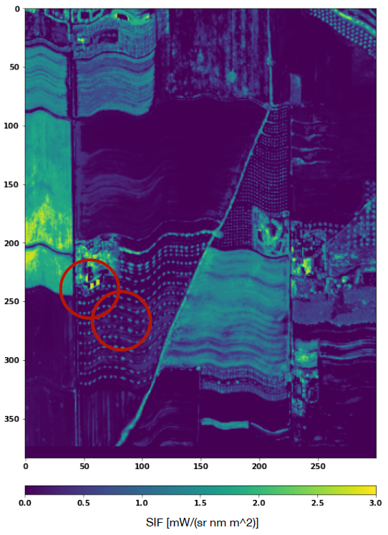
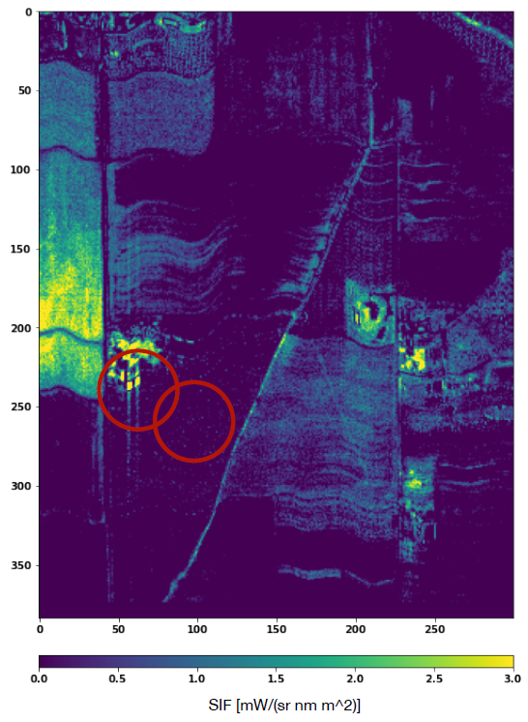
Deep Learning for Sun-Induced Fluorescence Retrieval
Work in progress
Self-supervised
Spectral fitting method
Less noise
Higher spatial resolution
Less artifacts
Quantitative evaluation ongoing
Cogliati et al. (2019), remote sensing

Slide 14
Segmentation of rhizotron images
Plant Phenotyping Example
Deep Learning for root image analysis

Slide 15
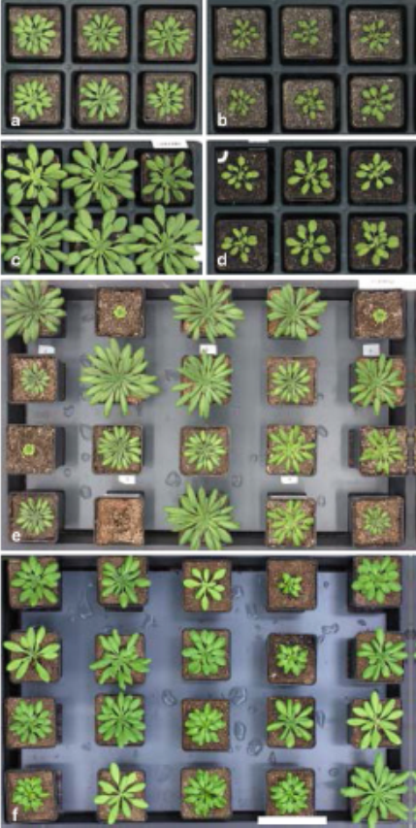
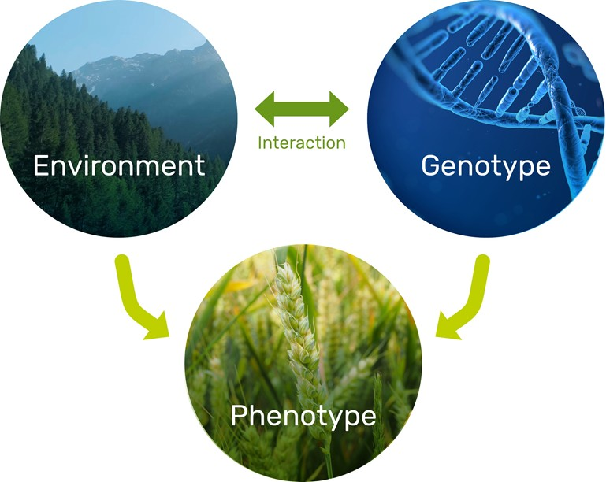
Plant Phenotyping
Relevant for food, feed, fibre, and fuel production
Same genotype different environment
Same environment
Different genotype

Slide 16
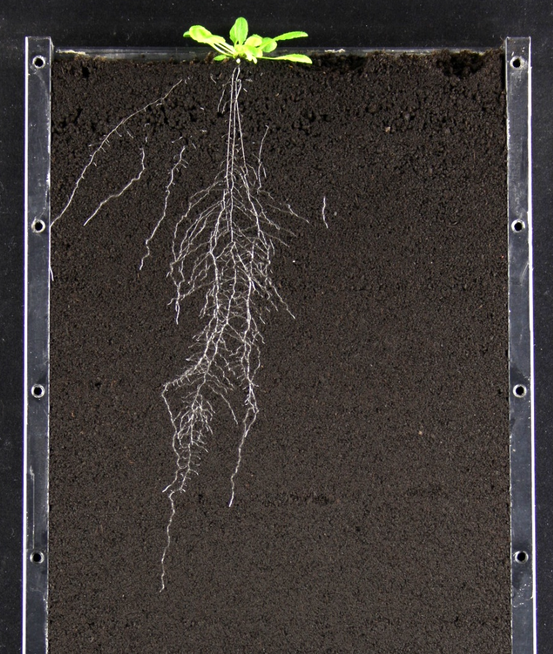
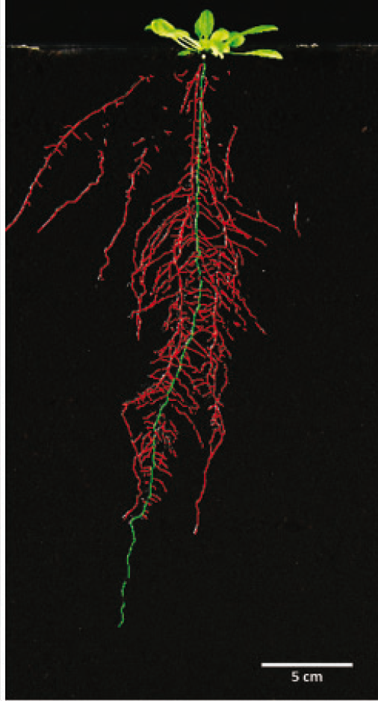
Root phenotyping in Soil: GrowScreen-Rhizo
Automated segmentation supported by manual clean up

Slide 17
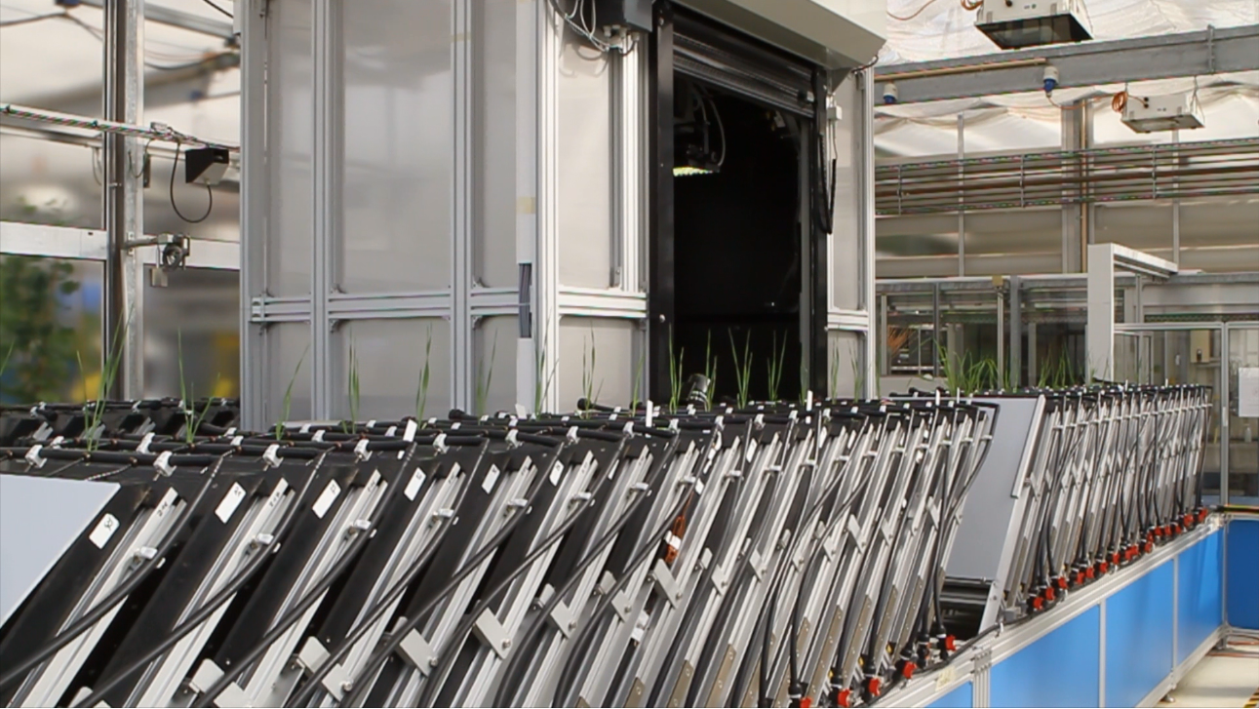
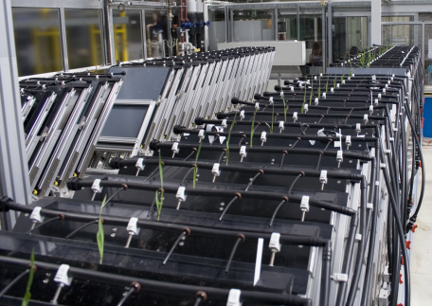
Root phenotyping in Soil: GrowScreen-Rhizo
Automated imaging of 72 rhizotrons
Nagel et al. Functional Plant Biology 2012

Slide 18
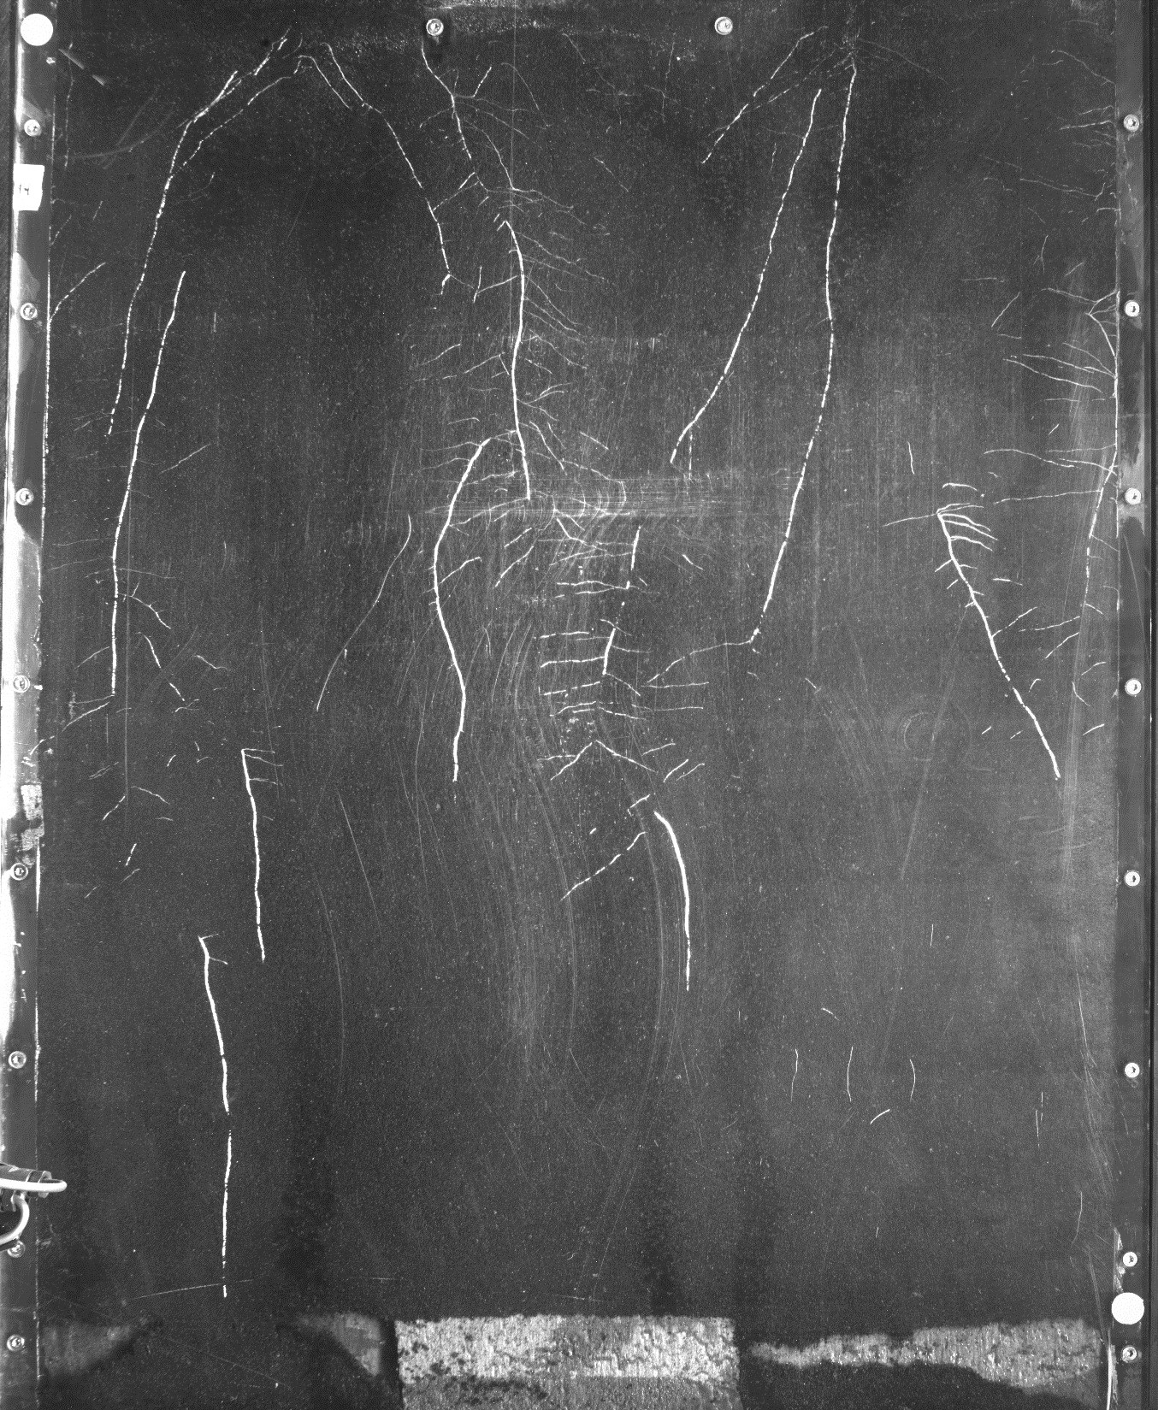
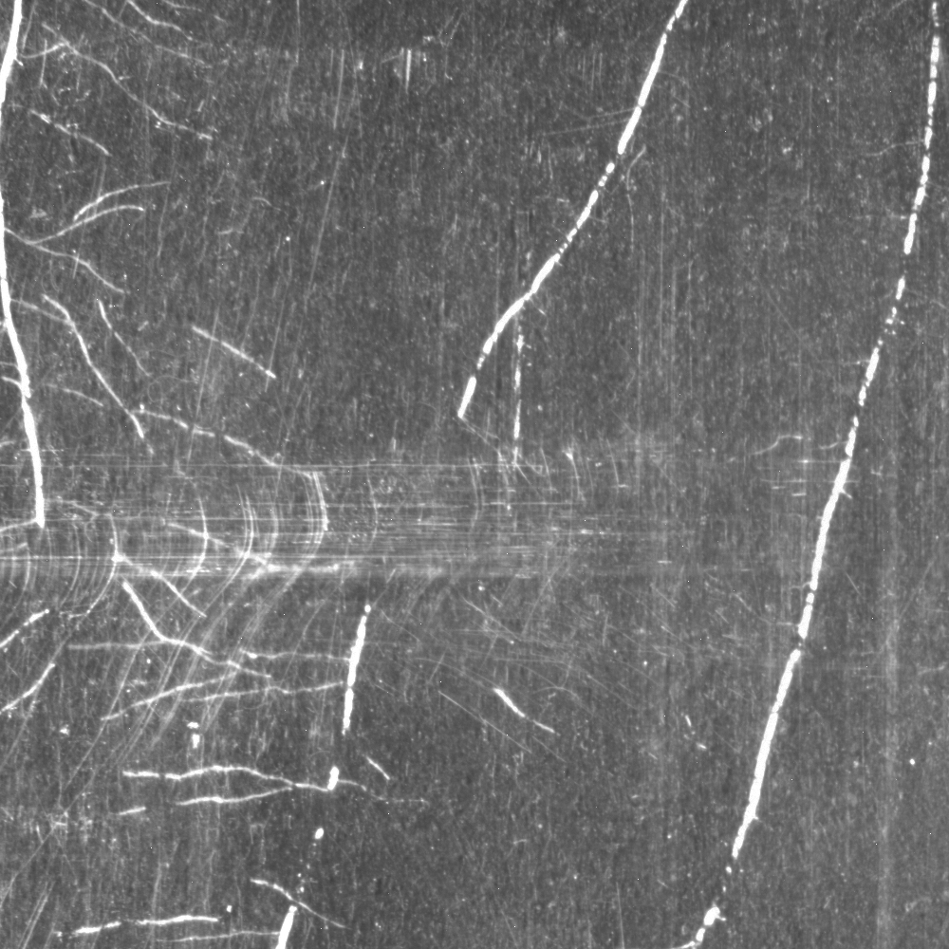
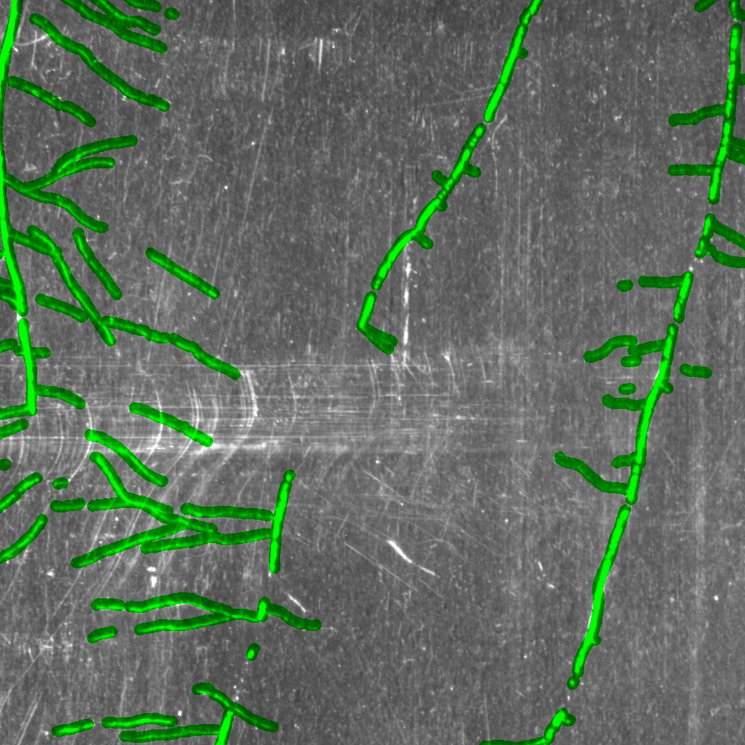
3600 x 4384
1000 x 1000

Slide 19
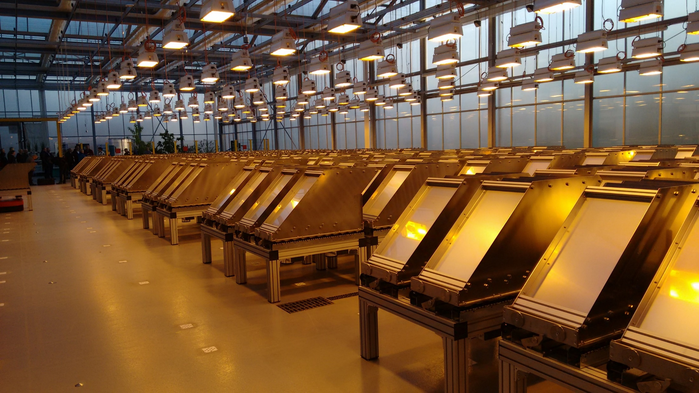
Root phenotyping in Soil: GrowScreen-Rhizo
~900 rhizotrons

Slide 20
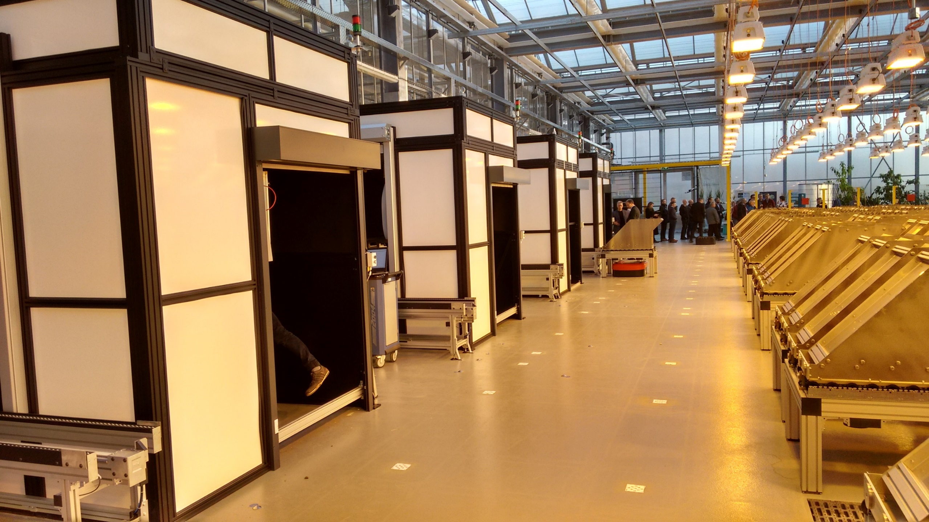
Root phenotyping in Soil: GrowScreen-Rhizo
4 measurement stations

Slide 21
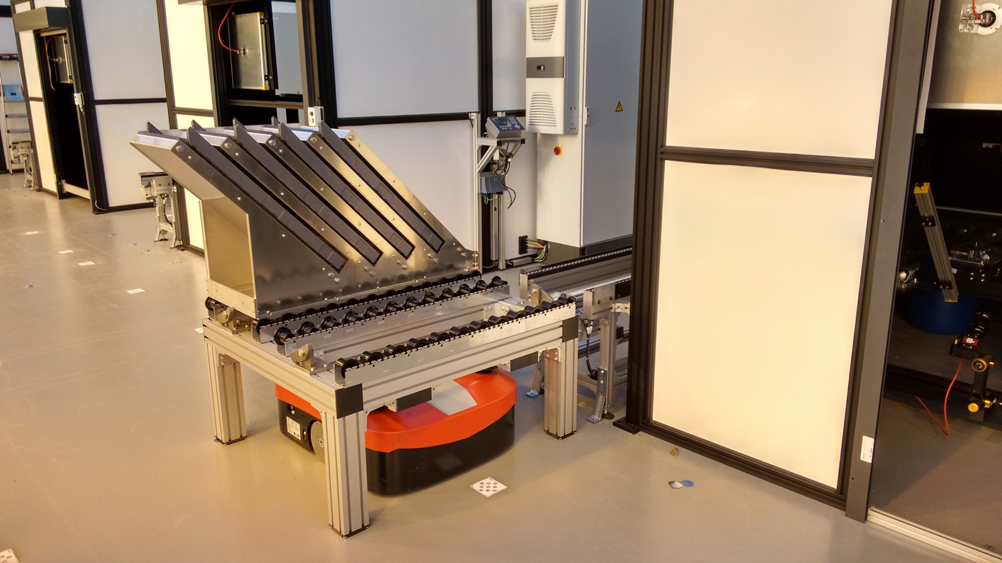
Root phenotyping in Soil: GrowScreen-Rhizo
Autonomous vehicules for transport

Slide 22
Segmentation by deep learning
High-level objective
Datasets big enough for deep learning (4.6k images, ~60GB, HPC for training)
LEARNER
Training data
Data representation
Model type
Optimization objective
Learning algorithm
Output
Evaluation
Visualization following Chen et al., ICCV 2017, https://arxiv.org/abs/1709.00643

Slide 23
Segmentation by deep learning
High-level objective
Datasets big enough for deep learning (4.6k images, ~60GB, HPC for training)
Manual labels with position noise – dilate lines and adapt loss function
LEARNER
Training data
Data representation
Model type
Optimization objective
Learning algorithm
Output
Evaluation
Visualization following Chen et al., ICCV 2017, https://arxiv.org/abs/1709.00643

Slide 24
Segmentation by deep learning
High-level objective
Datasets big enough for deep learning (4.6k images, ~60GB, HPC for training)
Manual labels with position noise – dilate lines and adapt loss function
Dilation instead of down-sampling – no up-sampling, no aliasing
LEARNER
Training data
Data representation
Model type
Optimization objective
Learning algorithm
Output
Evaluation
Visualization following Chen et al., ICCV 2017, https://arxiv.org/abs/1709.00643

Slide 25
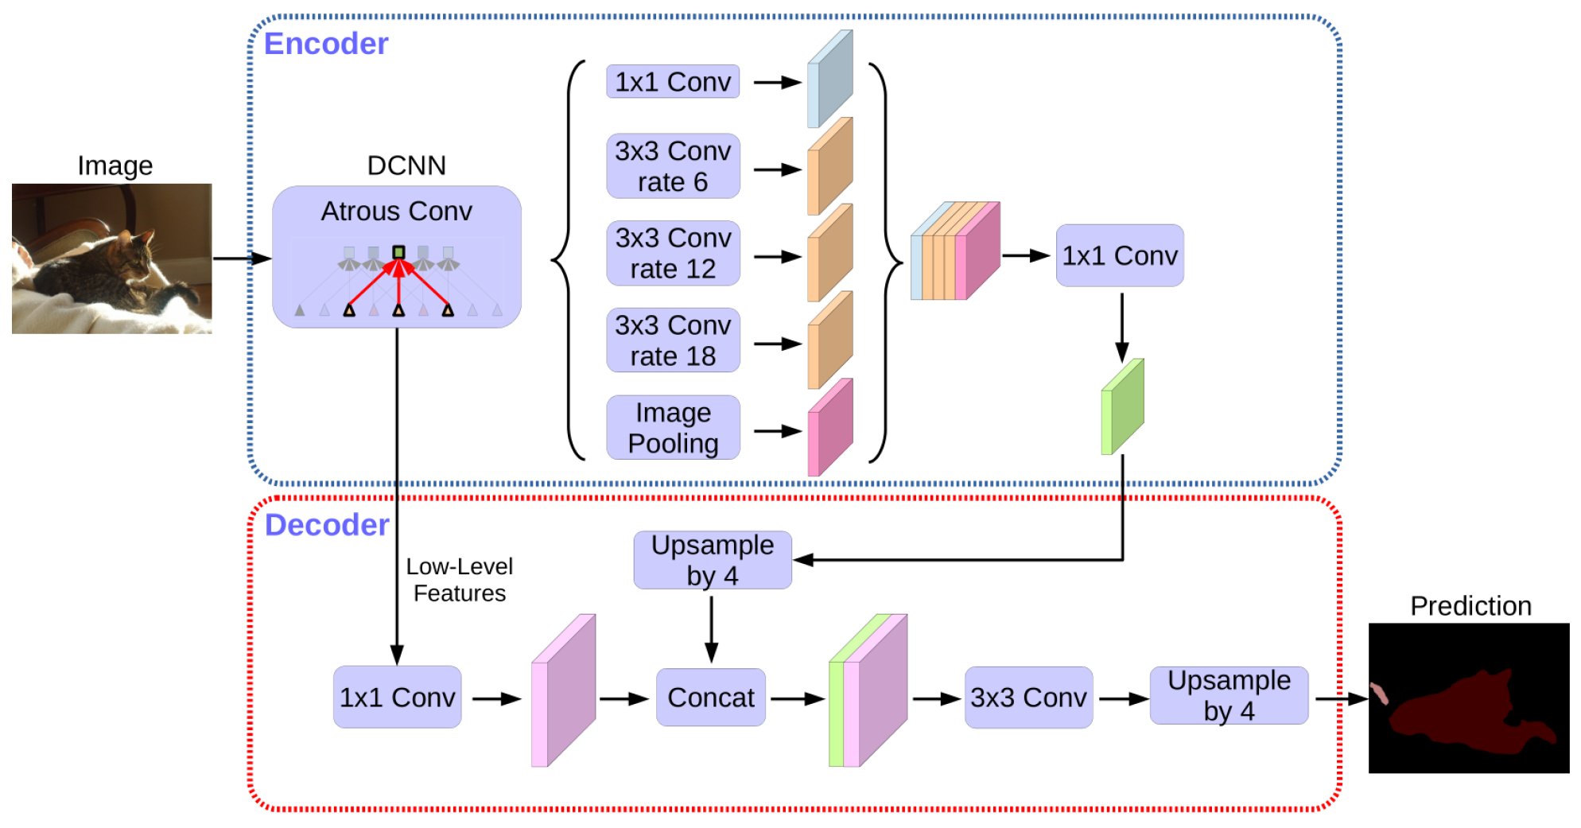
Segmentation by deep learning
High-level objective
Datasets big enough for deep learning (4.6k images, ~60GB, HPC for training)
Manual labels with position noise – dilate lines and adapt loss function
Dilation instead of down-sampling – no up-sampling, no aliasing
LEARNER
Training data
Data representation
Model type
Best architecture:
DeepLabV3+ with pretrained ResNet-101 backbone
Optimization objective
Learning algorithm
Output
Evaluation
Visualization following Chen et al., ECCV 2018, https://arxiv.org/abs/1802.02611

Slide 26
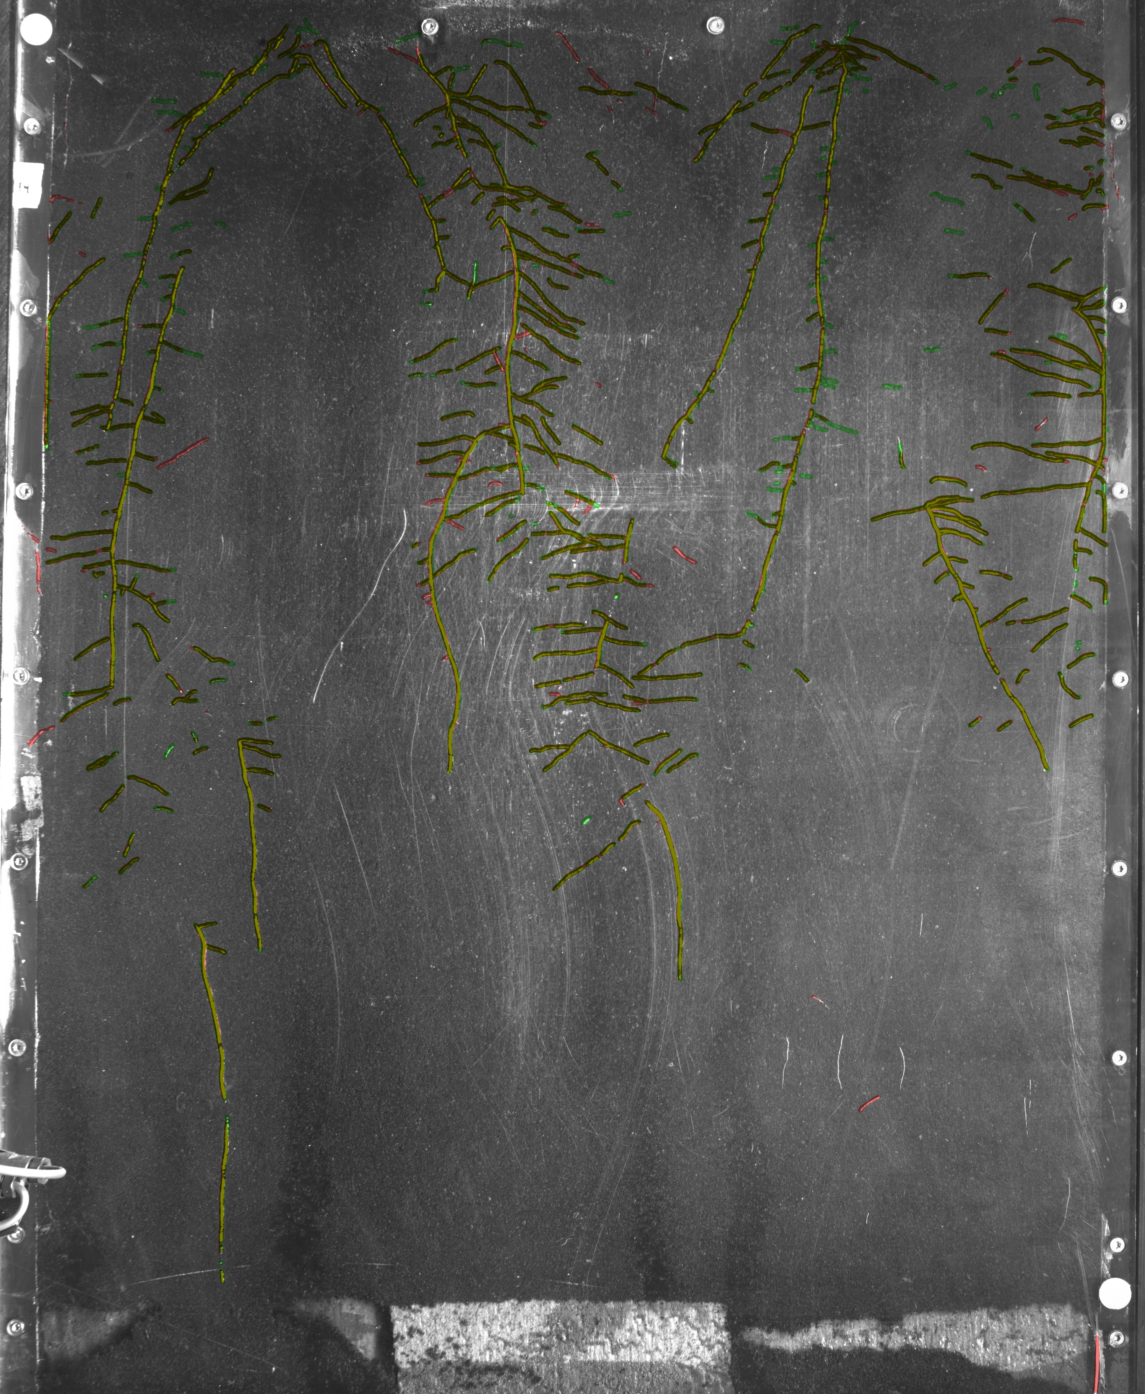
Segmentation by deep learning
Example result

Slide 27
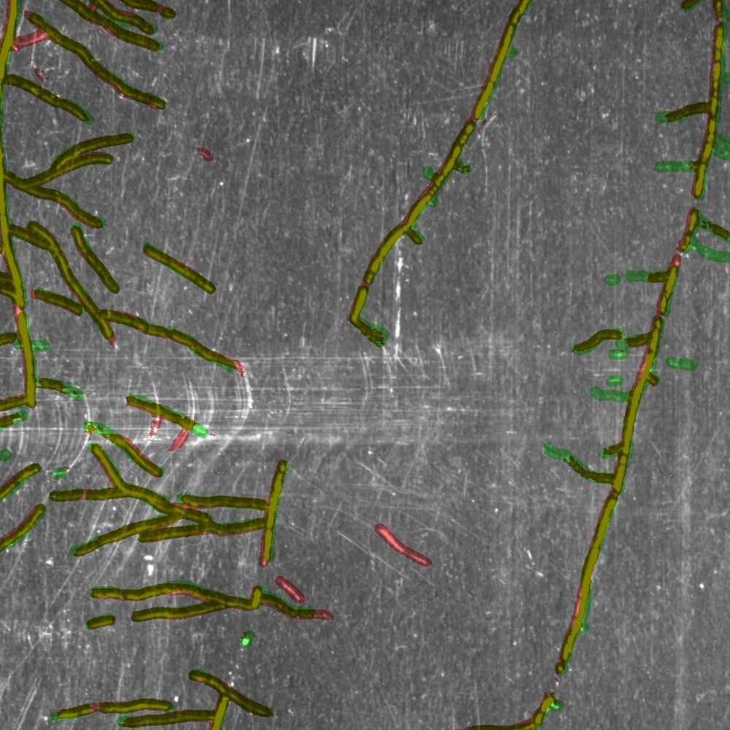
Segmentation by deep learning
Example result

Slide 28
Machine Learning for Scientific Applications
Hanno Scharr, IAS-8, Forschungszentrum Jülich

Slide 29
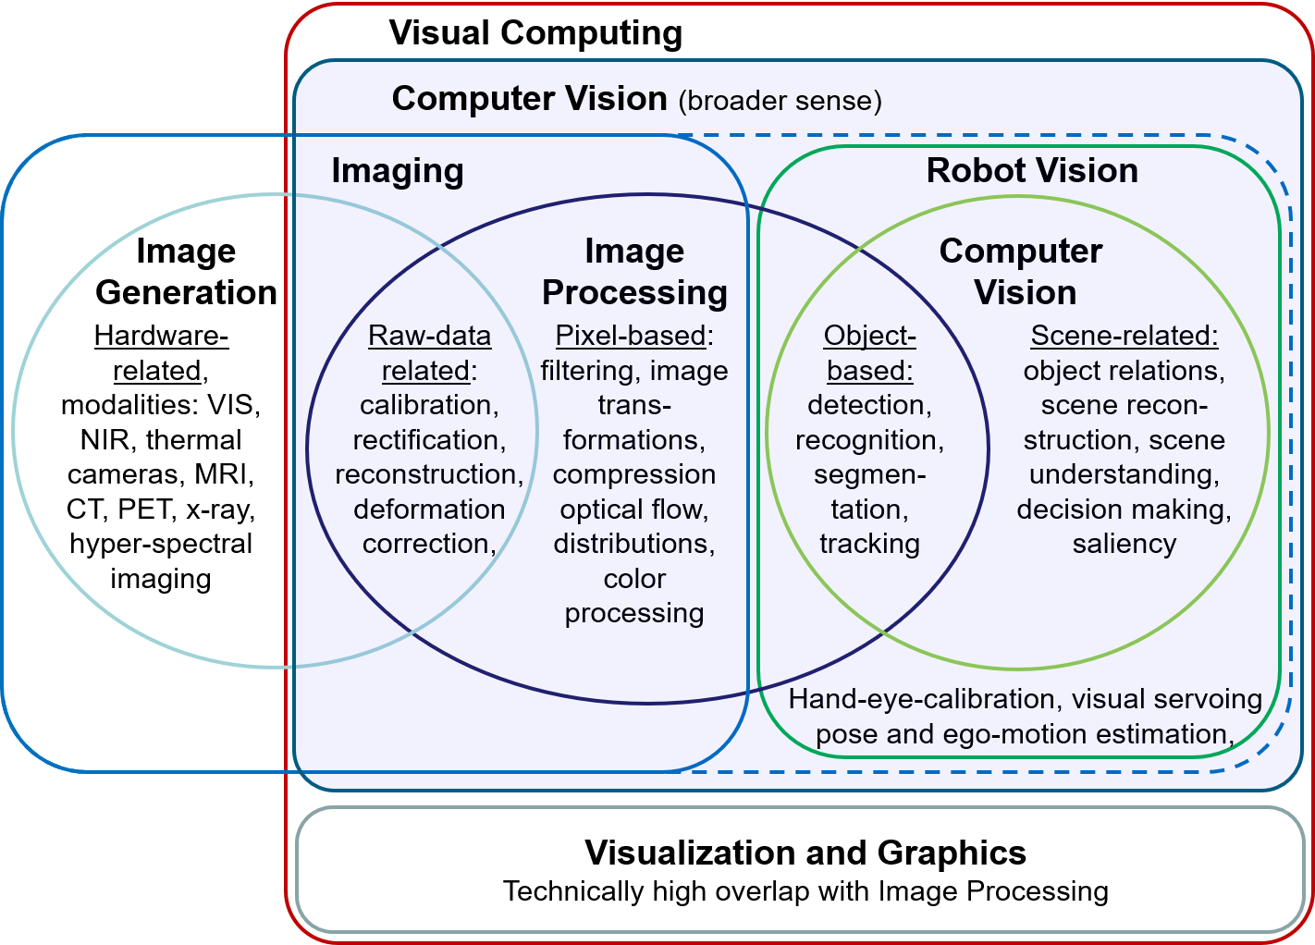
Computer Vision, Image Processing, Imaging, Visualization …

Slide 30
Data Challenges
Sharing Data: A Symbiosis of Domain Sciences and Machine Learning

Slide 31
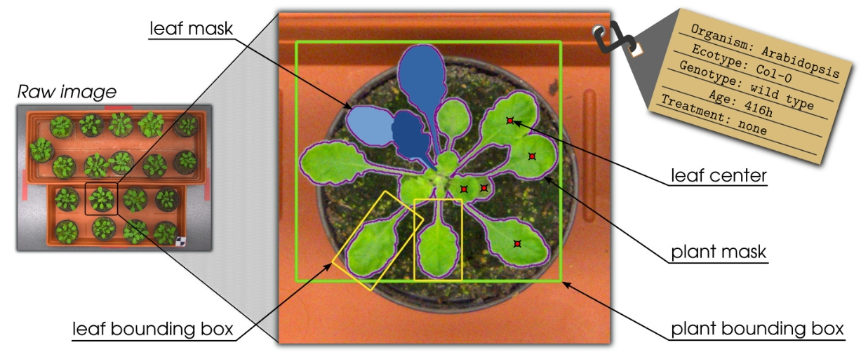
Data Challenges
Sharing Data: A Symbiosis of Domain Sciences and Machine Learning
Machine Learning needs data for developing and testing novel solutions
Domain scientists have data and knowledge on problem
Both are interested in the best solution for a posed problem
Bring their interests together by posing Data Challenges
Data with labels needed defining optimal outcome of desired solution

Slide 32
Dataset Challenges in Machine Learning
MNIST
Classification
70.000 images in 10 classes

Slide 33
Dataset Challenges in Machine Learning
CIFAR-10
Classification
60.000 images in 10 classes

Slide 34
Dataset Challenges in Machine Learning
MS-COCO: Common objects in context
object detection, segmentation and captioning
330K images
1.5 M object instances
80 object categories

Slide 35
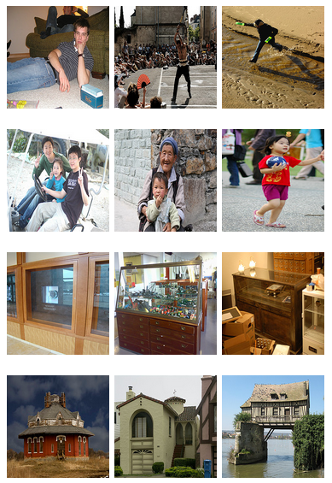
Dataset Challenges in Machine Learning
ImageNet-1k
~1.5M images
~1000 classes
each with multiple bounding boxes and respective class labels
ImageNet-21k
~14M images
~21k classes

Slide 36
Sharing Data: A Symbiosis with Machine Learning
Machine Learning needs appropriate data
For training and testing
For developing and testing novel solutions
Labels (‘ground truth’) needed for evaluation
Dataset Challenge
Combination of dataset and problem description
The best solution wins (most accurate or fastest)
Synergy
ML and domain scientists interested in best solution
ML: learn about algorithm
Dom. sci.: apply best solution
Domain scientists have data and knowledge on problem
➔ pose challenges to advance domain applications!

Slide 37
Data challenges are common in medical imaging
https://grand-challenge.org/challenges/
168 challenges since 2007
24 in 2018
Often organized together with workshops or conferences

Slide 38
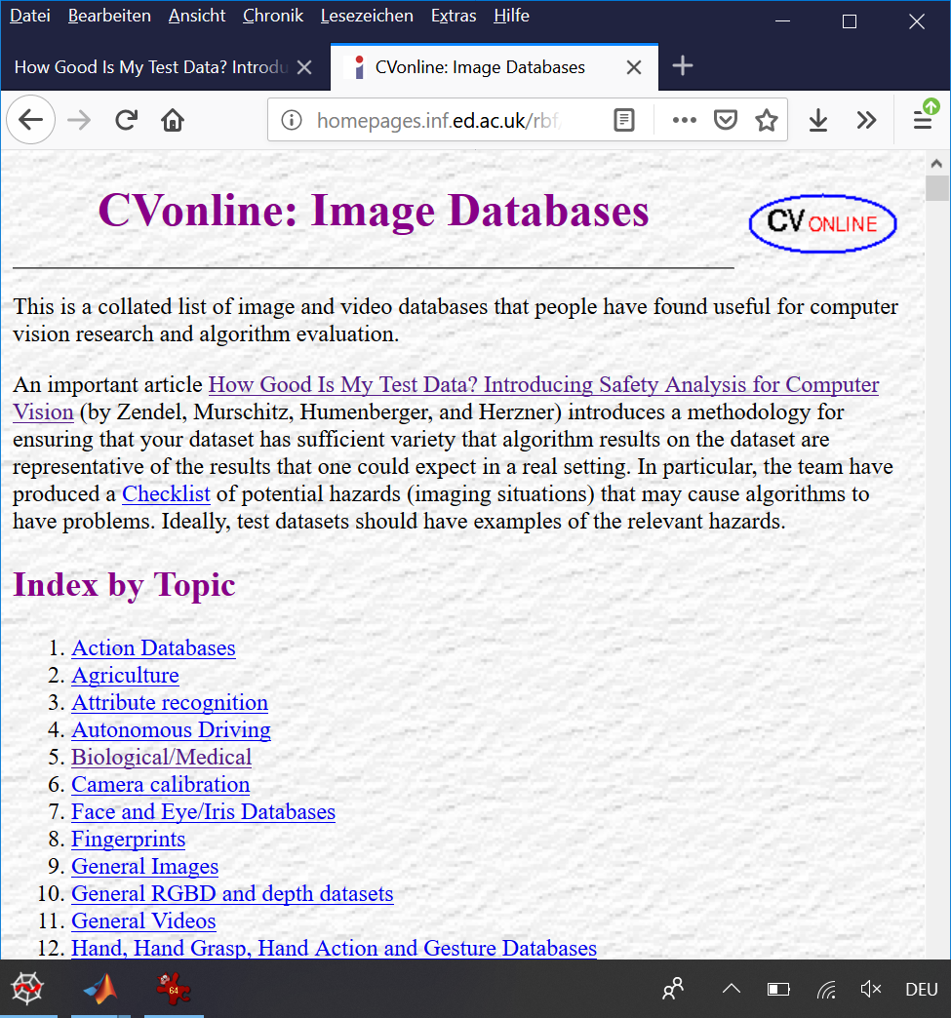
Many Datasets already available
CVonline: Image Databases
~1000 different datasets
25 topics

Slide 39
Progress by the Plant Phenotyping Dataset
Status in 2014: CV/ML researchers were largely unaware of plant phenotyping
We opened data for ‘hot’ CV/ML problems
‘multi-instance segmentation’ and
‘object counting’

Slide 40
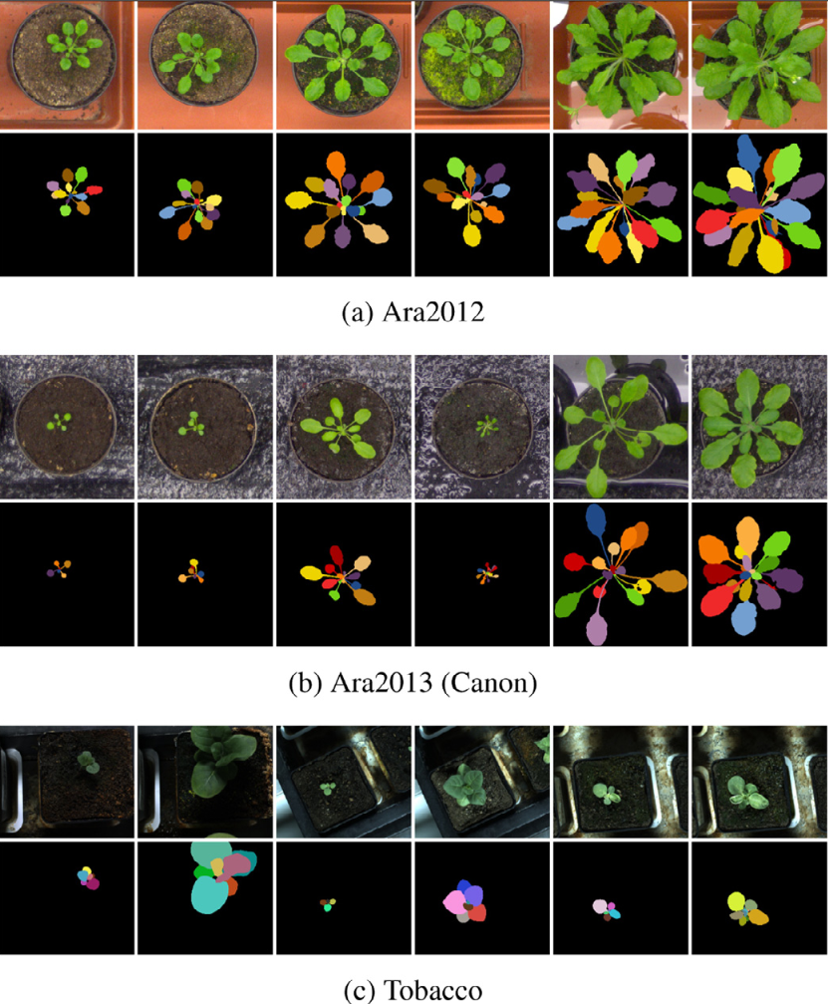
Progress by the Plant Phenotyping Dataset
Status in 2014: CV/ML researchers were largely unaware of plant phenotyping
We opened data for ‘hot’ CV/ML problems:
‘multi-instance segmentation’ and
‘object counting’

Slide 41
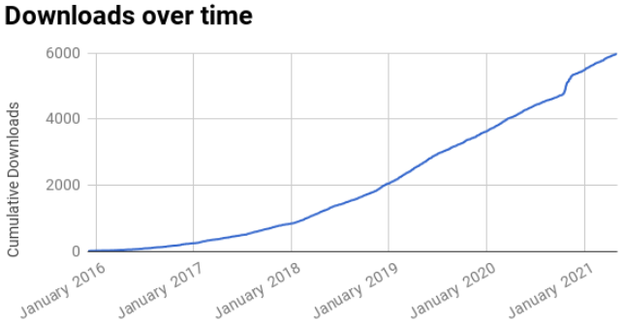
Progress by the Plant Phenotyping Dataset
Status in 2014: CV/ML researchers were largely unaware of plant phenotyping
We opened data for ‘hot’ CV/ML problems:
‘multi-instance segmentation’ and
‘object counting’

Slide 42
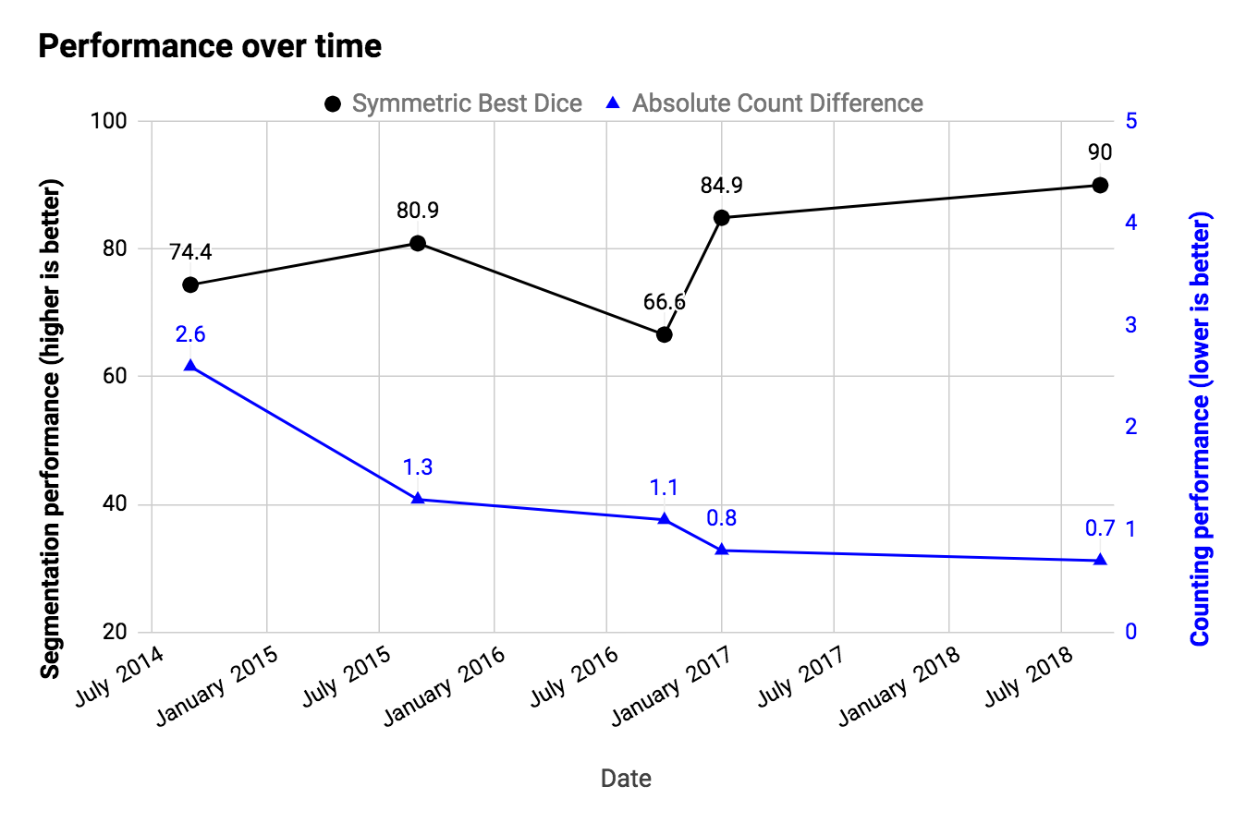
Progress by the Plant Phenotyping Dataset
Status in 2014: CV/ML researchers were largely unaware of plant phenotyping
We opened data for ‘hot’ CV/ML problems:
‘multi-instance segmentation’ and
‘object counting’

Slide 43
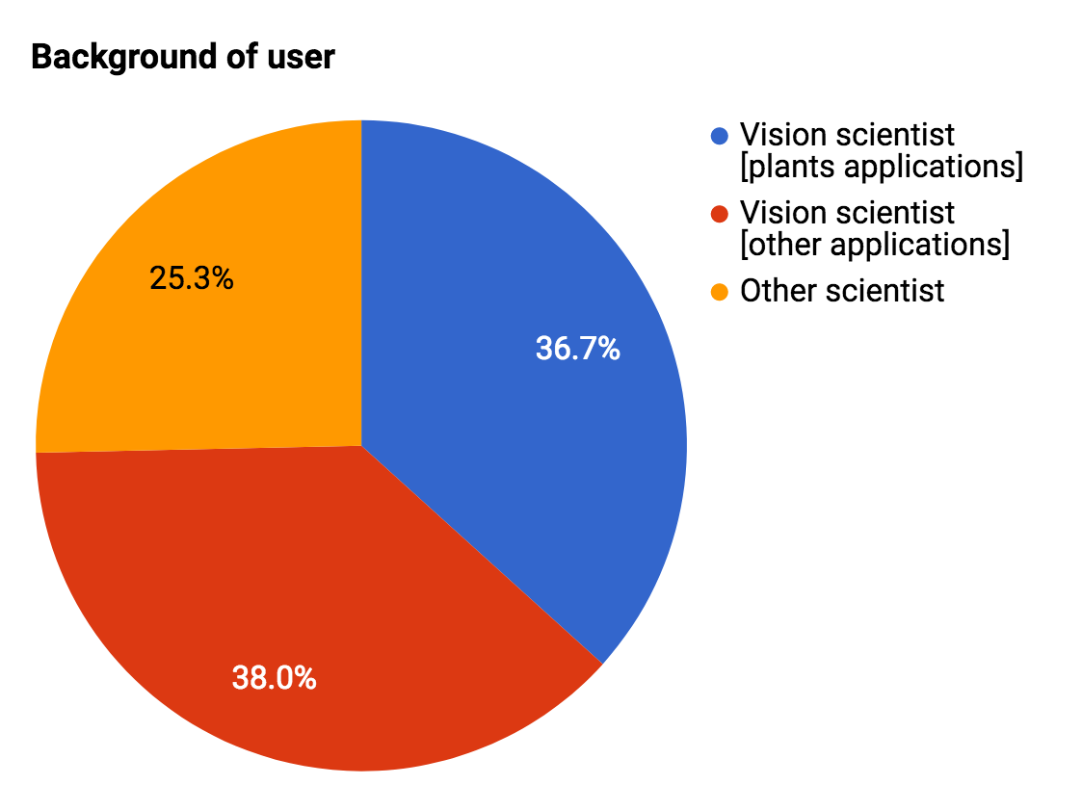
Progress by the Plant Phenotyping Dataset
Status in 2014: CV/ML researchers were largely unaware of plant phenotyping
We opened data for ‘hot’ CV/ML problems:
‘multi-instance segmentation’ and
‘object counting’

Slide 44
Progress by the Plant Phenotyping Dataset
Status in 2014: CV/ML researchers were largely unaware of plant phenotyping
We opened data for ‘hot’ CV/ML problems
‘multi-instance segmentation’ and
‘object counting’
Status in 2022
Performance of solution strongly increased
Dataset well known (~7000 downloads), considered a ‘standard dataset’ for these problems.
Plant Phenotyping is recognized for delivering valid CV/ML problems.

Slide 45
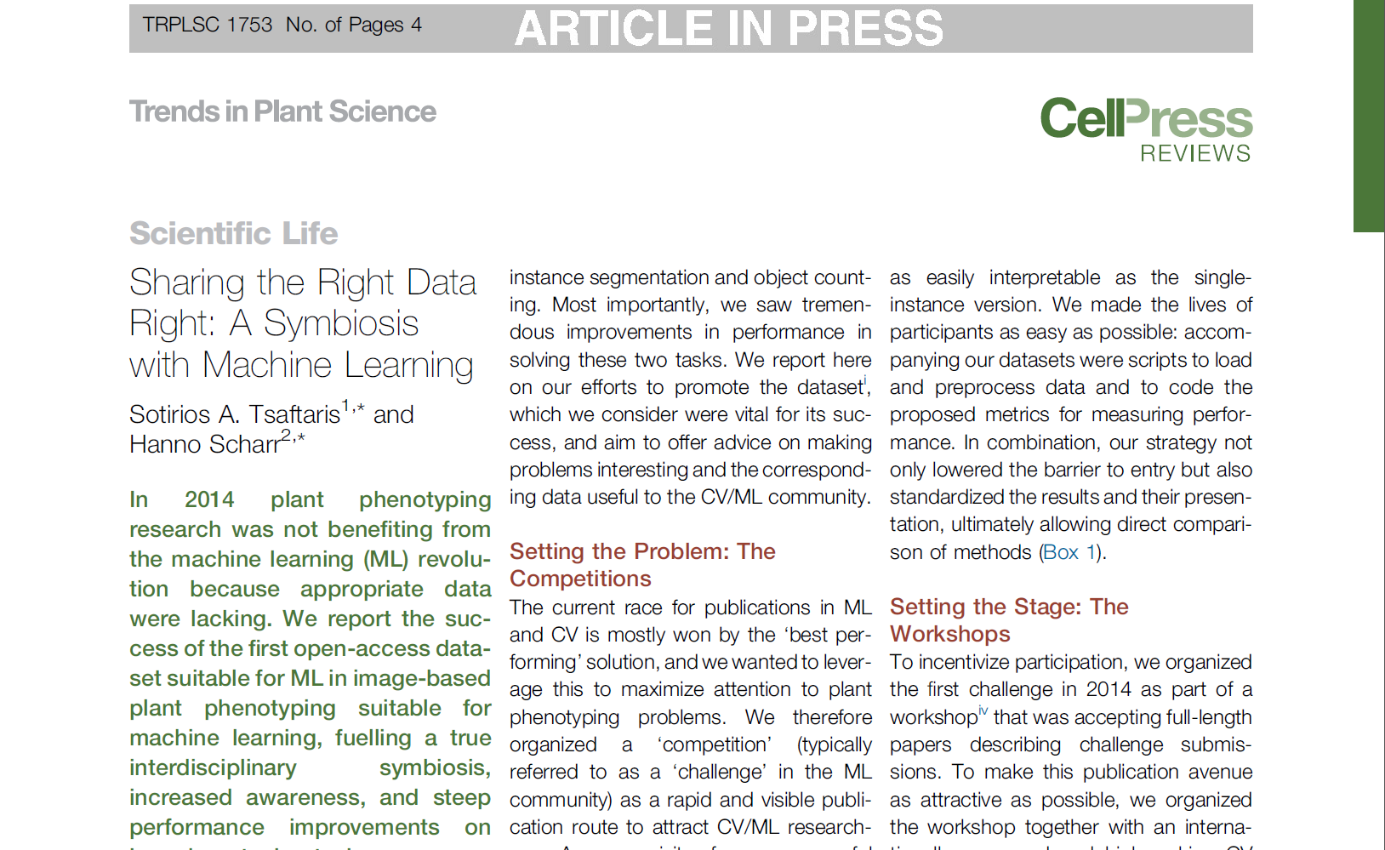
How was this achieved? Lessons learned
We derived a detailed set of recommendations, how a challenge can be supported for success
Leverage: In ML/CV the race for publications is won by the ‘best performing’ solution
Publish data as FAIR+ Problem Statement
Promote the Challenge
Workshops
Website, repository etc. FAIR principle
Automated evaluation and leader board

Slide 46
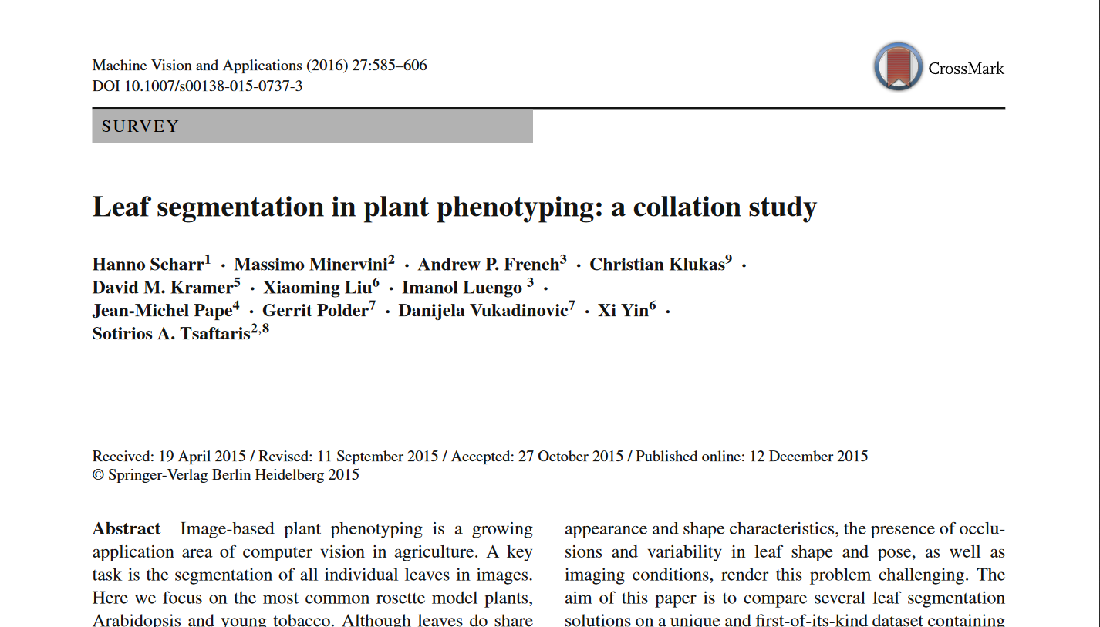
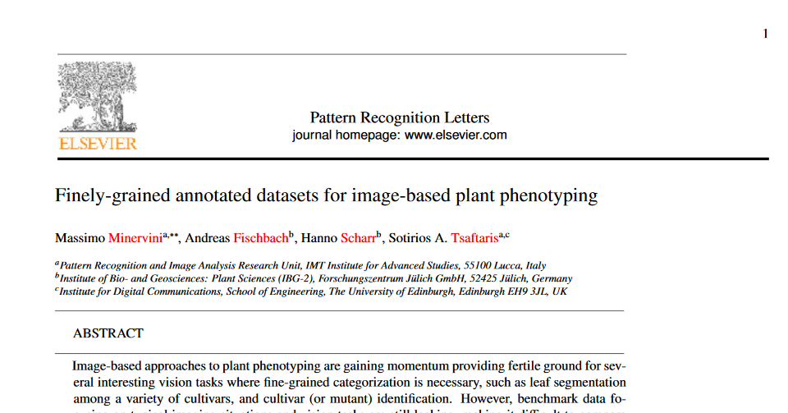
Setting the problem: competitions
FAIR+ Problem Statement
Baseline paper
~240 citations
Feasible: Challenging but doable problem
CV/ML state-of-the-art as baseline
Amenable: Problem that can be understood by everyone
Problem statement paper describes importance, impact and quality of the problem (in domain and ML/CV)
Incentive: Offer rapid, visible publication route for CV/ML researchers – workshops at good ML/CV conferences
Reproducible: Use a data challenge platform
Standardization of results allows comparison of methods
Decide on suitable performance metrics
Convenience:
Make lives of participants as easy as possible
Problem statement
~220 citations

Slide 47
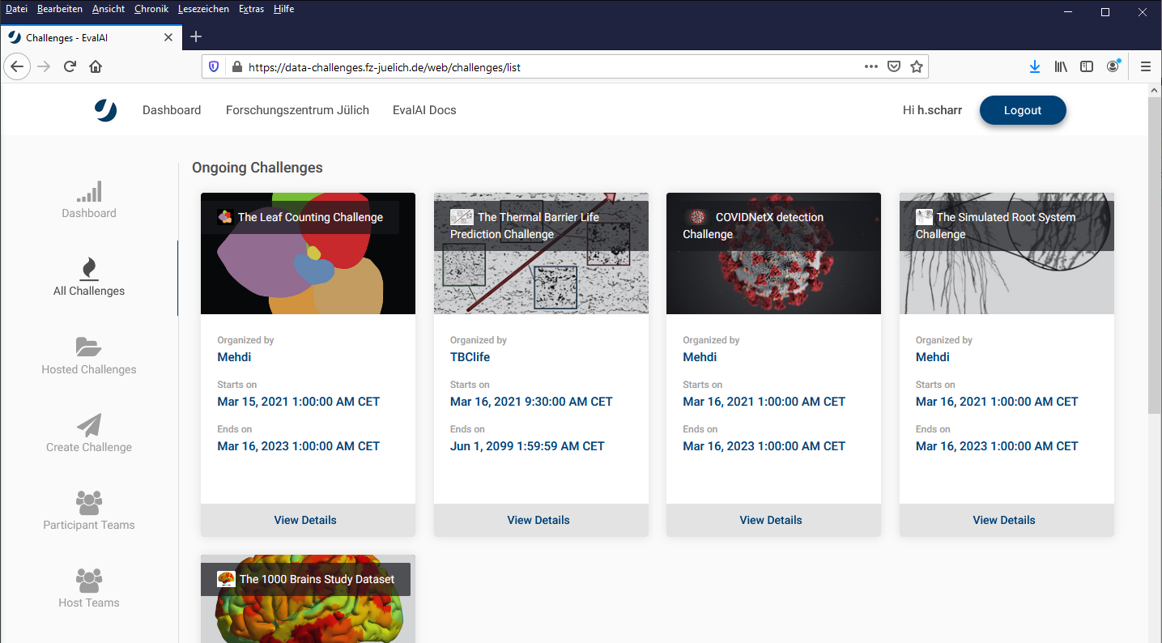
Jülich Challenges / Helmholtz Challenges Platform
An online challenge platform
47

Slide 48
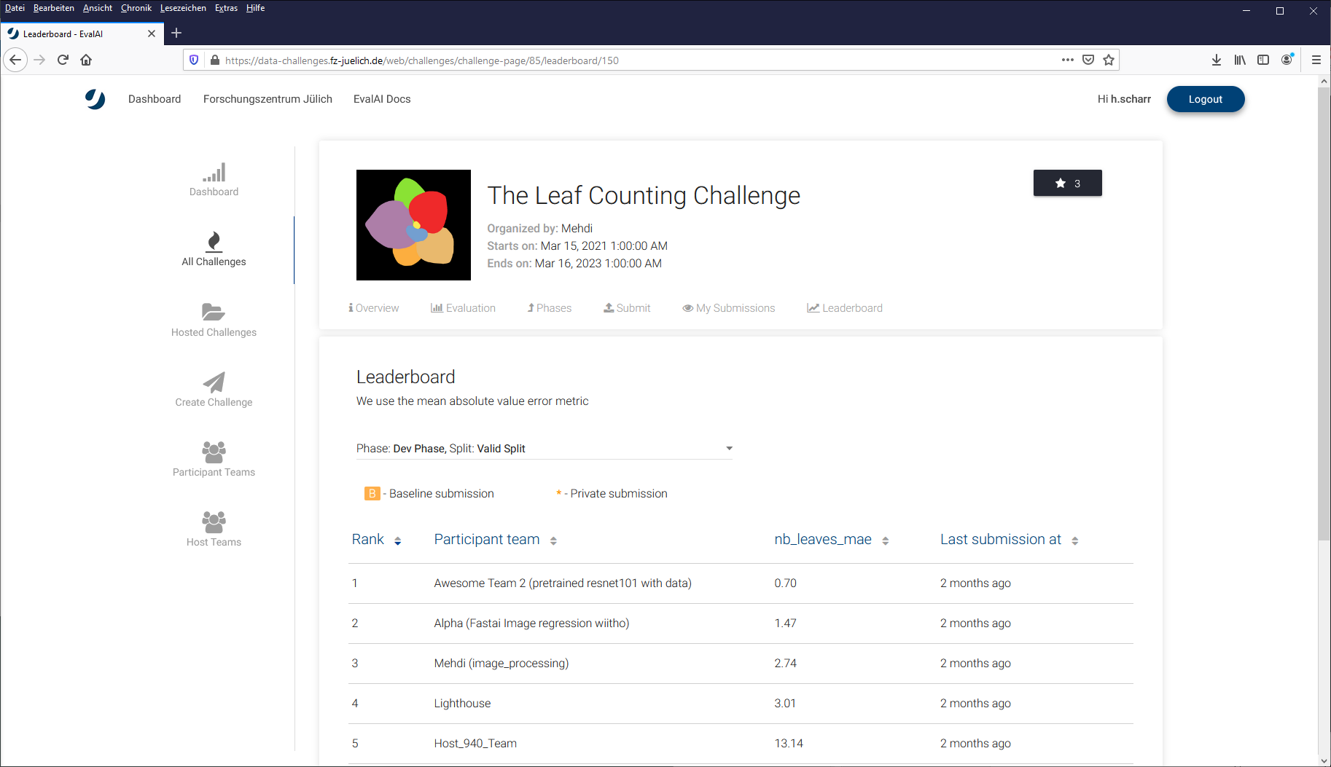
Jülich Challenges / Helmholtz Challenges Platform
An online challenge platform

Slide 49
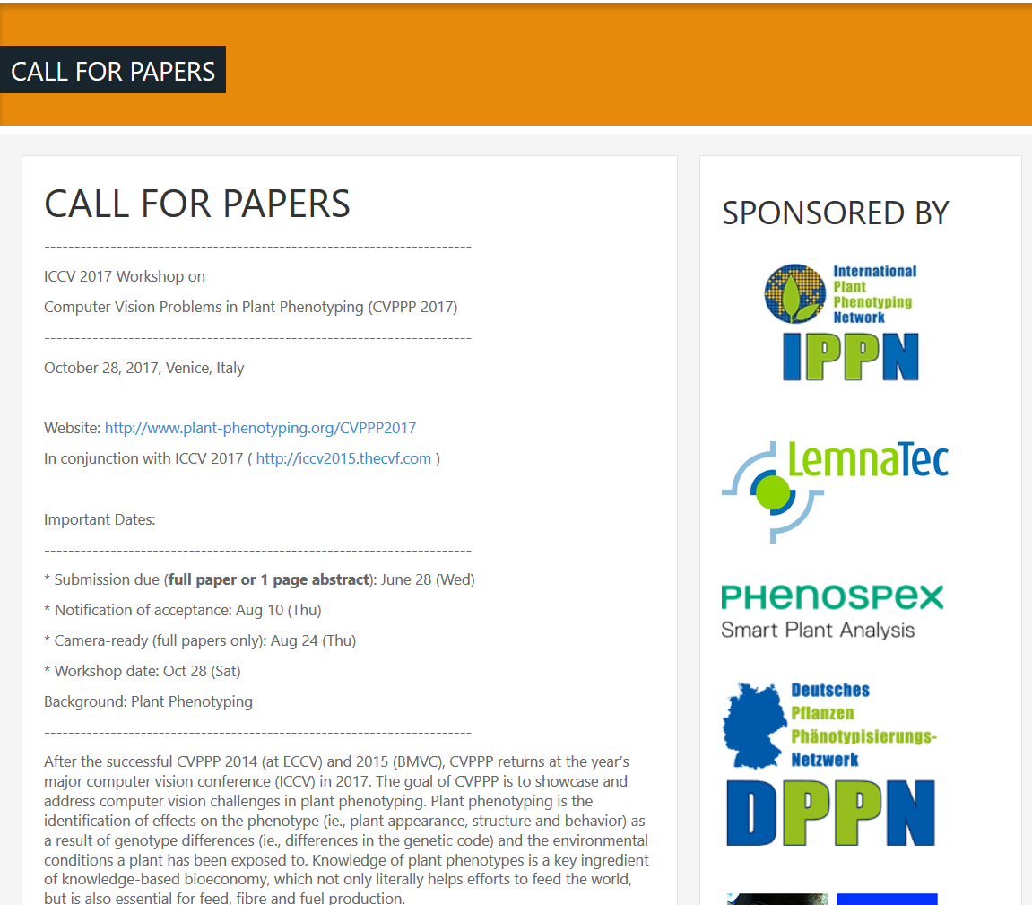
Setting the stage: workshops
Visibility and community building
Visibility: Workshops at high-ranking conferences
Community building:
Great value for ML/CV scientists
Accept full length papers with main conference proceedings
Double blind peer-review, solid program committee
Extended versions in special issue of good journal
Great value for domain scientists
Accept problem statement papers
Easy entry
Accept extended abstracts (Posters only, no peer review, no proceedings, available online)

