Slide 1
SMART|AtmoSim_Lab: Science Case – Atmospheric Chemistry
HEALTH AS A GLOBACL CHALLENGE: |CONTRIBUTIONS BY GGSB SMART LABS
Giorgi Jibuti
Georgian German Science Bridge (GGSB) 2022
September 15
Tbilisi, Georgia
1

Slide 2
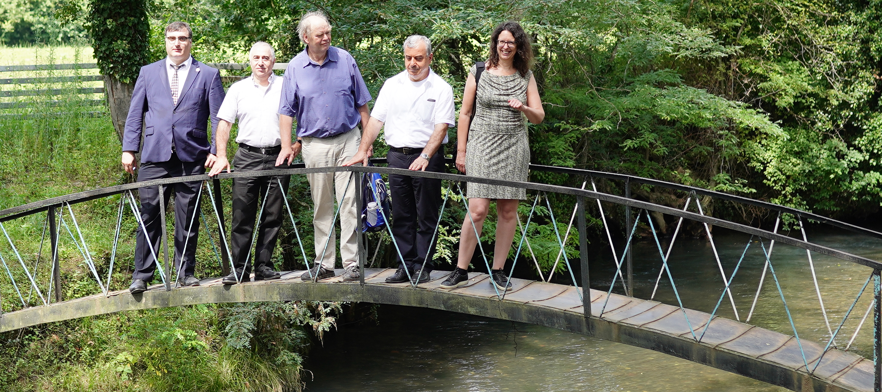
Abasha, 2019
2

Slide 3
Major equipment contributed by FZJ-IEK-8
•ECO PHYSICS: CLD 780 TR- NO & NO₂ measurements
•Evironnement S.A O₃ 41 M- Ozone measurements
•PICARRO CRDS : G2401 – CO, CO₂, CH₄, H₂O measurements
•Grimm Aerosol Technik: 1.129 OPC – Particulate matter measurement
3

Slide 4
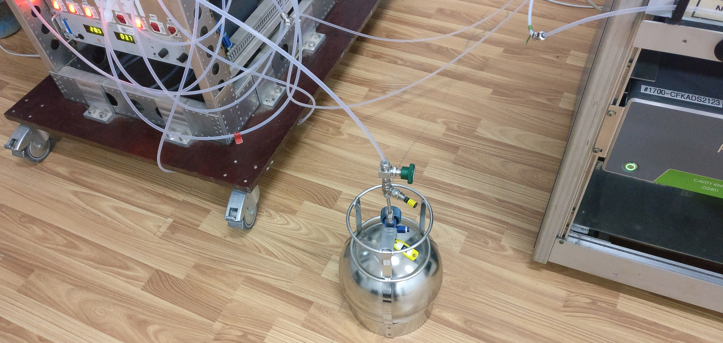
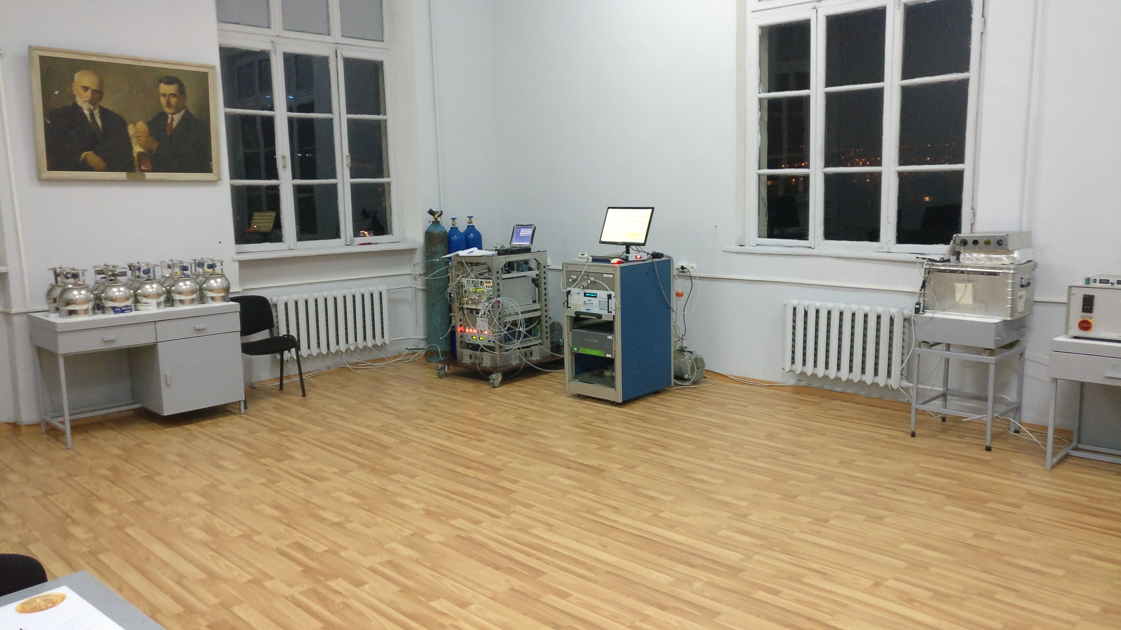
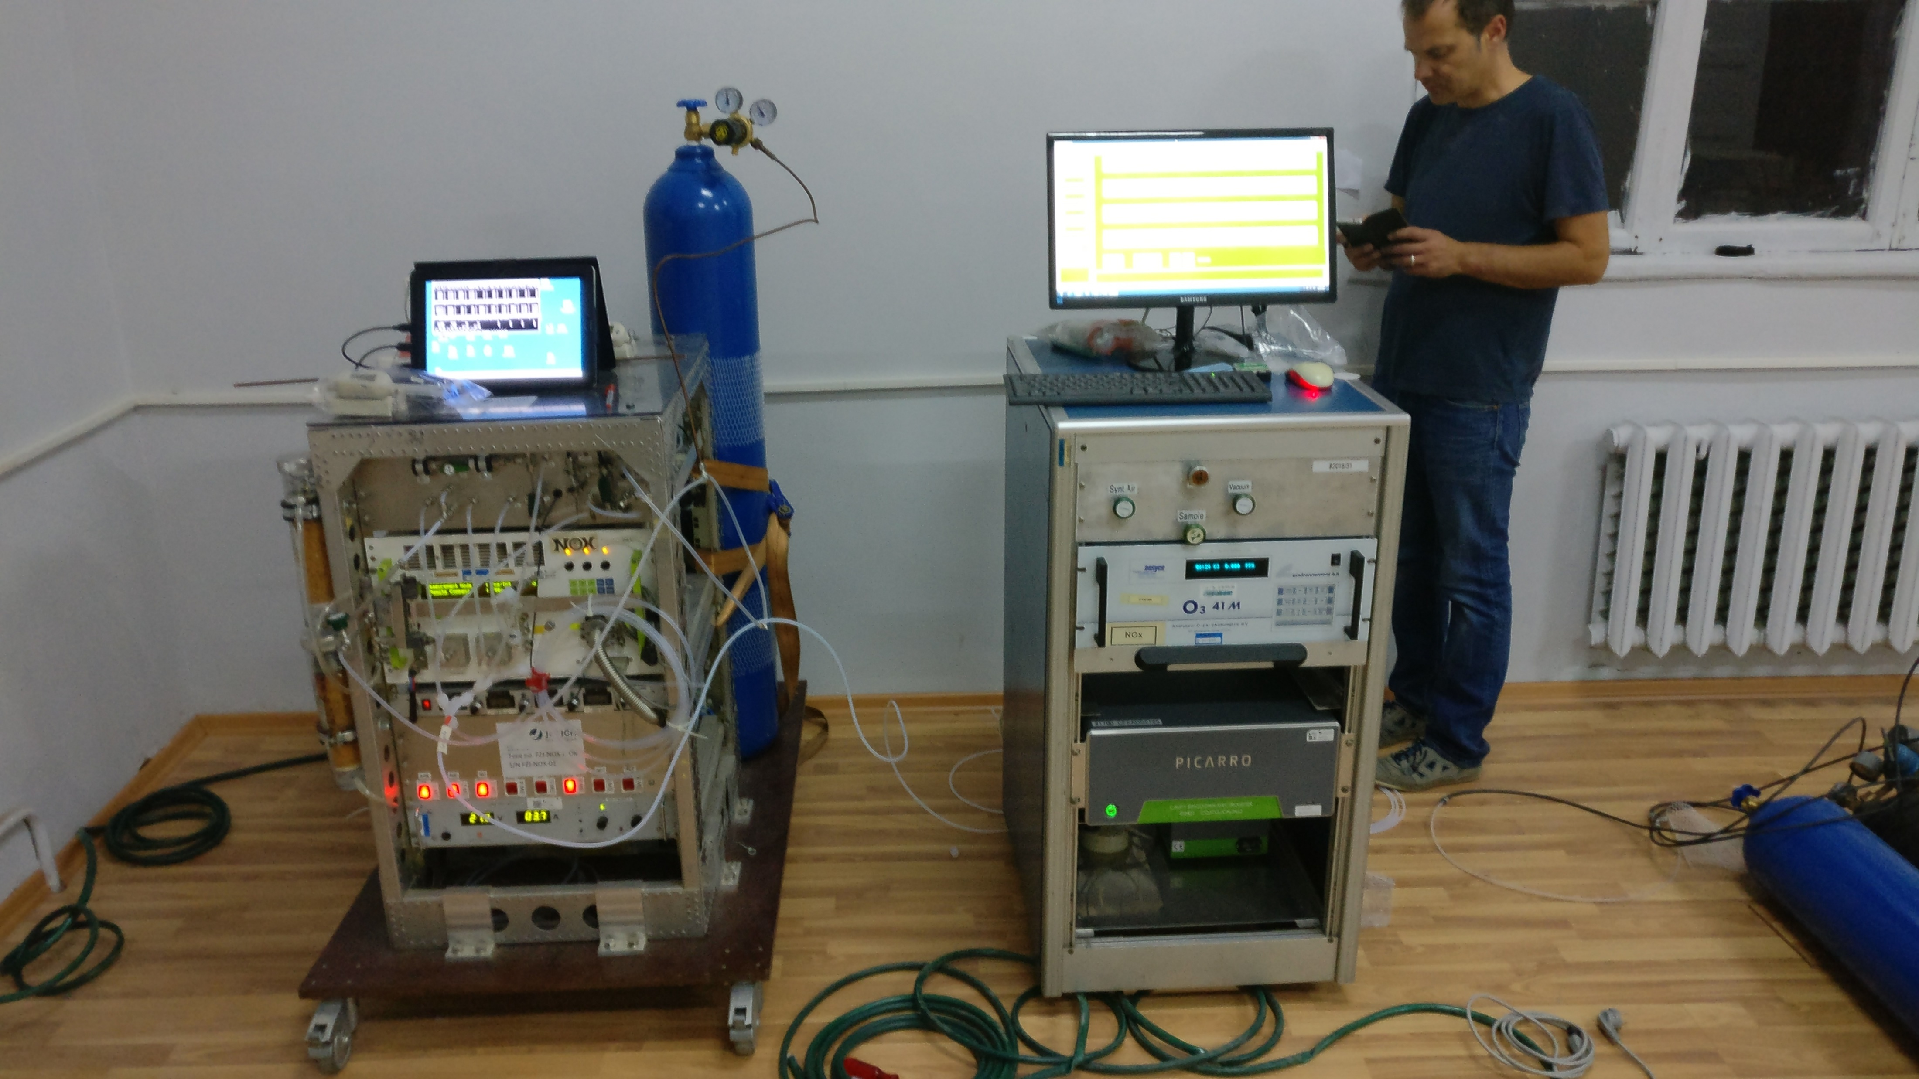
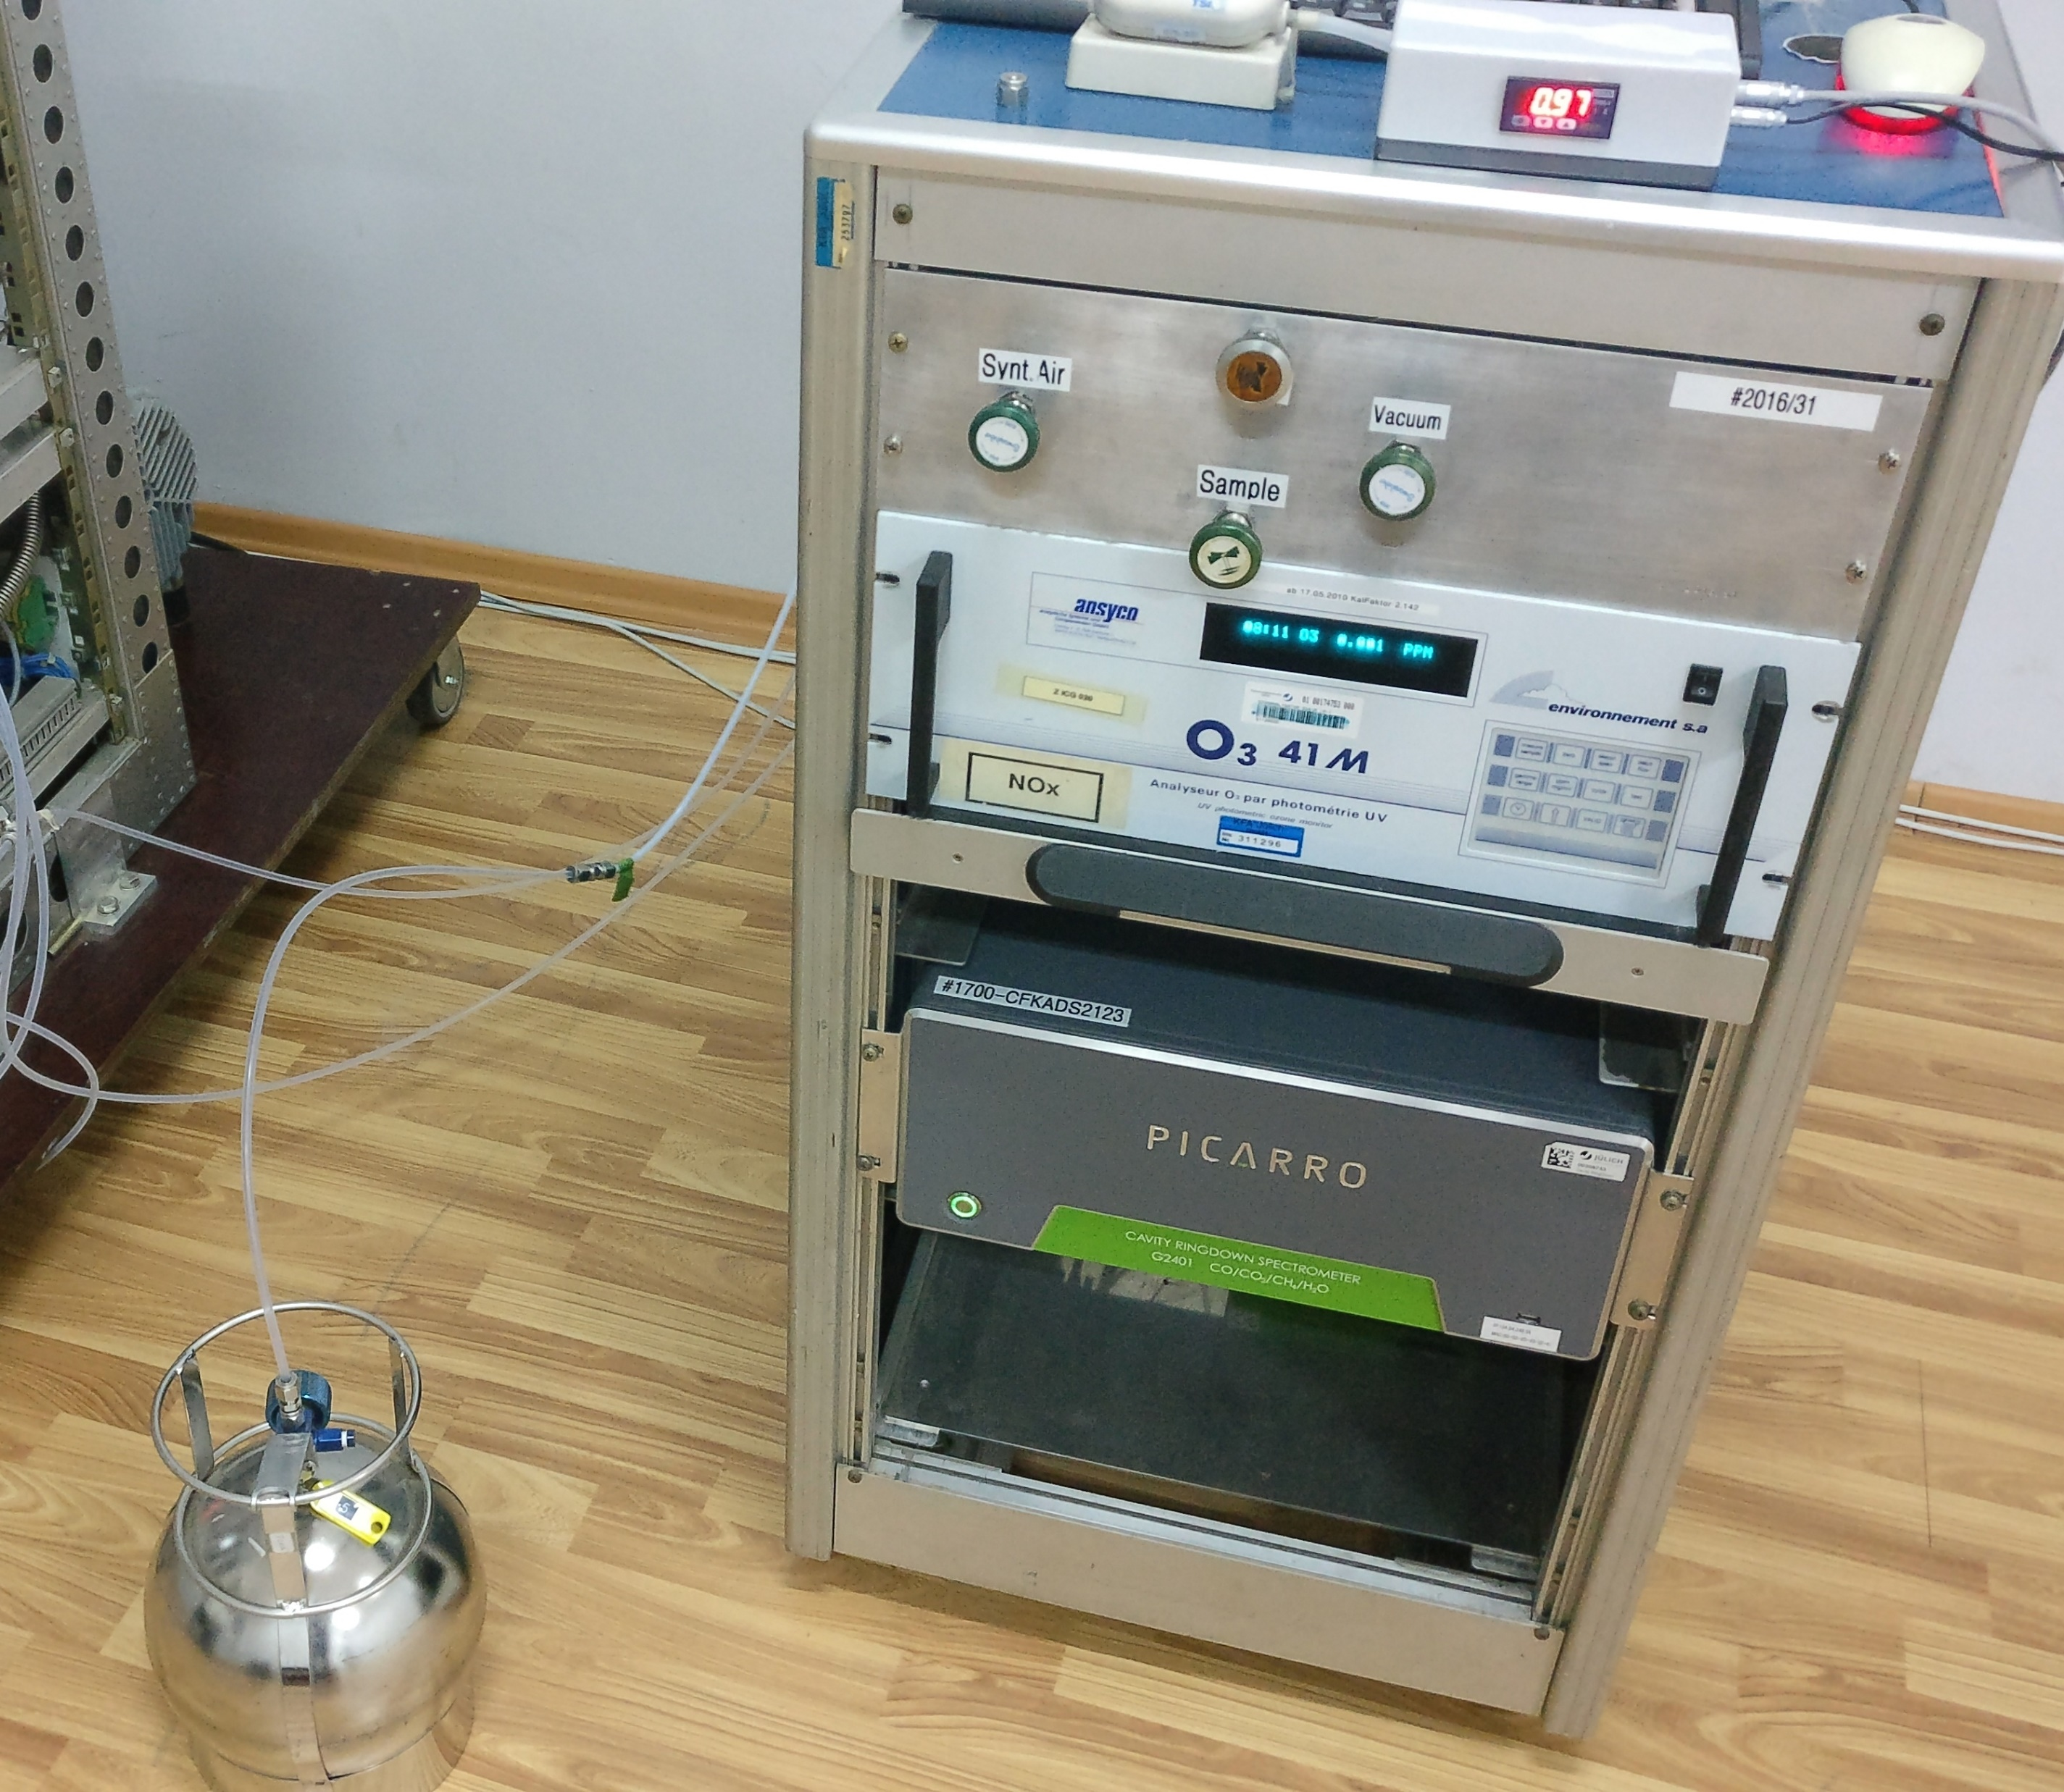

Slide 5
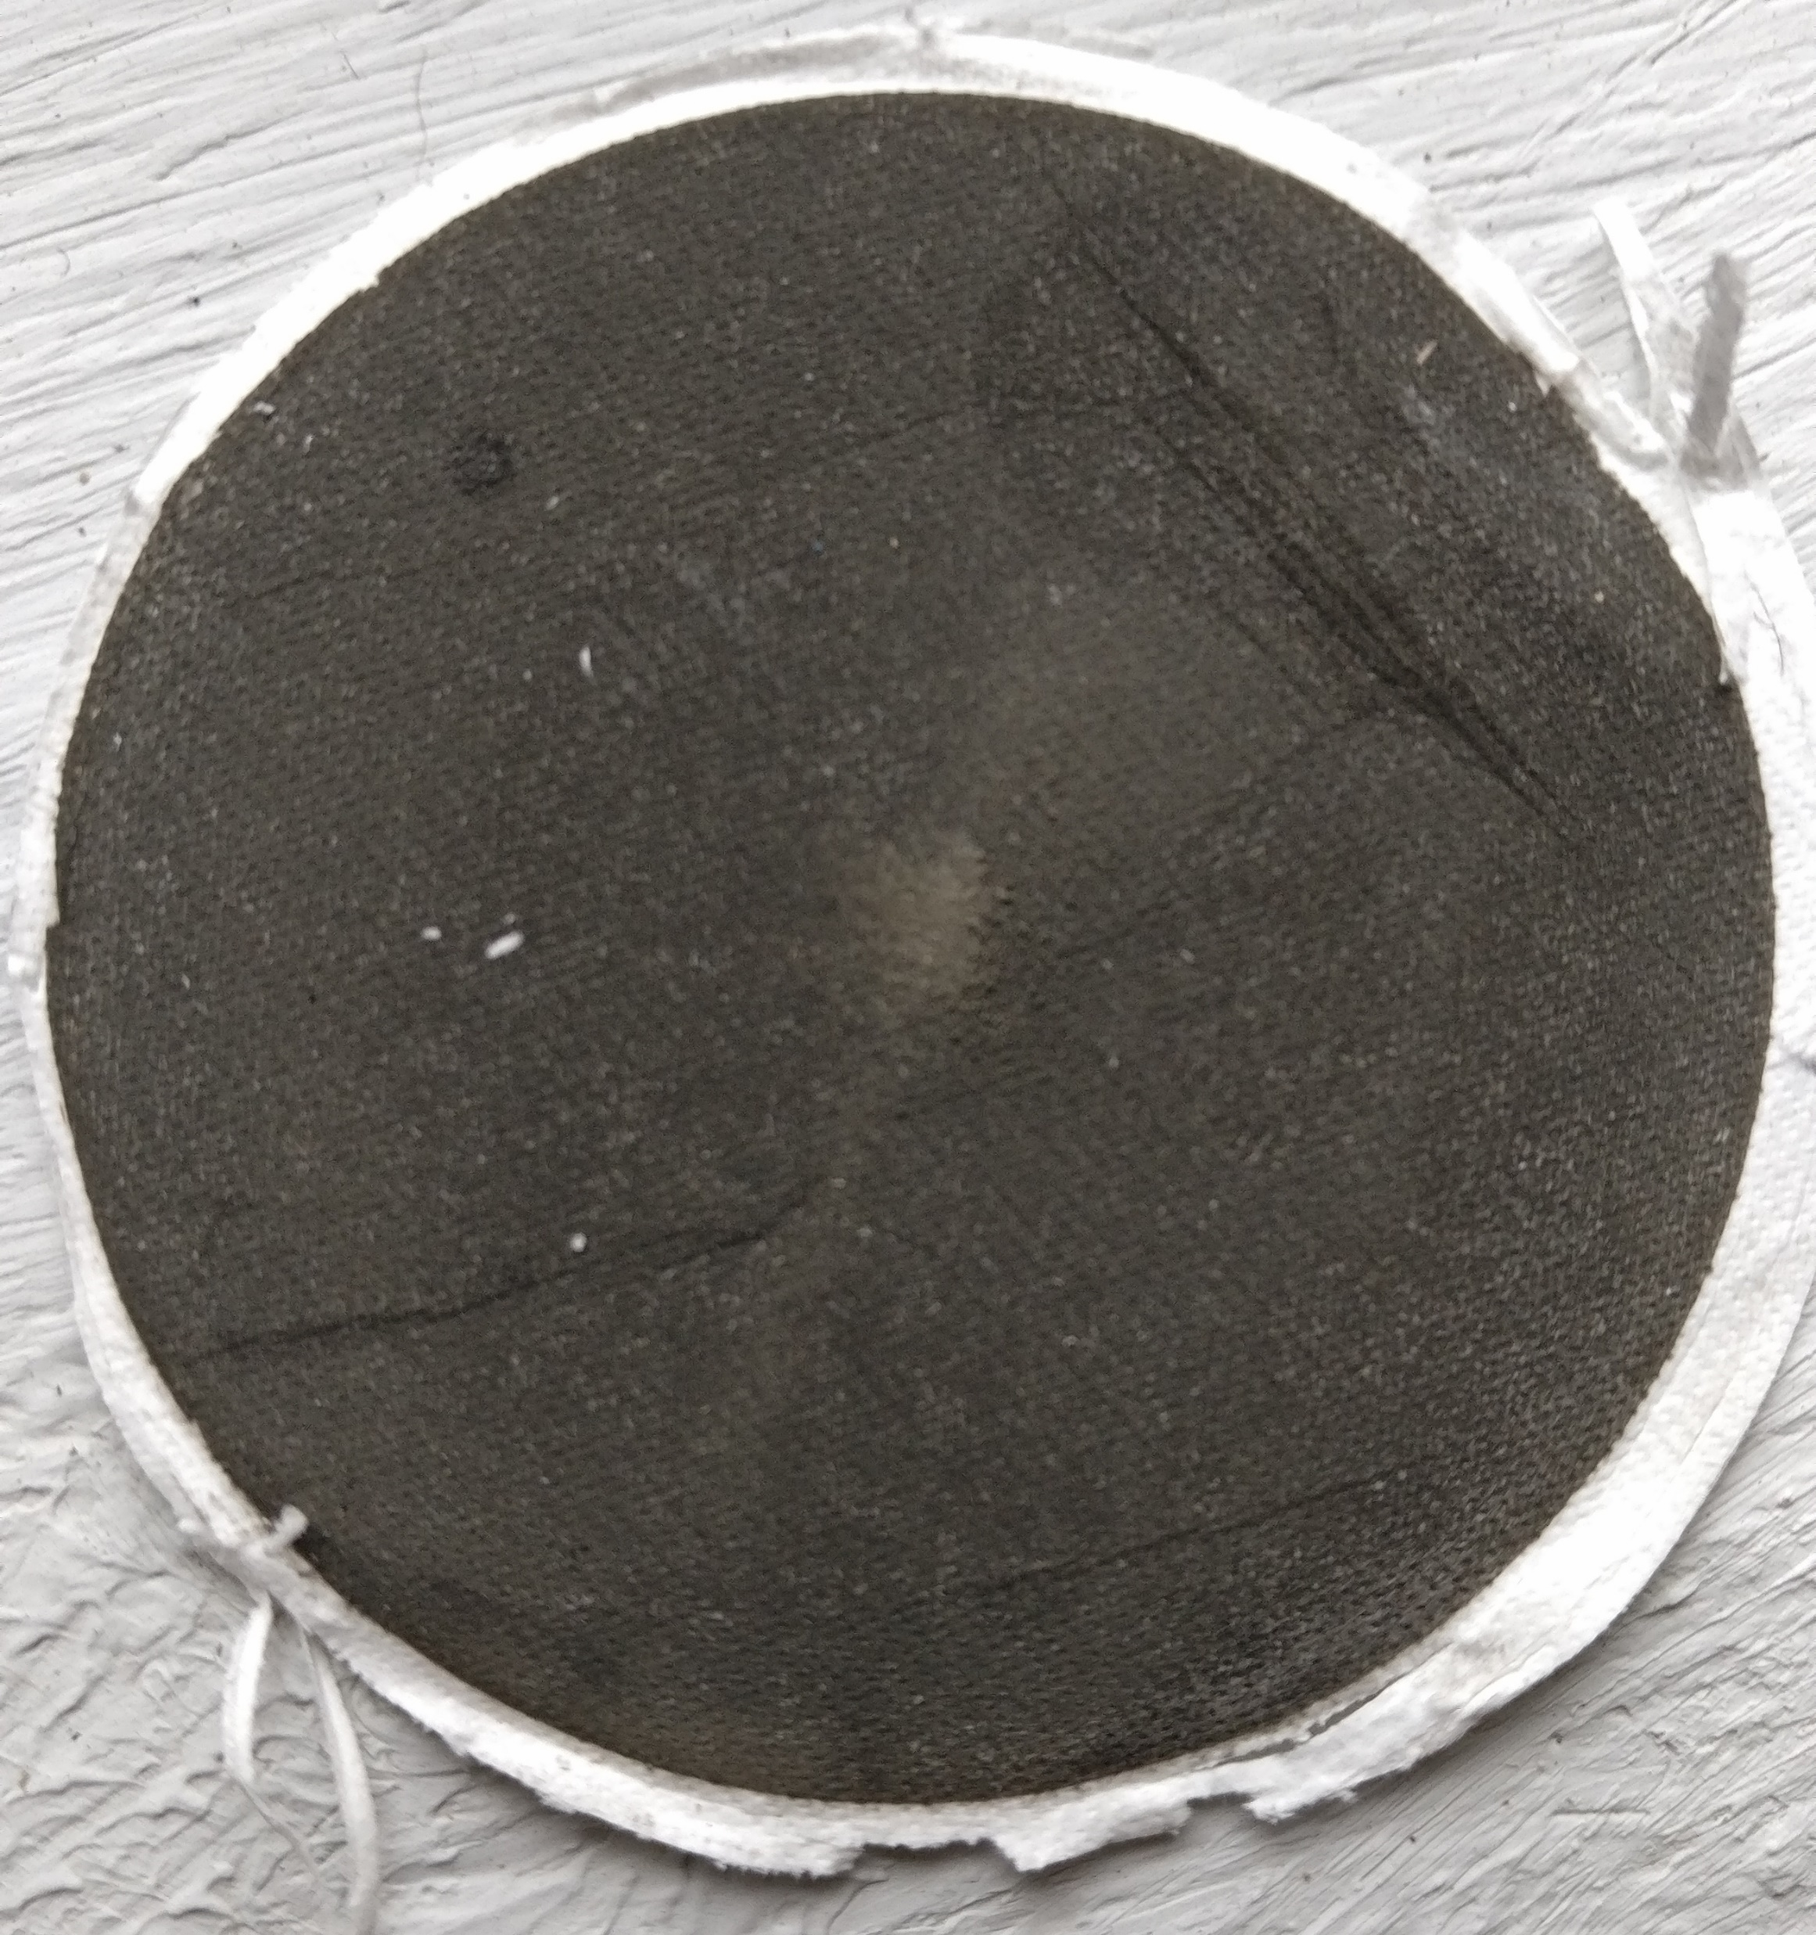
5

Slide 6
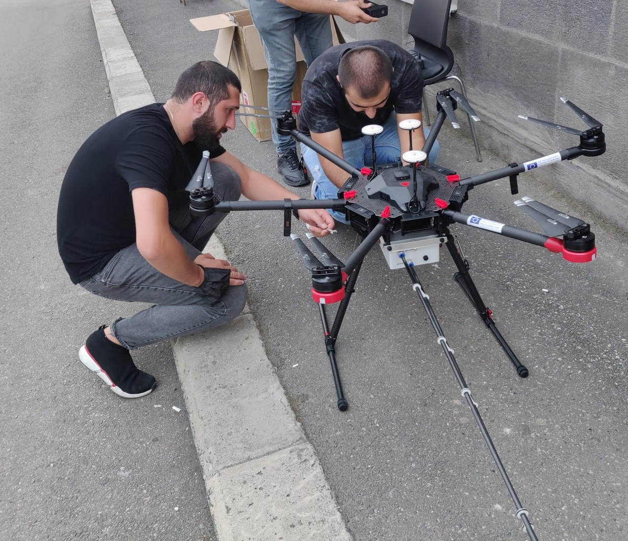
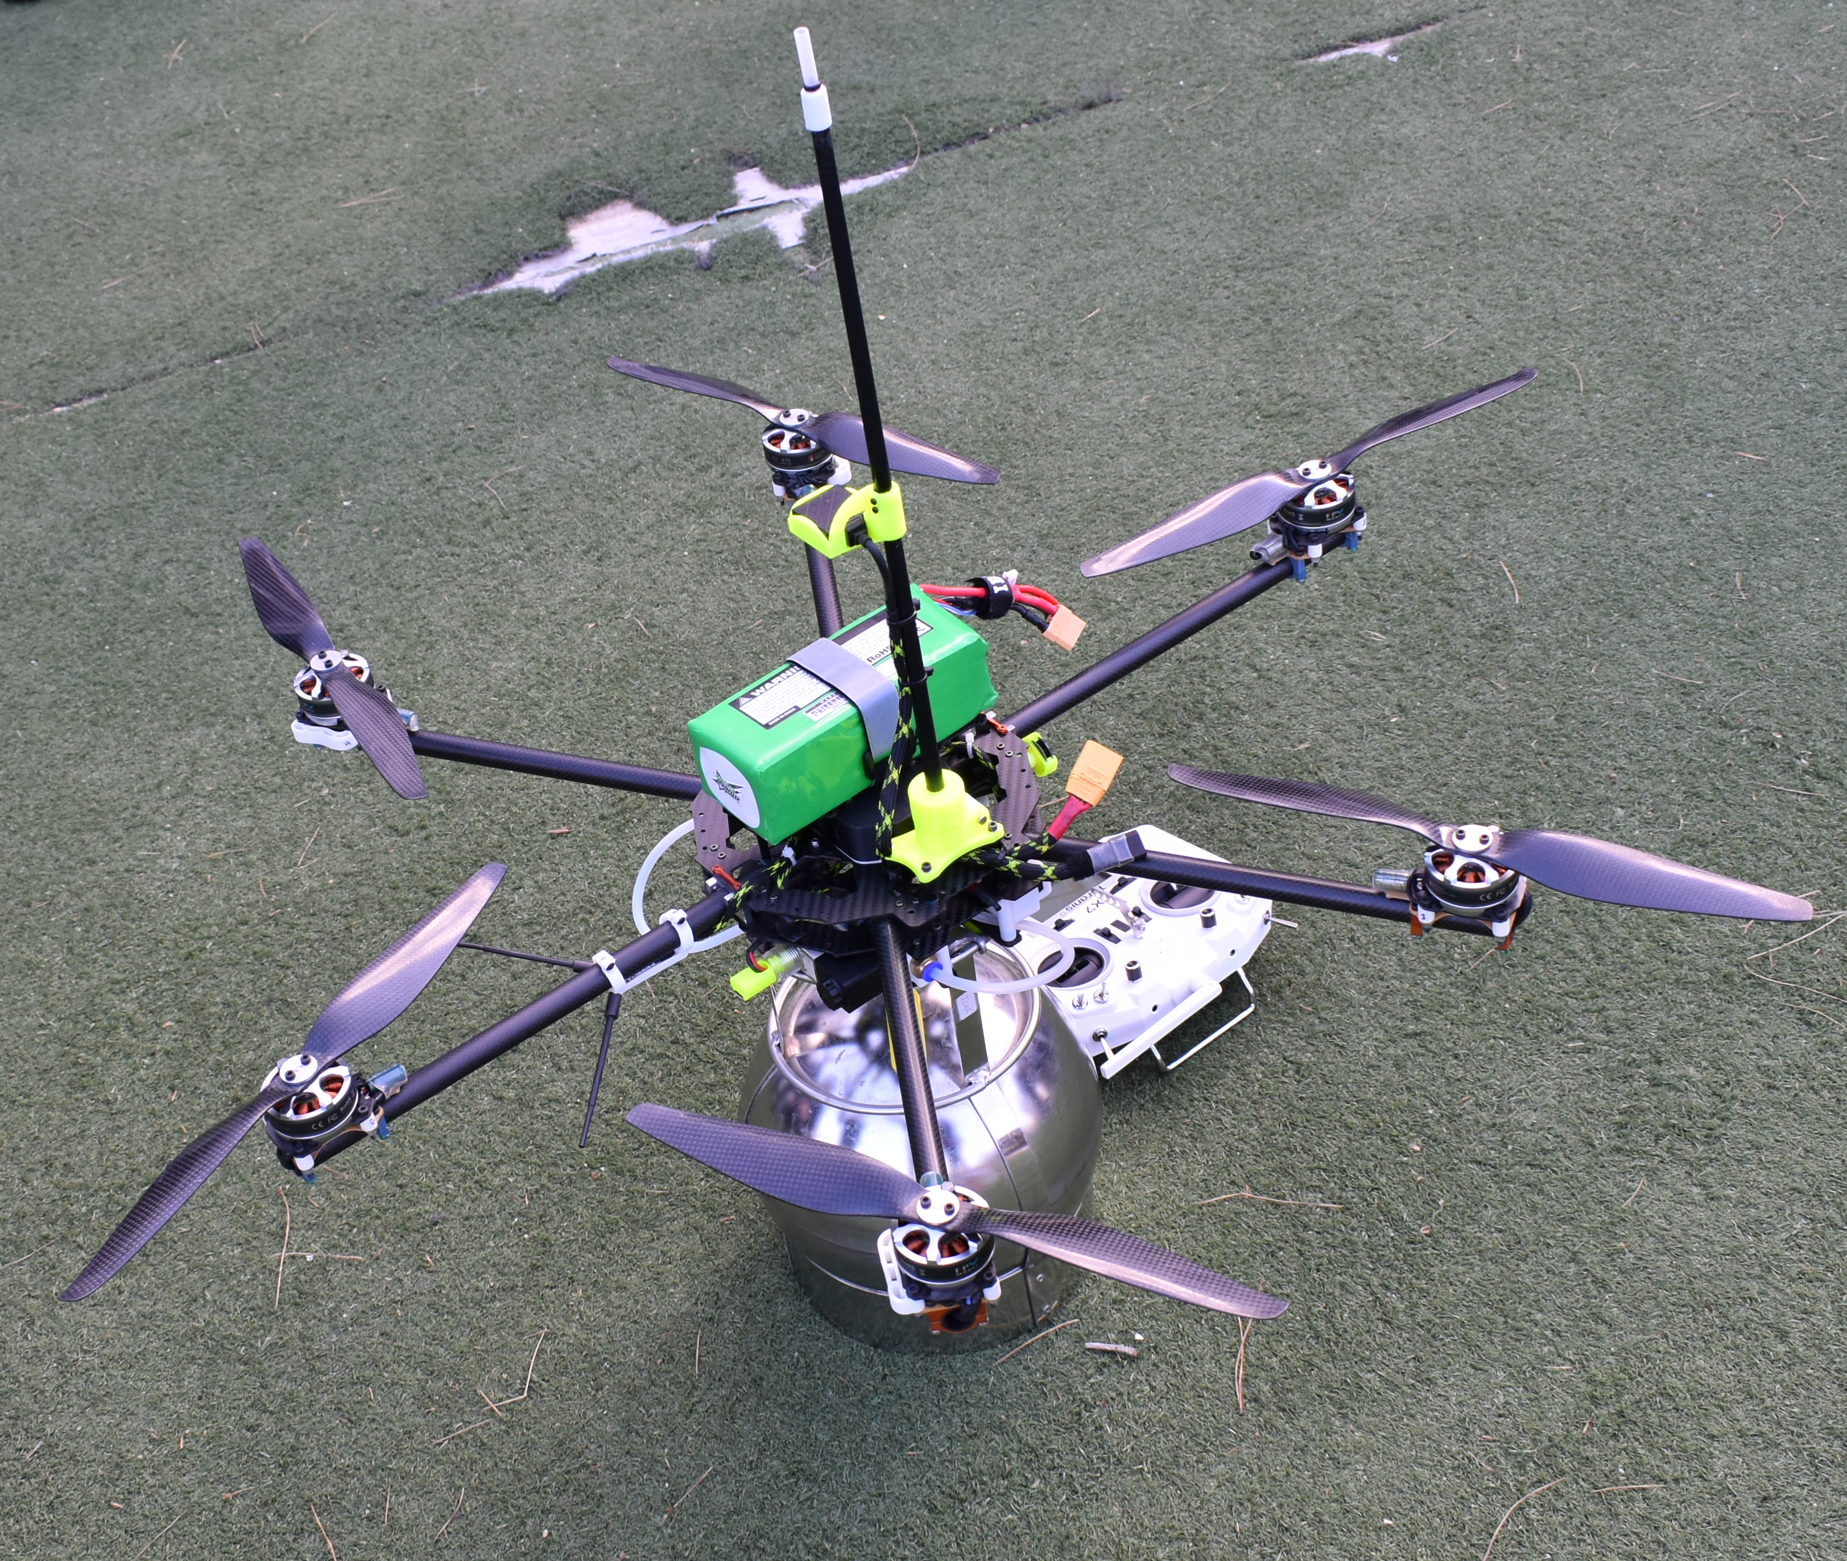
Sensor and UAV platform research
Educational for Drone (eDrone)
574090-EPP-1-2016-1-IT-EPPKA2-CBHE-JP
6

Slide 7
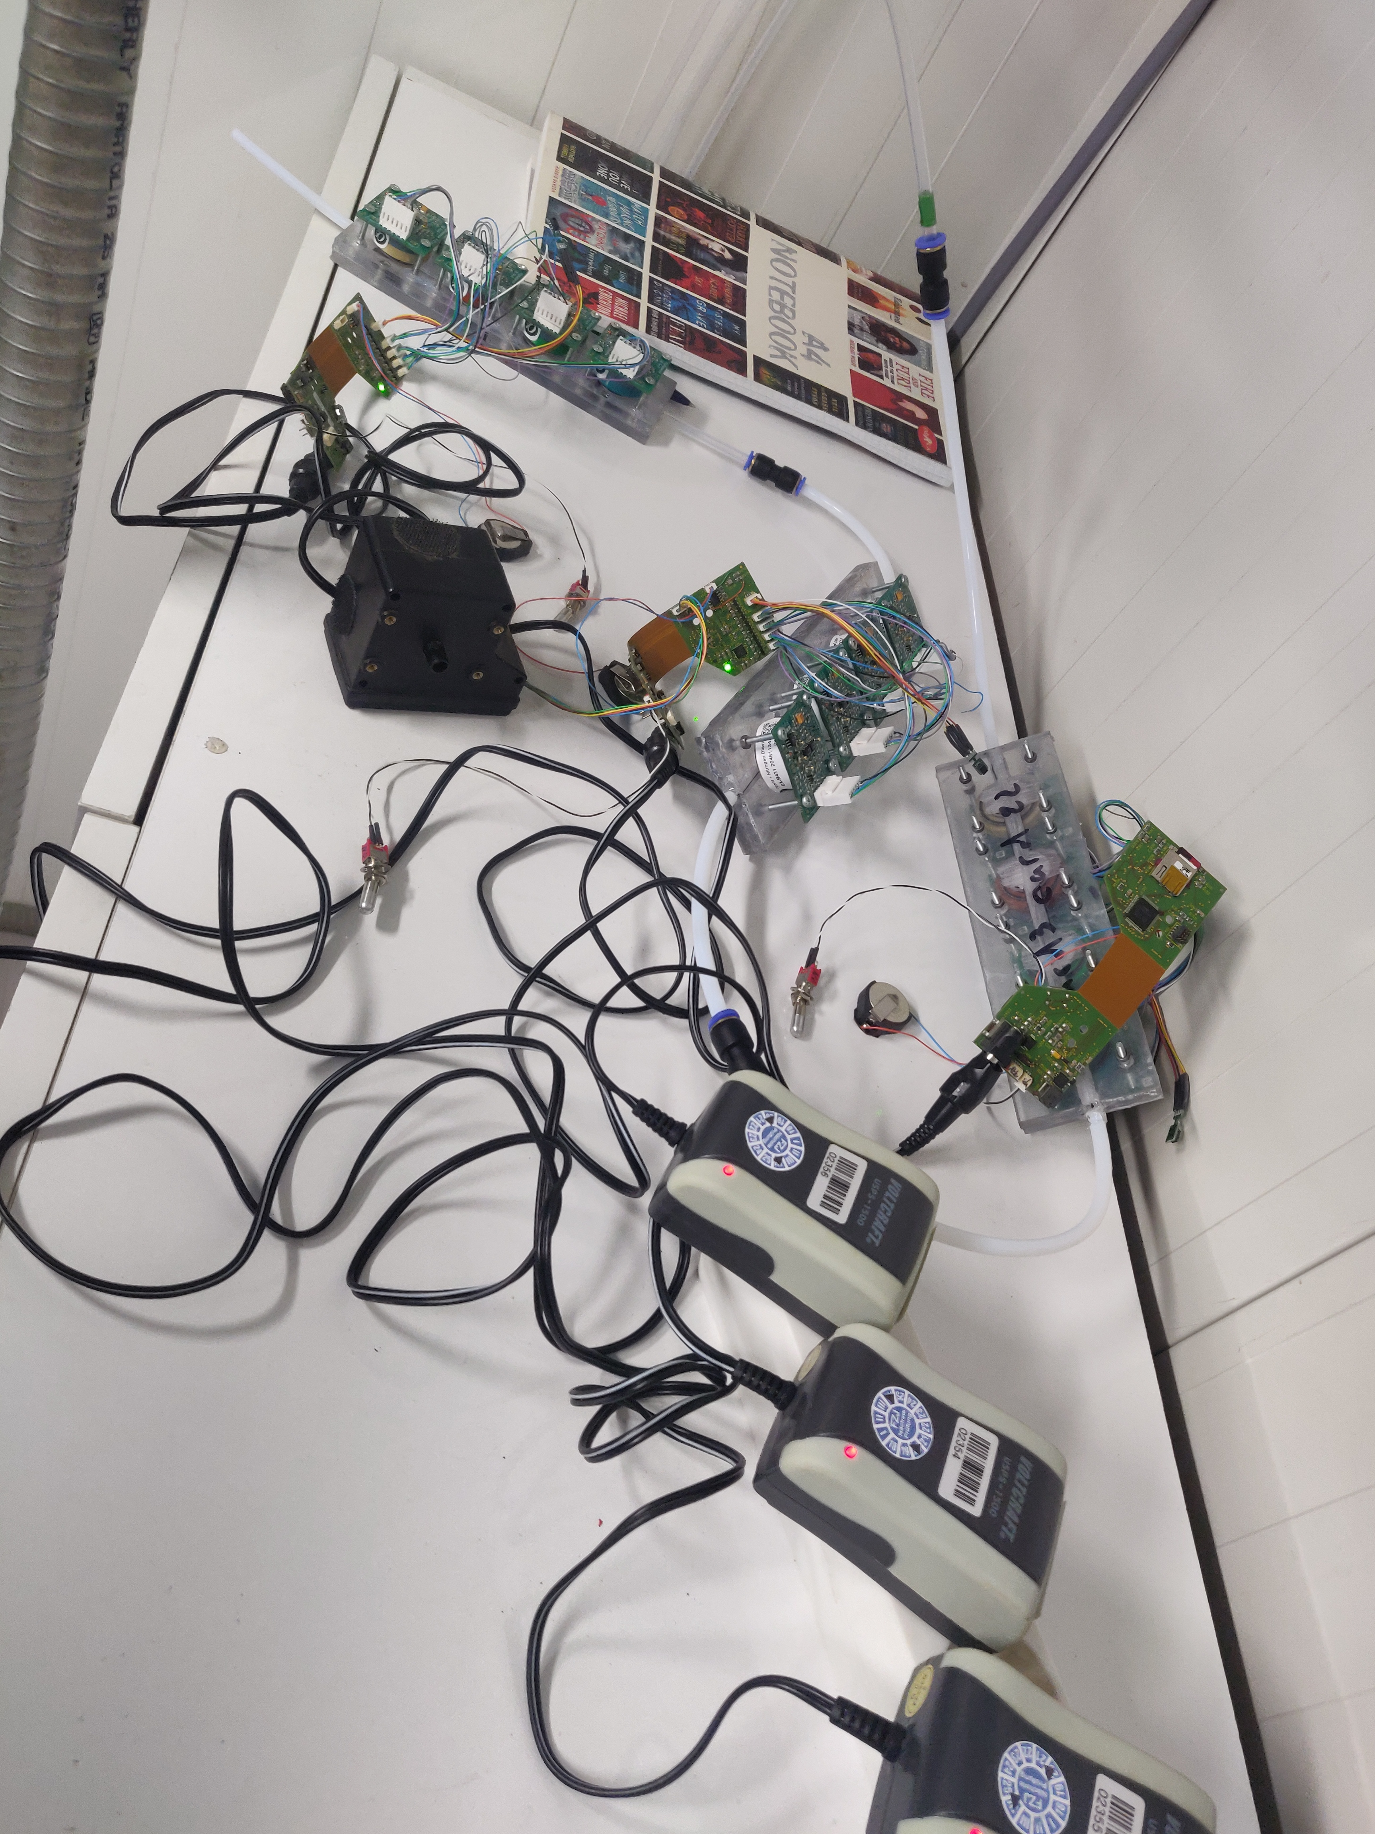
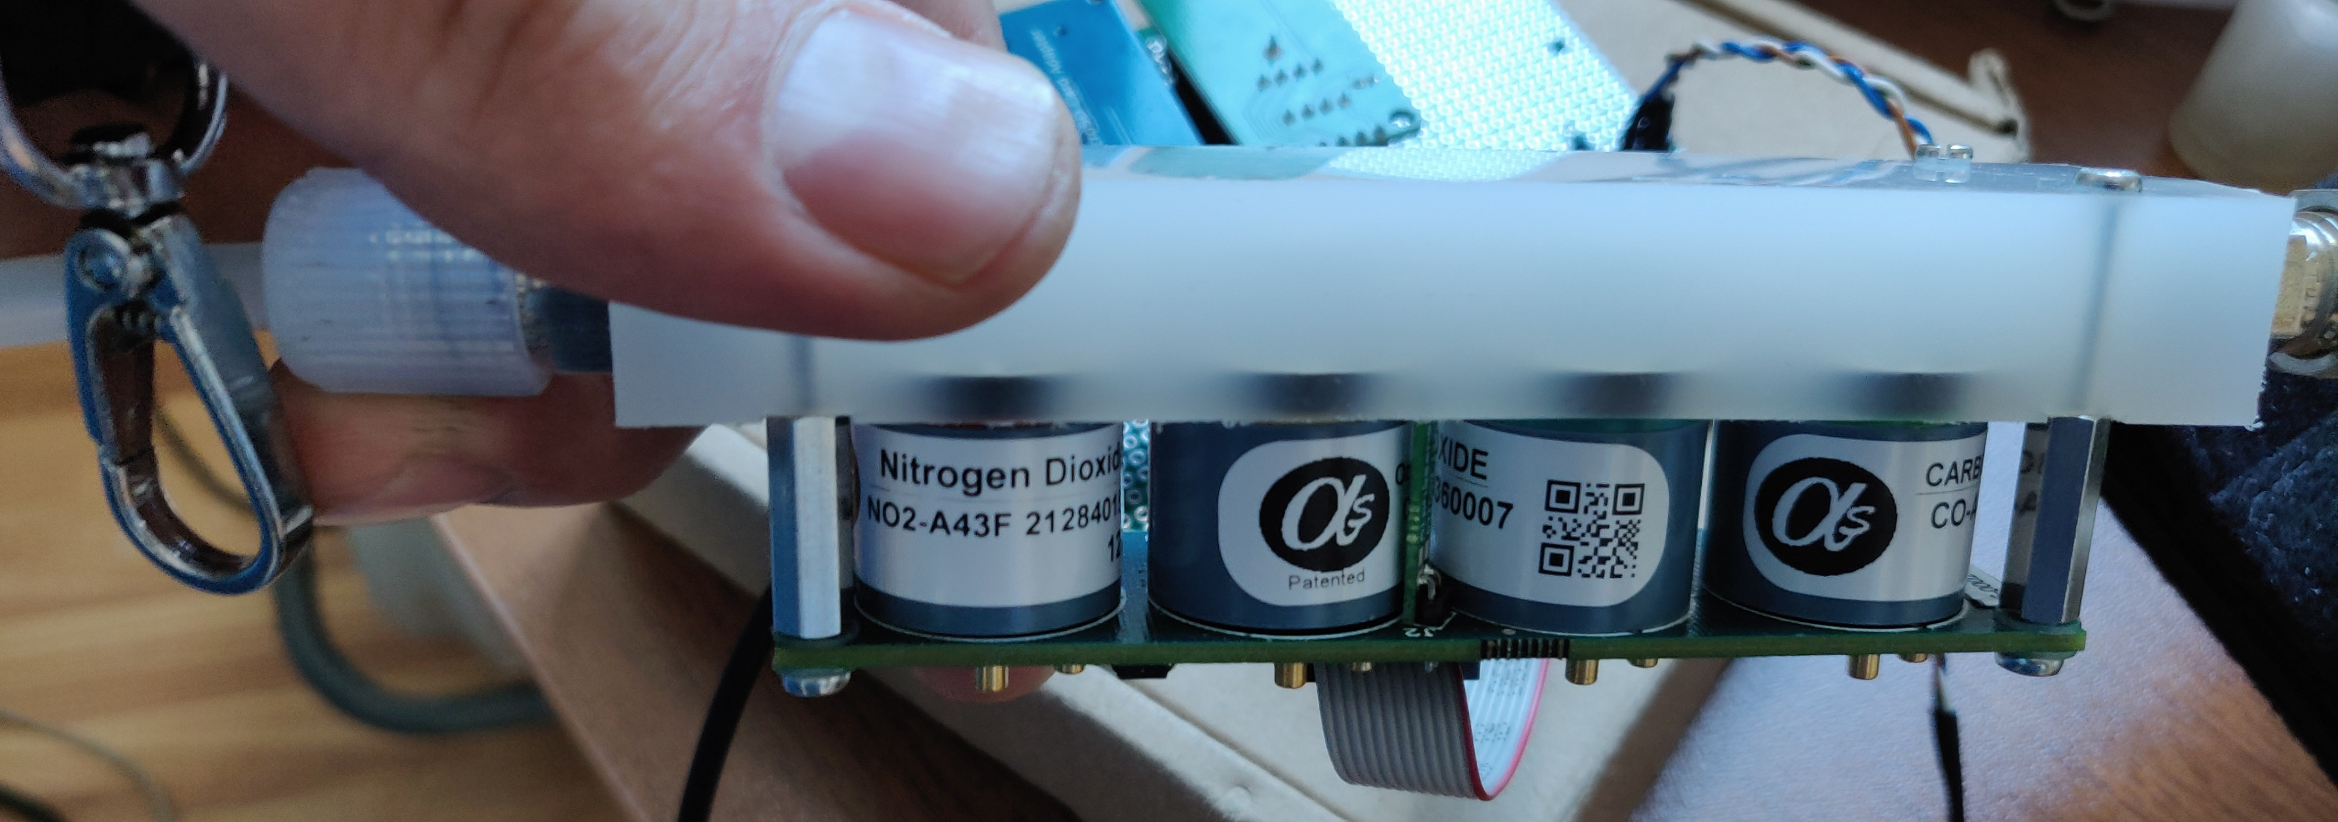
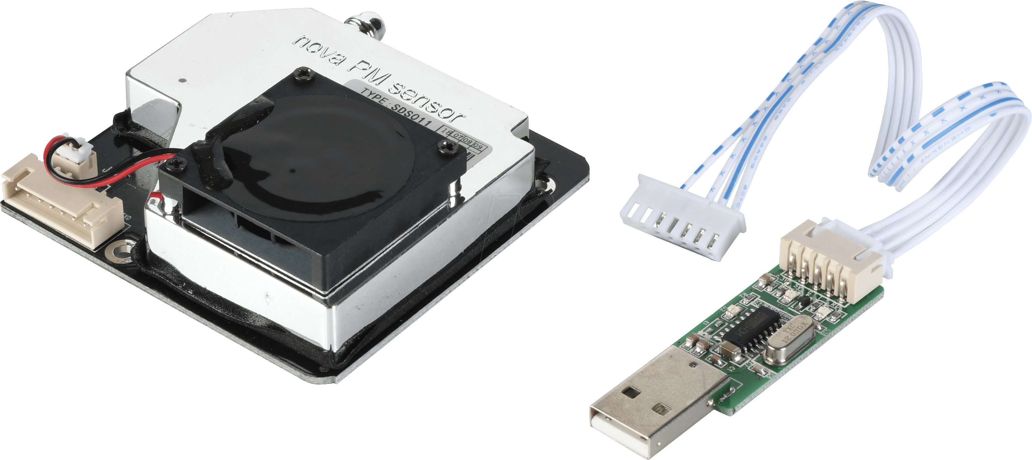
Sensor systems and collaborations
7

Slide 8
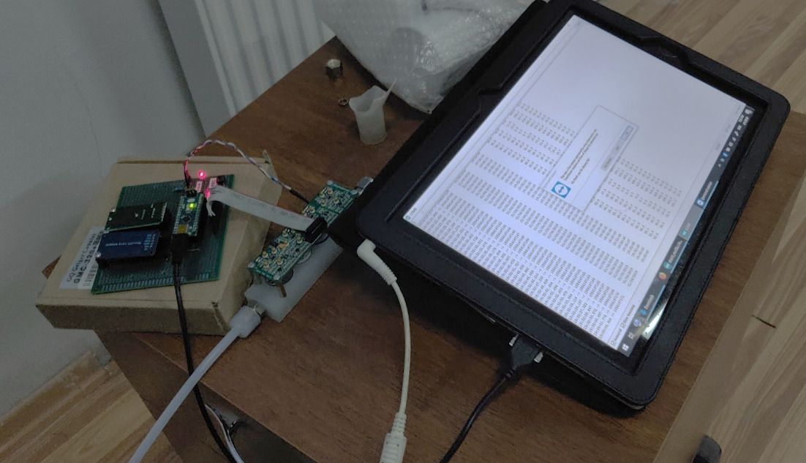
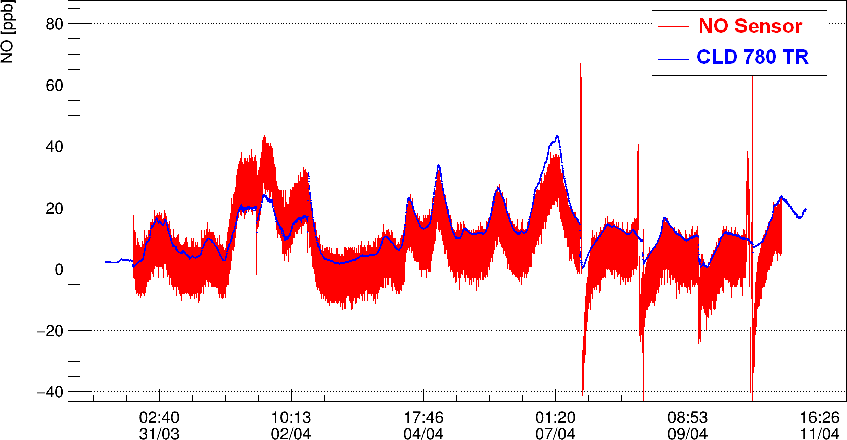
Collaboration with SMART|EDM_LAB
8
Notes:
Sensor data analysis employing machine learning Ramaz Botchorishvili

Slide 9
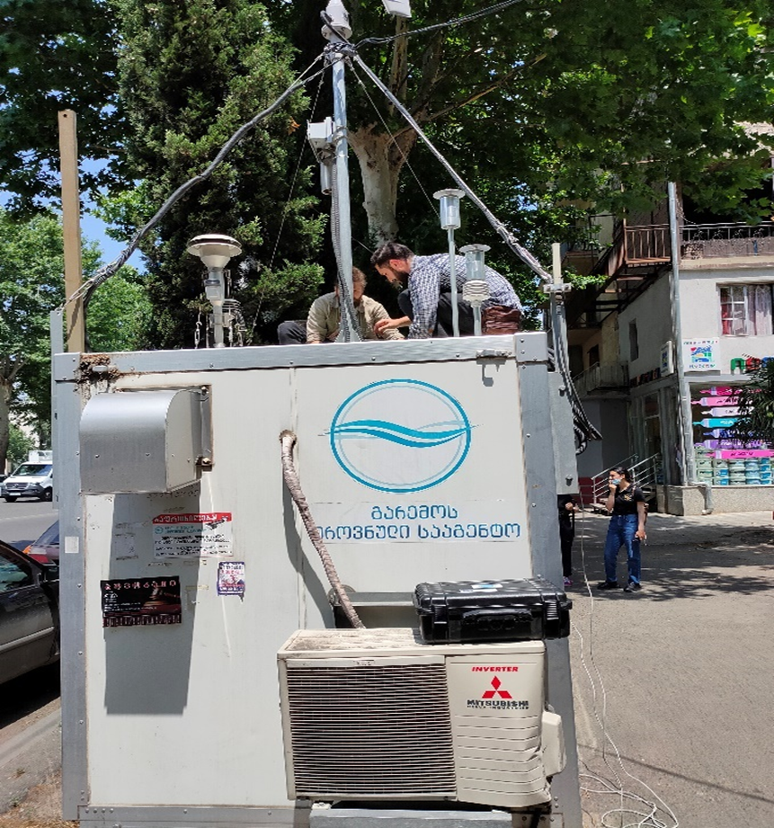
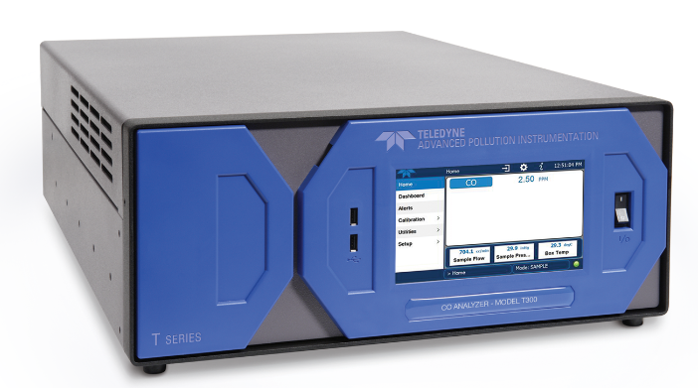
Collaboration with National Environmental Agency
During COVID/building renovation restrictions, we closely collaborated with NEA to test our sensor systems against their online stations
9

Slide 10
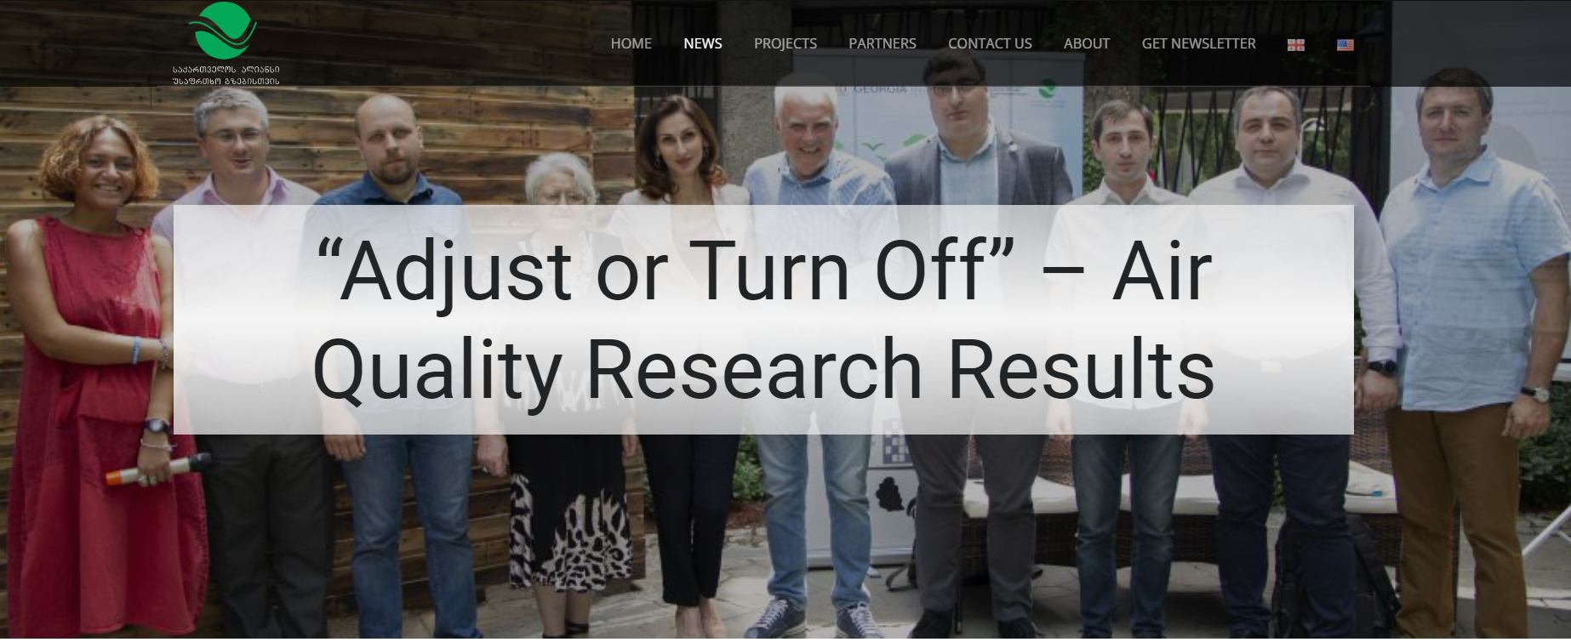
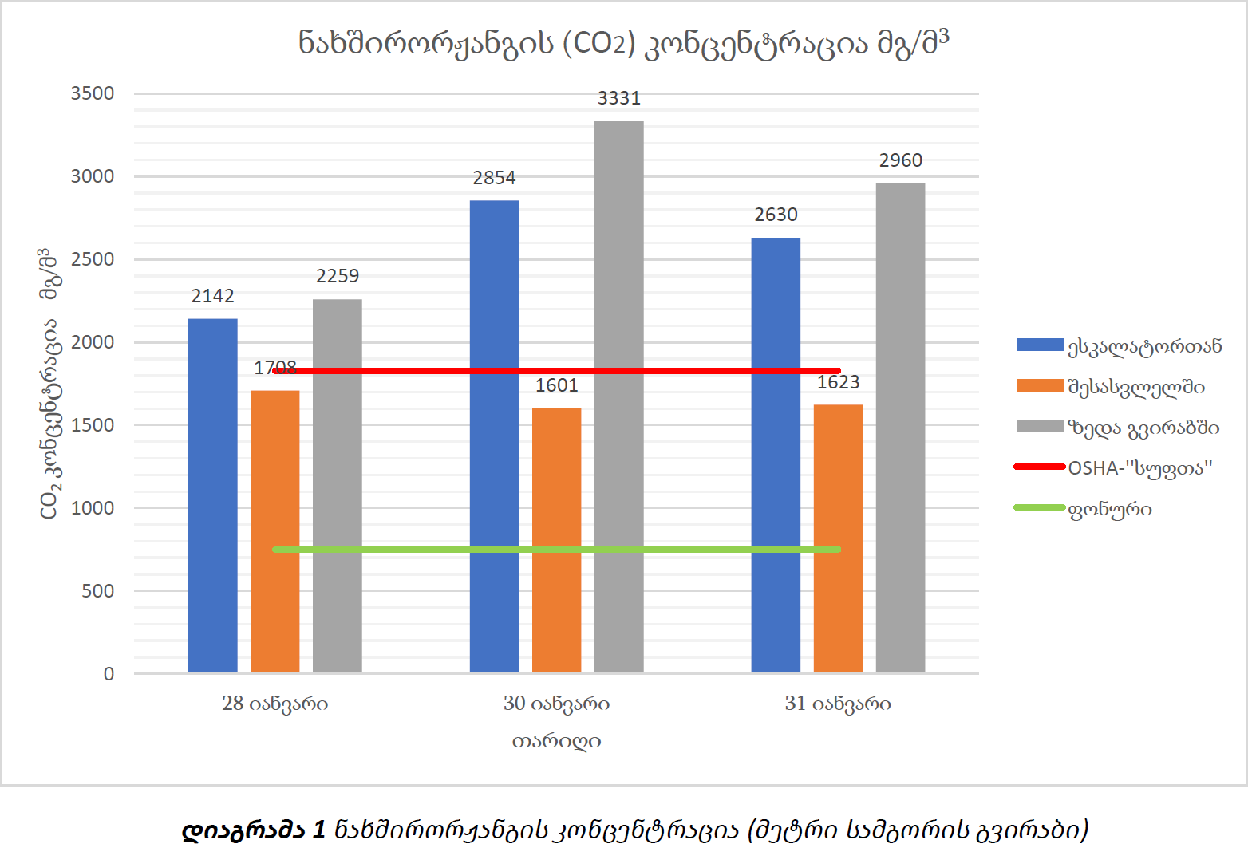
Civil/volunteering and other activities
PM measurements in living/commercial areas
10
Air contamination measurements in subway station

Slide 11
SMART|AtmoSim_LAB’s Contribution to Science and education
(some figures)
2 bachelor and 15 master degree diploma were completed at SMART|AtmoSim_LAB
Up to 35 presentations given at local and international scientific conferences
More than 20 students visited FZJ
1 master diploma was completed at FZJ
1 PhD diploma was completed 2 PhD students are currently working on it at FZJ
Joint workshops/summer schools at TSU
11
Notes:
Future outlook:
Prolonging project
Smart Sensors
Financial sources for permanent/semi permanent staff

Slide 12
Thank you for your attention

