Slide 1
Identification and comparative characterization of endogenous growth factor in human nerve cell transformed in different ways
Ivane Javakhishvili Tbilisi State University
George Aleksanashvili
Aleksandre Kordzadze
Levan Rusishvili
Aslan Germanishvili
Tbilisi; 2022

Slide 2
Cell proliferation
Cell proliferation is process that results in an increase of the number of cells.
Proliferation is initiated by cell membrane receptors getting signals from various mitogens and transferring them intracellularly via growth factors.
One of the many endogenic factors is identified in various organs of rats, so called thermostable protein complex which has calmodulin as an active precursor.
Notes:
Cell proliferation is the process that results in an increase of the number of cells. This process has been a matter of research for many years and still continues to be so. One of the many reasons for that is that damage to the regulation of cell proliferation can cause many illnesses counting oncological diseases.
Proliferation is initiated by cell membrane receptors getting signals from various mitogens and transducting that signal intracellularly via chemicals called growth factors which are coded by regulatory genes and can act as stimulators or inhibitors.
One of the many endogenic factors is identified in various organs of rats, so called thermostable protein complex which has calmodulin as an active precursor. This complex inhibits the proliferation of homologous cells due to inhibition of the transcription process.

Slide 3
Thermostable protein complex. What is known about that?
Thermostable protein complex which has calmodulin as an active precursor.
Thermostable protein complex inhibits the proliferation of homologous cells due to inhibition of the transcription process.
Intraperitoneal injection of an endogenous protein complex isolated from the brain tissue of adult rats has been shown to inhibit cell proliferation in various tissues of adolescent rats.
Notes:
Intraperitoneal injection of an endogenous protein complex isolated from the brain tissue of adult rats has been shown to inhibit cell proliferation in various tissues of adolescent rats.
Before using abovementioned proteins for therapeutic purposes, we need to determine their effectiveness not only with normal, but with tumorous tissues too.

Slide 4
Goal
Identification of endogenic growth factor inhibitor in different type of human brain tumor cells and its comparative characterization.
Notes:
Therefore, we made our goal...

Slide 5
Study objects and materials
The liver, brain and kidney tissues of adolescent rats.
The brain of adult rats.
Post-operative material of human brain tumor tissues.

Slide 6
Study methods
Surgical treatment
Extraction with alcohol of thermostable protein complex
Native electrophoresis of proteins in polyacrylamide gel
Staining gel with silver nitrate
Determination of mitotic index
Statistical processing of data
Preparation of hystological slides

Slide 7
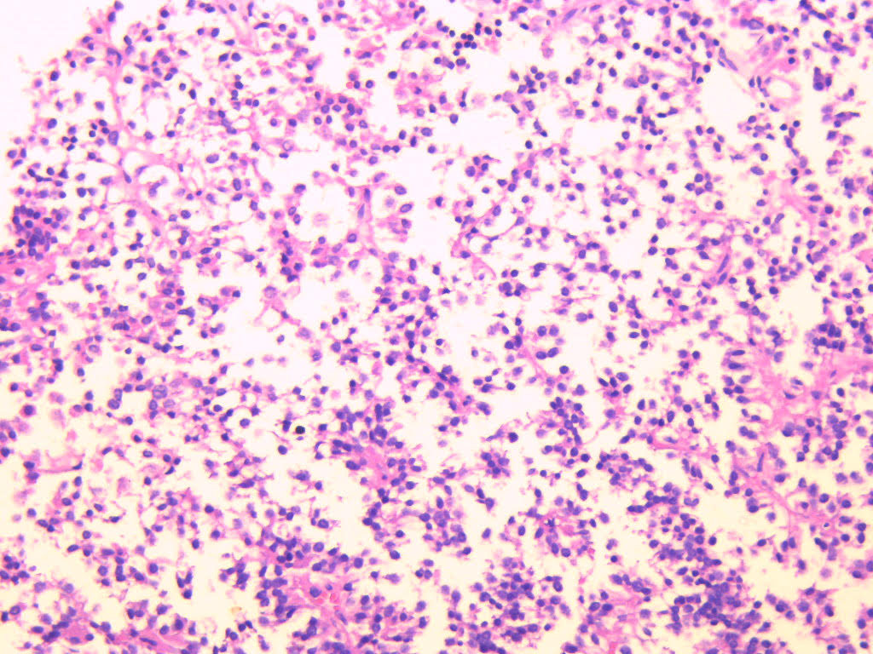
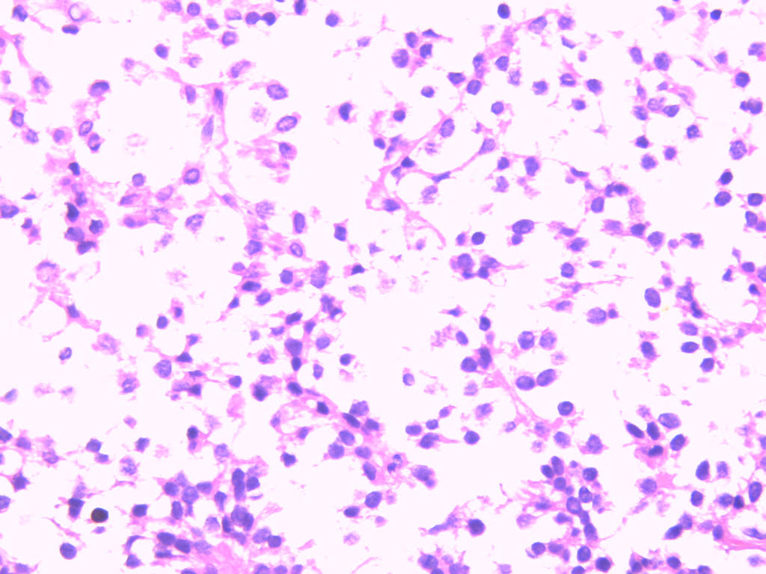
Human pituitary adenoma
Pituitary adenoma – Hematoxylin-eosin staining 10x300
Pituitary adenoma – Hematoxylin-eosin staining 10x400
Notes:
For this study were used two tumorous tissues. The first one as we can see is pituitary adenoma. We can see on the histological slide perivascularly located monomorphic cellular structures and couple of hyperemic changes.

Slide 8
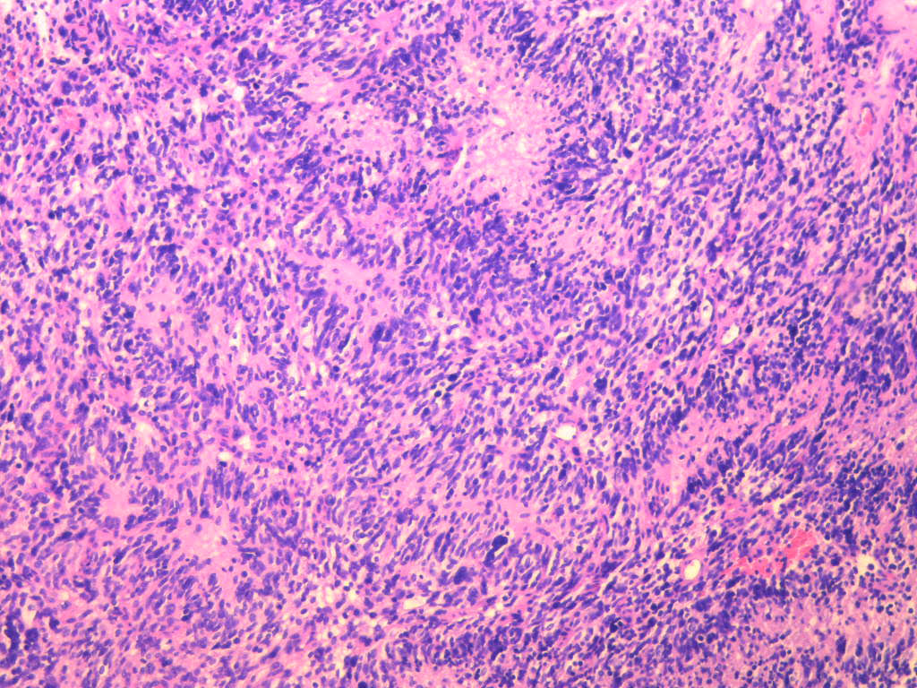
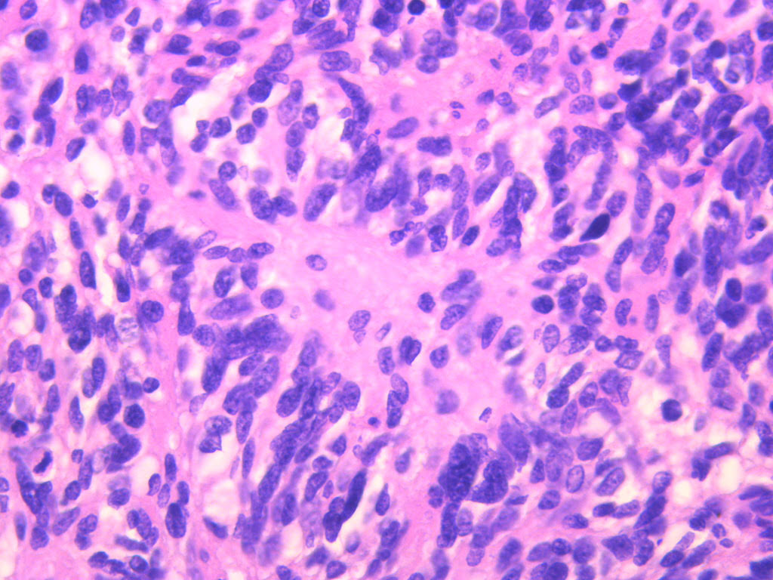
Human glioblastoma
Fig. A. Glyoblastoma – Hematoxylin-eosin staining 10x150
Fig. B. Glyoblastoma – Hematoxylin-eosin staining 10x400
Notes:
This tissue is composed of highly polymorphic cells, proliferative blood vessels and areas of necrosis so this histo-morphological picture fully matches with glioblastoma. It was used as a second specimen. It is worth mentioning the main difference between these two tumors, adenoma is benign and glioblastoma is malignant.

Slide 9
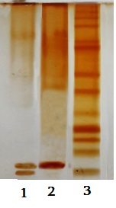
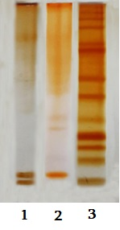
Electrophoretic analysis of a thermostable protein complex in polyacrylamide gel
A.
Protein complex extracted from adult rat brain;
Protein complex extracted from glioblastoma;
Marker proteins
B.
Protein complex extracted from adult rat brain;
Protein complex extracted from pituitary adenoma;
Marker proteins
Notes:
We used polyacrylamide gel electrophoresis method to evaluate the components included in thermostable protein complexes isolated from benign (adenoma) and malignant (glioblastoma) tumor cells by alcohol extraction. As a control, we used a protein complex obtained by a similar method from the brain tissue of intact rats. Through comparative analysis, it was revealed that the complex of thermostable proteins of patients diagnosed with glioblastoma, like the complex of intact rat brain, contains two subfractions of proteins: relatively high molecular weight (20-120kD) and low molecular weight subfractions (12-17kD). At the same time, it was revealed that the low-molecular subfraction is present in a major amount in malignant tumor cells. We observed same result in adenoma with high and low molecular weight subfractions but with main difference, the active precursor was in minor quantity.

Slide 10
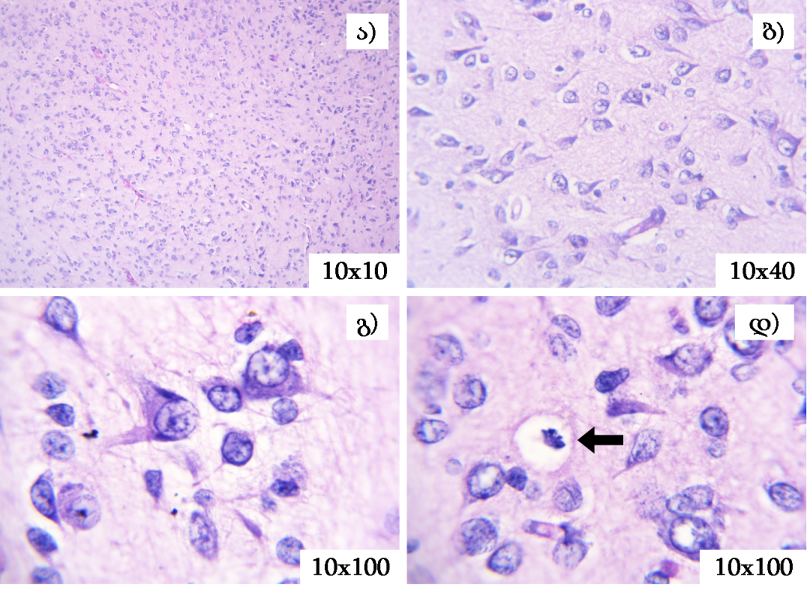
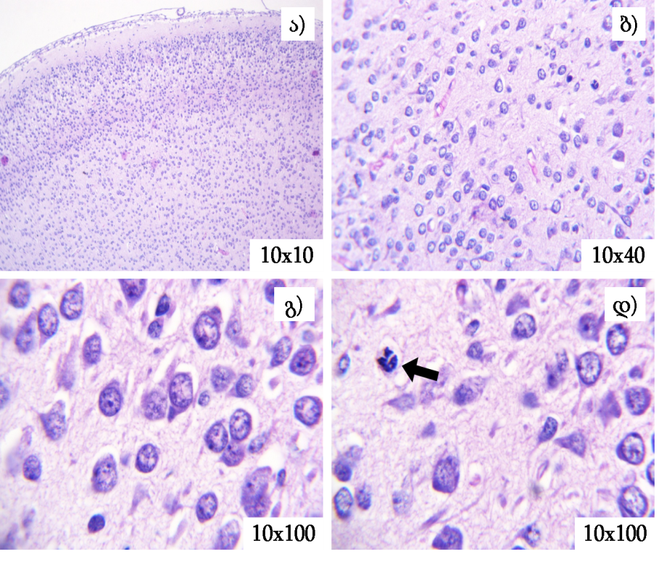
Adolescent white rat brain histoarchitectonics after injecting TPC* of glioblastoma
1
2
1
2
3
4
3
4
Control group; Hematoxylin-eosin staining
Test group; Hematoxylin-eosin staining
TPC*- Thermostable protein complex
Notes:
At the initial stage of the research, we studied the effect of the complex of thermostable proteins obtained from human tumor cells diagnosed with glioblastoma on the histoarchitectonic and the mitotic activity of liver, brain and kidney cells of 7-day-old intact rats.

Slide 11
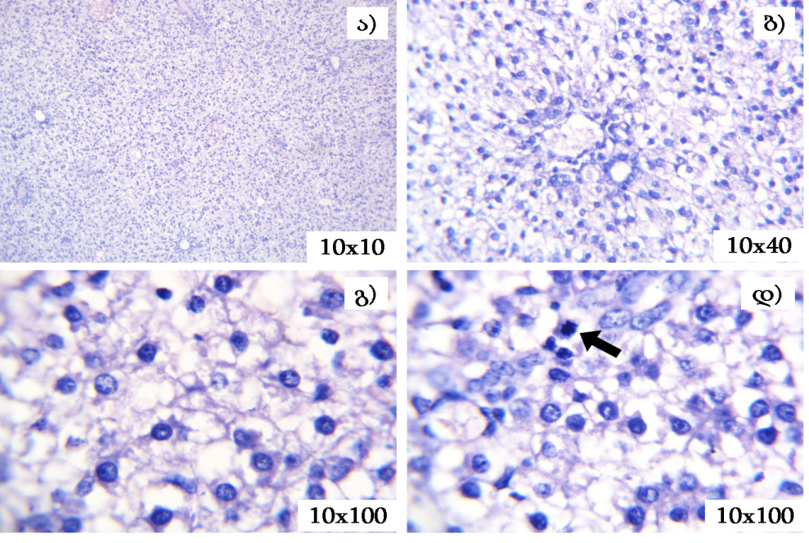
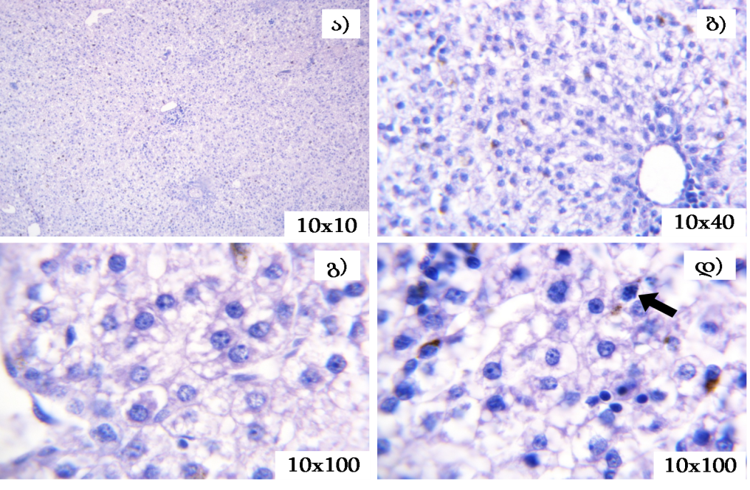
Adolescent white rat liver histoarchitectonics after injecting TPC of glioblastoma
1
2
1
2
3
4
3
4
Control group; Hematoxylin-eosin staining
Test group; Hematoxylin-eosin staining

Slide 12
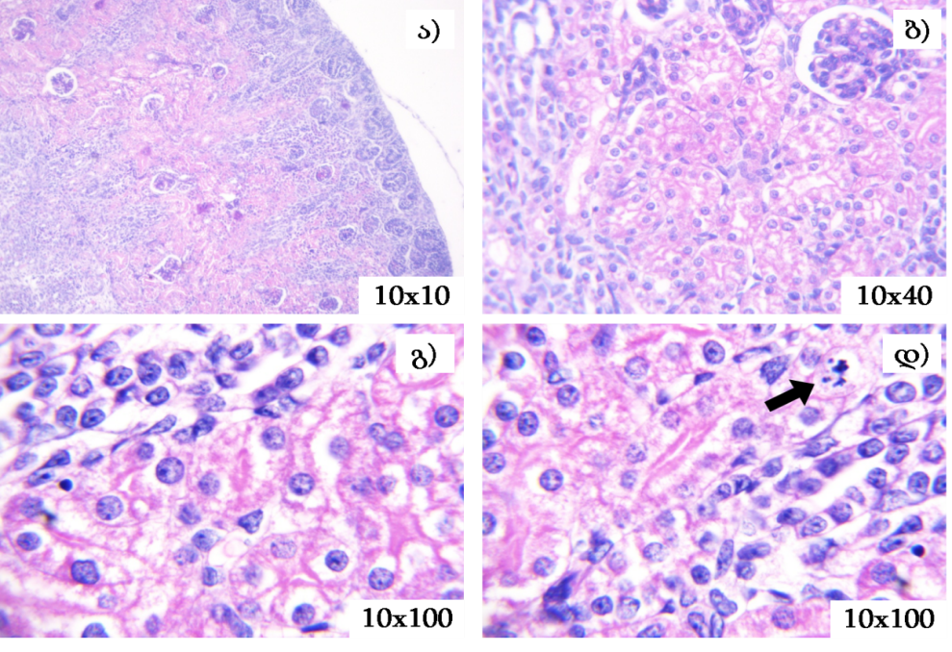
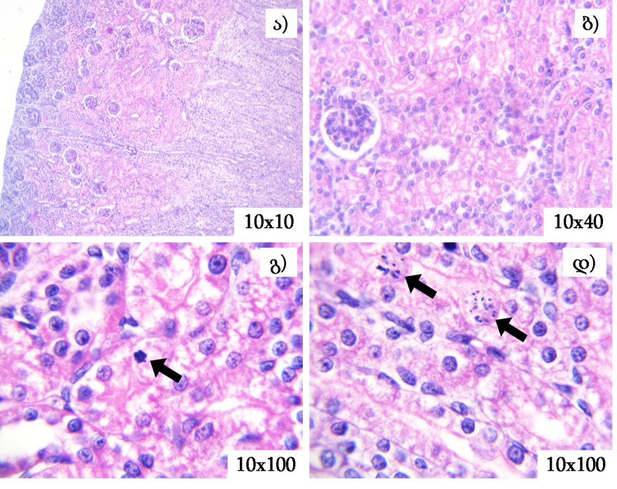
Adolescent white rat kidney histoarchitectonics after injecting TPC of glioblastoma
1
2
1
2
3
4
3
4
Control group; Hematoxylin-eosin staining
Test group; Hematoxylin-eosin staining

Slide 13
Effect of human glioblastoma thermostable protein complex in mitotic activity of various organs cells of adolescent white rats
Notes:
Research has also established that the complex of thermostable proteins obtained from human malignant tumor cells (glioblastoma) differs from the complexes obtained from normal tissues not only in the quantitative content of the components. It can be seen that the said complex stimulates the mitotic activity of parenchymal cells in the proliferative liver tissue of intact adolescent rats. How can the obtained data be explained?

Slide 14
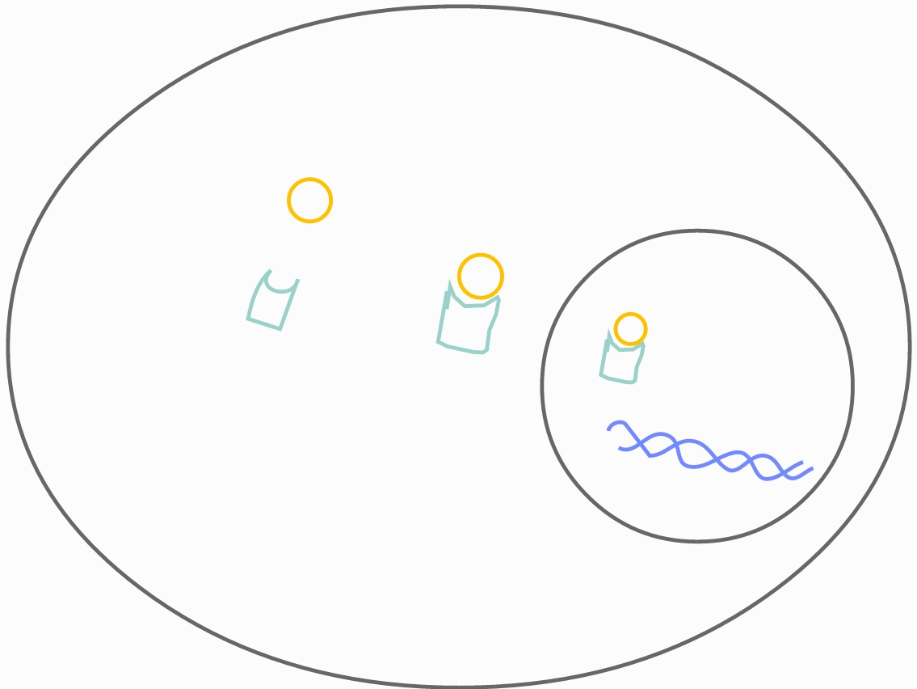
Why did TPC had stimulating effect on the hepatocytes proliferation?
Calmodulin
Androgen receptors are expressed in the hepatocytes as they are important in liver function.
In cytoplasm androgen receptor and calmodulin bind with each other, transport to the nucleus and initiate cell proliferation.
Nucleus
Androgen Receptor
Cytoplasm
Proliferation
Notes:
.... As they take place in many biochemical reactions in the liver.
Also according to other literature, in thermostable protein complex extracted from human prostate malignant tumor active precursor calmodulin was in major amount. Also prostate cells have high expression of androgen and androgen receptor. In cytoplasm androgen receptor and calmodulin bind with each other, transport to the nucleus and initiate cell proliferation.
From the analysis of the literature data and our results, it follows that the stimulating effect of the protein complex obtained from the tumor tissue of a patient diagnosed with glioblastoma on the proliferation of only liver cells is due to the major content of androgen receptors in these cells and the active precursor (calmodulin), which is presented in TPC in major amount, functionally bound to them in the said complex and initiate proliferation.

Slide 15
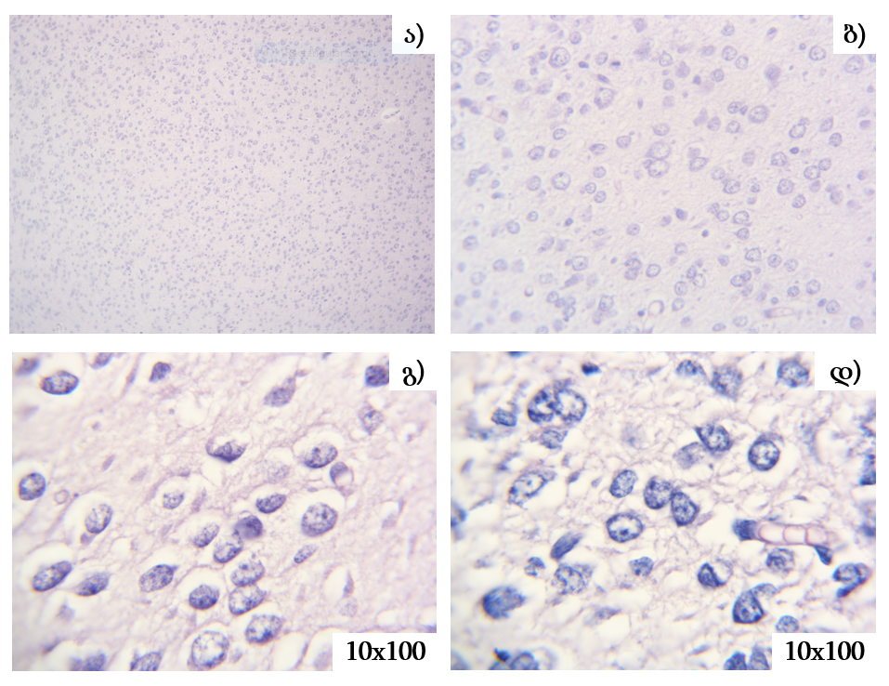
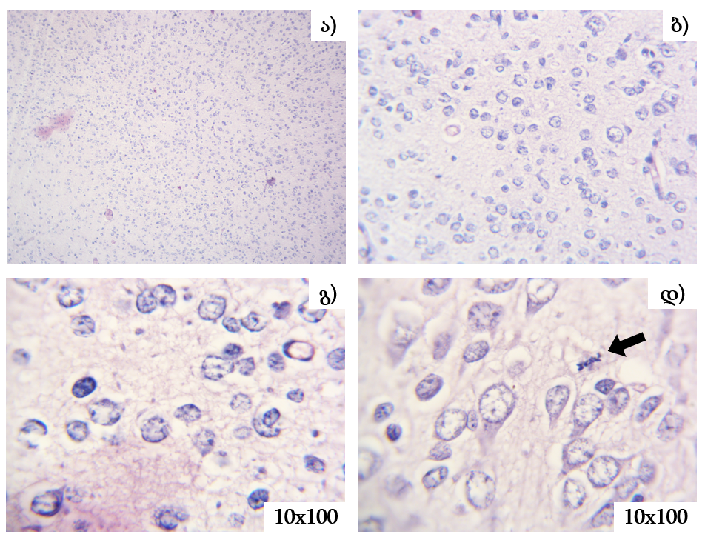
Adolescent white rat brain histoarchitectonics after injecting TPC of pituitary adenoma
1
2
1
2
3
4
3
4
Control group; Hematoxylin-eosin staining
Test group; Hematoxylin-eosin staining
Notes:
Same experiment was done with thermostable protein complex extracted from pituitary adenoma. Histoarchitectonics remain unchanged in this case too.

Slide 16
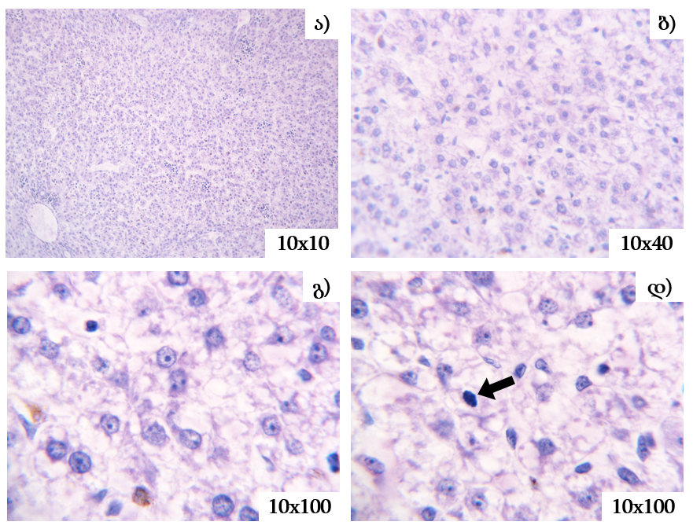
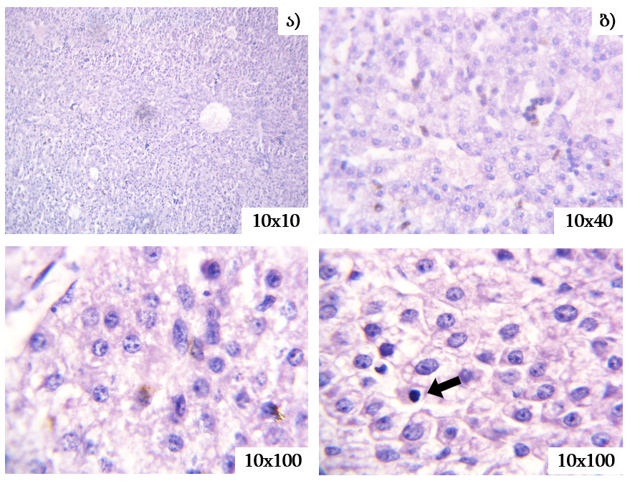
Adolescent white rat liver histoarchitectonics after injecting TPC of pituitary adenoma
1
2
1
2
3
4
3
4
Control group; Hematoxylin-eosin staining
Test group; Hematoxylin-eosin staining

Slide 17
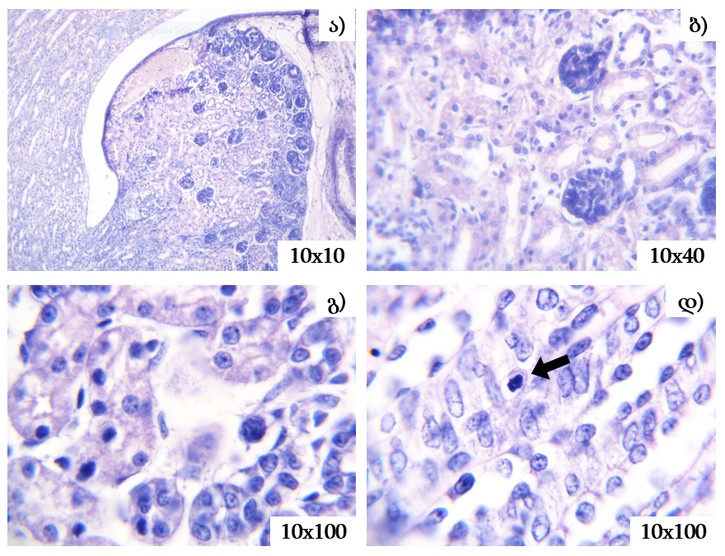
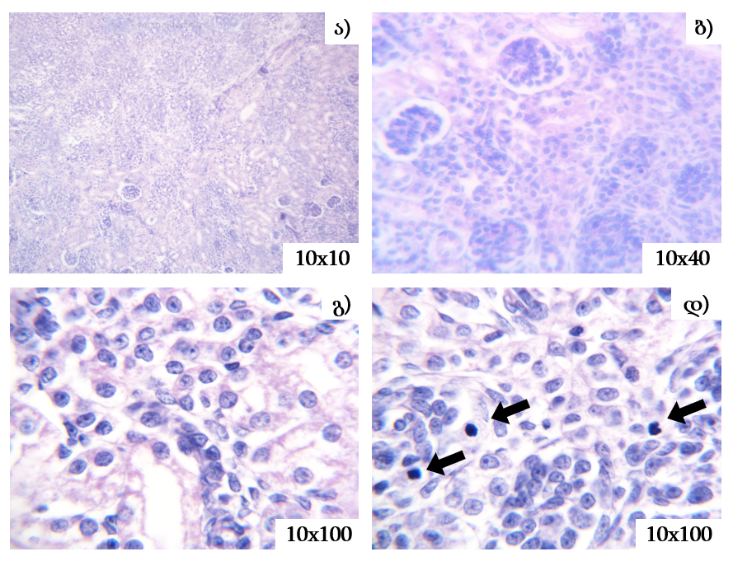
Adolescent white rat kidney histoarchitectonics after injecting TPC of pituitary adenoma
1
2
1
2
3
4
3
4
Control group; Hematoxylin-eosin staining
Test group; Hematoxylin-eosin staining

Slide 18
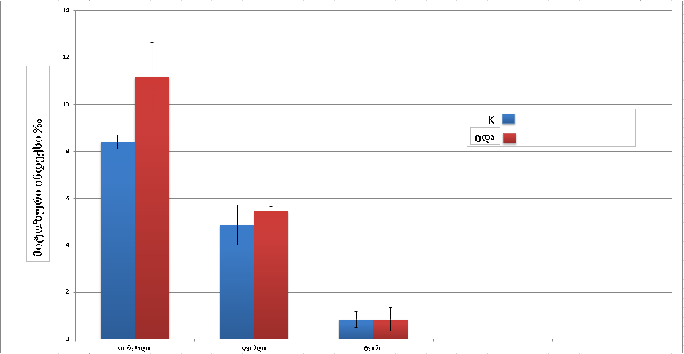
Effect of human pituitary adenoma thermostable protein complex in mitotic activity of various organs cells of adolescent white rats
Control group
Test group
Mitotic Index ‰
Kidney
Liver
Brain
Notes:
Also as we can see from the diagram, this complex doesn’t have inhibiting effect on adolescent rat cells, instead it had some stimulating effect on kidney parenchimal cells. Proliferation activity in those cells raised by 3 promilee compared to control group.

Slide 19
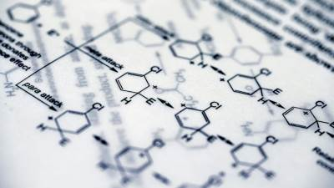
How did TPC of pituitary adenoma affect proliferation in kidneys only?
In the case of pituitary adenoma, we have hyperprolactinemia and prolactin is a thermostable protein compound.
prolactin is utilized in the kidneys and it also stimulates Na, K reabsorption and thus increases functional load.
The organ responds to an increase in the functional load on the kidney with an increase in proliferative activity.
Notes:
The explanation to that is quite interesting. In the case of pituitary adenoma, we have hyperprolactinemia and prolactin is a thermostable protein compound. It is allowed to pass from the adenoma tissue during the alcoholic extraction into a complex of thermostable proteins as a component. At the same time, it should be noted that prolactin is utilized in the kidneys. It also stimulates Na, K reabsorption and thus increases functional load. The organ responds to an increase in the functional load on the kidney with a small but reliable increase in proliferative activity. This explains the effect we described.

Slide 20
Conclusions
Endogenous thermostable protein complexes isolated from benign (pituitary adenoma) and malignant (glioblastoma) tumor tissues of the human brain differ in the quantitative content of the active precursor (calmodulin).
The thermostable protein complex obtained from the tumor tissue of a patient diagnosed with pituitary adenoma does not show the ability to suppress the proliferation of proliferative tissue cells of adolescent rats, which is explained by the minor content of the active element in it.
The thermostable protein complex isolated from pituitary adenoma has a stimulating effect only on the proliferative activity of the kidney, which reacts to functional overload.
The stimulatory effect of the protein complex obtained from the tumor tissue of a patient diagnosed with glioblastoma on the proliferation of only liver cells of adolescent rats is due to the major content of androgen receptors in these cells and the active precursor (calmodulin) functionally bound to them in the said complex.
Notes:
Lastly there should be mentioned conclusions that we’ve made out of these results.

Slide 21
Bibliography
D.Dzidziguri, M. Iobadze, T. Aslamazishvili, G. Tumanishvili, V. Bakhutashvili, T. Chigogidze, L. Managadze. Comparative study of influence of endogenic kidney factors on the proliferative activity of epitheliocytes. Tsitologiya. 2005, 47(6): 497-500.
Dzidziguri L.,Bakuradze E.,Modebadze I.,Oganezovi N.,Mikadze M., Comparative study of growth inhibitory protein complex derived from different forms of children hemangioma Georgian Med News. 2015, (246):73-7.
Kordzadze A; Dzidziguri D; “Identification and comparative characterization of endogenous growth inhibitory factor in human nerve cells transformed in different ways”; 2021
Dzidziguri, D., Modebadze, I., Bakuradze, E., Mosidze, G., & Berulava, M. (2018). Determination of The Properties of Rat Brain Thermostable Protein Complex which Inhibit Cell Proliferation. Cell journal, 19(4), 552–558. https://doi.org/10.22074/cellj.2018.4835
Kanda, T., & Yokosuka, O. (2015). The androgen receptor as an emerging target in hepatocellular carcinoma. Journal of hepatocellular carcinoma, 2, 91–99.
S. Niemczyk, L. Niemczyk, and K. Romejko-Ciepielewska, “Basic endocrinological disorders in chronic renal failure,” Endokrynologia Polska, vol. 63, no. 3, pp. 250–257, 2012.

Slide 22
Thank you for your attention!

Slide 23
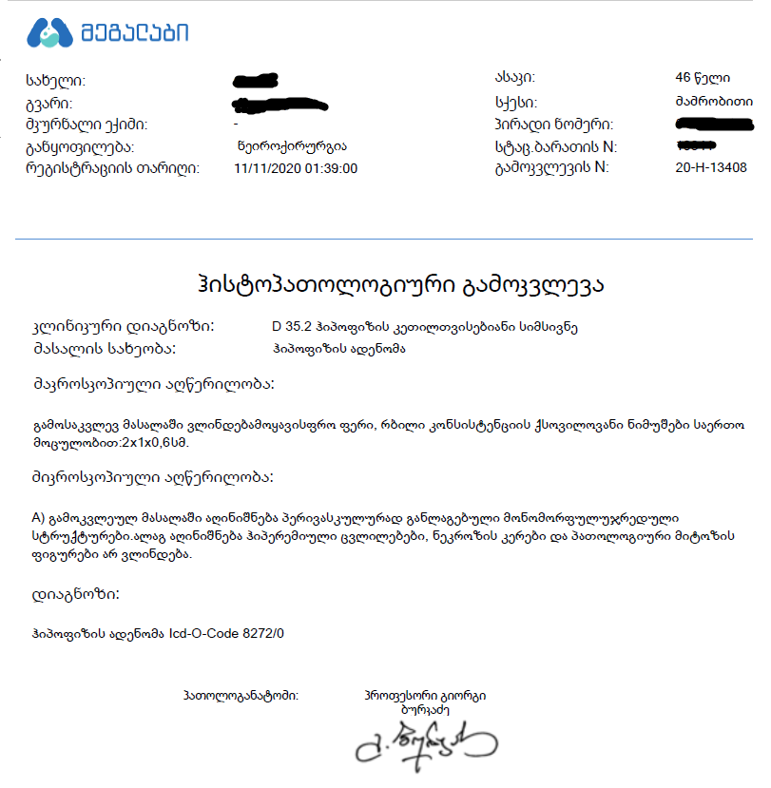
Pituitary adenoma
Fig. A. Pituitary adenoma – Hematoxylin-eosin staining 10x300
Fig. B. Pituitary adenoma – Hematoxylin-eosin staining 10x400
Notes:
ეს სლაიდი დაბლა

Slide 24
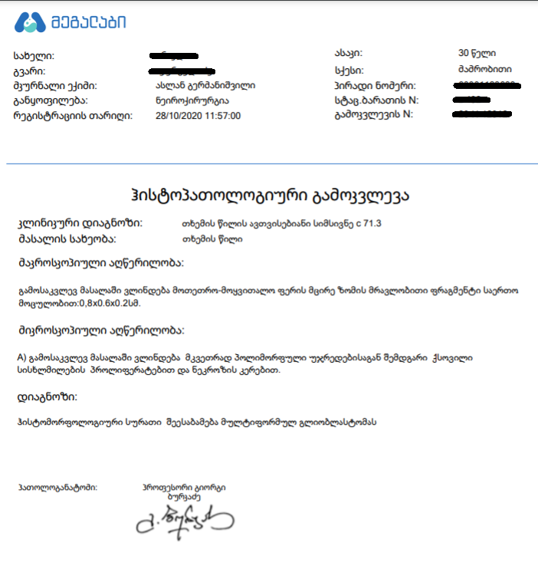
Glioblastoma
Fig. A. Glyoblastoma – Hematoxylin-eosin staining 10x150
Fig. B. Glyoblastoma – Hematoxylin-eosin staining 10x400

