Slide 1
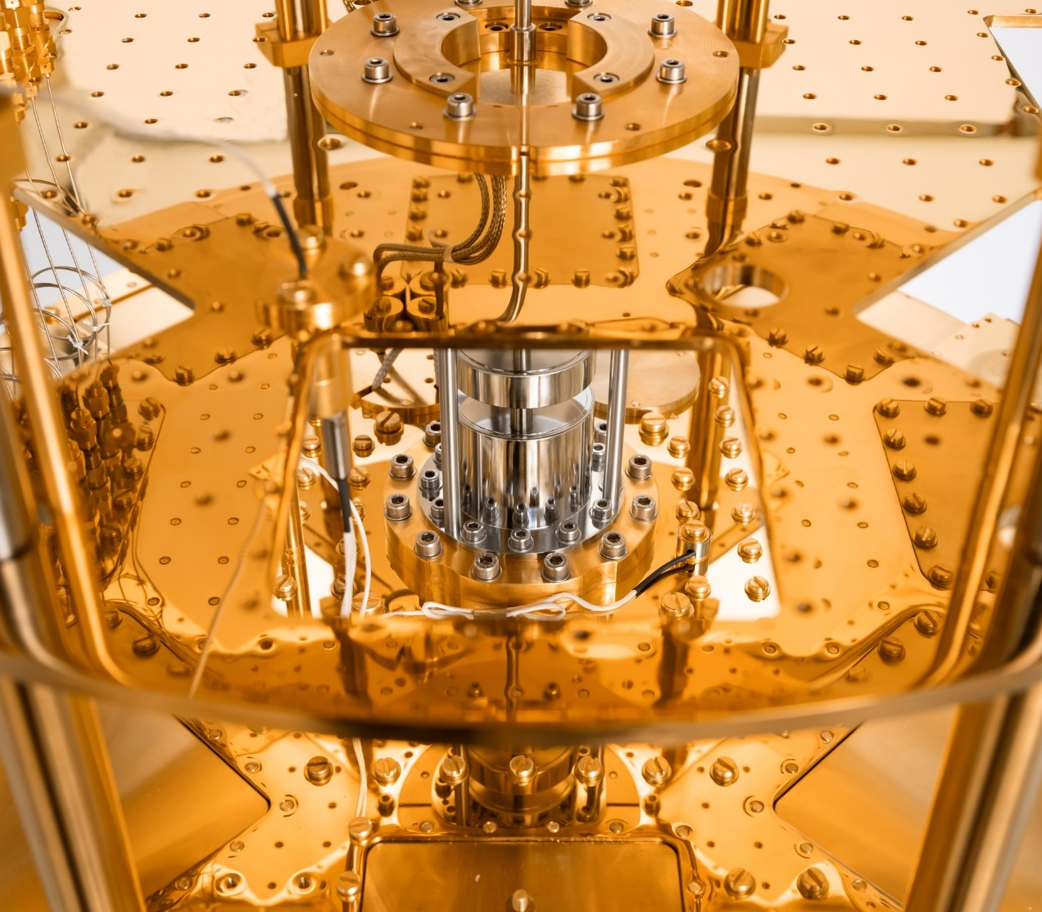
the Quali-Startup Science Lectures
An example of a Successful Educational Training Course format of the Georgian-German Science Bridge
16-09-2022 | Eva Portius

Slide 2
Forschungszentrum Juelich | Location

Slide 3
Georgian-german science bridge
THREE PILLARS
Joint Research
Collaboration with joint research projects in Hadron Physics, Climate and Sciences, Medical Imaging
Expand collaborations (HZDR, GSI)
Educational Training
Master- & PhD program (18 & 18)
Knowledge Transfer
Cotutelle de thèse program (1)
Scientific Workshops (9)
Lecture courses (5)
Internships (55)
SMARTLabs to return Alumni at Georgian Universities (2)
Training Courses (3)

Slide 4
AT a Glance
Timeline of workshops and schools 2004-2022

Slide 5
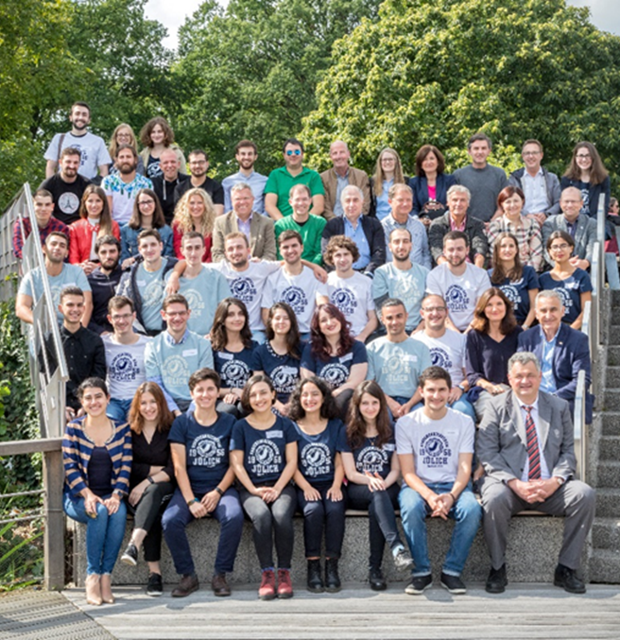
We promote young talent
We wish to inspire talented young scientists and give them the best possible support.
30 Georgian students visited the campus in 2019, 21 in 2017
Hands-on training & lectures in 8 institutes

Slide 6
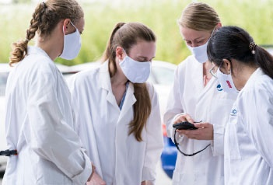
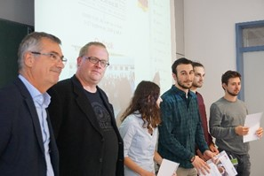
GGSB
We work Hand in Hand
Integrated in a framework of partners: Joint scholarship program of FZ Juelich, MES of Georgia,
LEPL Shota Rustaveli National Science Foundation & 5 Georgian Universities
Interdisciplinary:
physics,
computer science,
data science,
biology,
medicine,
chemistry,
engineering, electronic and information technology systems,
neuroscience,
(…)
A training course | Quali-START-Up
for qualified students
to obtain further qualification in basic science
to see an interdisciplinary research approach at work
to be inspired by one of Europe’s largest research facilities
take home ideas for the student´s own career development
.

Slide 8
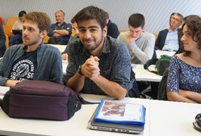
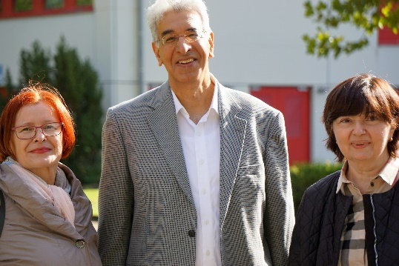
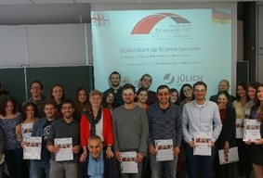
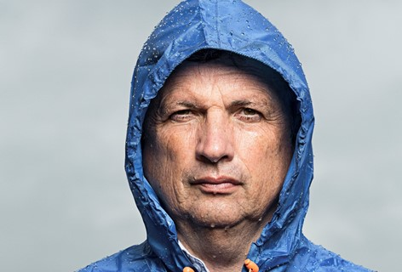
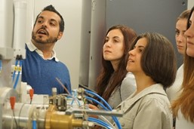
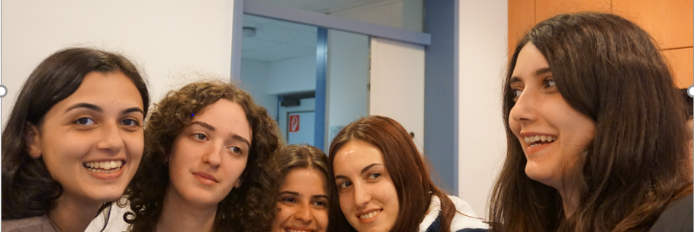
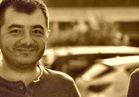
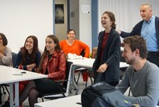
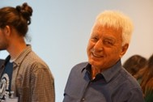
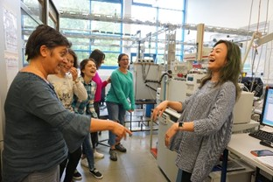
Impressions

Slide 9
WISHING YOU AN EXcITING DAY of PRESENTATIONS of Your RESEARCH Work!

Slide 10
Eva Portius
Manager International Relations –
Eastern Europe, Central Asia, Middle East, Israel, India
Forschungszentrum Jülich GmbH
Corporate Development
E-Mail: e.portius@fz-juelich.de
Phone: +49 2461 61 6232
Thank you very much for your attention!

