Slide 1
David Mchedlishvili
Head of SMART|EDM_lab, Tbilisi State University
SMART|EDM_lab: Science case –
Search for EDMs and DM
GGSB2022 (September 15, 2022)

Slide 2
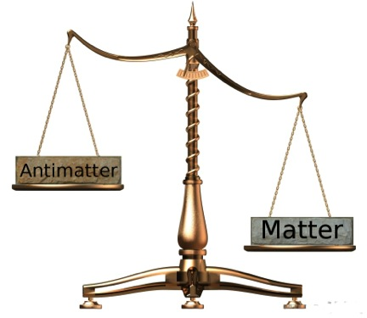
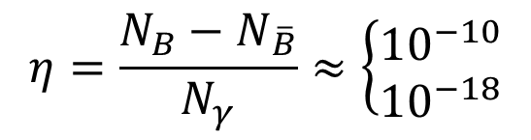
Science case: Baryon asymmetry in the Universe
Matter and antimatter balanced after
Big Bang
Current observation:
One of the unsolved problems in physics
Answer may be hidden in CP-symmetry breaking (Sakharov conditions)
$$η=\frac{N_{B}−N_{\overline{B}}}{N_{γ}}≈\left\{\begin{matrix}{10}^{−10} \\ {10}^{−18}\end{matrix}\right.$$
(measured)
(SCM prediction)

Slide 3


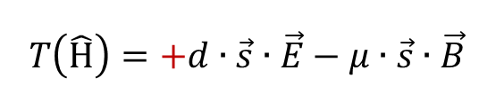






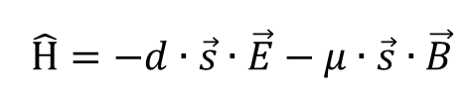




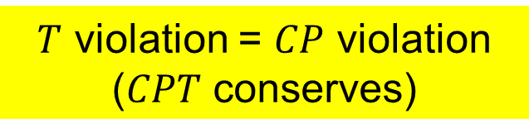



EDM and CP symmetry
$$\vec{B}$$
Hamiltonian:
$$\vec{d}$$
$$\vec{μ}$$
$$\hat{Η}=−d∙\vec{s}∙\vec{E}−μ∙\vec{s}∙\vec{B}$$
$$P$$
$$\vec{E}$$
$$\vec{B}$$
$$\vec{E}$$
$$P\left(\hat{Η}\right)=+d∙\vec{s}∙\vec{E}−μ∙\vec{s}∙\vec{B}$$
$$\vec{d}$$
$$\vec{μ}$$
$$T\left(\hat{Η}\right)=+d∙\vec{s}∙\vec{E}−μ∙\vec{s}∙\vec{B}$$
$$\vec{E}$$
$$T$$
$$\vec{d}$$
$$\vec{μ}$$
$T$ violation = $CP$ violation ($CPT$ conserves)
$$\vec{B}$$

Slide 4
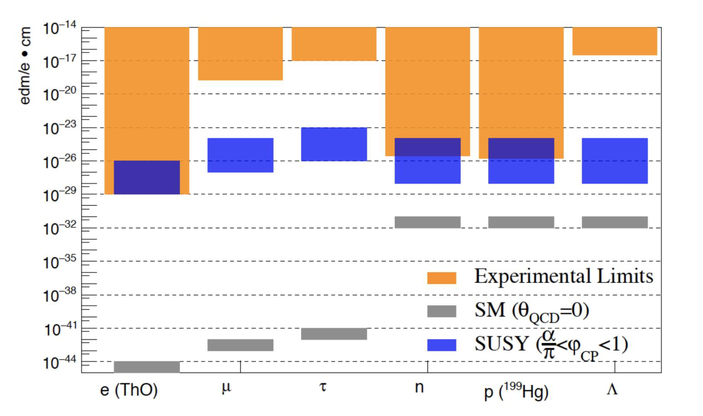
How small EDMs are?
10⁻¹³ cm → 10⁹ cm
d ~ 1 μm (10⁻²⁶ e∙cm)
No direct measurement of electron and proton!
No measurement (at all) of deuteron!

Slide 5
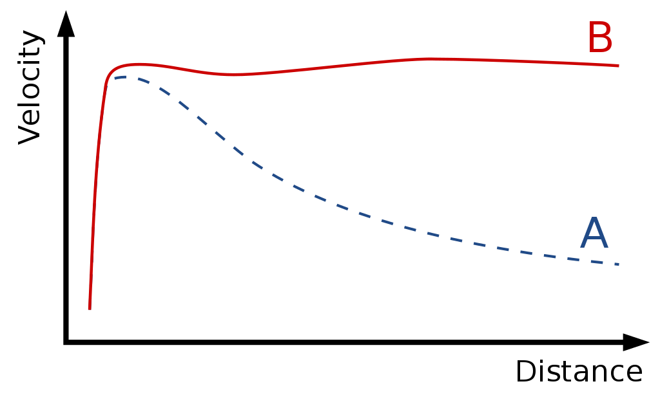



Science case: Dark matter
$$5\%$$
Composition of the Universe
$$27\%$$
$$68\%$$
Evidence:
Gravitational lensing
Rotational curves of spiral galaxies
Motion of galaxies
Observation
What is dark matter made of?
Axions? ALPs?
Prediction (visible matter)

Slide 6

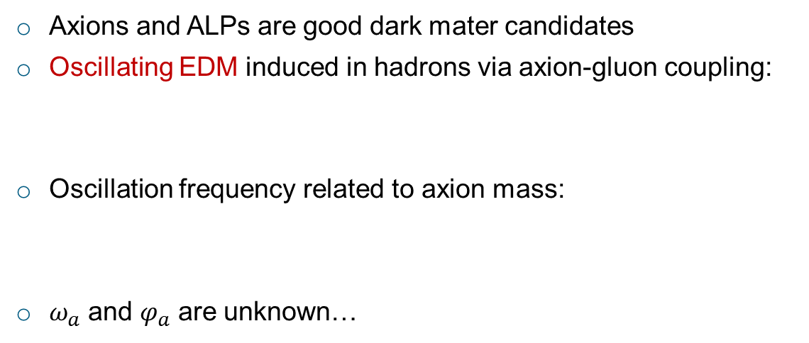

Dark matter and EDM
Axions and ALPs are good dark mater candidates
Oscillating EDM induced in hadrons via axion-gluon coupling:
Oscillation frequency related to axion mass:
$ω_{a}$ and $φ_{a}$ are unknown…
$$d=d_{DC}+d_{AC}\sin\left(ω_{a}t+φ_{a}\right)$$
$$ω_{a}=\frac{m_{a}c^{2}}{ℏ}$$
How to measure permanent and oscillating EDMs:
Polarise and store the particle beam in the storage ring
Observe the time development of the spin axis (Precision measurement!)

Slide 7
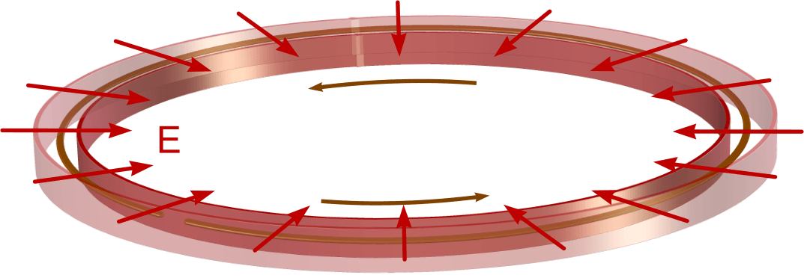
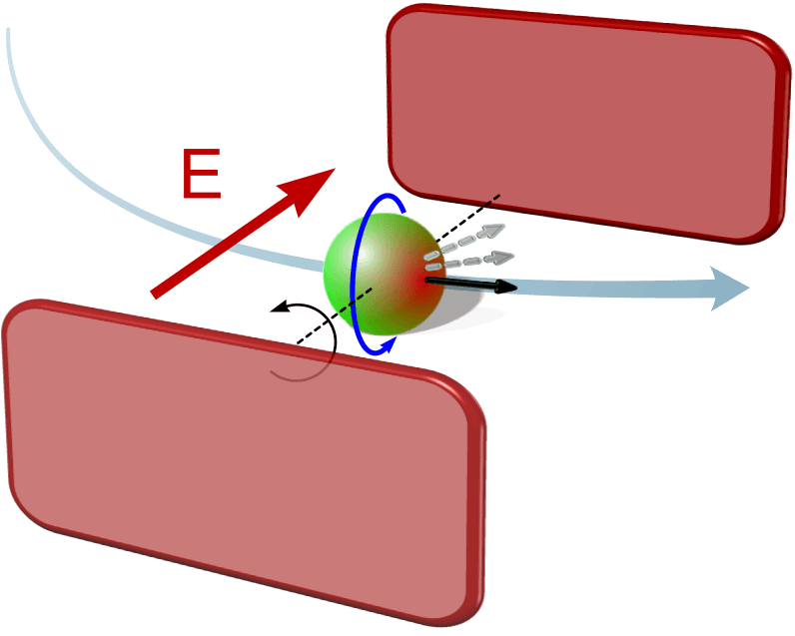

JEDI: Charged-Particle EDM Search
Main principle:
  Inject polarized particles into
  a storage ring:
  Apply radial electric field E:
  Non-zero EDM → spin rotation out of the plane
  Track spin rotation → need precise polarimeter

Slide 8
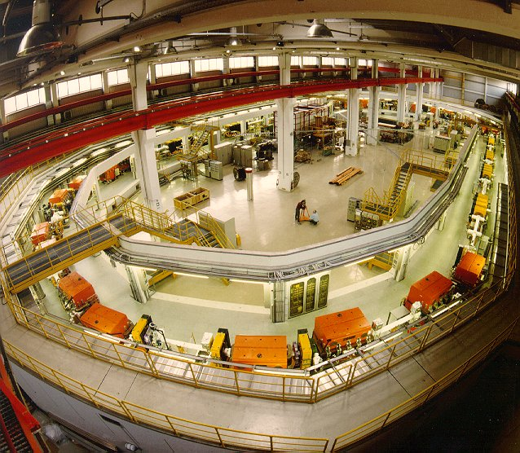
Test facility: COSY storage ring
COSY (COoler SYnchrotron) at Jülich (Germany)
Energy range:
0.045 – 2.8 GeV (p)
0.023 – 2.3 GeV (d)
Max. momentum ~ 3.7 GeV/c
Energy variation (ramping mode)
Electron and Stochastic cooling
Internal and external beams
High polarisation (p,d)
Spin manipulations

Slide 9
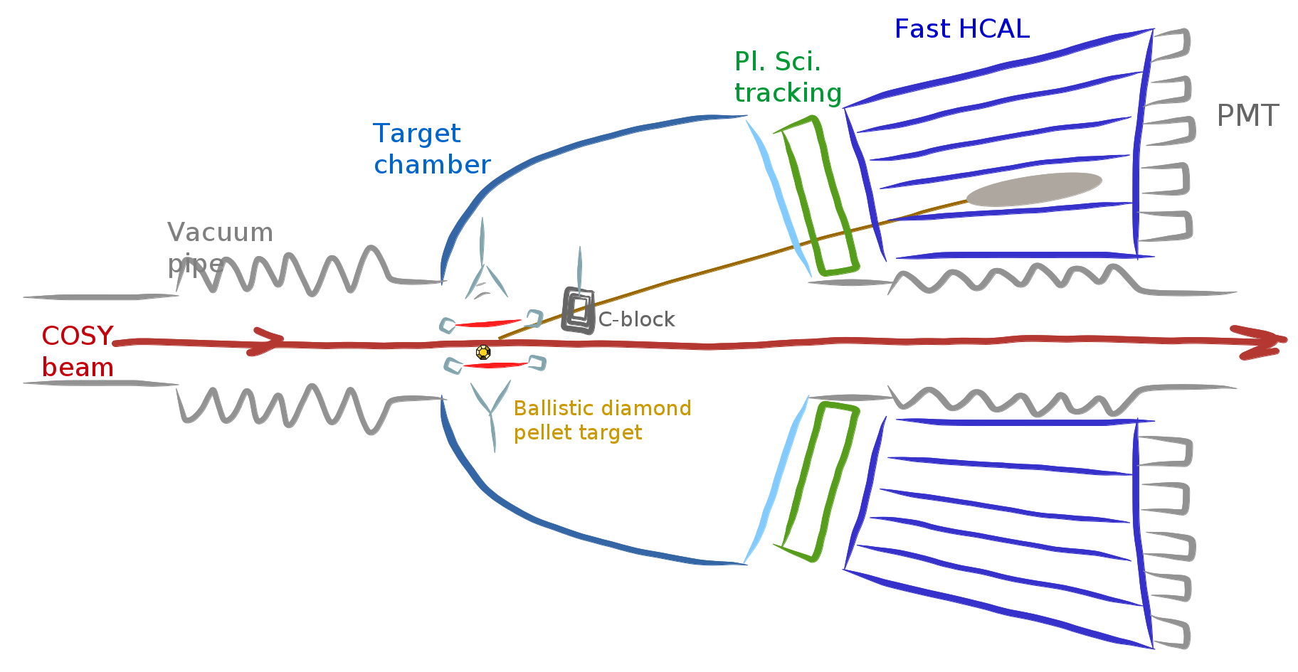
JEDI polarimeter (JePo)
Ballistic Diamond
Pellet Target
Requirements:
High precision
High efficiency
High stability
No magnetic /
electric field
Array of plastic scintillators
Calorimeter modules
LYSO based EM calorimeter for highest energy resolution
Fast plastic scintillators for particle identification
FADC based readout for fast data acquisition
New type of target for unprecedented precision

Slide 10
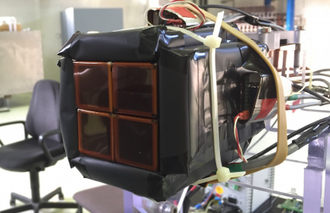
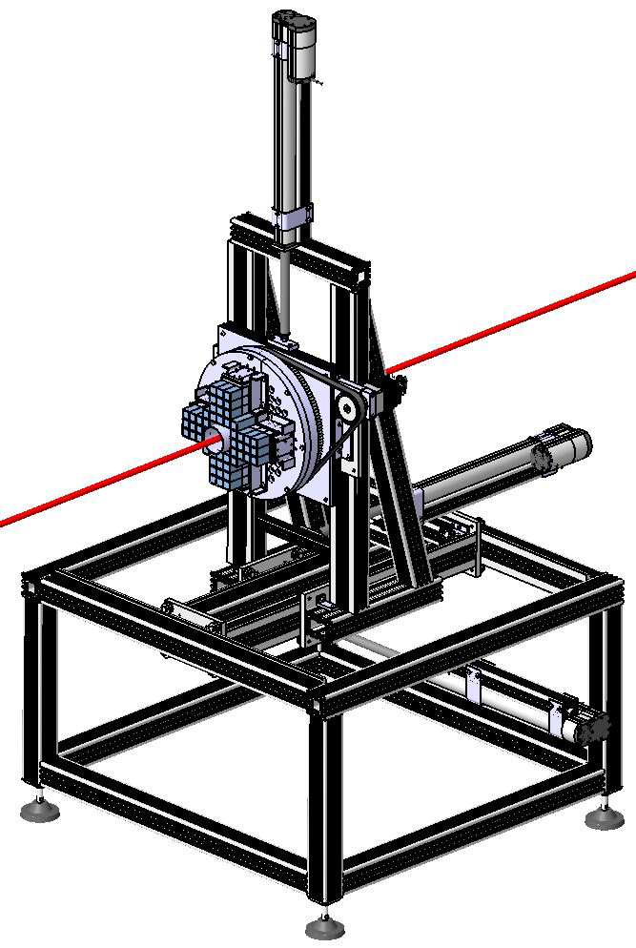
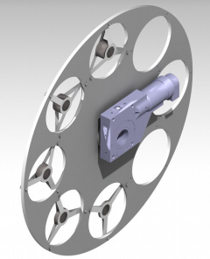
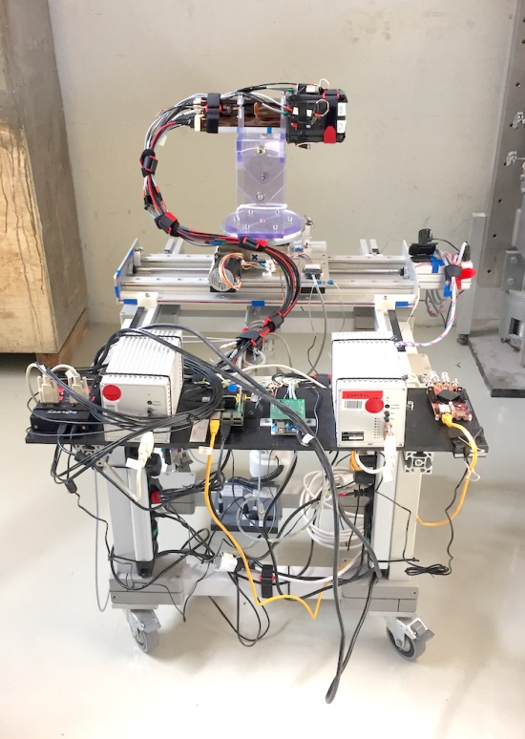
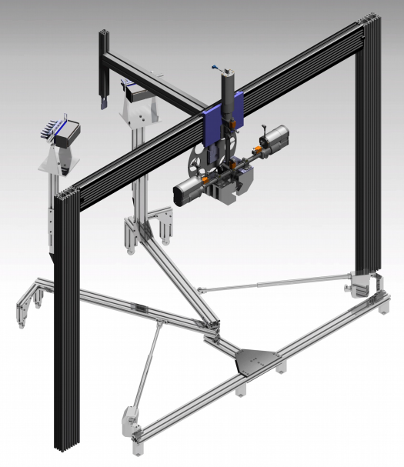
JePo development history
First test - 4 LYSO
modules
Final – 52 LYSO modules
Target wheel
Second test –
24 LYSO modules
Moving arms

Slide 11
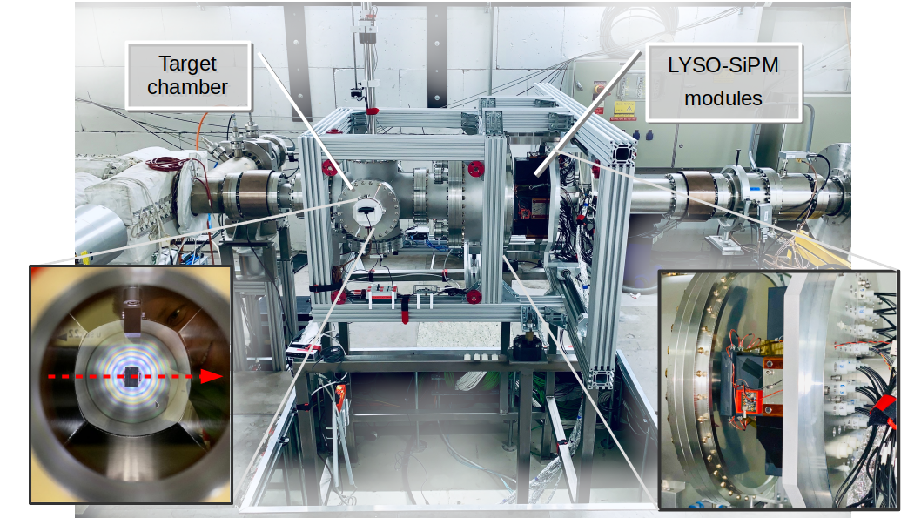
JePo installed in COSY ring

Slide 12
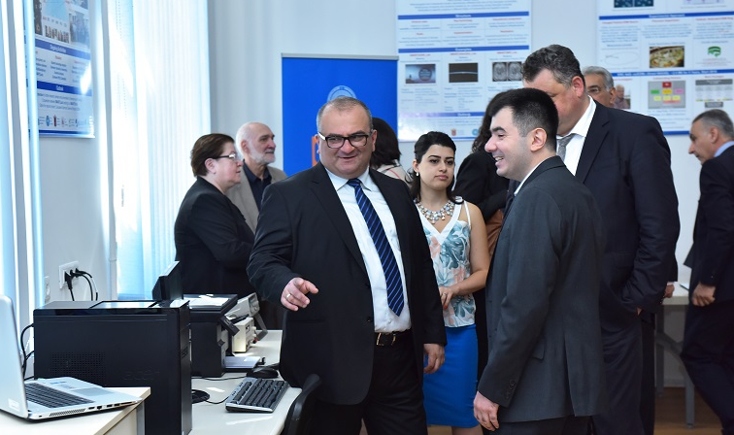

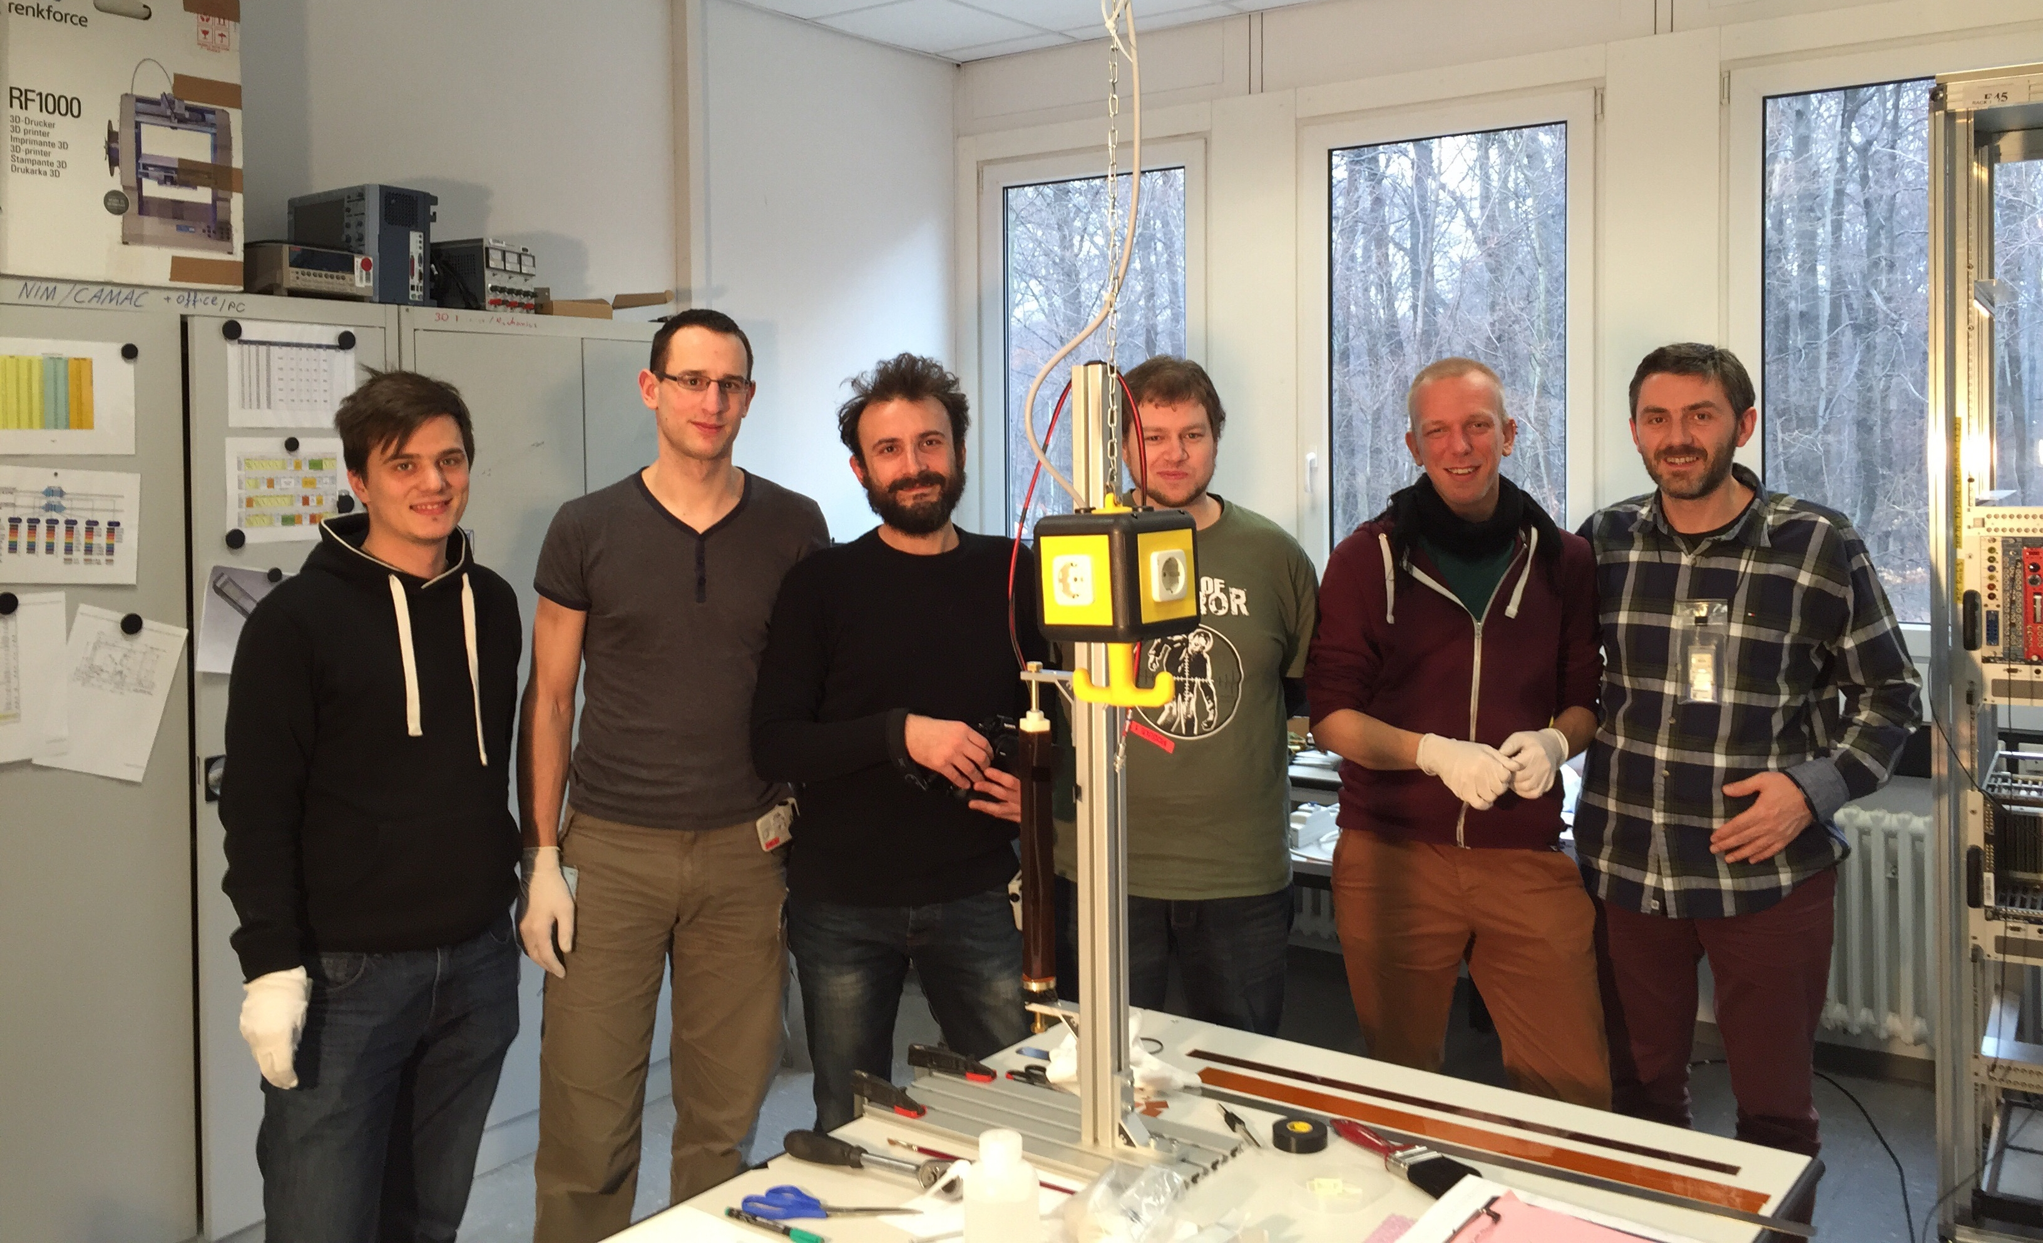
The idea of SMART|EDM_lab
Joint research project (strong cooperation with JEDI collaboration)
Well equipped and maintained
Great opportunity for Georgian MSc and PhD students
SMART|EDM_lab at TSU
PhD and Master students involved
Development of precise modular power supplies and monitoring
Development of online data monitoring system
Search for and motivate new students
SMART|EDM_lab at IKP
PhD and Master students involved
Detector assembly and lab tests
Engineering and mechanics
Slow control systems
Next generation target for JEDI polarimeter

Slide 13
SMART|EDM_lab contribution: Hardware

Slide 14
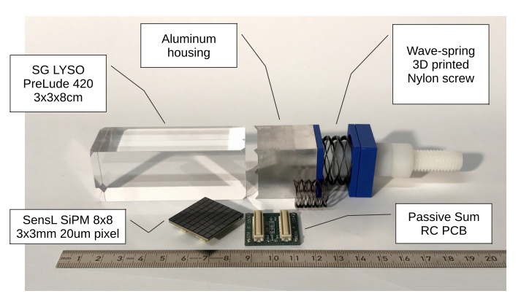
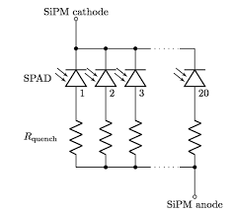
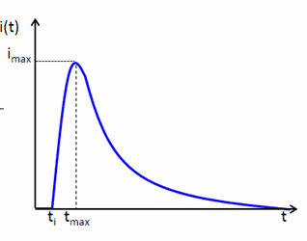
Calorimeter module assembly and tests
SiPM-based LYSO calorimeter module before assembly
SiPM array
V_{bias}
R_{ext}
Current consumption of a single SiPM array:
Internal radiation + dark current: ~10…30 μA (average)
300 MeV deuteron hit: can reach 100 mA! (peak)

Slide 15
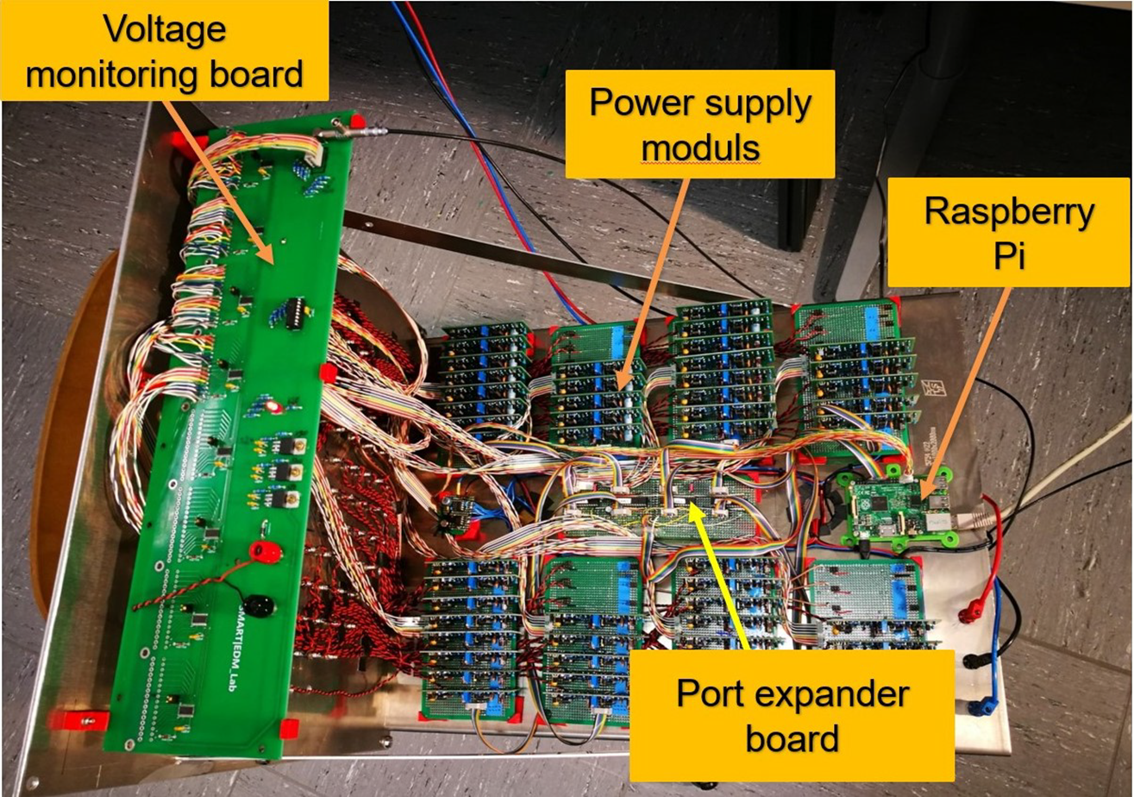
Power supply development for SiPMs
Key aspects:
Modular design
High output stability (temperature, long/short term, low noise)
Variable voltage
Remote control
Output ramping
Performance monitoring
Main development and laboratory tests at TSU
Final assembly and commissioning at Jülich
More details:
See talk by O. Javakhishvili

Slide 16
SMART|EDM_lab contribution:
Software

Slide 17
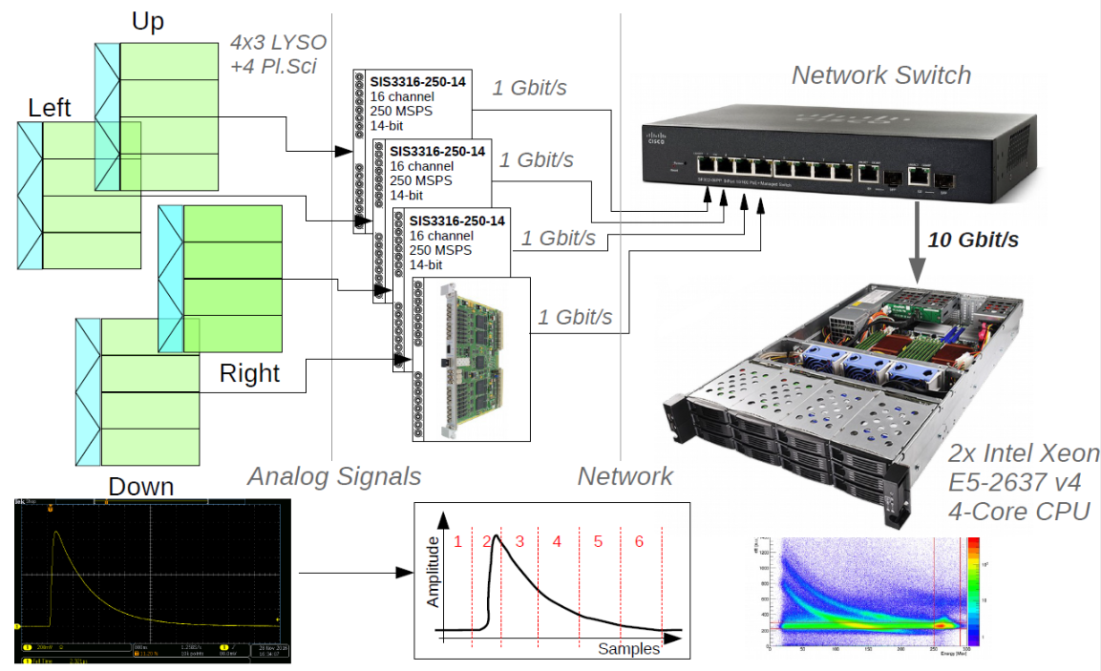
Data acquisition and online analysis software

Slide 18
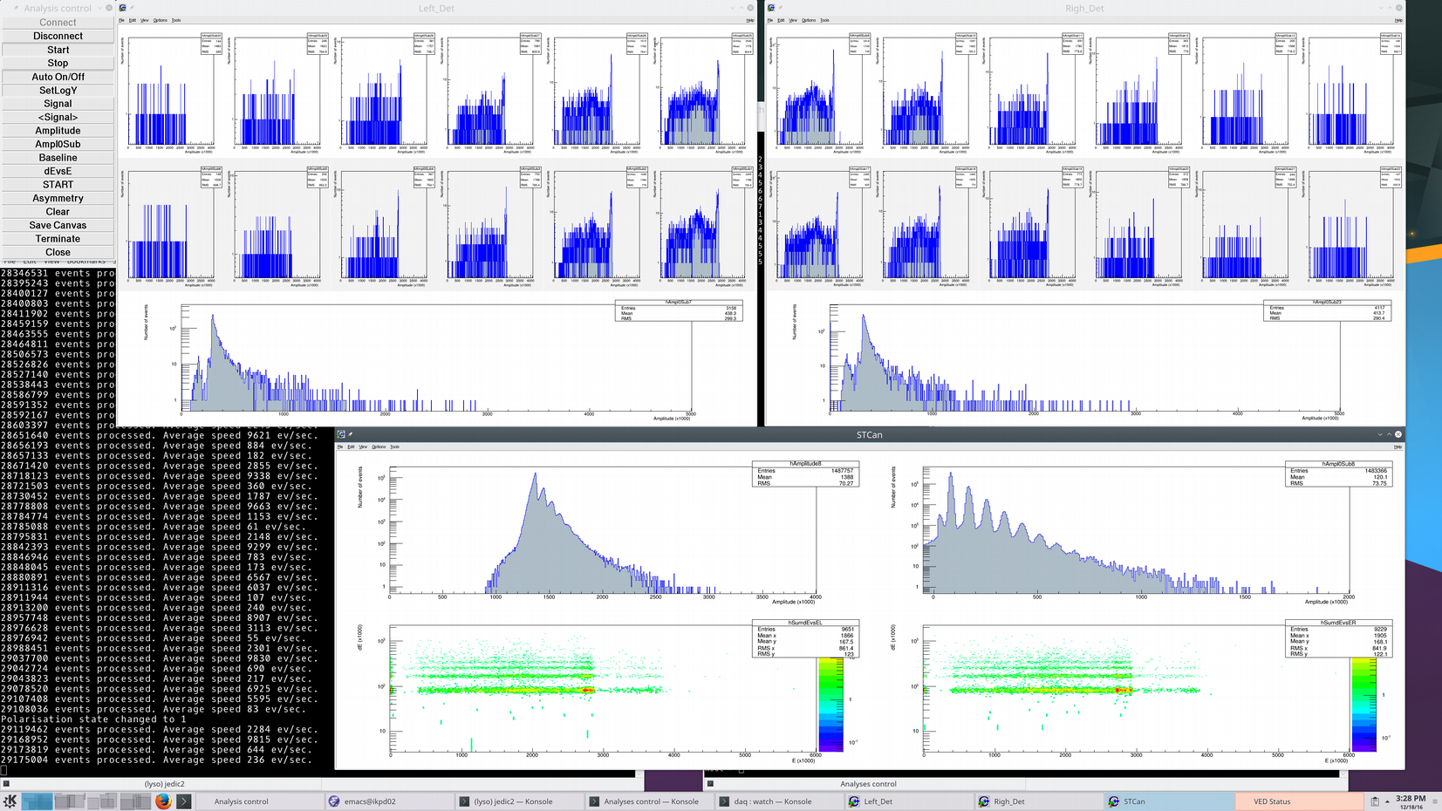
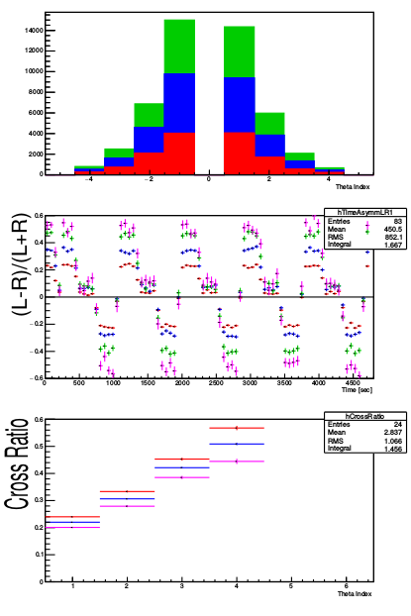
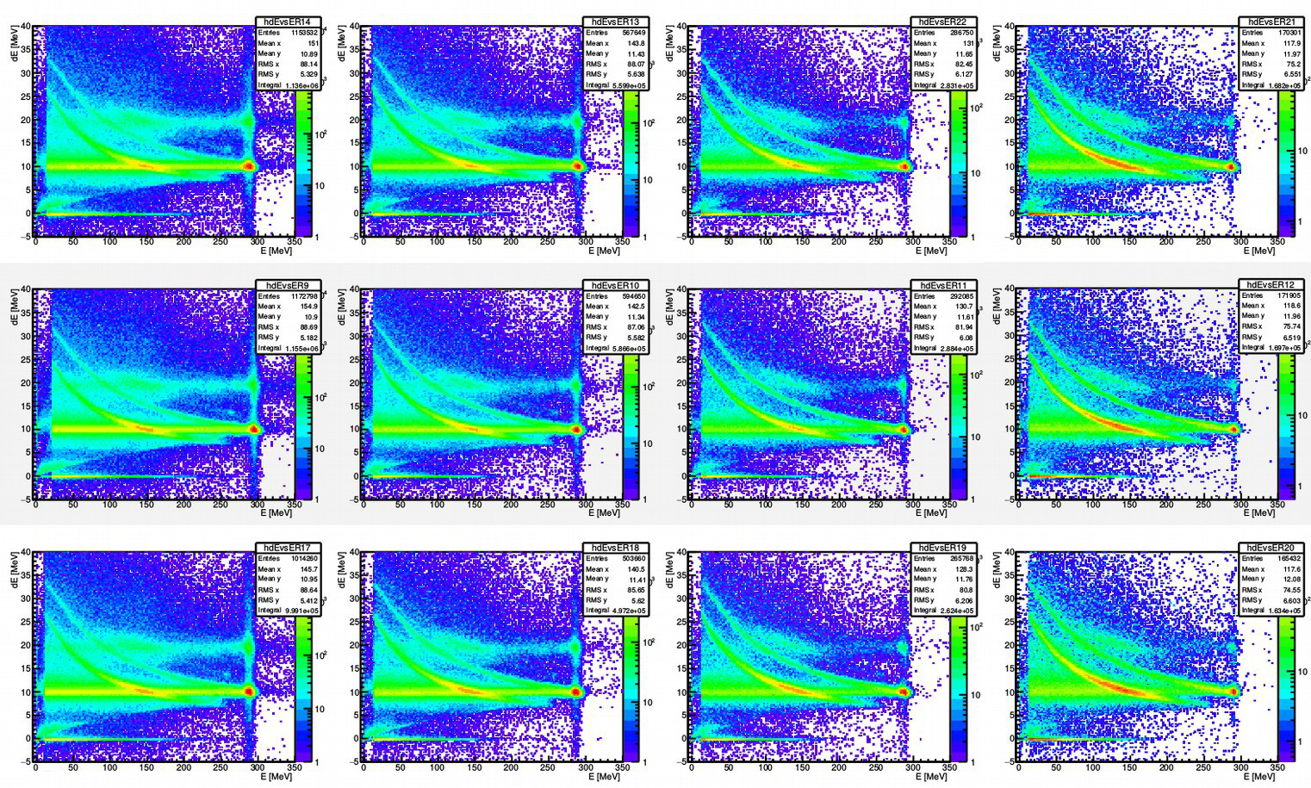
Online data analysis
Spectra from individual channels
Asymmetries
Particle identification

Slide 19
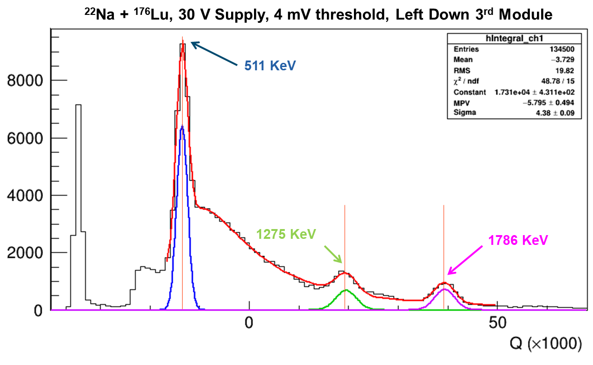
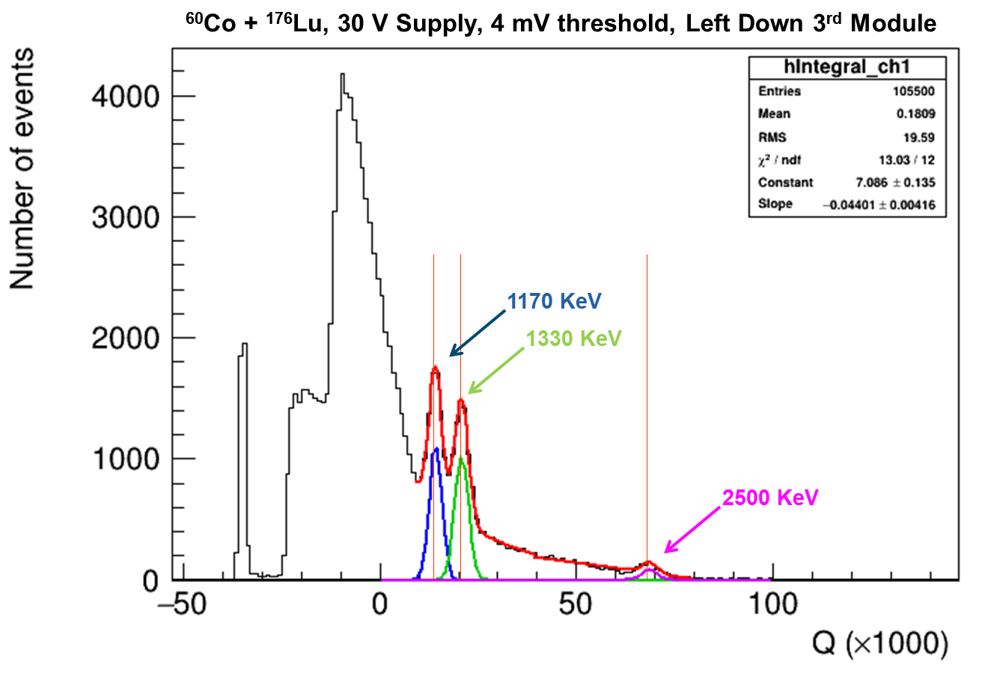
Laboratory tests
Tests using radioactive sources ²²Na & ⁶⁰Co + ¹⁷⁶Lu + cosmics

Slide 20
Publications:
O. Javakhishvili et al. - “Development of a multi-channel power supply for silicon photomultipliers reading out inorganic scintillators” - NIMA 977, 164337 (2020)
F. Müller et al. – “A new beam polarimeter at COSY to search for electric dipole moments of charged particles”, JINST 15, P12005 (2020)
I.Keshelashvili et al. – “A modular calorimeter based on LYSO scintillator crystals with SiPM readout” (in preparation for resubmission)
JEDI-related publications:
http://collaborations.fz-juelich.de/ikp/jedi/documents/colpapers.shtml

Slide 21
Student involvement
PhD:
Dito Shergelashvili (TSU)
Master:
Otar javakhishvili (AUG)
Giorgi Kvantrishvili (TSU)
Mikael Gagoshidze (AUG)
Mariam Abuladze (AUG)
Irakli Lomidze (AUG)
Ninea Anasovi (AUG)
Bachelor:
David Kordzaia (AUG)
Rati Chkhetia (AUG)
Giorgi Chaduneli (AUG)
Mariam Mukbaniani (TSU)
Valentina Sarkisova (TSU)
Lana Rekhviashvili (TSU)
Dachi Okropiridze (GTU)
Nino Shukakidze (AUG)
9 Male vs 6 Female
Students involved in all research activities: Hard- and software development, assembly of detectors and electronics, laboratory and on-site measurements, data taking and offline analysis…

Slide 22
Other activities and perspectives (i)
Remain in the active collaboration with the JEDI experiment and all related activities planned in frame of CPEDM collaboration
Close collaboration with existing/future SMART laboratories
Planned activities with GSI detector laboratory
Possible collaboration with:
HZDR - …
Hadron Therapy Center at KIU - …

Slide 23
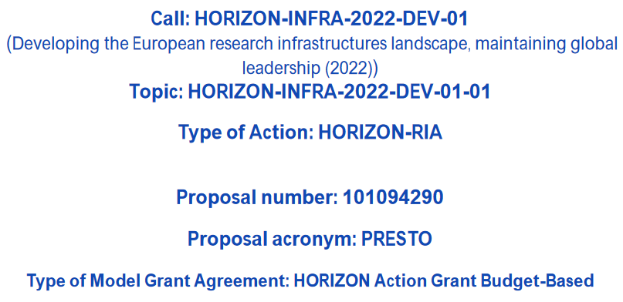
Other activities and perspectives (ii)
SMART|EDM_lab as a partner of PRESTO (Pathfinder facility for a new class of PREcision-physics STOrage rings, submitted in April, 2022)

Slide 24
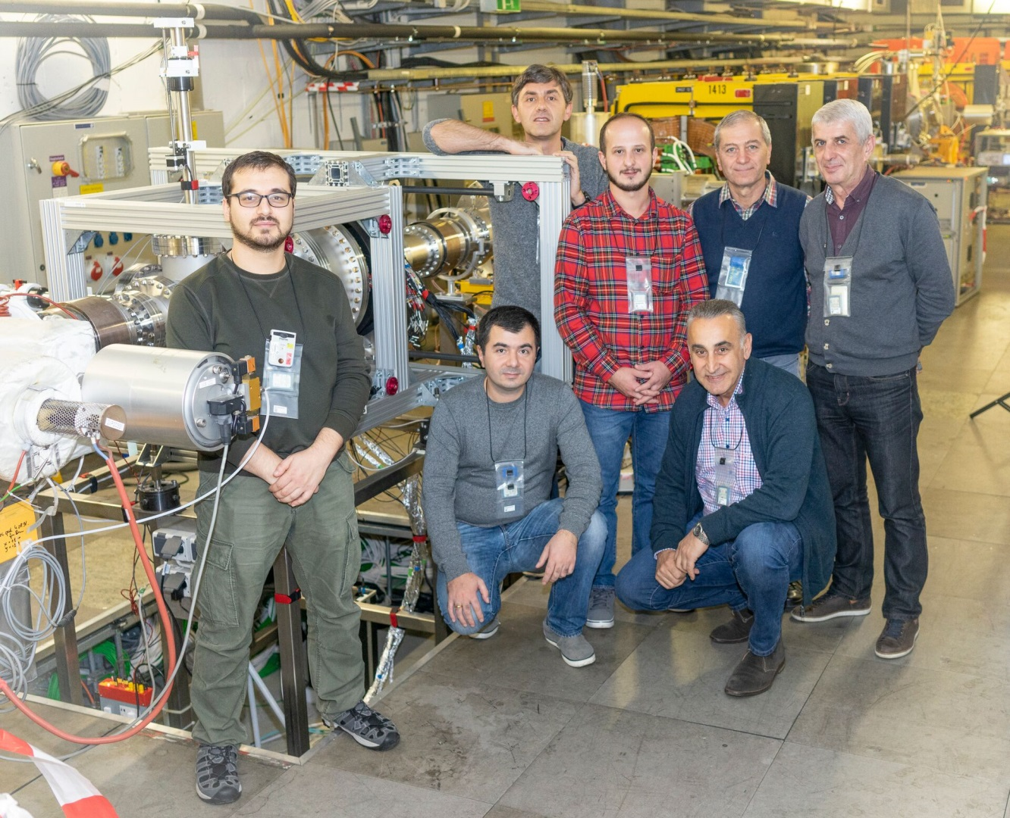
Thank you

Slide 25
Backup slides…

Slide 26



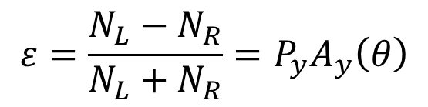
How to measure beam polarisation?
$$\left\langle \cos{φ}\right\rangle =−1$$
$$\left\langle \cos{φ}\right\rangle =1$$
$$σ_{pol}\left(θ,φ\right)=σ_{0}\left(θ\right)\left[1+P_{y}A_{y}\left(θ\right)\cos{φ}\right]$$
Polarisation
Analysing power
$$ε=\frac{N_{L}−N_{R}}{N_{L}+N_{R}}=P_{y}A_{y}\left(θ\right)$$
$$−1≤P_{y}≤1$$

Slide 27
Data acquisition and online analysis software
LYSO modules
PC #1
PC #2
Start & Stop counters
16 ch. FADC
(SIS3316)
EMS cluster server
Event builder
VETO detectors
Analyses modules
Data manager
Event builder, data manager and client software parts are based on CERN ROOT libraries
PC #3
Clients
(access spectra)

Slide 28
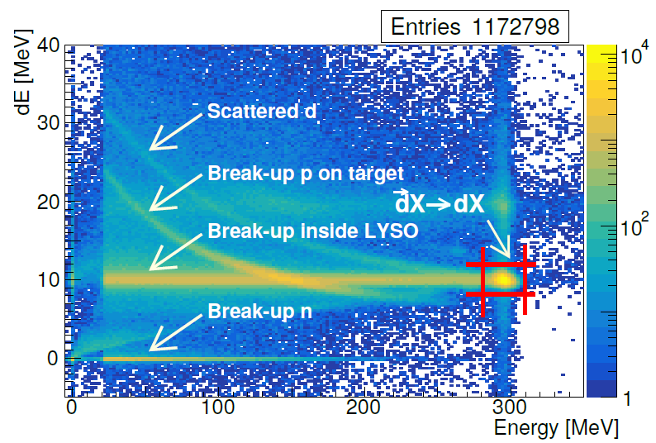
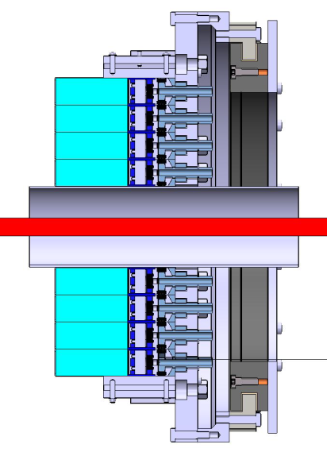
Particle and reaction identification by ∆E vs E

Slide 29
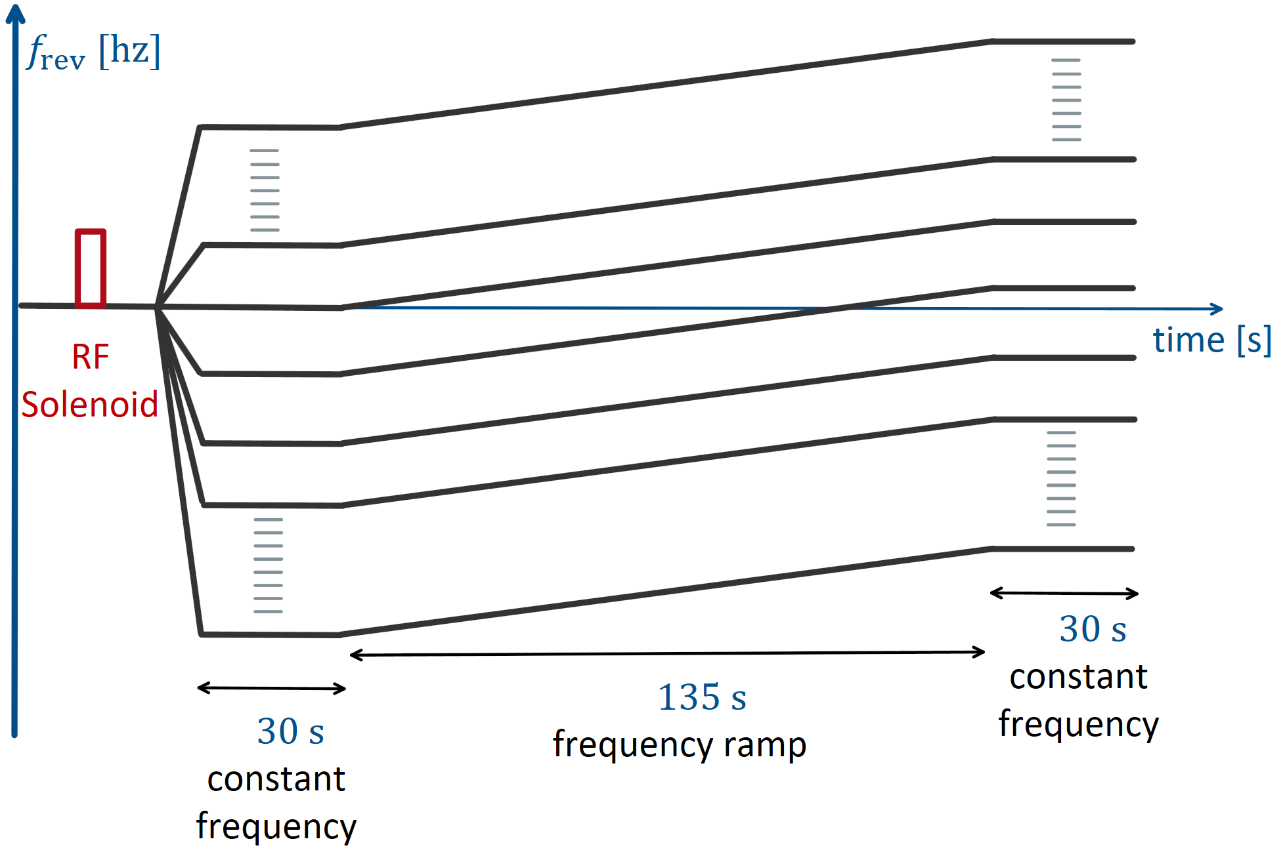
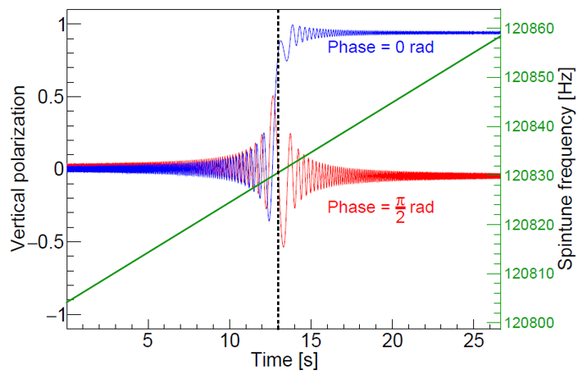
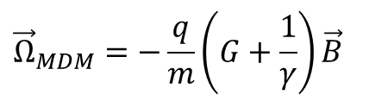
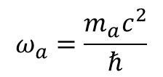
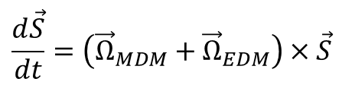



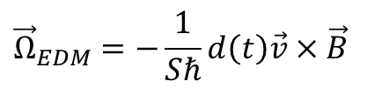
Oscillating EDM at COSY
$$d\left(t\right)=d_{DC}+d_{AC}\sin\left(ω_{a}t+φ_{a}\right)$$
$$ω_{a}=\frac{m_{a}c^{2}}{ℏ}$$
COSY conditions: $\vec{B}=B_{y}; \vec{E}=0$
$$\frac{d\vec{S}}{dt}=\left({\vec{Ω}}_{MDM}+{\vec{Ω}}_{EDM}\right)×\vec{S}$$
$${\vec{Ω}}_{MDM}=−\frac{q}{m}\left(G+\frac{1}{γ}\right)\vec{B}$$
$${\vec{Ω}}_{EDM}=−\frac{1}{Sℏ}d\left(t\right)\vec{v}×\vec{B}$$
Resonance conditions:
$${\vec{Ω}}_{MDM}=ω_{a}$$

