Slide 1
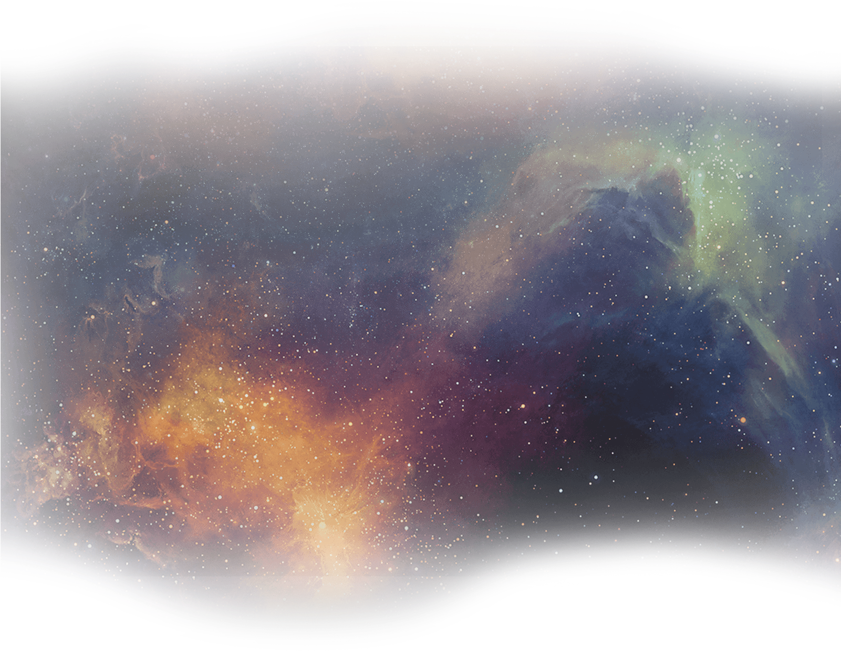






GSI - Compressed Baryonic Matter
Silicon Tracking Systems - Cold Start Up Experiment
Dachi Okropiridze
GSI Fair

Slide 2
Outline
The universe in the lab
GSI - Helmholtzzentrum für Schwerionenforschung
GSI Fair - The four pillars
GSI Fair - Project Plan
GSI Fair - Video
CBM
CBM - Setup
STS Module
Cold StartUp Experiment

Slide 3
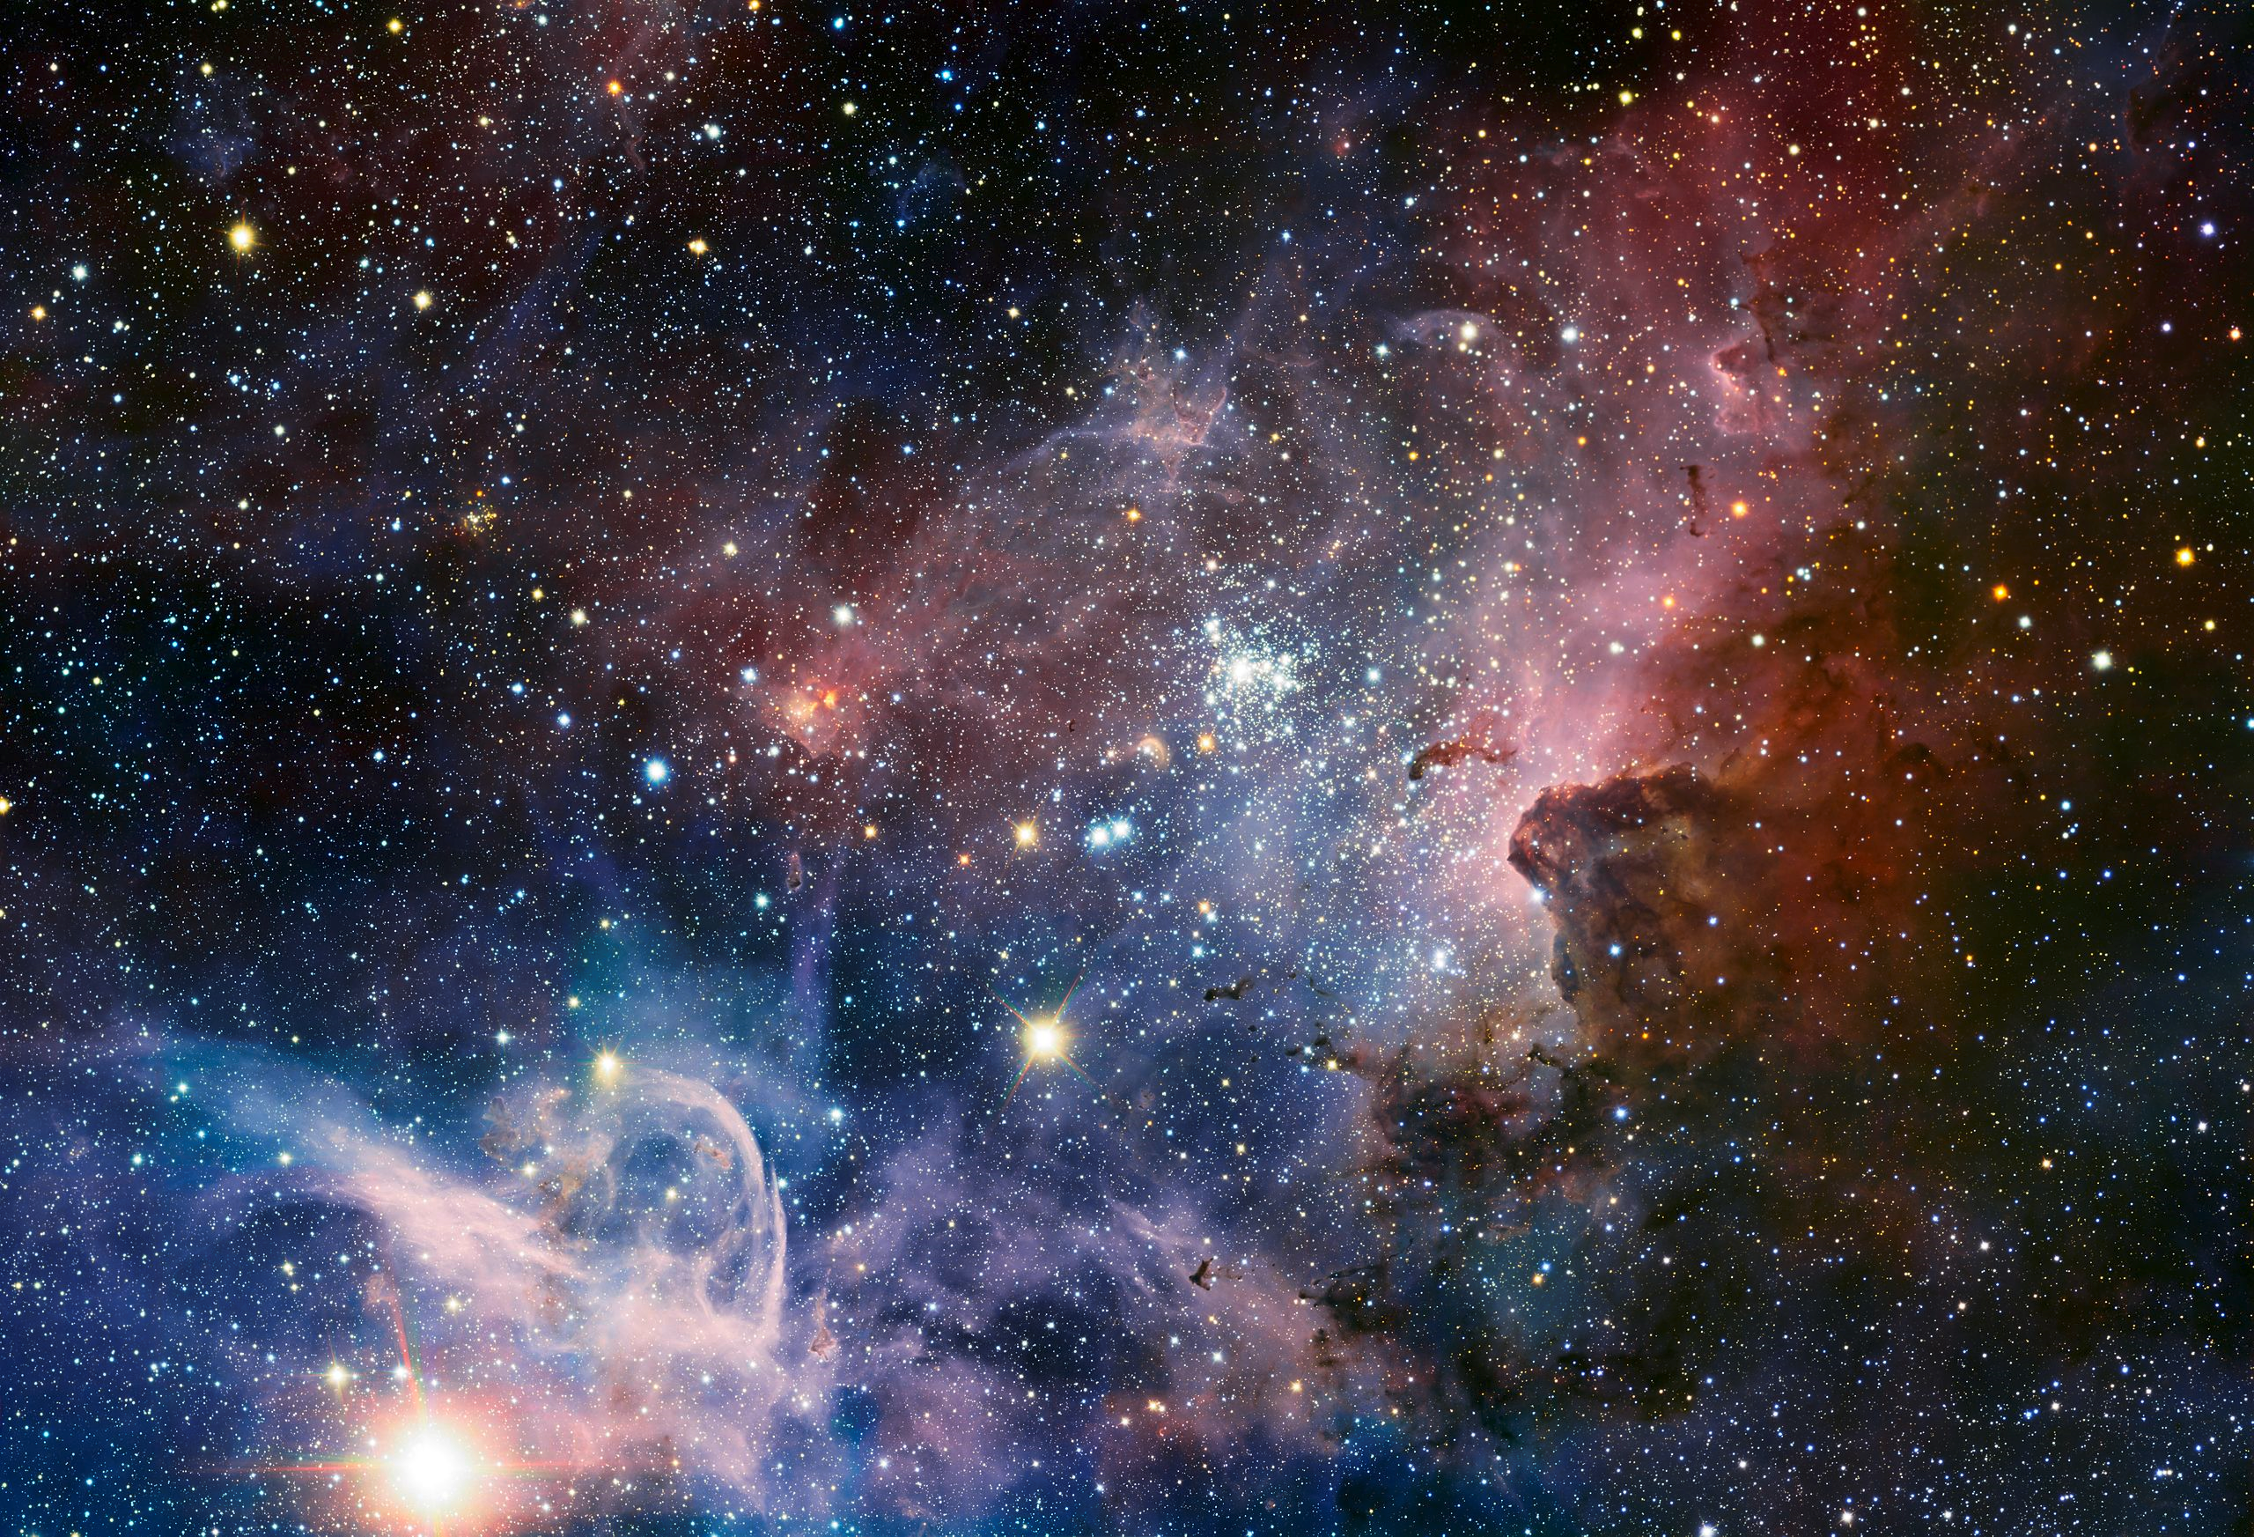

Slide 4
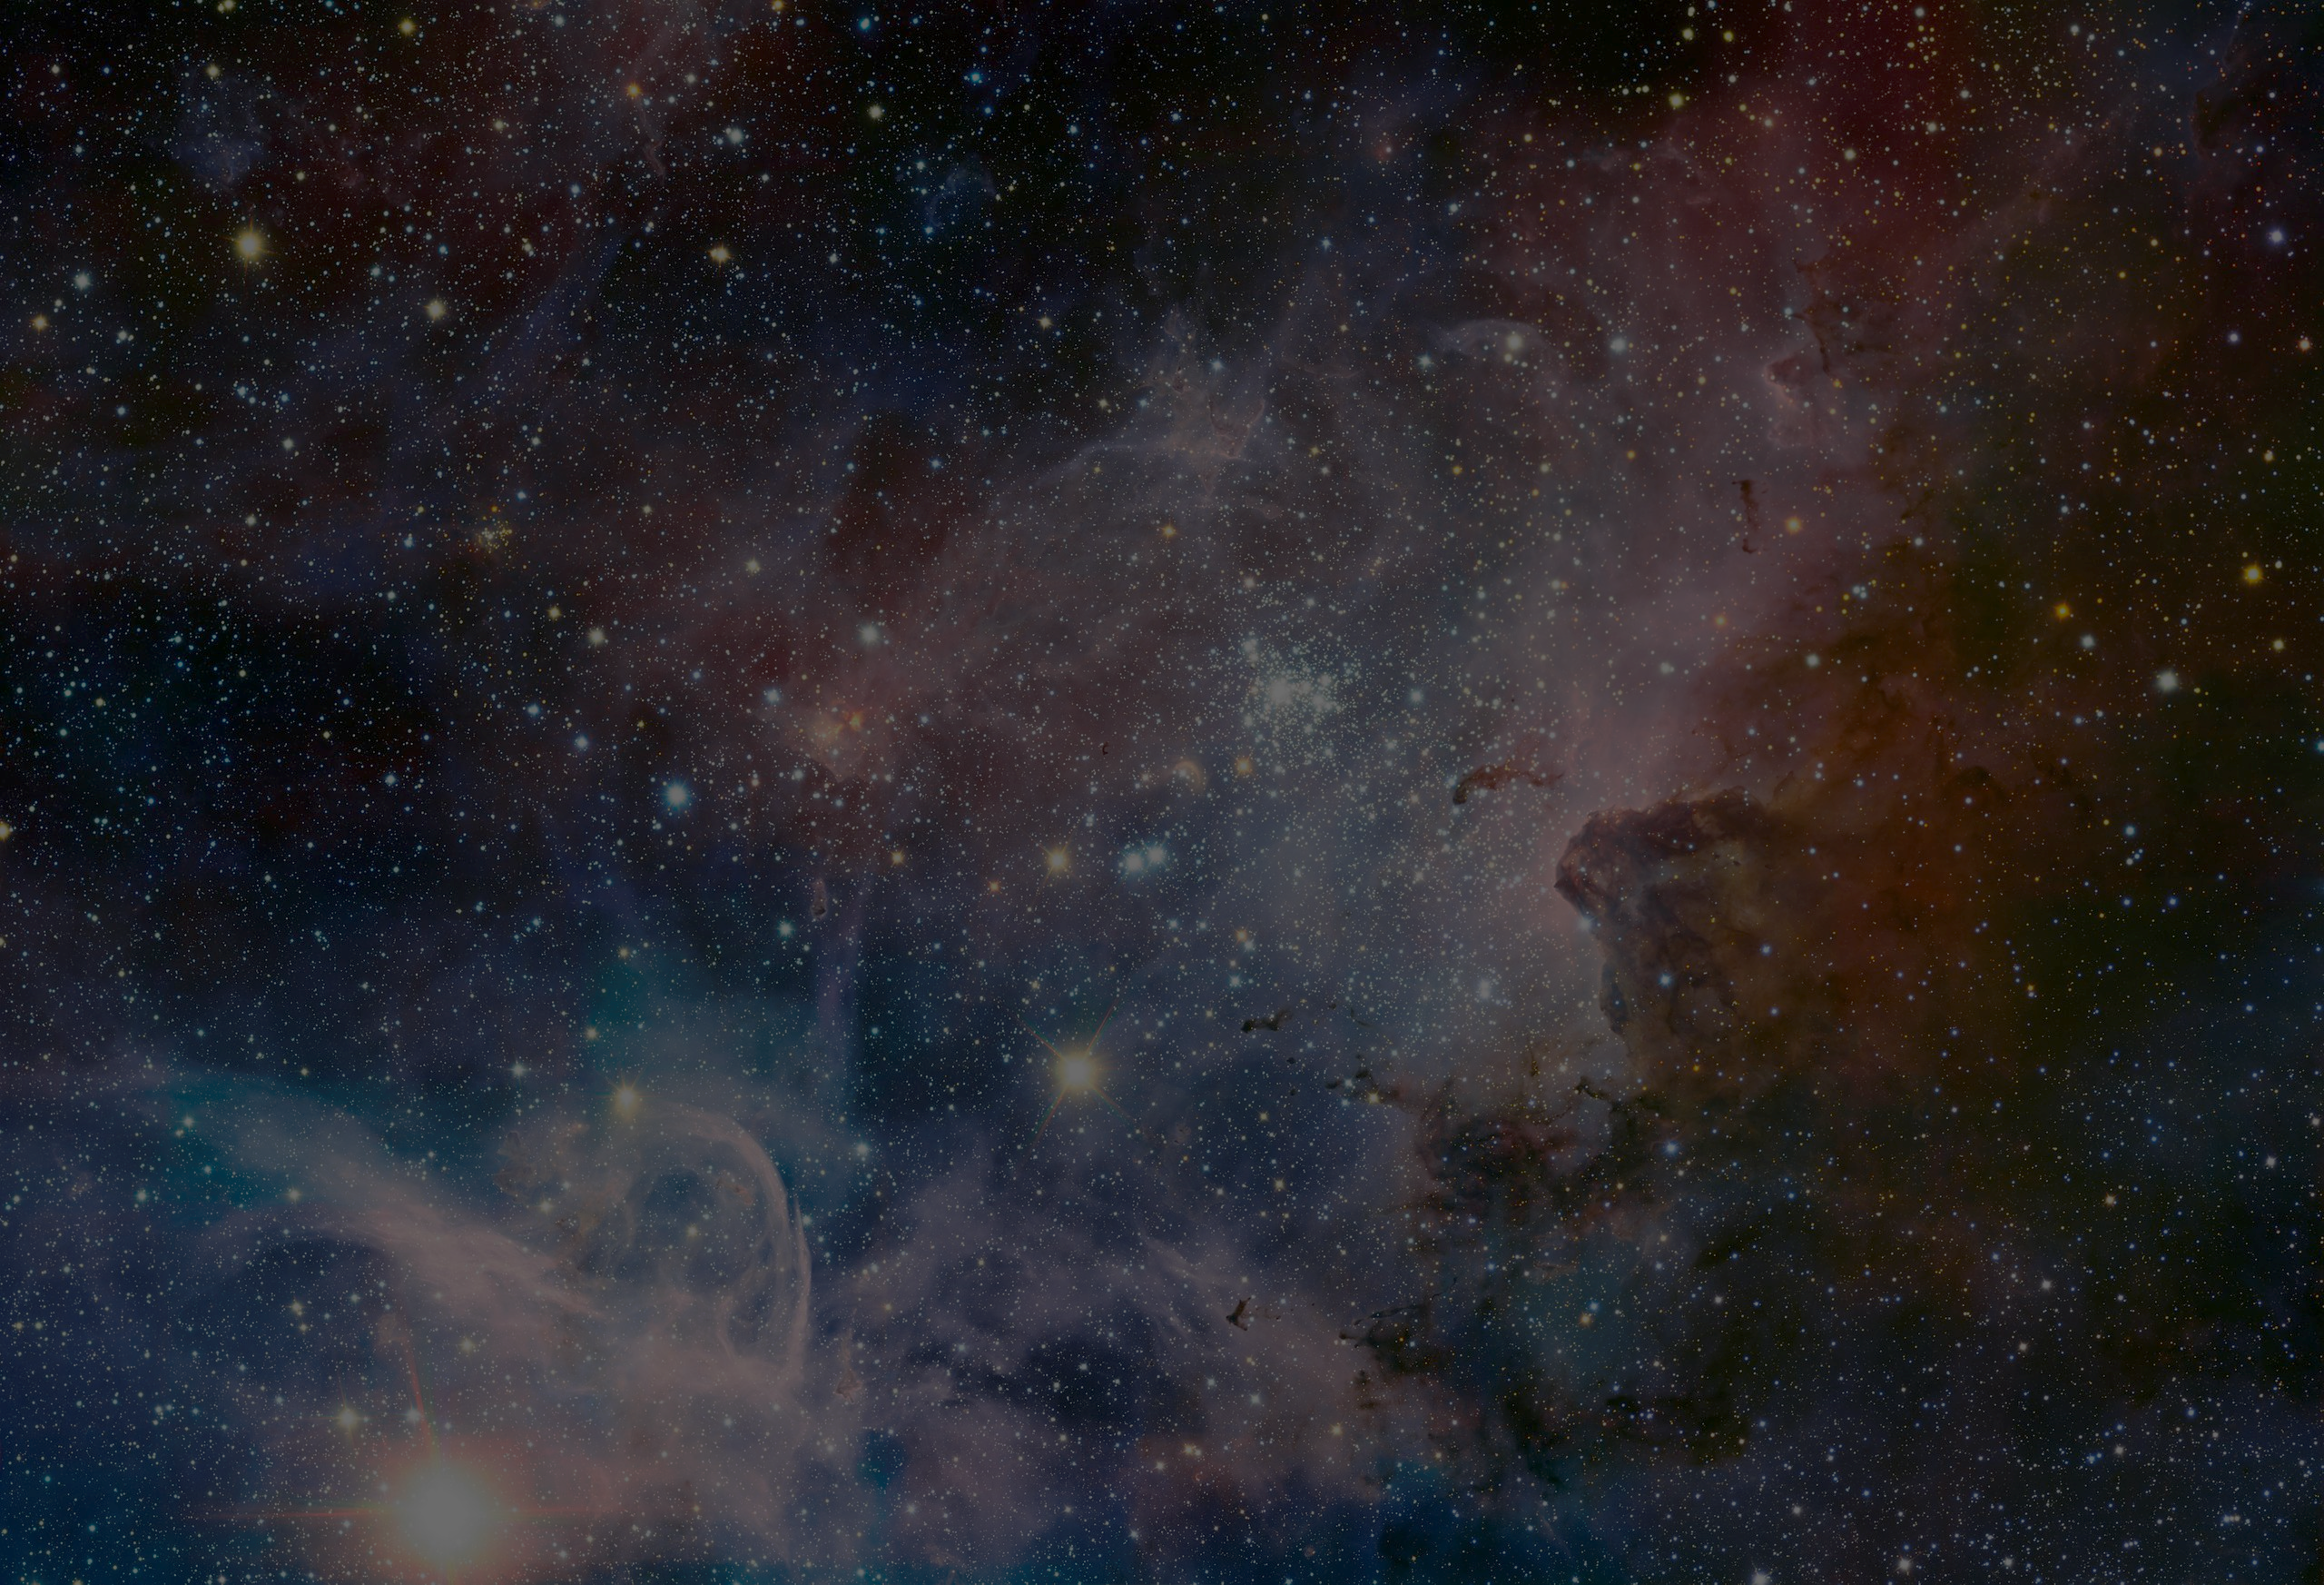
The universe in the lab
In giant planets, stars, and during stellar explosions and collisions,
matter is subject to extreme conditions such as very high temperatures,
pressures, and densities
FAIR will enable scientists to create such conditions in the laboratory. To do so, they will bombard small samples of matter with particles. These collisions will, for very short periods of time, create cosmic matter at the tiny impact points.
GSI and GSI FAIR Facilities will allow researchers to study the early stages of universe, matter at extreme conditions in the rarest places of universes such as Neutron stars and Supernovae
Research at GSI will push the limits of our technology and knowledge

Slide 6
GSI - Helmholtzzentrum für Schwerionenforschung
Research since 1969 – Atomic, Plasma and nuclear physics to materials science and biophysics
Discovery of Six new elements 107 – 112
Cancer therapy with heavy ions
Notes:
Scientists have been experimenting with heavy ions since 1969. Their aim is to gain new insights into the building blocks of matter. The research topics range from atomic, plasma and nuclear physics to materials science and biophysics.
The elements 107 to 112 were produced and detected for the first
time at GSI. With the help of a particle accelerator, two chemical
elements from the periodic table can be fused together to form a
new one.
A new form of cancer treatment was developed at GSI. From 1997
until 2008 more than 440 patients who suffered from tumors in
the head or neck region were treated with heavy ion beams. Ions
selectively damage tumor tissues while sparing the surrounding
healthy tissues. By now the therapy is well-established in clinics and
meanwhile scientists at GSI are working on its further development.

Slide 7
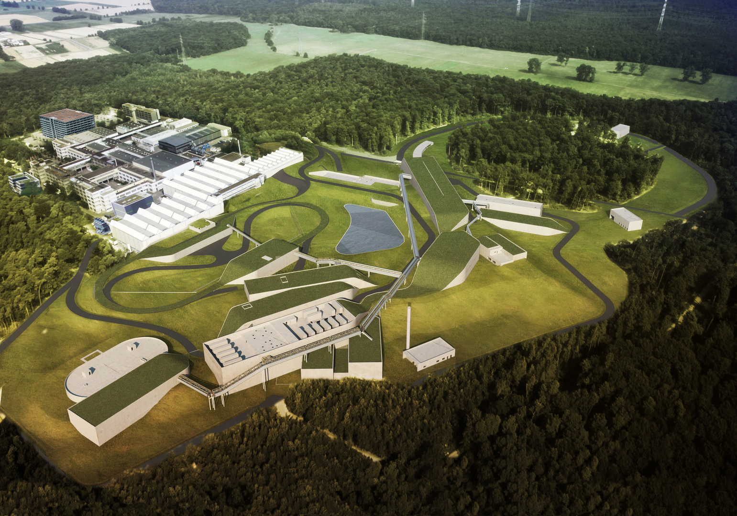

Slide 8
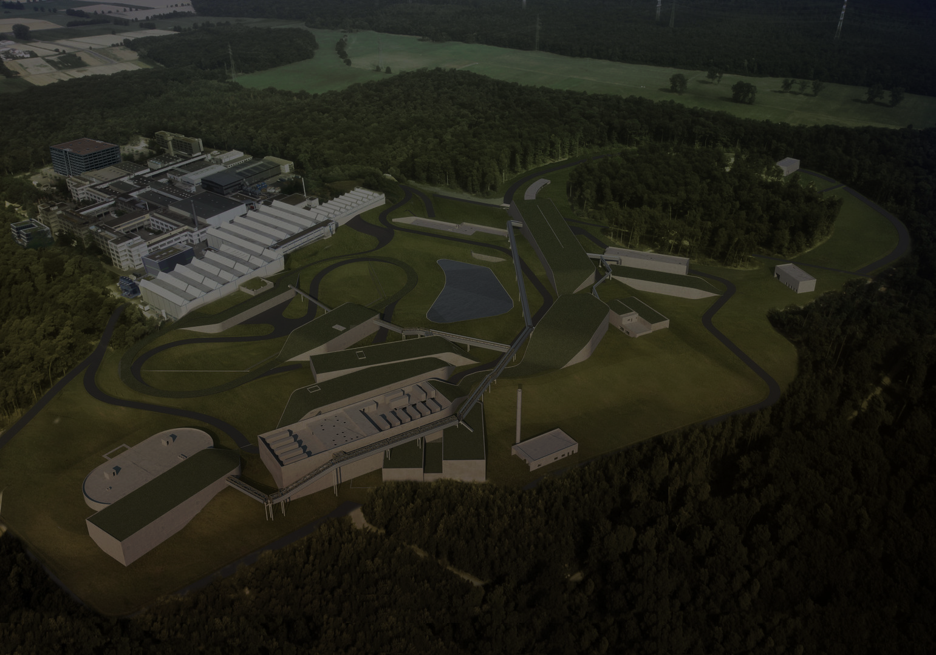
GSI Fair - The four pillars
CBM — INSIDE A NEUTRON STAR
In what form does matter exist in neutron stars the extremely compact remnants of supernova explosions?
APPA — FROM ATOMS AND PLANETS TO CANCER THERAPY
Which fundamental symmetries define our universe? What are the properties of the high density plasmas that occur in the interiors of large planets? How can we use particles to heal diseases, and how can we protect astronauts against cosmic radiation? Can we use ion beams to change specific properties of materials?
PANDA — ANTIMATTER RESEARCH
How can antimatter help us understand the mass of matter and the strong force?
NUSTAR — STARS AND NUCLEI
How are heavy chemical elements created in stars and stellar explosions?

Slide 9
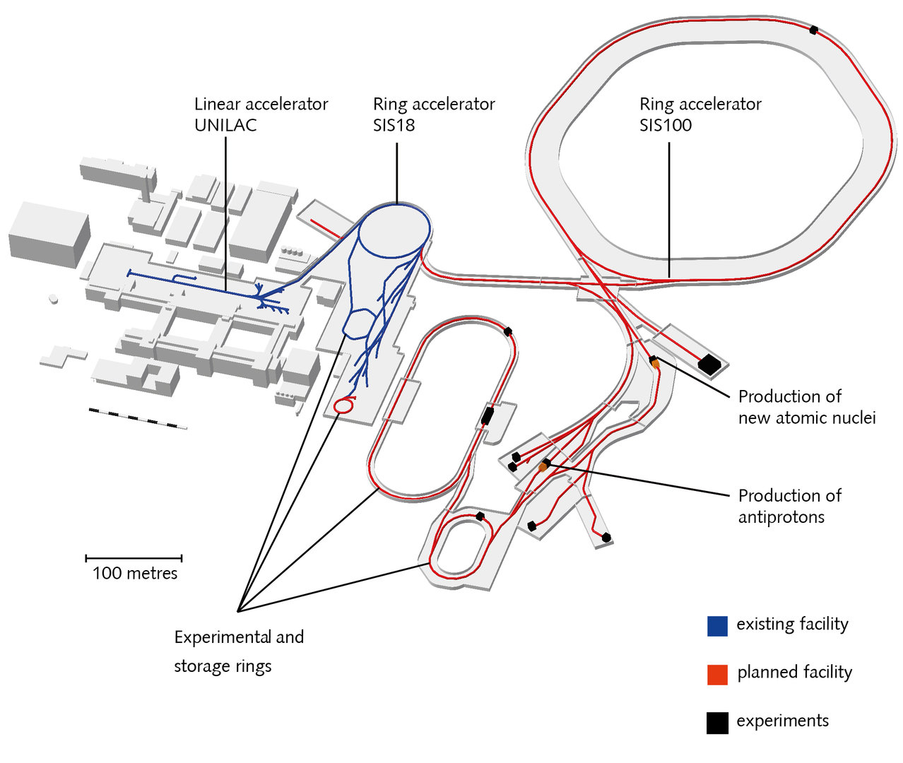
UNILAC (120 m length) SIS18 (216 m circumference)
Experimental Storage Ring ESR (108 m circumference)
All elements of the periodic table can be accelerated
Discovery of six new elements and many exotic nuclei
Development of a new cancer treatment
The GSI facility will be the first acceleration stage of FAIR
The heart of the future facility is the ring accelerator
SIS100 with a circumference of 1.1 km
Numerous large experiments and storage rings
Acceleration of all elements of the periodic table and antiprotons
Up to 99% of the speed of light
Intensity increased up to 10,000 times
The highest beam quality and precision

Slide 10
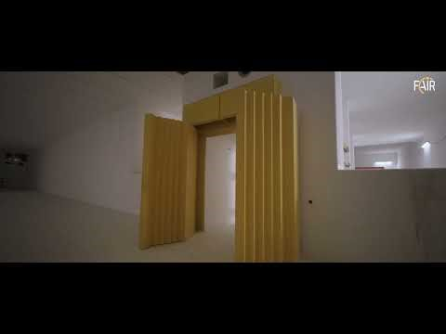

Slide 11
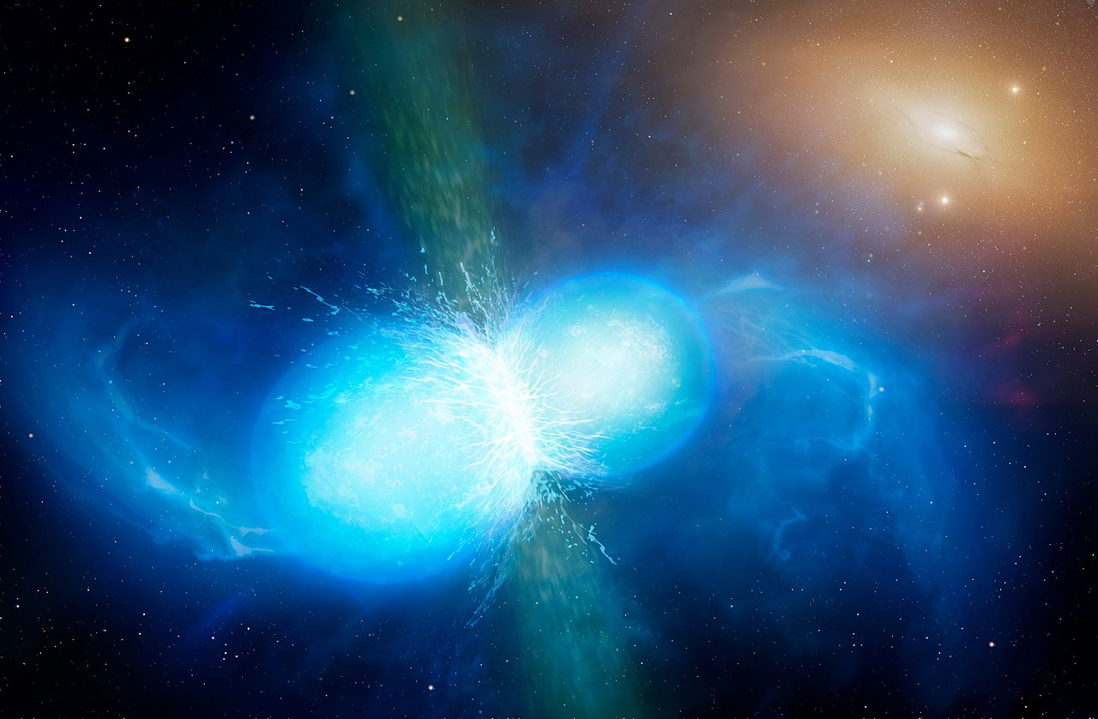

Slide 12
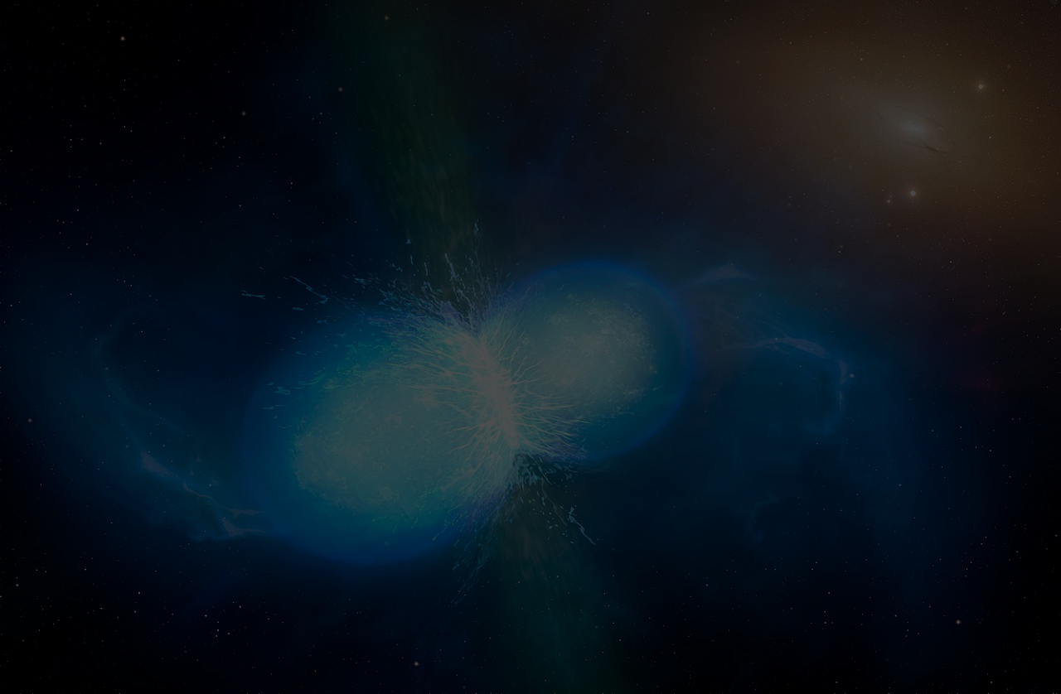
The Compressed Baryonic Matter (CBM)
To explore the properties of nuclear matter at high densities using high-energy nucleus-nucleus collisions
the study of the equation-of-state, which governs the structure of neutron stars, and the dynamics of supernova explosions and of neutron star mergers
the search for a predicted phase transition at high densities, where the nucleons are expected to dissolve into their elementary constituents, and chiral symmetry is restored
The CBM detector is designed to measure the collective behavior of hadrons, together with rare diagnostic probes such as multi-strange hyperons, charmed particles and lepton pairs with unprecedented precision and statistics
Notes:
The Compressed Baryonic Matter (CBM) experiment will be one of the major scientific pillars of the future Facility for Antiproton and Ion Research (FAIR) in Darmstadt. The goal of the CBM research program is to explore the properties of nuclear matter at high densities using high-energy nucleus-nucleus collisions. This includes the study of the equation-of-state, which governs the structure of neutron stars, and the dynamics of supernova explosions and of neutron star mergers. A fundamental aspect of the CBM program is the search for a predicted phase transition at high densities, where the nucleons are expected to dissolve into their elementary constituents, and chiral symmetry is restored.
The CBM detector is designed to measure the collective behaviour of hadrons, together with rare diagnostic probes such as multi-strange hyperons, charmed particles and lepton pairs with unprecedented precision and statistics. Most of these particles will be studied for the first time in the FAIR energy range. In order to achieve the required precision, the measurements will be performed at reaction rates up to 10 MHz. This requires very fast and radiation hard detectors, a novel data read-out and analysis concept including free streaming front-end electronics, and a high performance computing cluster for online event selection. The CBM prototype detectors, the data read-out chain and the event reconstruction algorithms are under commissioning in the miniCBM experiment with heavy-ion beams at GSI-SIS18, and partly used in other experiments like HADES at GSI and STAR at RHIC-BNL during the FAIR phase 0.
The CBM experiment is realized by an international collaboration of 470 scientists from 56 institutions and 12 countries. The last face-to-face collaboration meeting took place in Kolkata (India) from Sept. 29

Slide 13
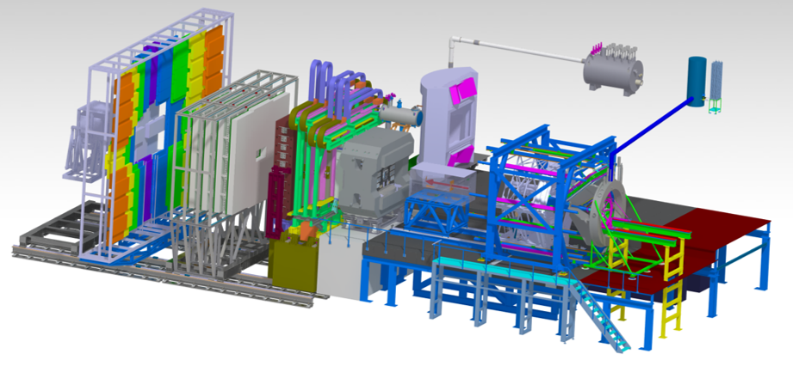
The Compressed Baryonic Matter (CBM)
The HADES detector (right) and the CBM experimental setup (left)
Notes:
DON’T READ THIS !!!! The research program on dense QCD matter at FAIR will be performed by the experiments CBM and HADES which are shown in figure 1. The two setups will be operated alternatively. The HADES detector, with its large polar angle acceptance ranging from 18 to 85 degrees, is well suited for reference measurements with proton beams and heavy-ion collision systems with moderate particle multiplicities, such as Ni+Ni or Ag+Ag at low SIS100 energies. With the HADES detector, electron-positron pairs and hadrons including multi-strange hyperons can be reconstructed.
Fig. 1: The HADES detector (right) and the CBM experimental setup (left) (see text). The CBM setup comprises the superconducting magnet hosting the STS and the MVD, the MuCh in measuring position and the RICH in parking position, the TRD, the TOF and the PSD (see text). When operating HADES, a beam dump will be installed in front of the CBM magnet.The CBM setup is a fixed target experiment which will be capable to measure hadrons, electrons and muons in heavy-ion collisions over the full FAIR beam energy range. In a central collision of two gold nuclei at FAIR energies, about 700 charged particles are emitted. The tracks of these particles will be measured by a Silicon Tracking System (STS) consisting of 8 layers of double-sided micro-strip sensors located in a magnetic field of a superconducting dipole magnet. The identification of hadrons requires an additional time-of-flight (TOF) measurement, which is performed by a wall of Multi-Gap Resistive Plate Chambers with an active area of about 120 m² located about 7 m downstream the target. A Micro-Vertex-Detector (MVD), consisting of four layers of silicon monolithic active pixel sensors located in front of the STS, provides high-precision information of secondary decay vertices of short-lived particles like of open charm mesons.
The identification of electrons and positrons is performed by a Ring Imaging Cherenkov (RICH) detector and a Transition Radiation Detector (TRD). Muons will measured by a Muon Chamber (MUCH) system which consists of Gas Electron Multiplier detector triplets sandwiched between hadron absorber plates made of graphite and iron. For muon measurements, the RICH detector will be replaced by the MUCH, and the TRD serves as tracking detector after the last hadron absorber. The reaction plane angle of the collision will be measured with the Project Spectator Detector (PSD), which is a segmented hadronic calorimeter located 10-15 m downstream the target.
In order to perform high precision measurements of rare diagnostic probes, the CBM experiment will be operated at collision rates up to 10 MHz, leading to data rates up to 1 TB per second. To achieve the required performance, a free-streaming, trigger-less Data Acquisition System (DAQ) is under development. All detector signals are readout by ultra-fast and radiation-tolerant ASICs as front-end chips, which mark each hit with a time stamp, and send it to CERN GBTx-based radiation-tolerant data aggregation units. Further down-stream, the data streams are handled by Common Readout Interface (CRI) boards containing powerful FPGAs, and are forwarded via a PCIe based FPGA board to the entry node of a large-scale computer farm, the First-Level Event Selector (FLES). Finally, the data are transmitted via a high-speed optical connection (InfiniBand) to the FLES processing nodes, which are located in the high-performance computing center of GSI, the GreenIT cube. Upon reception in a FLES processing node, the micro-slices originating from all active subsystems, i.e the detector hits with time stamps collected over about 100 ms, are grouped into larger time-slices of about 100 ms, containing information from all detector systems. These time-slices then are used for the online data reconstruction and selection.
In order to perform a full system test of the CBM data readout and acquisition chain, the miniCBM (mCBM) experiment has been installed at SIS18. The mCBM setup comprises final prototypes and pre-series components of all CBM detector subsystems and their read-out systems. The setup allows the commissioning of the free-streaming data acquisition system, the data transport to the high performance computer farm inside the GreenIT Cube, the online track and event reconstruction and event selection algorithms. In addition, high-rate detector tests will be performed with nucleus-nucleus collisions under realistic experiment conditions up to interaction rates of 10 MHz.
Detailed information on the various hardware and software developments towards the realization of the CBM experiment is presented in the CBM Progress Report 2019 (link).

Slide 14
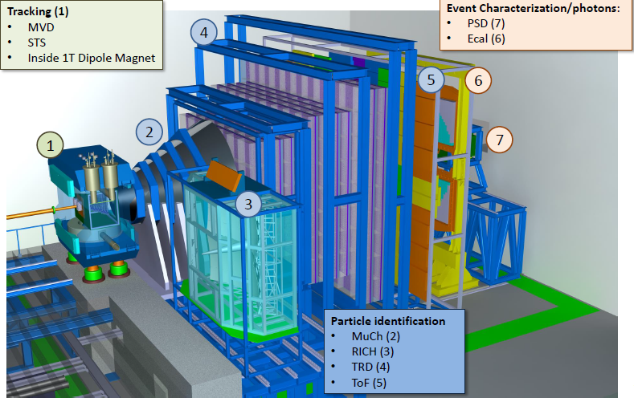
The Compressed Baryonic Matter (CBM) - Setup
CBM will measure hadrons, electrons and muons in heavy-ion collisions
CBM consists of :
  Silicon Tracking System (STS)
  Micro-Vertex-Detector (MVD)
  Superconducting Magnet with MVD and STS
  Muon Chamber (MuCH)
  Ring Imaging Cherenkov (RICH)
  Transition Radiation Detector (TRD)
  Project Spectator Detector (PSD)
Two gold nuclei collision will emit 700 charged particles
Notes:
The research program on dense QCD matter at FAIR will be performed by the experiments CBM and HADES which are shown in figure 1. The two setups will be operated alternatively. The HADES detector, with its large polar angle acceptance ranging from 18 to 85 degrees, is well suited for reference measurements with proton beams and heavy-ion collision systems with moderate particle multiplicities, such as Ni+Ni or Ag+Ag at low SIS100 energies. With the HADES detector, electron-positron pairs and hadrons including multi-strange hyperons can be reconstructed.
Fig. 1: The HADES detector (right) and the CBM experimental setup (left) (see text). The CBM setup comprises the superconducting magnet hosting the STS and the MVD, the MuCh in measuring position and the RICH in parking position, the TRD, the TOF and the PSD (see text). When operating HADES, a beam dump will be installed in front of the CBM magnet.The CBM setup is a fixed target experiment which will be capable to measure hadrons, electrons and muons in heavy-ion collisions over the full FAIR beam energy range. In a central collision of two gold nuclei at FAIR energies, about 700 charged particles are emitted. The tracks of these particles will be measured by a Silicon Tracking System (STS) consisting of 8 layers of double-sided micro-strip sensors located in a magnetic field of a superconducting dipole magnet. The identification of hadrons requires an additional time-of-flight (TOF) measurement, which is performed by a wall of Multi-Gap Resistive Plate Chambers with an active area of about 120 m² located about 7 m downstream the target. A Micro-Vertex-Detector (MVD), consisting of four layers of silicon monolithic active pixel sensors located in front of the STS, provides high-precision information of secondary decay vertices of short-lived particles like of open charm mesons.
The identification of electrons and positrons is performed by a Ring Imaging Cherenkov (RICH) detector and a Transition Radiation Detector (TRD). Muons will measured by a Muon Chamber (MUCH) system which consists of Gas Electron Multiplier detector triplets sandwiched between hadron absorber plates made of graphite and iron. For muon measurements, the RICH detector will be replaced by the MUCH, and the TRD serves as tracking detector after the last hadron absorber. The reaction plane angle of the collision will be measured with the Project Spectator Detector (PSD), which is a segmented hadronic calorimeter located 10-15 m downstream the target.
Detailed information on the various hardware and software developments towards the realization of the CBM experiment is presented in the CBM Progress Report 2019 (link).

Slide 15
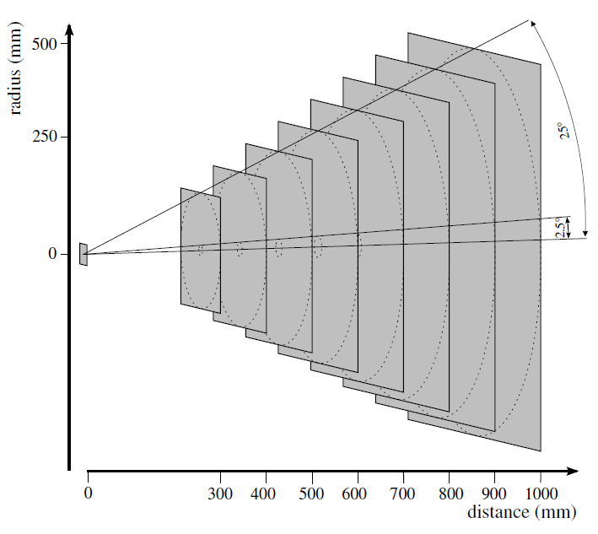
Silicon Tracking System (STS) – Physical, Design constraints
Aperture - 2.5 - 25 degrees (polar)
Spatial resolution - single-hit resolution of about 25 μm
Hit rates - 10 MHz per cm2
Signal shaping time - In order to avoid pile-up of events, fast self-triggering front-end electronics with a shaping time of the order of 20 ns have to be used.
Radiation damage - 1 MeV neutron equivalent fluence in the innermost regions of the STS reaching less than 10^13 per cm2 – Sensors need to be operated at bias voltages up to 500 V and temperature -5 C
Notes:
Design constraints
The design of the Silicon Tracking System is based on the following constraints:
Aperture
For the conception of the CBM experiment, the polar aperture 2.5 - 25 was chosen throughout
all detector systems to cover the hemisphere in the laboratory frame, i.e. from center-of-mass
rapidity close to beam rapidity. Examples of rapidity distributions of bulk probes are given in
Chapter 2.6.
Spatial resolution
Simulation studies have demonstrated that a single-hit resolution of about 25 μm provides the
required momentum resolution mainly determined by multiple scattering. A read-out strip pitch
of 58 μm was chosen matching this requirement.
Hit rates
Charged particle rates of about 10 MHz per cm2 are expected in the innermost regions of the
STS. They fall off by two orders of magnitude in the outer regions of the STS. Different read-out
strip lengths were chosen for different regions of the STS to keep maximum strip occupancies at
the level of a few percent.
Signal shaping time
In order to avoid pile-up of events, fast self-triggering front-end electronics with a shaping time
of the order of 20 ns have to be used.
Single-hit efficiency, track reconstruction efficiency
A detection layer should provide close to 100 per cent single-hit efficiency still keeping a low
noise hit rate. Earlier studies have shown [17] that a signal-to-noise ratio (the most probable
amplitude for a MIP divided by the RMS of the single strip noise distribution) has to be kept
exceeding 10 even after signal deterioration due to the radiation damage. The track reconstruction
algorithms utilizing the hits shall enable the trajectory finding with an efficiency exceeding
95% for particle momenta larger than 1 GeV/c.
Radiation damage
The running scenario of the experiment results in a 1 MeV neutron equivalent fluence in the
innermost regions of the STS reaching less than 1013 per cm2 at SIS100 and 1 × 1014 per cm2 at
SIS300. Their replacement is foreseen in case the integrated fluence exceeds those values. Thus
standard silicon sensors can be used. The sensors need to be operated at bias voltages of up to
500 V, at a temperature of around -5 C to limit radiation damage induced leakage currents.
Material budget, momentum resolution
As by design the momentum resolution is dominated by multiple scattering, the material budget
of the STS has to be kept as small as possible. The STS is laid out such that front-end read-out
electronics, cooling and mechanical infrastucture are located outside of the detector acceptance.
The momentum resolution required for physics observables is p/p 1%.
Number of read-out channels
The largest read-out pitch compatible with the required spatial resolution and the longest readout
strips compatible with requirements on occupancy and signal-to-noise performance were
chosen in order to minimize the number of read-out channels. Both the number of read-out
channels and the material budget in the aperture can be decreased by deployment of doublesided
silicon microstrip sensors of appropriate strip length.

Slide 16
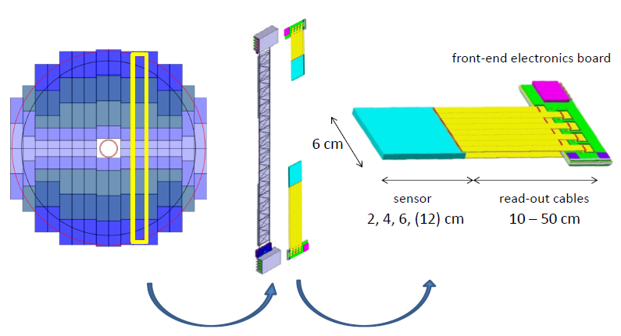
STS Module
Smallest assembled functional unit

Slide 17
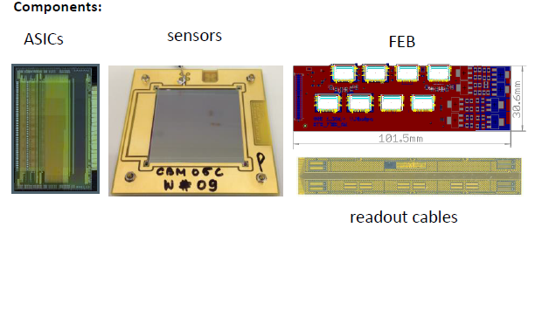
STS Module

Slide 18
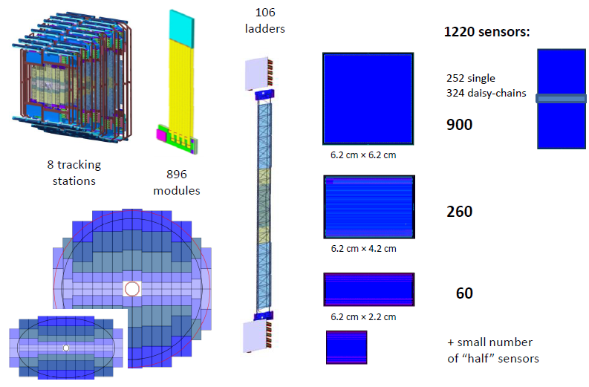
STS Module

Slide 19
Cold StartUp Experiment – Motivation & Objectives
The STS needs to operate under radiation environment, making effective cooling necessary
In the extreme conditions we need to know the performance of the STS modules
At what minimum temperatures they break and what is the weak point
What is the minimum Cold StartUp operating temperature (Emergency power switch off/on)

Slide 20
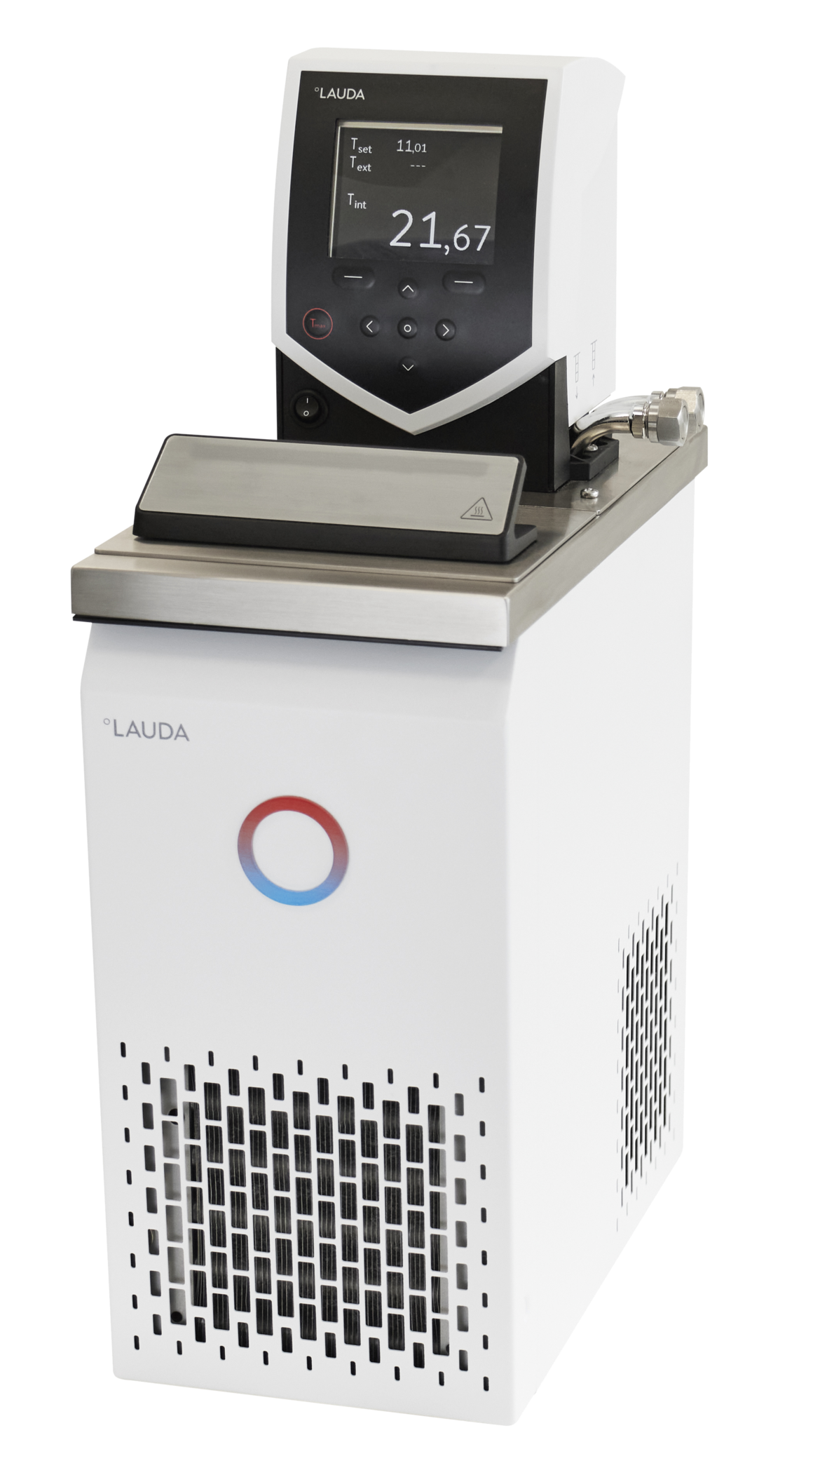
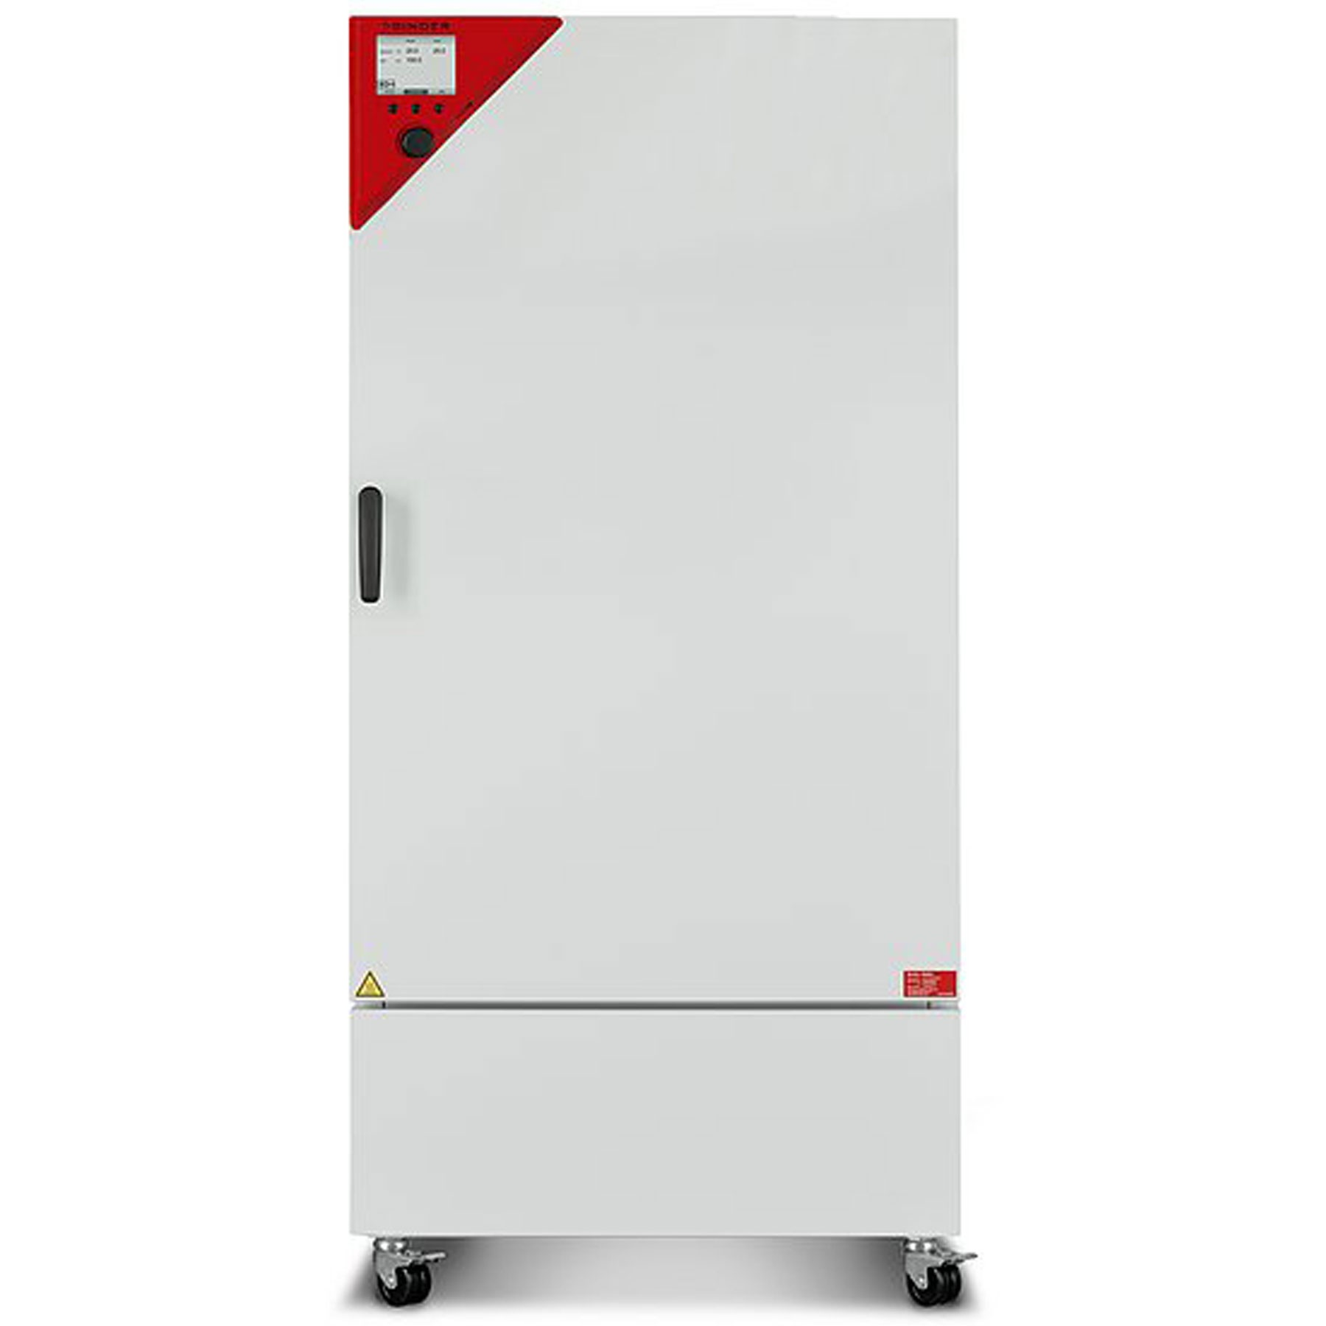
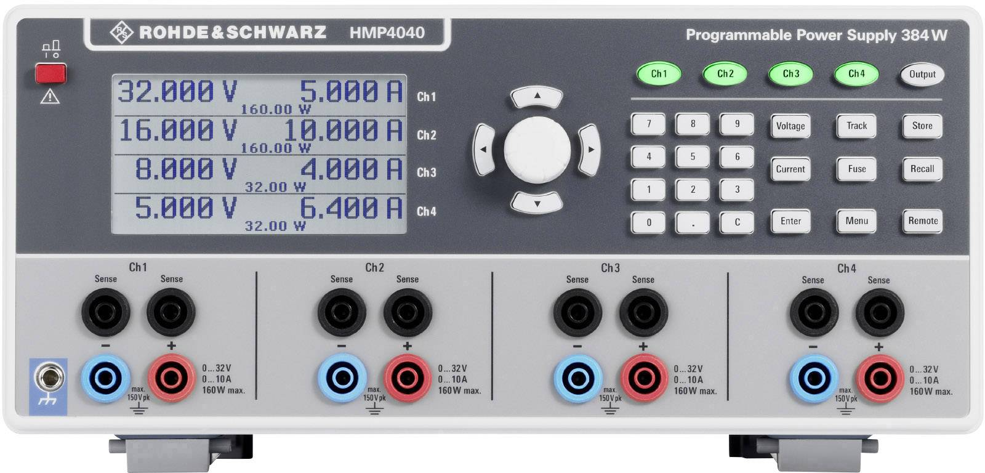
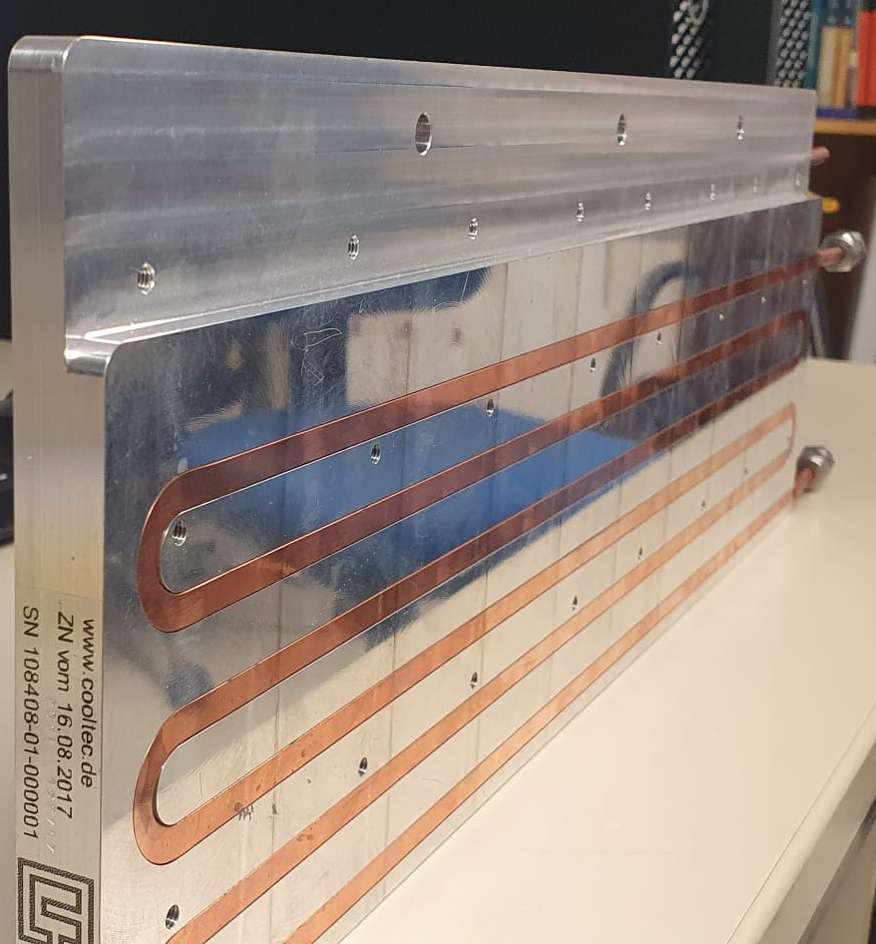
Cold StartUp Experiment
Binder – Cooling incubator
Lauda – cooling thermostat
Cooling plate and piping
Power Supplies for STS modules
Multiple sensors monitoring humidity, temperatures and electronics
Automated centralized (Epics) control of all systems (Binder, Lauda, Power supplies)
Automated experiment scenario in python coding language
Live testing of the STS module/Electronics performance
Visual inspection after experiment has ended

Slide 21
Cold Start Up Experiment Setup
3x Power Supplies
EMU board (FEB data readout)
Binder (Chiller/Freezer)
Epics Server (I/O Controllers)
Python Code
Cycling
FEB
FEB
Cooling plate
Lauda (External Freezer)
Kryo Liquid

Slide 22
Cold StartUp Experiment - Cycling
Cycling procedure is following:
Experiment starts with the setup (Binder, Lauda and FEBs) at a 20° C
The setup is being cooled down to -30°C
While being cooled FEB tests are running (Microchips are configured and various variables are measured)
When the setup reaches the desired temperature. FEBs are turned off waiting till the minimum temperature saturates
After “Cold minima” is reached the FEB tests are turned back on again running until “Cold maxima” of temperature is reached
After “Cold maxima” is reached, FEB tests are turned off again waiting the setup to reach the “Cold minima”
Cycle is being repeated

Slide 23
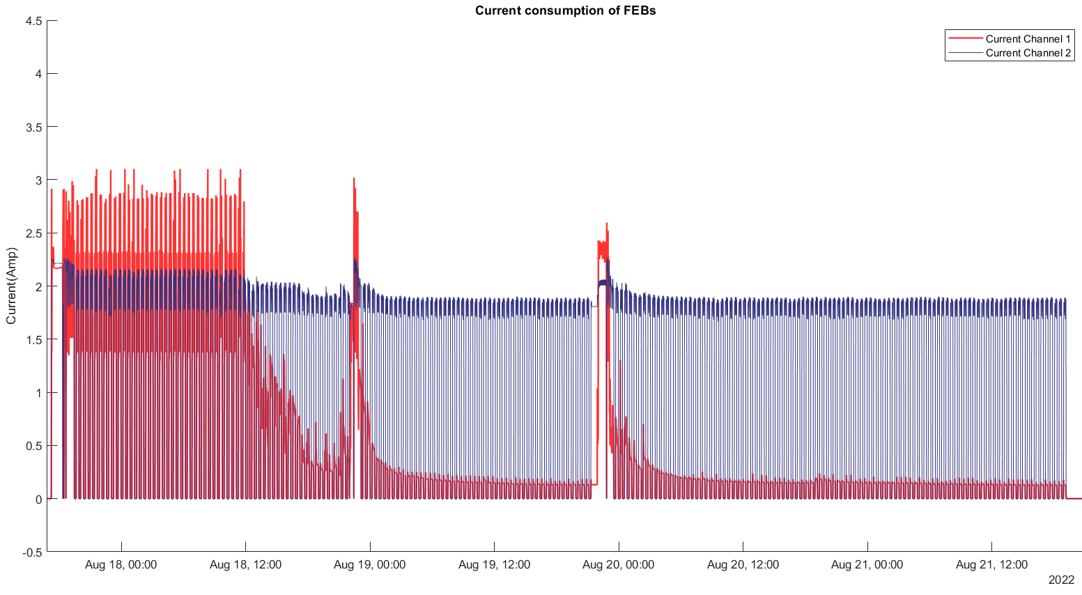
Cold StartUp Experiment - Cycling

Slide 24


Slide 25

It has been a pleasure! Hope you enjoyed it
Presentation by Dachi Okropiridze
under supervision of: Dr. Christian J. Schmidt, Dr. Irakli Keshelashvili
GSI

