Slide 1
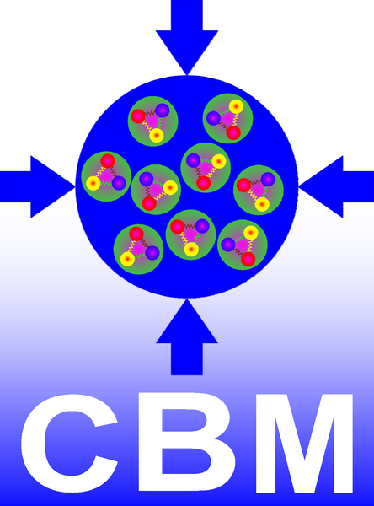
Micro Assembly Challenge: The CBM Silicon Tracking Station at FAIR Could SMART-Lab get involved?
Christian Joachim Schmidt
GGSB Tbilisi, Sept. 15th 2022

Slide 2
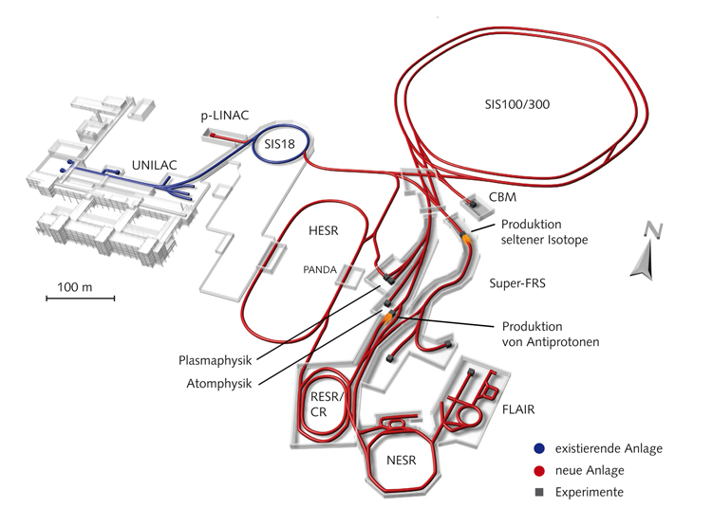
FAIR - Facility for Anti-Proton and Ion Research, Darmstadt
The GSI-future project under construction, operative in 2025 2028
a several billion Euro investment
in fundamental physics
1 km
circumference
CBM
p to U beams,
2 – 45 GeV/nucleon
highest intensities

Slide 3
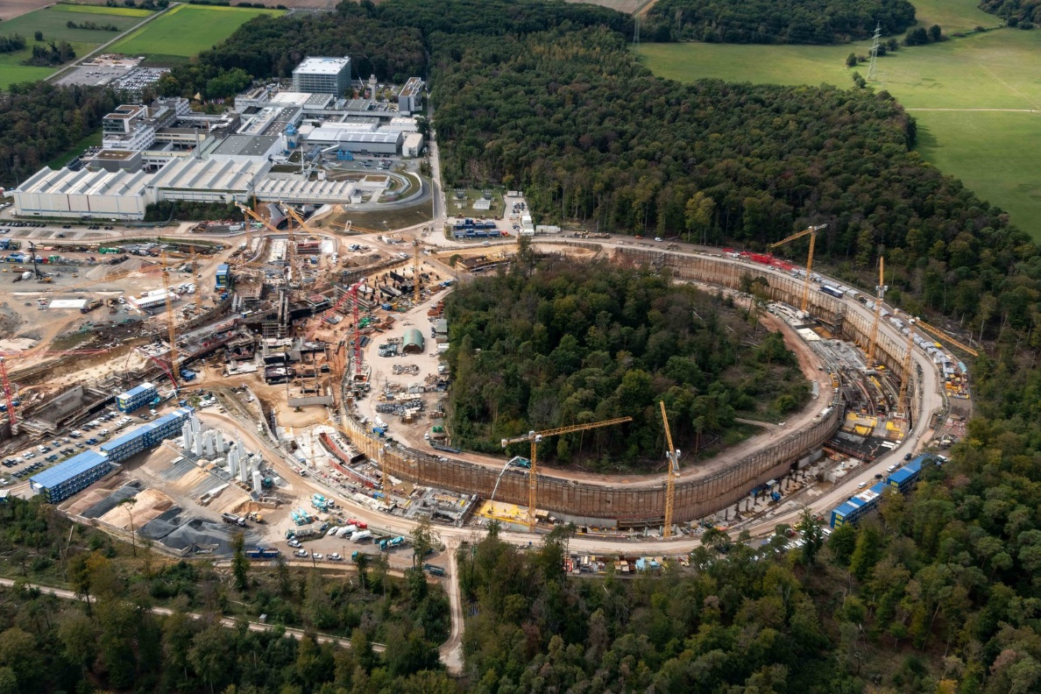

Slide 4
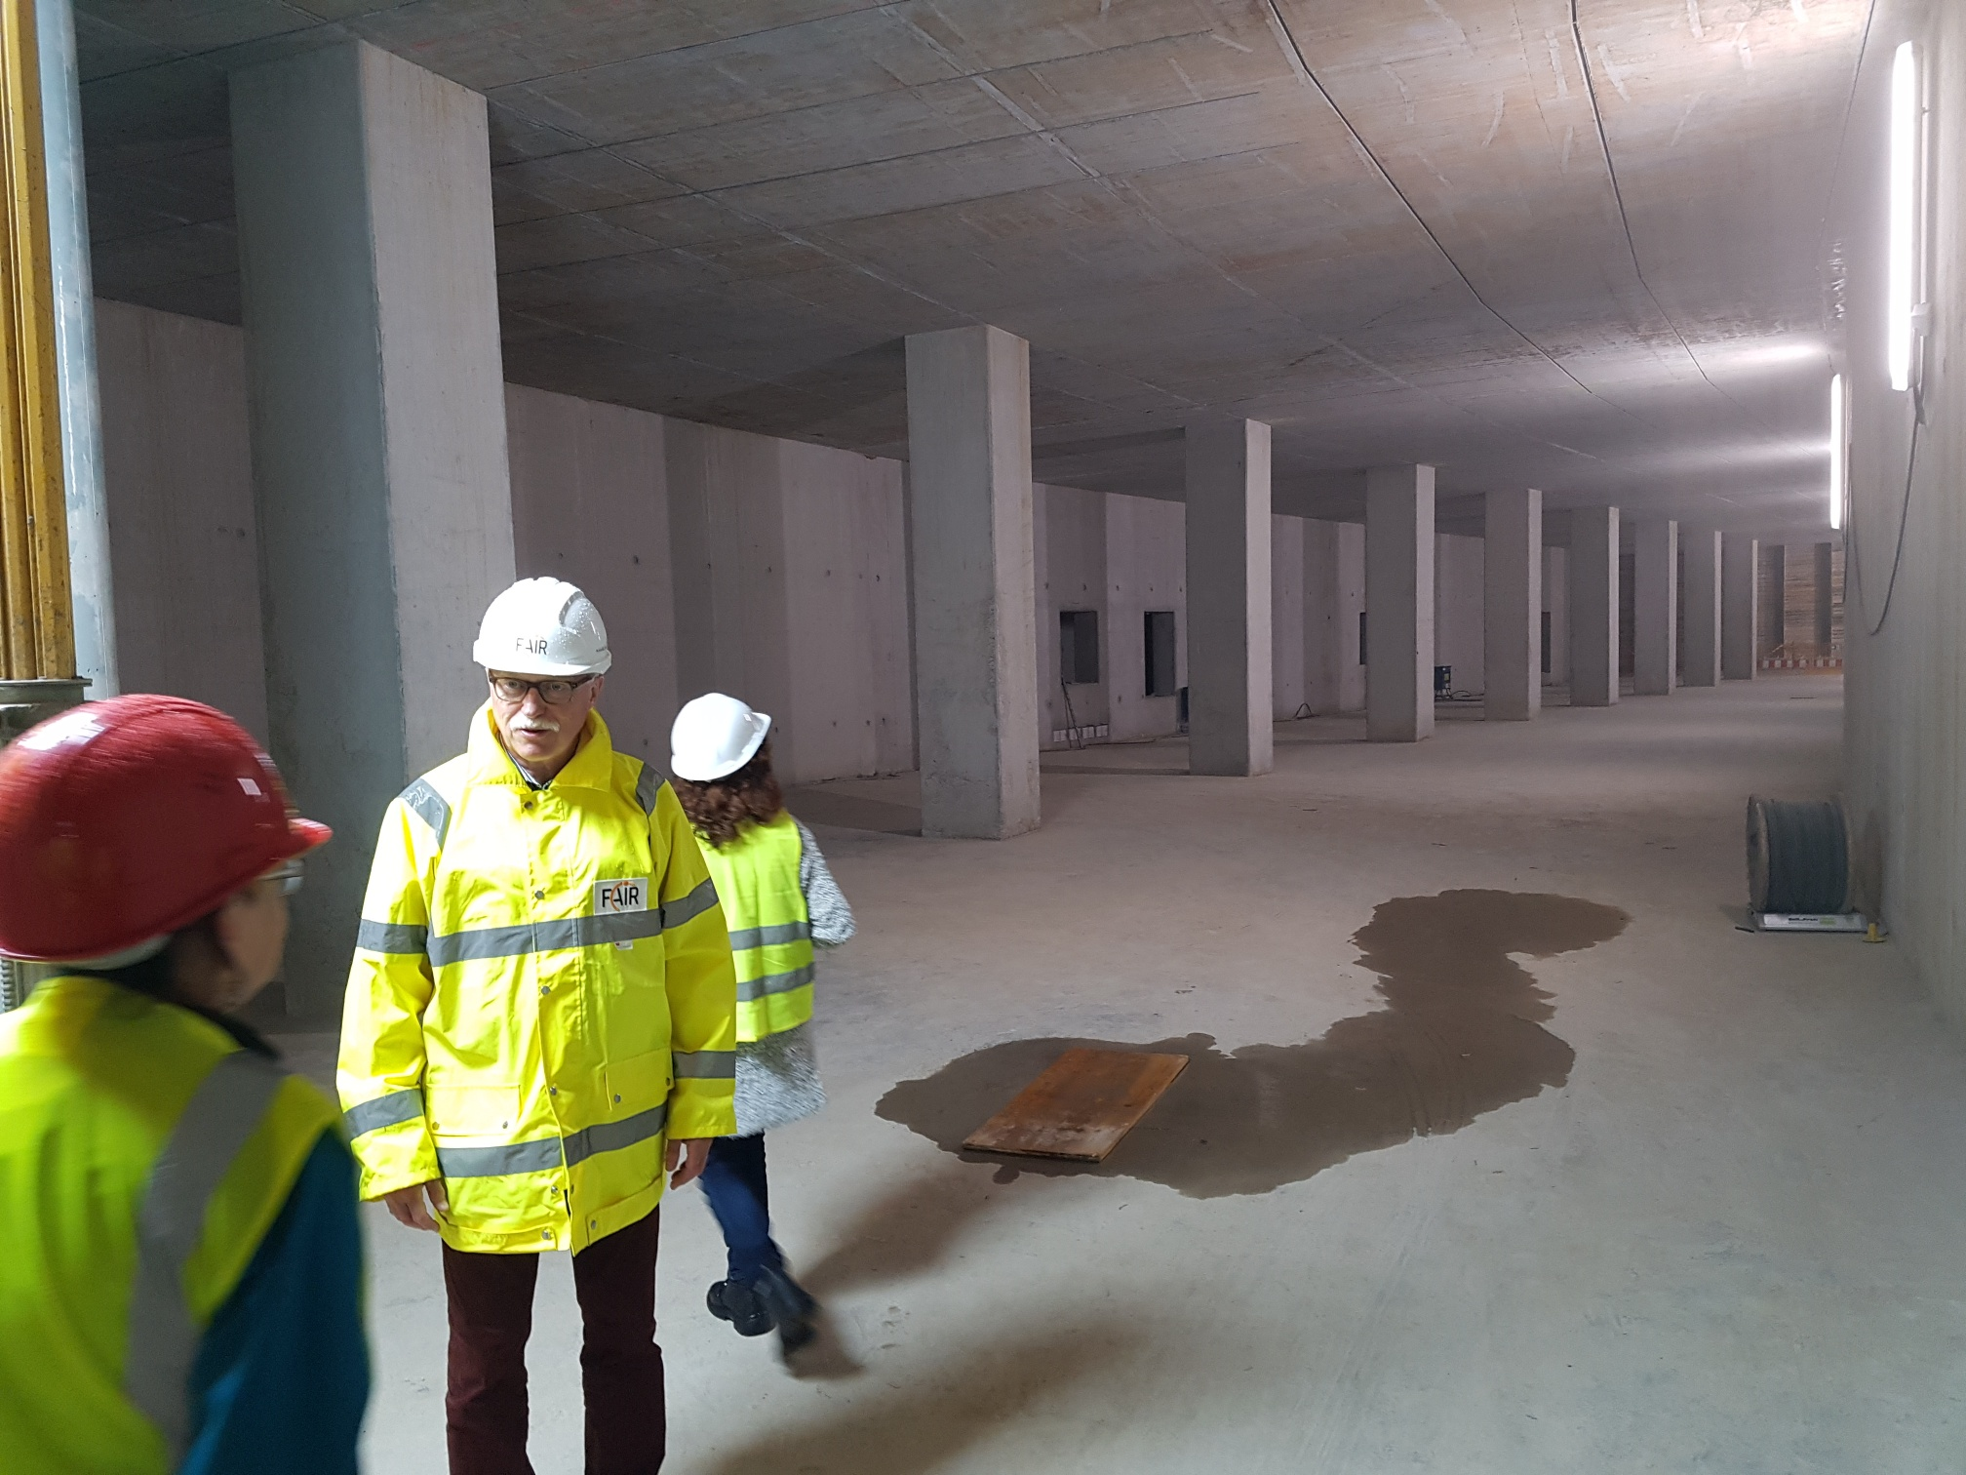
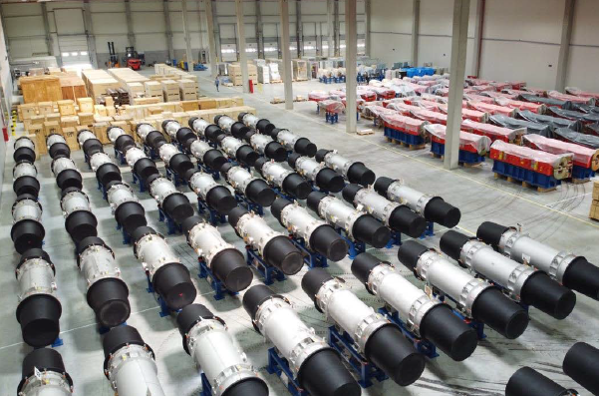
Synchrotron Magnets waiting!

Slide 5
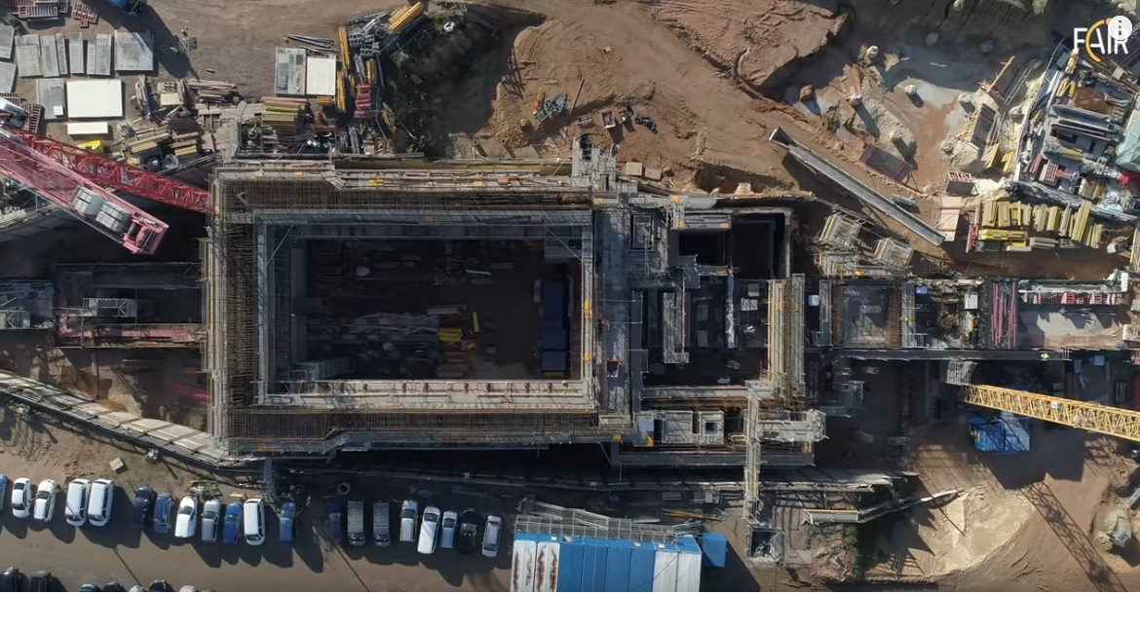
The CBM-Cave 2021
beam dump
4000 t iron
KIT-KASCADE

Slide 6
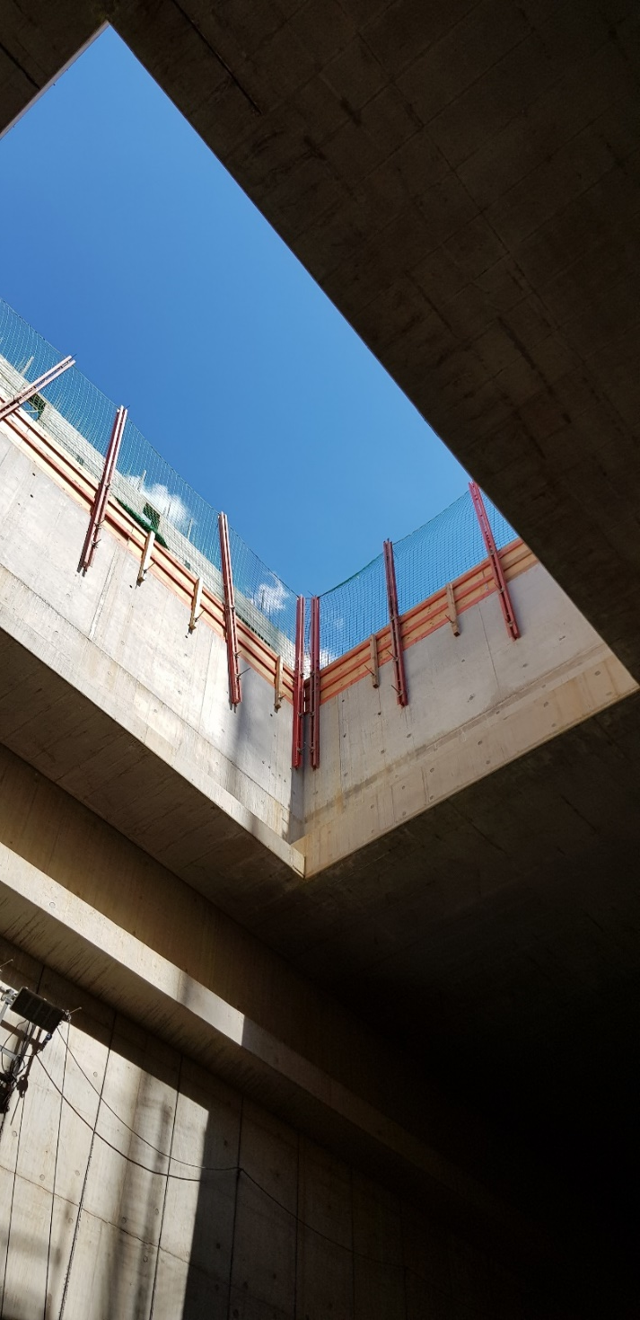
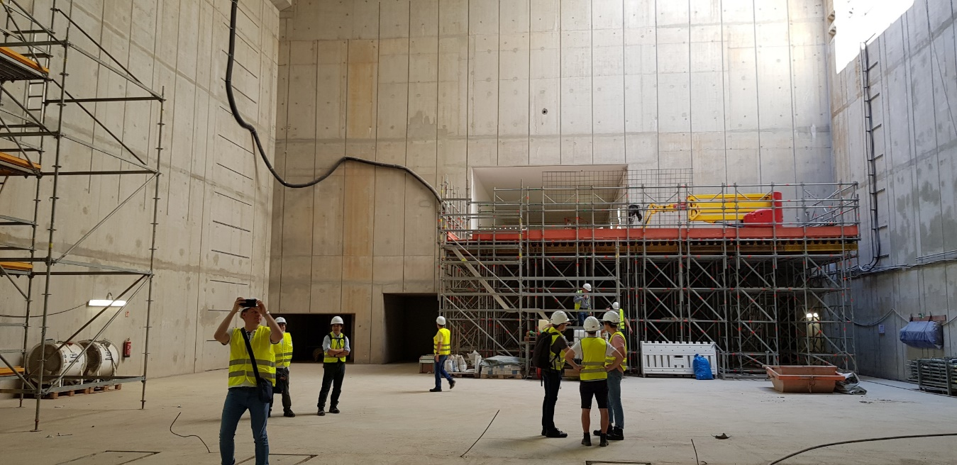
CBM-Cave Raw Construction Done

Slide 7
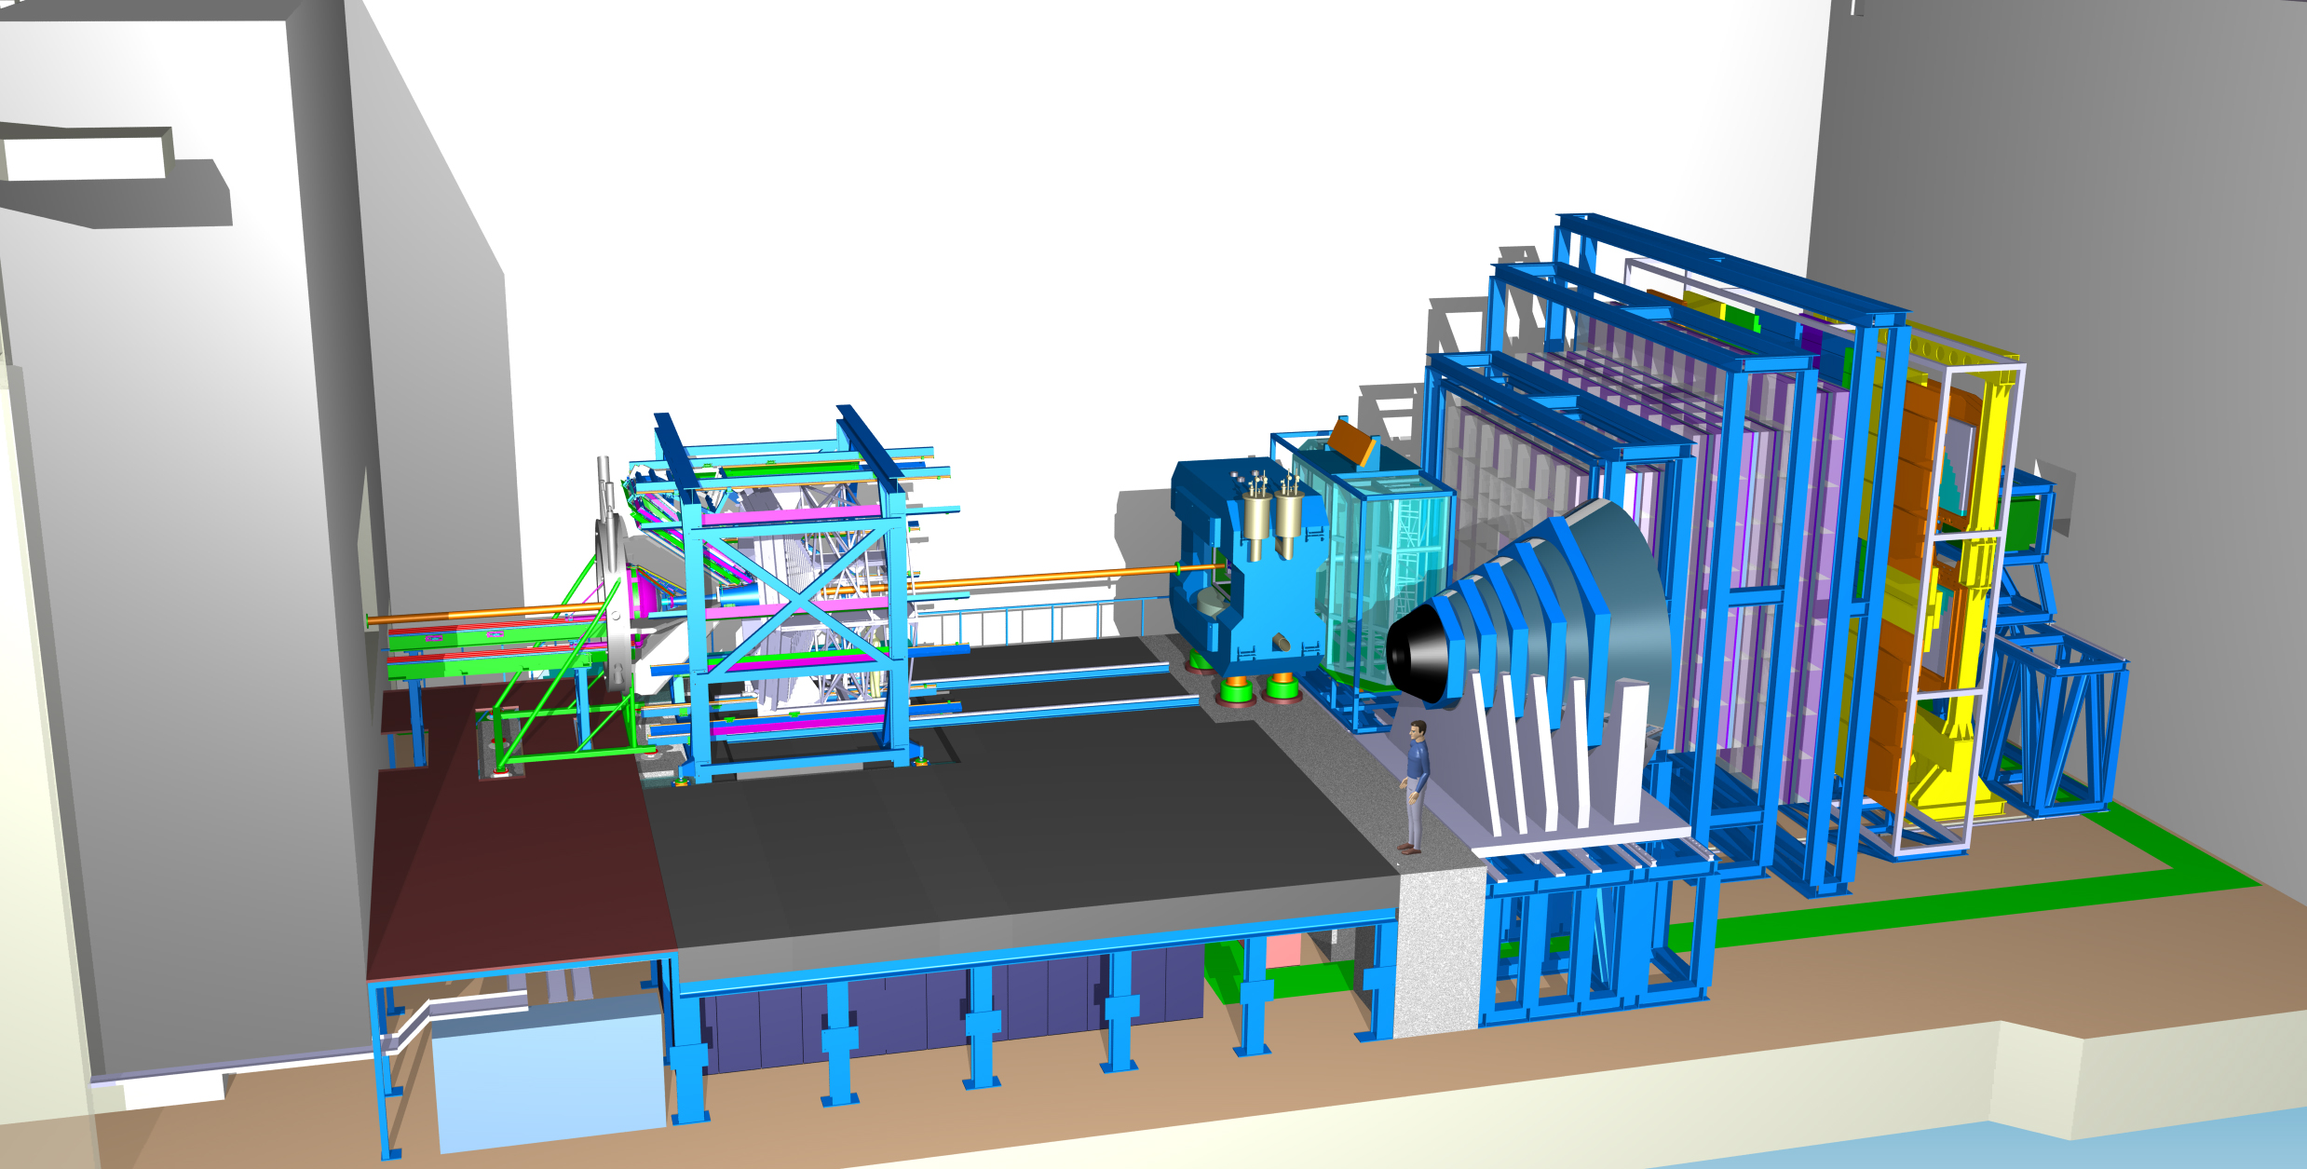
CBM Experiment
Ring
Imaging
Cherenkov Detector
Time-of-Flight Detector
Silicon
Tracking
System
Dipole
Magnet
HADES Detector
Transition
Radiation
Detector
Micro
Vertex
Detector
Beam Dump
99%
beam
1% Gold Target
Projectile
Spectator
Detector
Muon
Detector

Slide 8
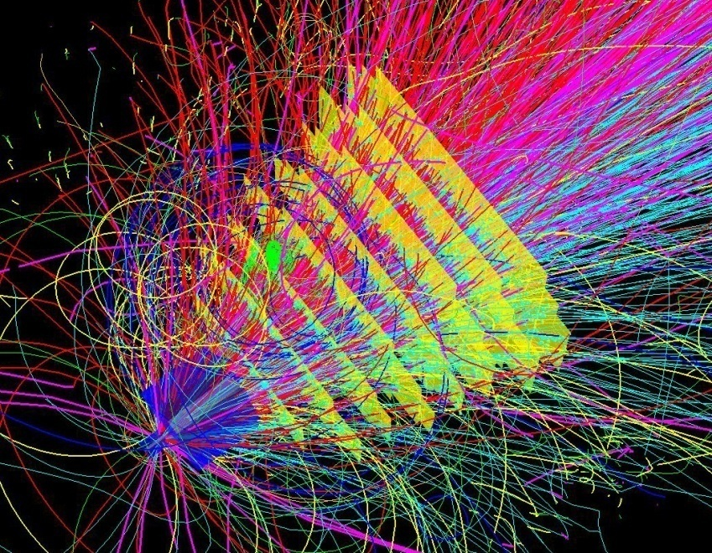
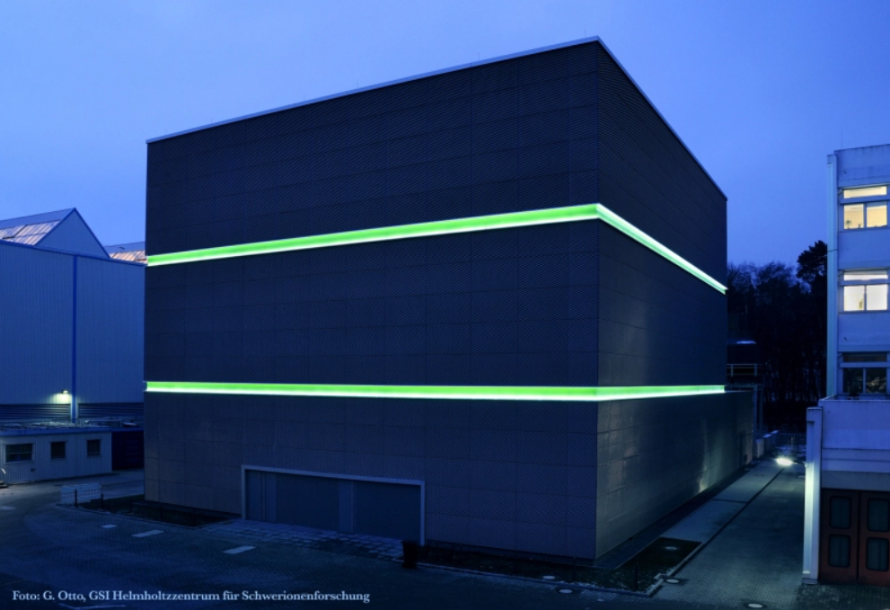
CBM technological challenges
fixed target configuration makes 10MHz Au+Au interaction rate feasible at FAIR
➢ 10 MHz → billions of tracks per second
➢ determination of (displaced) vertices (σ ≈ 50 μm)
➢ fast and radiation hard detectors
➢ free-streaming readout electronics
high speed data acquisition and high performance
computing for online event selection
➢ 4-D event reconstruction
Notes:
8
8
8

Slide 9
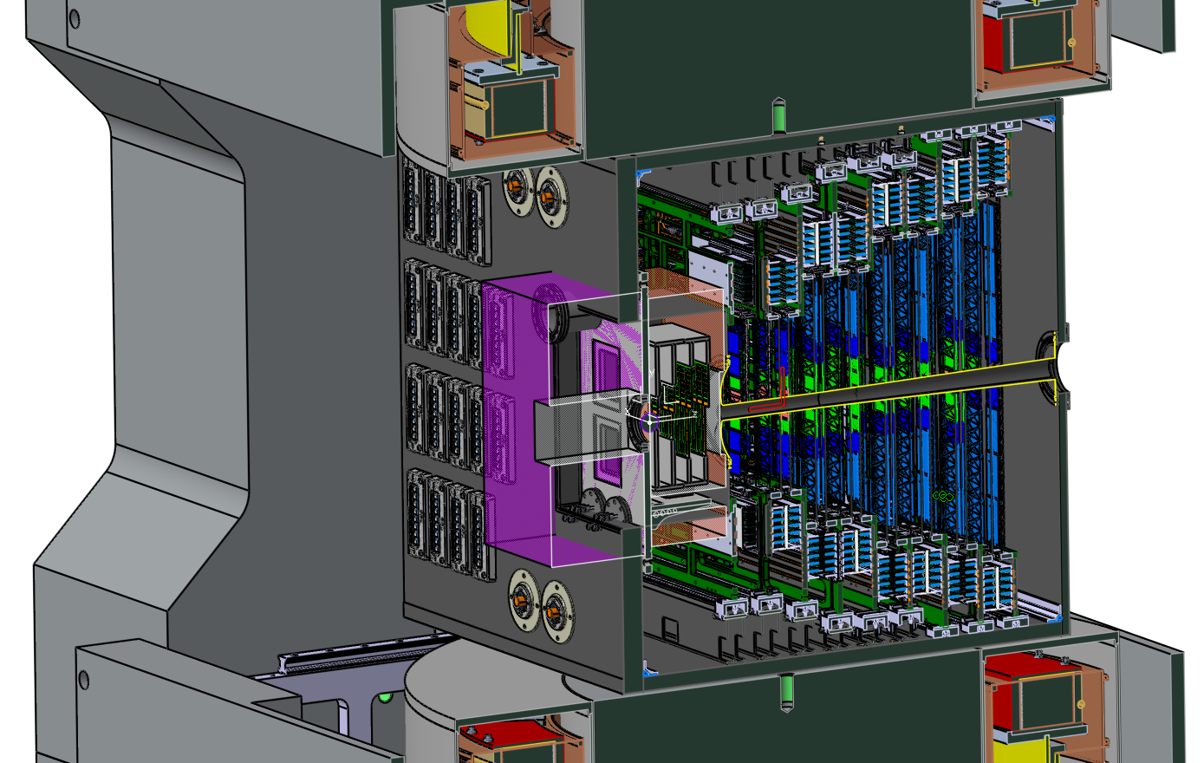
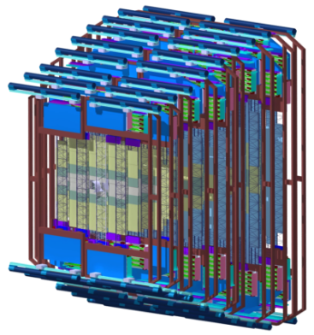
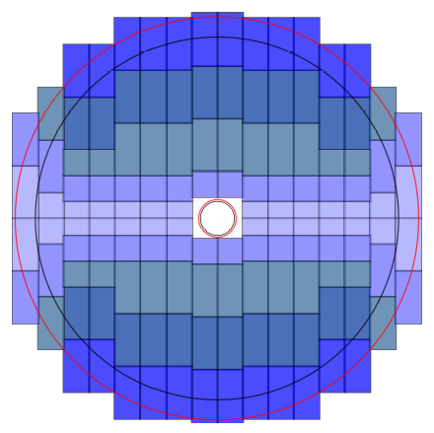
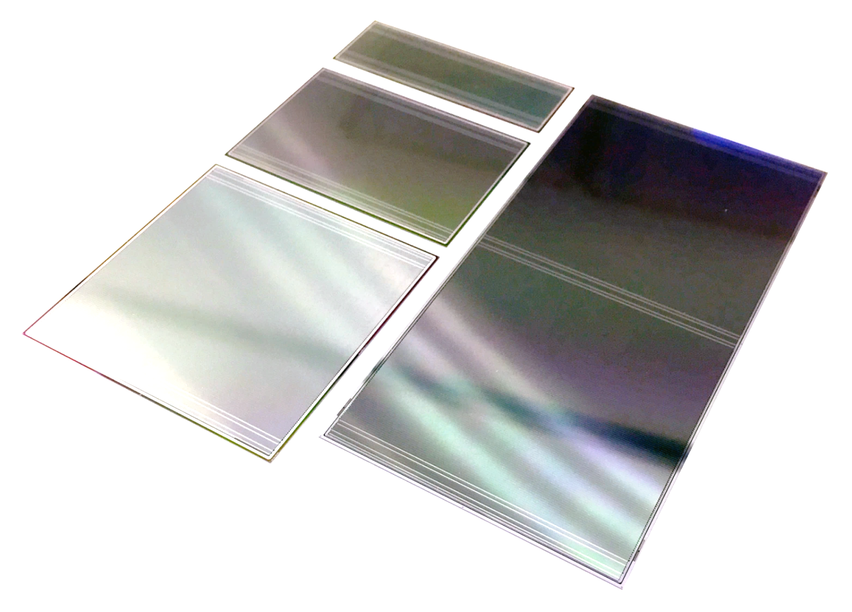
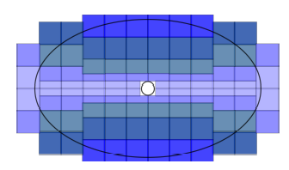
Silicon Tracker: Extremely low mass to avoid track diversion
CBM Silicon Tracker
tracking with 8 planes
1m
STS
sensor
Module
total
~ 3 m² detector area
micro cables
electronics
106 ladders

Slide 10
STS-Detector Modules: 876 monolithic items to make up STS
Fixed-target geometry implies module design in at least 166 variants!
One common module design
comprising 64 pieces to be assembled in various different ways.
Variation through sensor length, cable length and symmetry
32.000 micro cables needed

Slide 11
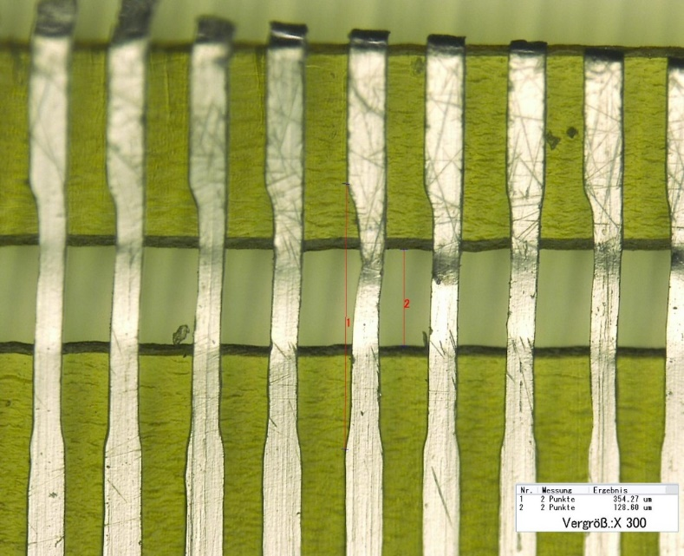
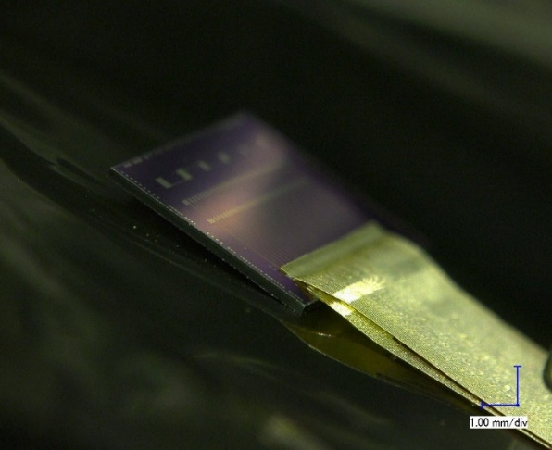
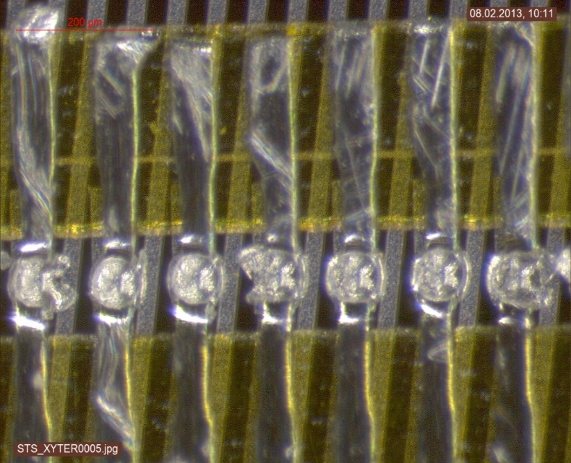
Micro Cable Technology, TAB-Bonding Interconnect
minimized material budget
double cable layer bonded onto chip
trace capacitance ~ 0.38 pF/cm
pitch 116 µm
LED Technologies of Ukraine (LTU) worldwide unique to provide cables
15 µm Al on 10µm polyimide
up to 500 mm long
free standing Aluminum traces for bonding
11

Slide 12
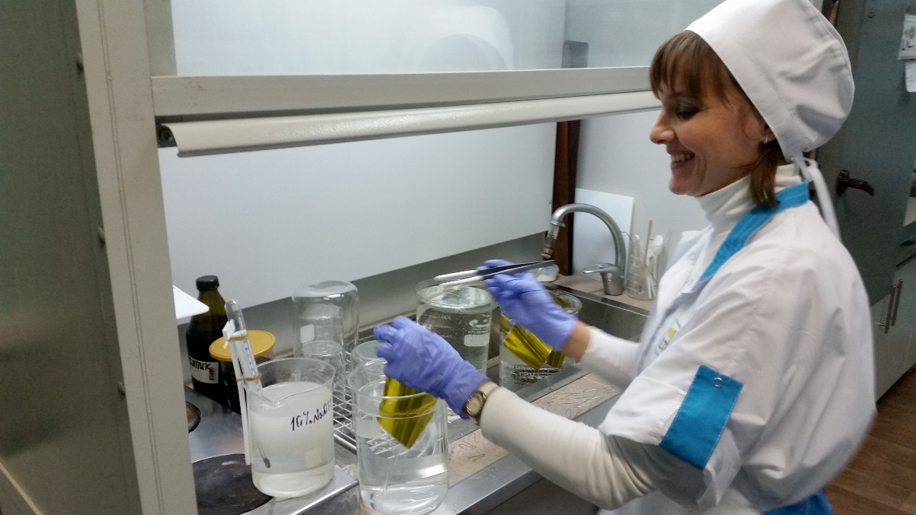
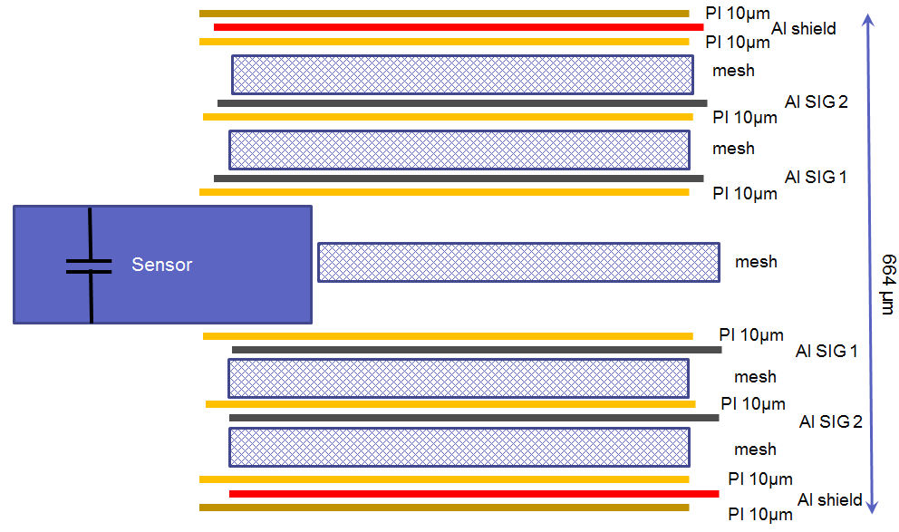
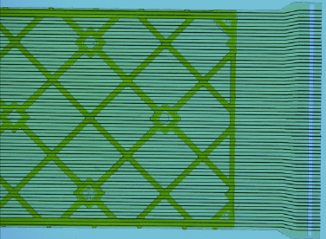
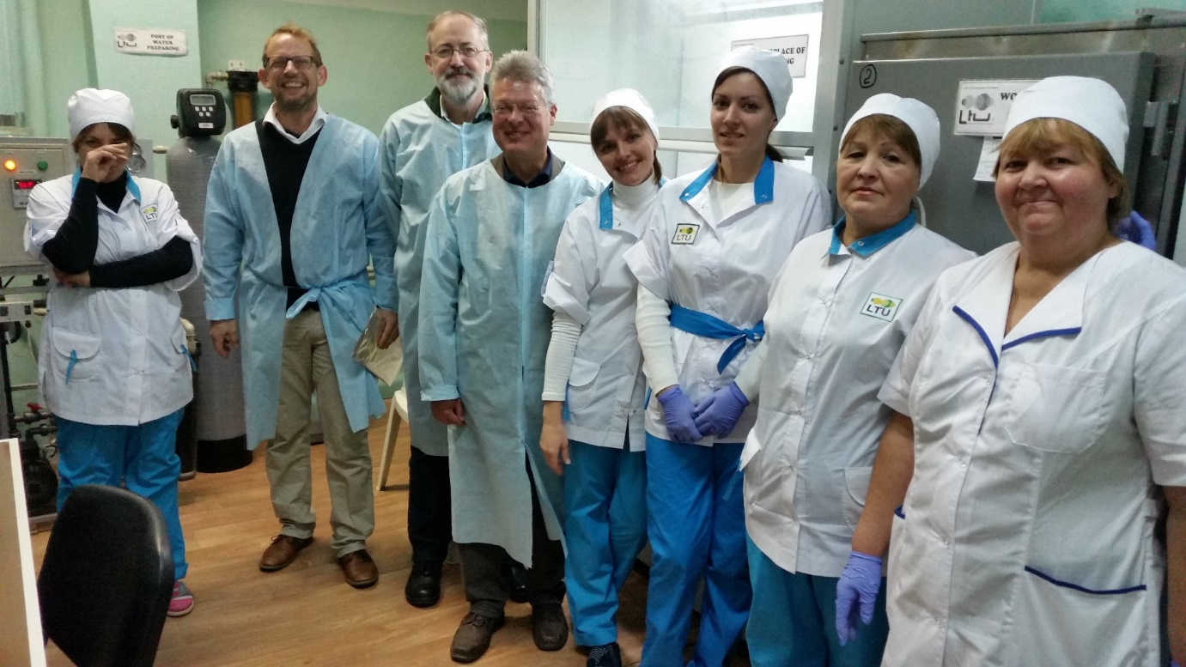
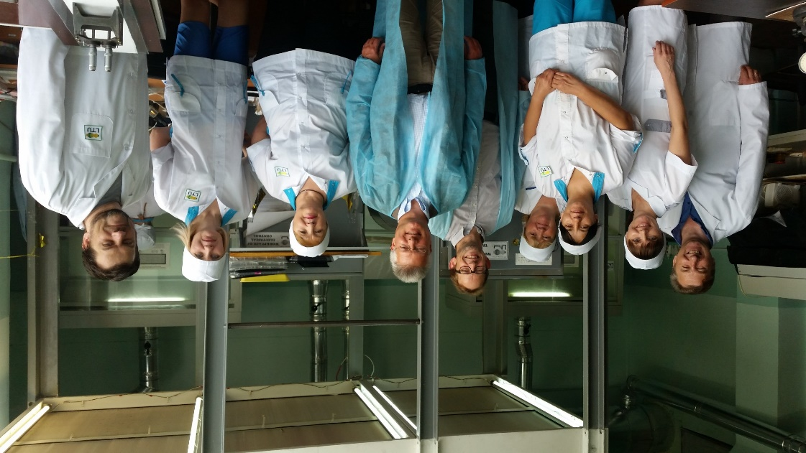
32.000 read-out cables being produced at LTU
cable stack: thickness 0.12 % X₀
spacer layer
Kharkiv, Ukraine
signal layer: 64 Al lines of 116 µm pitch, 14 µm thick on 10 µm polyimide, lengths up to 55 cm
10.000 done in 2020
10.000 done in 2021

Slide 13
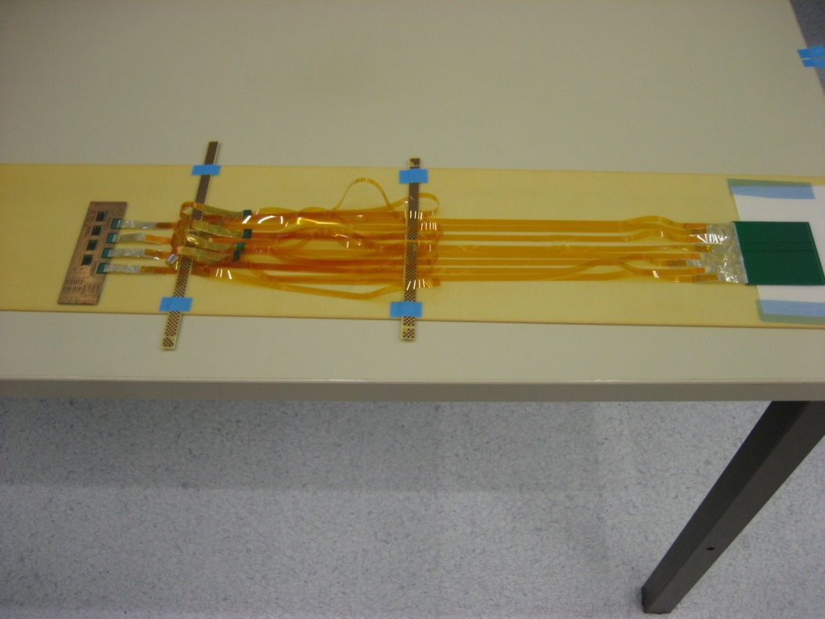
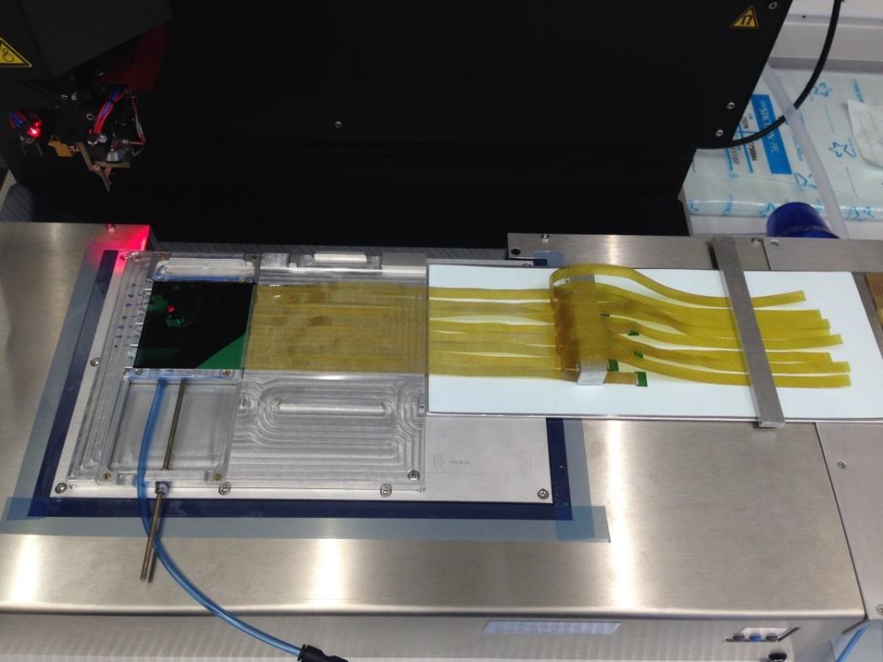
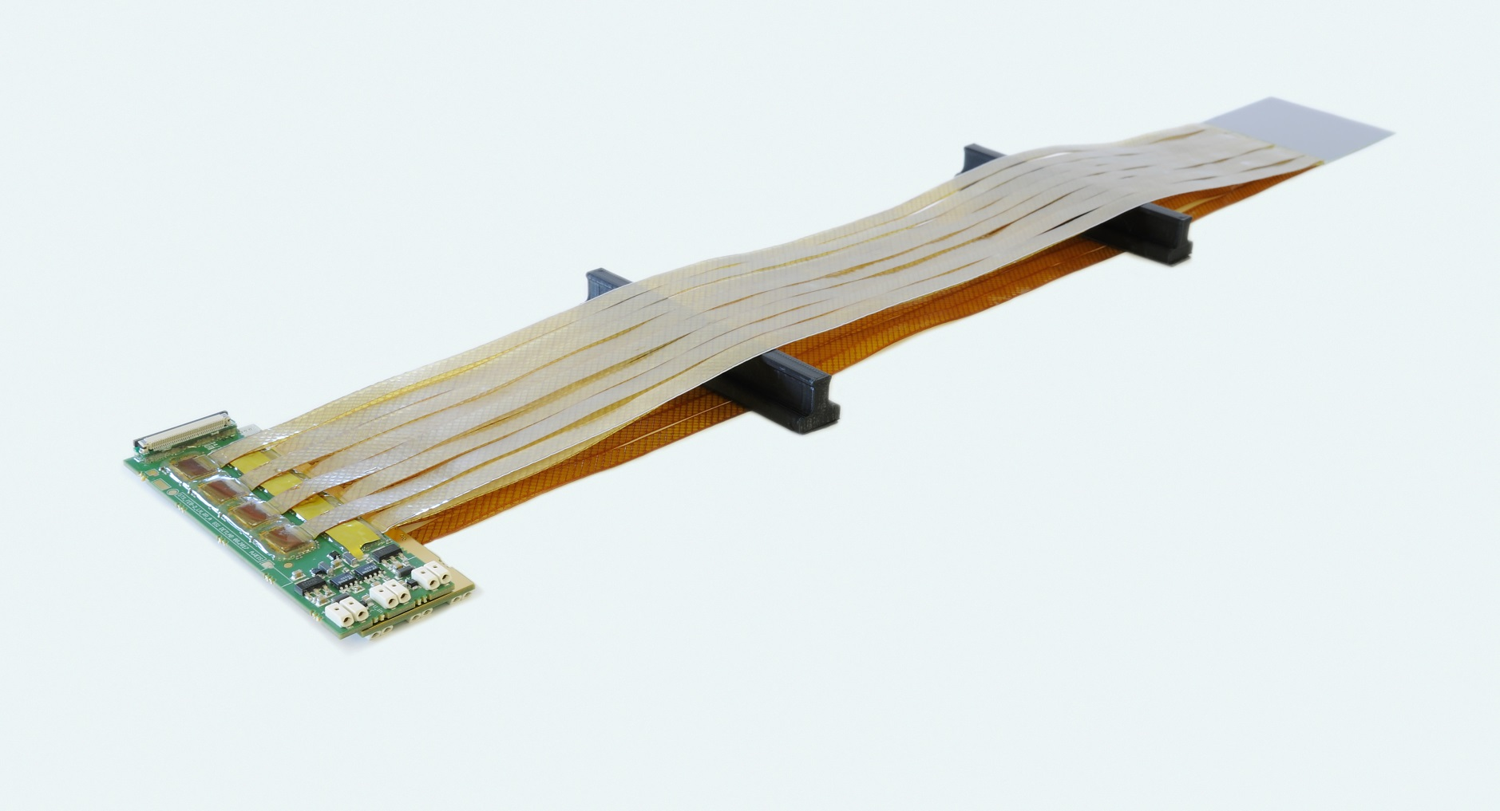
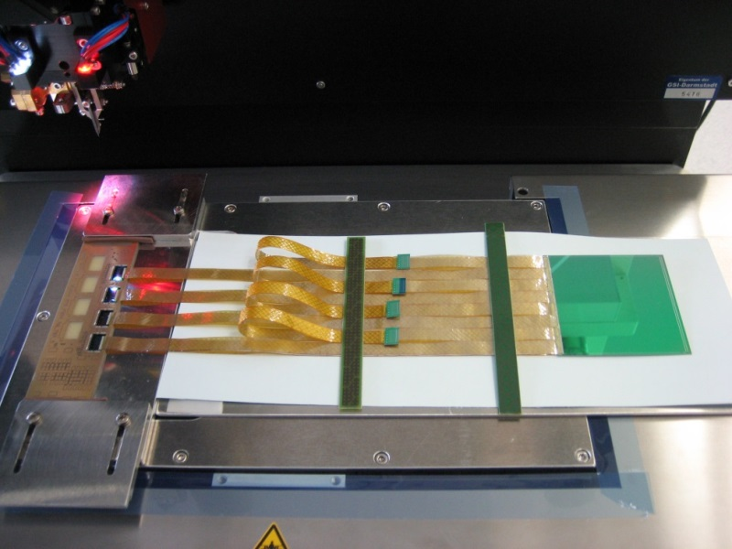
Assembly Procedures Developed
Bonding cables to sensors
and readout chips
Careful manual assembly work!
Tests after each step!
Wire Bonding Chip-Cables
to Readout Board
... and then the other side...

Slide 14
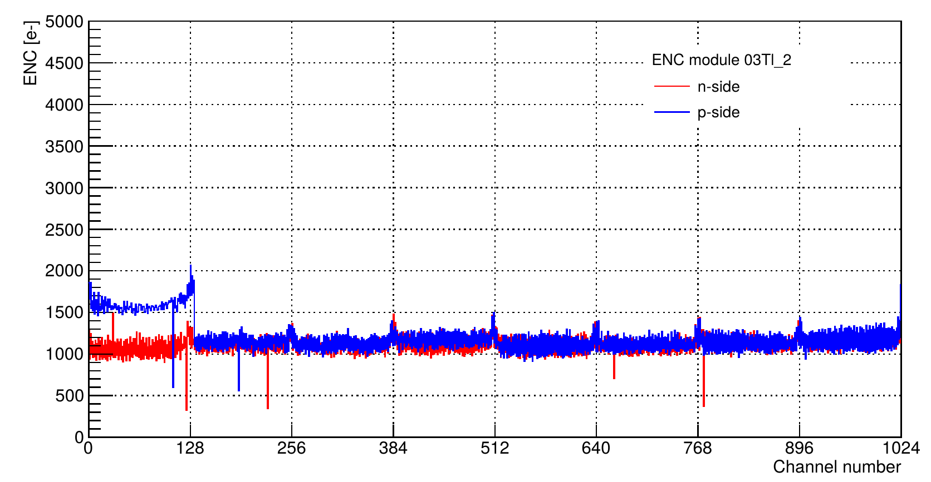
Sensor Module Noise Performance (6 cm sensor)
„Z“ strip
Projected module noise performance verified
2nd metal layer cross connect clearly visible
Modules can be assembled
with practically 100% yield
p side: edge strip interconnect on
second metallization layer

Slide 15
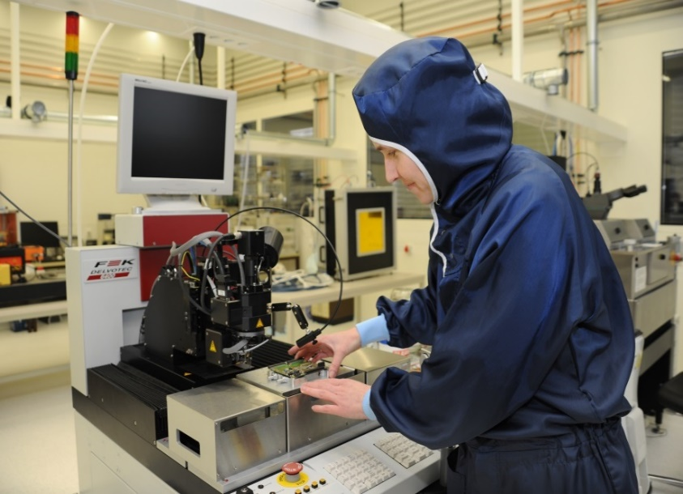
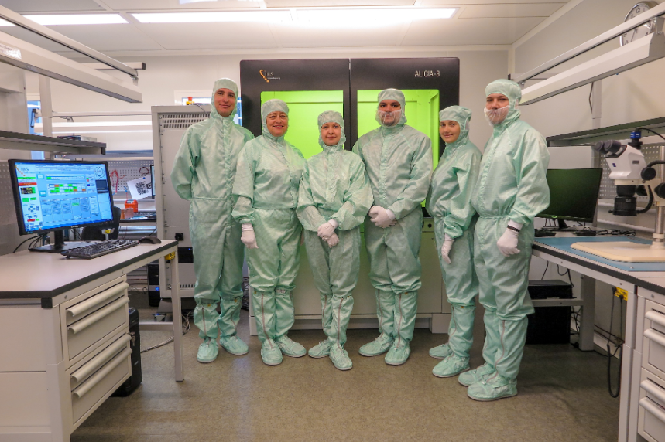
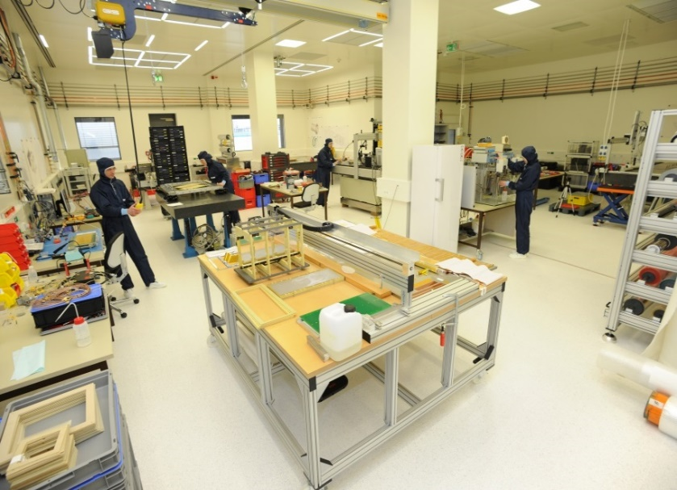
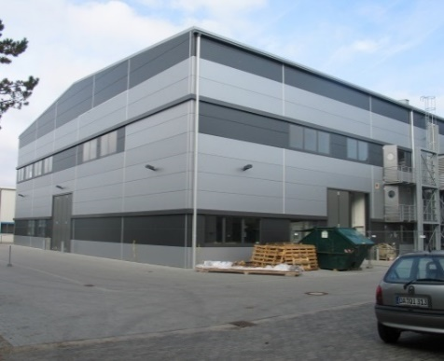
Three Module Assembly Sites, 876 Modules
GSI detector lab

Slide 16
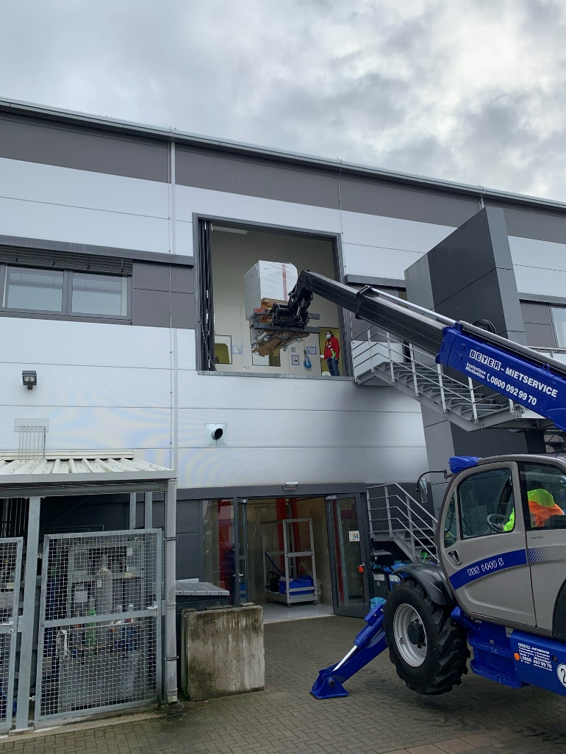
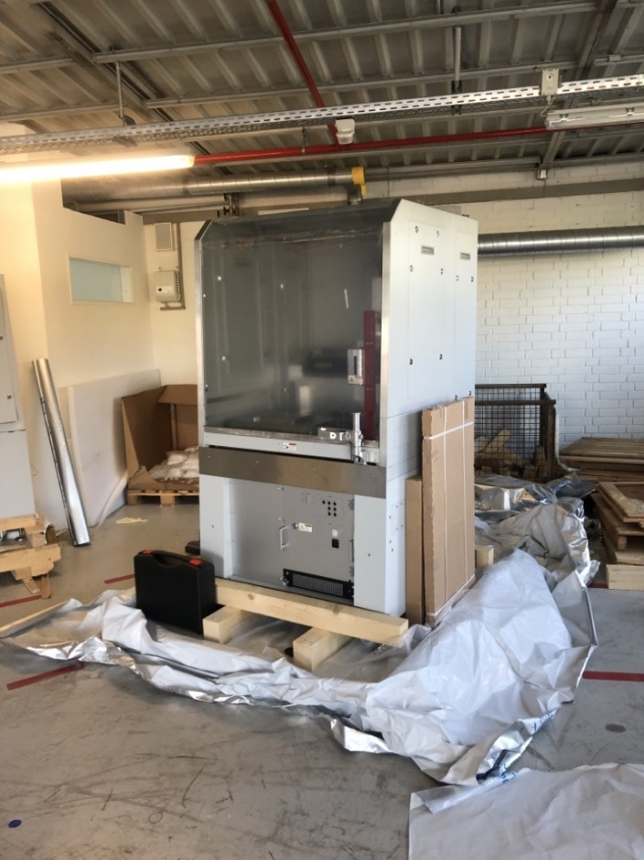
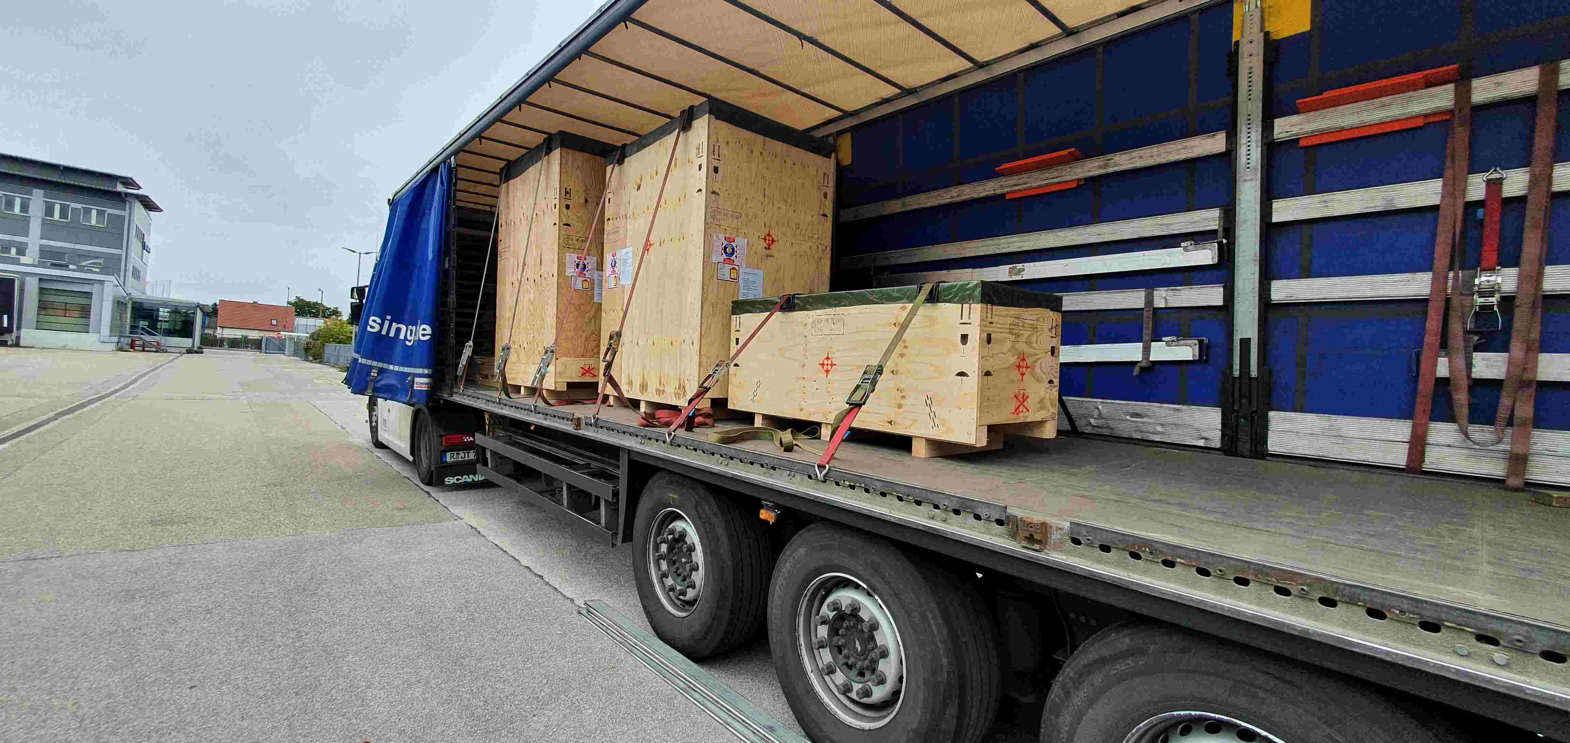
Bonding Machines and Climate Chambers Waiting at GSI…
Brand new
for a new team to engage

Slide 17
Summary
FAIR civil construction progressing fast
STS-Module and ladder serial assembly just about to start
Russian war against Ukraine hit us hard: the collaboration, the plans, production capacities, Russian contributions such as magnets
Seeking ambicious, eager new collaborators for module assembly
→ SMART-Lab appears as feasible organizational frame
Bonding machines available (procured to equip Russian collaborators)
May want to begin with extended visits to GSI
Many other fields for involvement (electronics, software, simulation)
Latest experience shows: Assembly yield at practically 100% well feasible

