Slide 1
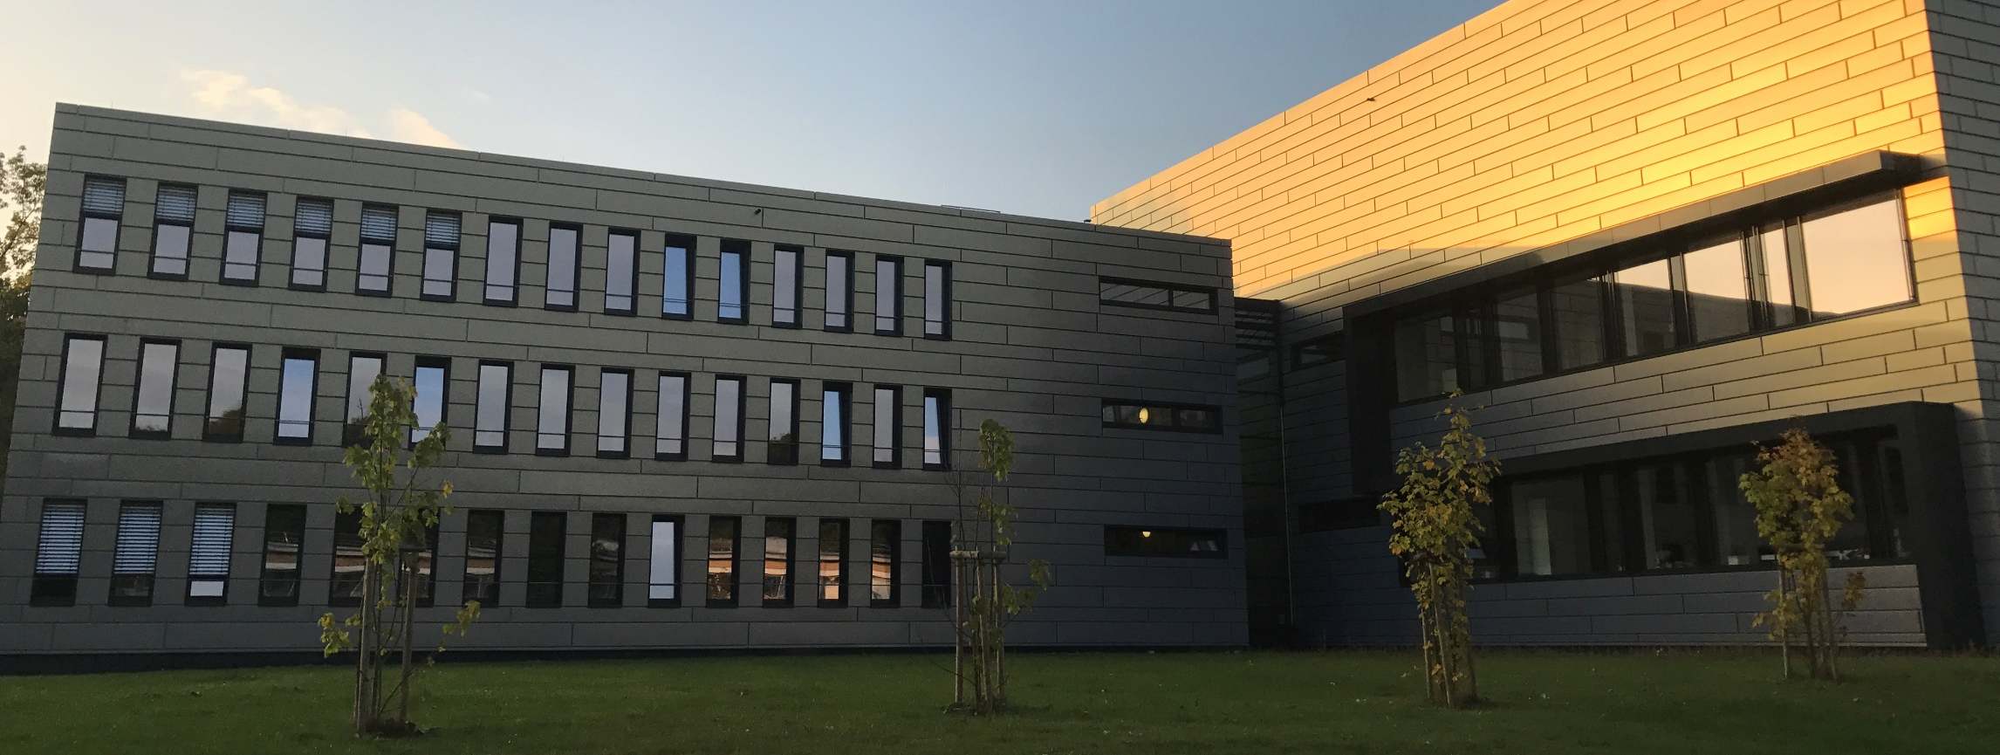
SMART | Bioimaging_Lab: Science Case - Radiotracers
15.09.2022 | Institute for Neuroscience and Medicine – INM-5| Bernd Neumaier

Slide 2

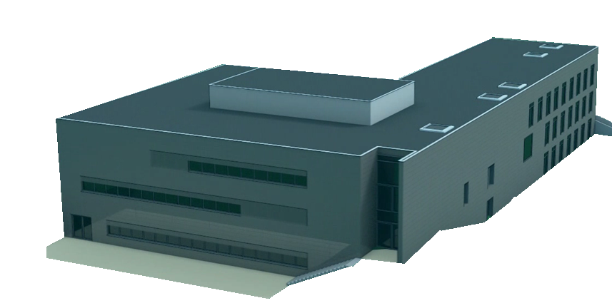
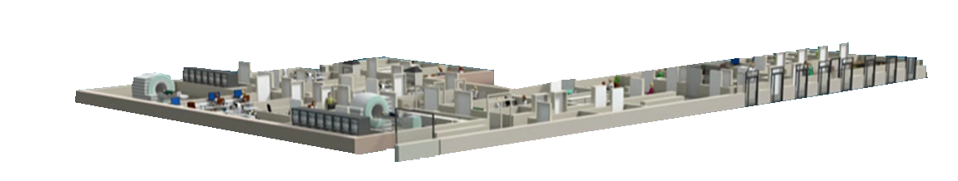
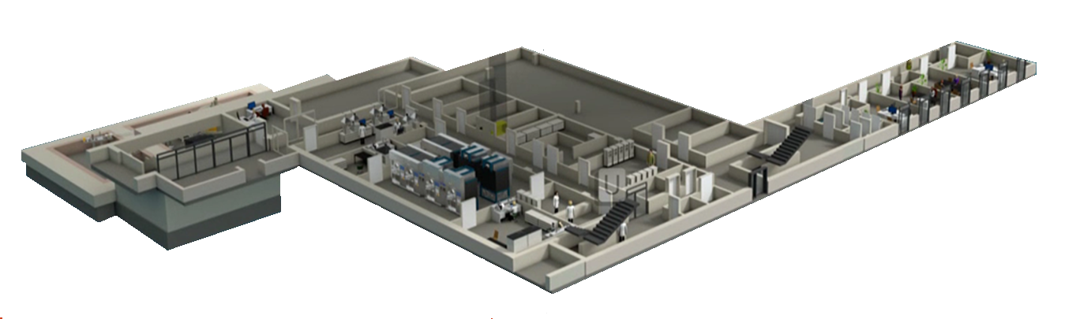

The new PET-Center
CLINICAL LEVEL
PRECLINICAL LEVEL
RADIOCHEMISTRY

Slide 3
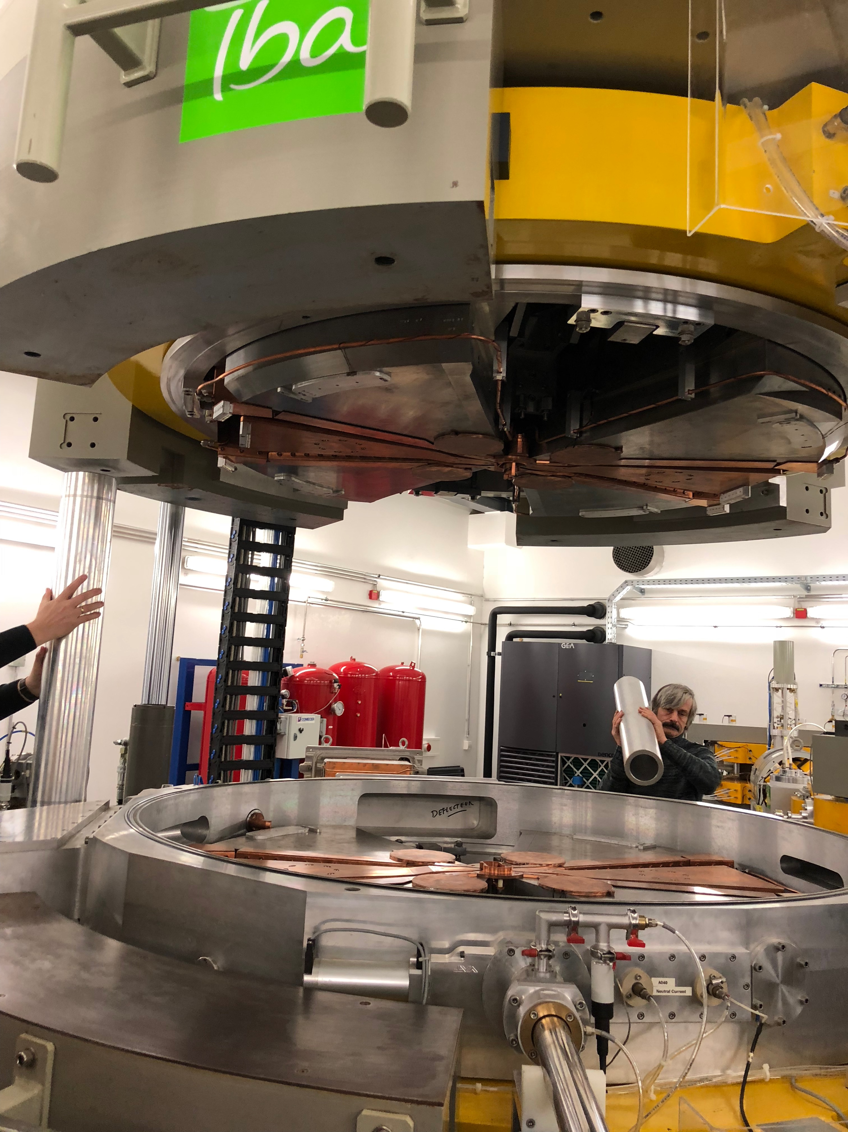
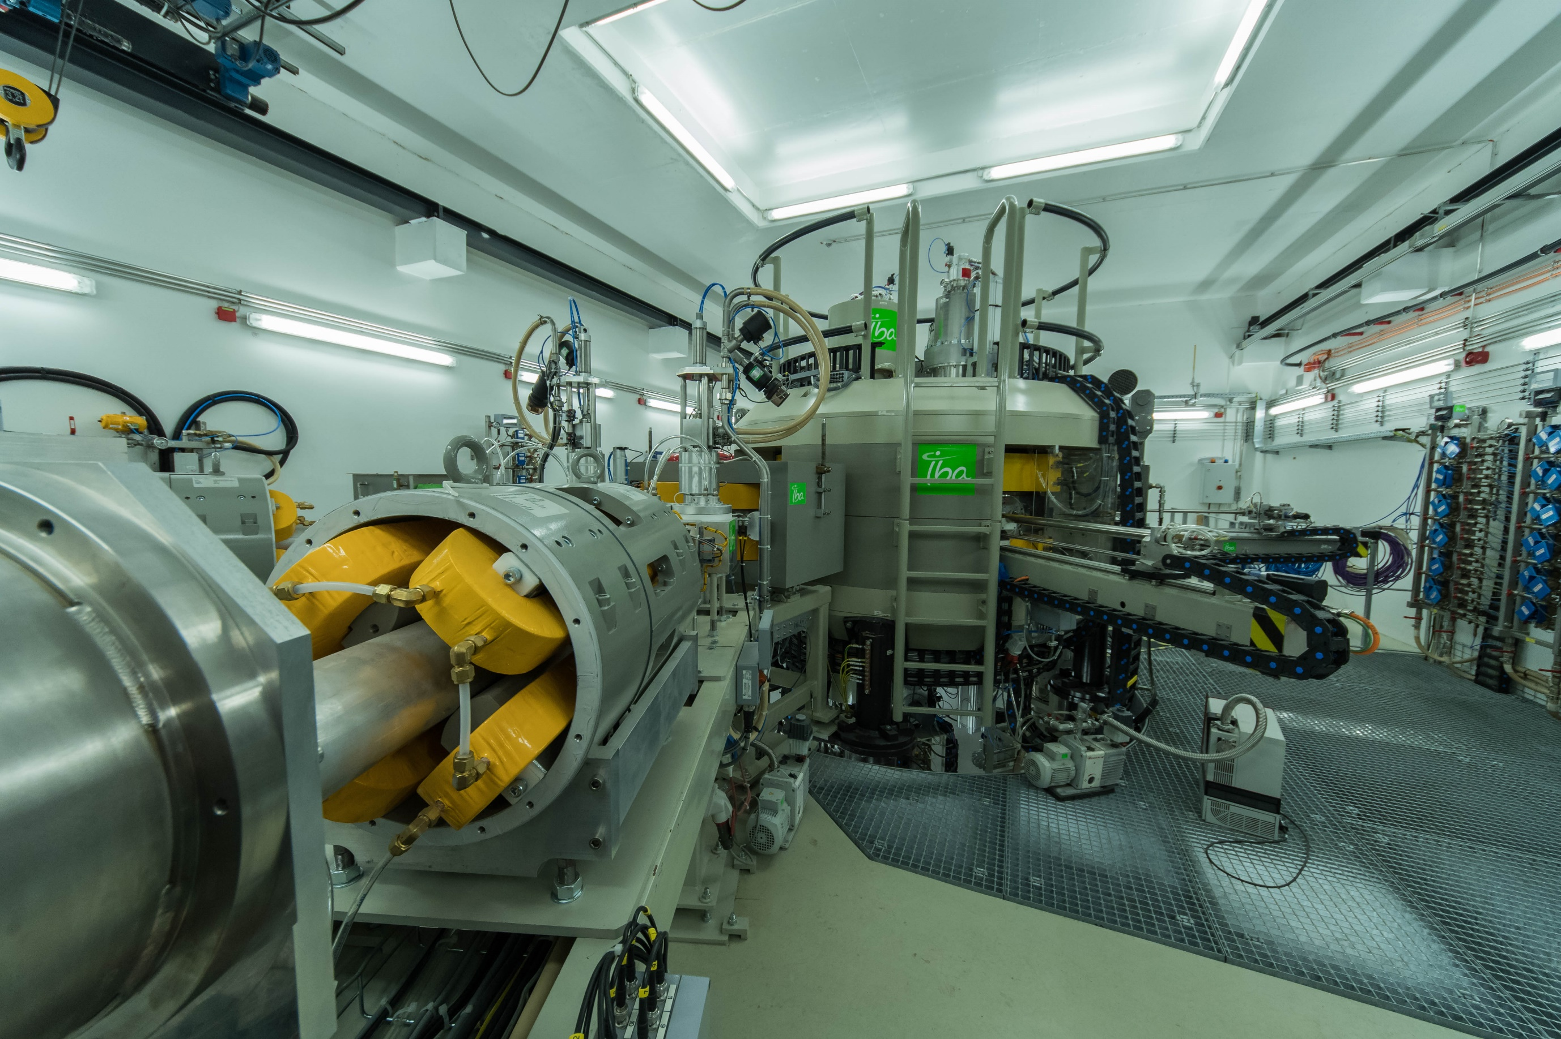
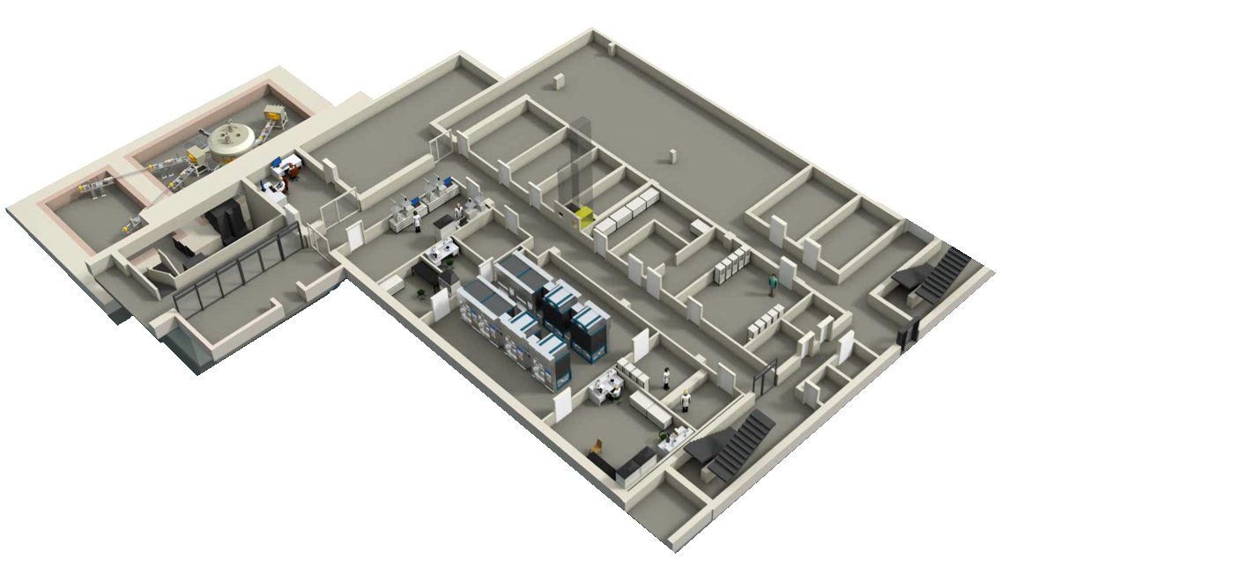
production Sector of INM-5
Cyclotron
Hot cells for production of radiopharmaceuticals
Cyclotron control
room
Quality control

Slide 4



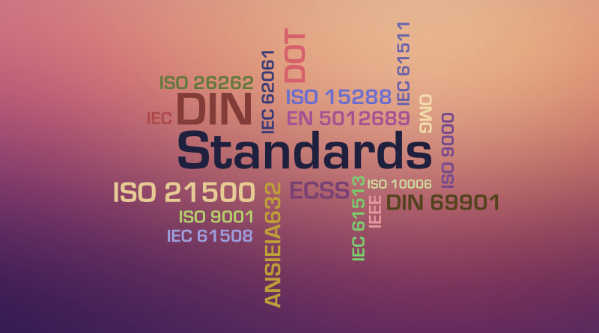

Steps of tracer development
Clinical need
Establishment of an appropriate
preclinical model for testing
Evaluation in an appropriate clinical setting
Comparison with existing standards
Documentation of safety, efficacy,
dosimetry & toxicity

Slide 5
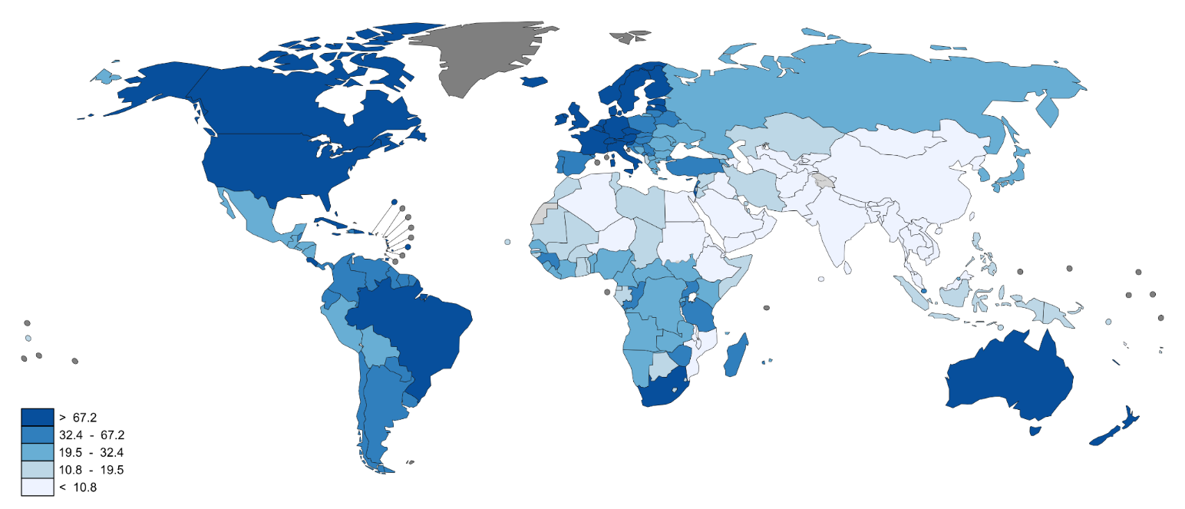
Clinical Need: Prostate carcinoma (PCa)
second most frequently diagnosed cancer worldwide
incidence rates highest in developed countries
1,1 million men with Pca (2012)
sixth leading cause of cancer death in males
Estimated age-standardised rates (World) per 100,000
…to enable best treatment options early detection of PCa and recurrent prostate cancer and/or metastases is required
Notes:
Second most common cancer in men. 1.1 million men worldwide were diagnosed with PCa in 2012.
70% of the cases occured in more developed countries
PCa incidence rates were highest in Australia/New Zealand and Northern America, and in Western nad Nothern Europe owing to the practice of PSA antigen testing and subsequent biopsy which has become widespread in these countries.
Incidence rates are also relatively high in less developed regions such as the Carribean, Southern Africa an South America, but remains low in Asian population.

Slide 6
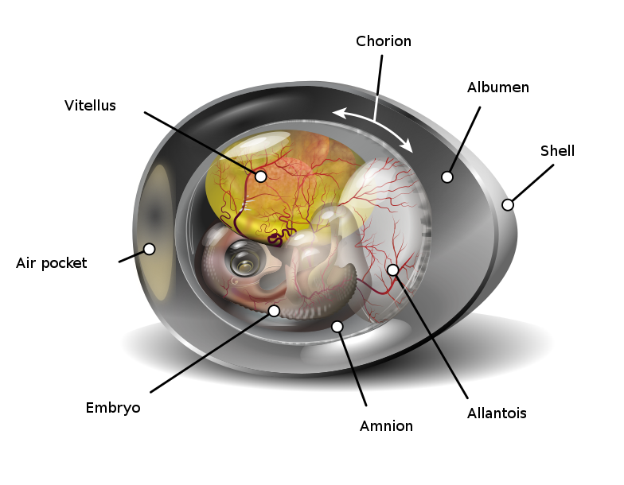
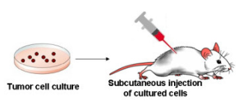
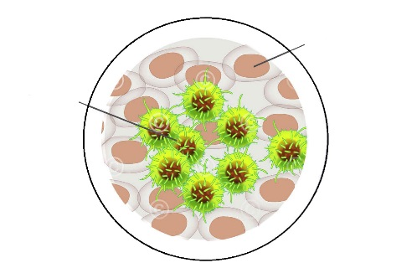
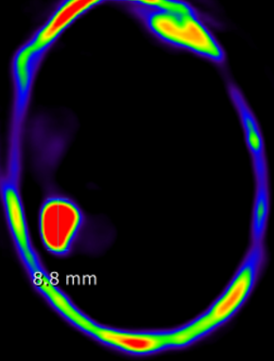
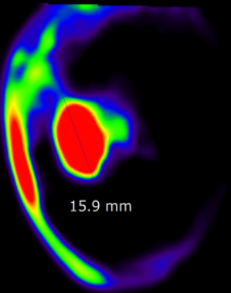
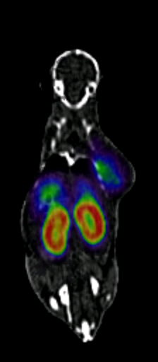
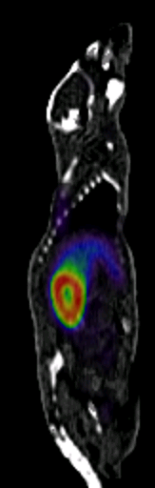
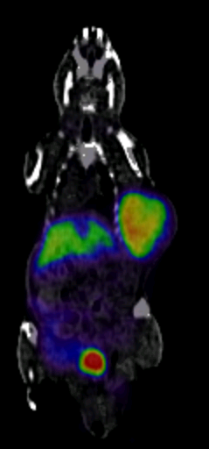
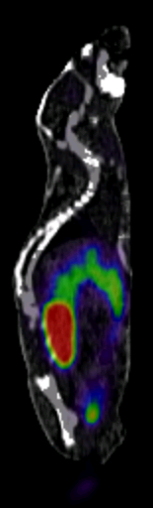
Establishment of an appropriate pre-clinical model for testing
In Vitro Evaluation
Chorioallantoic Membrane Model
Human Tumor Xenograft Model
healthy cell
tumor cell
Cellular uptake of PSMA-7
PC-3 (PSMA-) LNCap C4-2 (PSMA+)
PC-3 (PSMA-) LNCap C4-2 (PSMA+)
PC-3 PSMA-6
LNCaP C4-2 PSMA-6
PC-3 PSMA-7
LNCaP C4-2 PSMA-7
0.0
MBq/ccm
0.5
0.0
MBq/ccm
0.5
0.0
MBq/ccm
0.5
0.0
MBq/ccm
0.5
LNCaP C4-2 PSMA-7 + PMPA
LNCaP C4-2 PSMA-6 + PMPA

Slide 7
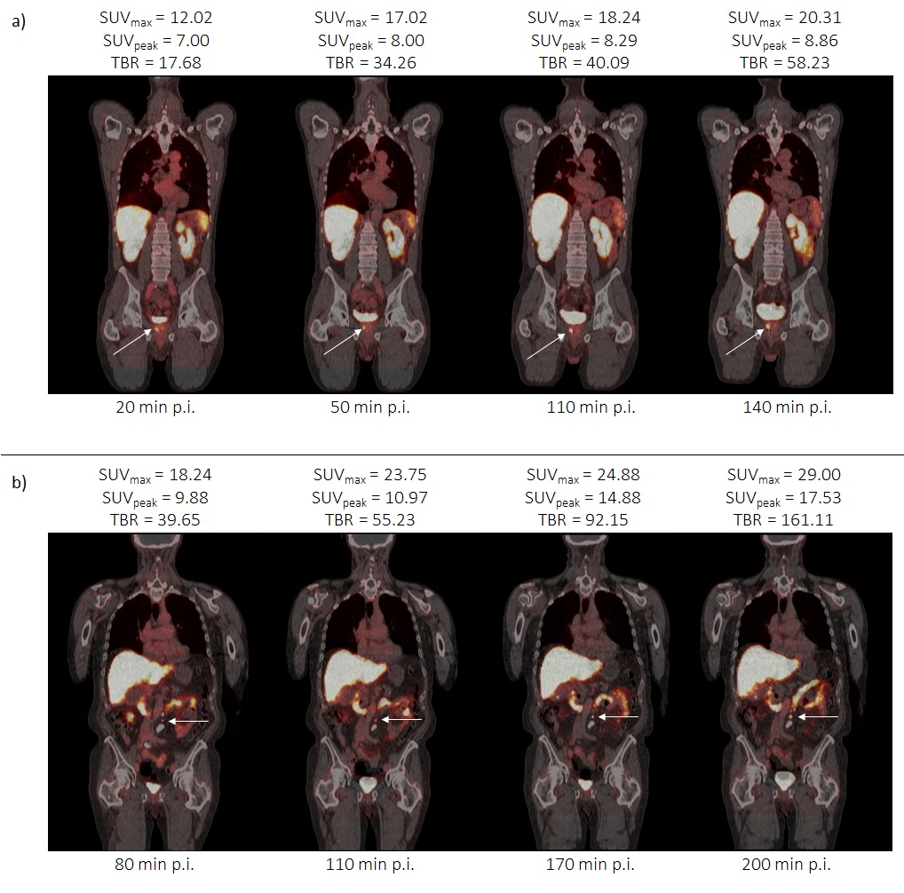
design and production of new tracers
Documentation of drug master file (dosimetry, toxicity etc.)

Slide 8
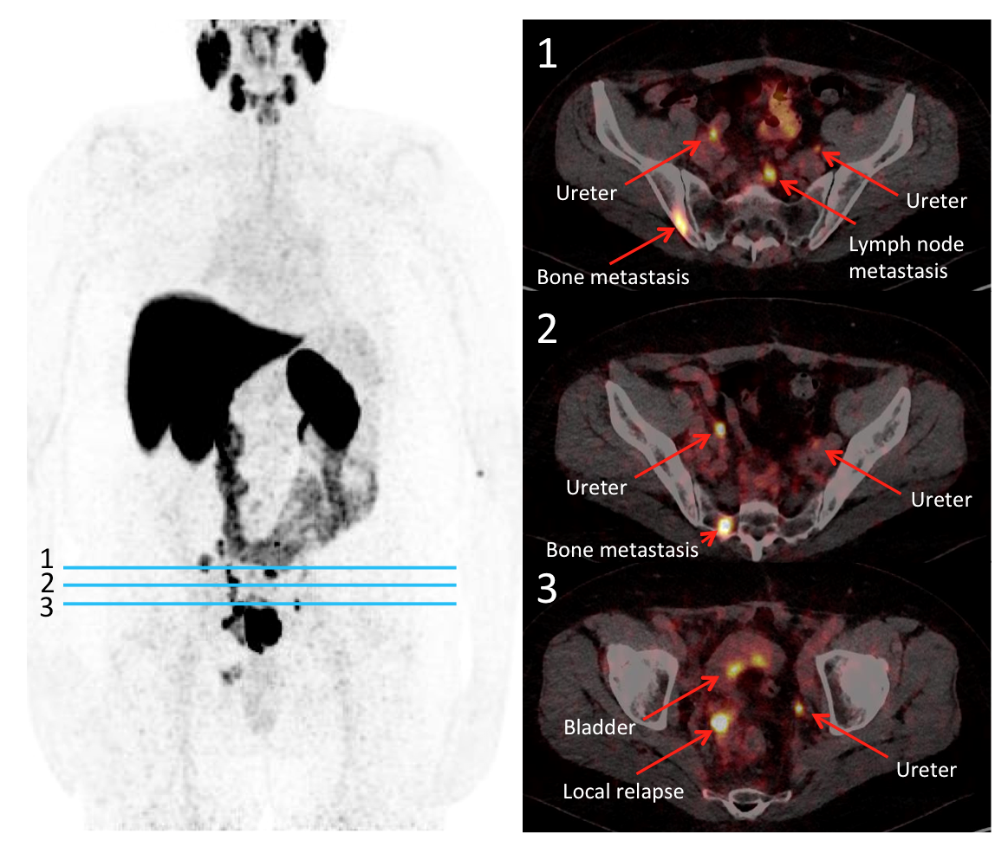
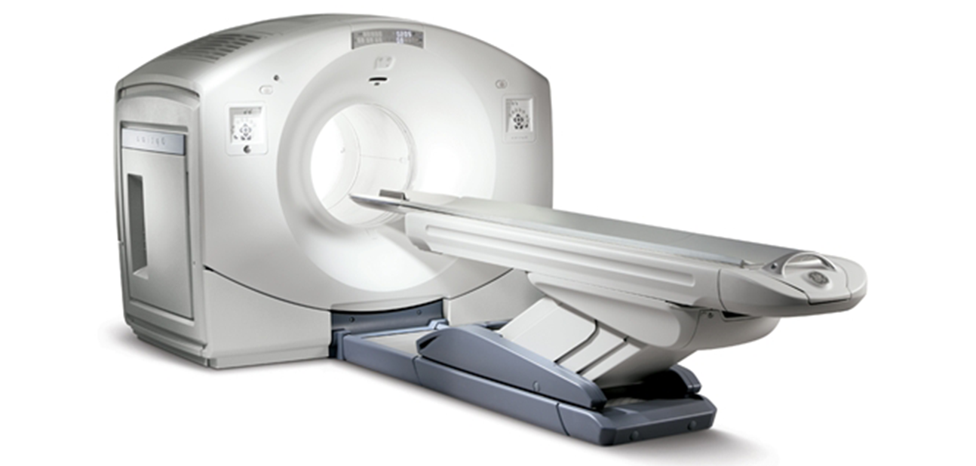
Evaluation in an appropriate clinical setting

Slide 9
Comparison with existing standards
Courtesy of C. Kobe, M. Dietlein, Nuklearmedizin UKK
Notes:
Patient with a rising PSA level. Usually in the clinical practice [68Ga]Ga-PSMA-HBED-CC is used to detect PCa recurrence. However, using the 18F-labeled compound [18F]DCFPyL revealed several several additional supradiaphragmatic PSMA-positive lesions whereas PET/CT with [68Ga]Ga-PSMA-HBED-CC PET/CT showed only the supradiaphragmal lesion in the sternum.

Slide 10
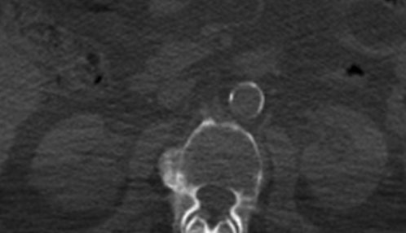
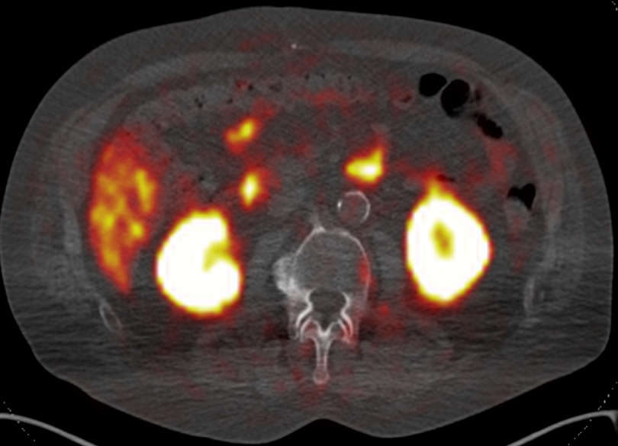
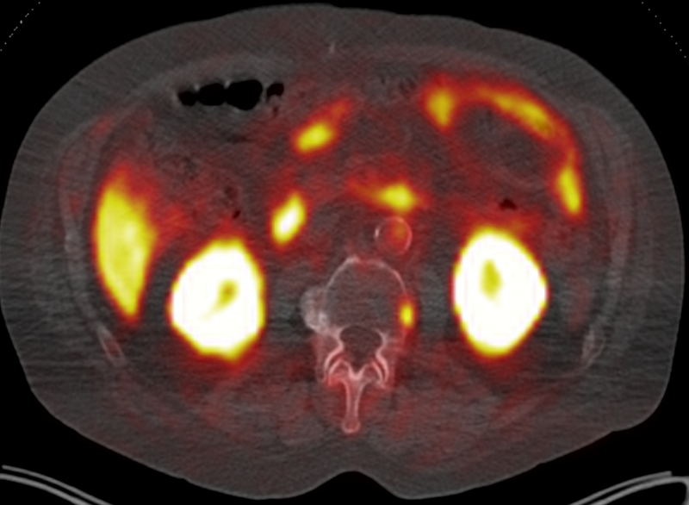
Comparison with existing standards
Detection of even very small lesions
?
?
[⁶⁸Ga]PSMA-PET
[¹⁸F]PSMA-6-PET
Courtesy of C. Kobe, M. Dietlein, Nuklearmedizin UKK

Slide 11

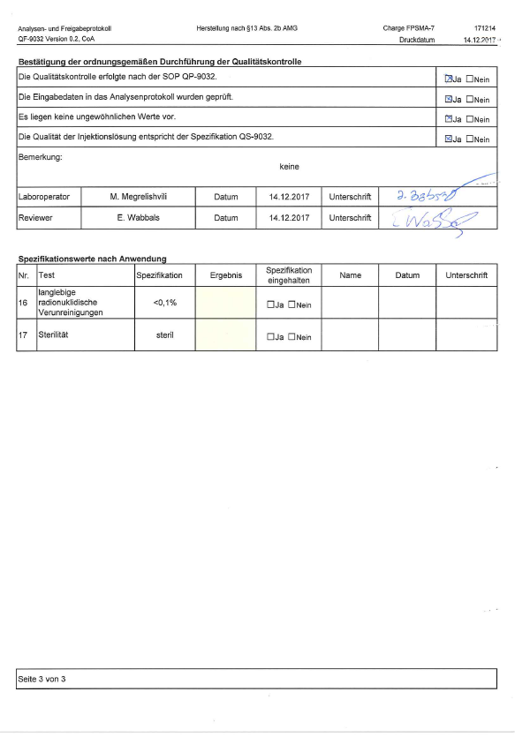
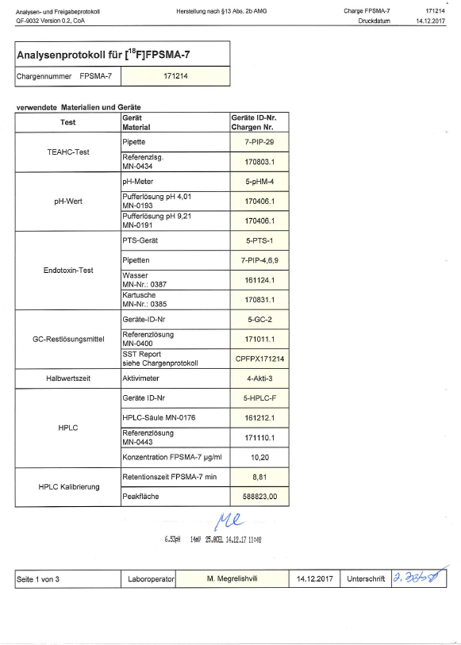
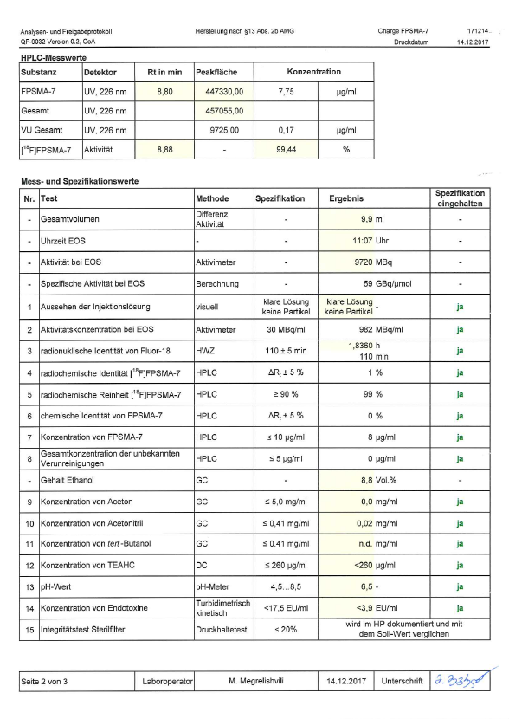
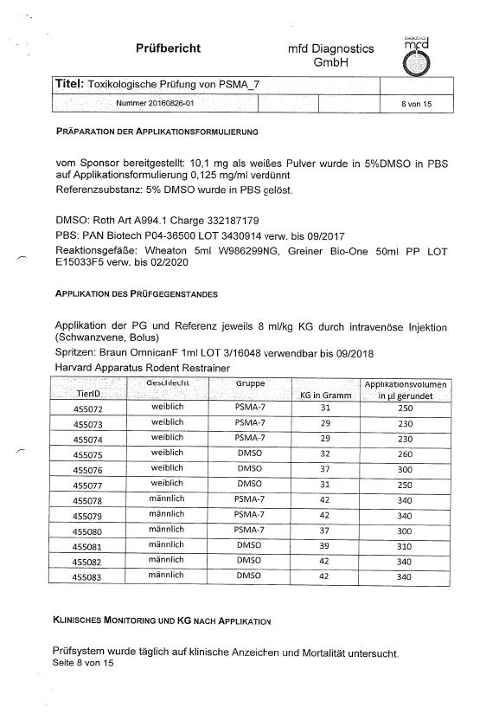
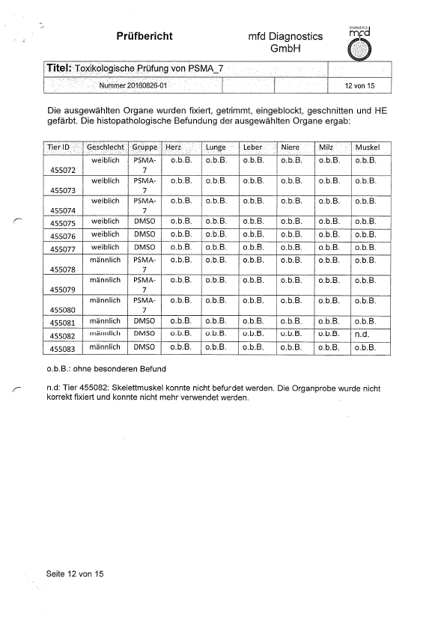
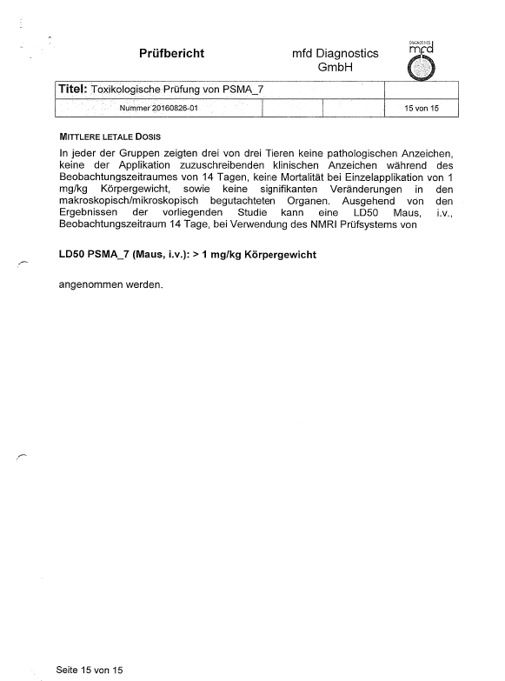
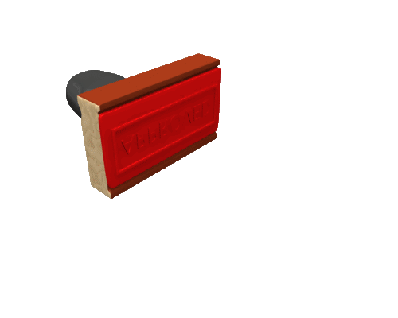

Documentation of safety and efficacy
[⁶⁸Ga]PSMA-PET

Slide 12
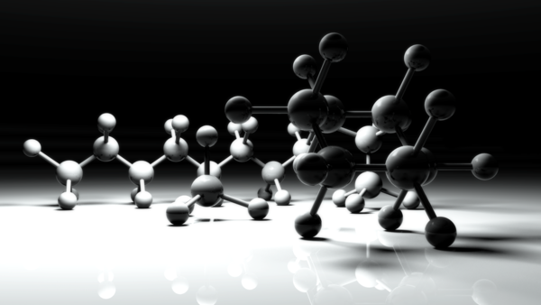
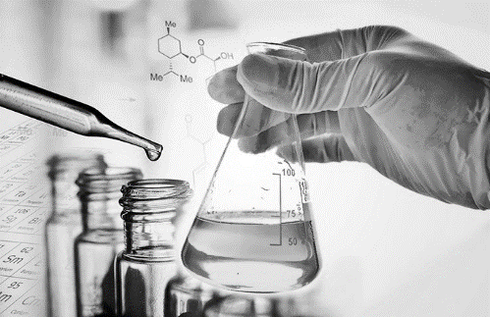
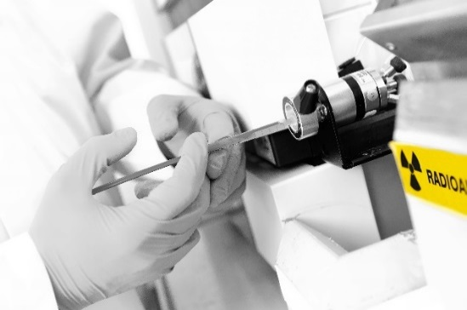

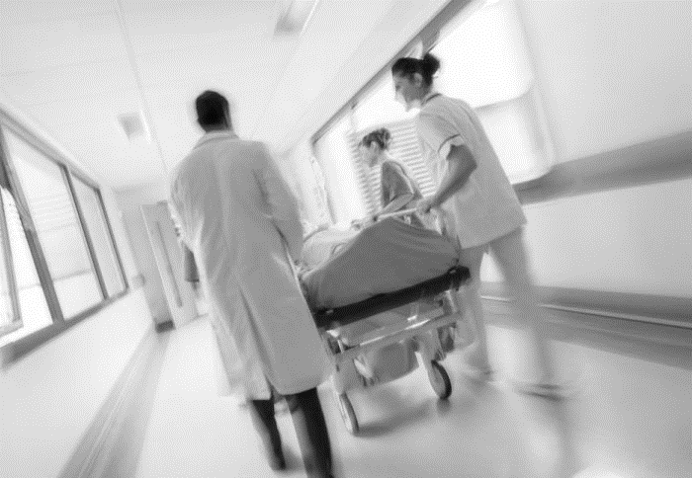
Chemical design and tracer Development
Identification of an appropriate target
Selection of lead structure with high affinity for molecular target
Precursor synthesis
Development of labelling strategies
Optimisation of labelling and QC
Documentation of drug master file (dosimetry, toxicity etc.)

Slide 13
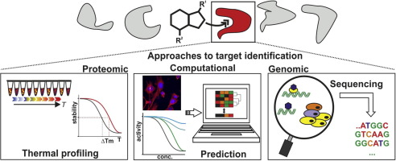
design and production of new tracers
Identification of an appropriate target

Slide 14
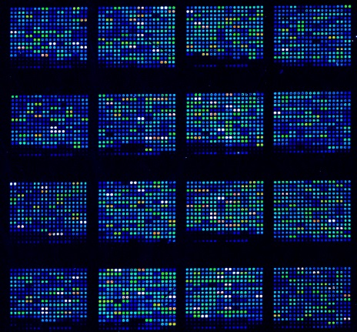
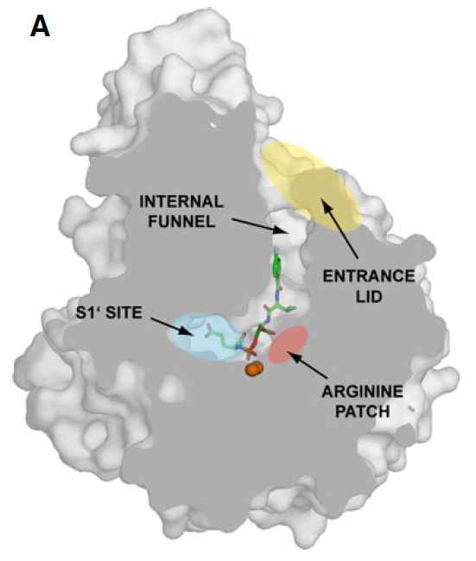
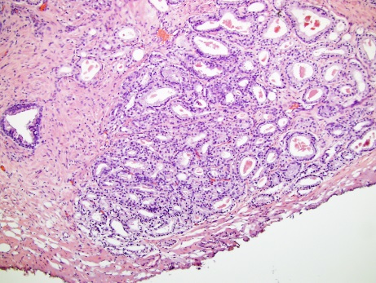
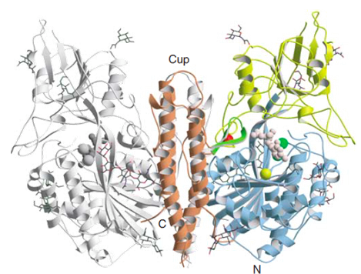

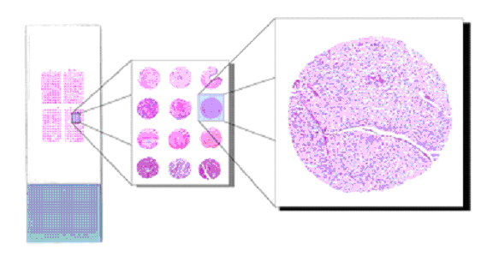
design and production of new tracers
Molecular biological
screening
Selection of key processes and target identification
Prostate-Specific-Membrane-Antigen:
Membrane-bound zinc metallopeptidase
in vivo: Hydrolysis of N-acetylaspartylglutamate (NAAG) into glutamate and N-acetylaspartate
High expression in the ephithelial cells of most PCa tumors

Slide 15
design and production of new tracers
Selection of lead structures with high affinity for molecular target

Slide 16
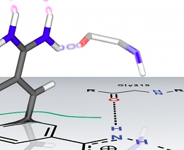
design and production of new tracers
Tracer design
Arginine-rich
Patch
Kozikowski et al. (2001)
Glutarat Sensor
Tracer design and
development
Endogenous ligand of PSMA
in-vivo: Cleavage to N-acetylaspartate and glutamate => short plasma half life
Not suitable as PET probe
Development of PSMA inhibitor
High affinity for PSMA
High metabolic stability
Suitable for radiolabeling by prosthetic groups

Slide 17
design and production of new tracers
Development of labeling strategies

Slide 18
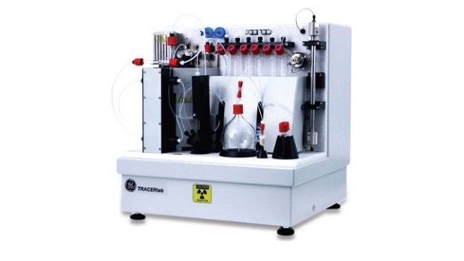
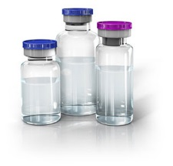
design and production of new tracers
Mechanism
+
[¹⁸F]FPSMA
[¹⁸F]F-Py-TFP

Slide 19
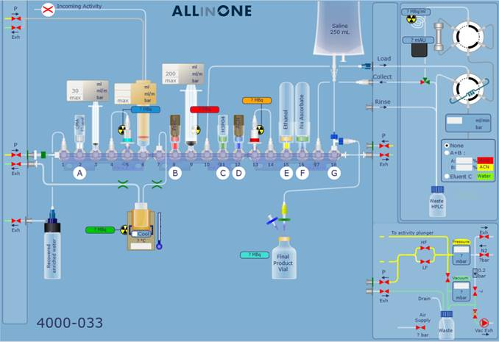
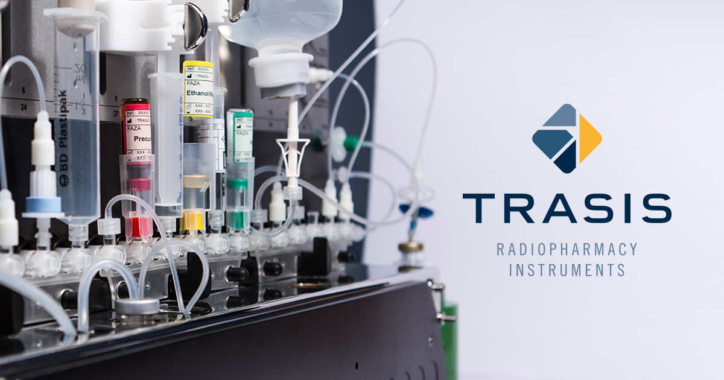
design and production of new tracers
Disposable cassette system

Slide 20
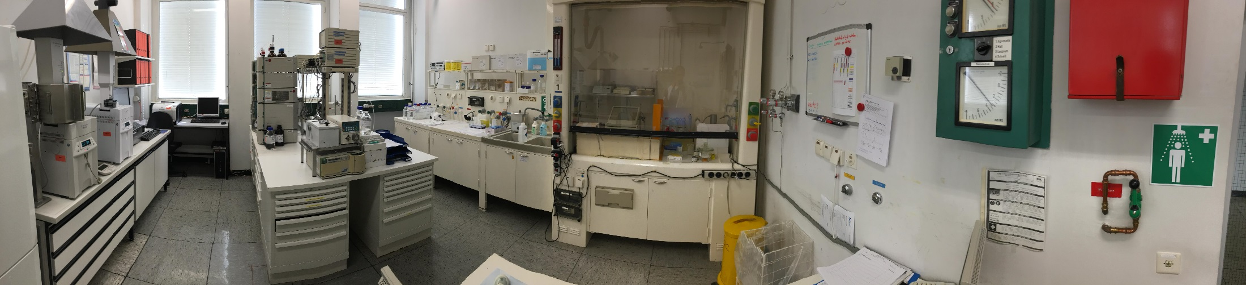
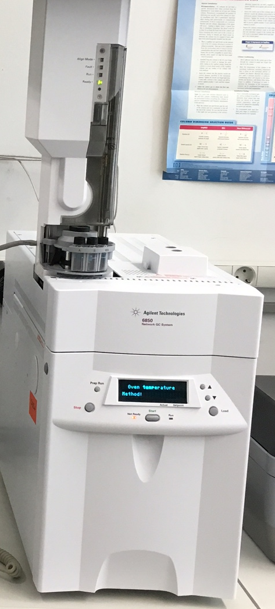
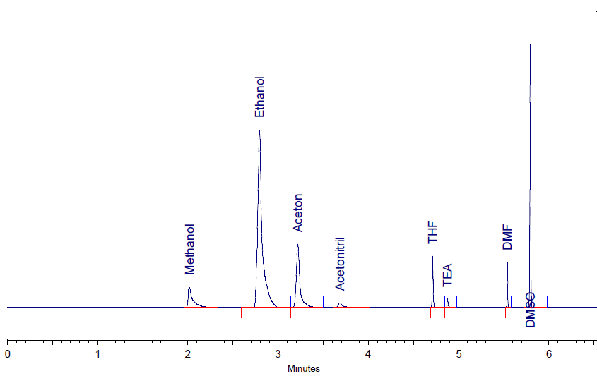
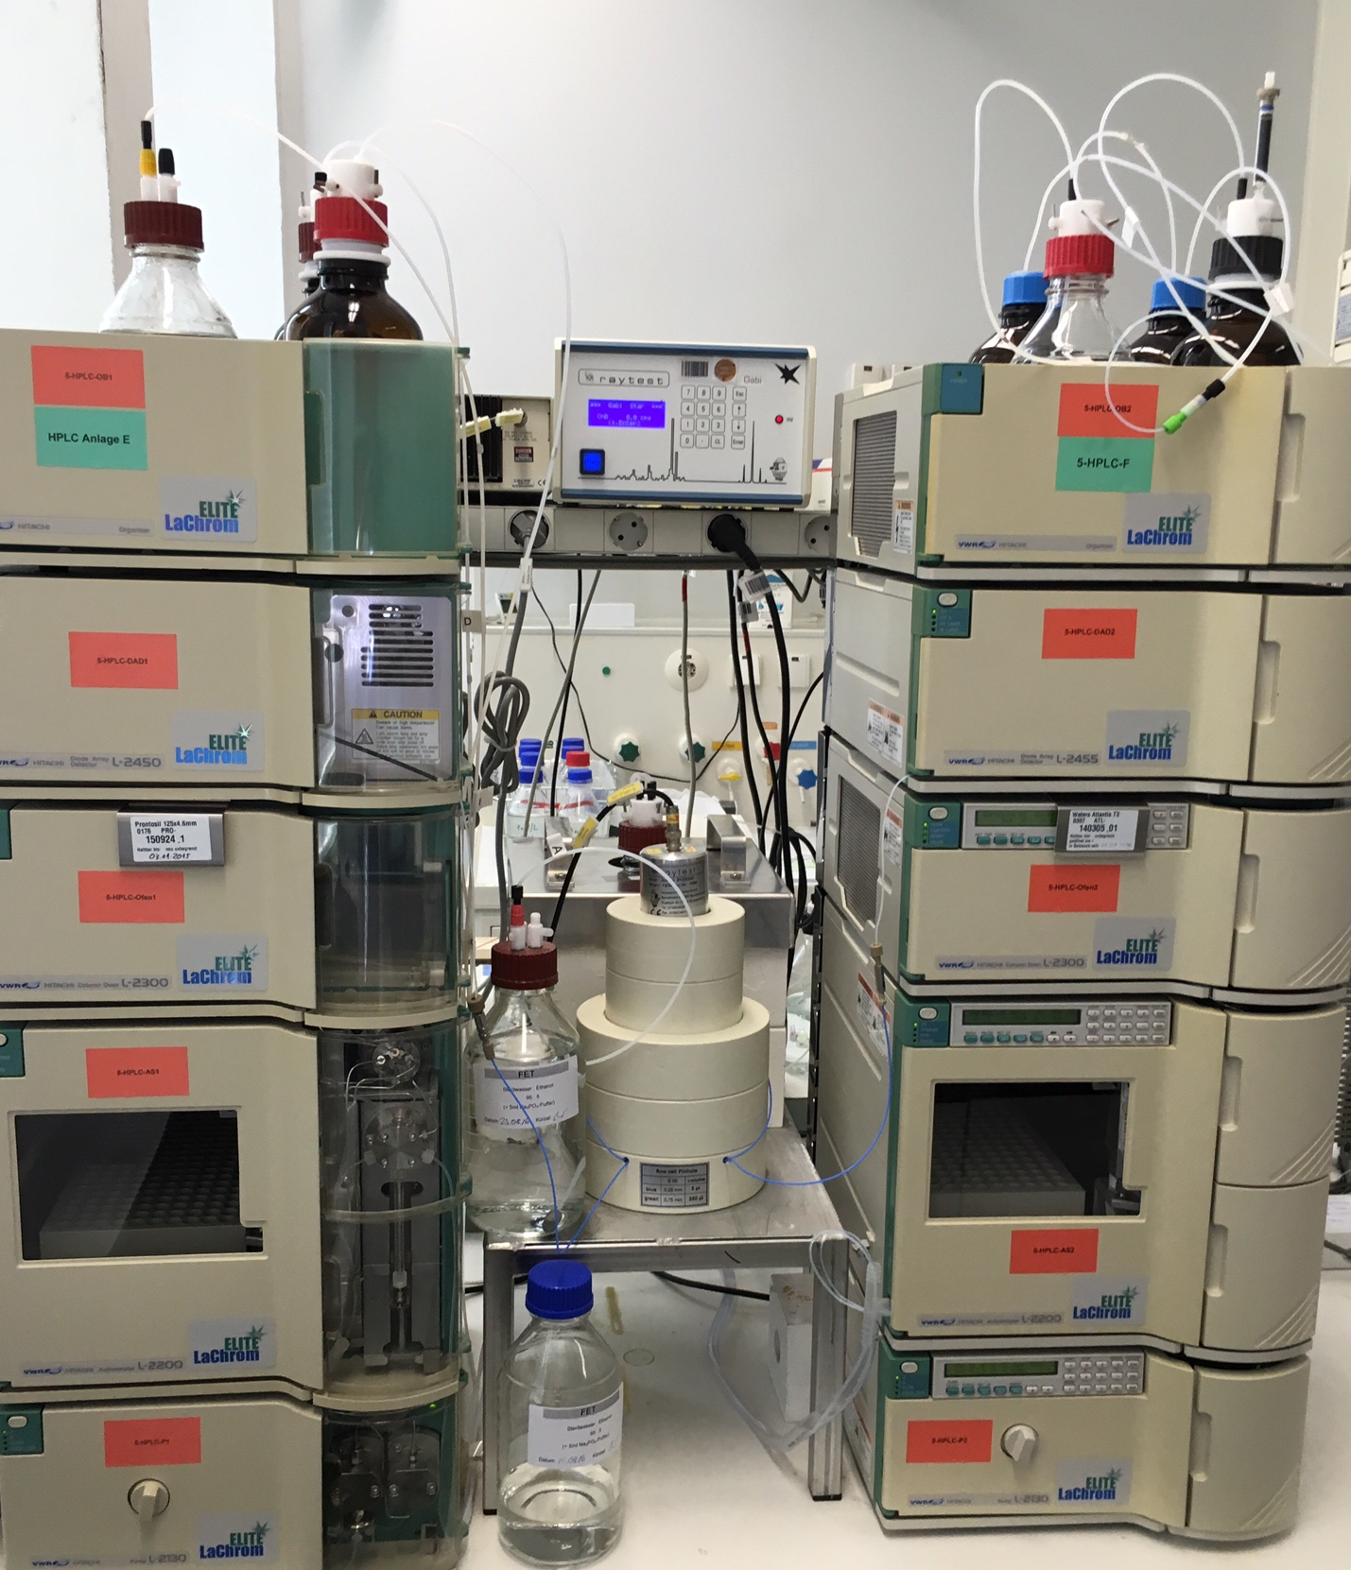




design and production of new tracers
Quality control
GC
HPLC
also:
Endotoxins
pH…

Slide 21






Summary of Tracer discovery
Cellular & Genetic Targets
Genomics
Proteomics
Bioinformation
Synthesis & Isolation
Combinatorial Chemistry
Assay Development
High-throughput Screnning
Library Development
Structure Activity Studies
In Silico Screening
Chemical Synthesis
Drug Affinity & Selectivity
Cellular Disease Models
Mechanism of Action
Lead Candidate Refinement
Animal Models of Disease States
Behavioural Studies
Functional Imaging
Ex Vivo Studies
Studies in Healthy Humans (Phase I)
Student in patients
(Phase II)
Large Clinical Trials in many Patients
(Phase III)
Target selection
Lead Discovery
Medicinal Chemistry
In Vitro Studies
In Vivo Studies
Clinical Trials

Slide 22
დიდი მადლობა
15.09.2022 | Institute for Neuroscience and Medicine – INM-5| Bernd Neumaier

Slide 23


